Slide 1

Notes:
This week is our His-Her Night.

Slide 2
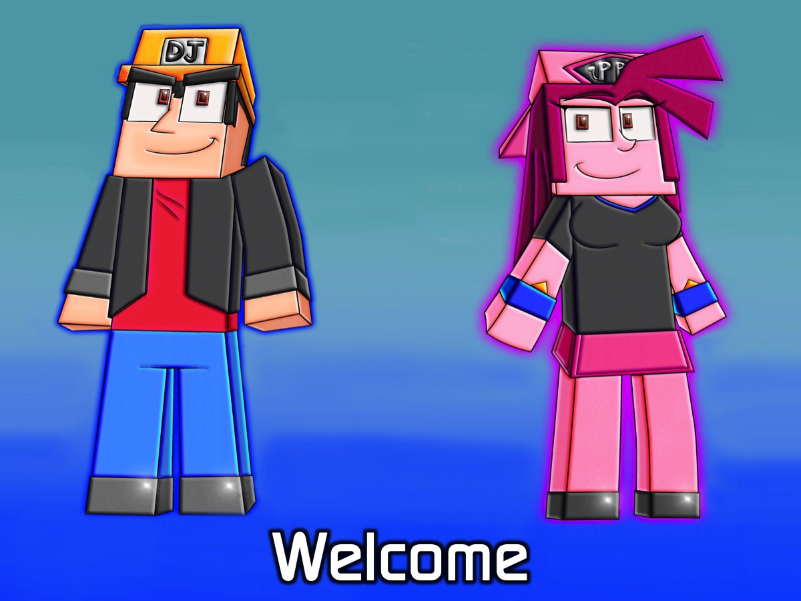
Notes:
Welcome to newcomers and regulars.

Slide 3

Notes:
On Sunday morning it is The Word-On series and we will be exploring what the Bible says about Humanity.

Slide 4

Notes:
There is no youth Next Friday Night as the leaders are away on a training weekend.

Slide 5

Notes:
We will be back the following Friday night with our Dodgeball Night.

Slide 6

Notes:
Tonight is His-Her Night.

Slide 7
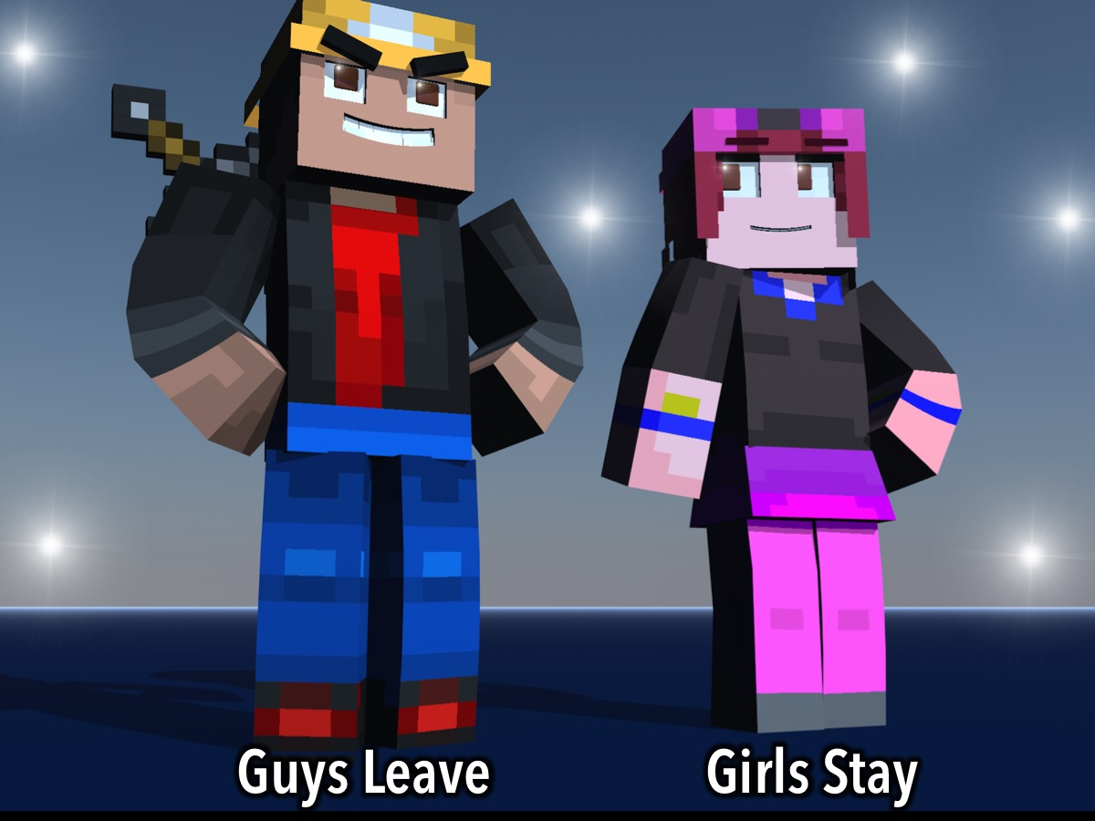
Notes:
Guys are going to head to the kids zone downstairs while Girls will stay in the youth room.

Slide 8
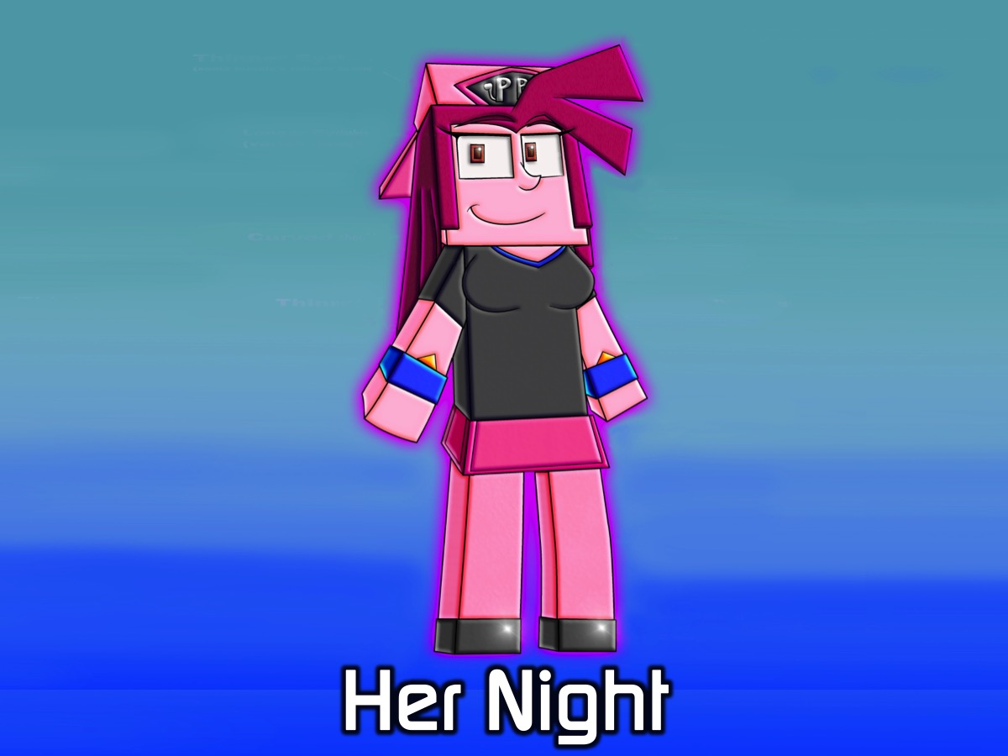
Notes:
Her Night Program
The stations are based on this statement: You will know me and you will find me, where the boldness of Esther meets the warm, closeness of Ruth, where the hospitality of Lydia is engulfed by the praying of Hannah. I will be the one drenched in Proverbs 31, waiting for you.
There will be four stations:
1. The Lydia station: purple station. This is a very relaxed station. The girls will paint themselves with purple nail polish. The girl's get to know each other. They get to explore the story of Lydia and her diligence. They'll be given a purple card on diligence. A motivational card.
2. The Esther station: Make your move. This part of the station is split into two parts with the aid of white tape. All the girls will stand on one side. For them to get to the other side, they have to do a silly dance move. Girls have to step out and be bold in this world. Esther had to do something that she was not comfortable with. This action ended saving God's people. When the girls get to the other side, they have to trust someone to apply make- up on their face. A small group question: what would you do for God if you weren't afraid?
3. The Ruth station. This will be about taking care of yourself. Hygiene, healthy eating and guarding your heart. We will enjoy a fresh vegetable dip.
4. The Hannah Station. This will be done at the end after all stations have been visited. A workout: situps, jumping jacks and jogging on the spot. It's tedious and fun. The aim of this station is to encourage us to never give up. To be persistent like Hannah in prayer.
Small Group Questions: Here are the questions for our small group time: (1) Did you enjoy about girls' night? (2) Which station did you most enjoy and why? (3) Which women would you most relate to? Esther: What would you do for God if you were not afraid? Hannah: What's one thing/person that you are willing to pray for and weep for? Lydia: What area in your life requires you to act more diligently? Ruth: Why is it important for one to read their Bible and take care of themselves? (4) Pray for each other
After small groups, we will pray as a group.

Slide 9
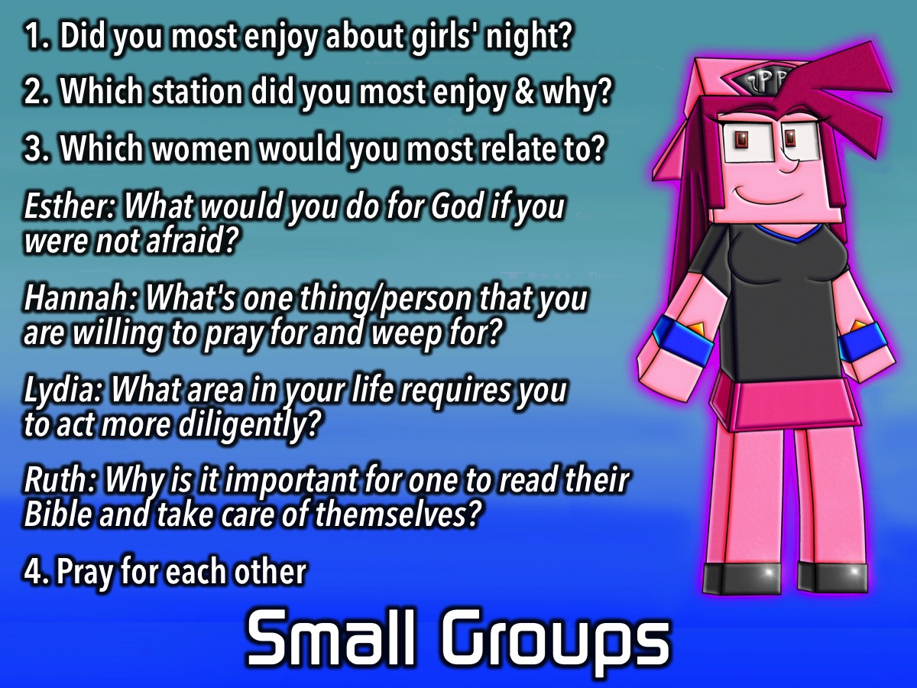
Notes:
Girls Small Groups: Here are the questions for our small group time: (1) Did you enjoy about girls' night? (2) Which station did you most enjoy and why? (3) Which women would you most relate to? Esther: What would you do for God if you were not afraid? Hannah: What's one thing/person that you are willing to pray for and weep for? Lydia: What area in your life requires you to act more diligently? Ruth: Why is it important for one to read their Bible and take care of themselves? (4) Pray for each other

Slide 10
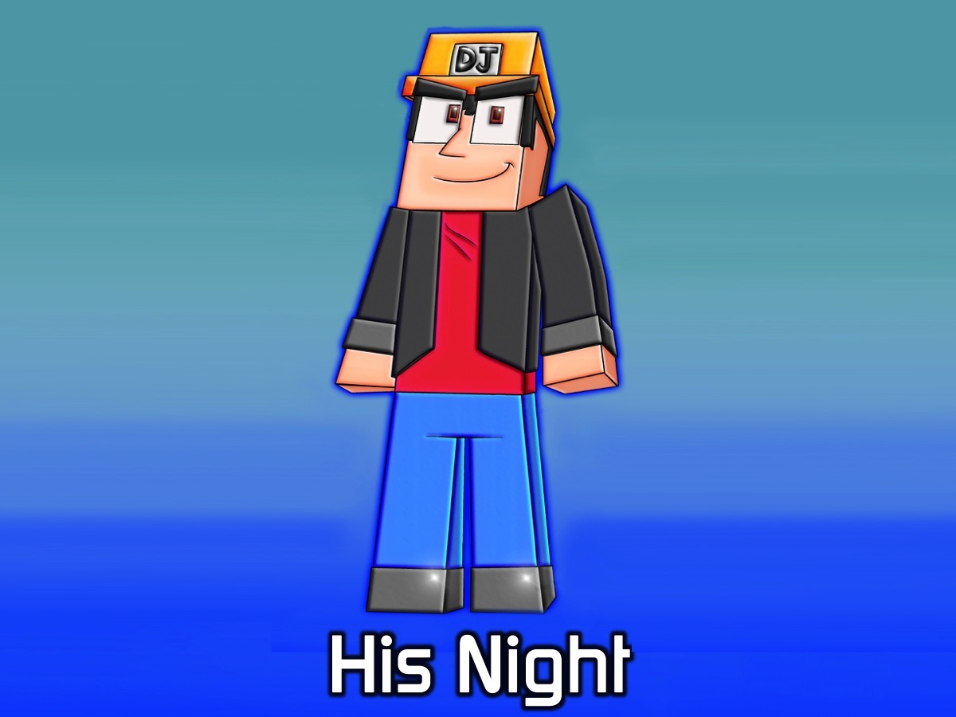
Notes:
His Night Program. Here's what we are aiming for at the end of the night:
* We want to create an openness among the guys at His Youth.
* We want eliminate some of the fictional, unfounded stereotypes about manhood.
* We want to jump in the deep end with some of issues that men are faced with on a daily basis.
Supplies: Bottles, cards that will have the questions printed on them.

Slide 11
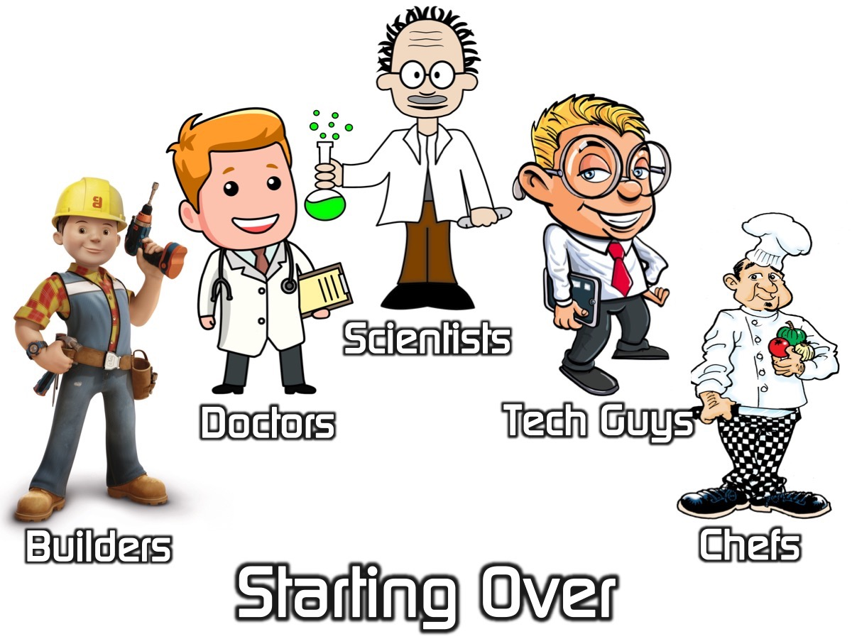
Notes:
1. Starting Over: As you all know we are ready as humans to start populating other planets. We are sending 5 space ships off to five different planets to start a new world of humankind on each planet. For that to be successful, we have to carefully create the five different groups. So we need the following kinds of people on each of the groups:
A. The Builder: 1 person who can work well with their hands - they build or repair things.
B. The Doctor: 1 person who really cares about people - who can help people adjust to the new world and homesickness.
C. The Scientist 1 person who is scientific - who help people survive on the planet.
D. The IT Guy: 1 person who is into technology - who will create ways for the group to connect among themselves and with people back home.
E. The Chef: 1 person who is a chef - who can create fun and healthy meals.
F. The Pastor: 1 person who is spiritual - who can help people connect with God.
You are first going to divide yourselves into six groups of these characters. All the builders must be in one group, all the Carers in another, etc.
Then we are going to take 5 Pastors and they are each going to select one person from each of the other 5 groups to join their team (it will be a schoolyard team picking style).
As soon as each team is formed – each person is given a chocolate and they have a few minutes to introduce themselves to each other.
2. Spin The Bottle. Each group is given a bottle and a pack of cards with questions printed on them. The first person spins the bottle and the person it points to have to pick up a card and answer the question. Here are some questions to choose from:
What do you "know now" that you wish you "knew then"?
Have you ever won a trophy, what was it for?
What is your favorite thing about your mom?
What was the worst punishment your got from your parents?
If you did not need the money what would you do for work?
What was some good advice that your father gave you? What is something from your life that is most likely to end up in a museum?
How would you explain love to somebody who had never heard of it before?
What do you feel strongly enough about to protest?Who is the most dependable person in your life?What makes you laugh?What is the first thing you think about when you wake up in the morning?
Who was your best friend growing up?
If you could win a 'life-time supply' of anything what would you want it to be?
If you could ask one person one questions and get a completely honest answer who would it be and what would you ask?When did you have a near death experience?
What was the last big risk you took?
What is your sense of purpose or calling in life?
Who do you admire as a leader?
What story from history inspires you?
What was the first big thing you bought with your own money?
How would your friends describe you to a someone you that have not met?
What TV show are you embarrassed about watching?What do you wear for pajamas?
What quality about yourself do you most value?
What can a friend do that will make you feel special?
When was your last encounter with wildlife?
What vivid memories do you have of spent time with your grandparents?
What part of your morning routine do you consider essential?
Who would you consider your enemy or rival?
What is something you know you do differently than most people?
What is the most played song in your music library?
When in your life has a bad experience turned out to be for the best?
Would you rather be able to visit 100 years in the past or 100 years in the future?
What is the most valuable life lesson you learned from your parents?
Which one of your responsibilities do you wish you could get rid of?
Would you volunteer to be one of the first colonists on Mars if it meant you could never return to earth?
If you could bring one musician back from the dead, who would it be and why?
What do you define as “manliness”?
If you had to choose to live without one of your five senses, which one would you give up?
If you could live in a book, TV show or movie, what would it be?
If you could get away with a crime, would you? If yes, what would it be?
What animal best represents you and why?
Where do you see yourself in five years?
How would you spend a billion Rand?
What would you do if you were the president of your own country?
How do you want to be remembered?
If you could travel anywhere in the world, where would it be?
If you could take only three items with you to a deserted island, what would they be?
In what ways are you a leader? In what ways are you a follower?
What was your dream job growing up?
What’s your greatest failure, and how did you overcome it?
What’s your greatest achievement and how has it shaped you?
If you could master one skill you don’t have right now, what would it be?
What would be your “perfect” day?
If you could have one superpower, what would it be and how would you use it?
If you could speak another language, which would it be and why?
If you could time travel, would you go to the past or the future and why?
What makes you happiest?
How would your best friends describe you?
If you could change one thing about yourself, what would it be?
If you could change one event from history, what would it be?
What is “home” to you?
Who’s your personal hero?
If you could bring one fictional character to life, who would it be and why?
If you could choose your last words, what would they be?
Would you rather explore a new planet, or the deepest parts of the ocean? Why?
In what ways are you the same as your childhood self?
What single message would you send to an advanced alien species?
What’s your favorite comedy movie?
If you could play one instrument you aren’t able to now, what would it be and why?
Would you rather live in the city or the woods? Why?
What’s your favorite holiday and why?
If you were on death row, what would your final meal be?
If you could choose how you die, how would you go out?
If you could bring back anyone from the dead, who would it be and why?
If you could speak to everyone in the world at the same time, what would you say?
If you could use technology to do one thing, what would it be?
What’s the craziest thing you’ve ever done?
If you could have dinner with any one person, living or dead, who would they be and why?
If you could speak another language, which would it be and why?
If you had a week to live, how would you live it?
If your house was burning and you could only save one item, what would it be and why?
If you could have the answer to any question, what would that question be?
What are you most grateful for?
What words of wisdom would you pass onto your childhood self?
If you had to change your name, what would you change it to?
Do you have a nickname? If so, where does it come from?
3. The Perfect Guy. Each group is going to prepare a drama that depicts the ideal kind of a man they think women find the most attractive or ideal person to be with. It should be interesting. Each play must at least contain a leading man and a leading female played by one of the guys in each group as well as some supporting actors. The dramas are presented.
Small Group Questions:
1. What did you learn about yourself tonight?
2. What can you do to become a better man?
3. What do you think God loves the most about you?
4. What do you think God wants to change the most about you?
5. Pray for each other to become real men of God.

Slide 12
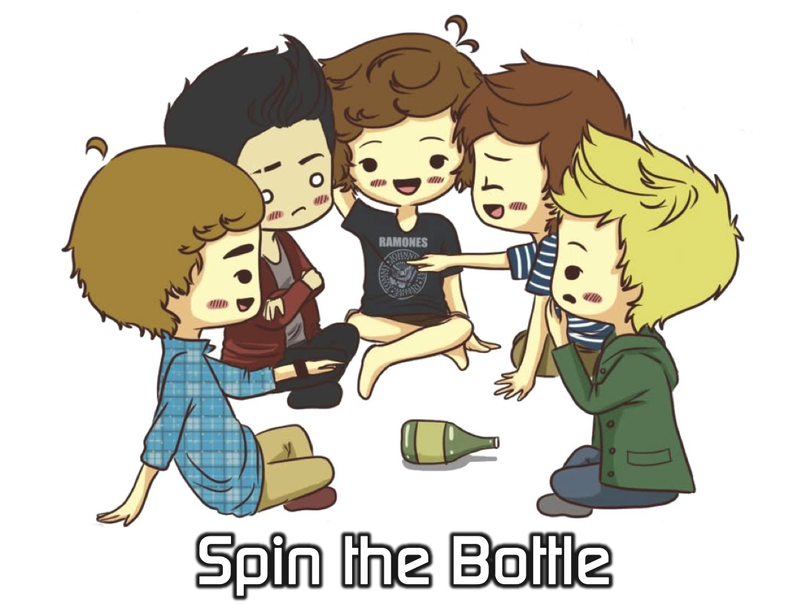
Notes:
2. Spin The Bottle. Each group is given a bottle and a pack of cards with questions printed on them. The first person spins the bottle and the person it points to have to pick up a card and answer the question. Here are some questions to choose from:
What do you "know now" that you wish you "knew then"?
Have you ever won a trophy, what was it for?
What is your favorite thing about your mom?
What was the worst punishment your got from your parents?
If you did not need the money what would you do for work?
What was some good advice that your father gave you? What is something from your life that is most likely to end up in a museum?
How would you explain love to somebody who had never heard of it before?
What do you feel strongly enough about to protest?Who is the most dependable person in your life?What makes you laugh?What is the first thing you think about when you wake up in the morning?
Who was your best friend growing up?
If you could win a 'life-time supply' of anything what would you want it to be?
If you could ask one person one questions and get a completely honest answer who would it be and what would you ask?When did you have a near death experience?
What was the last big risk you took?
What is your sense of purpose or calling in life?
Who do you admire as a leader?
What story from history inspires you?
What was the first big thing you bought with your own money?
How would your friends describe you to a someone you that have not met?
What TV show are you embarrassed about watching?What do you wear for pajamas?
What quality about yourself do you most value?
What can a friend do that will make you feel special?
When was your last encounter with wildlife?
What vivid memories do you have of spent time with your grandparents?
What part of your morning routine do you consider essential?
Who would you consider your enemy or rival?
What is something you know you do differently than most people?
What is the most played song in your music library?
When in your life has a bad experience turned out to be for the best?
Would you rather be able to visit 100 years in the past or 100 years in the future?
What is the most valuable life lesson you learned from your parents?
Which one of your responsibilities do you wish you could get rid of?
Would you volunteer to be one of the first colonists on Mars if it meant you could never return to earth?
If you could bring one musician back from the dead, who would it be and why?
What do you define as “manliness”?
If you had to choose to live without one of your five senses, which one would you give up?
If you could live in a book, TV show or movie, what would it be?
If you could get away with a crime, would you? If yes, what would it be?
What animal best represents you and why?
Where do you see yourself in five years?
How would you spend a billion Rand?
What would you do if you were the president of your own country?
How do you want to be remembered?
If you could travel anywhere in the world, where would it be?
If you could take only three items with you to a deserted island, what would they be?
In what ways are you a leader? In what ways are you a follower?
What was your dream job growing up?
What’s your greatest failure, and how did you overcome it?
What’s your greatest achievement and how has it shaped you?
If you could master one skill you don’t have right now, what would it be?
What would be your “perfect” day?
If you could have one superpower, what would it be and how would you use it?
If you could speak another language, which would it be and why?
If you could time travel, would you go to the past or the future and why?
What makes you happiest?
How would your best friends describe you?
If you could change one thing about yourself, what would it be?
If you could change one event from history, what would it be?
What is “home” to you?
Who’s your personal hero?
If you could bring one fictional character to life, who would it be and why?
If you could choose your last words, what would they be?
Would you rather explore a new planet, or the deepest parts of the ocean? Why?
In what ways are you the same as your childhood self?
What single message would you send to an advanced alien species?
What’s your favorite comedy movie?
If you could play one instrument you aren’t able to now, what would it be and why?
Would you rather live in the city or the woods? Why?
What’s your favorite holiday and why?
If you were on death row, what would your final meal be?
If you could choose how you die, how would you go out?
If you could bring back anyone from the dead, who would it be and why?
If you could speak to everyone in the world at the same time, what would you say?
If you could use technology to do one thing, what would it be?
What’s the craziest thing you’ve ever done?
If you could have dinner with any one person, living or dead, who would they be and why?
If you could speak another language, which would it be and why?
If you had a week to live, how would you live it?
If your house was burning and you could only save one item, what would it be and why?
If you could have the answer to any question, what would that question be?
What are you most grateful for?
What words of wisdom would you pass onto your childhood self?
If you had to change your name, what would you change it to?
Do you have a nickname? If so, where does it come from?

Slide 13

Notes:
3. The Perfect Guy. Each group is going to prepare a drama that depicts the ideal kind of a man they think women find the most attractive or ideal person to be with. It should be interesting. Each play must at least contain a leading man and a leading female played by one of the guys in each group as well as some supporting actors. The dramas are presented

Slide 14
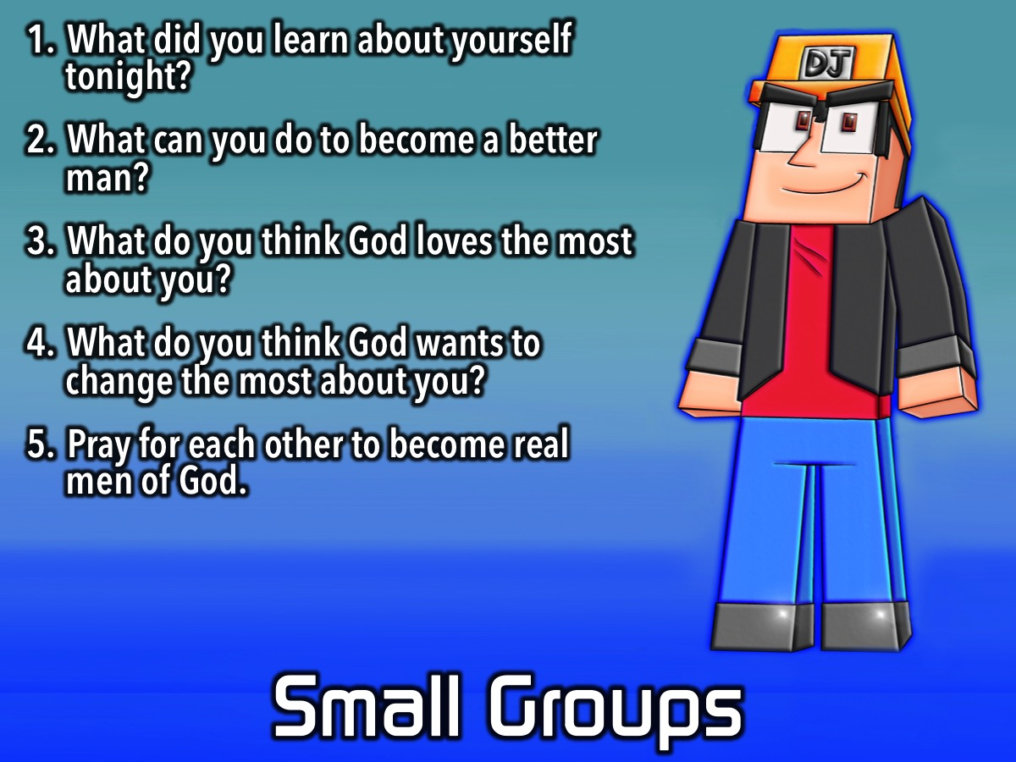
Notes:
Guys Small Groups: Here are the questions for the guys small group time: (1) What did you learn about yourself tonight? (2) What can you do to become a better man? (3) What do you think God loves the most about you? (4) What do you think God wants to change the most about you? (5) Pray for each other to become real men of God.

Slide 15

Notes:
On Sunday morning it is The Word-On series and we will be exploring what the Bible says about Humanity.

Slide 16

Notes:
Don’t forget there is no youth next Friday Night!

Slide 17

Notes:
It is time for Refreshments.

