Slide 1

Notes:
This week is our Mission Night.

Slide 2

Notes:
Welcome to newcomers and regulars.

Slide 3

Notes:
We are going to start with a preview of our events for Term 2.

Slide 4

Notes:
As we launch into Term 2 we are starting a brand new Friday night series - called ReCharge Friday - after a long week at school you need a place where you can get ReCharged. Each week there will be Fun, Fellowship. Food and Faith. Here are the events: Pizza Night, His-Her Night, Dodgeball Night, Movie, Night, Encounter Night, Chow Night, Talent Night, CrossFit Night, Power Night and Party Night.

Slide 5


Slide 6


Slide 7


Slide 8


Slide 9


Slide 10


Slide 11


Slide 12


Slide 13


Slide 14


Slide 15


Slide 16

Notes:
On Sunday mornings in Term 2 we are launching The Word-On Series where each week we will be looking at what the Bible says about different topics such as: God, Evolution, Humanity, Warfare, Media, Prophecy, Lifestyle, Gifts, Suffering and Miracles.

Slide 17


Slide 18


Slide 19


Slide 20


Slide 21


Slide 22
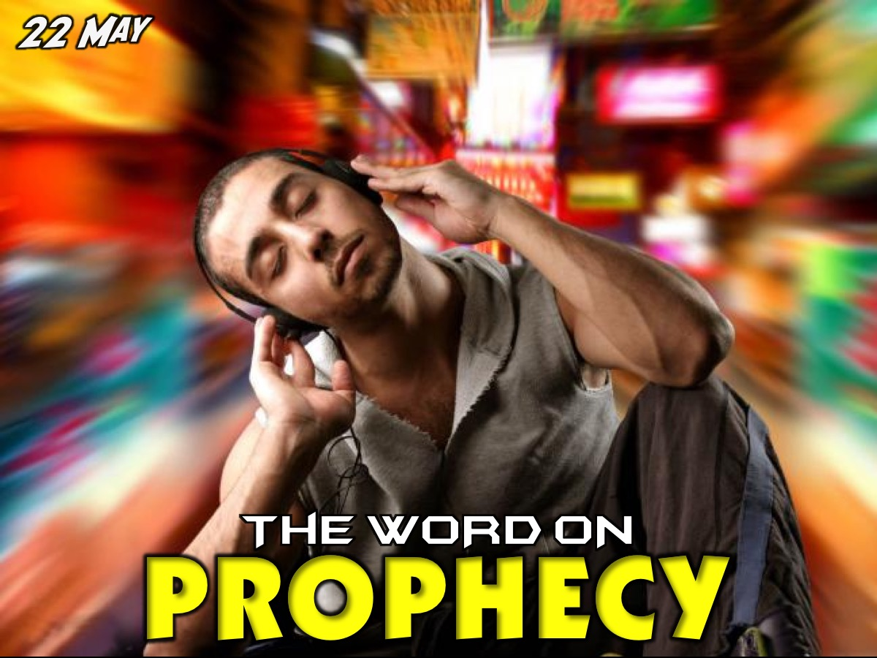

Slide 23


Slide 24


Slide 25
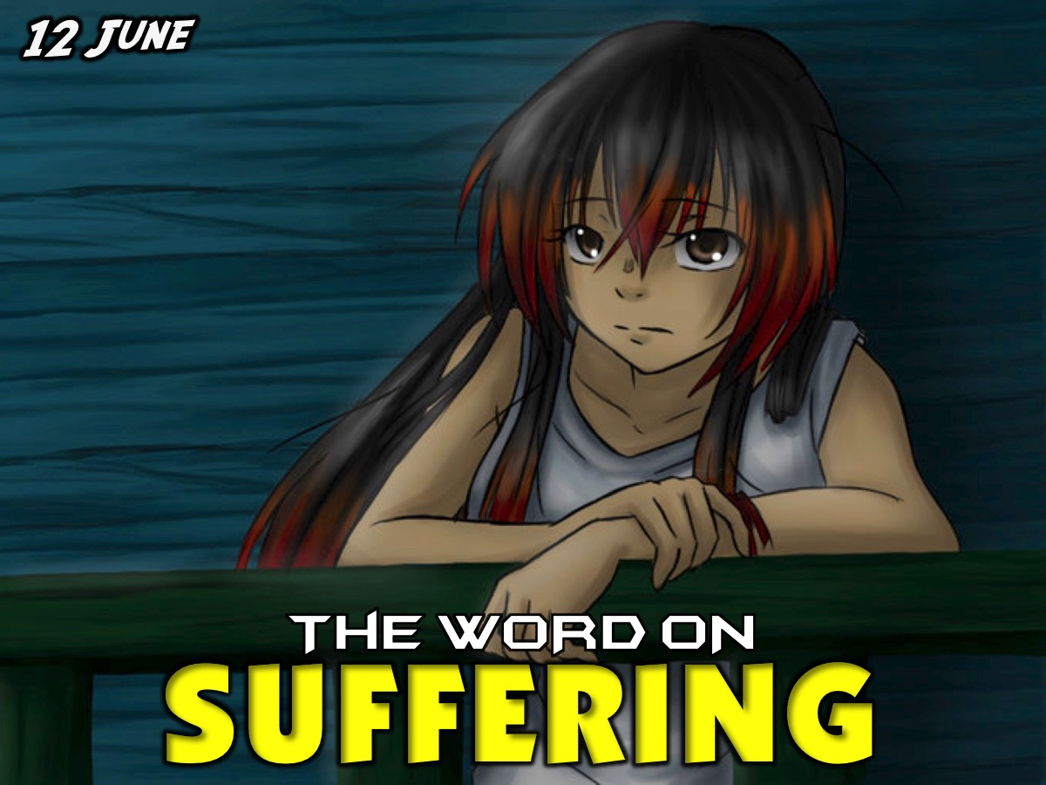

Slide 26


Slide 27

Notes:
So, welcome to Mission Night.

Slide 28

Notes:
Tonight we have a special guest from Open Doors to share with us!

Slide 29
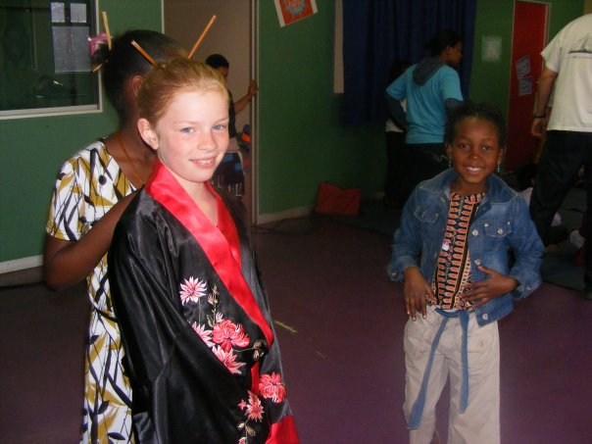
Notes:
Some pics from the last time Open Doors came to youth - in 2009.

Slide 30
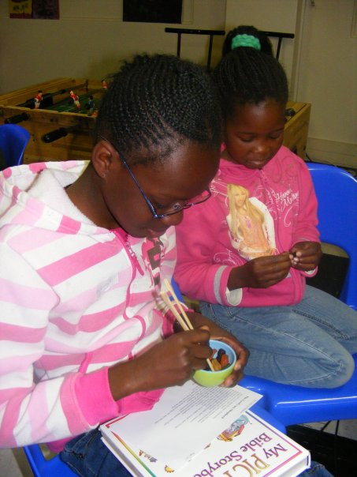
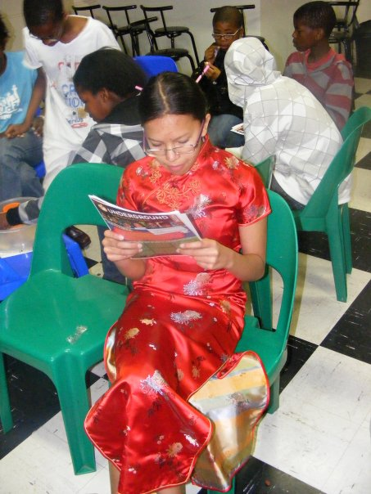
Notes:
Some pics from the last time Open Doors came to youth - in 2009.

Slide 31
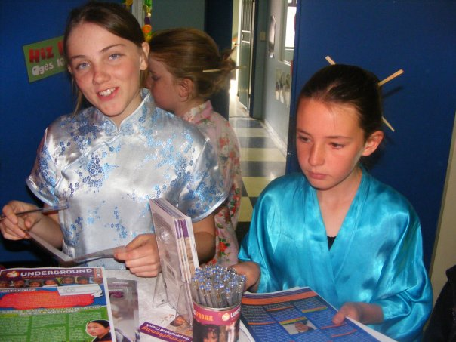
Notes:
Some pics from the last time Open Doors came to youth - in 2009.

Slide 32
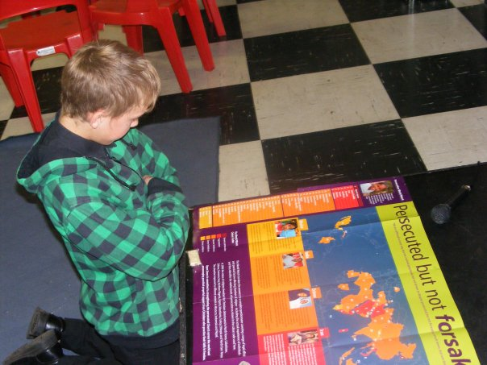
Notes:
Some pics from the last time Open Doors came to youth - in 2009.

Slide 33


Slide 34


Slide 35
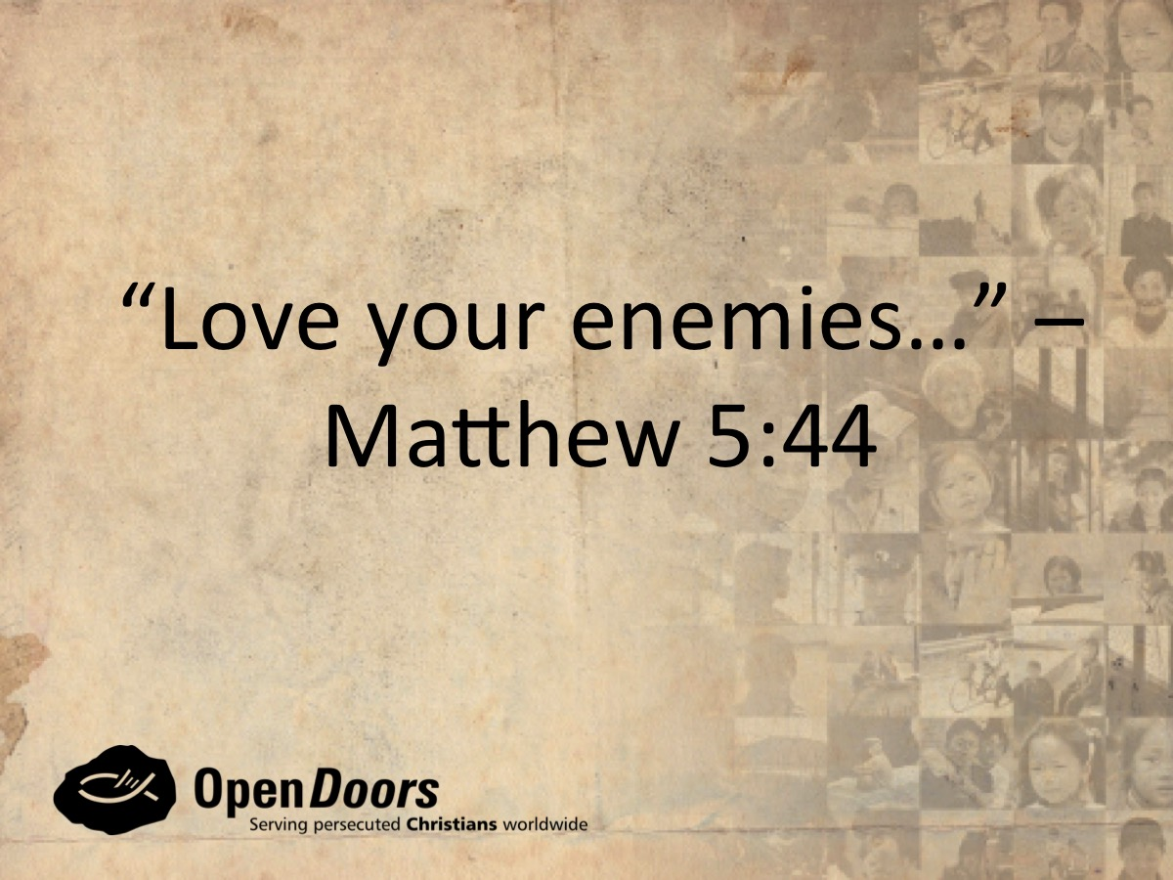

Slide 36
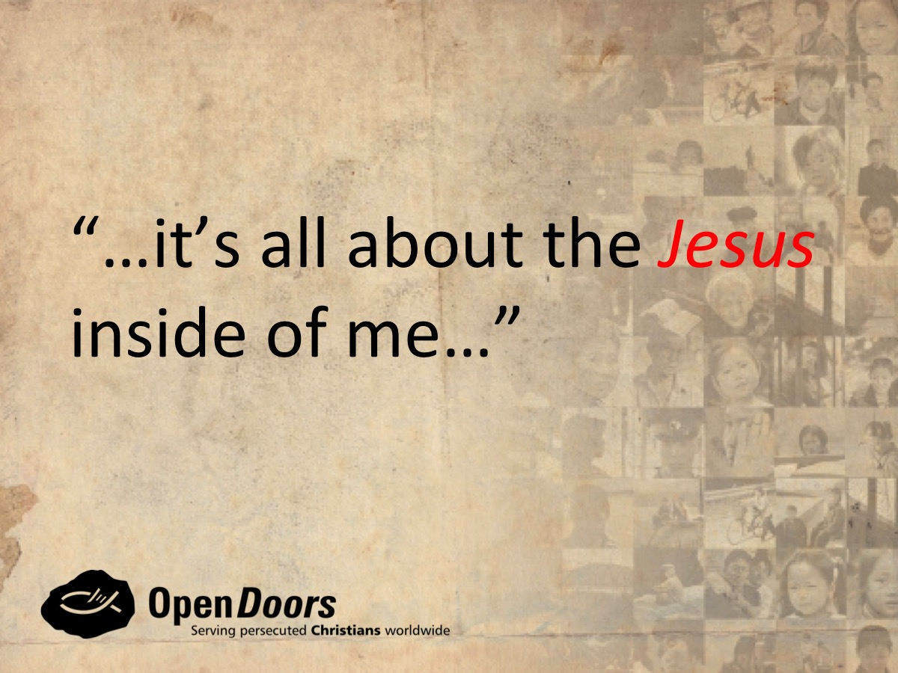

Slide 37


Slide 38


Slide 39


Slide 40


Slide 41
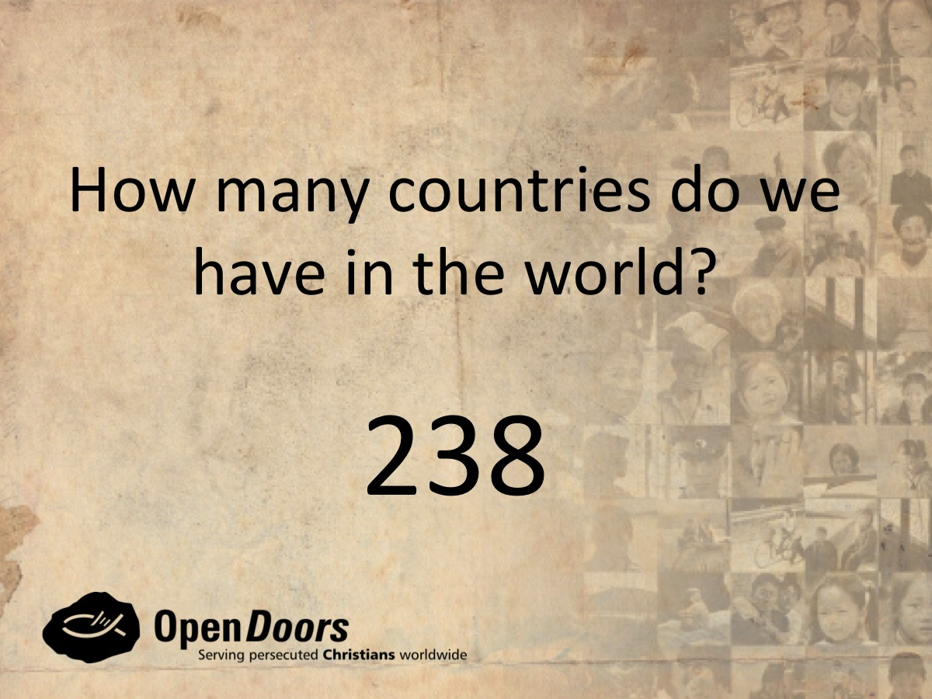

Slide 42
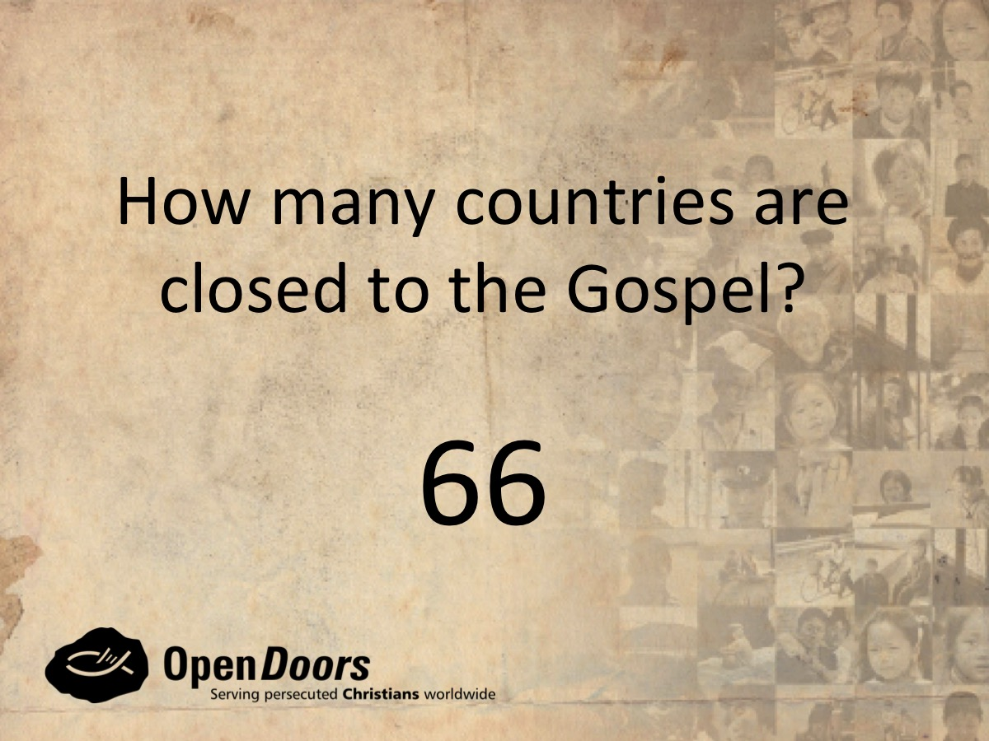

Slide 43
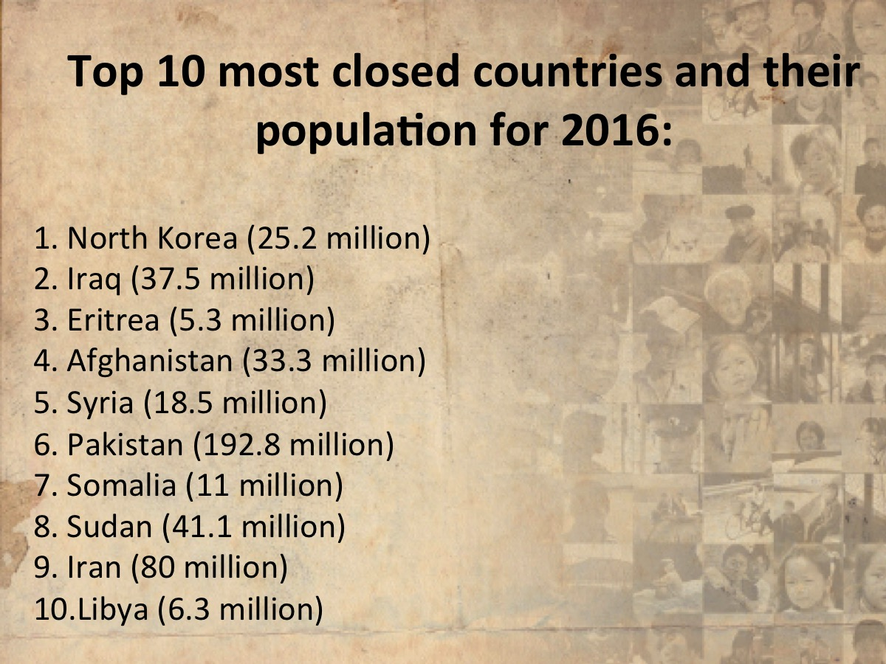

Slide 44
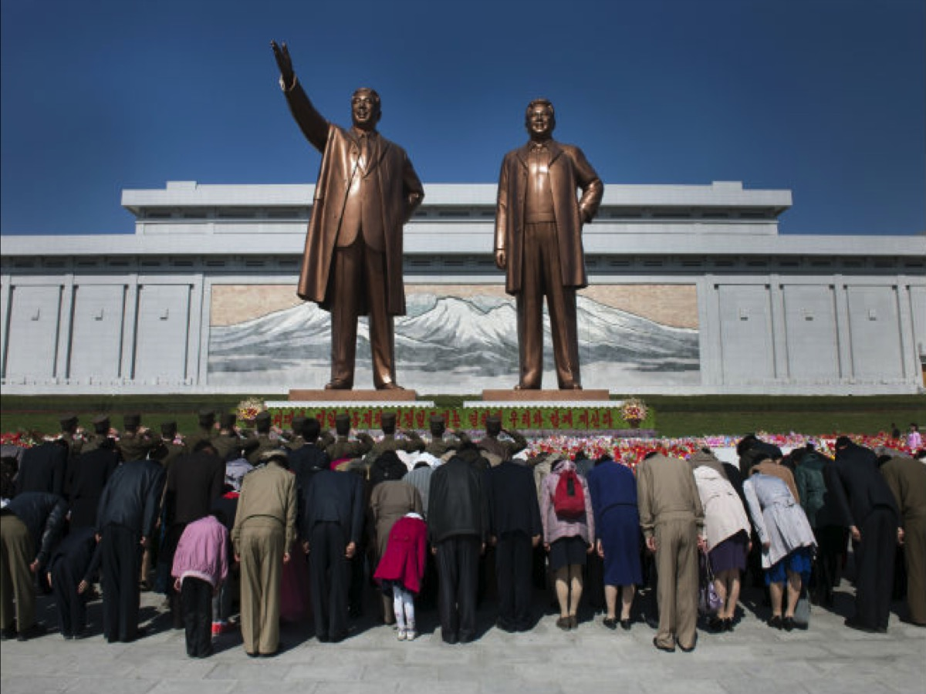

Slide 45
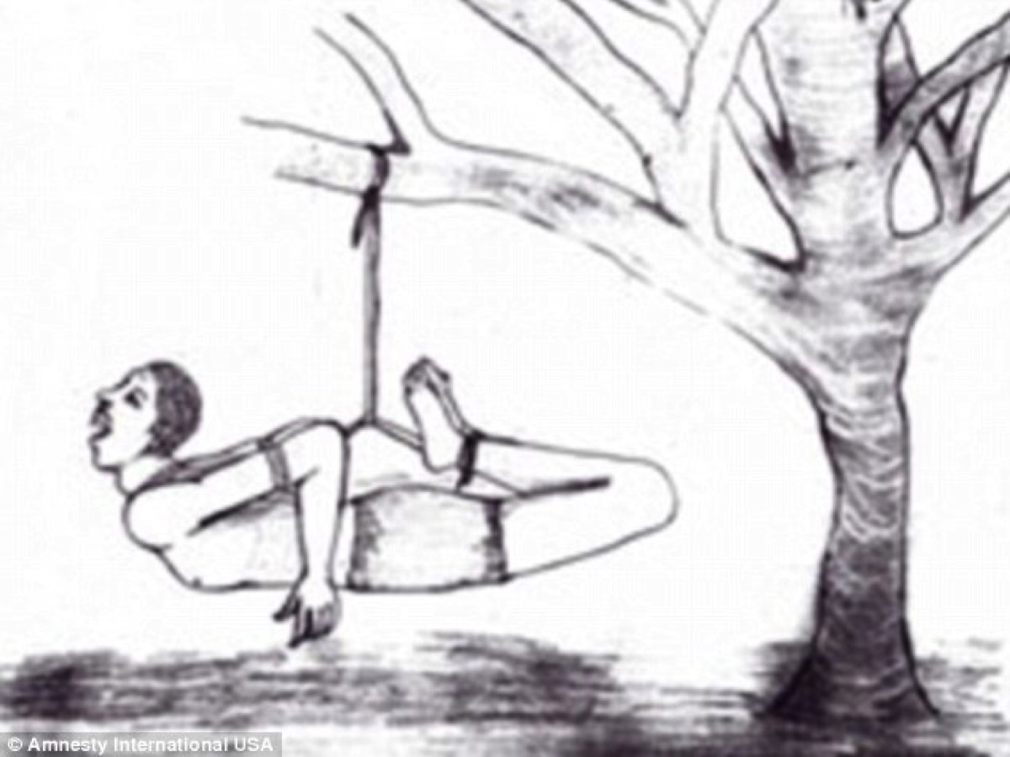

Slide 46
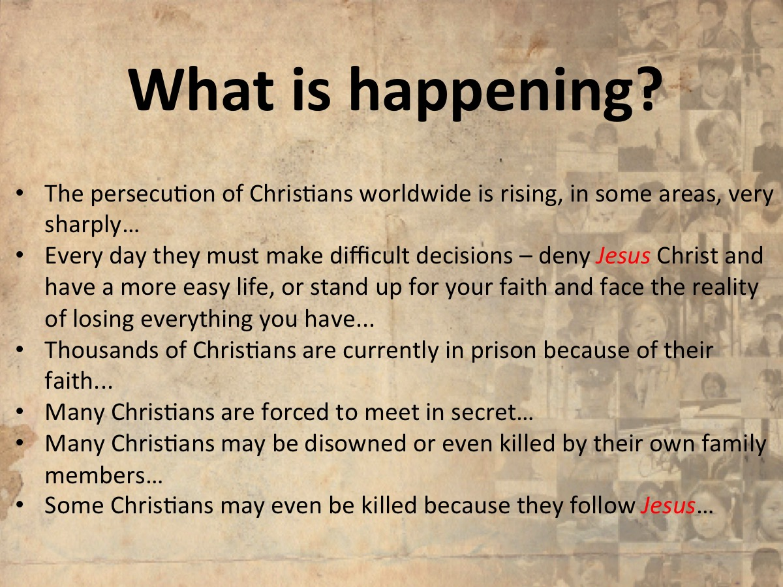

Slide 47
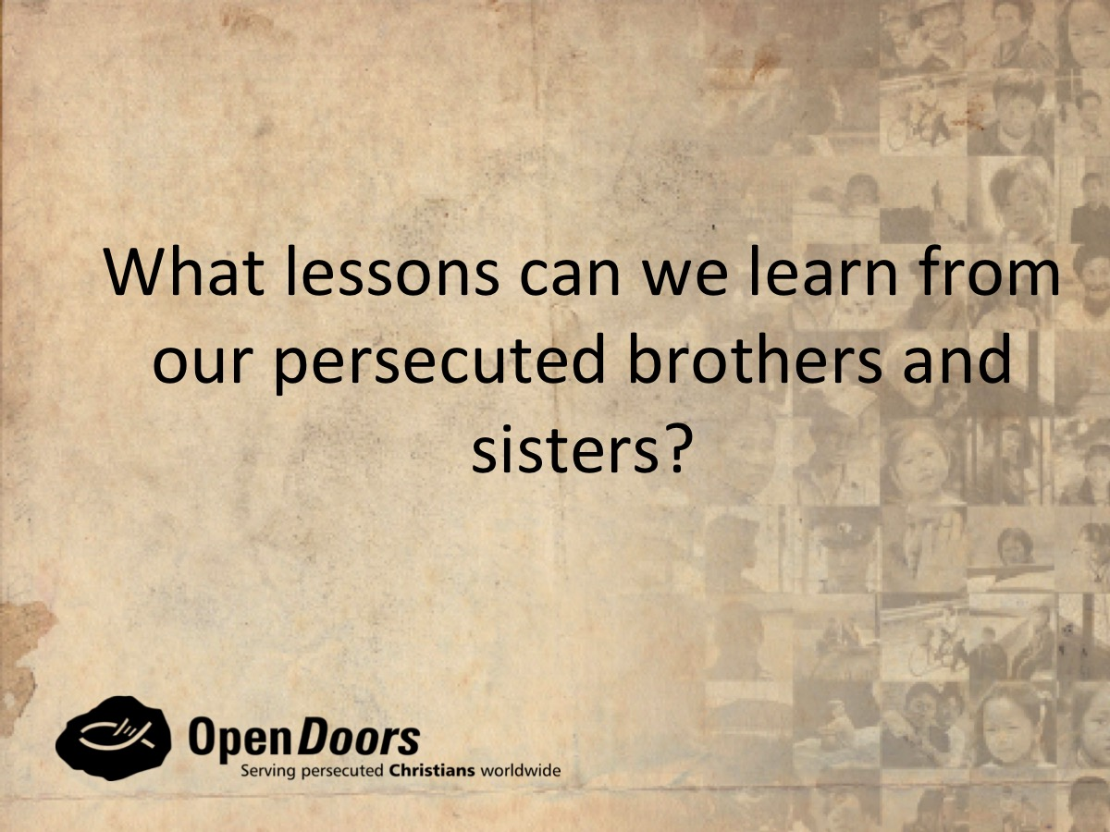

Slide 48
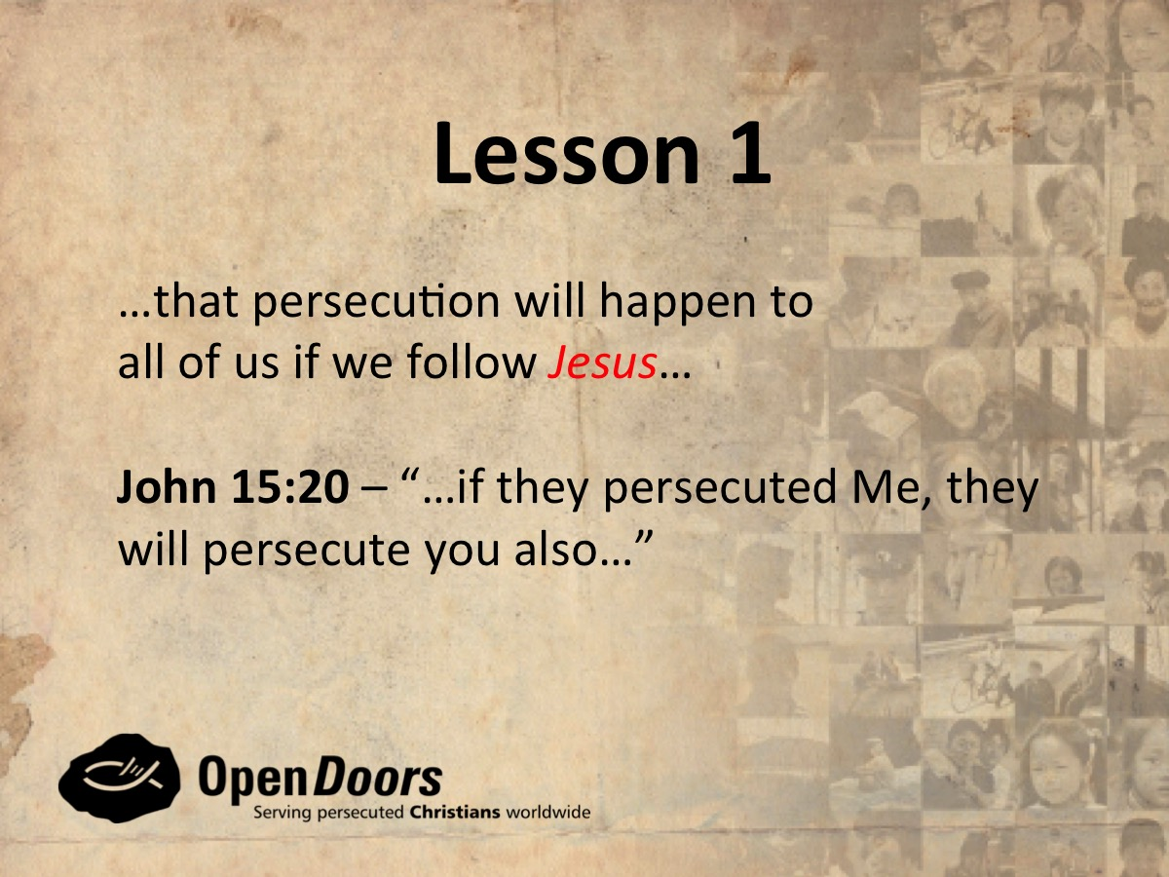

Slide 49


Slide 50
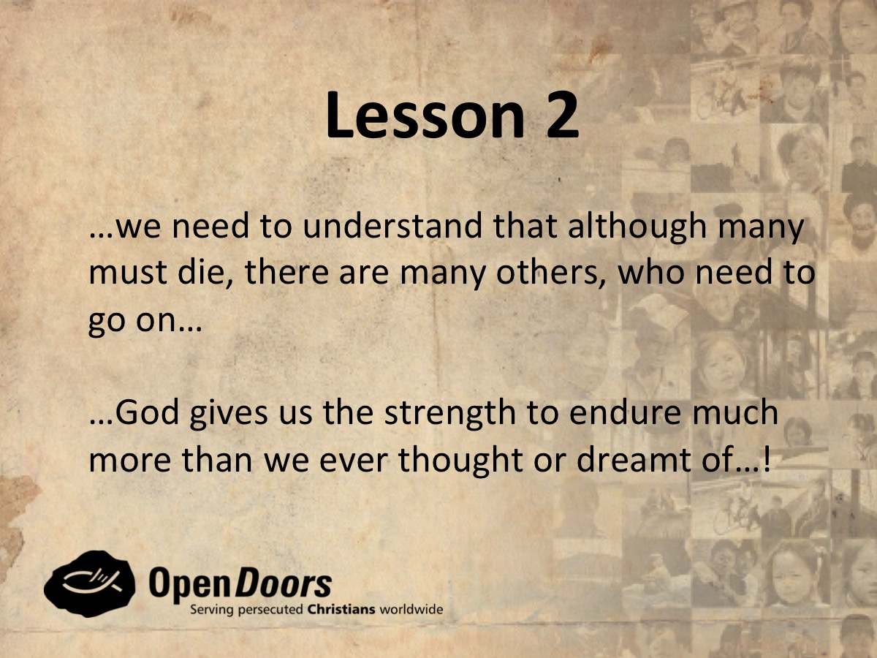

Slide 51


Slide 52


Slide 53


Slide 54

Notes:
It is time for Small Groups. First, we are going to watch a video.

Slide 55
Notes:
Video: Christian Persecution - Fatima in Saudi Arabia - Risk Taking Christianity. Get it on YouTube at: https://www.youtube.com/watch?v=4-t2VG-QMTo

Slide 56
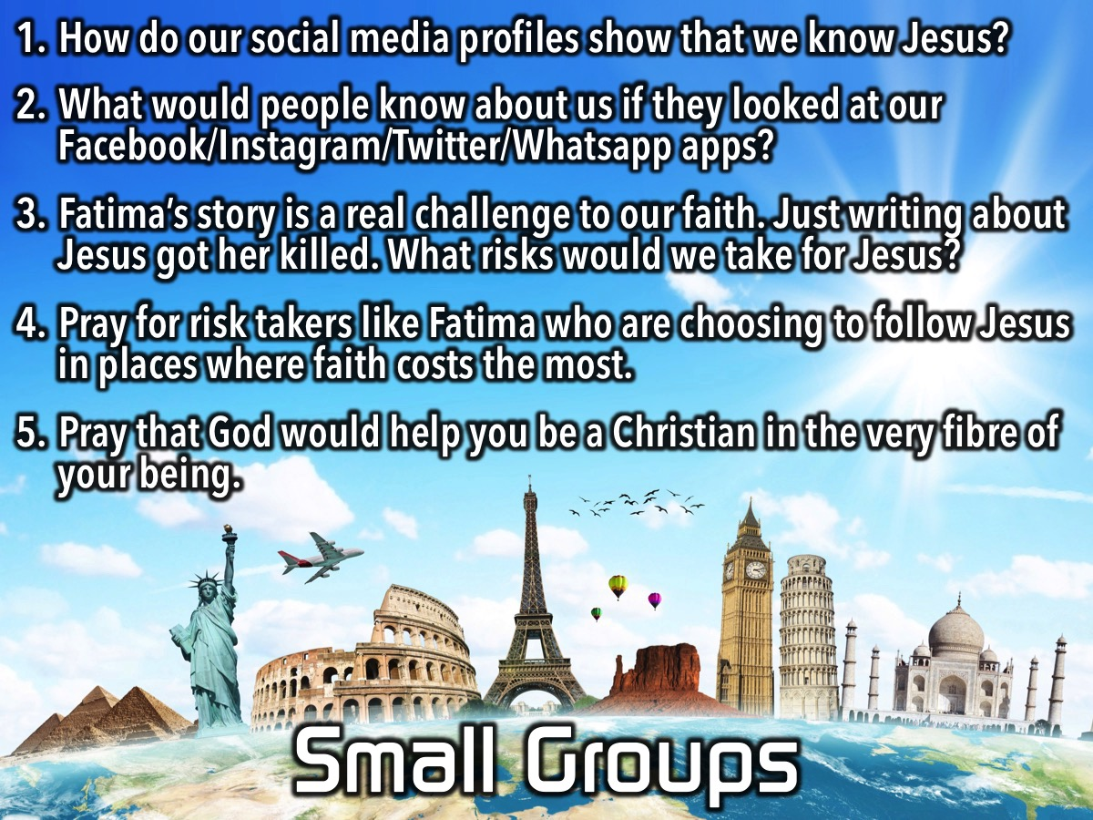
Notes:
Small Groups: Watch the video: Radical Faith – Fatima’s Story. Get it on YouTube at: https://www.youtube.com/watch?v=4-t2VG-QMTo. The video tells the story of a young woman named Fatima who used her blog to speak about her faith. Discuss these Questions: (1) How do our social media profiles show that we know Jesus? (2) What would people know about us if they looked at our Facebook/Instagram/Twitter/Whatsapp apps? (3) Fatima’s story is a real challenge to our faith. Just writing about Jesus got her killed. What risks would we take for Jesus? (4) Pray for risk takers like Fatima who are choosing to follow Jesus in places where faith costs the most. (5) Pray that God would help you be a Christian in the very fibre of your being.

Slide 57

Notes:
On Sunday morning we launch the Word-On Series and we will be discovering what the Bible says about God.

Slide 58

Notes:
Next Friday is Pizza Night!

Slide 59

Notes:
Refreshments are served.

