Slide 1

Notes:
This week is our Movie Night.

Slide 2
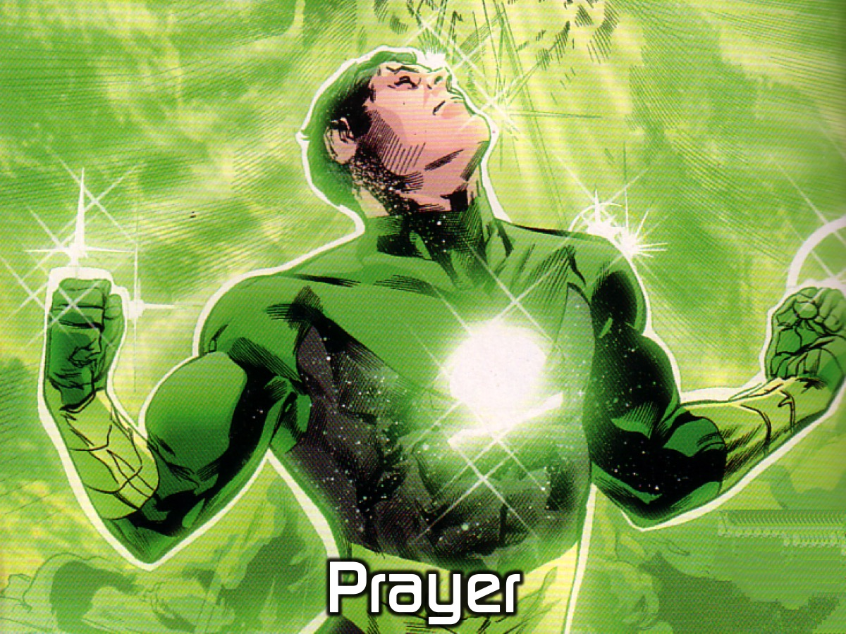
Notes:
Let’s open our meeting in prayer.

Slide 3

Notes:
Welcome to newcomers and regulars.

Slide 4

Notes:
On Sunday morning it is The Word-On series and we will be exploring what the Bible says about Media.

Slide 5

Notes:
Next Friday night is our Encounter Night.

Slide 6

Notes:
Tonight is Movie Night.

Slide 7

Notes:
Before our feature length movie we are going to watch a trailer of a movie that is coming out this month.

Slide 8
Notes:
Video: The Angry Birds Teaser Trailer. Get it on YouTube at: https://www.youtube.com/watch?v=1U2DKKqxHgE

Slide 9

Notes:
It is movie time. We will be providing snacks during the screening of the movie.

Slide 10
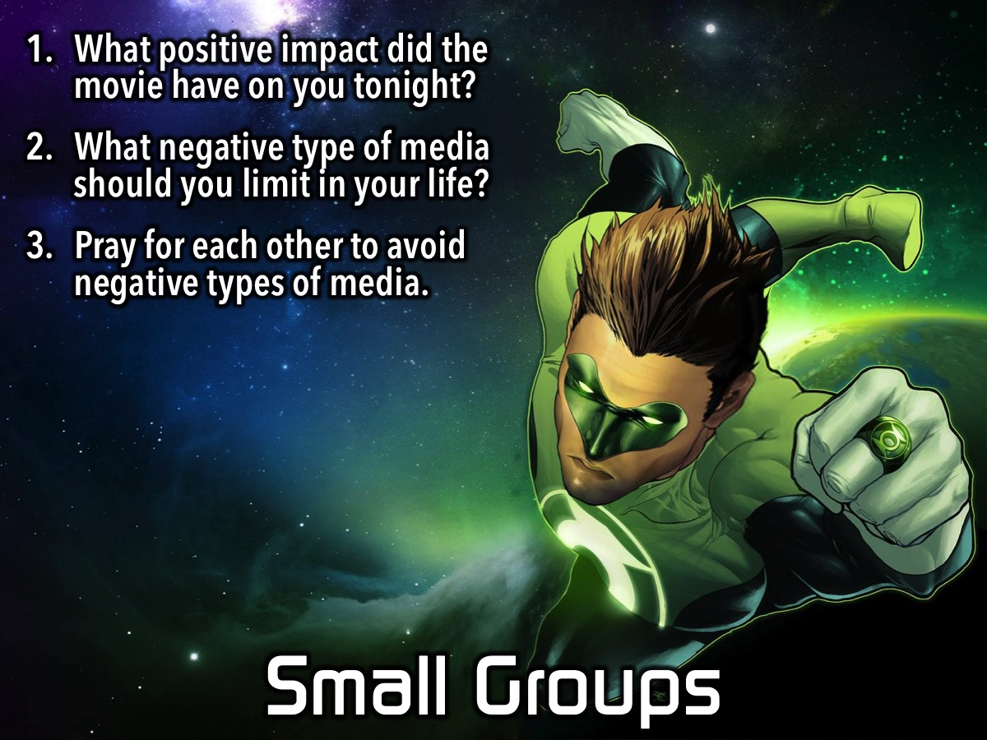
Notes:
Small Group Questions: (1) What positive impact did the movie have on you tonight? (2) What negative type of media should you limit in your life? (3) Pray for each other to avoid negative types of media.

Slide 11
Notes:
On Sunday morning it is The Word-On series and we will be exploring what the Bible says about Media.

Slide 12
Notes:
Next Friday night is our Encounter Night.

Slide 13

Notes:
It is time for Refreshments.

