Slide 1

Notes:
This week is our Pizza Night.

Slide 2
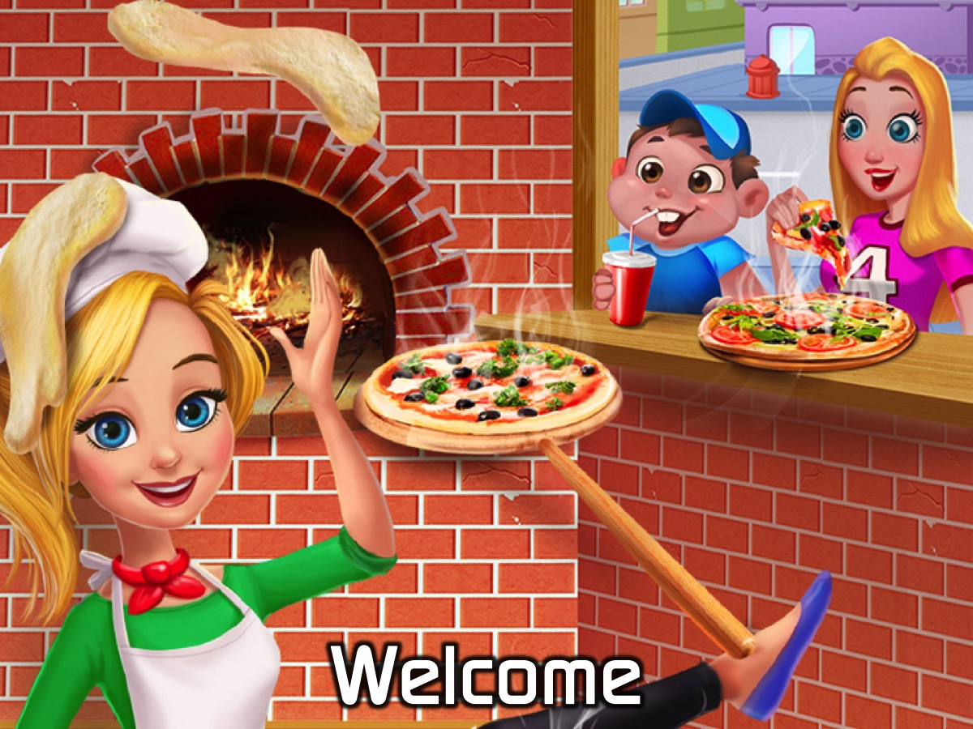
Notes:
Welcome to newcomers and regulars.

Slide 3

Notes:
On Sunday morning it is The Word-On series and we will be exploring what the Bible says about Evolution.

Slide 4
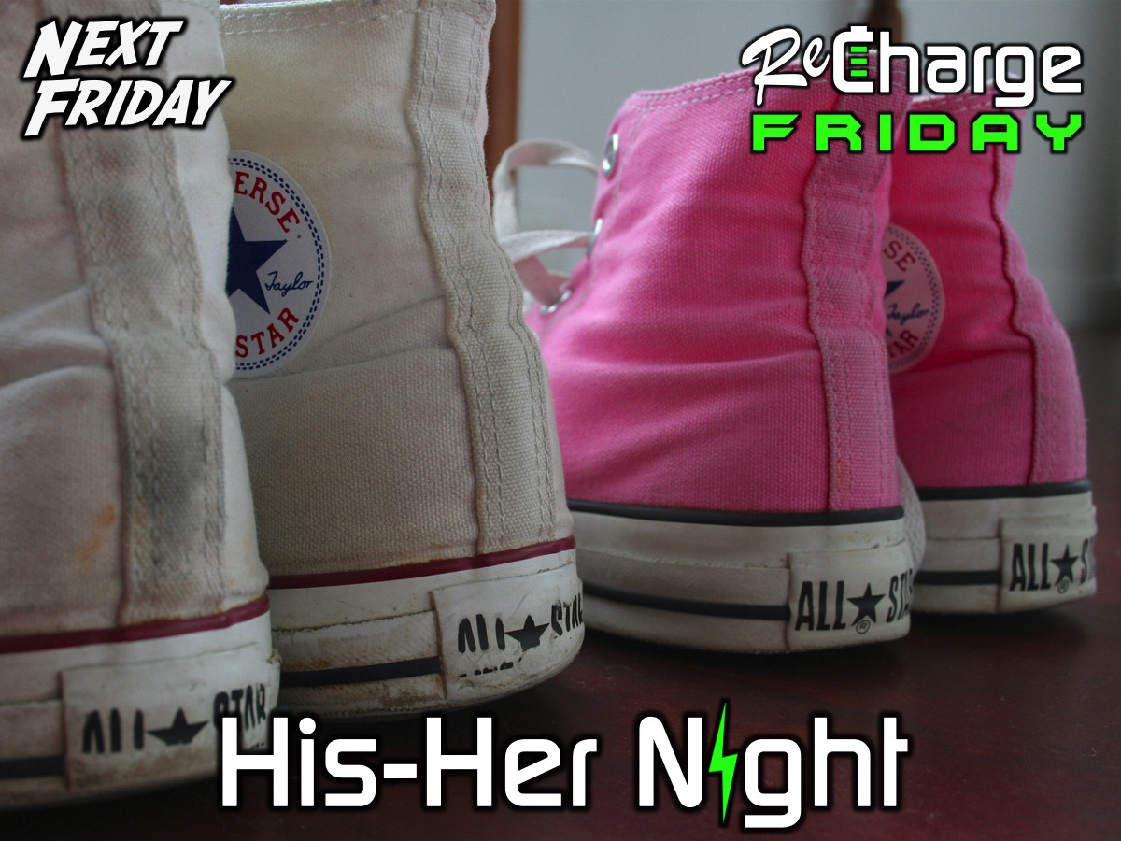
Notes:
Next Friday Night is His-Her Night!

Slide 5

Notes:
But tonight it is our Pizza Night

Slide 6
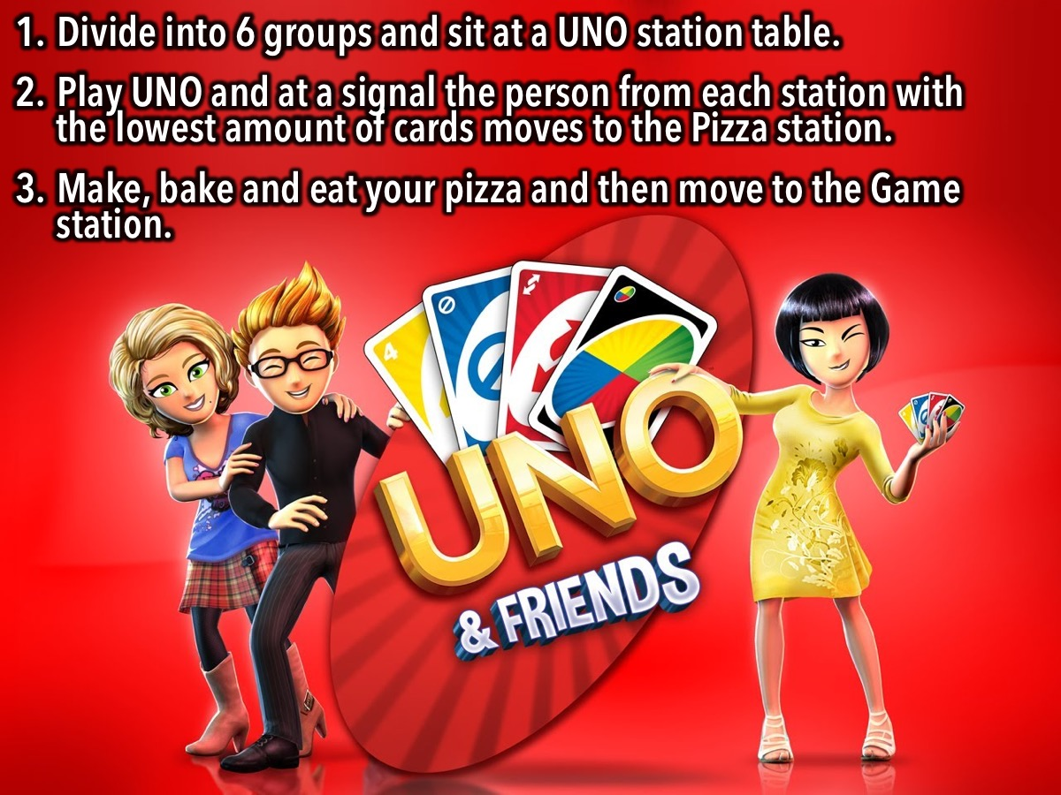
Notes:
Instructions for the Night: Divide into 6 groups and sit at a UNO station table. Play UNO and at a signal the person from each station with the lowest amount of cards moves to the Pizza station. Make, bake and eat your pizza and then move to the Game station.

Slide 7
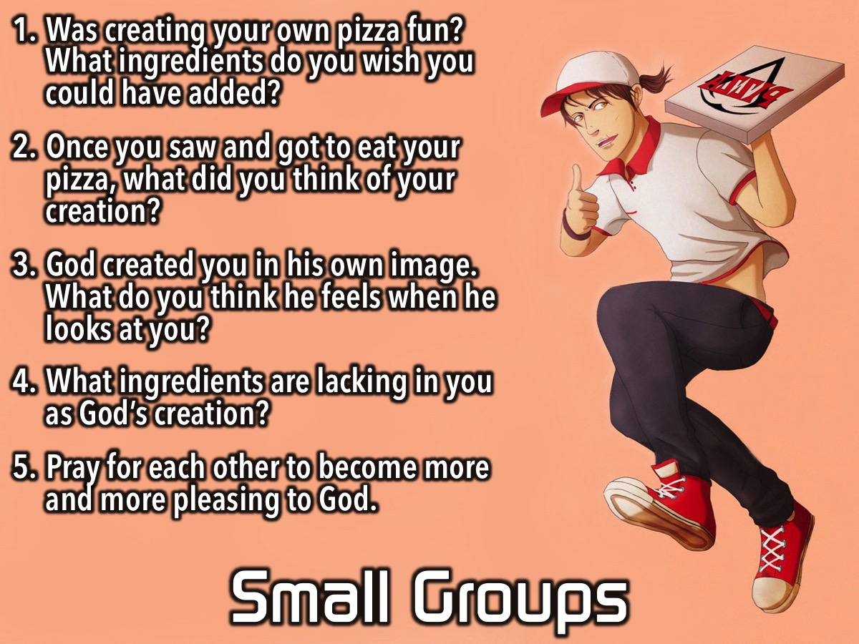
Notes:
Small Groups: Here are the questions for our small group time: (1) Was creating your own pizza fun? What ingredients do you wish you could have added? (2) Once you saw and got to eat your pizza, what did you think of your creation? (3) God created your in his own image. What do you think he feels when he looks at you? (4) What ingredients are lacking in you as God’s creation? (5) Pray for each other to become more and more pleasing to God.

Slide 9
Notes:
Next Friday is

Slide 10

Notes:
It is time for Refreshments.

