Slide 1

Notes:
This Friday is Talent Night.

Slide 2

Notes:
Let’s open our meeting in prayer.

Slide 3
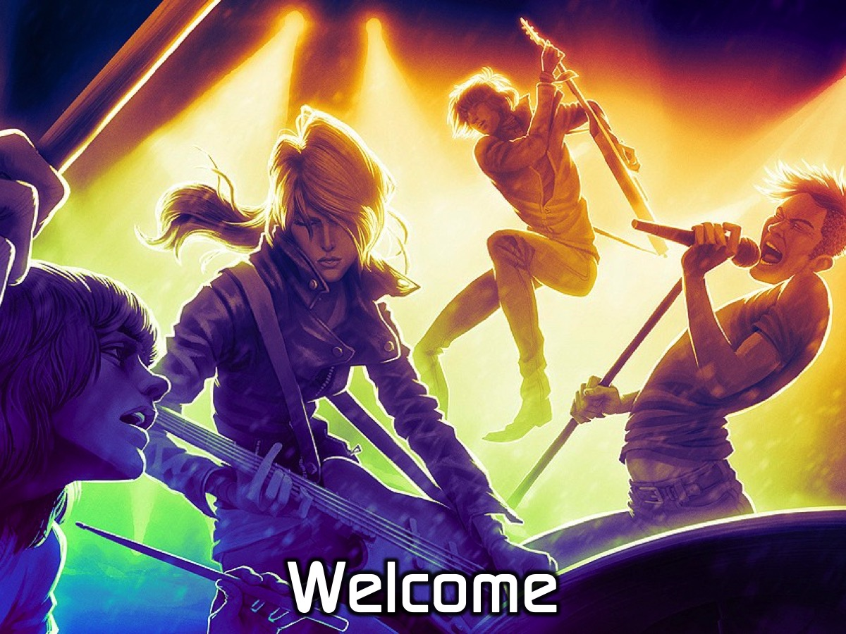
Notes:
Welcome to newcomers and regulars.

Slide 4

Notes:
On Sunday morning it is the Word-On series and we will be exploring what the Bible says about Gifts.

Slide 5

Notes:
Next Friday night is our CrossFit Night. Wear active clothing you would wear practising sport or going to gym.

Slide 6

Notes:
Tonight is Talent Night.

Slide 7

Notes:
Video: Storm Troopers on Britain’s Got Talent 2016. Get it on YouTube at: https://www.youtube.com/watch?v=uWzRvwg9z3E

Slide 8
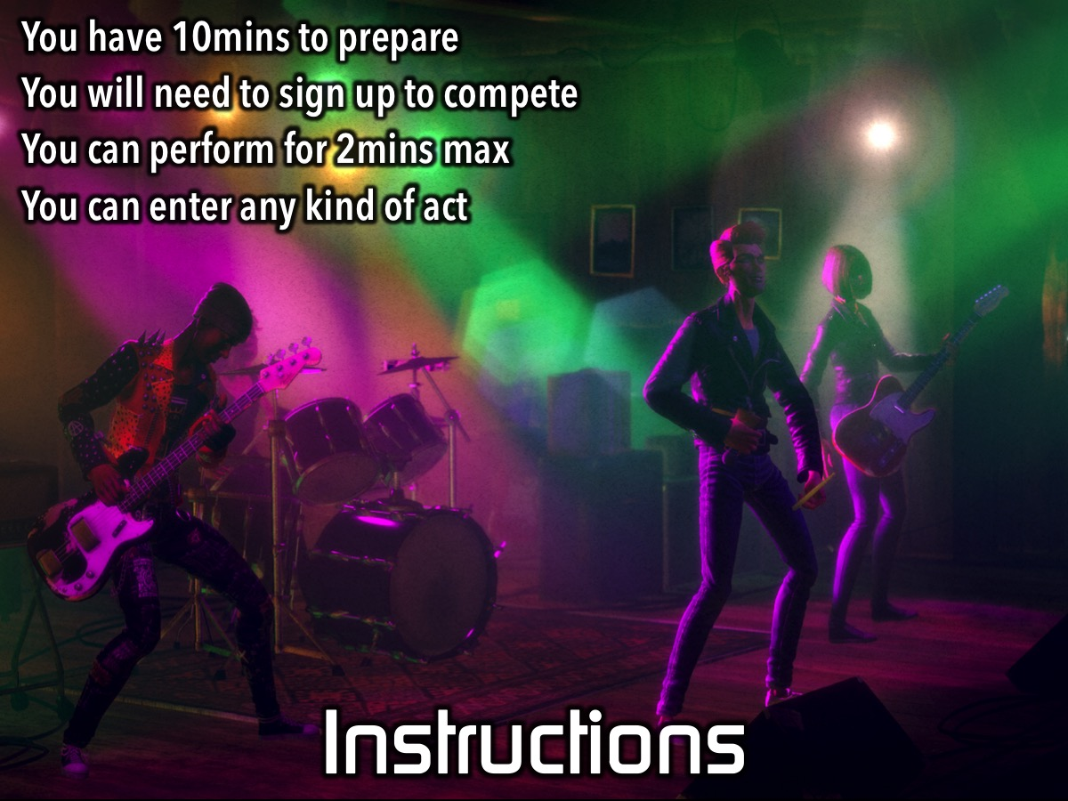
Notes:
Instructions: (1) You have 10mins to prepare. (2) You will need to sign up to compete. (3) You can perform for 2mins max. (4) You can enter any kind of act: such as…

Slide 9
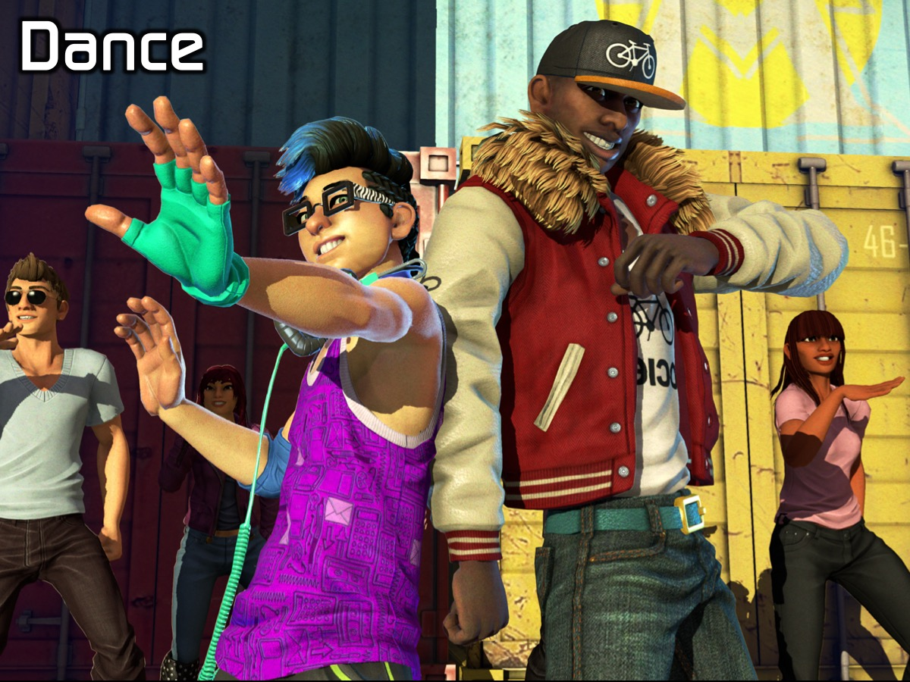
Notes:
Dance

Slide 10

Notes:
Sing

Slide 11
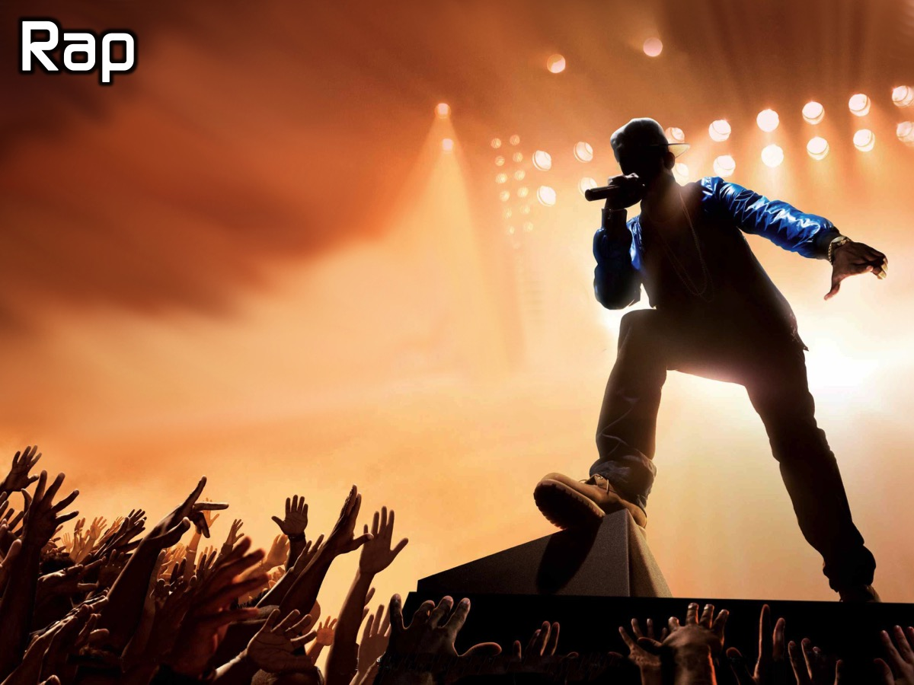
Notes:
Rap

Slide 12

Notes:
Act

Slide 13
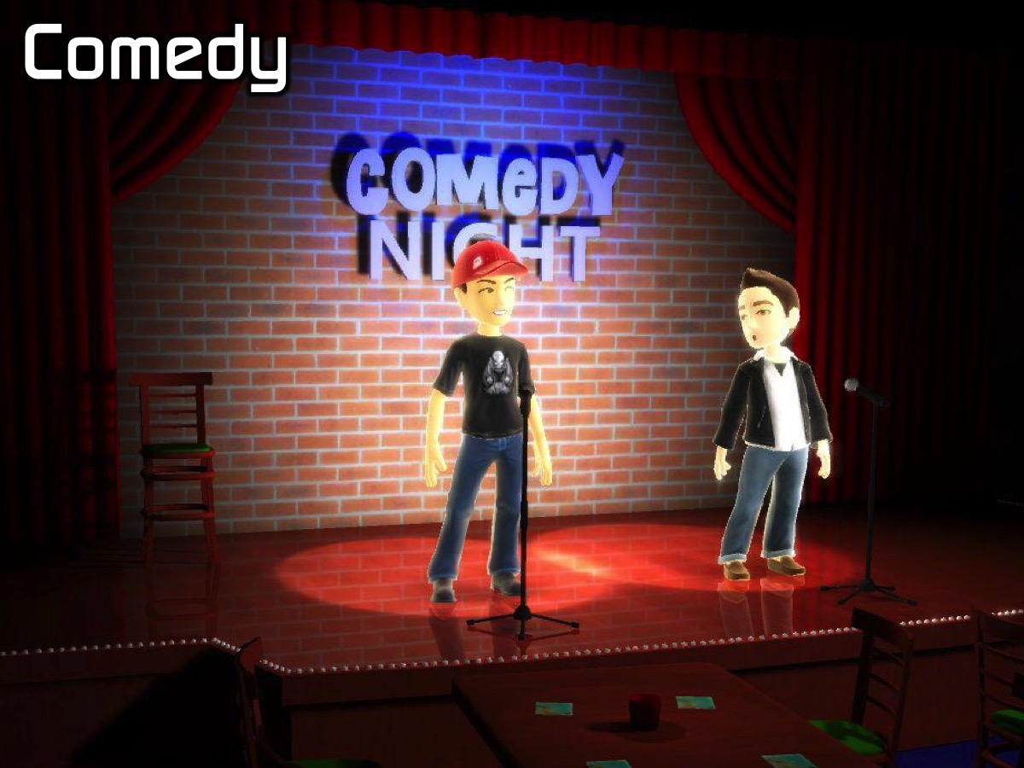
Notes:
Comedy

Slide 14
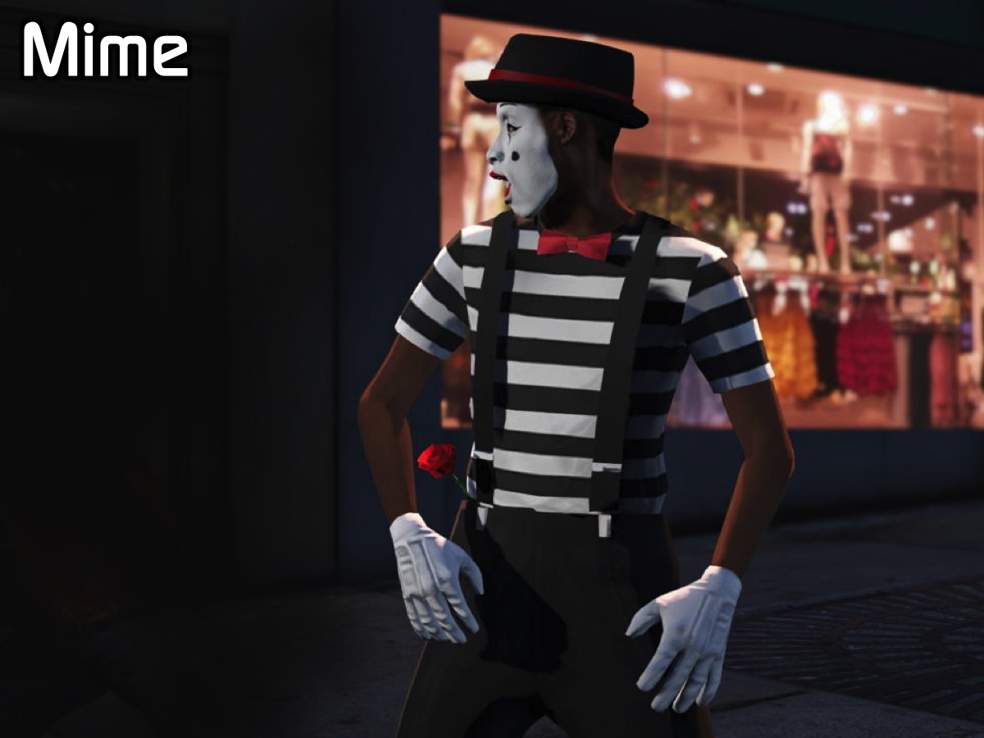
Notes:
Mime

Slide 15
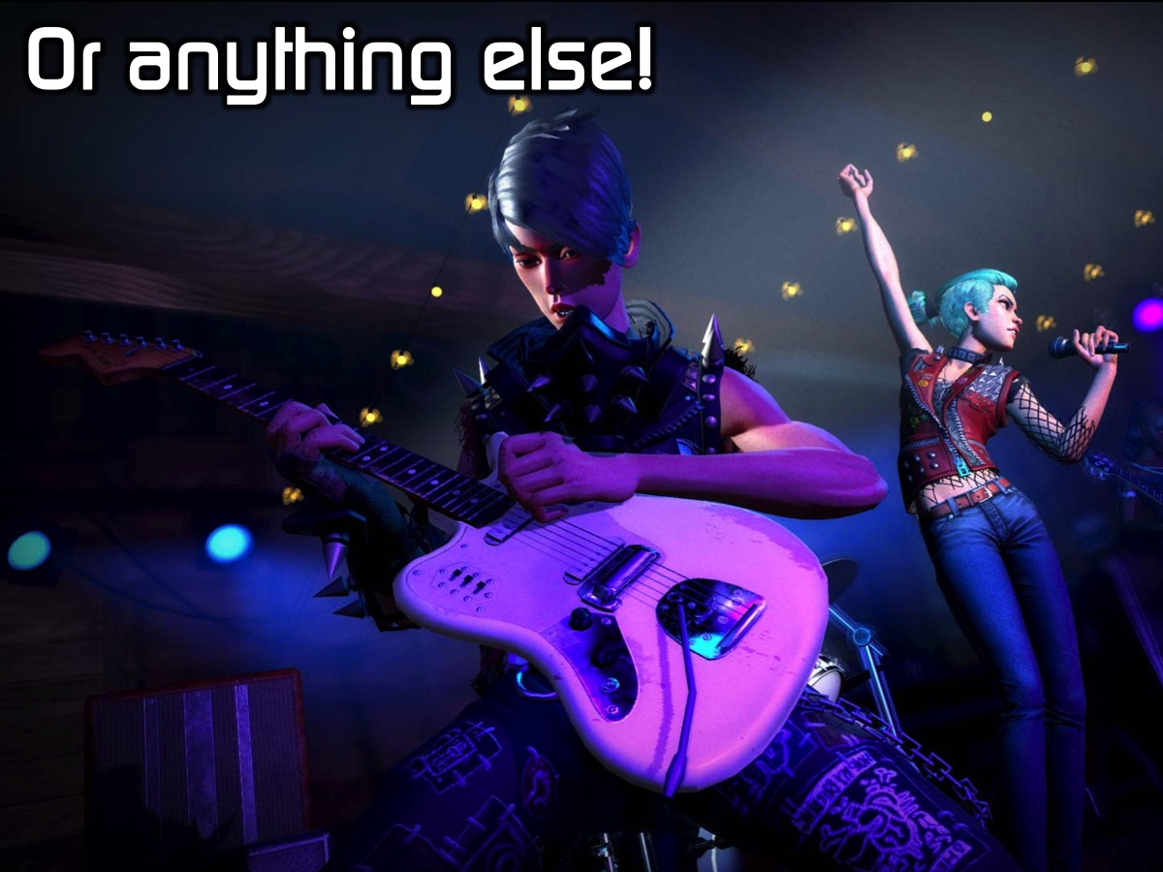
Notes:
Or anything else!

Slide 16
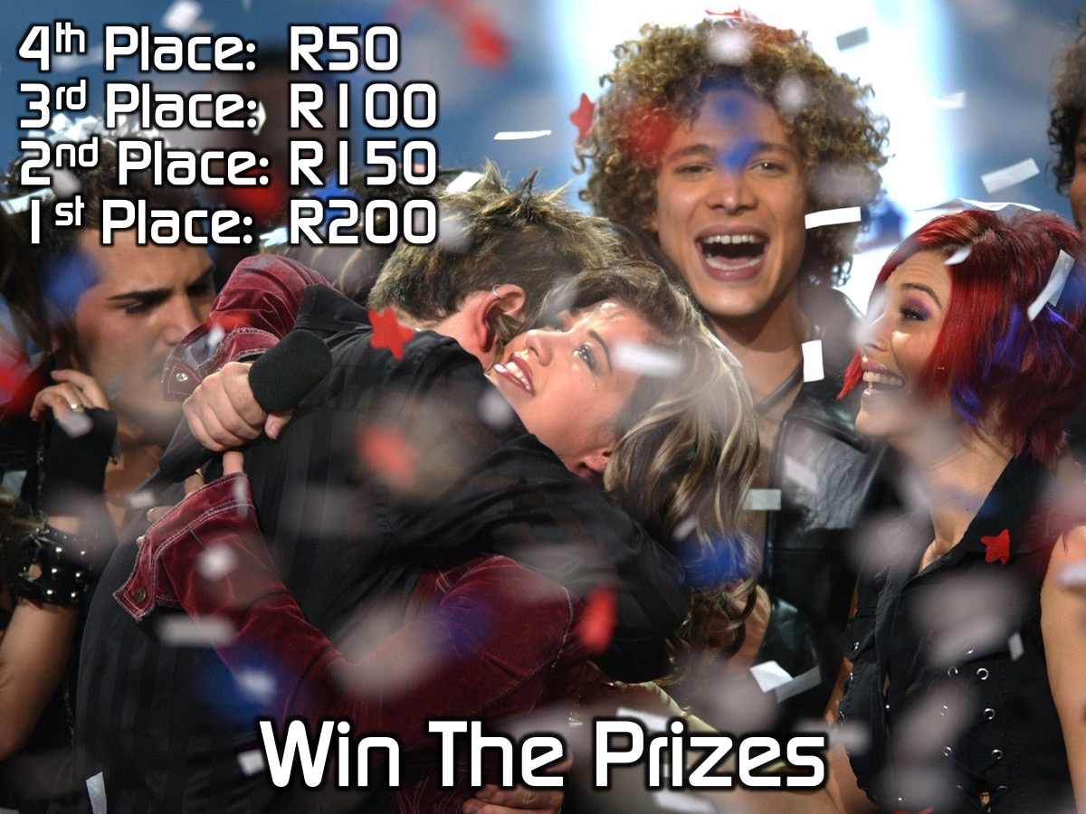
Notes:
Win the Prizes: There are real cash prizes on offer tonight:
4th Place: R50
3rd Place: R100
2nd Place: R150
1st Place: R200

Slide 17
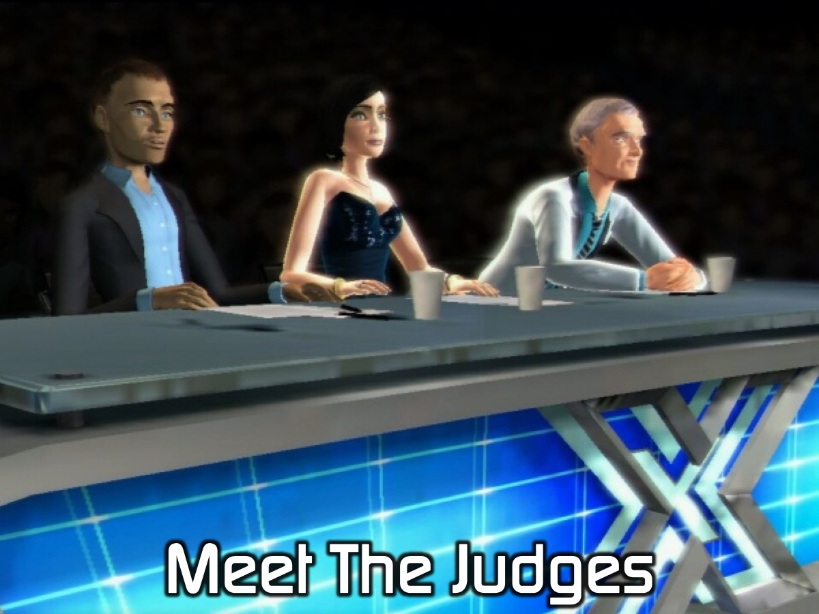
Notes:
Meet the Judges: Our judges this evening are Mario, Debbie and Nomalanga.

Slide 18
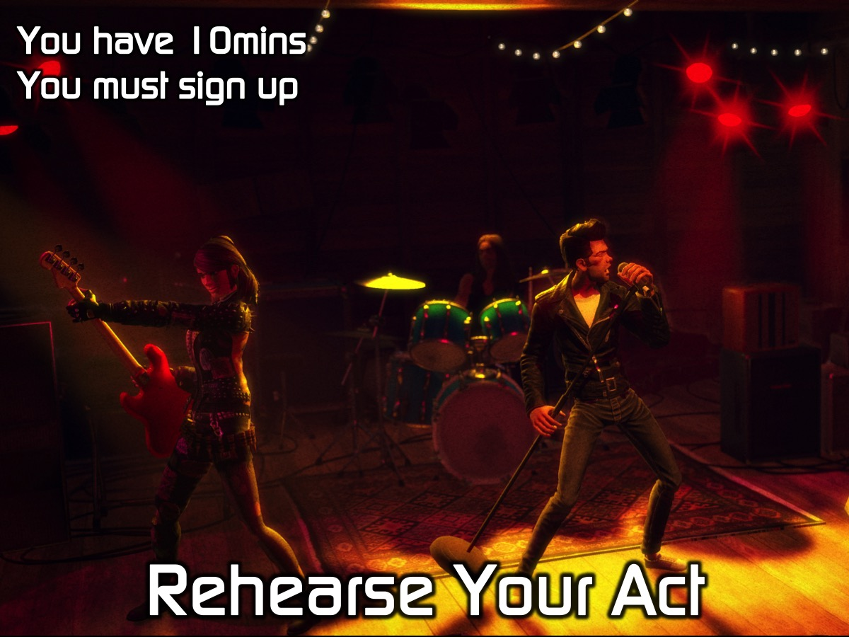
Notes:
Rehearse Your Act: You have 10 minutes and you need to sign up in this time if you have not done so already.

Slide 19
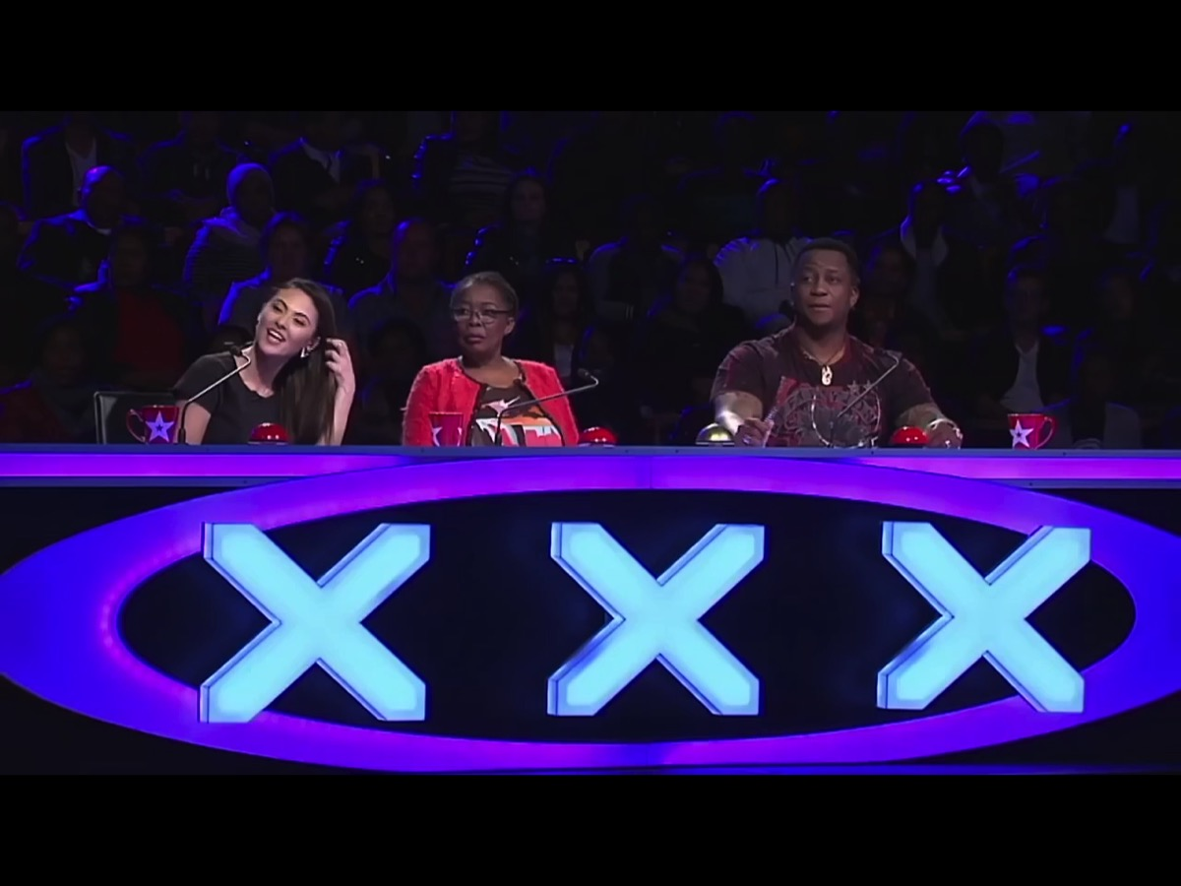
Notes:
Video: SA’s Youngest DJ on SA’s Got Talent. Get it on YouTube at: https://www.youtube.com/watch?v=f9KhlNLgA7U

Slide 20
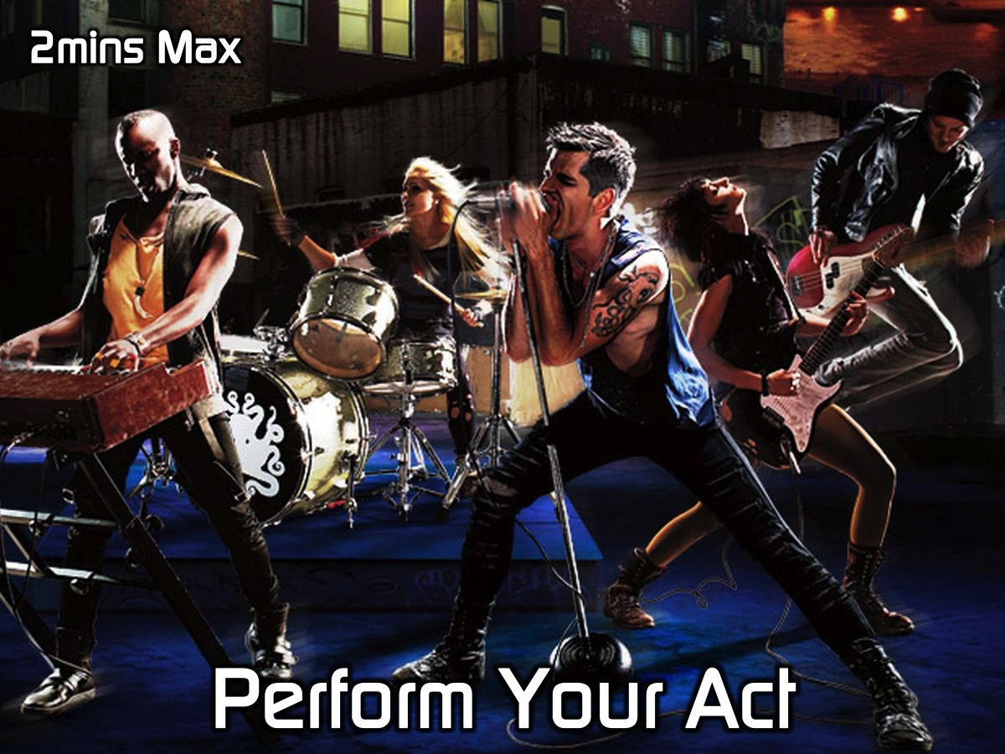
Notes:
Perform Your Act: Don’t forget there is a 2 minute maximum time limit on an act.

Slide 21
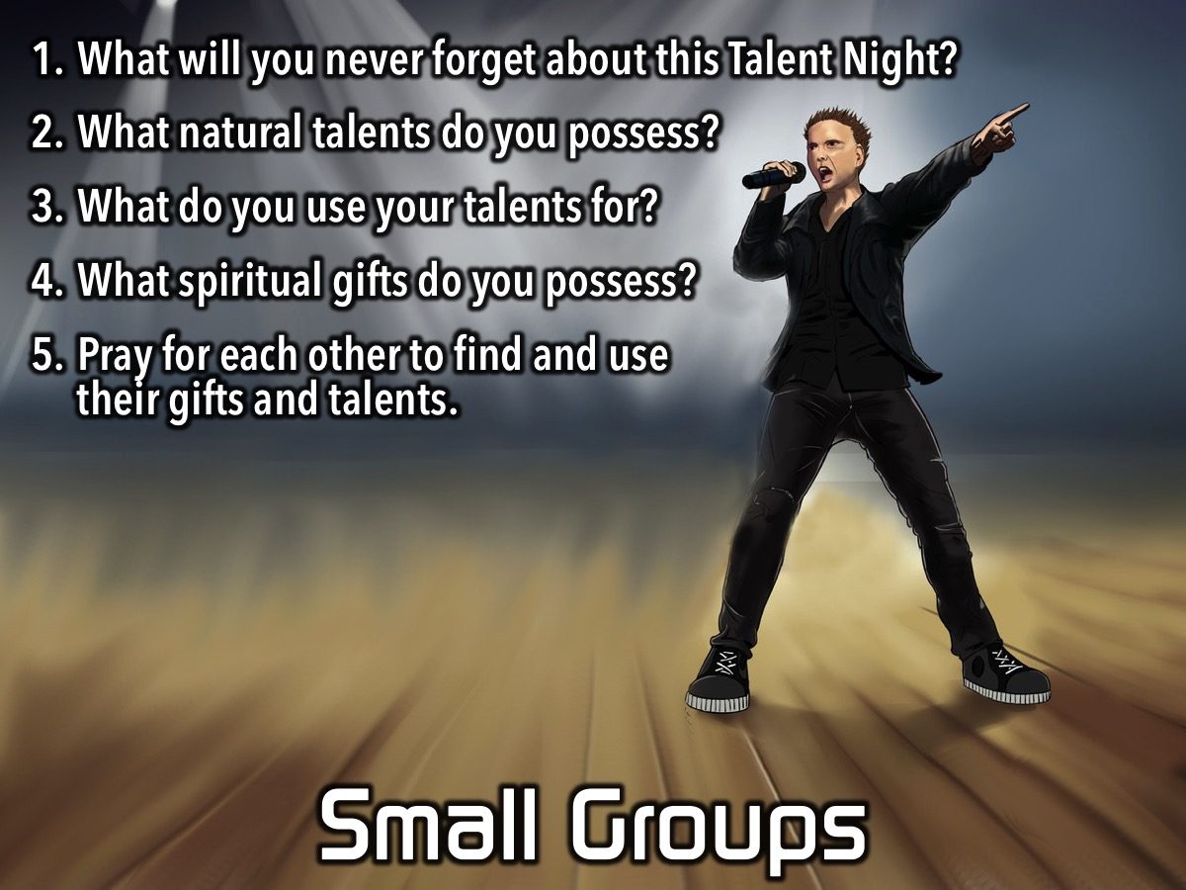
Notes:
Small Groups. Here are the questions for our small group time: (1) What will you never forget about this Talent Night? (2) What natural talents do you possess? (3) What do you use your talents for? (4) What spiritual gifts do you possess? (5) Pray for each other to find and use their gifts and talents.

Slide 22
Notes:
On Sunday morning it is the Word-On series and we will be exploring what the Bible says about Spiritual Gifts.

Slide 23

Notes:
Next Friday night is our CrossFit Night. Wear takkies and active wear!

Slide 24
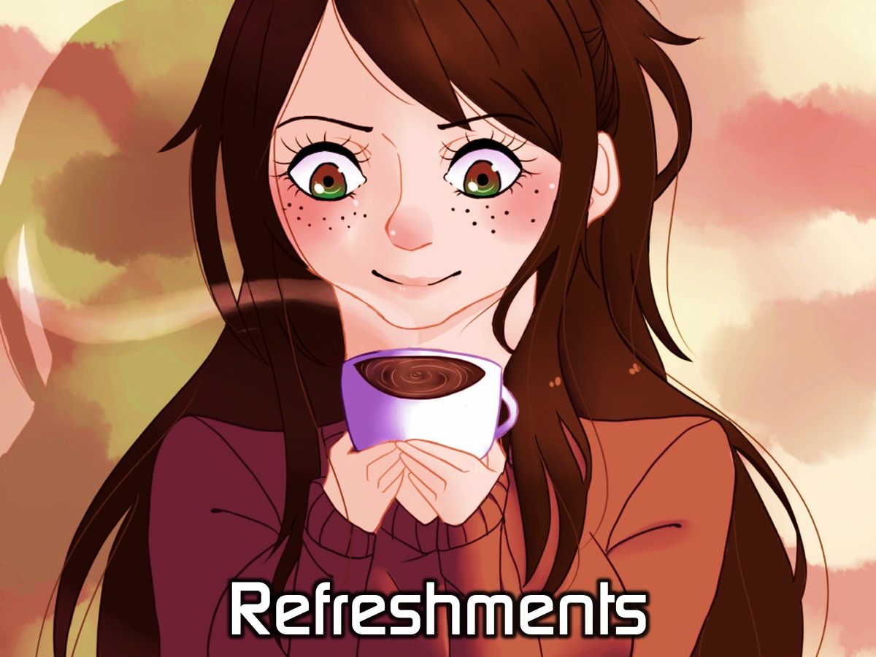
Notes:
It is time for Refreshments.

