Slide 1
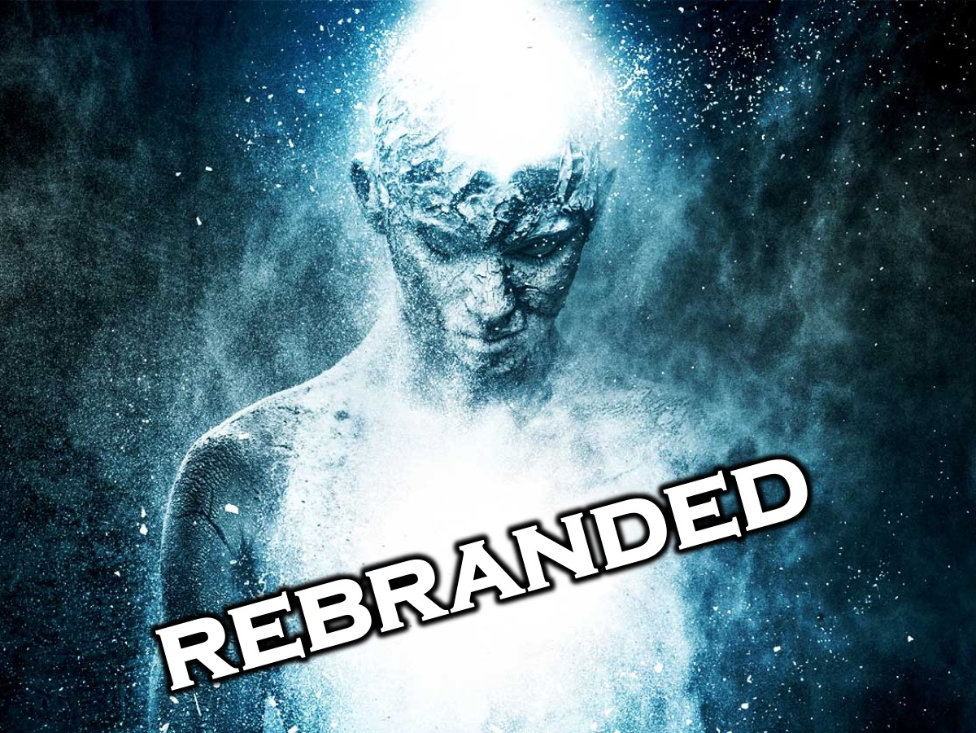
Notes:
Welcome to the ReBranded series. You can download and play the Creation rap song before and after the session ends. Here is the link: http://www.ymresourcer.com/documents/Rebranded_01_Creation.mp3
Be sure to visit the Rebranded website and register with the organisation One Hope to freely use their material in your youth ministry context. Here is the link:

Slide 2
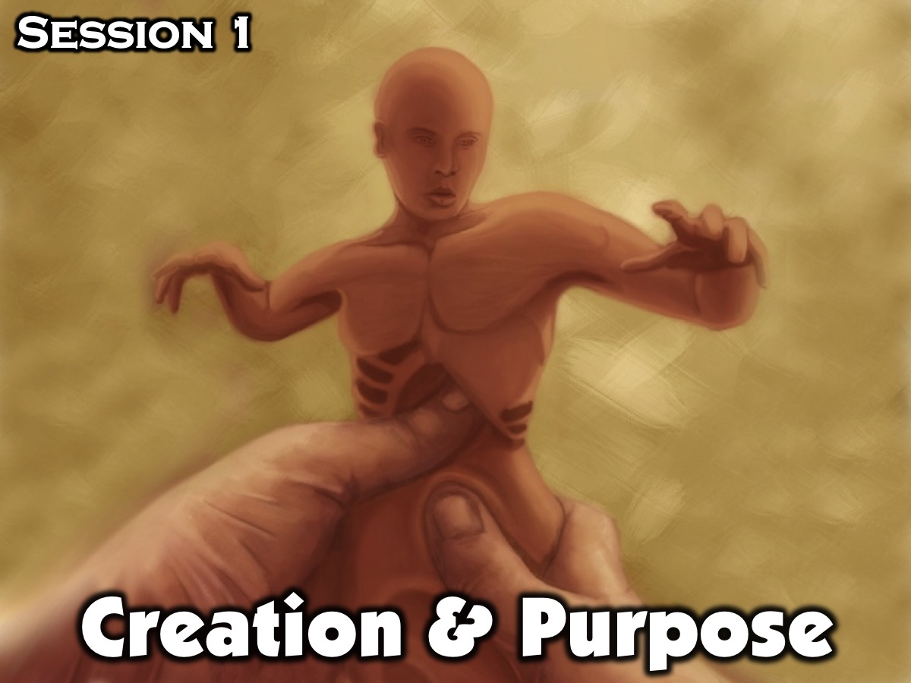
Notes:
Session 1 is all about how we have been created with a Purpose.

Slide 3

Notes:
Opening Exercise: The Right Rhymes (10 Minutes). This is a chance for each of you to write a poem, rap or song from God to yourself. This is for you and for you alone. What would God say in a poem, rap or song if He was writing it to help you? You can be very honest and transparent, because no one else will see it. This will be a way for you to see how you think God views you.
Supplies needed: Pen and Paper

Slide 4
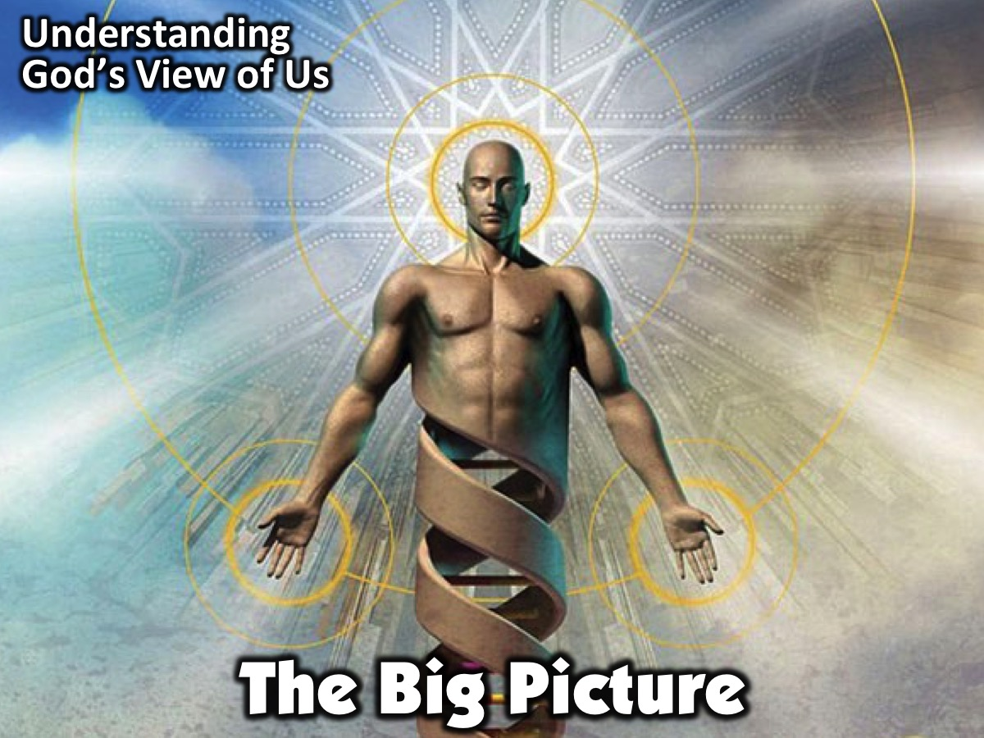
Notes:
The Big Picture: Understanding God’s View of Us (5 Minutes)

Slide 5
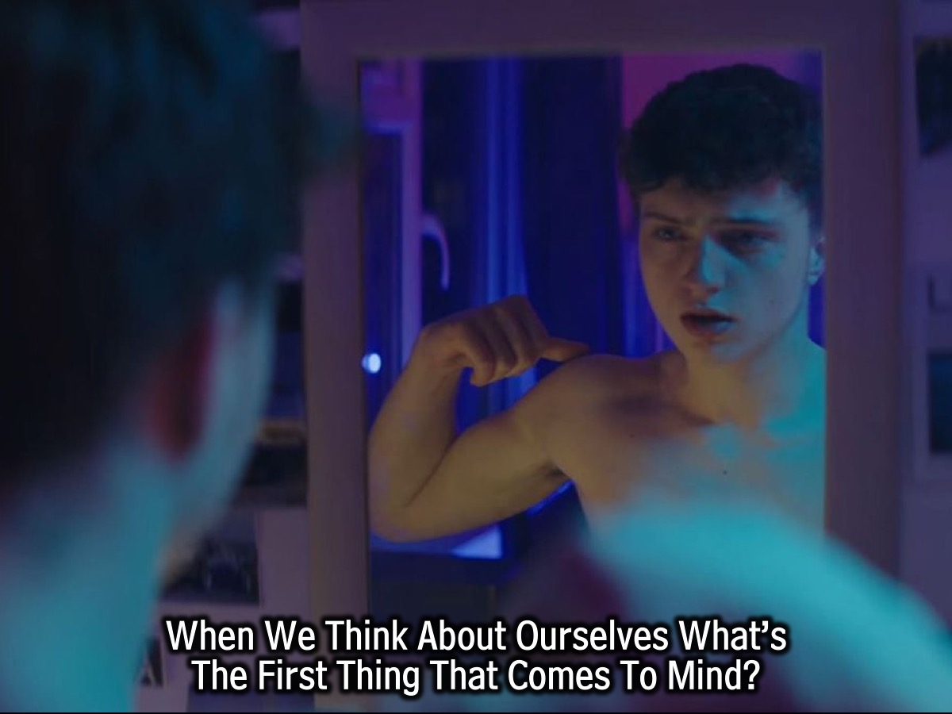
Notes:
When We Think About Ourselves What’s The First Thing That Comes To Mind?

Slide 6
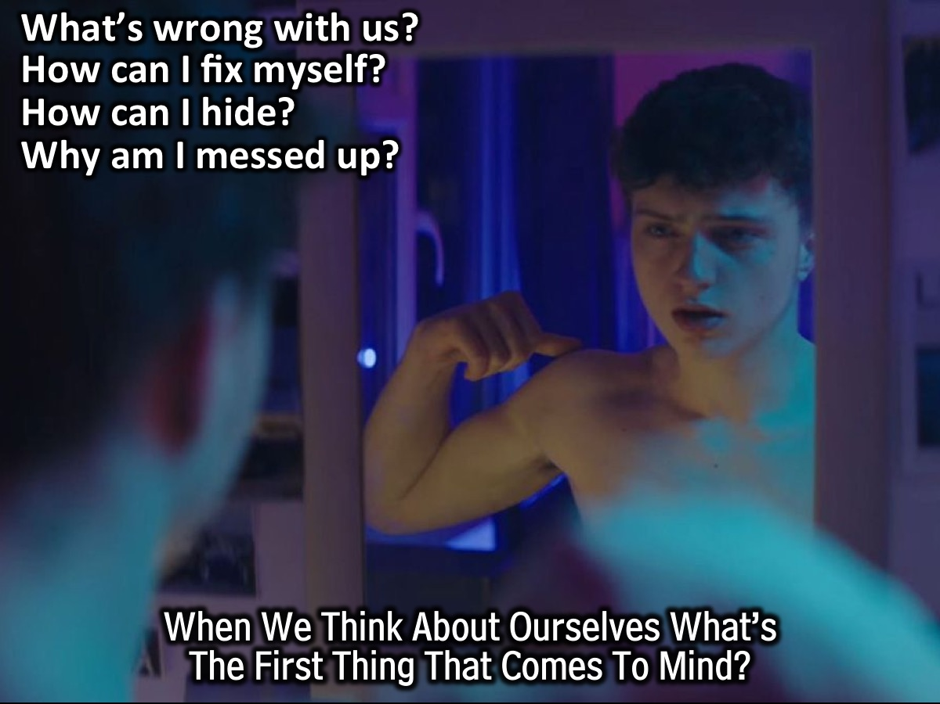
Notes:
Many of us think about what’s wrong with us. When we look in the mirror in the morning, and the first thing we think of is the same thing we think of throughout the rest of the day: “What’s wrong with me? How can I fix it or hide it? Will everyone know how messed up I am?” What’s funny is that how we view ourselves is normally how we think God views us.

Slide 7

Notes:
When You Think About What God Wants From People, What’s The First Thing That Comes To Mind?

Slide 8
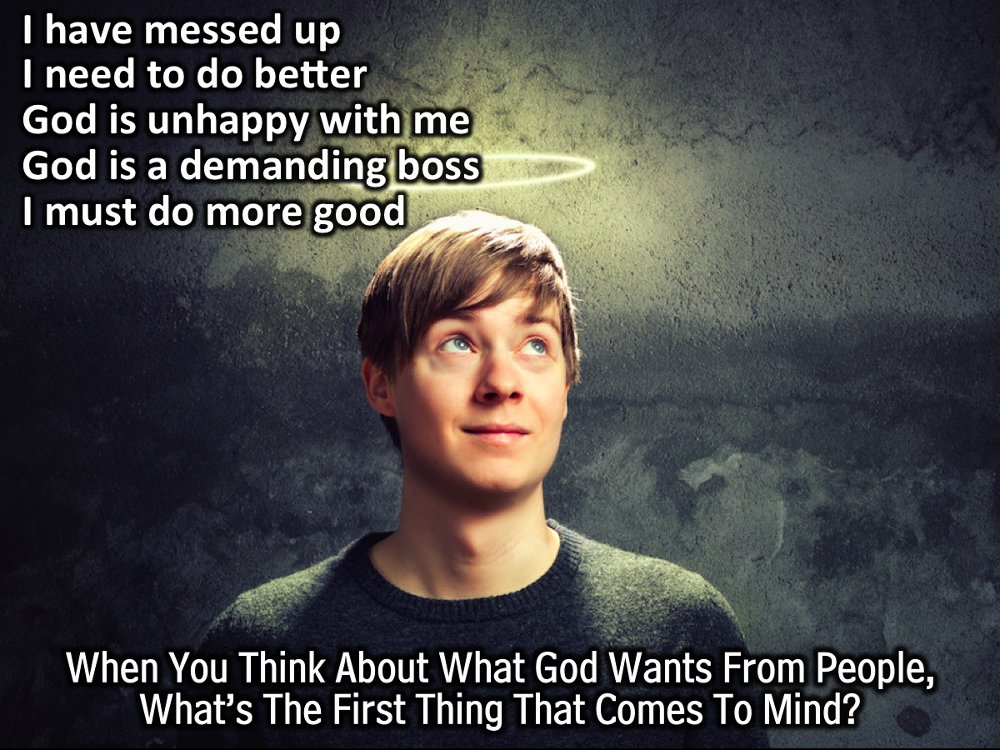
Notes:
When we answer this question we tend to think about all the ways we’ve messed up and how we need to “do better.” This tells us that we have a tendency to look at God as a boss more than as a Father: He has stuff for us to do, and as long as we do it well we are fine, but if we don’t do it or don’t do it well, then we’re not fine. What if this is not the way God wants us to view Him at all? If we view God as a boss, we might spend all of our time trying to impress Him by doing good things. For most of us, we think that doing good things for God is what being a Christian is all about, but that is not all we are created for.

Slide 9

Notes:
Video #1: Lets Take A Look At A Music Video About Creation. You can download the video from: http://www.ymresourcer.com/documents/Rebranded_01a_Creation.mp4

Slide 10
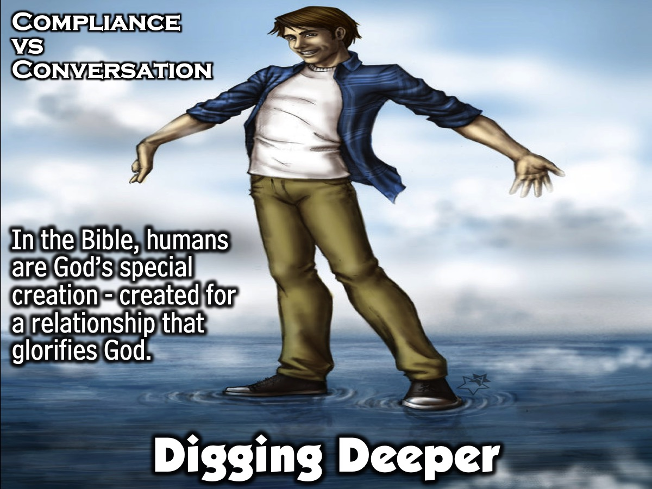
Notes:
Digging Deeper: Compliance vs Conversation (20 Minutes). Leader: At the core of today’s lesson is the fact that, in the Bible, humans are highlighted as God’s special creation. They are created for a relationship that glorifies God. God’s interaction with human beings is an intimate and thoughtful process.

Slide 11
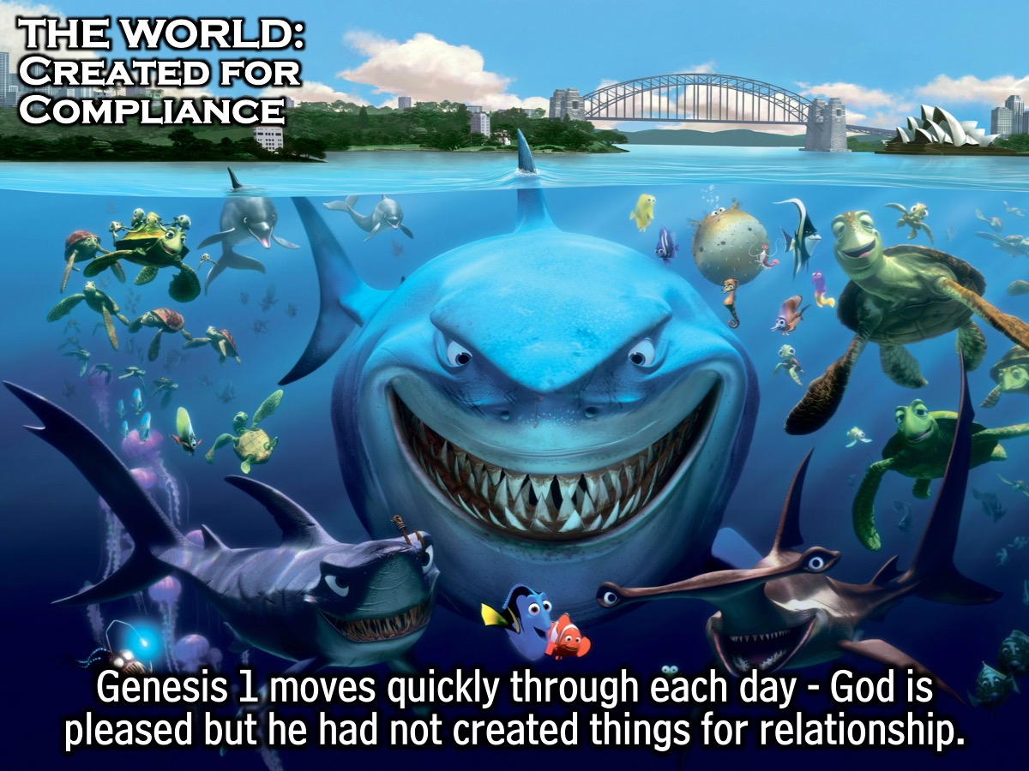
Notes:
The World: Created for Compliance (Genesis 1). As we look through the days of creation, we see how God moves through each day quickly. He speaks; light is created. He speaks; waters separate. He speaks; land appears. He speaks; birds fly and fish swim. He speaks; land animals roam. He creates all these things, but He doesn’t interact with this creation. He simply commands things to happen and they do. Nature and animals were made out of commands and for compliance. God is pleased, but He has not created these things for relationship with Him.

Slide 12
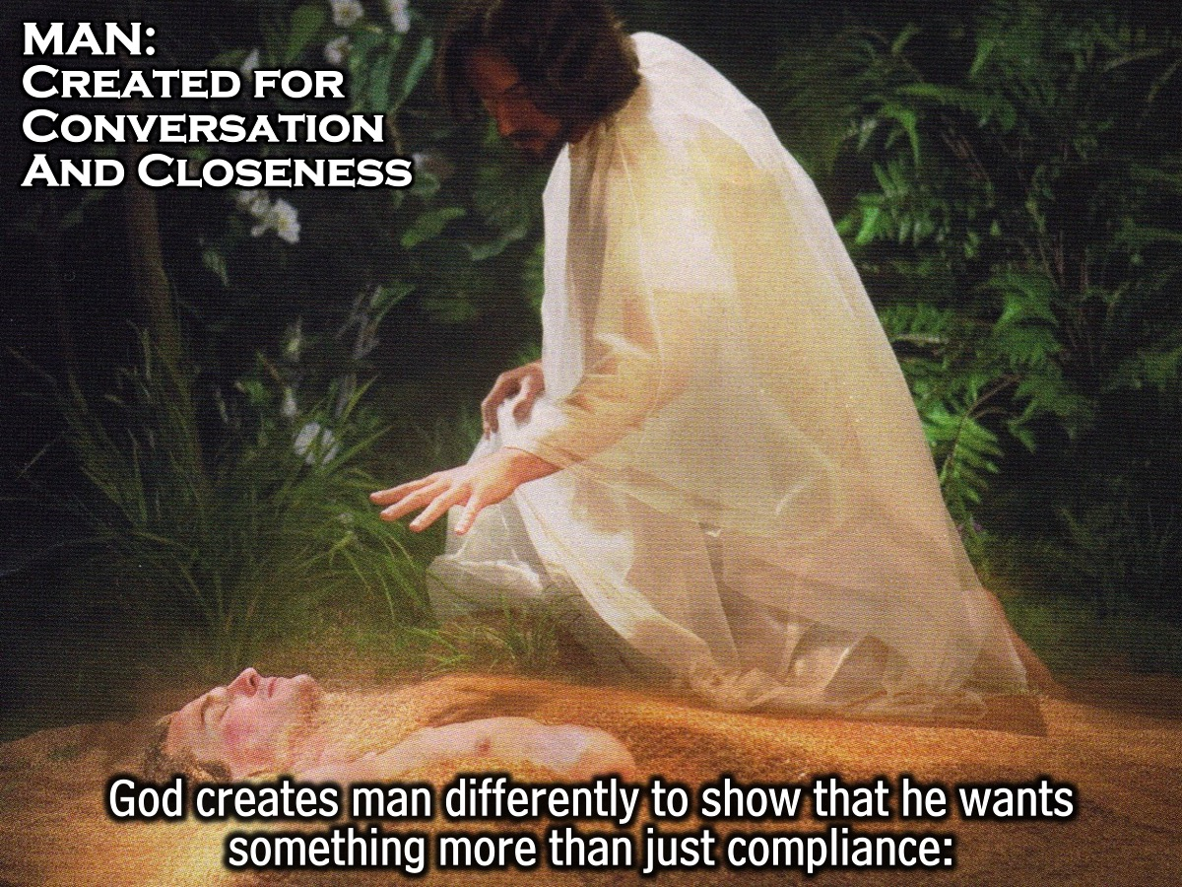
Notes:
Man: Created for Conversation and Closeness. As we look at scripture there is something different in the way that God Creates Man, Which Shows That He Wants Something More Than Just Compliance. When God is getting ready to make man, God does a few things:

Slide 13
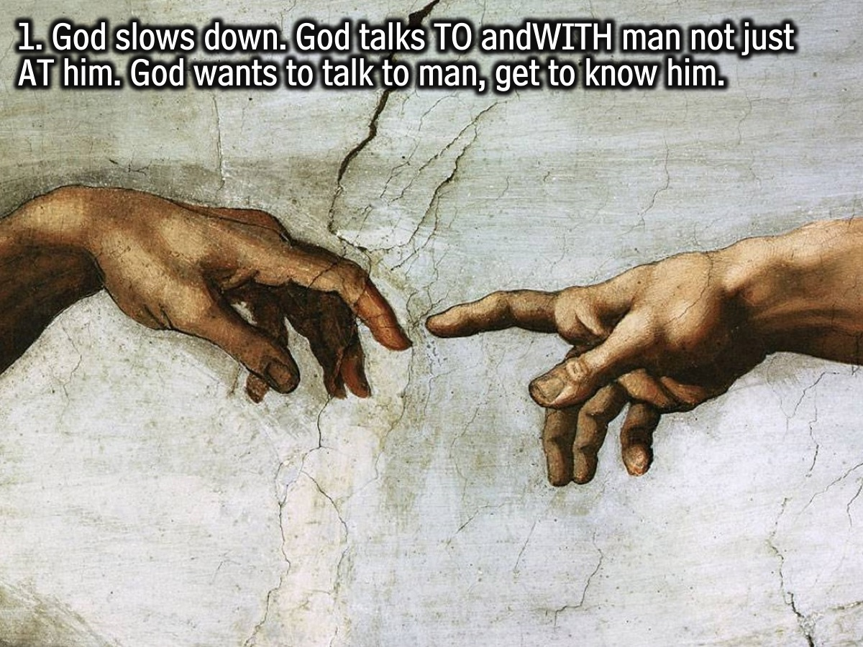
Notes:
1. God doesn’t just breeze through the creation of man the same way that he did before. God slows down. Not only does God slow down, but instead of talking AT man, God talks TO and WITH man. God is not concerned with man just following His rules; God wants to talk to man, to get to know him, and for man to know Him.

Slide 14
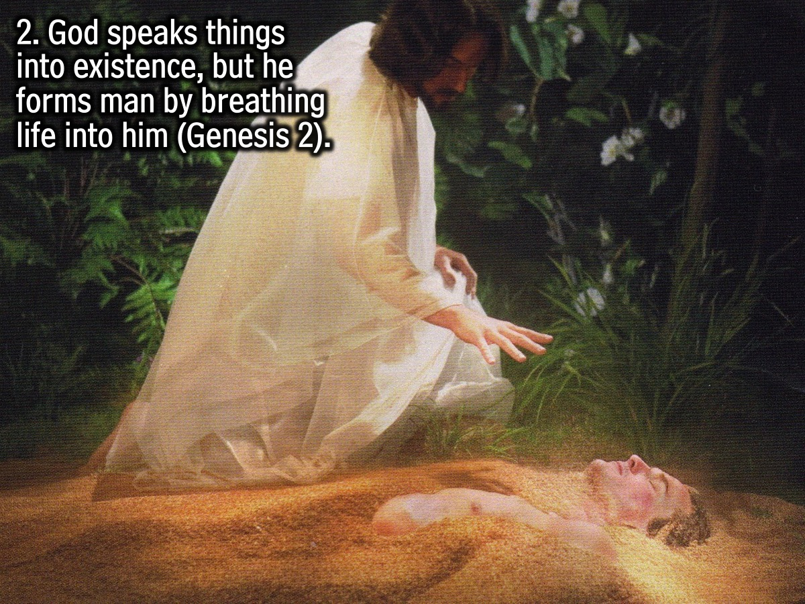
Notes:
2. Not only does God want to have a conversation with us, but God wants to be close to man in a way that He is not with the rest of creation. Look at Chapter 2:1-3 as it tells the story of creation from a different angle. Notice how, with the rest of Creation, God speaks from far off and everything is created. In Chapter 2:7, it tells us that God forms man from the dust of the earth and then breathes into his nostrils. The picture that’s painted here is that God doesn’t want to bark orders at man. He wants to get close to us and be involved with every detail of our lives. This is what brings glory to God.

Slide 15
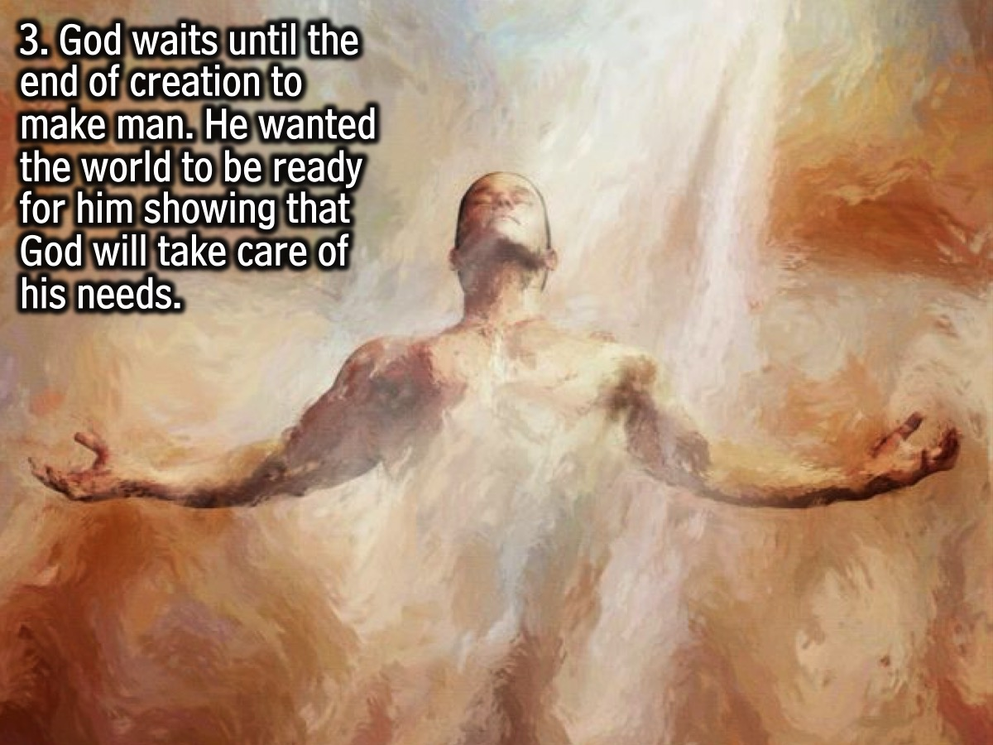
Notes:
3. God waits until the end of creation to make man. In the same way that a father would get a room ready in preparation for the coming of his newborn child, God created the world first so that it was ready when He created man. This is to show man that God is going to take care of all of his needs.

Slide 16
Notes:
Let’s hear the story of someone who found her identity and purpose in a relationship with God. Video: Sarah’s Testimony. You can download the video from: http://www.ymresourcer.com/documents/Rebranded_01b_Sarah.mp4

Slide 17
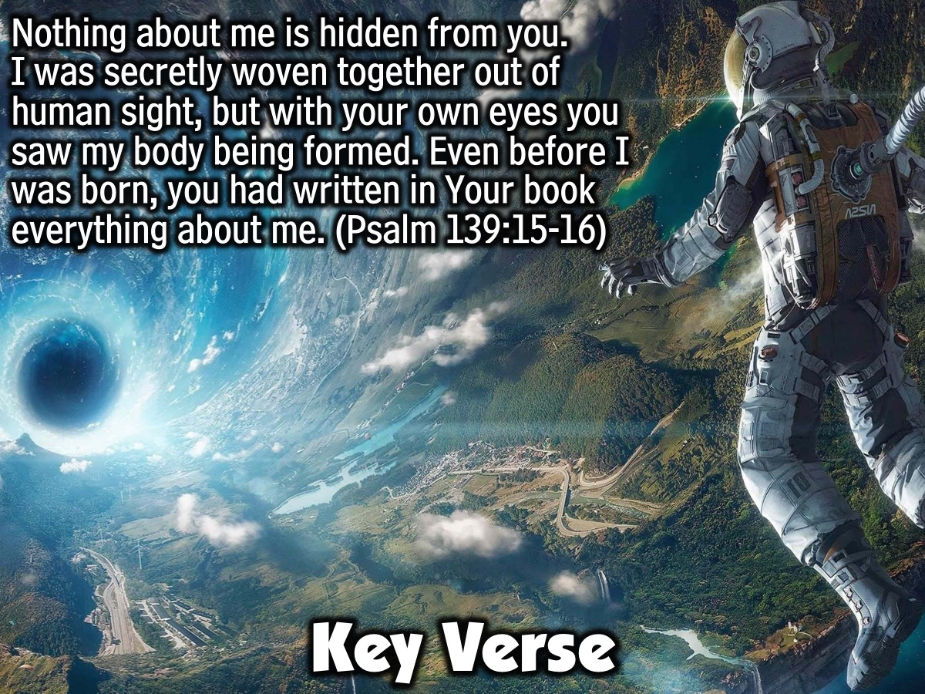
Notes:
Key Verse: Nothing about me is hidden from you. I was secretly woven together out of human sight, but with your own eyes you saw my body being formed. Even before I was born, you had written in Your book everything about me. (Psalm 139:15-16)

Slide 18
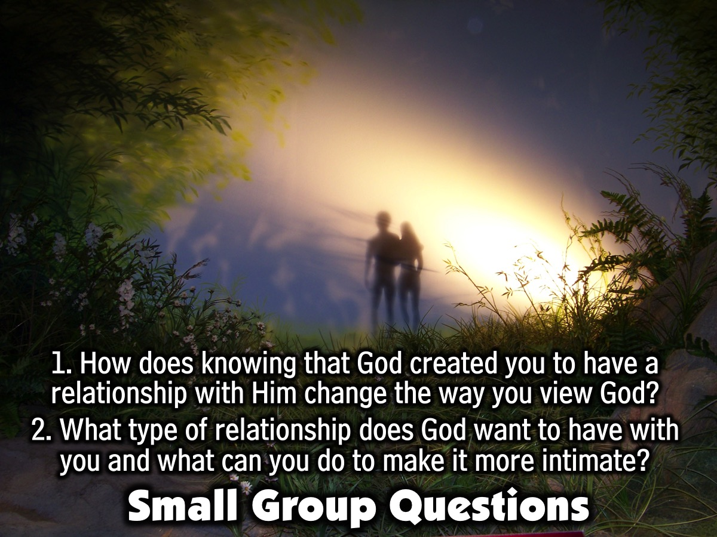
Notes:
Small Group Questions: (1) What does God’s way of creating man and preparing the world for man show us about how God views human beings? Does knowing that God created you to have a relationship with Him change the way you view God? Possible Answer: It Tells Us That We Are Special To God And That We Are Worth His Time. We Are Valuable. (2) If all of this is really true and God made all humans with this sense of worth, how does this change your opinion of someone you don’t like much? Why? Possible Answer: If God Says All People Are Valuable, Then I Should Believe That As Well And Treat People Based On How God Views Them. (3) What type of relationship is God desiring to have with you? What are some things you can do in order to make your relationship with God a more intimate one? Possible Answer: God Wants To Have A Personal, Intimate Relationship With Each Person On Earth. You can: (a) Read and study the Bible. This will help you get to know God’s thoughts and personality better. It’s kind of like someone telling you all about their life. (b) One of the best parts of being in a relationship is that both people communicate with each other. It’s a two way street. Praying to God helps keep the lines of communication open. (c) You can develop good relationships with people who have their own relationship with God. We all need solid people who love God around us to help us walk through life. This can be a leader or a friend your own age.

Slide 19
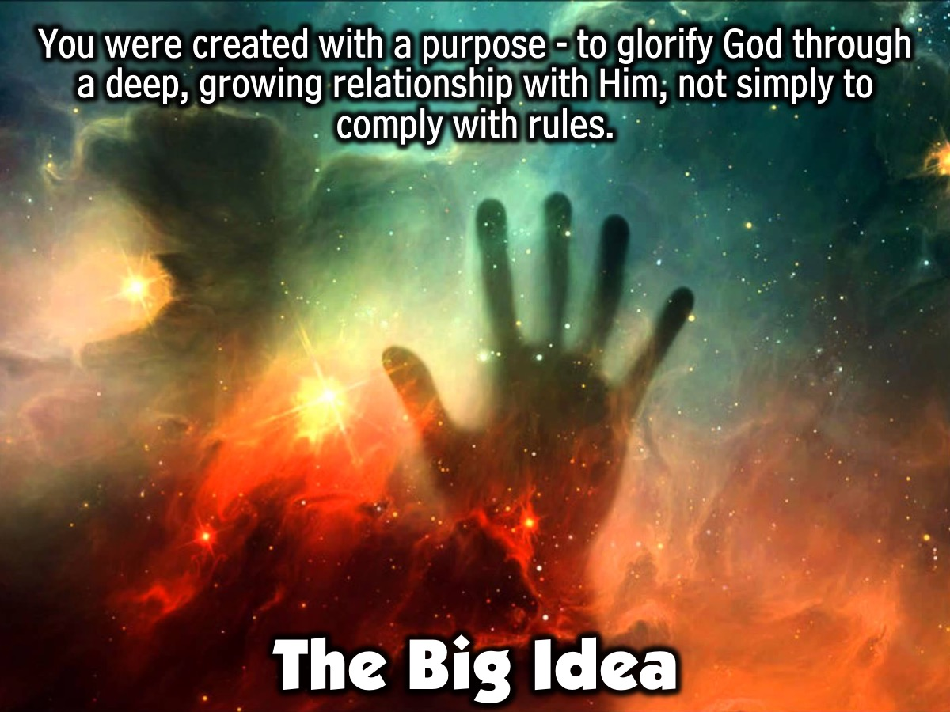
Notes:
The Big Idea: You were created with a purpose - to glorify God through a deep, growing relationship with Him, not to simply comply with rules.

Slide 20
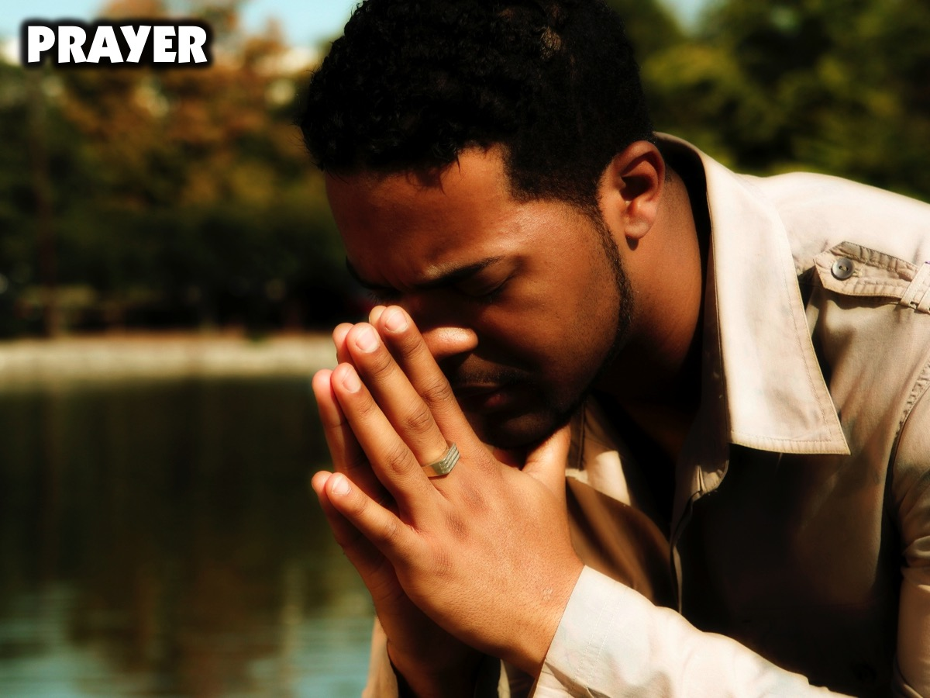
Notes:
Prayer.

Slide 21
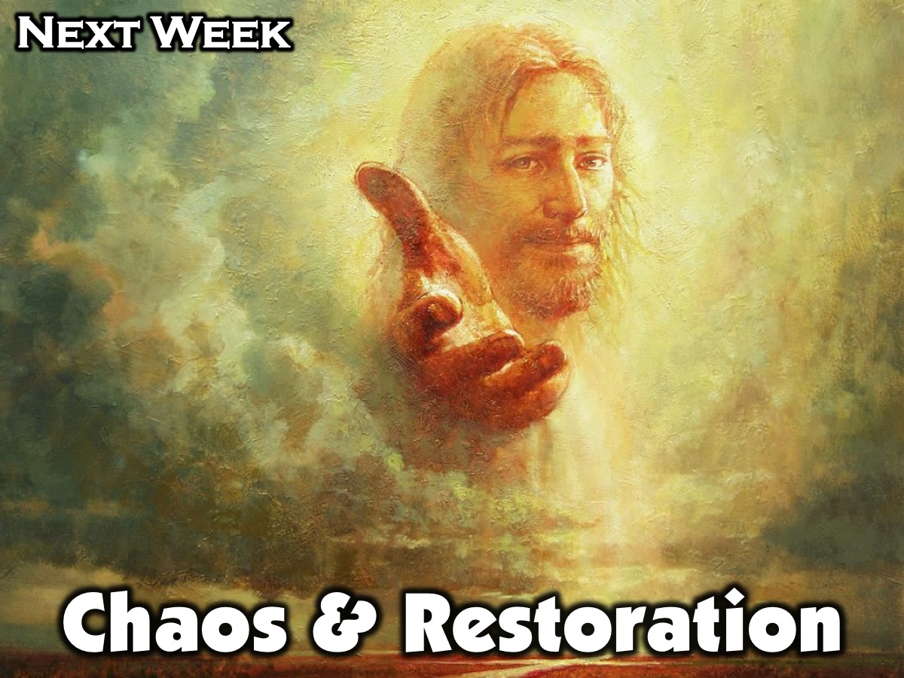
Notes:
Next week in session 2 we will be focusing on Chaos and Restoration.

