Slide 1

Notes:
Welcom to Rebranded.

Slide 2
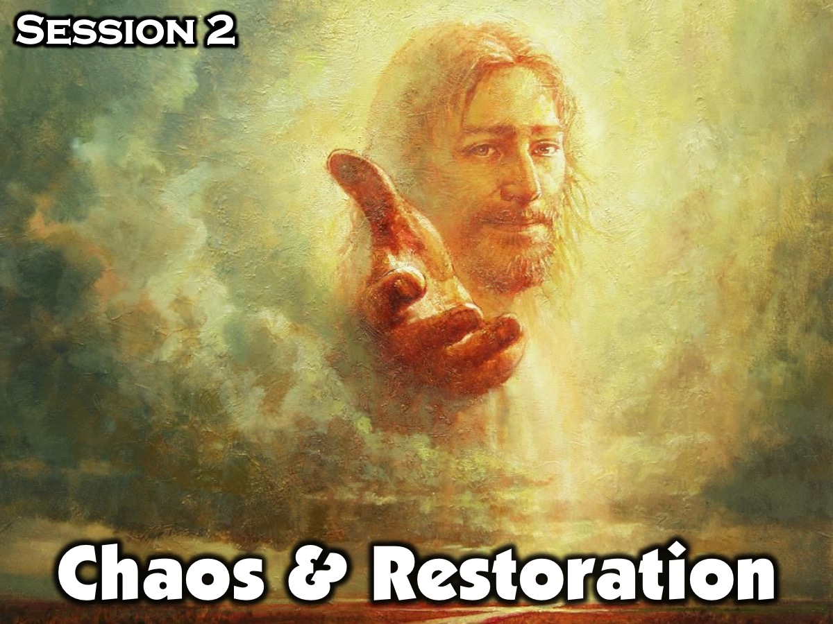
Notes:
This is Session 2: Chaos & Restoration

Slide 3

Notes:
Opening Exercise: The Chaos of Sin (10 Minutes). Supplies needed: Blindfolds, Chairs. Before you start the activity: (a) Place a chairs in various places around the room creating an obstacle course. (b) Divide the students into 2 groups: the green group and the red group. (c) Ask for 2 volunteers (one from each team) who will be blindfolded. (d) Have each volunteer start at opposite ends of the obstacle course. Each group should be instructed to give correct verbal instructions to their teammate and incorrect instructions to the opposing blindfolded teammate. Instructions are to be spoken all at the same time creating a very chaotic (and maybe noisy) environment. Share with the students that you, as the leader, will act as the voice of God. During the game you will try to tell both blindfolded volunteers the correct instructions. The objective is for both groups to try and guide their blindfolded teammate to every chair and walk around or step over each obstacle.

Slide 4
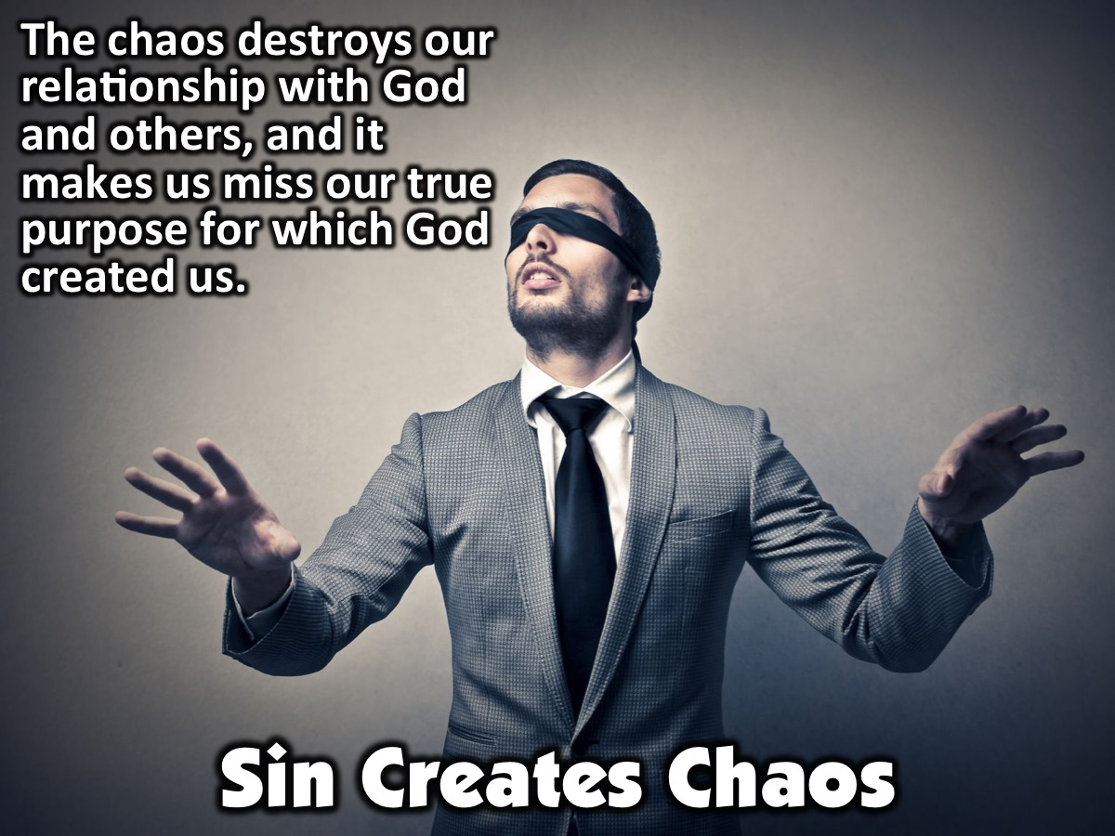
Notes:
Leader: This confusion and noise is what sin does in our lives. It creates chaos that destroys our relationship with God and others, and it causes us to miss out on our true purpose for which God created us.

Slide 5
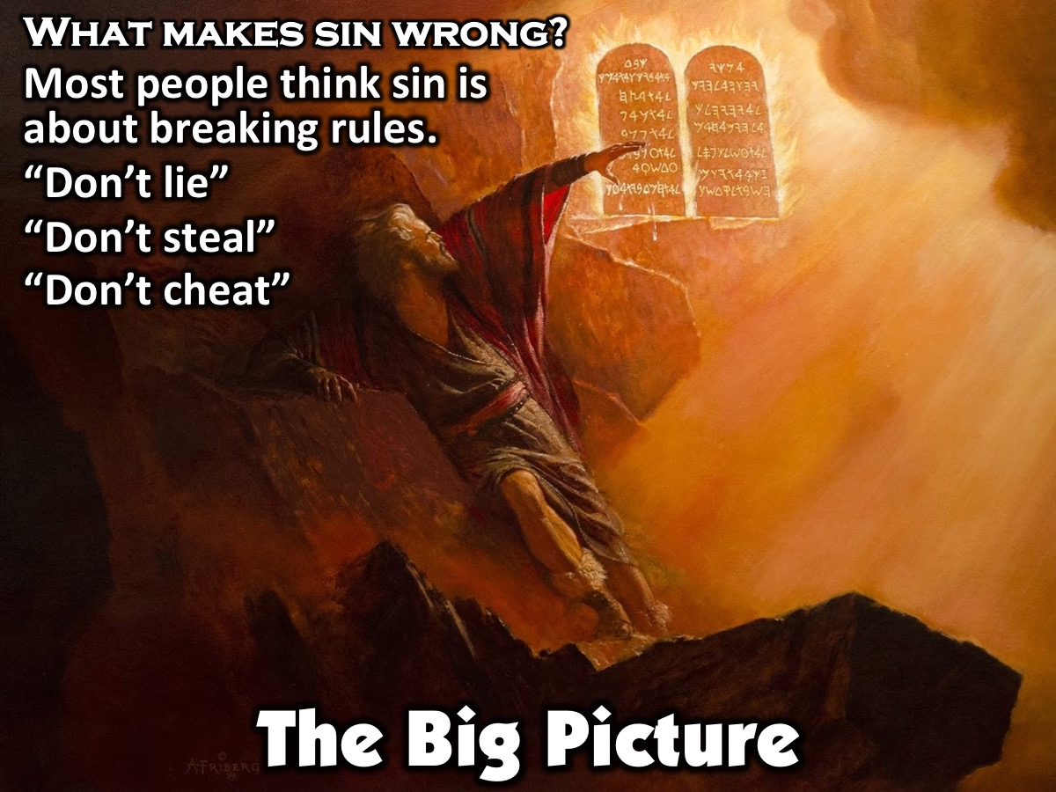
Notes:
The Big Picture: What makes sin wrong? Most people think sin is about breaking rules. Most people, when asked about how not to sin, will give a long list of things not to do. They may say, “don’t lie,” “don’t steal,” or “don’t cheat.”

Slide 6
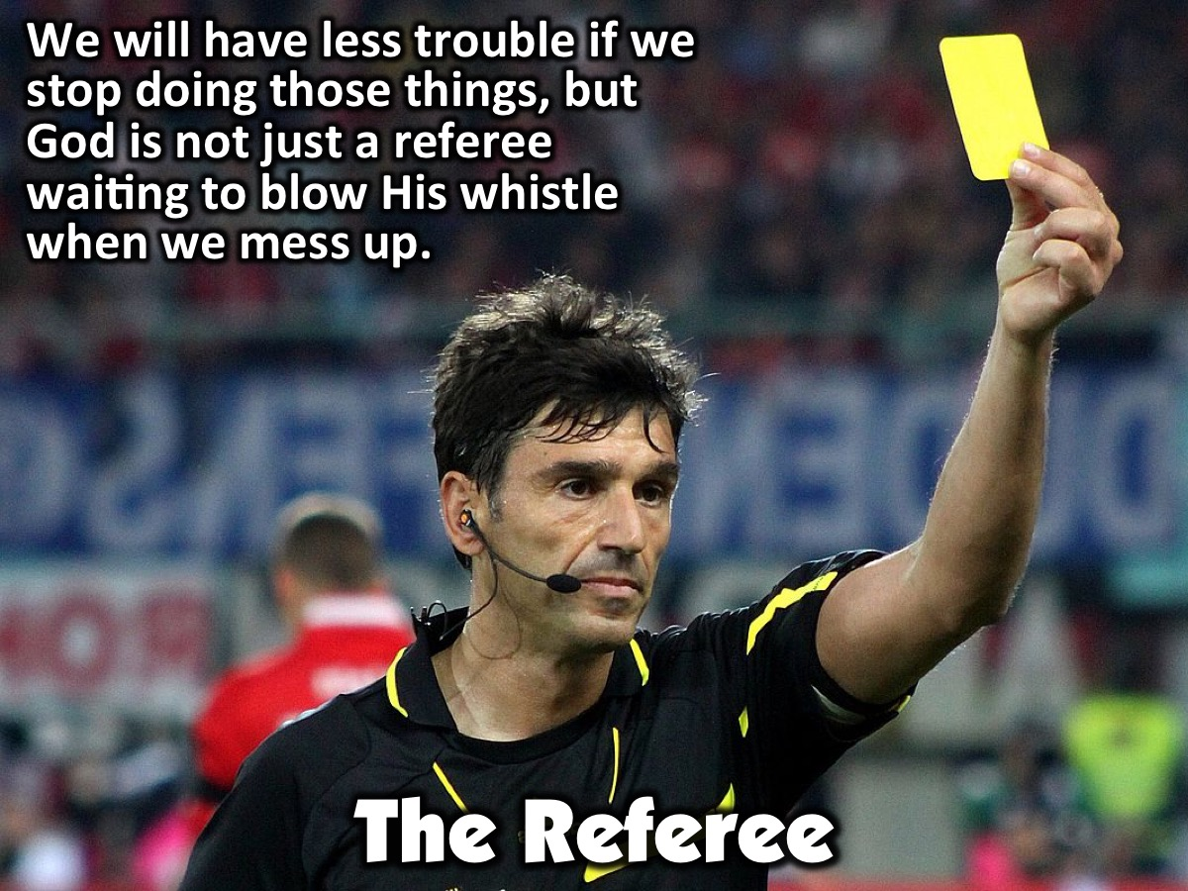
Notes:
It’s true that we will have less trouble in life if we keep from doing these things, but God is not some referee just waiting to blow His whistle when we go out of bounds in life.

Slide 7
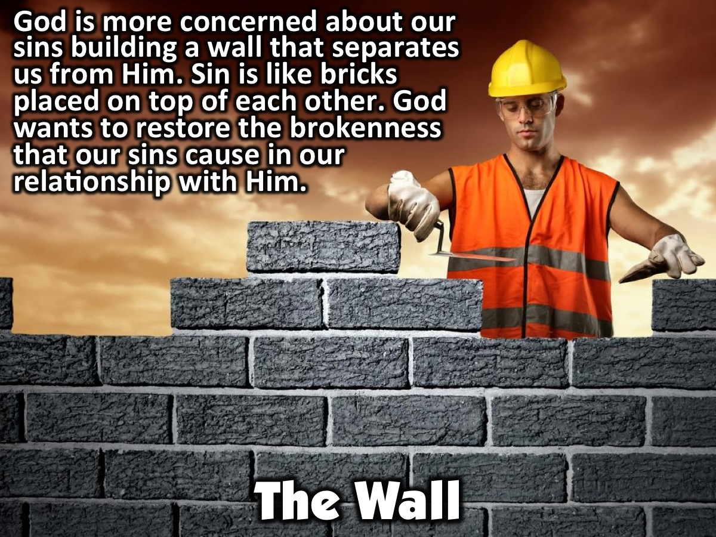
Notes:
God is far more concerned about our sins building a wall that separates us from Him. The reality is that sin is more like bricks that are placed one on top of the other than a checklist. He desires to restore the brokenness that our sins cause in our relationship with Him. Let’s take a few minutes to discuss why we may feel far from God.

Slide 8
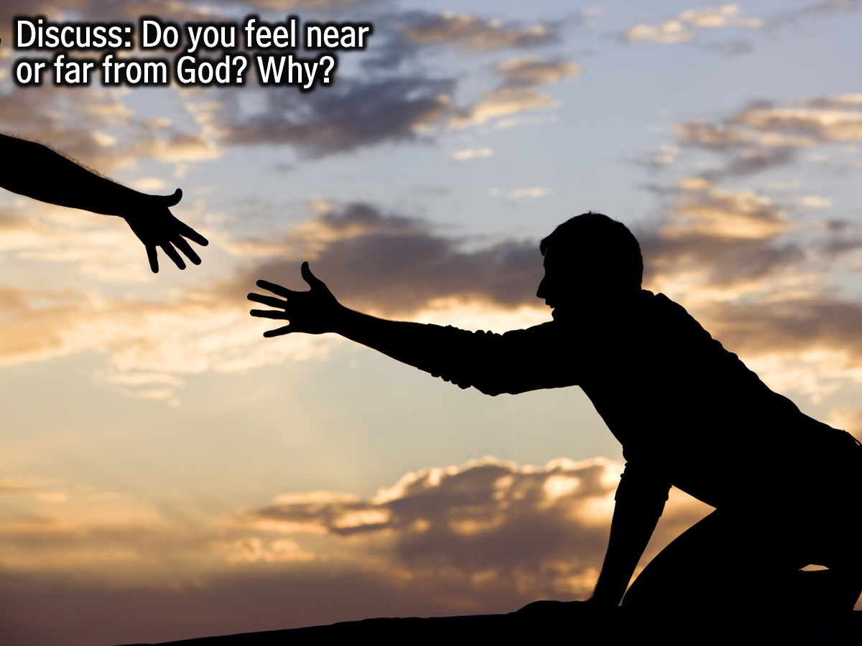
Notes:
Small Group Leaders: Do you feel near or far from Him? Why?

Slide 9

Notes:
Video #1: Lets Take A Look At A Music Video About the Fall.

Slide 10
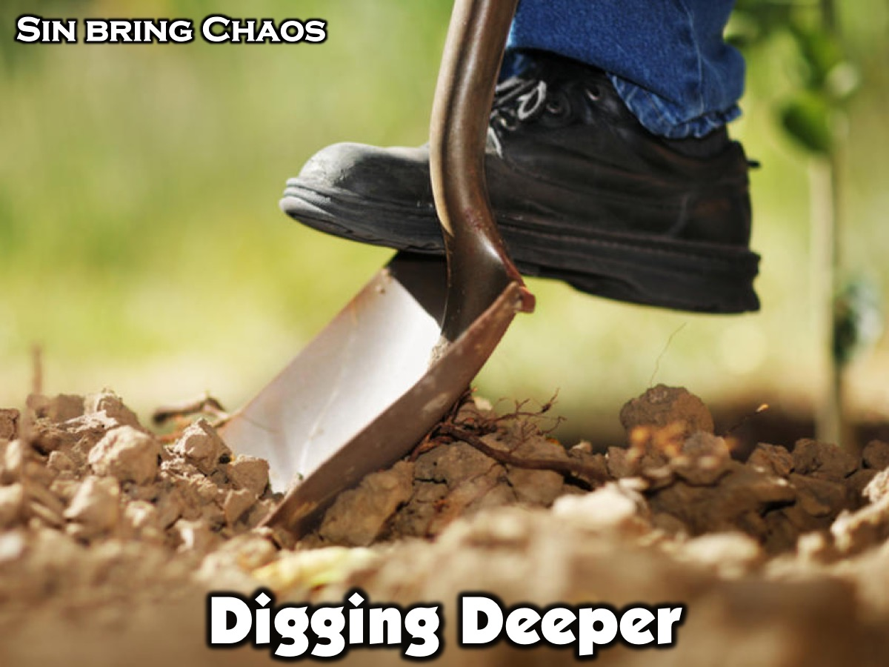
Notes:
Digging Deeper: Sin Brings Chaos (20 Minutes).

Slide 11
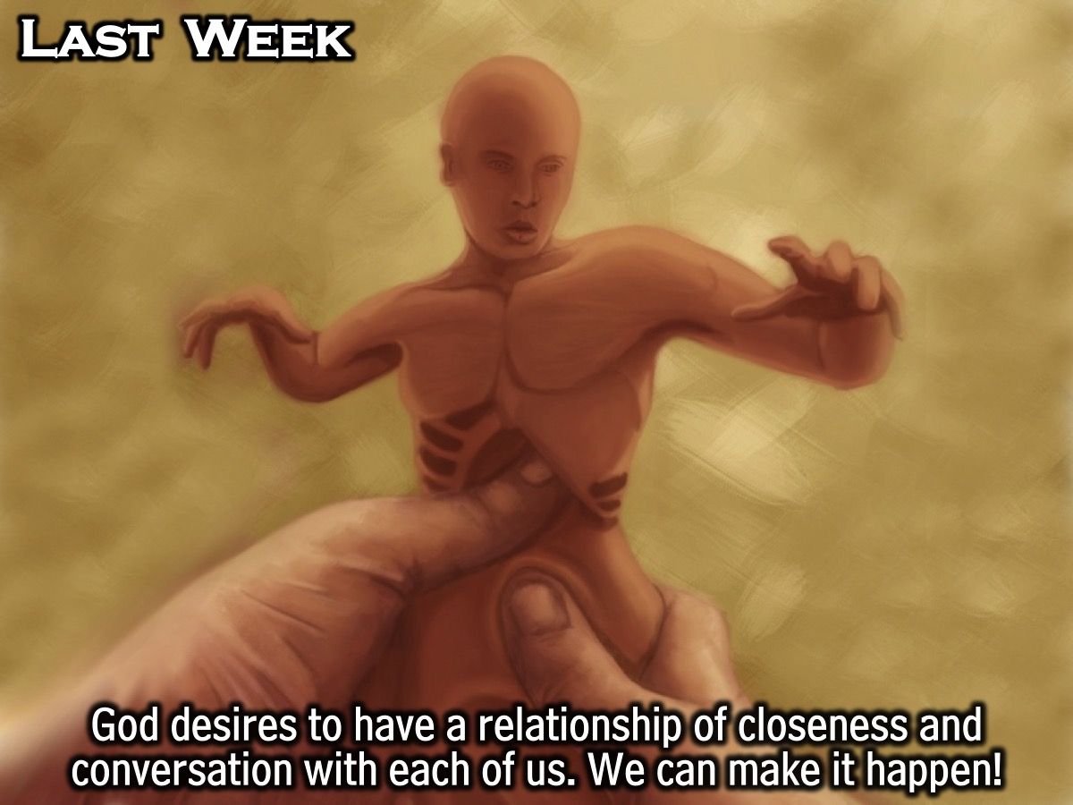
Notes:
Last week, we discussed how God desires to have a relationship of closeness and conversation with each of us. We also talked about ways that we can foster a closer relationship with God.

Slide 12
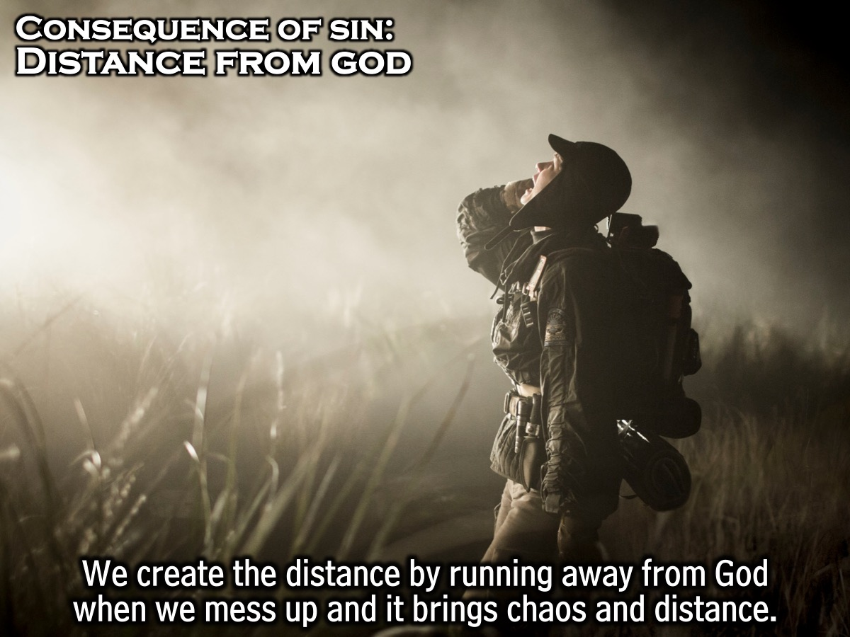
Notes:
Have you ever found that it is really hard to read your Bible or pray when you’re sinning? This is one of the consequences of sin: distance from God. The truth is that we create that distance. Think about it. What’s the first thing we tend to do when we mess up? Do we run away from or toward God? Most of the time when we sin, we are sinning either with someone or against someone. Sin can be anything we do that misses the mark of God’s purpose for us. Here are a couple of examples. Bullying someone at school is sinning against another person. Or, if you and your boyfriend/girlfriend are escalating your physical relationship, you’re sinning with someone but also against them. When we look at it this way, it is easier to see that sin will always bring chaos and distance into our relationships with others.

Slide 13
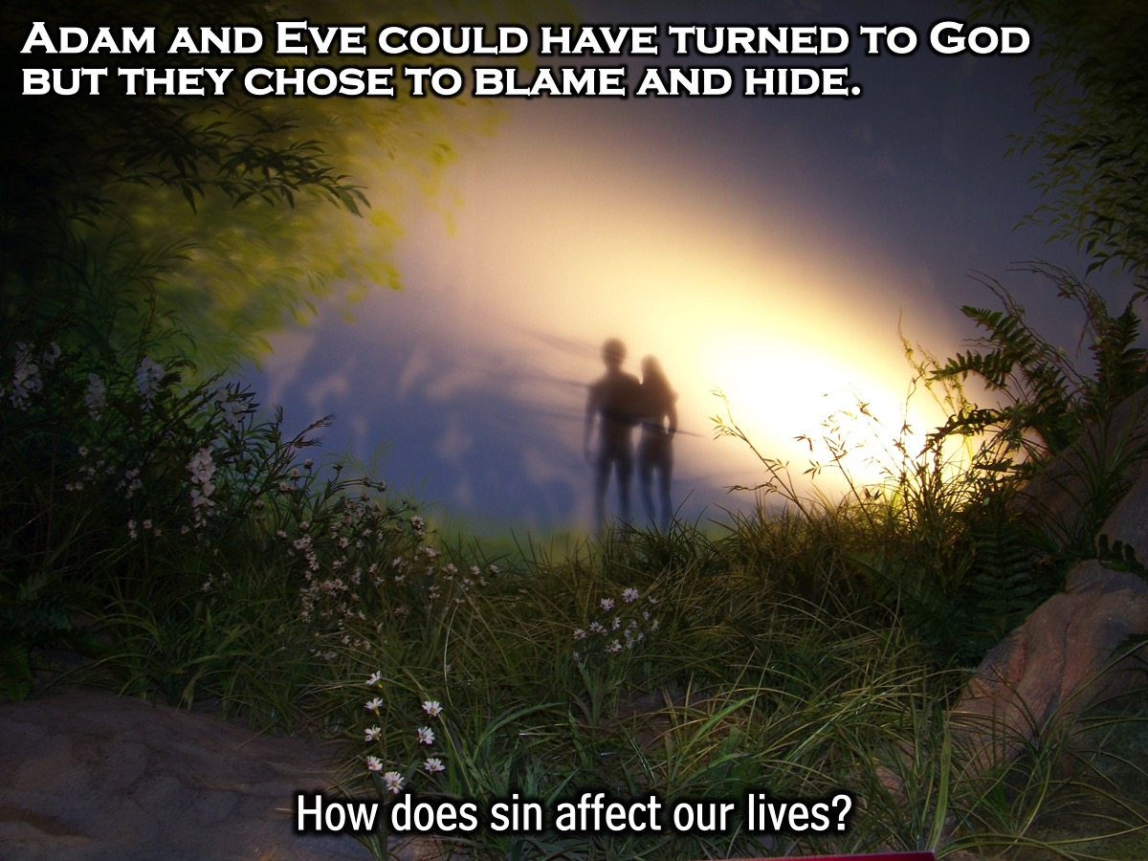
Notes:
If we look at the story of Adam and Eve in the garden, how is distance reflected in their relationship with God? Would you consider yourself someone who leads others toward God? But once we realize that sin separates us from God, it doesn’t end there. We have hope. Knowing that we all have sinned and we can’t fix ourselves, where do we turn for hope in these situations? Are we all just destined to ruin our lives by our sin? This is the very picture we have in a life without God, without Jesus. God pursues us before we even think to turn to Him. Adam and Eve had every chance to return to God by coming to Him with their sin and asking for forgiveness, but instead, they blamed others and even blamed God Himself. Discuss in your small groups some of the effects of sin in your life.

Slide 14
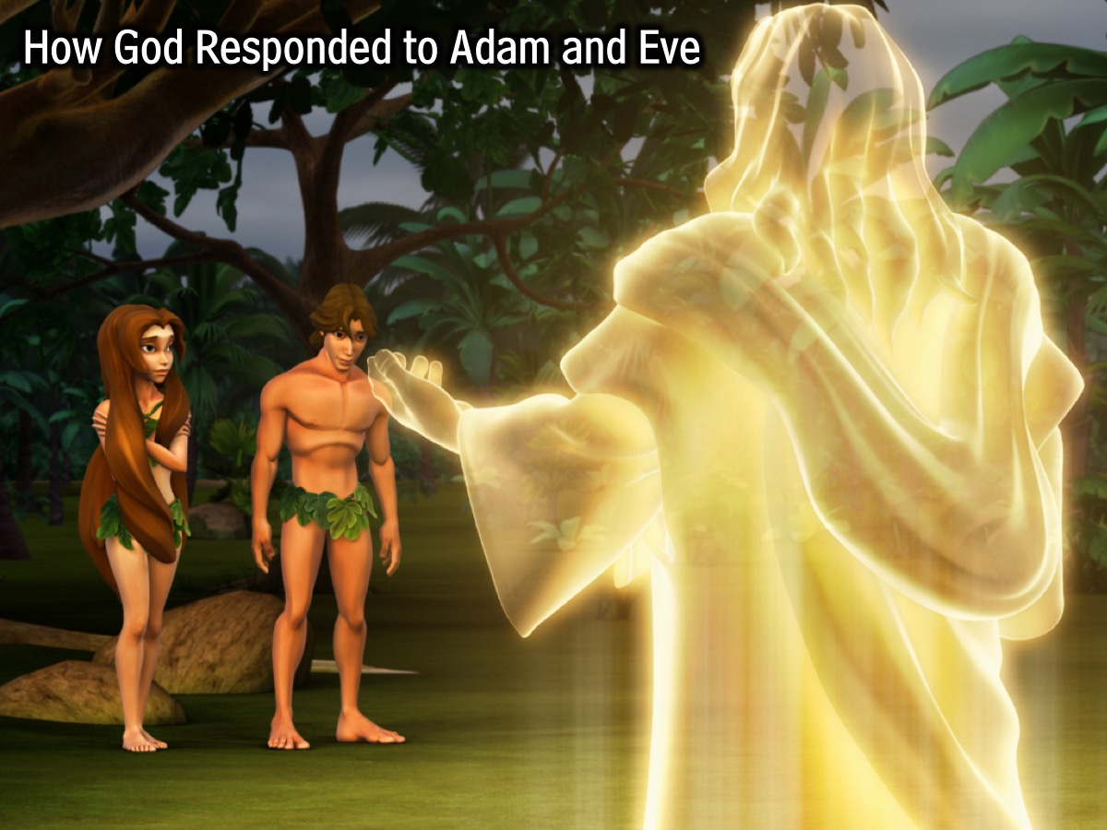
Notes:
Small Group Leader: (Gather students’ attention) Now that we have spent a few minutes looking at the sin that has affected our lives, we can take a look at God’s response to Adam and Eve’s sin.

Slide 15
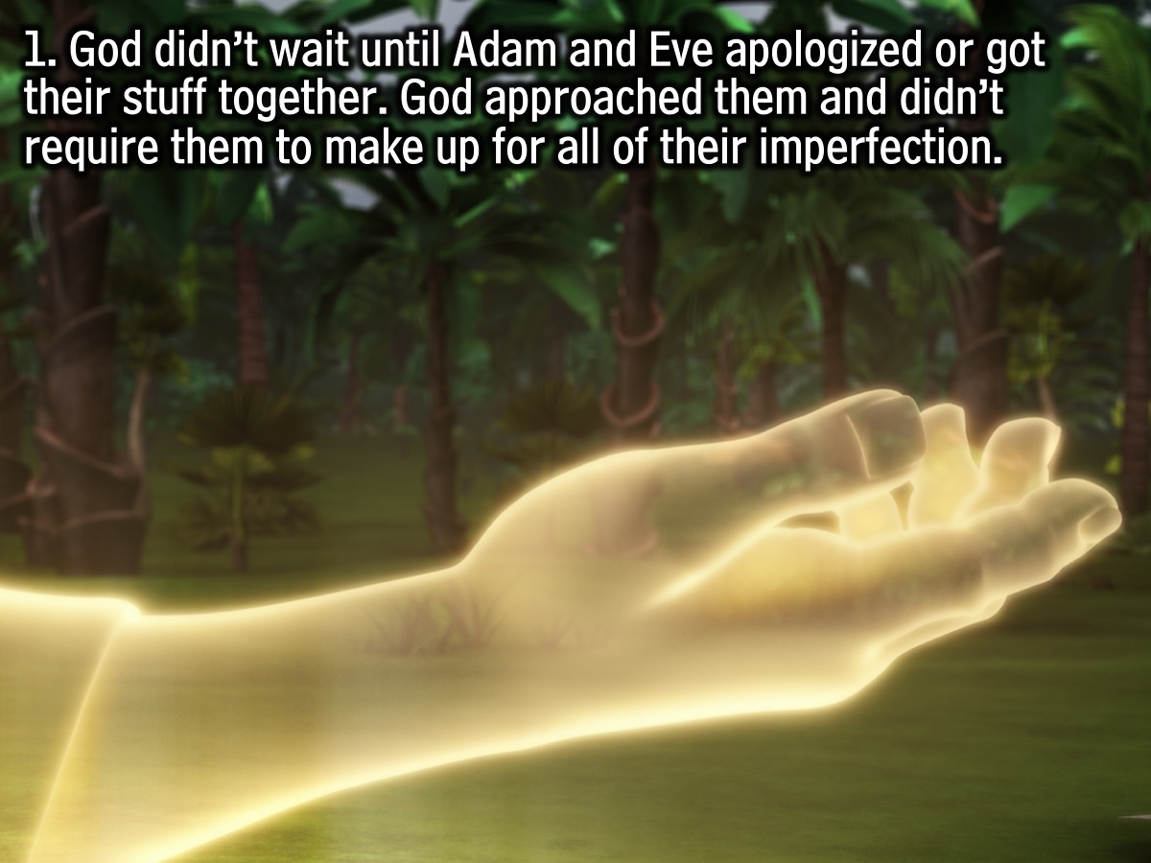
Notes:
1. The first thing we see is that God didn’t wait until Adam and Eve apologized. God didn’t wait until Adam and Eve got their stuff together. God approached them and didn’t require them to make up for all of their imperfection.

Slide 16
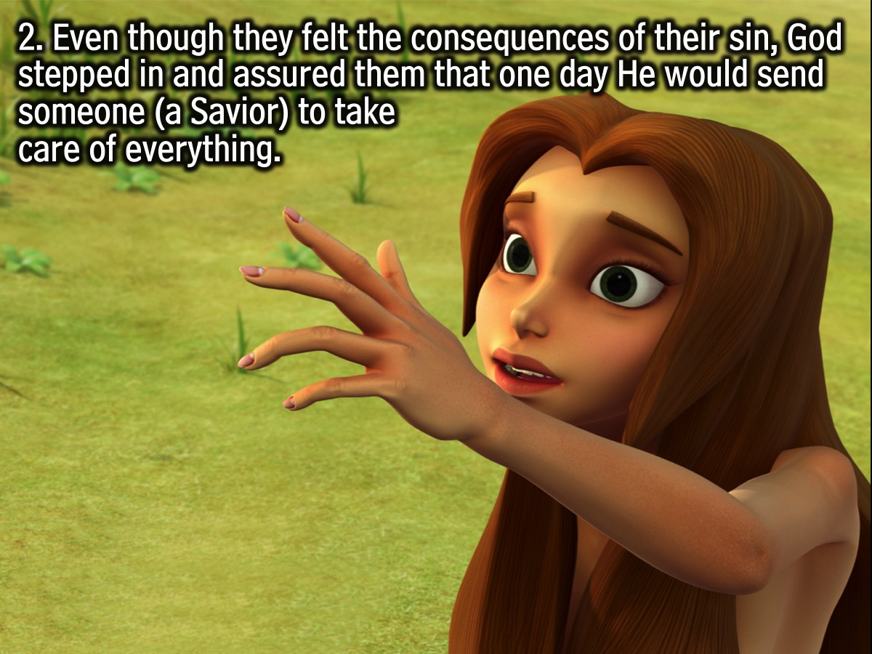
Notes:
2. Even though they felt the consequences of their sin, God stepped in and assured them that one day He would send someone ––a “Savior”––to take care of everything.

Slide 17
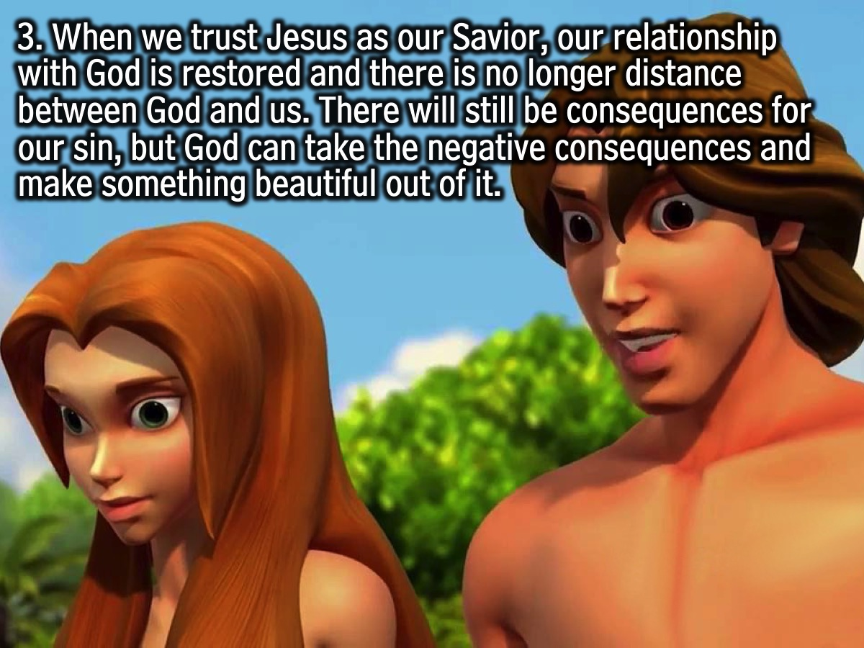
Notes:
3. When we trust Jesus as our Savior, our relationship with God is restored and there is no longer distance between God and us. There will still be consequences for our sin, but one thing that we can be assured of is that God can take the negative consequences and make something beautiful out of it.

Slide 18
Notes:
Let’s take a look at a person whose relationship with God has been restored even though the consequences of sin were still present.
Video: Gus’ Testimony.

Slide 19
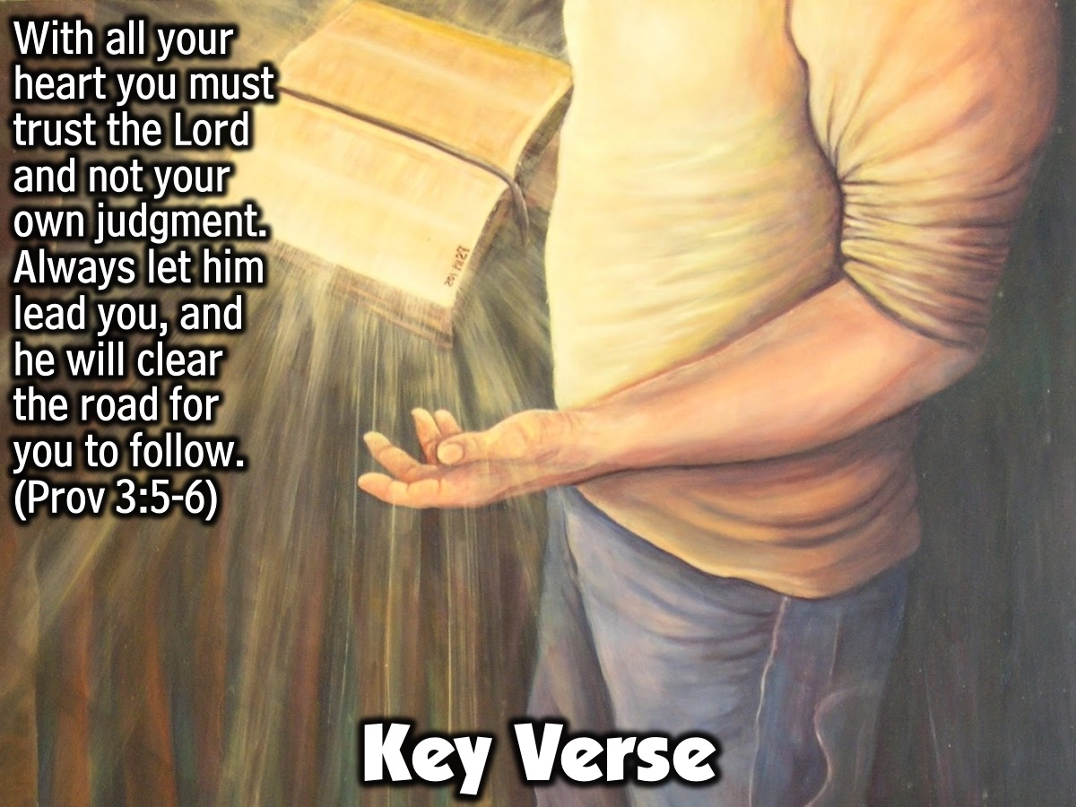
Notes:
Key Verse: With all your heart you must trust the Lord and not your own judgment. Always let him lead you, and he will clear the road for you to follow. (Proverbs 3:5-6)

Slide 20
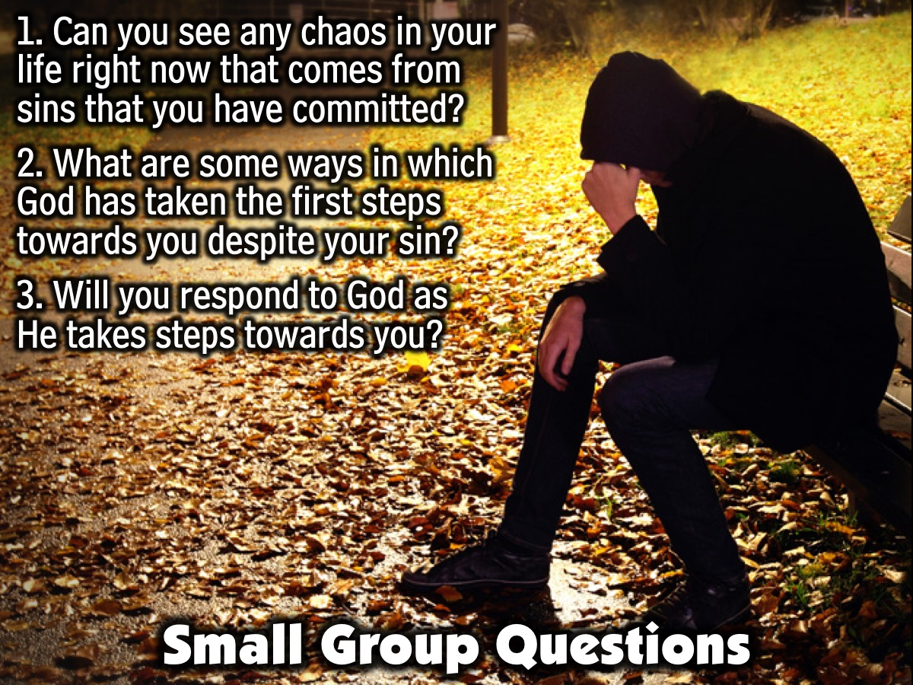
Notes:
Small Group Questions: (1) What does God’s way of creating man and preparing the world for man show us about how God views human beings? Does knowing that God created you to have a relationship with Him change the way you view God? Possible Answer: It Tells Us That We Are Special To God And That We Are Worth His Time. We Are Valuable. (2) If all of this is really true and God made all humans with this sense of worth, how does this change your opinion of someone you don’t like much? Why? Possible Answer: If God Says All People Are Valuable, Then I Should Believe That As Well And Treat People Based On How God Views Them. (3) What type of relationship is God desiring to have with you? What are some things you can do in order to make your relationship with God a more intimate one? Possible Answer: God Wants To Have A Personal, Intimate Relationship With Each Person On Earth. You can: (a) Read and study the Bible. This will help you get to know God’s thoughts and personality better. It’s kind of like someone telling you all about their life. (b) One of the best parts of being in a relationship is that both people communicate with each other. It’s a two way street. Praying to God helps keep the lines of communication open. (c) You can develop good relationships with people who have their own relationship with God. We all need solid people who love God around us to help us walk through life. This can be a leader or a friend your own age.

Slide 21
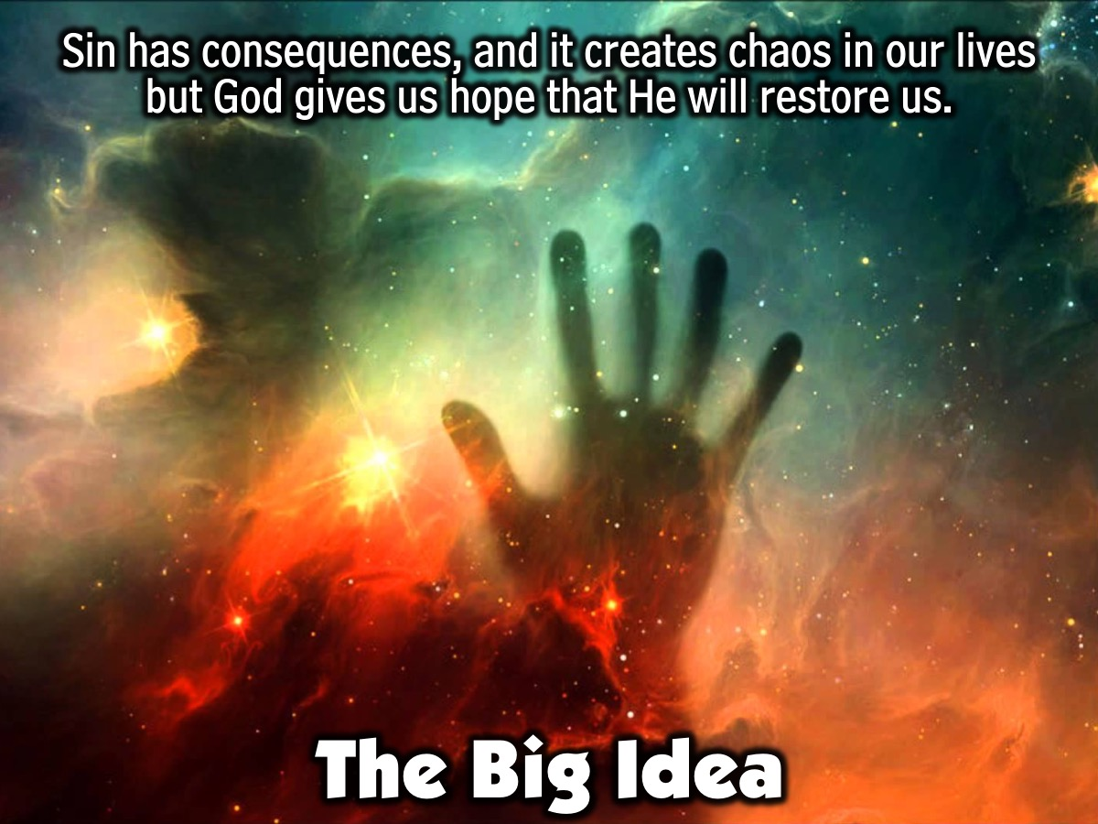
Notes:
The Big Idea: Sin has consequences, and it creates chaos in our lives but God gives us hope that He will restore us.

Slide 22
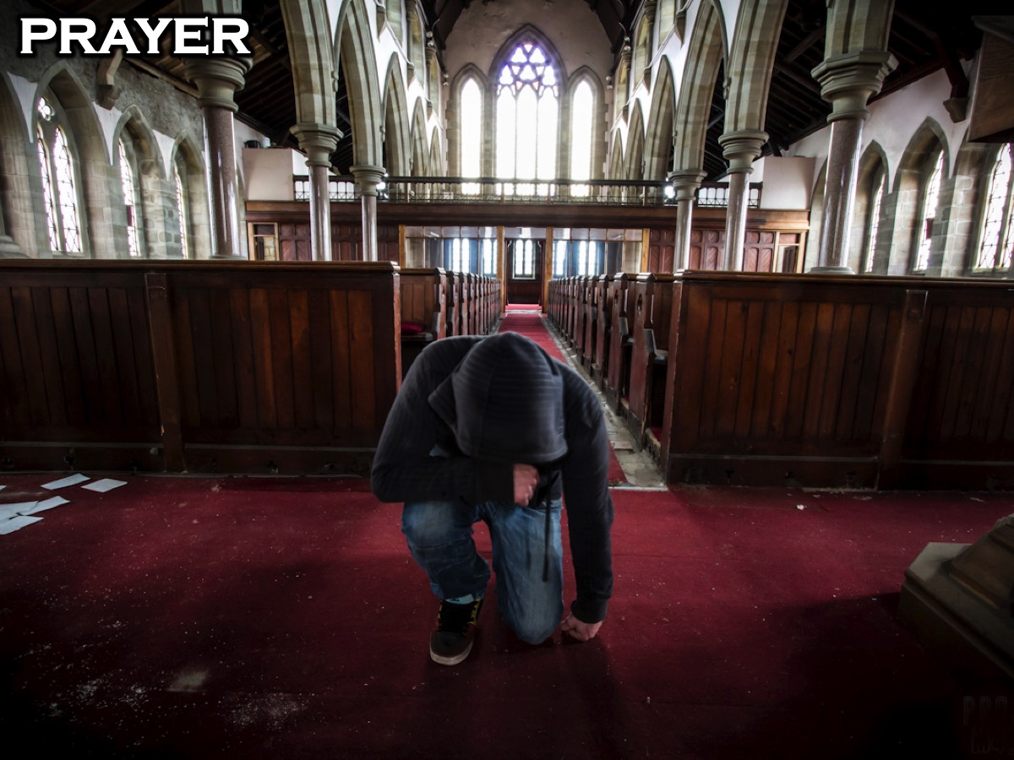
Notes:
Prayer: Use the closing prayer to remind students of God’s goodness in His desire to be near us in the midst of our sins. You can reference Romans 5:8.

Slide 23
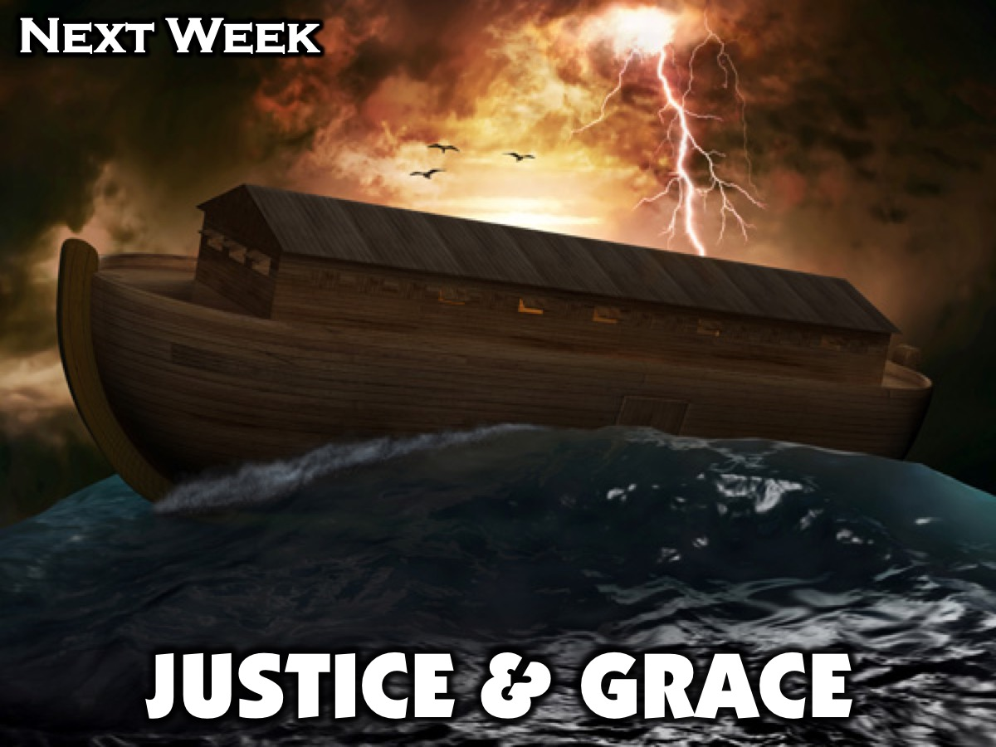
Notes:
Next week in session 3 we will be focusing on Justice and Grace.

