Slide 1
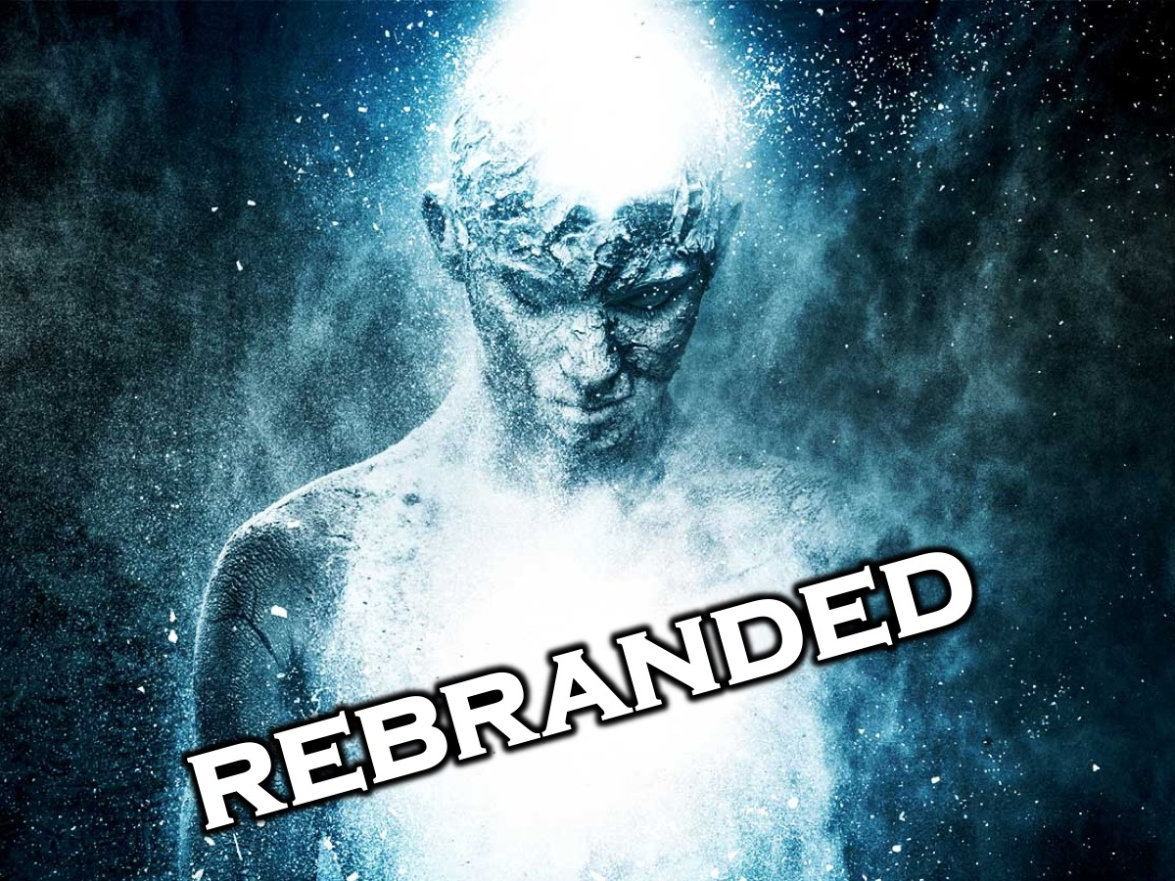
Notes:
Welcom to Rebranded.

Slide 2
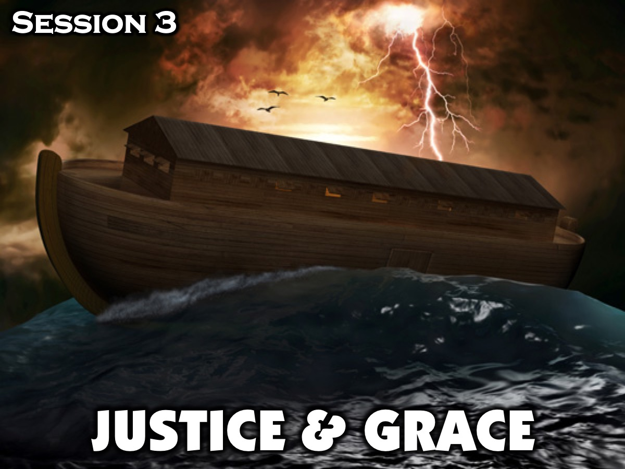
Notes:
This is Session 3: Justice & Grace

Slide 3
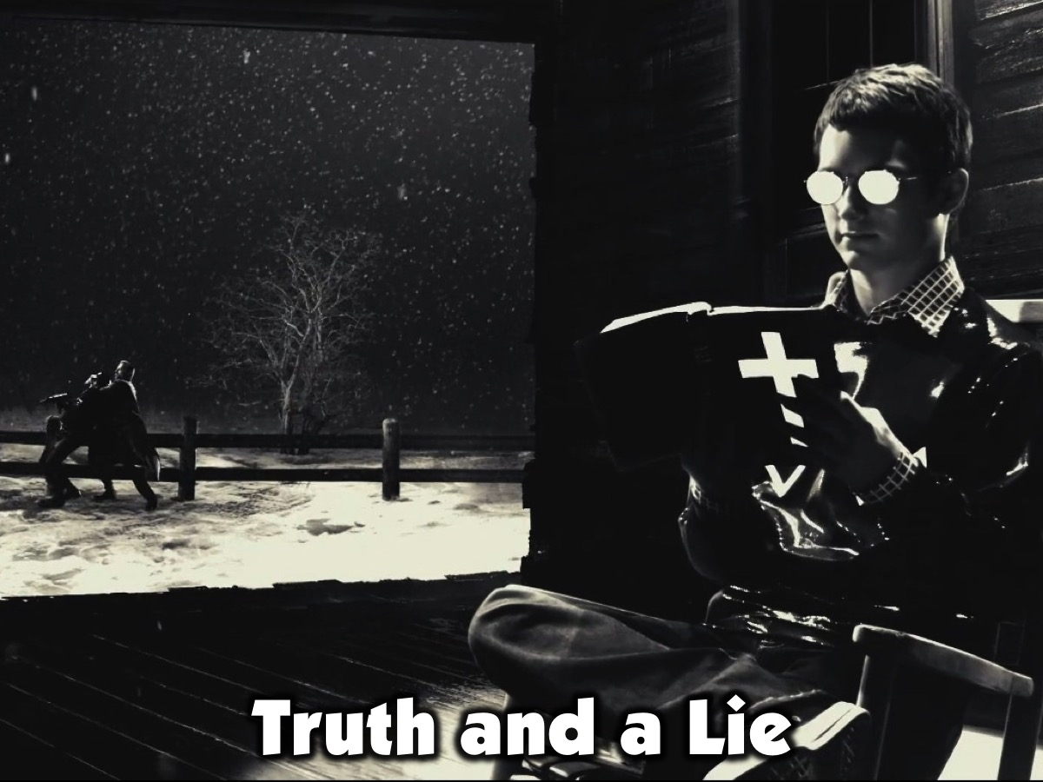
Notes:
Opening Exercise: Truth and a Lie (5 Minutes). Each person in the group shares one truth about themselves and 1 lie - the group has to try and figure out which is the lie and which is the truth. Leader: How well were people able to lie? Why doe we find it easier to tell a lie than the truth sometimes?

Slide 4
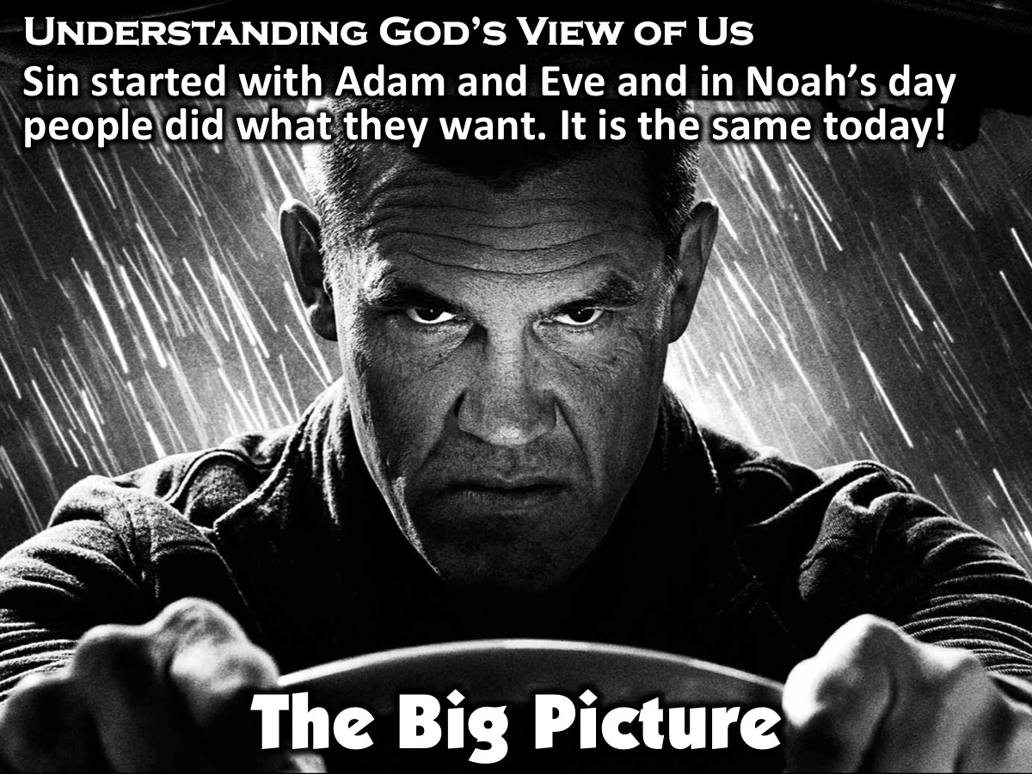
Notes:
The Big Picture: Understanding God’s View of Us (5 Minutes). Back in Noah’s time, everyone did what they wanted, despite what it meant for others around them. Adam and Eve’s sin had been passed on to all humans. Noah’s story sounds kind of similar to our day doesn’t it? Just look around. Our schools, our neighborhoods, our cities, and even our country are filled with people that treat life the exact same way. They do what they want and completely ignore how it affects others around them.

Slide 5
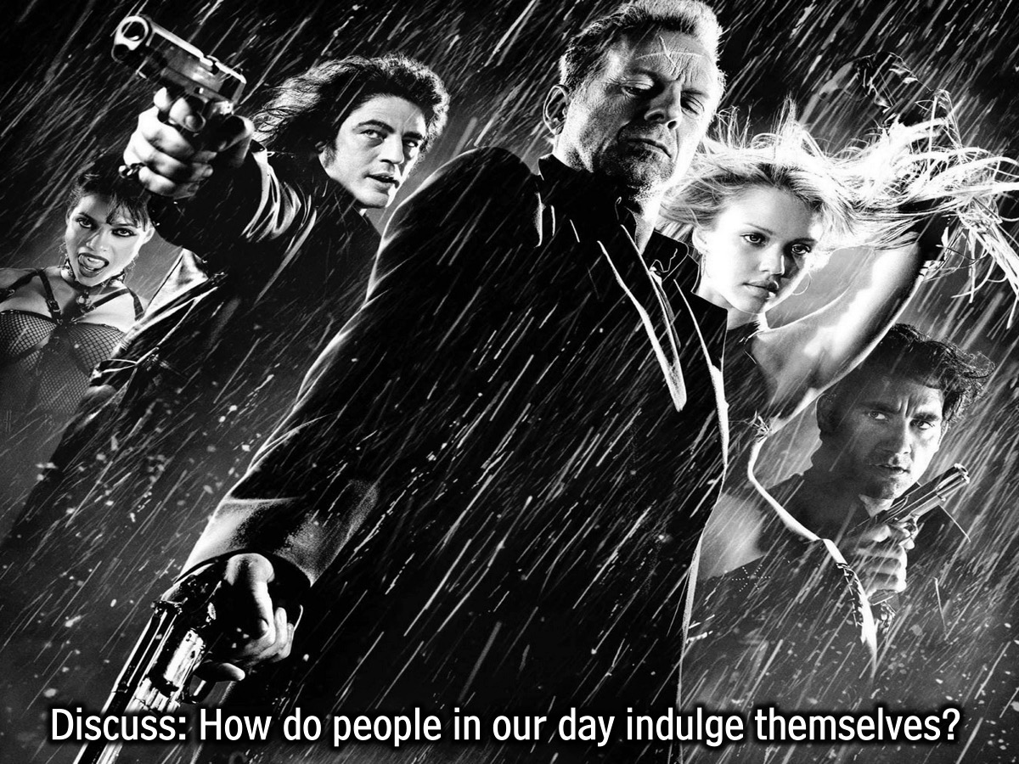
Notes:
Discuss in Pairs: Take some time in your small groups to discuss the ways people, including all of us, indulge themselves. Note: We want to get them thinking about what they have in common with people in Noah’s time. We want them to realize that sin is sin, and as the previous lesson states, it separates us from God.

Slide 6

Notes:
Video #1: Lets Take A Look At A Music Video About the Flood.

Slide 7
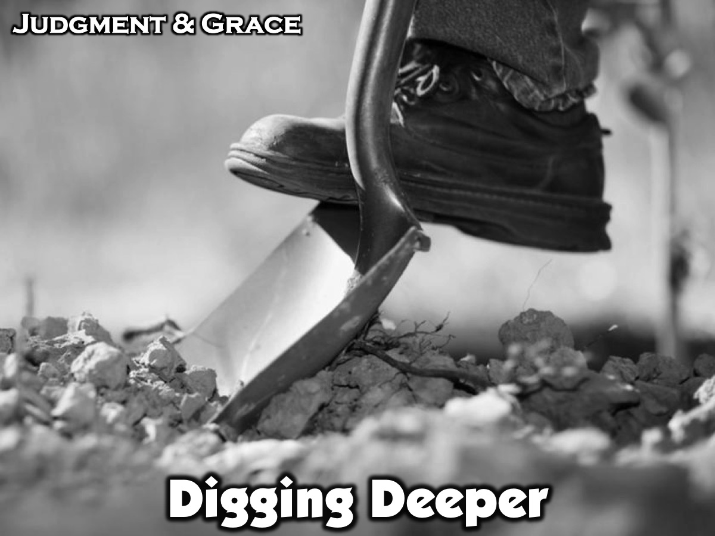
Notes:
Digging Deeper: Judgment & Grace (20 Minutes).

Slide 8
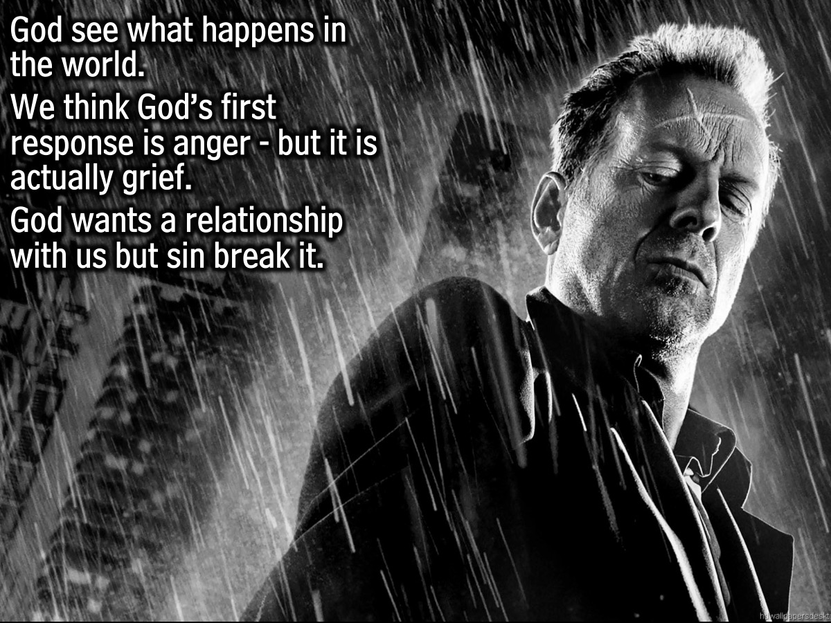
Notes:
In Focus: Judgment & Grace (20 Minutes)
God takes notice of what’s going on in the world. Since He created it, He is intimately invested in His creation, which includes you and me. He sees the sin in the world. Does it ever feel like God isn’t looking or that He doesn’t care? Those who believe that God sees everything often believe that God’s first response to sin is anger. That is not the case. In reality, God’s first response is grief. Again, He is not a referee that’s upset with us simply because we broke the rules. No. God desires a relationship with us. When we sin, it breaks the relationship that He created us to have with Him. It keeps us from hearing Him and obeying His Word, which ultimately brings us peace and freedom. God knows the kind of relationship you could have with Him and how fulfilling that relationship could be. That is why God’s first reaction to sin is grief. When a mother finds out that her son has cancer, she is struck with grief, because she knows his life will never be the same. The only thing different about this kind of grief is that her son didn’t choose to have cancer. We, however, often choose to sin, which breaks down the relationship we could have with God. He is struck with grief as He sees His creation, you and me, dying of this disease called sin. And just like the mother, whose son is dying of cancer, would give anything if it meant her son could be healed, even so God gave everything, even His own Son Jesus, to give us the opportunity to spend eternity with Him.

Slide 9
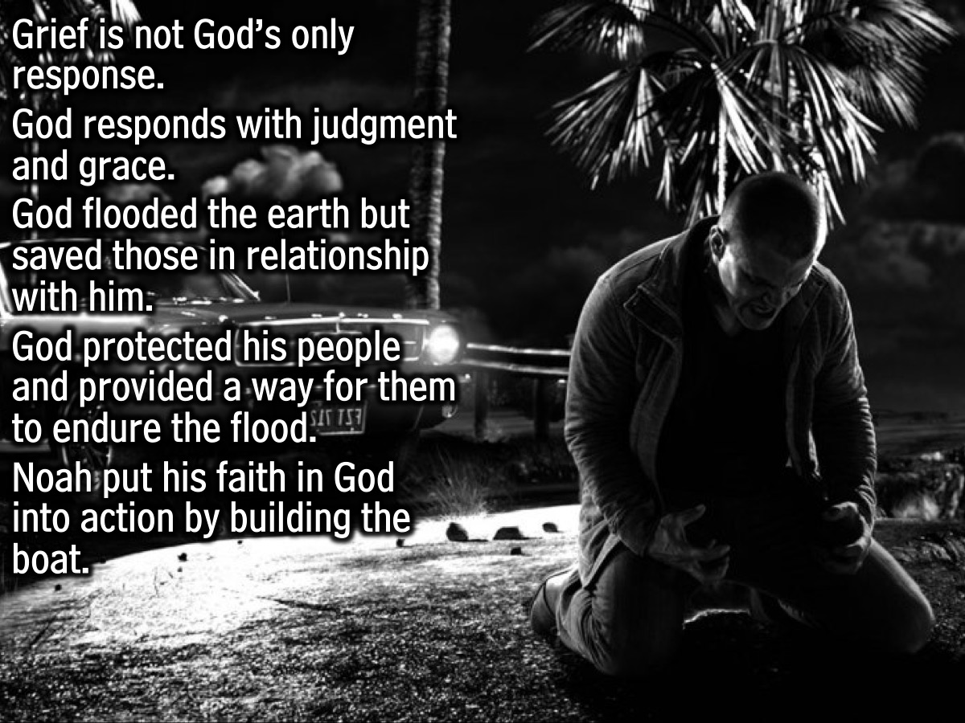
Notes:
While grief is God’s first response to sin, it’s not His only response. He responds with both judgment and grace. In this story, God responded to the sin of those who disobeyed, rebelled, and ultimately didn’t want a relationship with Him by flooding the entire earth. There is ultimately a judgment. God saved those who had a relationship with Him. God protected His people, and He provided a way for them to endure the flood. It wasn’t easy. It took Noah many years to build the boat that God used to protect him. Noah had to put his faith in God into action by building the boat.

Slide 10
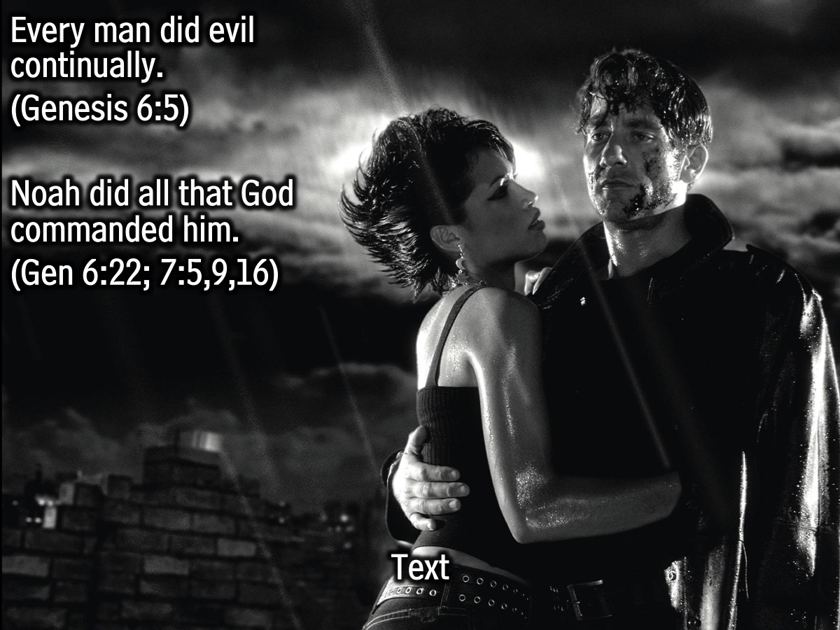
Notes:
Genesis 6:5 says, “Every man did evil continually.” People were content with living for themselves, setting their own course for their lives, but Noah did all that God commanded Him (Genesis 6:22; 7:5, 9, 16).

Slide 11
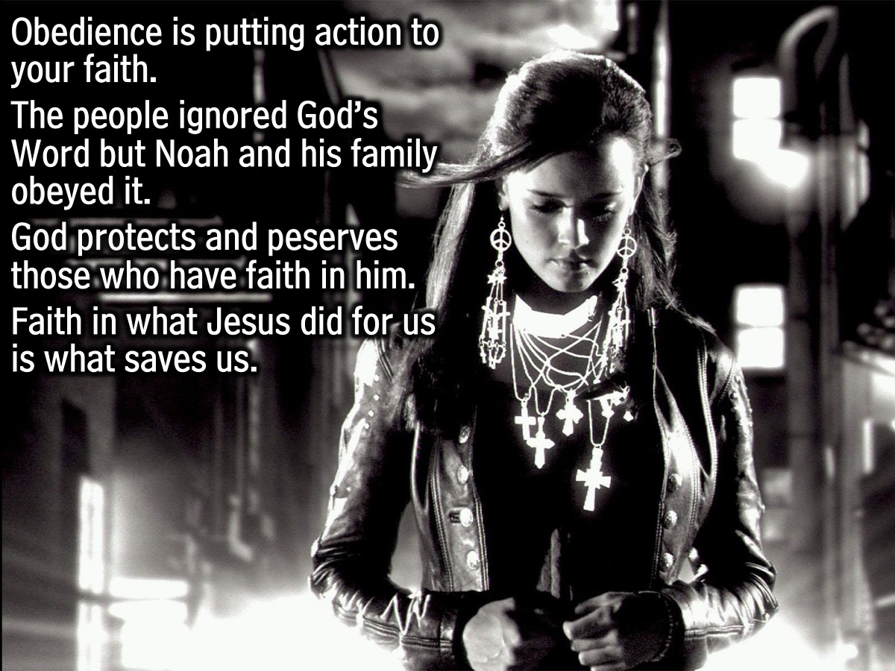
Notes:
Obedience is a by-product of faith (Hebrews 11:7). If you have faith in God as your protector, then He may ask you to build a boat that won’t see a drop of water for many years. Obedience is putting action to your faith, even when it doesn’t seem to make sense. God takes care of His own people, but how does someone know if they are part of God’s people? The only difference that we see in this story between Noah and the other people is how they responded to the Word of God. One group ignored God’s Word, which shows a lack of faith in God, while Noah and his family obeyed God’s Word. They put their faith into action. God protects and preserves those that have faith in Him. We don’t have to fear God’s judgment (much like Noah), because God has provided a way for all of those who have faith in Him to be freed from the consequence of sin, through Jesus. God’s protection is not limited by how good you are.

Slide 12
Notes:
Let’s watch a video about the life of a person who has experienced God’s protection first hand.
Video: Jacy’s Testimony.

Slide 13
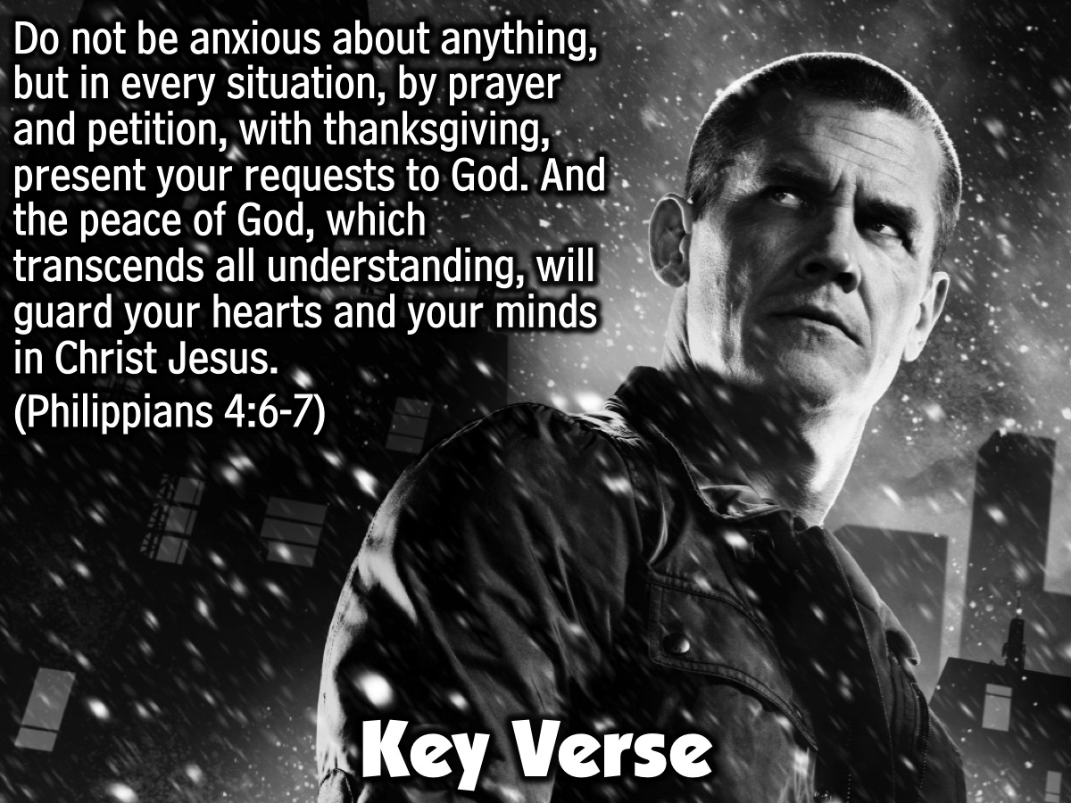
Notes:
Key Verse: With all your heart you must trust the Lord and not your own judgment. Always let him lead you, and he will clear the road for you to follow. (Proverbs 3:5-6)

Slide 14
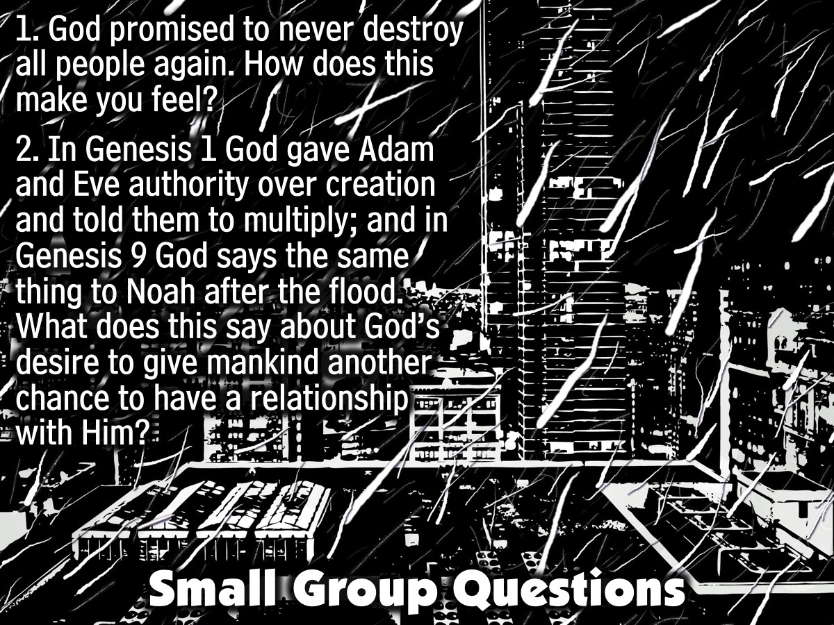
Notes:
Before we leave, take the last 10 minutes to discuss some questions with your small group: (1) God promised to never destroy all people again. How does this make you feel?
(2) In Genesis 1 God gave Adam and Eve authority over creation and told them to multiply. In Genesis 9 God says the same thing to Noah after the flood. What does this say about God’s desire to give mankind another chance to have a relationship with Him?

Slide 15
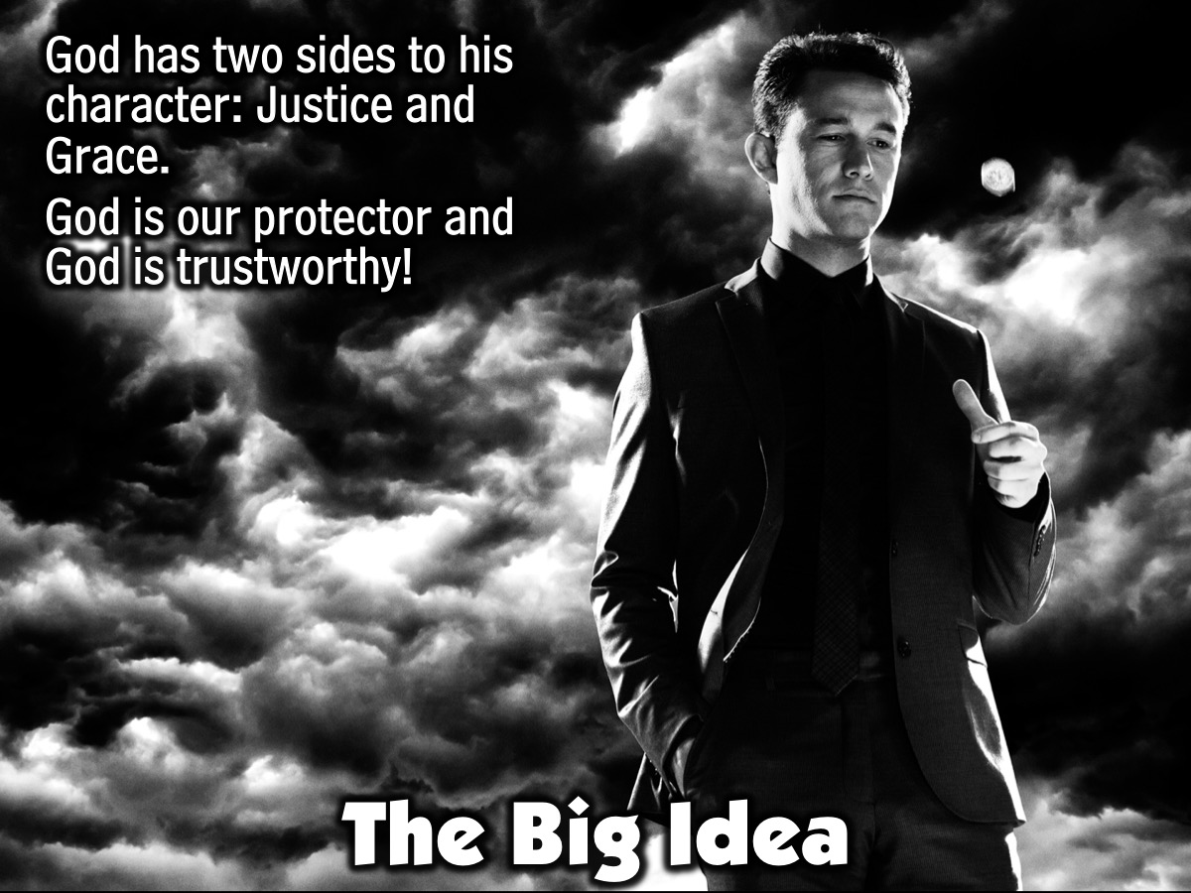
Notes:
The Big Idea: God has two sides to his character: Justice and Grace. God is our protector and God is trustworthy!

Slide 16
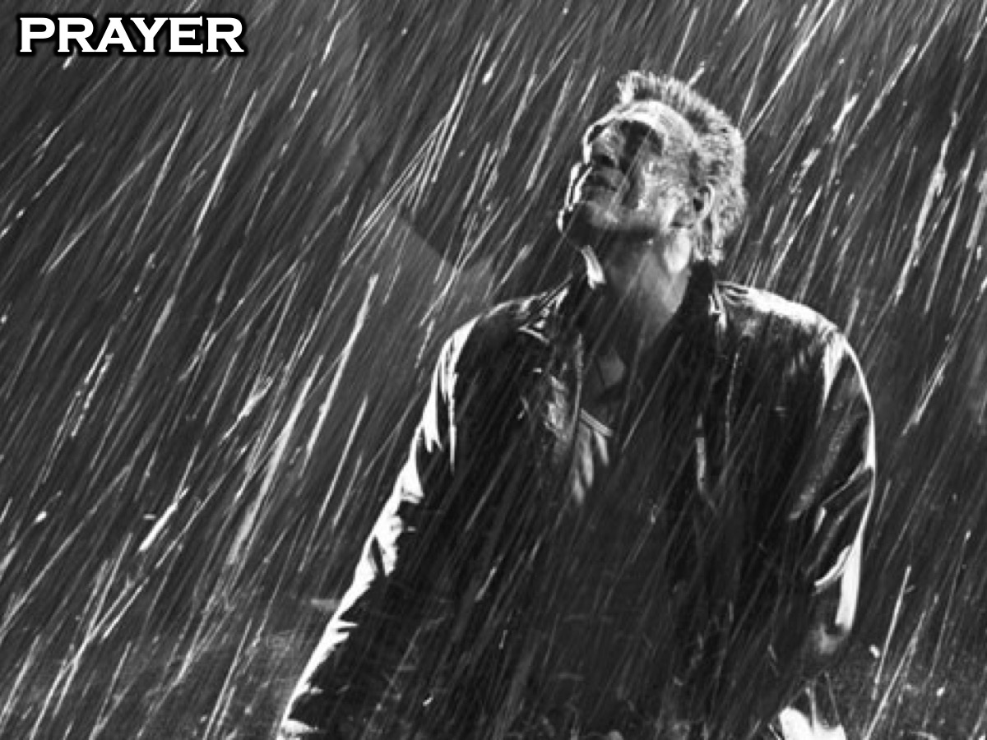
Notes:
Prayer: Pray that the students would see God’s protection in their lives and put action to their faith in obedience to Him.

Slide 17
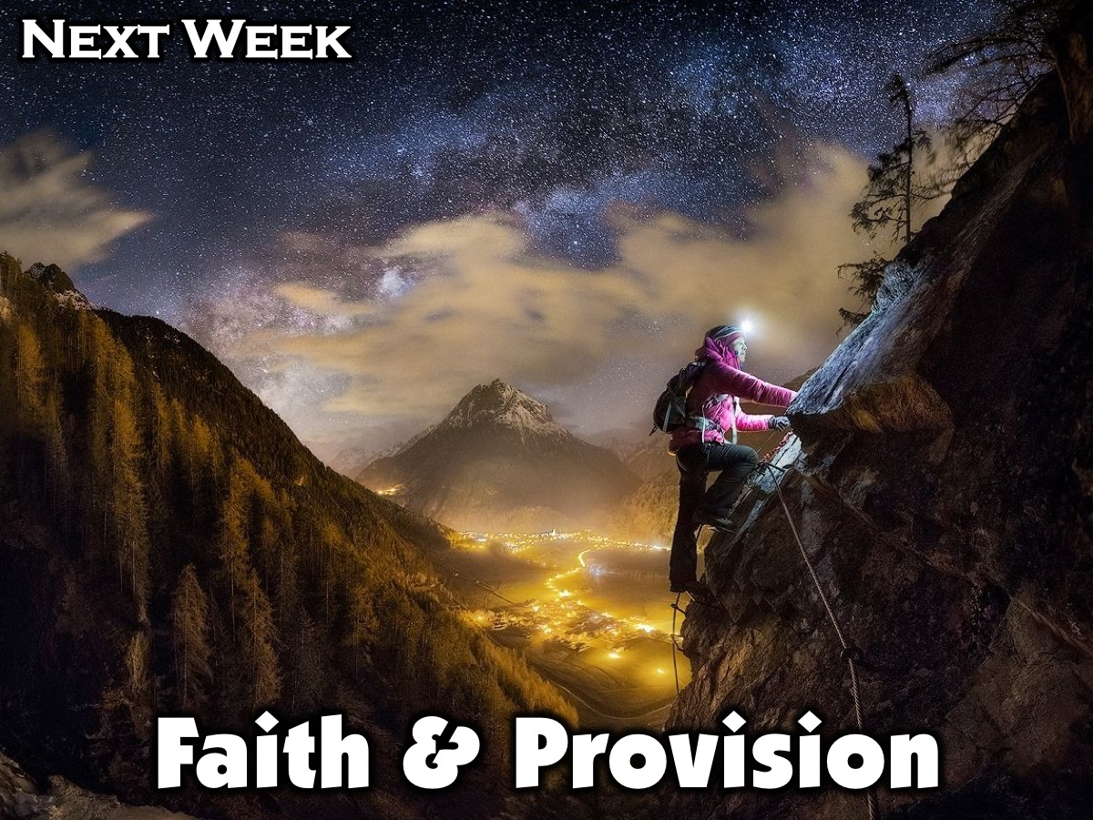
Notes:
Next week in session 4 we will be focusing on Faith & Provision.

