Slide 1

Notes:
Welcom to Rebranded.

Slide 2
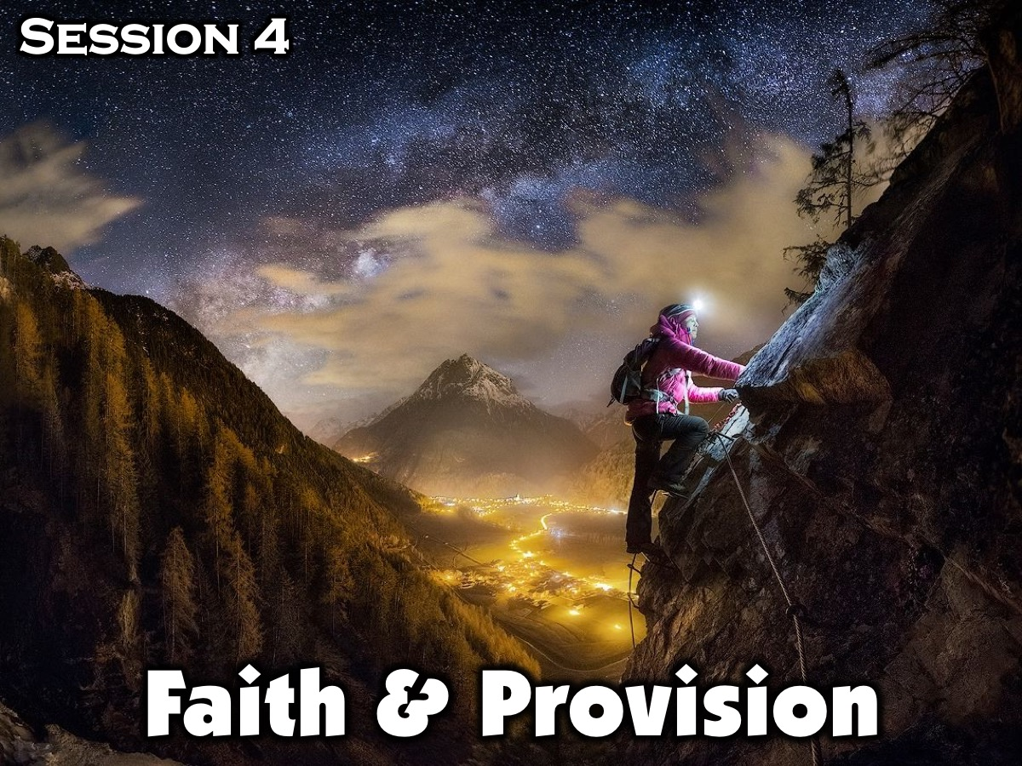
Notes:
This is Session 4: Faith & Provision

Slide 3
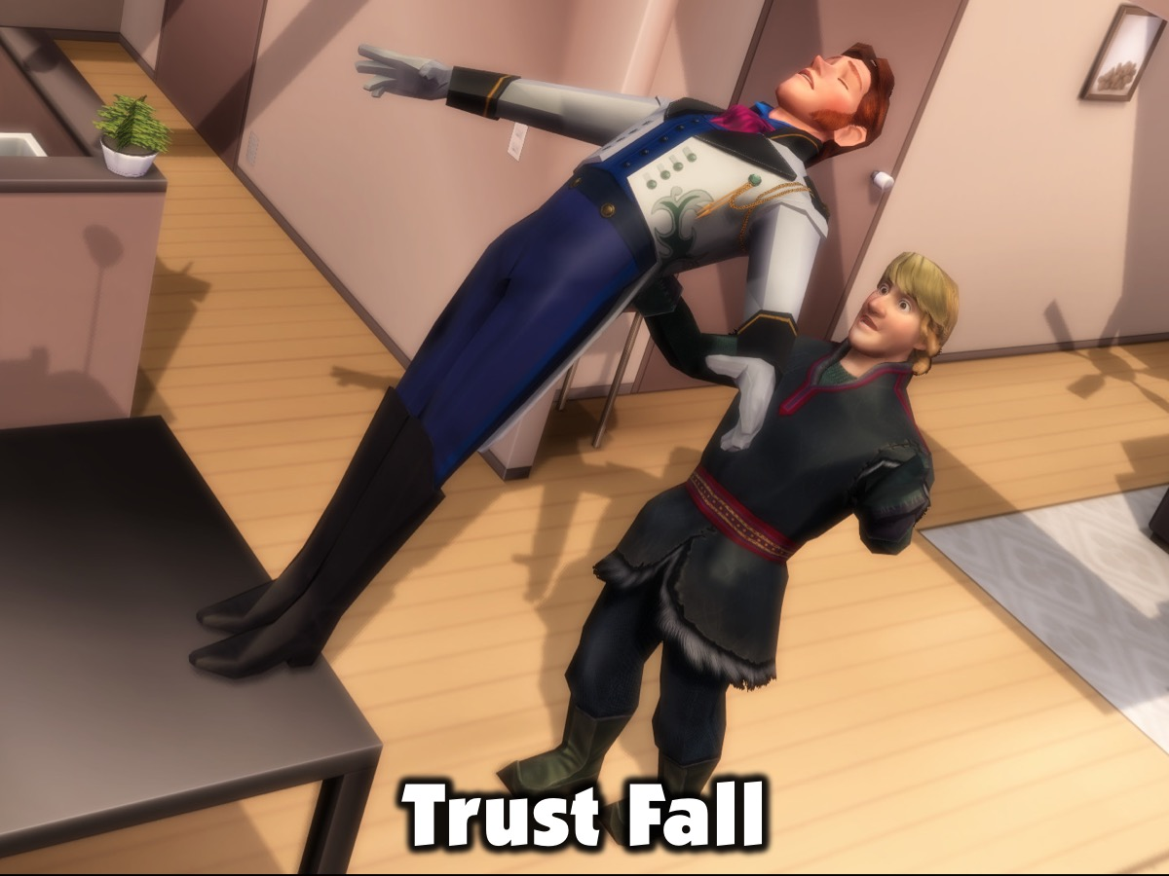
Notes:
Opening Exercise: Trust Fall (10 Minutes). Break into pairs. One partner stands with his back to the other with his hands at his side and tells his partner when he is going to fall backwards. When he falls his partner catches his and gently lowers him to the ground. Partner can stand close together to start with and then increase the distance between them as they become more confident with themselves and each other.

Slide 4
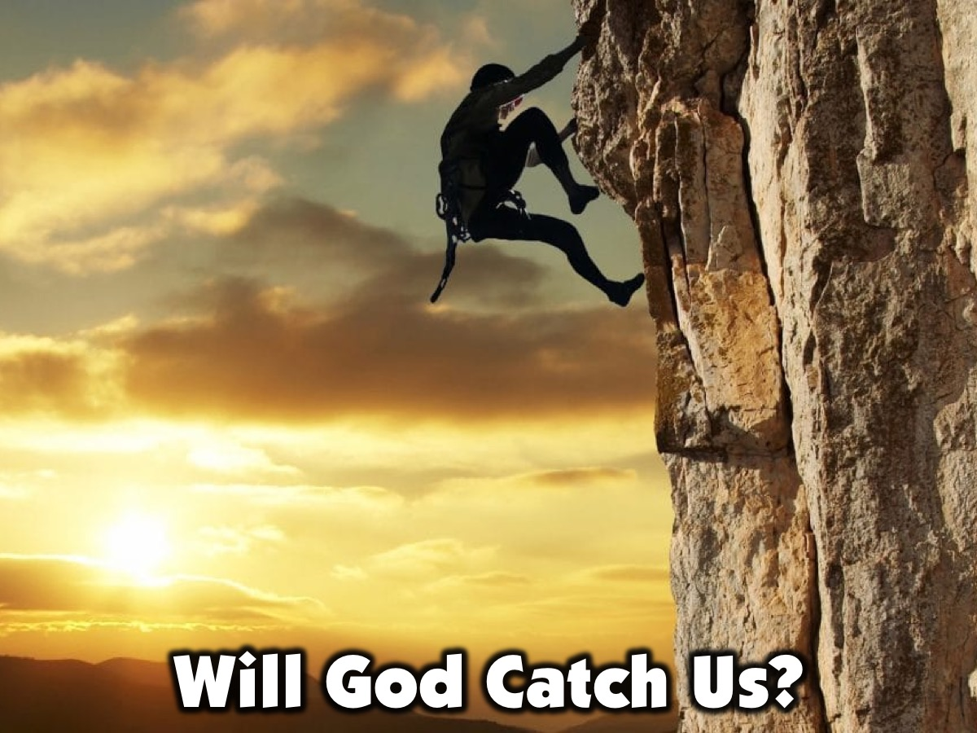
Notes:
Leader: Some of you may have decided to catch yourself before you fell. This is a great example for our lives. We sometimes lack faith in others, and we think that the person responsible for catching us might let us fall. We don’t believe they will be there for us. Many times, that it how we feel about God. We can’t see Him. So how are we supposed to believe He will catch us?

Slide 5
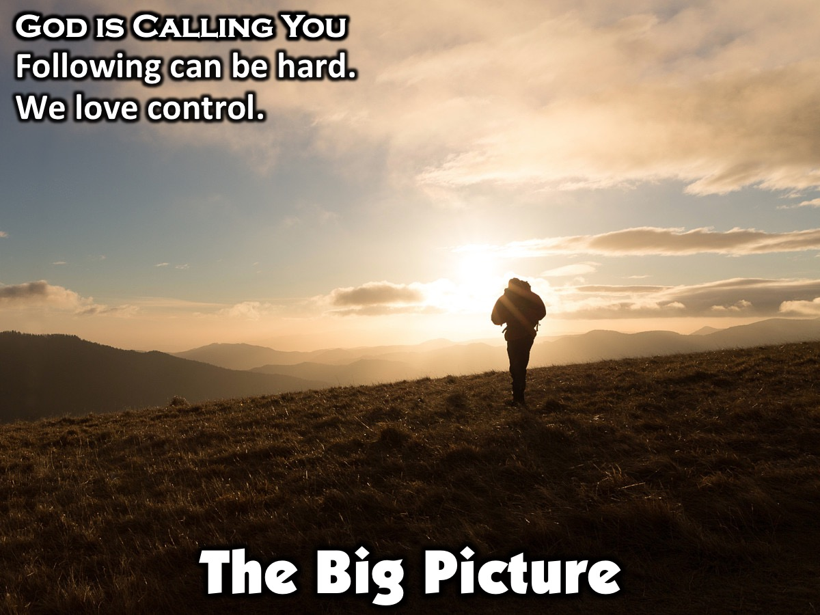
Notes:
The Big Picture: God is Calling You (5 Minutes)
Regardless of where you are in life, how old you are, or what you look like, God calls all people to follow Him. Following God is often hard, because sacrifice lies at the heart of what it means to follow Him. The funny thing about us is that we love to have control. Even those who are not professed control freaks don’t just give up every detail in their lives very easily. Most of us try to figure out how everything will work out in the end, before we will obey and follow God.

Slide 6
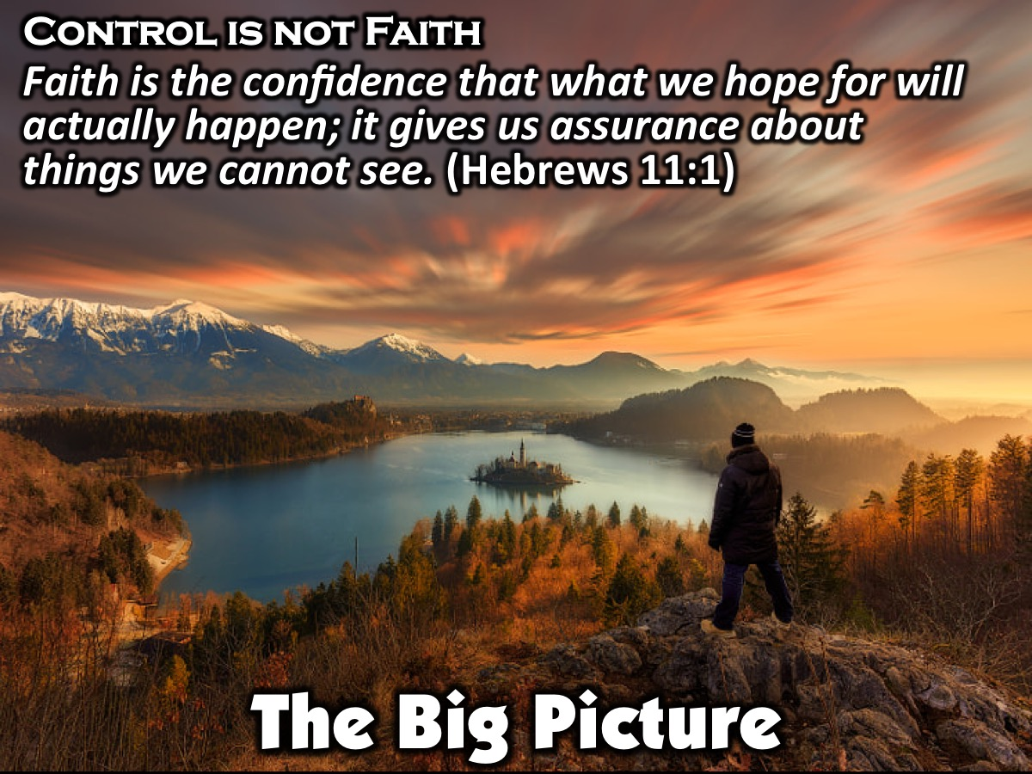
Notes:
The truth is that trying to have complete control is not faith at all. Hebrews 11:1 gives us a definition of faith: “Faith is the confidence that what we hope for will actually happen; it gives us assurance about things we cannot see.” By this definition, true faith comes by obeying the step that God asks us to take, in that moment. God blesses obedience that is produced by faith.

Slide 7

Notes:
Video #1: Lets watch a video about Abraham.

Slide 8
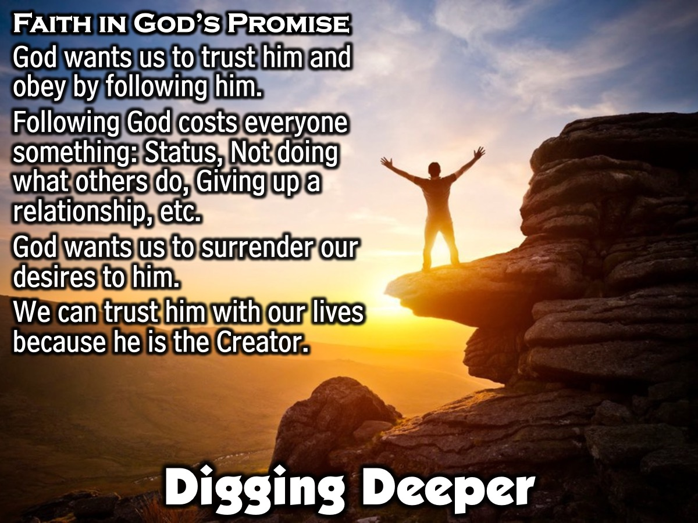
Notes:
In Focus: Faith in God’s Promise (20 Minutes)
For many people, faith is not something that is understood, let alone practiced. Here we will explain faith, as God sees it, and show how obedience, as a result of faith, provides good for us regardless of the outcome. What does true faith look like? God wants us to trust Him and obey by following Him. Following God costs everybody something. For you, it may mean losing your status of popularity, not participating in things because you want to be a good example for your siblings, or giving up a relationship with a boyfriend or girlfriend. The bottom line is that real faith results in trusting God even when we don’t know how the story is going to turn out. He wants us to surrender our desires and our false sense of security to His perfect way of doing things. When we have faith that God cares for us and can do the impossible, it makes it easier to surrender our desires to Him. Because He is the Creator, He knows everything. Think about it. Do you know every hair on your head or every cell in your body and how it works? He knows infinitely more than we do and sees things we can’t. He not only knows the outcome of things before they happen but makes it so that we don’t know the outcome yet. Let’s talk in our groups about why we think God might not want us to know how things are going to play out.

Slide 9
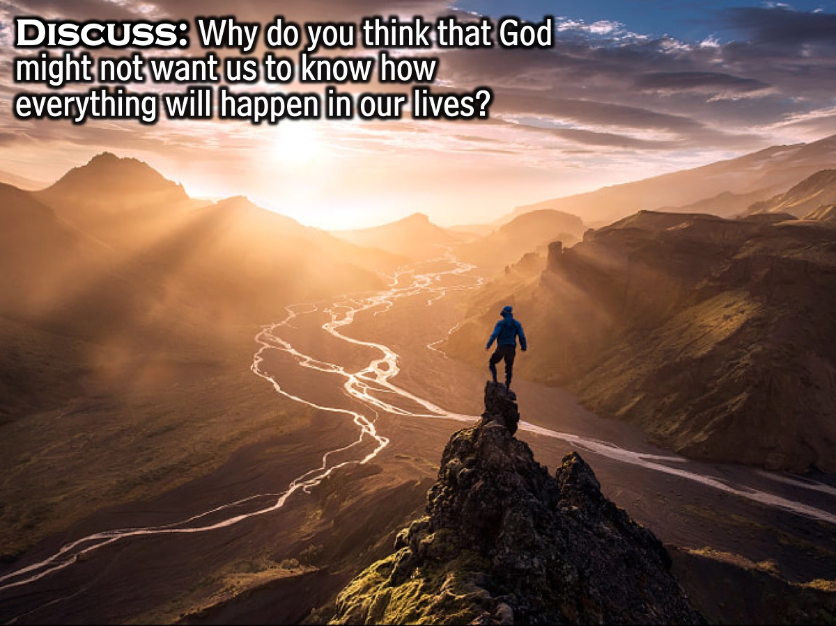
Notes:
Discuss in Pairs: Why do you think that God might not want us to know how everything will happen in our lives?

Slide 10
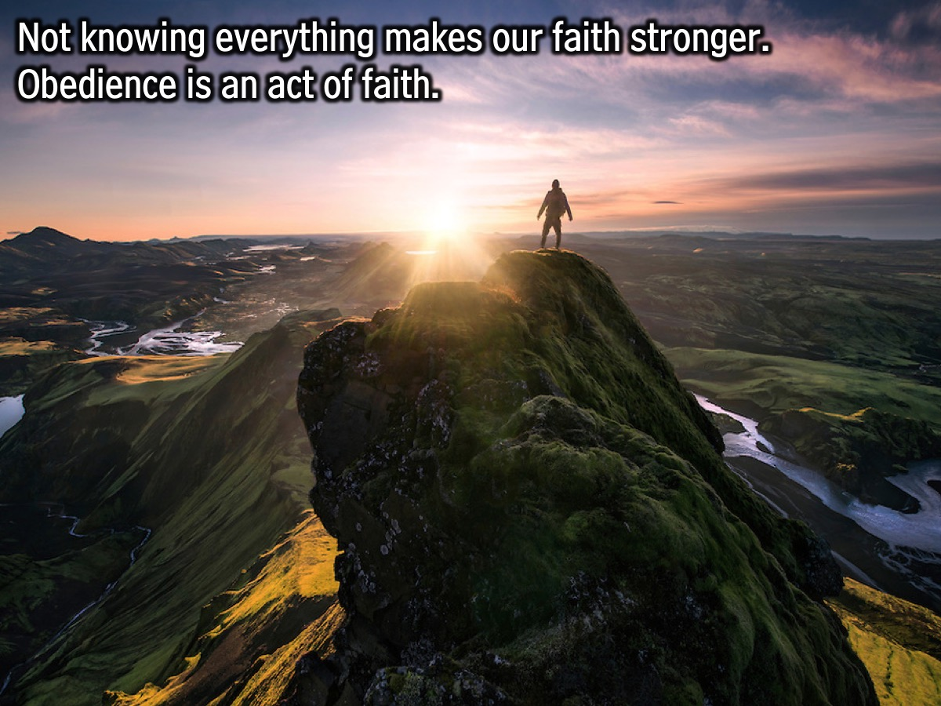
Notes:
Leader: Now that you’ve discussed this with your group, let’s see if your thoughts line up with this idea. One reason God does this is so that He can make our faith in Him stronger. Following God by faith without the details in this way brings us to a deeper level of trust and belief in Him. Let’s look at it like this: if I was going on a road trip, and I got my map out to highlight the path I want to take, but decided I didn’t want to go until I knew every speed bump that would come my way. I would never leave my house, would I? That tends to be what we do with God. We want to know every situation that will come up before we even take the first step of obedience, but at that point our obedience wouldn’t be an act of faith.

Slide 11
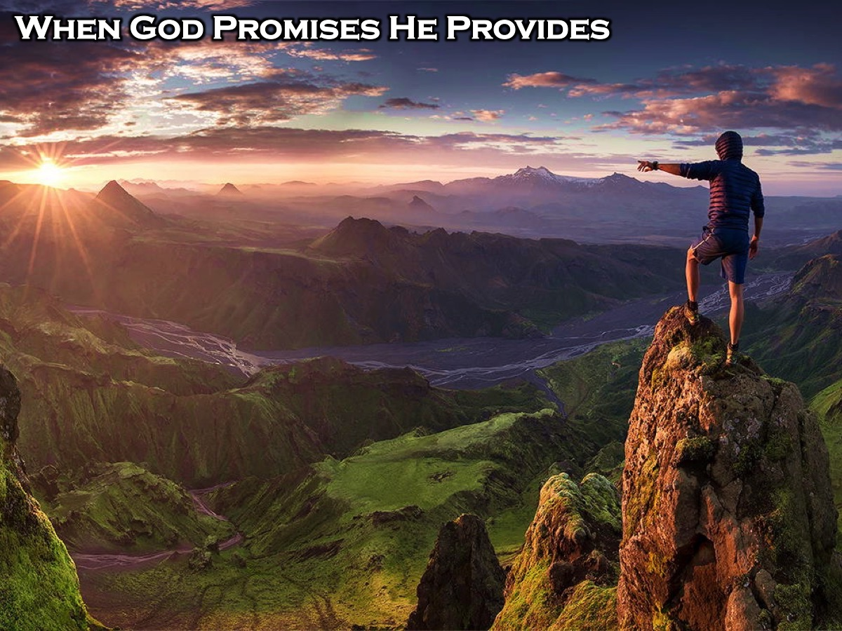
Notes:
Extra Input: WHEN GOD PROMISES HE PROVIDES. For many of us, it can be difficult to have faith and to act in obedience as a result of that faith. However, for God, providing for His people when He makes a promise is not only easy, but enjoyable for Him. Sometimes God helps in ways we’d never expect. Since He has a bigger picture of what’s going on, His help might not look the way we expect or be what we think we need. Sometimes we only see how He helped us a little while later. On many occasions the Bible calls God “faithful,” when speaking about the promises He makes to His people. The word “faithful” means that God actually walks through life with us, even the difficult situations in life. God is always excited to help us and meet our needs. Have there ever been times when you felt God was there to help you when you needed it? God was faithful to provide a ram in the bush for Abraham and Isaac, and He was faithful to provide a Savior for us. Jesus was the ultimate sacrifice to take the place of each one of us. All of humanity was destined for death because of sin, but God sent His Son to die in our place. God promised we could live in close relationship with Him and be with Him for eternity after this life. He provided a way for this to happen through his Son, Jesus, who trusted His Father and obeyed Him perfectly.

Slide 12
Notes:
Video: Chrome’s Testimony.

Slide 13
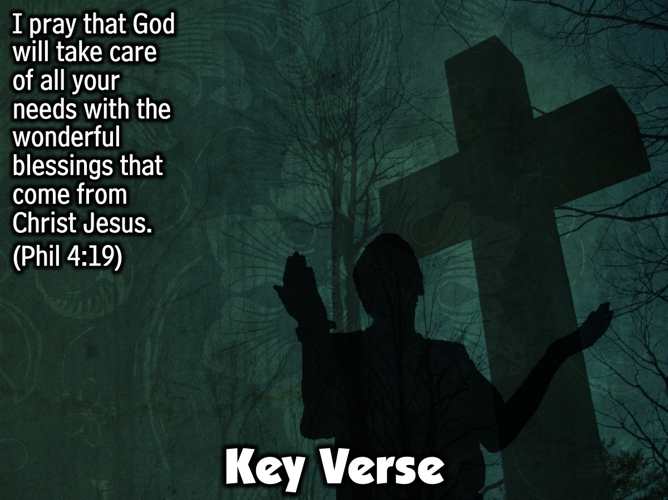
Notes:
Key Verse: I pray that God will take care of all your needs with the wonderful blessings that come from Christ Jesus. (Philippians 4:19)

Slide 14
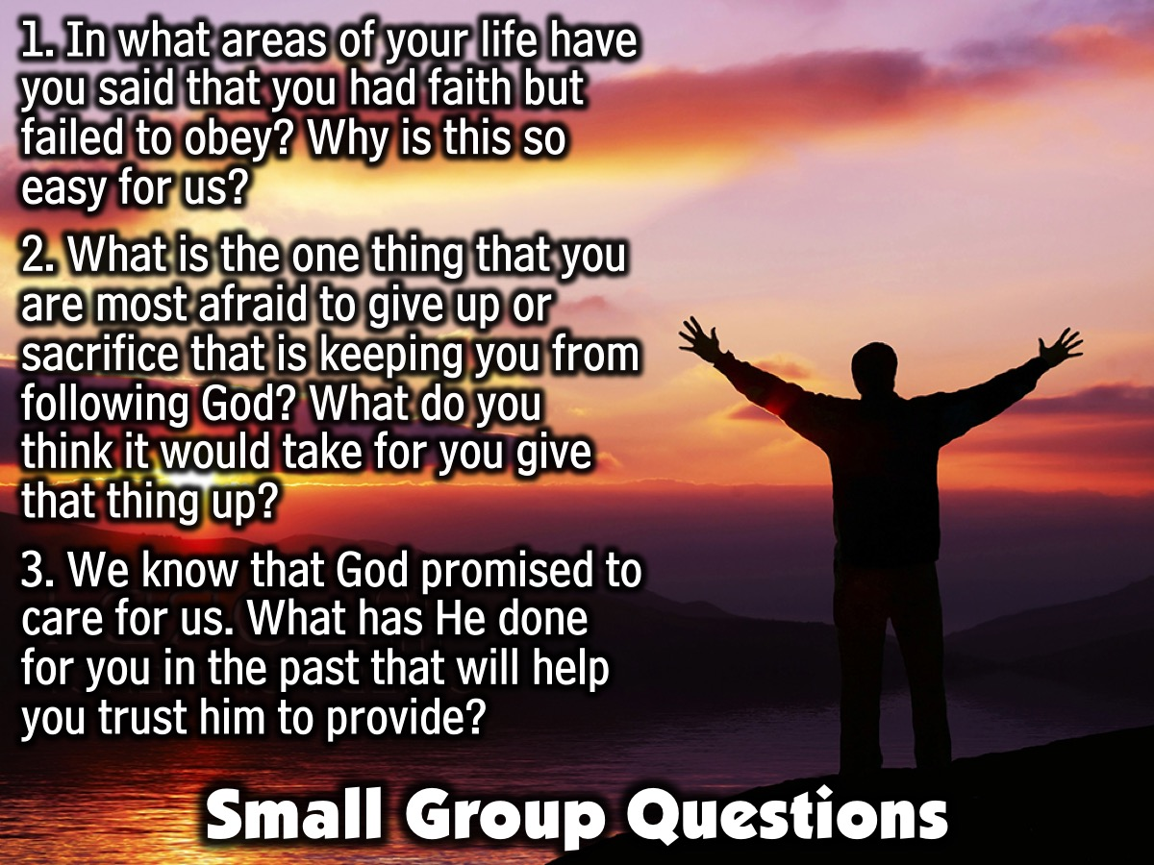
Notes:
Small Group Questions: Before we leave, take the last 10 minutes to discuss some questions with your small group: (1) In what areas of your life have you said that you had faith but failed to obey? Why is this so easy for us? (2) What is the one thing that you are most afraid to give up or sacrifice that is keeping you from following God? What do you think it would take for you give that thing up? (3) We know that God promised to care for us. What has He done for you in the past that will help you trust him to provide?

Slide 15
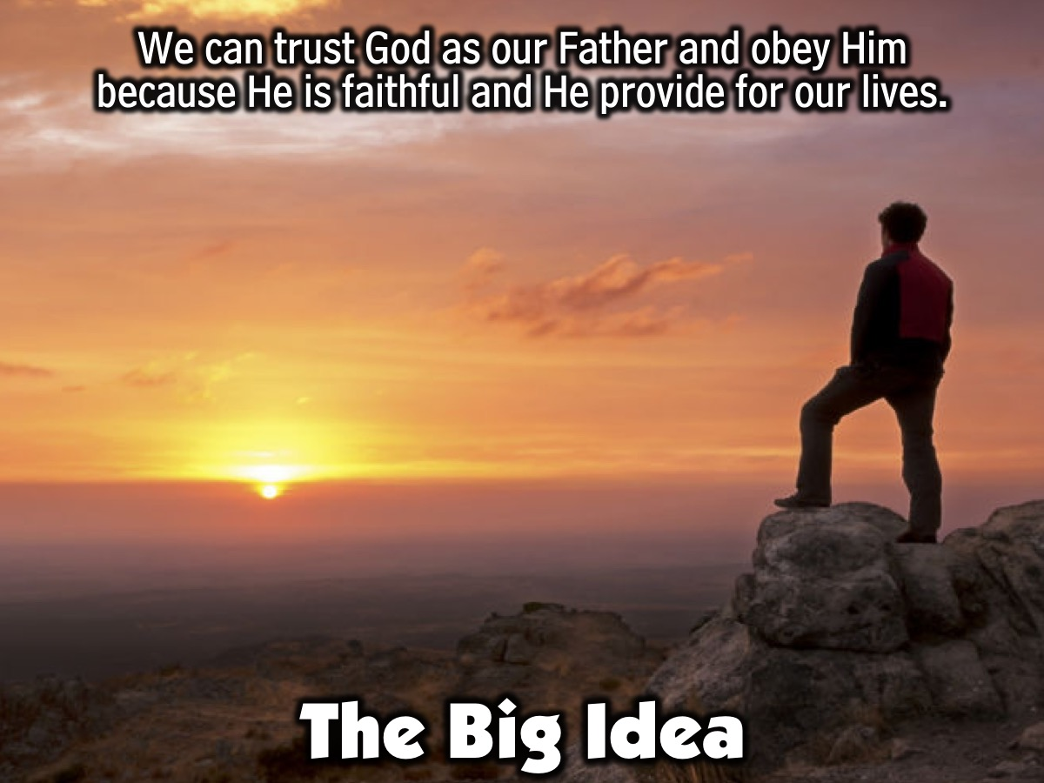
Notes:
The Big Idea: We can trust God as our Father and obey Him because He is faithful and He provide for our lives.

Slide 16
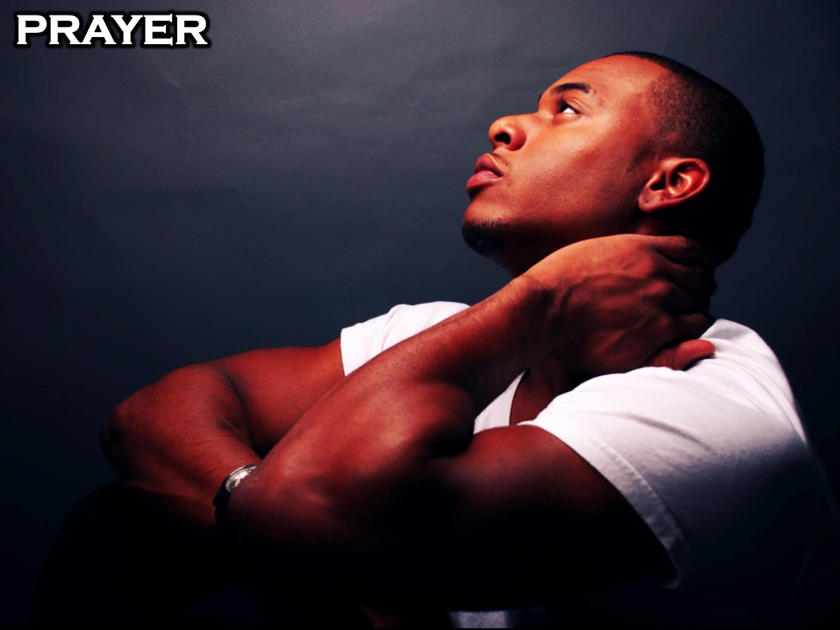
Notes:
Prayer: Have students pray for a couple of minutes, asking God to give them the faith to sacrifice whatever is necessary to follow Him. Close the prayer by asking God to help each student believe in Him and follow Him unashamedly.

Slide 17

Notes:
Next week in session 5 we will be focusing on Trials & Tests.

