Slide 1

Notes:
Welcom to Rebranded.

Slide 2
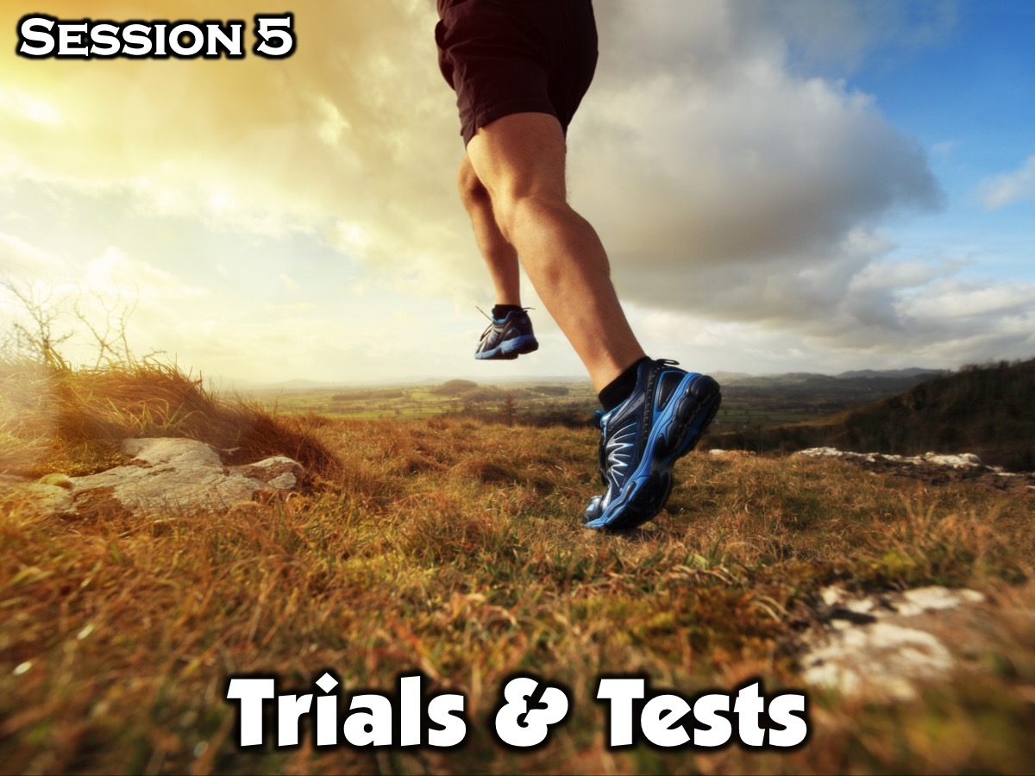
Notes:
This is Session 5: Trials & Tests/

Slide 3
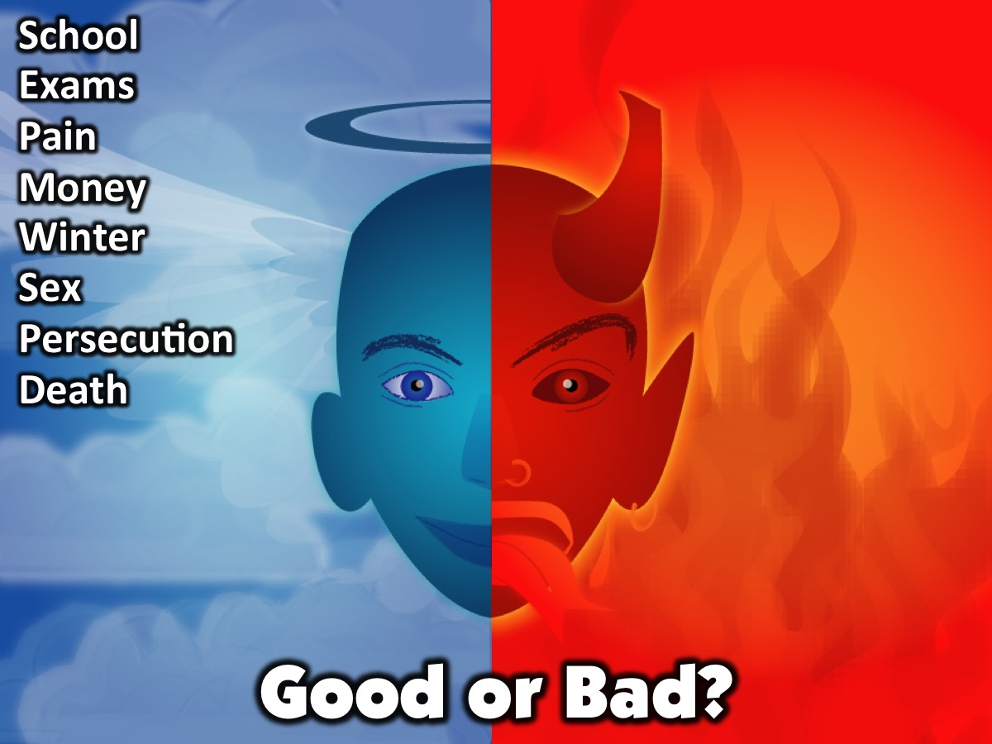
Notes:
Opening Exercise: Good or Bad (10 Minutes). Reveal the list of Good or Bad items one at a time. Have youth stand in the middle of the room and move toward one side of the room if they think it is a good thing or the other side of the room if they think it is bad thing. Before showing the next item have them step back to the line. Along the way, ask for some responses for why they think something is good or bad.

Slide 4
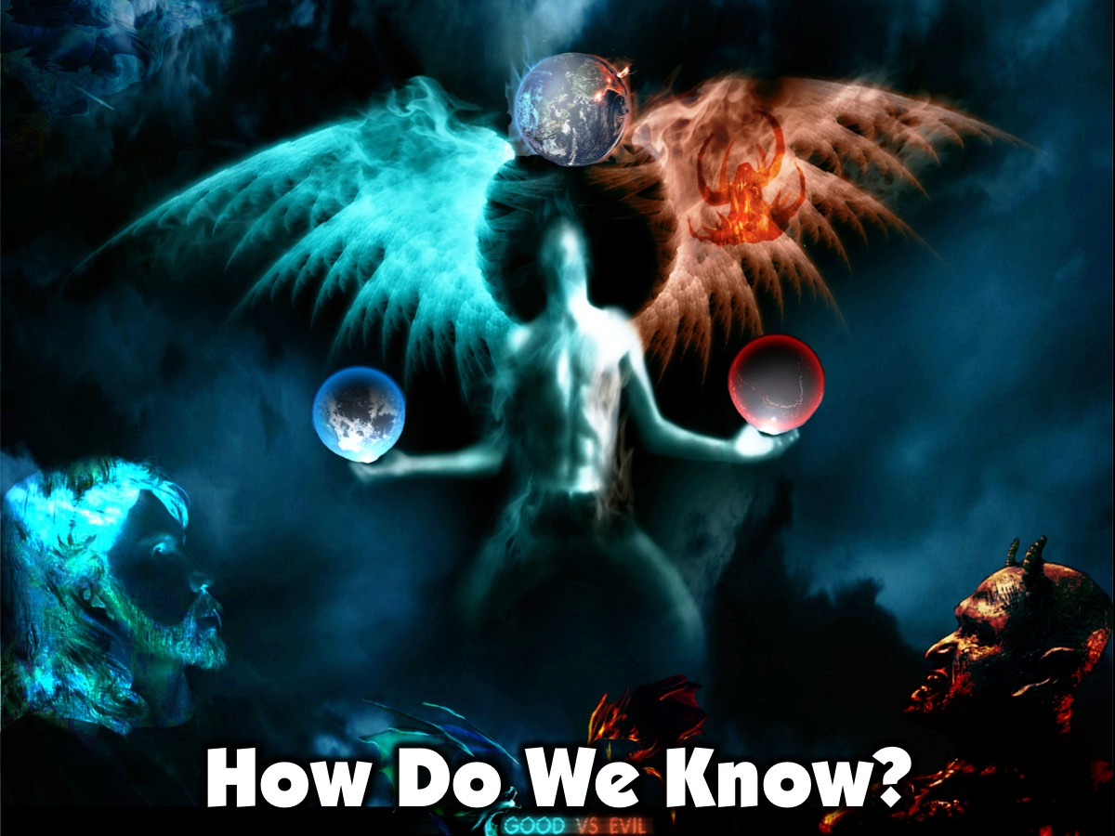
Notes:
Leader: Our perception of what is good or bad does not always mean that things are good or bad in reality. In life, it is God who determines what’s good or bad, even though we may think differently. He sees more of the picture than we do, so He knows why things happen. We can’t judge if something is truly good or bad until we know why it happened.

Slide 5
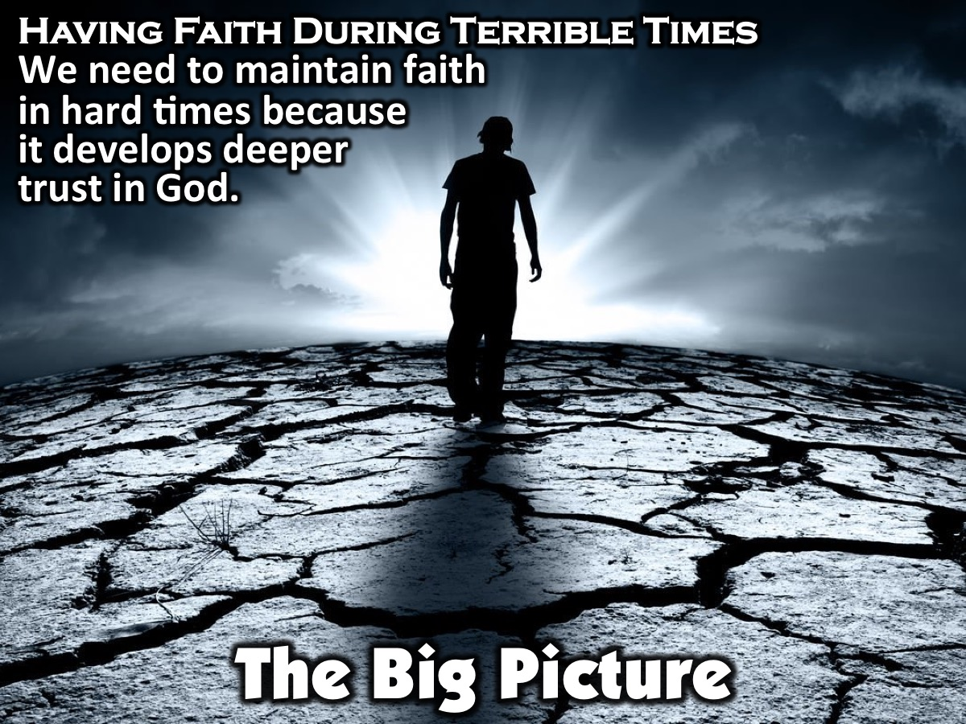
Notes:
The Big Picture: Having Faith During Terrible Times (5 Minutes): Last time, we discussed faith and what that means for us all. This week, we are still emphasizing faith, but on a deeper level. It is important to maintain faith in the midst of hard times, because this develops in us a deeper trust in God. Since we don’t know how everything will work out, our tendency is to try to regain control instead of believing that God knows all things and is working all things together for the good of those who love Him (Romans 8:28).

Slide 6
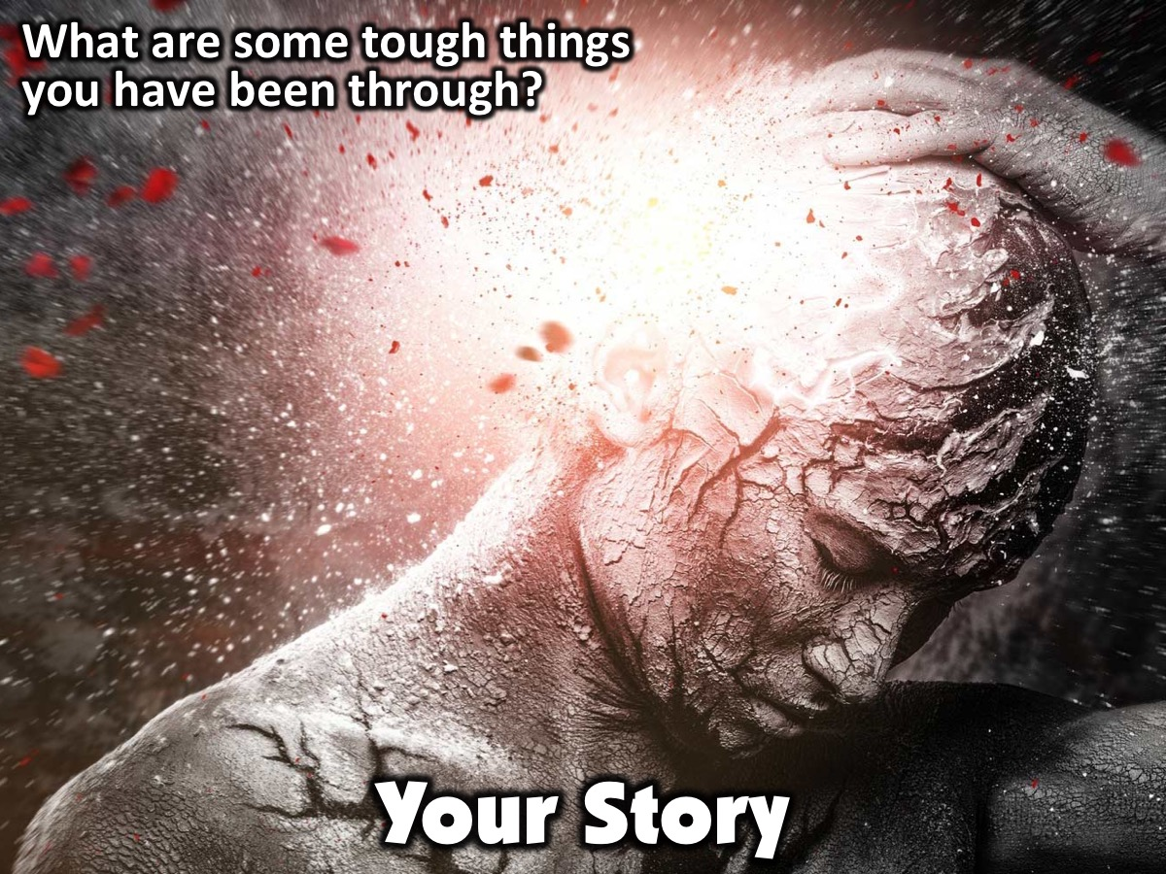
Notes:
Your Story: Can you think of some tough things that you are currently going through or have gone through in the past? Have there been times when you didn’t do anything to “deserve” the situation you were in?

Slide 7
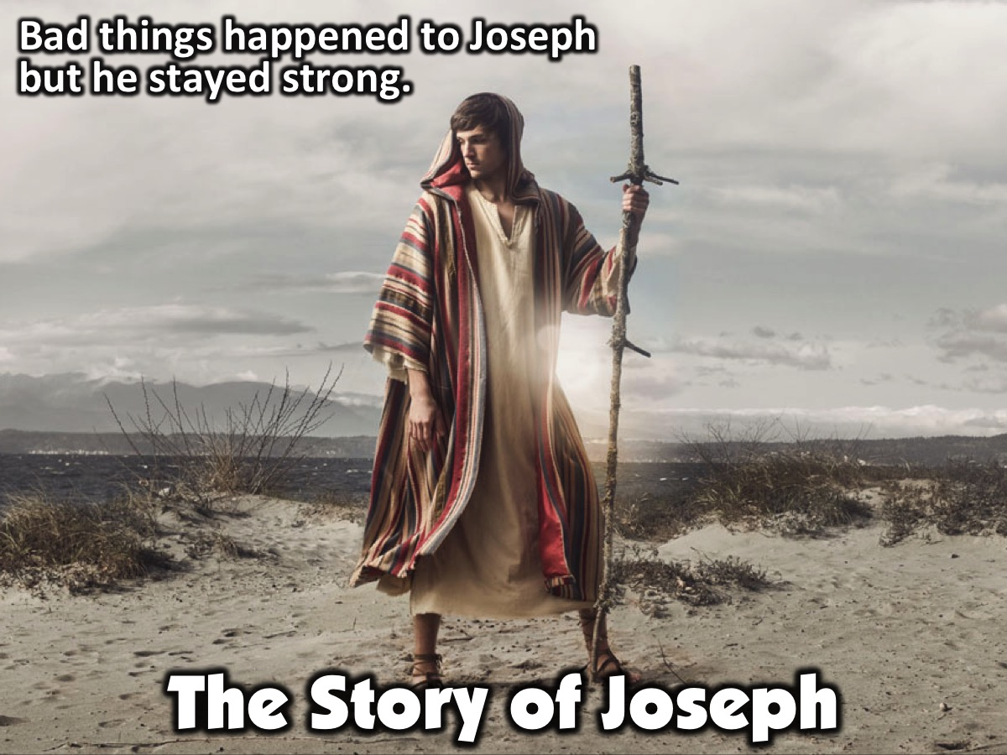
Notes:
The Story of Joseph: Many things happened to him due to the actions of others, but his faith stayed strong despite it all. Let’s look at his story.

Slide 8

Notes:
Video #1: Lets watch a video about Joseph.

Slide 9
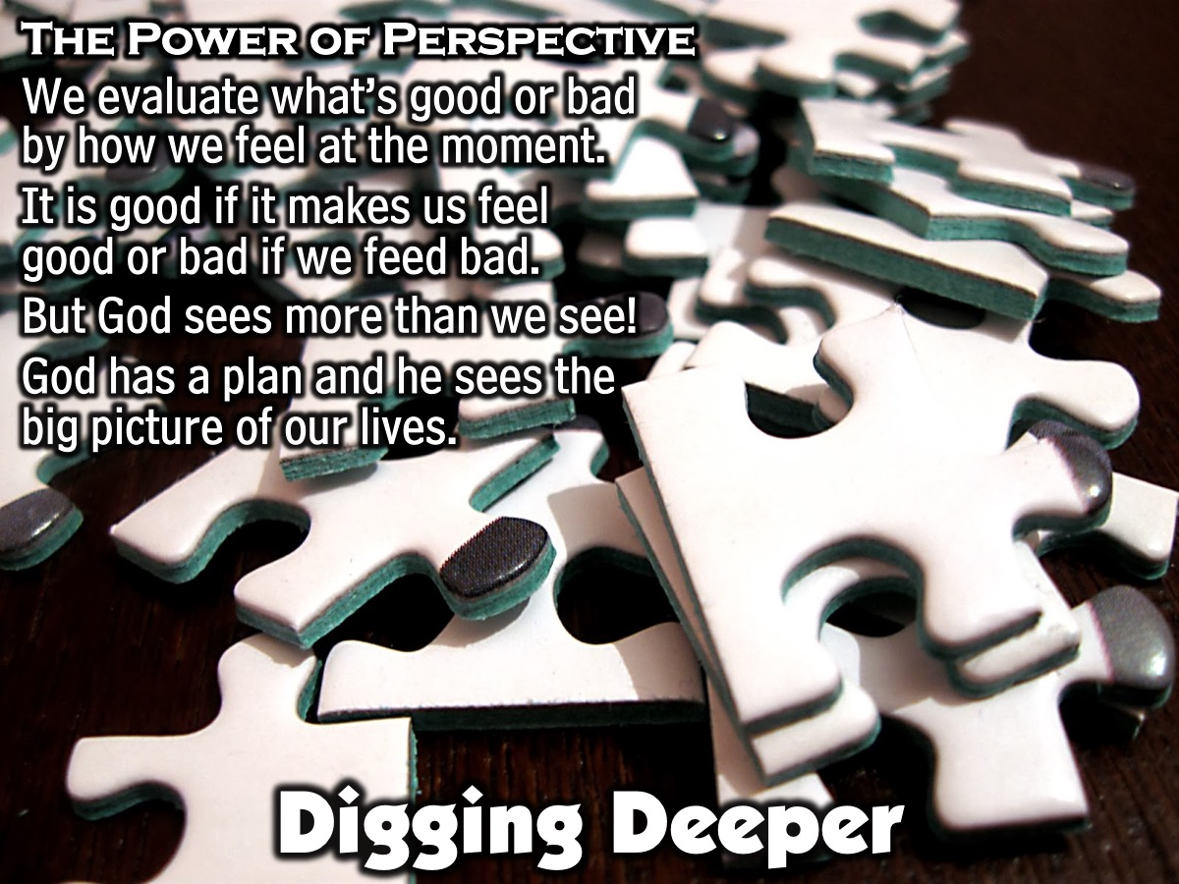
Notes:
Digging Deeper: Most of us evaluate what’s good or bad based on how we feel at the moment. We often say that something is “good” when it makes minutes us feel good or when the outcome is good in our eyes. In the same way, we often label something as “bad” based on our bad feelings about it or because the outcome of a situation was unexpected. As we learned last week, God sees more than we can in every situation. God has a plan, and He prepares us in ways that we may not understand, because He can see further down the road than we can. God sees the big picture, and we just see a small section.

Slide 10
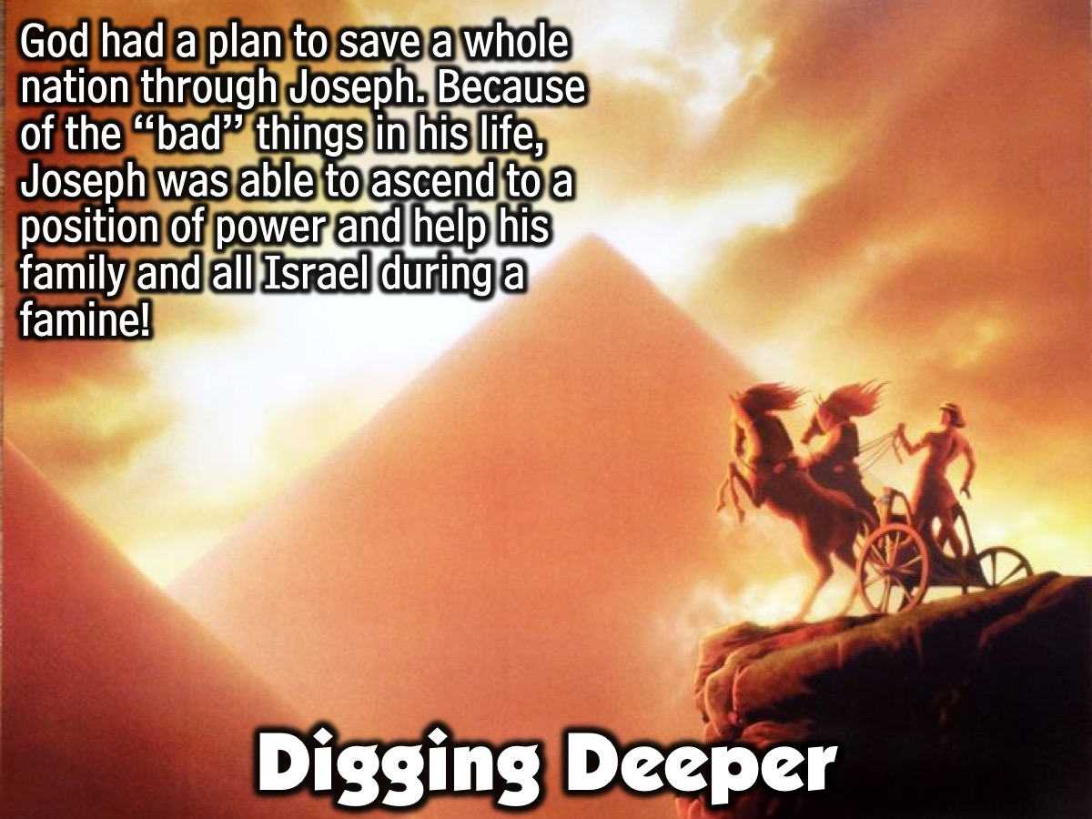
Notes:
What does God’s ability to see down the road tell us? It tells us that God has a plan, about more than just Joseph’s own life. God’s plan was to save an entire nation through his life. Just look at how God wove Joseph’s story to ensure that this happened. Because of all of the “bad” things in his life, Joseph was able to ascend to a position of power. Since he held this high position of power, he was able to help his brothers and, eventually, all of Israel during a famine.

Slide 11
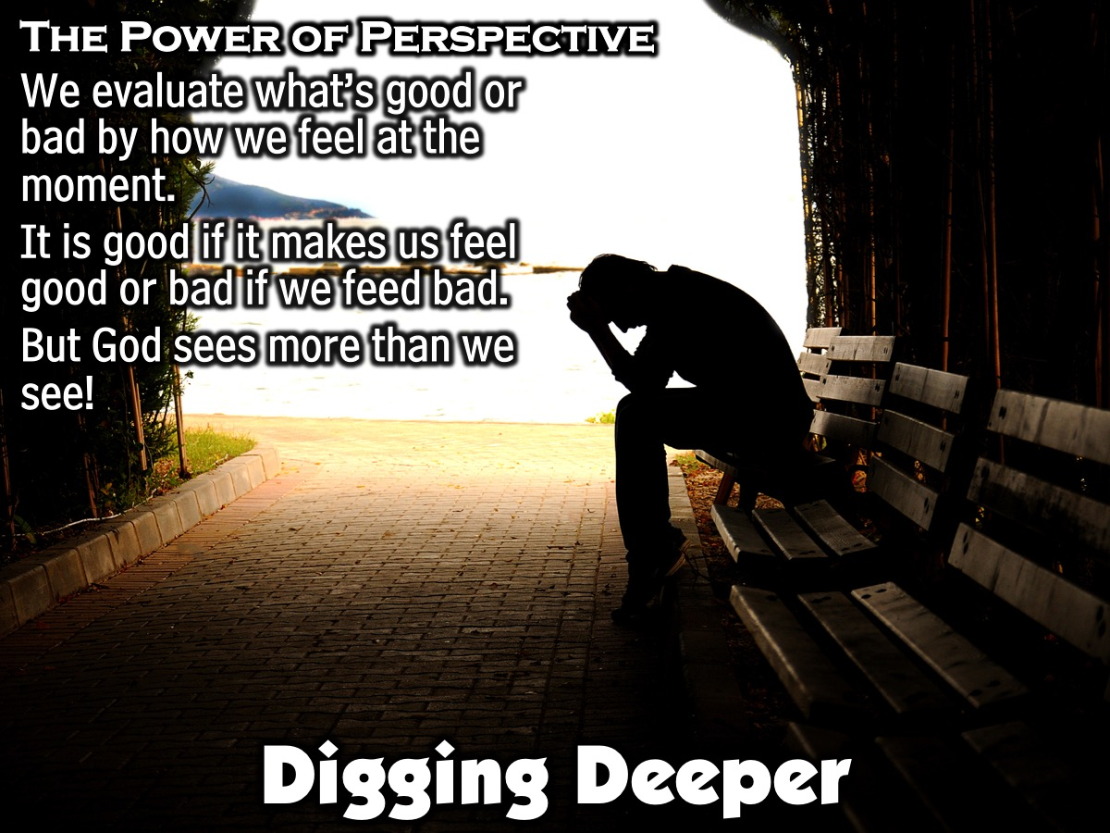
Notes:
How would you use the power that Joseph had if you were in his shoes? In the tough times, God desired to develop certain character traits in Joseph. He desired to develop a man who was noble, honest, and did what was good and right. Gold is refined by fire, and diamonds are made under pressure. The same is true in our lives. Because God is our Father, He is concerned about preparing us to be who He created us to be. God is working all things together for good, even when it doesn’t feel like it. In your small groups, lets discuss this idea a little further.

Slide 12
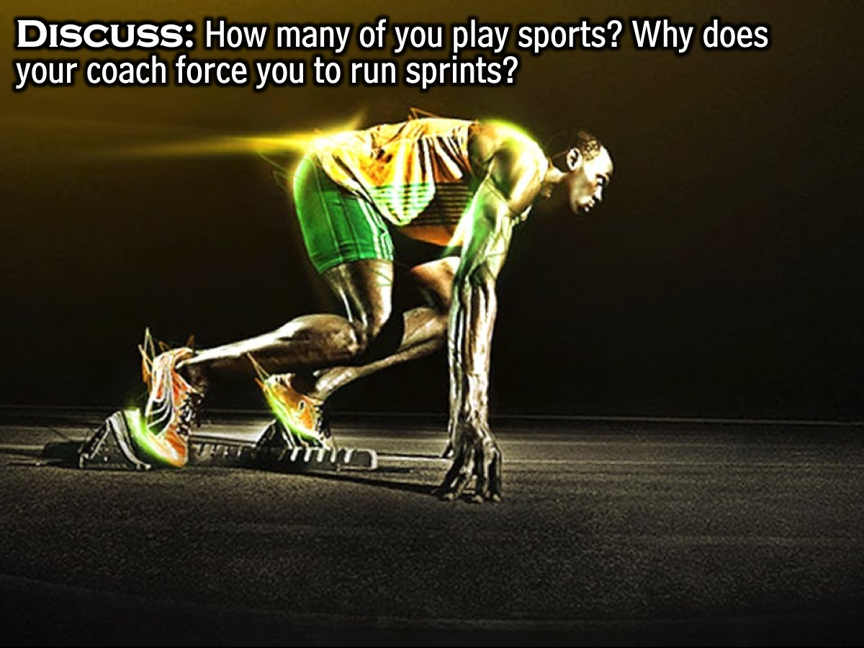
Notes:
Discuss in Pairs: How many of you play sports? Why does your coach force you to run sprints?
Leader: He knows that in order to get you where you want to go (victory), you’re going to have to do things you don’t want to do (push your body to the limits). This is the heartbeat of our loving Father. He uses the tough exercises in life to prepare us to be stronger and more in shape spiritually. He desires that we have victory over the troubles we face in life.

Slide 13
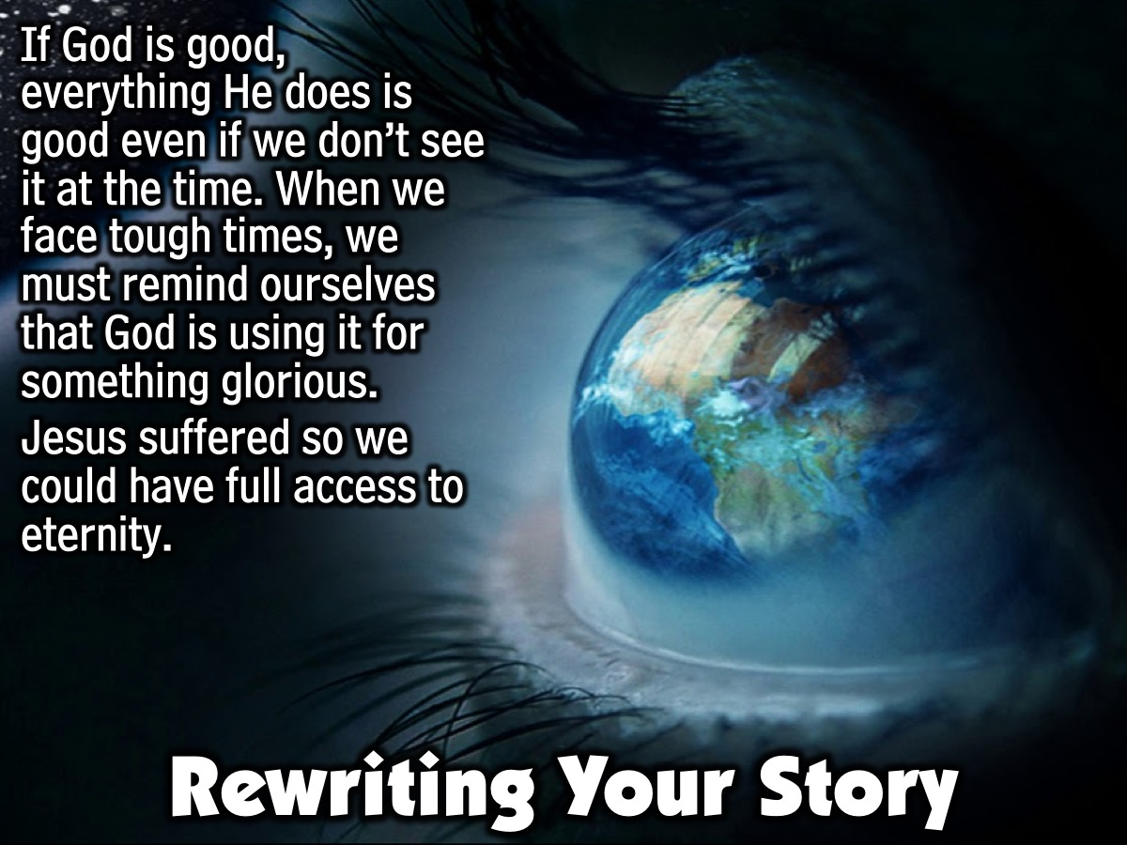
Notes:
Rewriting Your Story...According to God’s Plan: If God is good, that means that everything He does is good, even if it doesn’t feel like it’s good right now. It was only by living out the end of his story that Joseph was able to understand that what God was doing in his life was good. One way we can stay faithful in the middle of rough circumstances is by reminding ourselves that God uses our struggles for something glorious. Jesus endured the greatest suffering of all in order to give us full access to an eternity without suffering. Aren’t you so grateful that your suffering is so small in comparison to Jesus? Here is the story of a person that lived through many hardships with faith.

Slide 14
Notes:
Video: Crystal’s Testimony.

Slide 15
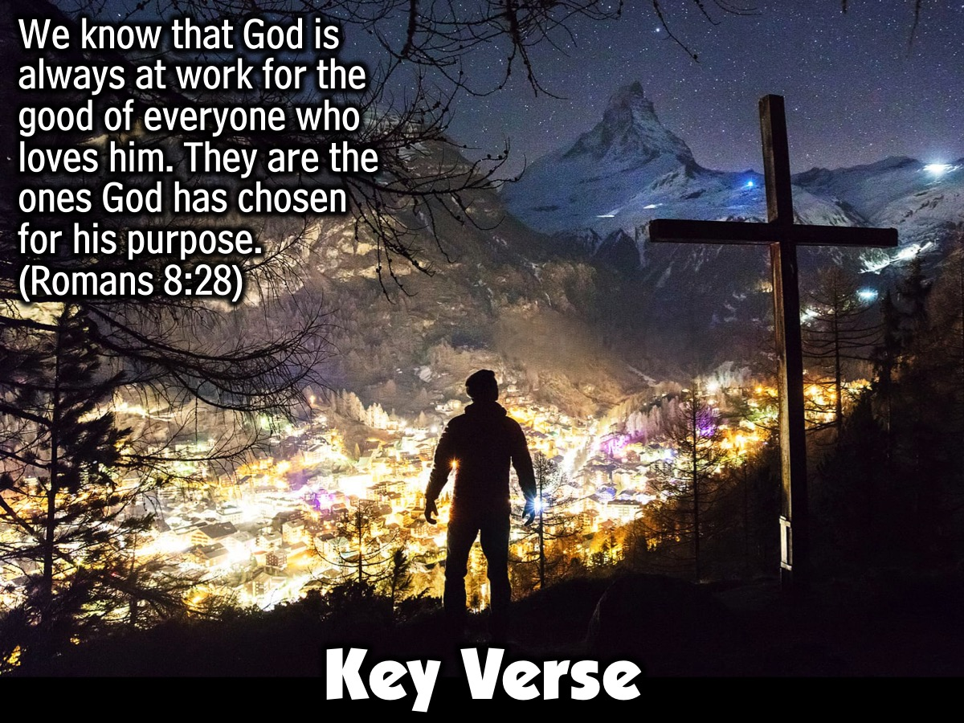
Notes:
Key Verse: We know that God is always at work for the good of everyone who loves him. They are the ones God has chosen for his purpose. (Romans 8:28)

Slide 16
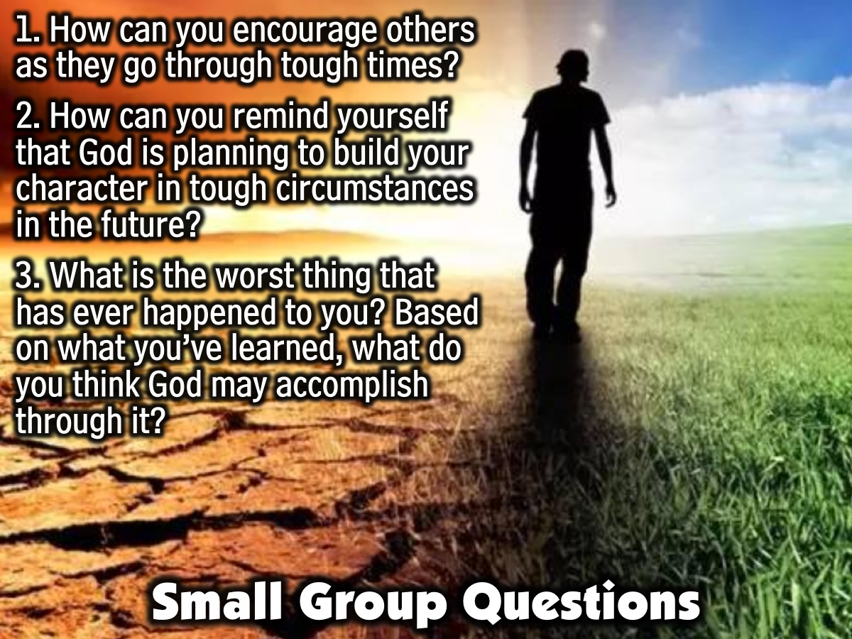
Notes:
Small Group Questions: Before we leave, take the last 10 minutes to discuss some questions with your small group: (1) How can you encourage others as they go through tough times? (2) How can you remind yourself that God is planning to build your character in tough circumstances in the future? (3) What is the worst thing that has ever happened to you? Based on what you’ve learned, what do you think God may accomplish through it?

Slide 17
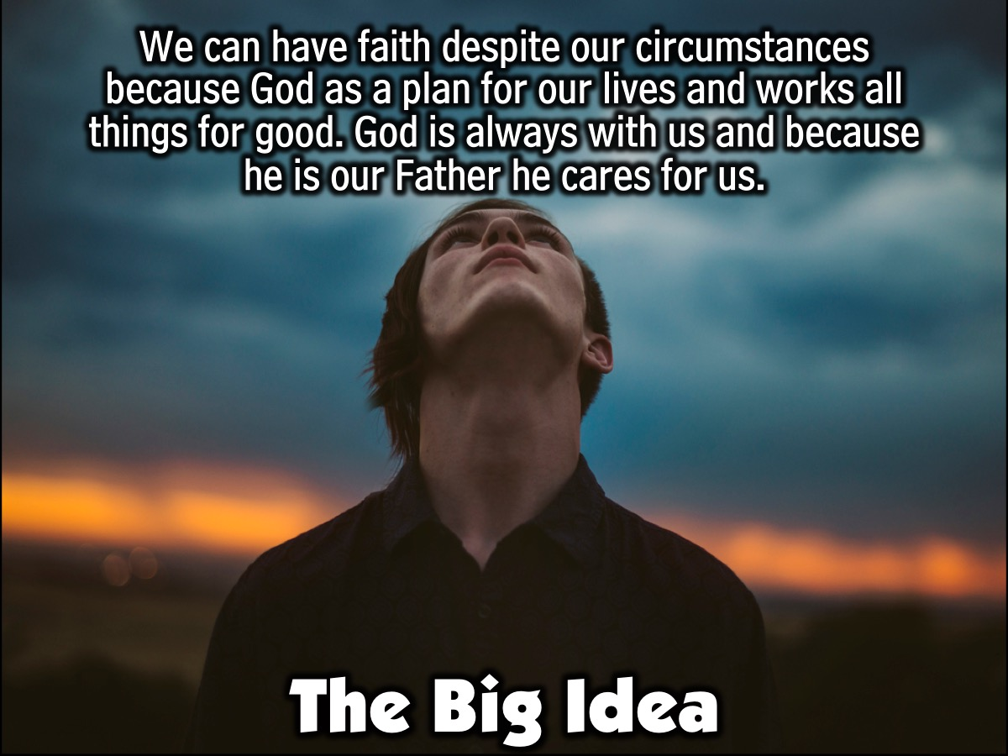
Notes:
The Big Idea: We can have faith despite our circumstances because God as a plan for our lives and works all things for good. God is always with us and because he is our Father he cares for us.

Slide 18
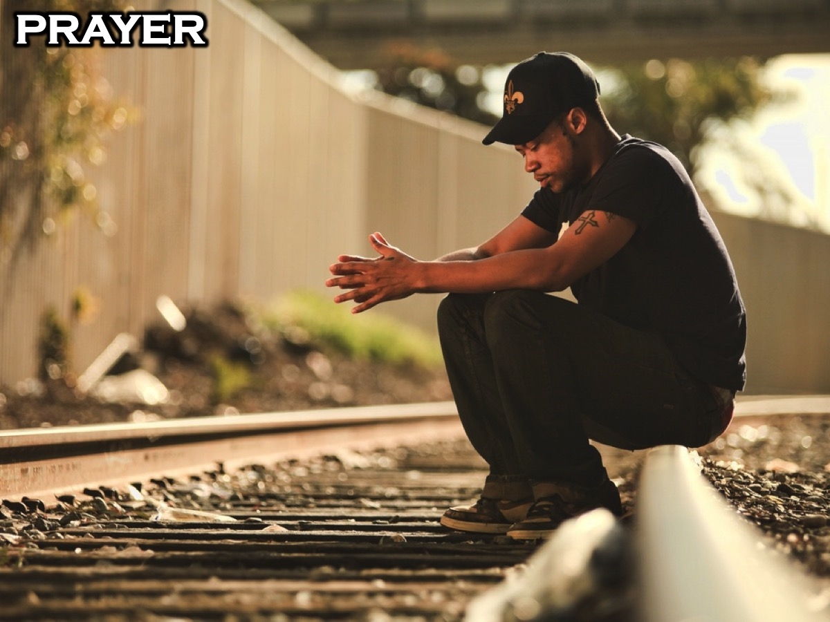
Notes:
Prayer: Pray that God will reveal His sovereign plan to the students as they go through tough times in their lives and that they will be able to endure these tough times well.

Slide 19
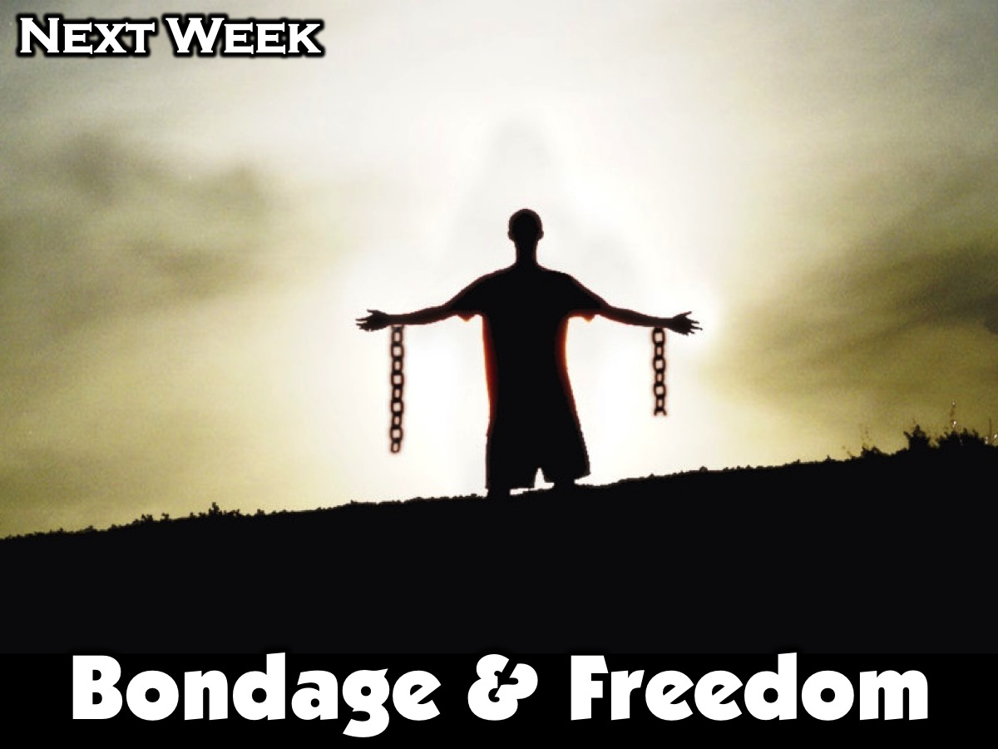
Notes:
Next week in session 6 we will be focusing on Bondage & Freedom.

