Slide 1

Notes:
It’s the Relationship Series!

Slide 2

Notes:
Welcome to regulars and newcomers!

Slide 3
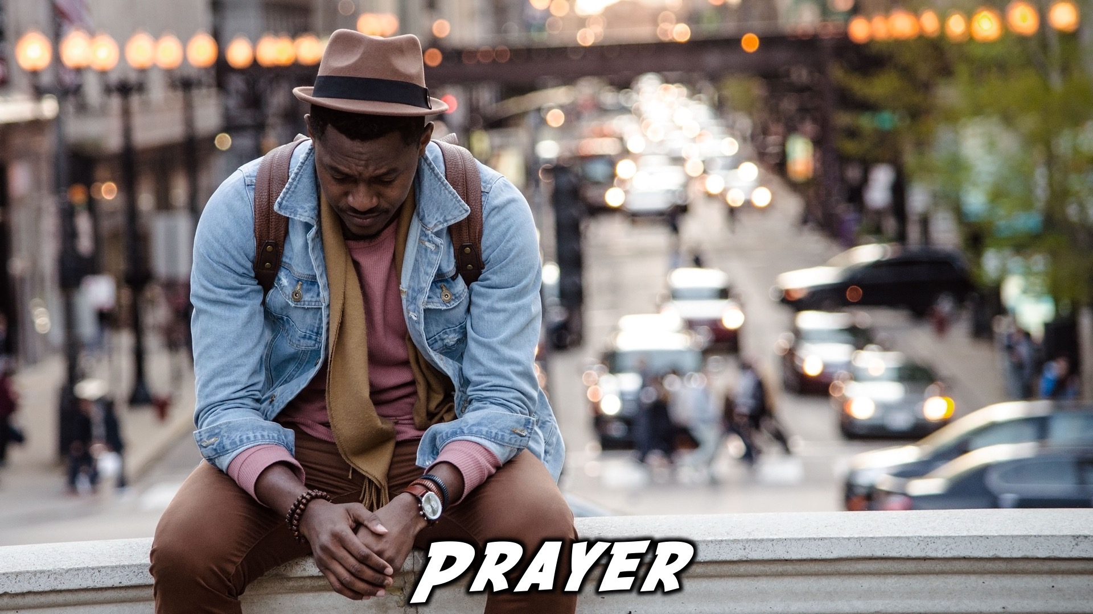
Notes:
Prayer: Let’s open our meeting in prayer.

Slide 4

Notes:
Announcements: Please Listen up to the following announcement.

Slide 5

Notes:
Next Week: On Sunday we begin our mini-series on relationships. This Sunday we are learning about Romantic Relationships.

Slide 6

Notes:
Next Friday the topic is Relationship with yourself.

Slide 7
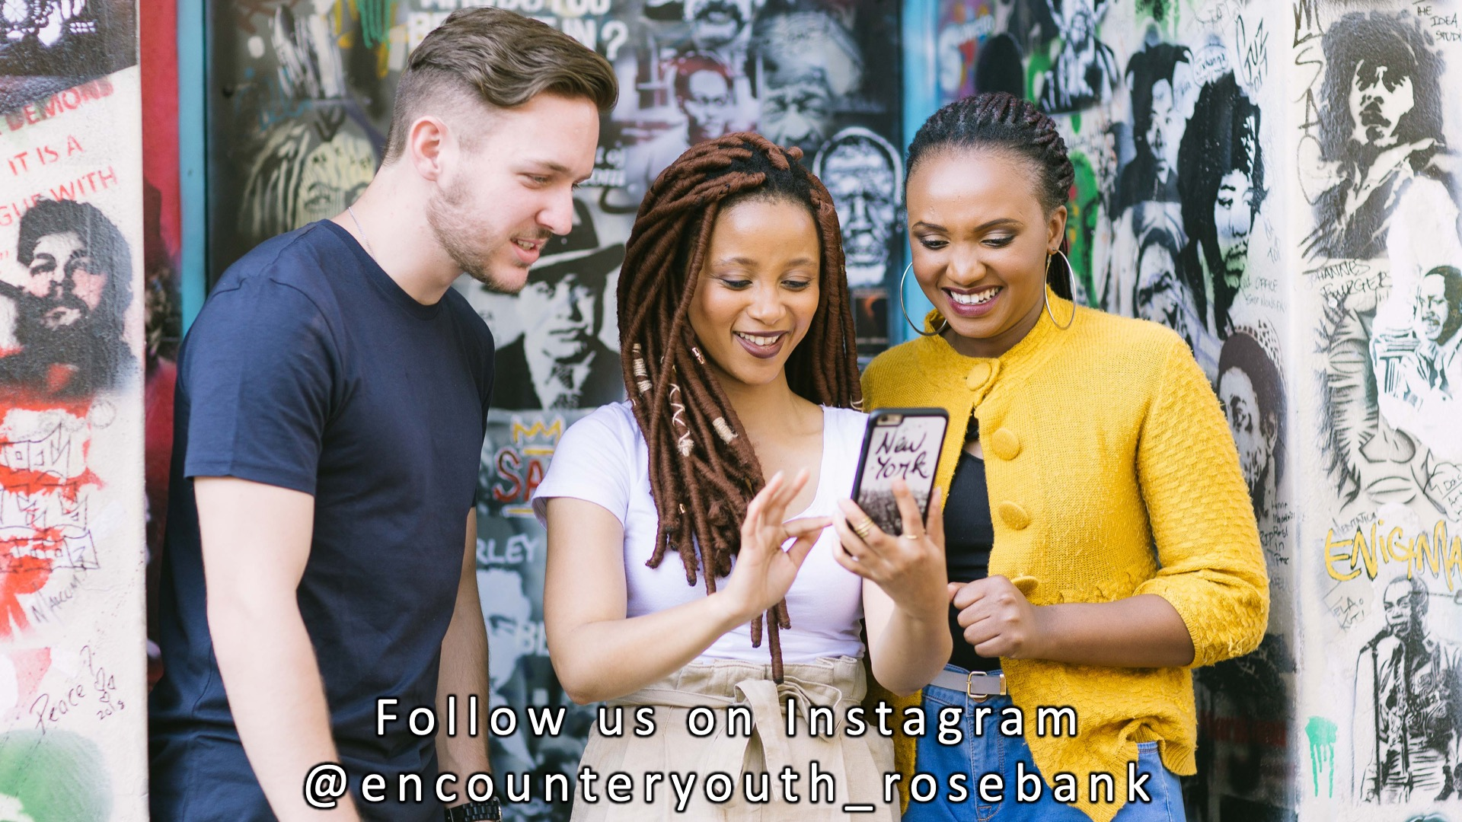
Notes:
Announcements: Follow us on Instagram! @EncounterYouth_Rosebank

Slide 8

Notes:
Announcements: Join our WhatsApp group!

Slide 9

Notes:
Tonight: Our topic is Romance.

Slide 10
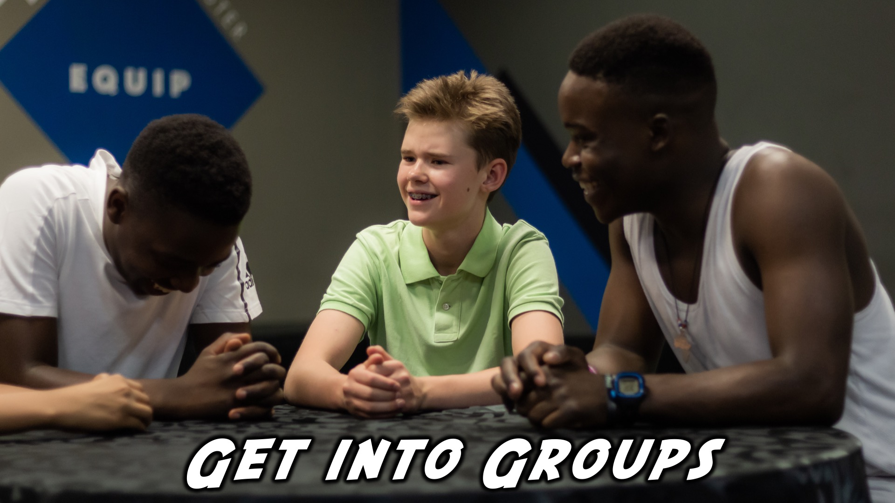
Notes:
Get into groups

Slide 11

Notes:
Game: Smartie Relay.

Slide 12

Notes:
Game: Marshmallow Tower

Slide 13

Notes:
Game: Peanut Butter Eat-a-lot.

Slide 14

Notes:
Panel Discussion.

Slide 15

Notes:
Small Group Time.

Slide 16

Notes:
Ministry Time at the front

Slide 17

Notes:
Refreshments

Slide 18

Notes:
Join us on Sunday!

