Slide 1

Notes:
It’s the Relationship Series!

Slide 2
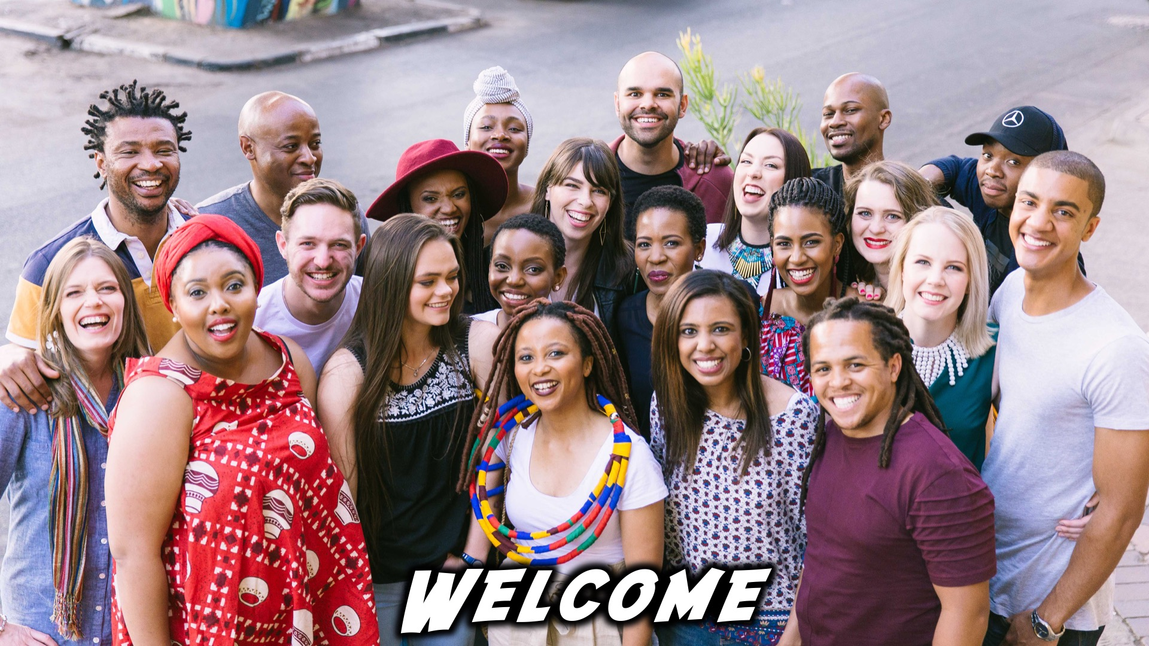
Notes:
Welcome to regulars and newcomers!

Slide 3
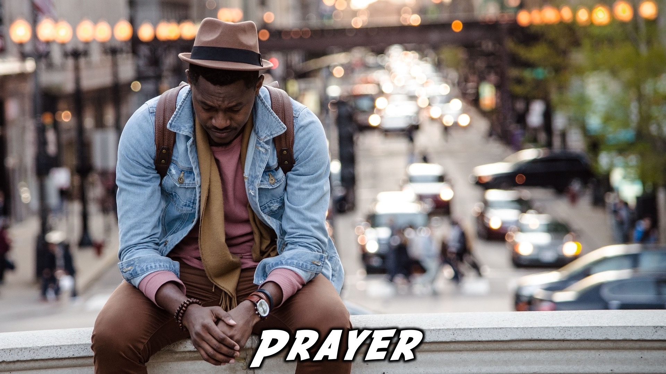
Notes:
Prayer: Let’s open our meeting in prayer.

Slide 4
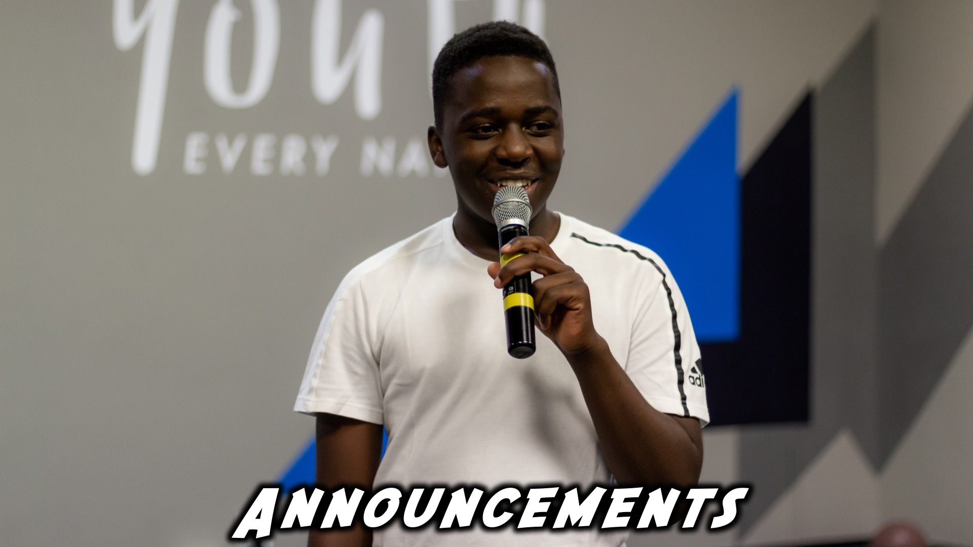
Notes:
Announcements: Please Listen up to the following announcement.

Slide 5

Notes:
Next Week: On Sunday we begin our mini-series on relationships. This Sunday we are learning about Romantic Relationships.

Slide 6

Notes:
Next Friday the topic is Relationship with yourself.

Slide 7
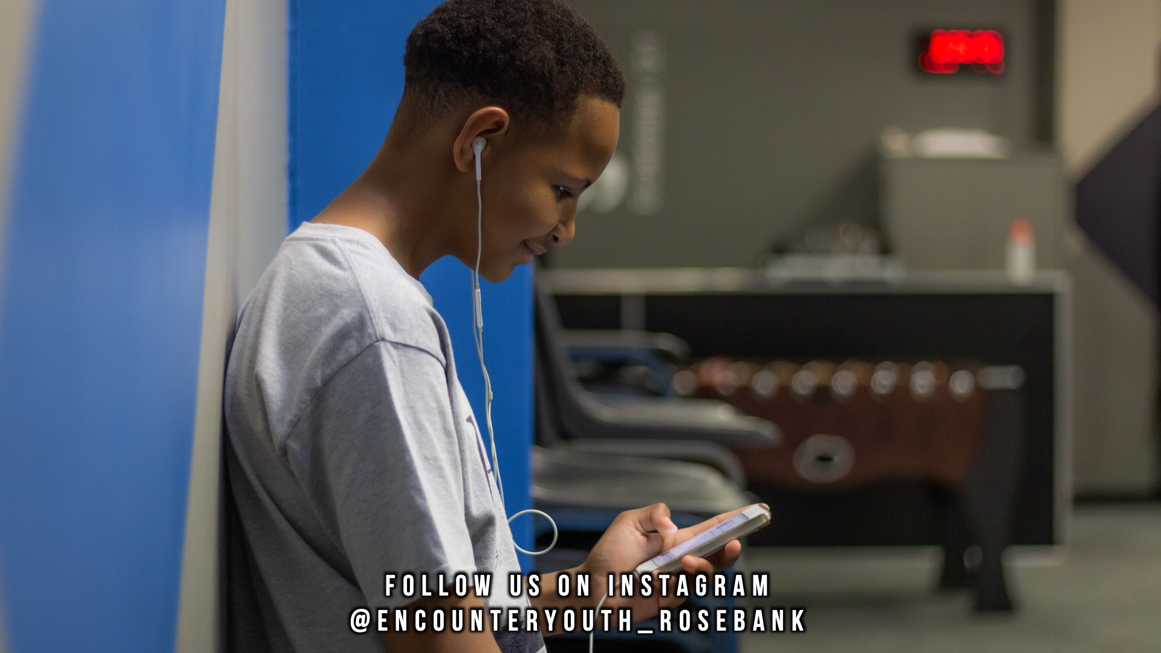
Notes:
Announcements: Follow us on Instagram! @EncounterYouth_Rosebank

Slide 8

Notes:
Announcements: Join our WhatsApp group!

Slide 9

Notes:
Tonight: Our topic is loving yourself.

Slide 10
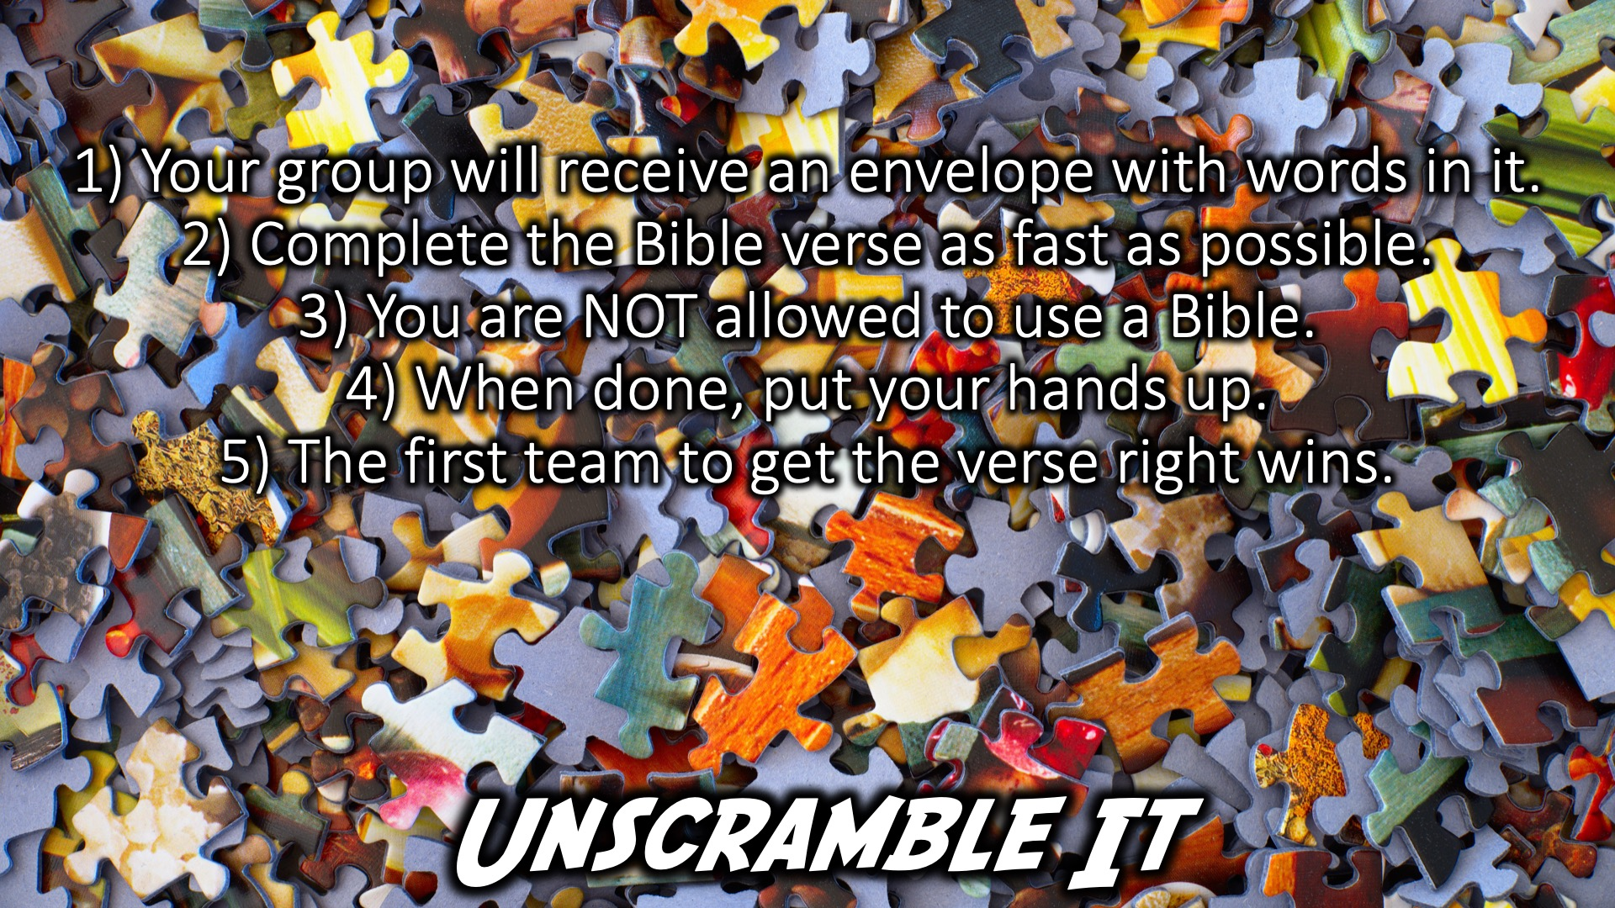
Notes:
Unscramble it: 1) Your group will receive an envelope with words in it.
2) Complete the Bible verse as fast as possible.
3) You are NOT allowed to use a Bible.
4) When done, put your hands up.
5) The first team to get the verse right wins.

Slide 11
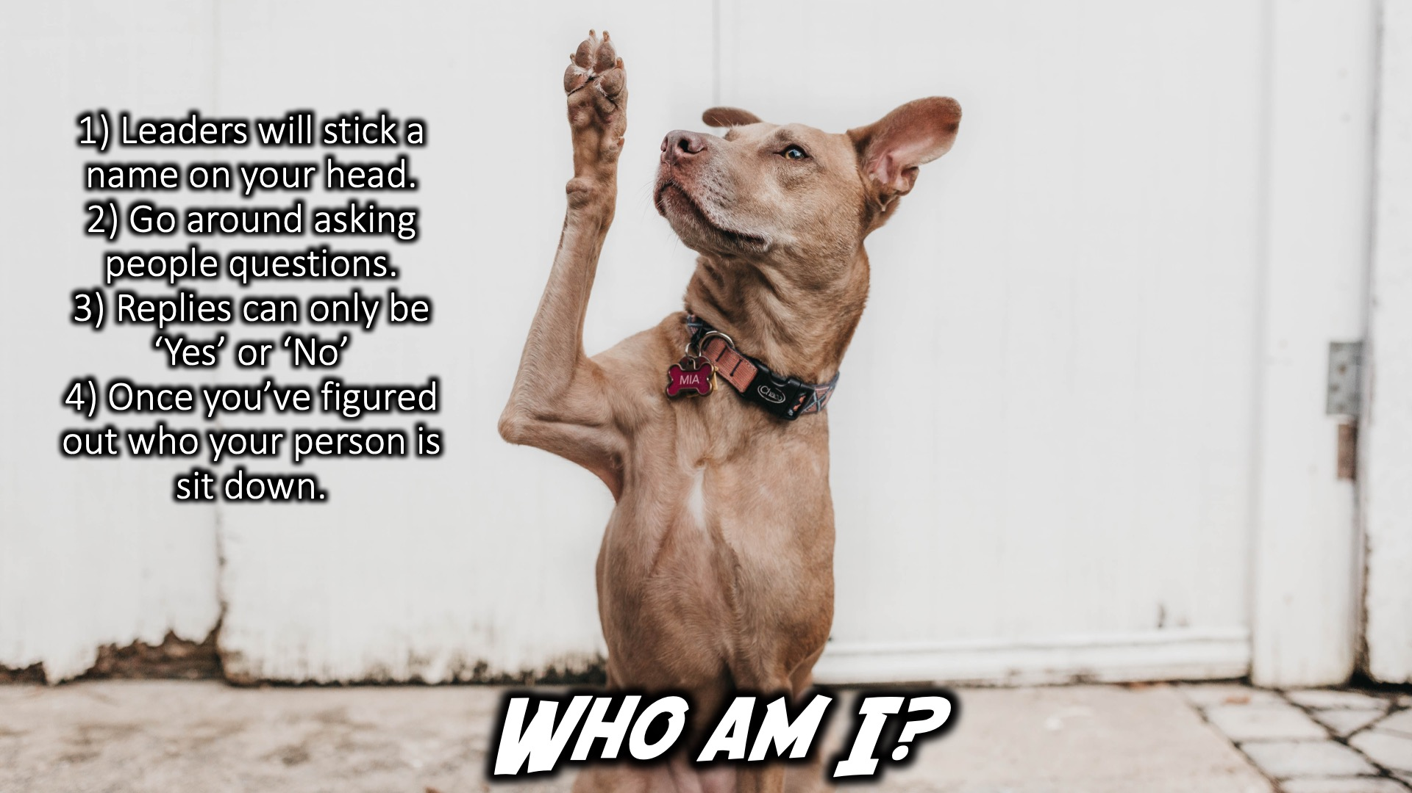
Notes:
Who am I: 1) Leaders will stick a name on your head.
2) Go around asking people questions.
3) Replies can only be ‘Yes’ or ‘No’
4) Once you’ve figured out who your person is sit down.

Slide 12

Notes:
Divide into Grades

Slide 13
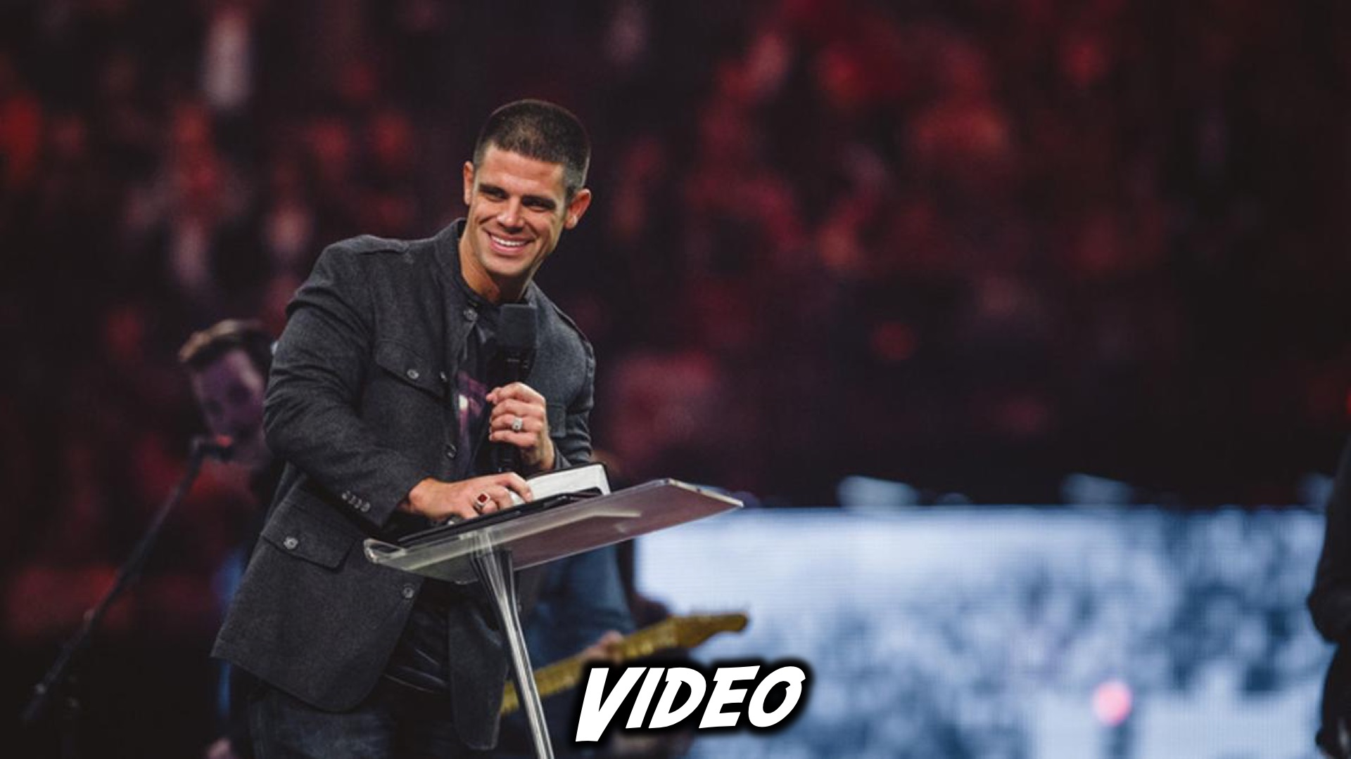
Notes:
Video

Slide 14

Notes:
Video: We’re going to watch a brief video, find it on YouTube at https://www.youtube.com/watch?v=ZFt-0-rA1yM

Slide 15
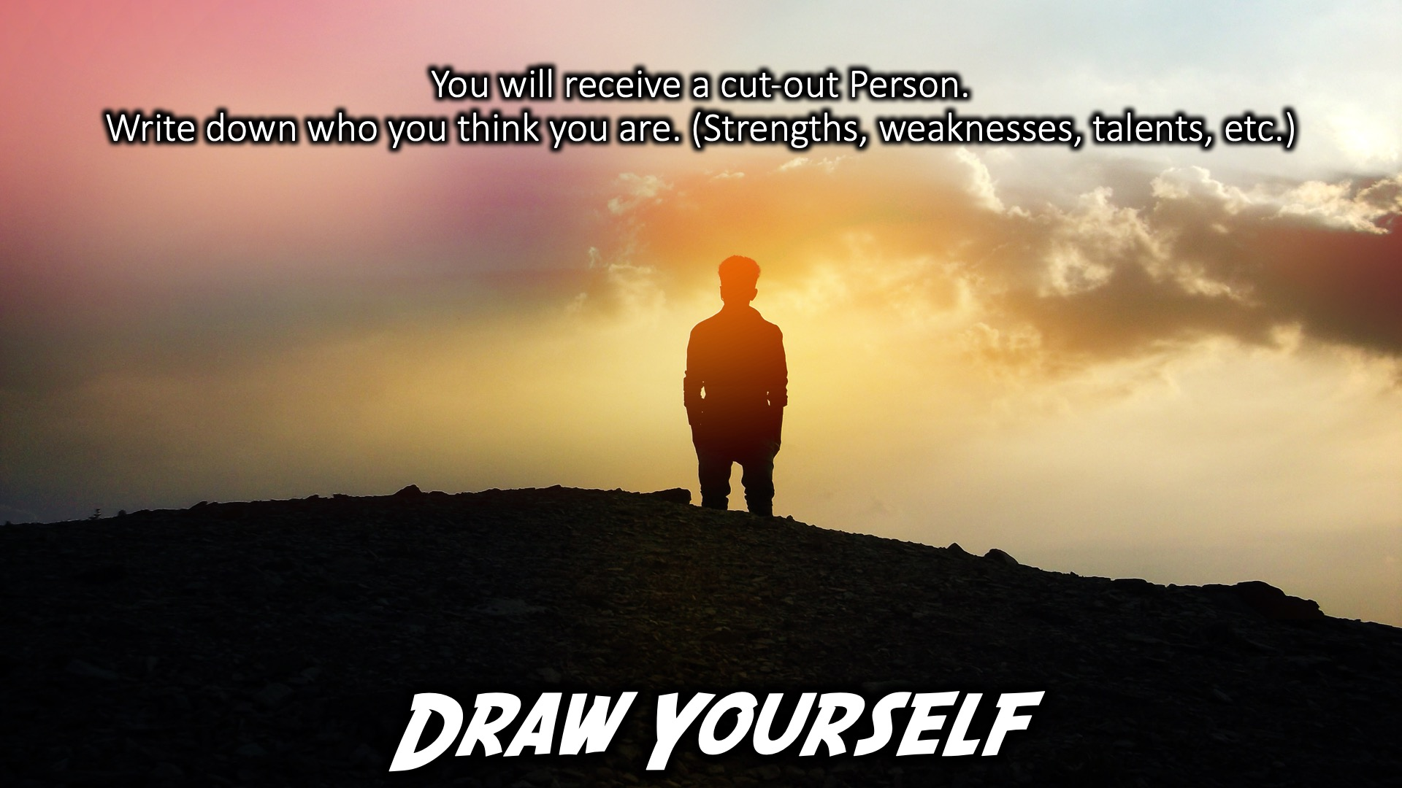
Notes:
Draw Yourself: You will receive a cut-out Person. Write down who you think you are. (Strengths, weaknesses, talents, etc.)

Slide 16
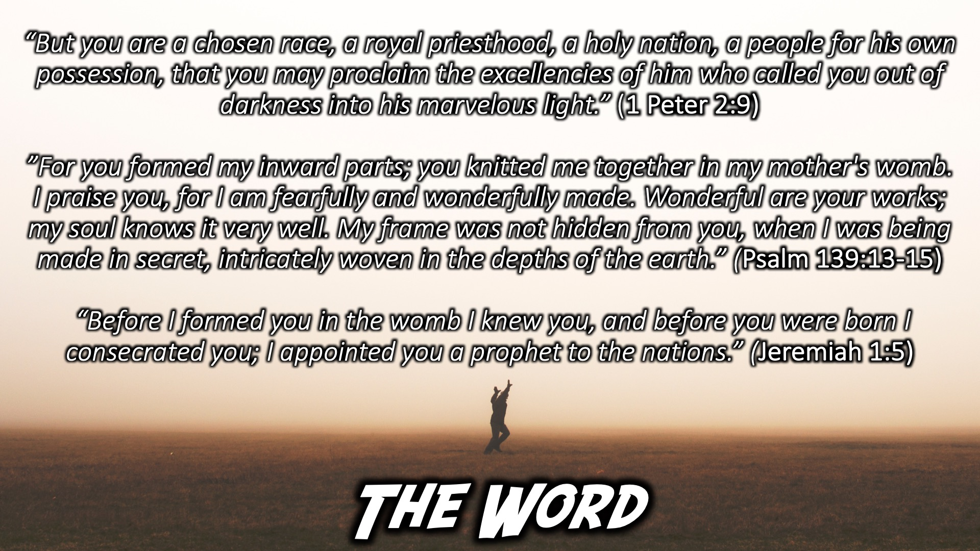
Notes:
What the Bible Says: “But you are a chosen race, a royal priesthood, a holy nation, a people for his own possession, that you may proclaim the excellencies of him who called you out of darkness into his marvelous light.” (1 Peter 2:9)
”For you formed my inward parts; you knitted me together in my mother's womb. I praise you, for I am fearfully and wonderfully made. Wonderful are your works; my soul knows it very well. My frame was not hidden from you, when I was being made in secret, intricately woven in the depths of the earth.” (Psalm 139:13-15)
“Before I formed you in the womb I knew you, and before you were born I consecrated you; I appointed you a prophet to the nations.” (Jeremiah 1:5)

Slide 17
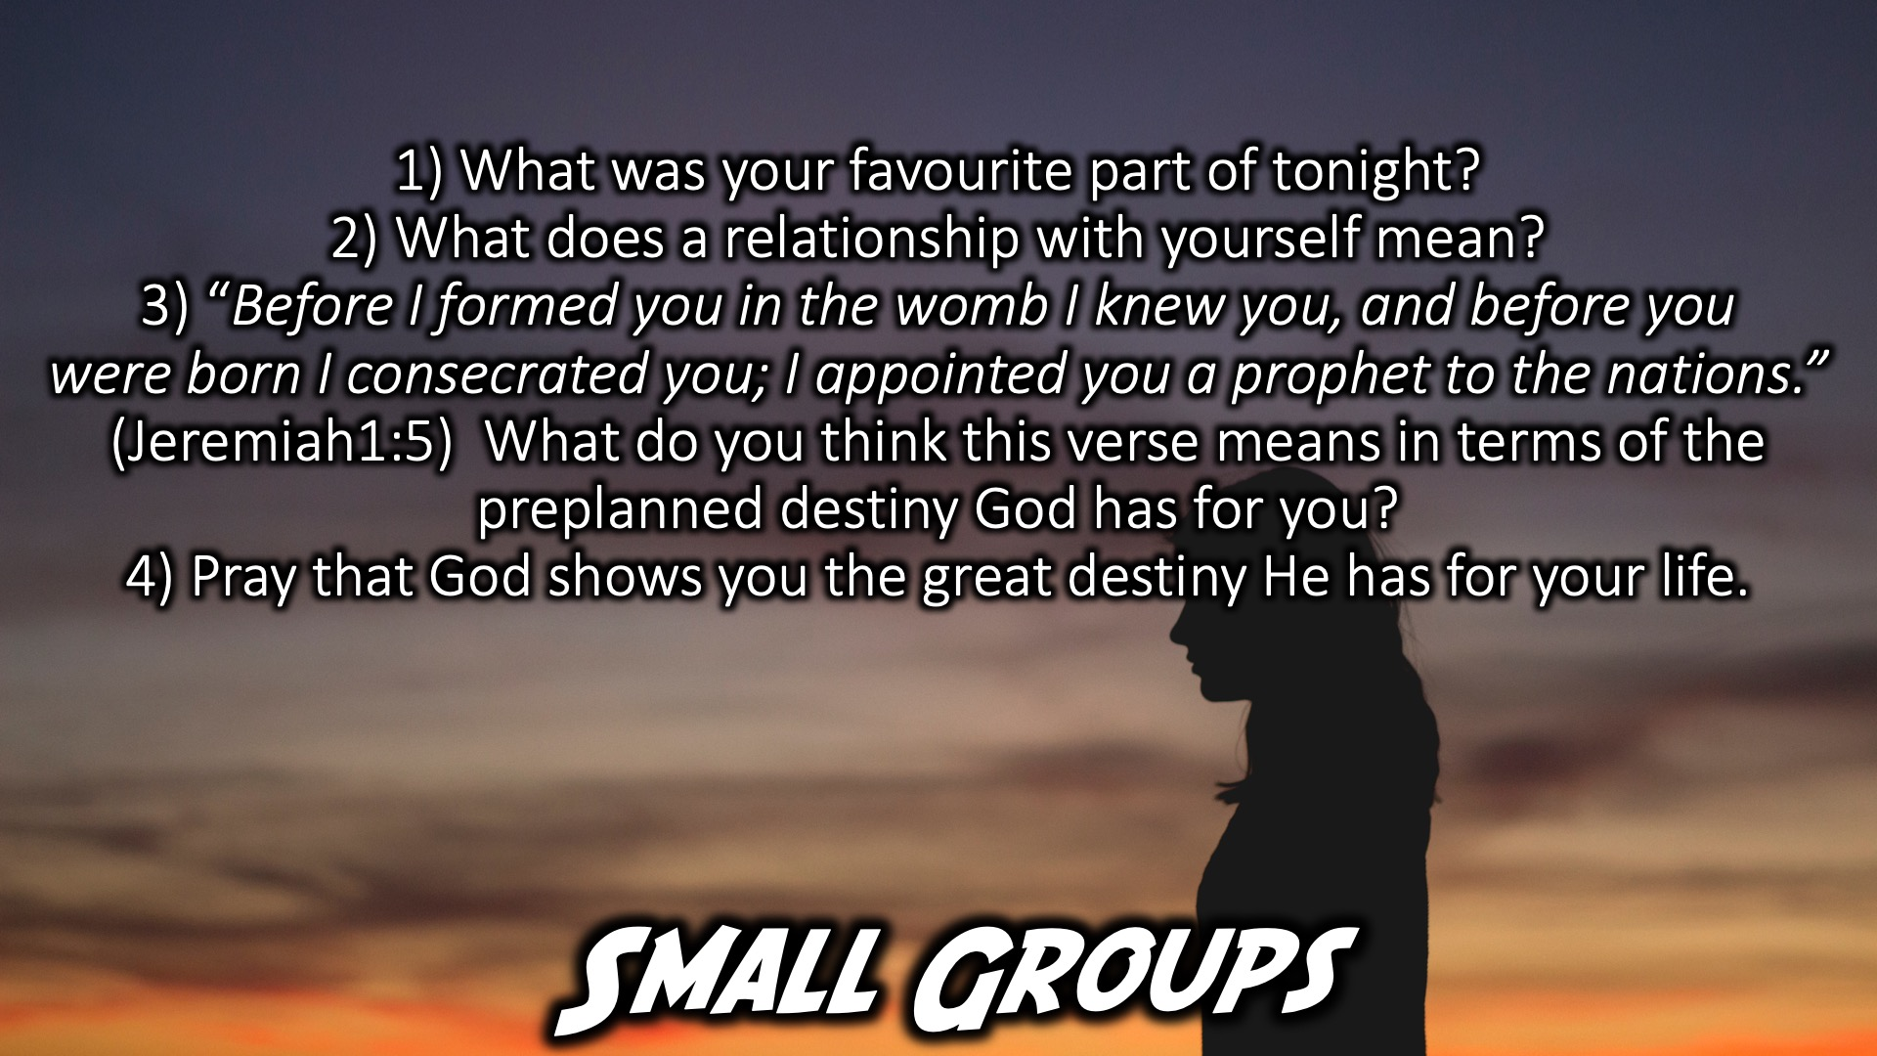
Notes:
Small Group Time: 1) What was your favourite part of tonight?
2) What does a relationship with yourself mean?
3) “Before I formed you in the womb I knew you, and before you
were born I consecrated you; I appointed you a prophet to the nations.” (Jeremiah1:5) What do you think this verse means in terms of the preplanned destiny God has for you?
4) Pray that God shows you the great destiny He has for your life.

Slide 18
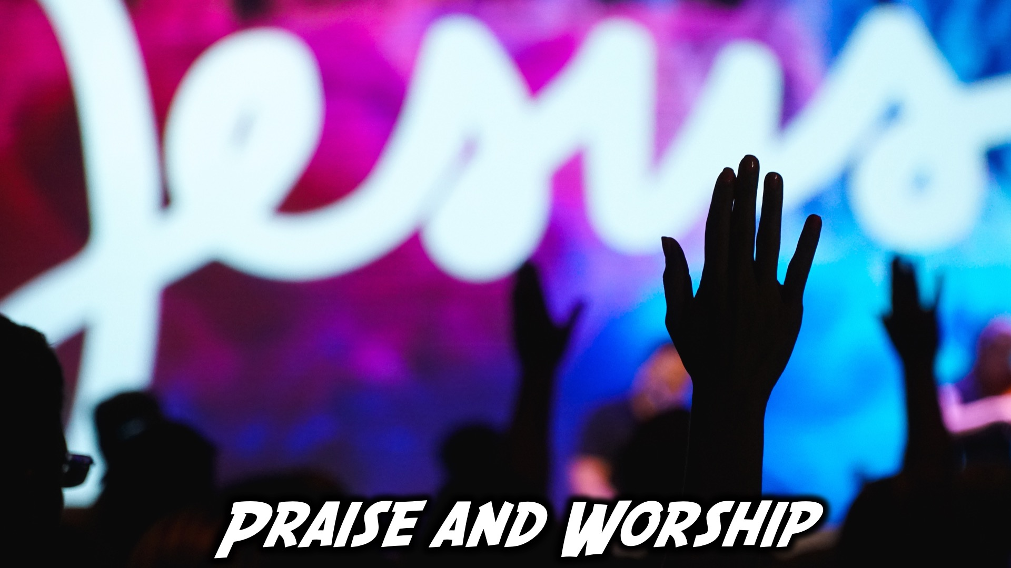
Notes:
Praise and Worship

Slide 19

Notes:
Let’s Go

Slide 20

Notes:
Author of my life

Slide 21

Notes:
What a beautiful name

Slide 22
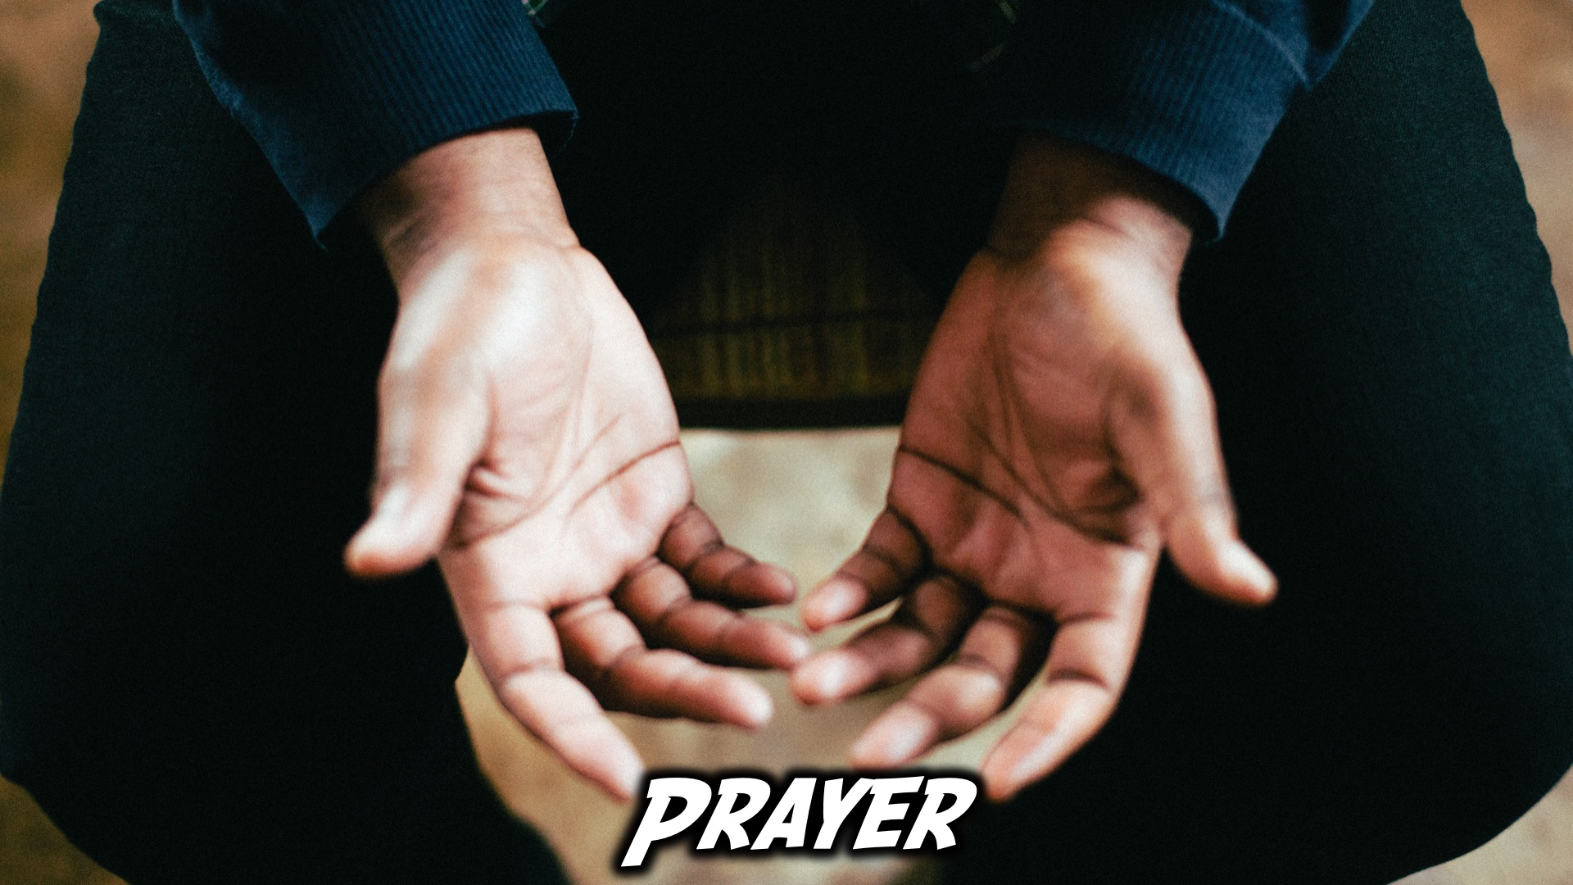
Notes:
Ministry Time at the front

Slide 23

Notes:
Refreshments

Slide 24

Notes:
Join us on Sunday!

