Slide 1

Notes:
It’s the Relationship Series!

Slide 2

Notes:
Welcome to regulars and newcomers!

Slide 3
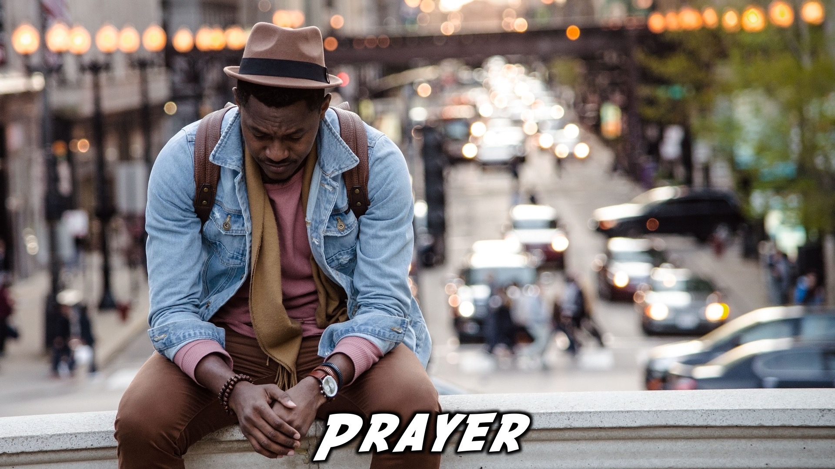
Notes:
Prayer: Let’s open our meeting in prayer.

Slide 4

Notes:
Announcements: Please Listen up to the following announcement.

Slide 5

Notes:
Next Week: On Sunday we continue our mini-series on relationships. This Sunday we are learning about Relationships with parents.

Slide 6

Notes:
Next Friday the topic is Relationship with God.

Slide 7
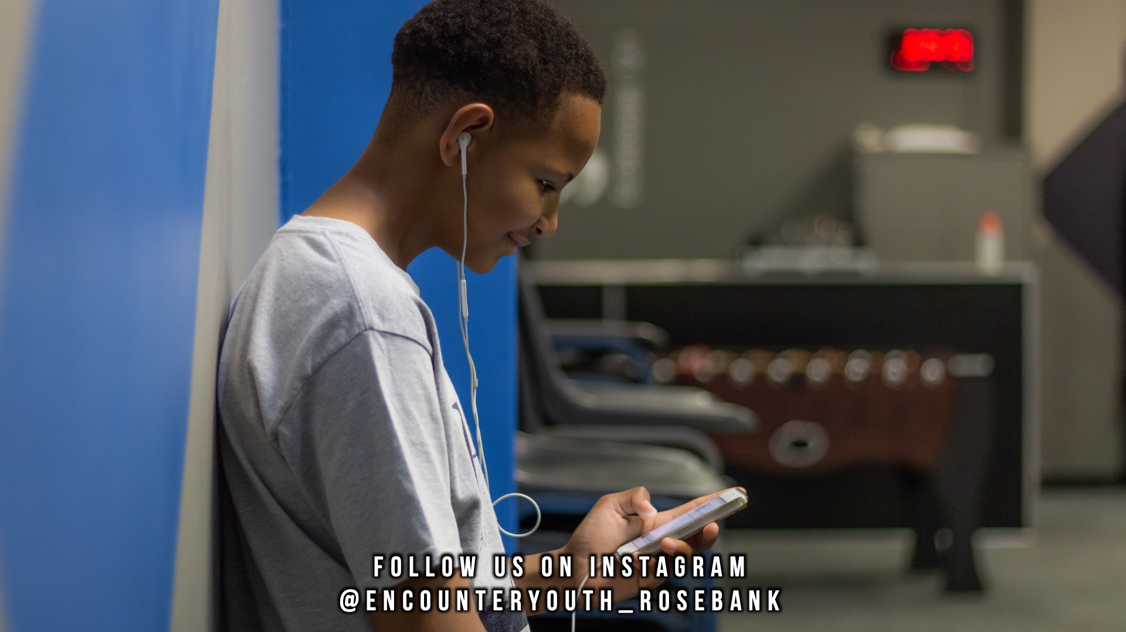
Notes:
Announcements: Follow us on Instagram! @EncounterYouth_Rosebank

Slide 8

Notes:
Announcements: Join us for our youth outreach, Saturday 2 February, 10-12

Slide 9

Notes:
Announcements: Join our WhatsApp group!

Slide 10

Notes:
Tonight: Our topic is Romance.

Slide 11

Notes:
Praise and Worship

Slide 12

Notes:
Praise and Worship: For your purpose

Slide 13

Notes:
Praise and Worship: Oh Sing

Slide 14

Notes:
Praise and Worship: Whole Heart (Hillsong)

Slide 15
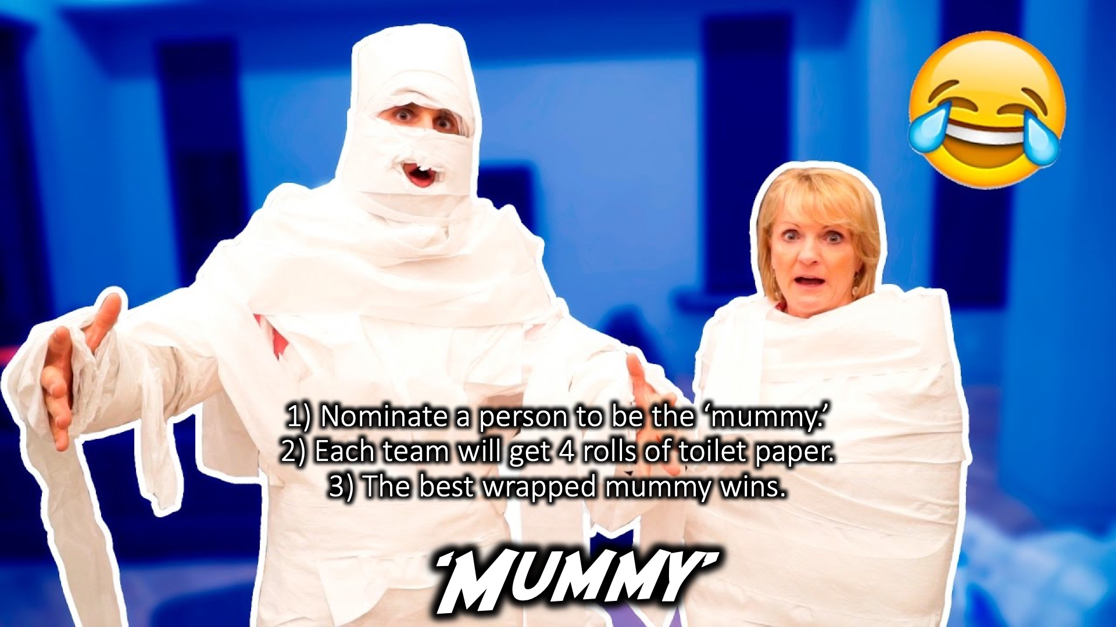
Notes:
Game: Mummy - 1) Nominate a person to be the ‘mummy.’
2) Each team will get 4 rolls of toilet paper.
3) The best wrapped mummy wins.

Slide 16
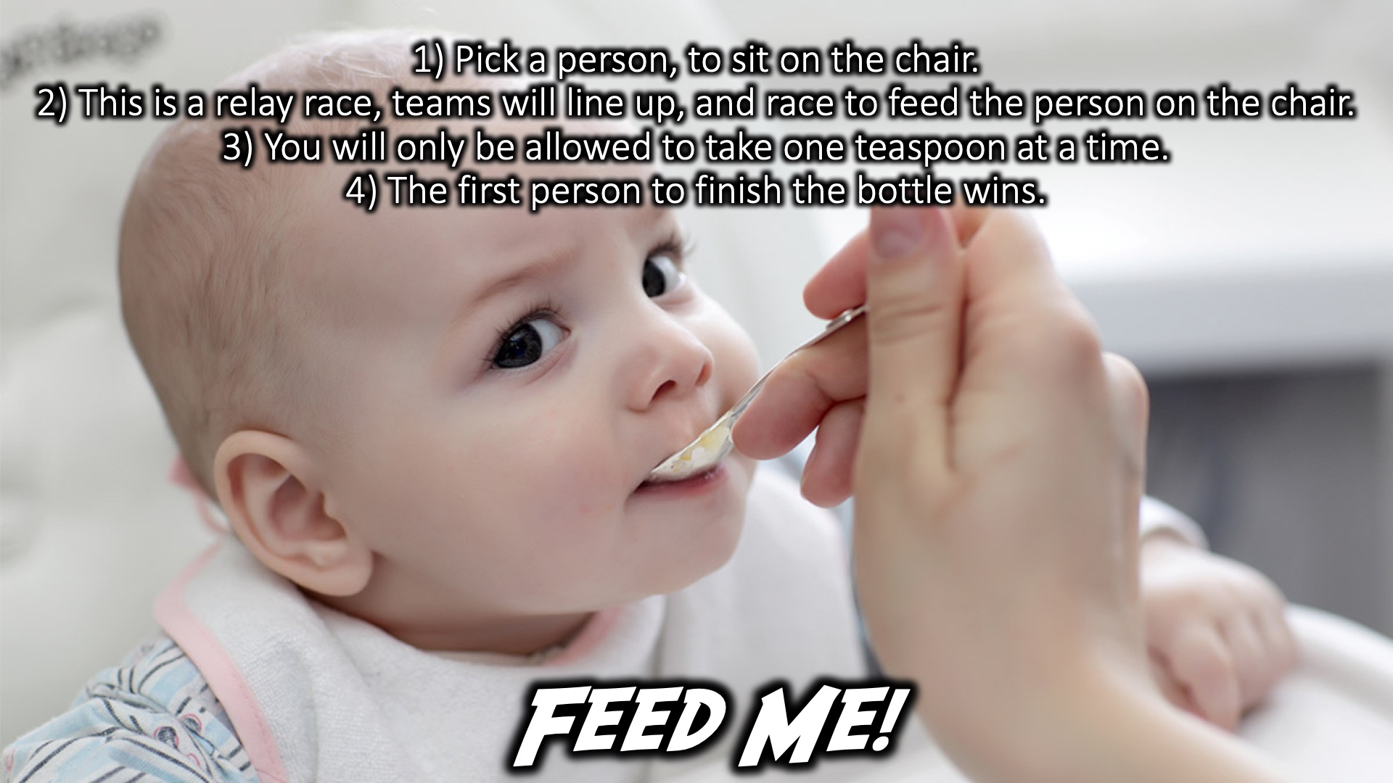
Notes:
Feed Me: 1) Pick a person, to sit on the chair.
2) This is a relay race, teams will line up, and race to feed the person on the chair.
3) You will only be allowed to take one teaspoon at a time.
4) The first person to finish the bottle wins.

Slide 17

Notes:
Baby Burps: 1) Choose someone to be the baby.
2) They will receive a baby bottle with a fizzy drink in it.
3) The first person to finish the bottle, and burp, wins!

Slide 18

Notes:
Tonight: Our topic is Romance.

Slide 19

Notes:
Video

Slide 20
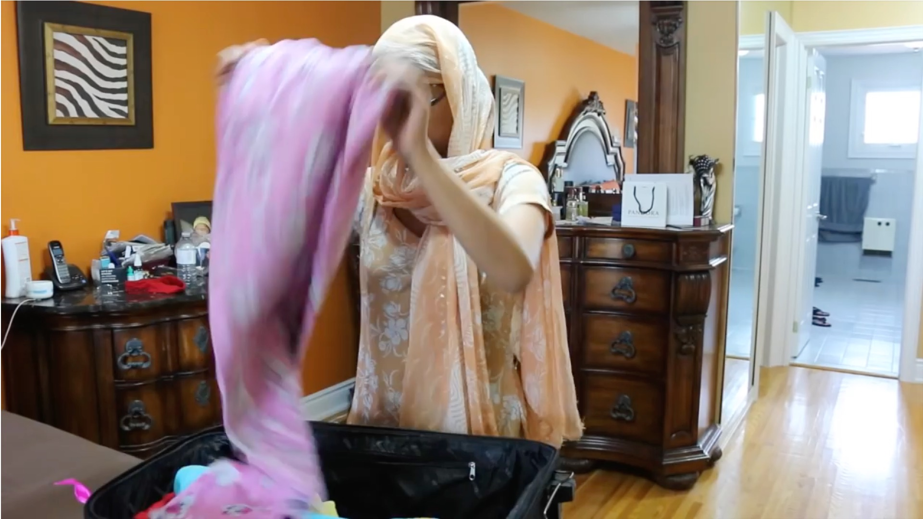
Notes:
Video: Find it on YouTube at https://www.youtube.com/watch?v=x6kBXbw9E5M

Slide 21
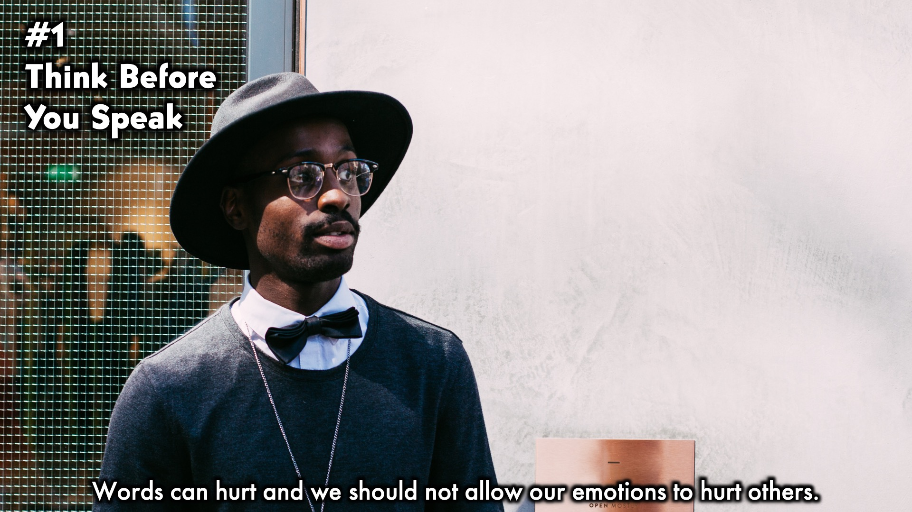
Notes:
Brief talk on parents.

Slide 22
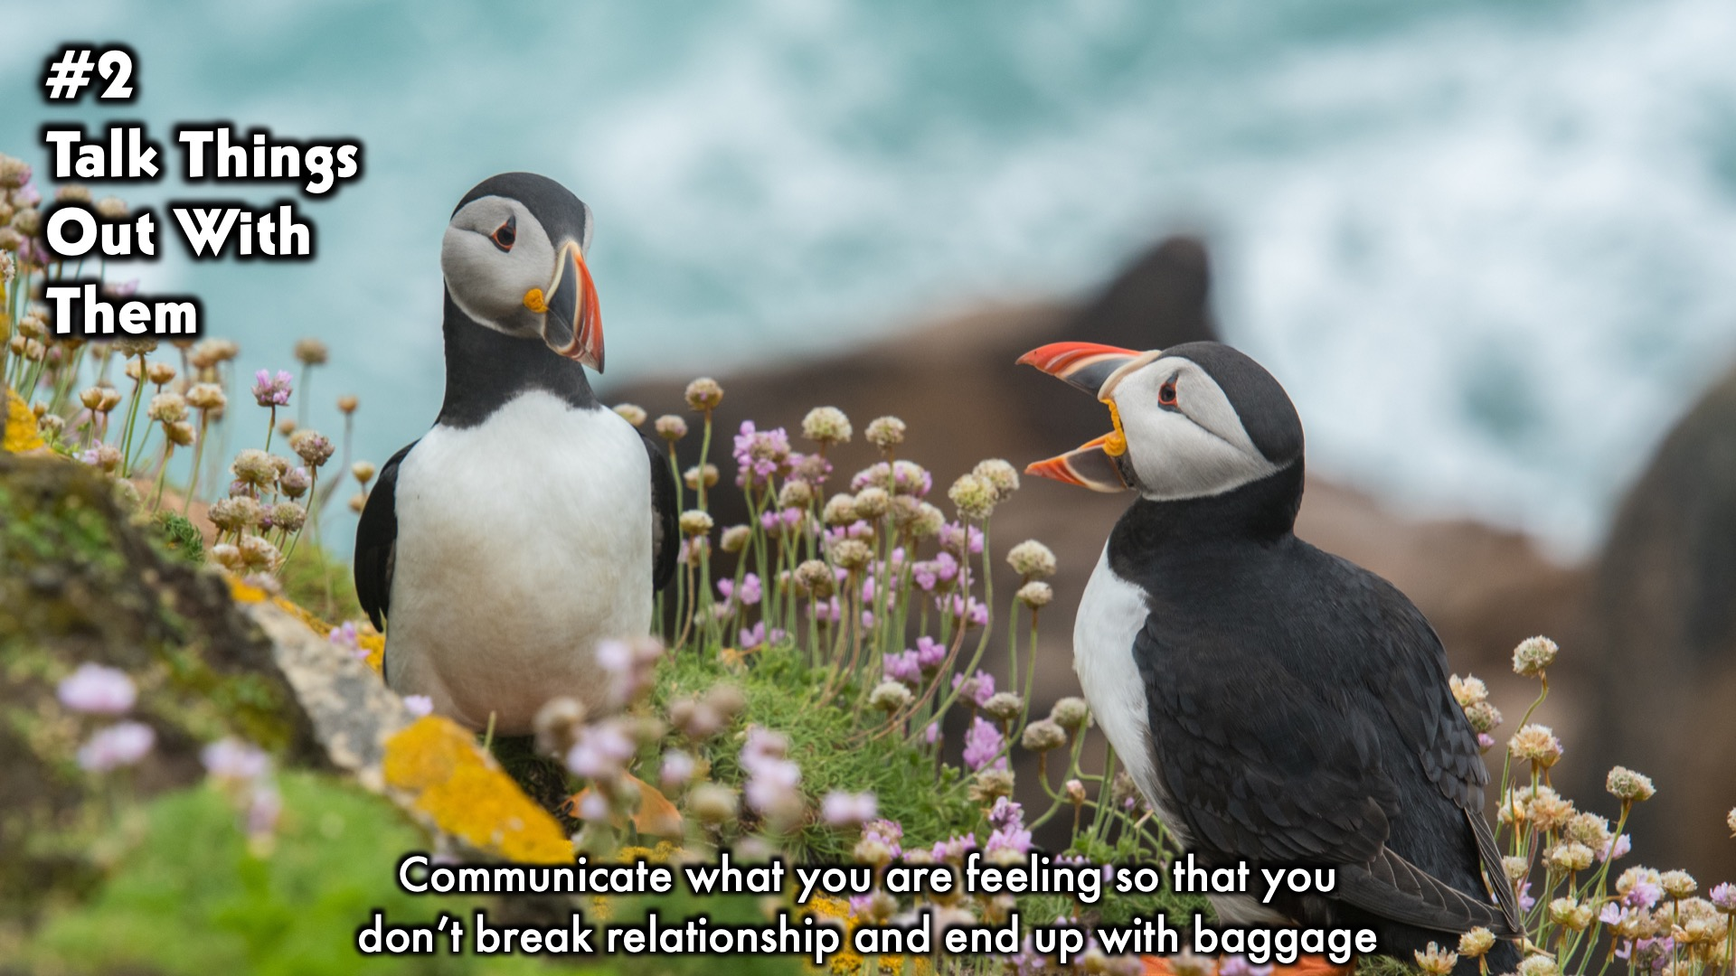
Notes:
Panel Discussion:

Slide 23
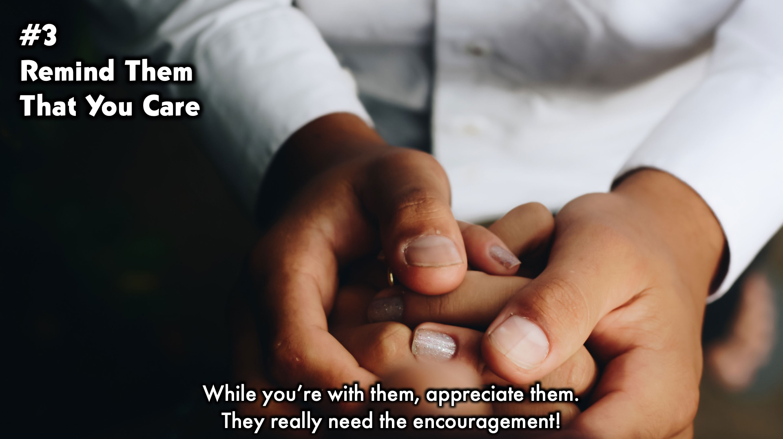
Notes:
Panel Discussion:

Slide 24

Notes:
Panel Discussion:

Slide 25
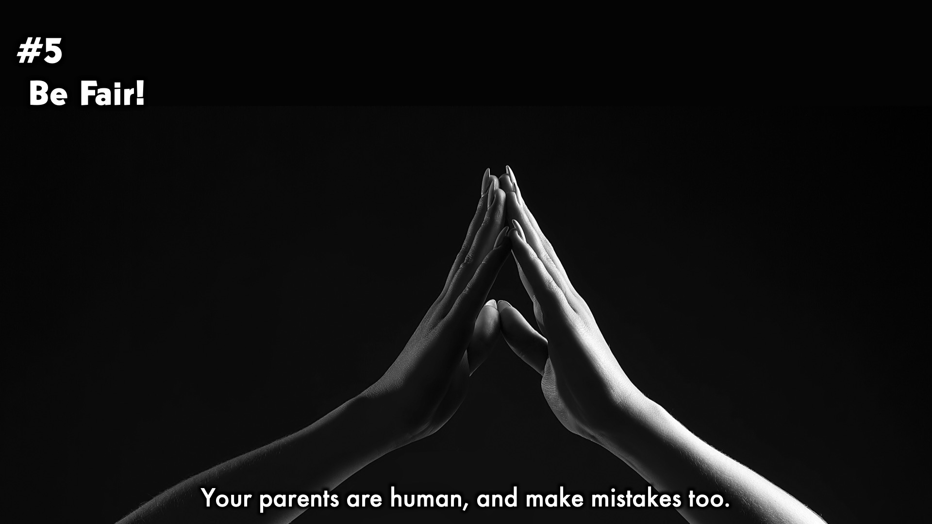
Notes:
Panel Discussion:

Slide 26

Notes:
Panel Discussion:

Slide 27

Notes:
Small Group Time: (1) What was your favourite part of tonight? (2) What do you struggle with most with regards to respecting your parents? (3) What are the benefits that should motivate us to honour and respect our parents?“If one curses his father or his mother, his lamp will be put out in utter darkness.” (Proverbs 20:20) (4) Break into pairs and pray for each other’s relationships with their parents.

Slide 28
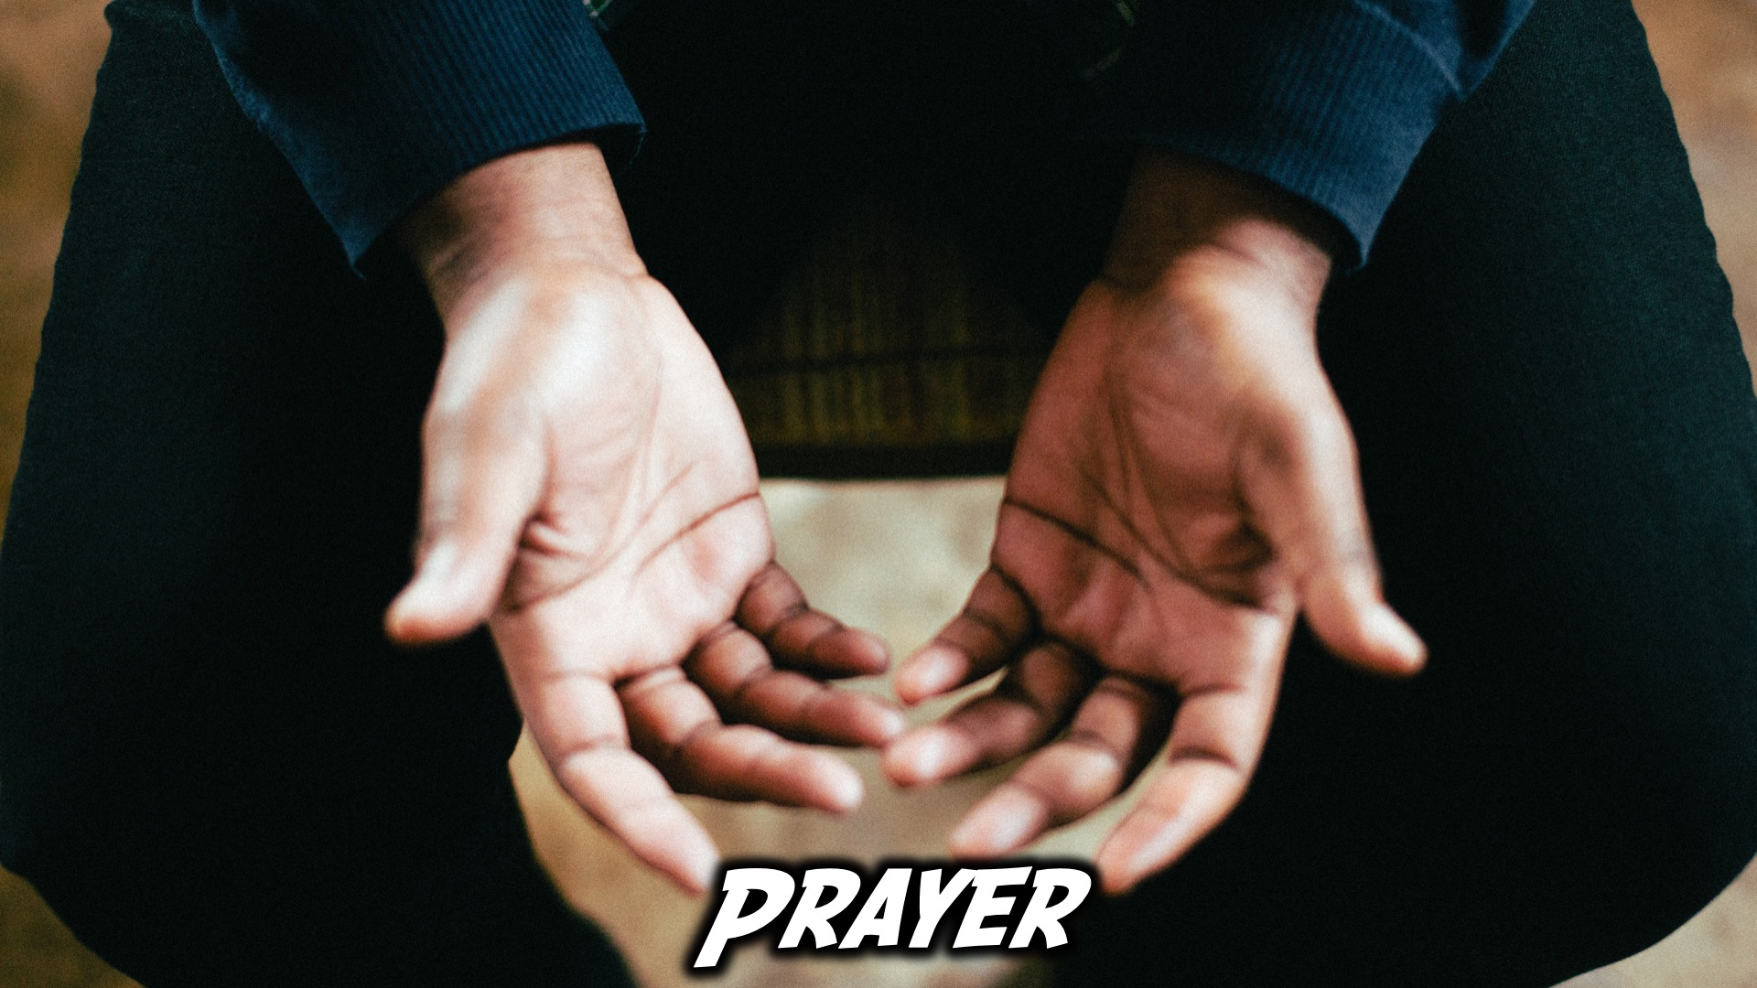
Notes:
Ministry Time at the front

Slide 29

Notes:
Refreshments

Slide 30

Notes:
Join us on Sunday!

