Slide 1

Notes:
It’s the Relationship Series!

Slide 2
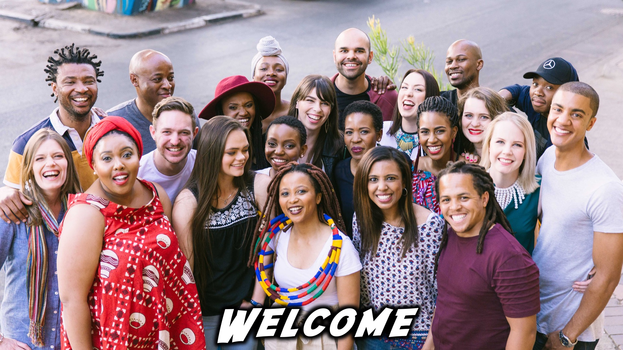
Notes:
Welcome to regulars and newcomers!

Slide 3
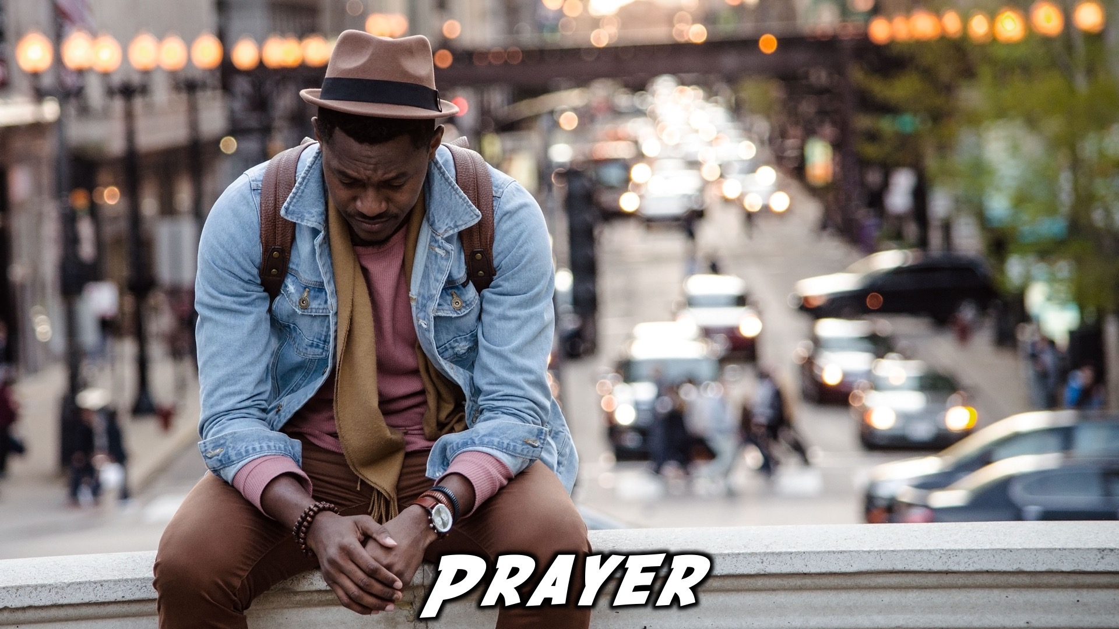
Notes:
Prayer: Let’s open our meeting in prayer.

Slide 4
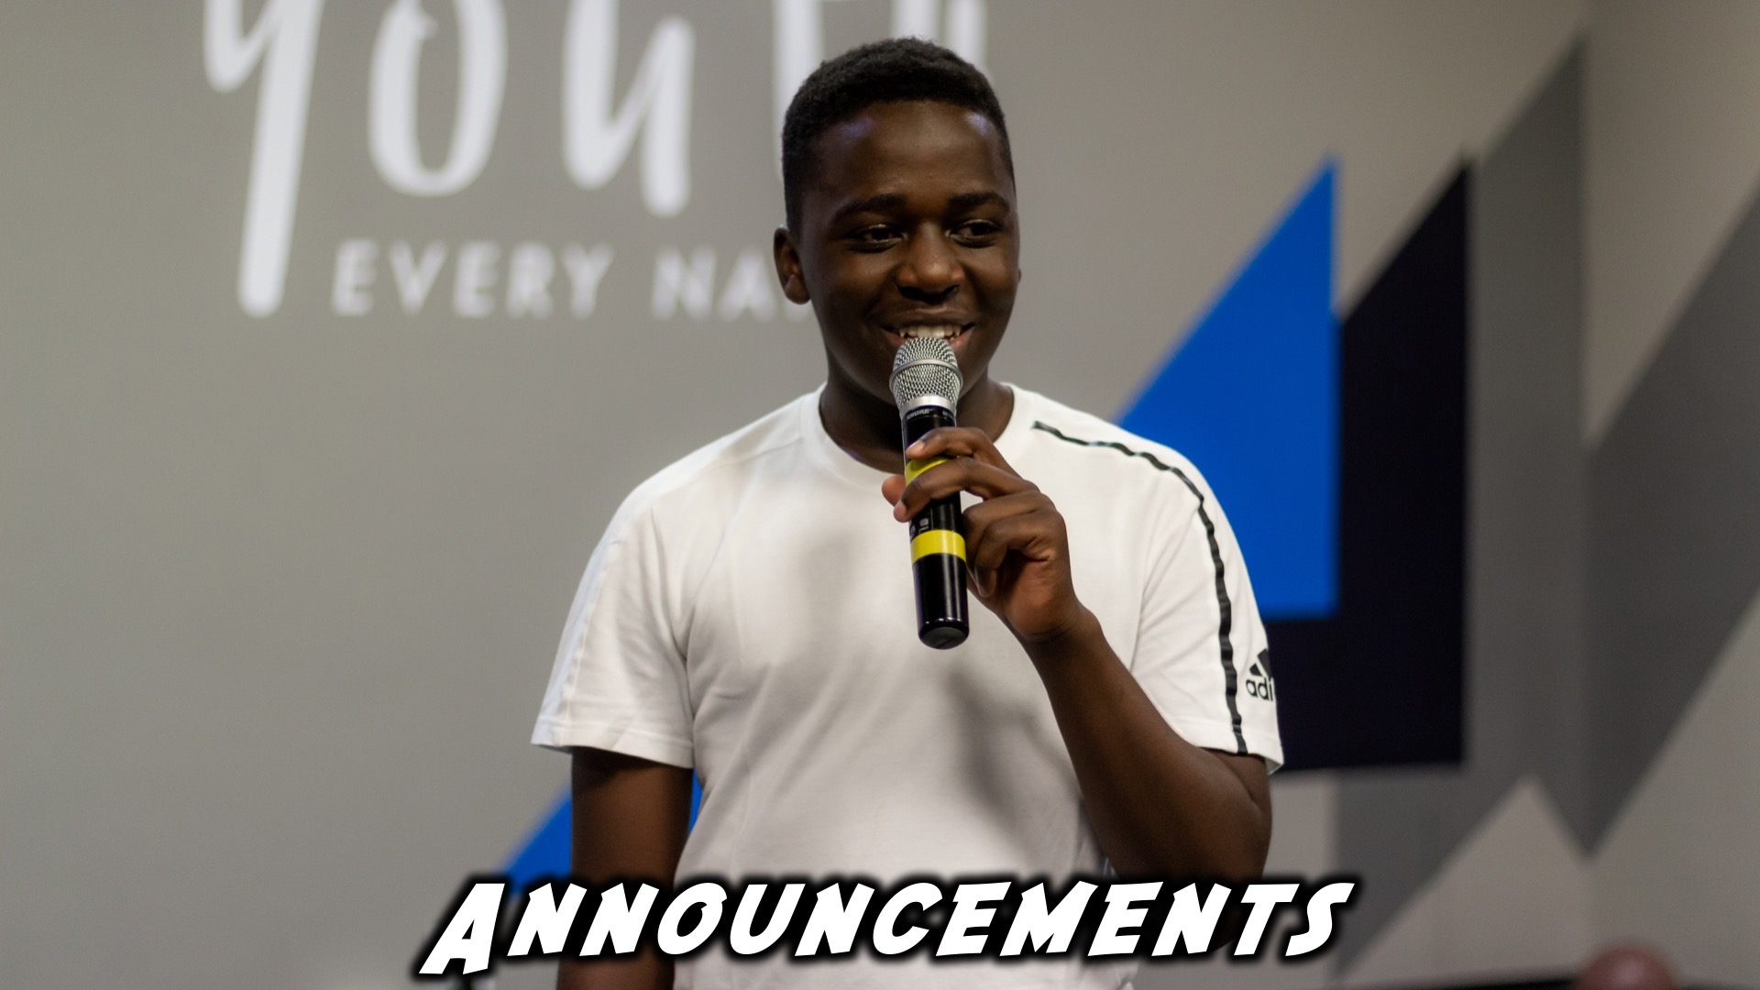
Notes:
Announcements: Please Listen up to the following announcement.

Slide 5

Notes:
Next Week: On Sunday we continue our mini-series on relationships. This Sunday we are learning about our Relationships with God.

Slide 6

Notes:
Next Friday we begin our Campaign, “What On Earth Am I Here For.”

Slide 7
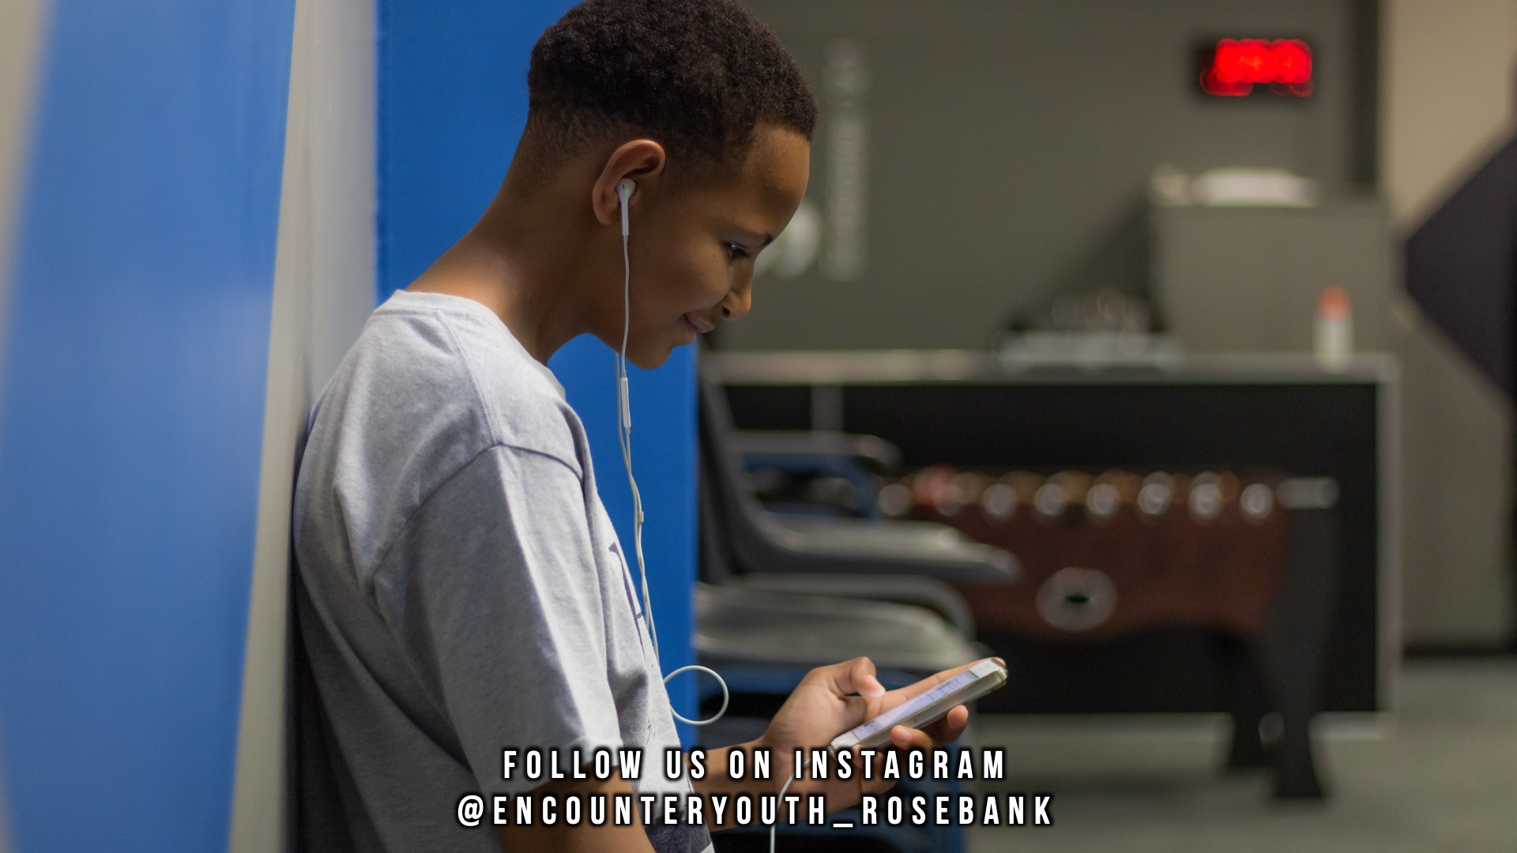
Notes:
Announcements: Follow us on Instagram! @EncounterYouth_Rosebank

Slide 8
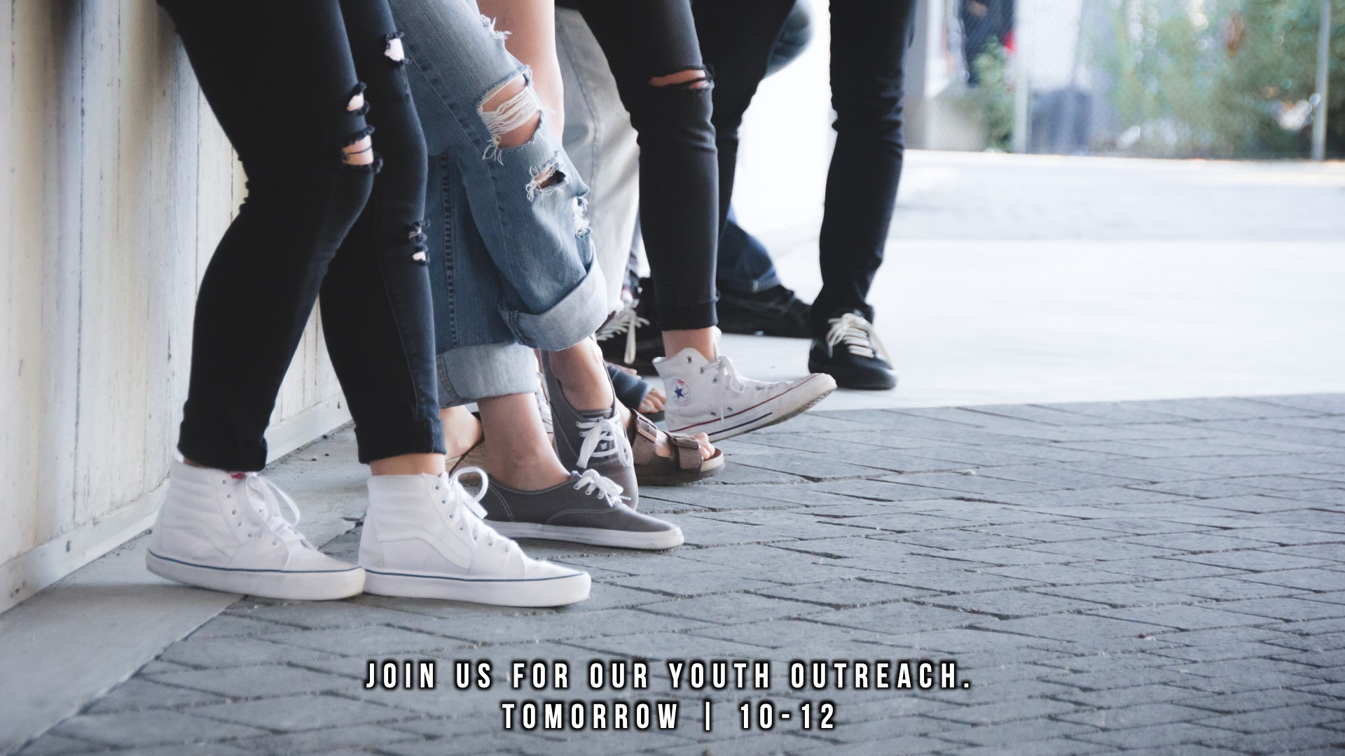
Notes:
Announcements: Join us for our youth outreach, Saturday 2 February, 10-12

Slide 9

Notes:
Announcements: Join our WhatsApp group!

Slide 10

Notes:
Tonight: Our topic is a Relationship With God.

Slide 11

Notes:
Praise and Worship

Slide 12

Notes:
1. Endless Praise by PlanetShakers

Slide 13

Notes:
2. Unstoppable God by Elevation Worship

Slide 14
Notes:
3. This I know by We Will Worship

Slide 15
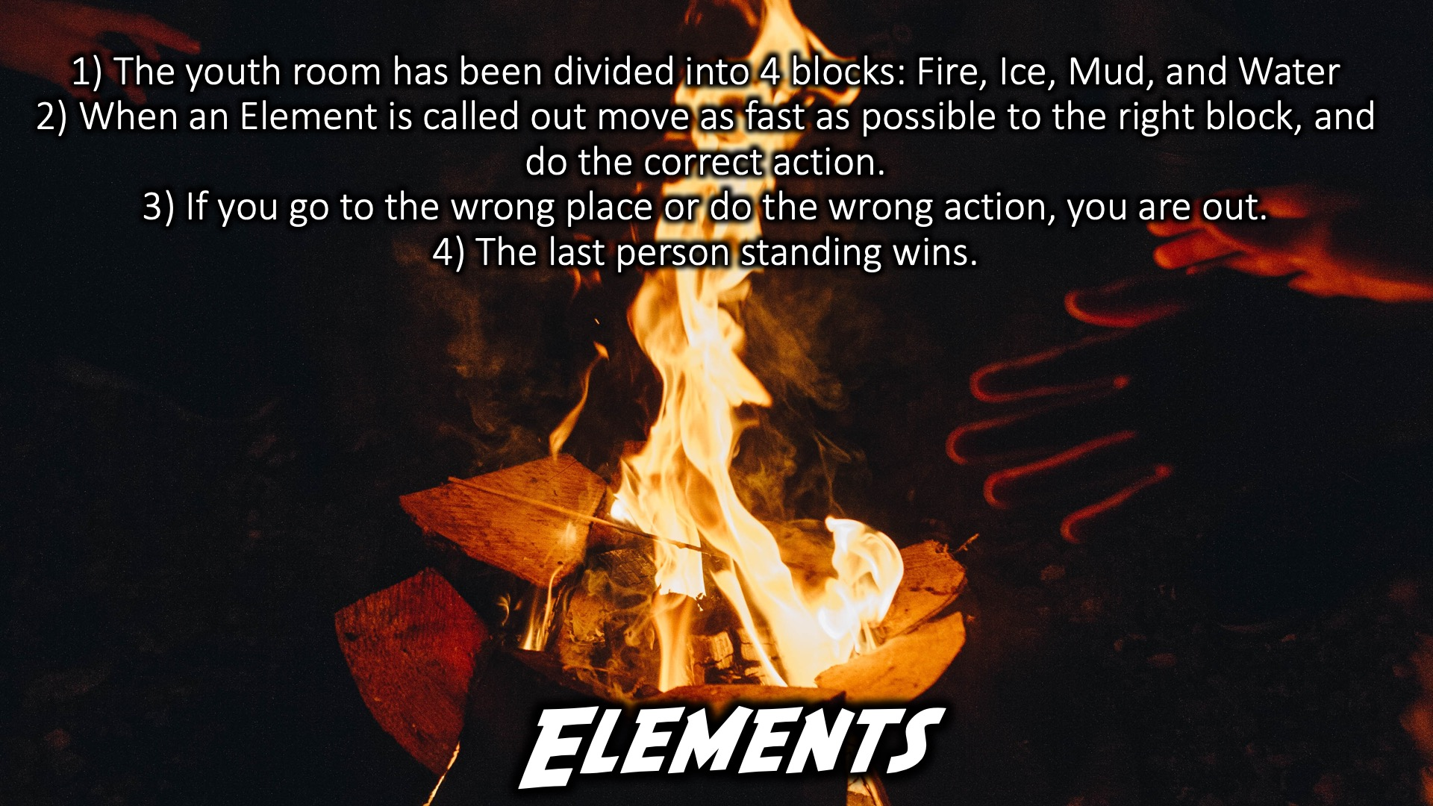
Notes:
Elements:
Divide the room into four quadrants.
Each quadrant represents a different element (1. Fire, 2. Ice, 3. Mud, 4. Water).
The leader of the game calls out a different element and the teens have to run to that quadrant and do something (Fire- Jump up and down, Ice- Freeze, Mud- Pretend to sink, Water- Swim).
If they run to the wrong place or do the wrong action they are out, and the last person there wins.

Slide 16

Notes:
Introducing God:
Divide the teens into groups of about five and get them to come up with an introduction for God as if He were a guest artist or speaker at an event. They can be creative and use effects or music.
Give them 10-15 minutes to prepare and then take it in turns to have each group perform.
Score them on enthusiasm, effects, creativity, etc
This game gives them a chance to have fun, be creative as well as discuss who God is and what they think of Him.

Slide 17
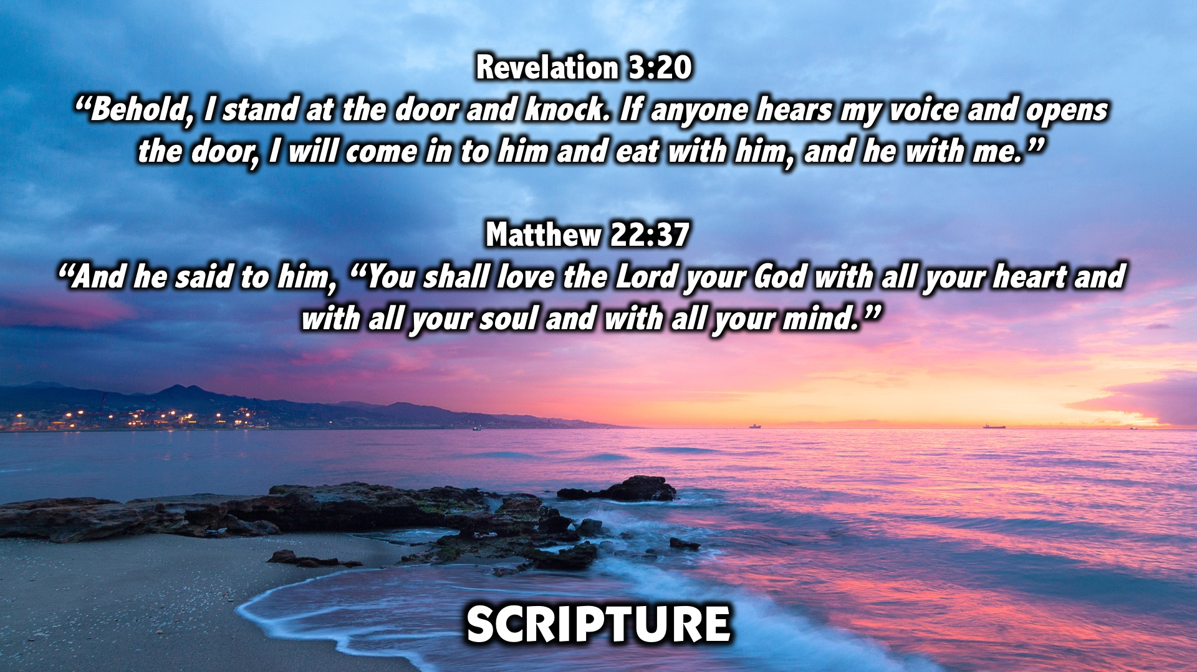
Notes:
Scripture: Matthew 22:37, Revelation 3:20

Slide 18

Notes:
Divide into your Groups

Slide 19

Notes:
Small Group Time: What was your favourite thing about tonight?
“Behold, I stand at the door and knock. If anyone hears my voice and opens the door, I will come in to him and eat with him, and he with me.”
Revelation 3:20
If God was knocking at your front door, would you open it for Him? Would you do the same in your heart?
“And he said to him, “You shall love the Lord your God with all your heart and with all your soul and with all your mind.” Matthew 22:37
What do you love with everything in you? What would change if you loved God that way?
How is your relationship with God?
Pray for each other’s relationships with God, and if you don’t have a relationship with Him, ask Him into your heart.

Slide 20
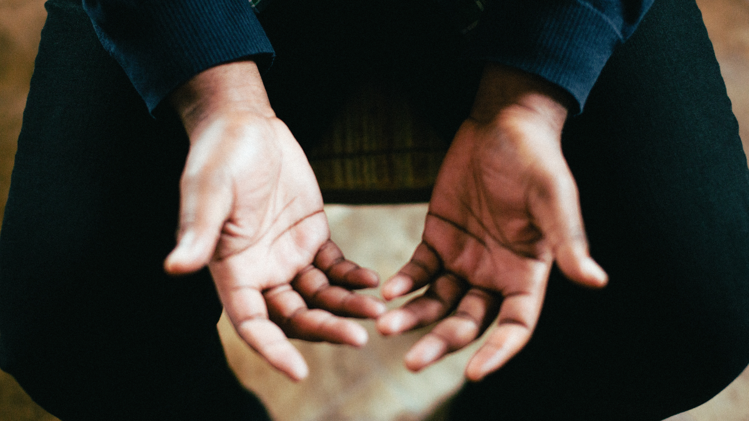
Prayer
Notes:
Ministry Time at the front

Slide 21

Notes:
Refreshments

Slide 22

Notes:
Join us on Sunday!

