Slide 1

Notes:
Welcome to the Relationship Series.
Mini Series
Friday = Precursor

Slide 2

Notes:
This week we are exploring Romantic Relationships

Slide 3

Notes:
Next Week we will explore relationships with yourselves.

Slide 4

Notes:
In Week 3 we will explore your relationship with your parents.

Slide 5

Notes:
In Week 4 we will explore your relationship with God.

Slide 6

Notes:
Today: Romantic Relationships.

Slide 7

Notes:
Opening Question: Why would you get into a romantic relationship? (lust, to get something, fulfilment, to show off, popularity… real reason: to be selfless, show love, respect the person…)

Slide 8
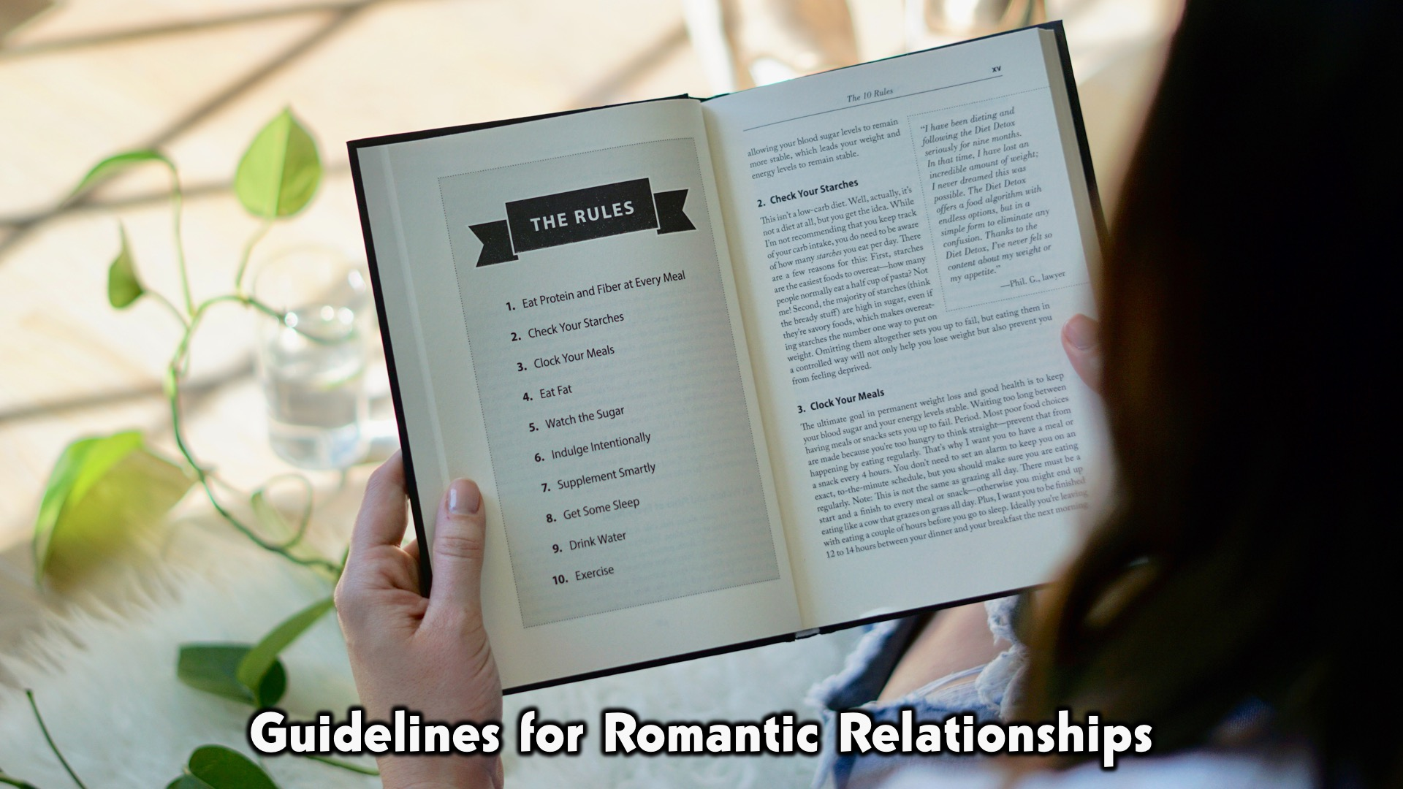
Notes:
We want to discuss the guidelines for romantic relationships today and what the Bible says

Slide 9
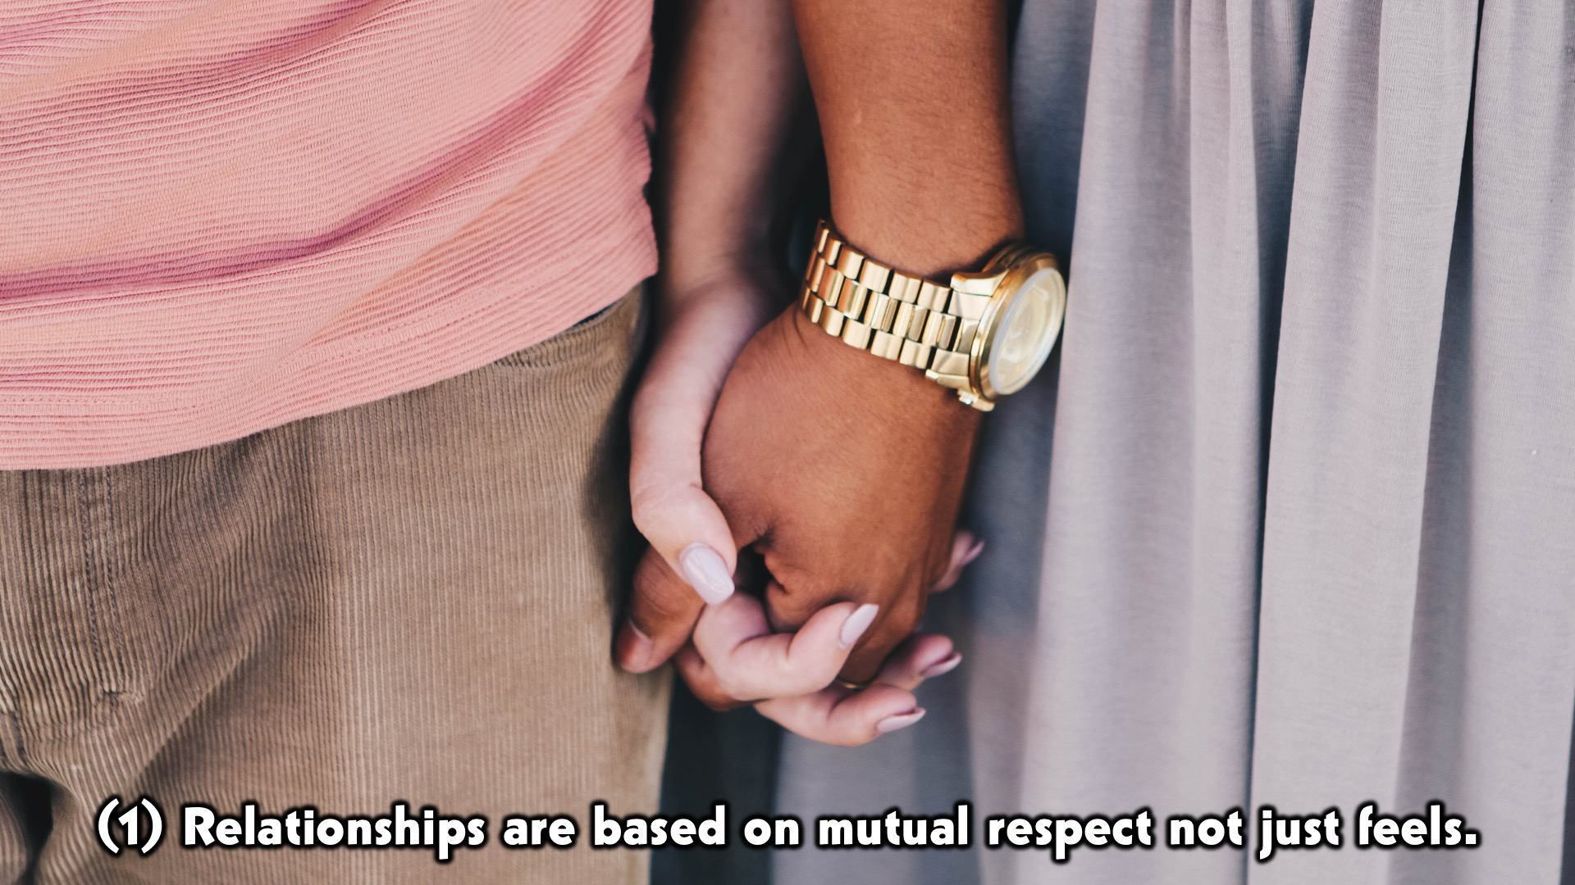
Notes:
Relationships are based on based on mutual respect not just feels. (mutual respect leads to truth, honesty, safety/security)
Scripture reference: “submitting to one another out of reverence for Christ. Wives, submit to your own husbands, as to the Lord. For the husband is the head of the wife even as Christ is the head of the church, his body, and is himself its Savior. Now as the church submits to Christ, so also wives should submit in everything to their husbands.” Ephesians 5:21-24
Subpoint: This is so because all creation is modeled on the God-head

Slide 10
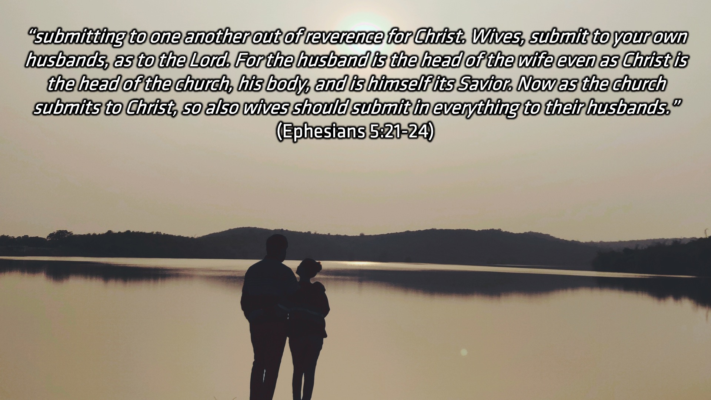
Notes:
Relationships are based on based on mutual respect not just feels. (mutual respect leads to truth, honesty, safety/security)
Scripture reference: “submitting to one another out of reverence for Christ. Wives, submit to your own husbands, as to the Lord. For the husband is the head of the wife even as Christ is the head of the church, his body, and is himself its Savior. Now as the church submits to Christ, so also wives should submit in everything to their husbands.” Ephesians 5:21-24
Subpoint: This is so because all creation is modeled on the God-head

Slide 11
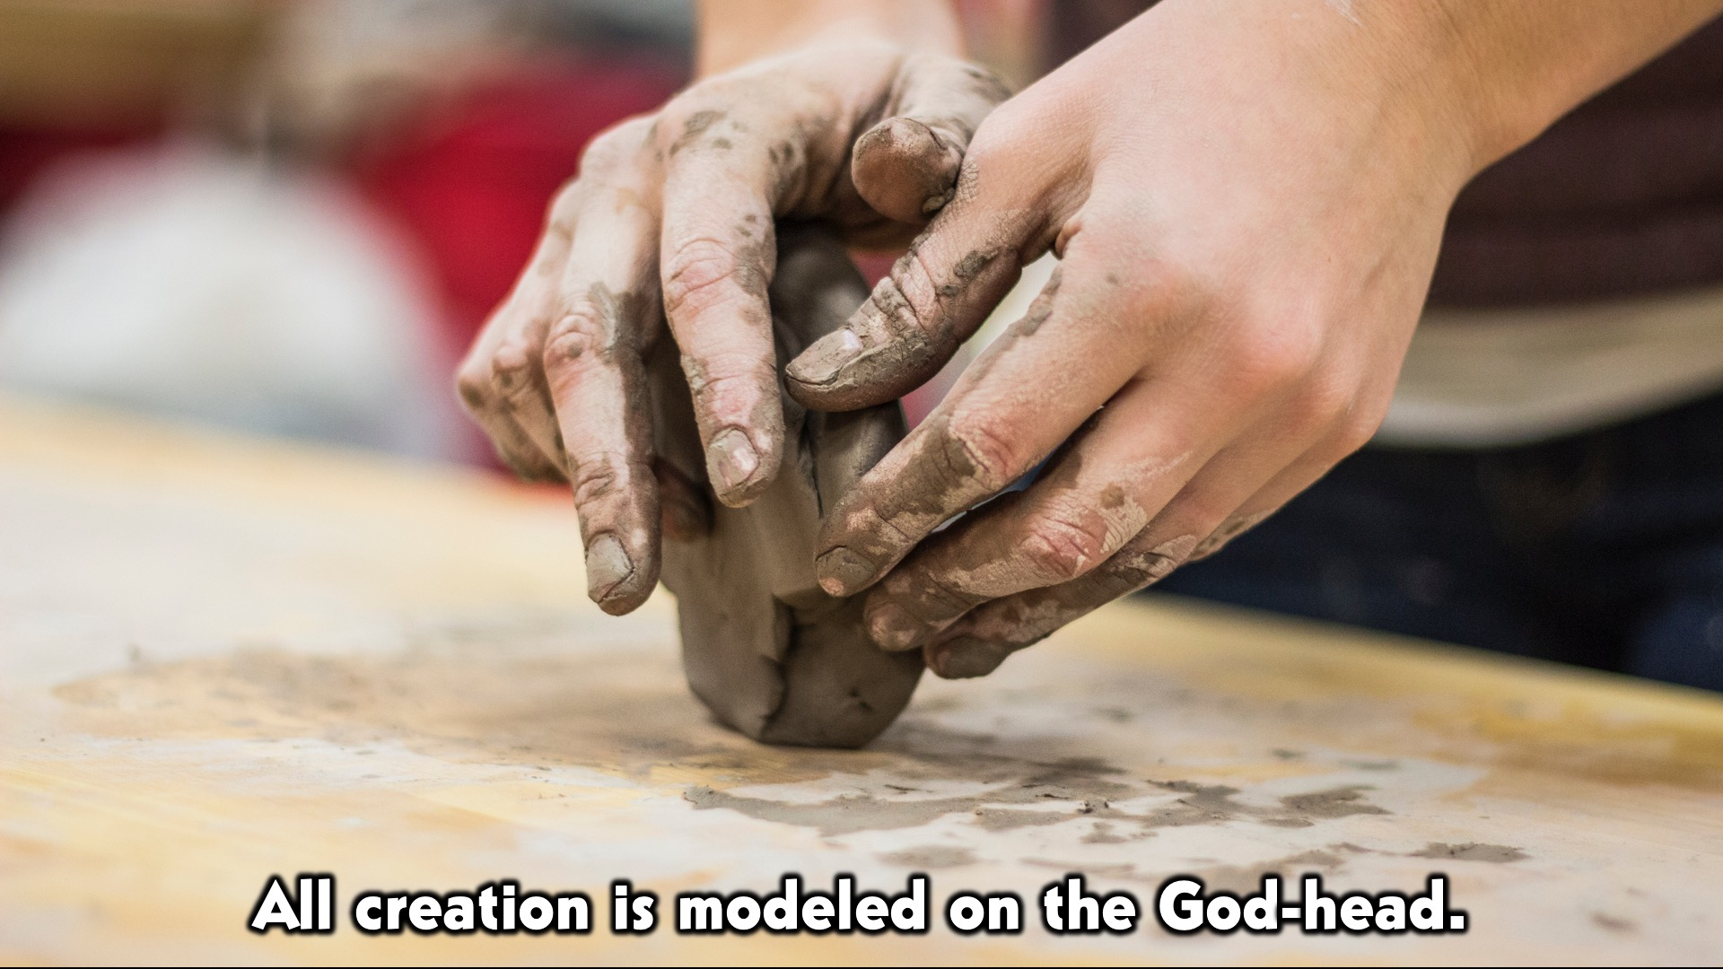
Notes:
Relationships are based on based on mutual respect not just feels. (mutual respect leads to truth, honesty, safety/security)
Scripture reference: “submitting to one another out of reverence for Christ. Wives, submit to your own husbands, as to the Lord. For the husband is the head of the wife even as Christ is the head of the church, his body, and is himself its Savior. Now as the church submits to Christ, so also wives should submit in everything to their husbands.” Ephesians 5:21-24
Subpoint: This is so because all creation is modeled on the God-head

Slide 12
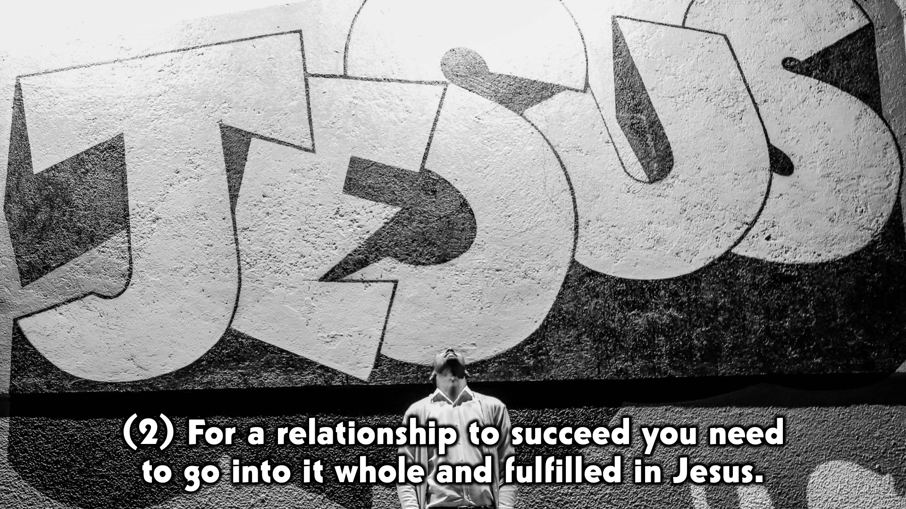
Notes:
#2 For a relationship to succeed you need to go into it whole and fulfilled in Jesus.
Scripture reference: “and in Christ you have been brought to fullness. He is the head over every power and authority.” Colossians 2:10
Subpoint: When you idolize your partner or look to them to complete you, you are not going to be fulfilled. Fulfilled in Christ= able to be yourself and confident and authentic, love from a secure place. Be completely YOU.

Slide 13
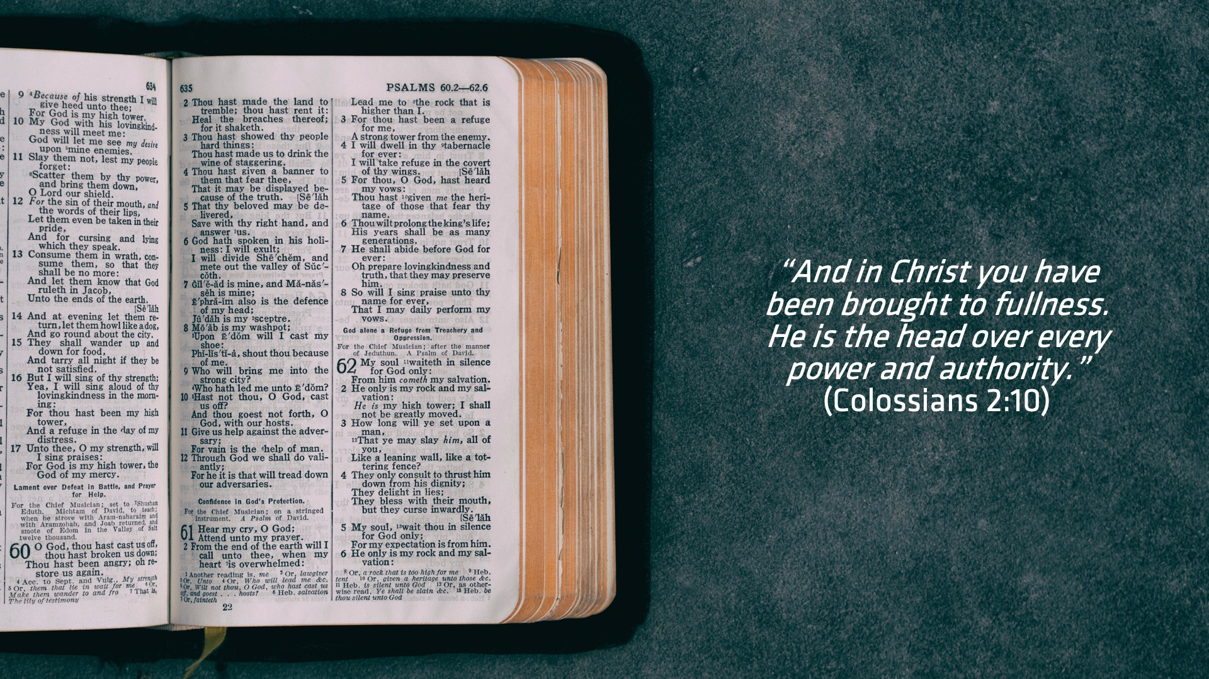
Notes:
#2 For a relationship to succeed you need to go into it whole and fulfilled in Jesus.
Scripture reference: “and in Christ you have been brought to fullness. He is the head over every power and authority.” Colossians 2:10
Subpoint: When you idolize your partner or look to them to complete you, you are not going to be fulfilled. Fulfilled in Christ= able to be yourself and confident and authentic, love from a secure place. Be completely YOU.

Slide 14

Notes:
#2 For a relationship to succeed you need to go into it whole and fulfilled in Jesus.
Scripture reference: “and in Christ you have been brought to fullness. He is the head over every power and authority.” Colossians 2:10
Subpoint: When you idolize your partner or look to them to complete you, you are not going to be fulfilled. Fulfilled in Christ= able to be yourself and confident and authentic, love from a secure place. Be completely YOU.

Slide 15

Notes:
#3 Relationships should be born out of love not lust.
Scripture reference: “Love is patient and kind; love does not envy or boast; it is not arrogant or rude. It does not insist on its own way; it is not irritable or resentful; it does not rejoice at wrongdoing, but rejoices with the truth. Love bears all things, believes all things, hopes all things, endures all things. Love never ends.”
1 Corinthians 13:4-8a
Subpoint: You cannot get into a relationship if it is based on anything other than selfless love. If your love doesn’t look like the verse above and if you aren’t willing to love that person like that every day, then you should not go into that relationship because you don’t really love them.

Slide 16
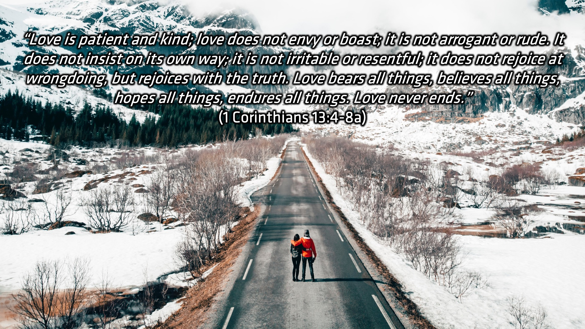
Notes:
#3 Relationships should be born out of love not lust.
Scripture reference: “Love is patient and kind; love does not envy or boast; it is not arrogant or rude. It does not insist on its own way; it is not irritable or resentful; it does not rejoice at wrongdoing, but rejoices with the truth. Love bears all things, believes all things, hopes all things, endures all things. Love never ends.”
1 Corinthians 13:4-8a
Subpoint: You cannot get into a relationship if it is based on anything other than selfless love. If your love doesn’t look like the verse above and if you aren’t willing to love that person like that every day, then you should not go into that relationship because you don’t really love them.

Slide 17

Notes:
#3 Relationships should be born out of love not lust.
Scripture reference: “Love is patient and kind; love does not envy or boast; it is not arrogant or rude. It does not insist on its own way; it is not irritable or resentful; it does not rejoice at wrongdoing, but rejoices with the truth. Love bears all things, believes all things, hopes all things, endures all things. Love never ends.”
1 Corinthians 13:4-8a
Subpoint: You cannot get into a relationship if it is based on anything other than selfless love. If your love doesn’t look like the verse above and if you aren’t willing to love that person like that every day, then you should not go into that relationship because you don’t really love them.

Slide 18

Notes:
Disclaimer:
We are not perfect. Our relationship is a journey and we are striving to seek God in everything. We make mistakes, but that’s okay, so long as we are willing to learn from them.

Slide 19
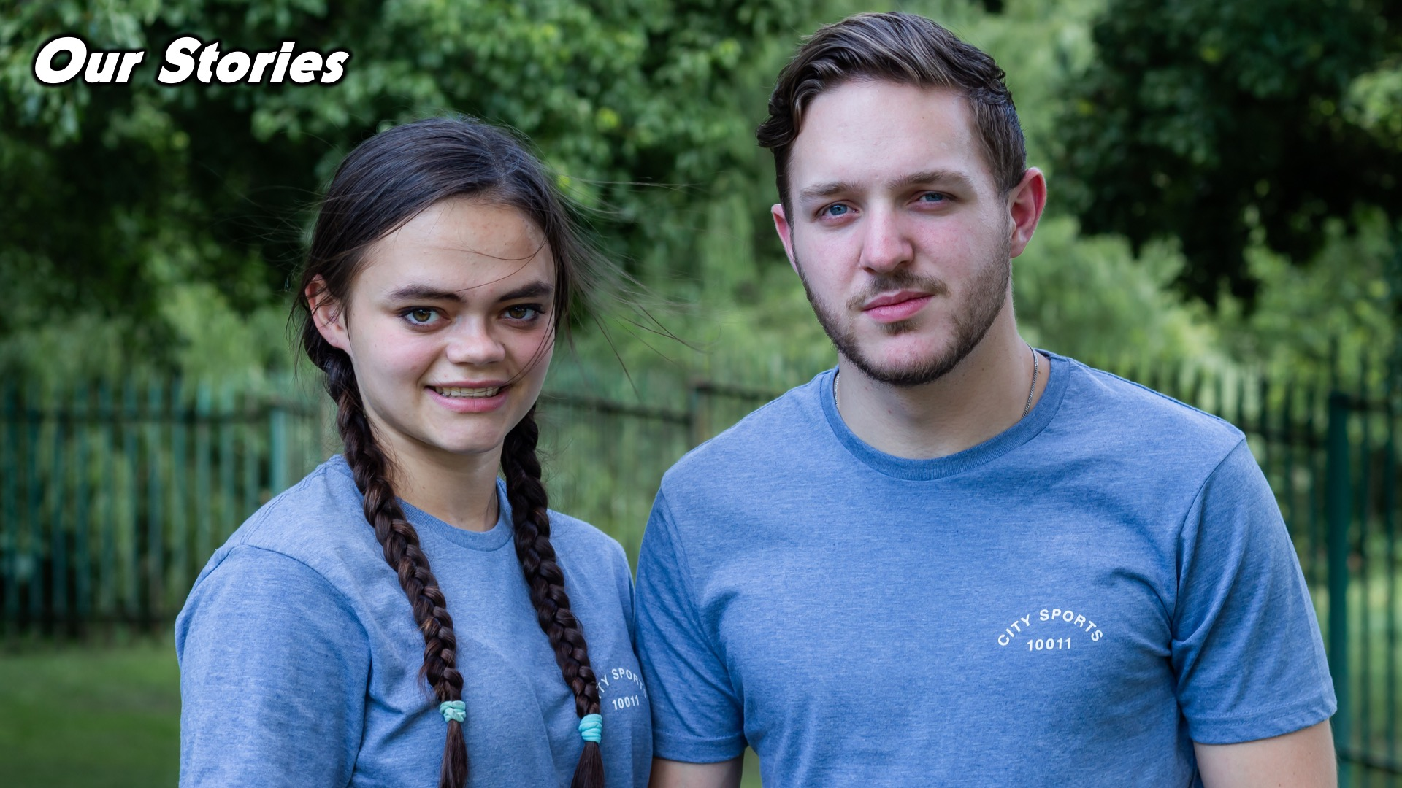
Notes:
Our Stories:
Asher’s Story:
Grace’s Story:
Our story
(we made our mistakes before and learnt from them, that is how ours has worked)

Slide 20
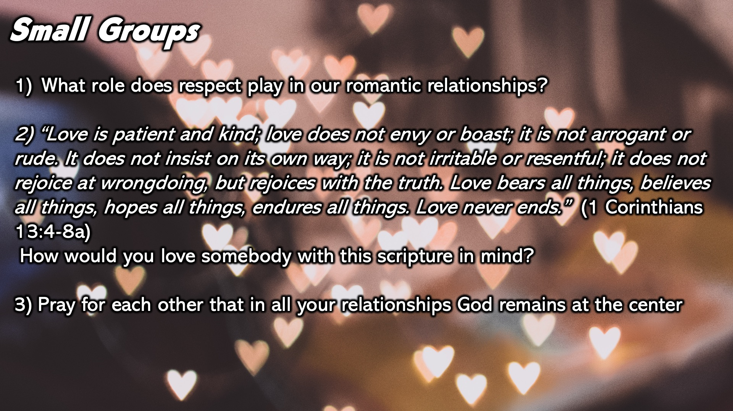
Notes:
Small Group Discussion: You have ten minutes to apply the message to your life in small groups using these 3 questions: Small Groups:
What role does respect play in our romantic relationships?
“Love is patient and kind; love does not envy or boast; it is not arrogant or rude. It does not insist on its own way; it is not irritable or resentful; it does not rejoice at wrongdoing, but rejoices with the truth. Love bears all things, believes all things, hopes all things, endures all things. Love never ends.”
1 Corinthians 13:4-8a
How would you love somebody with this scripture in mind?
Pray for each other that in all your relationships God remains at the center

Slide 21

Notes:
Wrap Up: Wrap Up:
Relationships are not just about feels but about mutual respect. (whole in yourself and fulfilled in Jesus before you go into a relationship)
It is never too late to fix mistakes that you’ve made and learn form them. We have made plenty and are far from perfect. We were not proud of them or pleased with ourselves, but we spent years sifting that out with Jesus and becoming WHOLE and so now when we talk about that, it isn’t a part of us anymore. We are free from it and we still qualify to have a beautiful romance and a success story!

Slide 22
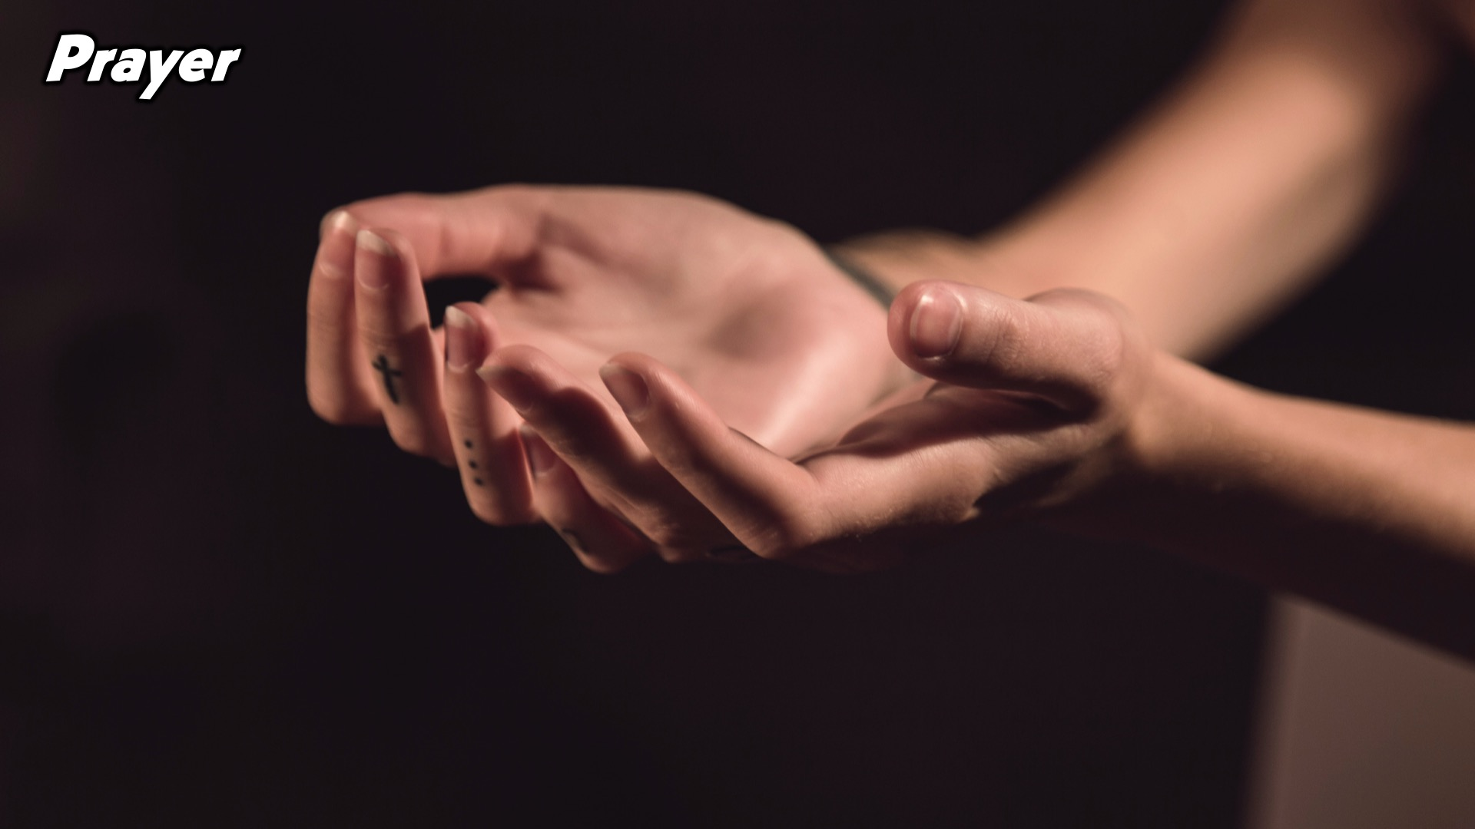
Notes:
Prayer: It is never too late to fix mistakes that you’ve made and learn form them. We have made plenty and are far from perfect. We were not proud of them or pleased with ourselves, but we spent years sifting that out with Jesus and becoming WHOLE and so now when we talk about that, it isn’t a part of us anymore. We are free from it and we still qualify to have a beautiful romance and a success story!

Slide 23

Notes:
Daily Devotions: We will post devotions on the WhatsApp group every night of the week throughout this series. Do everything you can to be a part of the daily journey.

Slide 24

Notes:
Next Week we will explore relationships with yourselves.

