Slide 1
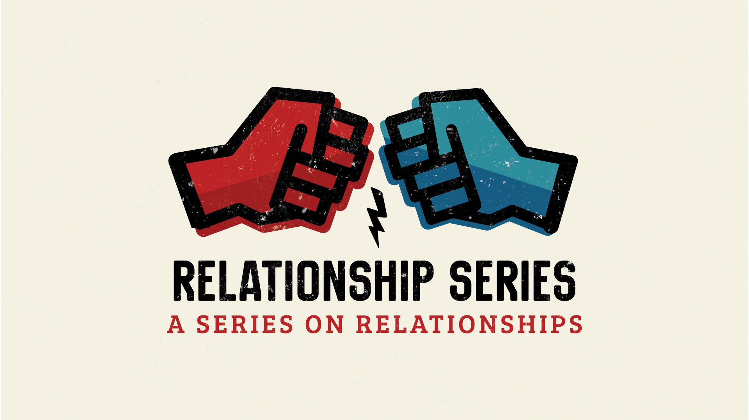
Notes:
Welcome to the Relationship Series.
Mini Series
Friday = Precursor

Slide 2

Notes:
Last Week We looked at Romantic Relationships

Slide 3

Notes:
Today we are exploring relationships with yourselves.

Slide 4
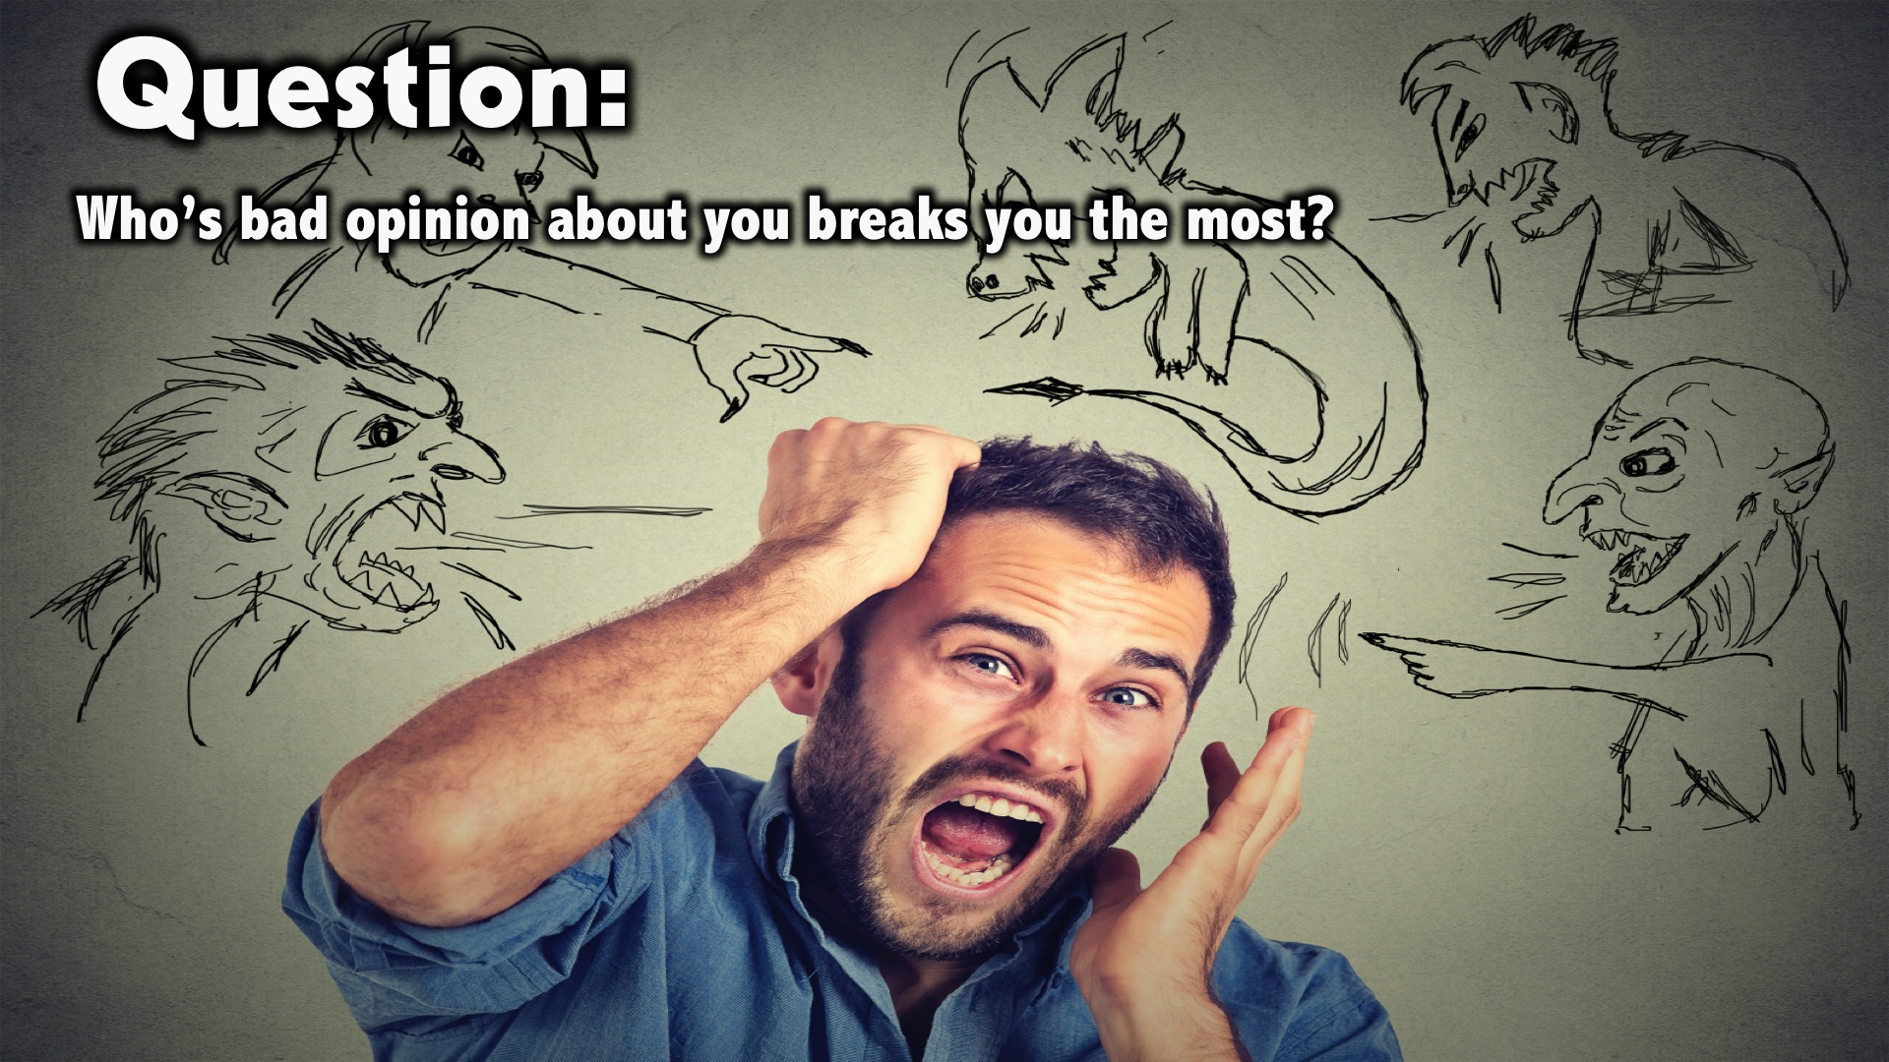
Notes:
Question: Who’s bad opinion about you breaks you the most?

Slide 5
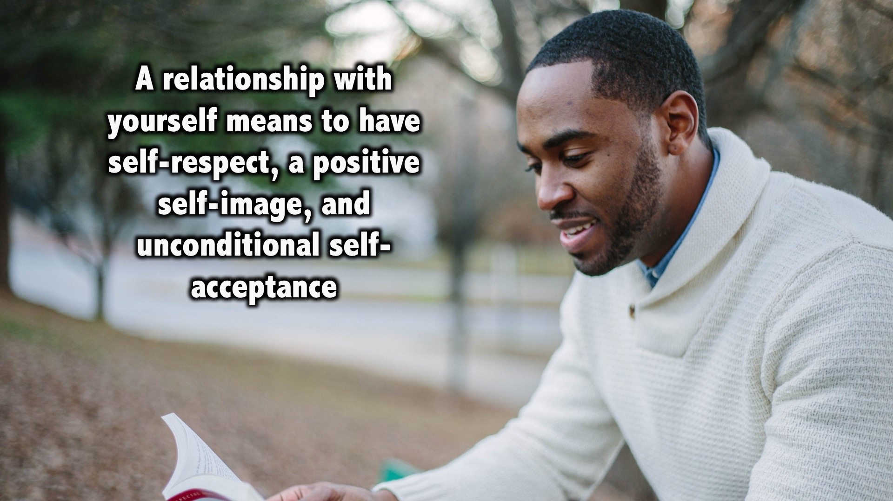
Notes:
A relationship with yourself means to have self-respect, a positive self-image, and unconditional self-acceptance. It does not mean being arrogant, or thinking that you are better than anyone else. It means having a healthy regard for yourself knowing that you are a worthy human being.

Slide 6
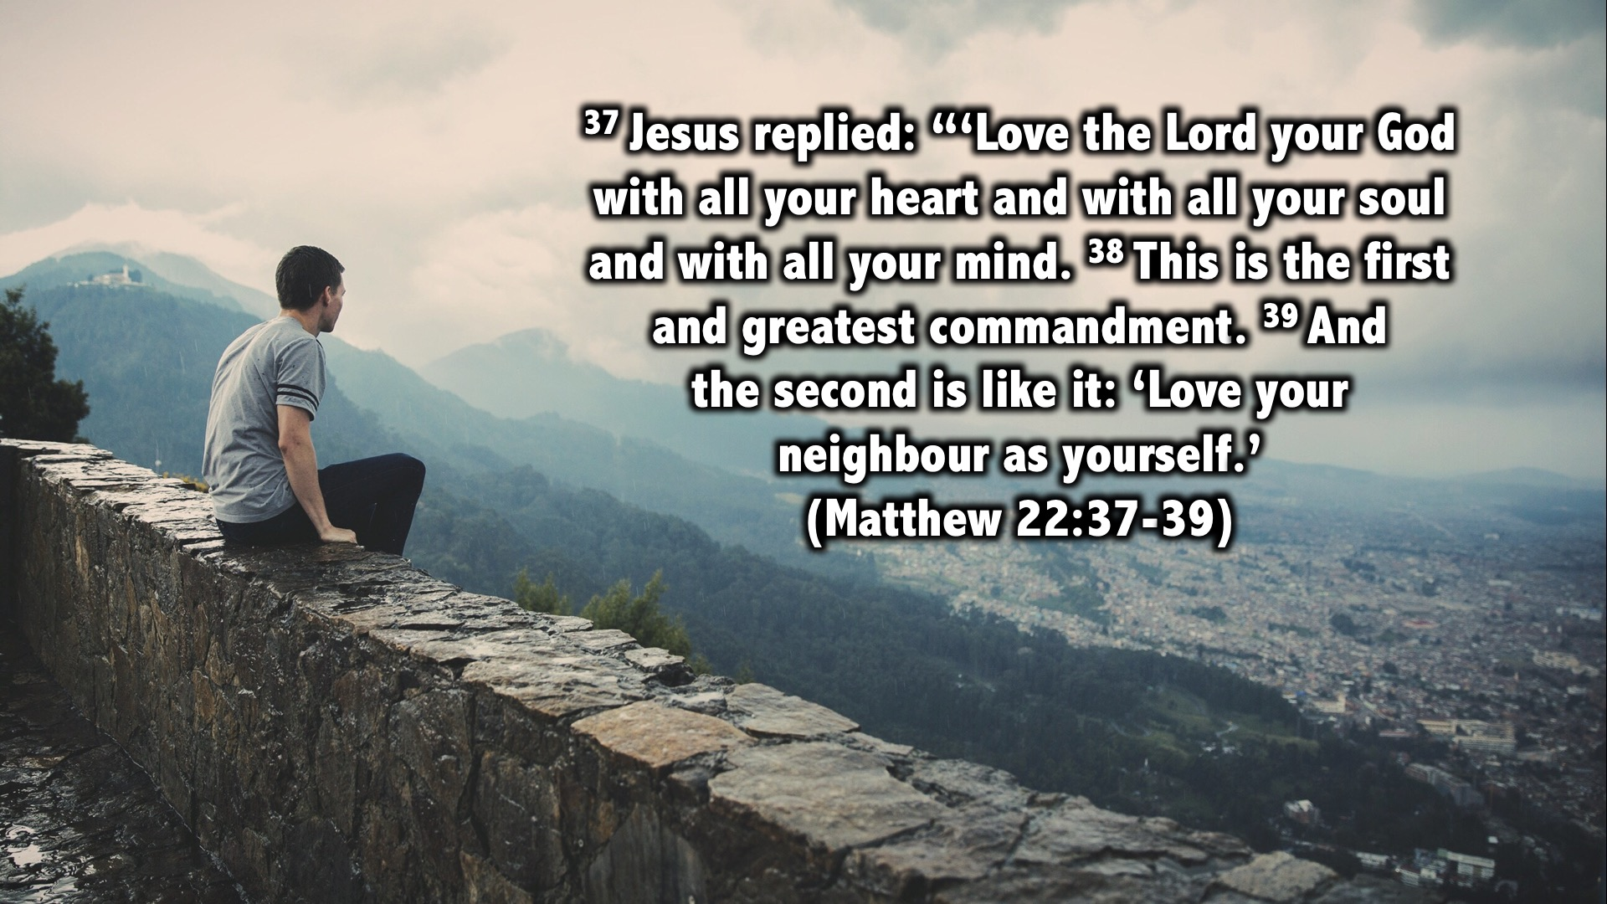
Notes:
³⁷ Jesus replied: “‘Love the Lord your God with all your heart and with all your soul and with all your mind. ³⁸ This is the first and greatest commandment. ³⁹ And the second is like it: ‘Love your neighbour as yourself.’ (Matthew 22:37-39)
One of the Pharisees, an expert in religious law, tried to trap Jesus with this question: Teacher, which is the most important law in the law of Moses?
(READ THE SCRIPTURE)
Jesus here was trying to teach the Pharisees and us that the most important relationship is with ourselves. The absence of a healthy relationship with ourselves is the reason why we try so much to conform to the standards and patterns of this world and end up destroying ourselves.

Slide 7
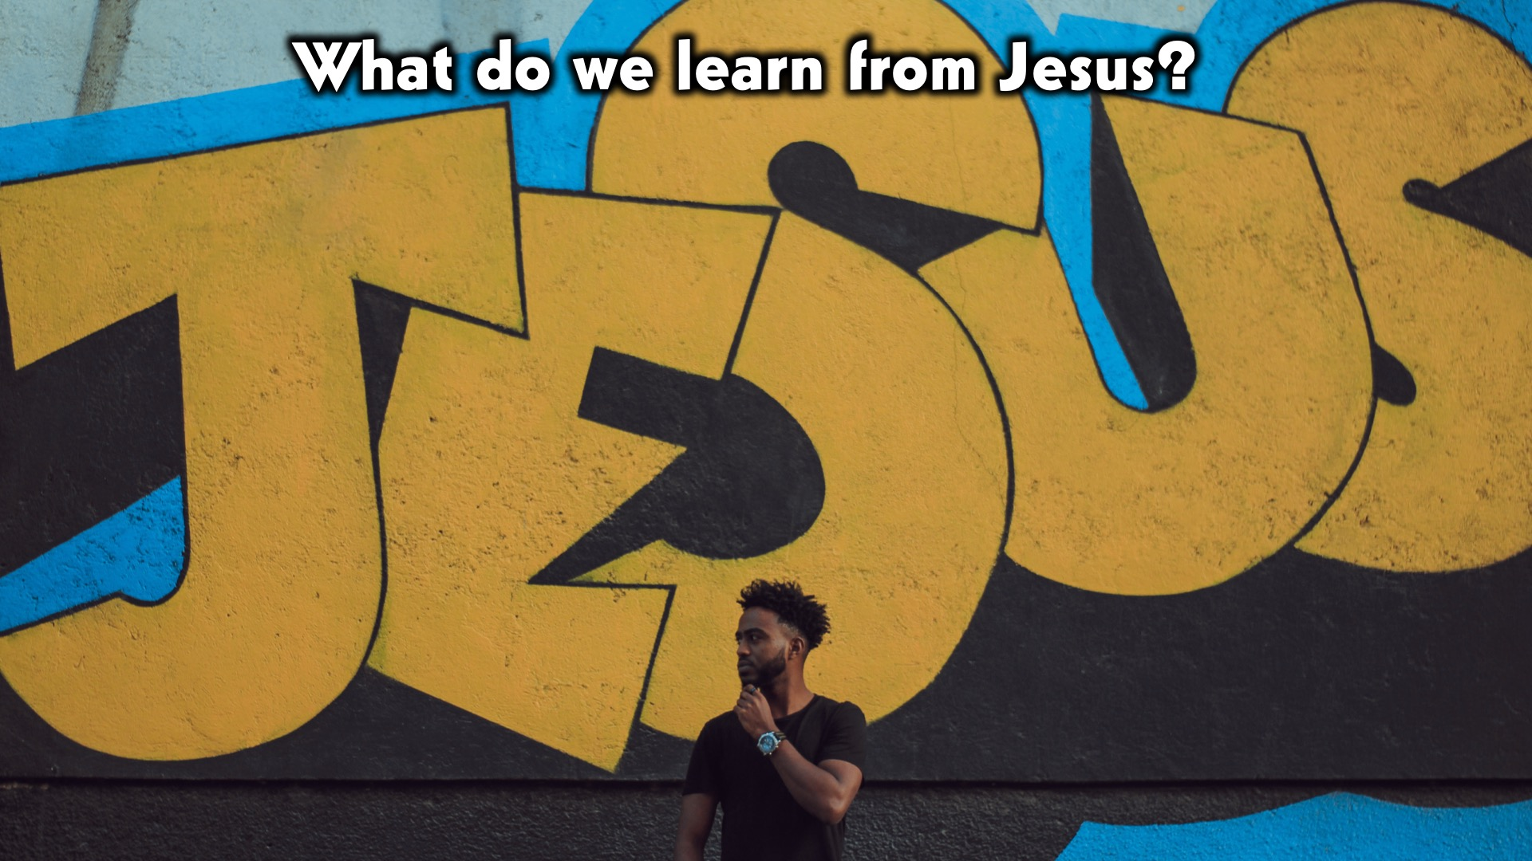
Notes:
What do we learn from Jesus?

Slide 8
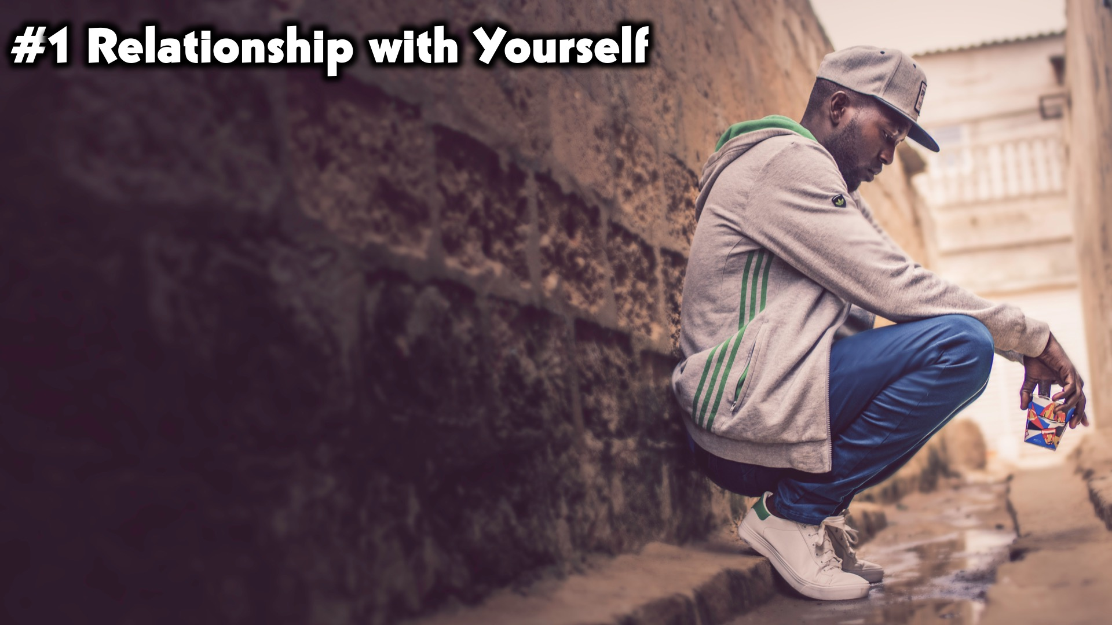
Notes:
#1. Relationship with Yourself. The relationship with yourself in the most important relationship, its only through a relationship with yourself that you may make sound and good decisions.

Slide 9

Notes:
#2. Relationship with Your Neighbor. You can never have a functional relationship with anyone else unless you have a healthy relationship with yourself. And you can never claim to have a relationship with God unless you have a relationship with those around you.

Slide 10
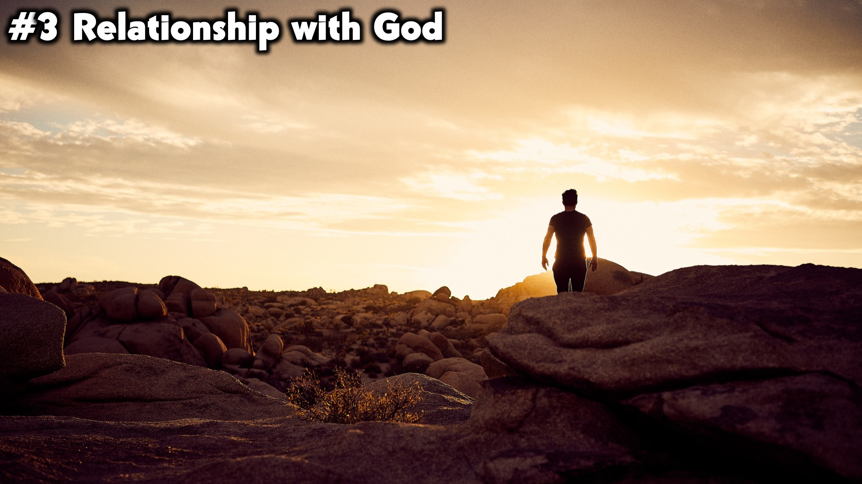
Notes:
#3. Relationship with God. Having a relationship with God builds your character and heals the broken parts of your life so that you may have a healthy relationship with yourself. So Jesus here was trying to show us that having a relationship with yourself, your community and ultimately with God, is a system that can not be avoided for a Christian life.

Slide 11
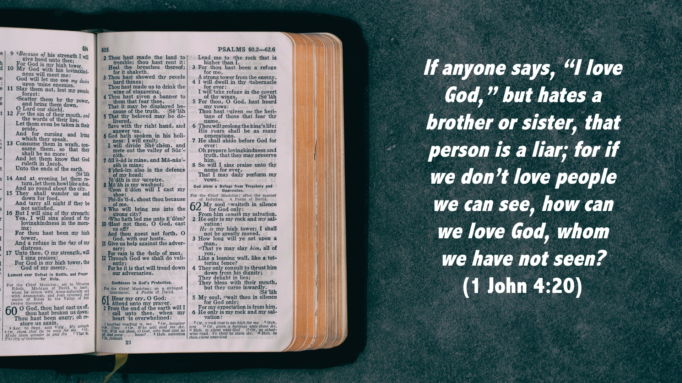
Notes:
If anyone says, “I love God,” but hates a brother or sister, that person is a liar; for if we don’t love people we caan see, how can we love God, whom
we have not seen?
(1 John 4:20)
John is simply saying that we can not have a relationship with God unless we have a relationship with the people we live with everyday. And we can not have a healthy relationship with ourselves unless we have a great relationship with God.
-For in him we live and move and have our being. (Acts 17:28)

Slide 12
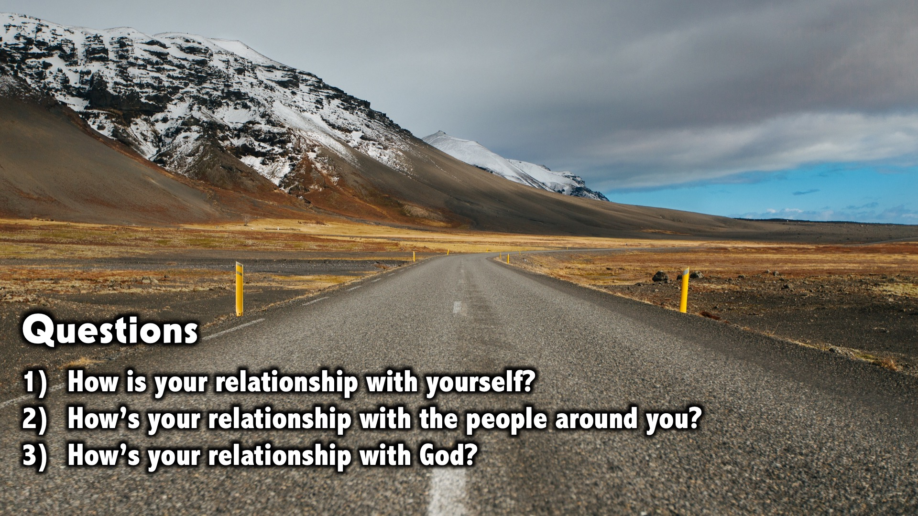
Notes:
Small Group Discussion: You have ten minutes to apply the message to your life in small groups using these 3 questions: (1) How is your relationship with yourself?(2) How’s your relationship with the people around you? (3) How’s your relationship with God?

Slide 13

Notes:
Wrap Up: A healthy relationship with yourself will unlock your purpose and its pleasing to God.

Slide 14
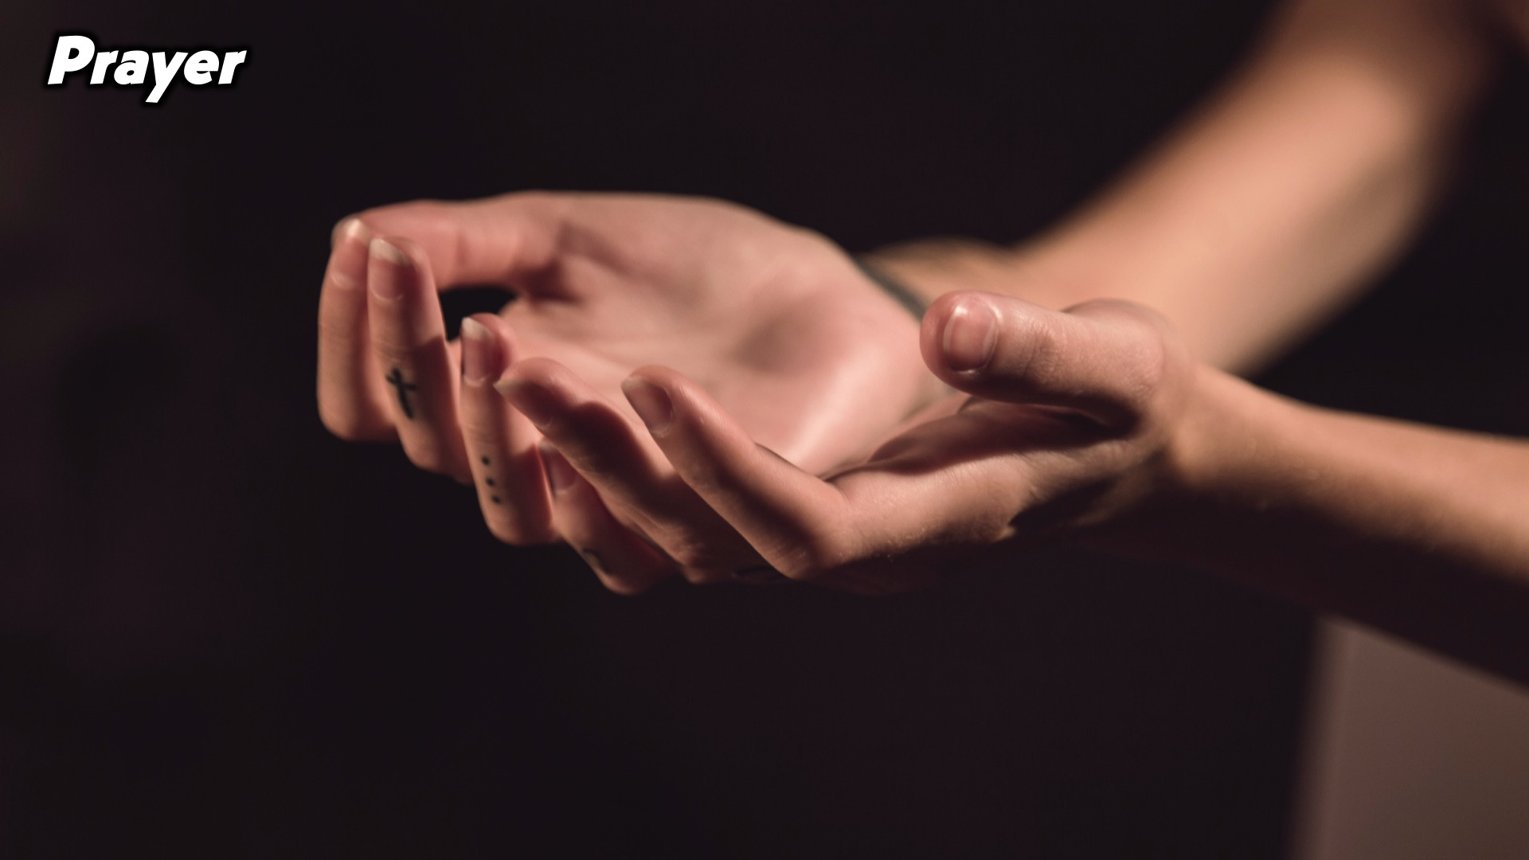
Notes:
Prayer:

Slide 15
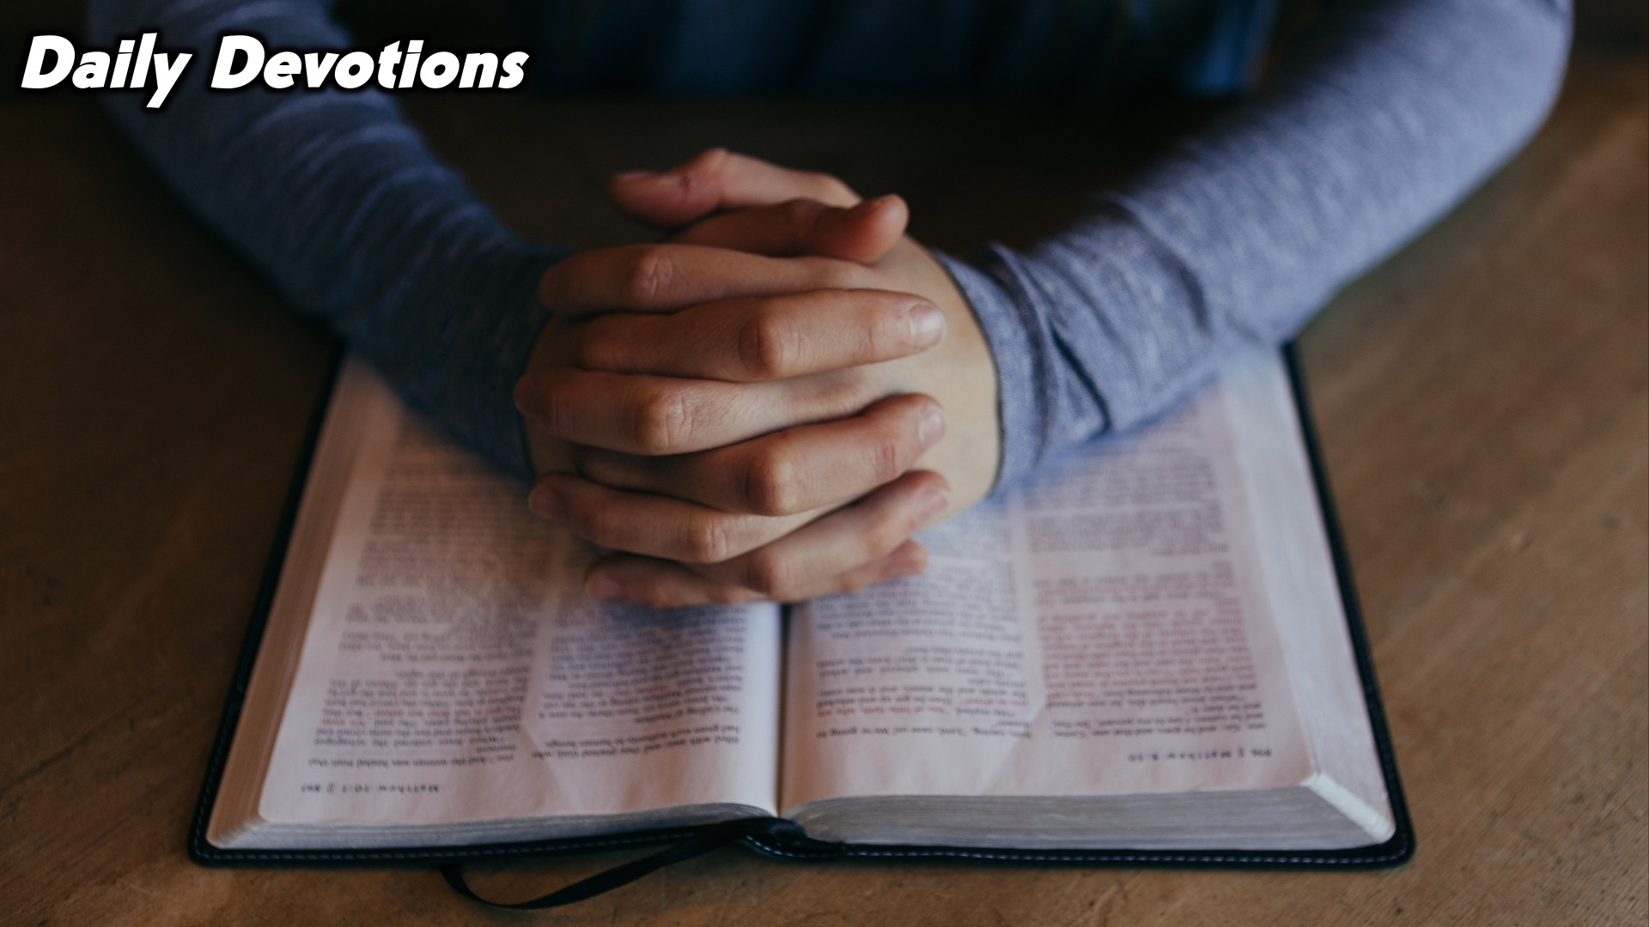
Notes:
Daily Devotions: We will post devotions on the WhatsApp group every night of the week throughout this series. Do everything you can to be a part of the daily journey.

Slide 16

Notes:
Next week we’ll learn about relationships with our parents

