Slide 1

Notes:
Welcome to the Relationship Series.
Mini Series
Friday = Precursor

Slide 2

Notes:
Last Week We looked at relationships with yourself

Slide 3

Notes:
Today we are exploring relationships with your parents.

Slide 4
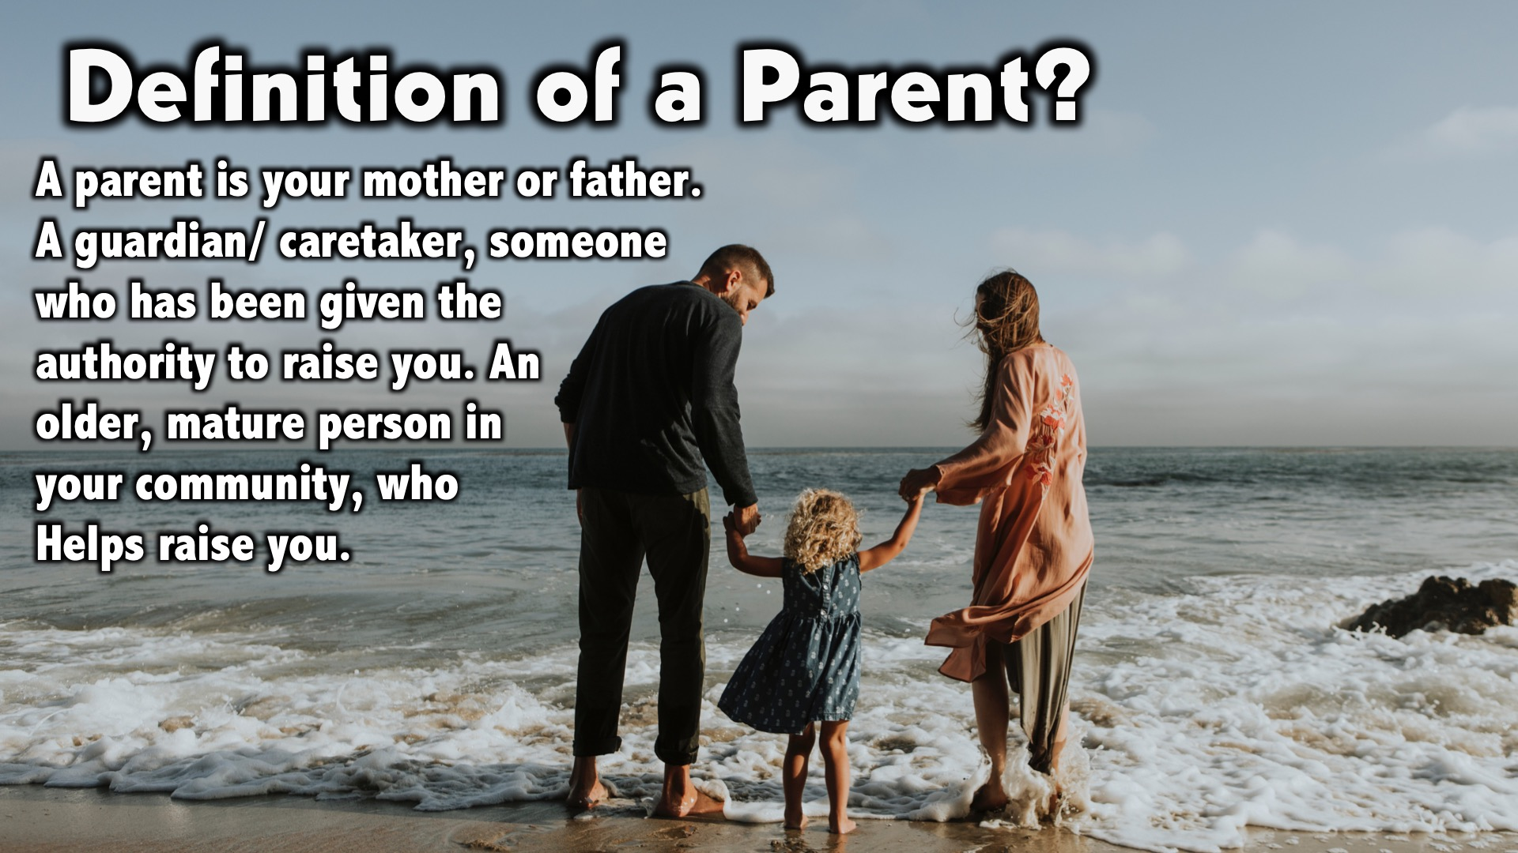
Notes:
Definition of a Parent?
A parent is your mother or father.
A guardian/ caretaker, someone who has been given the authority to raise you.
An older, mature person in your community, who helps raise you.

Slide 5
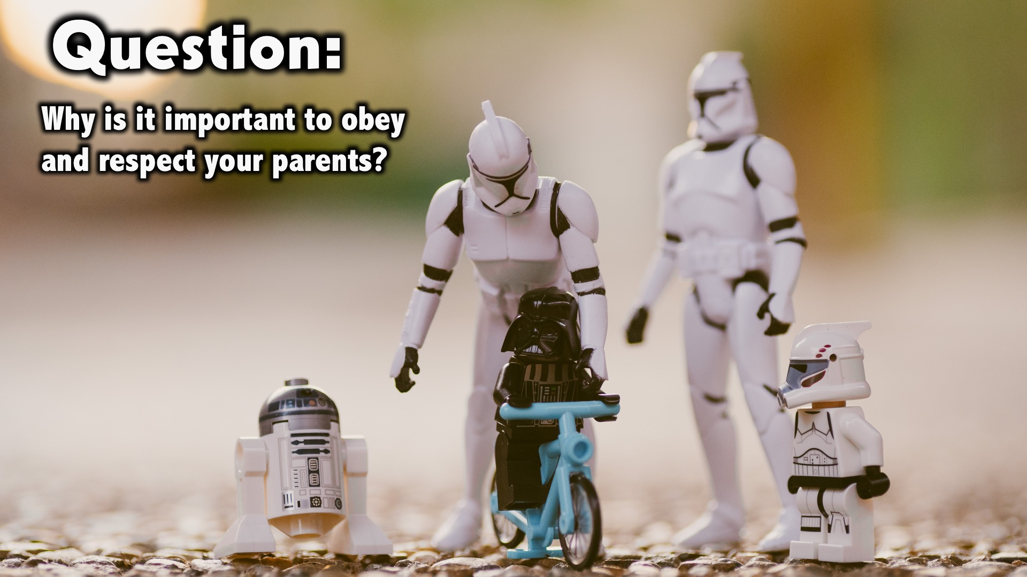
Notes:
Question: Why is it important to obey and respect your parents?

Slide 6
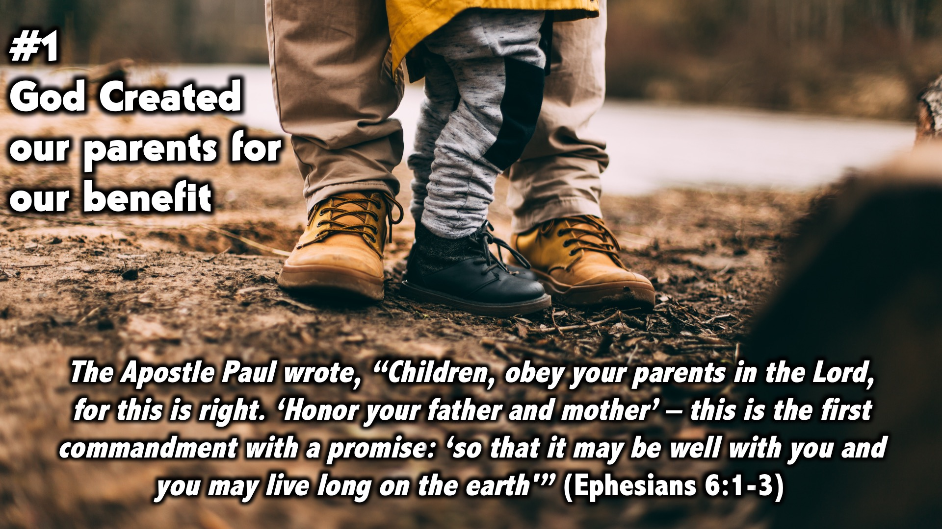
Notes:
No we will look at a few points to see what the bible says about the parent-child relationship
#1 God created our parents for our benefit.
The Apostle Paul wrote, “Children, obey your parents in the Lord, for this is right. ‘Honor your father and mother’ – this is the first commandment with a promise: ‘so that it may be well with you and you may live long on the earth'” (Ephesians 6:1-3).
Personal notes: The point I would like to highlight in this verse is that we need to obey. In the process we will find a full, positive life, in other words God will bless us and reward us.

Slide 7
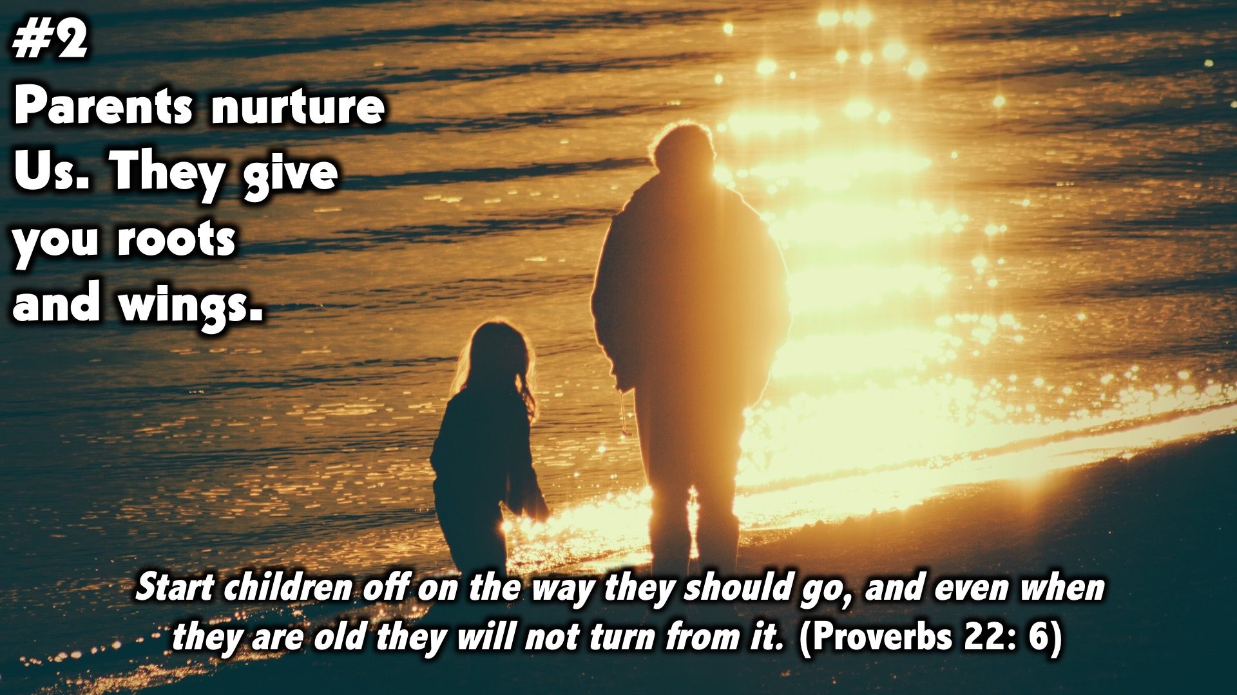
Notes:
#2 Parents nurture us through that they give you roots and wings.
Start children off on the way they should go, and even when they are old they will not turn from it. (Proverbs 22: 6)

Slide 8
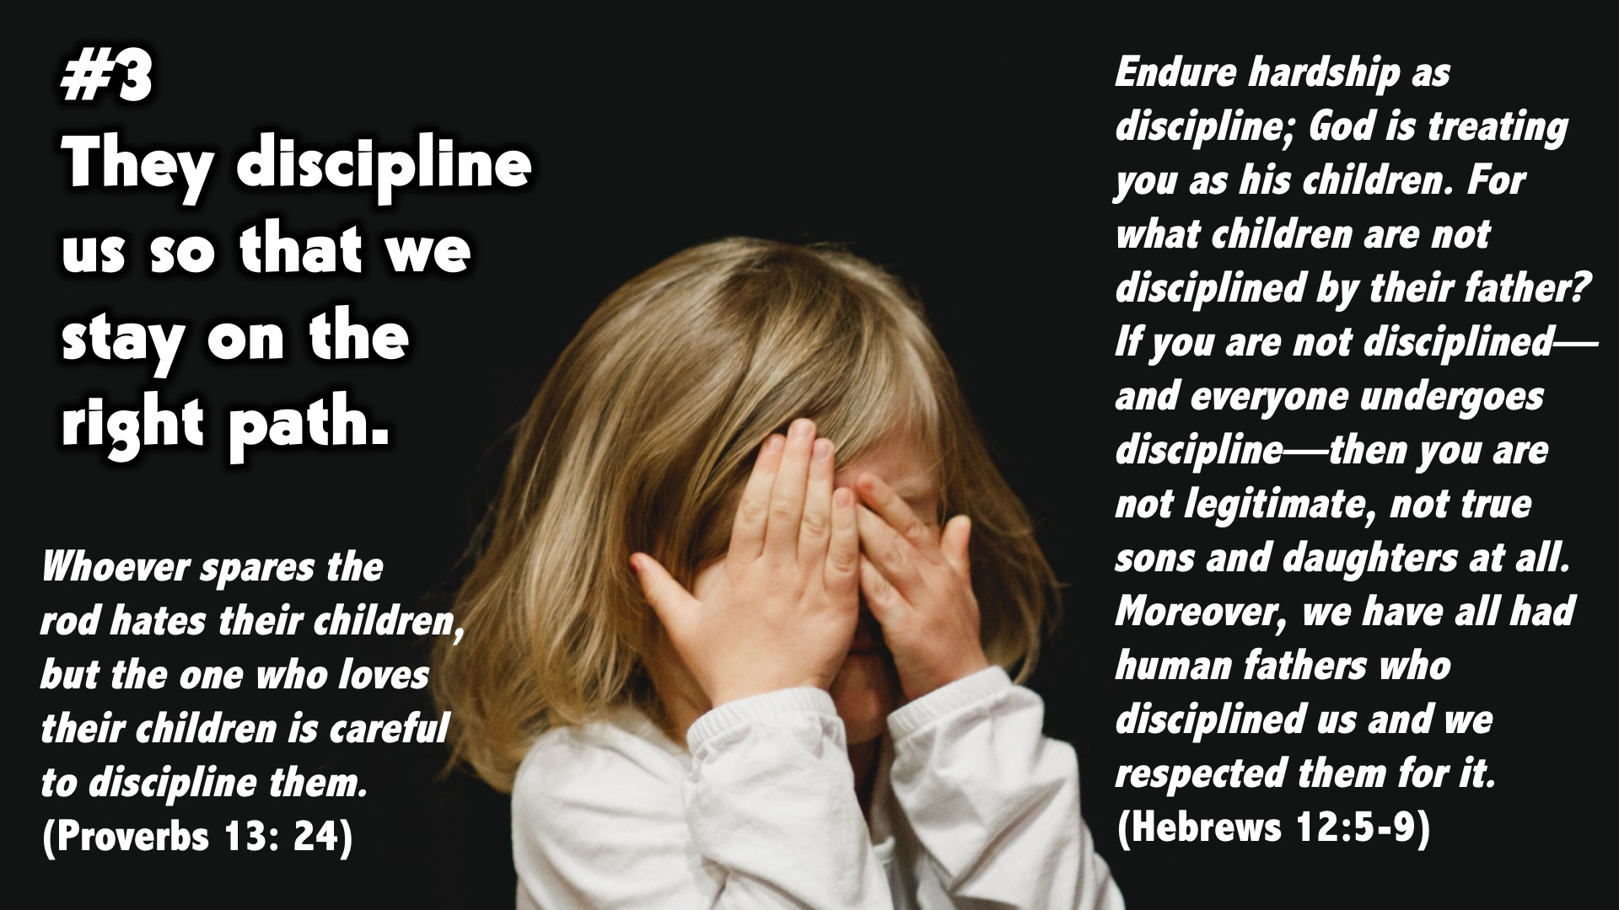
Notes:
#3 They discipline us so that we stay on the right path.
Whoever spares the rod hates their children, but the one who loves their children is careful to discipline them. (Proverbs 13: 24)
………..because the Lord disciplines the one he loves, and he chastens everyone he accepts as his son.”7 Endure hardship as discipline; God is treating you as his children. For what children are not disciplined by their father? 8 If you are not disciplined—and everyone undergoes discipline—then you are not legitimate, not true sons and daughters at all. 9 Moreover, we have all had human fathers who disciplined us and we respected them for it. (Hebrews 12:5-9)
Personal notes: Parents have lived and experienced life more than us. They have your best interest at heart. When they discipline you they are trying to keep you on the straight path. It’s hard to see the good when you are being disciplined and yes you may develop an attitude towards your parents. Being disciplined is just a process of them making sure that your roots grow deep and that as you grow you will have a strong foundation. When you leave the care of your parents you will have the wings to soar and start your own journey based on the principles and values your parents taught you.

Slide 9
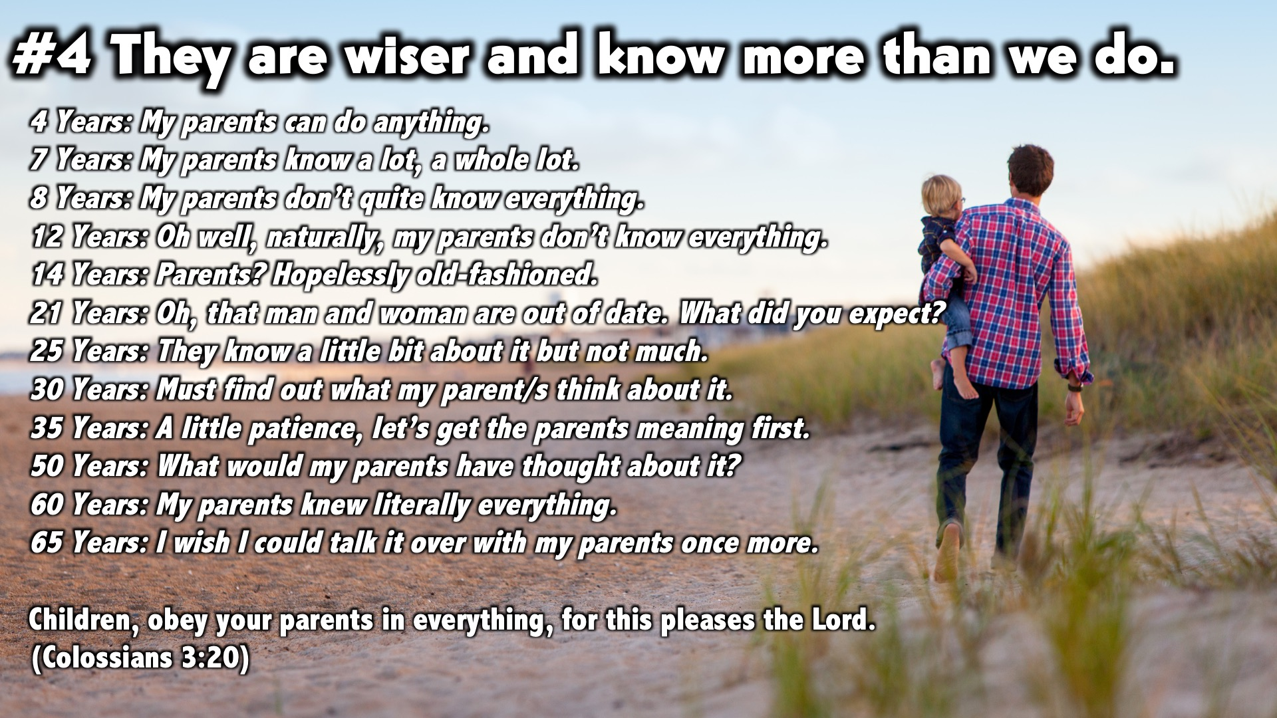
Notes:
#4 They are wiser they know more than we do.
Personal notes: There are times we think and even believe that our parents are old fashioned and they are completely out of date. Just because our parents don’t keep up with the trends it doesn’t mean they know nothing and their advice is irrelevant. They have gone through a process of learning and maturing.
4 Years: My parents can do anything.
7 Years: My parents know a lot, a whole lot.
8 Years: My parents don’t quite know everything.
12 Years: Oh well, naturally, my parents don’t know everything.
14 Years: Parents? Hopelessly old-fashioned.
21 Years: Oh, that man and woman are out of date. What did you expect?
25 Years: They know a little bit about it but not much.
30 Years: Must find out what my parent/s think about it.
35 Years: A little patience, let’s get the parents meaning first.
50 Years: What would my parents have thought about it?
60 Years: My parents knew literally everything.
65 Years: I wish I could talk it over with my parents once more.
Children, obey your parents in everything, for this pleases the Lord. (Colossians 3:20)
Personal notes: Learn to appreciate and learn from your parents every chance you get. One day you will be grateful and actually start teaching your descendants the same lessons. The next time you think you know more than your parents put yourself in their shoes, would you appreciate the way you would be treated? Parents don’t want to cramp your style, they want you to have a good life. Yes I understand parents aren’t perfect but they are in charge, they have been given authority over you to teach you, correct you, rebuke you so that when you become an adult you will be wise and will be ready to do the same for your children.

Slide 10
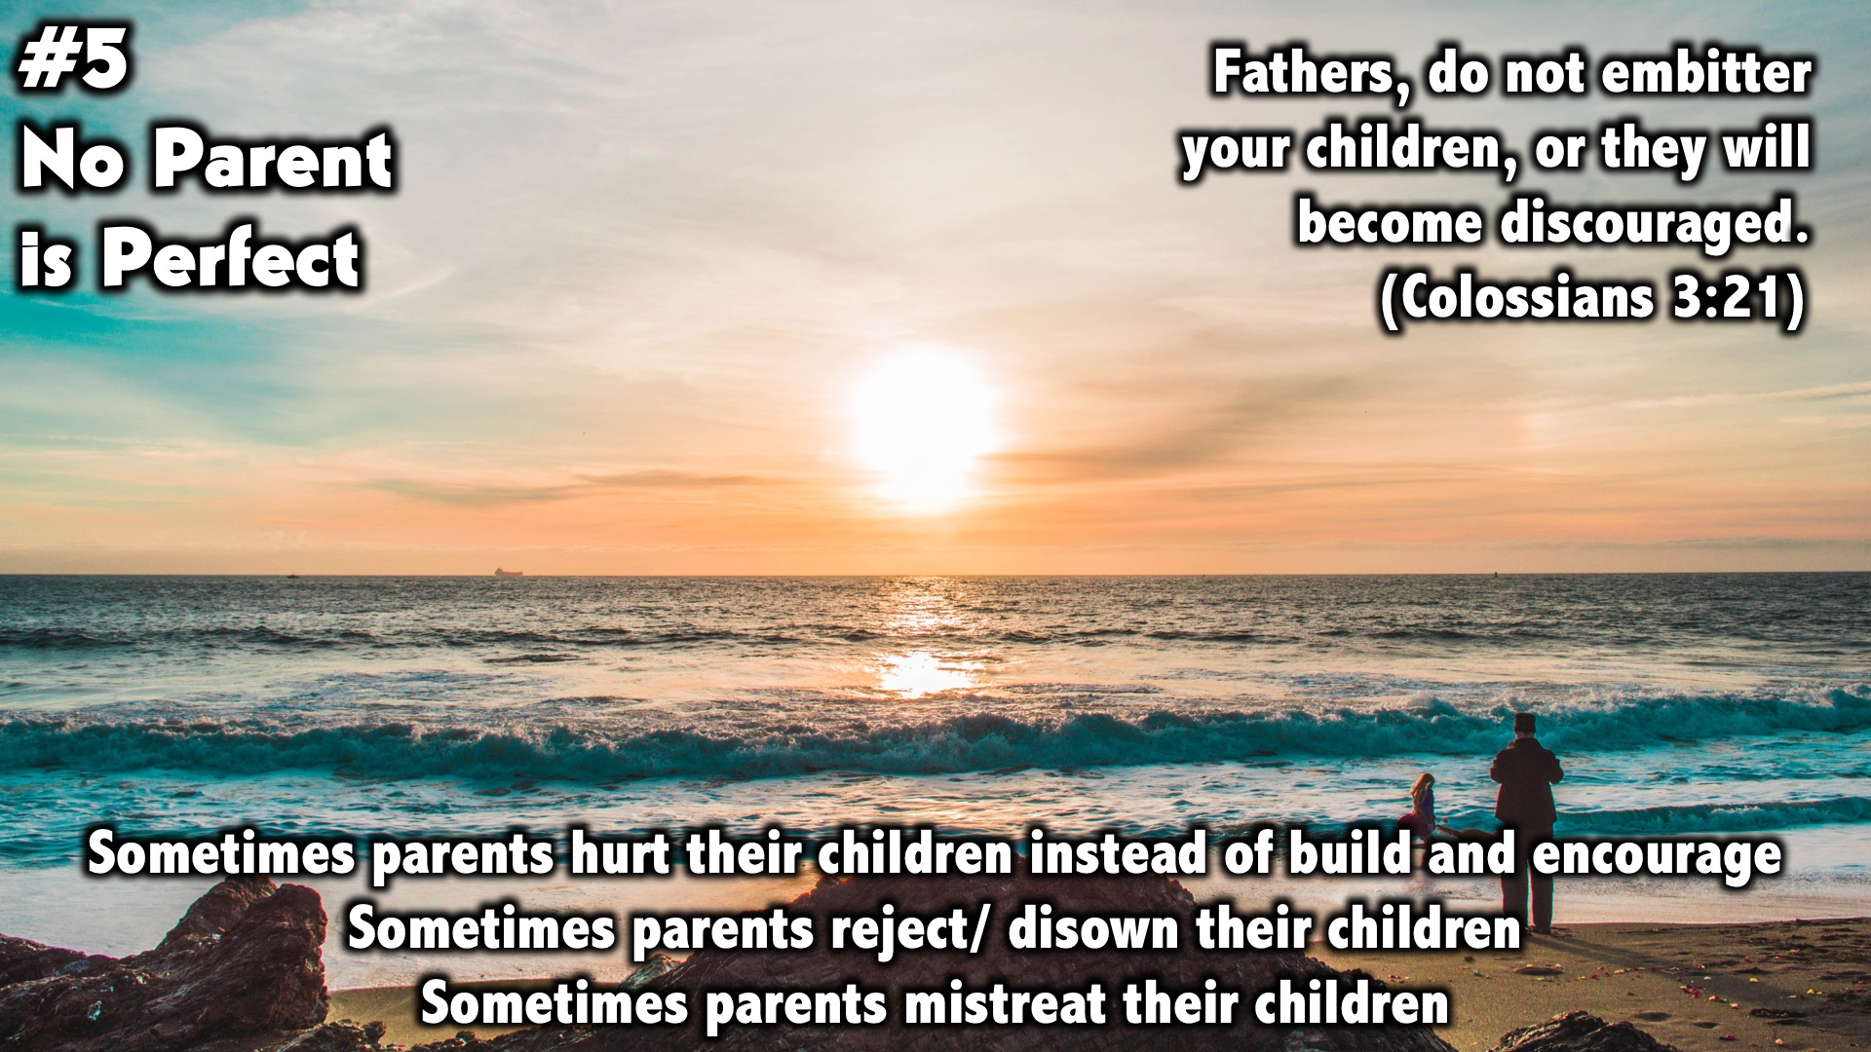
Notes:
#5 No parent is perfect………….
²¹ Fathers, do not embitter your children, or they will become discouraged. (Colossians 3:21)
Sometimes parents hurt their children instead of build and encourage
Sometimes parents reject/ disown their children
Sometimes parents mistreat their children
It’s important to note that no parent is perfect and no one has a perfect relationship with their parents. Just as children were instructed to obey their parents, parents were also instructed not to anger or embitter their children. We don’t live in a perfect world, just as children fall short parents fall short too. This is why we need God as the center of our relationships. He is the only one who can train us, correct us and turn us into the people He designed us to be. Having said this we as children still need to obey, respect and honour our parents for this commandment has blessings attached to it.
Tell personal story.
Even though I felt like my parents hurt me, disowned and rejected me I had to learn to still obey, respect and honour them. Everything that happens to us is an occasion for God to exercise His glory through us. And to prepare us to have the ability to comfort others when others face the same trials. I was very upset and angry thinking why should I honour them when they treat me badly or disown me or don’t even try to understand me. God had to work on my heart for me to be able to firstly forgive my parents. Then go through a process of healing and then I was able to start respecting them and honouring them again.

Slide 11

Notes:
Small Group Discussion: You have ten minutes to apply the message to your life in small groups using these 3 questions: How do you think God expects you to treat your parents?
When you think your parents are wrong, how do you handle it?
What do you think your parents expect from you?

Slide 12
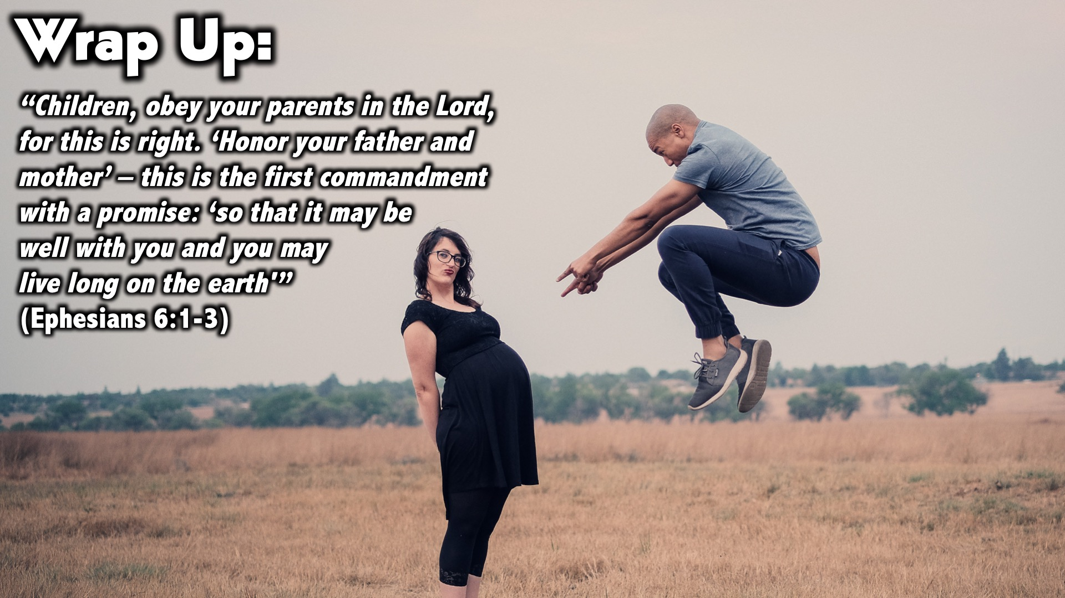
Notes:
Wrap up
I just want to wrap up by reading this verse once more
“Children, obey your parents in the Lord, for this is right. ‘Honor your father and mother’ – this is the first commandment with a promise: ‘so that it may be well with you and you may live long on the earth'” (Ephesians 6:1-3).
Time for ministry
If you don’t have a good relationship with your parents and you want someone to pay with you please raise your hand. I will ask the leaders to pray with you.

Slide 13
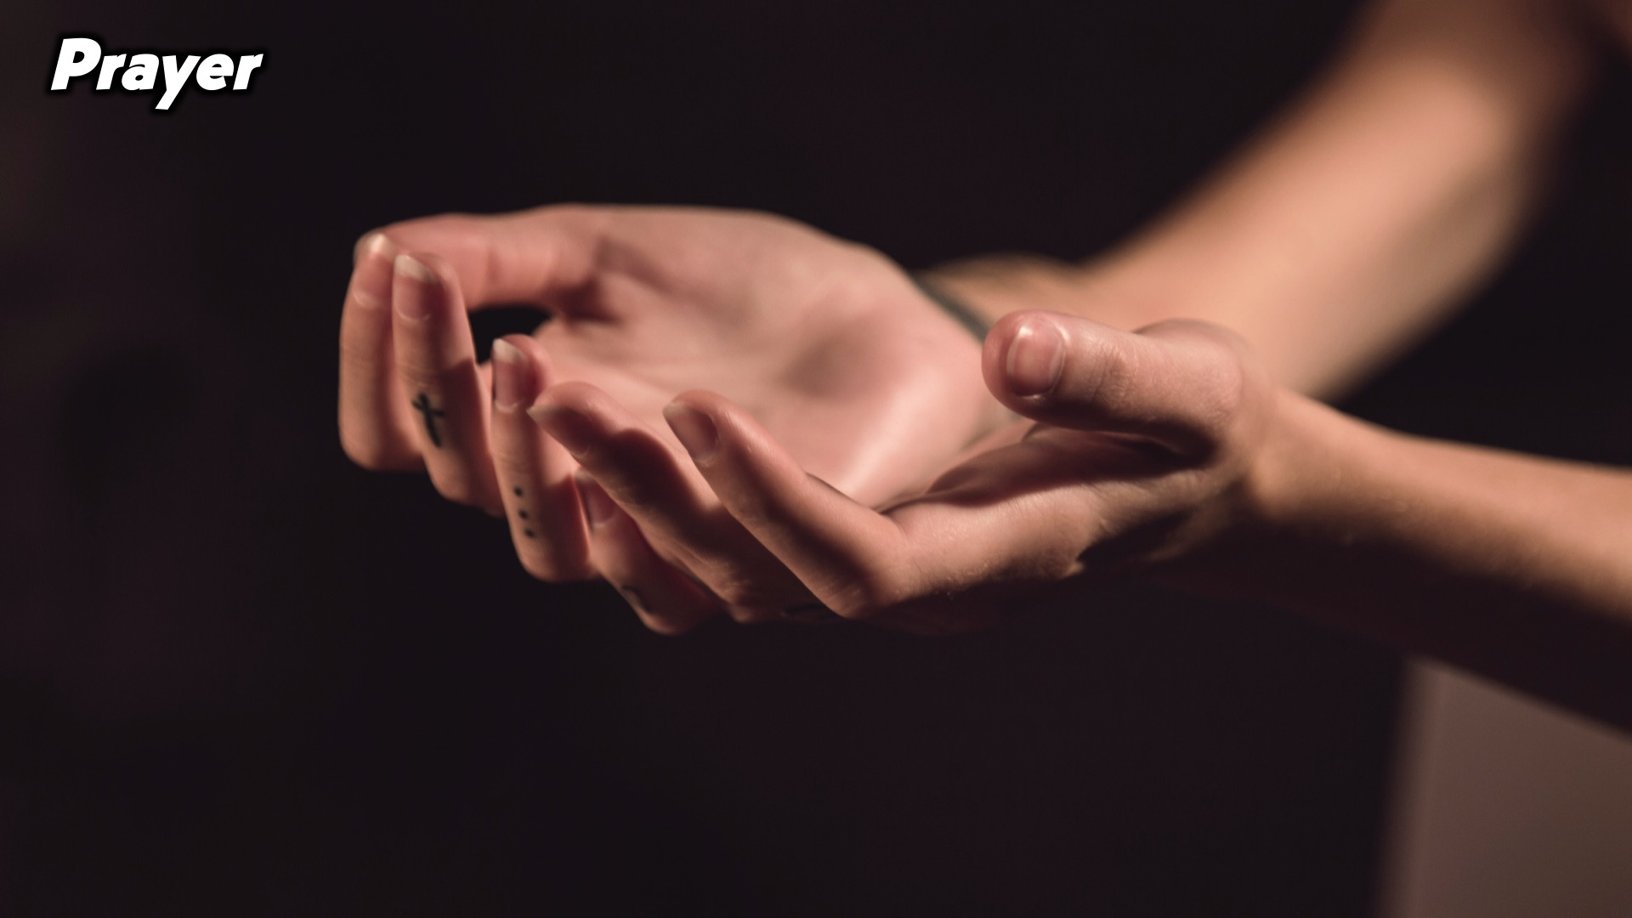
Notes:
Prayer:

Slide 14
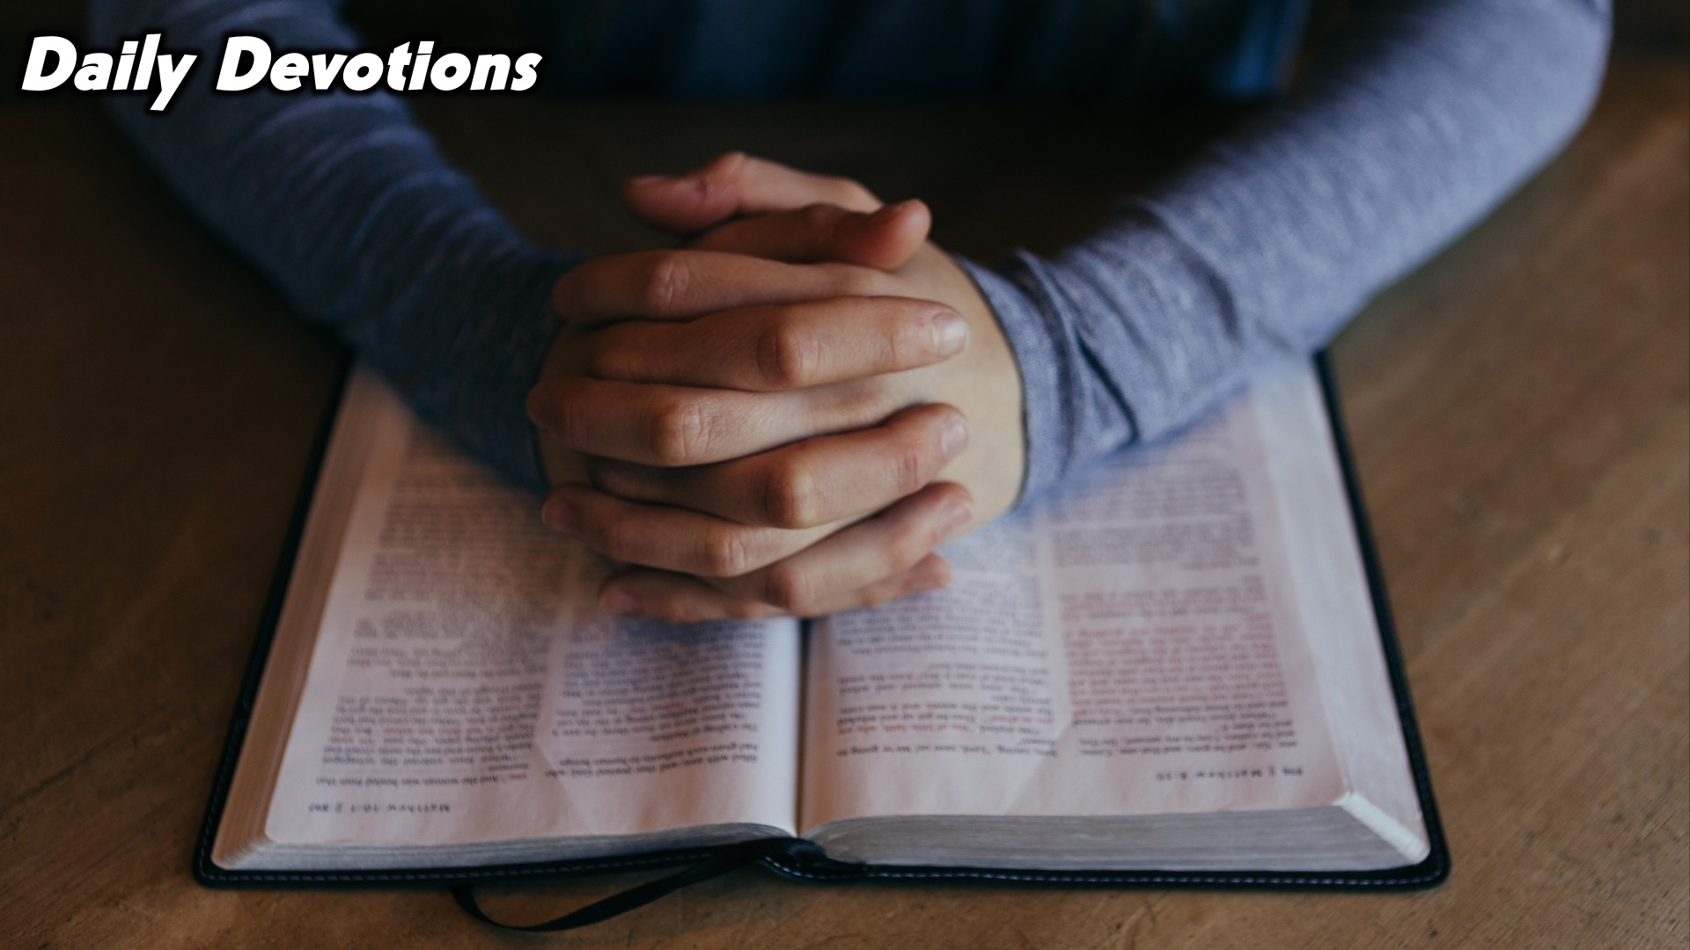
Notes:
Daily Devotions: We will post devotions on the WhatsApp group every night of the week throughout this series. Do everything you can to be a part of the daily journey.

Slide 15

Notes:
Next week we’ll learn about relationship with God

