Slide 1

Notes:
Welcome to the Relationship Series.
Mini Series
Friday = Precursor

Slide 2

Notes:
Last week we explored a relationship with our parents.

Slide 3
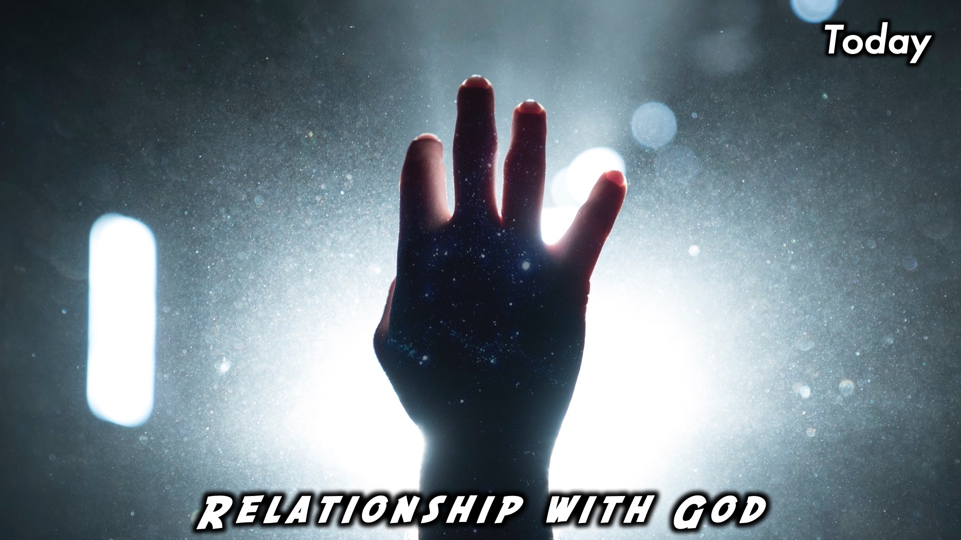
Notes:
Today we are learning about a relationship with God

Slide 4
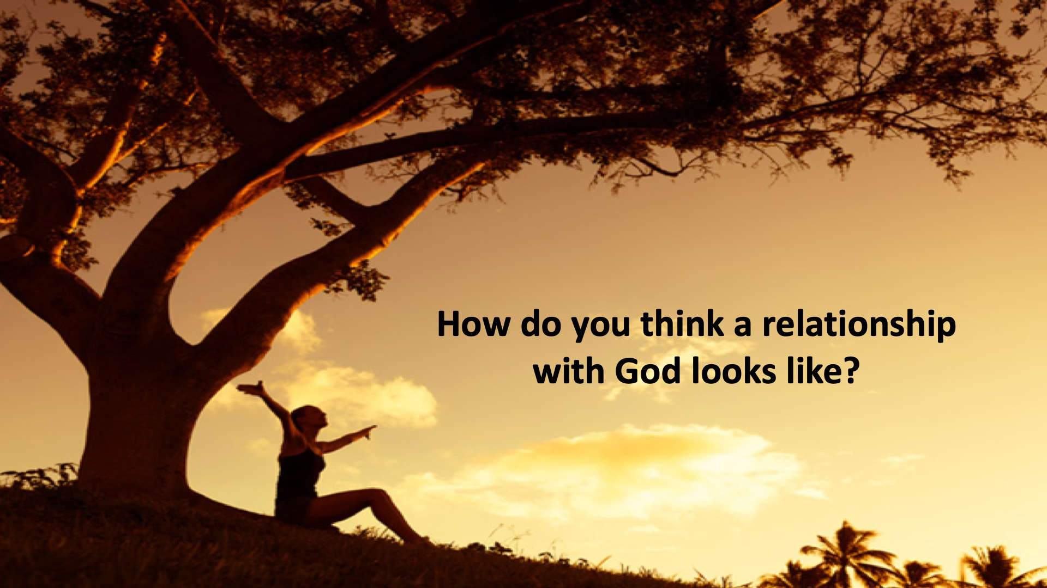
Notes:
Discuss: What do you think a relationship with God looks like?

Slide 5
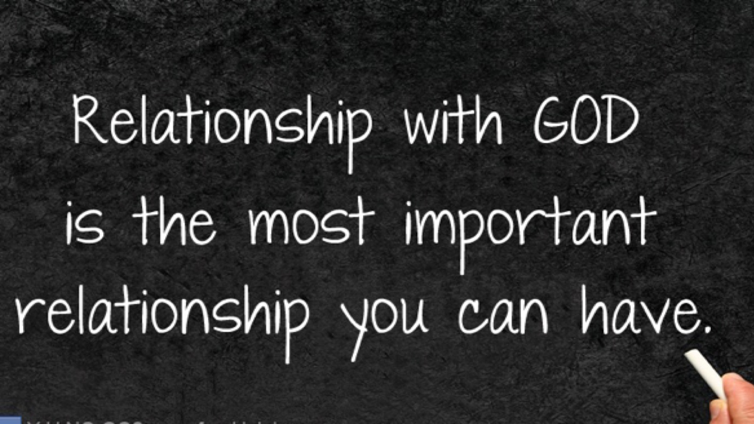
Notes:
A relationship with God is the most important relationship you can have.

Slide 6
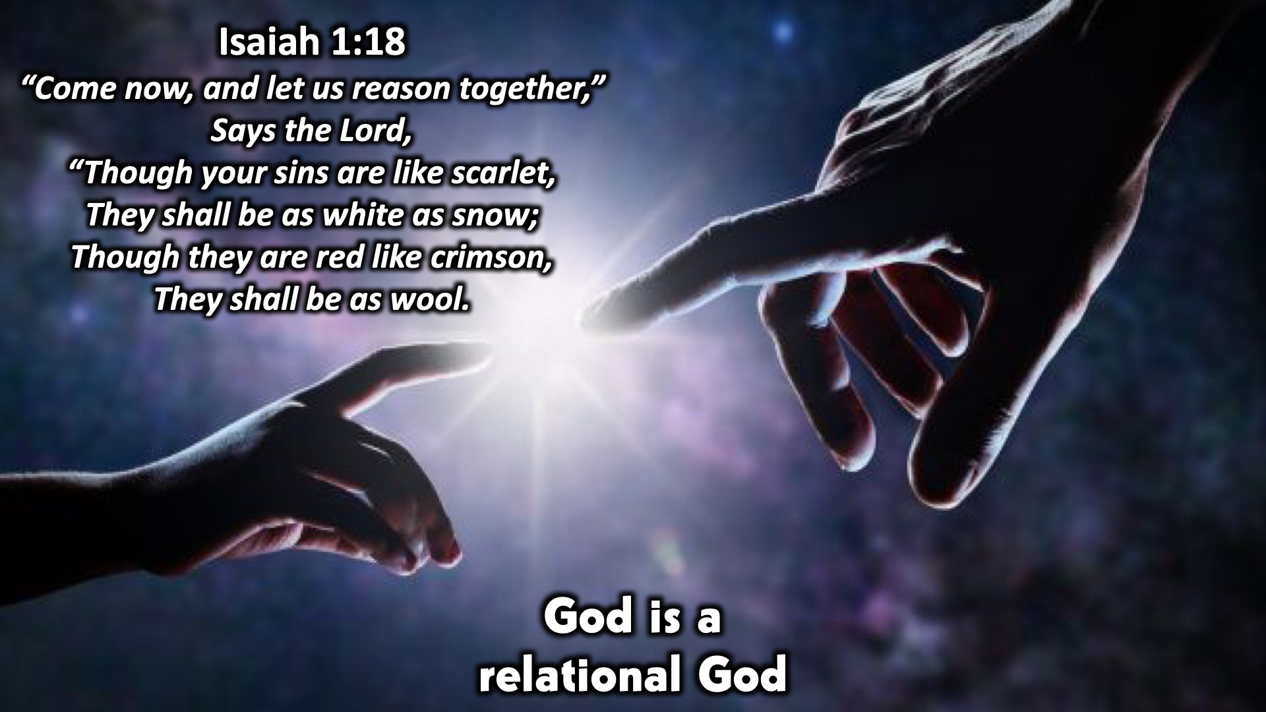
Notes:
God is a relational God. Isaiah 1:18 says: “Come now, and let us reason together,” Says the Lord, “Though your sins are like scarlet, They shall be as white as snow; Though they are red like crimson, they shall be as wool.
We are relational beings, we were created for relationships. You can’t have a relationship with someone without talking to them.

Slide 7
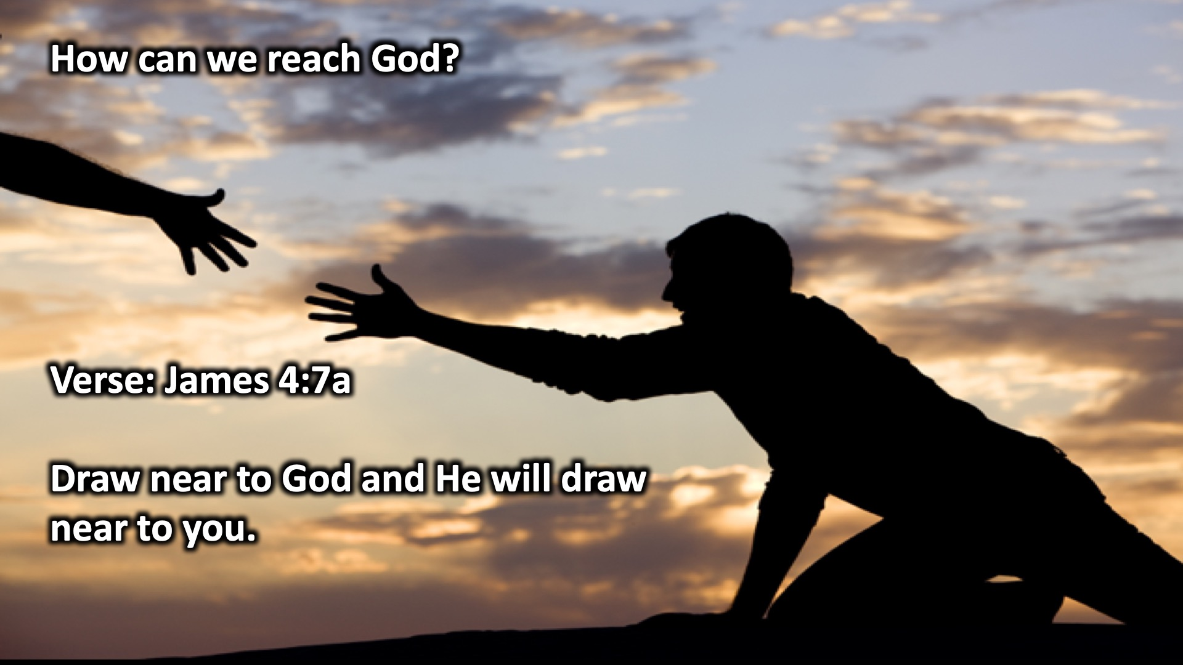
Notes:
How can we reach God? James 4:7a says, “Draw near to God and He will draw near to you.”
It’s up to us to draw near to God. We just need to sit and listen. We’re not just reaching out to God when there’s trouble, but also when things are going well.
When our parents give us stuff we should thank them, this is the same for God.

Slide 8
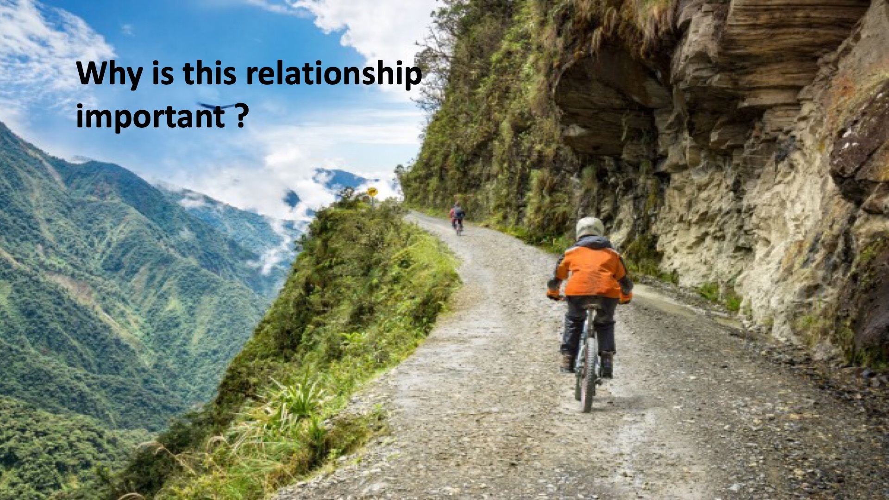
Notes:
Why is this relationship important?
It’s important, because God loves us, and is yearning to spend time with us.
God loves us so much that he wants to protect us.

Slide 9
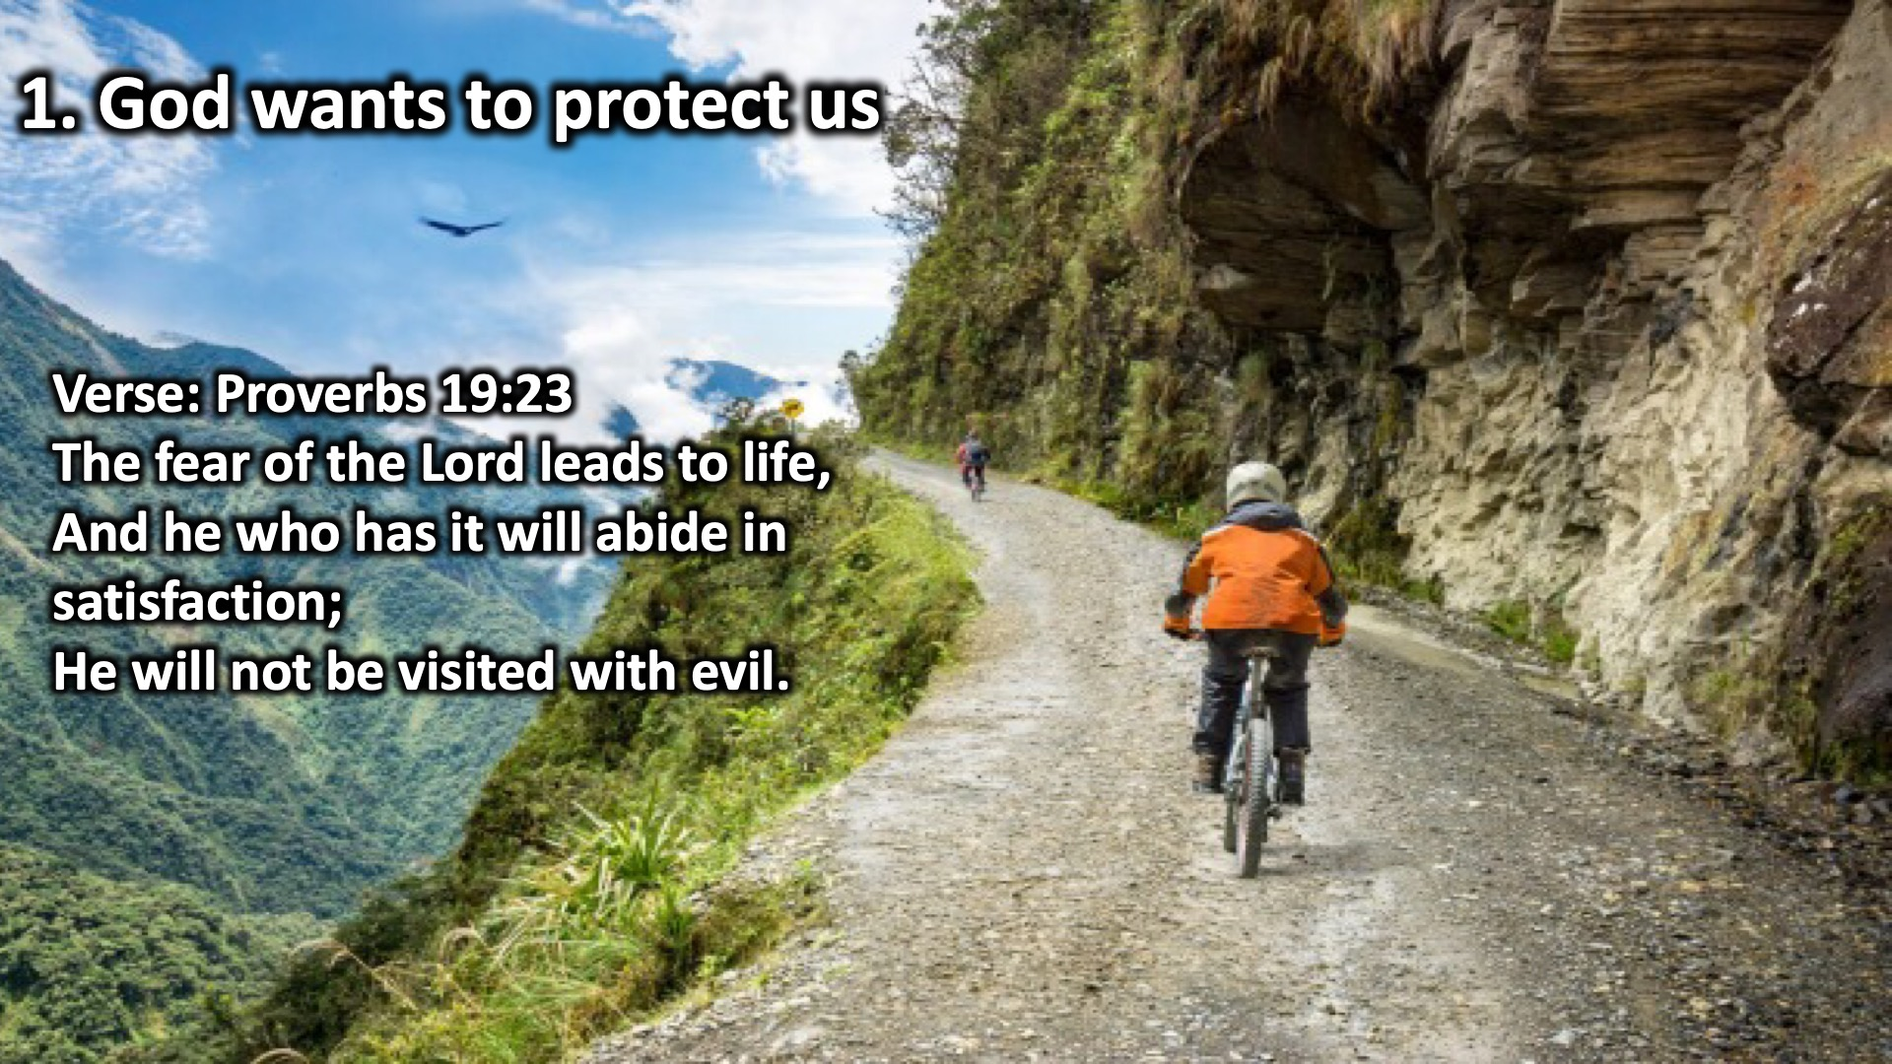
Notes:
God wants to protect us: Proverbs 19:23 says, “The fear of the Lord leads to life, And he who has it will abide in satisfaction; He will not be visited with evil.”

Slide 10
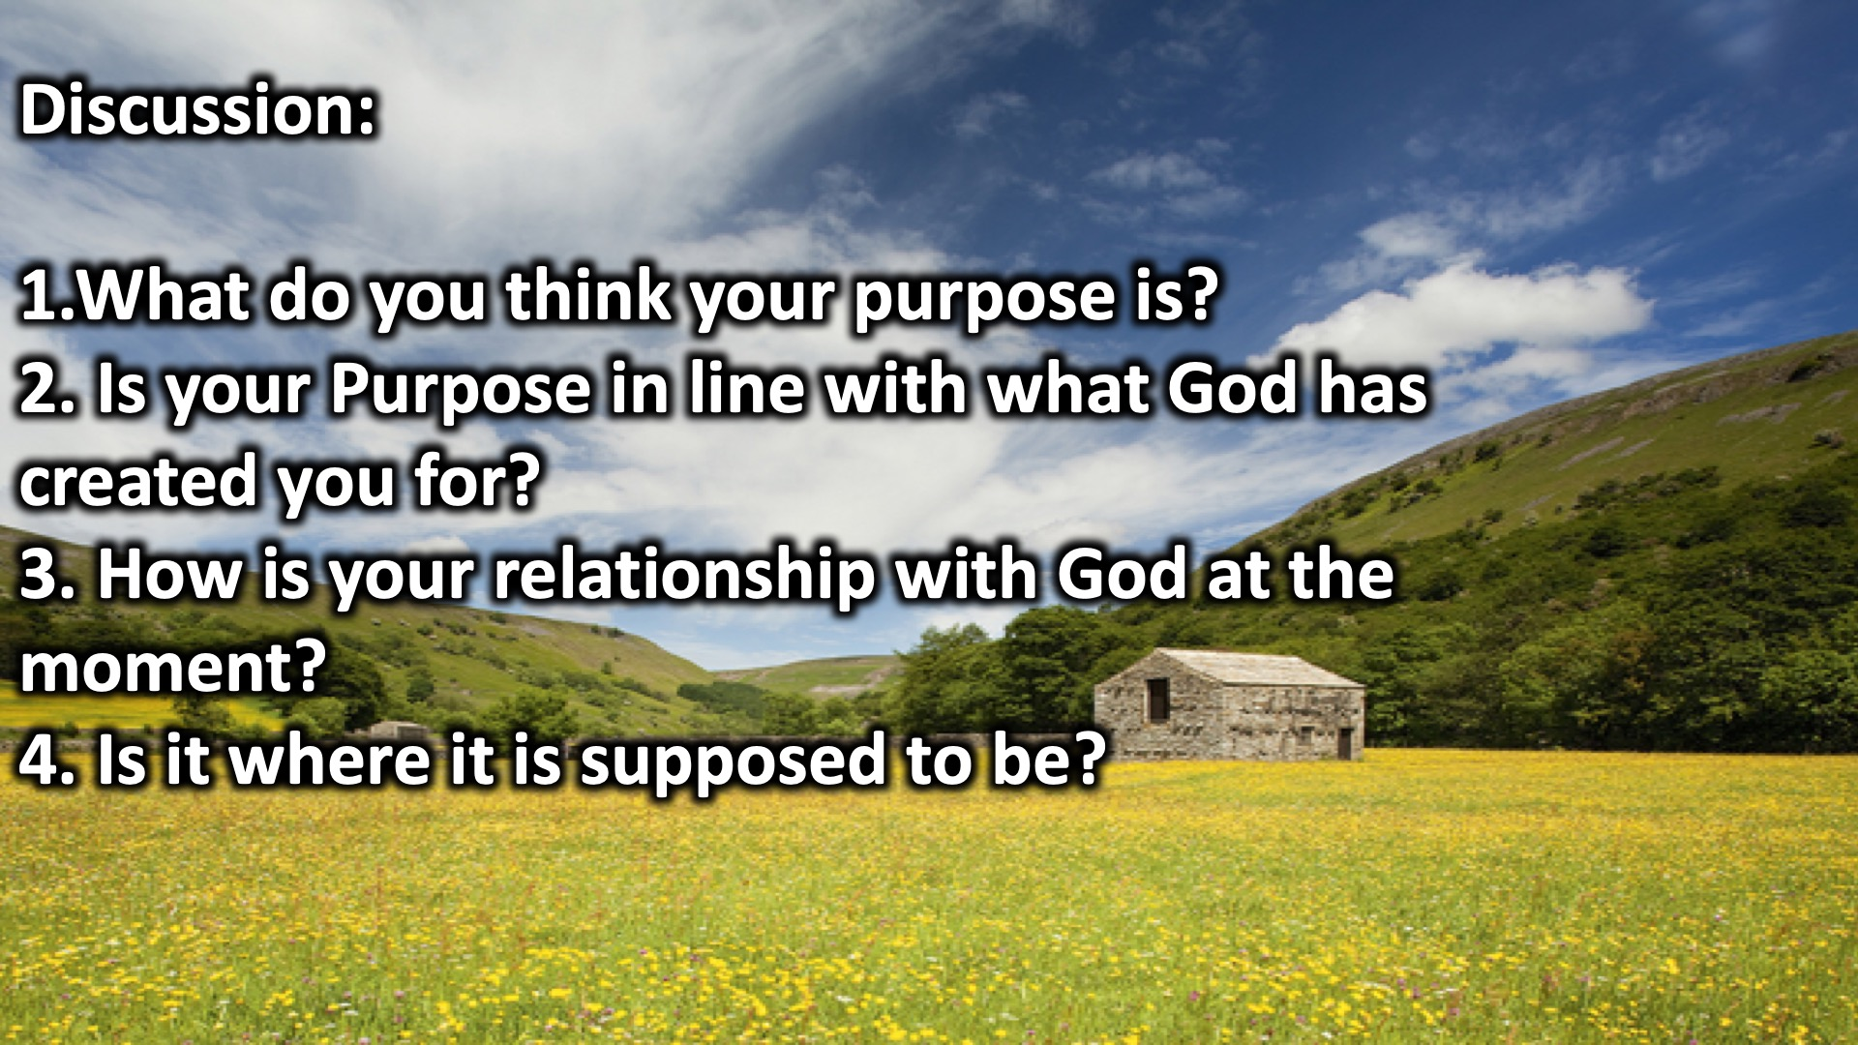
Notes:
Discussion: (1) What do you think your purpose is? (2) Is your Purpose in line with what God has created you for? (3) How is your relationship with God at the moment? (4) Is it where it is supposed to be?

Slide 11
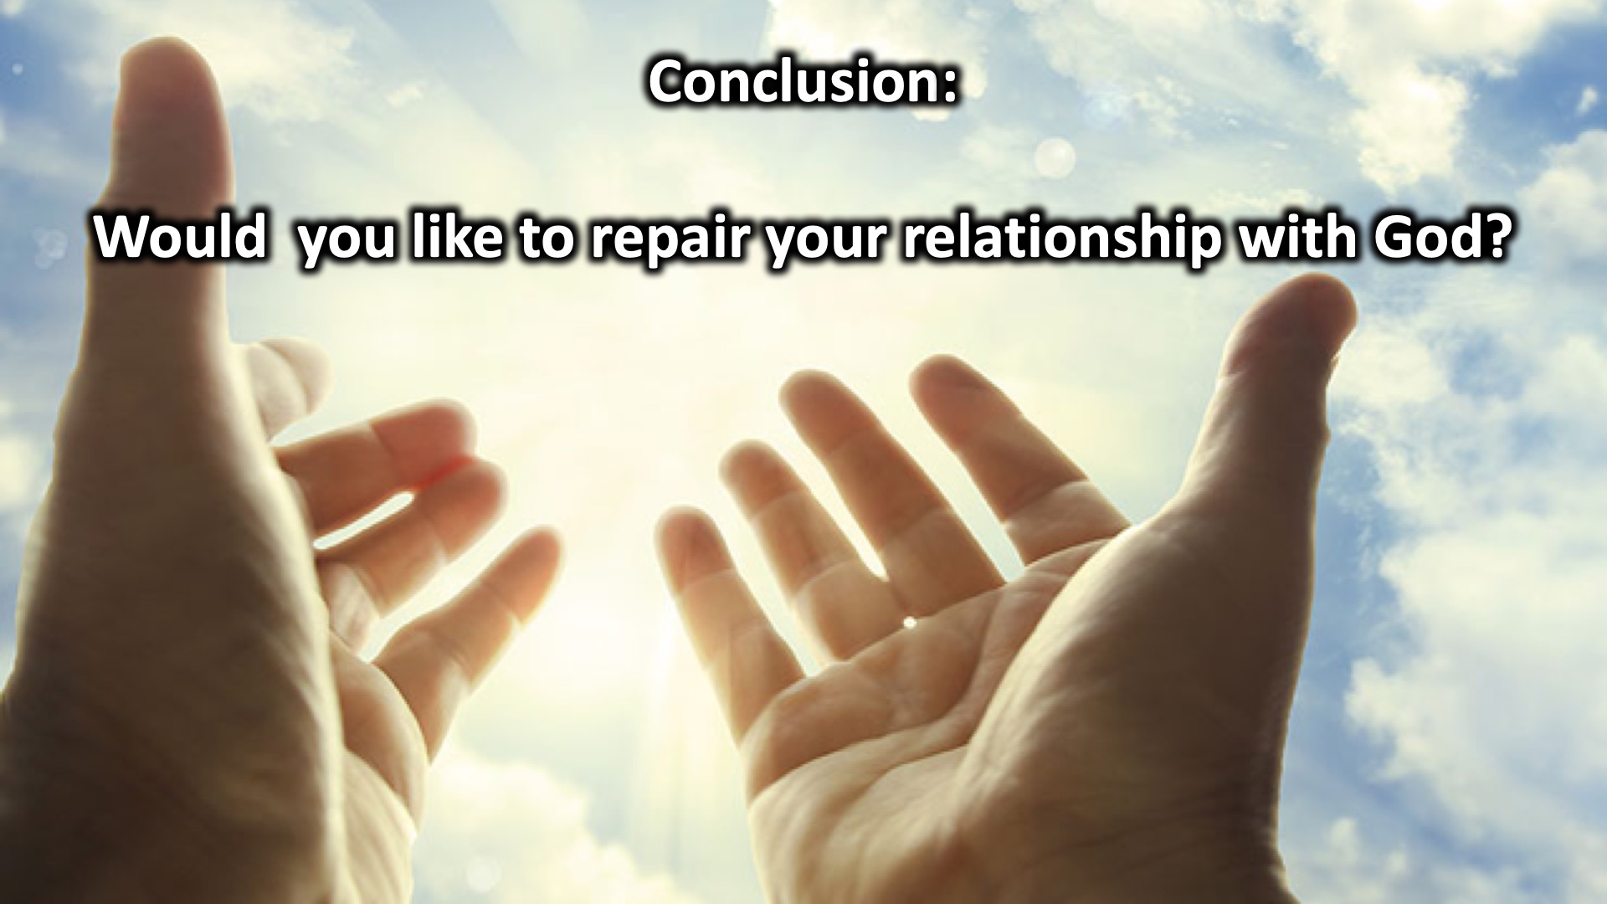
Notes:
Conclusion: Would you like to repair your relationship with God?

Slide 12
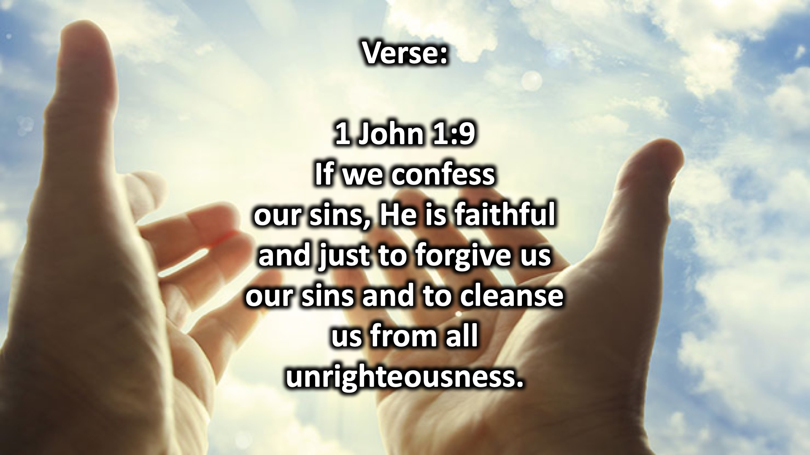
Notes:
1 John 1:9 says, “If we confess our sins, He is faithful and just to forgive us our sins and to cleanse us from all unrighteousness.

Slide 13
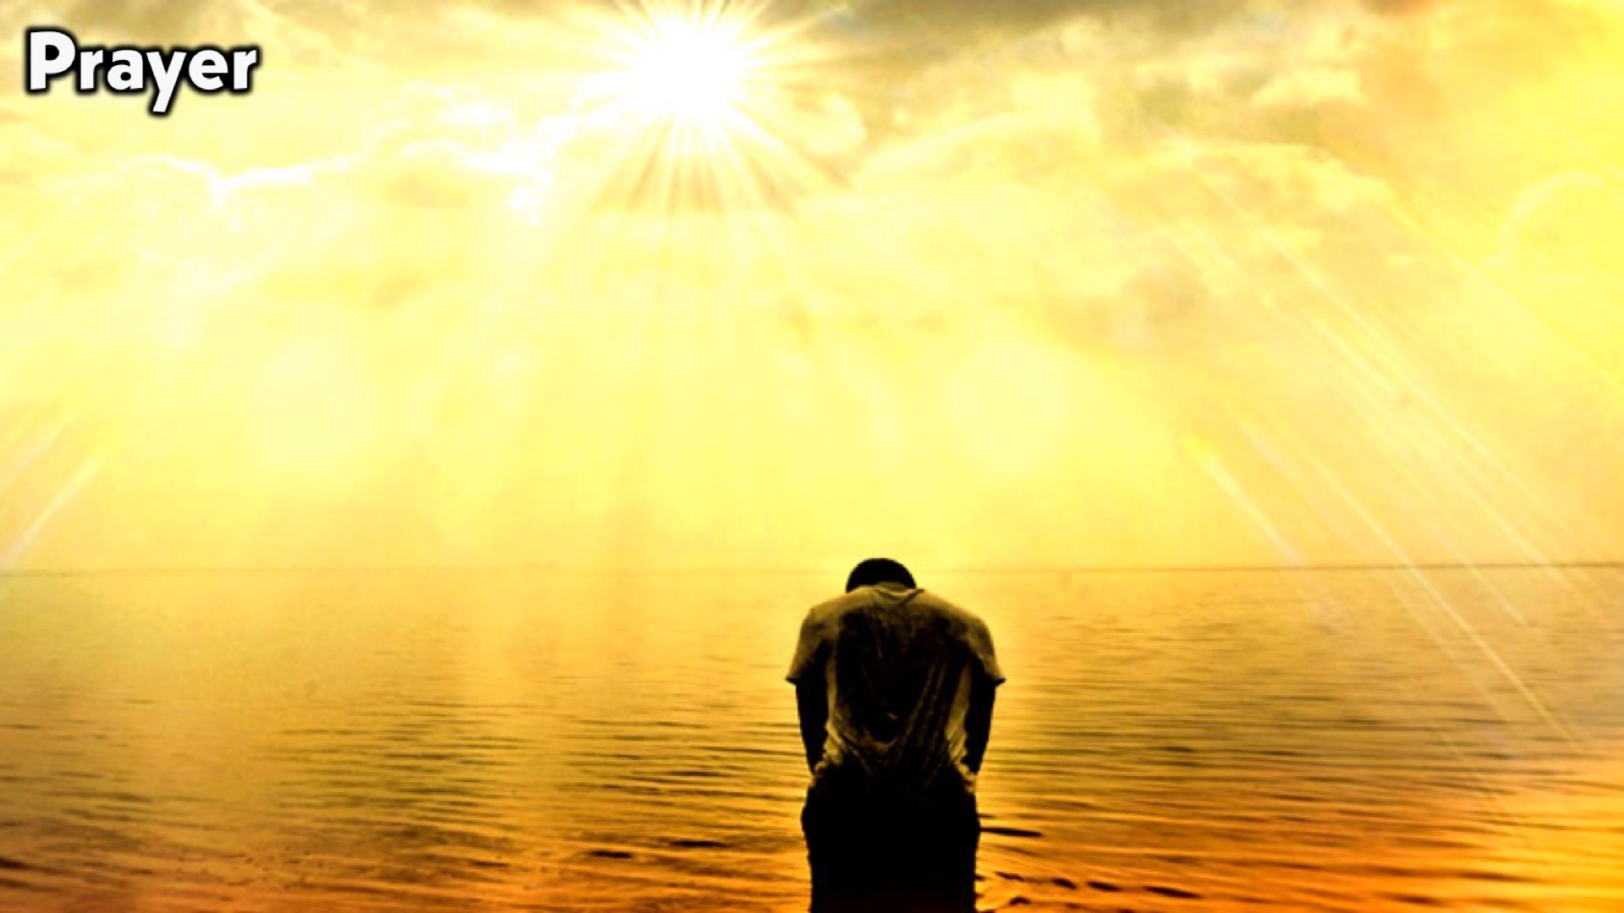
Notes:
Prayer

Slide 14
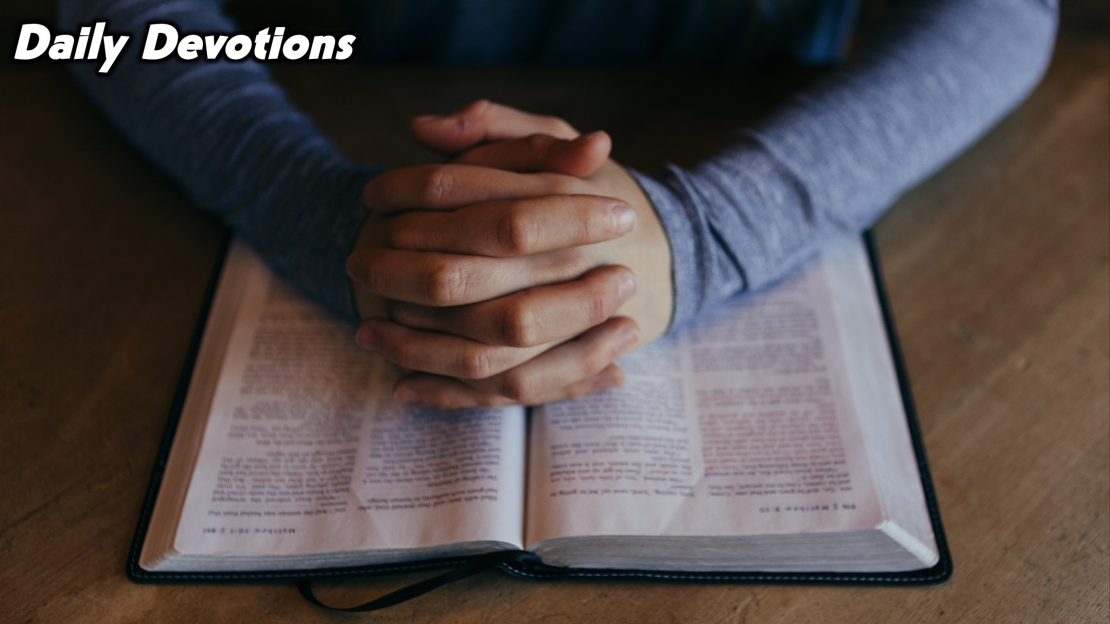
Notes:
Daily Devotions: We will post devotions on the WhatsApp group every night of the week throughout this series. Do everything you can to be a part of the daily journey.

Slide 15

Notes:
Next Sunday we begin our Campaign: What on Earth am I Here for?

