Slide 1

Notes:
Welcome to Term 2! Hopefully you had a good break and are ready for the new term. Late last year I stumbled across an amazing Podcast by Dr. Amber Selking entitled “Building Championship Mindsets” and during Term 2 we are going to learn how to think like champions by renewings our minds. Checkout her website at: http://selkingperformance.com.

Slide 2
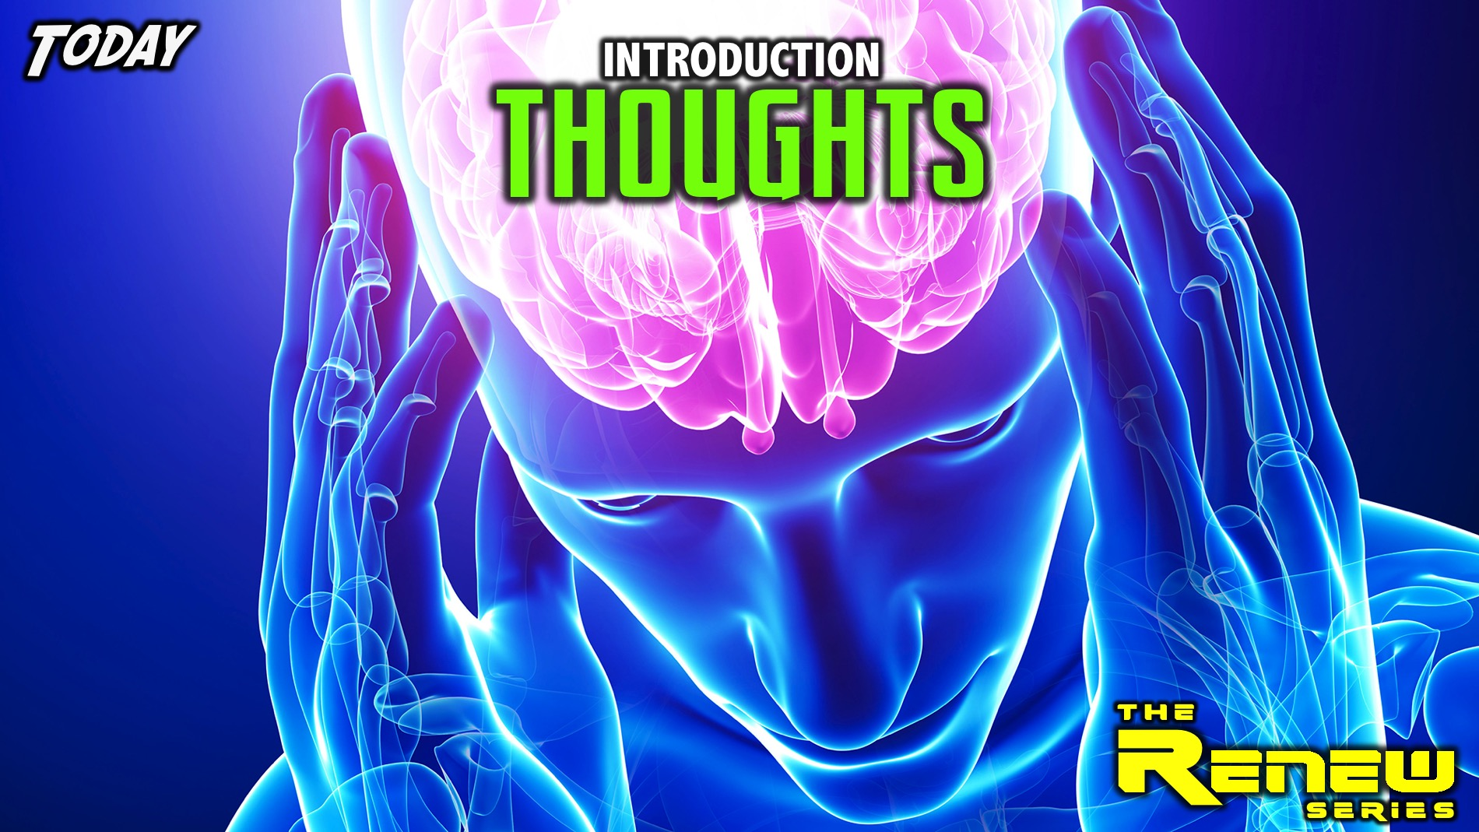
Notes:
Today is our introduction to the series and we are going to focus on our Thoughts.

Slide 3
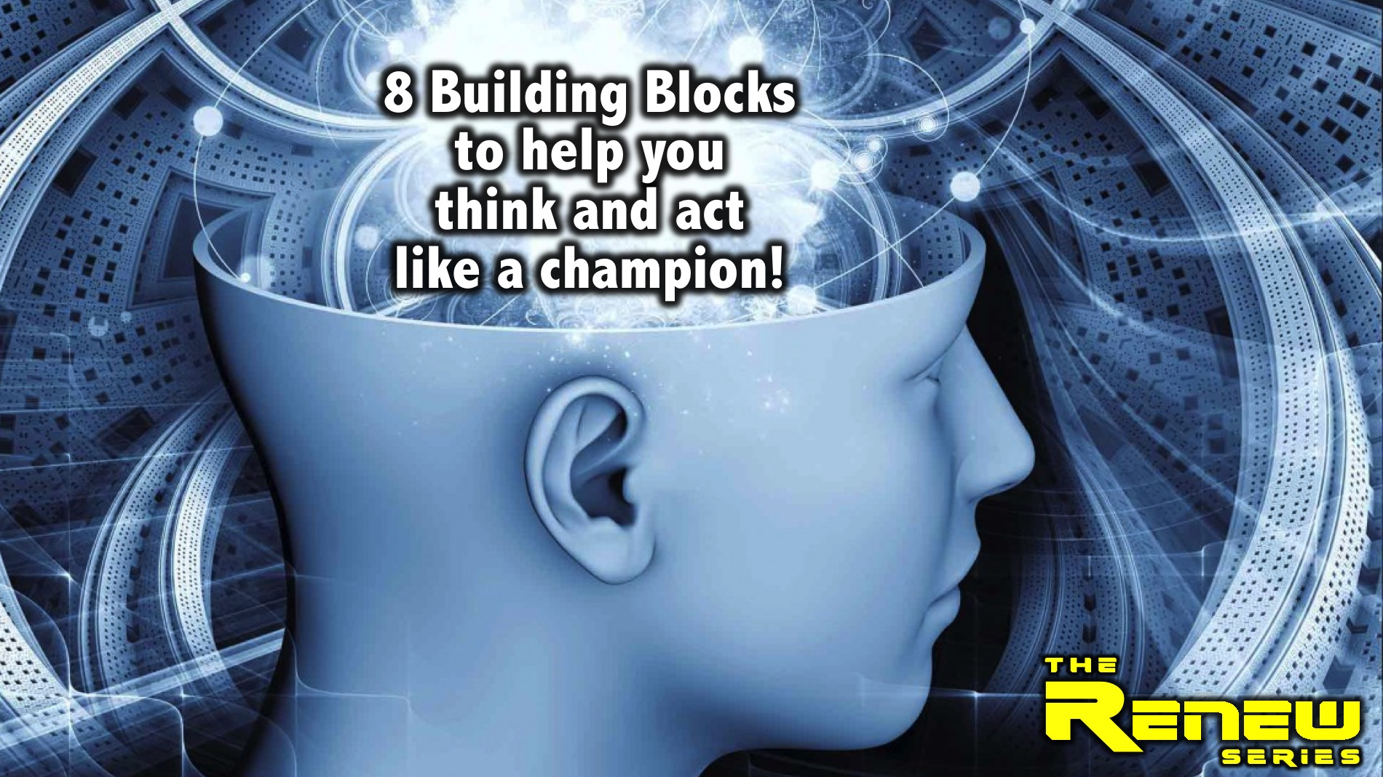
Notes:
Then for the rest of the series we are going to explore 8 building blocks to help you think and act like a champion - to achieve greatness in you whole life:

Slide 4
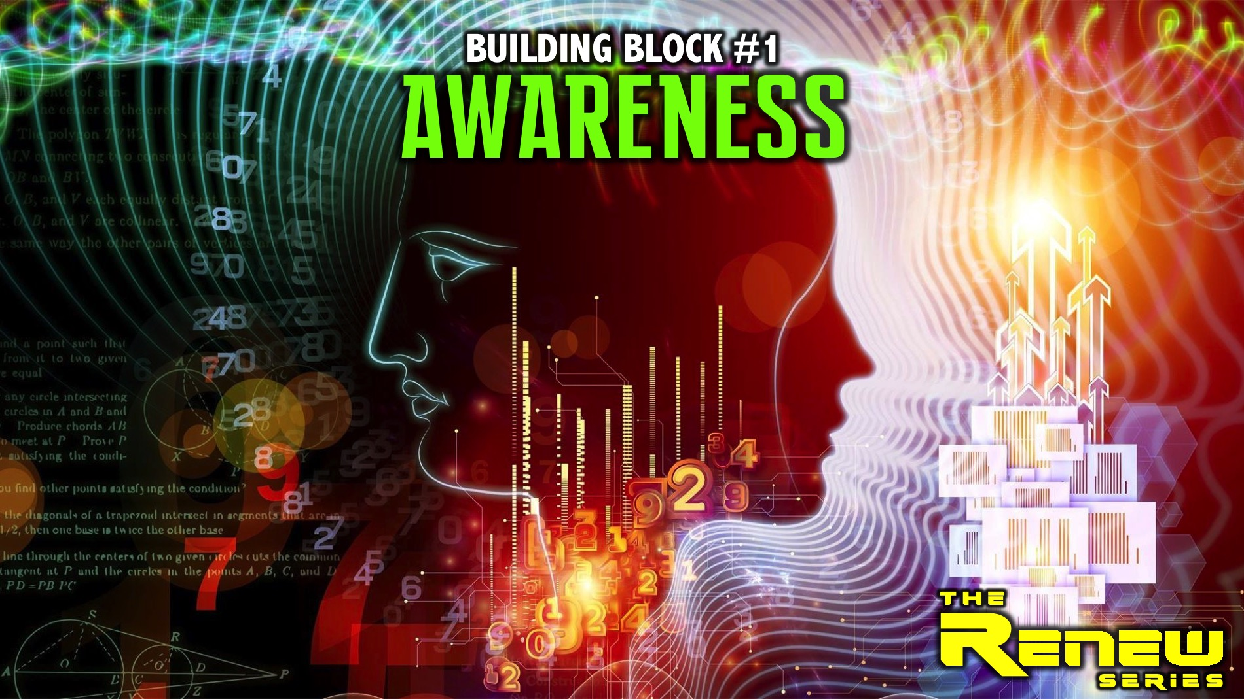
Notes:
Building Block #1: Awareness

Slide 5
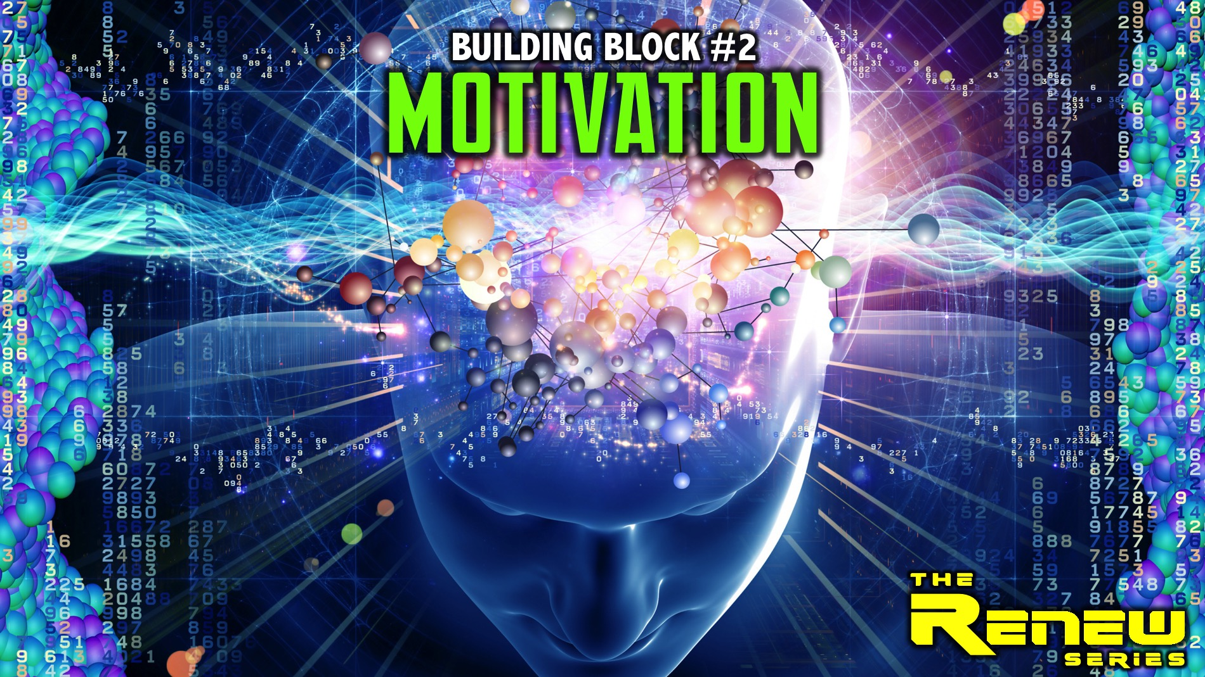
Notes:
Building Block #2: Motivation

Slide 6
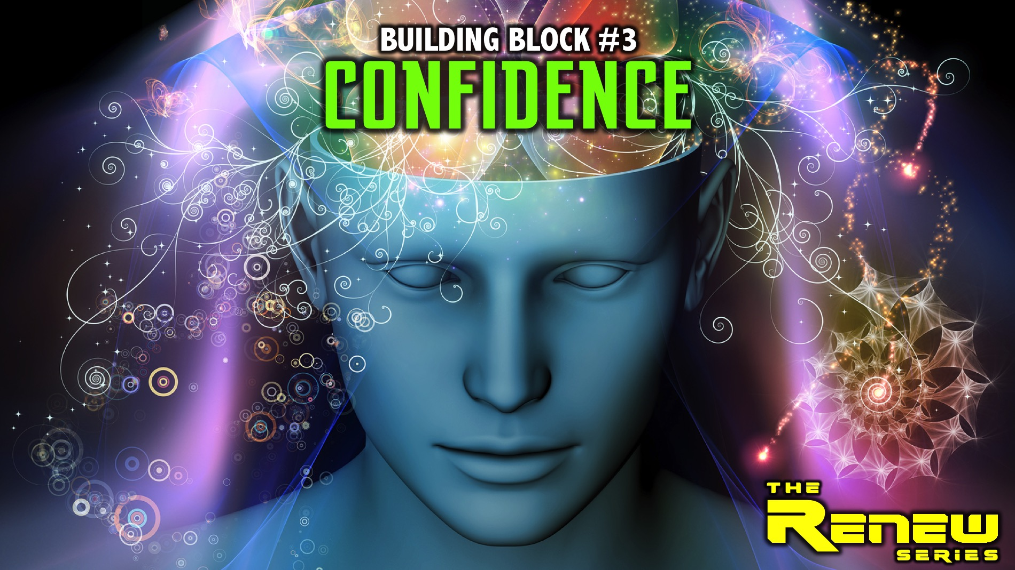
Notes:
Building Block #3: Confidence

Slide 7
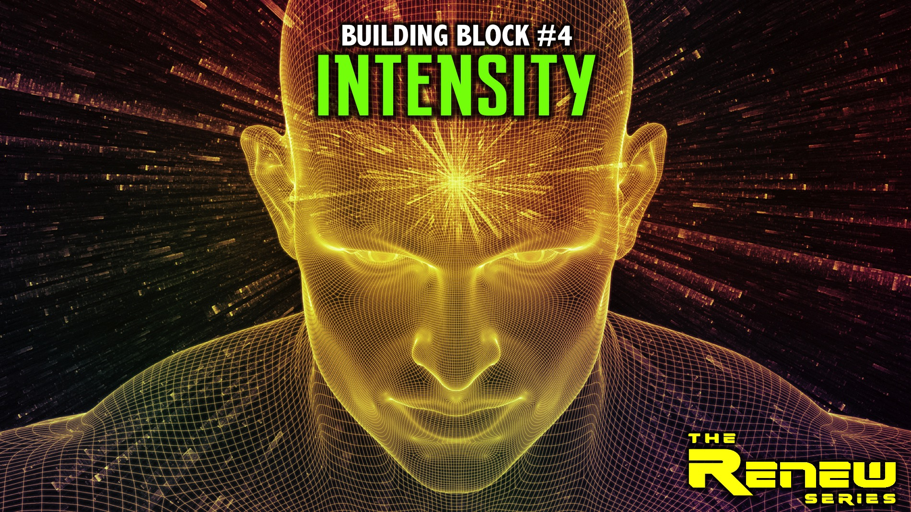
Notes:
Building Block #4: Intensity

Slide 8
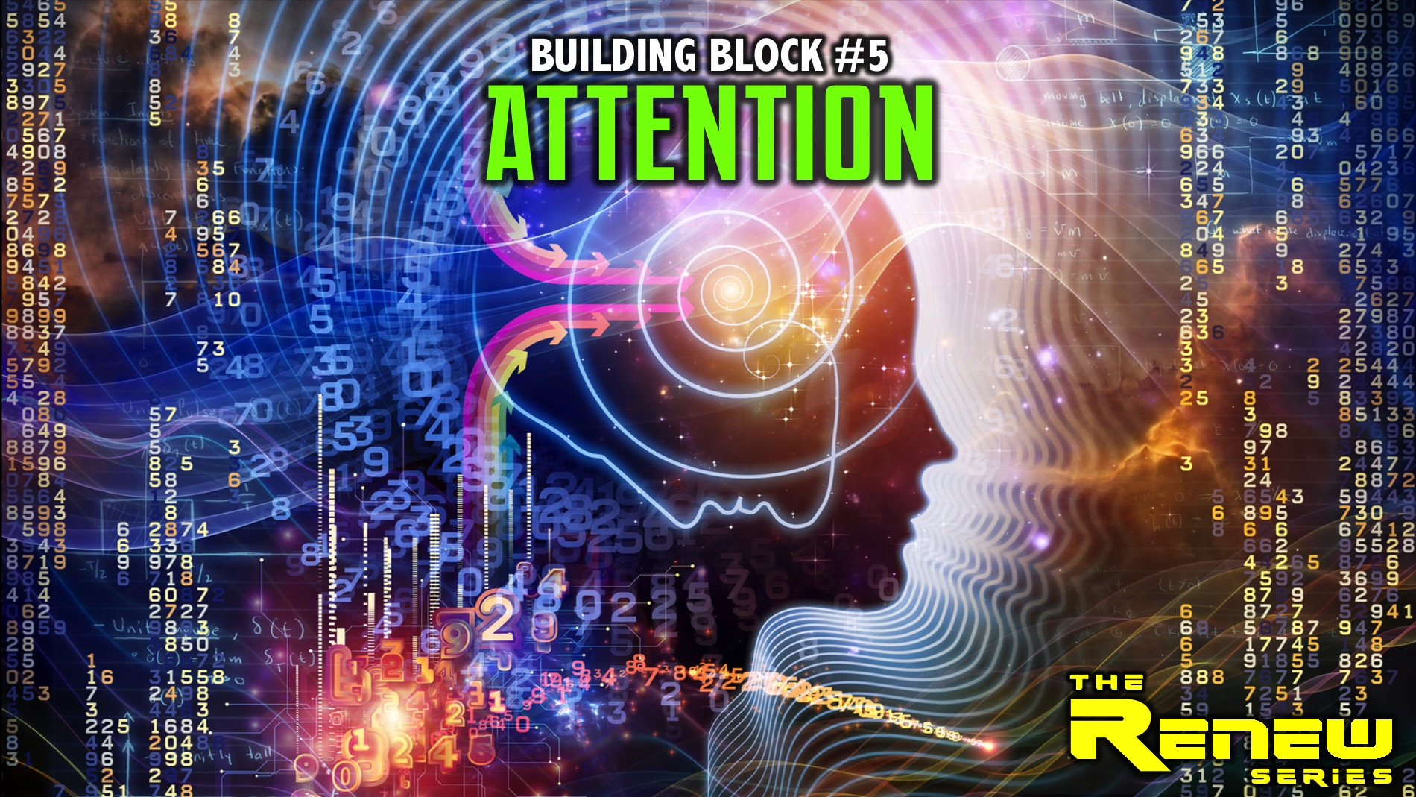
Notes:
Building Block #5: Attention

Slide 9

Notes:
On the last weekend of May, the 25th to 27th May we will be attending the Lead The Cause evangelism training weekend at GodFirst church in Fourways. We won’t have youth that Sunday morning but will stay in the sanctuary.

Slide 10
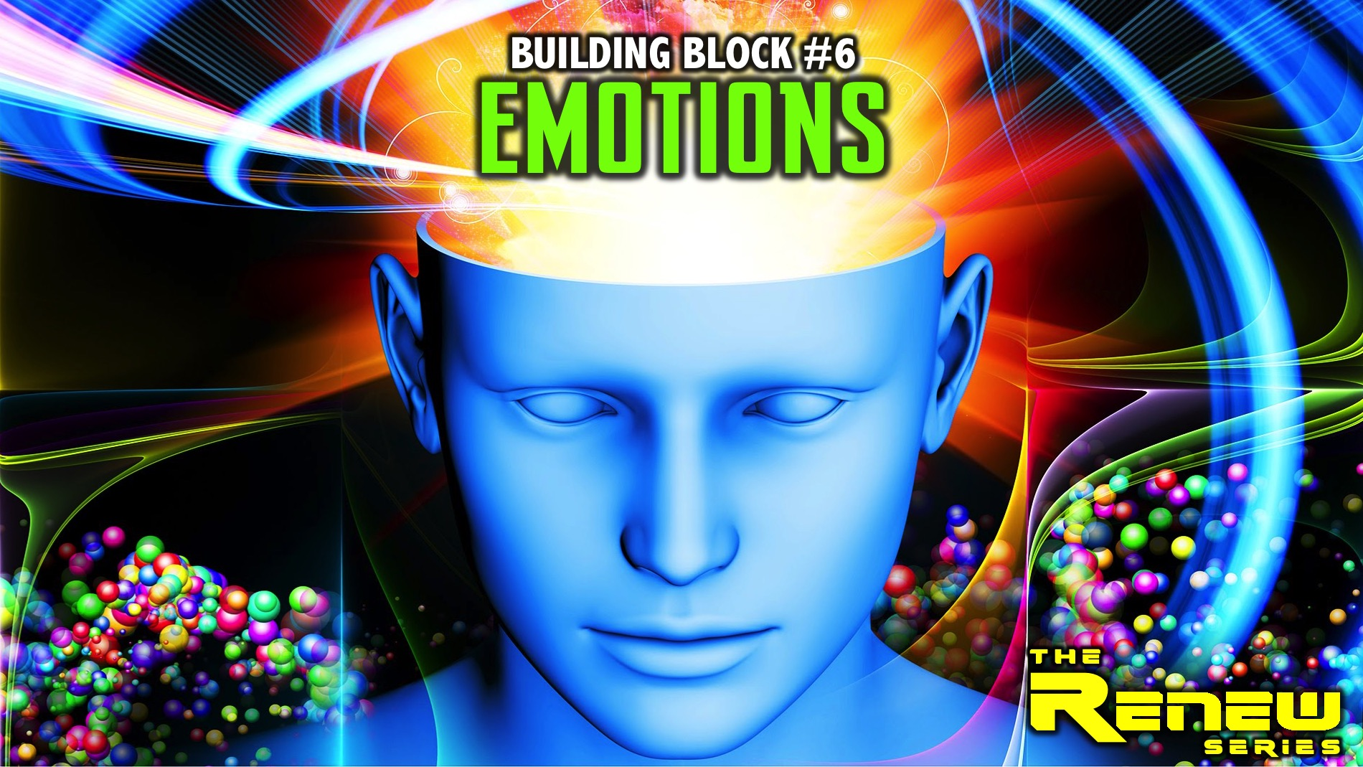
Notes:
Building Block #6: Emotions

Slide 11
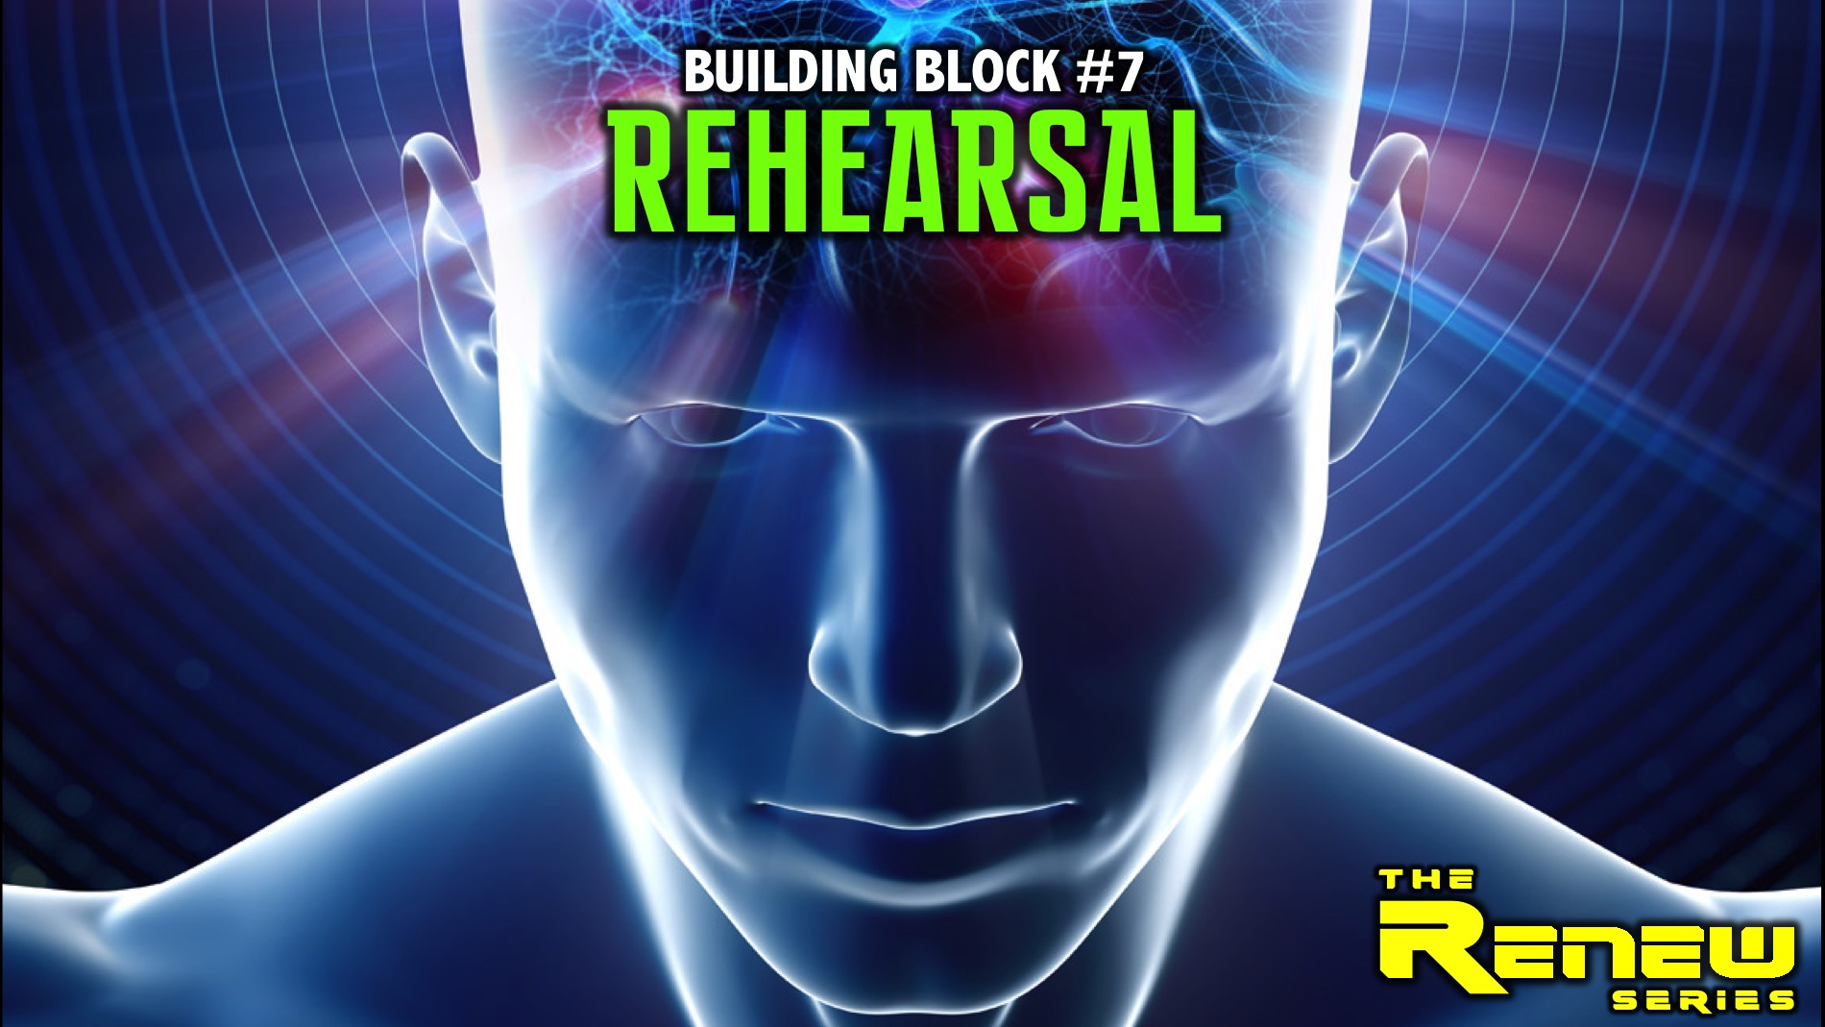
Notes:
Building Block #7: Rehearsal

Slide 12
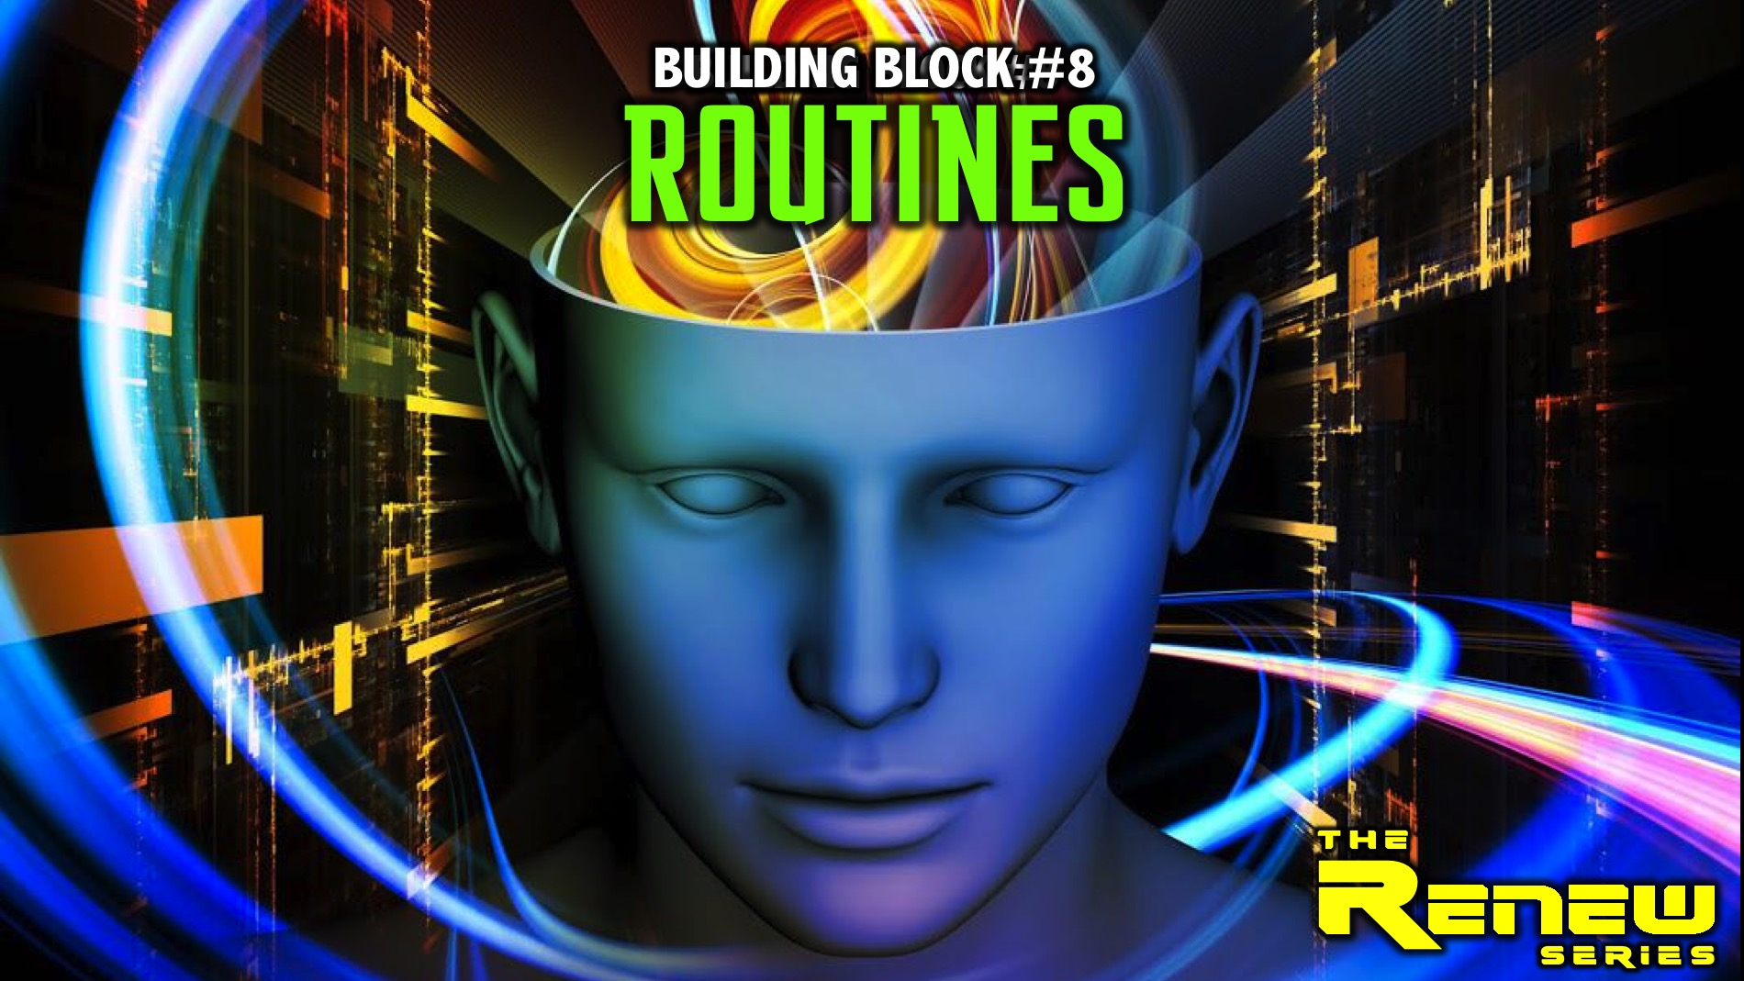
Notes:
Building Block #8: Routines

Slide 13

Notes:
Today is Session 1 and we will be talking about our thoughts!

Slide 14
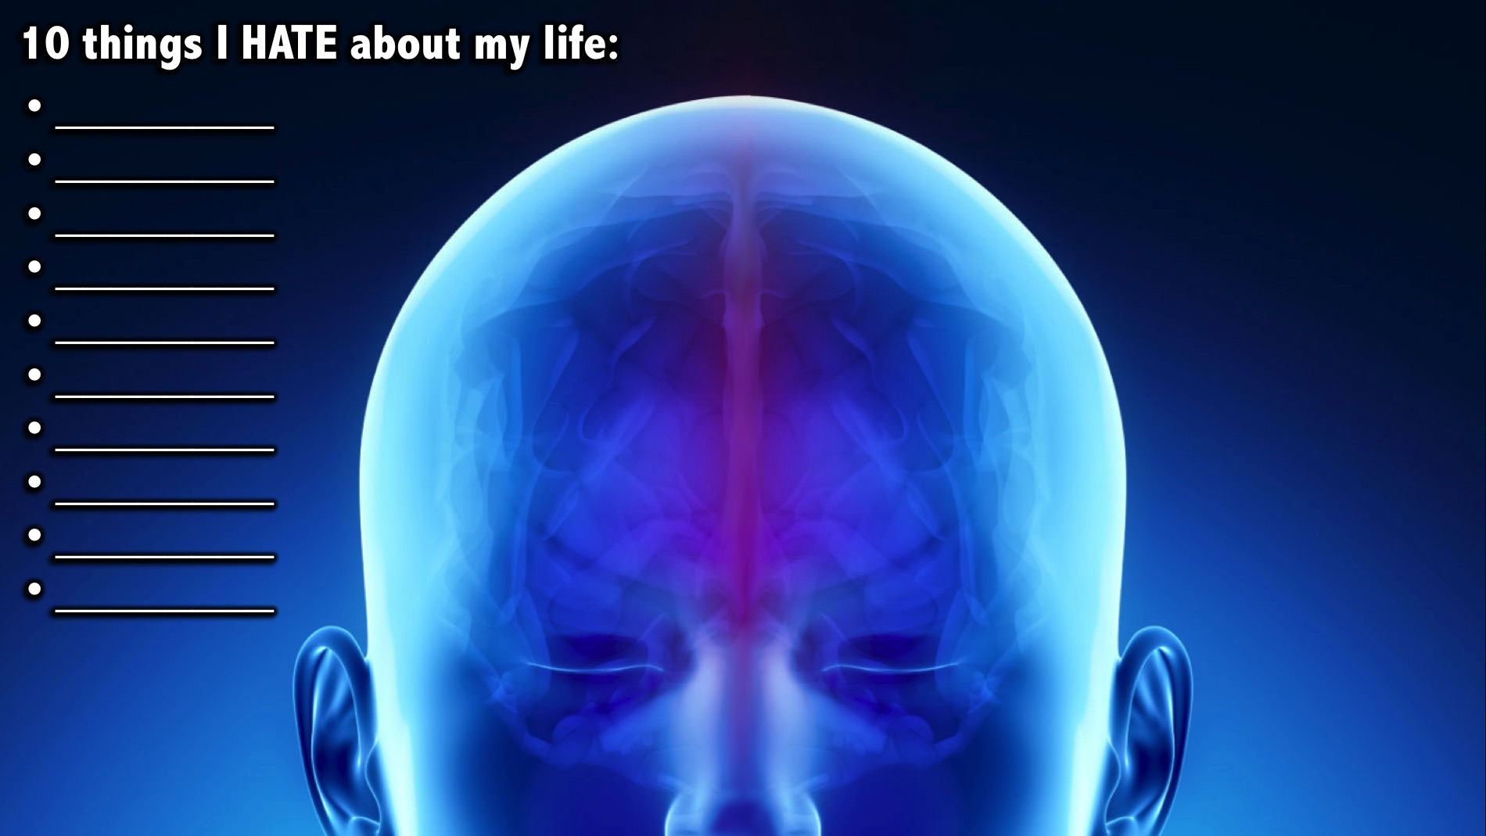
Notes:
Exercise Part 1: List 10 things that you HATE about your life.
Facilitators Notes: At your table, make sure each person has a pen and piece of paper and encourage them to focus on the activity and not waste time getting going. They should not over think the question but just start writing down things they DON’T like about their life - or things they wish they could change about their lives.

Slide 15
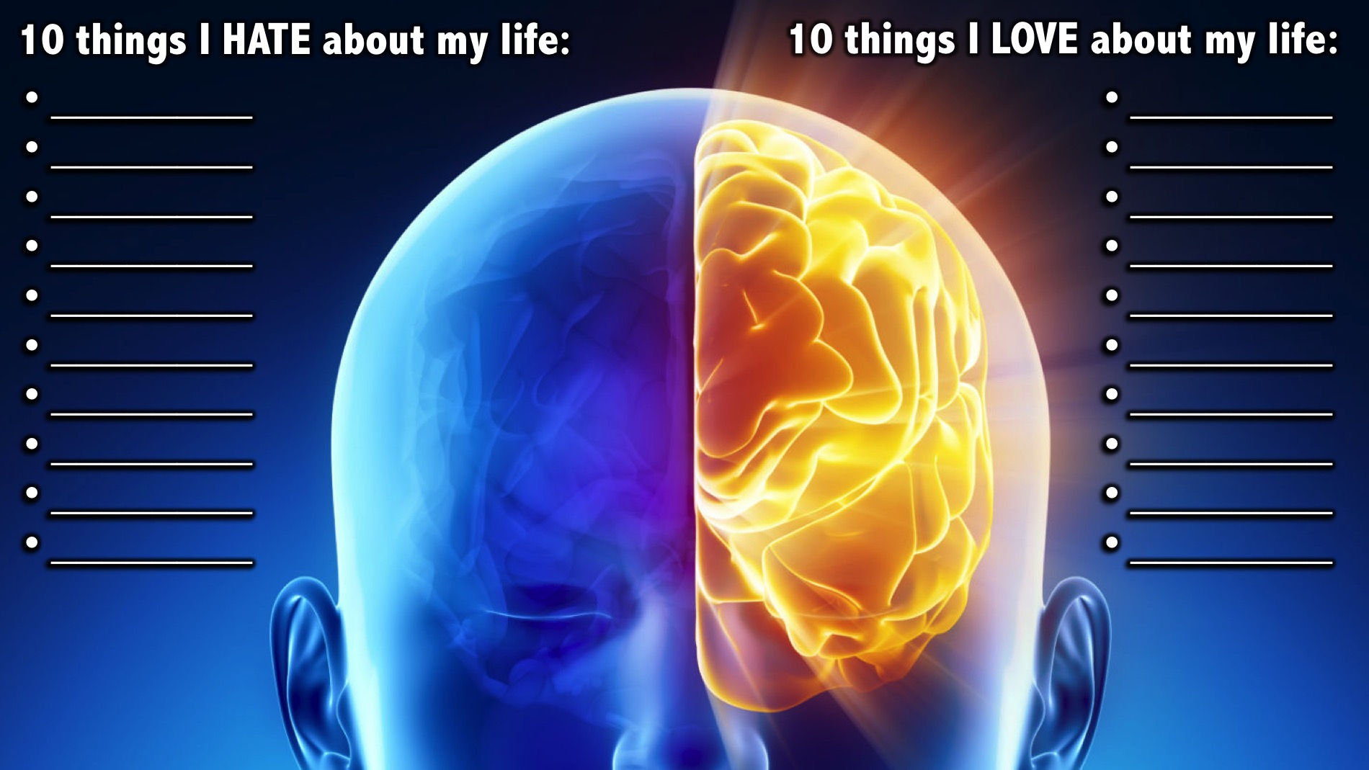
Notes:
Exercise Part 2: Now list 10 things that you LOVE about your life.
Facilitators Notes: Encourage each person at your table to stop working on the things they hate about their lives and start working on the list of things that they love about their lives.

Slide 16
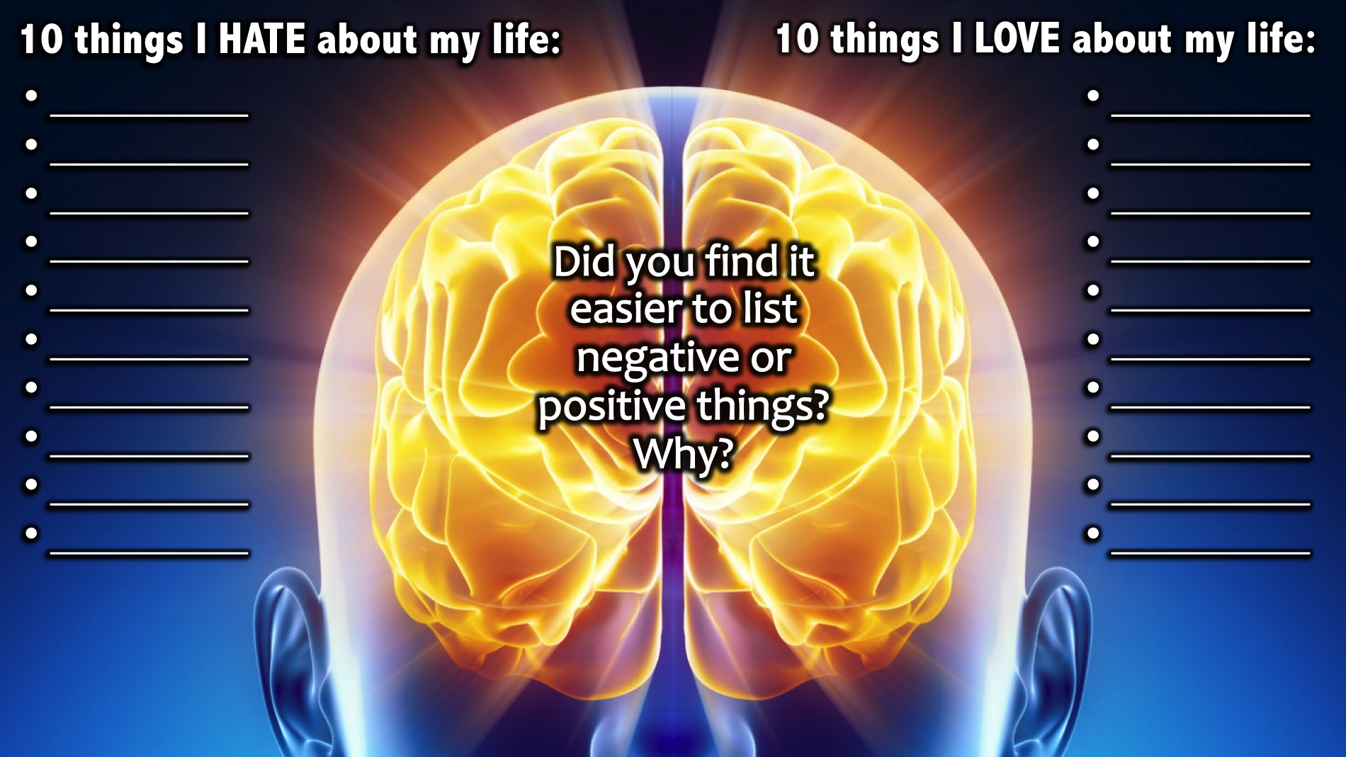
Notes:
Debrief: Did you find it easier to list negative or positive things? Why?
Facilitators Notes: Lead a brief time of reflection around the table - maybe start with getting teens who found it easier to find things they hate about their lives to put their hands up and then have those who found it easier to list the things they love about their lives. It is likely that some people may be more positive in mindset already and they may have found the LOVE list easier to complete. Ask them for reasons why it was easier to list negative or positive items and also why that was the case.

Slide 17
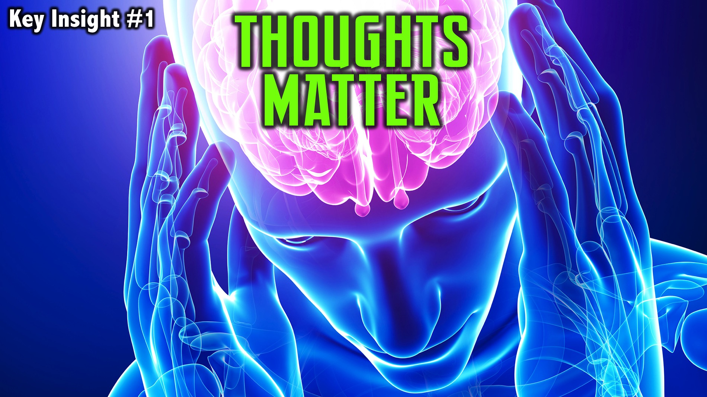
Notes:
Key Insight #1: Thoughts Matter

Slide 18
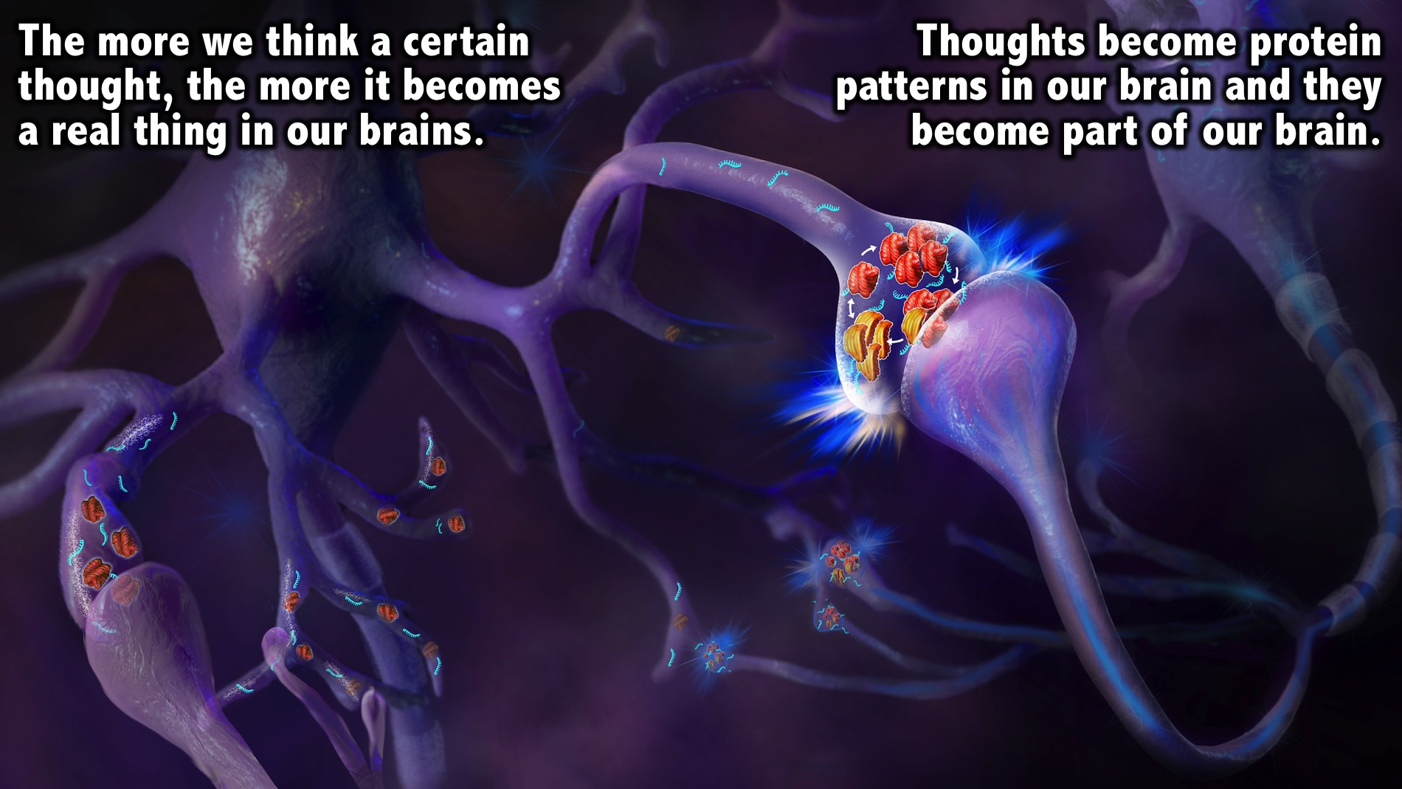
Notes:
Why do thoughts matter? The more we think a certain thought, the more it becomes a real thing in our brains. Thoughts become protein patterns in our brain and they stay with us - they become part of our brain.

Slide 19
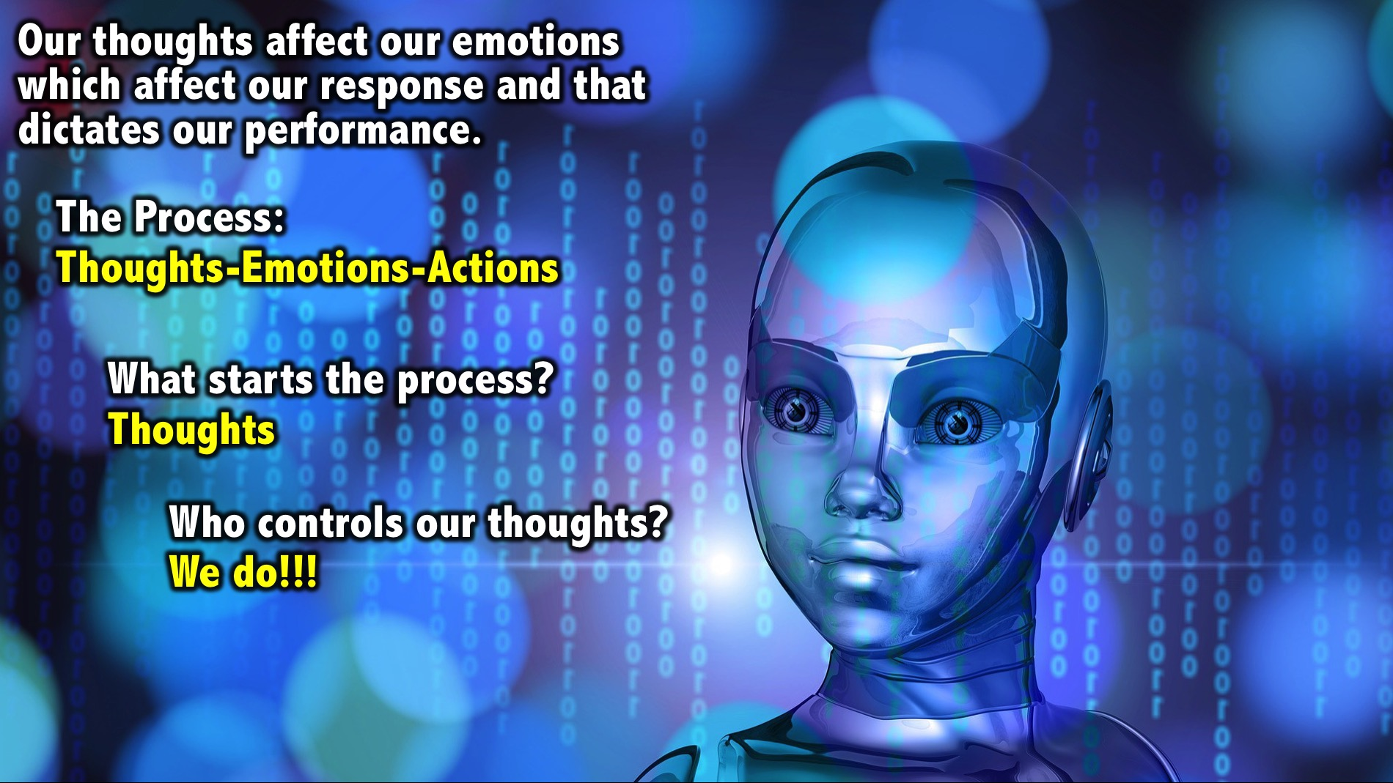
Notes:
Our thoughts affect our emotions which affect our psychological response and ultimately that is what dictates our performance. The process is: Thoughts - Emotions - Actions. So what starts this process? Thoughts! And who controls your thoughts....WE DO!!

Slide 20
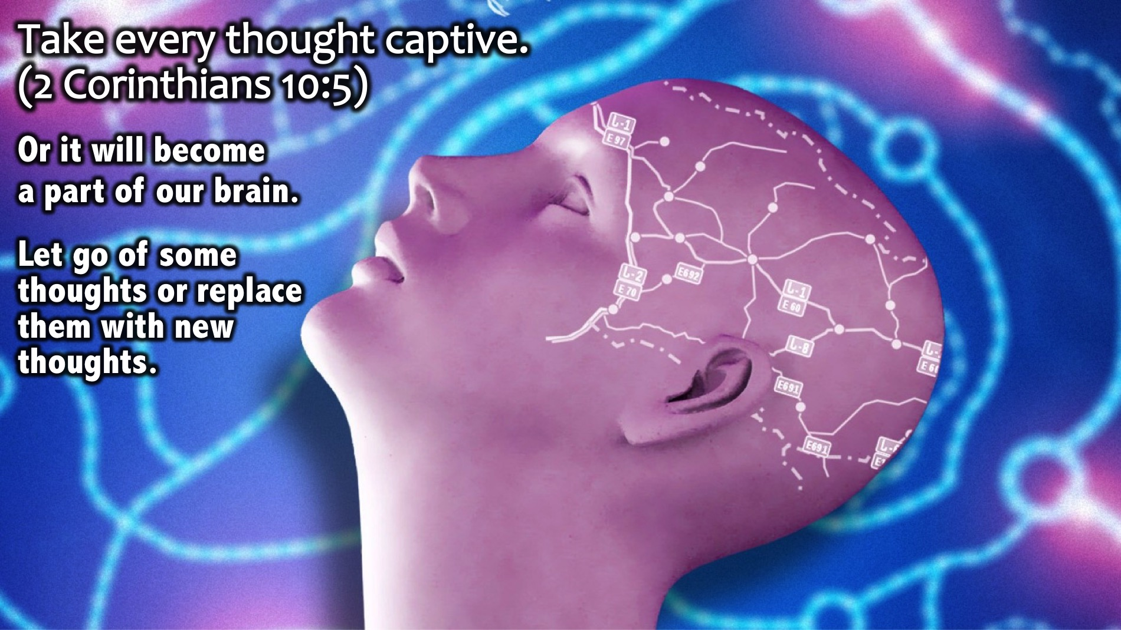
Notes:
God's Word says that we must take every thought captive (2 Corinthians 10:5) otherwise it becomes a part of our brain. We must let go of some thoughts or replace them with new thoughts.

Slide 21
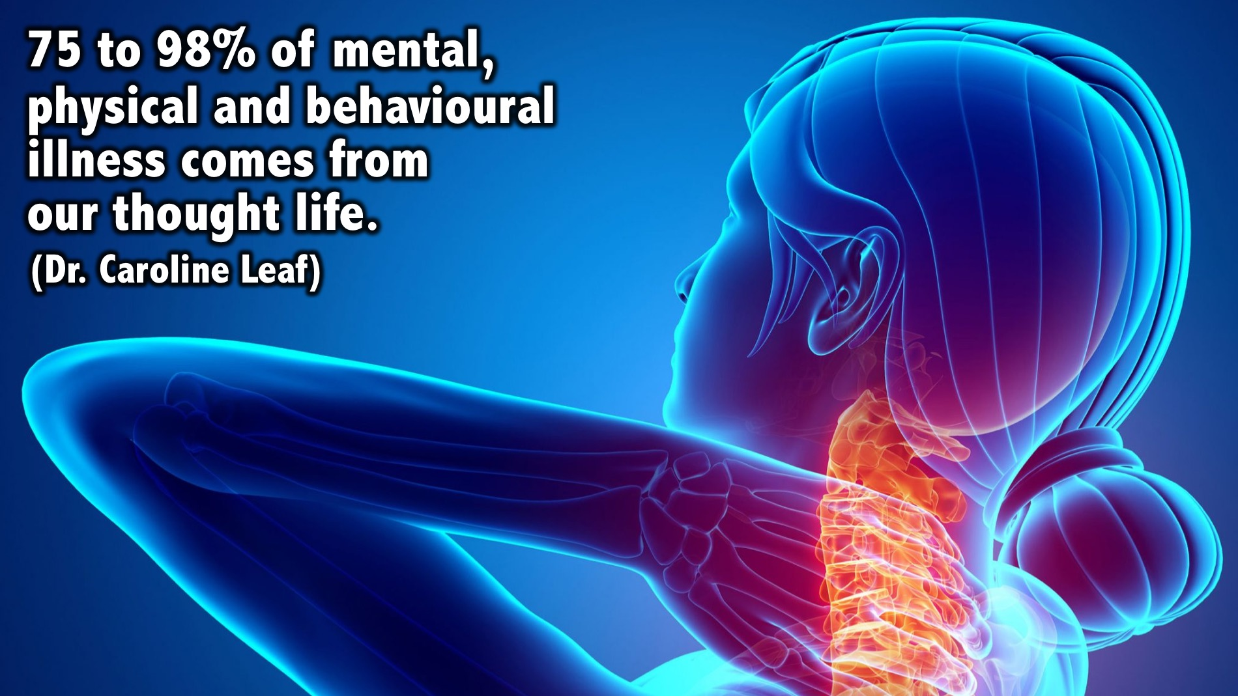
Notes:
Dr Caroline Leaf says that research shows that 75 to 98% of mental, physical and behavioural illness comes from our thought life.

Slide 22
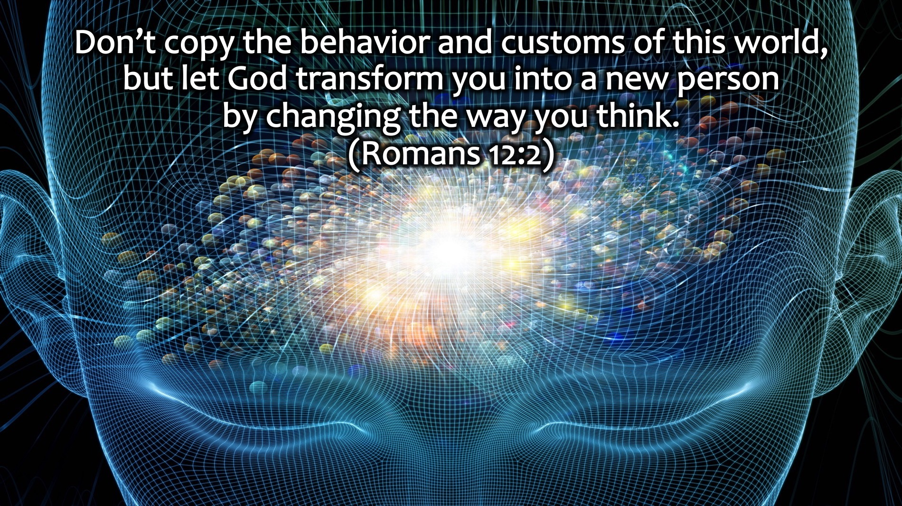
Notes:
Romans 12:2 says: “Don’t copy the behavior and customs of this world, but let God transform you into a new person by changing the way you think.”

Slide 23
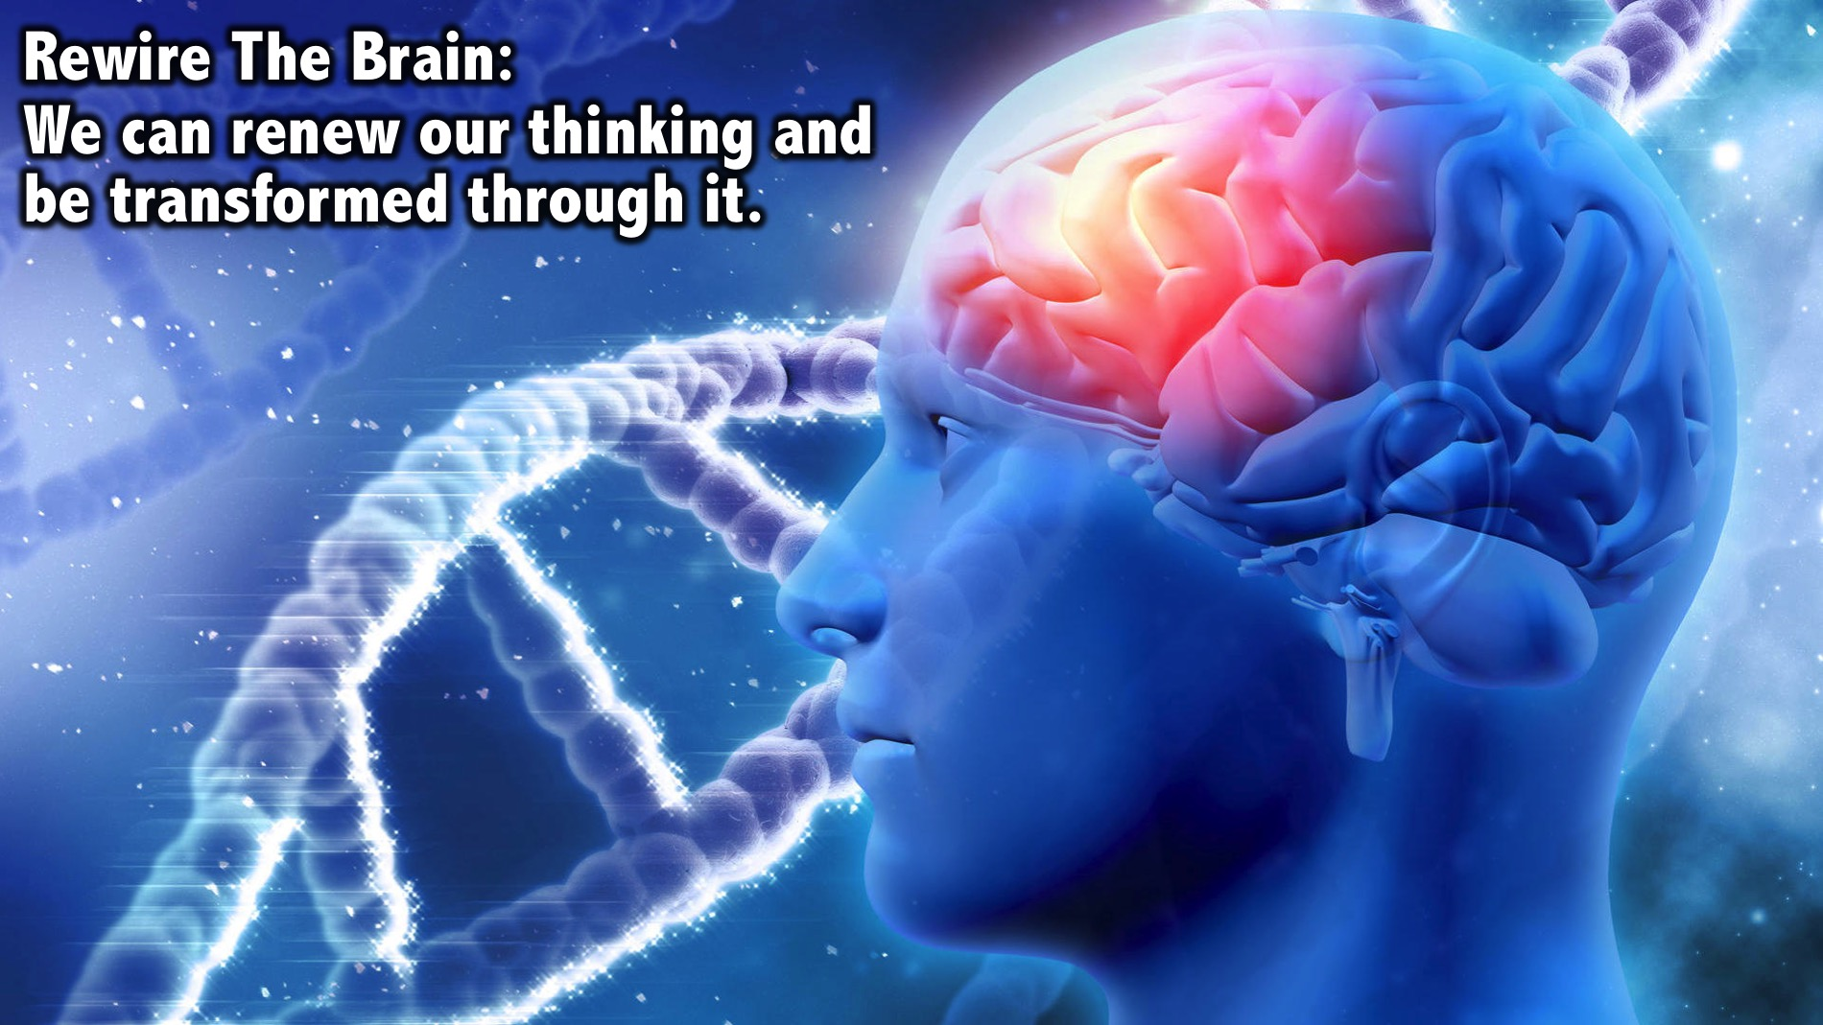
Notes:
We can renew our thinking and be transformed through it. We can rewire how we think.

Slide 24
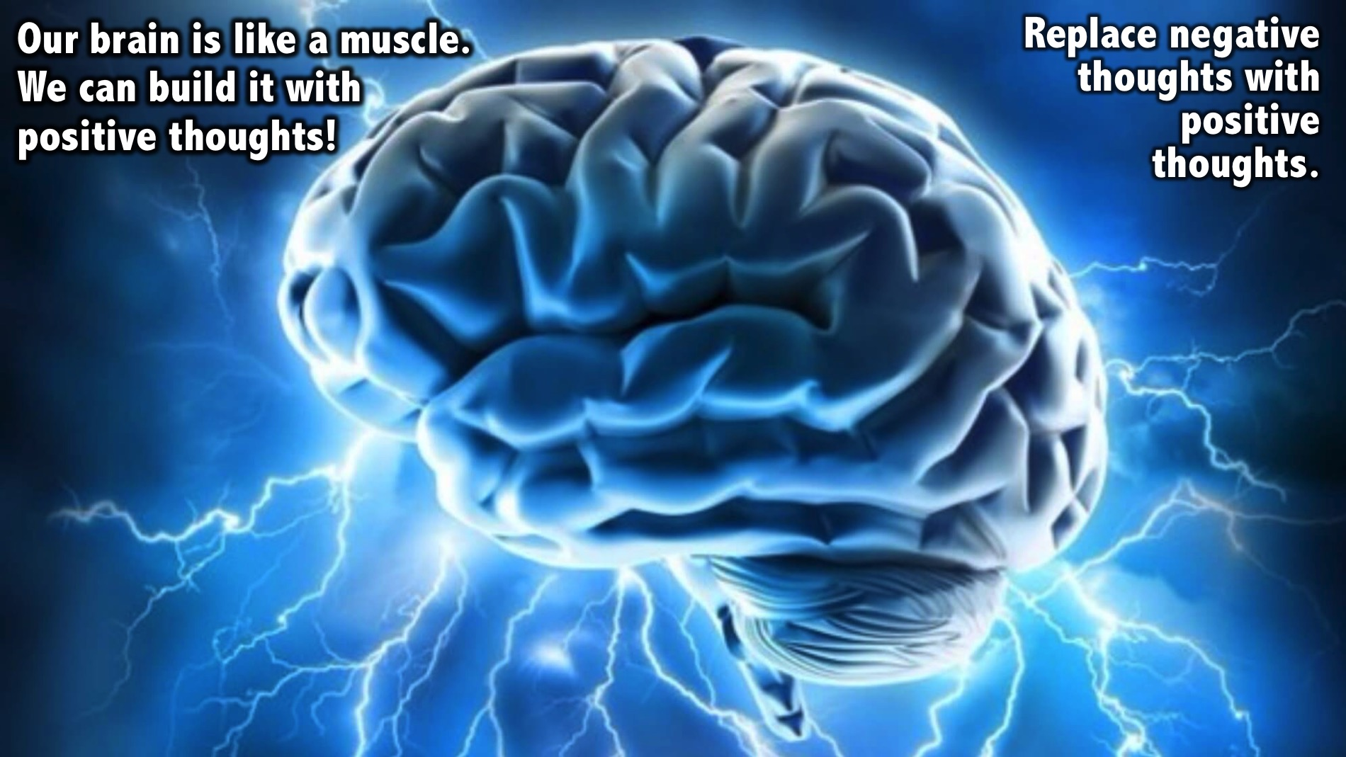
Notes:
Illustration: Our brain is like a muscle. When you go to the gym you break down muscles and then you build them up and they get bigger. But if you don’t work out or use a muscle it gets smaller. The same happens with our brains. When you stop using a negative thought it gets smaller and smaller and as you rebuild a more productive thought process it grows. We don’t just stop thinking negatively, we must replace it with a positive thinking process. We should list negative thoughts we are having and think of positive thoughts to replace them with.

Slide 25
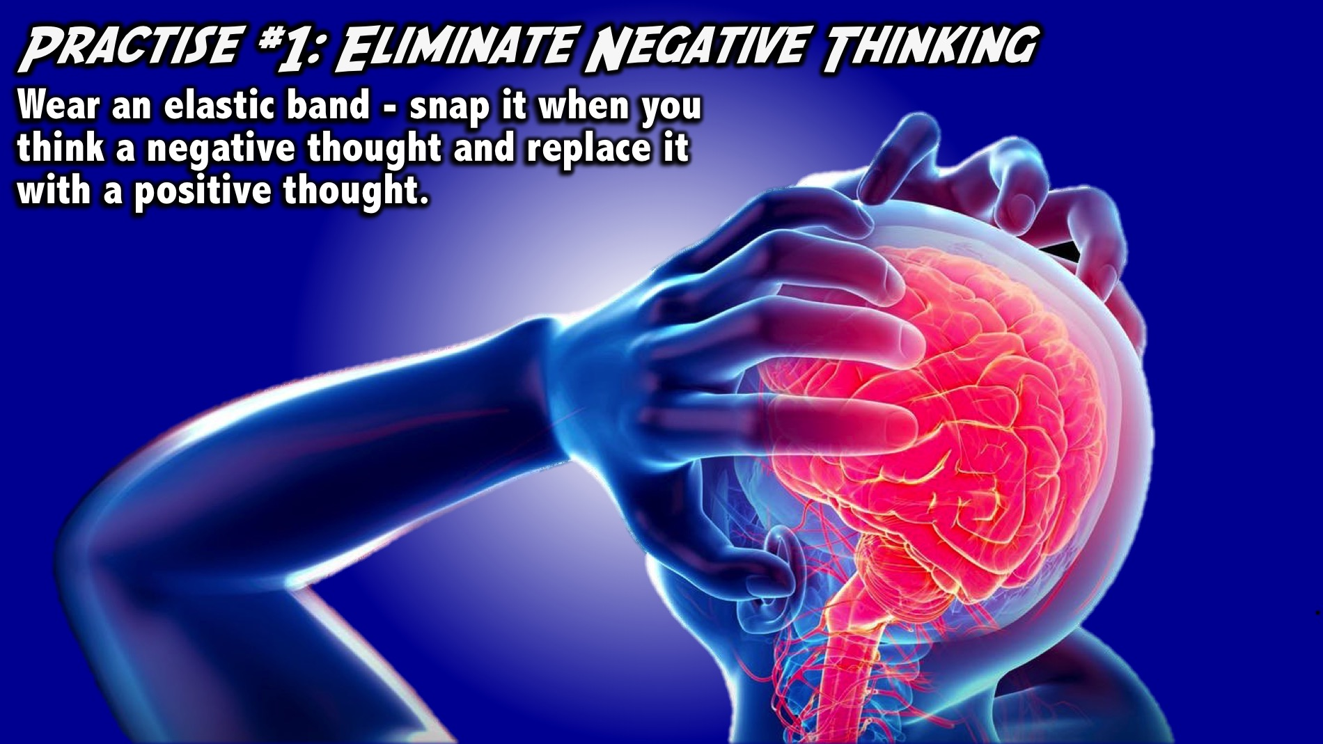
Notes:
Practice #1: Eliminate Negative Thinking. Be aware of your thoughts: Make a note of what you think about during the day. Remember that if you think negatively it will affect your emotions and that will affect your health and then your performance. When you find yourself thinking negatively do something about it. One way to help you do this is to put an elastic band on your wrist and when you have the negative thought stretch and let it go when you think negatively about something - you will stop thinking negatively because you don’t want to be hurt.
Facilitators Notes: Make sure everyone chooses an elastic band and places it on their wrist - do it yourself to set an example. Ask them a question or that two that would most likely cause them to have a negative thought and tell them to practise pulling and releasing the elastic band. Encourage them to do this throughout the coming week.

Slide 26

Notes:
So our first key insight this morning is that thoughts matter!

Slide 27
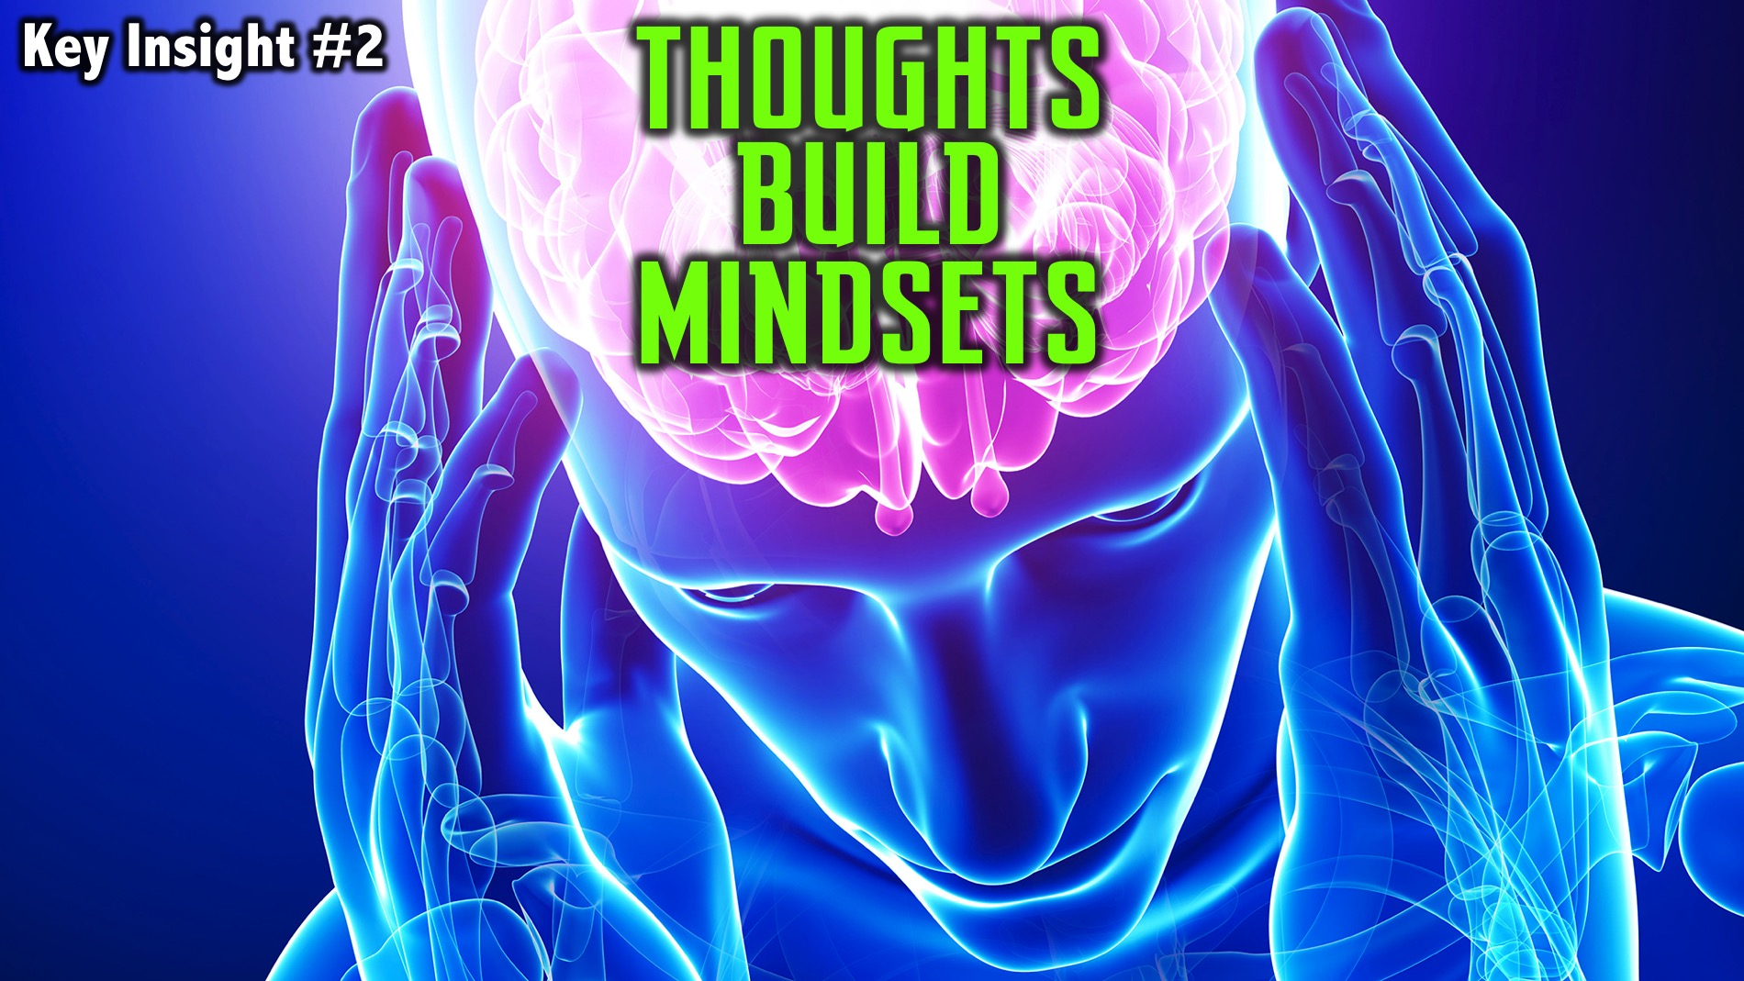
Notes:
Key Insight #2: Thoughts Build Mindsets

Slide 28
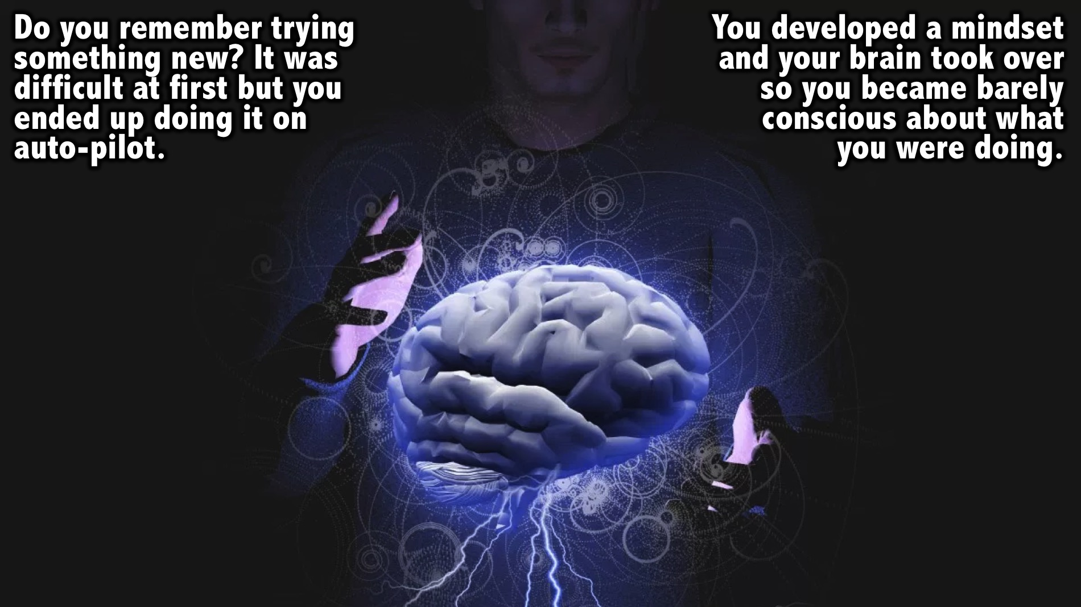
Notes:
Illustration: Do you remember when you tried something new? It was difficult and you have to think carefully about every aspect of what you were doing. What happened in time? You started to do it on auto-pilot. What happened? You developed a mindset where your brain took over and you were barely conscious about what you were doing. We can also develop thinking mindsets that control us.

Slide 29
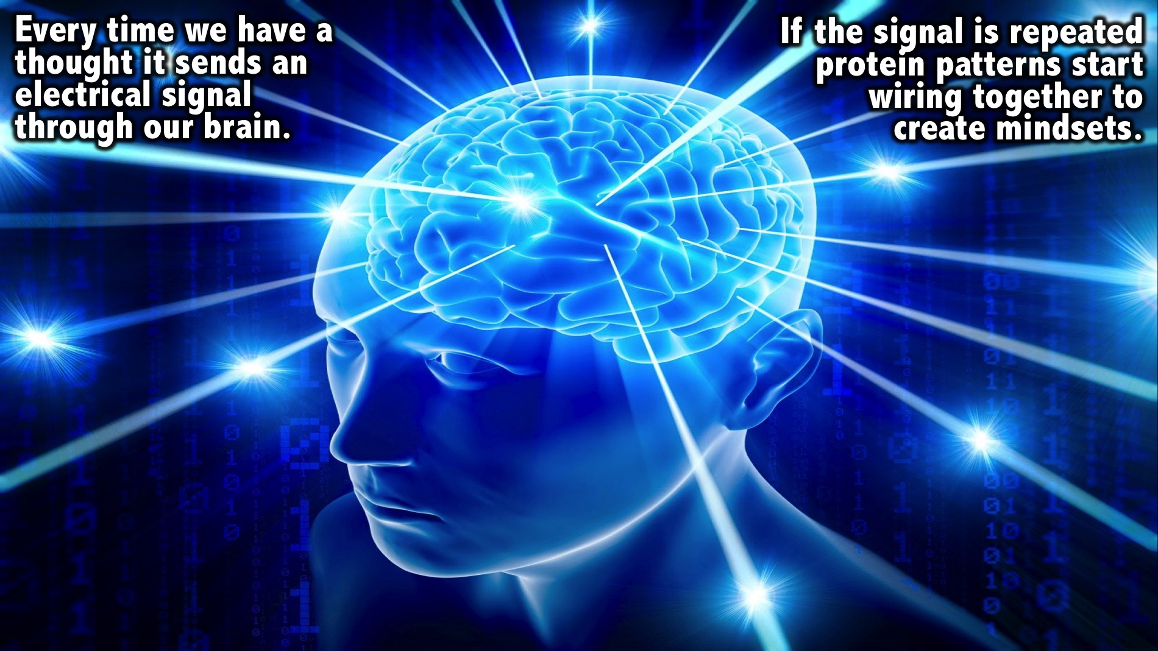
Notes:
Every time we have a thought it sends an electrical signal through our brain. If the signal is repeated protein patterns start wiring together to create mindsets.

Slide 30
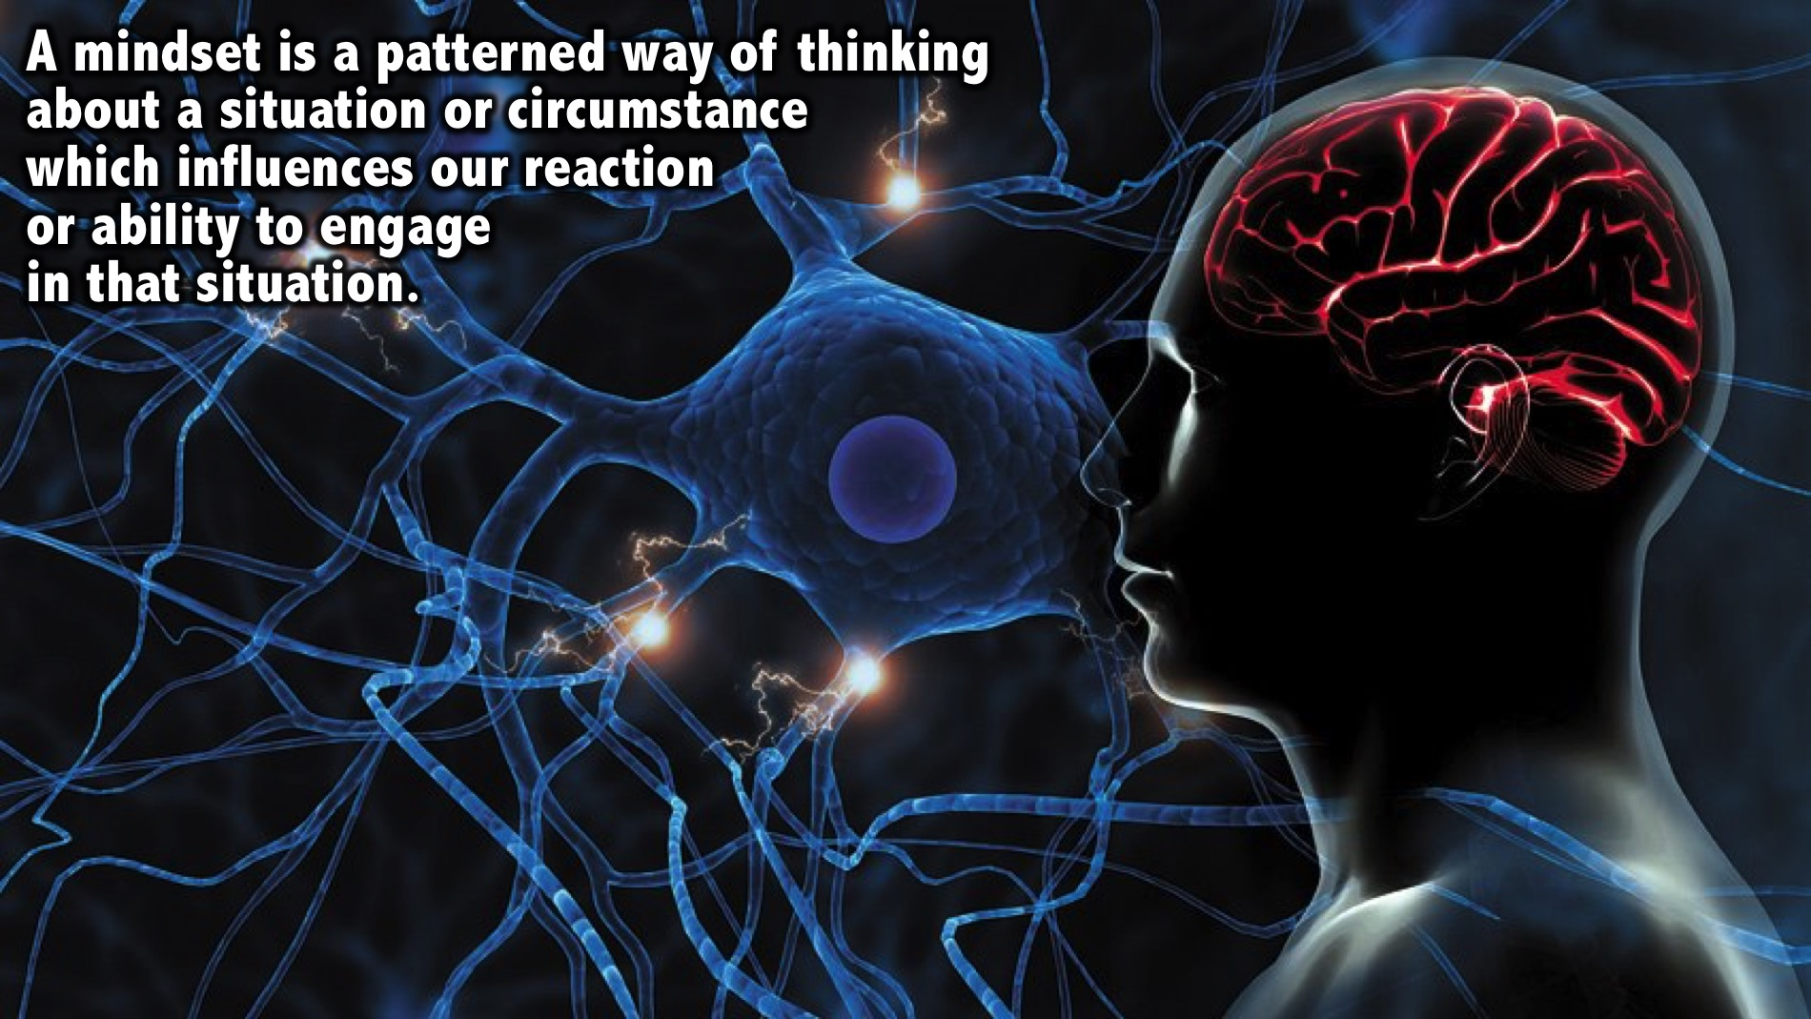
Notes:
What is a mindset? A mindset is a patterned way of thinking about a situation or circumstance which influences our reaction or ability to engage in that situation.

Slide 31
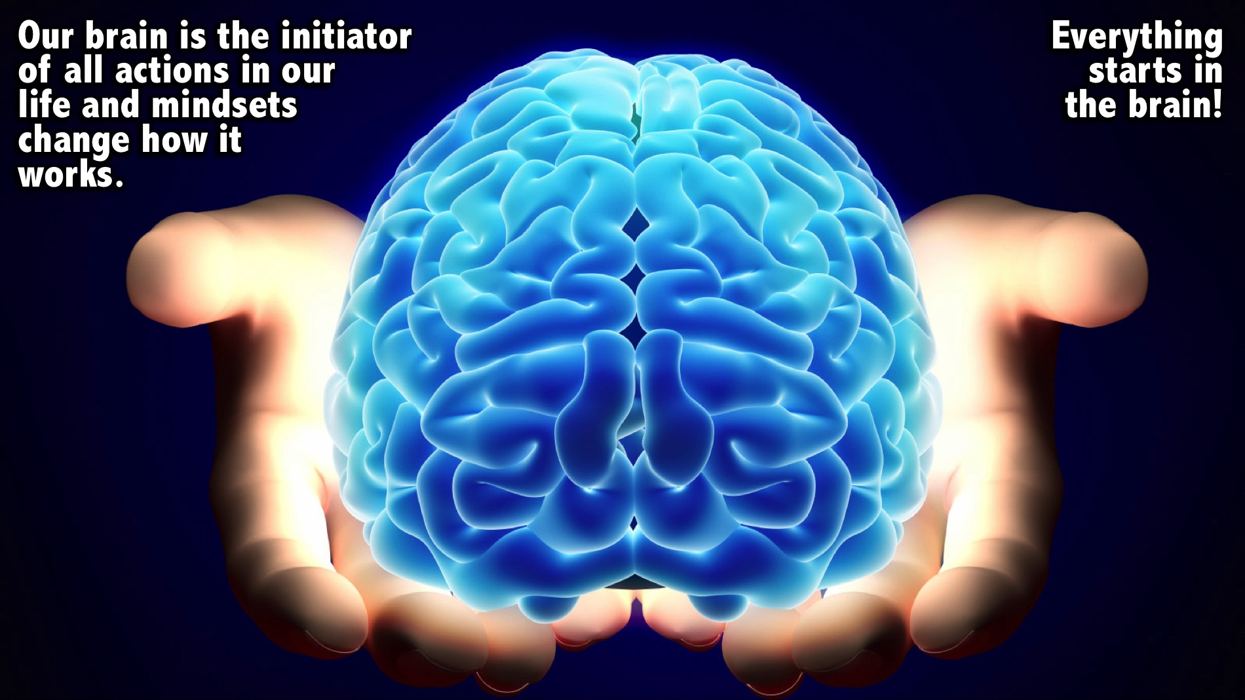
Notes:
Our brain is the initiator of all actions in our life and mindsets change how it works. It all starts in the brain!

Slide 32
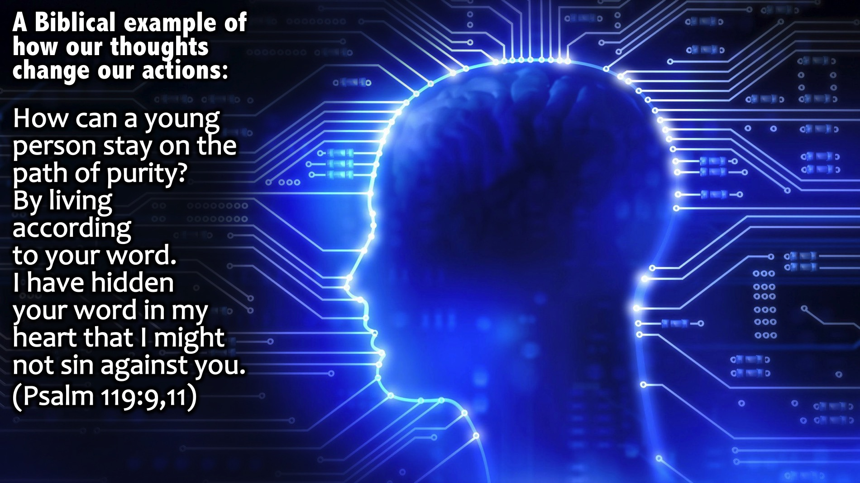
Notes:
Here is a Biblical example of how our thoughts change our actions: “How can a young person stay on the path of purity? By living according to your word. I have hidden your word in my heart that I might not sin against you.” (Psalm 119:9,11). This passage says that as we put God’s words or thoughts in our hearts we won’t sin against God!

Slide 33
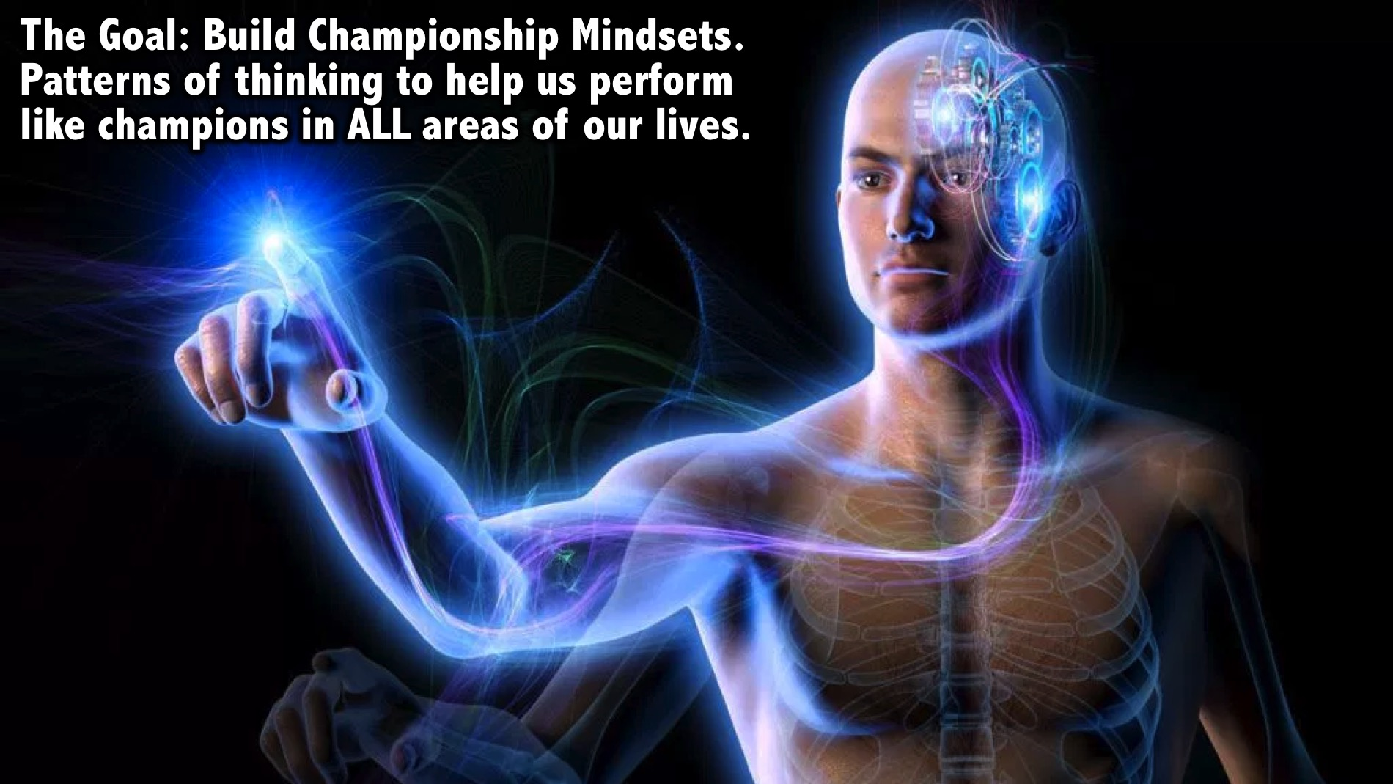
Notes:
The goal is to build championship mindsets - patterns of thinking that will actually help us perform like champions in ALL areas of our lives.

Slide 34
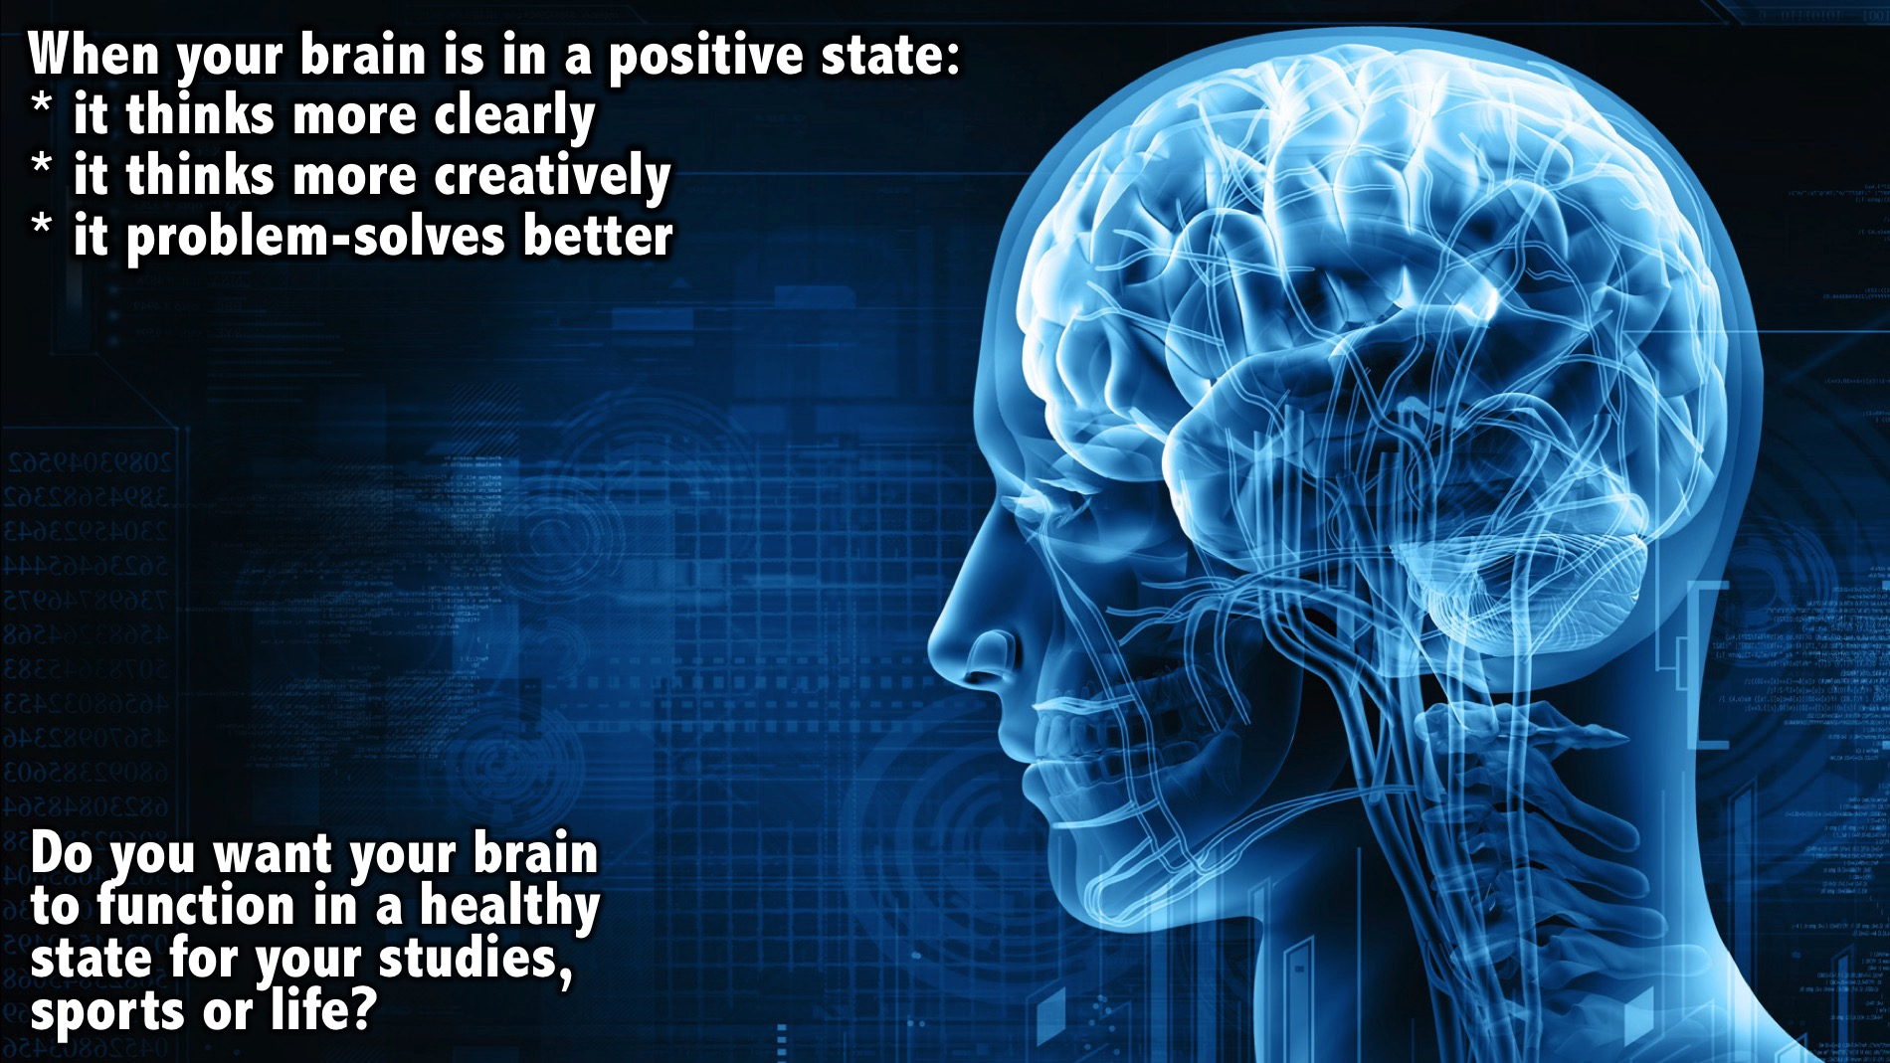
Notes:
When your brain is in a positive state: (1) it thinks more clearly; (2) It thinks more creatively and (3) it problem-solves better. Do you want your brain to function in a health state for your studies, sports or life?

Slide 35
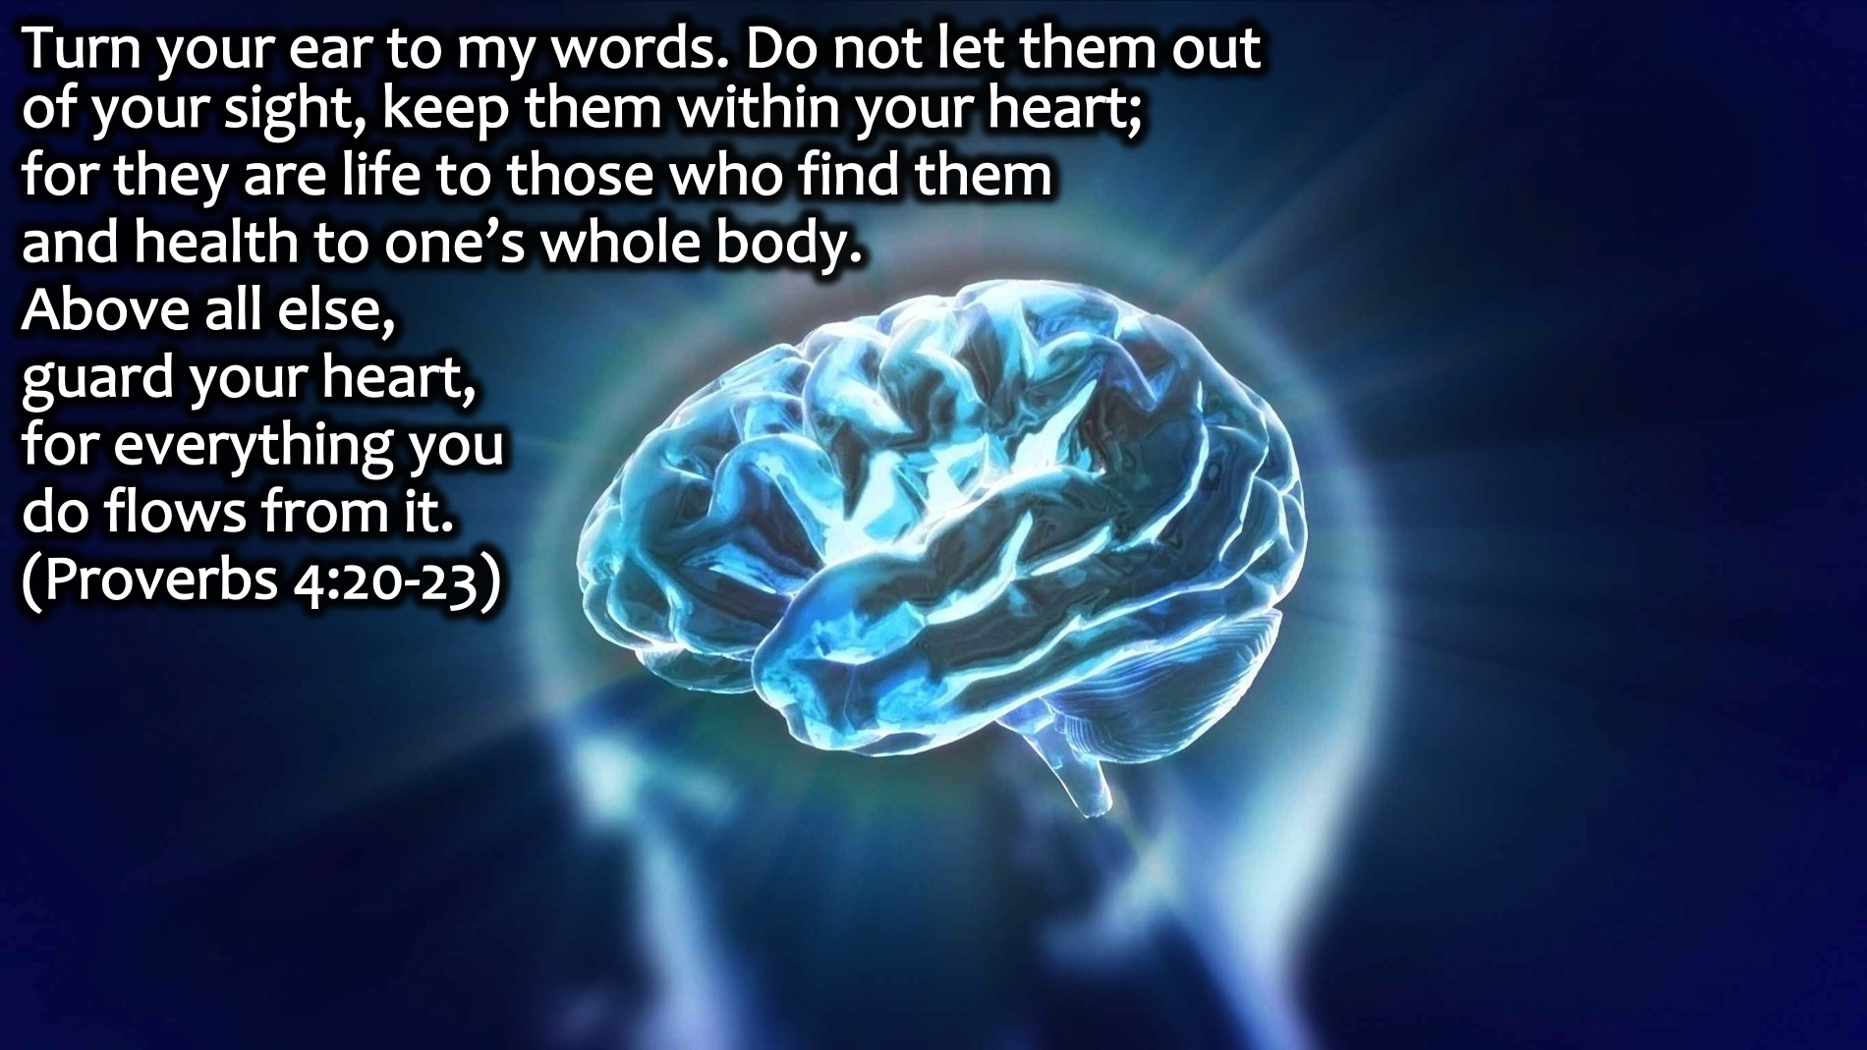
Notes:
Proverbs 4:20-23 says that everything starts in our hearts or our thought lives: “Turn your ear to my words. Do not let them out of your sight, keep them within your heart; for they are life to those who find them and health to one’s whole body. Above all else, guard your heart, for everything you do flows from it.”

Slide 36
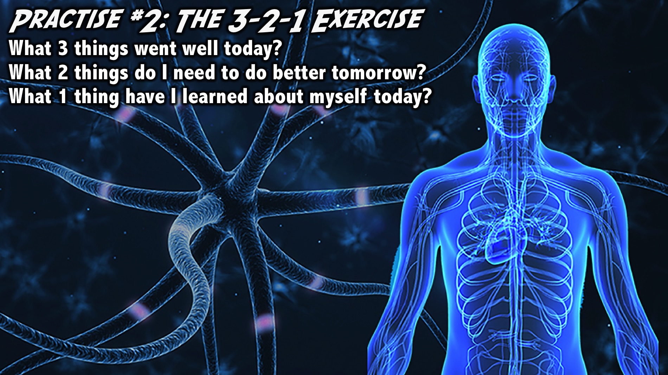
Notes:
Practice #2: The 3-2-1 Exercise. End each day with a time of reflection where you ask yourself these 3 questions: What 3 things went well today? What 2 things do I need to do better tomorrow? What 1 thing have I learned about myself today? This does not need to take more than a couple of minutes. Write things down or type them on your phone.
Facilitators Notes: Make sure each person in your small group gets a piece of paper and a pencil and actually does the exercise - make sure they work along and don’t chat together as they do the exercise. If everyone is finished and the the groups are still busy, you can ask them what they got out of doing the exercise.

Slide 37
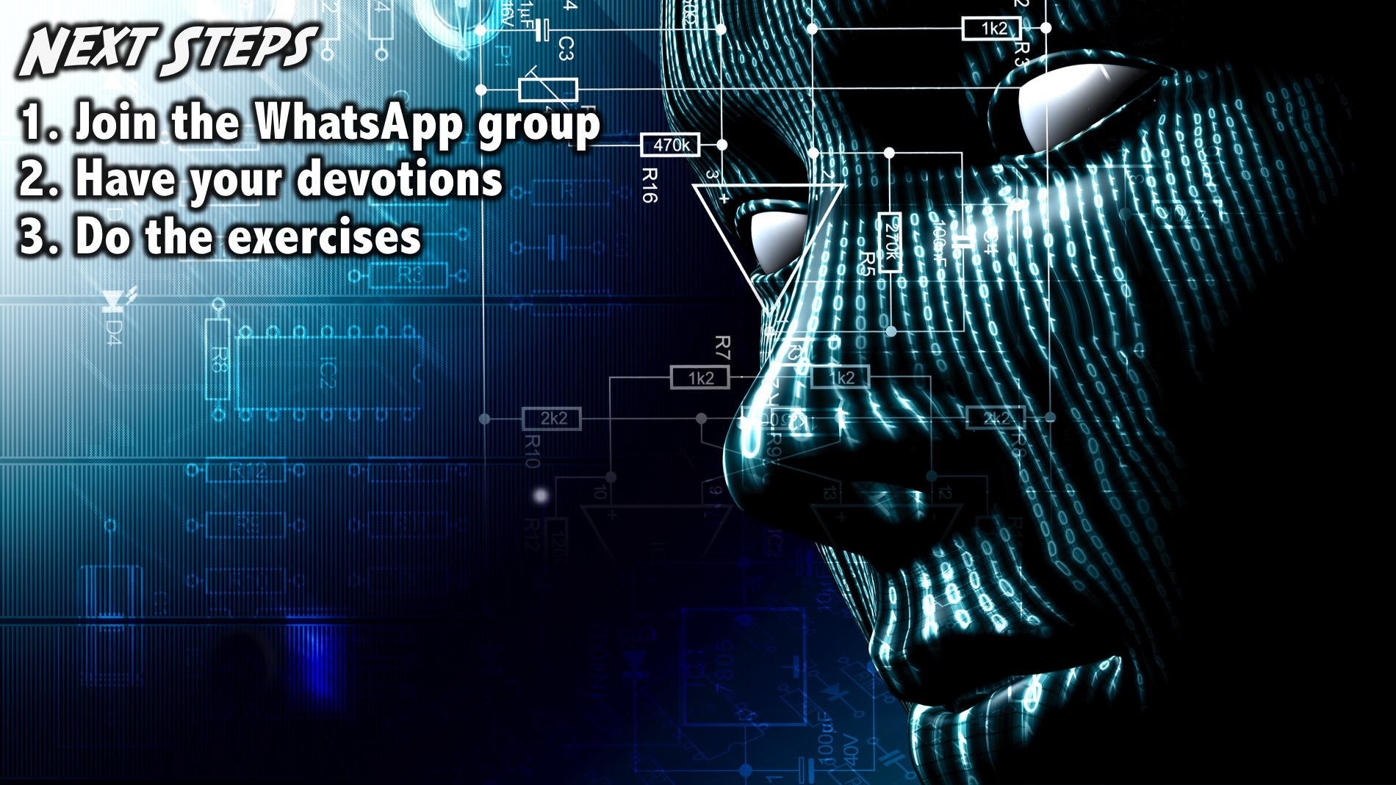
Notes:
Next Steps: (1) Join the WhatsApp group. (2) Have your daily devotions. (3) Do the brain exercises.
Facilitators Notes: Before your group leaves your table after the prayer - make sure they have all signed up for the WhatsApp group.

Slide 38

Notes:
Prayer

Slide 39
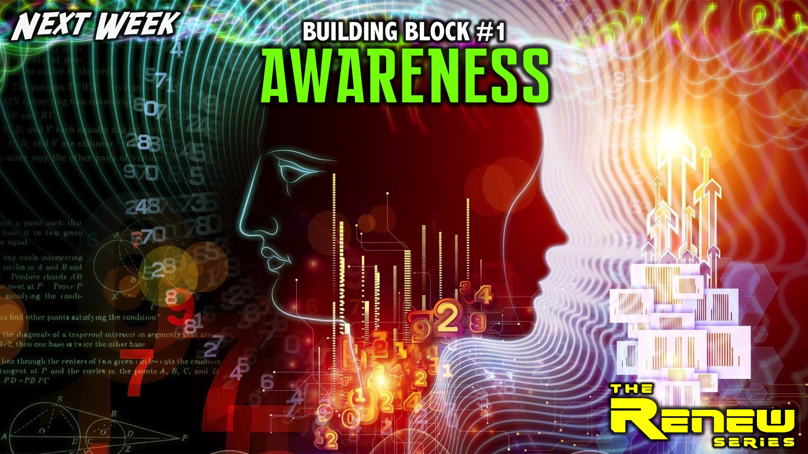
Notes:
Next Week: Next Sunday we are going to start exploring the first of 8 Building Blocks (Awareness) to prepare us for thinking like champions.

