Slide 1

Notes:
Welcome to the Renew Series. The content for this series has been taken from an amazing Podcast by Dr. Amber Selking entitled “Building Championship Mindsets”. Checkout her website at: http://selkingperformance.com.

Slide 2

Notes:
Last Week: We began the Renew series learning about how our thoughts matter and how our thoughts build mindsets!

Slide 3
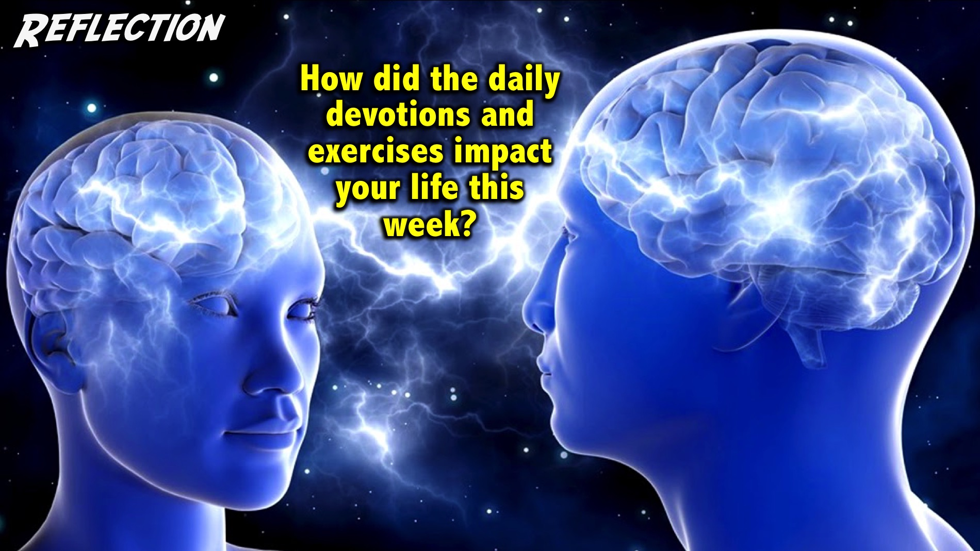
Notes:
Reflection: How did the daily devotions and exercises impact your life this week?
Facilitator Notes: Use follow up questions if necessary to get people at your table reflecting on the past week. Examples: Did you get the devotions on your phone? Do you need to take a printed copy today? How many days were you able to do your devotions? Did wearing the elastic band help you think positive thoughts? Were you able to do the 3-2-1 exercise? How did it help you think positively and creatively about your day and your life?

Slide 4

Notes:
Preview: In the next 8 weeks we will be exploring 8 Building Blocks to help you think and act like a champion.

Slide 5
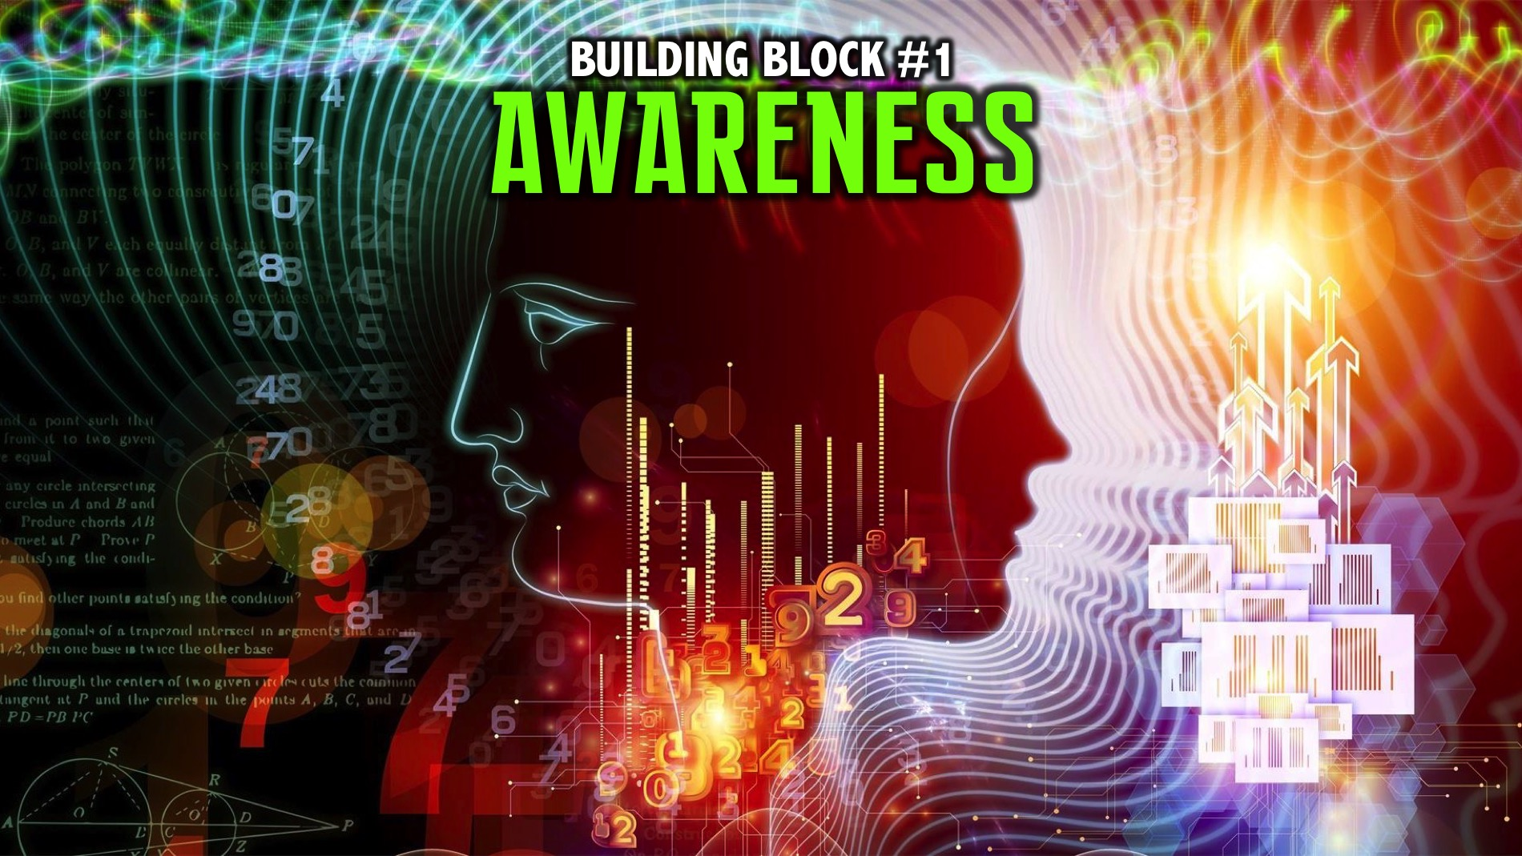
Notes:
Today we are going to explore the first of the eight building blocks: Awareness.

Slide 6
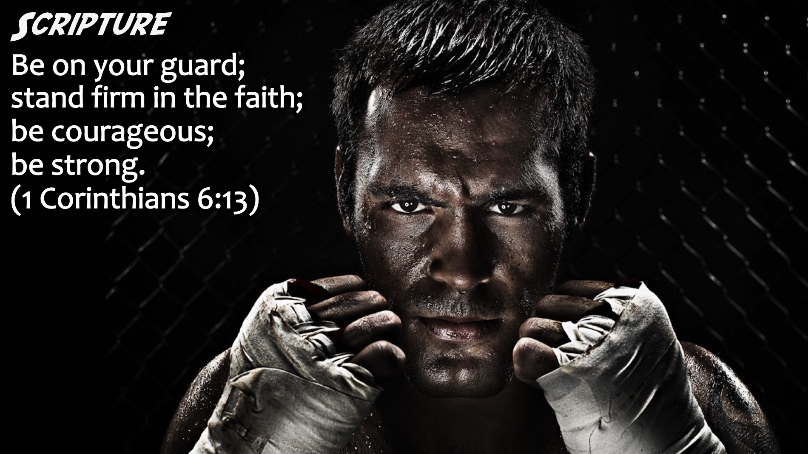
Notes:
Scripture: “Be on your guard; stand firm in the faith; be courageous; be strong.” (1 Corinthians 6:13)

Slide 7
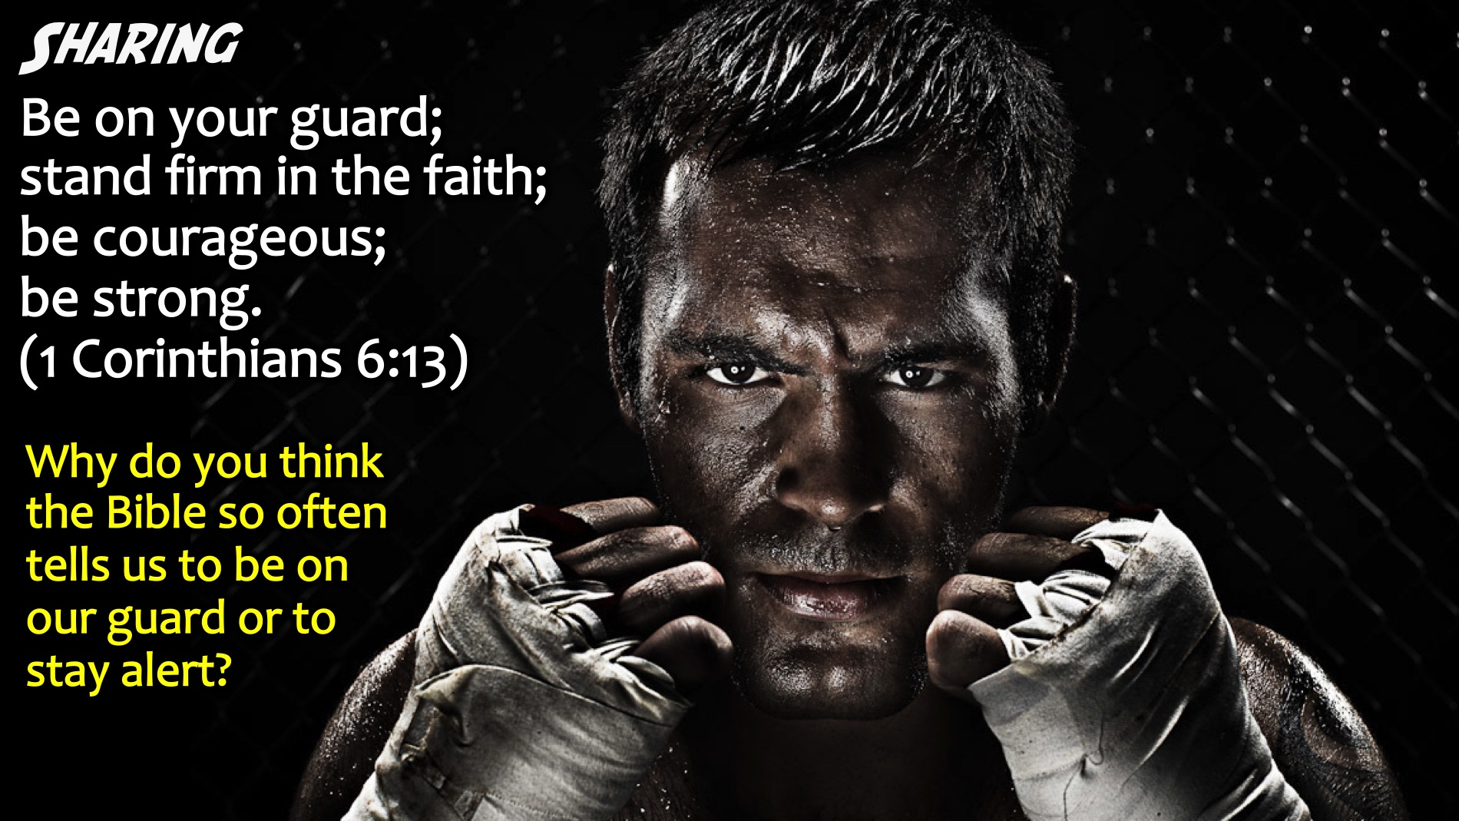
Notes:
Small Group Sharing: Why do you think the Bible so often tells us to be on our guard or to stay alert?
Facilitators Notes: Don’t let teens just say the obvious – or repeat the words in the verse – ask them to go deeper by using why more than once, or ask them to think of something that has not been shared yet.

Slide 8
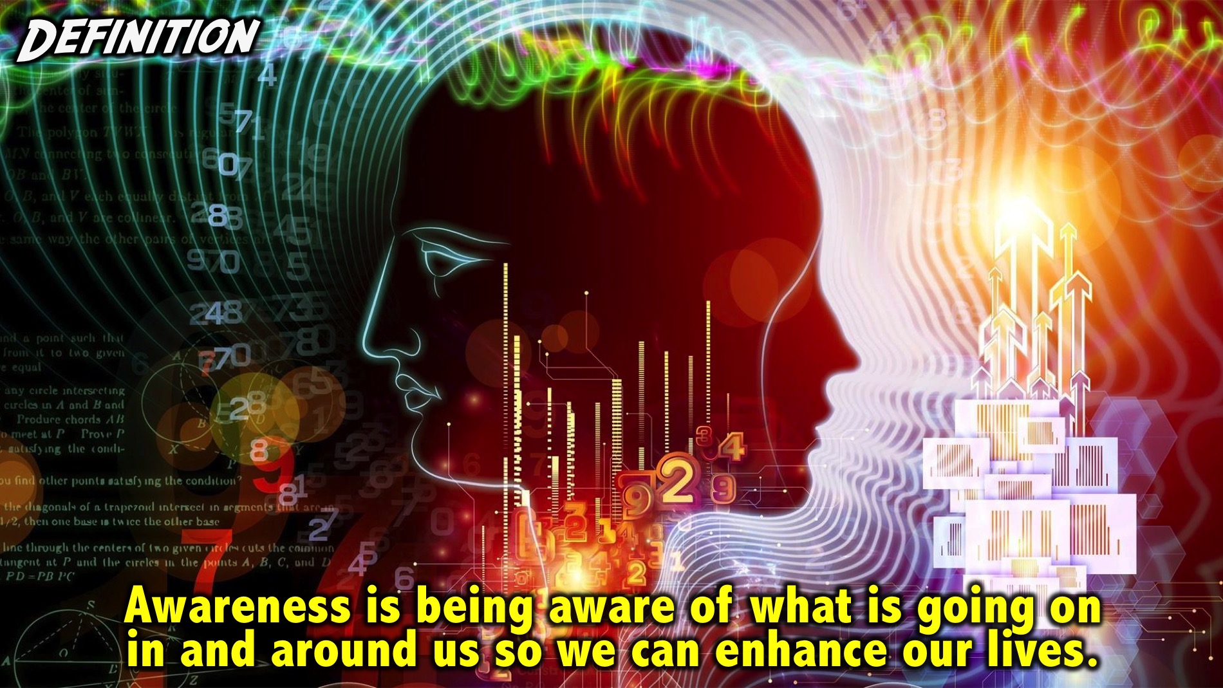
Notes:
Definition: Awareness is being aware of what is going on in and around us so we can enhance our lives.

Slide 9

Notes:
You may have seen one of the Bourne movies - here is a ciip from the first movie that shows an example of awareness…

Slide 10
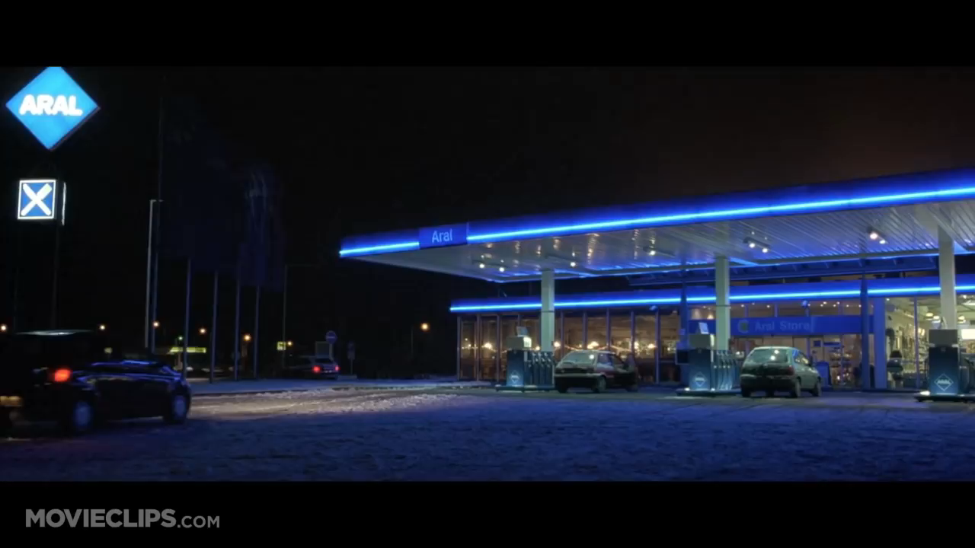
Notes:
Video: The Bourne Identity Why Would I Know That Clip. Get it on YouTube at: https://www.youtube.com/watch?v=IjrWOZby8s8 (the clip was shown until 1:10)

Slide 11
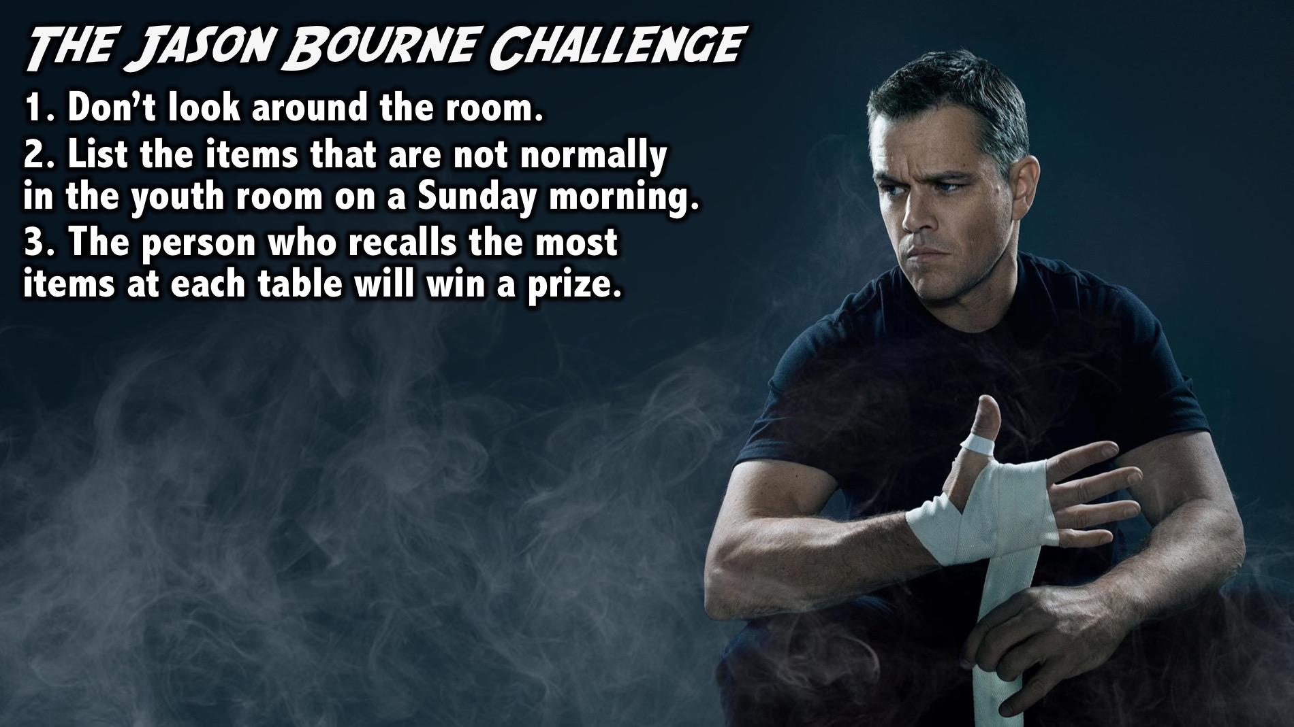
Notes:
The Jason Bourne Challenge: Without looking around the room, write down on the piece of paper as many items as possible that are not normally in the Youth room on a Sunday morning. The person at each table who can think of the most items will receive a prize.
Facilitators Notes: Make sure no one looks around - if you see someone looking around and writing an item on their list make sure they cross it off and don’t count it. Make sure teens are honest when they count their items.

Slide 12

Notes:
Champions are aware of what is going on inside them and around them.

Slide 13
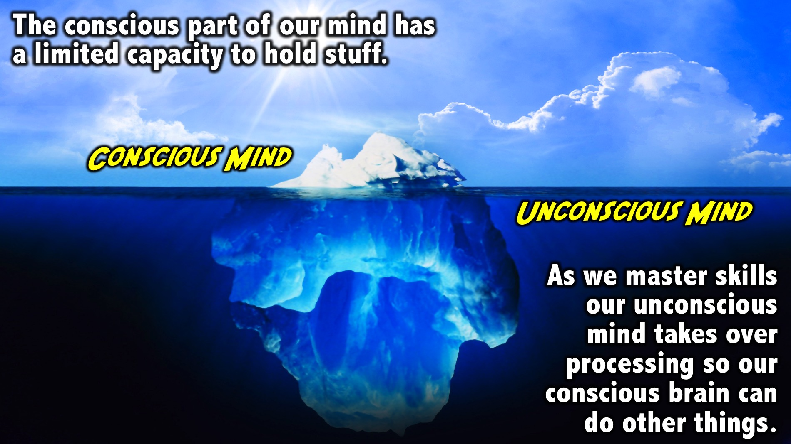
Notes:
The brain has a conscious and an unconscious part to it. There is a lot going on in the conscious portion of our brain but it has a limited capacity to hold stuff. In the initial stages of learning something new the brain has a lot to deal with and hold on to. But as we learn basic skills we no longer think about them because they move into subconscious processing and that frees our conscious brain up to do other things or deal with more information. If we are aware of what is going in our brain we can move more stuff to the subconscious part of the brain to deal with other things. This helps us make adjustments in our game to have influence in our domain.

Slide 14
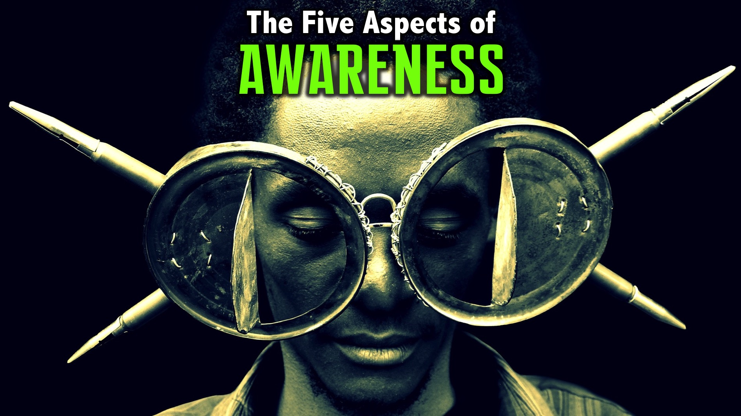
Notes:
There are Five Aspects of Awareness: (1) Physical, (2) Mental, (3) Emotional, (4) Spiritual and (5) Situational.

Slide 15
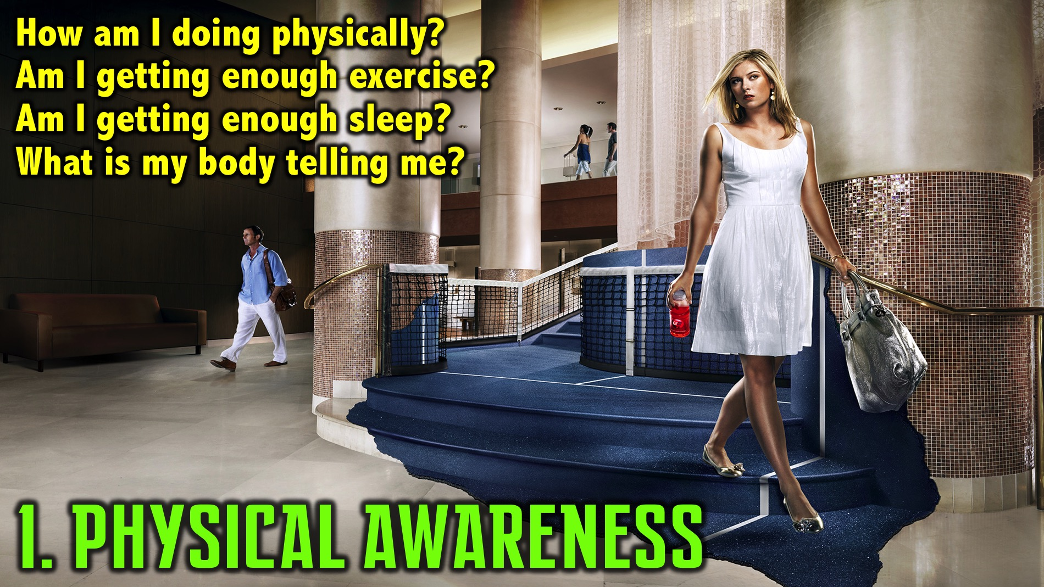
Notes:
1. Physical Awareness - this is about knowing what is is going on in side of me. Am I getting enough exercise or sleep? Do I feel energized or depleted? What is my body telling me?

Slide 16
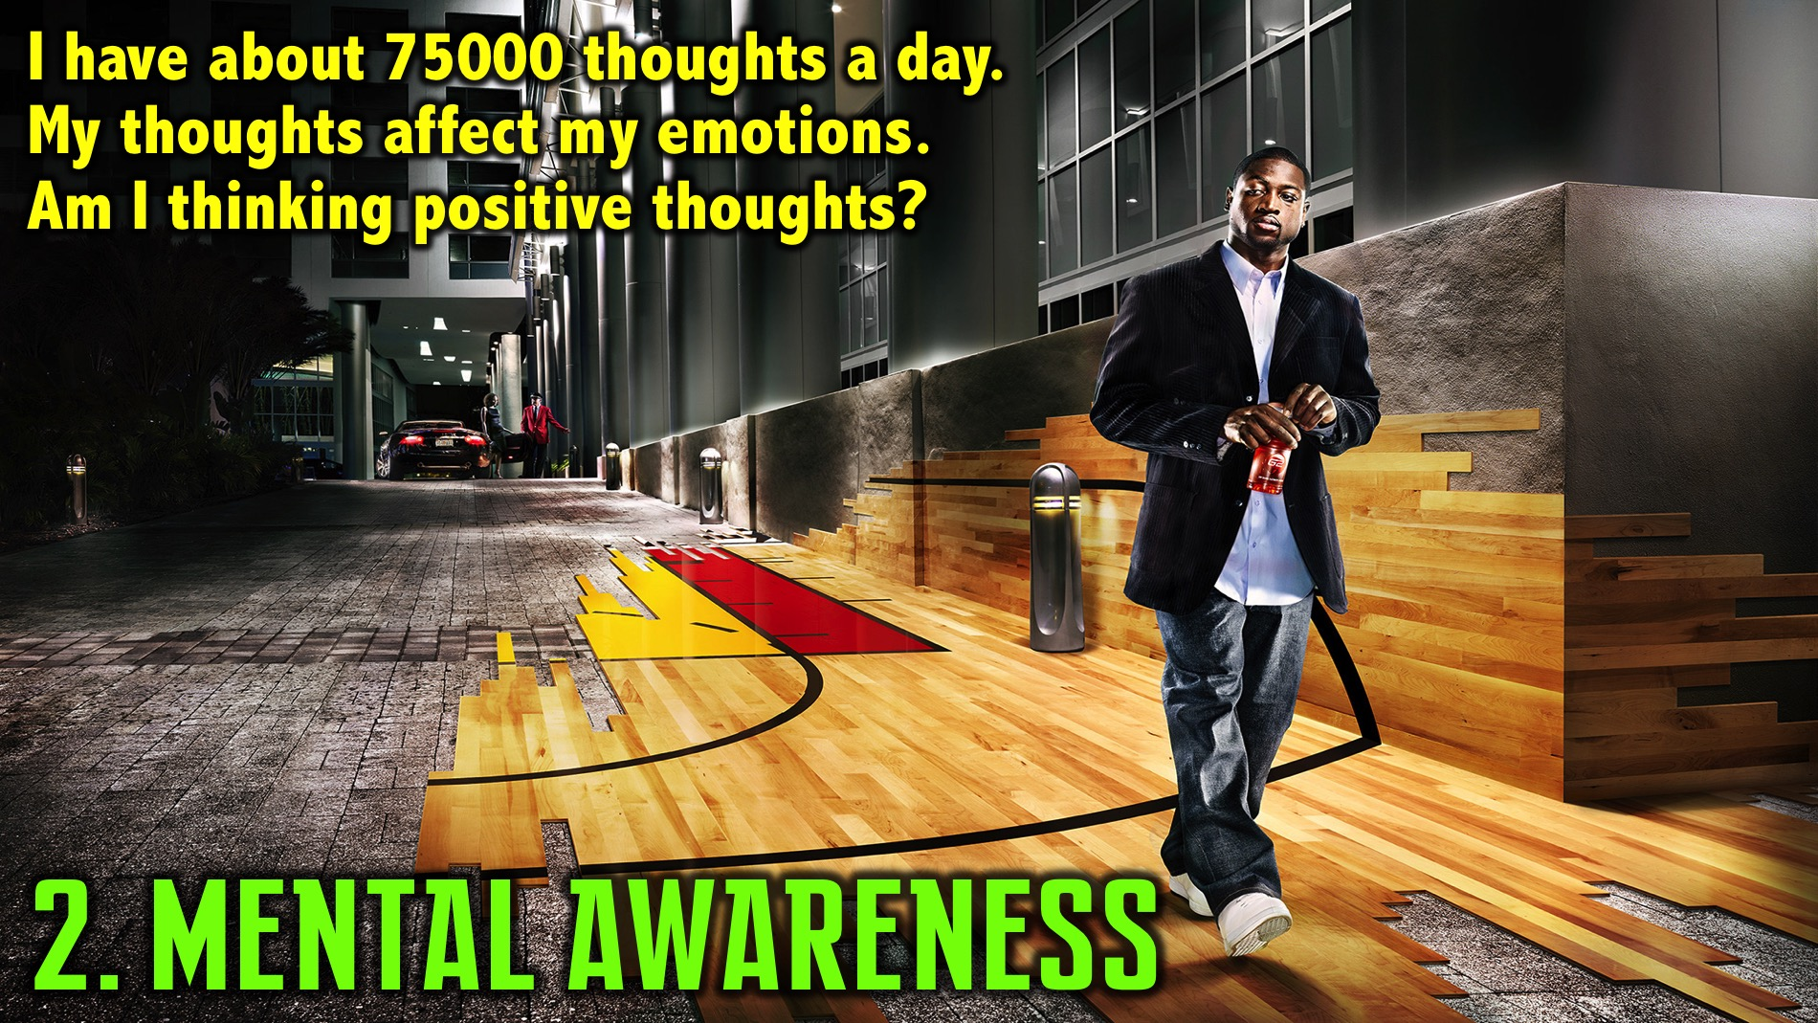
Notes:
2. Mental Awareness - we have 70 to 80 000 thoughts every day. We just pay attention to our thoughts because they affect our emotions, which affects our bodies response and ultimately that dictates our performance. What we think about starts to manifests in our brains. Through Awareness we can stimulate positive emotions and that has an effect on our body.

Slide 17
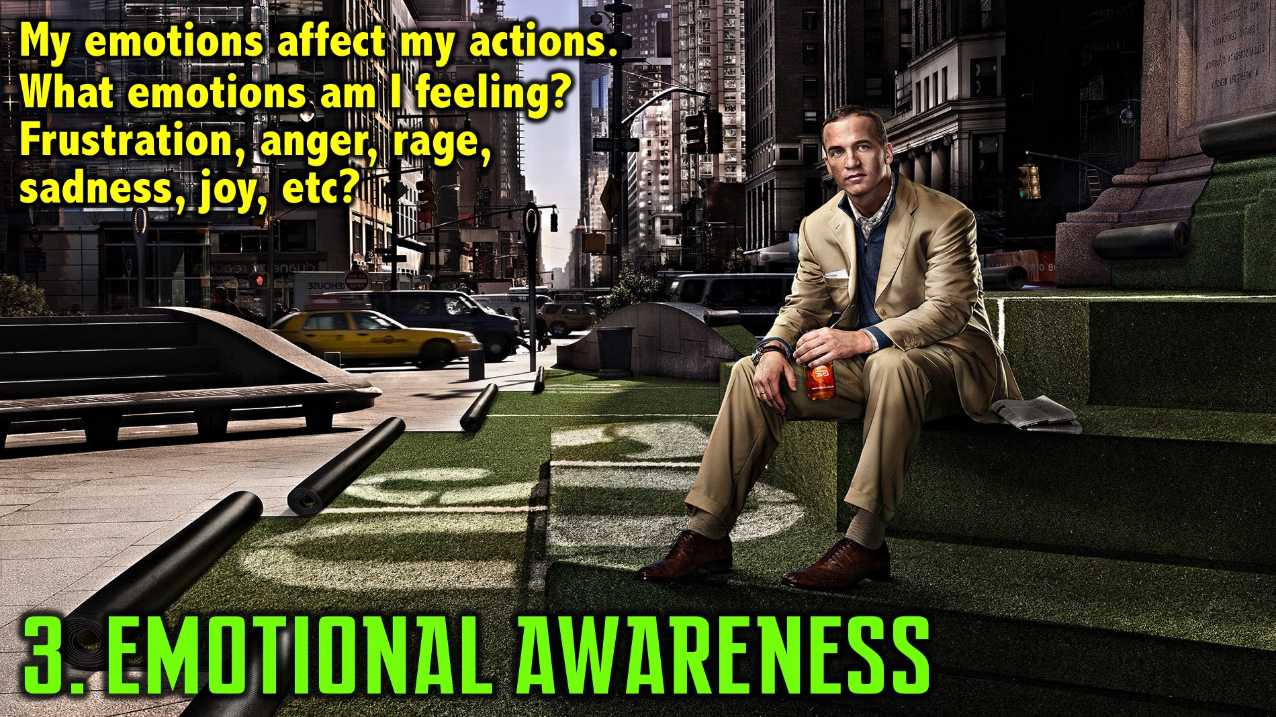
Notes:
3. Emotional Awareness - we must have a good understanding of our emotions because they dictate how we function in this world. We often are aware of emotions before we know what we are thinking. We should backup and check out the thoughts that are creating the emotions. We must understand where the emotions we are feeling sits in the spectrum. For example, it could be frustration, anger or rage that we are experiencing.

Slide 18

Notes:
4. Spiritual Awareness - understanding what is going on in my relationship with God. Am I connecting with God in devotions each day? Is there anything that I need to confess and make right with God?

Slide 19
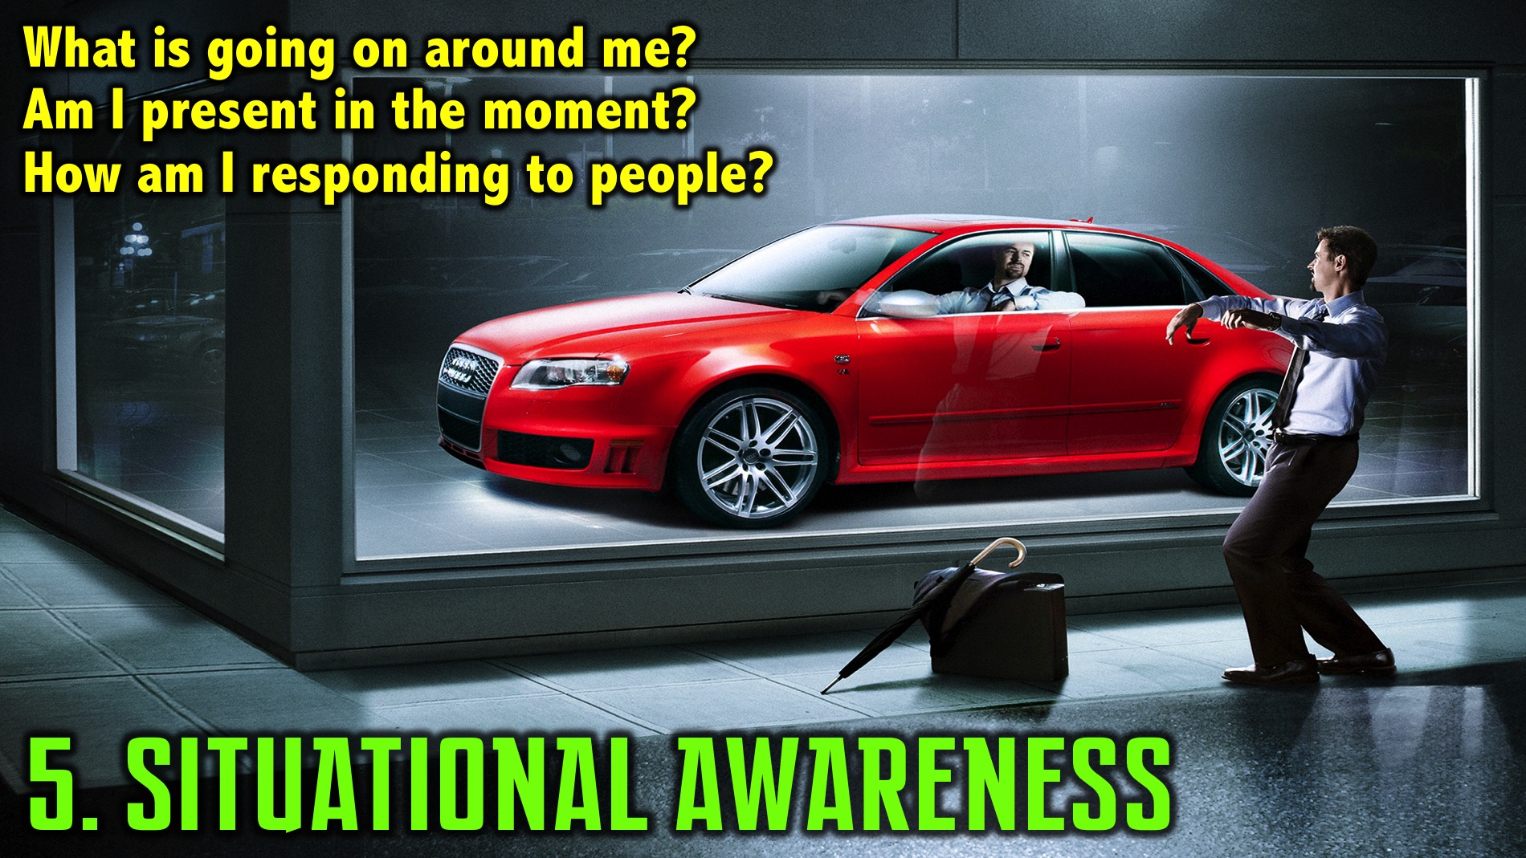
Notes:
5. Situational Awareness - understanding what is going on around us - aware of time, people’s responses, etc. This allows us to take what we get from the physical, mental, emotion and spiritual aspects of awareness and apply it to our situation to position ourselves to positively impact the world. The first four aspects of awareness are about internal awareness, but the fifth is what is going on around us.

Slide 20
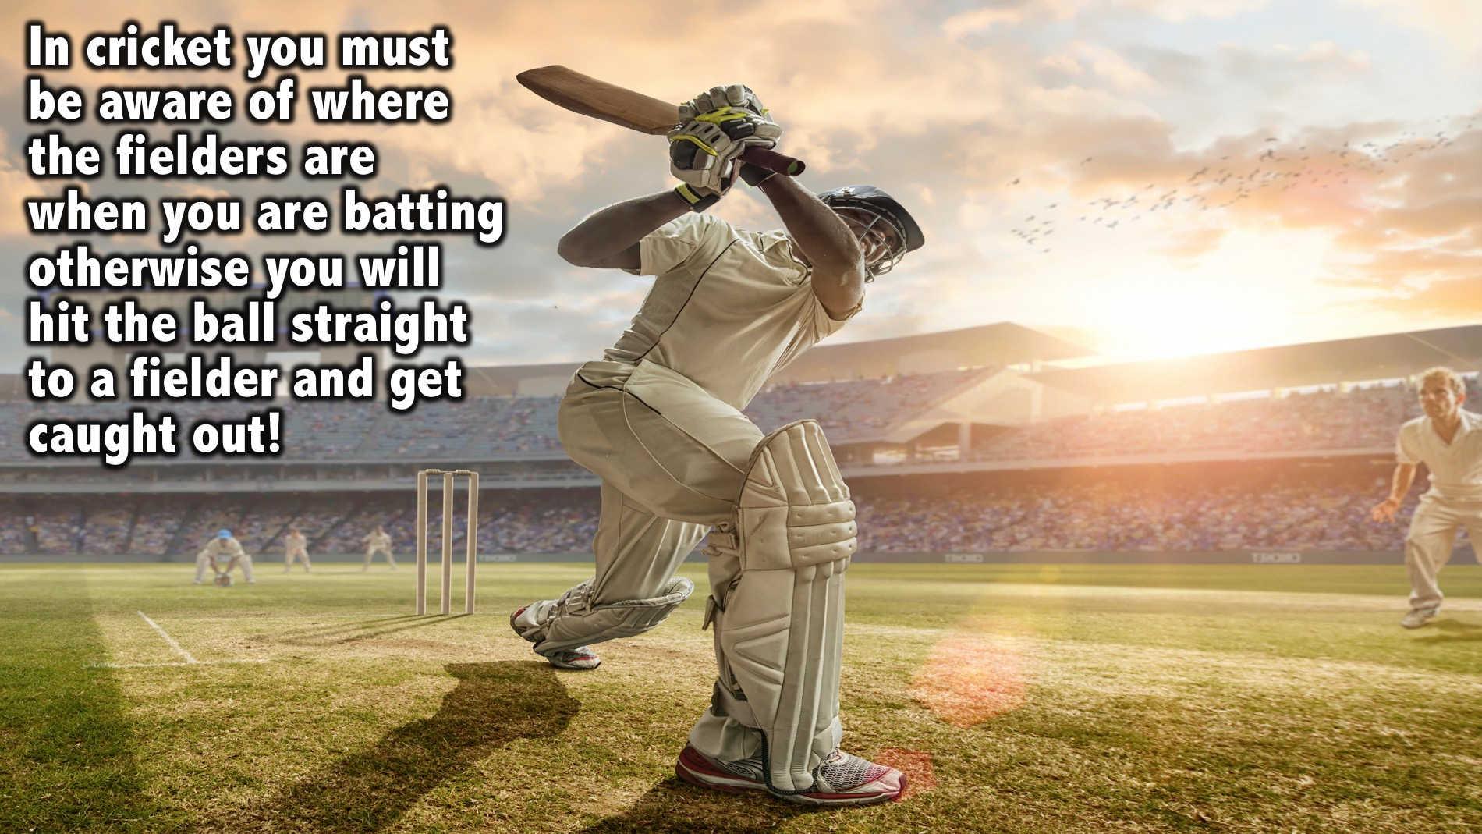
Notes:
Illustration: In cricket you must be aware of where the fielders are when you are batting otherwise you will hit the ball straight to a fielder and get caught out!

Slide 21
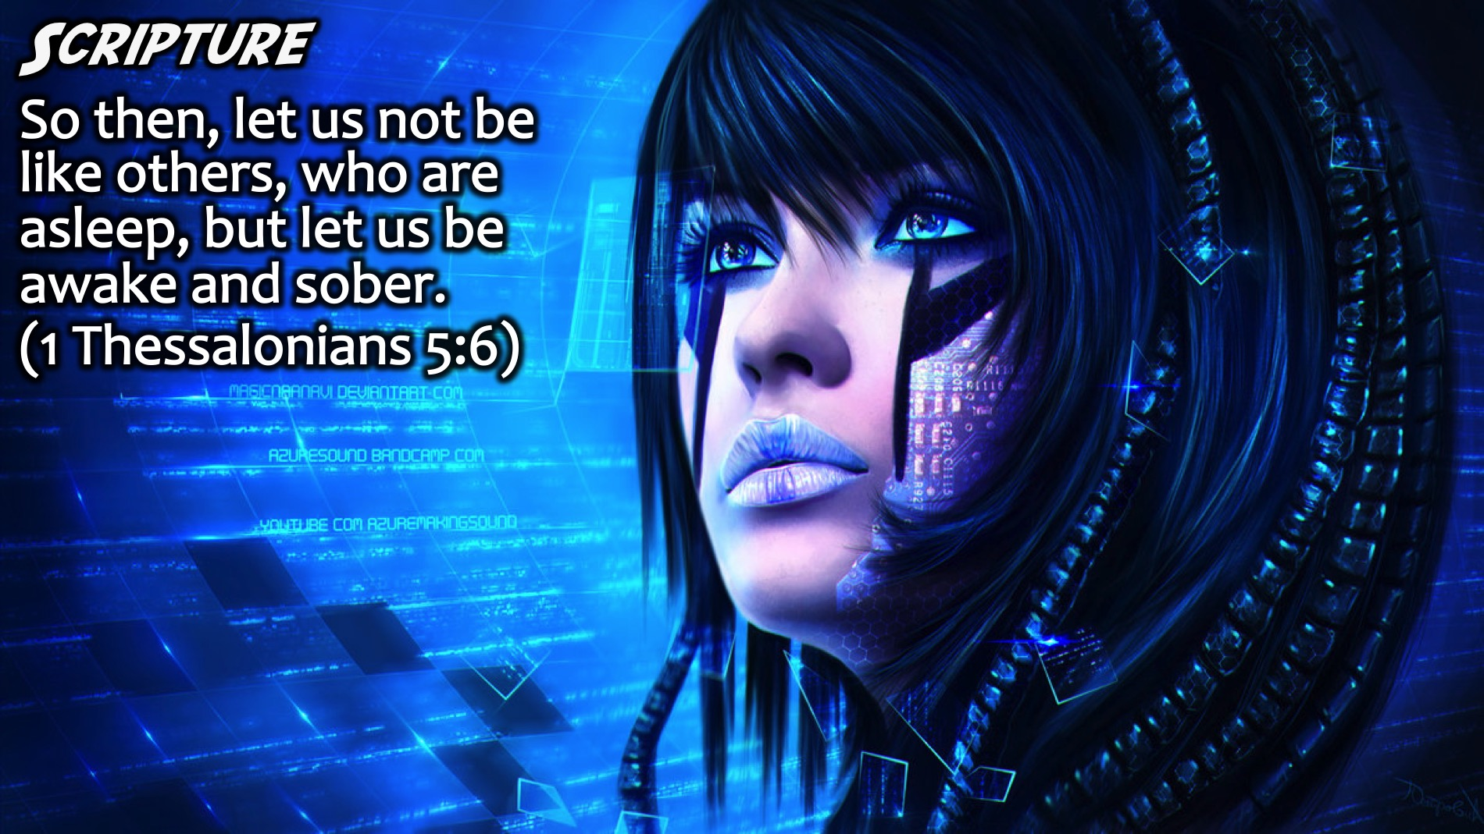
Notes:
Scripture: “So then, let us not be like others, who are asleep, but let us be awake and sober.” (1 Thessalonians 5:6)

Slide 22

Notes:
Champions are deeply aware of what is going on inside and around them and they know what their goal and mission is so they can have a positive impact on their world.

Slide 23

Notes:
Scripture: “Stay alert! Watch out for your great enemy, the devil. He prowls around like a roaring lion, looking for someone to devour.” (1 Peter 5:8)

Slide 24
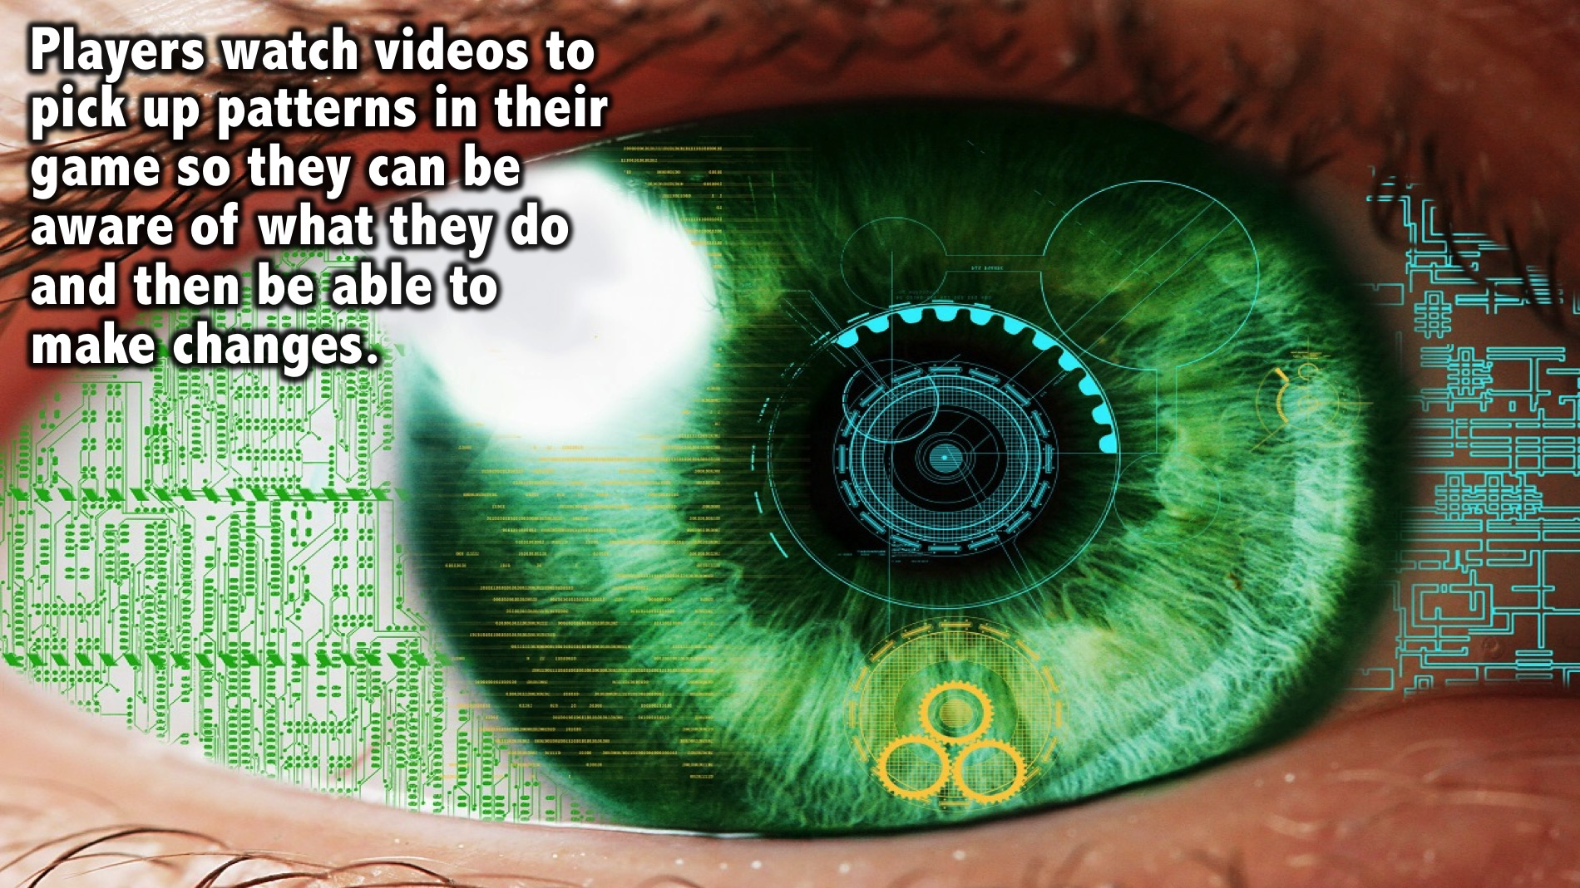
Notes:
Players watch videos to pick up patterns in their game so they can be aware of what they do and then be able to make changes.

Slide 25
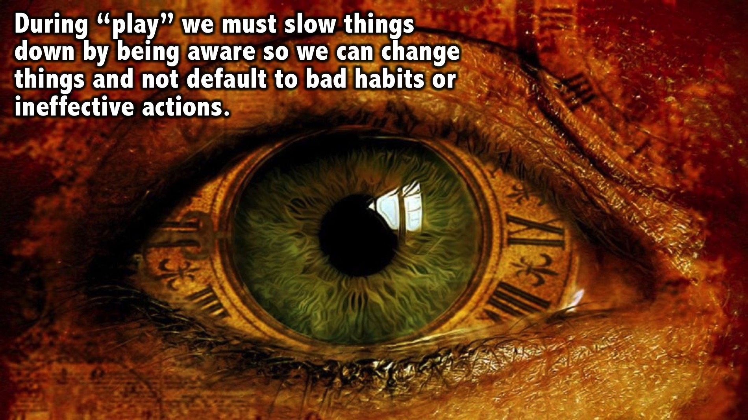
Notes:
During “play” we must slow things down by being aware so we can change things and not default to bad habits or ineffective actions.

Slide 26

Notes:
Practice: The 3x3+1 Exercise: Do a 3x3+1 whenever you can by identifying: 3 things you See; 3 things you Hear; 3 things you Feel, and 1 thing of Excellence.

Slide 27

Notes:
Scripture: “Watch and pray so that you will not fall into temptation. The spirit is willing, but the flesh is weak.” (Matthew 26:41)

Slide 28
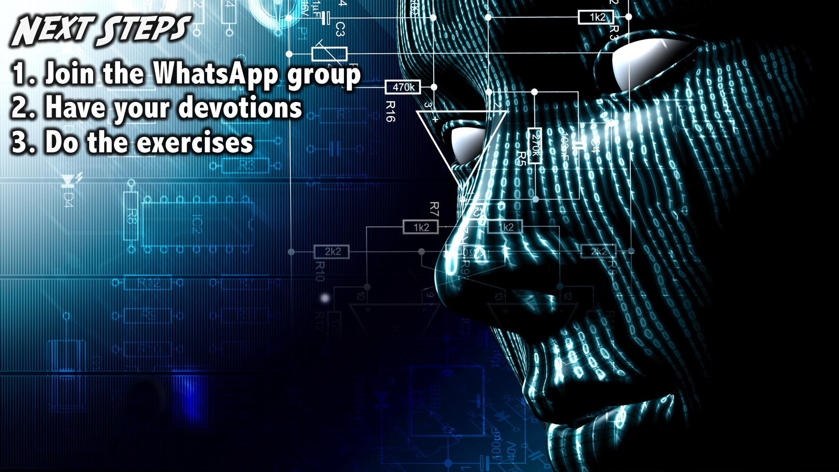
Notes:
Next Steps: (1) Join the WhatsApp group. (2) Have your daily devotions. (3) Do the brain exercises.
Facilitators Notes: Before your group leaves your table after the prayer - make sure they have all signed up for the WhatsApp group and challenge them one more time to do their devotions and the exercise during the week- including last weeks 3-2-1 exercise.

Slide 29
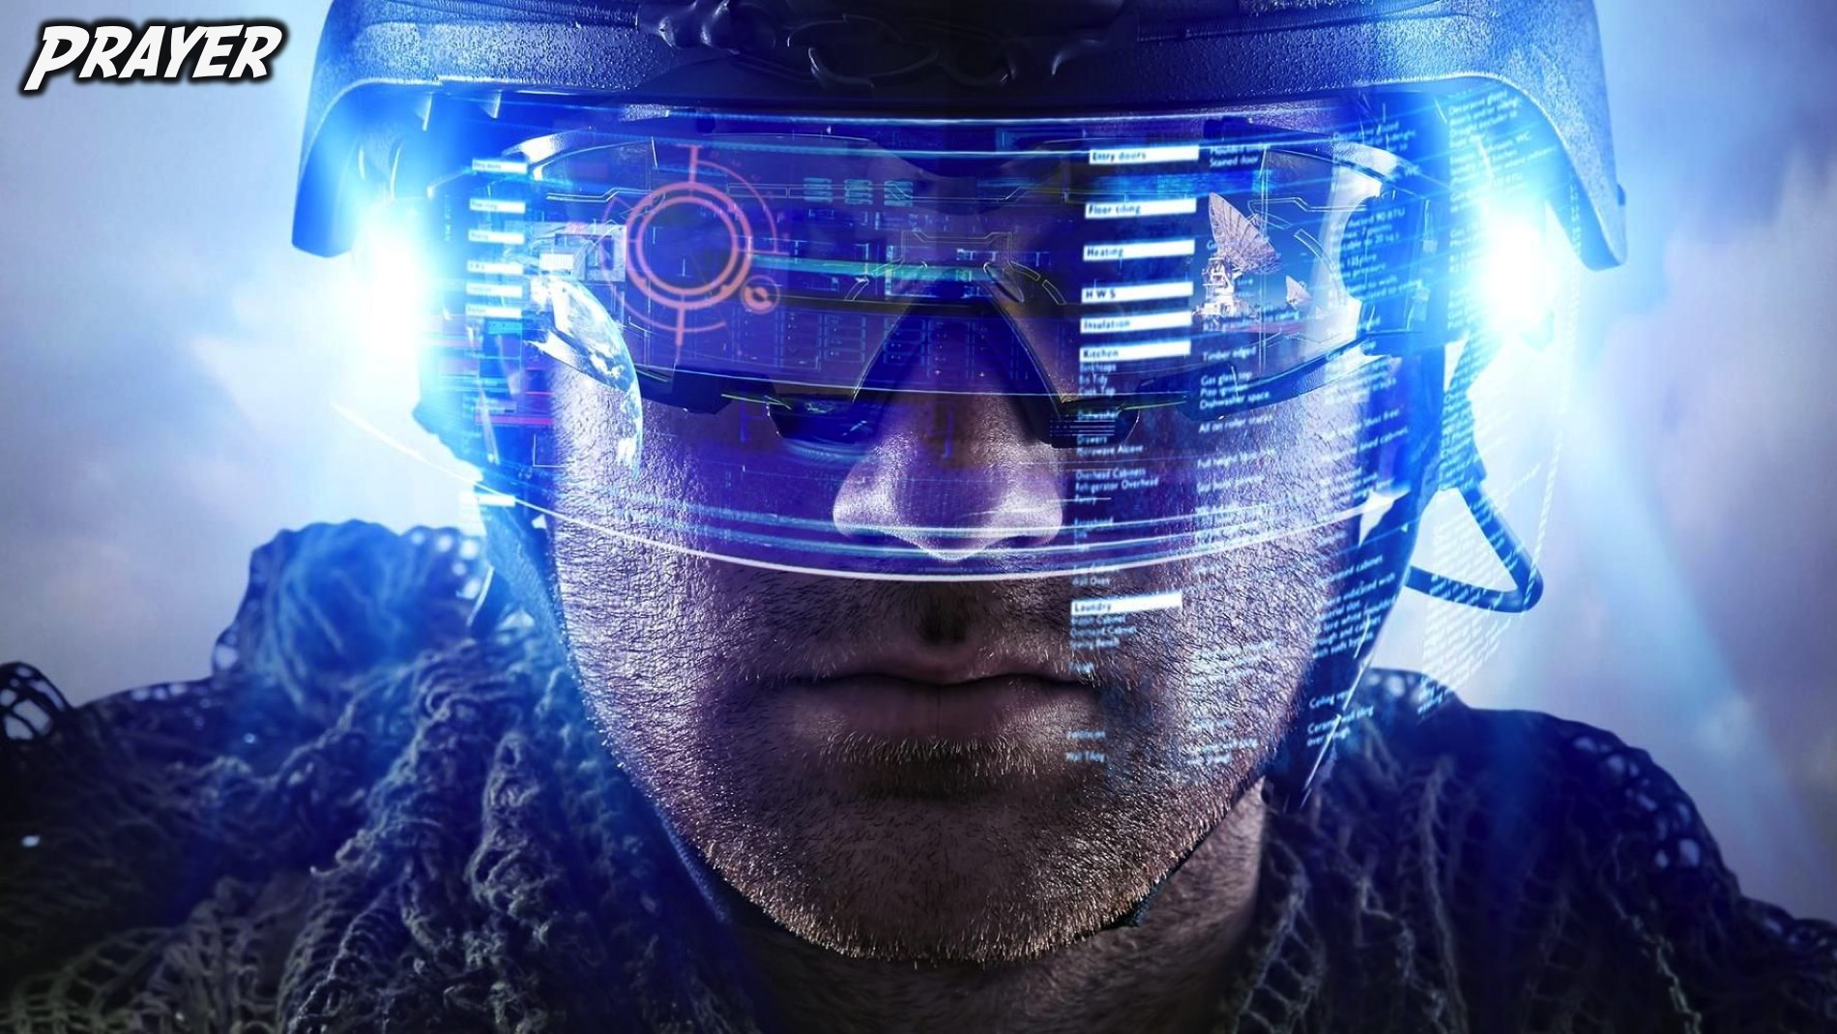
Notes:
Prayer:

Slide 30
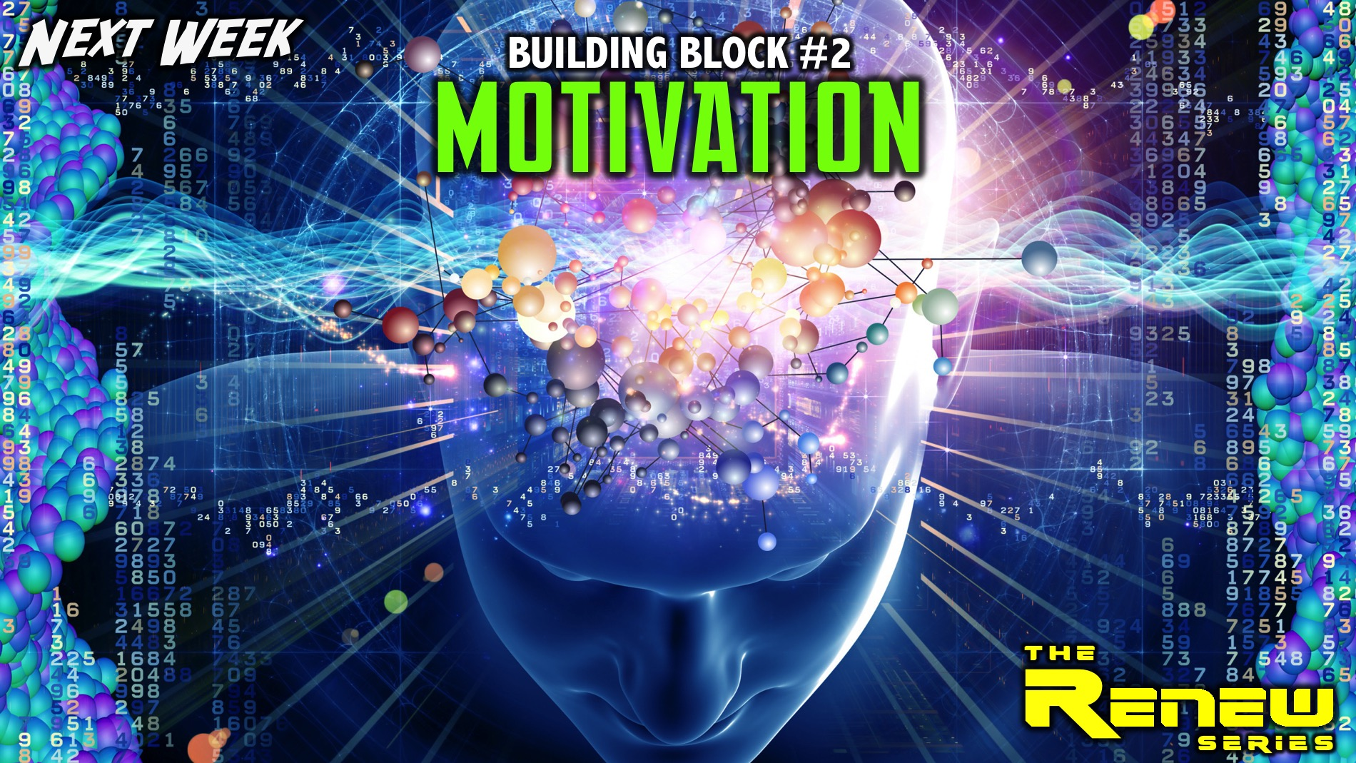
Notes:
Next Week: Next week we will explore the second building block: Motivation

