Slide 1

Notes:
Welcome to the Renew Series. The content for this series has been taken from an amazing Podcast by Dr. Amber Selking entitled “Building Championship Mindsets”. Checkout her website at: http://selkingperformance.com.

Slide 2
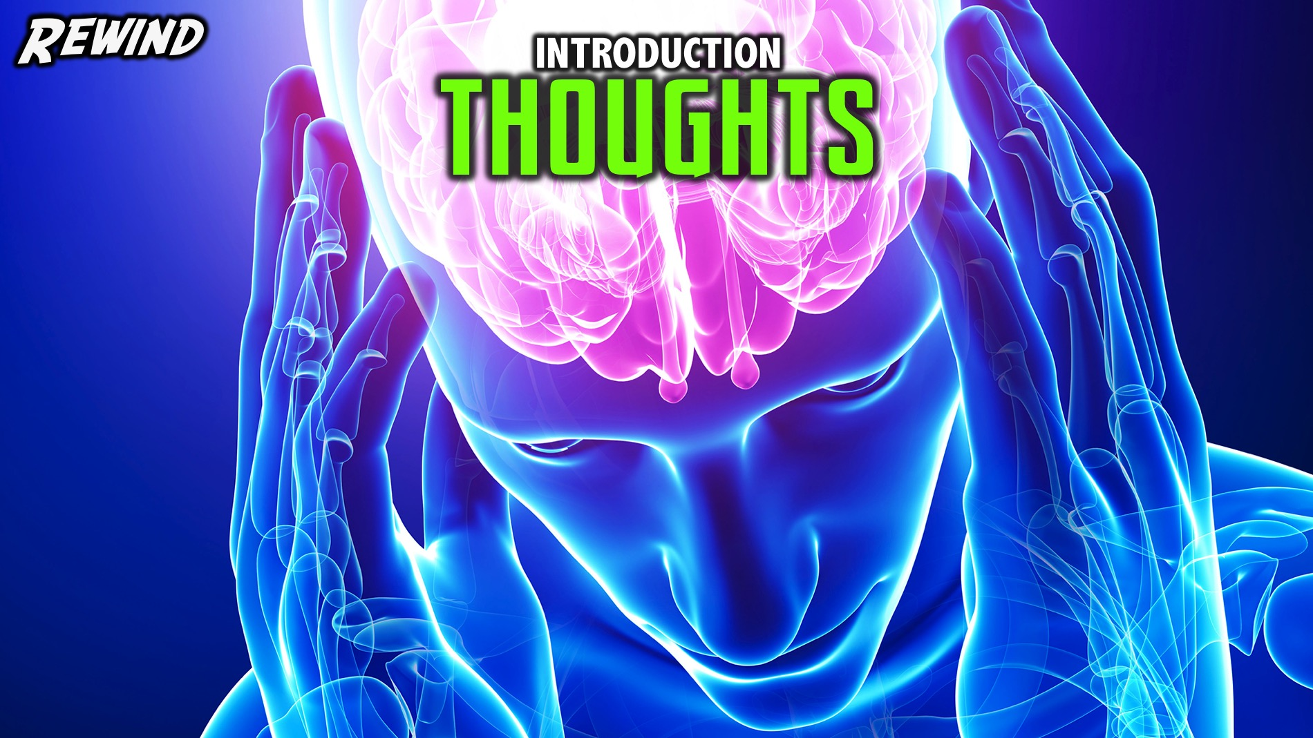
Notes:
Rewind: We began the Renew series learning about how our thoughts matter and how our thoughts build mindsets!

Slide 3
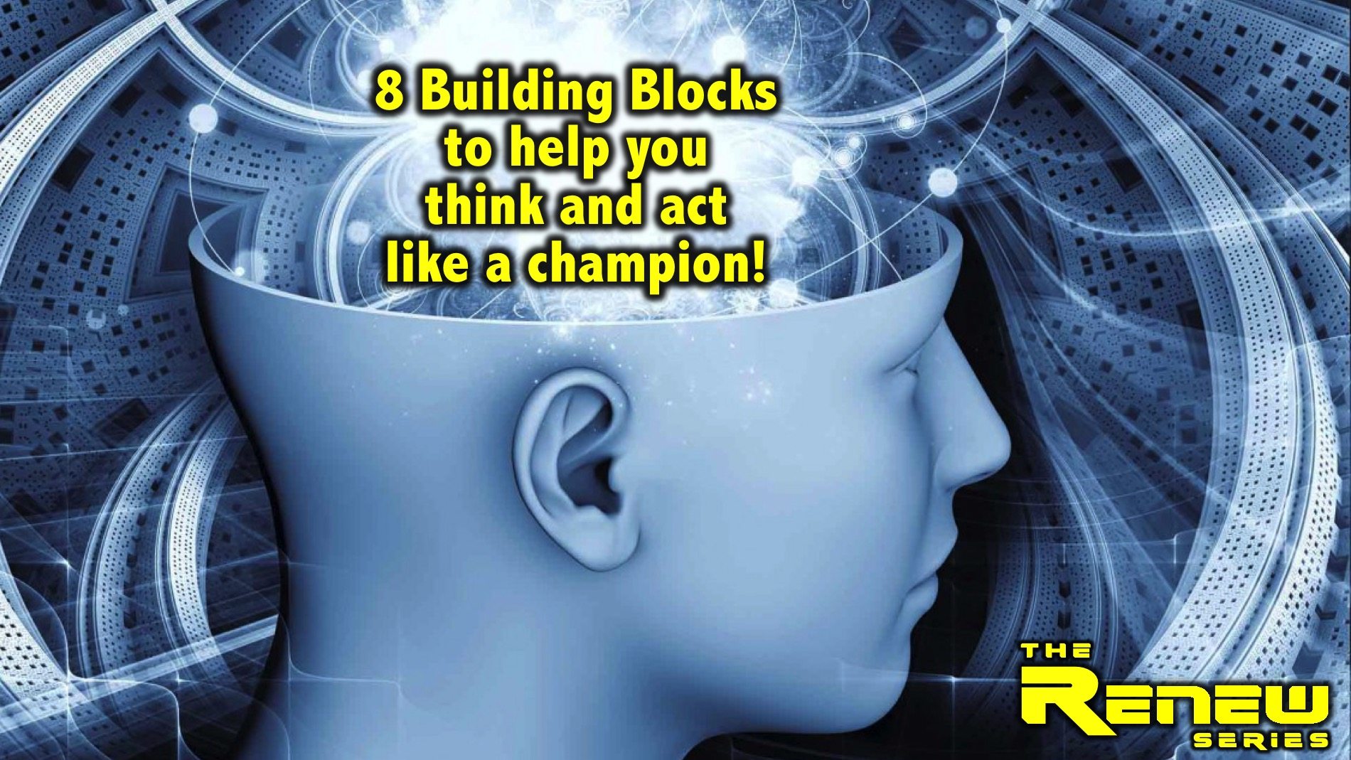
Notes:
In this series we are exploring 8 Building Blocks to help you think and act like a champion.

Slide 4
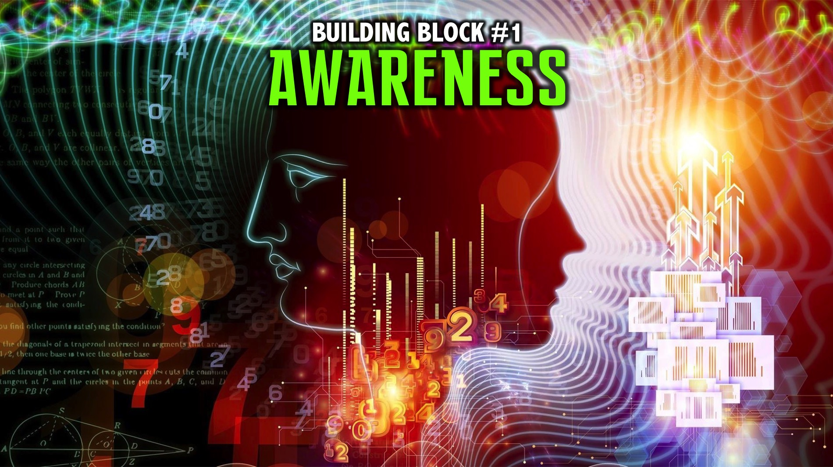
Notes:
We explored the first building block: Awareness.

Slide 5
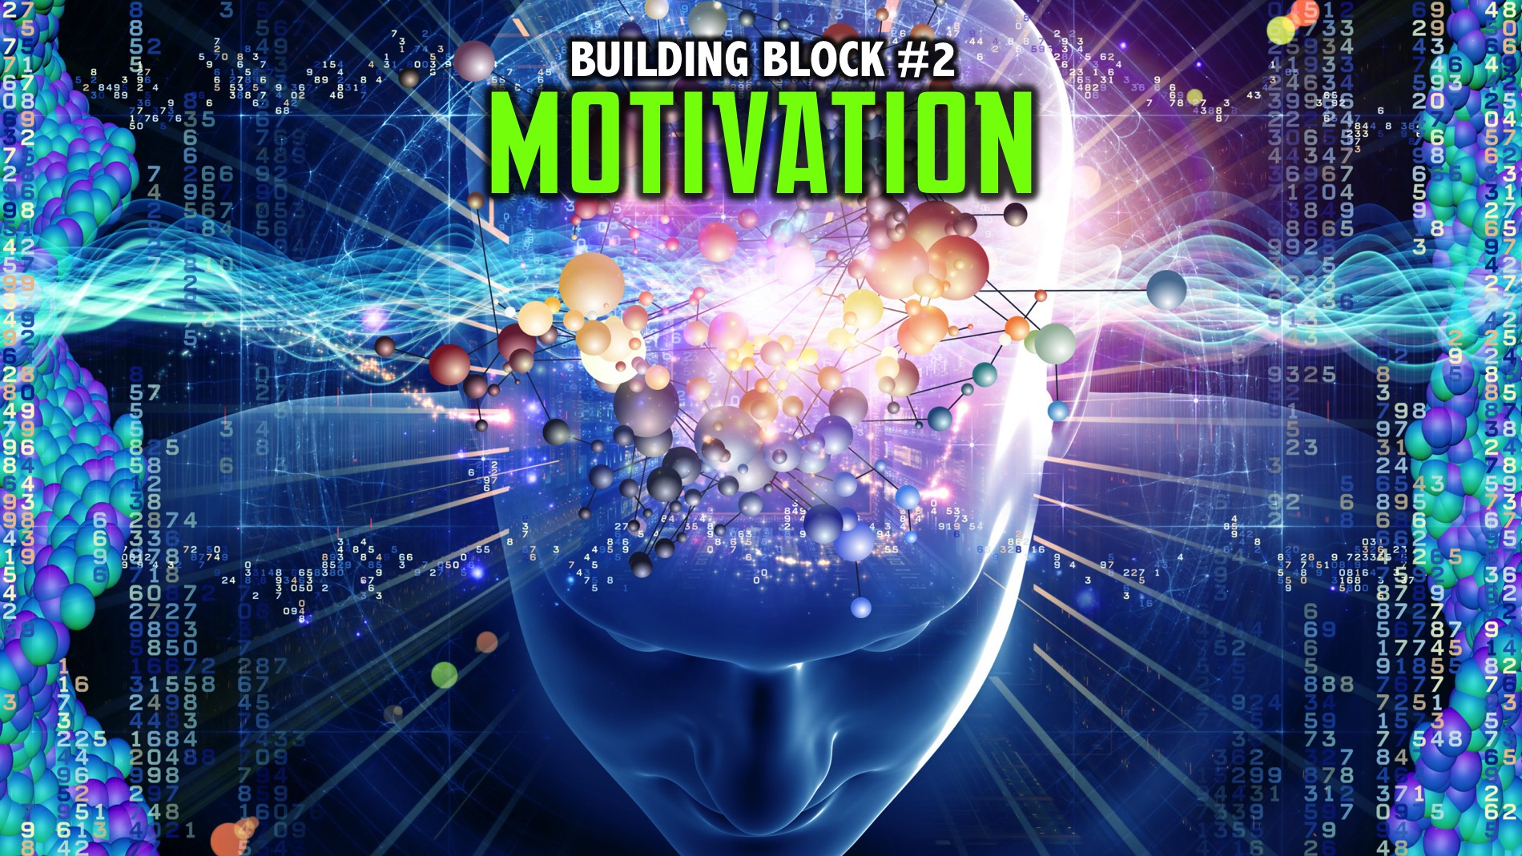
Notes:
Last week we explored the second building block: Motivation.

Slide 6
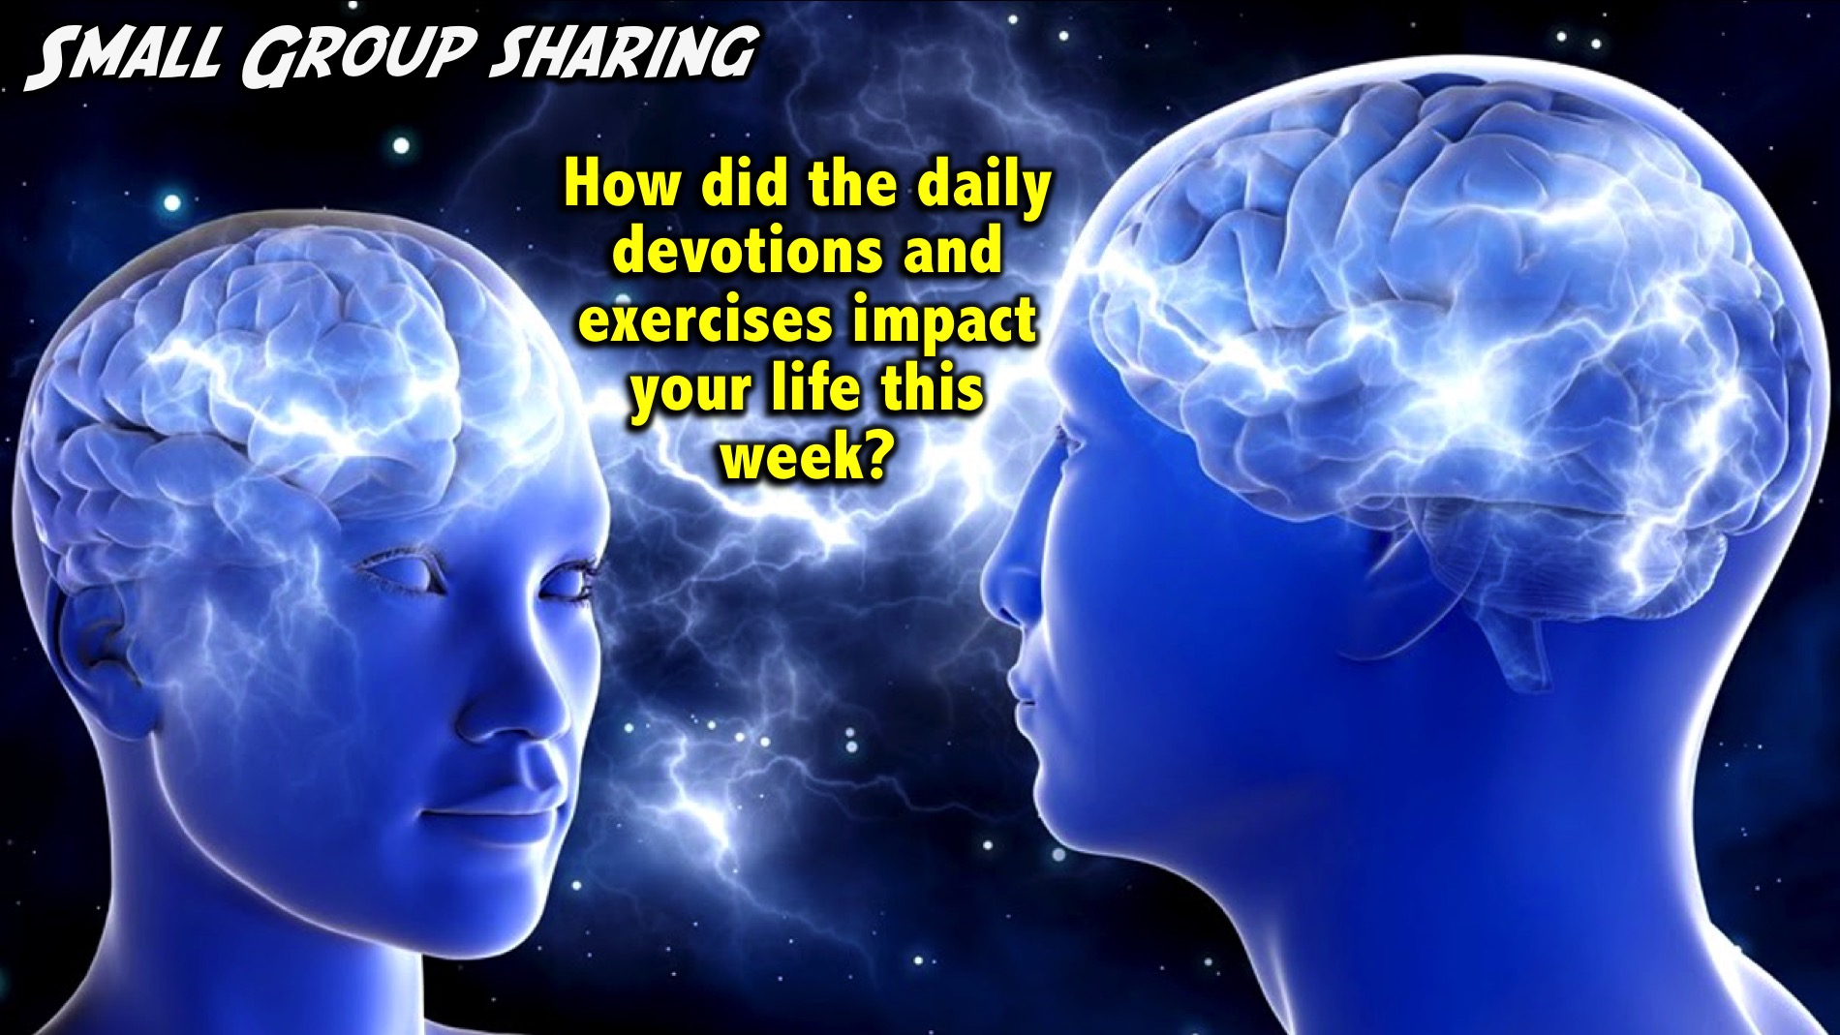
Notes:
Small Group Sharing: How did the daily devotions and exercises impact your life this week?
Facilitator Notes: Use follow up questions if necessary to get people at your table reflecting on the past week. Examples: Did you get the devotions on your phone? Do you need to take a printed copy today? How many days were you able to do your devotions? Did wearing the elastic band help you think positive thoughts? Were you able to do the 3-2-1 exercise? How did it help you think positively and creatively about your day and your life?

Slide 7
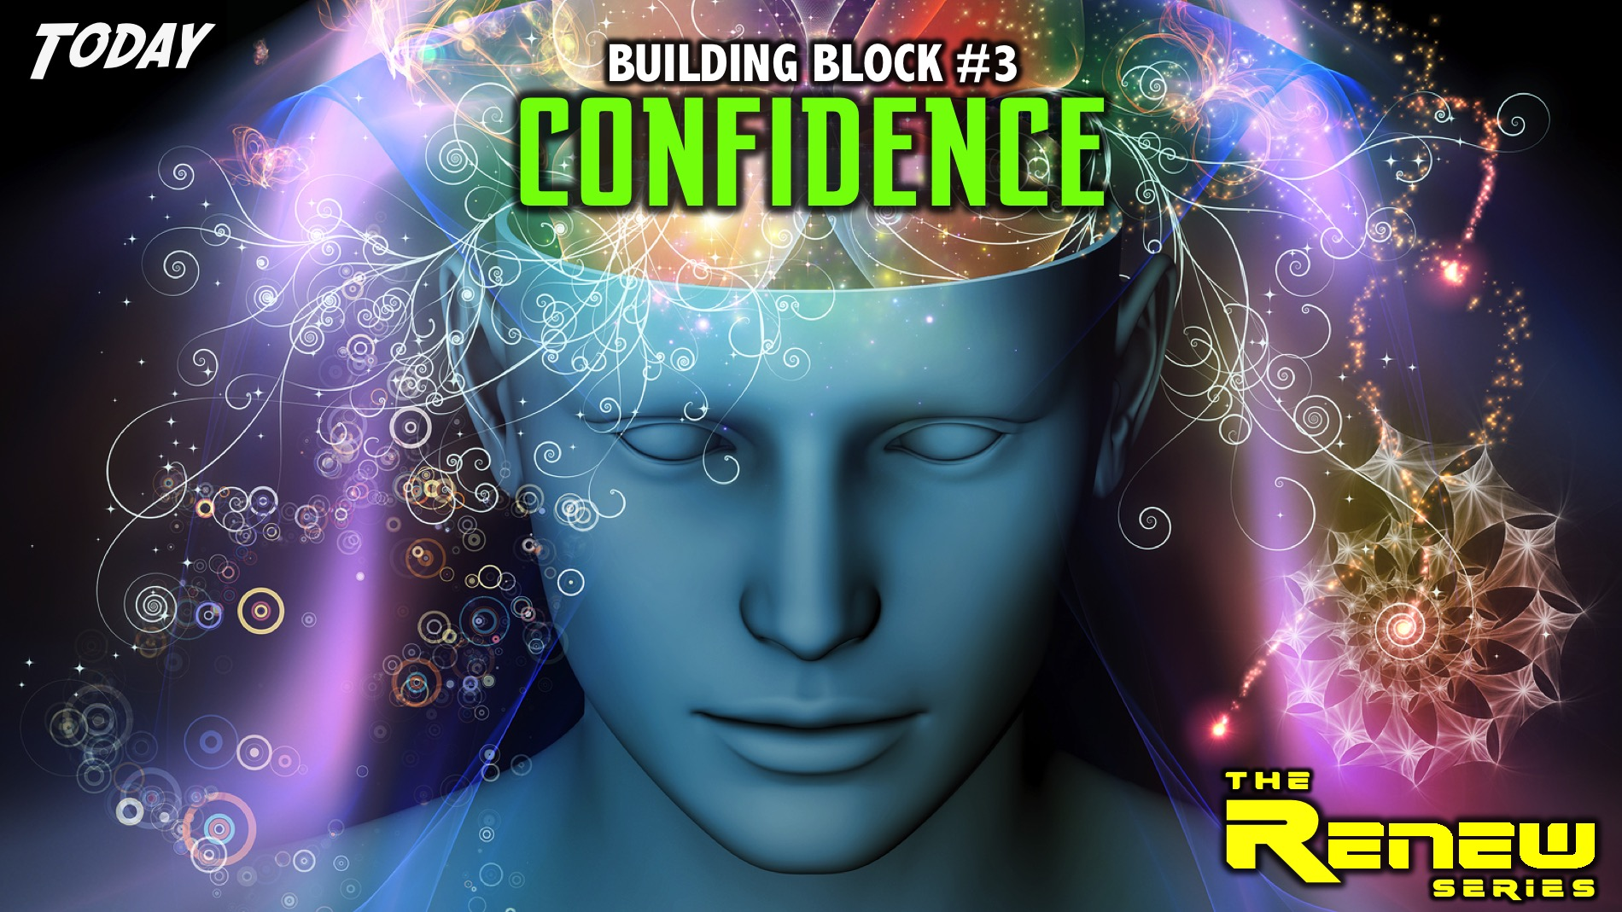
Notes:
Today we are going to explore the third building block: Confidence.

Slide 8
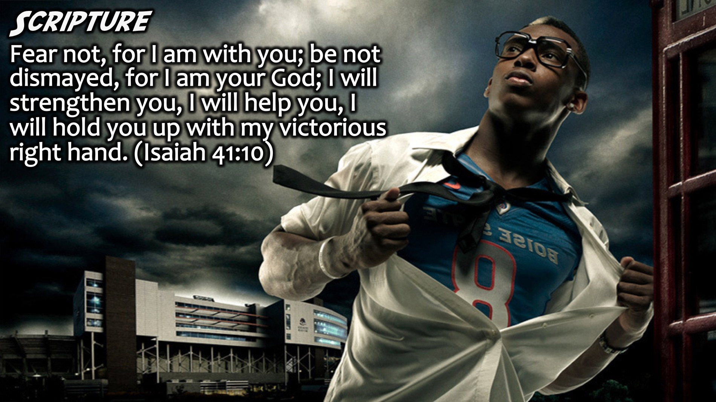
Notes:
Scripture: Fear not, for I am with you; be not dismayed, for I am your God; I will strengthen you, I will help you, I will hold you up with my victorious right hand. (Isaiah 41:10)

Slide 9
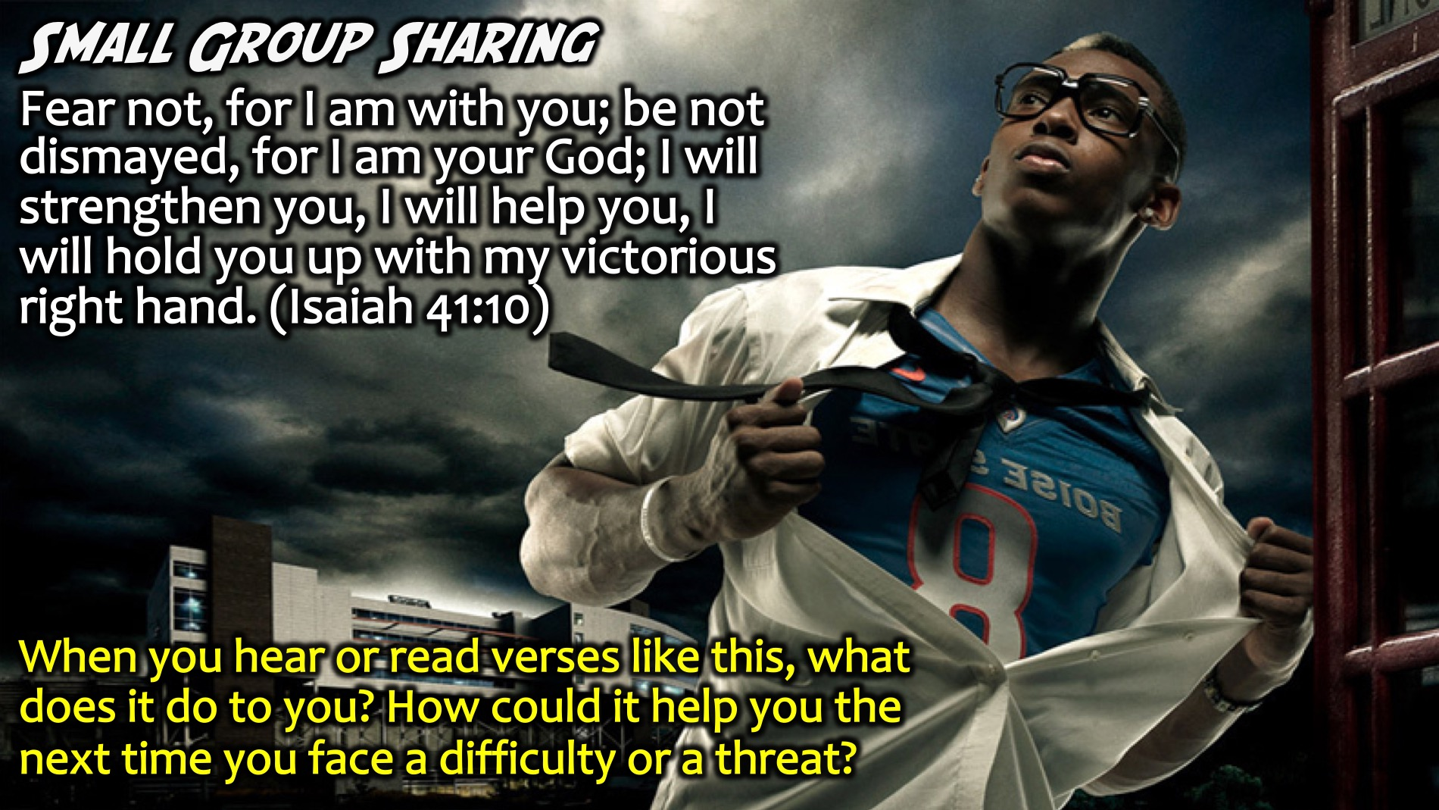
Notes:
Small Group Sharing: When you hear or read verses like this, what does it do to you? How could it help you the next time you face a difficulty or a threat?
Facilitators Notes: Don’t let teens just say the obvious – or repeat the words in the verse – ask them to go deeper by asking Why more than once, or ask them to think of something that has not been shared yet.

Slide 10

Notes:
You need to show up and be awesome in every situation you find yourself in.

Slide 11

Notes:
This does not mean that you are cocky or arrogant and walk around like you own the place.

Slide 12

Notes:
Definition: Confidence is a healthy sense of identity that comes from the inside where you know exactly who you are, what your mission is and what you have to contribute.

Slide 13
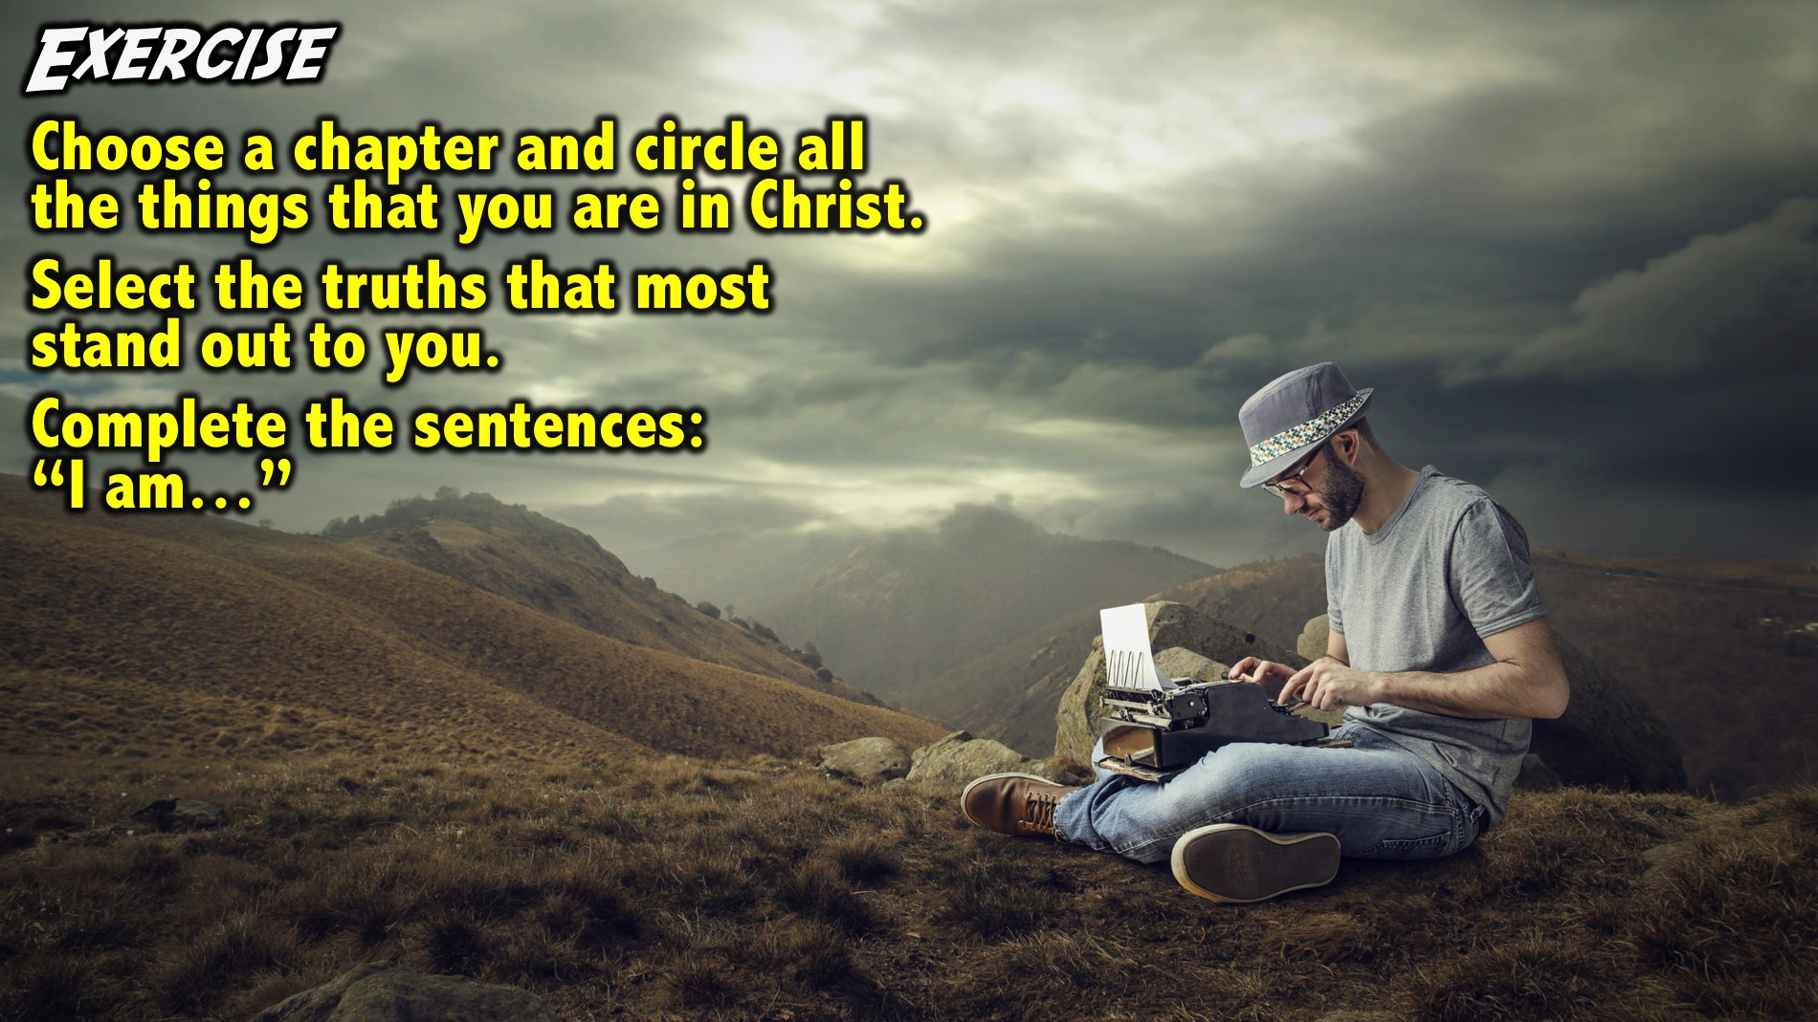
Notes:
Exercise: Choose one of the chapters from the book of Ephesians and identify all that things that you are in Christ. Then select the truths that most stand out to you and complete the sentences: “I am…”
Facilitators Notes: We will provide handouts with one of 2 chapters written on them: Ephesians 1 or Ephesians 2. Have each person choose 1 and circle who they are in Christ in the verses. Then they complete the sentences to describe who they are: “I am…”

Slide 14
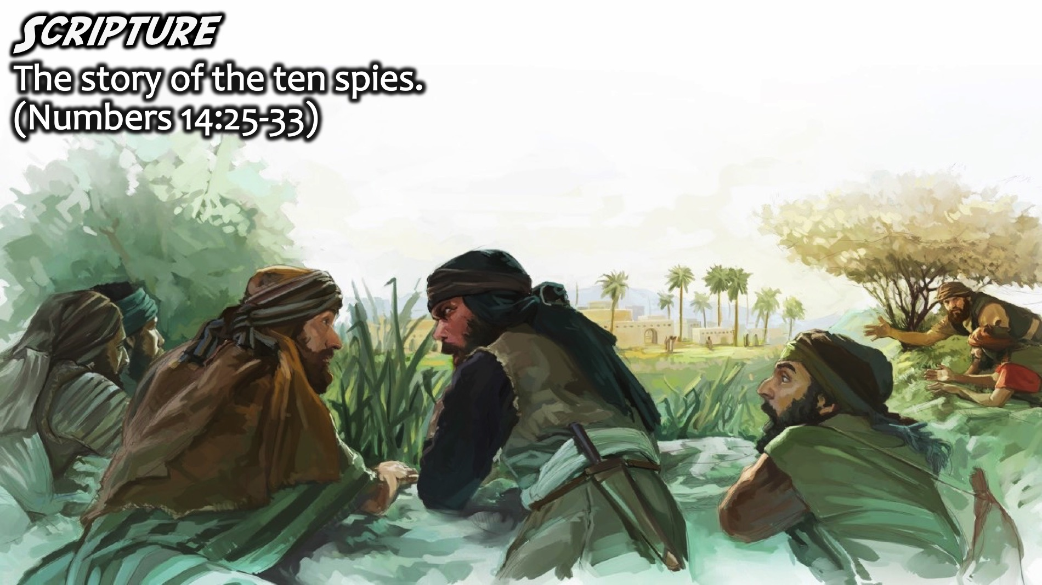
Notes:
Scripture: There is a great example of Confidence in Numbers 14:25-33) - Ten spies were sent out to survey the land to see if the Israelis could enter the Land that God had promised to them but only two spies returned with a confident report while the others said that it could not be done because of the giants in the land and the fortified cities.

Slide 15
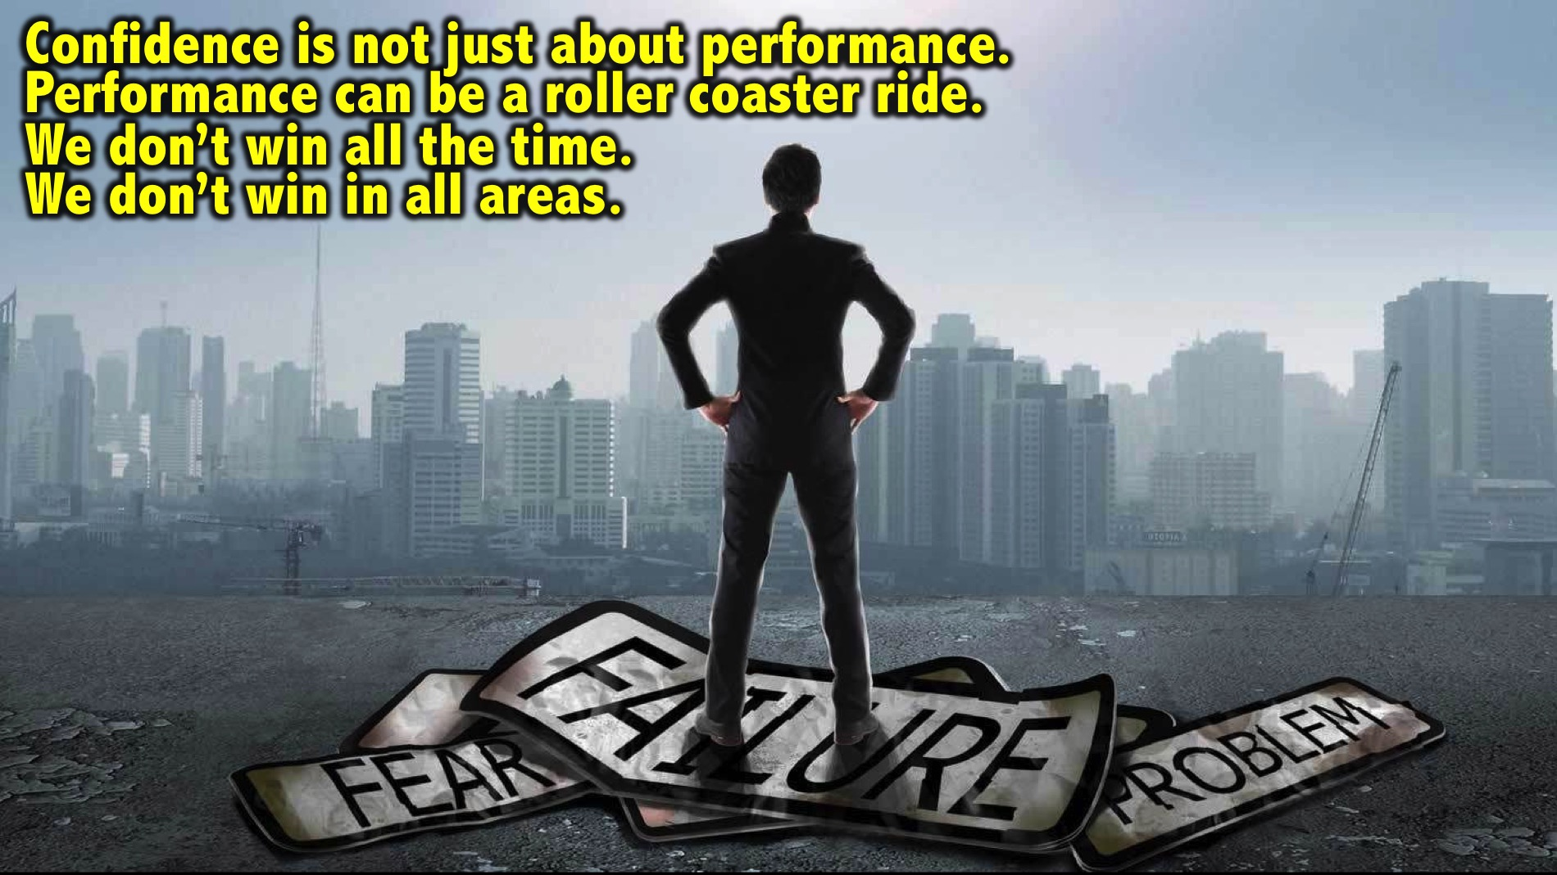
Notes:
We often relate confidence to how we are performing. But that is limited and can be an emotional roller coaster. We can also win in one area but lose in another and that can negatively impact on our confidence and also our performance.

Slide 16
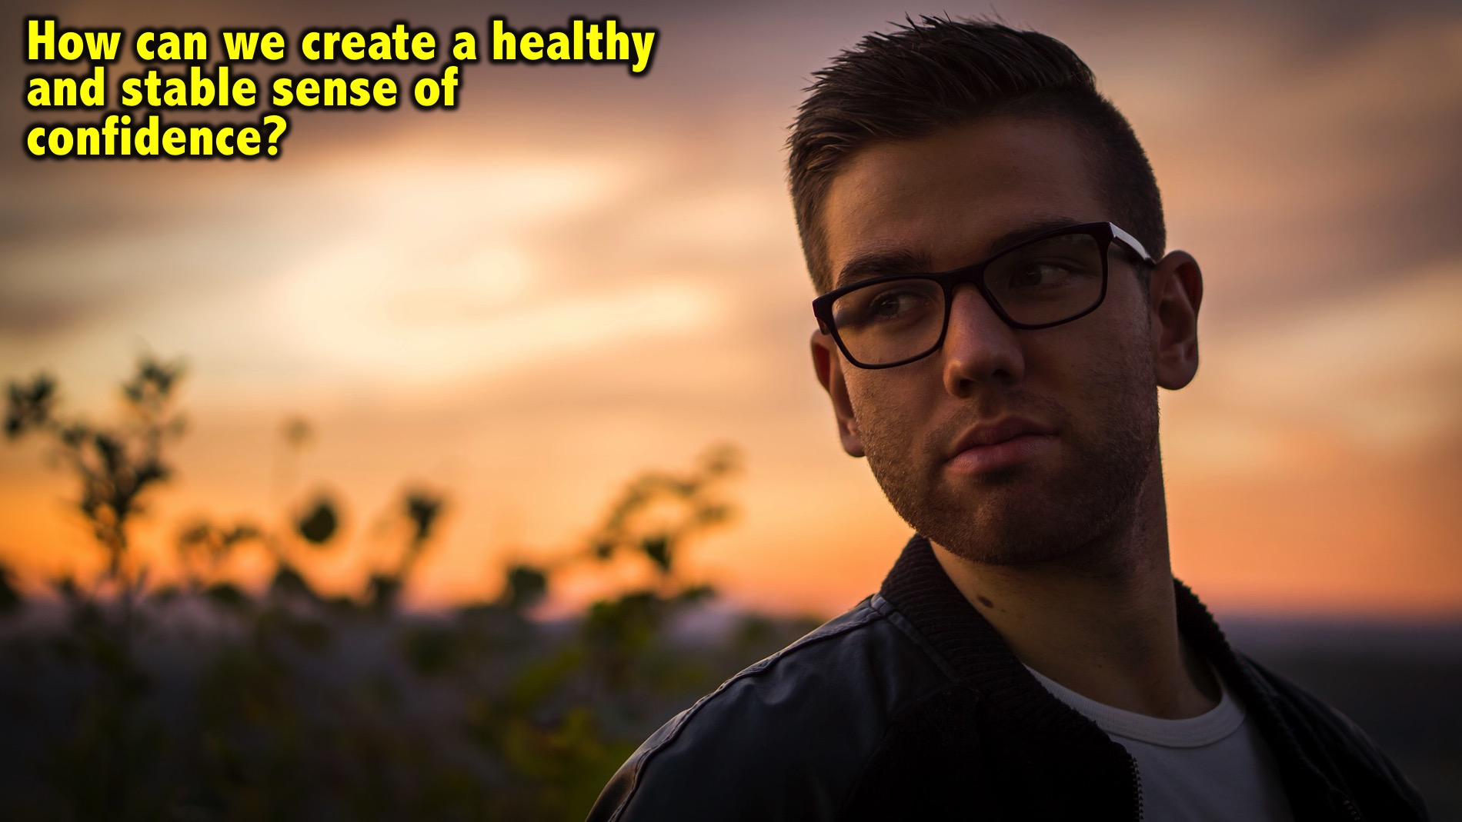
Notes:
If confidence is not just dependent on performance, what is it driven by and how do you create a more stable sense of confidence despite the highs and lows of your performances?

Slide 17
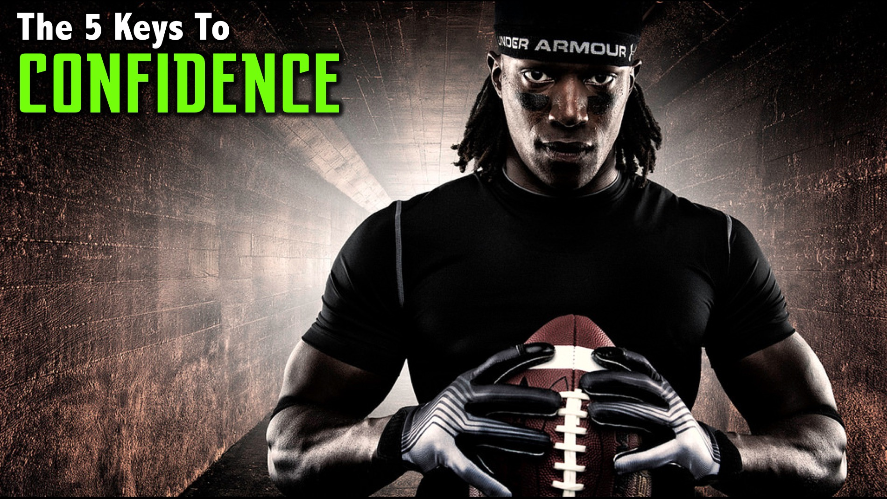
Notes:
There are 5 Keys to Confidence:

Slide 18
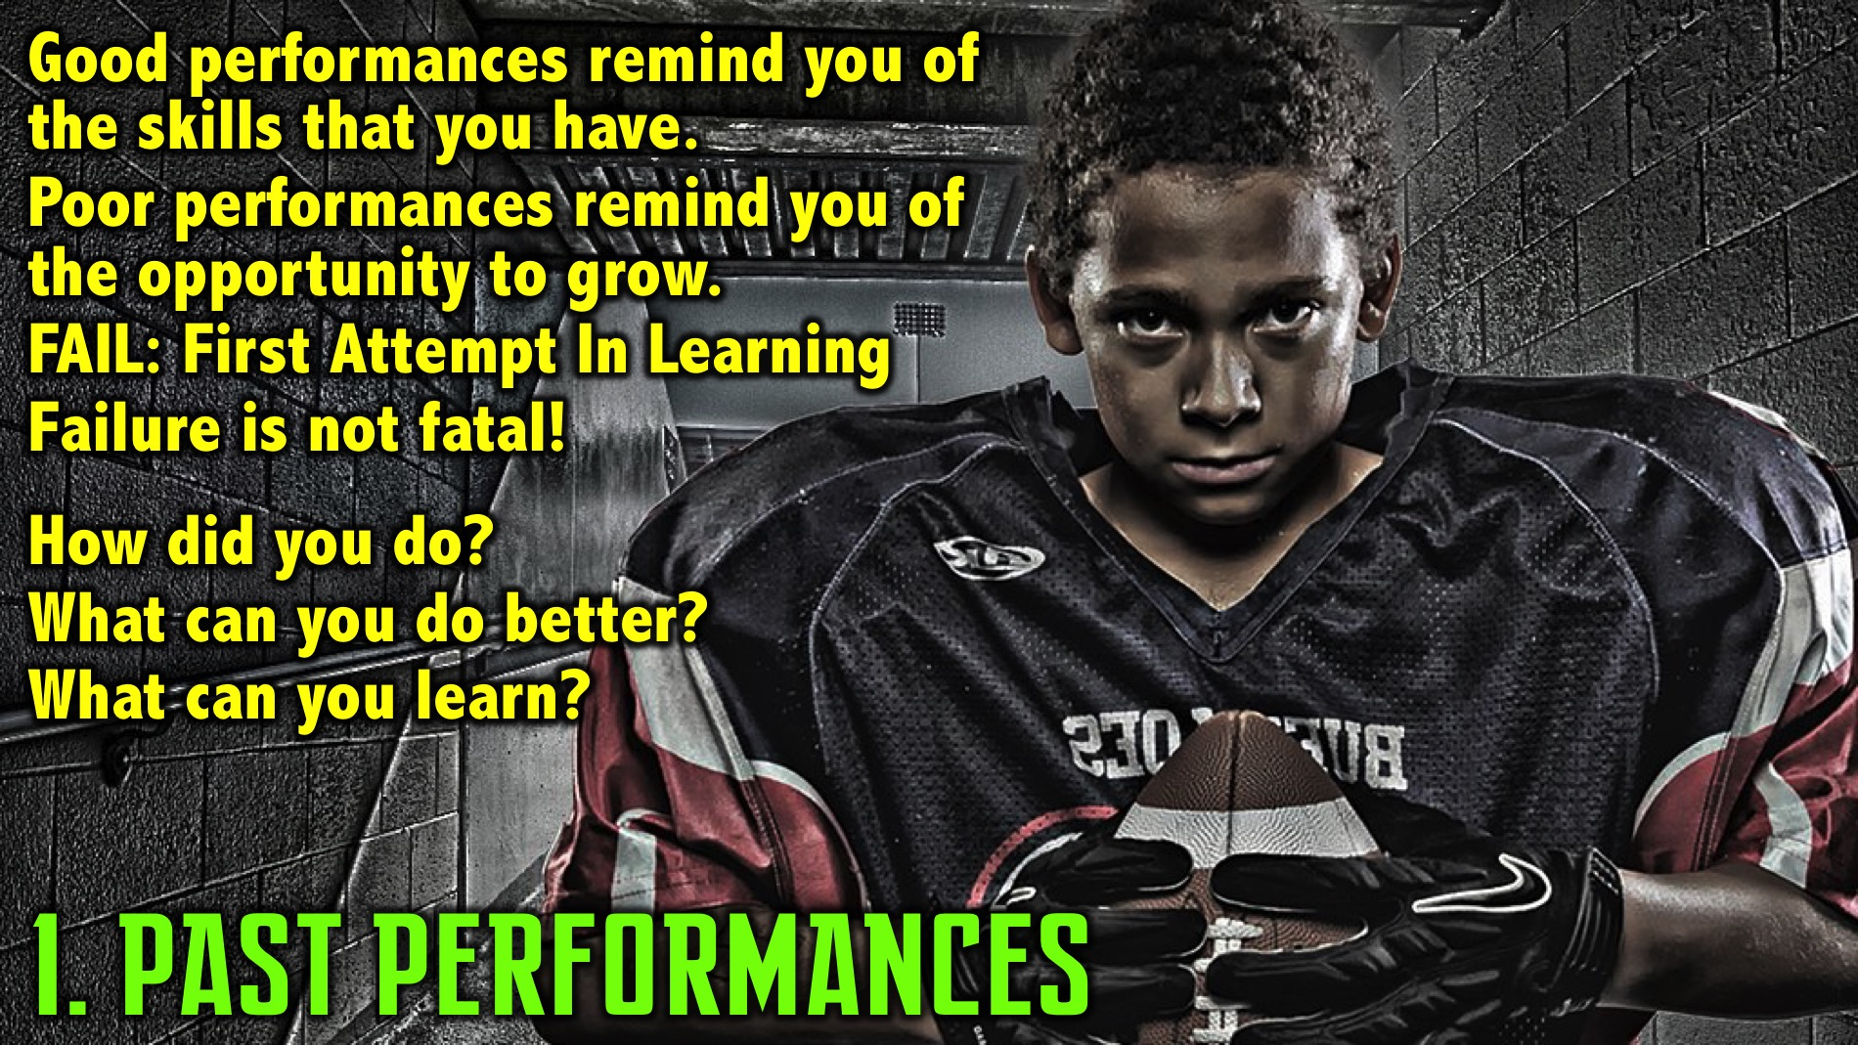
Notes:
1. Past Performances. Champions think differently about past performances that helps build their confidence. They look at the good and the bad and every performance. Let the good performances remind you of the skills you have. Let the poor performances remind you of the opportunity to grow - where you go back to the process and analyze what you did that could be changed - and come out the next time and be the pro that you know you are. Champions know that failure is not fatal. Fail can be defined as: First Attempt in Learning. Every performance is an opportunity for you to reflect on what you did today. Look at what you did well, what you can do better next time and what you have learnt about yourself.

Slide 19
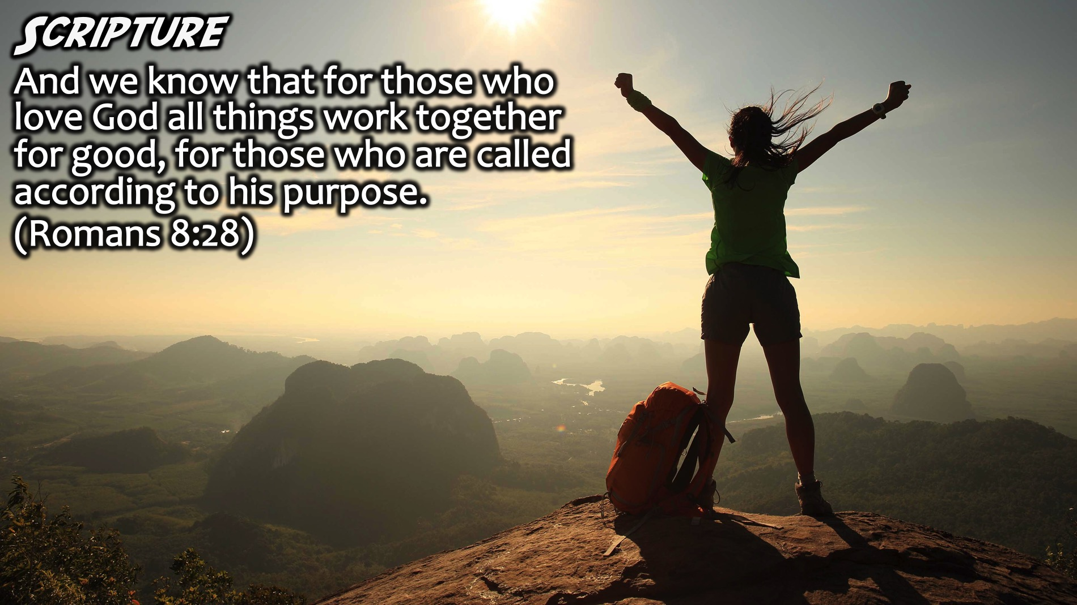
Notes:
Scripture: And we know that for those who love God all things work together for good, for those who are called according to his purpose. (Romans 8:28) This verse reminds us that no matter what happens, God is at work!

Slide 20
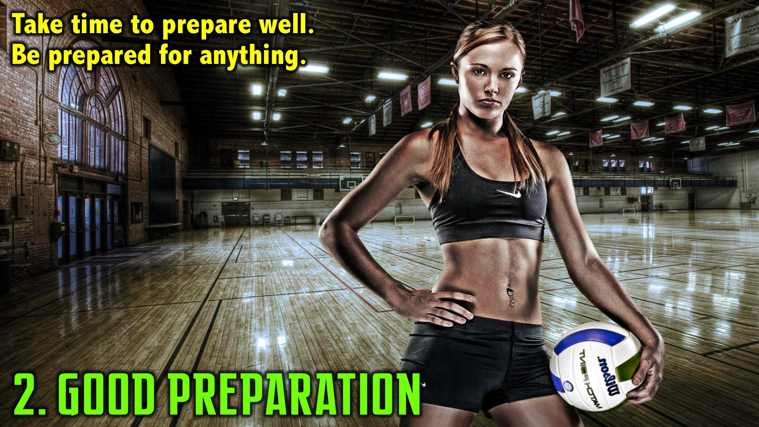
Notes:
2. Good Preparation. When you take time to prepare you can go in with some nerves but also be confident that it will be great because you have something to deliver because you are prepared for what lies ahead.

Slide 21
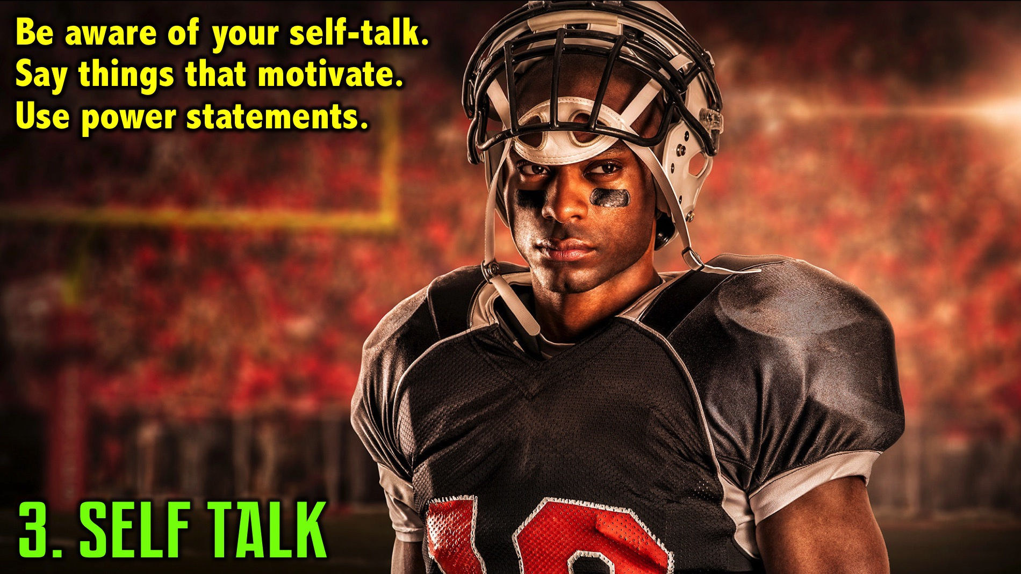
Notes:
3. Self Talk. In Building Block 1 we spoke about being aware of the mental thoughts we have because they ultimately drive our performance. The thoughts we have in our head must be checked. We often Listen to ourselves when we should Talk to our selves. Negative thoughts impact us negatively. If we start talking to ourselves about how prepared we are and what we need to do to be successful (for example: “I can only do everything I can do, and today I am going to give my best”) - then you will be on track to be confident. This kind of self-talk will have a huge impact on your performance. Self-talk changes the form and function of our brains. Remember we learnt that we create actual protein patterns in our brain through our thinking. If we can train our brains to have powerful, active productive self-talk that will create the right brain matter that will stimulate our excellence and productivity and therefore our output in each of these domains. Creating power statements really helps! For example: “I am strong, powerful and a threat”. What are the things you say to yourself? Do you have power statements that talk about your strengths and the roles that you are playing and do they help you facilitate performance?
Scripture: Some good examples of Biblical self-talk:
If God is for us, who can be against us? (Romans 8:31)
The Lord is my helper; I will not fear.” (Hebrews 13:6)
He who is in me is greater than he who is in the world. (1 John 4:4)

Slide 22
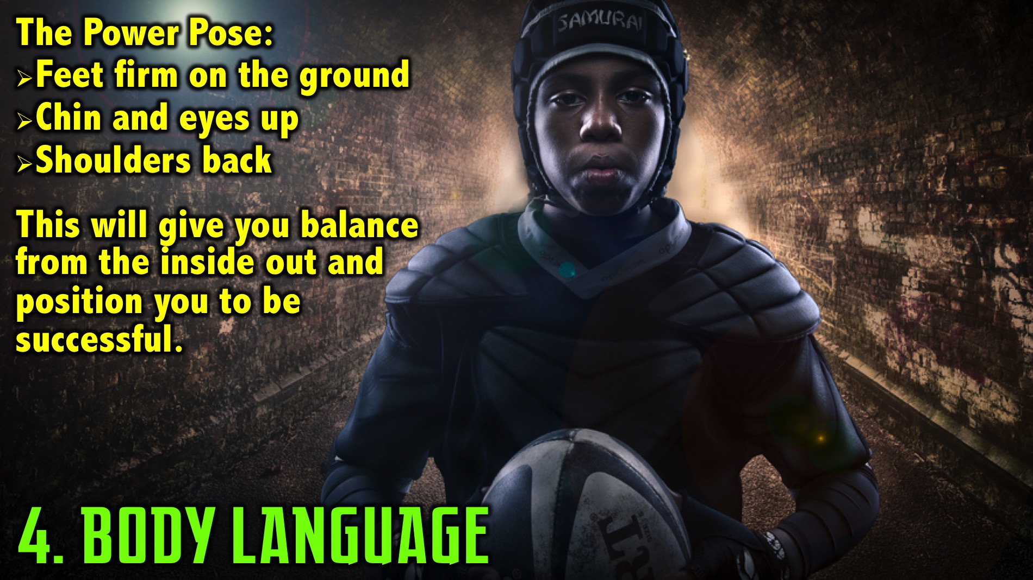
Notes:
4. Body Language. When you are in a power pose - head up, shoulders back and open to your surroundings, our testosterone levels go up and our cortisol levels go down. Testosterone is a power chemical while Cortisol is a stress one. Power up, stress down is critical! You can manage your body language to ensure the internal hormonal balance is in your favour. You must maintain your space without being domineering or creating a sense of unease in others. The posture you need is: feet firmly on the ground, arms not folded, chin up, eyes up and shoulder is back. This helps you get balanced from the inside out and it positions you to be successful.

Slide 23
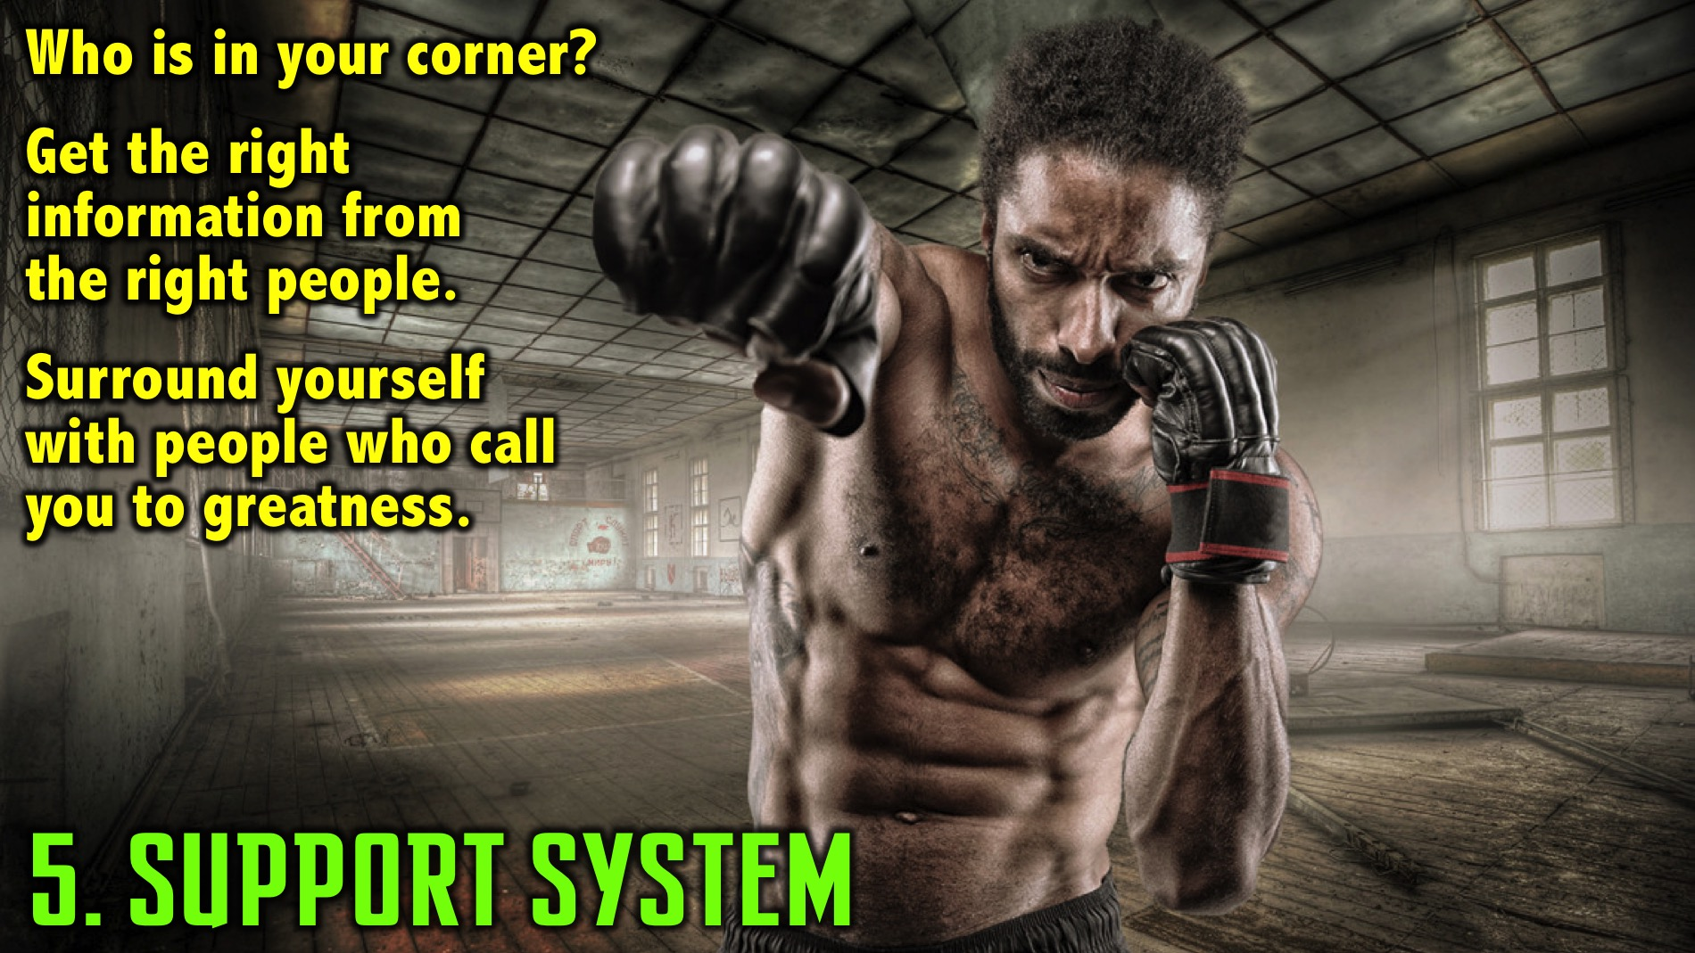
Notes:
5. Support System. You need to know who is in your corner. When someone is in the boxing fight they are the only one in the ring with their opponent, but when the bell goes they go to you corner and get advice from their friends, coach, trainer, significant other, etc. Each plays a different role. You need to know who is in your corner and what role they play. You must go to the right people for the right kinds of information. Do people in a fighters corner demoralise them or hold them back from greatness? Of course not! People in your corner believe in you! You must be careful to only allow the right people into your corner!

Slide 24

Notes:
Scripture: Two are better than one, if either of them falls down, one can help the other up. But pity anyone who falls and has no one to help them up. Also, if two lie down together, they will keep warm. But how can one keep warm alone? Though one may be overpowered, two can defend themselves. A cord of three strands is not quickly broken. (Ecclesiastes 4:9-12)

Slide 25
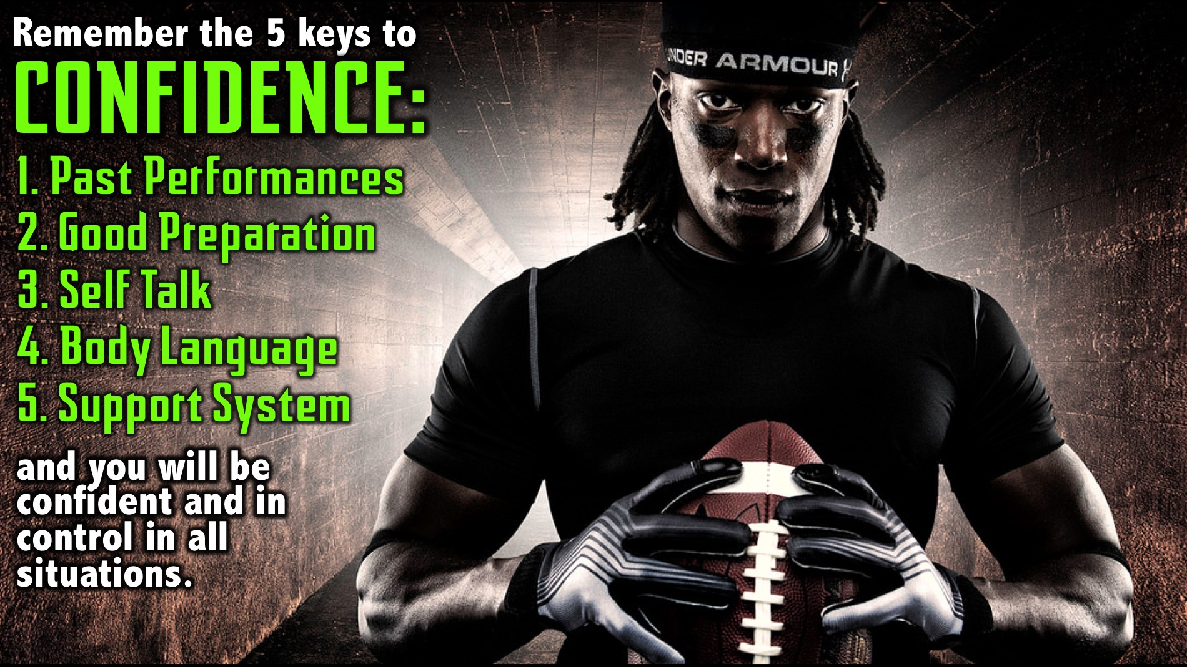
Notes:
Summary: Remember the 5 keys to confidence and invest in each of those areas and you will remain confident and in control of yourself in all situations.

Slide 26
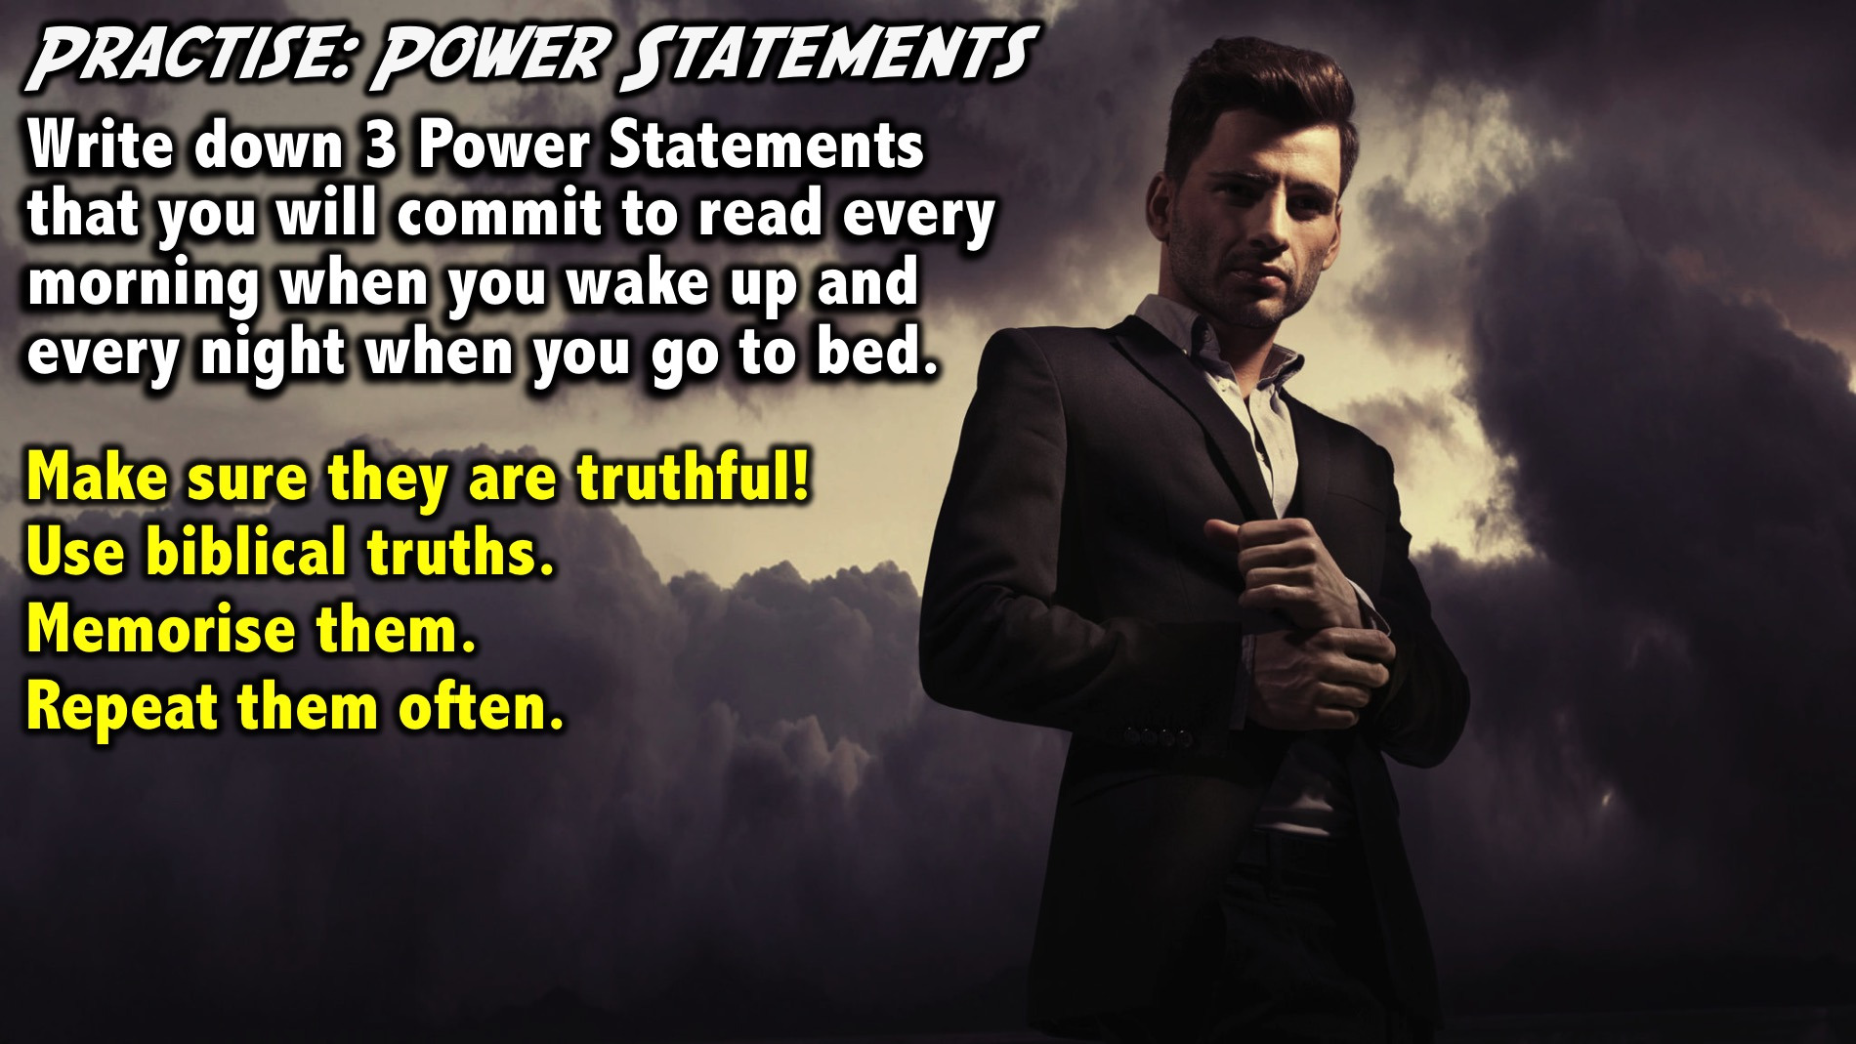
Notes:
Practice: Power Statements. Write down 3 Power Statements that you will commit to read every morning when you wake up and every night when you go to bed. The goal is to memorize them so you don’t have to read them each time but can do it from memory. They need to be grounded in truth to be really powerful. They cannot be lies! Don’t say: “I am a millionaire!” unless that is true! I should affirm truth in my life and that will develop the right self-talk and mindsets. Say things that will facilitate winning performance in each domain. As a communicator you could say: “I speak truth to people.” Sports guys could say: “I am the fastest person on the ice.” Think about your 3 power statements and start to memorise them. When adversity strikes we revert to habits in our lives - so we must build the self-talk that will drive us!
Facilitators Notes: Make sure everyone works on writing power statements - they can base them on the characteristics they identified in the earlier exercise from Ephesians or Colossians.

Slide 27
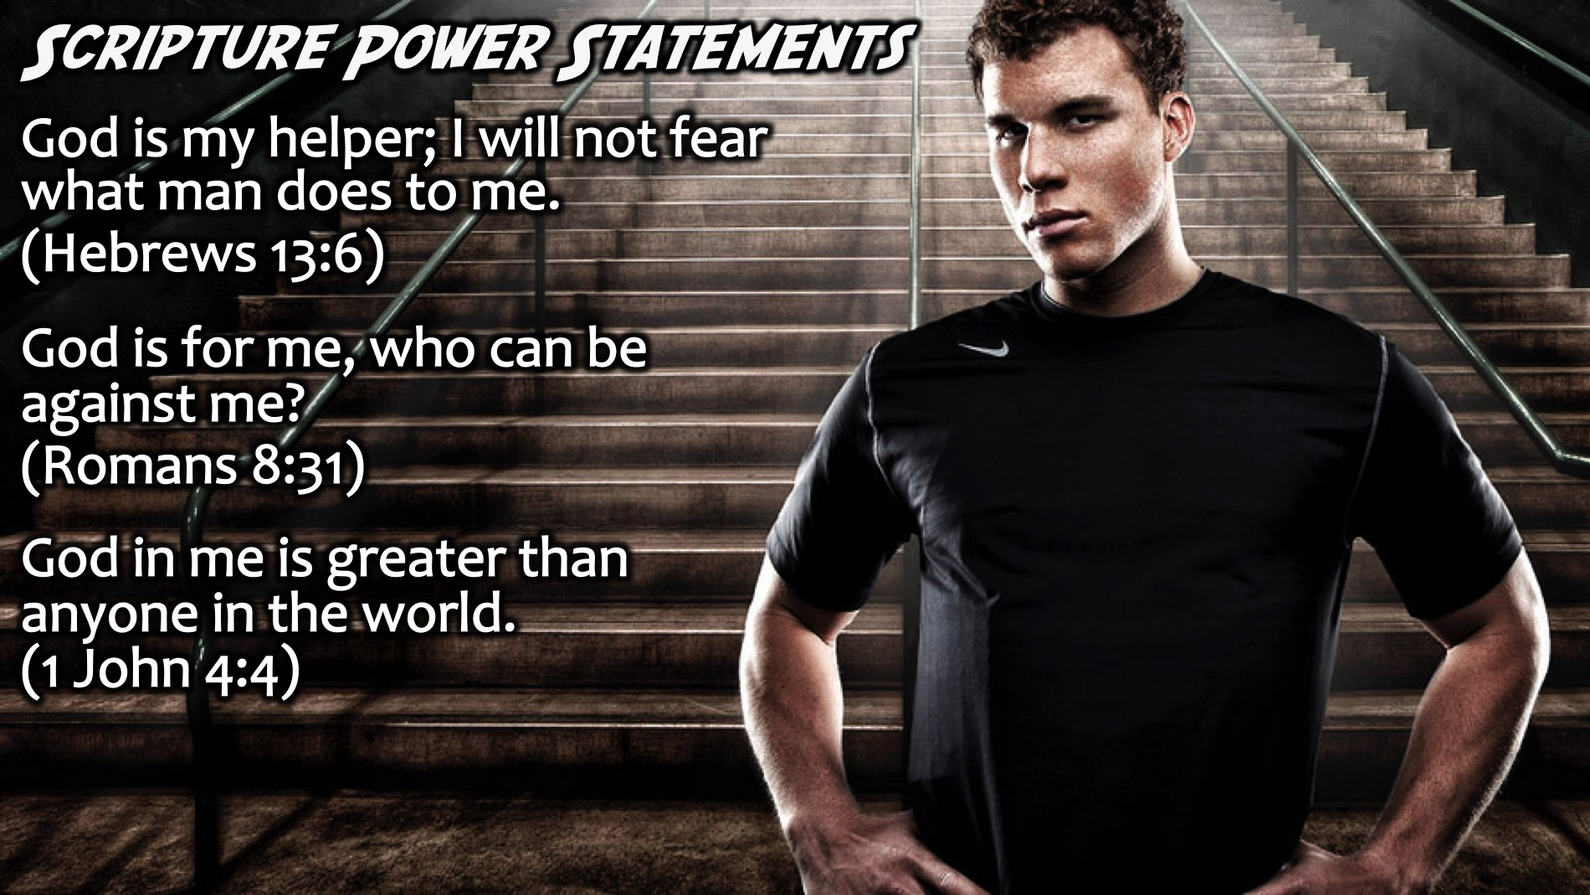
Notes:
Here is some examples of how Bible verses can be used as power statements:
God is my helper; I will not fear what man does to me. (Hebrews 13:6)
God is for me, who can be against me? (Romans 8:31)
God in me is greater than anyone in the world. (1 John 4:4)

Slide 28
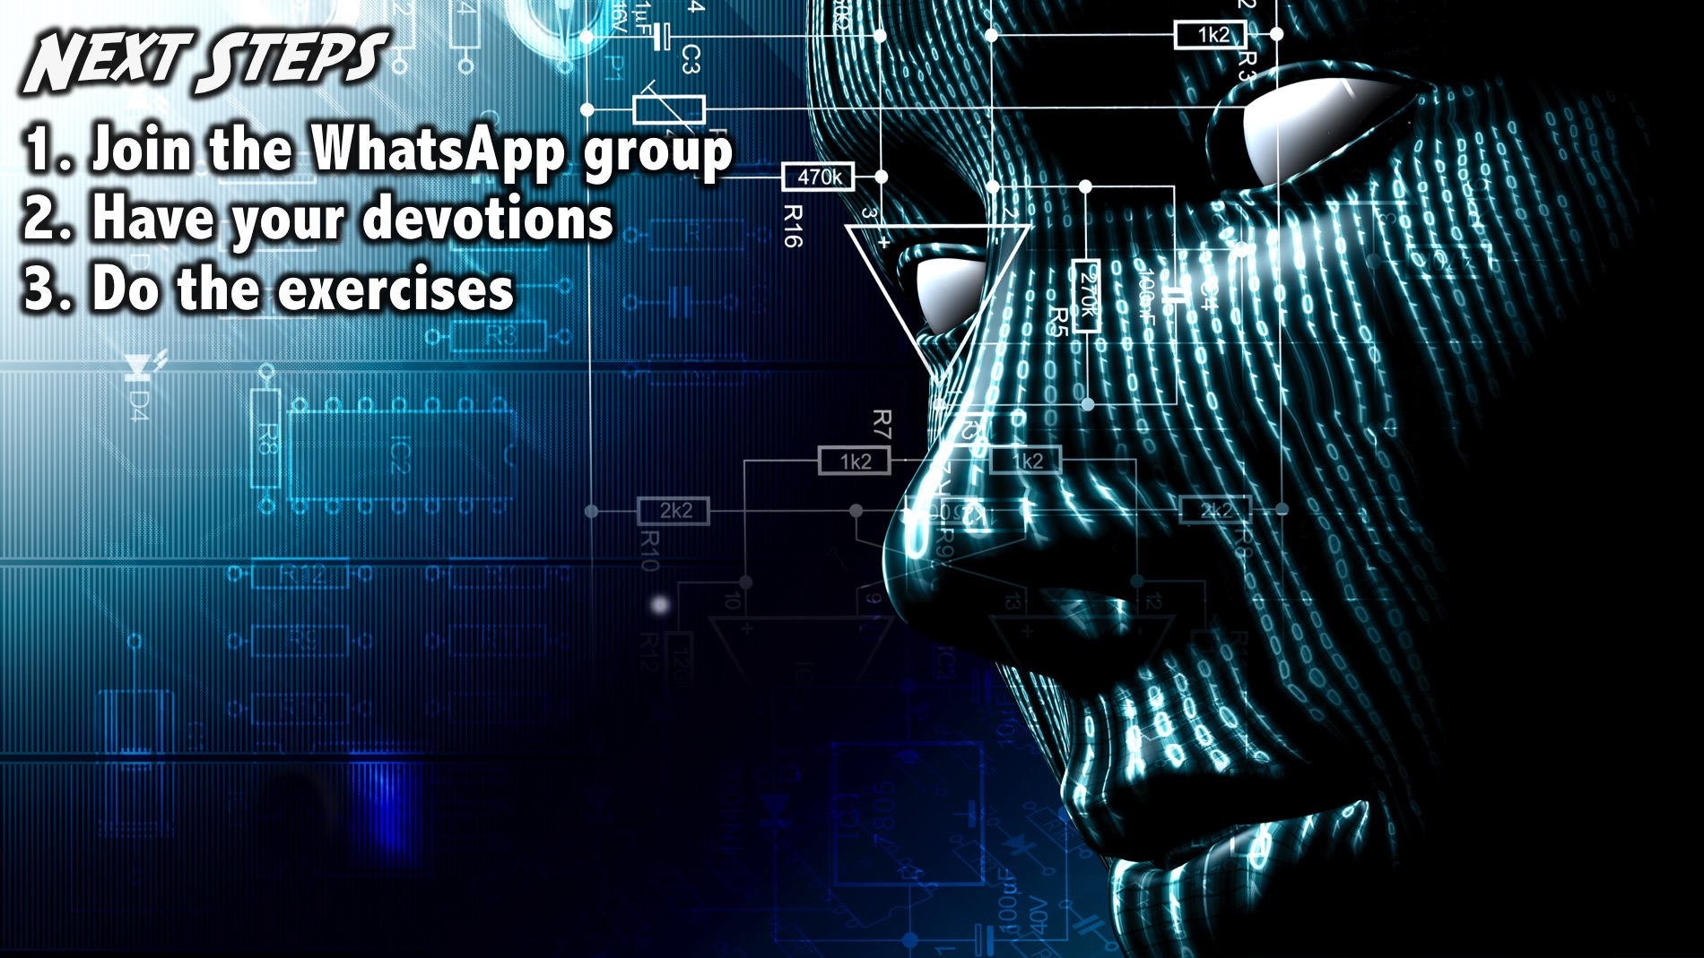
Notes:
Next Steps: (1) Join the WhatsApp group. (2) Have your daily devotions. (3) Do the brain exercises.
Facilitators Notes: Before your group leaves your table after the prayer - make sure they have all signed up for the WhatsApp group and challenge them one more time to do their devotions and the exercise during the week- including last weeks 3-2-1 exercise.

Slide 29

Notes:
Prayer:

Slide 30
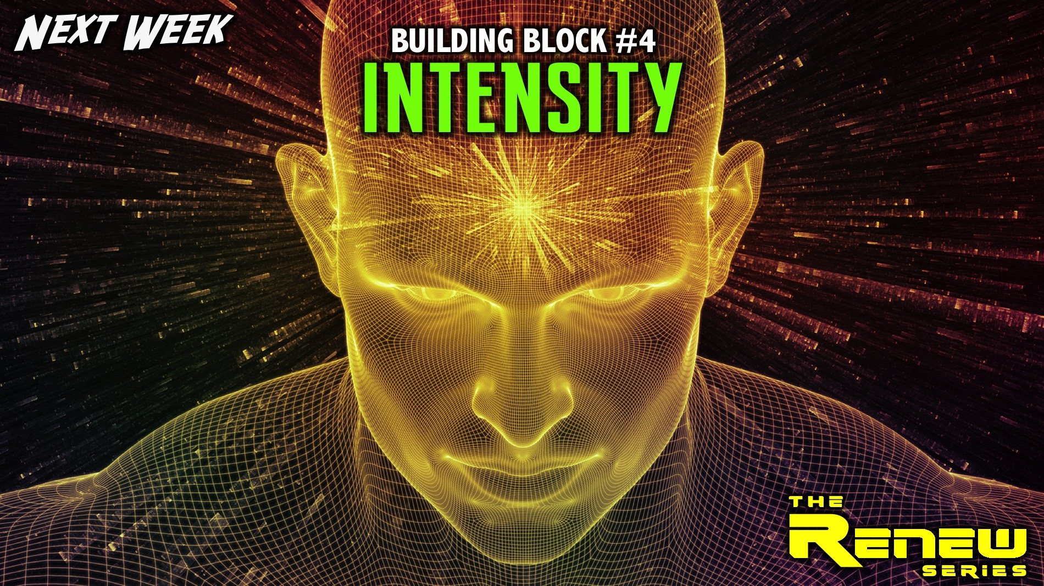
Notes:
Next Week: Next week we will explore the fourth building block: Intensity.

