Slide 1

Notes:
Welcome to the Renew Series. The content for this series has been taken from an amazing Podcast by Dr. Amber Selking entitled “Building Championship Mindsets”. Checkout her website at: http://selkingperformance.com.

Slide 2

Notes:
Rewind: We began the Renew series learning about how our thoughts matter and how our thoughts build mindsets!

Slide 3

Notes:
In this series we are exploring 8 Building Blocks to help you think and act like a champion.

Slide 4
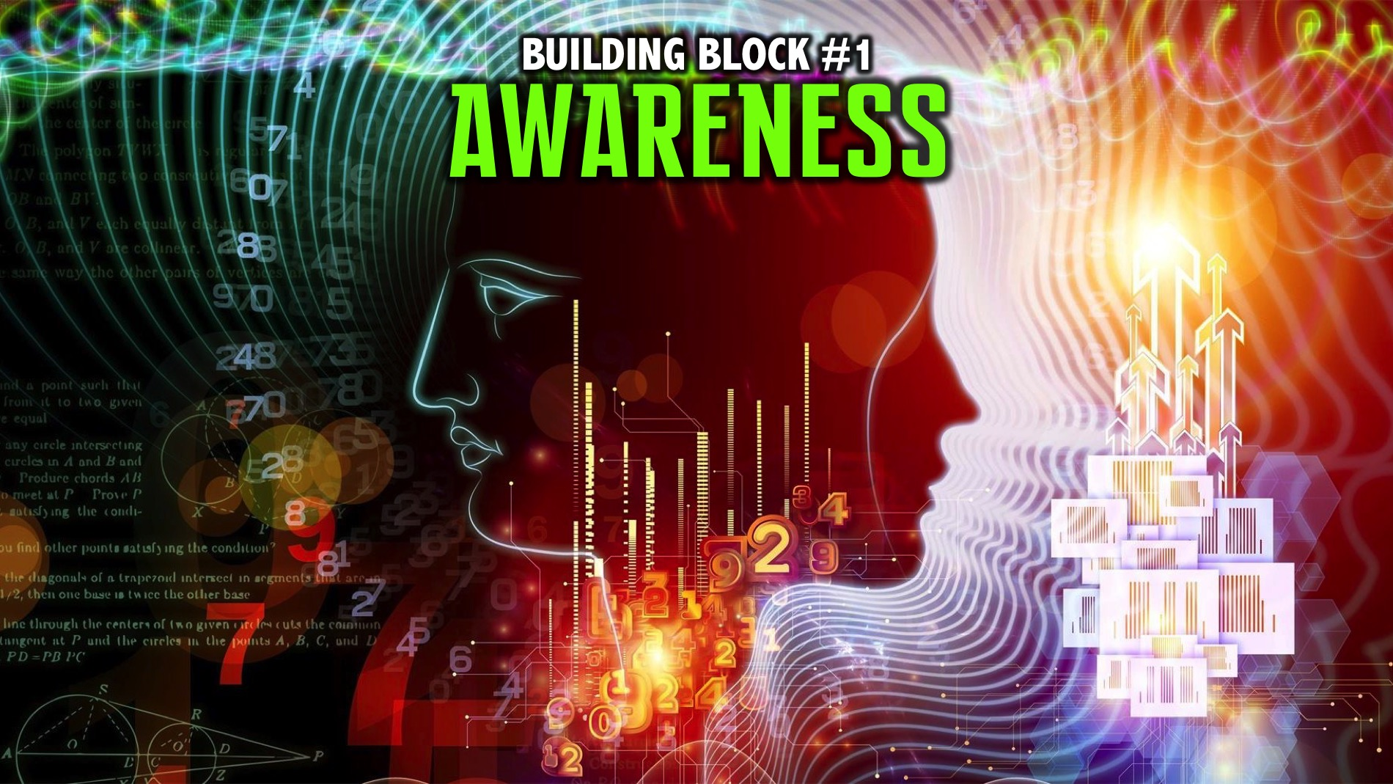
Notes:
We explored the first building block: Awareness.

Slide 5

Notes:
We explored the second building block: Motivation.

Slide 6

Notes:
Last week we explored the third building block: Confidence.

Slide 7

Notes:
Last week we explored the fourth building block: Intensity.

Slide 8
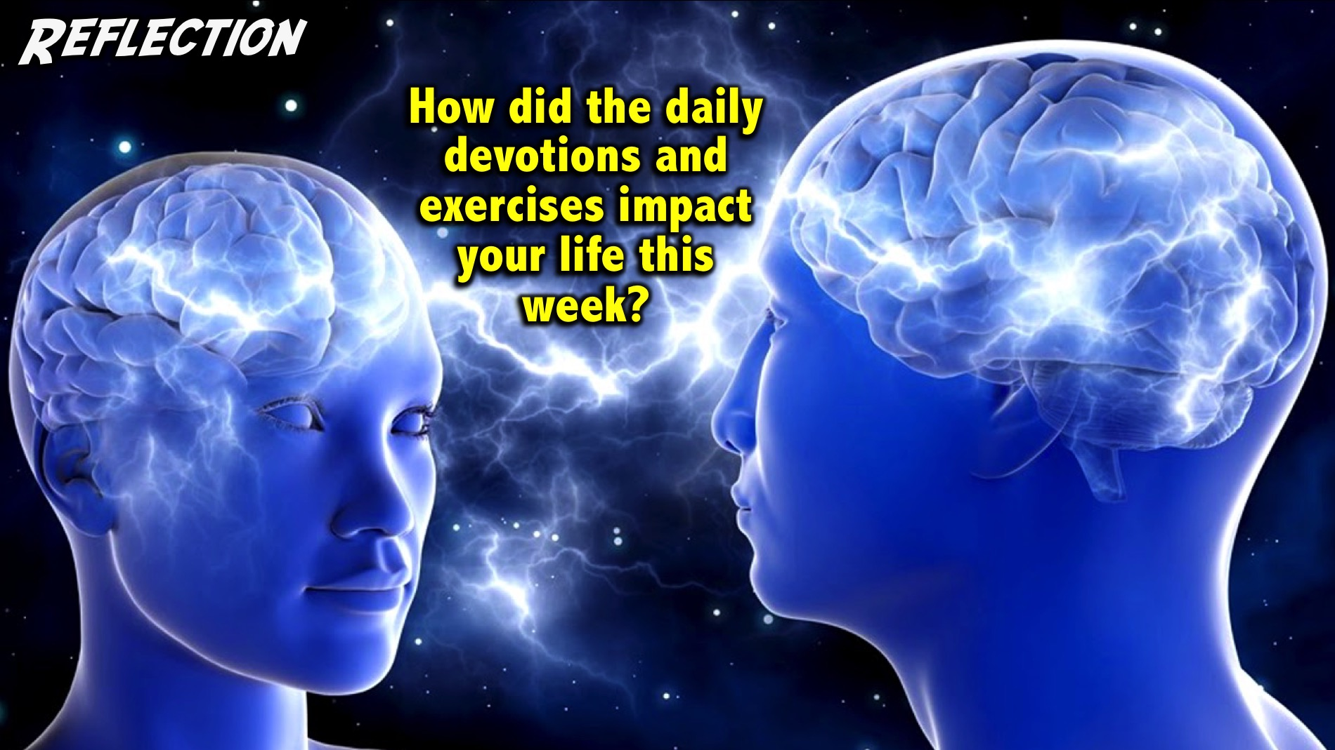
Notes:
Reflection: How did the daily devotions and exercises impact your life this week?
Facilitator Notes: Use follow up questions if necessary to get people at your table reflecting on the past week. Examples: Did you get the devotions on your phone? Do you need to take a printed copy today? How many days were you able to do your devotions? Did wearing the elastic band help you think positive thoughts? Were you able to do the 3-2-1 exercise? How did it help you think positively and creatively about your day and your life?

Slide 9

Notes:
Today we are going to explore the fifth building block: Attention. This is about controlling our attention and how important it is to place our attention on the things that are necessary in… (Your phone rings and you stop to answer it - and pretend to have a conversation for a few seconds!). See what happened there? In that moment my attention was misplaced! I am sure that happens to you often!

Slide 10
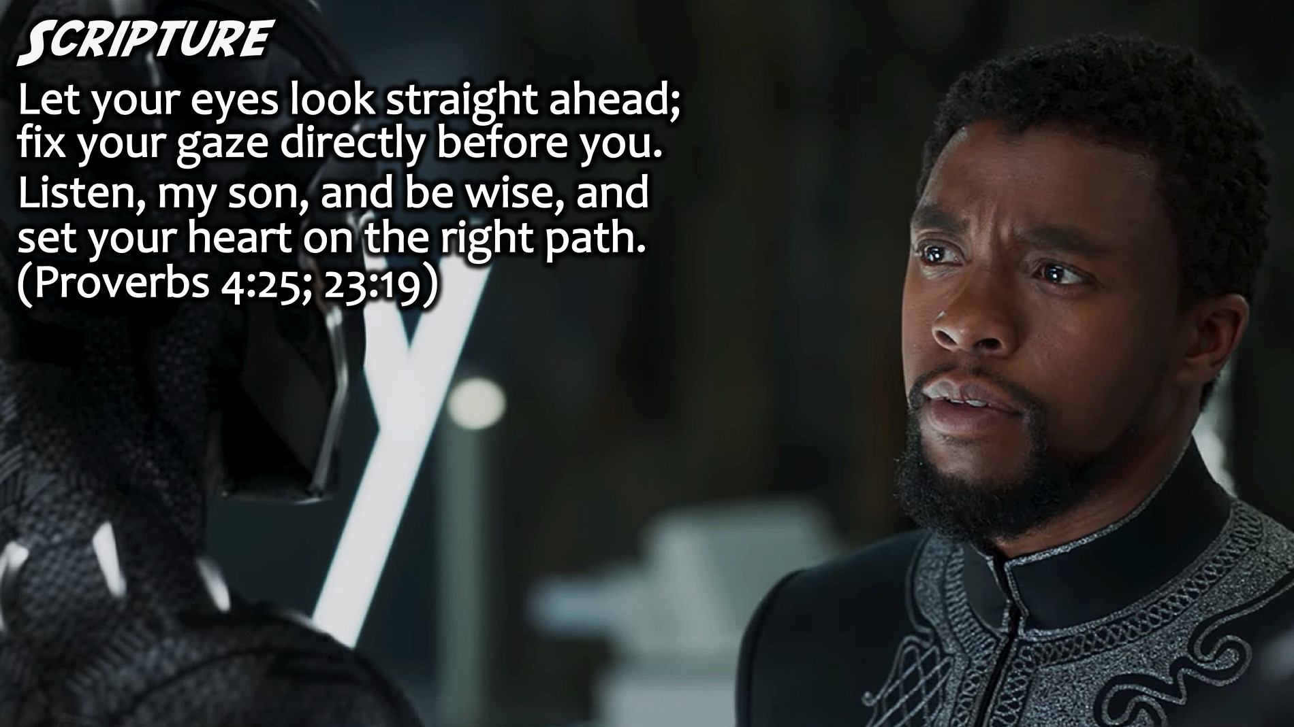
Notes:
Scripture: “Let your eyes look straight ahead; fix your gaze directly before you. Listen, my son, and be wise, and set your heart on the right path.” (Proverbs 4:25, 23:19)

Slide 11
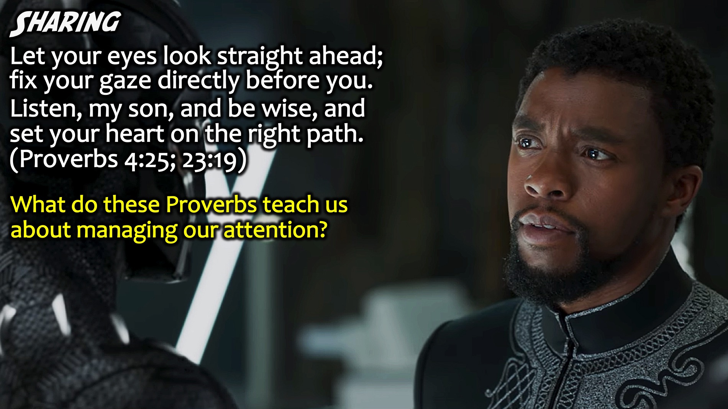
Notes:
Sharing: What do these Proverbs teach us about managing our attention?
Facilitators Notes: Don’t let teens just say the obvious – or repeat the words in the verse – ask them to go deeper by asking Why more than once, or ask them to think of something that has not been shared yet.

Slide 12
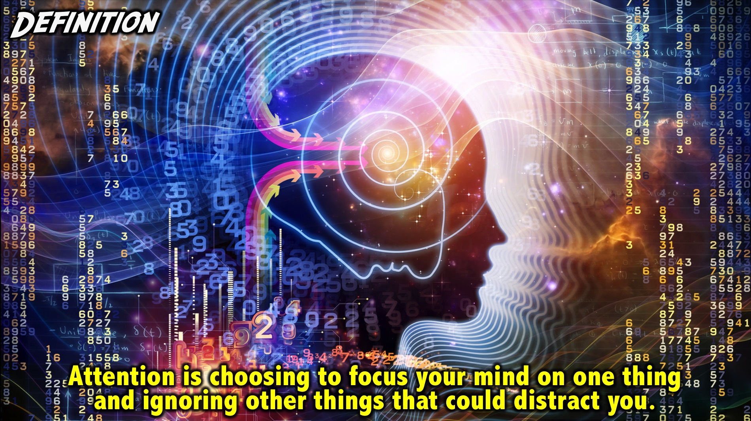
Notes:
Definition: Attention is choosing to focus your mind on one thing and ignoring other things that could distract you. This is how Noluthando, one of the adult leaders from our Youth defined attention this week: “Attention is the ability to concentrate on something for a sustained period of time until it is understood or something is learned from it while ignoring everything else.”

Slide 13
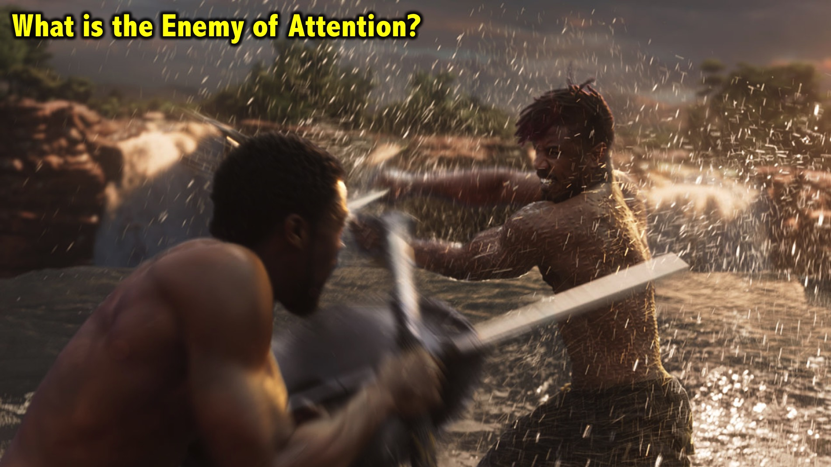
Notes:
What’s is the Enemy of Attention?

Slide 14
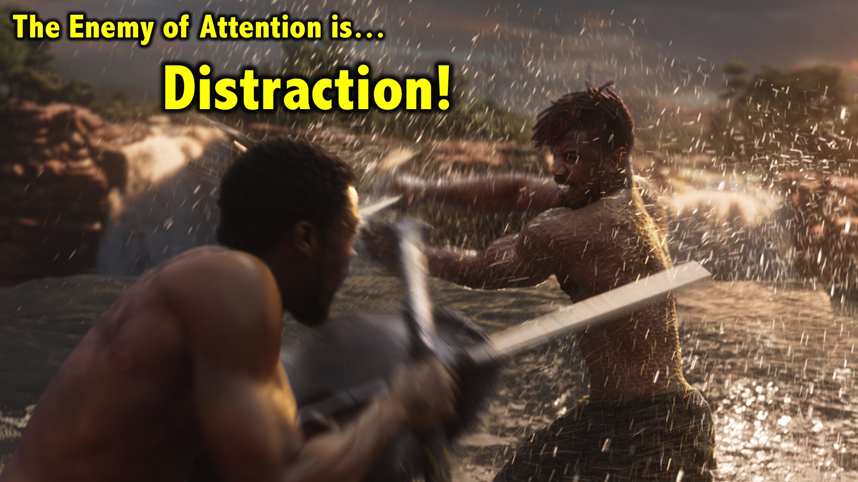
Notes:
The Enemy of Attention is Distraction!

Slide 15
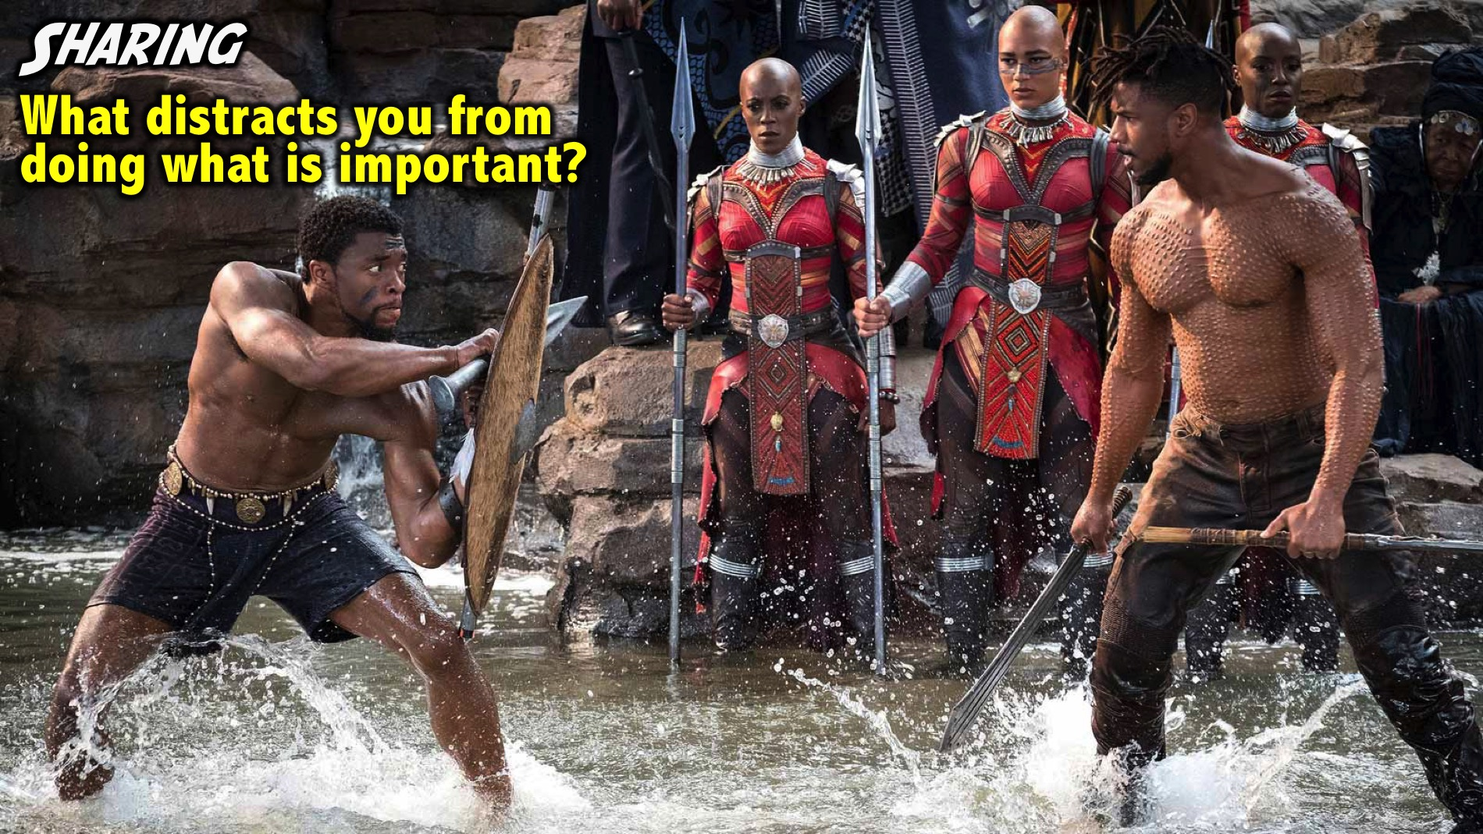
Notes:
Sharing: Turn to the person sitting next to you and ask them: What distracts you from doing what is important?
Facilitators Notes: Make sure that each person at your table pairs up and asks this question of each other.

Slide 16
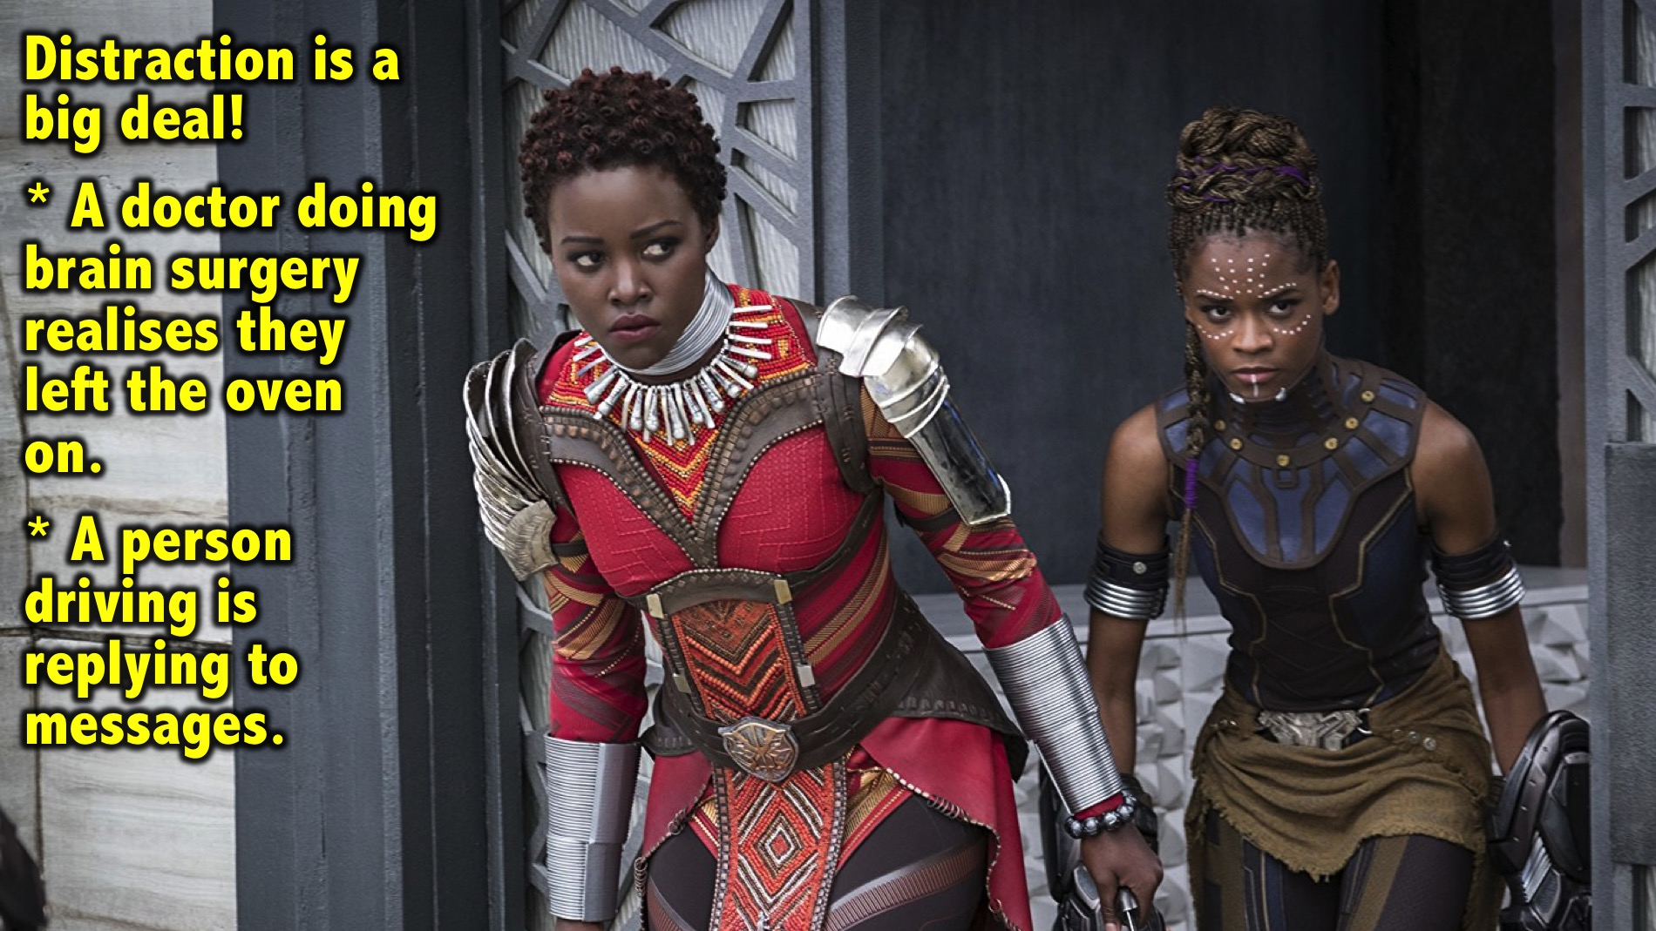
Notes:
We may think distraction is not such a huge thing but imagine this: (1) A doctor who is doing heart or brain surgery suddenly realises they left the oven on at home. (2) A person driving is constantly looking at their phone or replying to text messages.

Slide 17
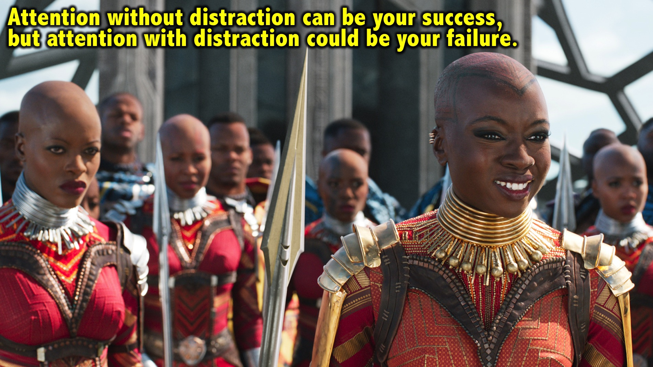
Notes:
Attention without distraction can be your success, but attention with distraction could be your failure.

Slide 18
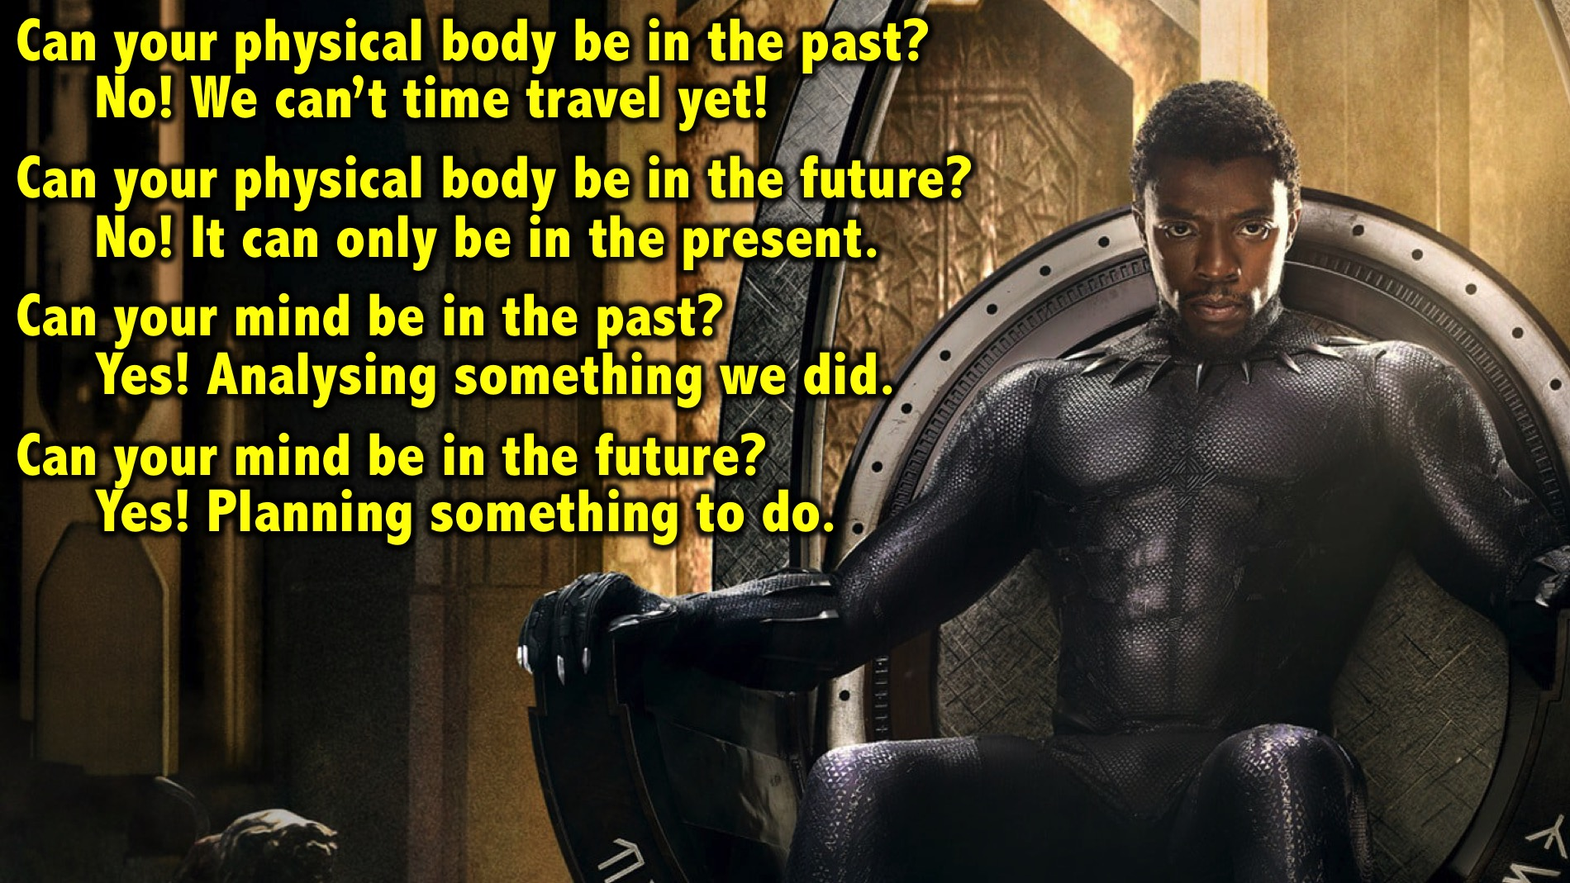
Notes:
Can your physical body be in the past? No! It cannot because we don’t have a time machine yet.
Can your physical body be in the future? No! It cannot! It can only be in the present – right here and right now.
Can your mind be in the past? Yes. They can be analysing past performances, questioning what we just did or the action we just took, or the decision we just made, or the way we just communicated something.
Can your mind be in the future? Yes! They can be planning, thinking about the outcome of the meeting or the game while we are in the present

Slide 19
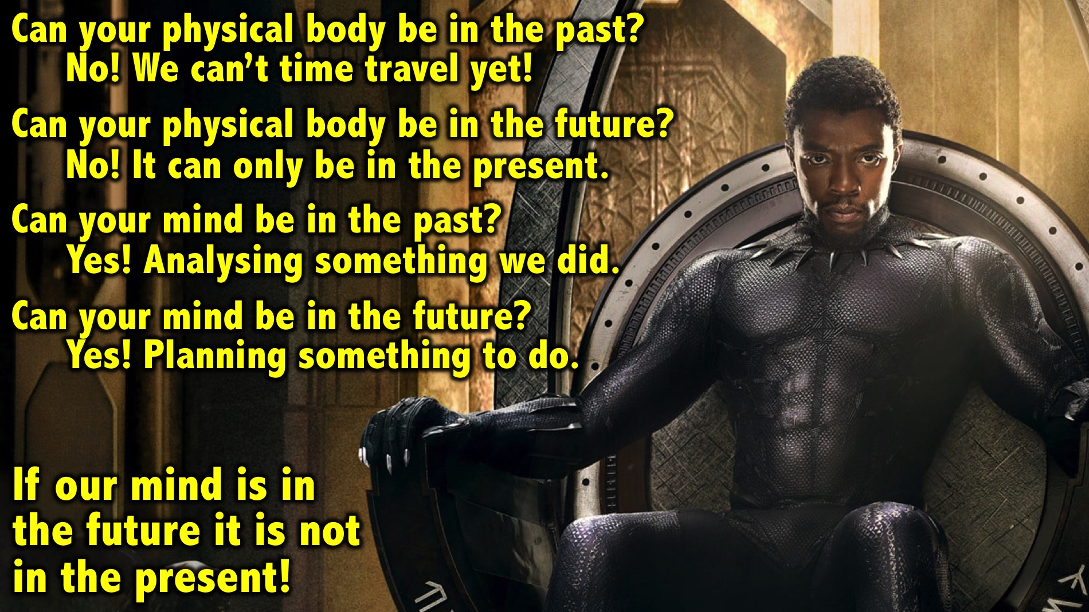
Notes:
If our mind is the future it is not in the present!

Slide 20
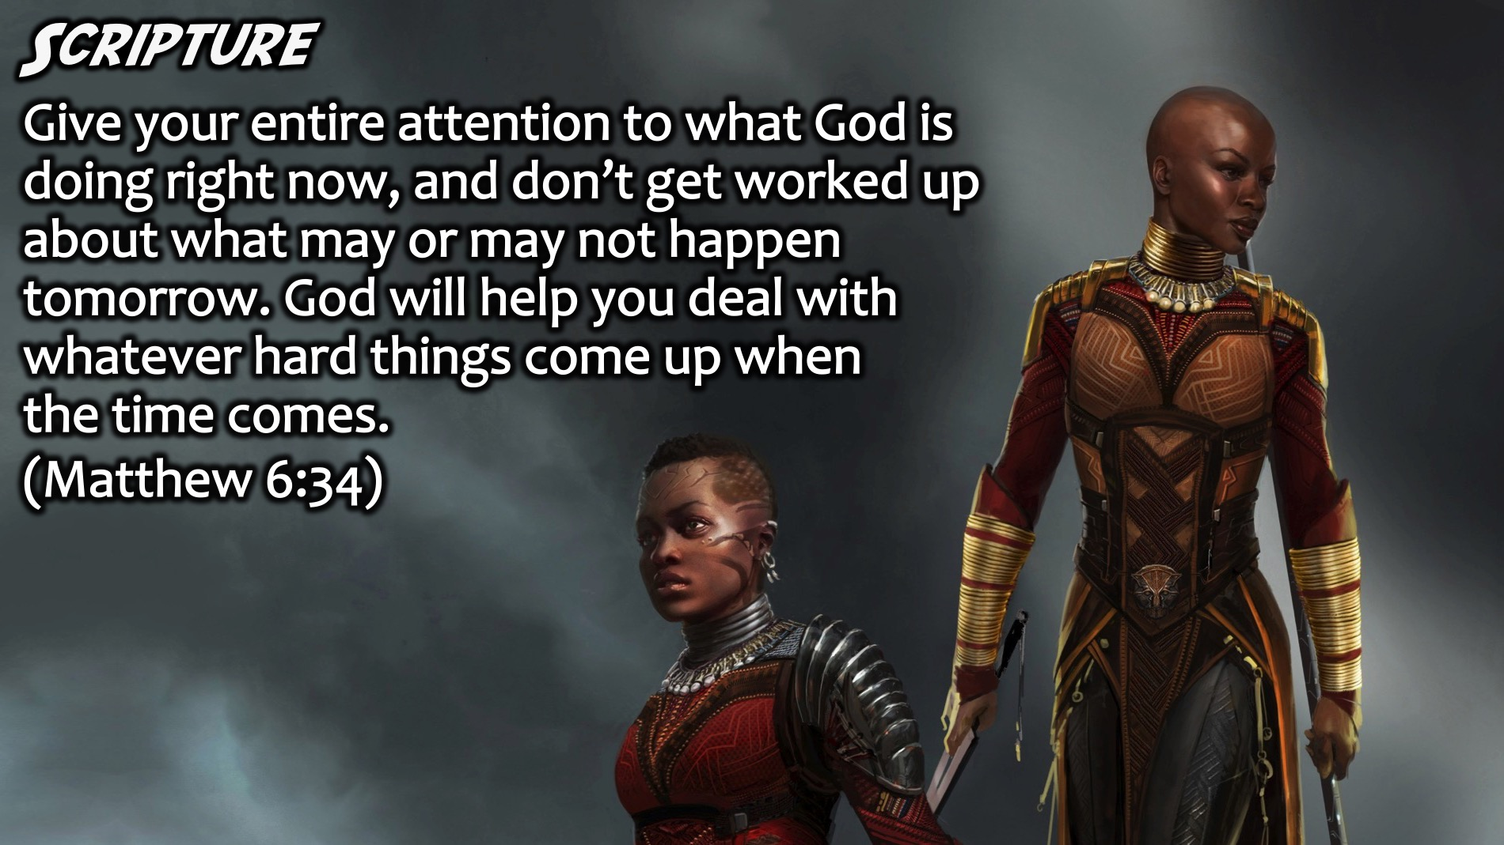
Notes:
Scripture: “Give your entire attention to what God is doing right now, and don’t get worked up about what may or may not happen tomorrow. God will help you deal with whatever hard things come up when the time comes.” (Matthew 6:34 MSG)

Slide 21
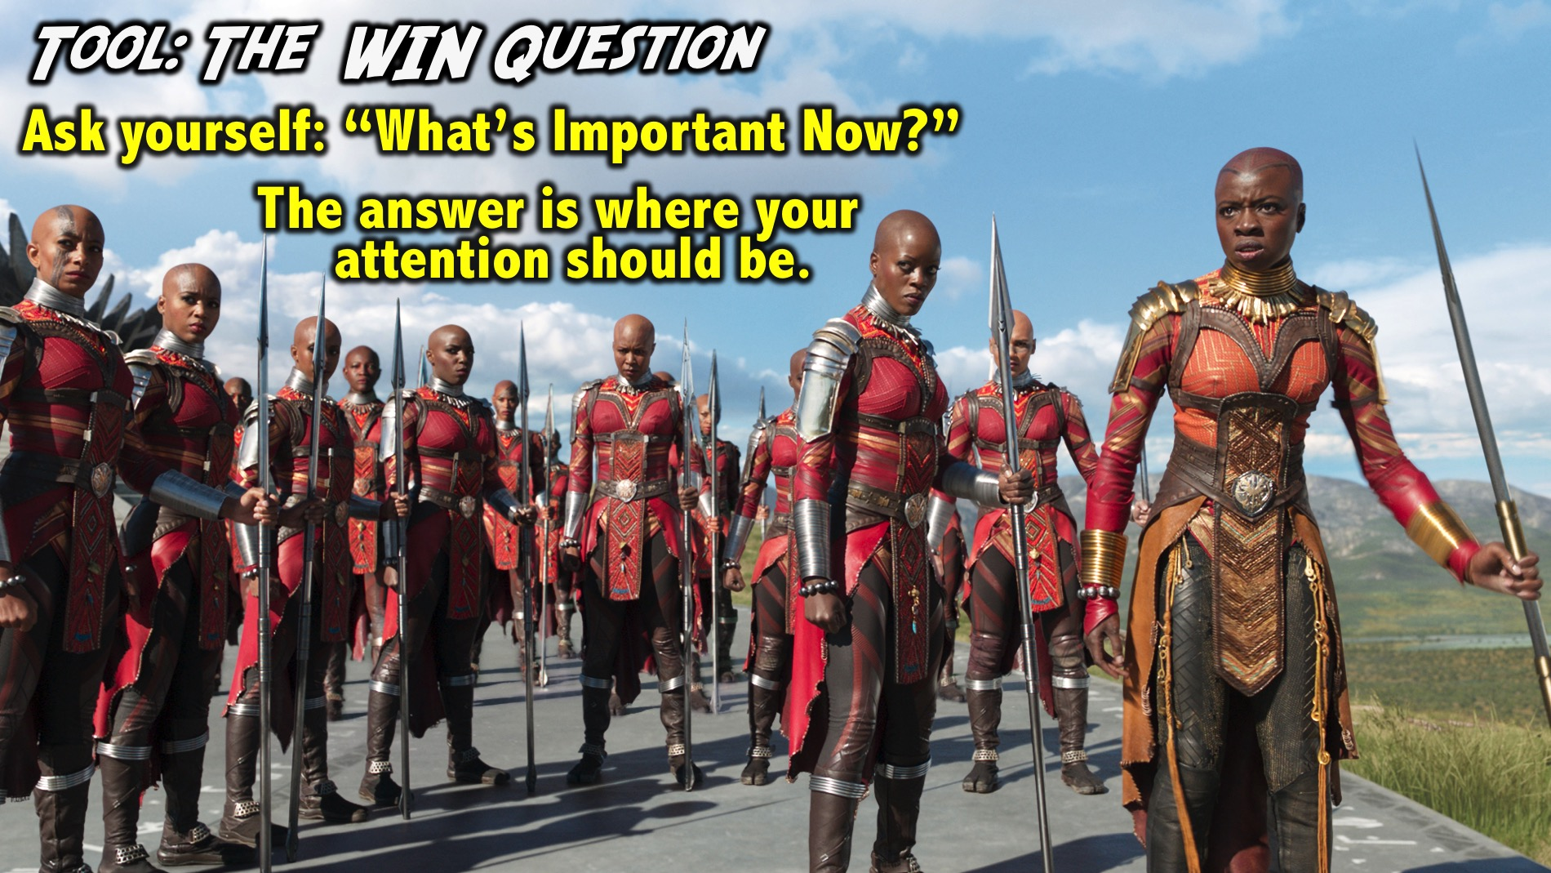
Notes:
Tool: The WIN Question. One of the best ways to focus your attention is to ask the WIN question which stands for “What’s Important Now?” Every day and in every situation you need to ask: “What’s Important Now?” The answer to that question is where your attention should be placed in the moment. Long term goals are important, but focussing on what is next is critical. There is no point in planning for 15 years from now, if your very next step won’t take you there! Be aware of “What’s Important Now” and how it can impact your tomorrow!

Slide 22
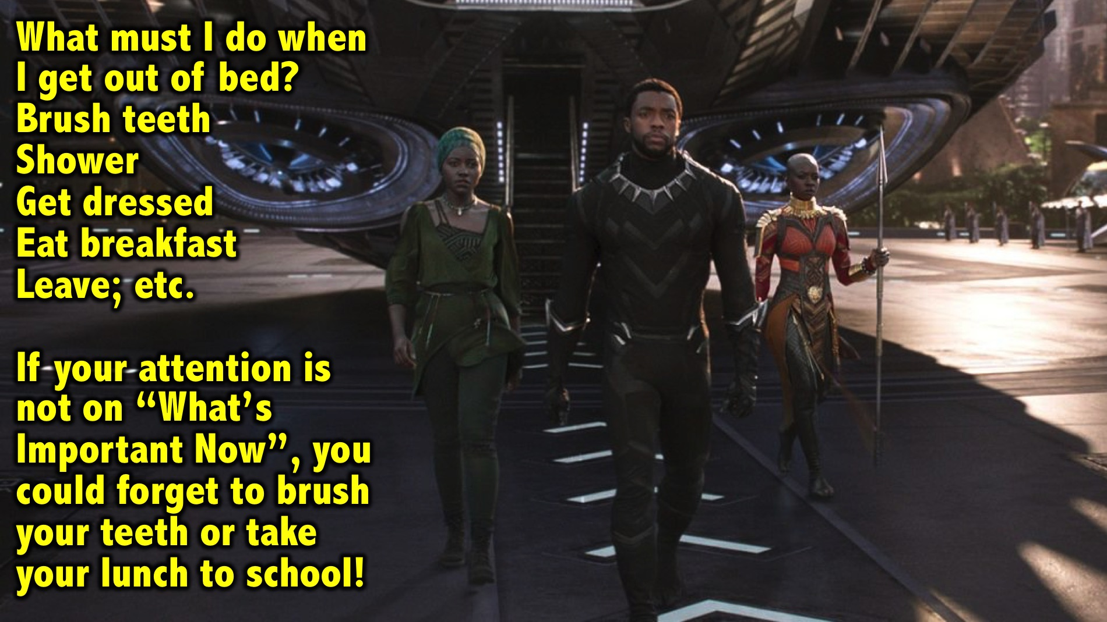
Notes:
Illustration: What must I do when I get out of bed in the morning? Brush teeth; Shower; Get dressed; Eat breakfast; Leave; etc. If your attention is not on “What’s Important Now”, you could forget to brush your teeth or take your lunch to school!

Slide 23

Notes:
Skills for Paying Attention. There are 3 things you can do to help you improve you attention:

Slide 24
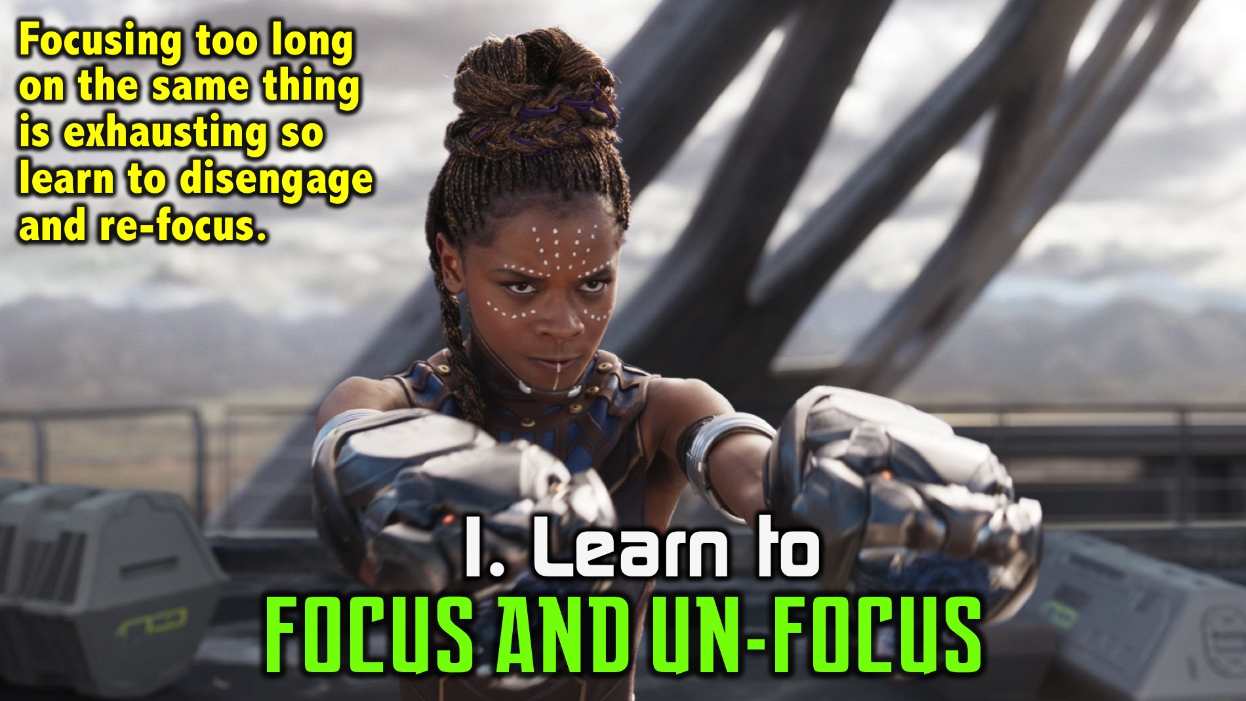
Notes:
1. Learn to Focus and Un-focus: Focusing too long on the same thing can be exhausting so it is helpful to disengage at the right time and then re-focus again.

Slide 25
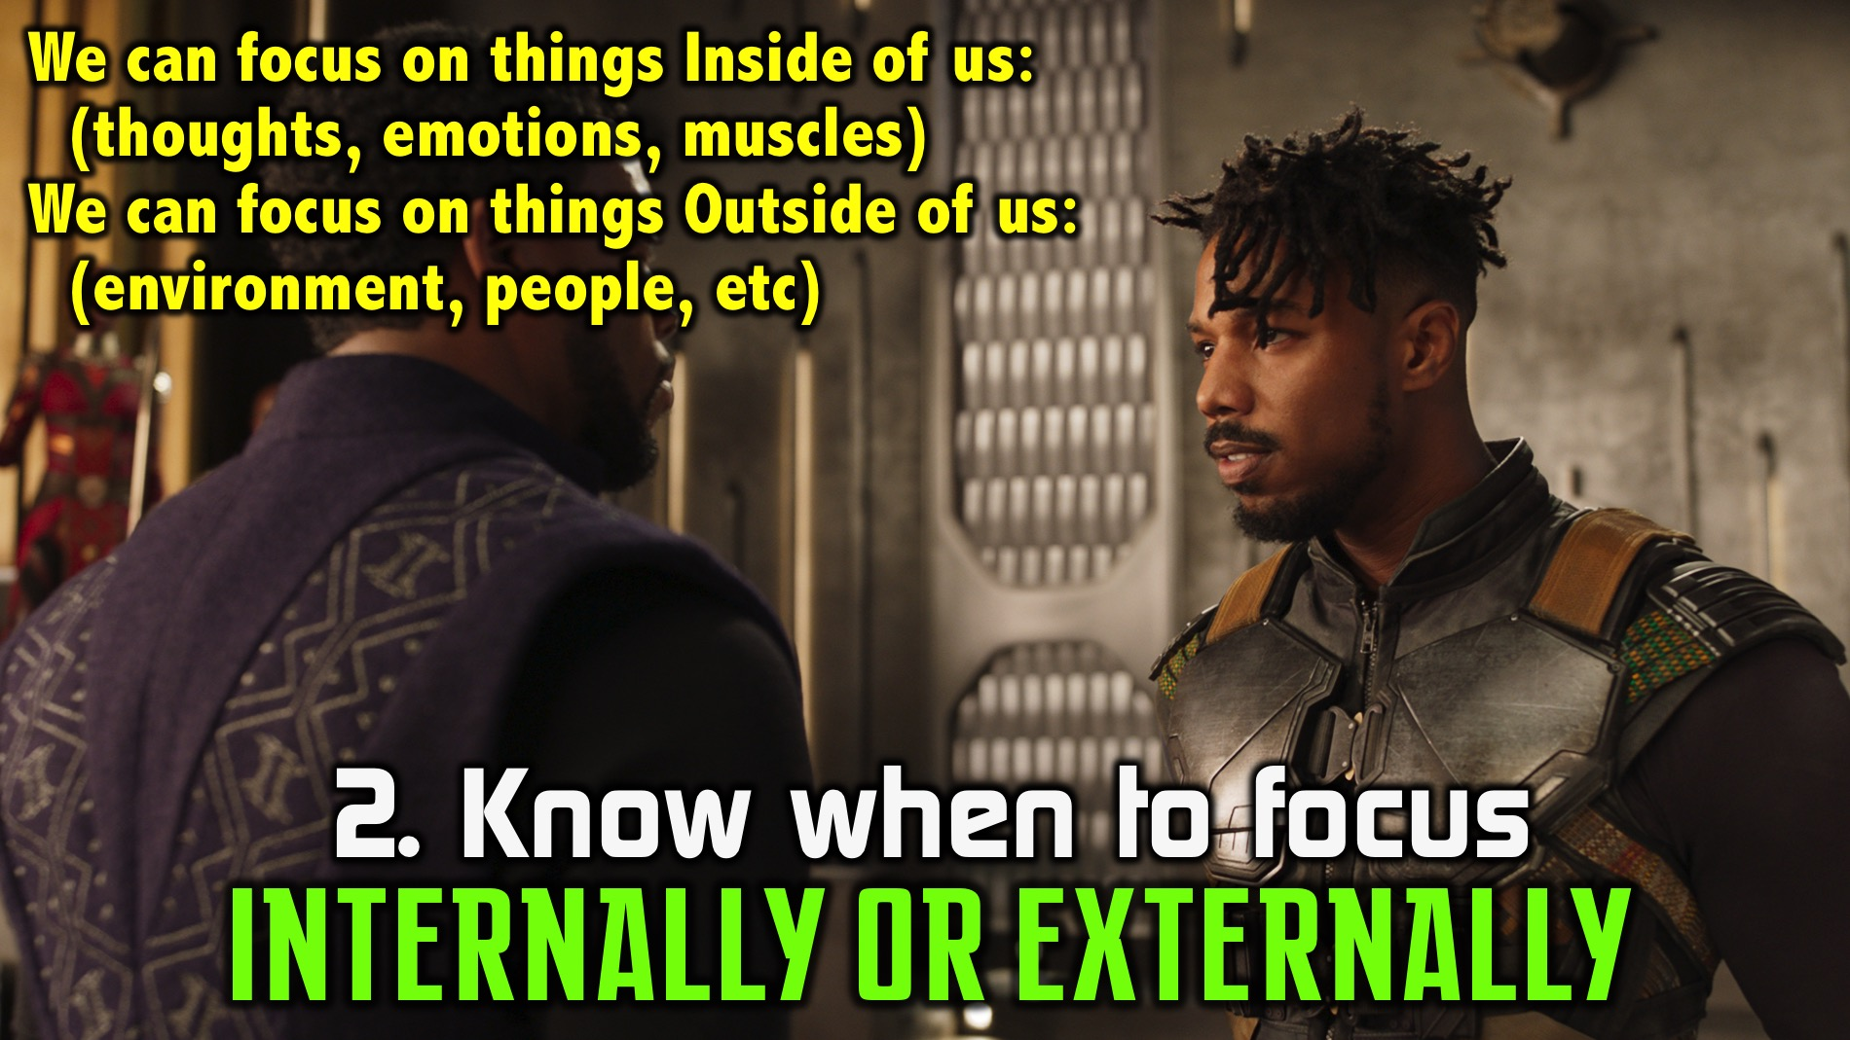
Notes:
2. Know when to focus internally or externally: Attention can be Internal or External: Our attention can be placed either internally or externally. We can focus on things inside of us, our thoughts, emotions, muscles, fatigue or externally: anything outside of our bodies, other people, etc.

Slide 26
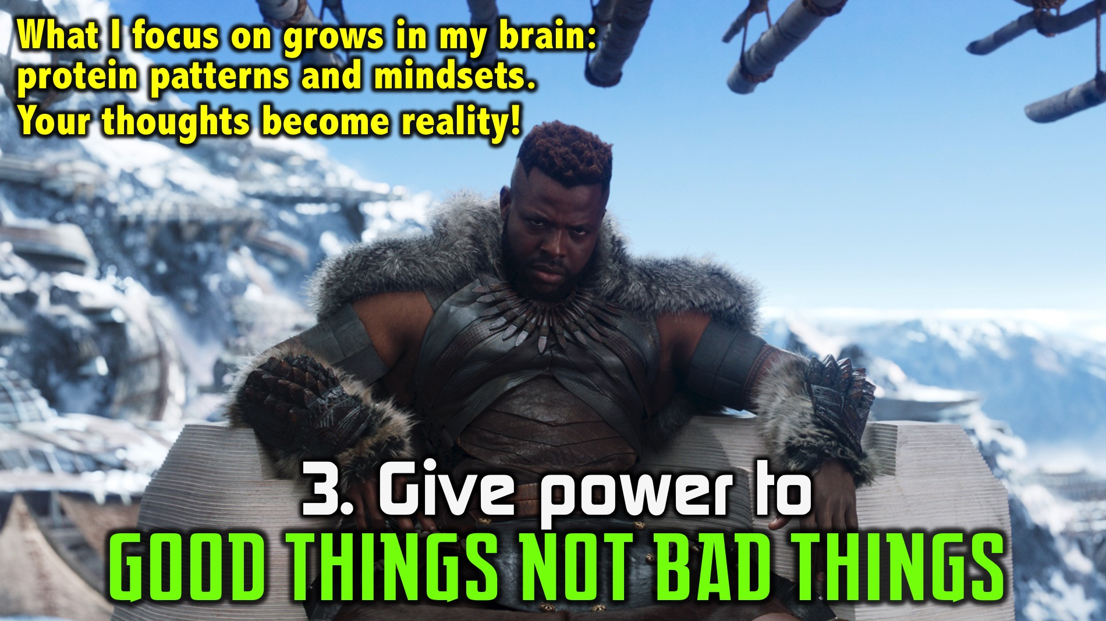
Notes:
3. Give power to good things not bad things: You give power to what you focus on! What I focus on will actually grow in my brain – protein patterns and mindsets. This can be good or bad. Every thought matters because it grows in our brain. When you think it is hot outside, that will impact on how you feel. If you say you are tired and your legs are tired you will get tired, but if you think differently you will feel differently.

Slide 27
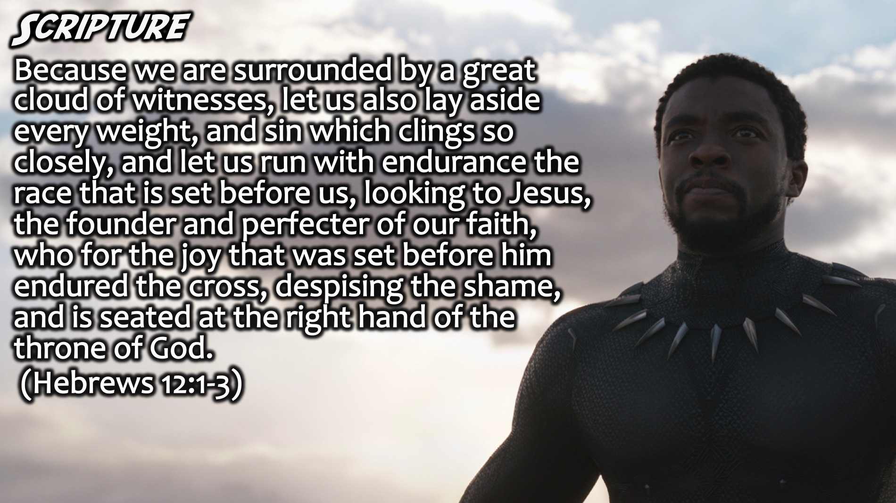
Notes:
Scripture: Here is a passage that tells us where to place our focus: “Therefore, since we are surrounded by so great a cloud of witnesses, let us also lay aside every weight, and sin which clings so closely, and let us run with endurance the race that is set before us, looking to Jesus, the founder and perfecter of our faith, who for the joy that was set before him endured the cross, despising the shame, and is seated at the right hand of the throne of God.” (Hebrews 12:1-3)

Slide 28
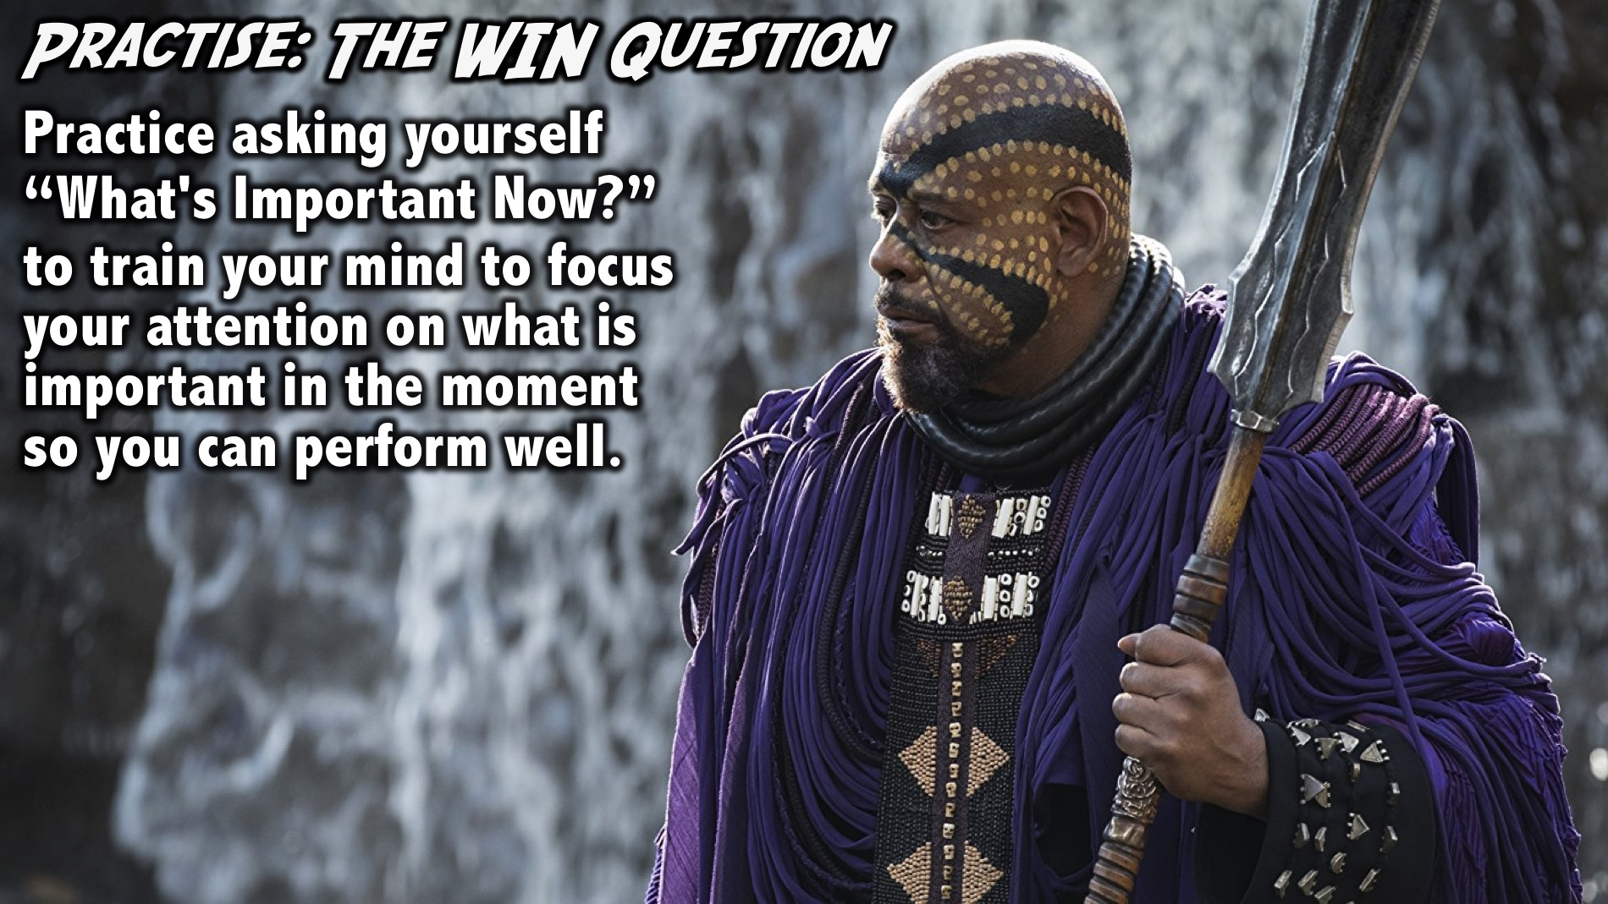
Notes:
Practice: The WIN Question. Practice asking yourself ”What's Important Now?" throughout the day to train your mind to focus your attention on what is important in the moment so you can perform well.

Slide 29
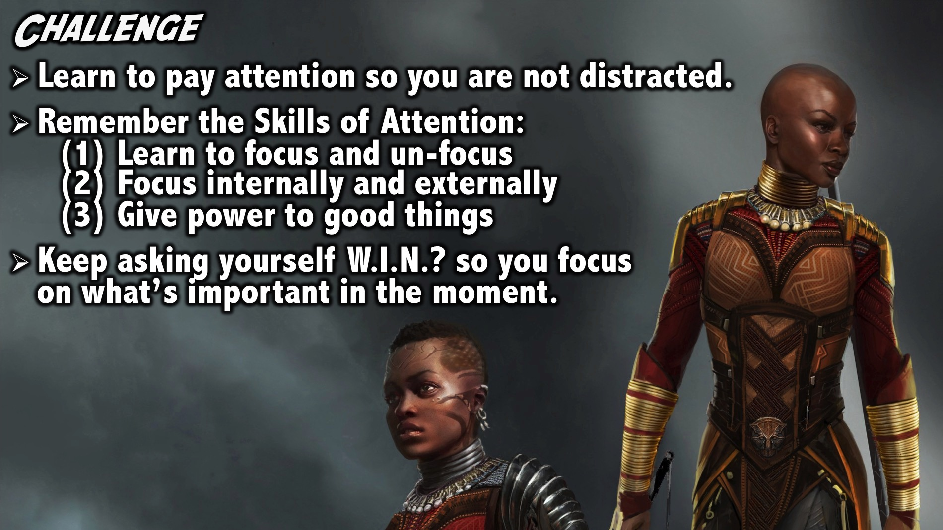
Notes:
Challenge: (1) Learn to pay attention so you are not distracted. (2) Remember the Skills of Attention: Learn to focus and un-focus; Focus internally and externally; and Give power to good things. (3) Keep asking yourself What’s Important Now? so you focus on what’s important in the moment.

Slide 30
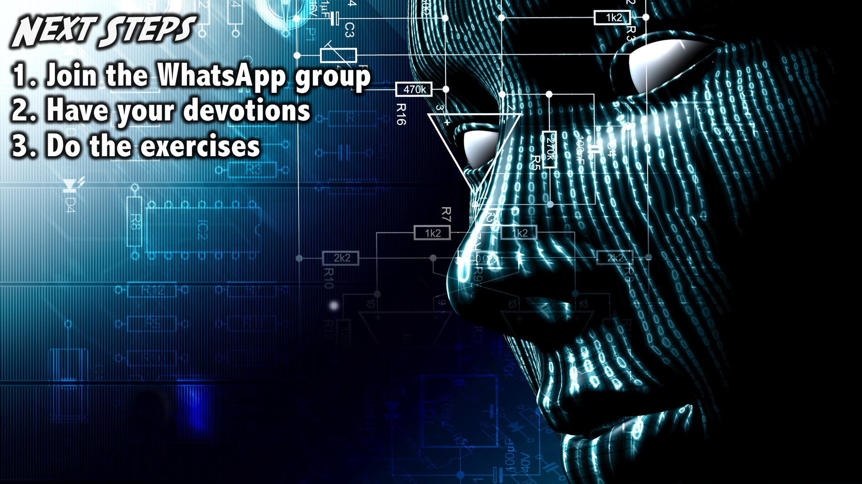
Notes:
Next Steps: (1) Join the WhatsApp group. (2) Have your devotions. (3) Do the exercises.
Facilitators Notes: Before your group leaves your table after the prayer - make sure they have all signed up for the WhatsApp group and challenge them one more time to do their devotions and the WIN exercise during the week.

Slide 31

Notes:
Prayer

Slide 32

Notes:
Next Week: Next week we will stay in the Sanctuary because many of us will be away at Lead The Cause and the following Sunday we will explore the sixth building block: Emotions.

Slide 33

Notes:
2 Weeks Time: In two weeks time we will explore the sixth building block: Emotions.

