Slide 1

Notes:
Welcome to the Renew Series. The content for this series has been taken from an amazing Podcast by Dr. Amber Selking entitled “Building Championship Mindsets”. Checkout her website at: http://selkingperformance.com.

Slide 2
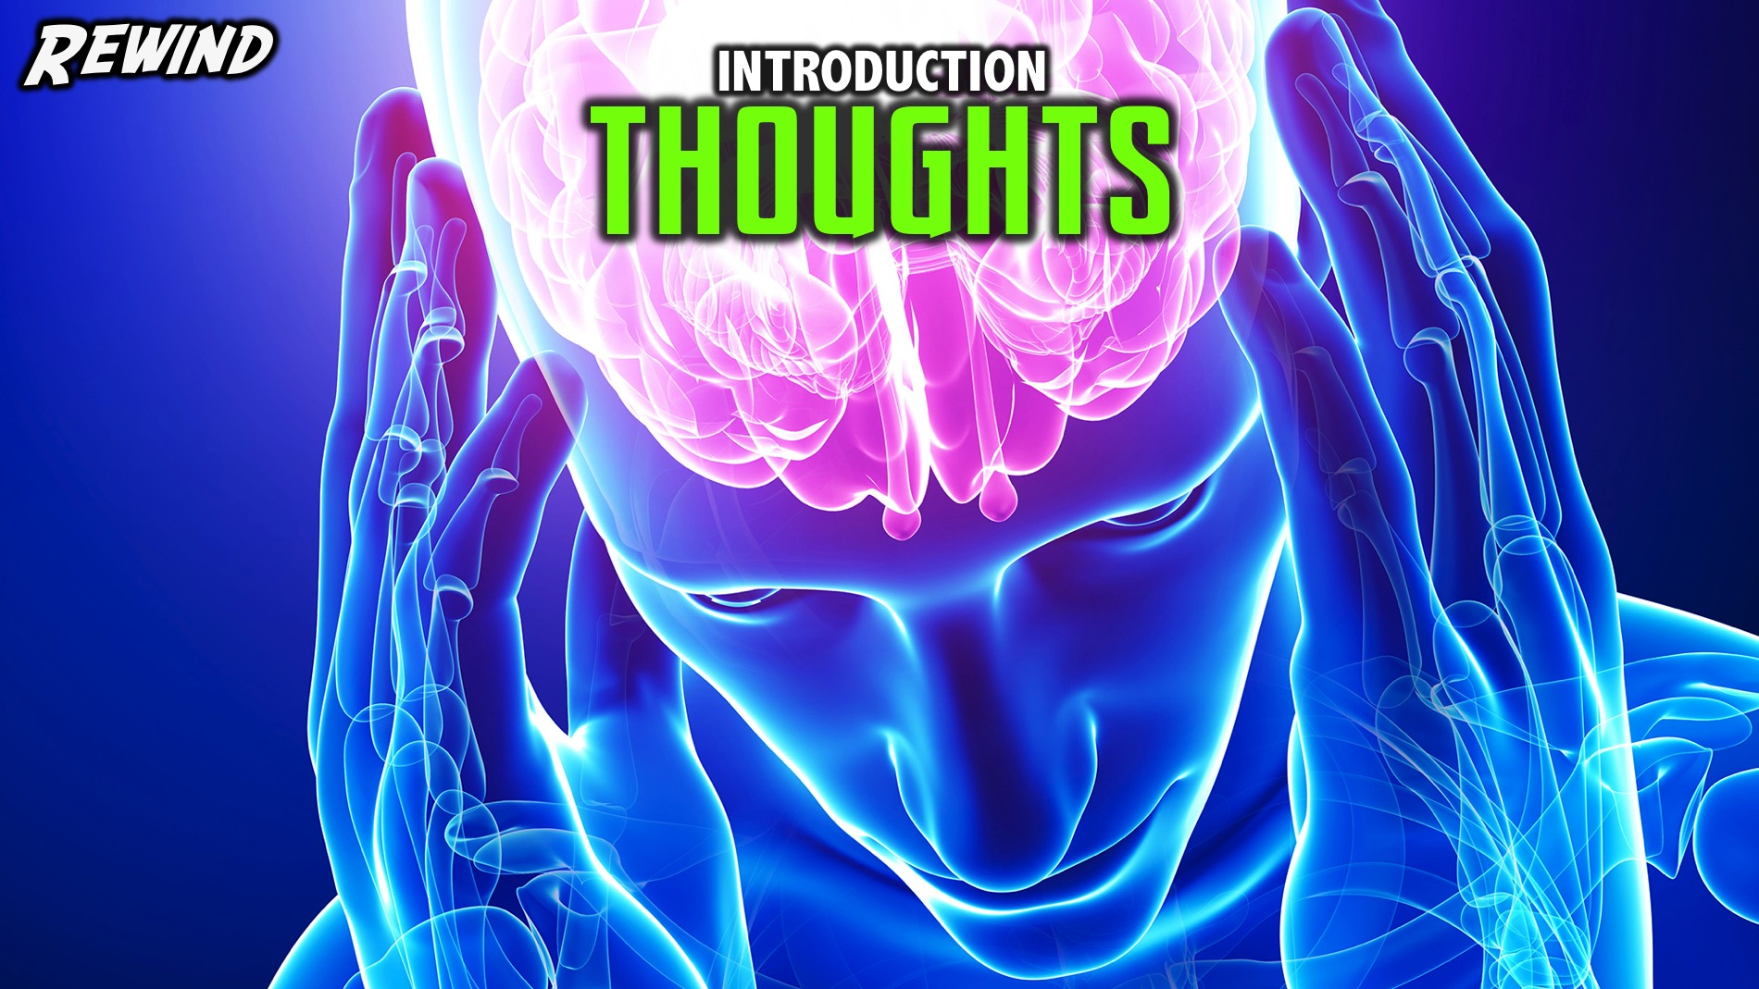
Notes:
Rewind: We began the Renew series learning about how our thoughts matter and how our thoughts build mindsets!

Slide 3
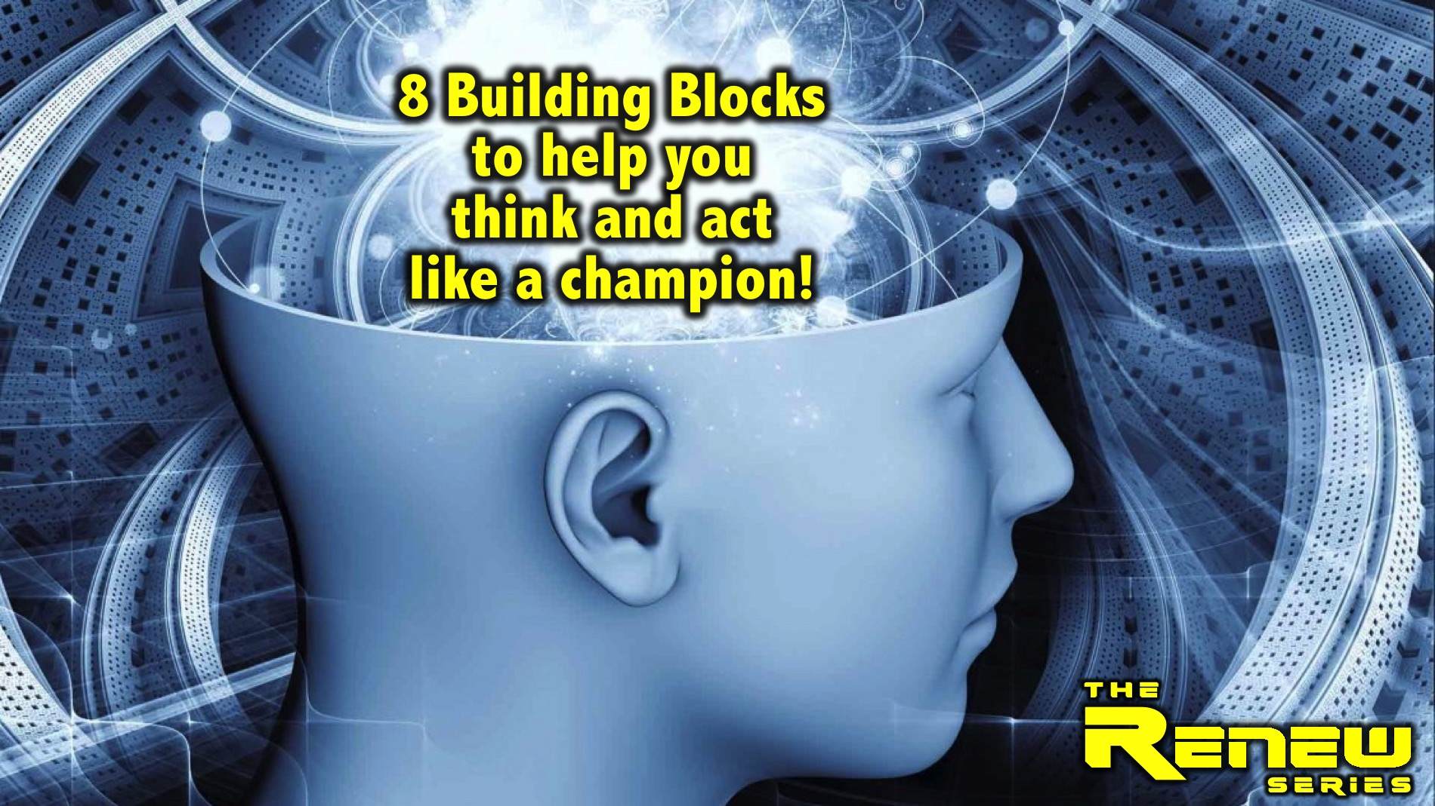
Notes:
In this series we are exploring 8 Building Blocks to help you think and act like a champion.

Slide 4
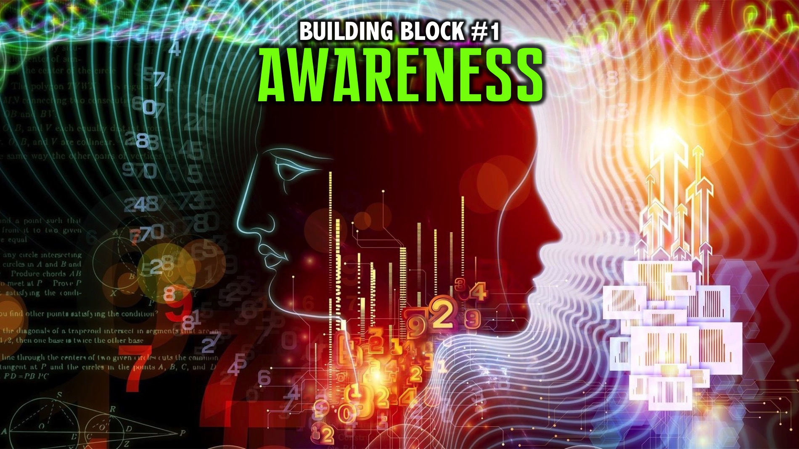
Notes:
We explored the first building block: Awareness.

Slide 5
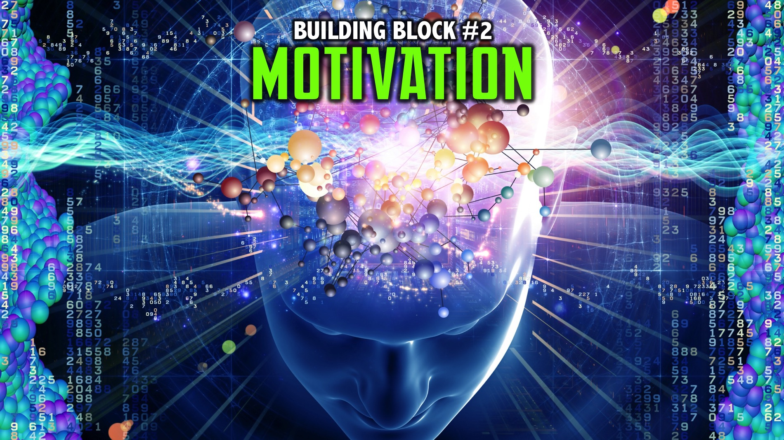
Notes:
We explored the second building block: Motivation.

Slide 6
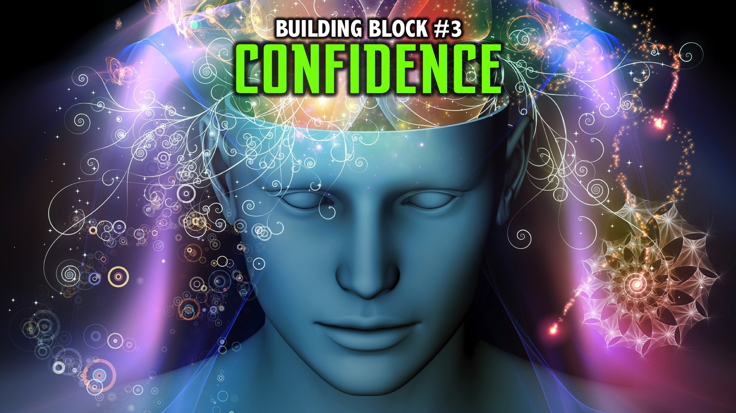
Notes:
We explored the third building block: Confidence.

Slide 7
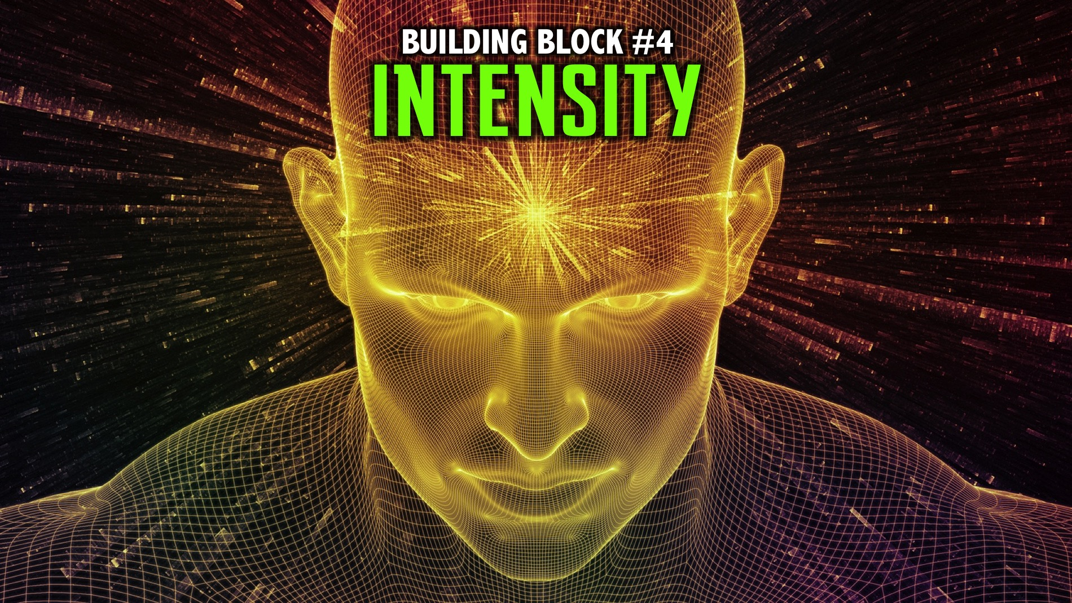
Notes:
We explored the fourth building block: Intensity.

Slide 8
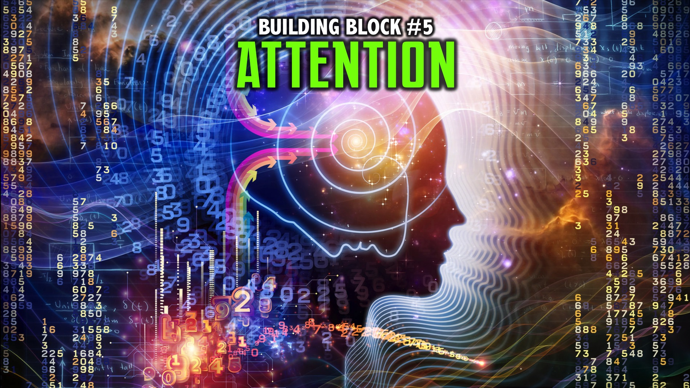
Notes:
We explored the fifth building block: Attention.

Slide 9
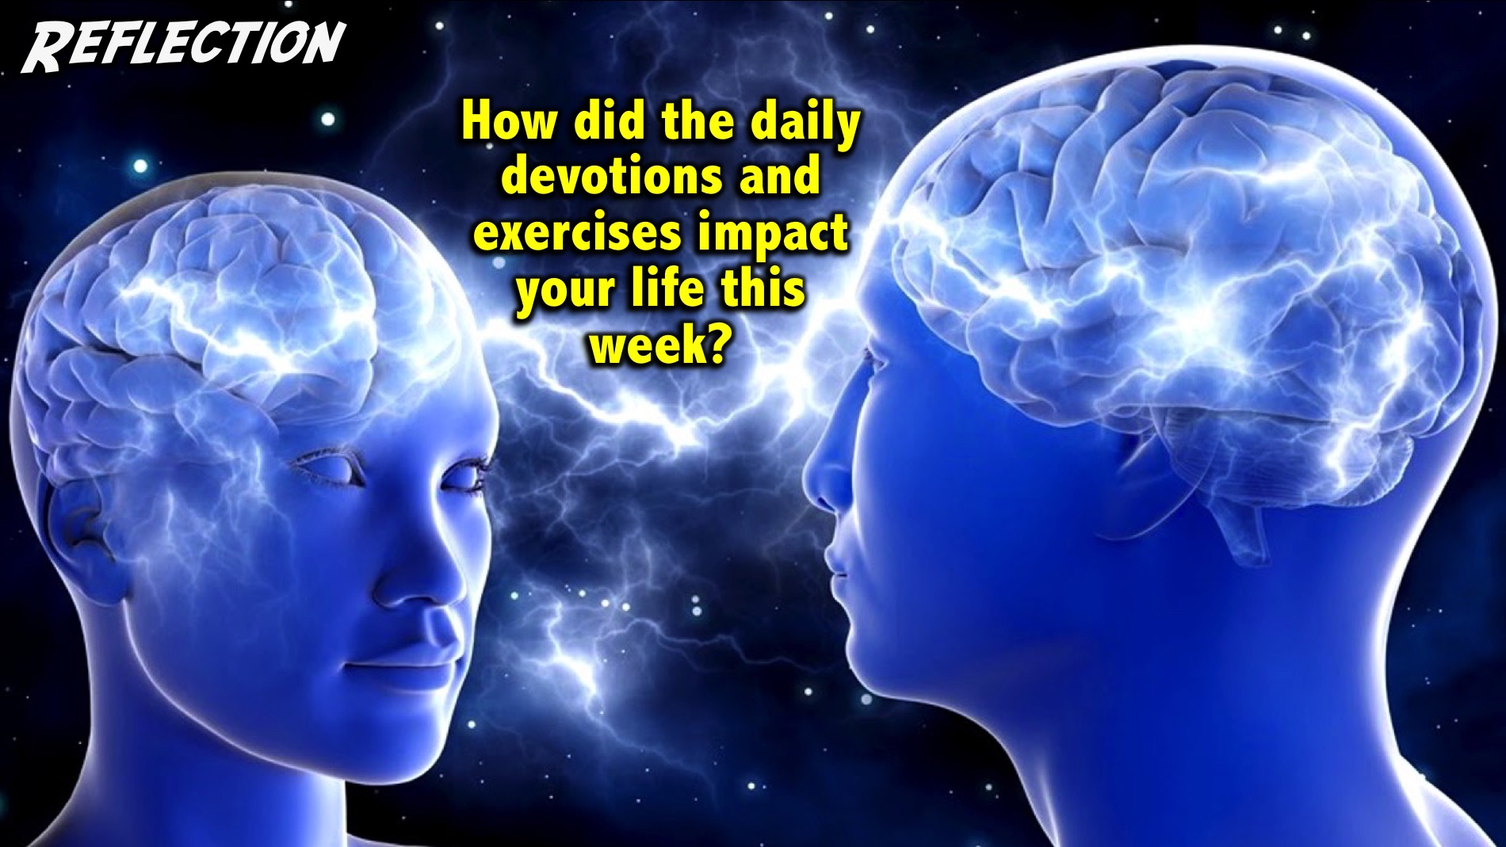
Notes:
Reflection: How did the daily devotions and exercises impact your life this week?
Facilitator Notes: Use follow up questions if necessary to get people at your table reflecting on the past week. Examples: Did you get the devotions on your phone? Do you need to take a printed copy today? How many days were you able to do your devotions? Did wearing the elastic band help you think positive thoughts? Were you able to do the 3-2-1 exercise? How did it help you think positively and creatively about your day and your life?

Slide 10
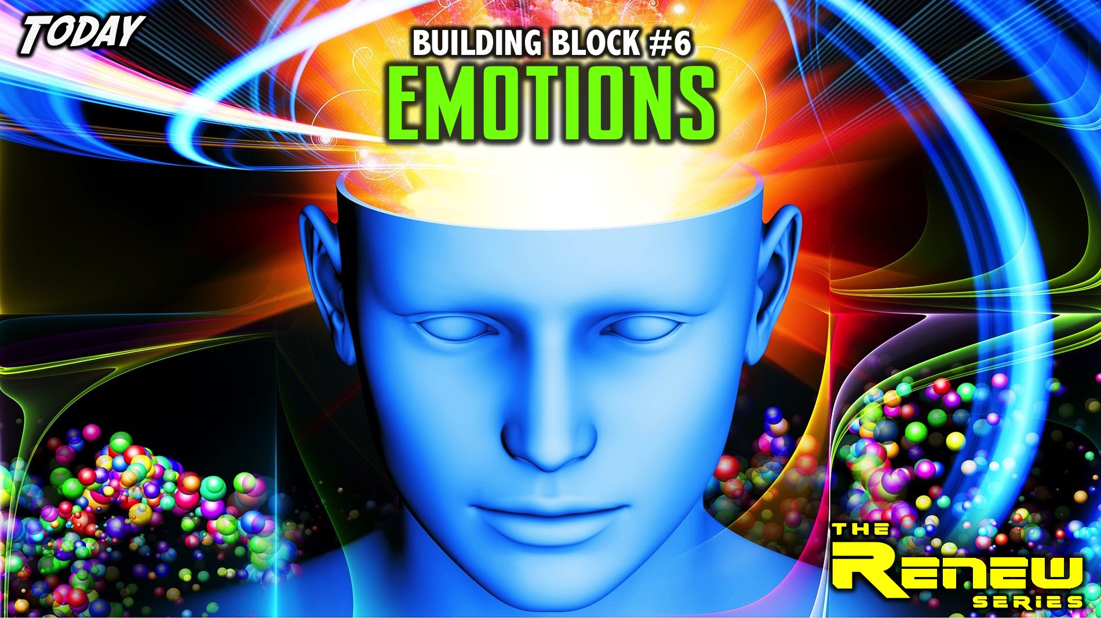
Notes:
Today we are going to explore the sixth building block: Emotions.

Slide 11

Notes:
There is a great animated Disney movie that you may have seen called Inside Out and it uses different characters to represent the emotions that we have: Anger, Joy, Despair, Sadness and Disgust.

Slide 12
Notes:
Video: Inside Out Trailer #2 (2015). Get it on YouTube at: https://www.youtube.com/watch?v=seMwpP0yeu4

Slide 13
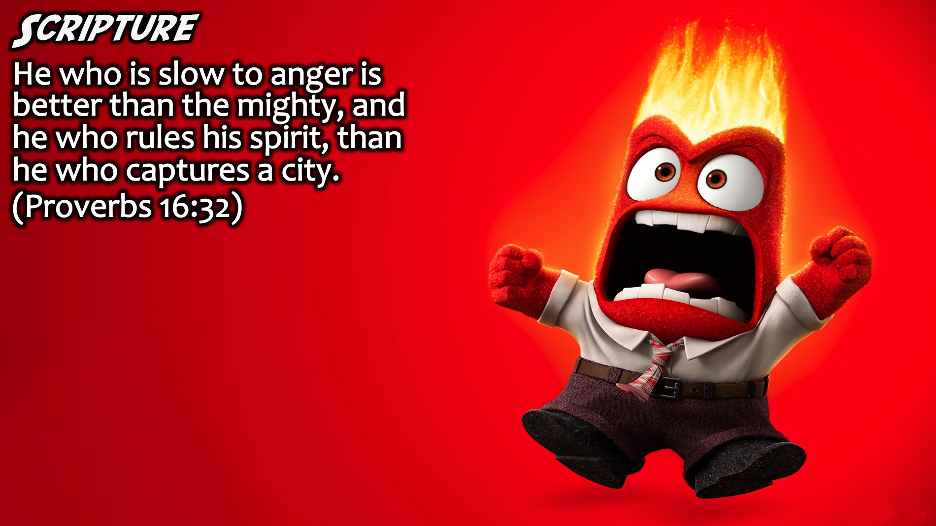
Notes:
Scripture: “He who is slow to anger is better than the mighty, and he who rules his spirit, than he who captures a city.” (Proverbs 16:32)

Slide 14
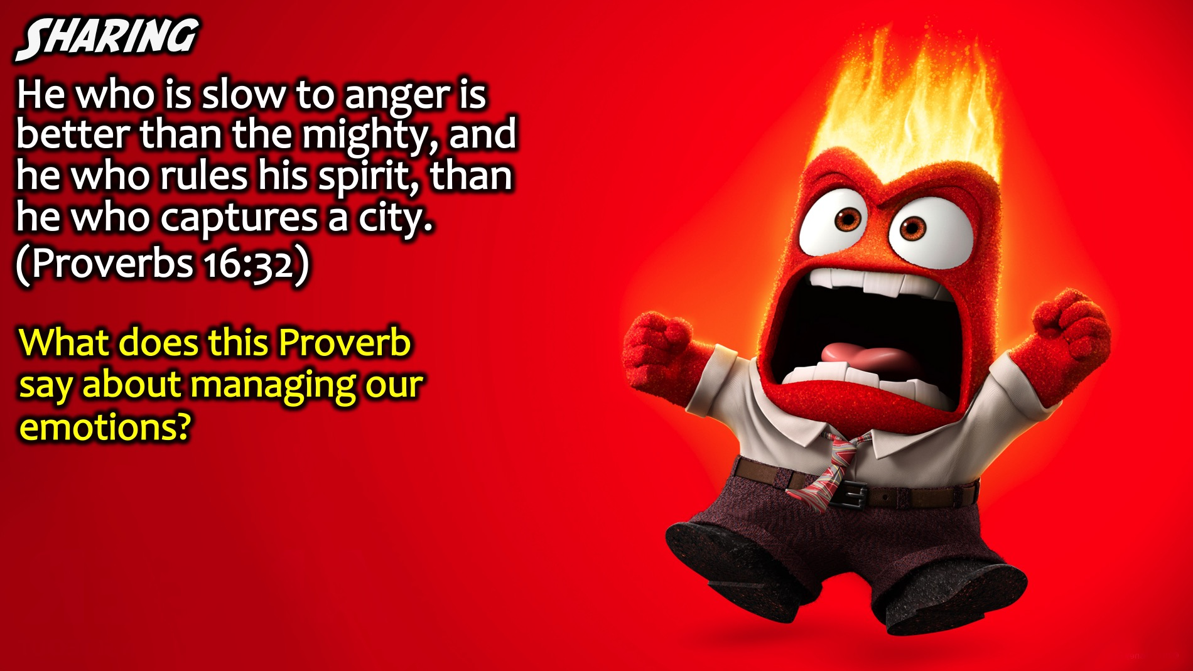
Notes:
Sharing: What does this Proverb say about managing our emotions?
Facilitators Notes: Don’t let teens just say the obvious – or repeat the words in the verse – ask them to go deeper by asking Why more than once, or ask them to think of something that has not been shared yet.

Slide 15
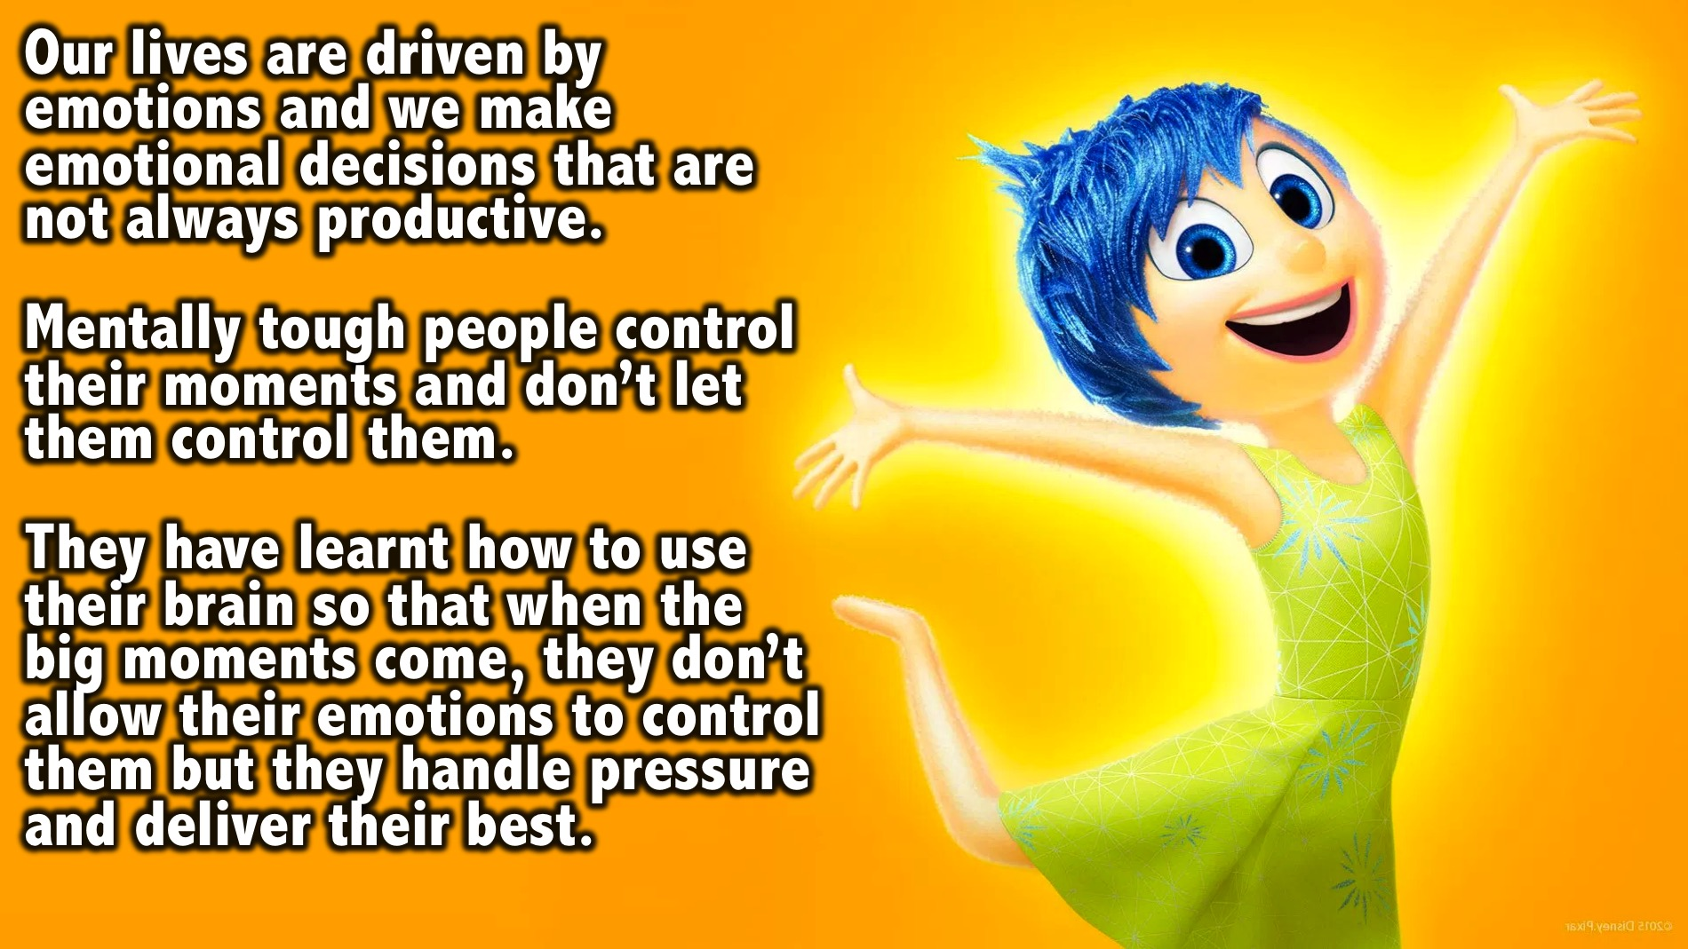
Notes:
Our lives are driven by emotions and we often make emotional decisions which are not always productive. Mentally tough people are masters of their emotions. They control their moments and don’t let them control them. They have learnt how to use their brain so that when the big moments come, they don’t allow their emotions to control them but they handle pressure and deliver their best.

Slide 16
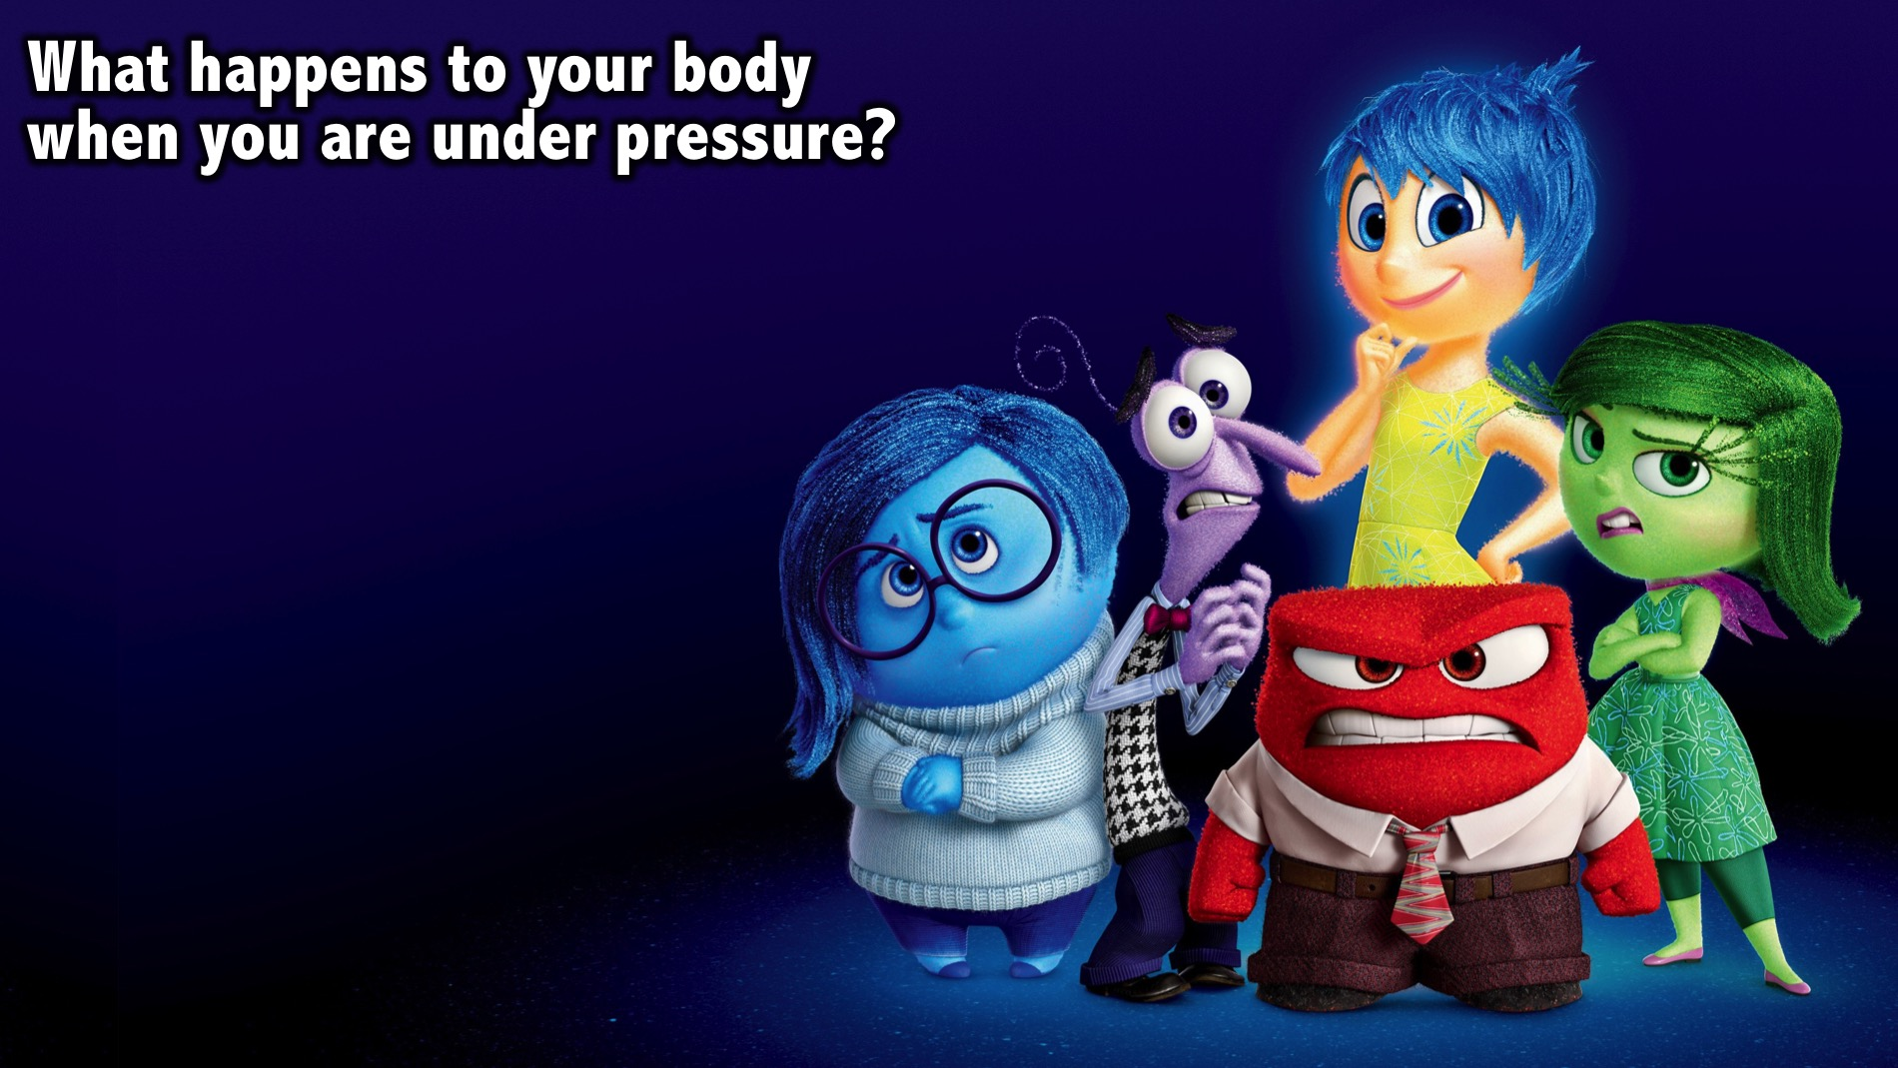
Notes:
What happens to your body when you are under pressure?

Slide 17
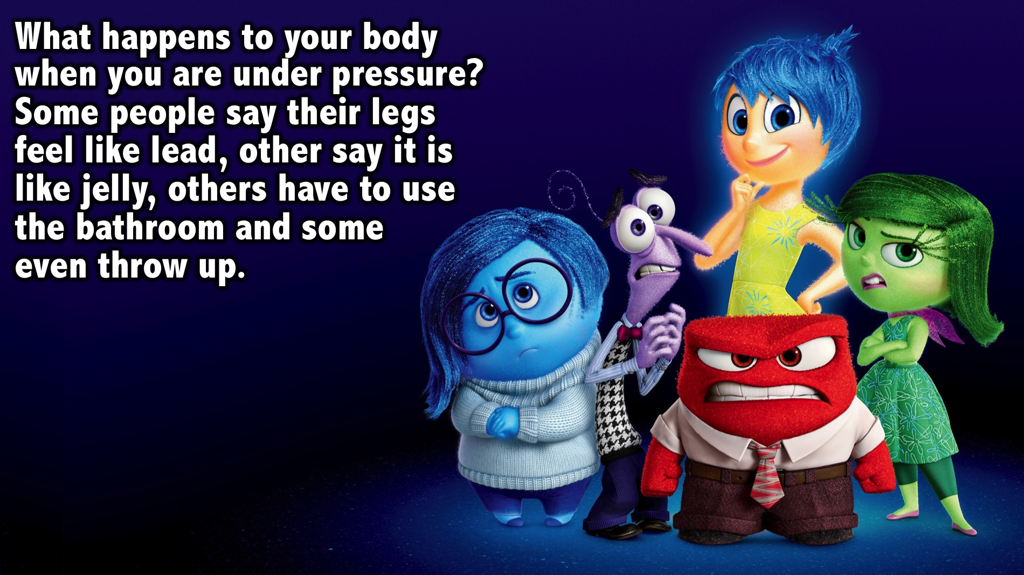
Notes:
Some people say their legs feel like lead, other say it is like jelly, others have to use the bathroom or some even throw up.

Slide 18
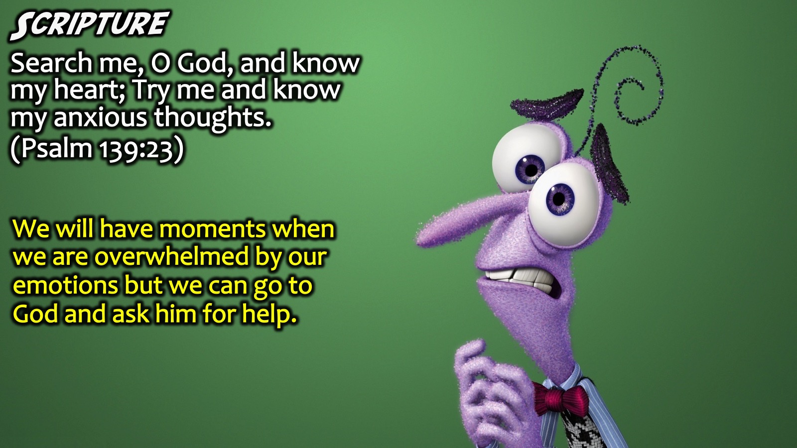
Notes:
Scripture: “Search me, O God, and know my heart; Try me and know my anxious thoughts.” (Psalm 139:23). David reminds us that we will have moments when will are overwhelmed by our emotions but we can go to God and ask him for help!

Slide 19
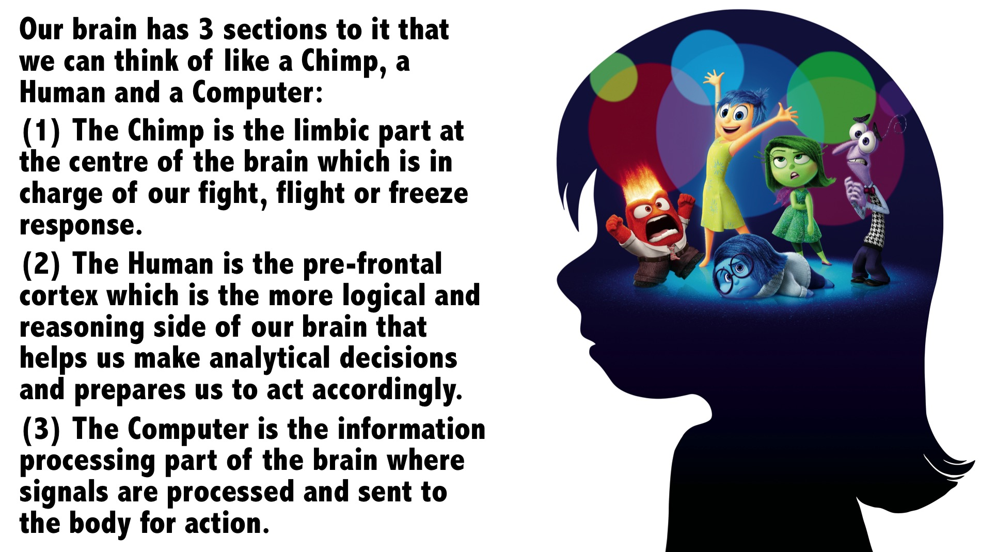
Notes:
Illustration: Our brain is like a Chimp, a Human and a Computer:
(1) The Chimp is the limbic part at the centre of the brain which is charge of our fight, flight or freeze response. A quick response that prepares us to act in situations.
(2) The Human is the pre-frontal cortex which is the more logical and reasoning side of our brain that helps us make analytical decisions and prepares us to act accordingly.
(3) The Computer is the information processing part of the brain where signals are processed and sent to the body for action.

Slide 20
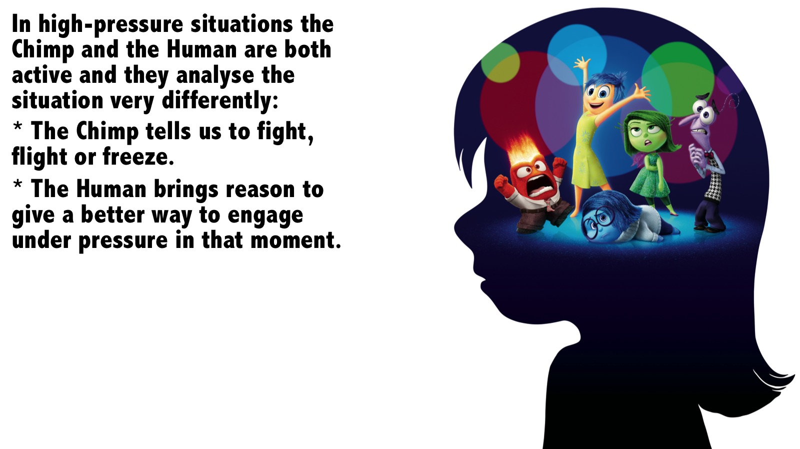
Notes:
In high-pressure situations the Chimp and the Human are both active and they are both analysing the situation but very differently:
* The Chimp tells us to fight, flight or freeze
* The Human brings reason to give a better way to engage under pressure in that moment.

Slide 21
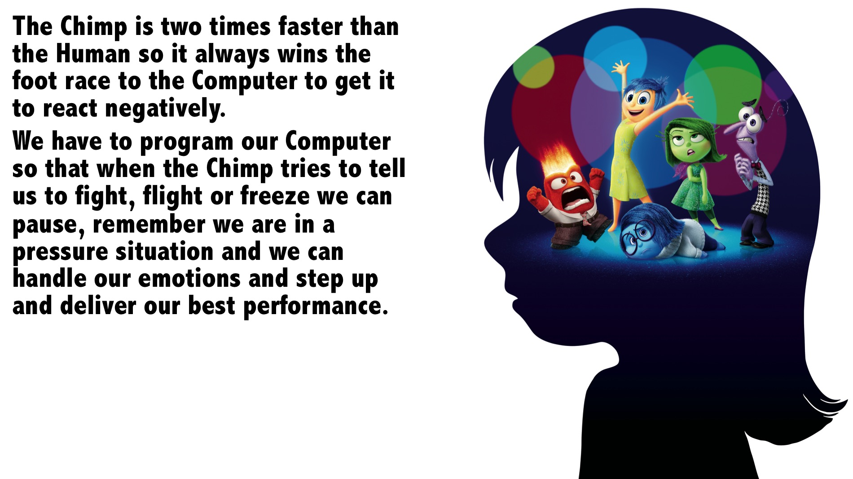
Notes:
The Chimp is two times faster than the Human so it always wins the foot race to the Computer to get it to react negatively. We have to program our Computer so that when the Chimp tries to tell us to fight, flight or freeze we can pause, remember we are in a pressure situation and we can handle our emotions and step up and deliver our best performance.

Slide 22
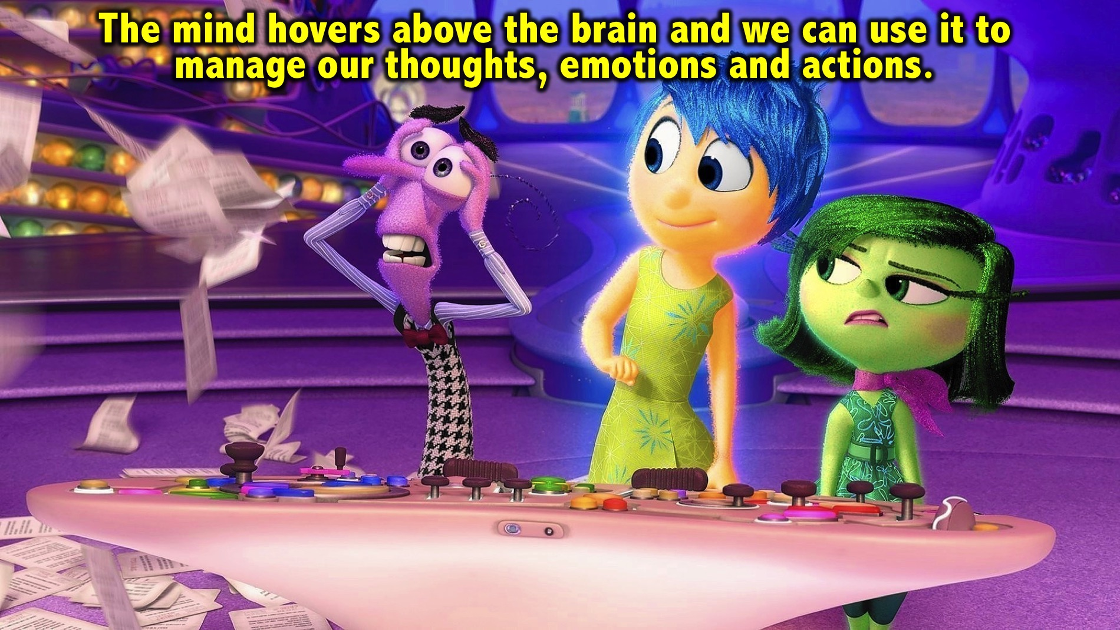
Notes:
The mind hovers above the brain and allows us to choose what thoughts we are going to have and entertain. If we allow our brain to get stressed out we will end up in a bad state, but if we use our mind to manage our emotions, it will affect our bodies response and that will dictate our performance.

Slide 23
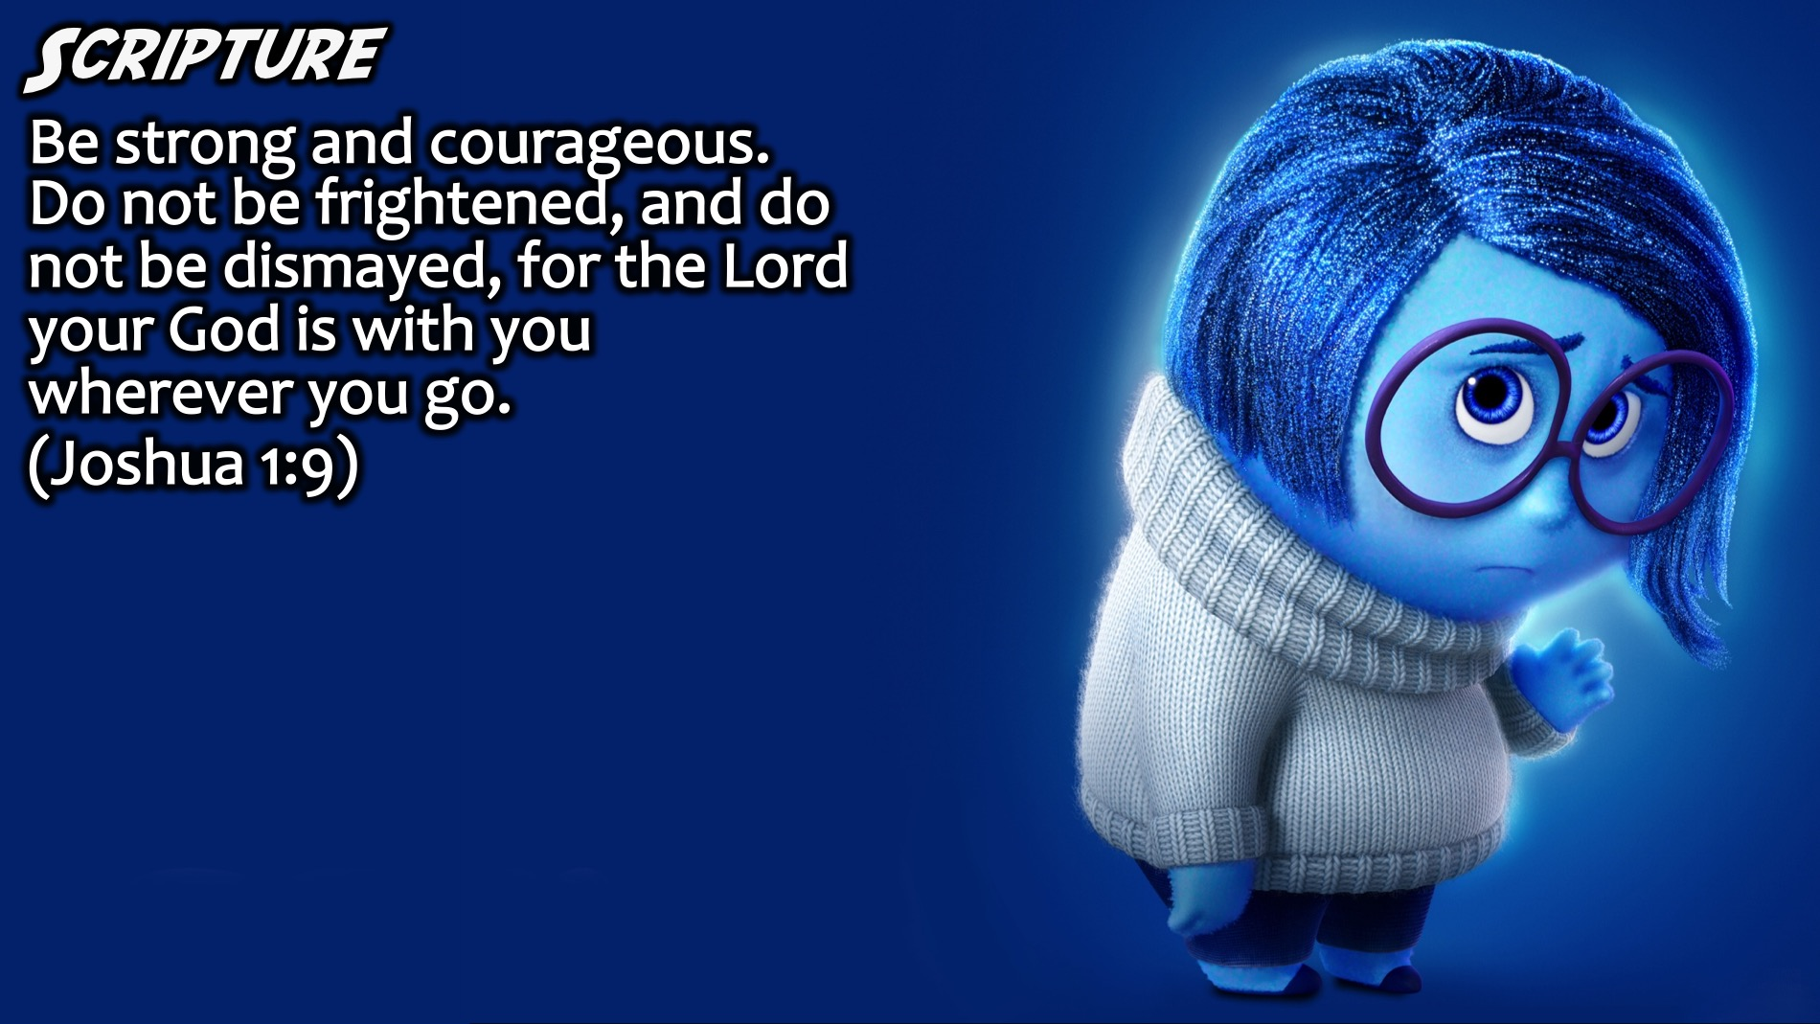
Notes:
Scripture: Be strong and courageous. Do not be frightened, and do not be dismayed, for the Lord your God is with you wherever you go. (Joshua 1:9)

Slide 24
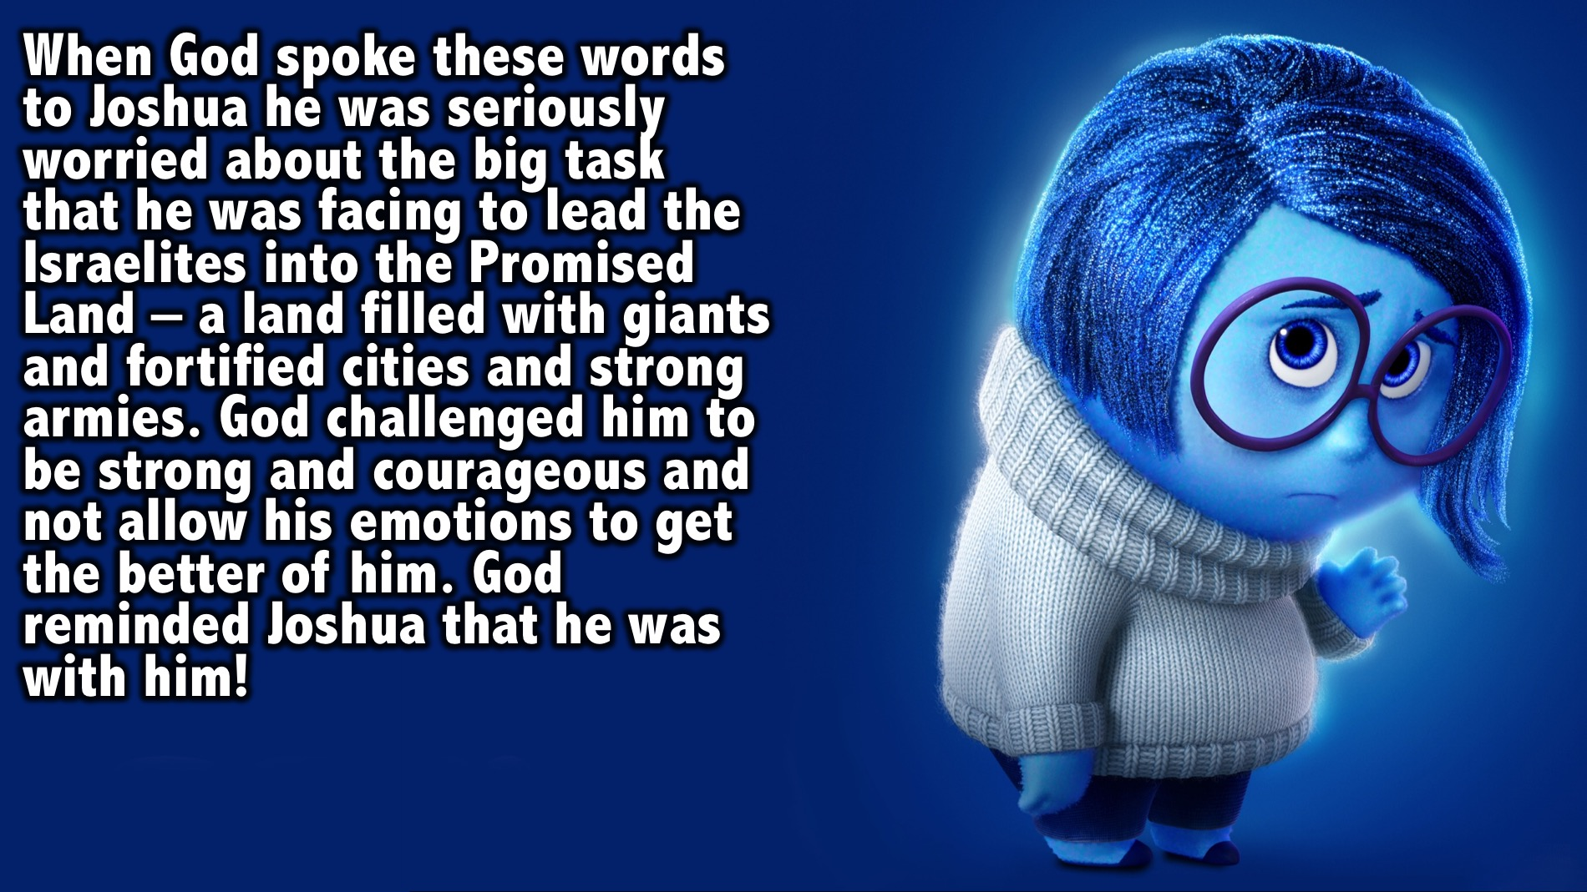
Notes:
When God spoke these words to Joshua he was seriously worried about the big task that he was facing to lead the Israelites into the Promised Land – a land filled with giants and fortified cities and strong armies. God challenged him to be strong and courageous and also to not allow his emotions to get the better of him. God reminded Joshua that he was with him!

Slide 25

Notes:
Have any of you played rugby or watched a game on TV?

Slide 26
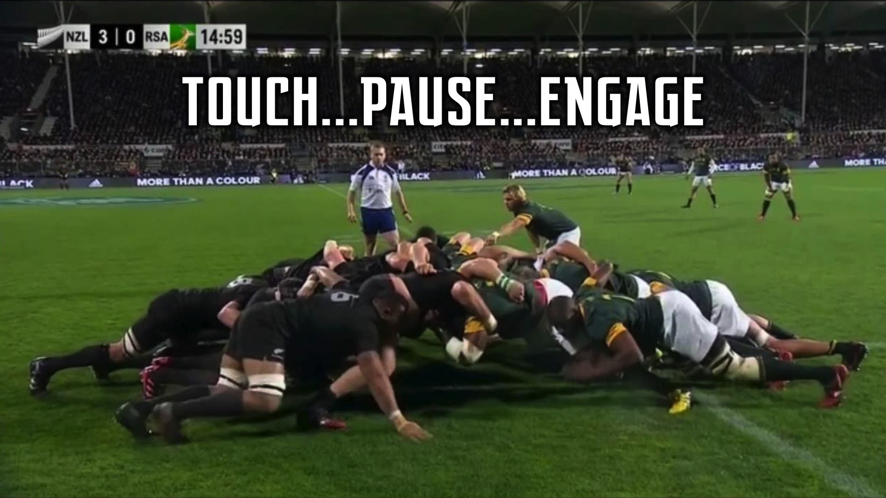
Notes:
In Rugby when a scrum is set the referee will say: Touch, Pause, Engage - so that the scrum sets properly and play can continue.

Slide 27
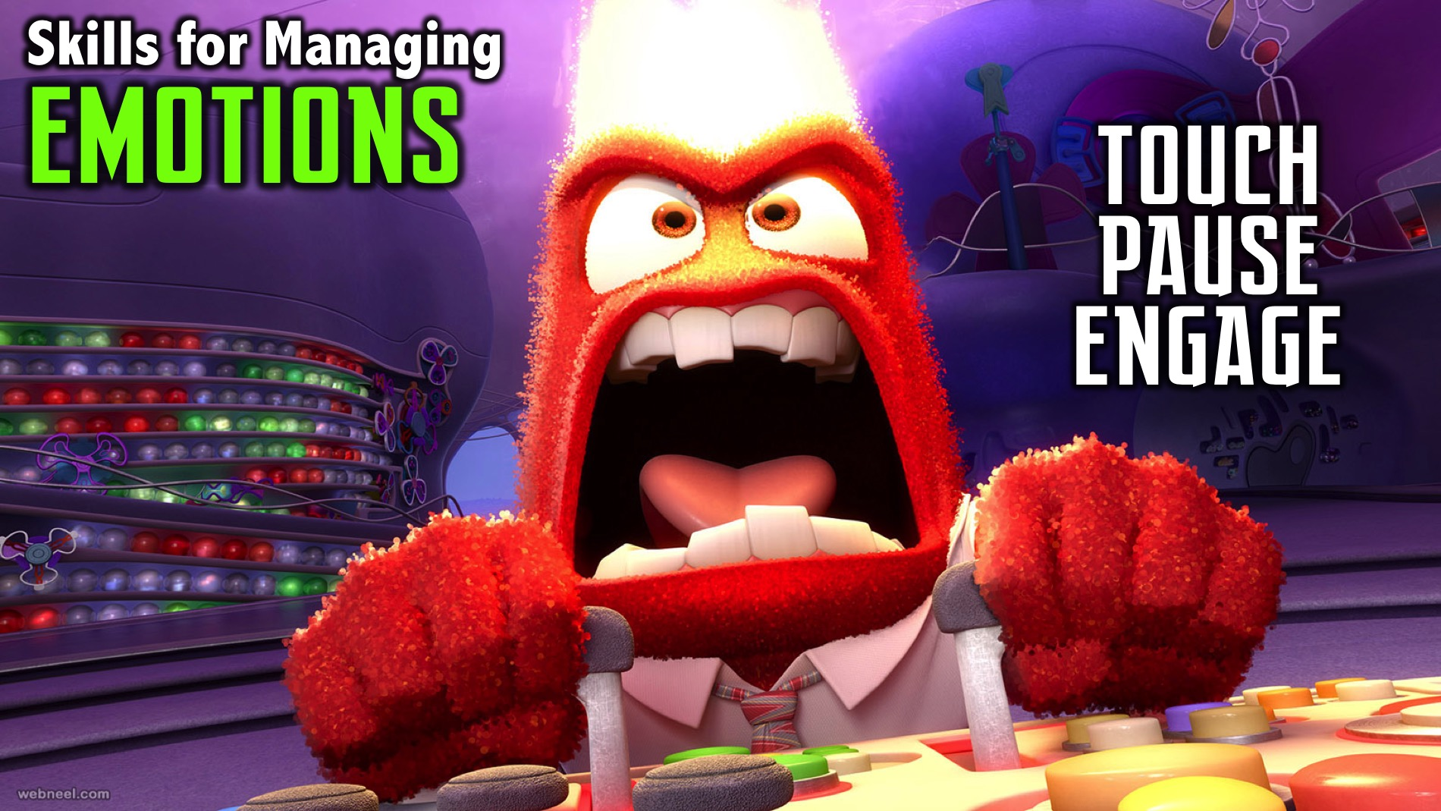
Notes:
Skills for Managing our Emotions: When you face a tough situation and your emotions are all over the place, you need to think Touch, Pause and Engage as skills for managing your emotions:

Slide 28
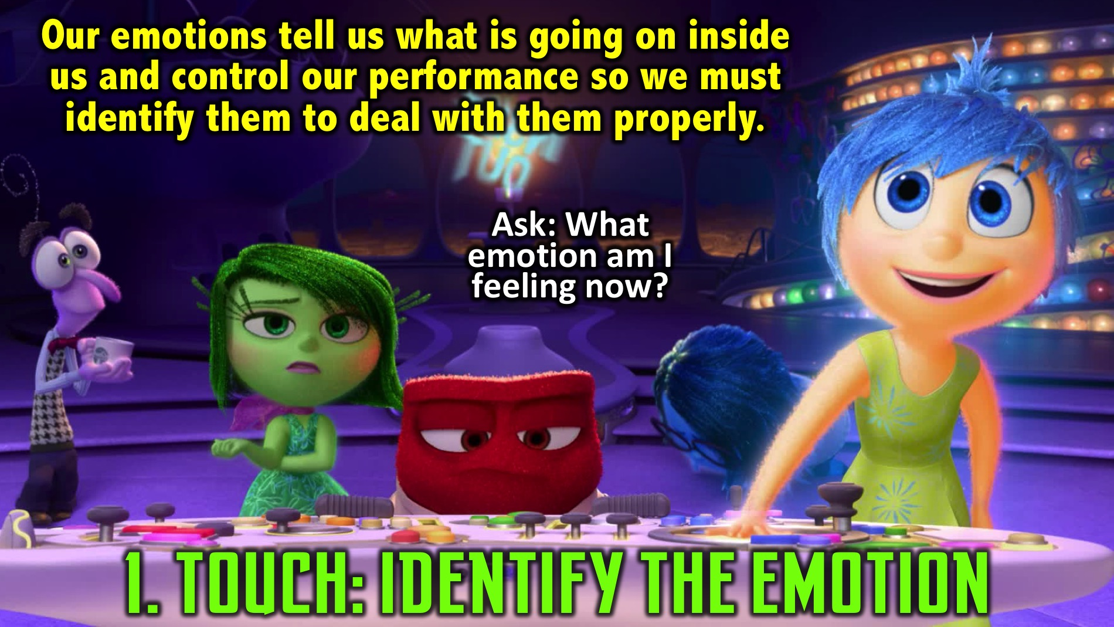
Notes:
(1) Touch: Identify The Emotion: Our emotions tell us what is going on inside us. They have power over our performance so it is essential that we identify them so we can deal with them properly. Ask yourself: What emotion am I feeling now? Remember in week 1 we said that everything starts with awareness!!!

Slide 29
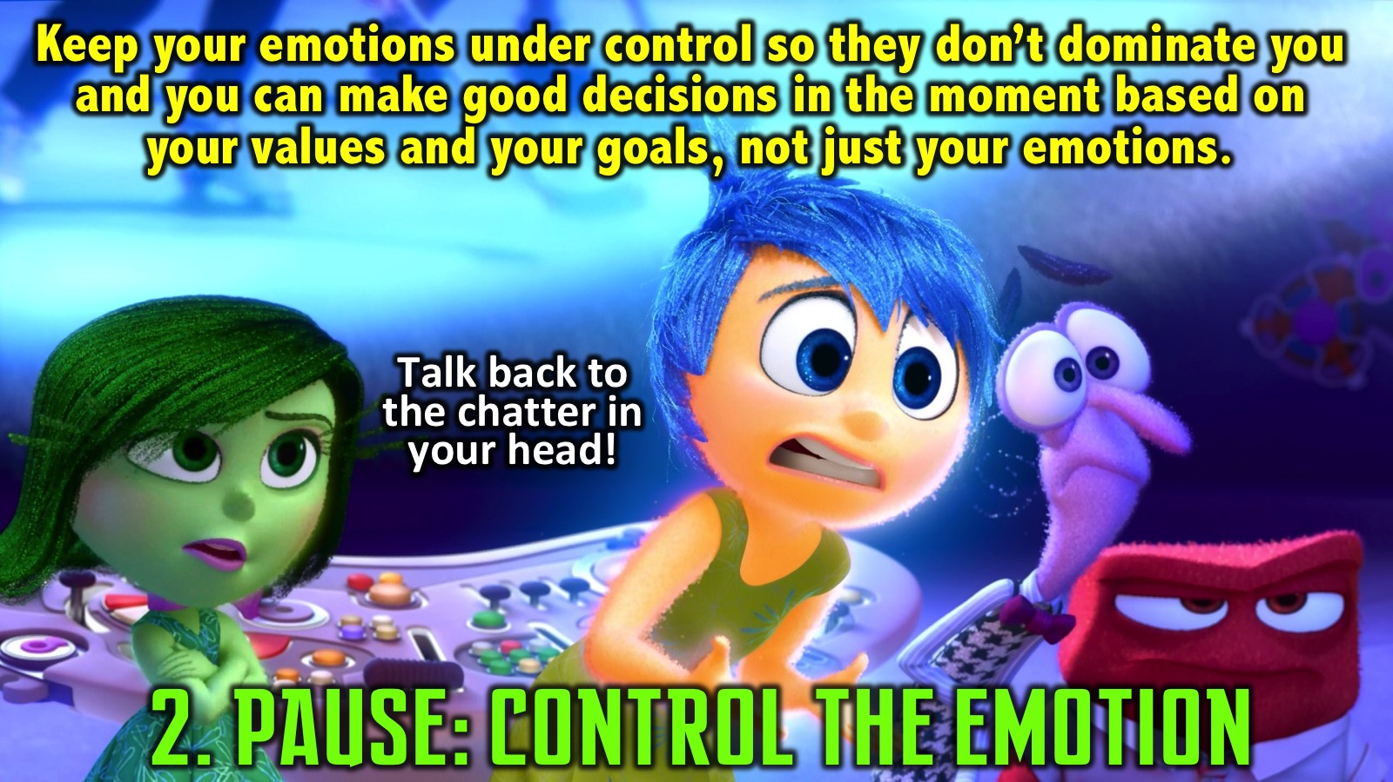
Notes:
(2) Pause: Control The Emotion: You cannot let your emotions dominate you. We need to keep them under control so we can make good decisions on a moment by moment basis. Our decision should be based on our values or our goals and not just our emotions. As we said in a previous session, instead of listening to the chatter in our head we need to talk back to it and bring a different perspective to the situation.

Slide 30
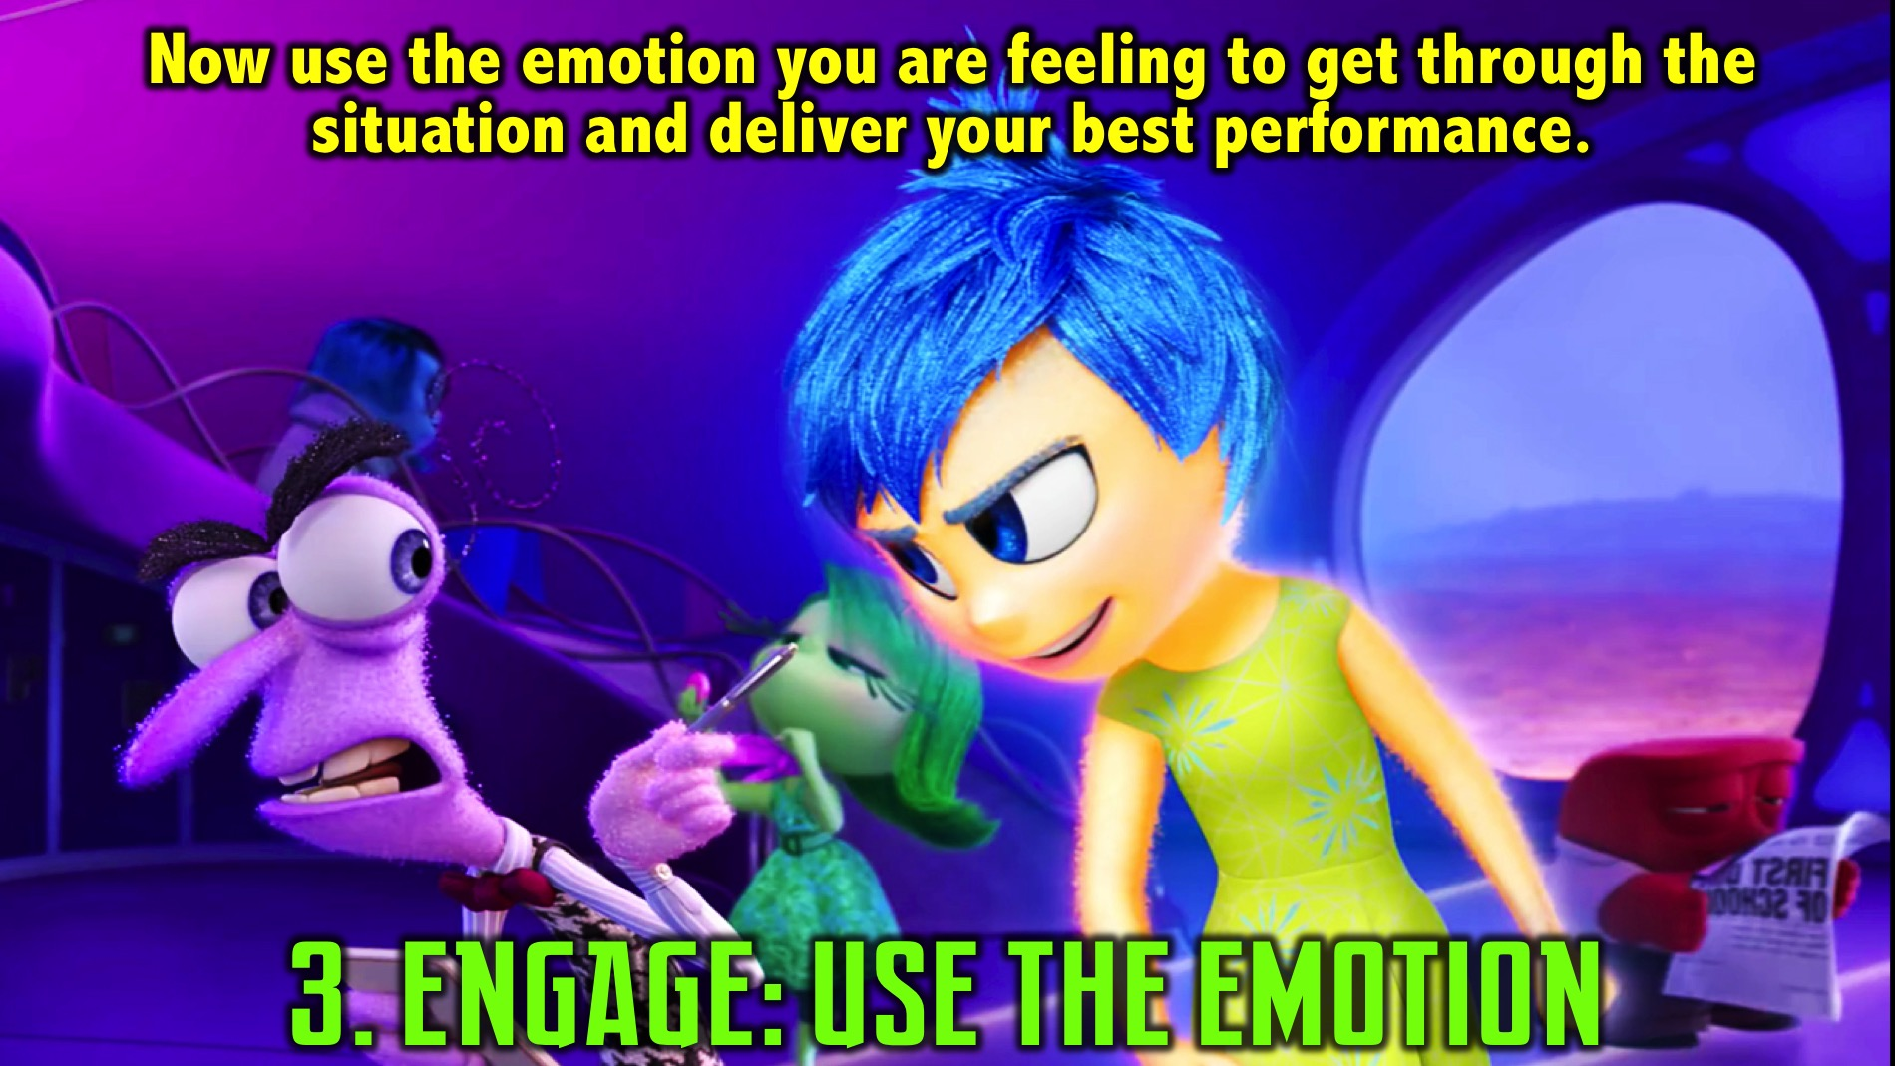
Notes:
(3) Engage: Use The Emotion: Now use the emotion you are feeling to get through the situation and deliver your best performance.

Slide 31
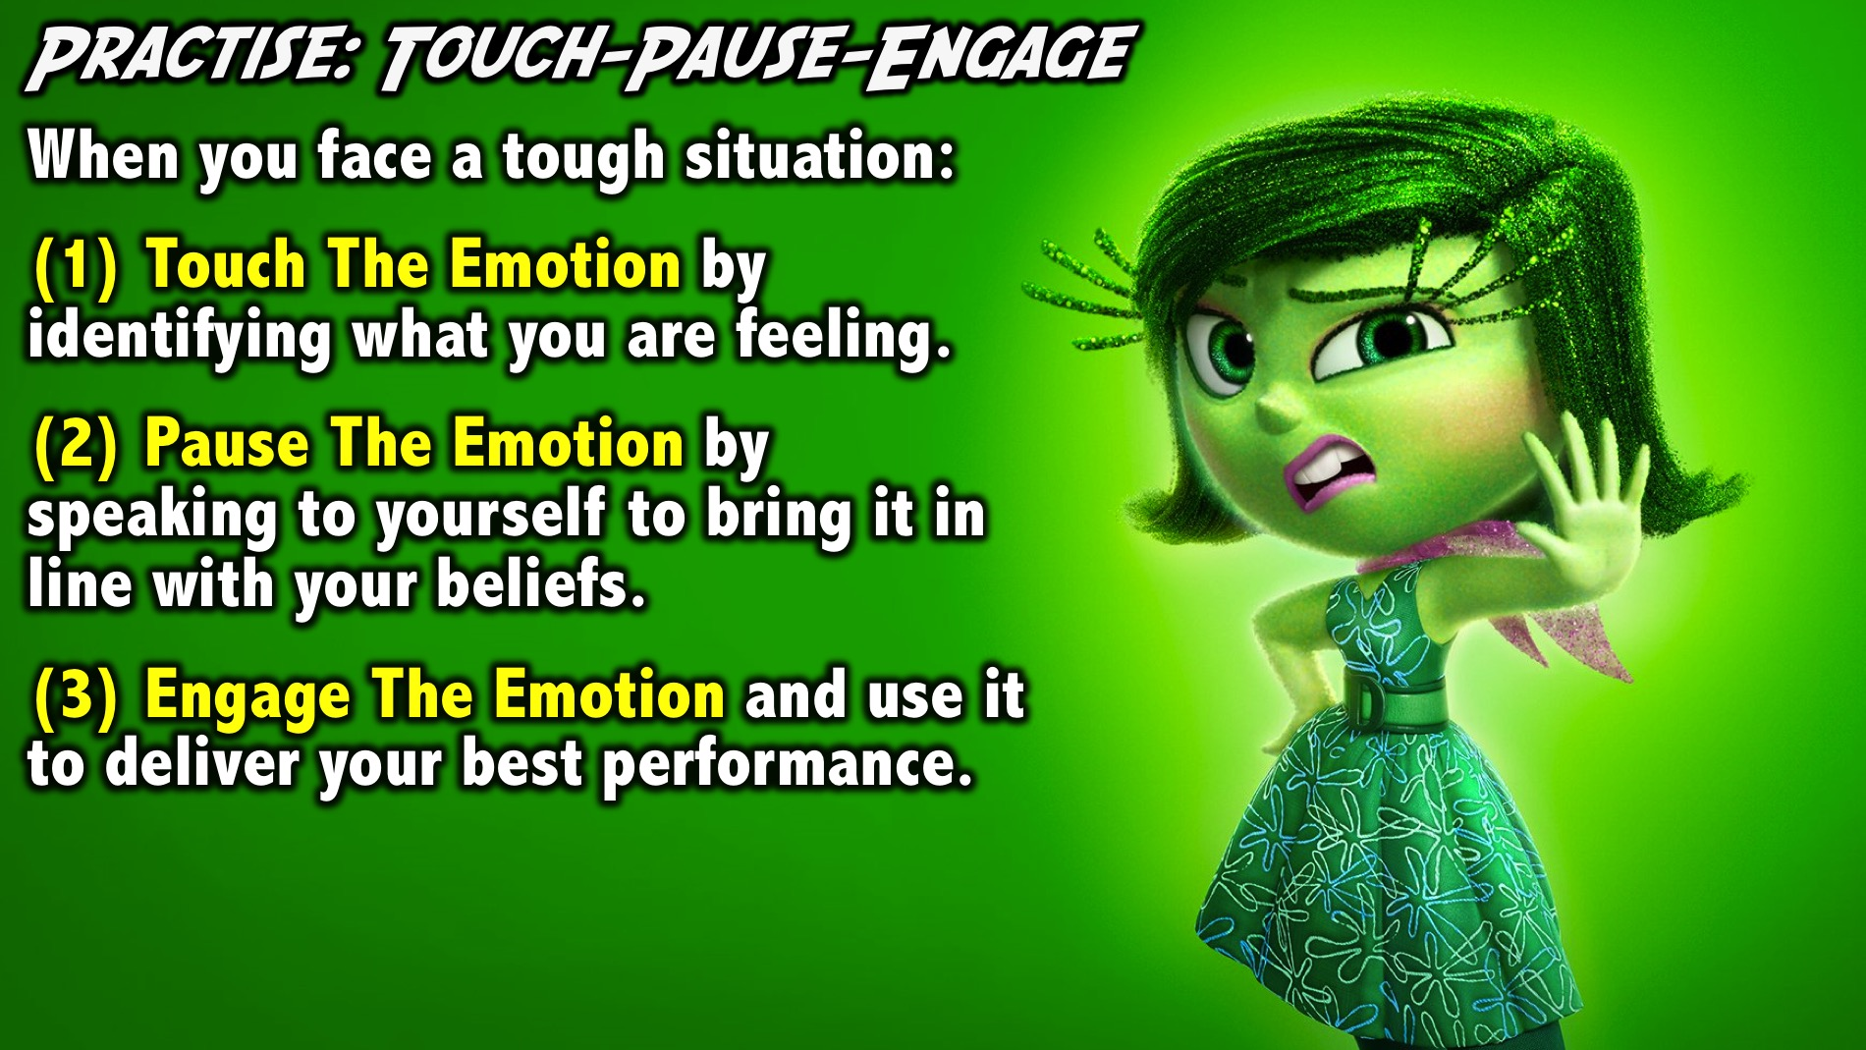
Notes:
Practice: Touch-Pause-Engage. When you face a tough situation: (1) Touch The Emotion by identifying what you are feeling. (2) Pause The Emotion by speaking to yourself to bring it in line with your beliefs. (3) Engage The Emotion and use it to deliver your best performance.

Slide 32
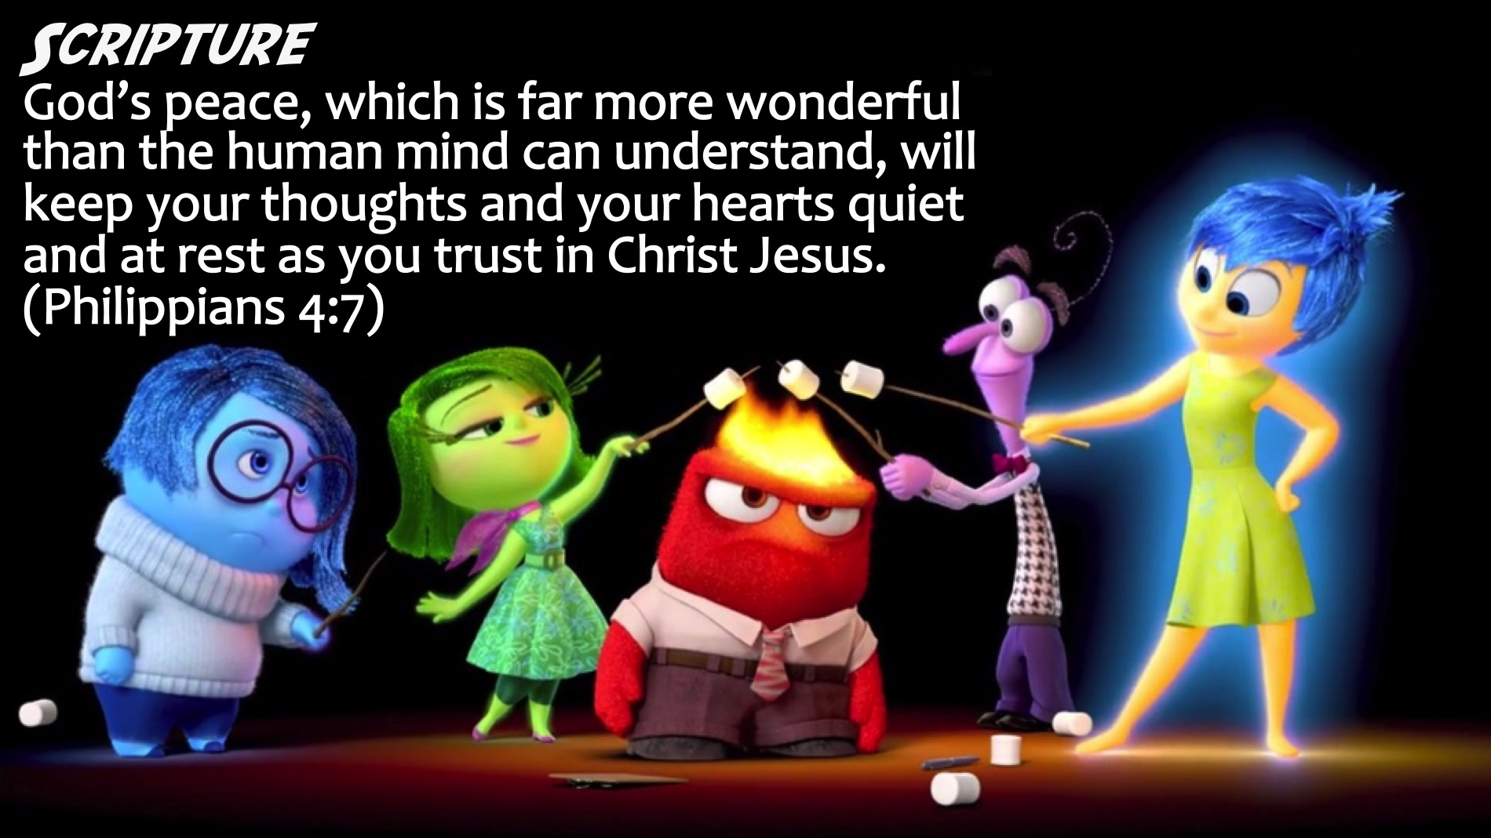
Notes:
Scripture: God’s peace, which is far more wonderful than the human mind can understand, will keep your thoughts and your hearts quiet and at rest as you trust in Christ Jesus. (Philippians 4:7)

Slide 33
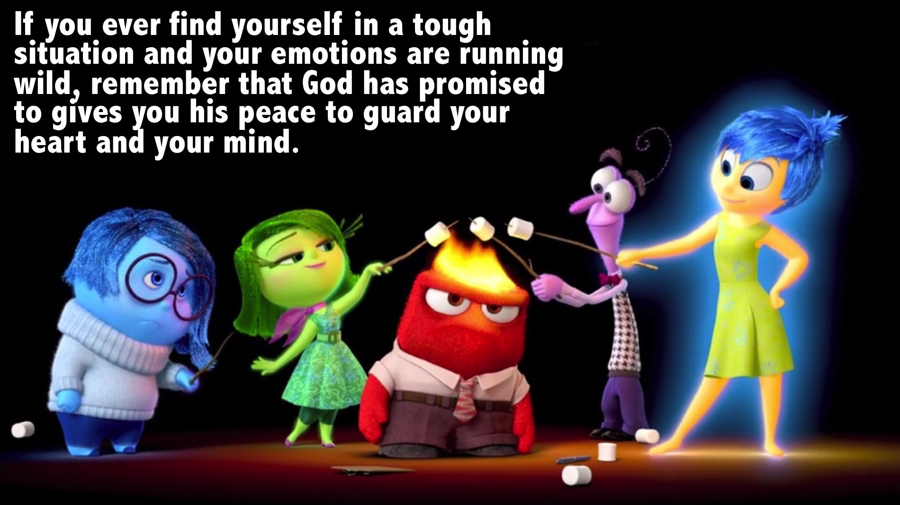
Notes:
Challenge: If you ever find yourself in a tough situation and your emotions are running wild, remember that God has promised to gives you his peace to guard your heart and your mind.

Slide 34
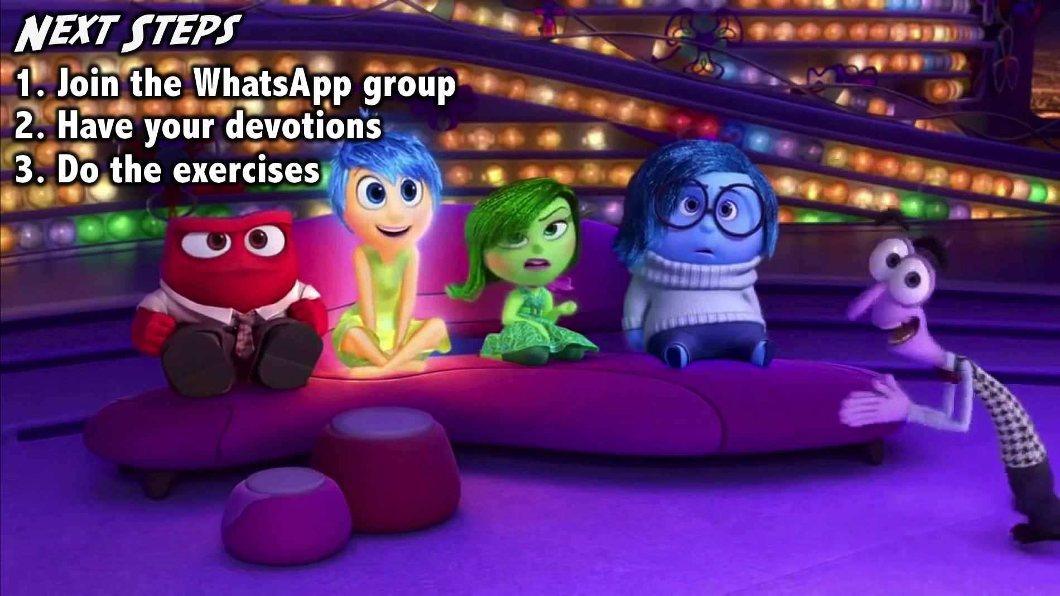
Notes:
Next Steps: (1) Join the WhatsApp group. (2) Have your devotions. (3) Do the exercises.
Facilitators Notes: Before your group leaves your table after the prayer - make sure they have all signed up for the WhatsApp group and challenge them one more time to do their devotions and the exercise during the week- including last weeks 3-2-1 exercise.

Slide 35
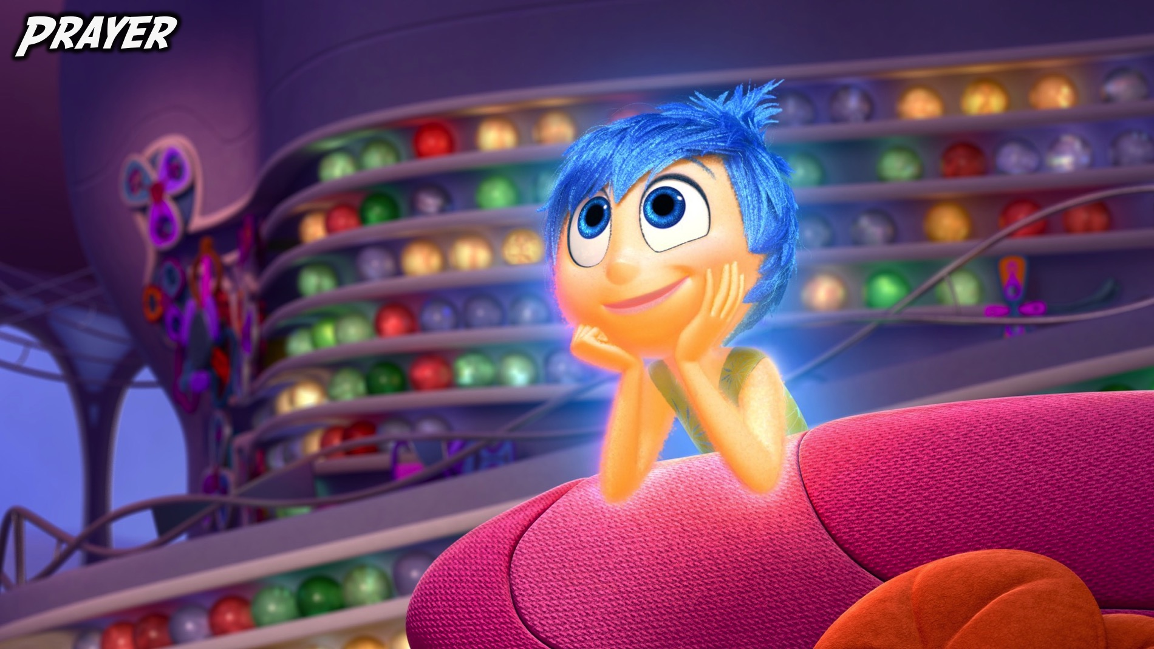
Notes:
Prayer:

Slide 36

Notes:
Next Week: Next week we will explore the seventh building block: Rehearsal.

