Slide 1
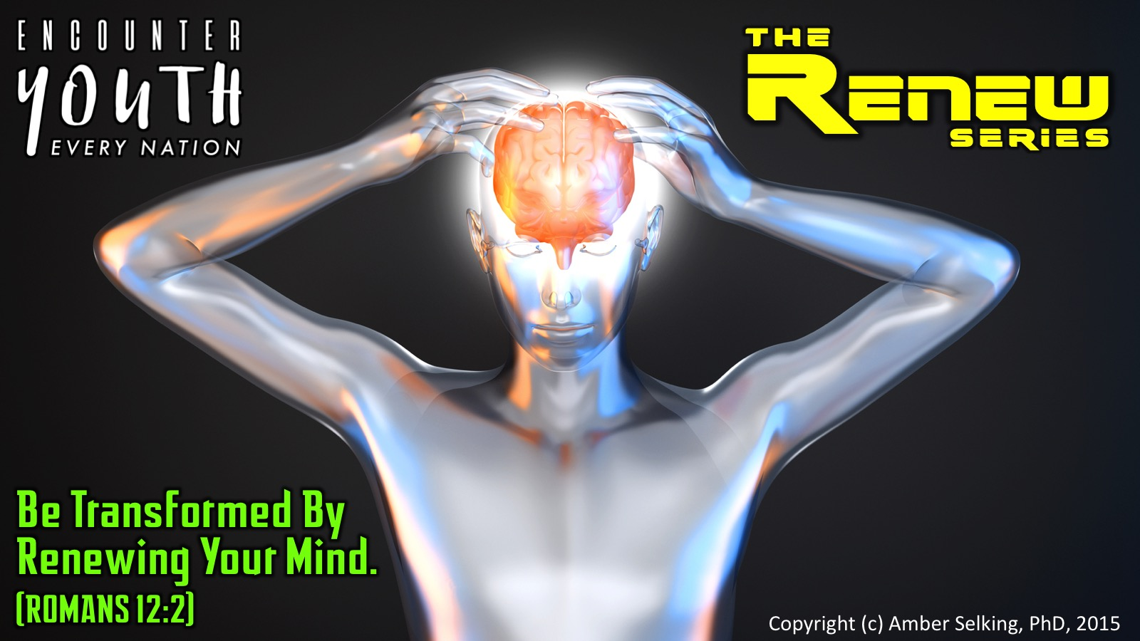
Notes:
Welcome to the Renew Series. The content for this series has been taken from an amazing Podcast by Dr. Amber Selking entitled “Building Championship Mindsets”. Checkout her website at: http://selkingperformance.com.

Slide 2
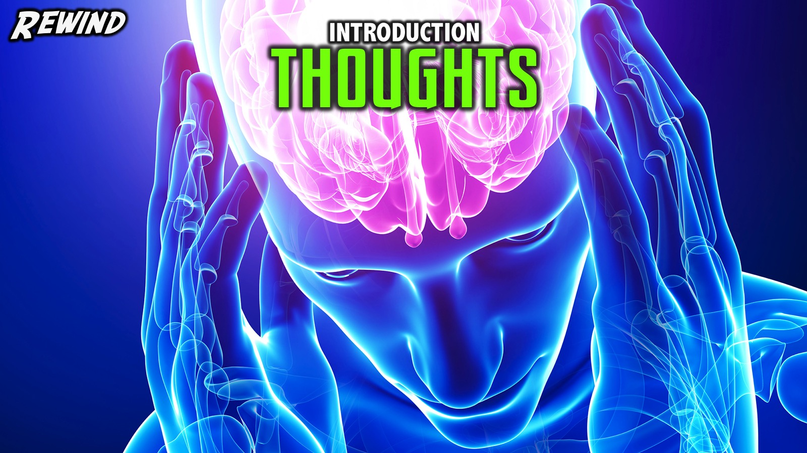
Notes:
Rewind: We began the Renew series learning about how our thoughts matter and how our thoughts build mindsets!

Slide 3
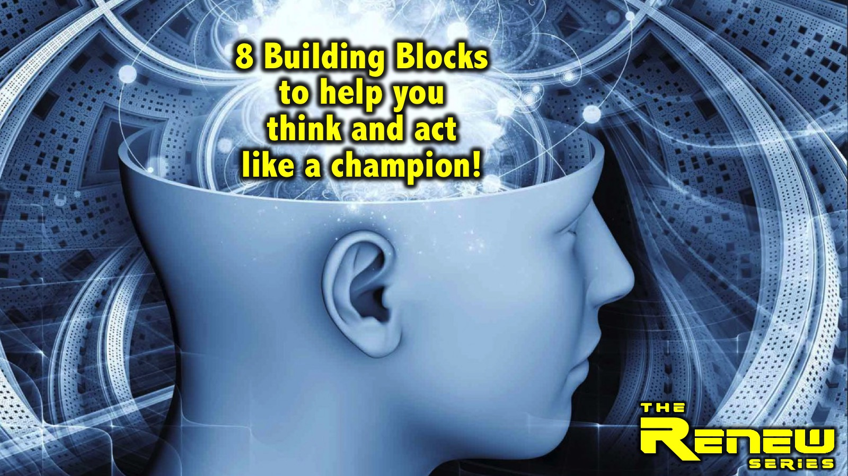
Notes:
In this series we are exploring 8 Building Blocks to help you think and act like a champion.

Slide 4
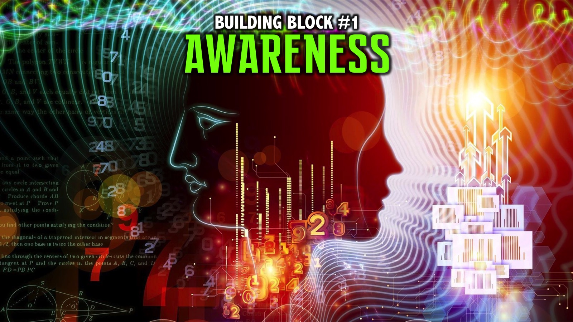
Notes:
We explored the first building block: Awareness.

Slide 5
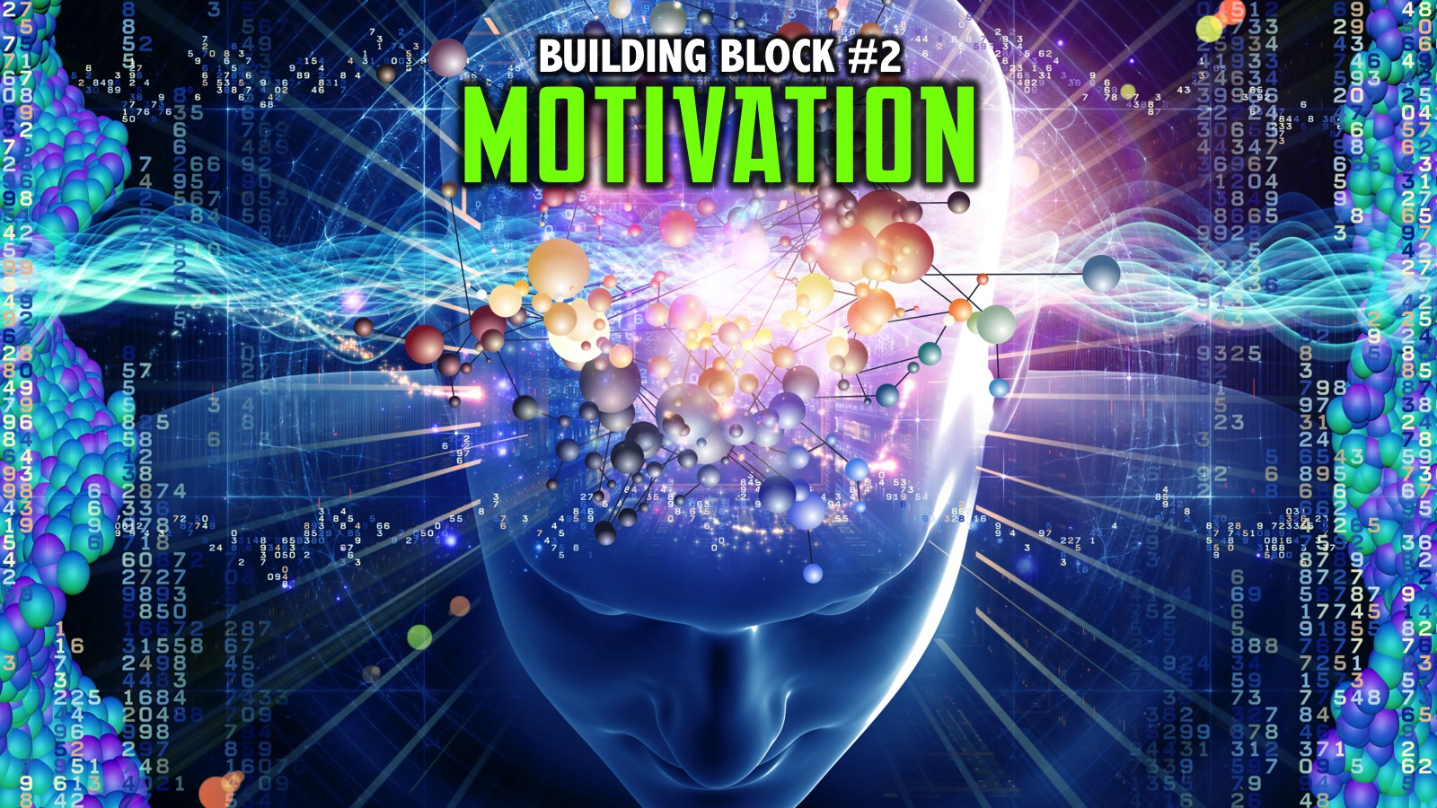
Notes:
We explored the second building block: Motivation.

Slide 6
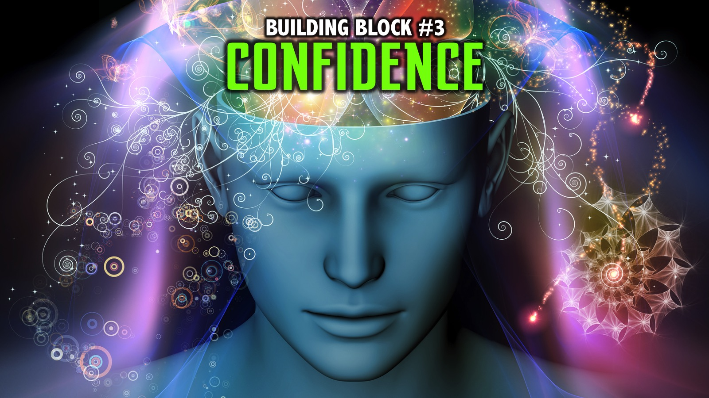
Notes:
Last week we explored the third building block: Confidence.

Slide 7
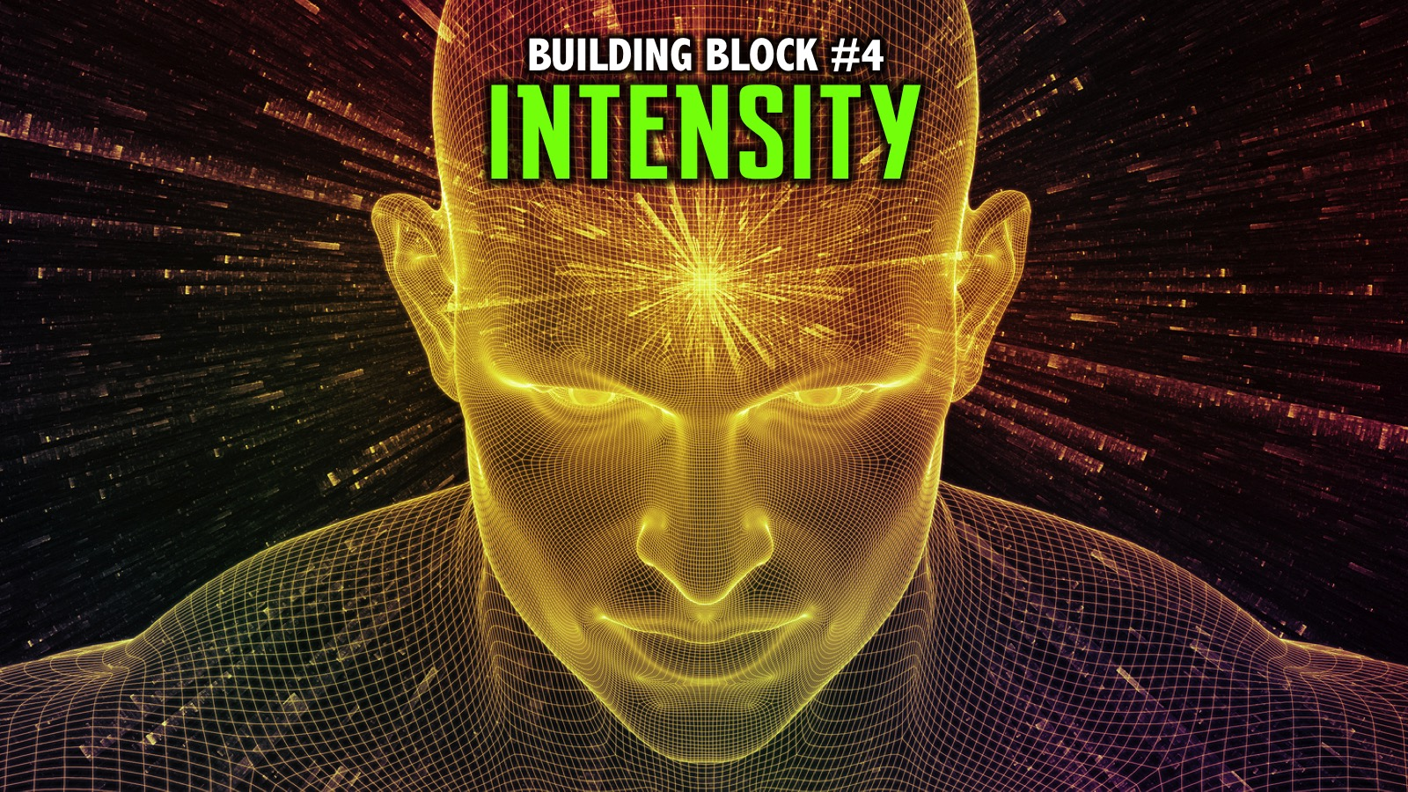
Notes:
We explored the fourth building block: Intensity.

Slide 8
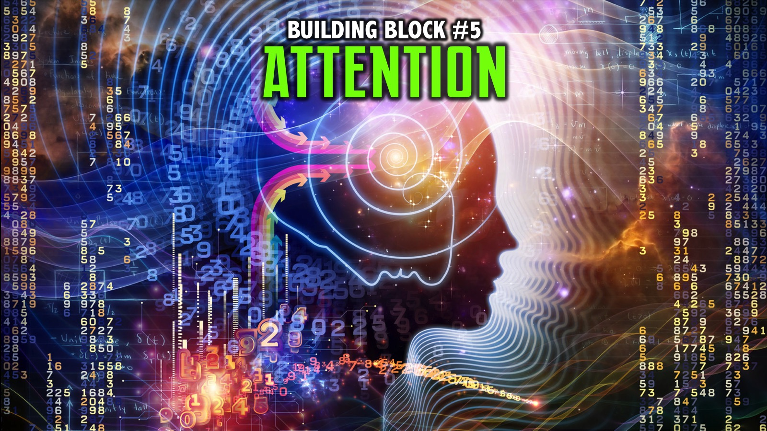
Notes:
We explored the fifth building block: Attention.

Slide 9
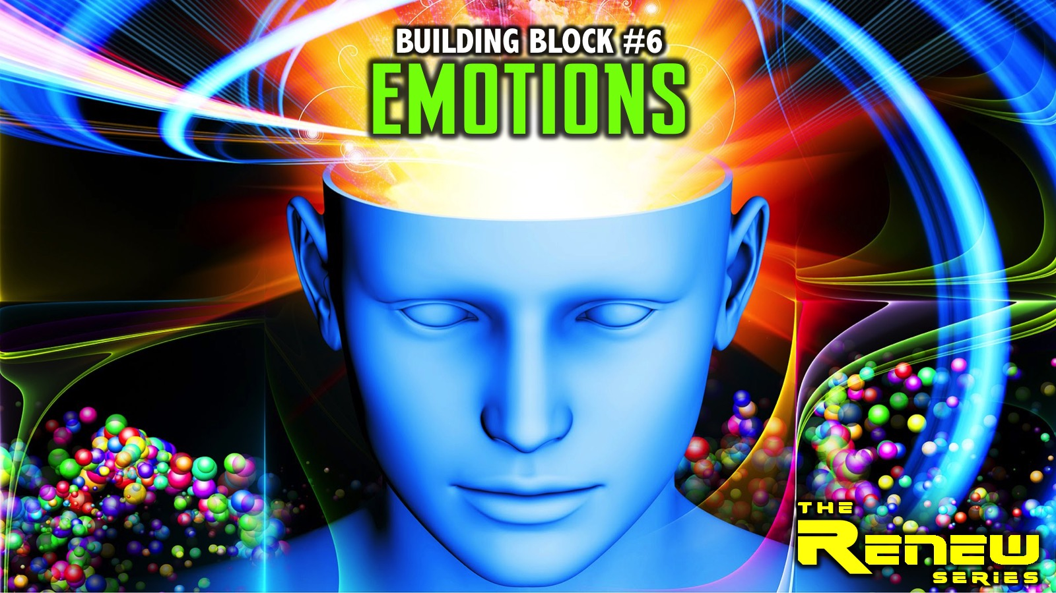
Notes:
Last week we explored the sixth building block: Emotions.

Slide 10
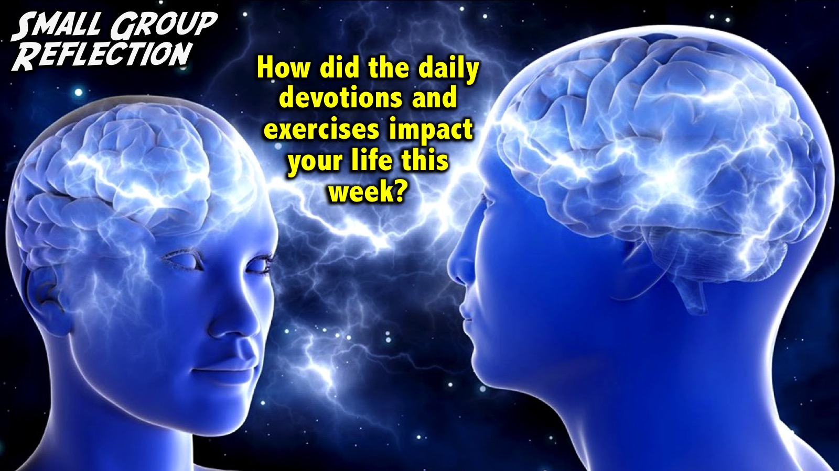
Notes:
Reflection: How did the daily devotions and exercises impact your life this week?
Facilitator Notes: Use follow up questions if necessary to get people at your table reflecting on the past week. Examples: Did you get the devotions on your phone? Do you need to take a printed copy today? How many days were you able to do your devotions? Did wearing the elastic band help you think positive thoughts? Were you able to do the 3-2-1 exercise? How did it help you think positively and creatively about your day and your life?

Slide 11
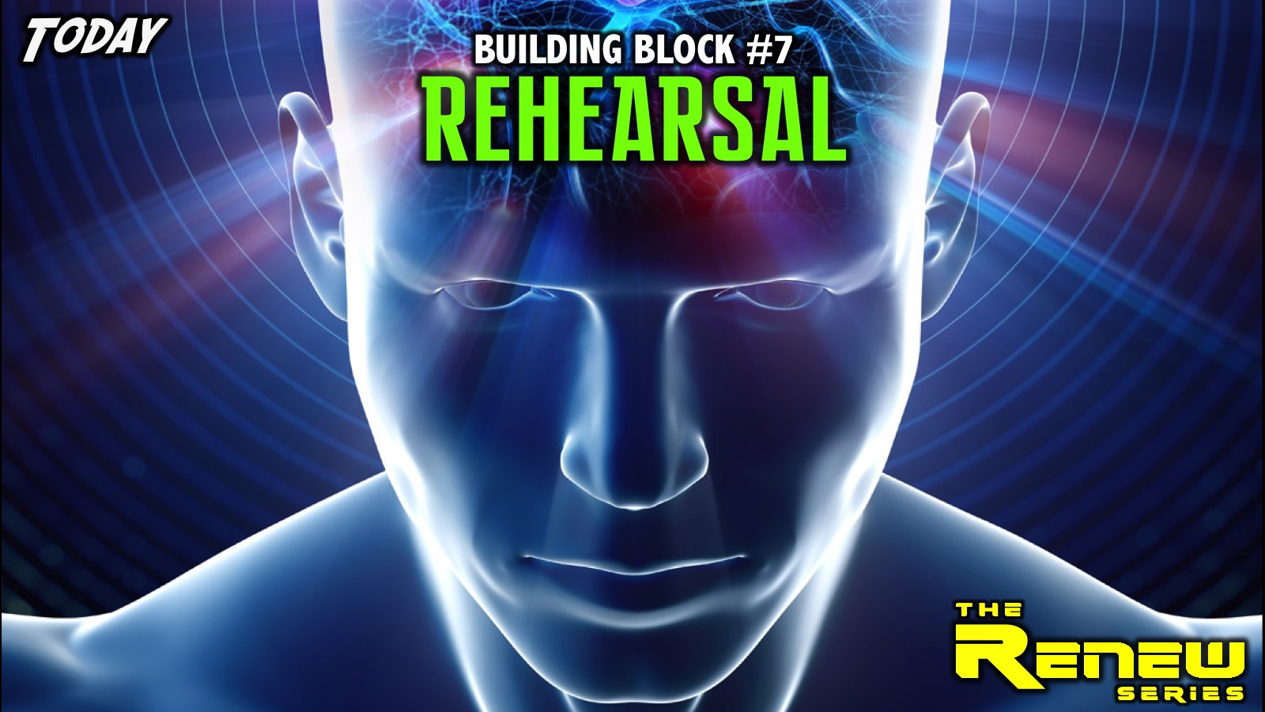
Notes:
Today we are going to explore the seventh building block: Emotions.

Slide 12
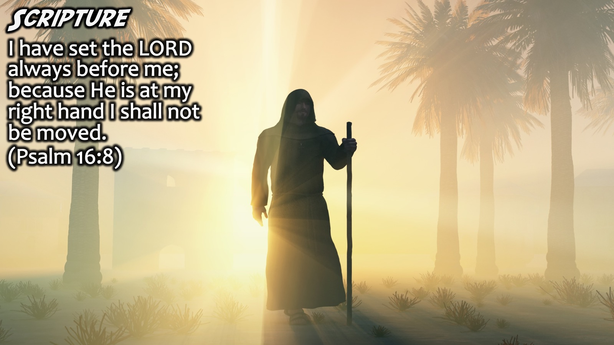
Notes:
Scripture: “I have set the LORD always before me; because He is at my right hand I shall not be moved.” (Psalm 16:8)

Slide 13
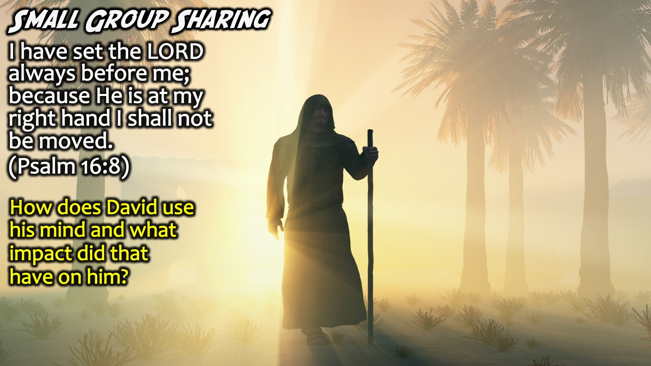
Notes:
Small Group Sharing: How does David use his mind and what impact did that have on him?
Facilitators Notes: Don’t let teens just say the obvious – or repeat the words in the verse – ask them to go deeper by asking Why more than once, or ask them to think of something that has not been shared yet.

Slide 14
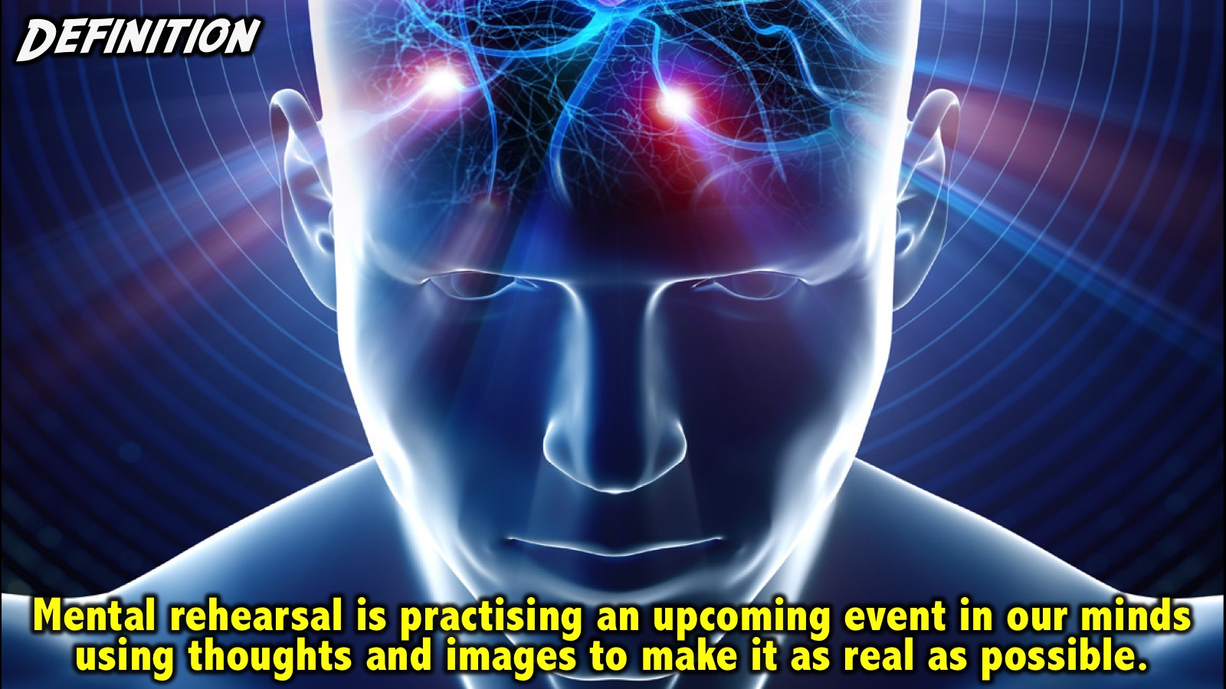
Notes:
Definition: Mental rehearsal is practising an upcoming event in our minds using thoughts and images to make it as real as possible.

Slide 15
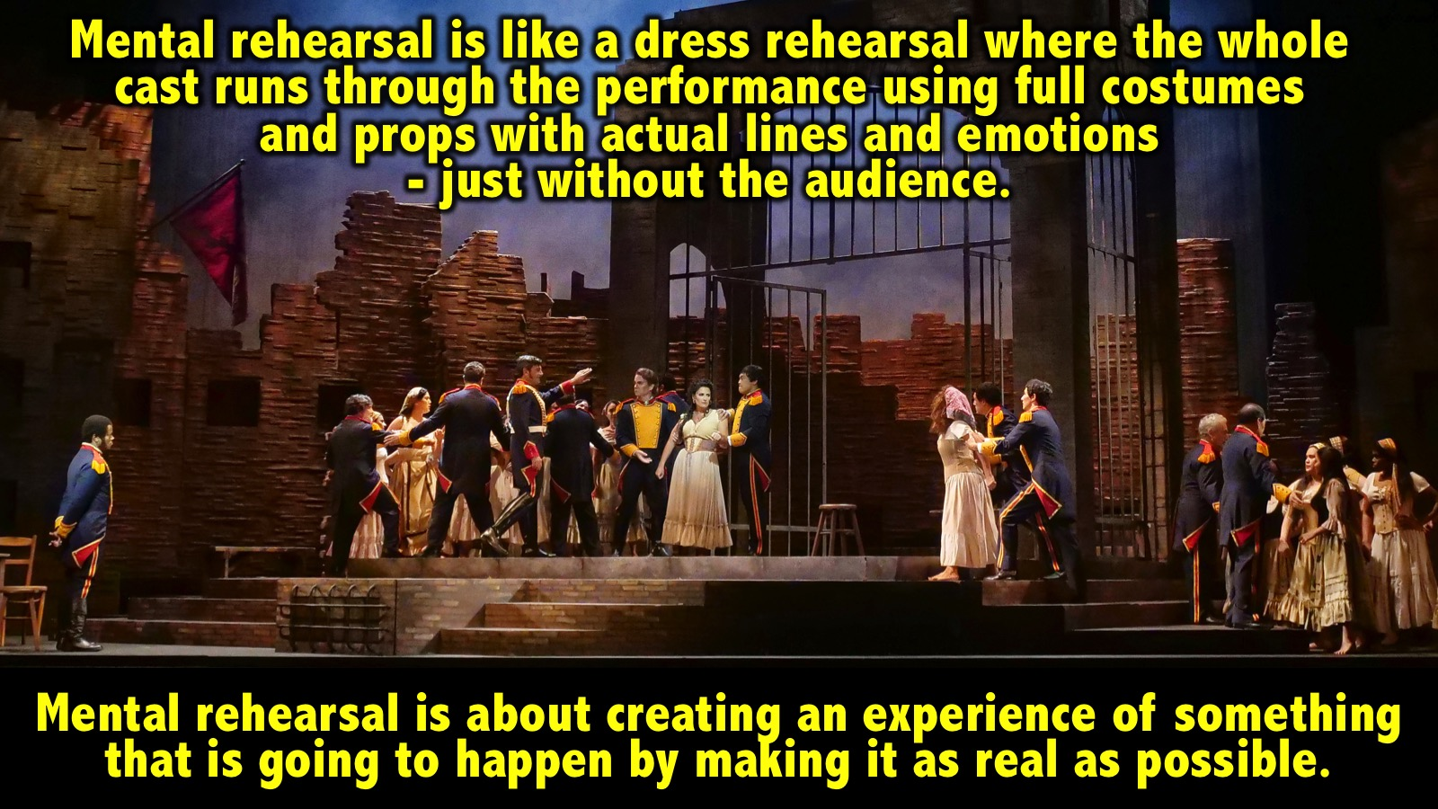
Notes:
Mental rehearsal is like a dress rehearsal where the whole cast runs through the performance using full costumes and props with actual lines and emotions - just without the audience. Mental rehearsal is about creating an experience of something that is going to happen by making it as real as possible.

Slide 16
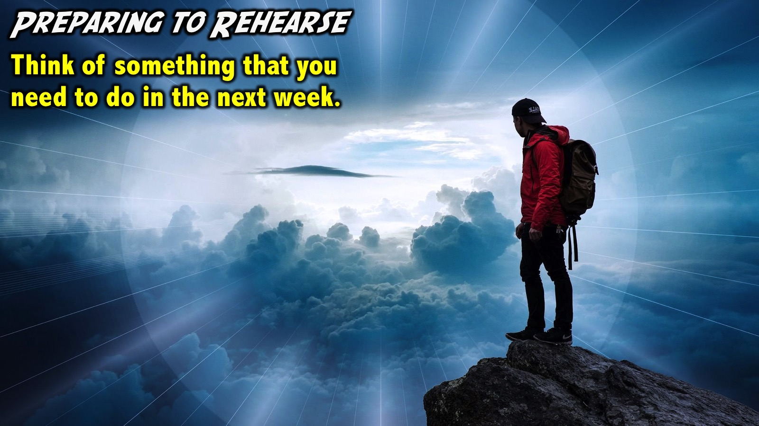
Notes:
Preparing to Rehearse: Think of something that you need to do in the next week.
Facilitators Notes: Make sure that each person at your table thinks of something specific they need to get done in the coming week - a task, a project, a game, a difficult challenge, etc. Make sure each person has something in their mind as we continue with the session.

Slide 17
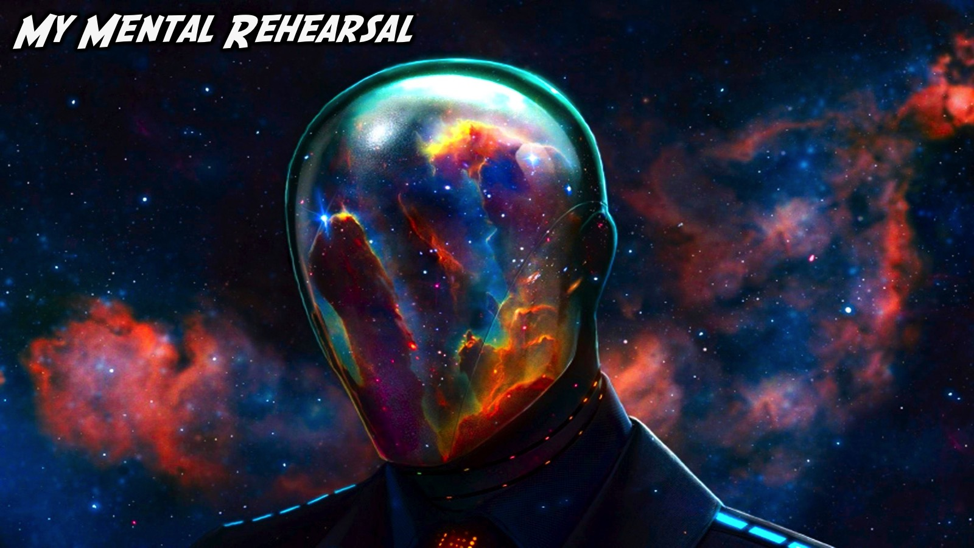
Notes:
My Mental Rehearsal: (The facilitator will share an example from their life of how they have mentally rehearsed something in the past.)

Slide 18
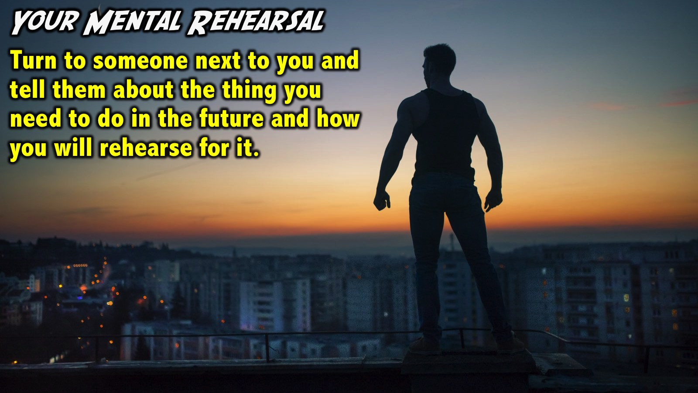
Notes:
Your Mental Rehearsal: Turn to someone next to you and tell them about the thing you need to do in the future and how you will rehearse for it.

Slide 19
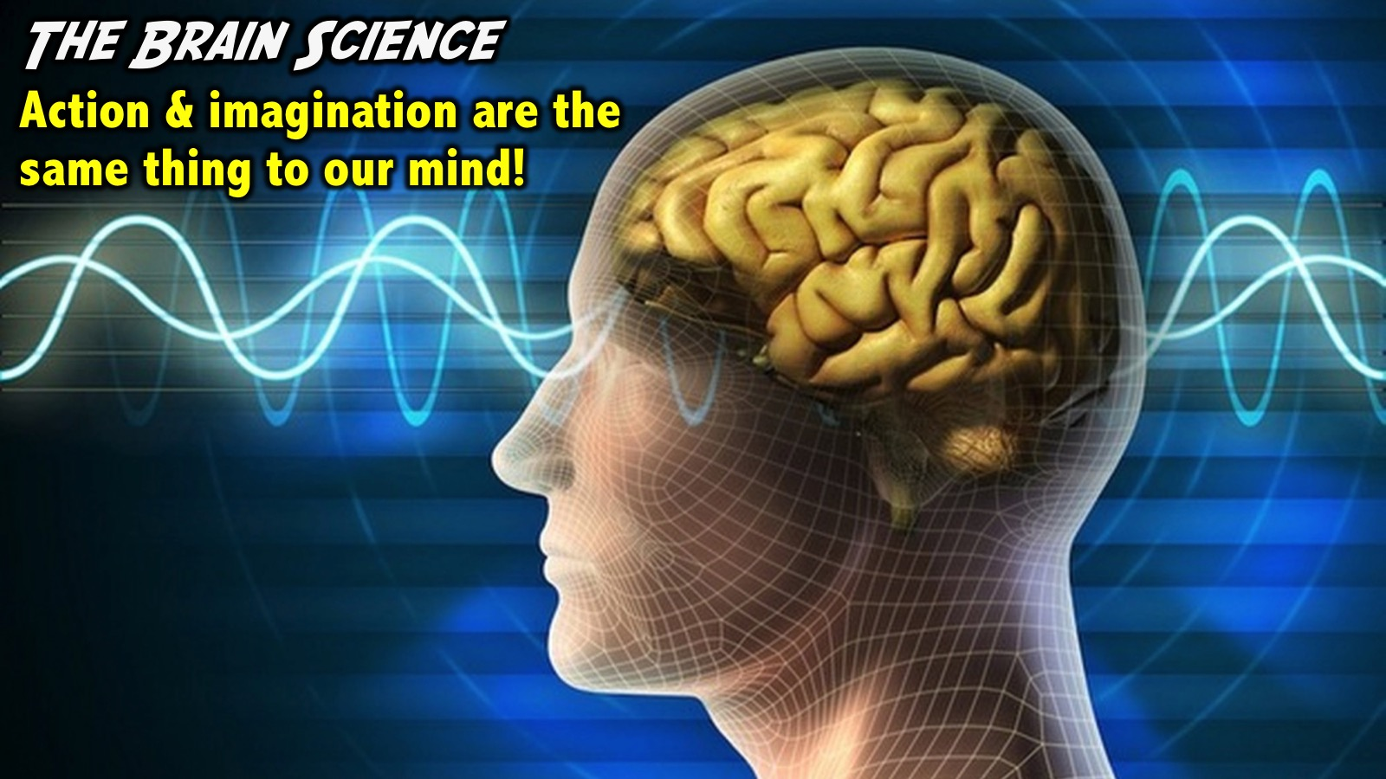
Notes:
The Brain Science: Brain science has taught us that action and imagination are integrated in our minds: the exact same neutrons and processes that happen when we actually do something actually occur when we mentally do it as well.

Slide 20
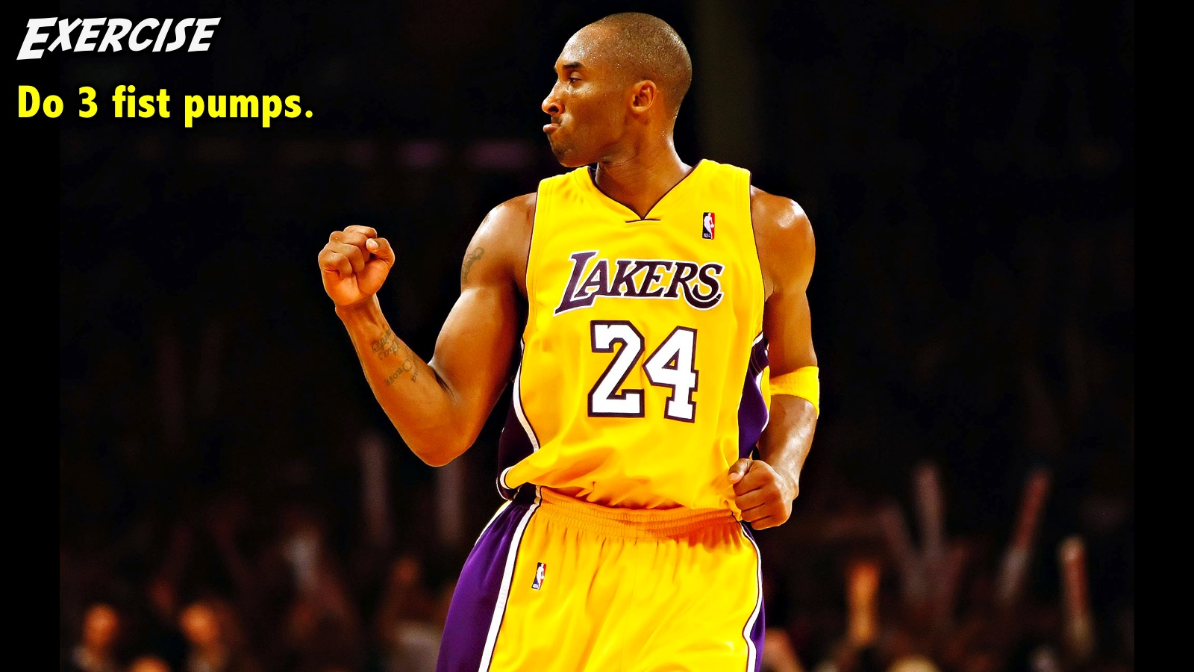
Notes:
Exercise: Do 3 fist pumps in the air over your head.

Slide 21
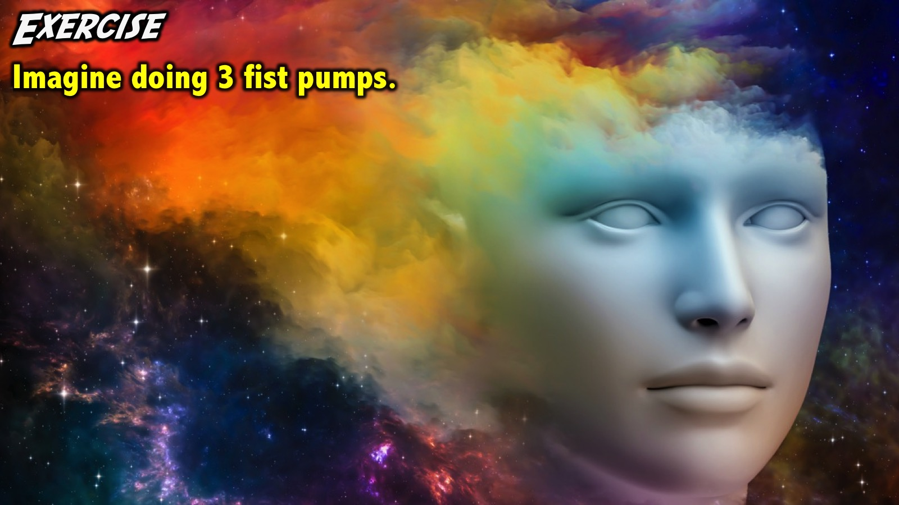
Notes:
Exercise: Now, imagine yourself doing the same 3 fist pumps.

Slide 22
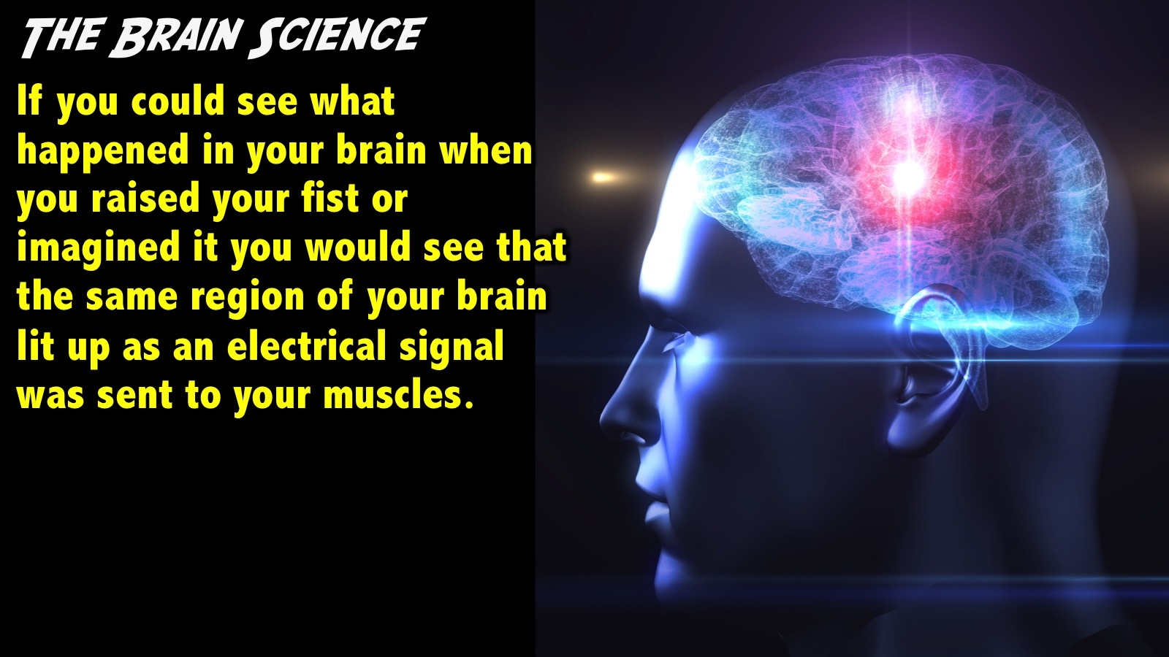
Notes:
The Brain Science: If you could see what happened in your brain when you raised your fist or imagined it you would see that the same region of your brain lit up as an electrical signal was sent to your muscles.

Slide 23
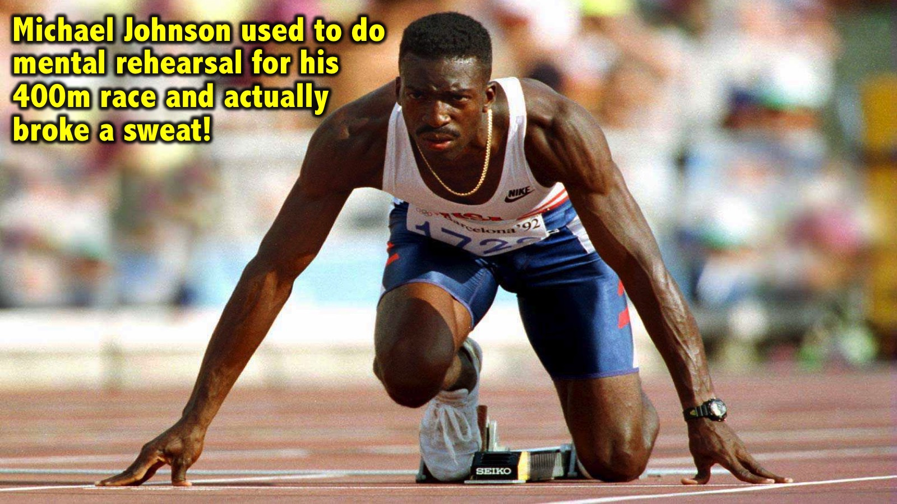
Notes:
Michael Johnson used to do mental rehearsal for his 400m race and actually broke a sweat!

Slide 24
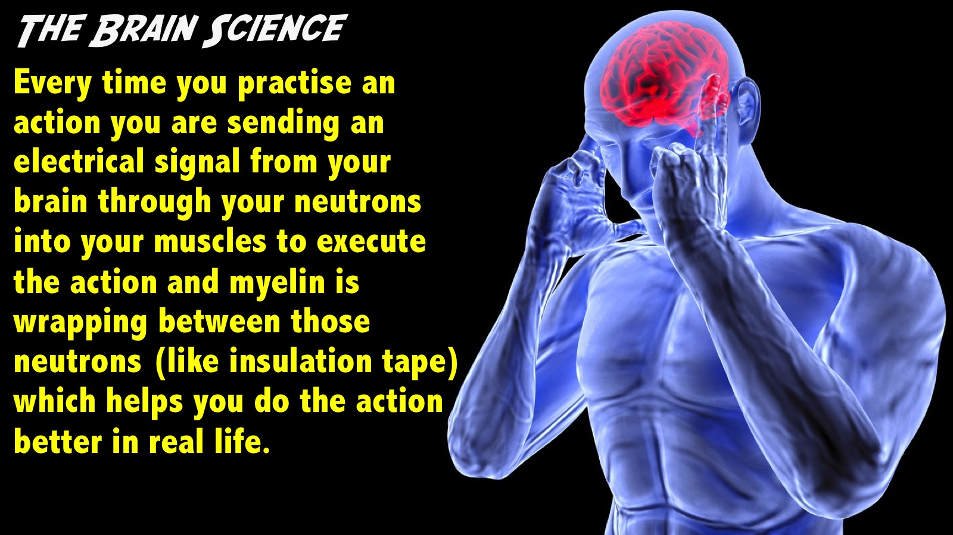
Notes:
So every time you practise an action you are sending an electrical signal from your brain through your neutrons into your muscles to execute the action and myelin is wrapping between those neutrons which helps you do the action better in real life.

Slide 25
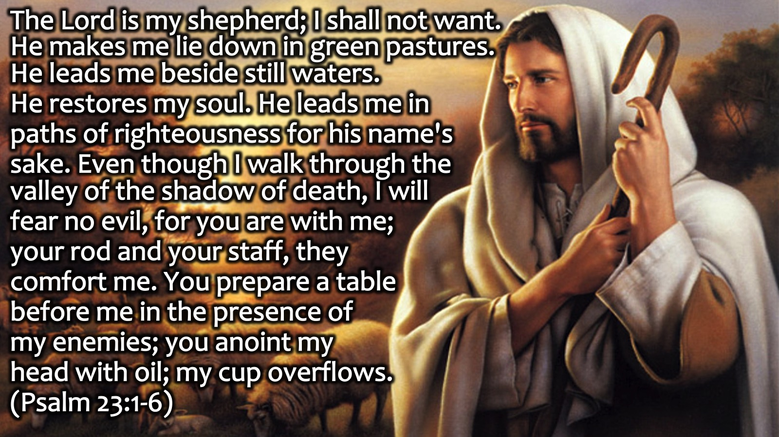
Notes:
Scripture: “The Lord is my shepherd; I shall not want. He makes me lie down in green pastures. He leads me beside still waters. He restores my soul. He leads me in paths of righteousness for his name's sake. Even though I walk through the valley of the shadow of death, I will fear no evil, for you are with me; your rod and your staff, they comfort me. You prepare a table before me in the presence of my enemies; you anoint my head with oil; my cup overflows.” (Psalm 23:1-6).

Slide 26
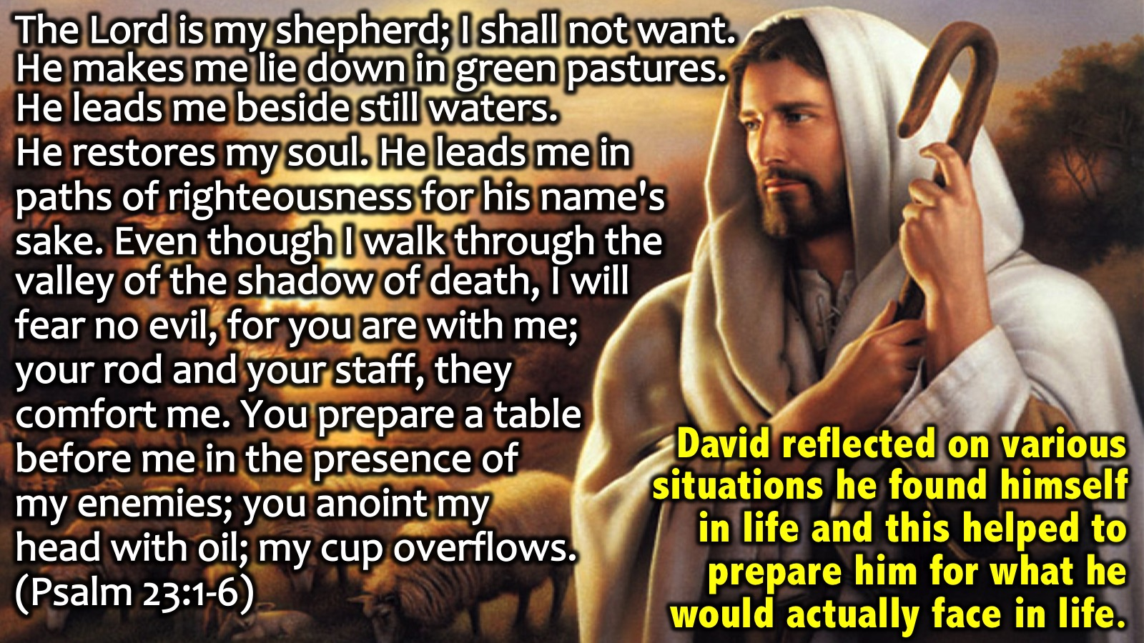
Notes:
In Psalm 23 we read of how David reflected on various situations he found himself in life and this helped to prepare him for what he would actually face in life.

Slide 27
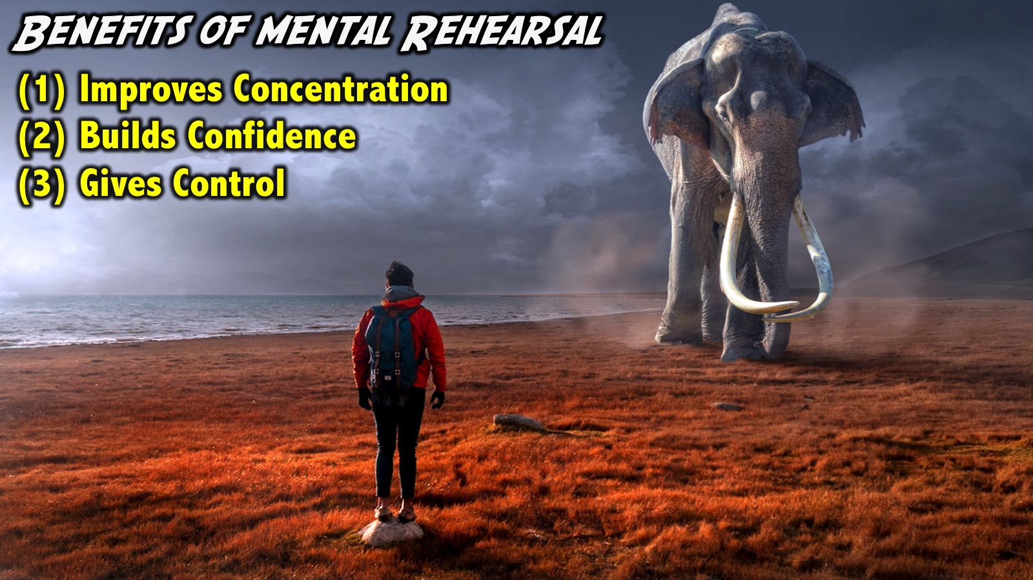
Notes:
Benefits of Mental Rehearsal: Great mental rehearsal have the following benefits: (1) It improves concentration, (2) it builds confidence and (3) it gives a greater sense of control in what we are doing and what we have to execute in that moment. These three things are key to improve our performance. A coach speaks of how he ran his team through total mental rehearsal. He would have them lie on the field and he would walk them through a game. He often said what the mind believe the body achieves so mental rehearsal helps our minds believe what we are rehearsing. When a team does this they all get the same image and belief in their mind and they end up planing great and winning the championship!

Slide 28
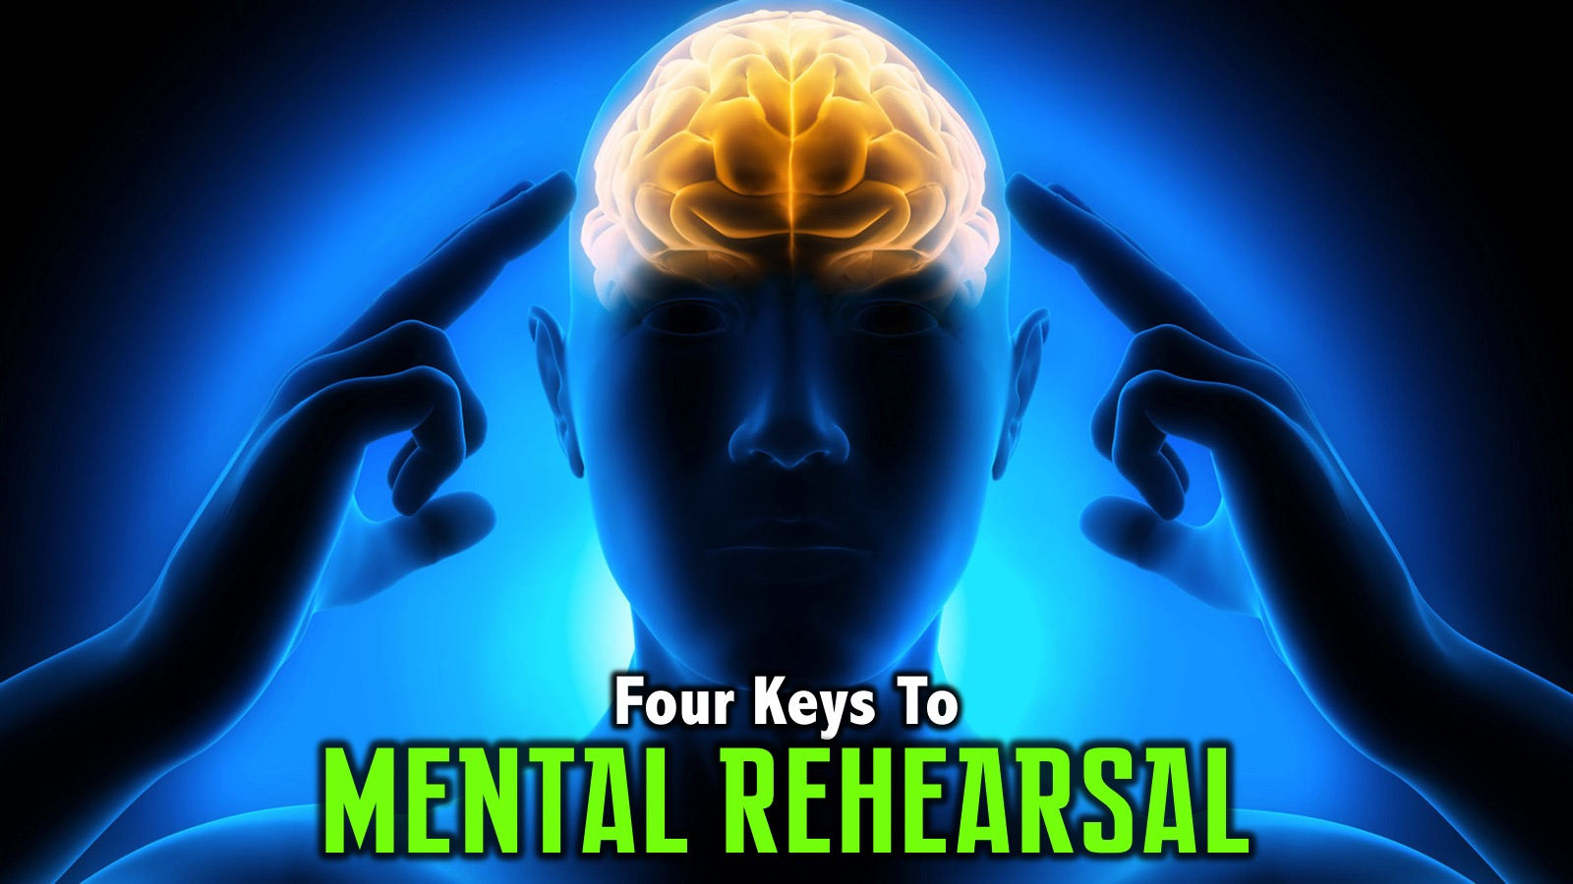
Notes:
Four Keys to Mental Rehearsal: How do we do really good mental rehearsal? Michael Johnson used to do mental rehearsal for his 400m race and actually broke a sweat! There are 4 keys to great effective mental rehearsal:

Slide 29
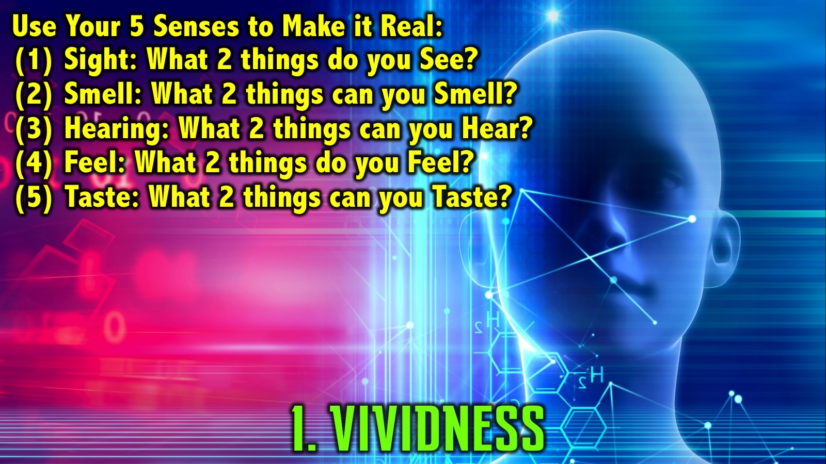
Notes:
(1) Vividness. We must make the image or the experience as real as possible in our minds. One way we can do that is incorporating all 5 senses into our mental rehearsal. We create vividness by integrating all 5 senses into the mental rehearsal experience. Activity: Choose an activity you want to mentally rehearse. We will walk through the five senses and use them as we rehearse: (1) Sight: What are 2 things that you see in that experience right now? (2) Smell: What are 2 things that you smell in that experience right now? (3) Hearing: What are 2 things that you hear going on around you? (4) Feel: What are 2 things that you feel right now? (5) Taste: What are 2 things that you taste in that experience right now? This is one way for us to start practising mental rehearsal.

Slide 30
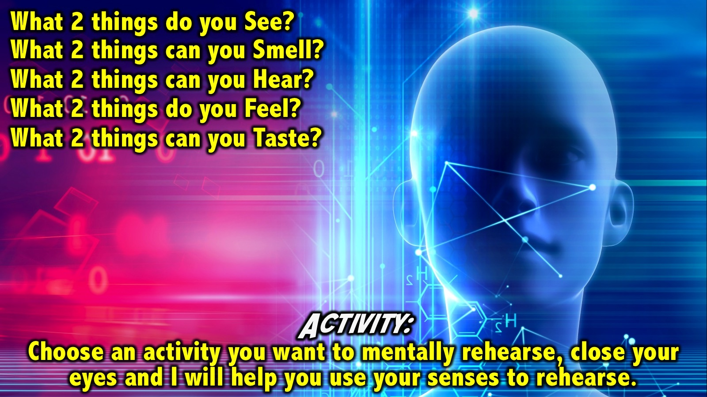
Notes:
Activity: Choose an activity you want to mentally rehearse, close your eyes and I will help you use your senses to rehearse:
What are 2 things that you see in that experience right now?
What are 2 things that you smell in that experience right now?
What are 2 things that you hear going on around you?
What are 2 things that you fell right now?
What are 2 things that you taste in that experience right now?
Open your eyes. How did using your senses help you to rehearse the activity in your mind?

Slide 31
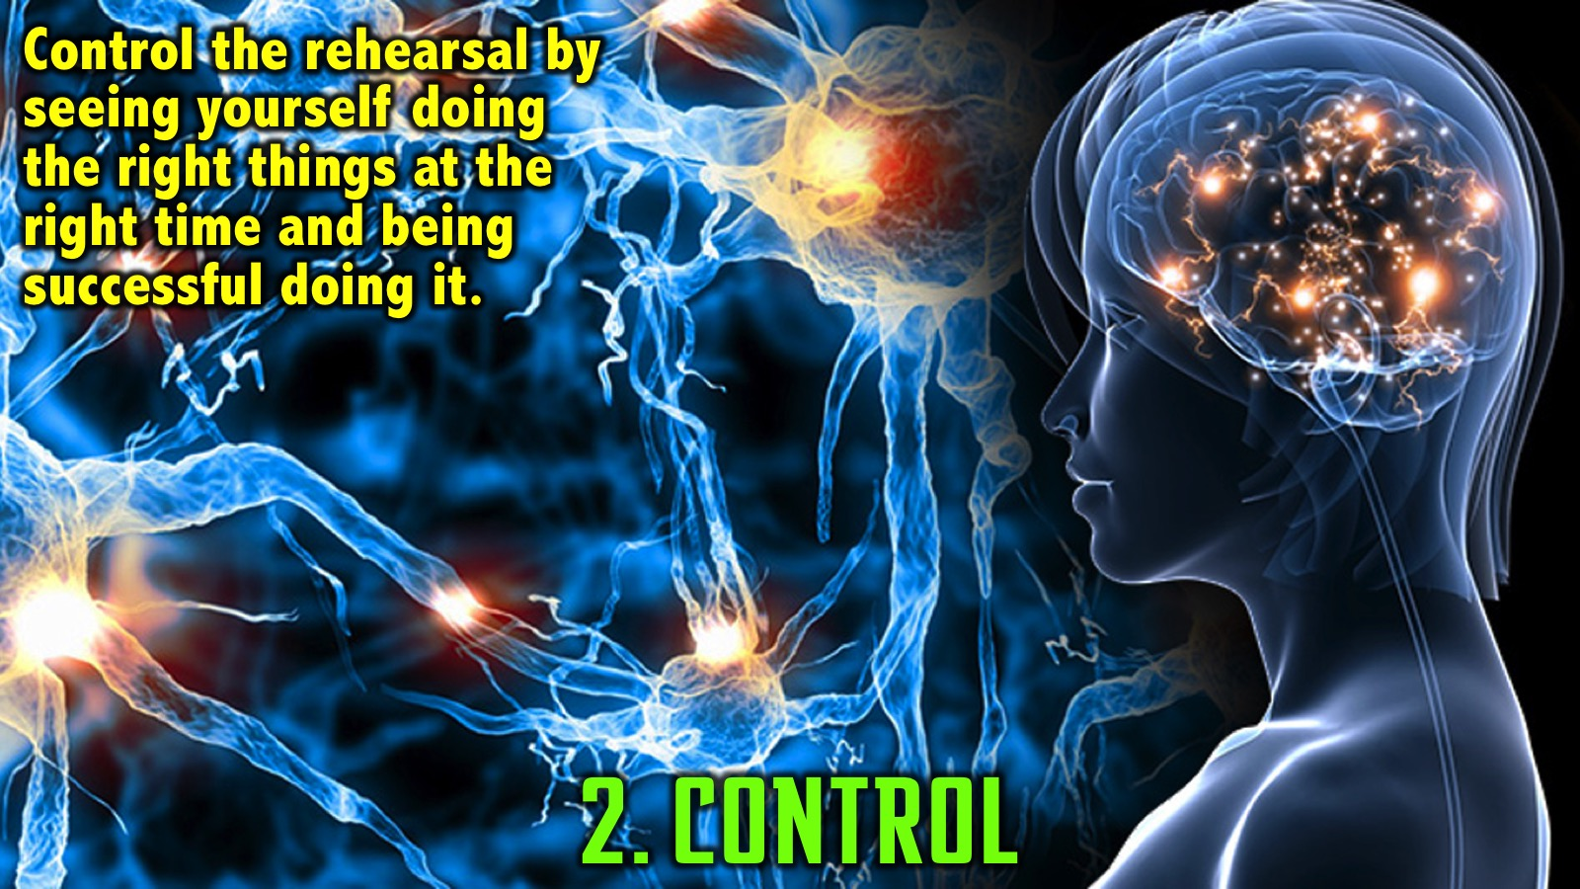
Notes:
(2) Control. We should control the image and see ourselves executing the right task at the right time. We don’t want to be sending the wrong electrical signal or myelinating the wrong neural path ways - but seeing ourselves doing the right things at the right time and seeing our selves being successful doing it.

Slide 32
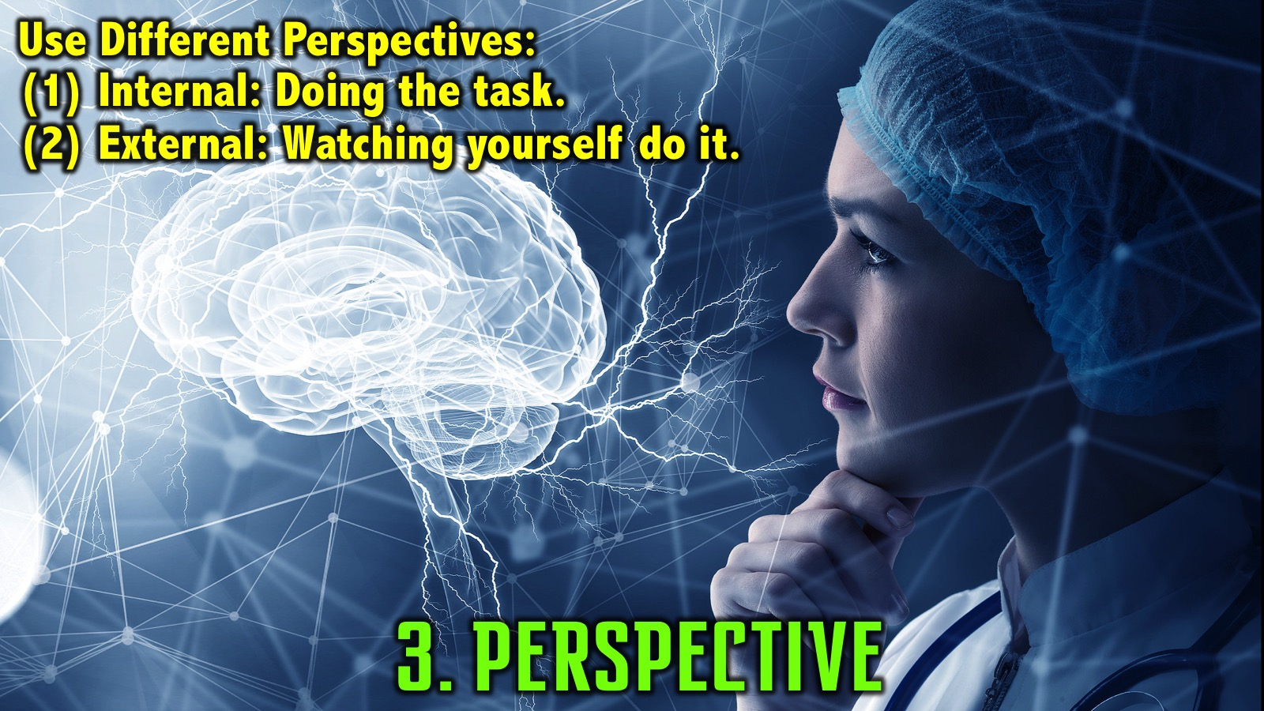
Notes:
(3) Perspective. We can adopt one of two perspectives: An internal perspective where are are inside our body executing the task or an external perspective where we are watching ourselves executing the task.

Slide 33
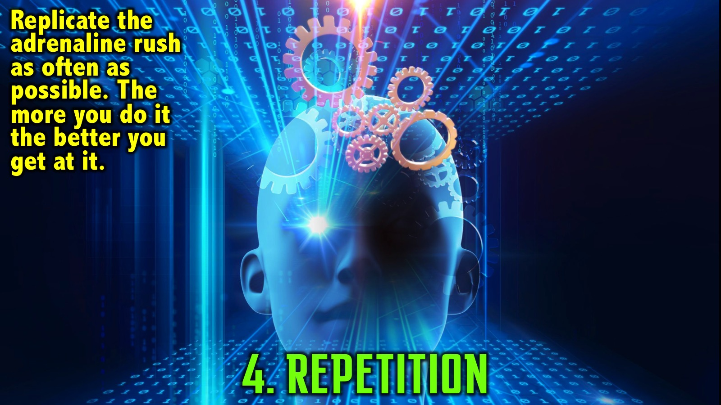
Notes:
(4) Repetition. We need to replicate the adrenaline rush or the mindset that we need as often as possible to build skills to execute in the moment. The more we do it the better we get at it!

Slide 34
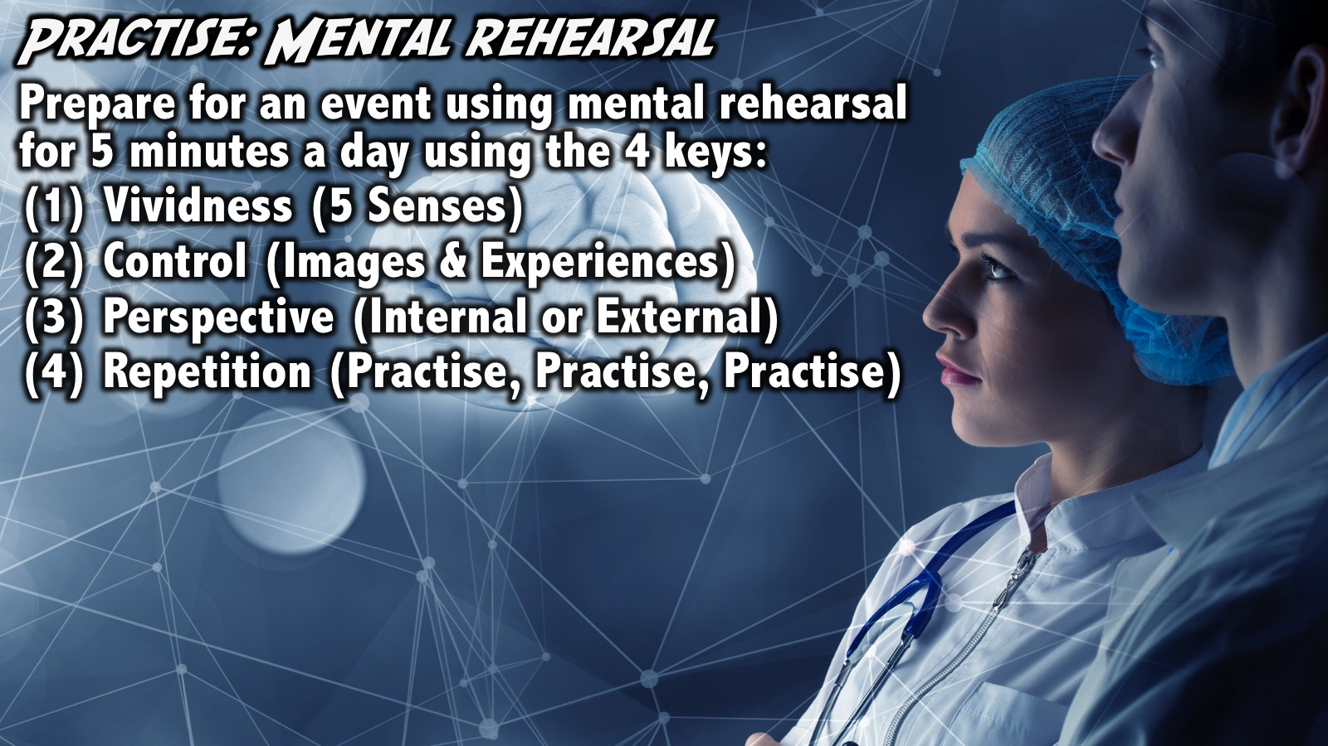
Notes:
Practice: Practice mental rehearsal training for an upcoming event for 5 minutes/day using the keys to effective mental rehearsal: (1) Vividness (use all 5 senses); (2) Control (images and experiences so we are imagining the right things); (3) Perspective (internal or external) and (4) Repetition (practise, practise, practise). Get to a place where we can fully rehearse experiences we are going to actually have.
Try it now - using the event or activity you thought of earlier in this session.

Slide 35
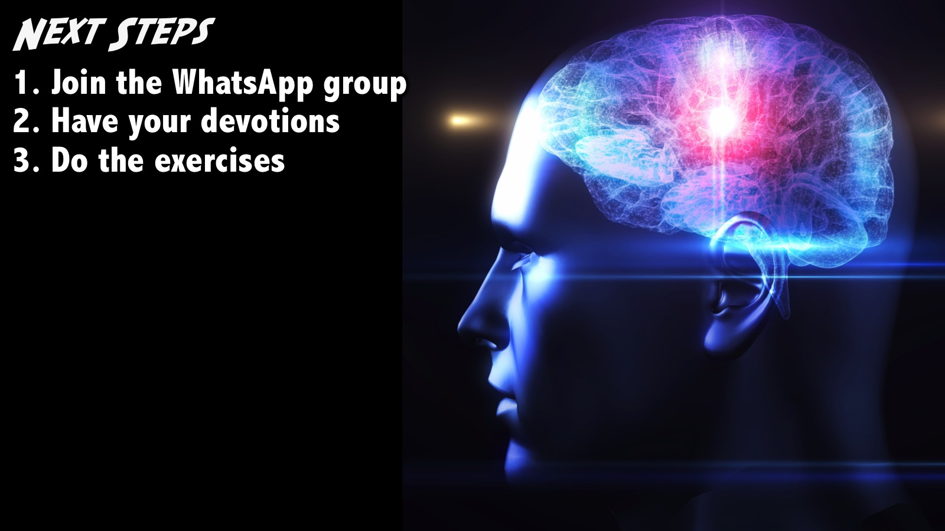
Notes:
Next Steps: (1) Join the WhatsApp group. (2) Have your devotions. (3) Do the exercises.
Facilitators Notes: Before your group leaves your table after the prayer - make sure they have all signed up for the WhatsApp group and challenge them one more time to do their devotions and the exercise during the week- including last weeks 3-2-1 exercise.

Slide 36
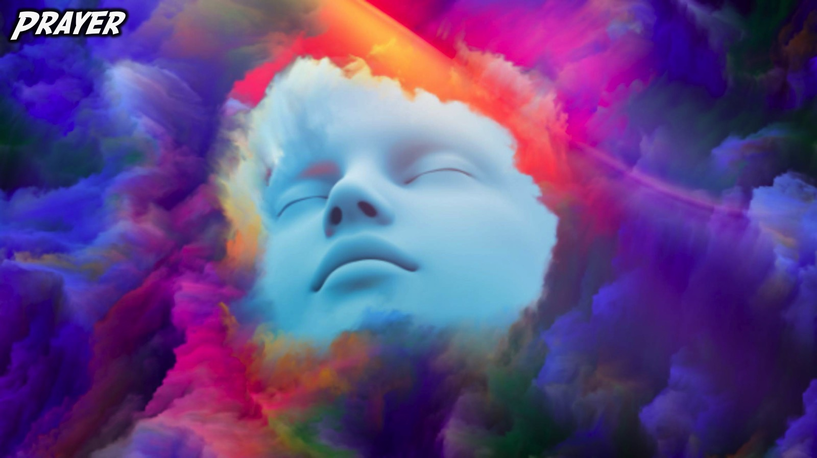
Notes:
Prayer

Slide 37
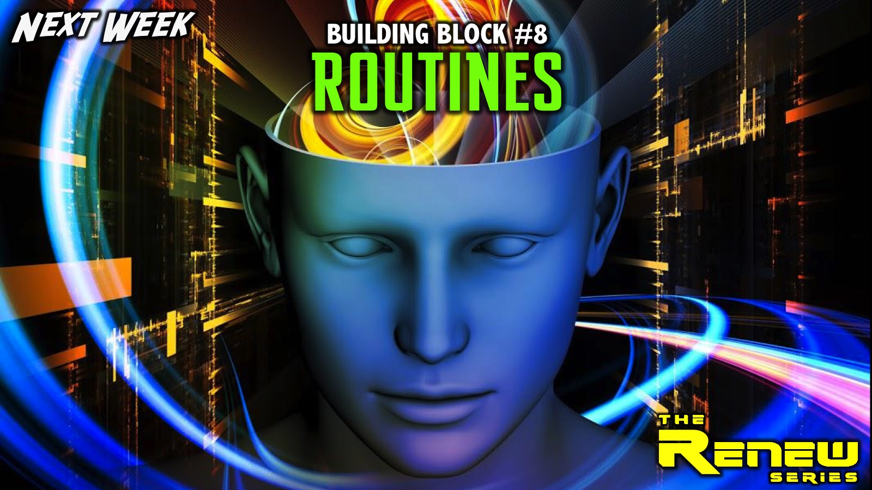
Notes:
Next Week: Next week we will explore the eighth and final building block: Routines.

