Slide 1

Notes:
Welcome to the Renew Series. The content for this series has been taken from an amazing Podcast by Dr. Amber Selking entitled “Building Championship Mindsets”. Checkout her website at: http://selkingperformance.com.

Slide 2
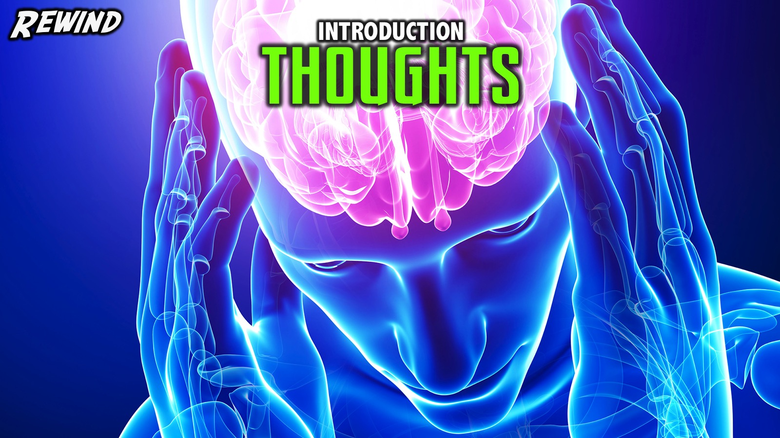
Notes:
Rewind: We began the Renew series learning about how our thoughts matter and how our thoughts build mindsets!

Slide 3
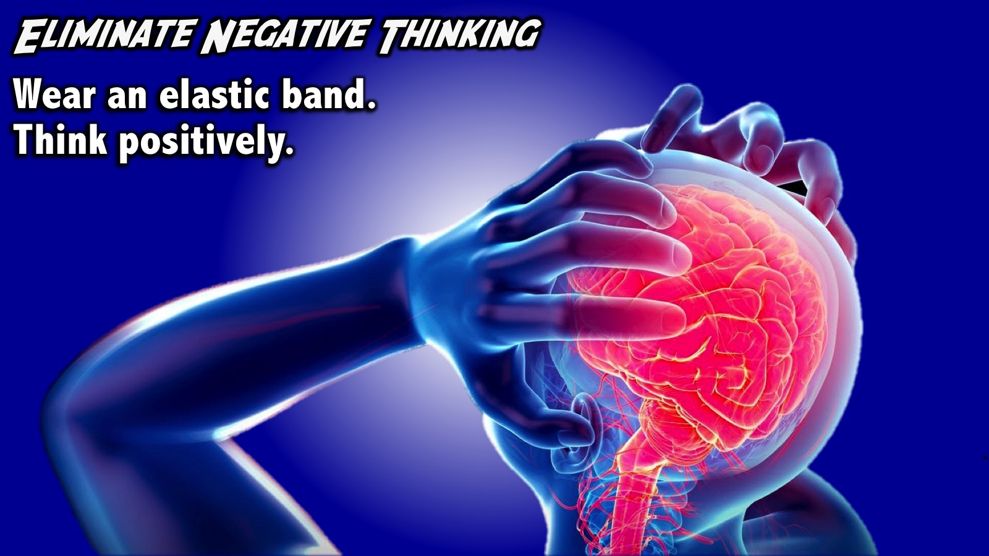
Notes:
Practice #1: Eliminate Negative Thinking. Put an elastic band on your wrist and when you have the negative thought stretch and let it go when you think negatively about something - you will stop thinking negatively because you don’t want to be hurt.

Slide 4
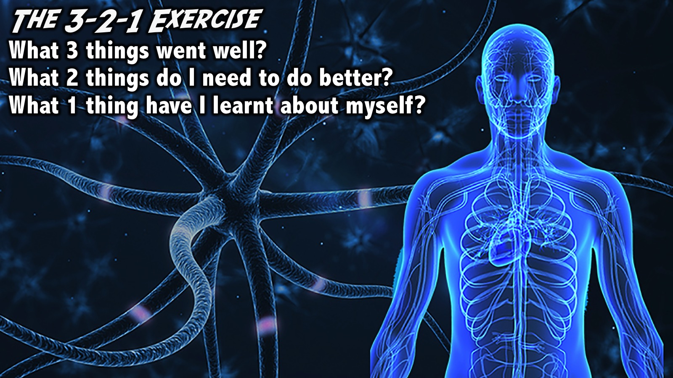
Notes:
Practice #2: The 3-2-1 Exercise. End each day with a time of reflection where you ask yourself these 3 questions: What 3 things went well today? What 2 things do I need to do better tomorrow? What 1 thing have I learned about myself today? This does not need to take more than a couple of minutes. Write things down or type them on your phone.

Slide 5
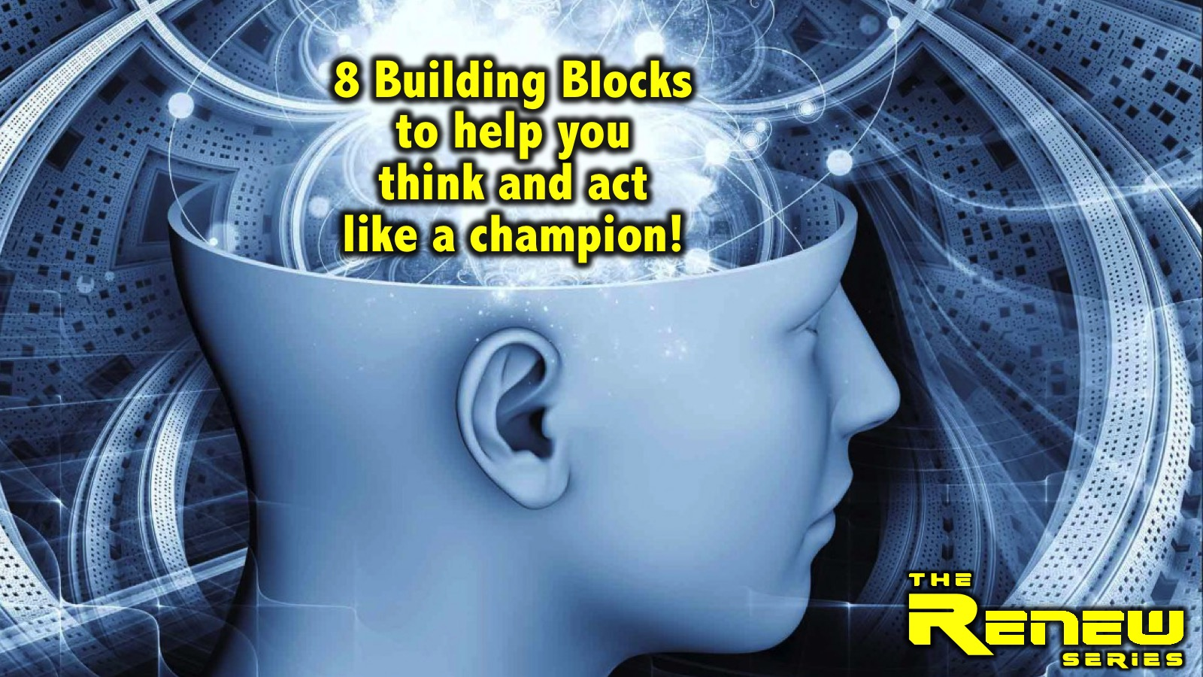
Notes:
We then explored 8 Building Blocks to help you think and act like a champion:

Slide 6
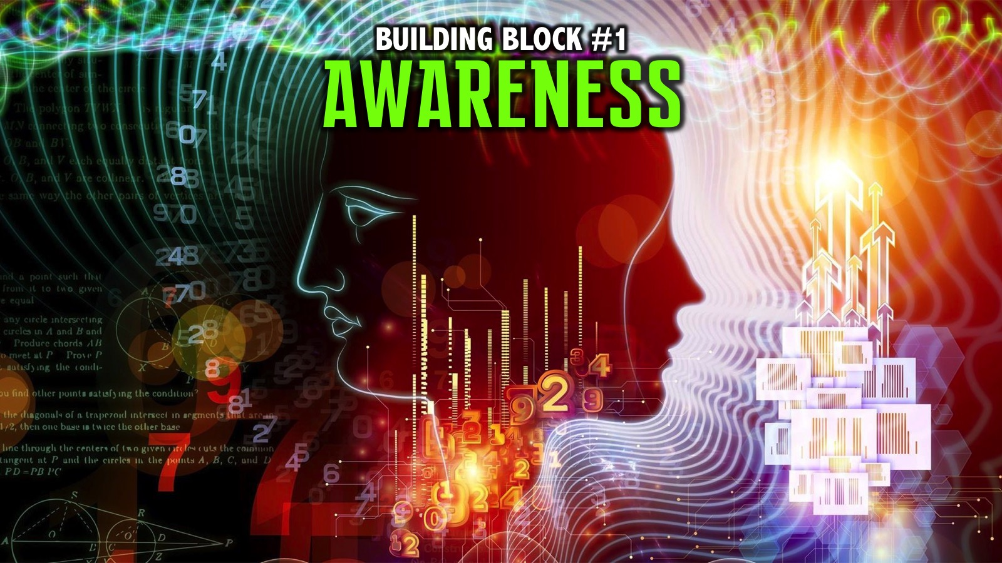
Notes:
We explored the first building block: Awareness.

Slide 7
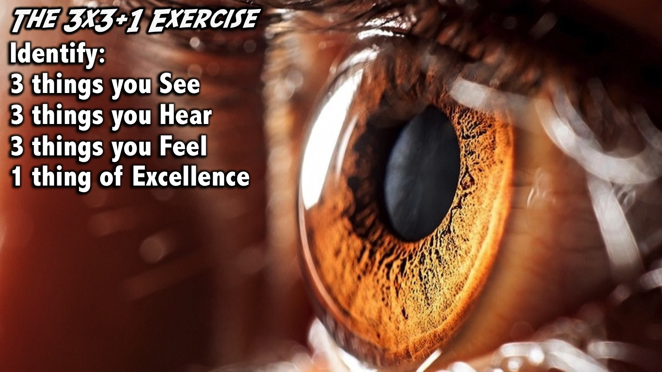
Notes:
Practice: The 3x3+1 Exercise: Do a 3x3+1 whenever you can by identifying: 3 things you See; 3 things you Hear; 3 things you Feel, and 1 thing of Excellence.

Slide 8
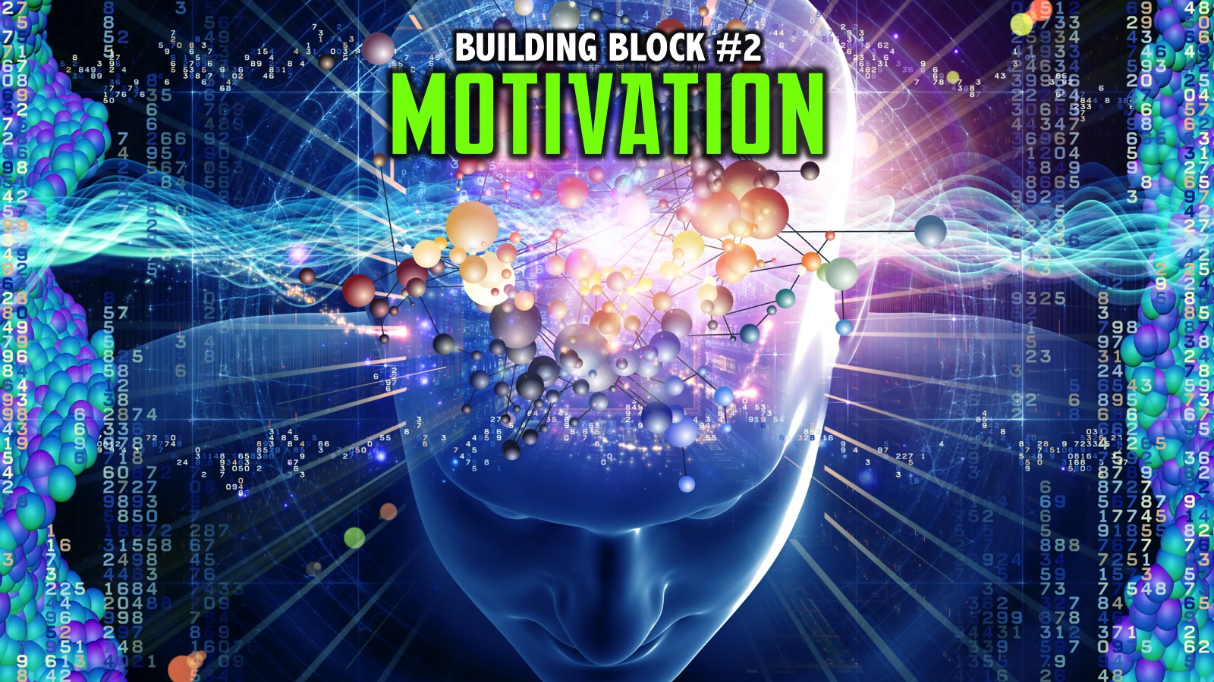
Notes:
We explored the second building block: Motivation.

Slide 9

Notes:
Practise: The Yearbook Exercise: When the Yearbook is printed at the end of your high school career what do you want it to say about you?

Slide 10
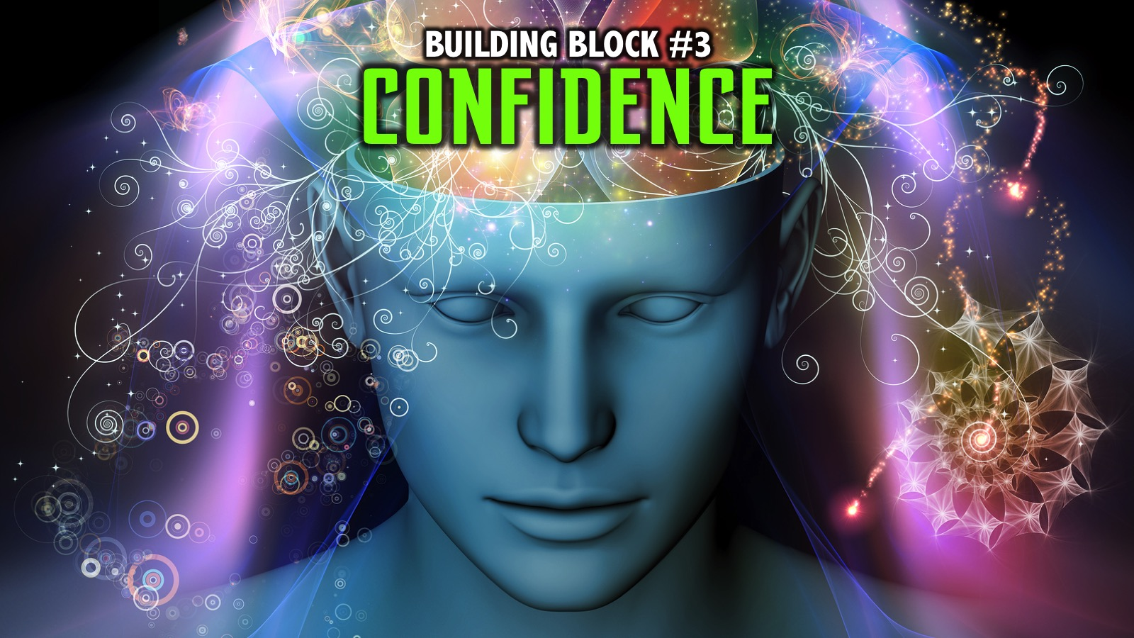
Notes:
We explored the third building block: Confidence.

Slide 11
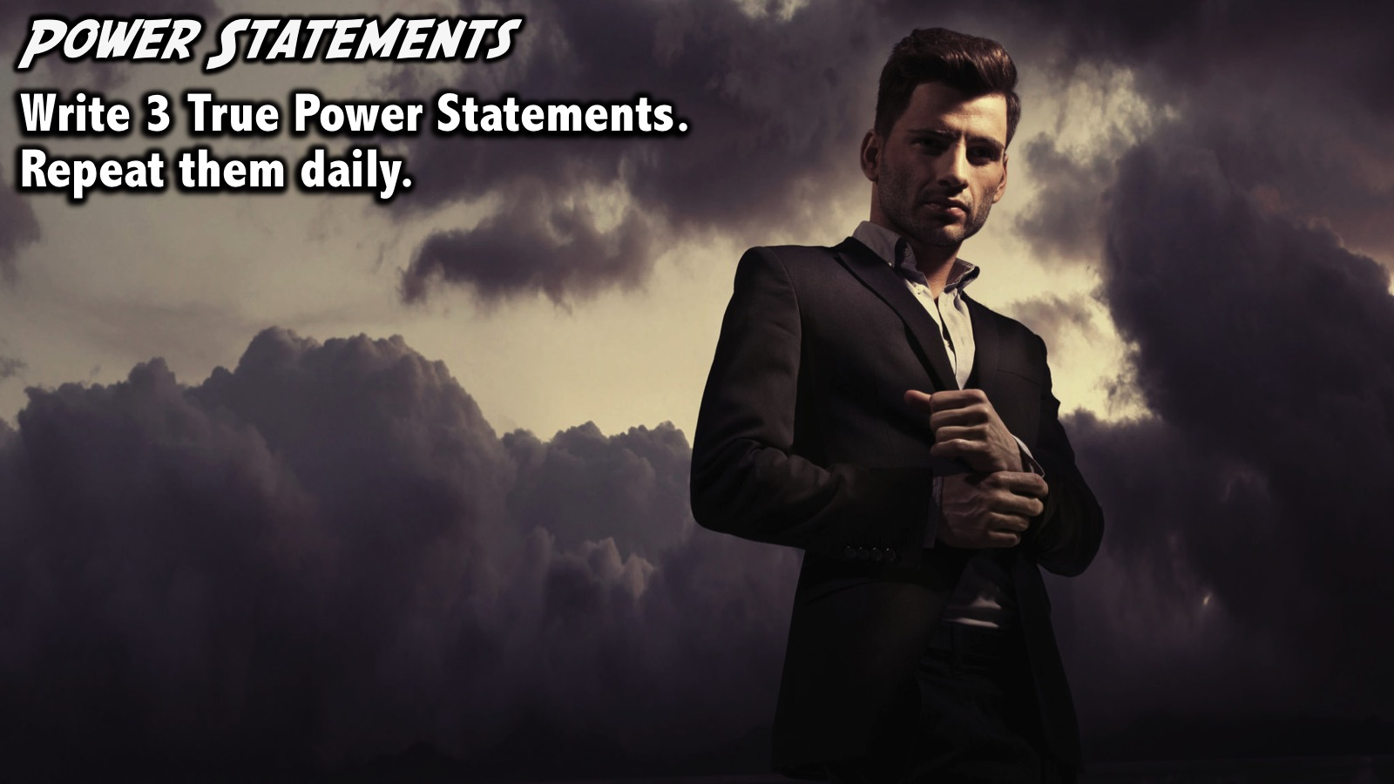
Notes:
Practice: Power Statements. Write down 3 truthful Power Statements that you will commit to read every morning when you wake up and every night when you go to bed.

Slide 12
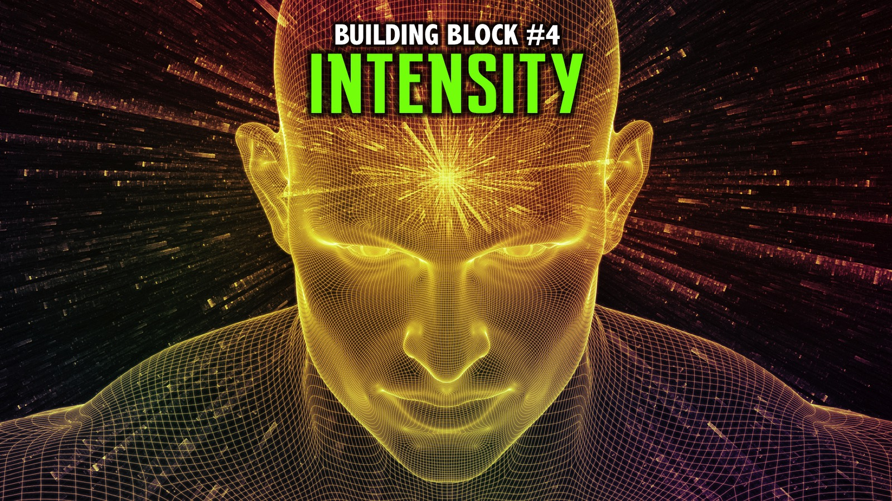
Notes:
We explored the fourth building block: Intensity.

Slide 13
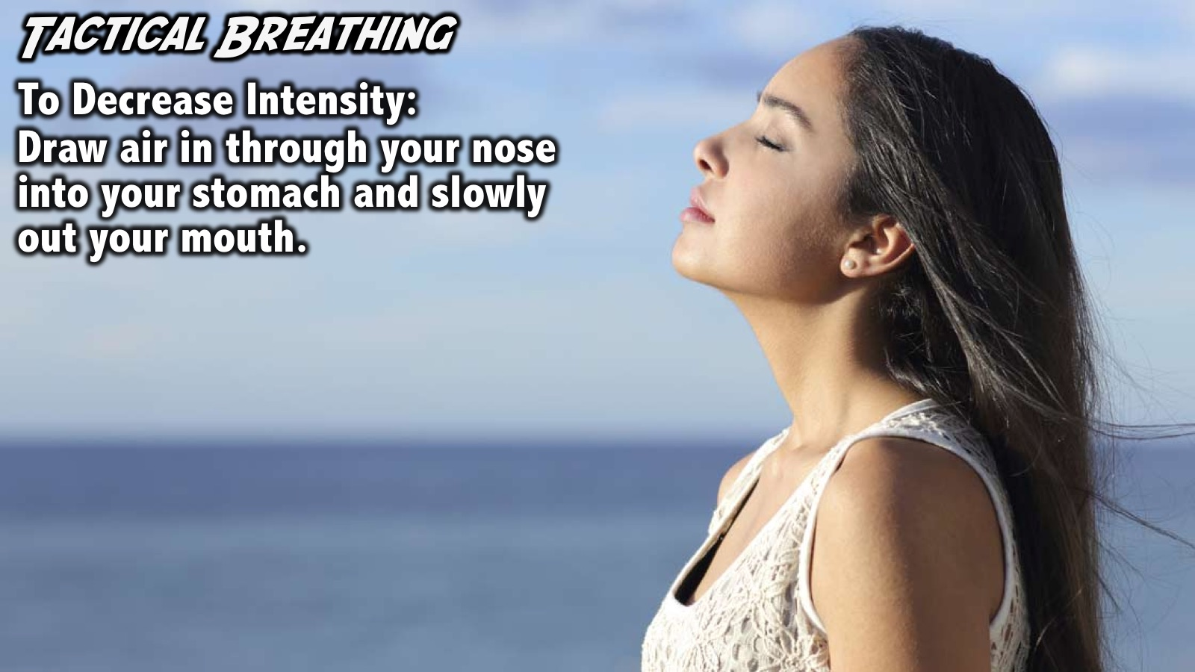
Notes:
Practise #1: Tactical Breathing: You can tone down you intensity by doing tactical breathing where you draw air in through your nose down into your stomach, your chest should not move but your stomach should go out and then the air goes out through your mouth.

Slide 14
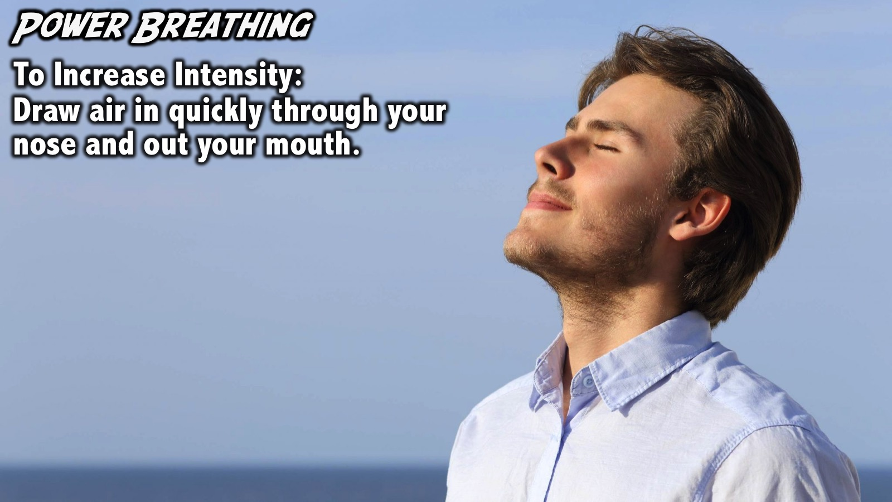
Notes:
Practise #2: Power Breathing: You can turn up your intensity by doing power breathing where you take air in quickly through your nose and exhale it through your mouth.

Slide 15

Notes:
Practise #3: Park it and Refocus. When something happens in life you need to learn to park it (let it go) and then refocus on what needs to be done next.

Slide 16
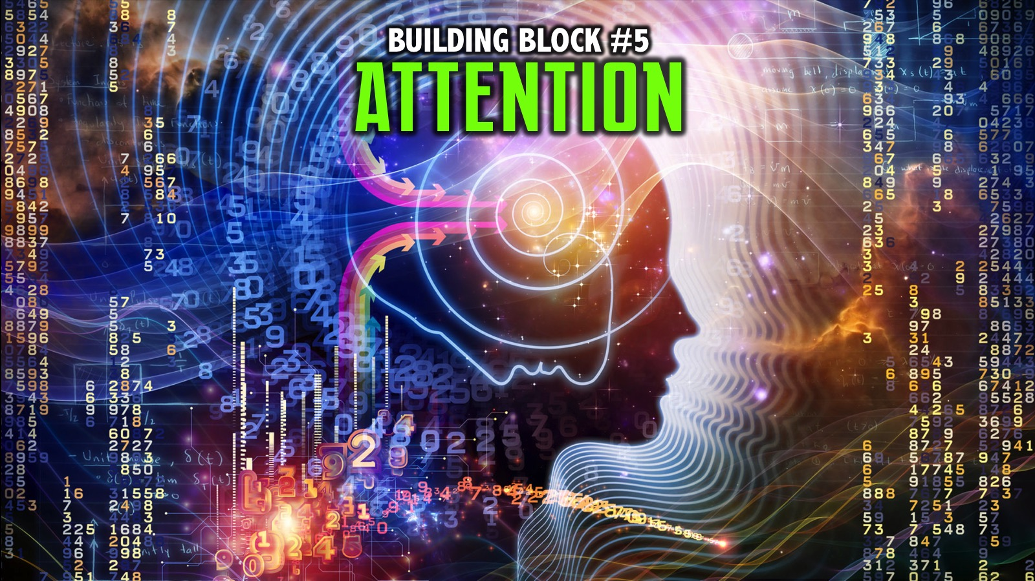
Notes:
We explored the fifth building block: Attention.

Slide 17
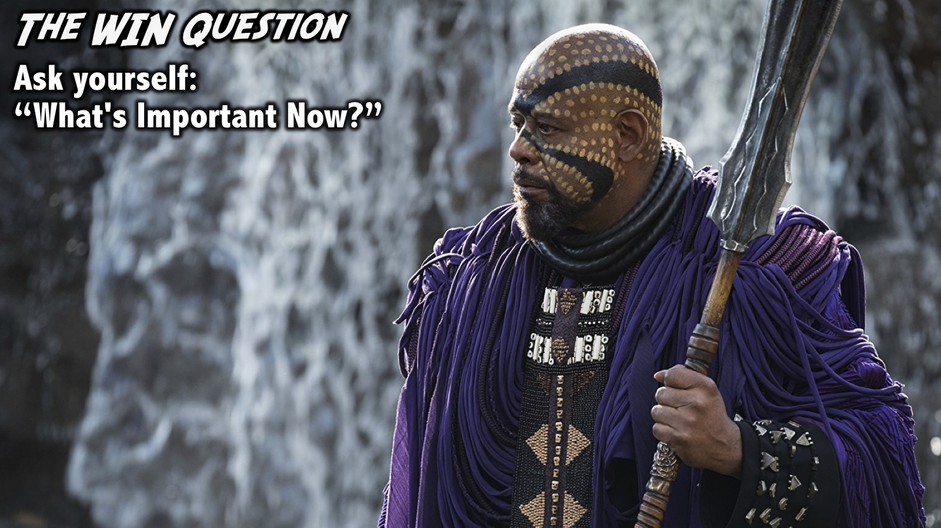
Notes:
Practice: The WIN Question. Practice asking yourself ”What's Important Now?" throughout the day to train your mind to focus your attention on what is important in the moment so you can perform well.

Slide 18
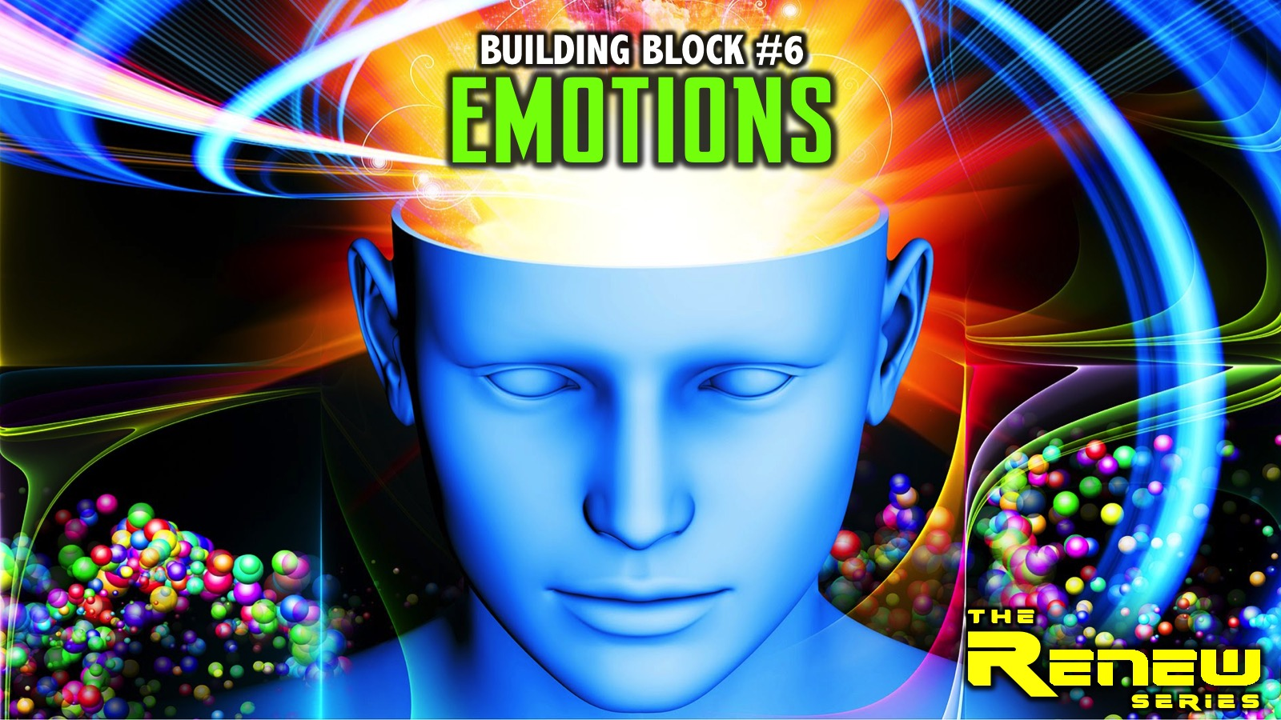
Notes:
We explored the sixth building block: Emotions.

Slide 19
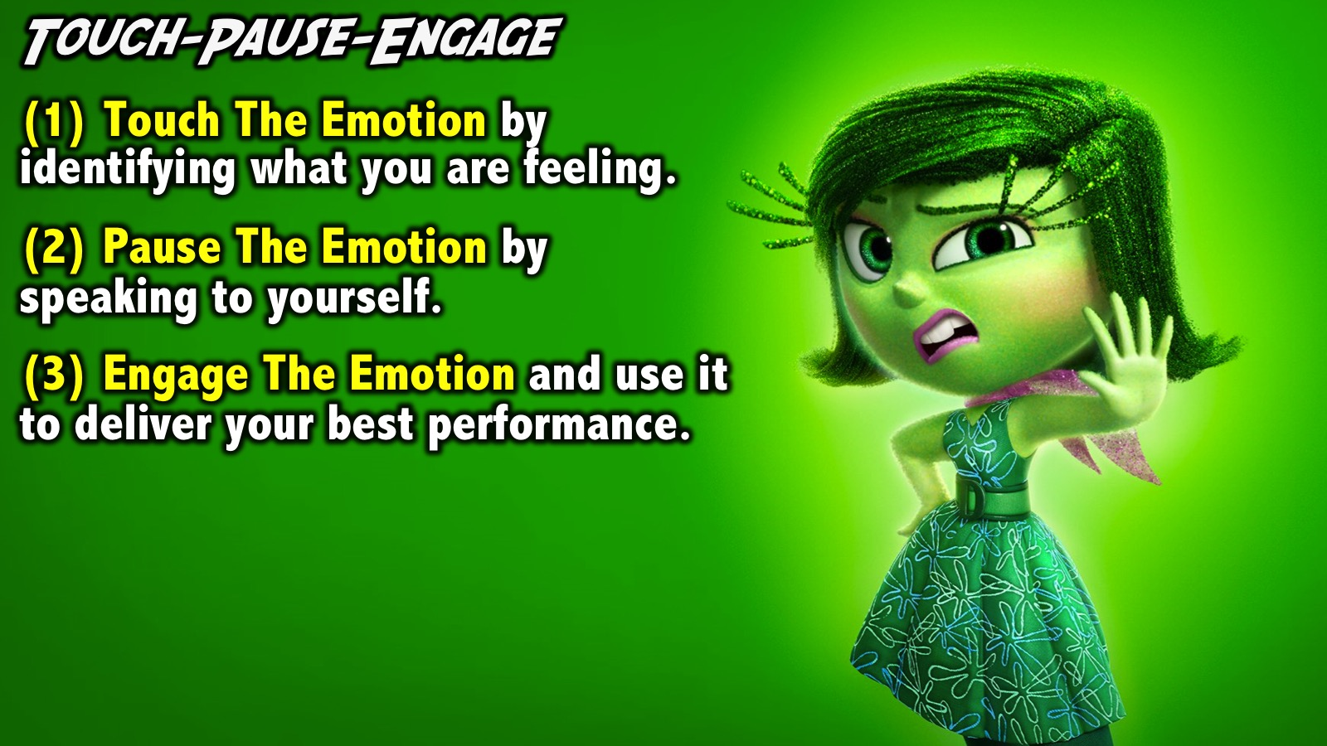
Notes:
Practice: Touch-Pause-Engage. When you face a tough situation: (1) Touch The Emotion by identifying what you are feeling. (2) Pause The Emotion by speaking to yourself to bring it in line with your beliefs. (3) Engage The Emotion and use it to deliver your best performance.

Slide 20
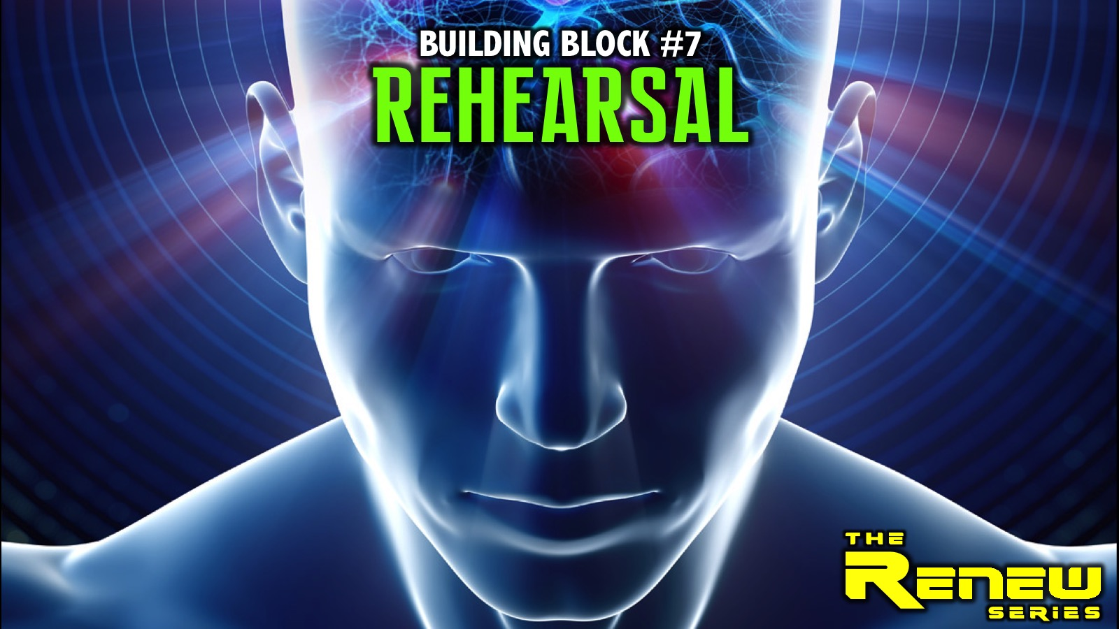
Notes:
Last week we explored the seventh building block: Rehearsal.

Slide 21
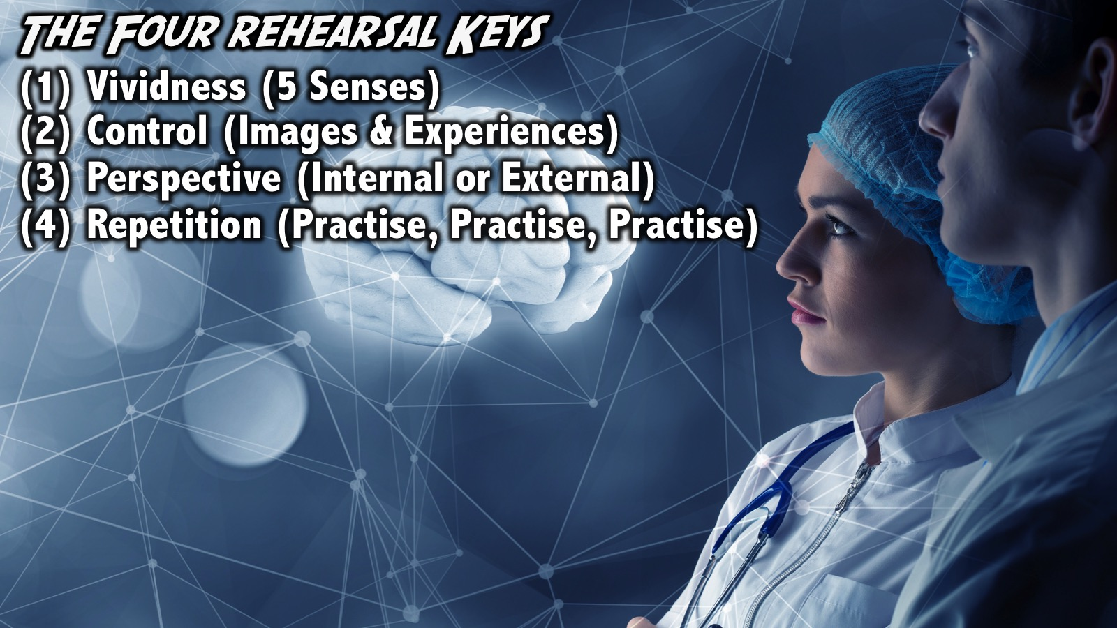
Notes:
Practice: The Four Rehearsal Keys - Practice mental rehearsal training for an upcoming event for 5 minutes/day using the keys to effective mental rehearsal: (1) Vividness (use all 5 senses); (2) Control (images and experiences so we are imagining the right things); (3) Perspective (internal or external) and (4) Repetition (practise, practise, practise).

Slide 22
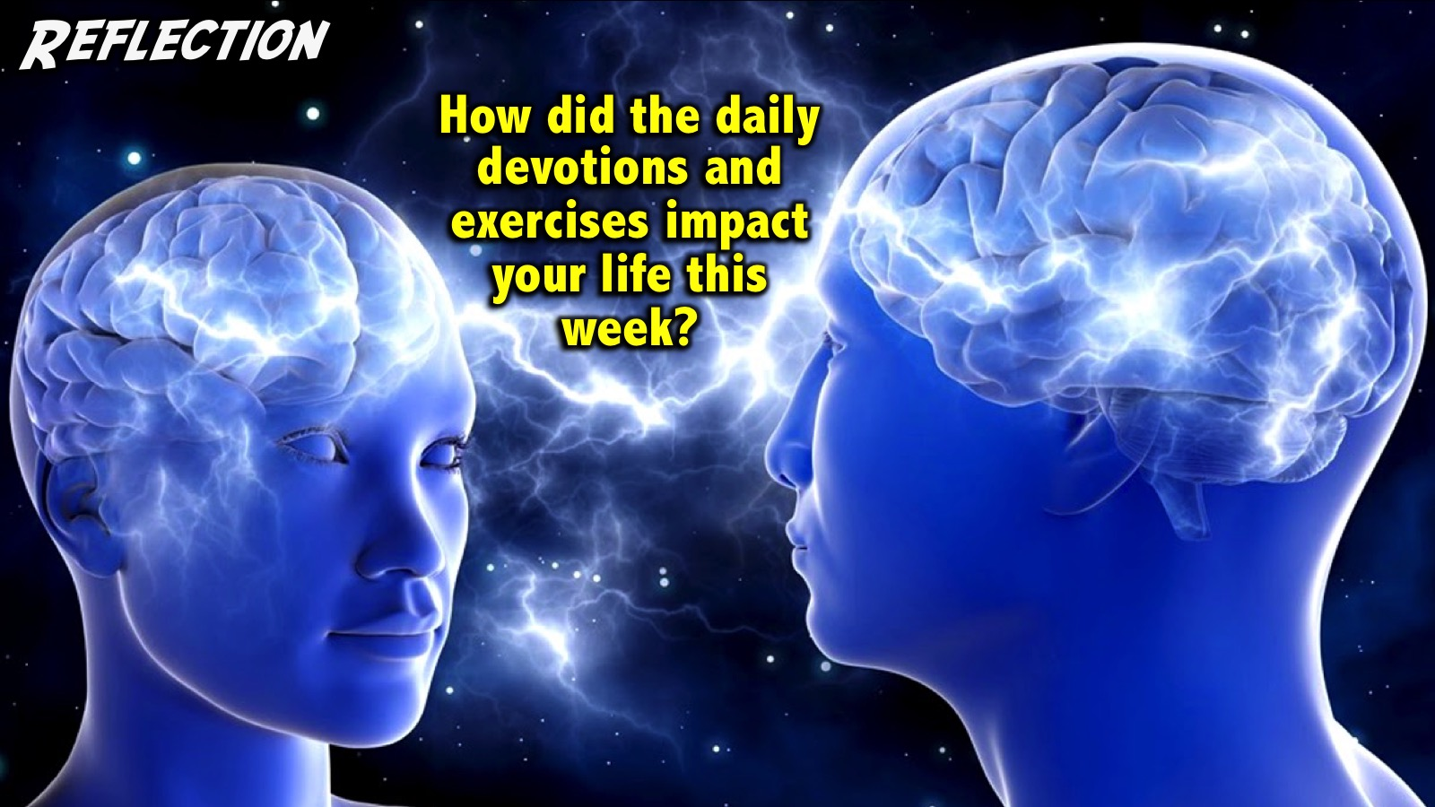
Notes:
Reflection: How did the daily devotions and exercises impact your life this week?

Slide 23
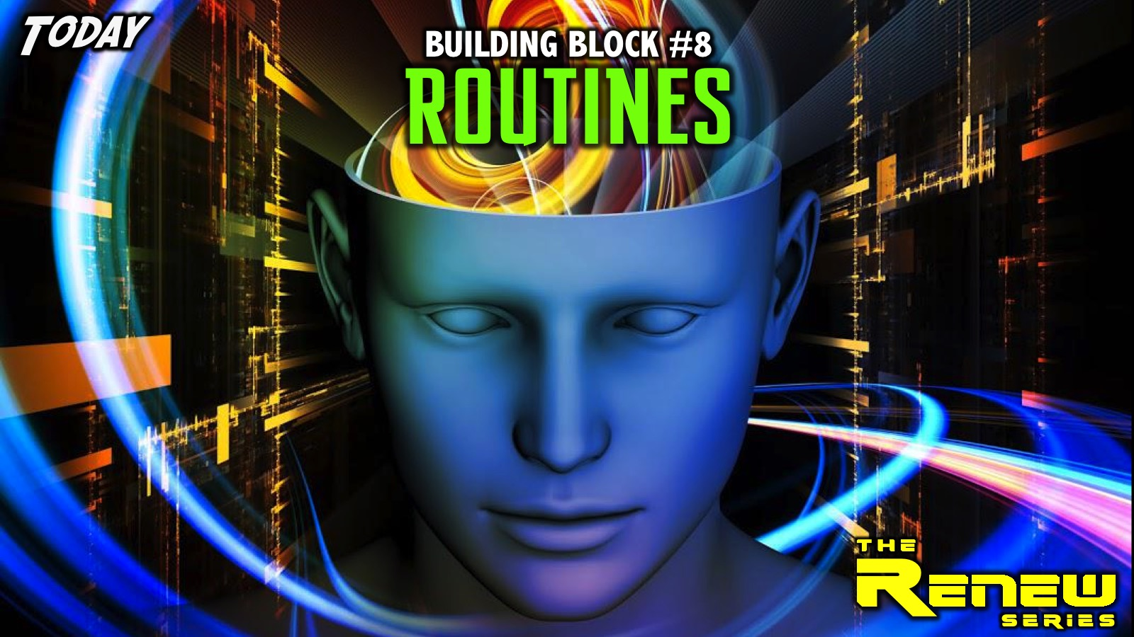
Notes:
Today we are going to explore the eighth and final building block: Routines.

Slide 24
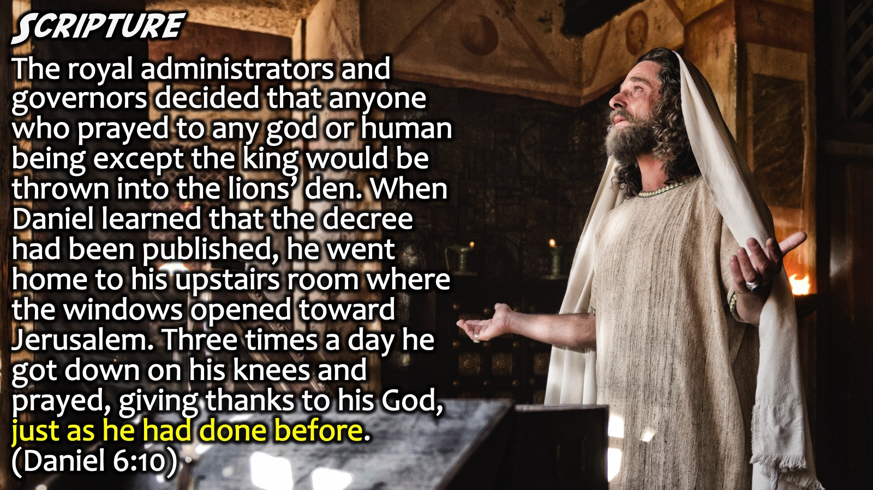
Notes:
Scripture: “The royal administrators and governors decided that anyone who prayed to any god or human being except the king would be thrown into the lions’ den. When Daniel learned that the decree had been published, he went home to his upstairs room where the windows opened toward Jerusalem. Three times a day he got down on his knees and prayed, giving thanks to his God, just as he had done before.” (Daniel 6:10)

Slide 25
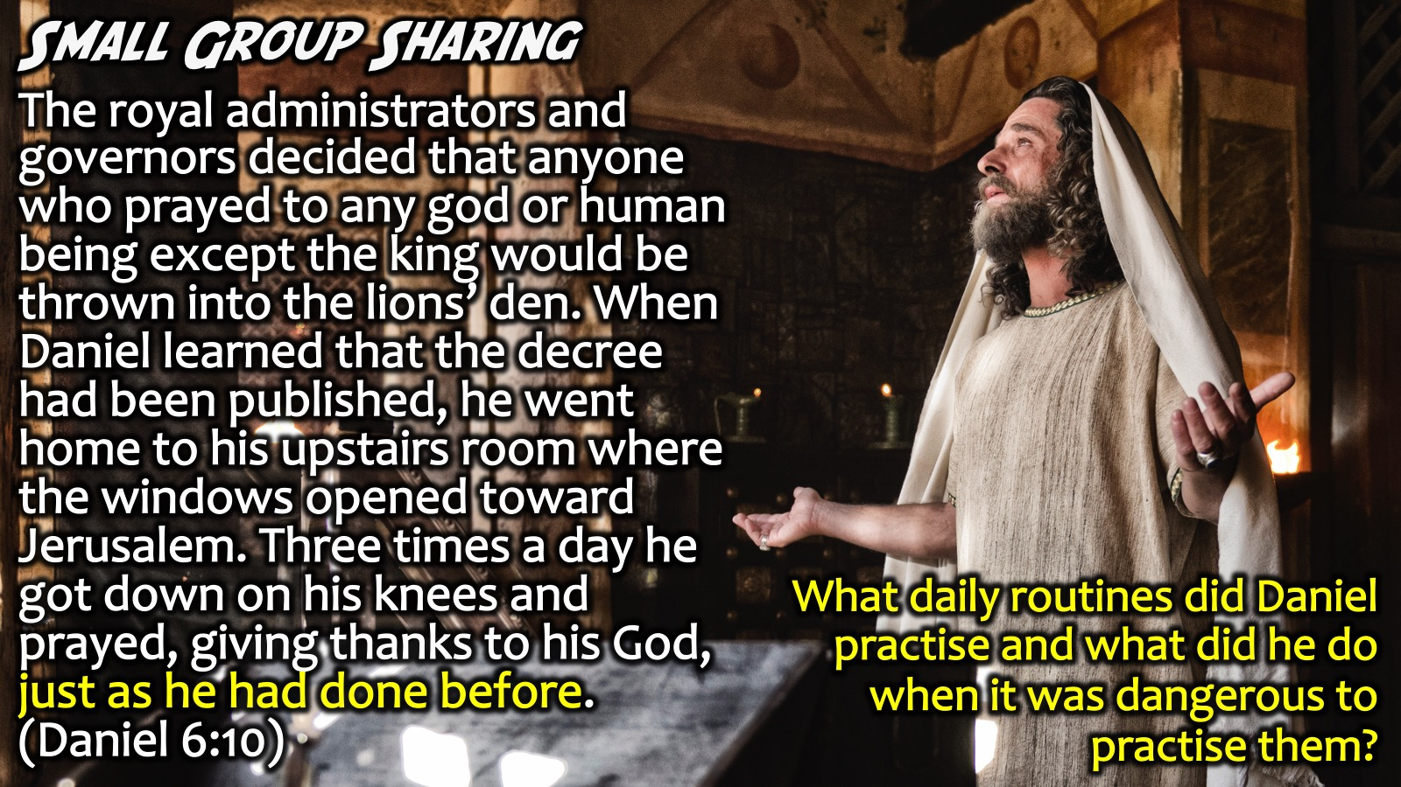
Notes:
Small Group Sharing: What daily routines did Daniel practise and what did he do when it was dangerous to practise them?
Facilitators Notes: Daniel got on his knees three times a day to pray to God and to give thanks, and not even the threat of death made him change his routine.

Slide 26
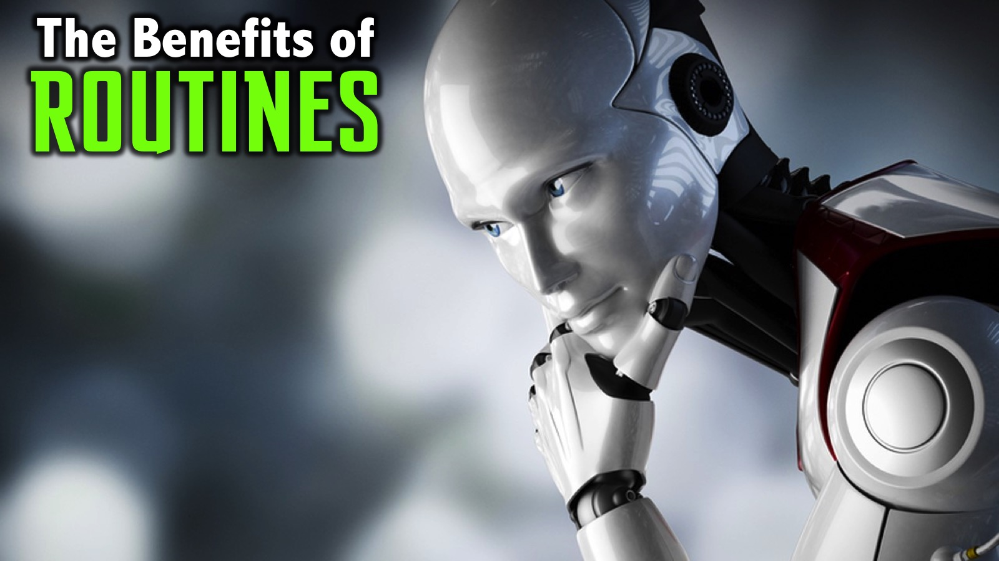
Notes:
The Benefits of Routines: The best of the best have routines built into how they live and function. Why is that?

Slide 27
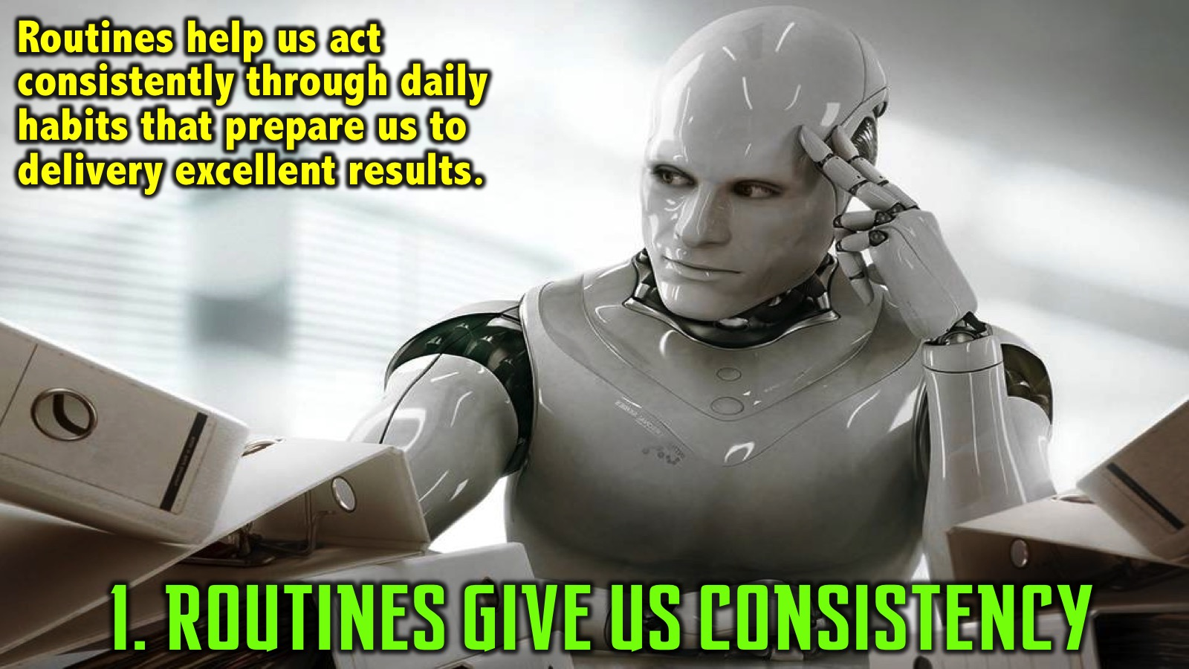
Notes:
1. Routines give us Consistency. Routines helps drive consistence in how we think and how we function. There is a book called: “The Mundanity of Excellence” - excellence is not glamorous and sexy - the core of excellence is consistency over time - day in and day out daily habits that prepare us to delivery excellent results. We must learn to love the grind - routines help us get into a groove where we practise disciples that lead us to greatness over time.

Slide 28
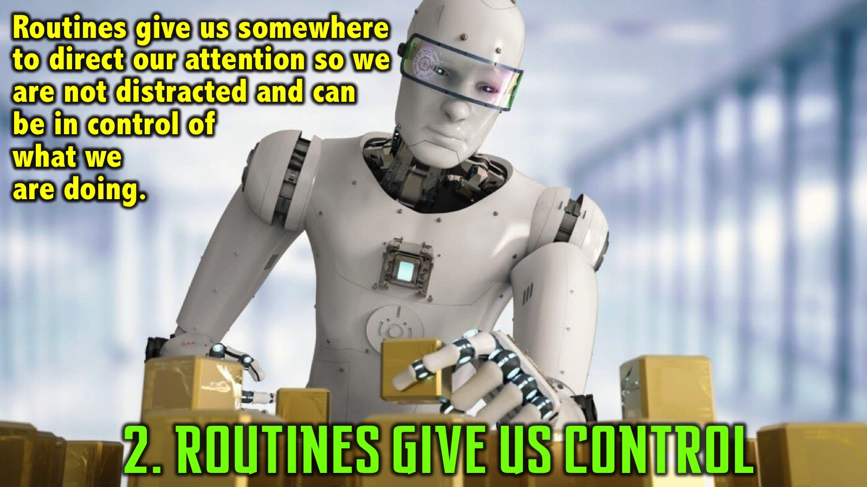
Notes:
2. Routines give us Control. Routines give us somewhere to direct our attention so we are not distracted by the crowds or internal direction - it gives us control and calmness about what we are doing and how we are doing it. They help us focus our attention despite distractions. “Garbage is going to hit the fan, when that happens we need something to go to.” Life is not just about home run hits - but often it is about grinding through life in a productive away.

Slide 29
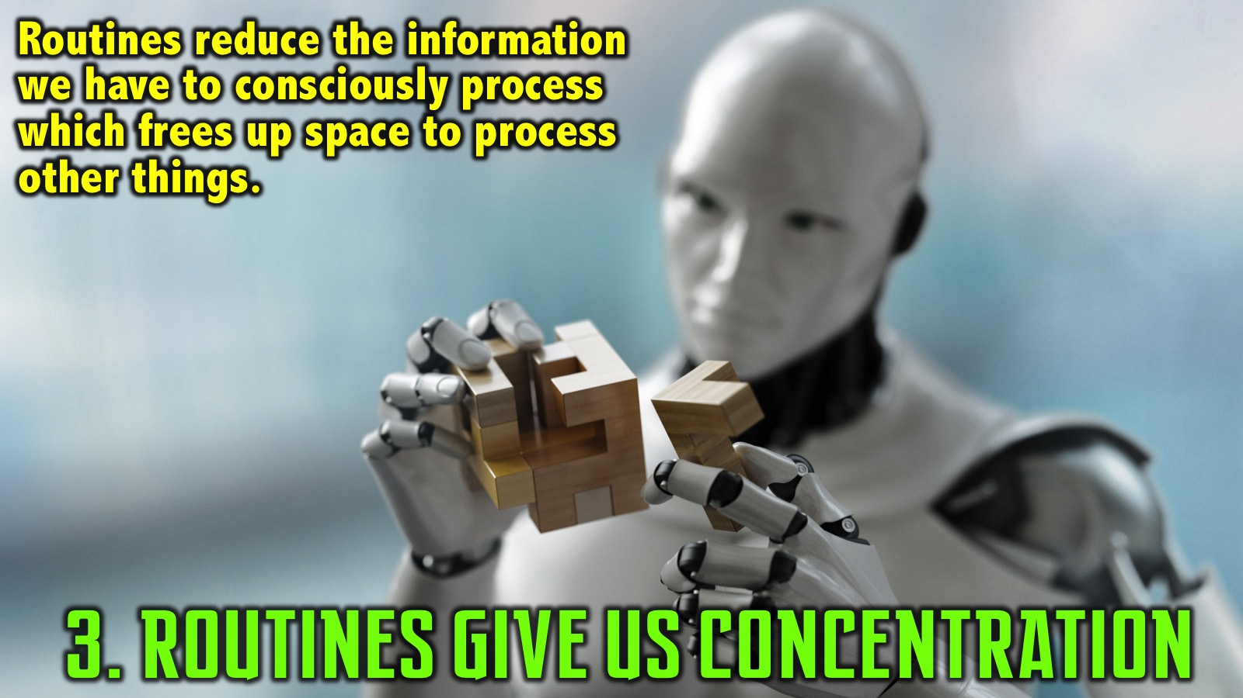
Notes:
3. Routines give us Concentration. Routines minimise the amount of information that we have to consciously process. Routines create an ease and consistency - a lack of conscious processing that has to happen which frees up space for us to think about and process other things.

Slide 30

Notes:
Activity: Cross your arms. It takes a split second to do!

Slide 31

Notes:
Now cross your arms in the opposite way. What do we notice? It took longer and we had to think about it and focus and maybe even start with the old way and then figure out how to get out arms positioned correctly. This is the power of routines!!!

Slide 32
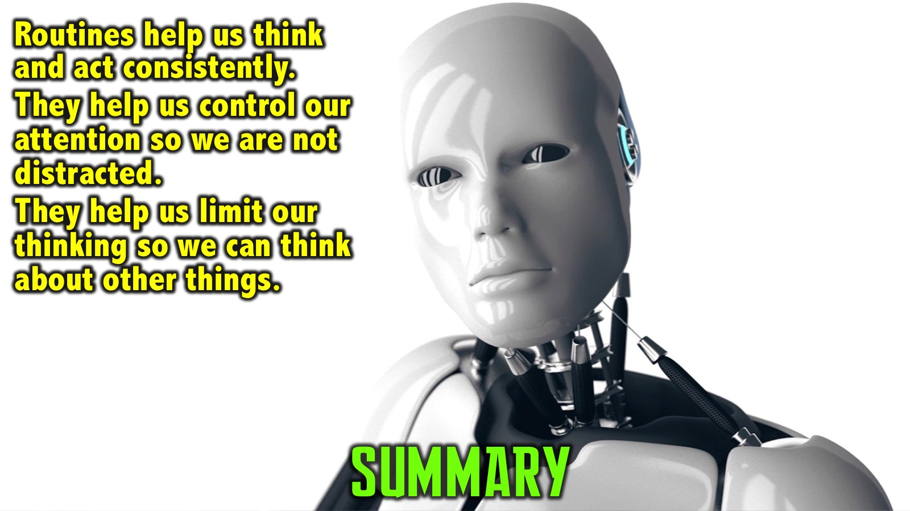
Notes:
Summary: Routines are important because they help drive consistency in how we live and function; they give us somewhere to direct our attention so we can better manage our attention and they help us manage the amount of conscious processing that takes place to free up elements to be processed towards other things to set our game up and take us to the next level.

Slide 33
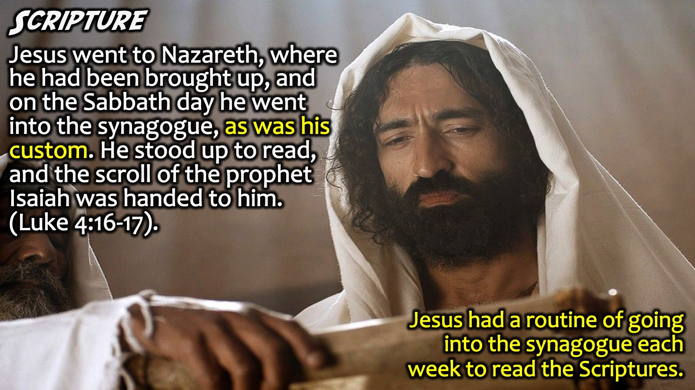
Notes:
Scripture: “Jesus went to Nazareth, where he had been brought up, and on the Sabbath day he went into the synagogue, as was his custom. He stood up to read, and the scroll of the prophet Isaiah was handed to him.” (Luke 4:16-17). Jesus had a routine of going into the synagogue each week to read the Scriptures.

Slide 34
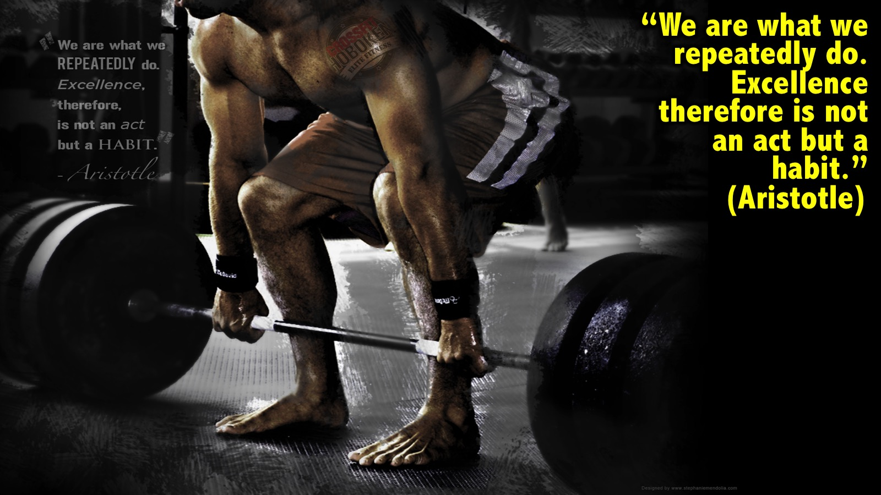
Notes:
“We are what we repeatedly do. Excellence therefore is not an act but a habit.” (Aristotle). A habit is something you do so often that it becomes a part of the very essence of your being.

Slide 35
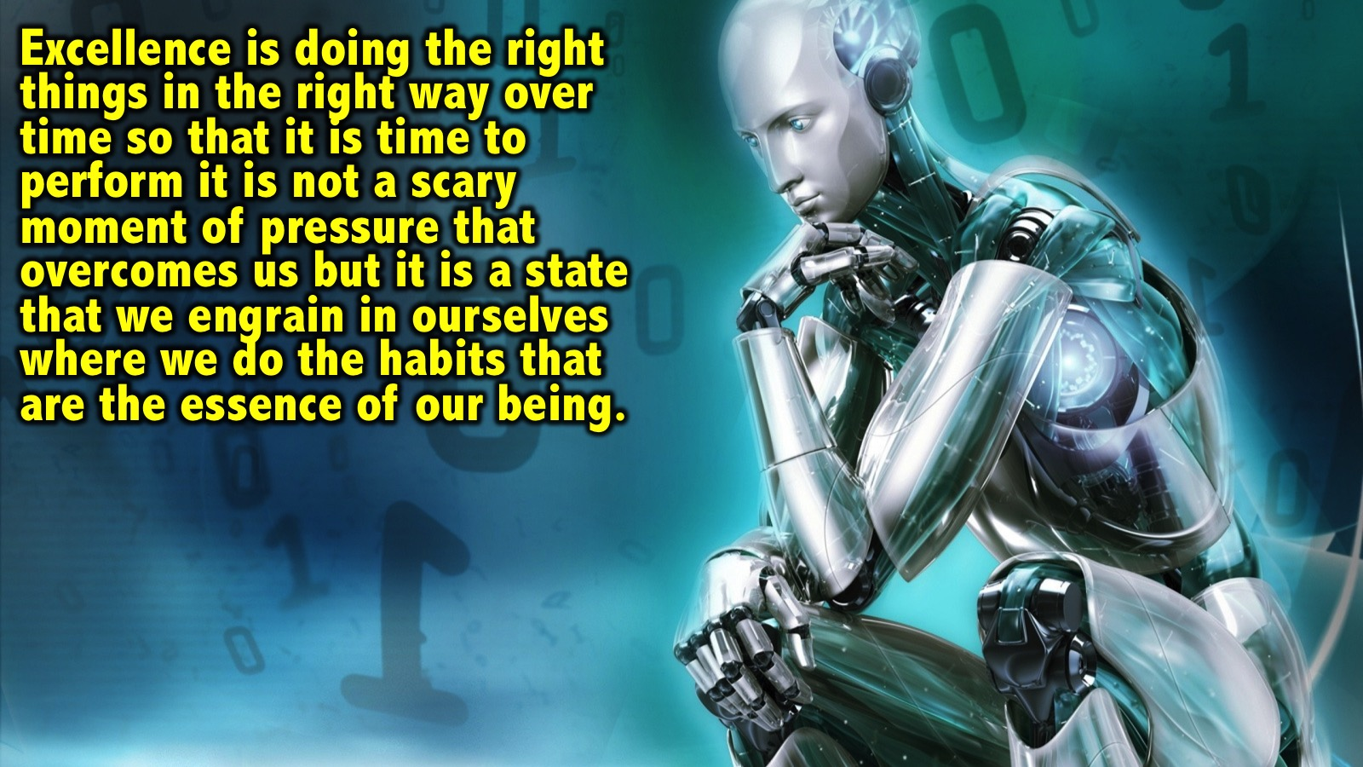
Notes:
Excellence is not always a glamorous thing but it is the consistent application of doing the right things in the right way over time so that when our performance moments happen, when our big opportunities to shine come, it is not a scary moment of pressure that overcomes us but rather it is a state that we engrain in ourselves where we demonstrate and apply the very habits that are the essence of our being.

Slide 36
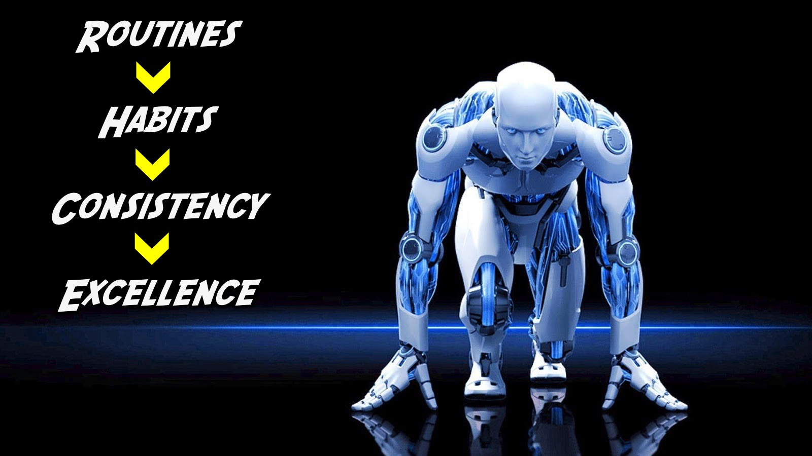
Notes:
The Process: Routines lead to habits and habits lead to consistency which leads us to excellence. Routines become the initiating factor that create habits of excellence and consistency in how we live and function. It is this consistence that gives us the courage to show up and bring our best selves to whatever domain that we are in whether at home in sport or in competition. So routines are connected to excellence.

Slide 37

Notes:
Illustration: The New Zealand All Black debuted in 1903 and won 73% of all rugby games they played over the years. They could just not translate all the wins into winning a world cup - they won one in 1987 and could not do it again for a long time.

Slide 38

Notes:
A sports psychologist was brought in to analyse what was going wrong and they noticed that they did the Haka prior to each competition - an intense and historical dance - but they never did it in practise. Let’s watch one of their greatest Haka’s of all times…

Slide 39
Notes:
Video: The Greatest Haka Ever. Get it on YouTube at: https://www.youtube.com/watch?v=yiKFYTFJ_kw

Slide 40
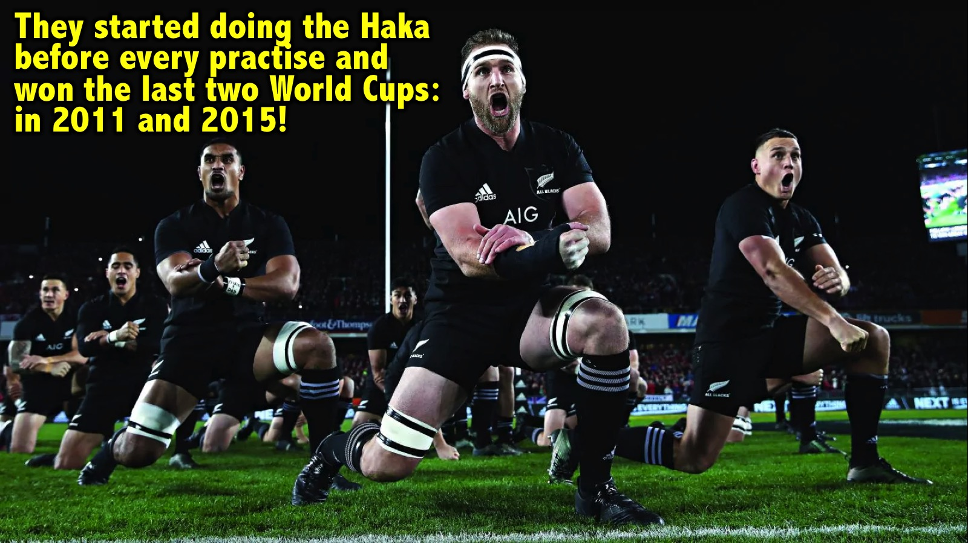
Notes:
So they started doing the Haka before their practise games and this started to created a similar mindset, emotion, mental state and attention detail and focus in practise so that when they got to games it was a routine and a habit and they were ready to play and deliver their absolute best. They won the last two world cups in 2011 and 2015 and they attention to detail and consistency over time have been amazing! Implication: We must get routines built into our lives and not just in game times.

Slide 41
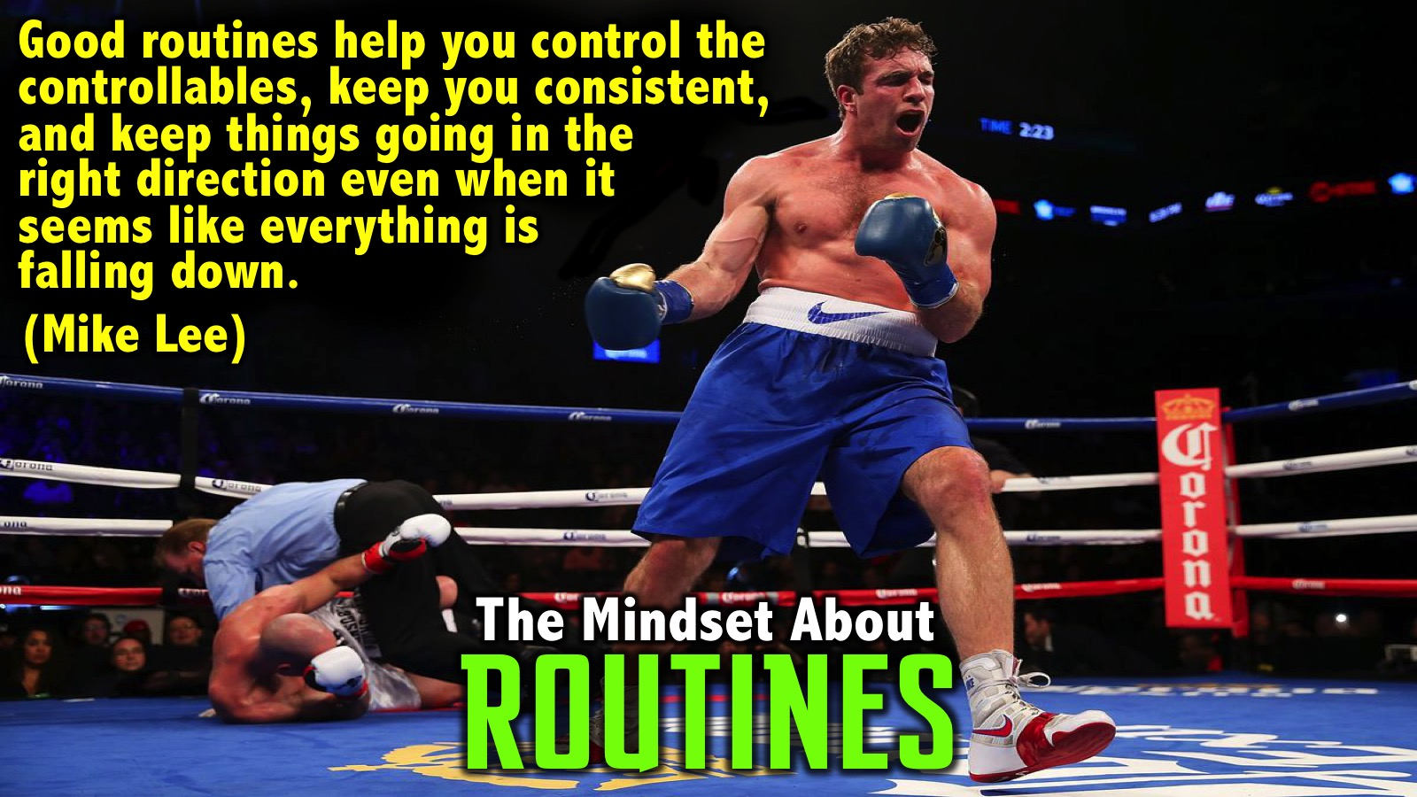
Notes:
The Mindset About Routines: Here is what a boxer, Mike Lee, has to say about routines: Good routines are an absolute necessity, they help us control the controllables, and you must keep good routines and good people around you because they keep you consistent and keep things going in the right direction even when it seems like everything is falling down.

Slide 42
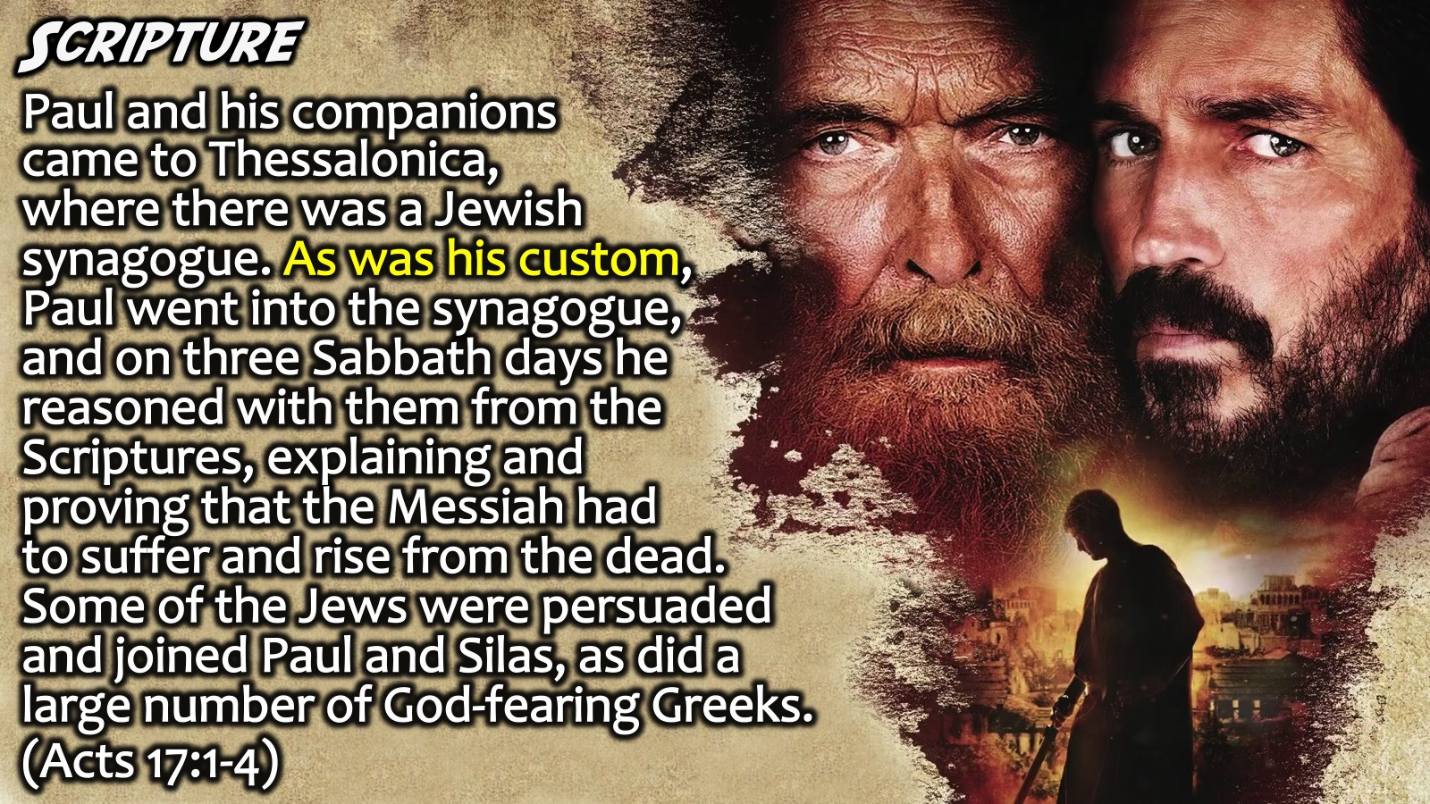
Notes:
Scripture: When Paul and his companions had passed through Amphipolis and Apollonia, they came to Thessalonica, where there was a Jewish synagogue. As was his custom, Paul went into the synagogue, and on three Sabbath days he reasoned with them from the Scriptures, explaining and proving that the Messiah had to suffer and rise from the dead. “This Jesus I am proclaiming to you is the Messiah,” he said. Some of the Jews were persuaded and joined Paul and Silas, as did a large number of God-fearing Greeks and quite a few prominent women. (Acts 17:1-4).

Slide 43
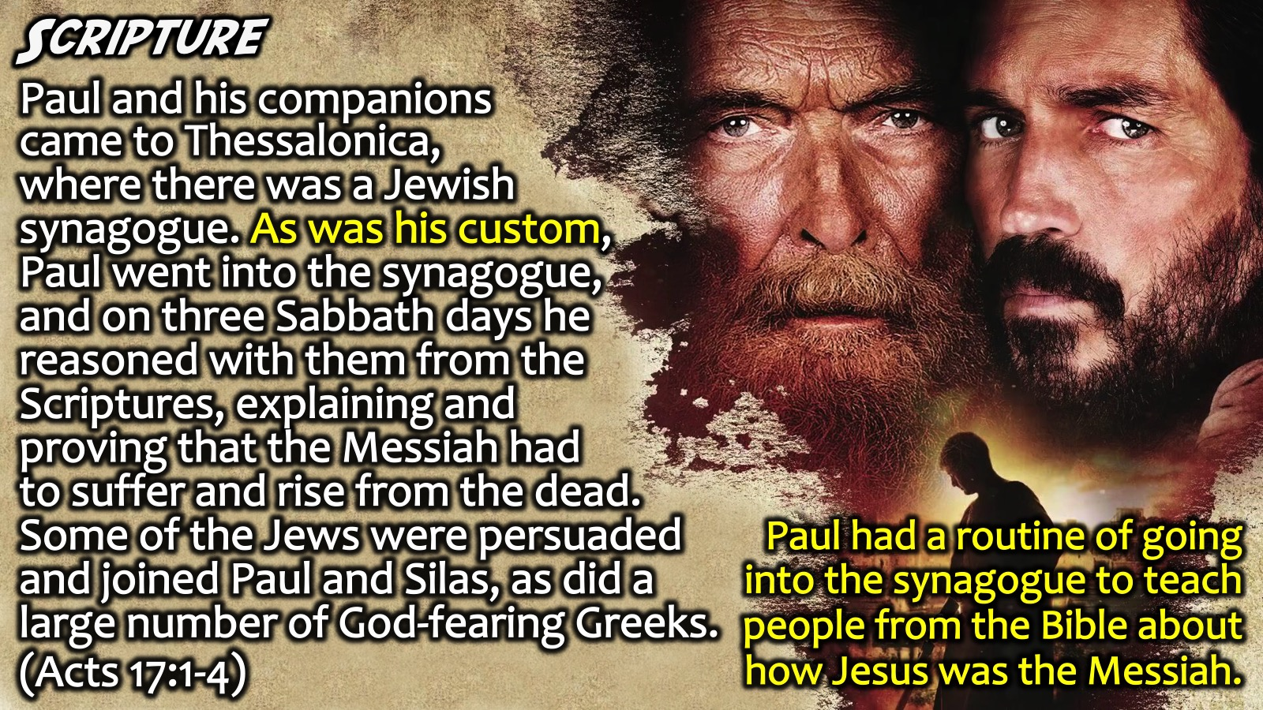
Notes:
Paul had a routine of going into the synagogue to teach people from the Bible about how Jesus was the Messiah.

Slide 44
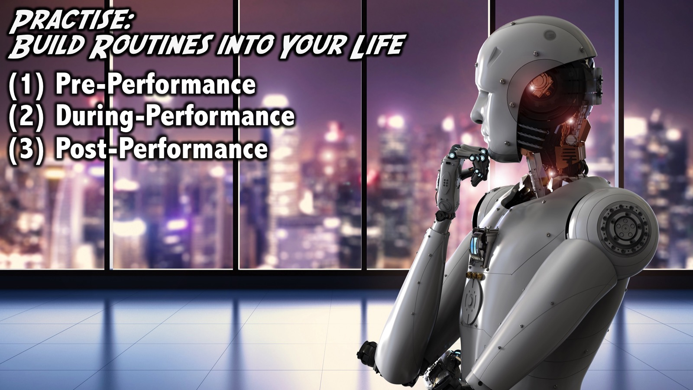
Notes:
Practise: Build Routines into Your Life: Incorporate all you have learnt from the previous 7 building blocks and start to build routines into your life. Create routines around everything you do. Create Pre-Performance, During Performance and Post-Performance routines.

Slide 45
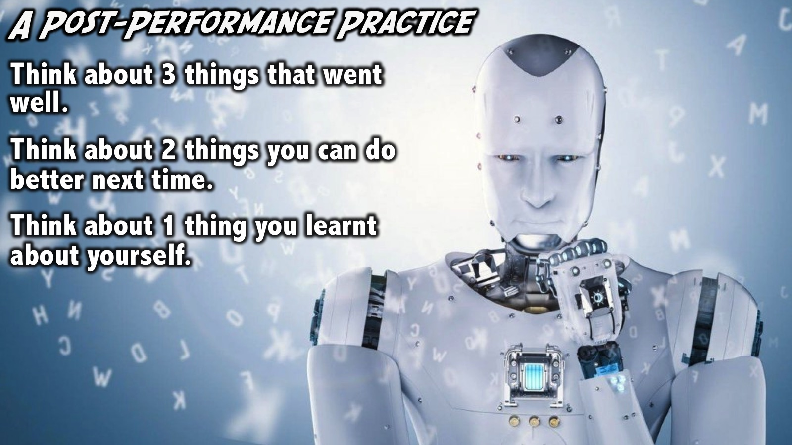
Notes:
A Post-Performance Practise: Here is an example of how you can do after a performance: (1) Think about 3 things that went well; (2) think about 2 things you can do better next time; and (3) think about 1 thing you learnt about yourself.

Slide 46
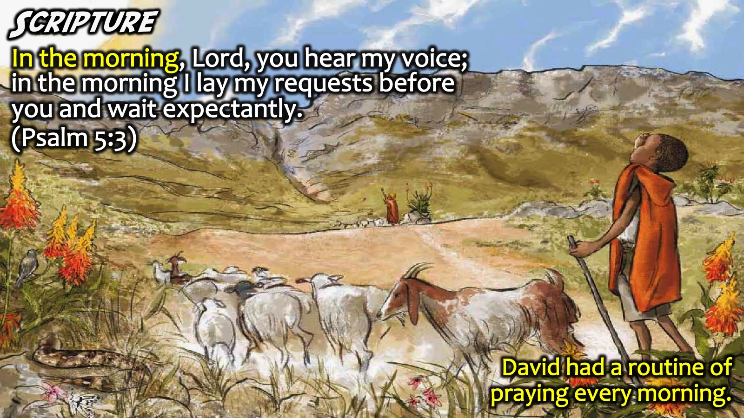
Notes:
Scripture: In the morning, Lord, you hear my voice; in the morning I lay my requests before you and wait expectantly. (Psalm 5:3). David had a routine of praying every morning.

Slide 47
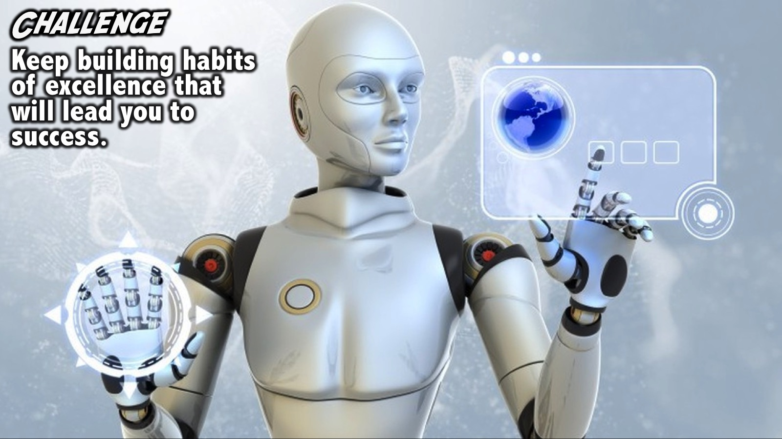
Notes:
Challenge: Keep building habits of excellence that will lead you to success.

Slide 48
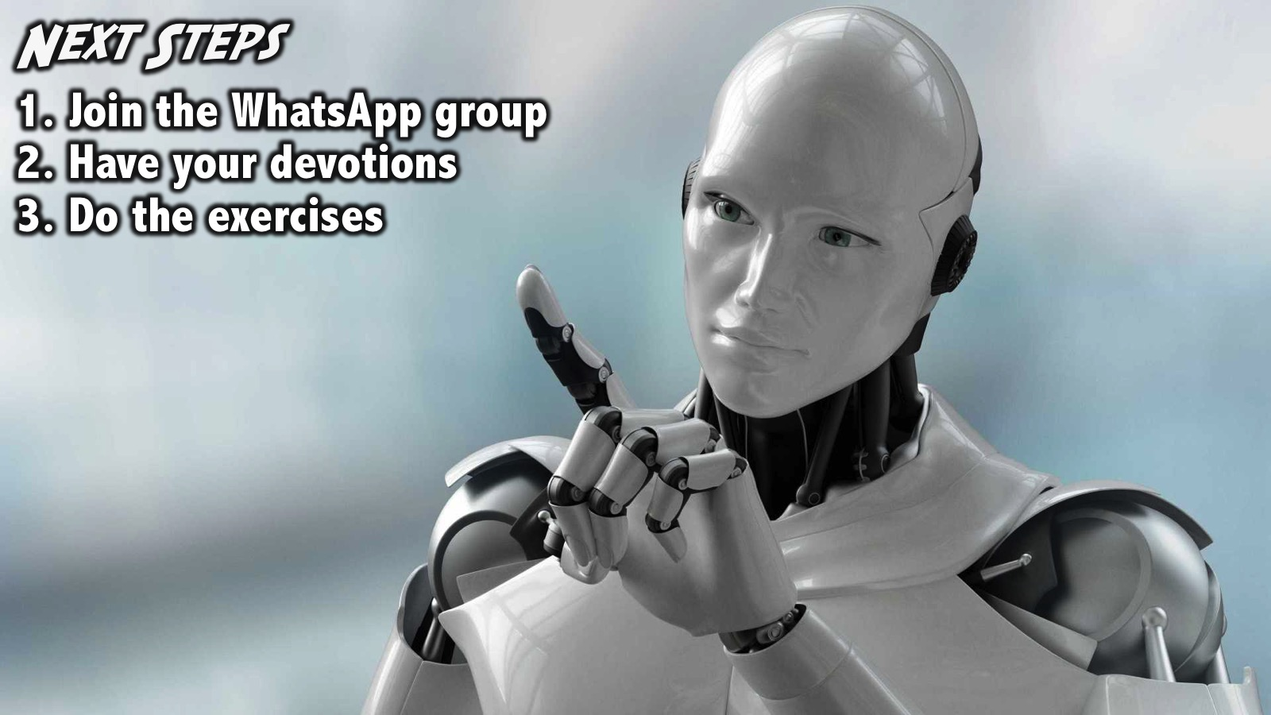
Notes:
Next Steps: (1) Join the WhatsApp group. (2) Have your devotions. (3) Do the exercises.

Slide 49
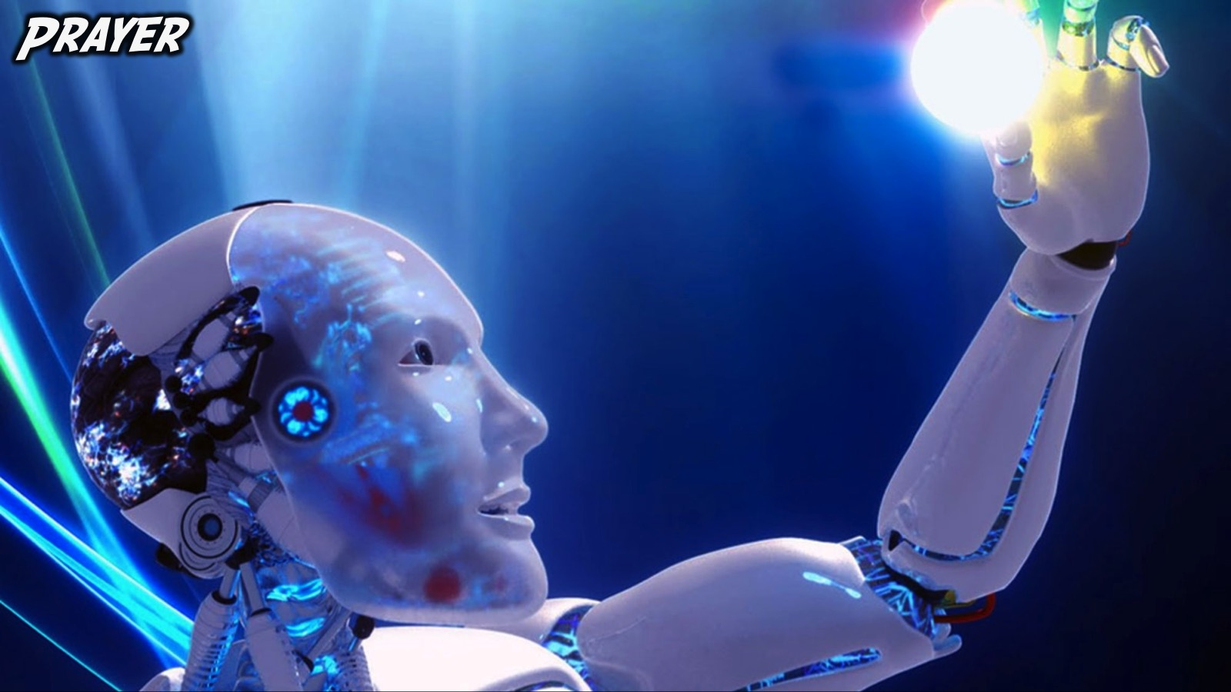
Notes:
Prayer:

Slide 50
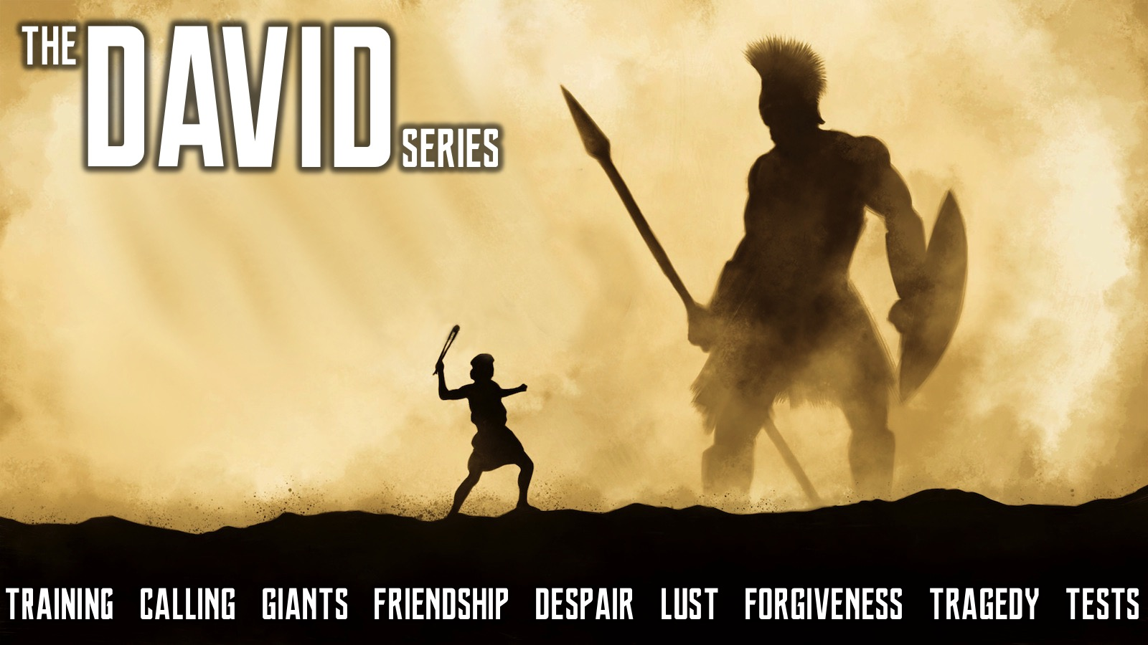
Notes:
Next Term: We have a band new series lined up for next term at Youth - we will be exploring the life of David and along the way we are going to discover that he deal with many of the issues that we face in our life and can help us deal with our stuff!

