Slide 1

Notes:
The Replicate Series

Slide 2

Notes:
Welcome to week 1 where we are going to introduce the series and talk about the need to LAUNCH a Movement.

Slide 3
Notes:
Video: Star Wars The Force Awakens Trailer (Official). Get it on YouTube at: https://www.youtube.com/watch?v=sGbxmsDFVnE

Slide 4
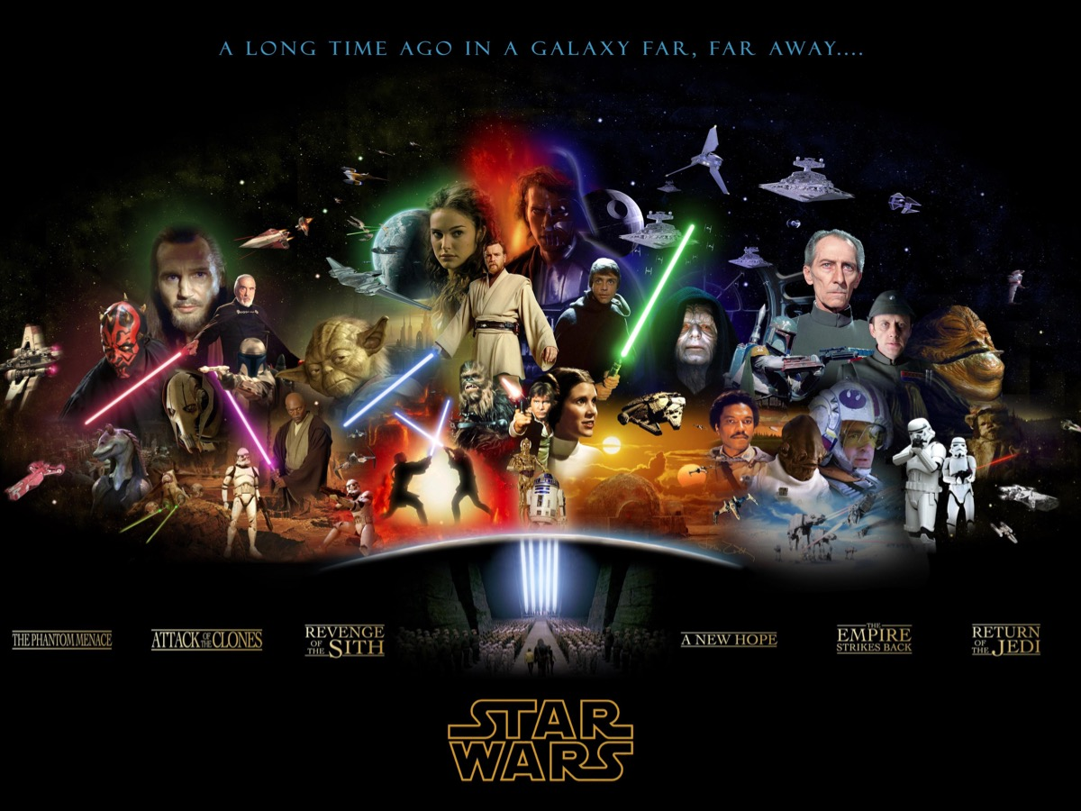
Notes:
How many of you enjoy the Star Wars movies or television series?

Slide 5
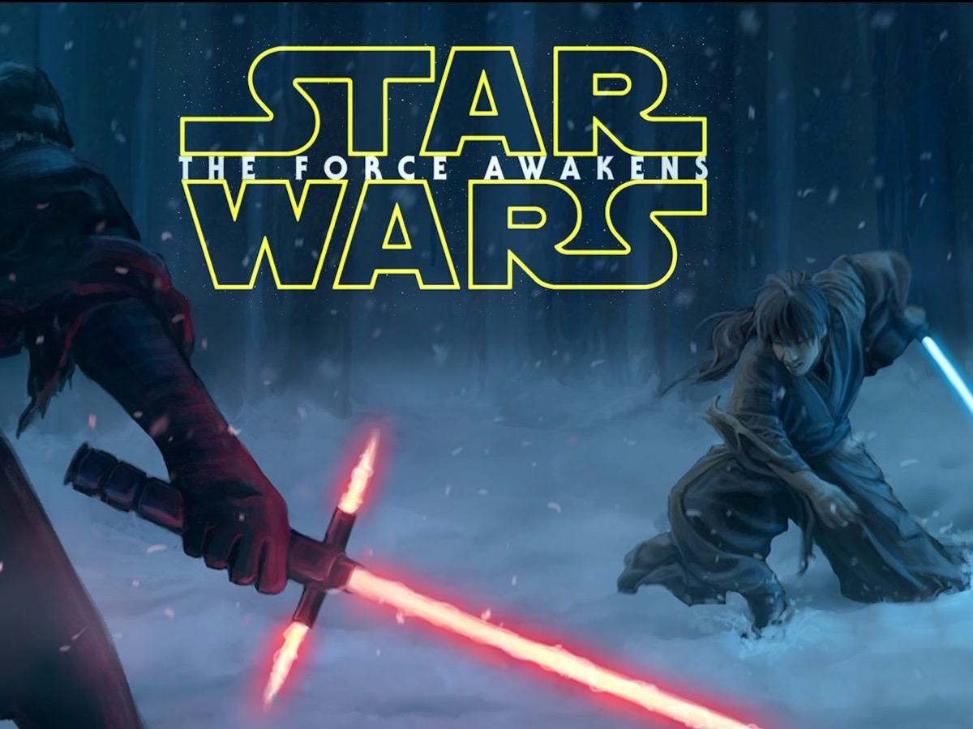
Notes:
Maybe you got to watch the 7th movie that was out in cinemas recently!

Slide 6
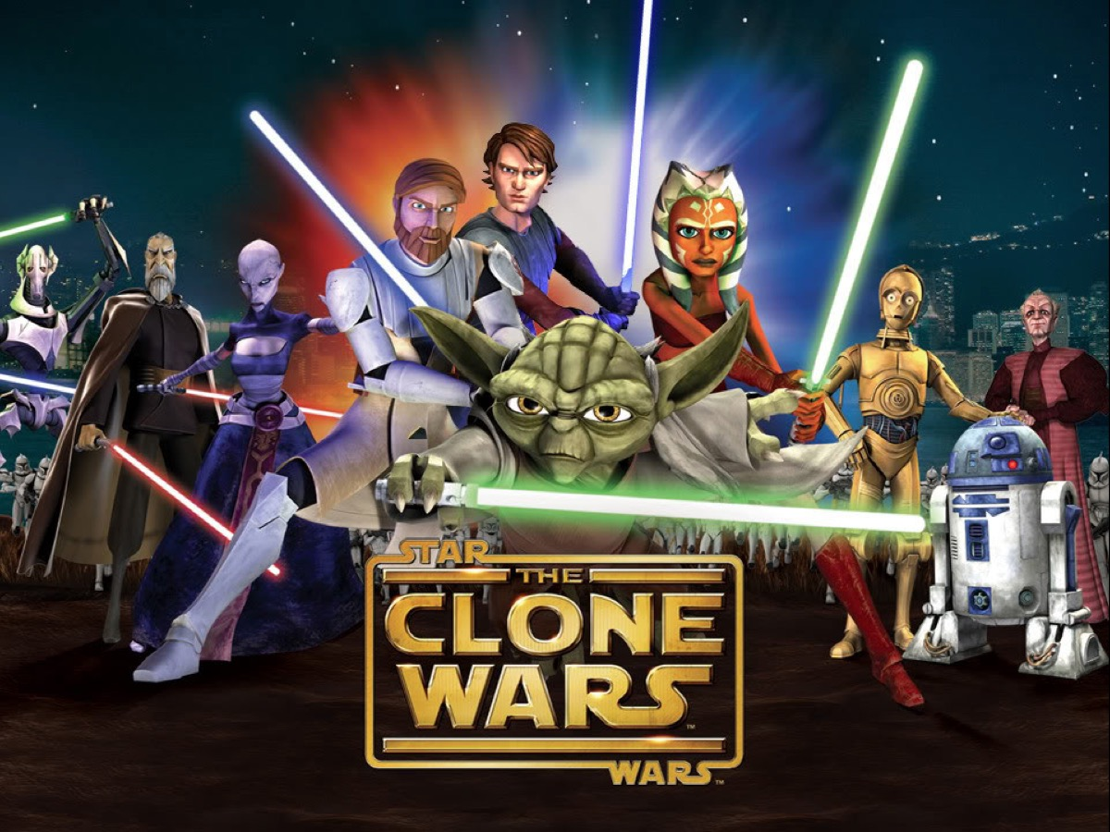
Notes:
Maybe you watched the animated series: The Clone Wars.

Slide 7

Notes:
Or Star Wars Rebels.

Slide 8

Notes:
I have always thought that there are great spiritual themes and ideas in the Star Wars franchise that relate to the our Christian faith:

Slide 9
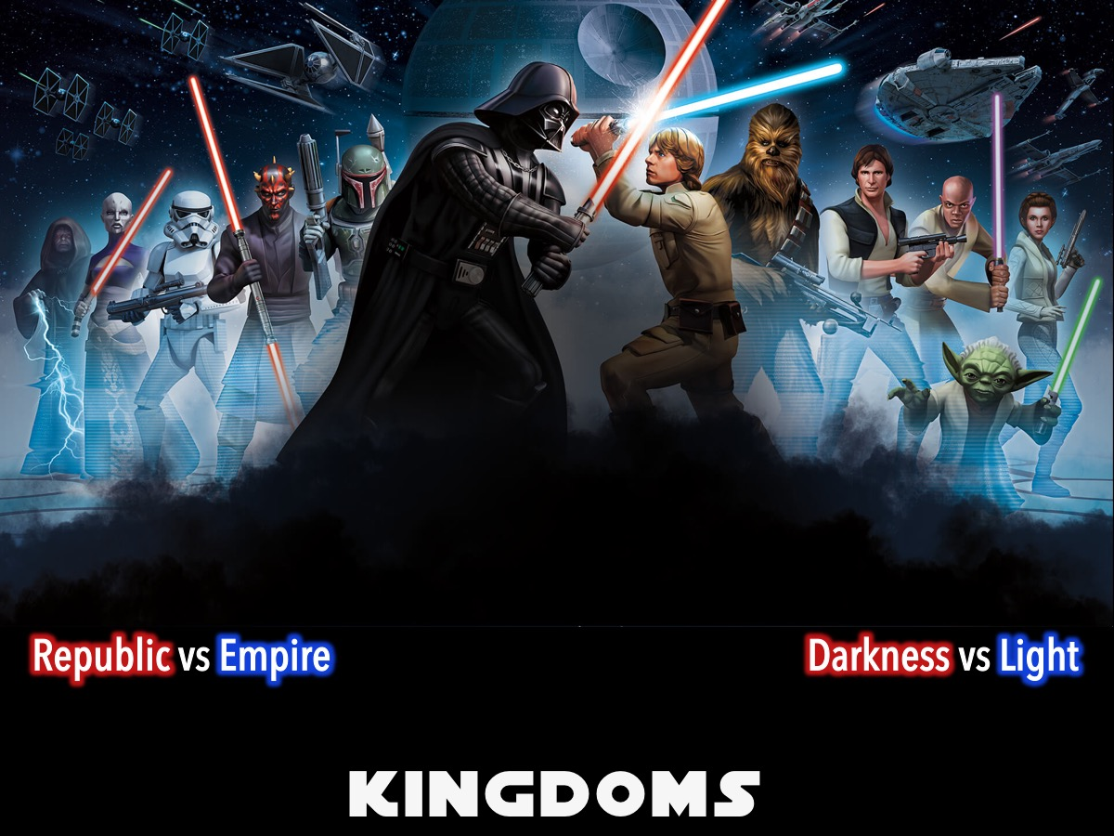
Notes:
1. Kingdoms: Star Wars is all about the epic struggle between two kingdoms: The Republic and the Empire. Good guys and bad guys. This reminds me of the epic struggle between darkness and light - between Satan and God - between Good and Evil in the world today.

Slide 10
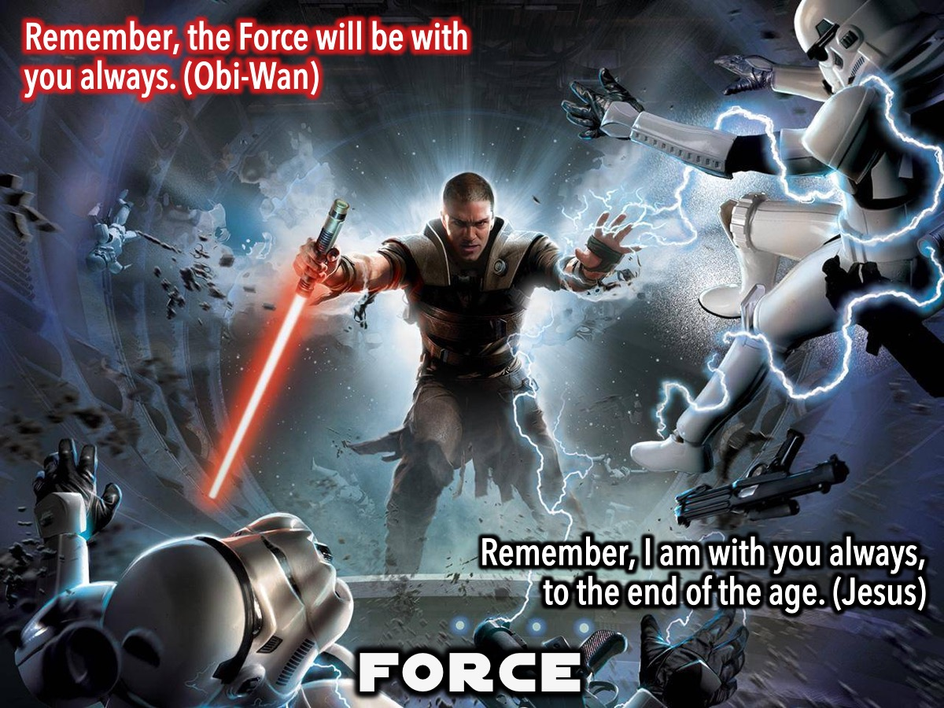
Notes:
2. The Force: Instead of God, George Lucas’ Star Wars saga speaks of ‘The Force’. The blessing ‘May the Force be with you’ echoes an old Christian one of ‘May God be with you”. When the Jedi Master Obi-Wan says to young Luke Skywalker: “Remember, the Force will be with you always”, we are reminded of what Jesus said to his disciples: “Remember, I am with you always, to the end of the age.” (Matthew 28:20)

Slide 11
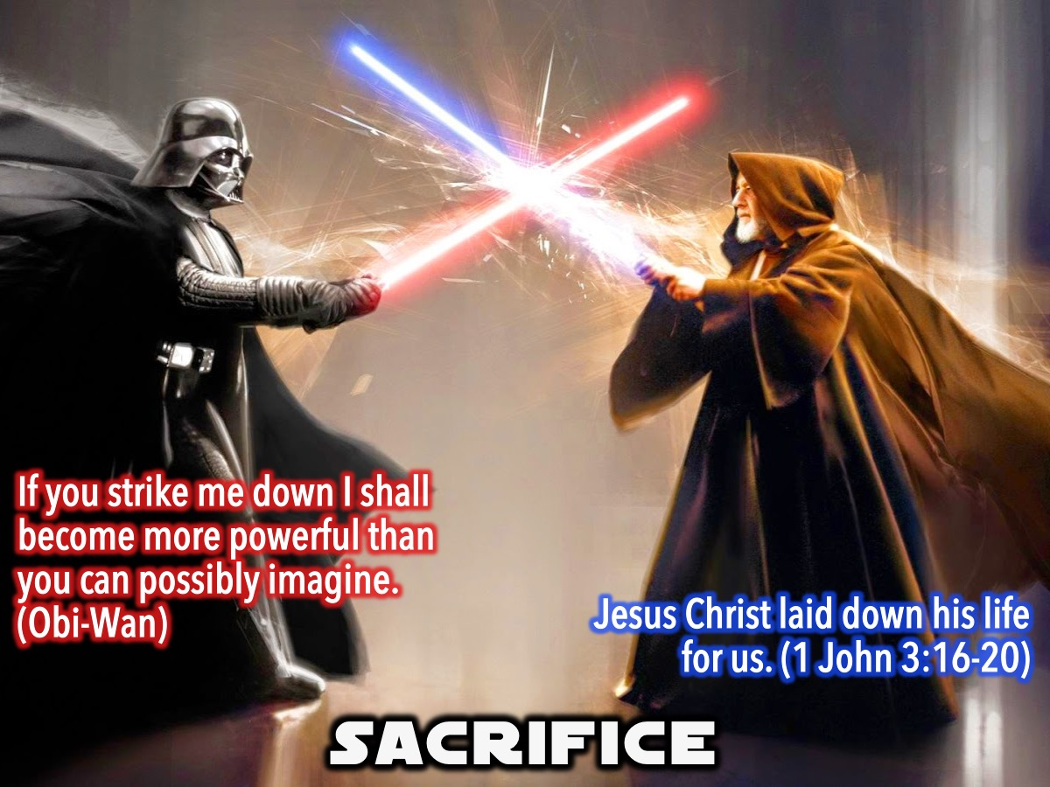
Notes:
3. Sacrifice. There is no greater love than to give your life for your friends. Sometimes the quest to save people from the darkness can lead to suffering and sacrifice. Obi-Wan lets himself be killed by Darth Vader so Luke, Leia and Han can escape.

Slide 12
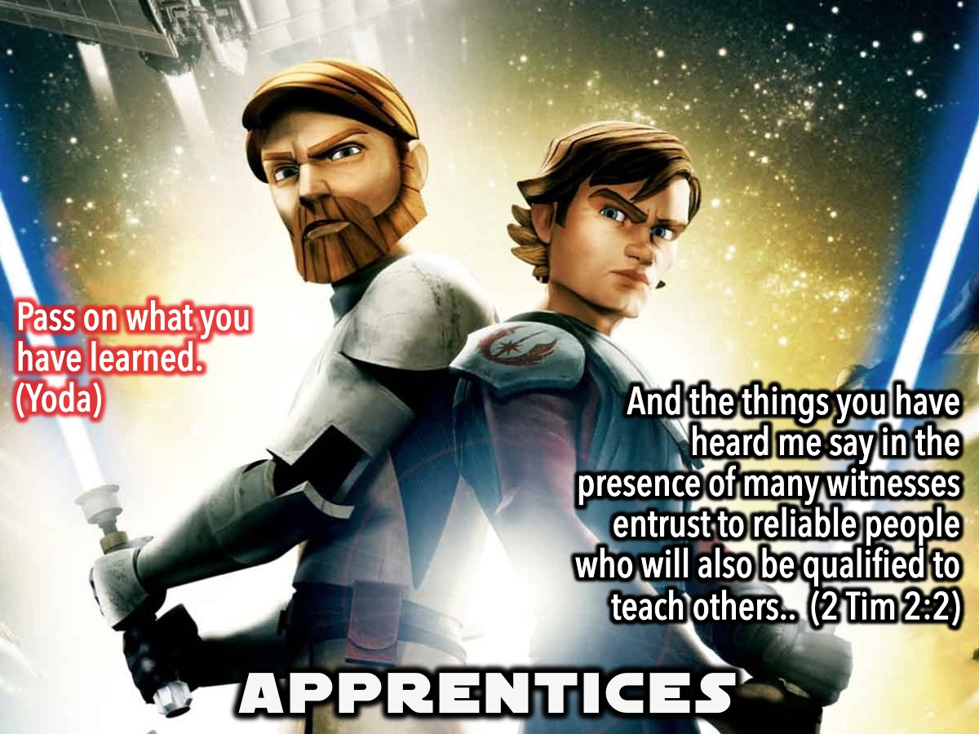
Notes:
4. Apprentices. I have always been fascinated by how someone apprentices themselves to someone who is usually older and more skilled - and normally a Jedi - to learn from them and become like them.

Slide 13
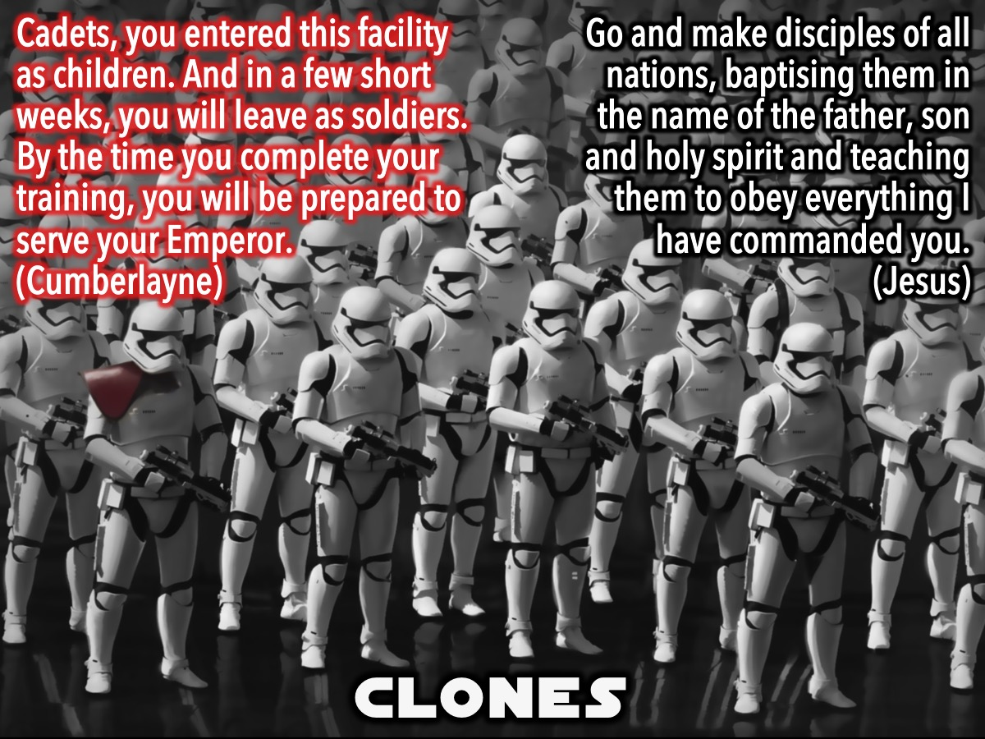
Notes:
5. Clones. Clone troops or Storm troopers play a key role in the great battle that takes place between the two kingdoms. Here is a quote from the movie: Cadets, you entered this facility as children. And in a few short weeks, you will leave as soldiers. By the time you complete your training, you will be prepared to serve your Emperor. (Cumberlayne Aresko). Jesus called us to kinda clone ourselves or to make disciples - people who will follow us as we follow Jesus: Go and make disciples of all nations, baptising them in the name of the father, son and holy spirit and teaching them to obey everything I have commanded you. (Jesus)

Slide 14
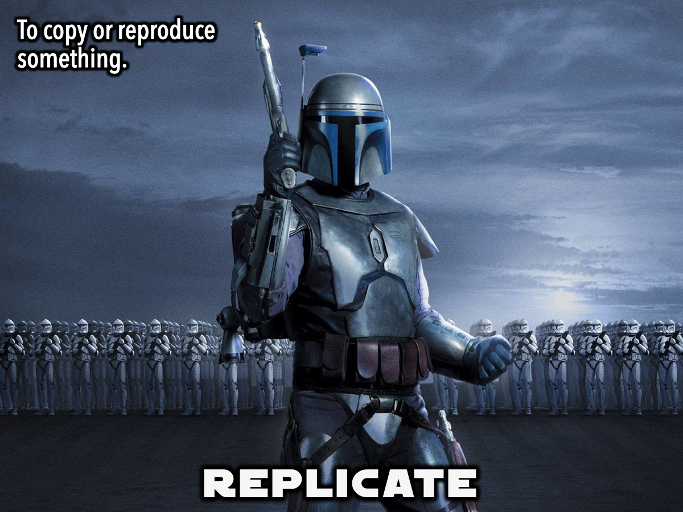
Notes:
Replication is to copy or reproduce something. DNA replication replicates two identical replicas from one original DNA molecule.

Slide 15
Notes:
Video: Drowning Friend. A video where a girl is watching a friend drowning and she does nothing to help and turns away in the end.

Slide 16
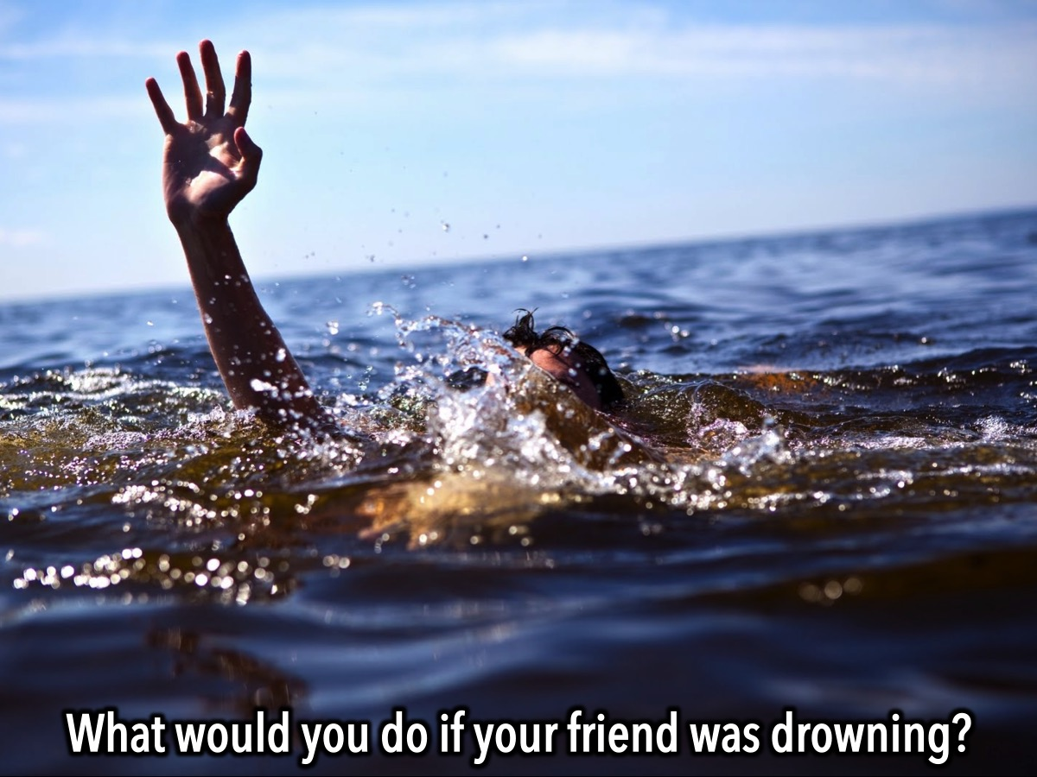
Notes:
Sharing: What would you do if a friend of yours was drowning?

Slide 17
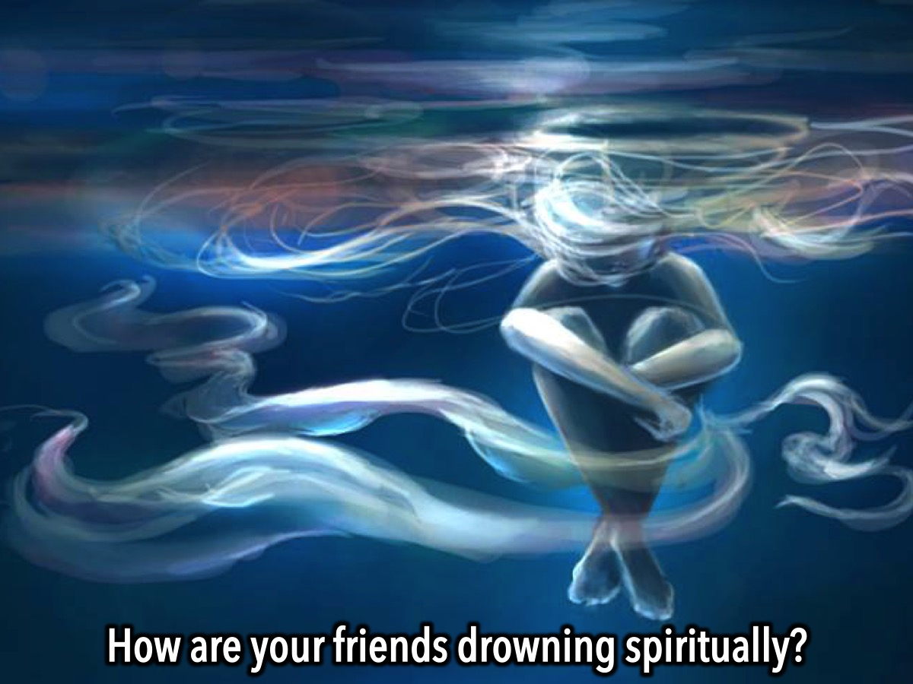
Notes:
Sharing: How are your friends drowning spiritually?

Slide 18
Notes:
Video: Penn Jillette, an atheist, some time back shared this in a video blog that he posted. Get it on YouTube at: https://www.youtube.com/watch?v=6md638smQd8

Slide 19
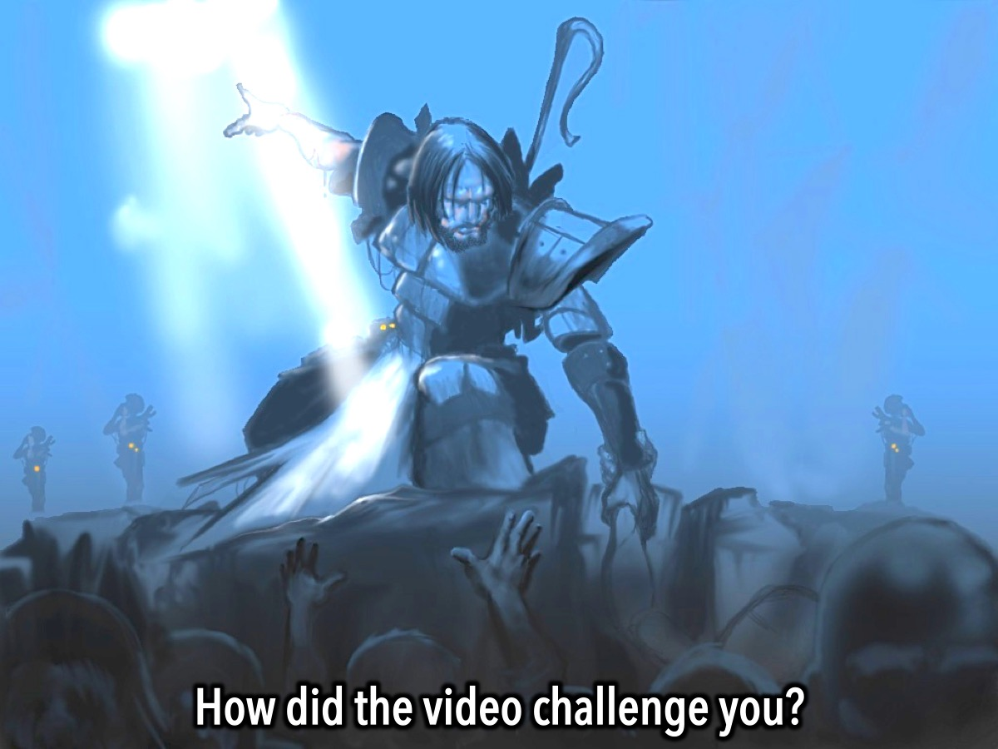
Notes:
Sharing: How did the video challenge you?

Slide 20
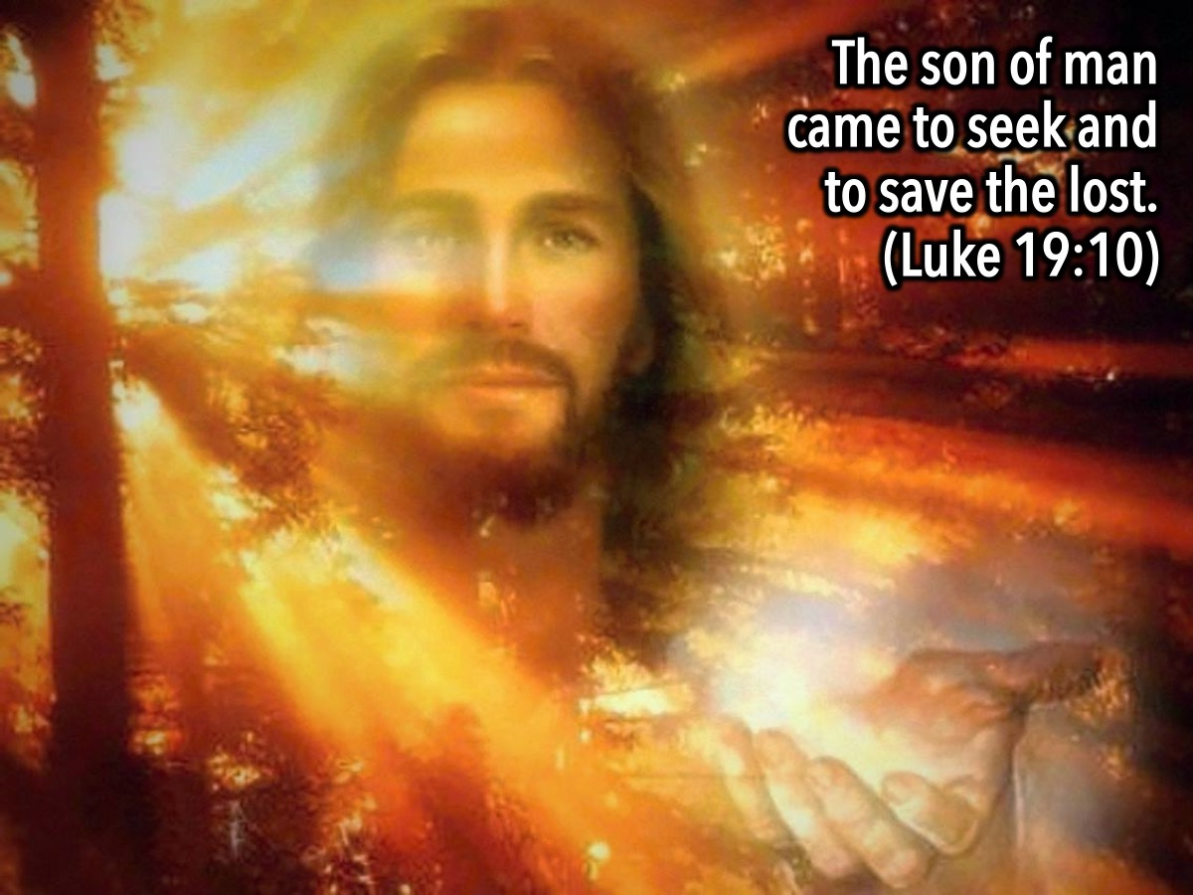
Notes:
Jesus once told people why he came to earth - what his mission was: “The son of man came to seek and to save the lost.” (Luke 19:10)

Slide 21
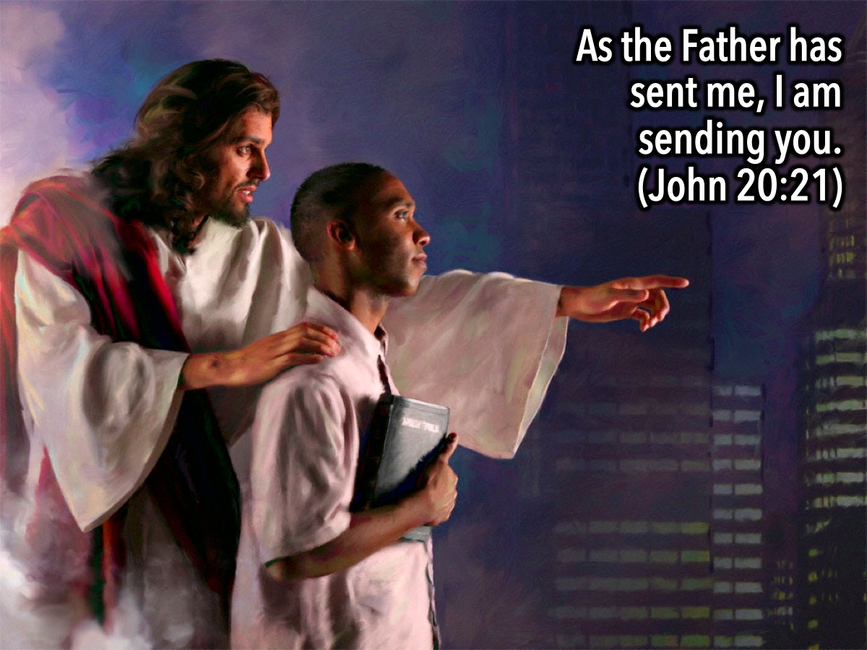
Notes:
And Jesus gave us the same mission when he said to his disciples: “As the Father has sent me, I am sending you.” (John 20:21)

Slide 22

Notes:
We are called to be disciples who make disciples: “Go and make disciples of all nations, baptising them in the name of the father, son and holy spirit and teaching them to obey everything I commanded you.” (Matthew 28:18-19)

Slide 23
Notes:
So how do you do that? Well, the Replicate Series has been designed to equip you to make disciples

Slide 24
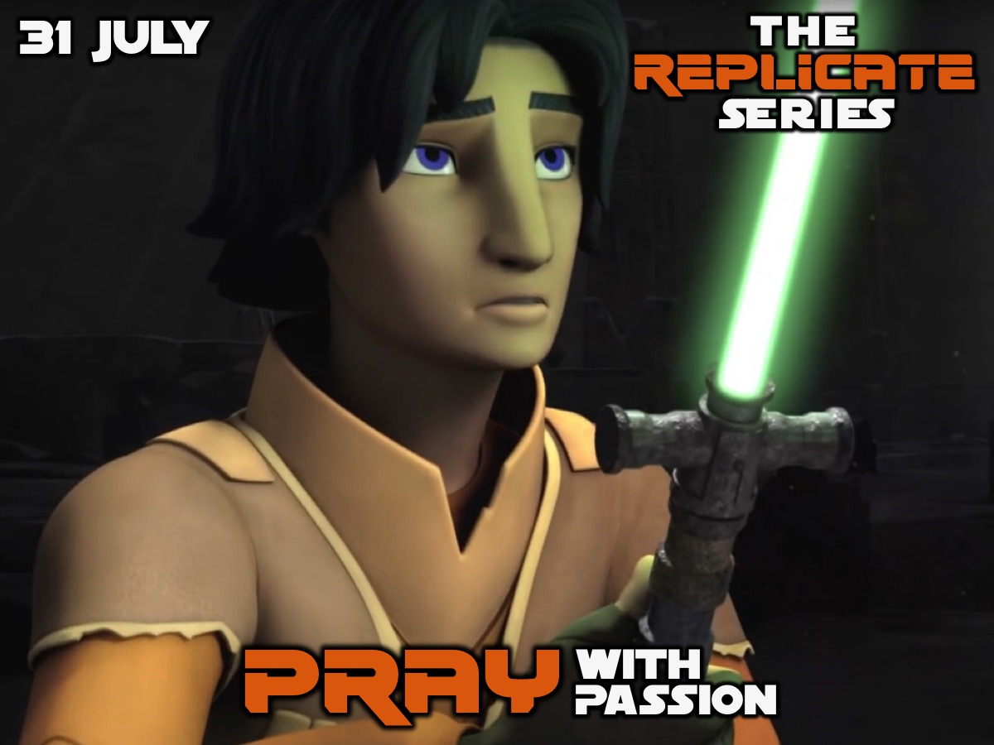
Notes:
Week 2: PRAY with Passion

Slide 25

Notes:
Week 3: PURSUE with Love

Slide 26

Notes:
Week 4: PERSUADE with Truth

Slide 27

Notes:
Week 5: START a Conversation (Ask Admire Admit)

Slide 28
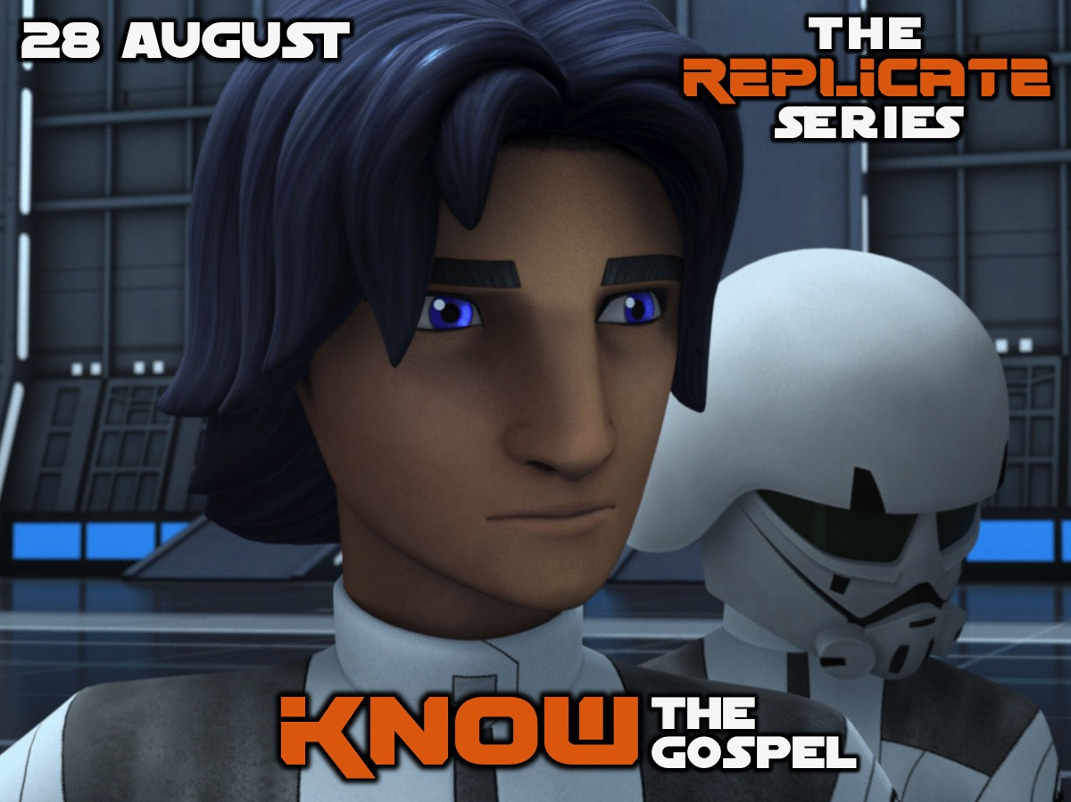
Notes:
Week 6: KNOW the Gospel (Life in 6 Words)

Slide 29
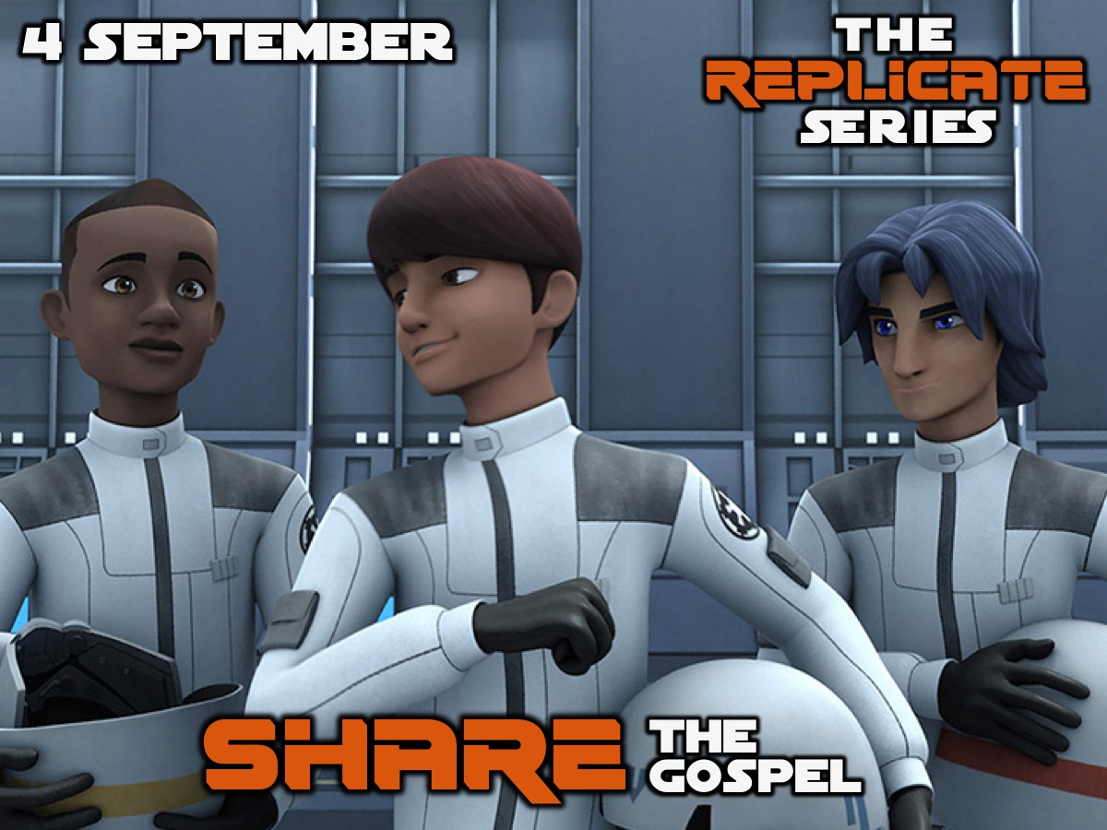
Notes:
Week 7: SHARE the Gospel (Practise)

Slide 30
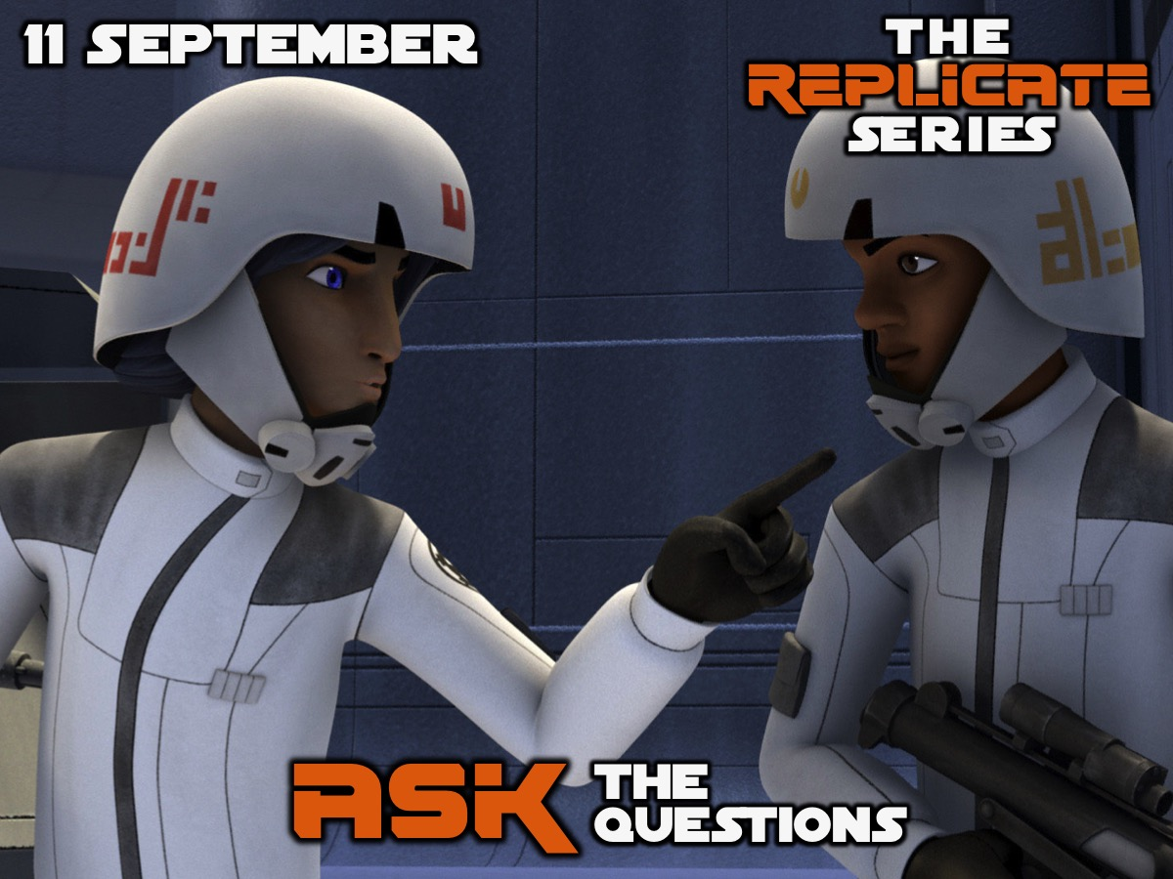
Notes:
Week 8: ASK the Questions (What Now?)

Slide 31
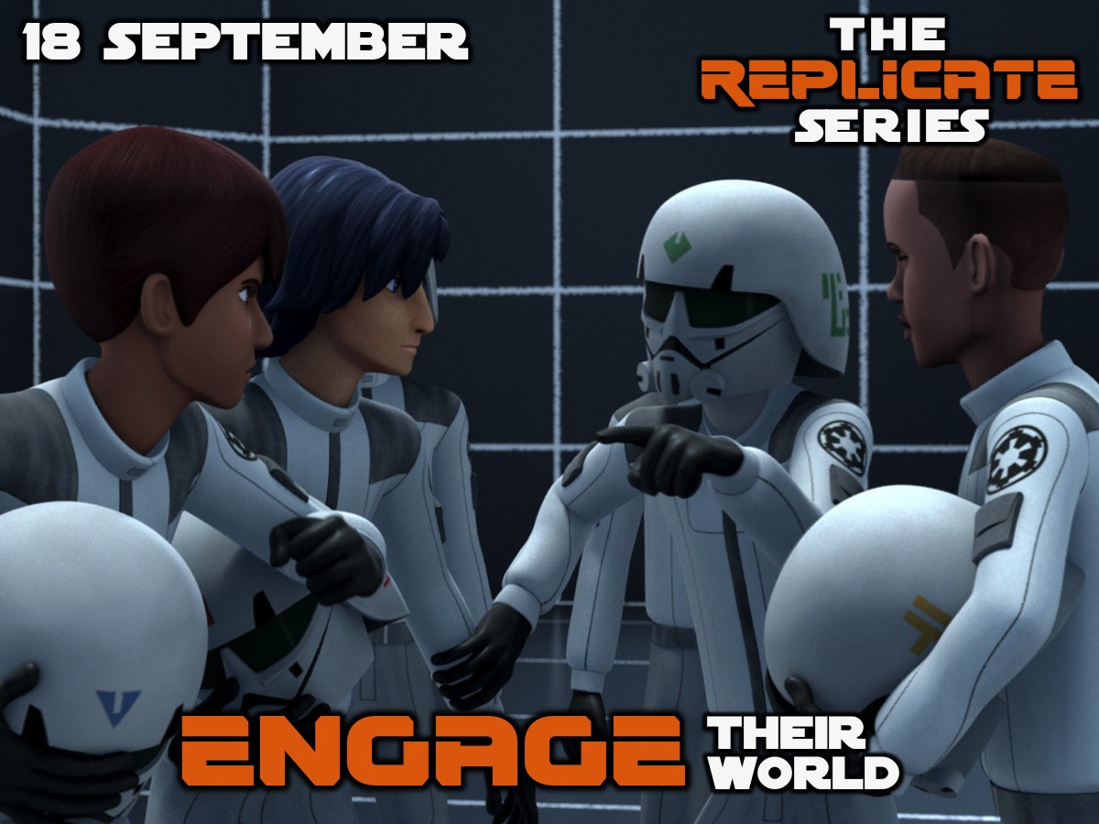
Notes:
Week 9: ENGAGE their World (Reaching Different Worldviews)

Slide 32

Notes:
Week 10: Celebrate the Harvest

Slide 33

Notes:
And as a start, why not consider inviting one of your friends to our Friday night Alpha event?

Slide 34

Notes:
This coming Friday night we will be answering the question: Life: Is This It?

Slide 35

Notes:
You need to invite an unsaved friend, given them one of these flyer’s and get them to attend from next Friday night.

Slide 36

Notes:
Next week we will learn how to PRAY with Passion for our lost friends.

