Slide 1

Notes:
Welcome to the Replicate Series

Slide 2
Notes:
Video: Star Wars Rebels - Ezra's Jedi training (from 1:06 to the end). Get it on YouTube at: https://www.youtube.com/watch?v=AfGtyMF3SJw

Slide 3

Notes:
Last week we launched the series and spoke about how we need to launch a movement where we replicate our lives.

Slide 4
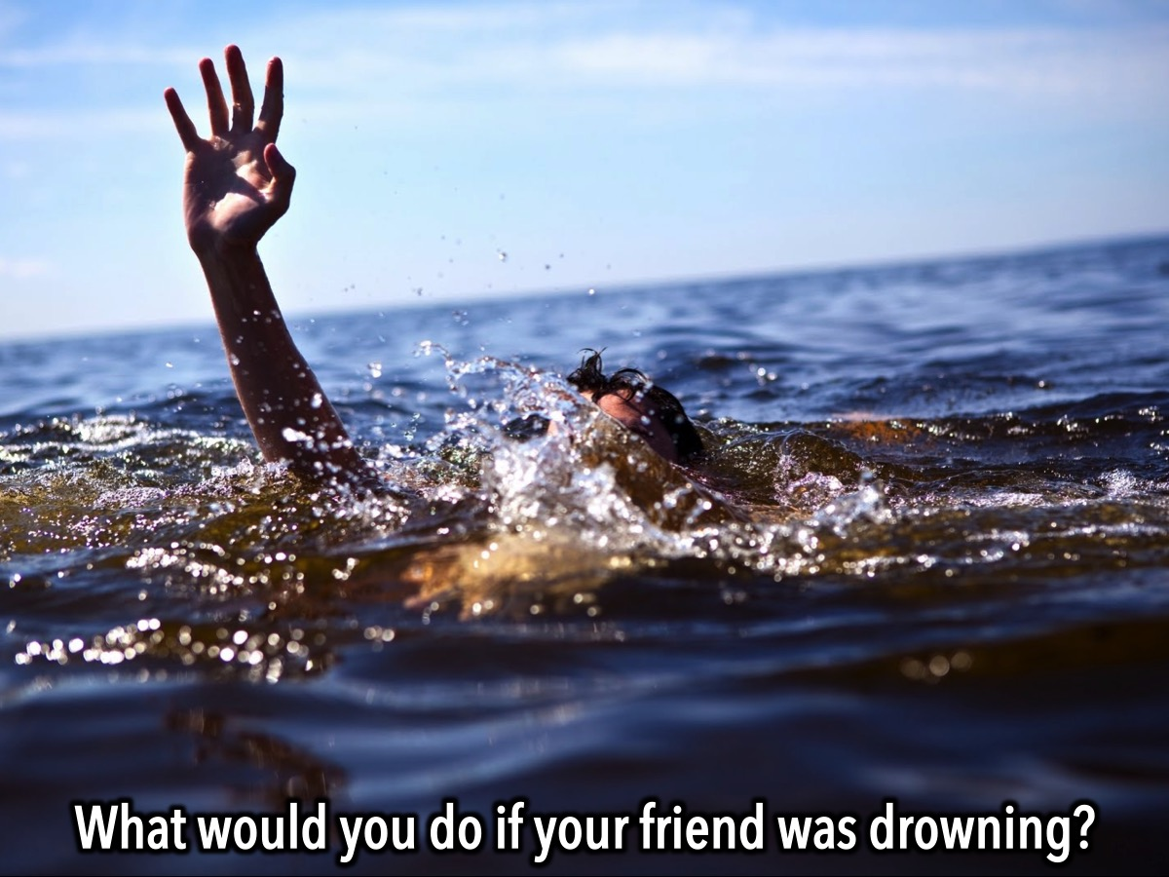
Notes:
We were challenged to do something if our friends are drowning - and unless they come to know Jesus, they are drowning spiritually!

Slide 5
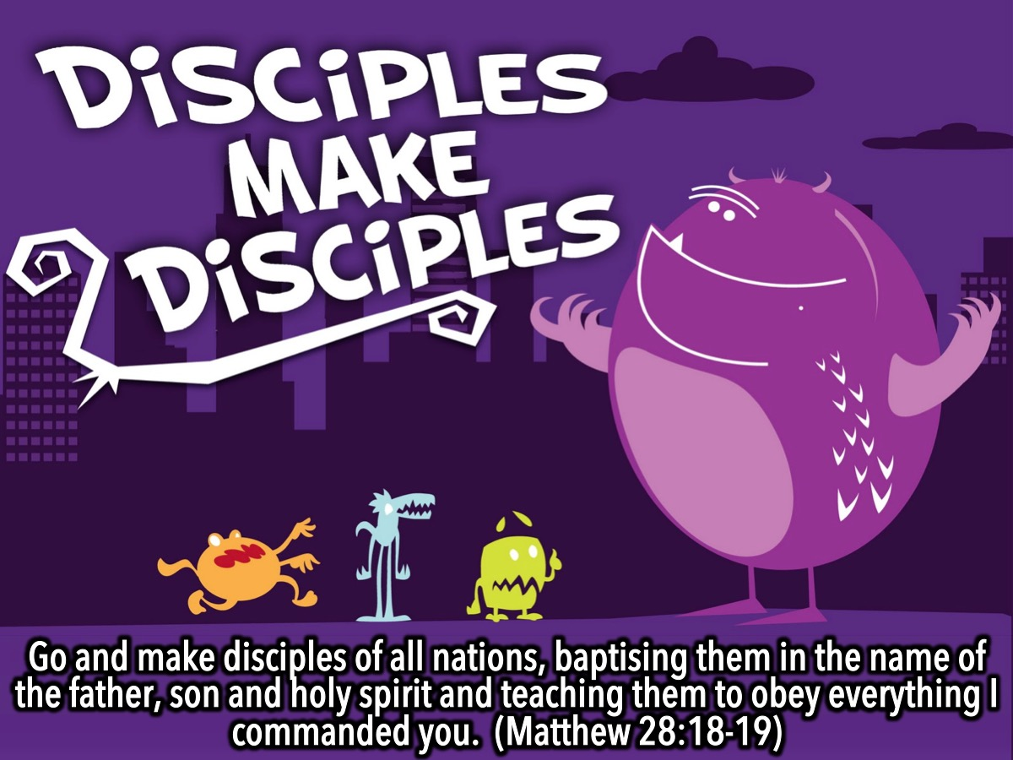
Notes:
We are called to be disciples who make disciples: “Go and make disciples of all nations, baptising them in the name of the father, son and holy spirit and teaching them to obey everything I commanded you.” (Matthew 28:18-19)

Slide 6
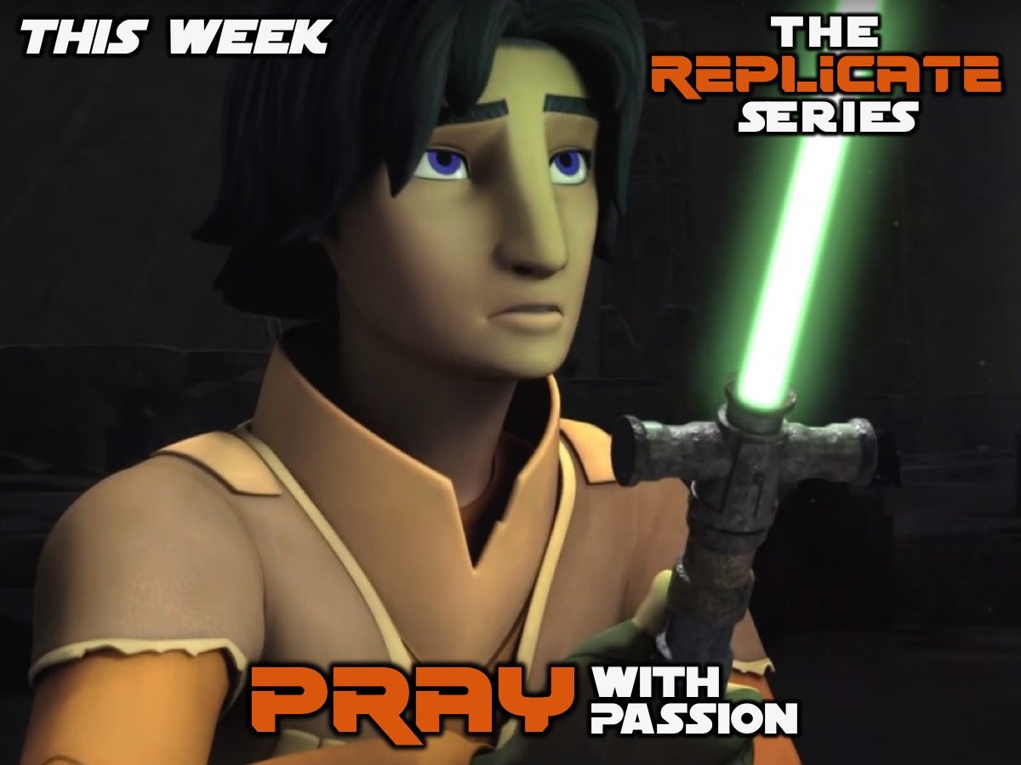
Notes:
Welcome to week 2 of the Replicate series: Pray With Passion.

Slide 7
Notes:
Video: The Cause Circle. Get it on YouTube at: https://www.youtube.com/watch?v=g-10zyrIyxA

Slide 8
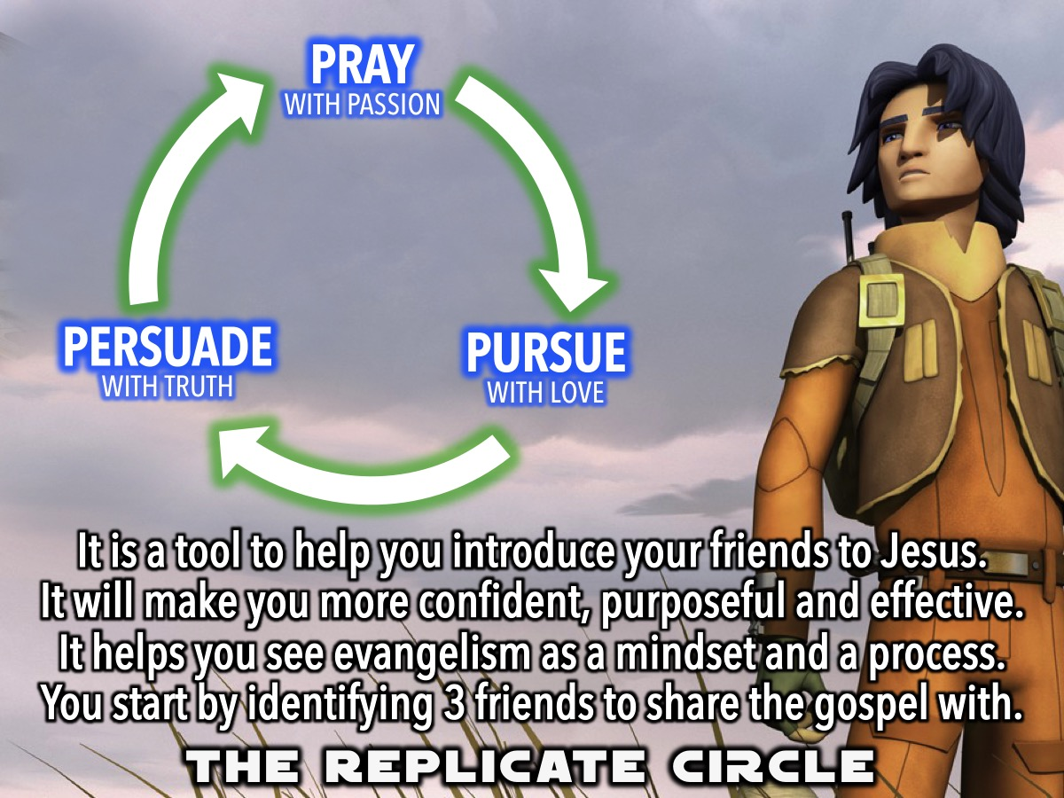
Notes:
The Replicate Circle. The Replicate Circle is a simple tool that breaks the evangelism process down into more understandable, incremental sub-parts. The Replicate Circle’s three basic component are: (1) Pray with Passion, (2) Pursue with Love and, (3) Persuade with Truth. These steps are simply ways that can help you get a feel for the amazing privilege of introducing others (YOUR FRIENDS) to Jesus. This tool can make them more confident, purposeful and effective, and it gets them thinking about evangelism as both a mindset and a process. The Replicate Circle helps you with the initial step, which is simply to identify three friends you want to share the gospel with.

Slide 9
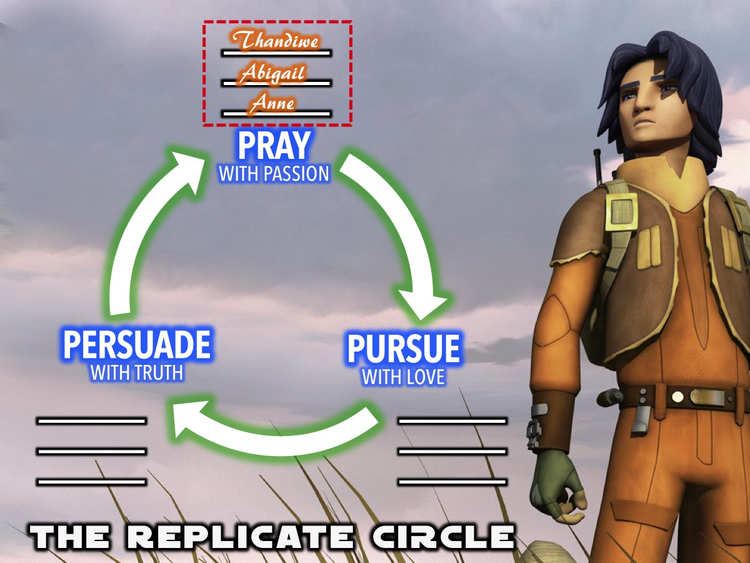
Notes:
The Replicate Circle - we are handing out copies of the circle and want you to start by writing down the names of 3 friends who don’t know Jesus on the top lines.

Slide 10
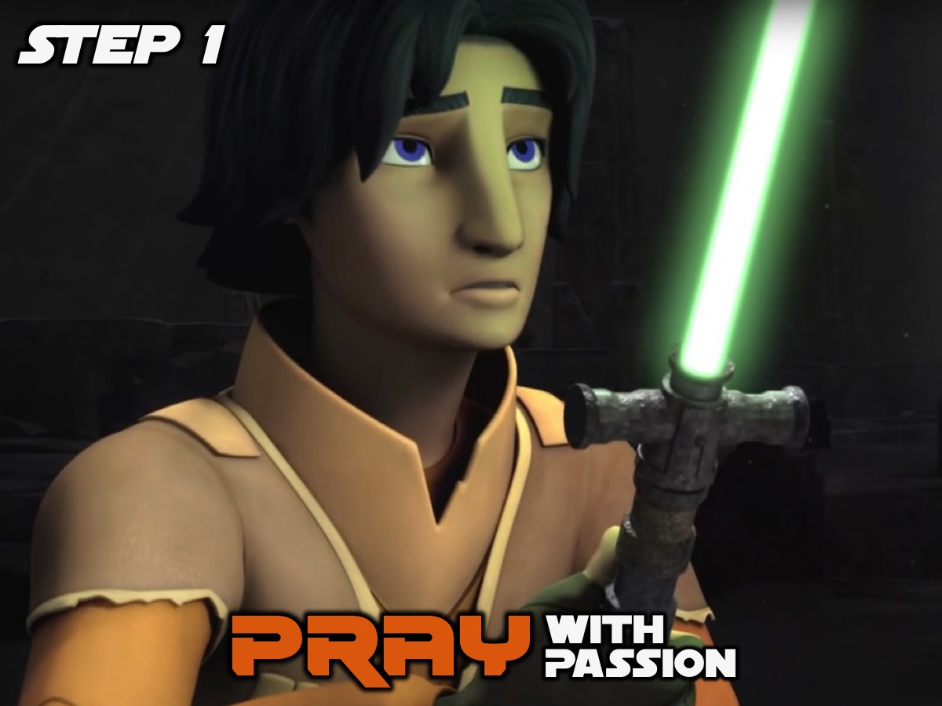
Notes:
Step 1 in the Replicate Circle is to Pray with Passion!

Slide 11
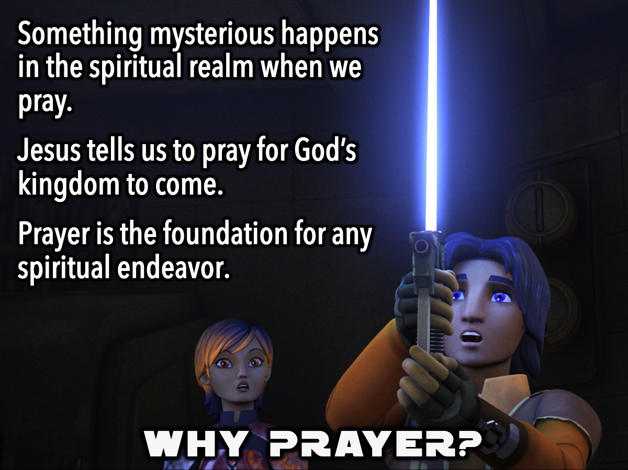
Notes:
Why Prayer is an Essential First Step: Scripture assures us that something mysterious happens in the spiritual realm when we pray. And while our human reasoning can’t entirely wrap our minds around how prayer works, Jesus tells us to pray, and to pray specifically for God’s kingdom to come. That makes prayer the bedrock foundation for any spiritual endeavor we undertake.

Slide 12
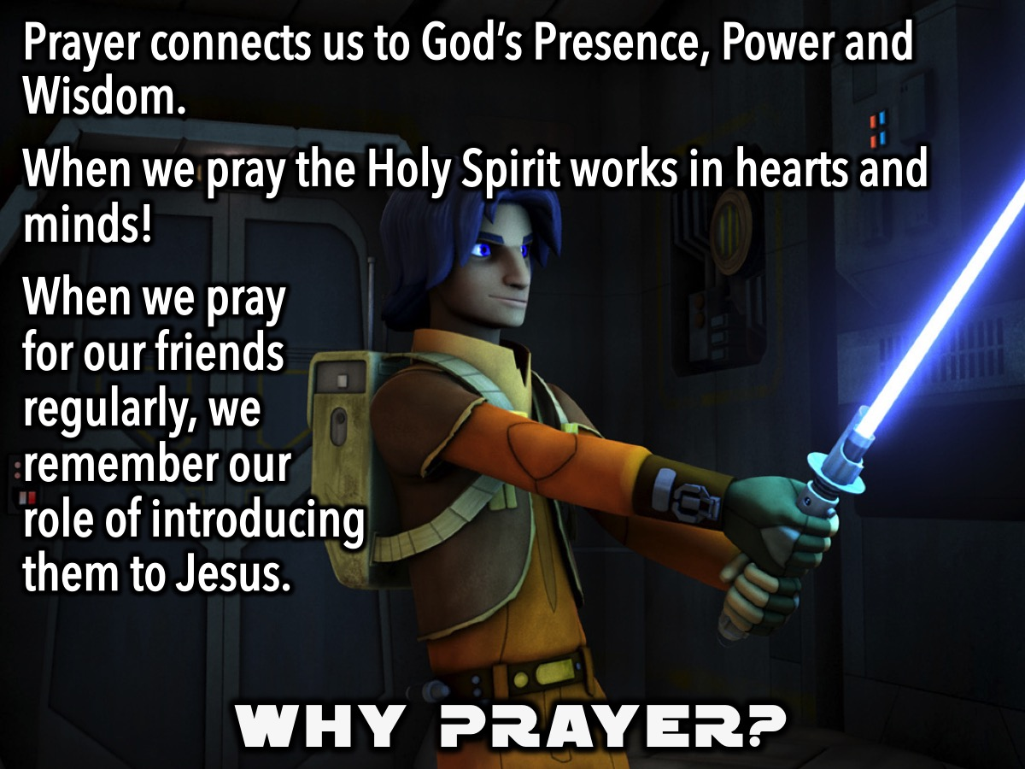
Notes:
Prayer is so essential and powerful because it connects us to God—His presence, His power and His wisdom. If you can get your teenagers praying for just a few of their unreached friends, all sorts of good things get set into motion—including the Holy Spirit’s work in hearts and minds! Plus, when your are praying for their friends regularly, it also serves as an internal prompt for YOU to consider and pray about your role in the replicate circle of introducing their friends to Jesus.

Slide 13
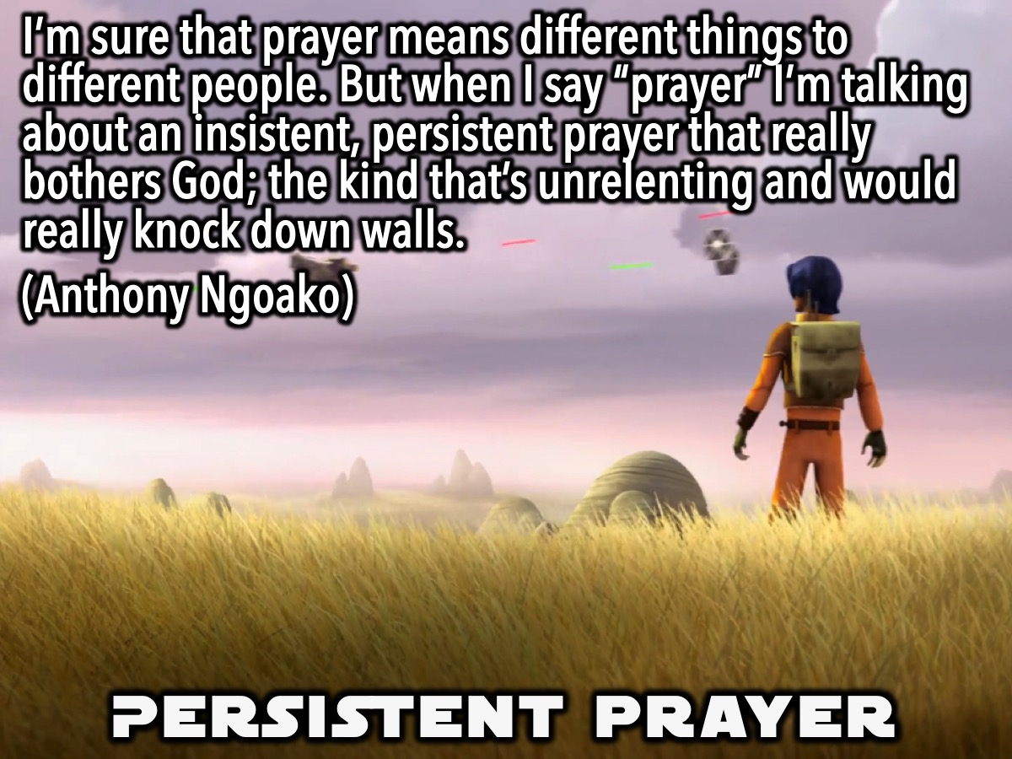
Notes:
Persistent Prayer: "I’m sure that prayer means different things to different people. But when I say “prayer” I’m talking about an insistent, persistent prayer that really bothers God; the kind that’s unrelenting and would really knock down walls." (Anthony Ngoako)

Slide 14
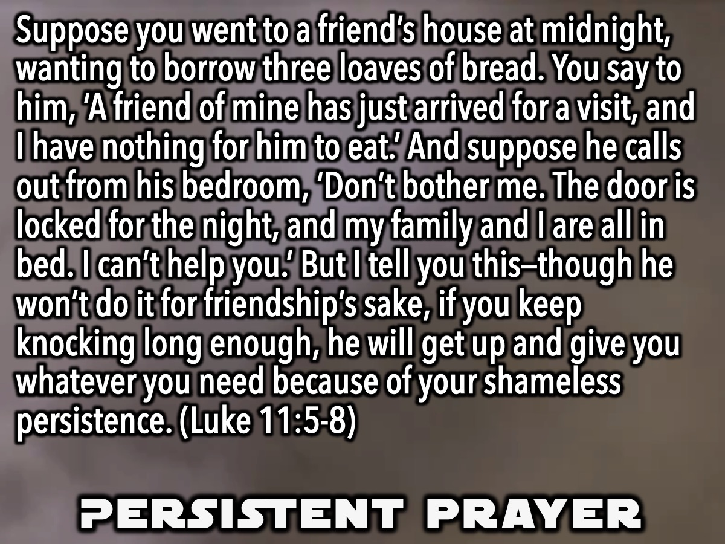
Notes:
An example of the power of Persistent Prayer is seen in a story Jesus told in Luke 11:5-8: “Then, teaching them more about prayer, he used this story: “Suppose you went to a friend’s house at midnight, wanting to borrow three loaves of bread. You say to him, ‘A friend of mine has just arrived for a visit, and I have nothing for him to eat.’ And suppose he calls out from his bedroom, ‘Don’t bother me. The door is locked for the night, and my family and I are all in bed. I can’t help you.’ But I tell you this—though he won’t do it for friendship’s sake, if you keep knocking long enough, he will get up and give you whatever you need because of your shameless persistence.”

Slide 15
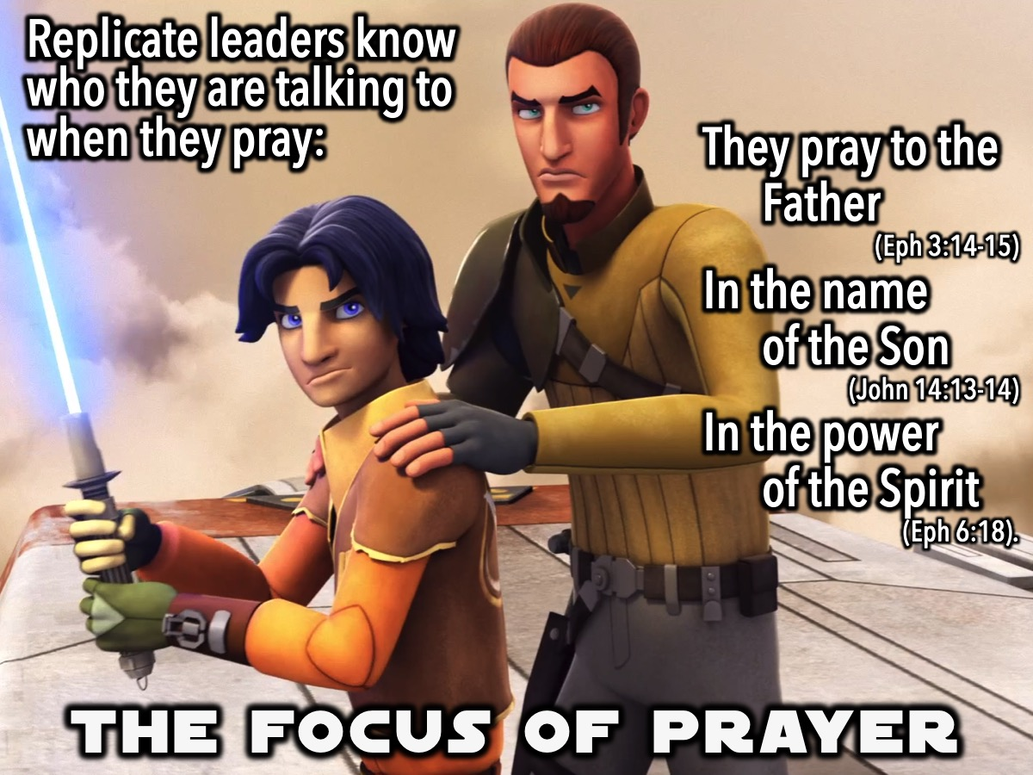
Notes:
Replicate leaders know who they are talking to when they pray: They pray to the Father (Ephesians 3:14-15) in the name of the Son (John 14:13-14) in the power of the Spirit (Ephesians 6:18).

Slide 16
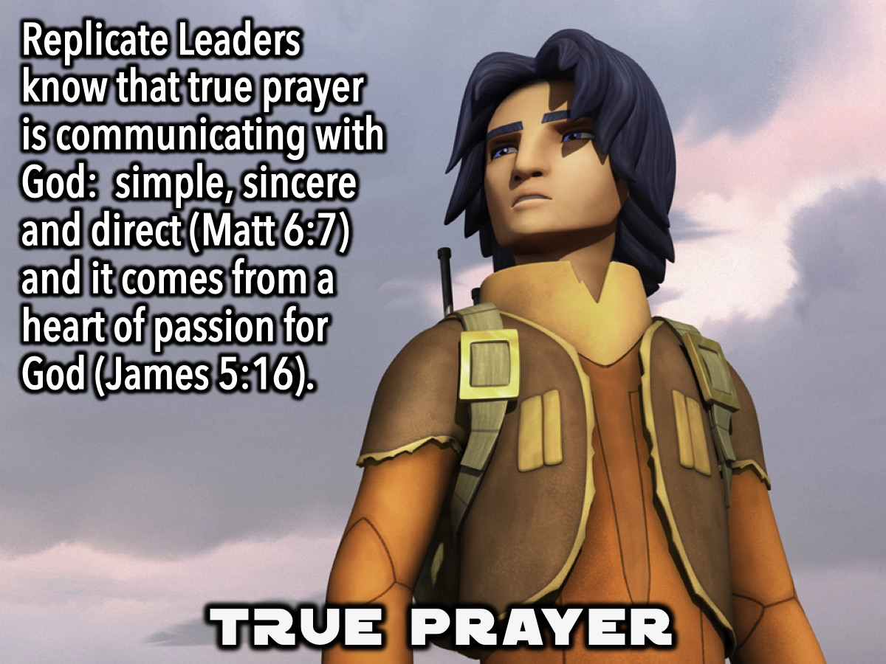
Notes:
Replicate Leaders know that true prayer is communicating with God – simple, sincere and direct (Matt 6:7), they pour forth from a heart of passion for God (James 5:16).

Slide 17
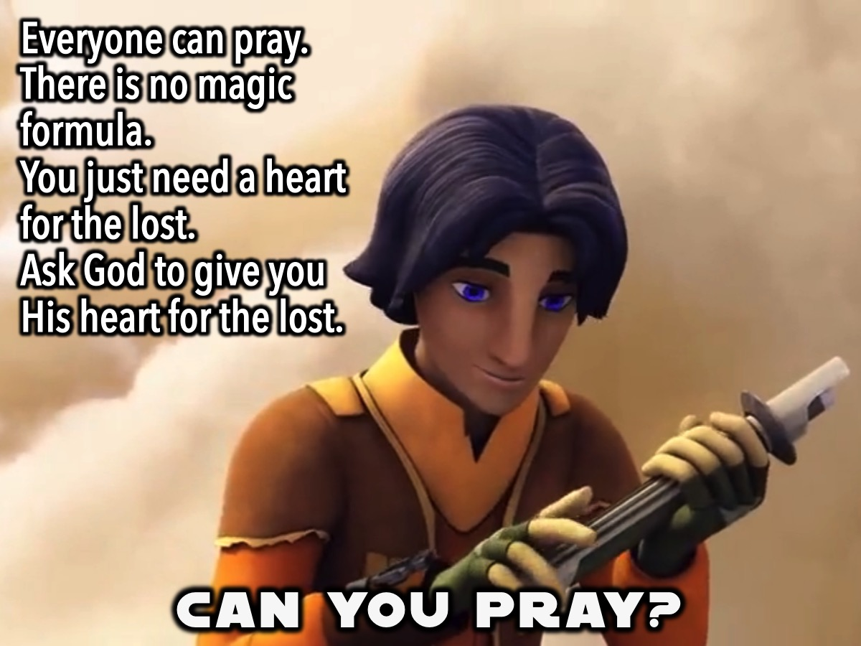
Notes:
Everyone can pray! There are no magical formulas needed for praying with passion. All it takes is a heart for the lost and an authentic, honest and open conversation with God, begging Him for the souls of their friends. Sometimes we need to pray and ask God to give us his heart so we can human lives they way he sees us, the importance of a soul and the importance to reach the lost.

Slide 18
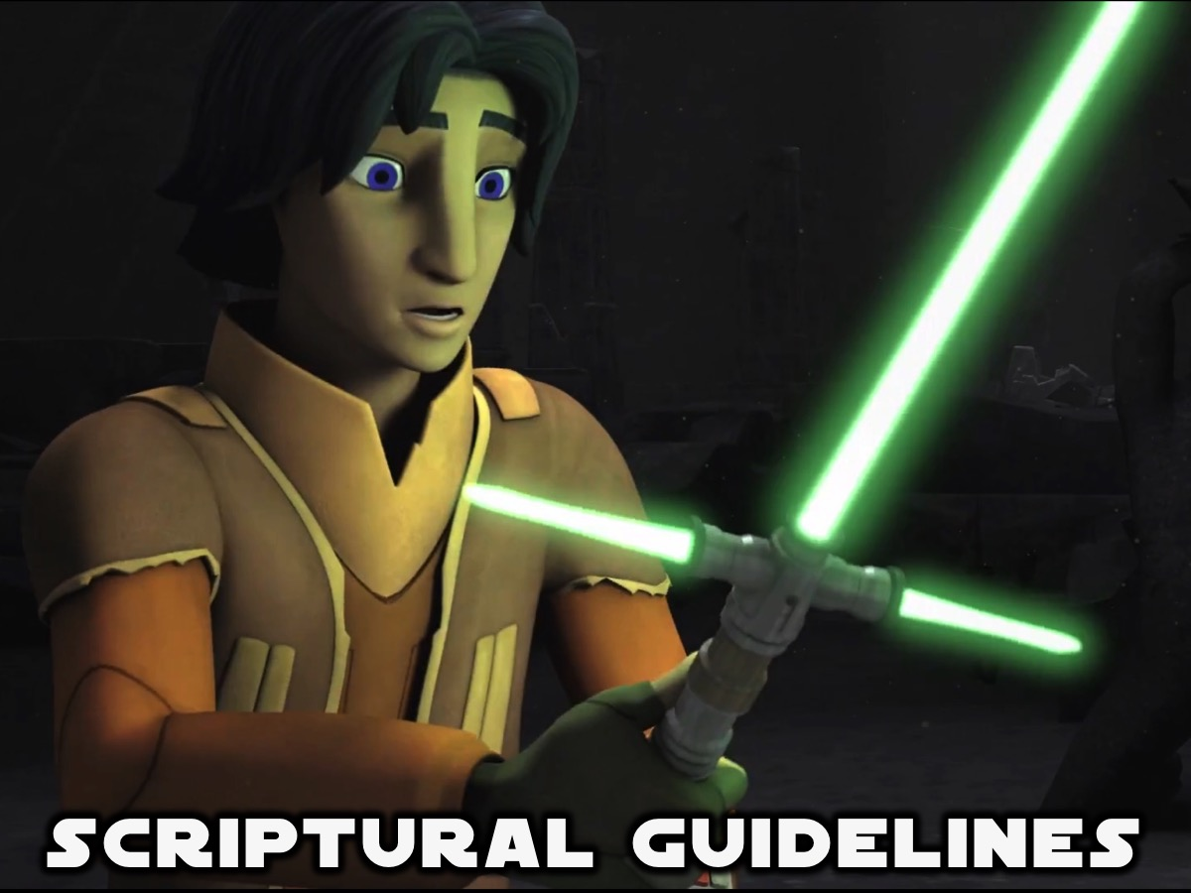
Notes:
Here are some scriptural references to guide your Prayer with Passion:

Slide 19
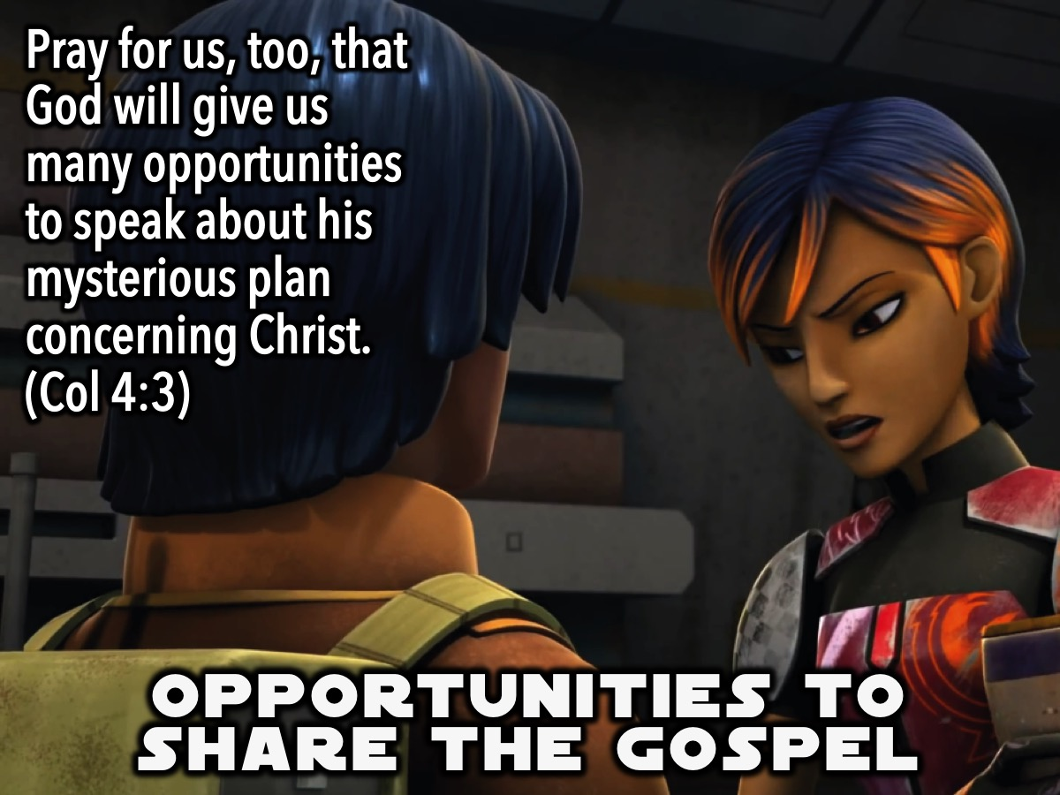
Notes:
1. Opportunities to share the gospel. Pray for us, too, that God will give us many opportunities to speak about his mysterious plan concerning Christ. (Colossians 4:3)

Slide 20
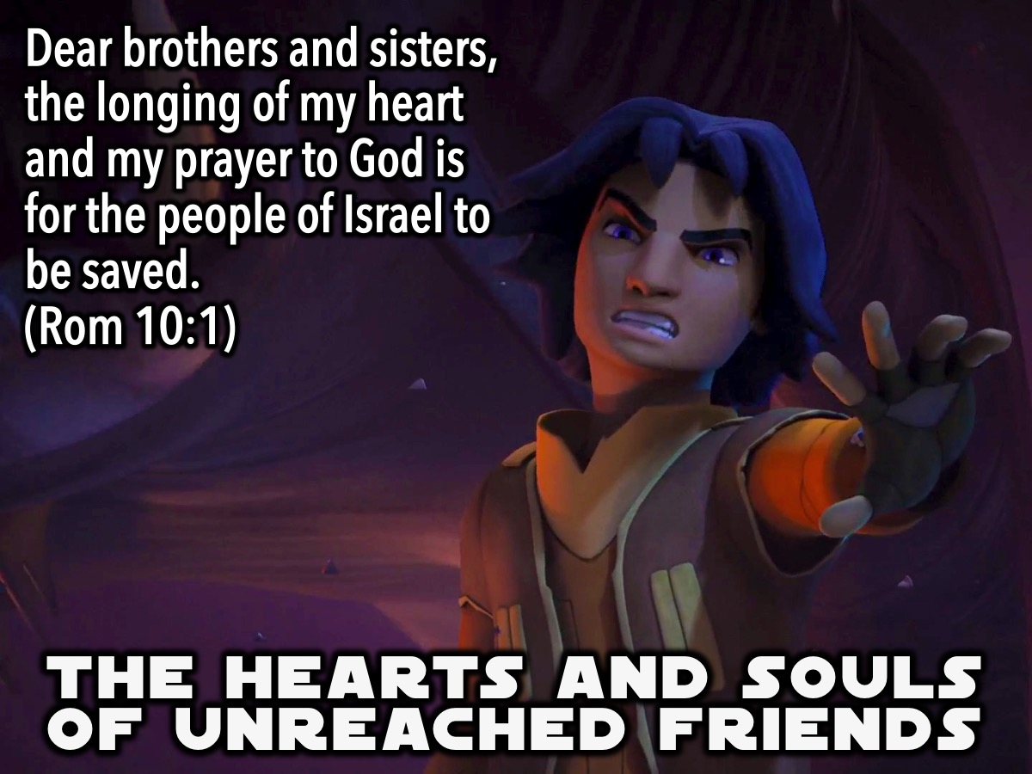
Notes:
2. The hearts and souls of unreached friends. Dear brothers and sisters, the longing of my heart and my prayer to God is for the people of Israel to be saved (Romans 10:1)

Slide 21
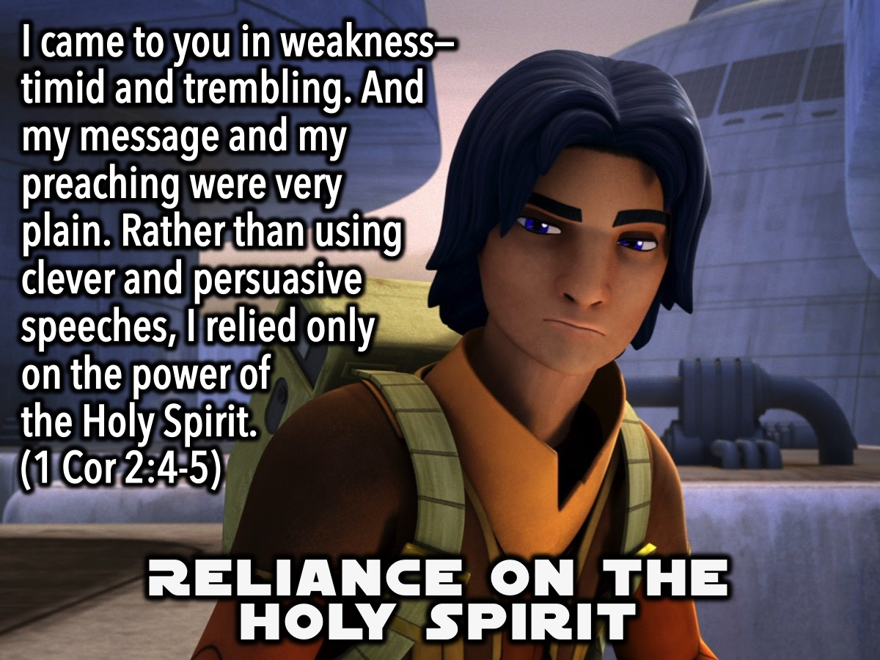
Notes:
3. Reliance on the Holy Spirit. I came to you in weakness—timid and trembling. And my message and my preaching were very plain. Rather than using clever and persuasive speeches, I relied only on the power of the Holy Spirit. (1 Corinthians 2:4-5).

Slide 22
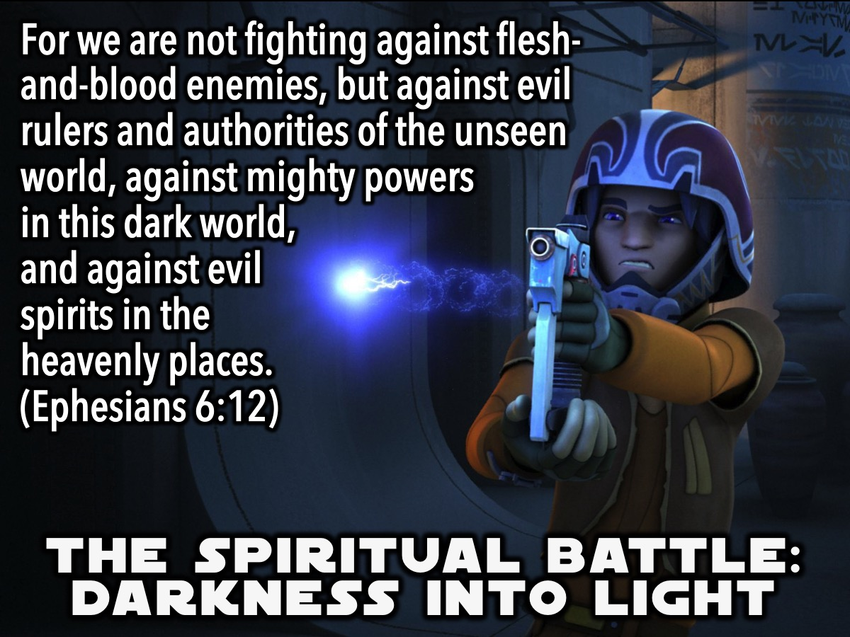
Notes:
4. The spiritual battle being waged as souls are being called out of darkness and into His marvelous light. For we are not fighting against flesh-and-blood enemies, but against evil rulers and authorities of the unseen world, against mighty powers in this dark world, and against evil spirits in the heavenly places. (Ephesians 6:12)

Slide 23
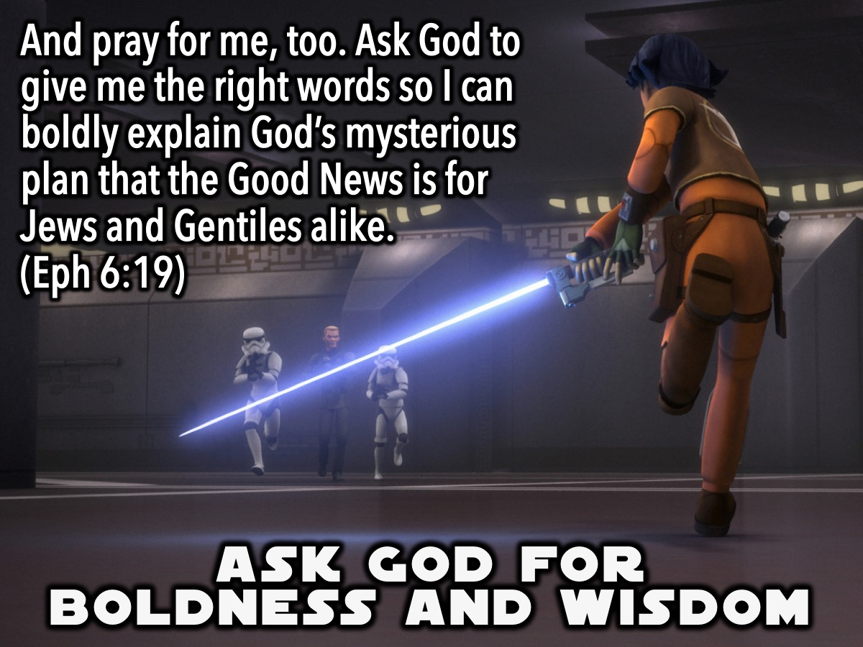
Notes:
5. Ask God for Boldness and Wisdom. And pray for me, too. Ask God to give me the right words so I can boldly explain God’s mysterious plan that the Good News is for Jews and Gentiles alike. (Eph 6:19)

Slide 24
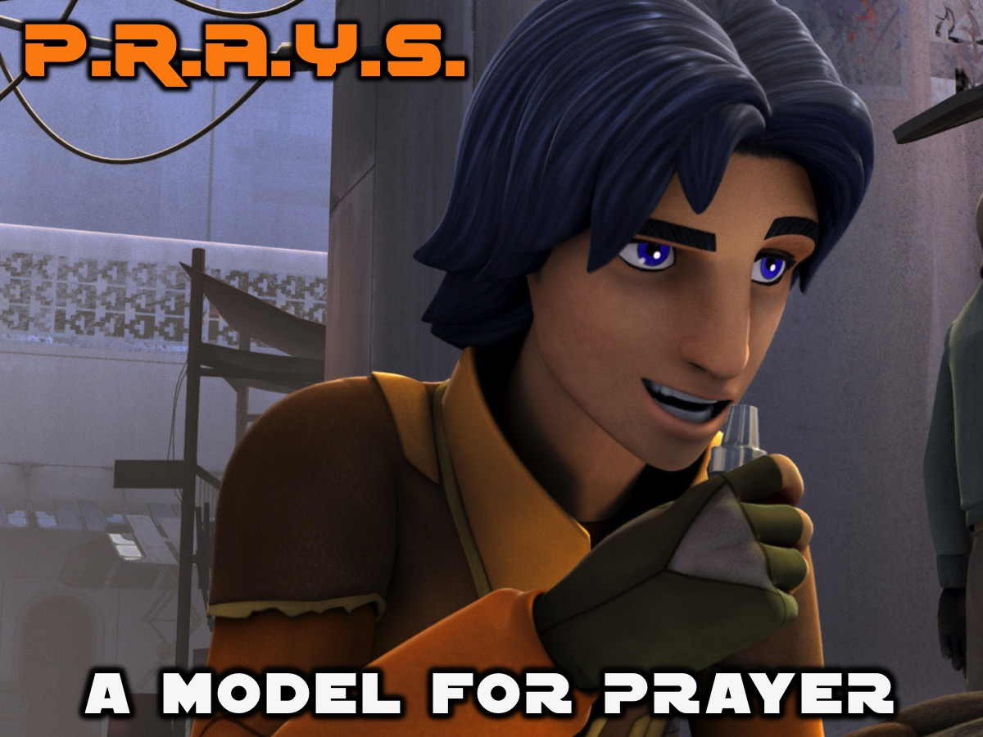
Notes:
The P.R.A.Y.S. Model. So how do we take all this learning on praying with passion and use it to in a meaningful way to pray for those friends we have written down. There are different ways to pray: Here is a method based on the prayer that Jesus used to teach his disciples to pray and we are following @HisYouth:

Slide 25
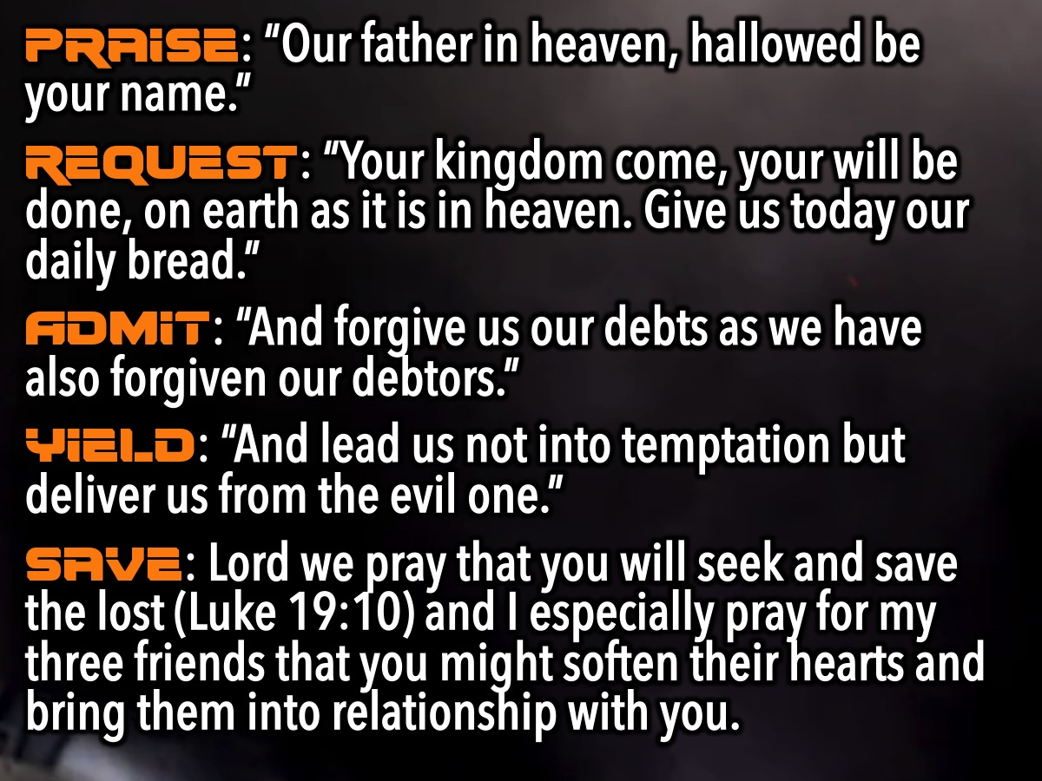
Notes:
* Praise: “Our father in heaven, hallowed be your name.”
* Request: “Your kingdom come, your will be done, on earth as it is in heaven. Give us today our daily bread.”
* Admit: “And forgive us our debts as we have also forgiven our debtors.”
* Yield: “And lead us not into temptation but deliver us from the evil one.”
* Save: Lord we pray that you will seek and save the lost (Luke 19:10) and I especially pray for my three friends that you might soften their hearts and bring them into relationship with you.

Slide 26
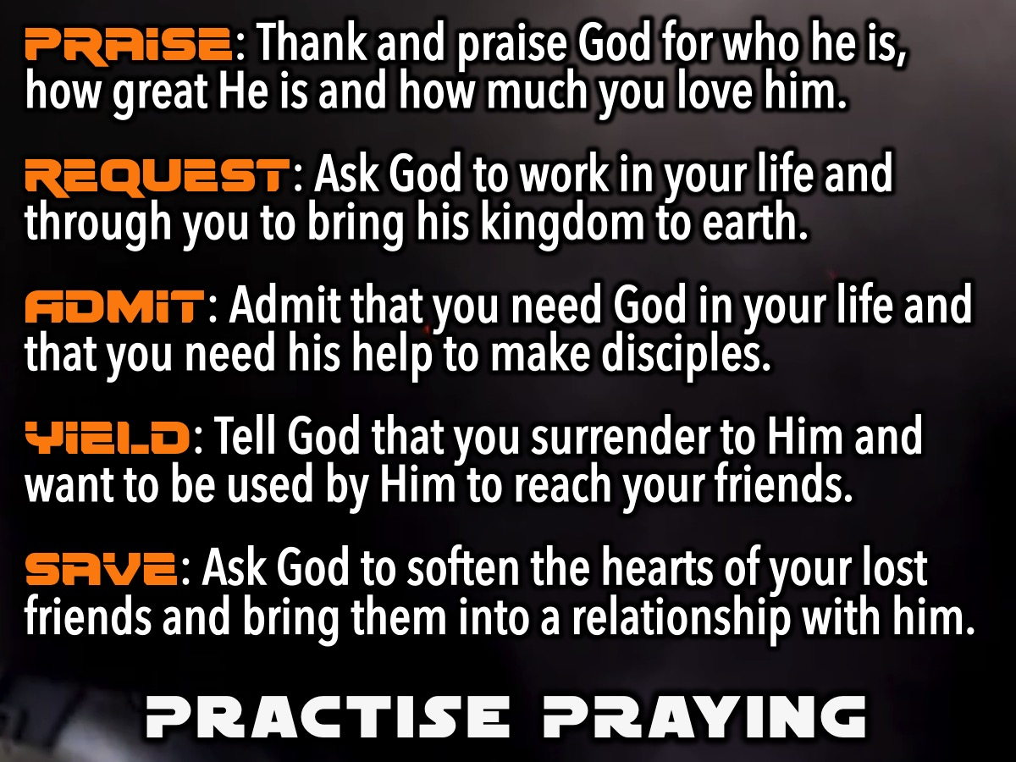
Notes:
Practise Praying: It is time for you to practise praying: Write a letter to God using the outline P.R.A.Y.S.:
* Praise: Thank and praise God for who he is , how great He is and how you love him.
* Request: Ask God to work in your life and through you to bring his kingdom to earth.
* Admit: Admit that you need God in your life and that you need his help to make disciples.
* Yield: Tell God that you surrender to Him and want to be used by Him to reach your friends.
* Save: Ask God to soften the hearts of your lost friends and bring them into a relationship with him.

Slide 27
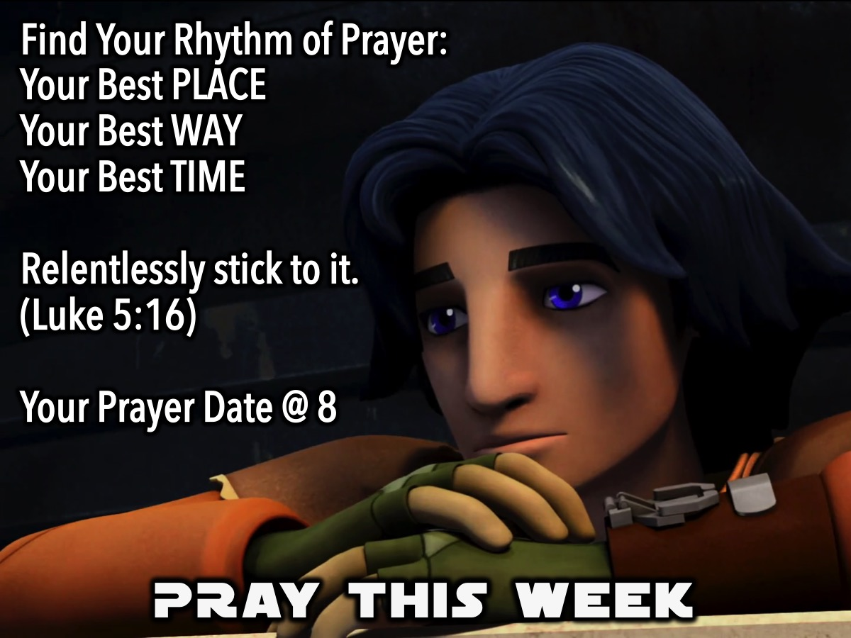
Notes:
Pray This Week: Find your rhythm of prayer and relentlessly stick to it. (Luke 5:16). Find your best PLACE, WAY and TIME to pray. Also, for the next week we are challenging you to pray for your three lost friends every night at 8pm! You could use the P.R.A.Y.S. outline and also pray for your 3 lost friends by name.

Slide 28
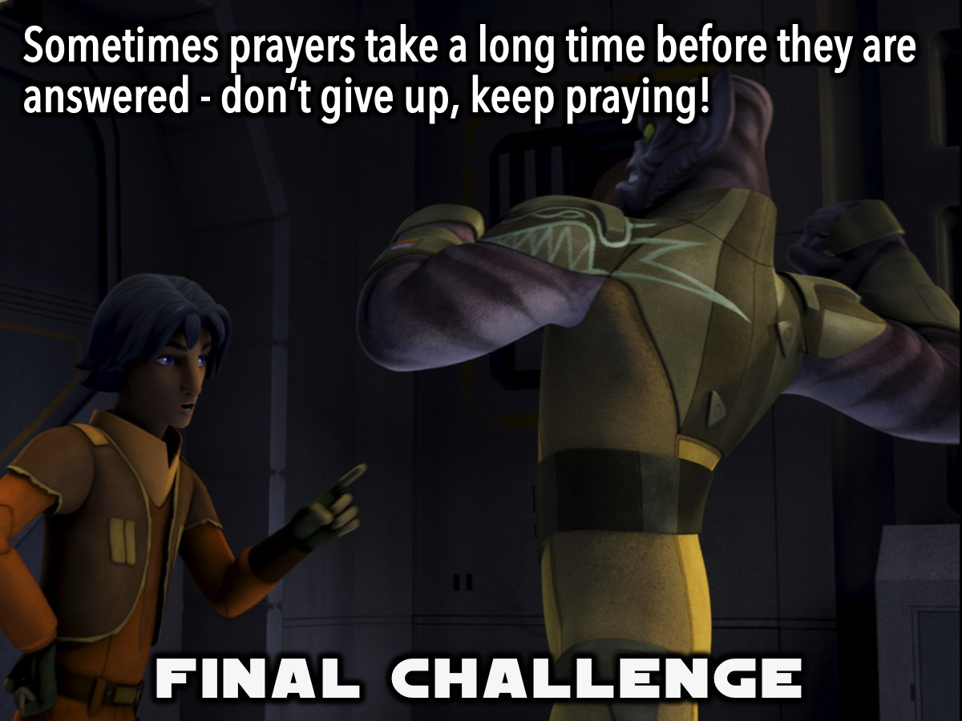
Notes:
Final Challenge: Sometimes prayers take a long time before they are answered - don’t give up, keep praying!

Slide 29
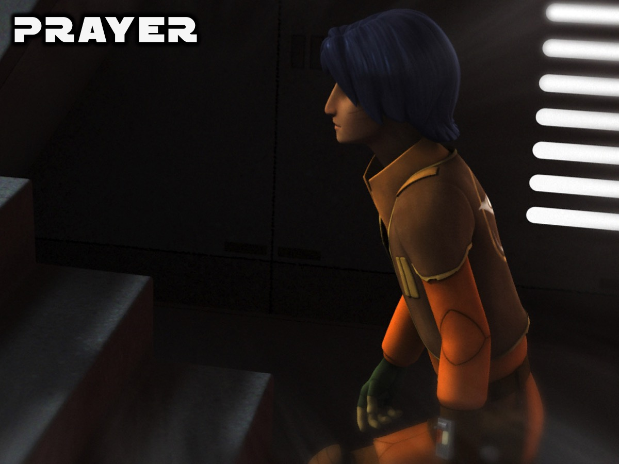
Notes:
Closing Prayer

Slide 30

Notes:
Next week we will be looking at how to PURSUE our lost friends with Love.

