Slide 1

Notes:
Welcome to the Replicate Series. Let’s first watch another Star Wars Rebels video clip.

Slide 2
Notes:
Video: A Look Ahead Star Wars Rebels. Get it on YouTube at: https://www.youtube.com/watch?v=JYkXif5Q2mA

Slide 3
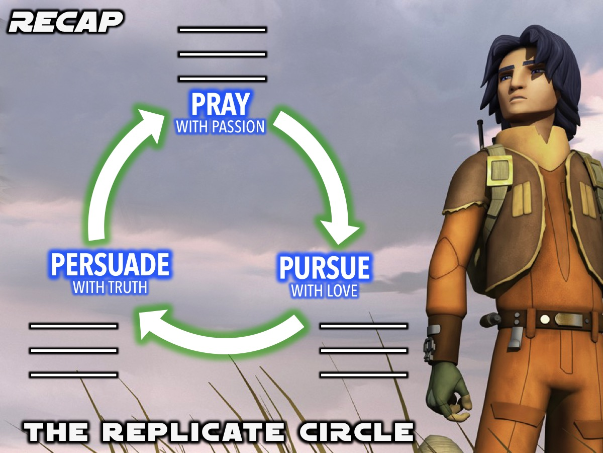
Notes:
Recap: Last week we were introduced to the Replicate Circle - which is a tool to help us lead our friends to Jesus.

Slide 4
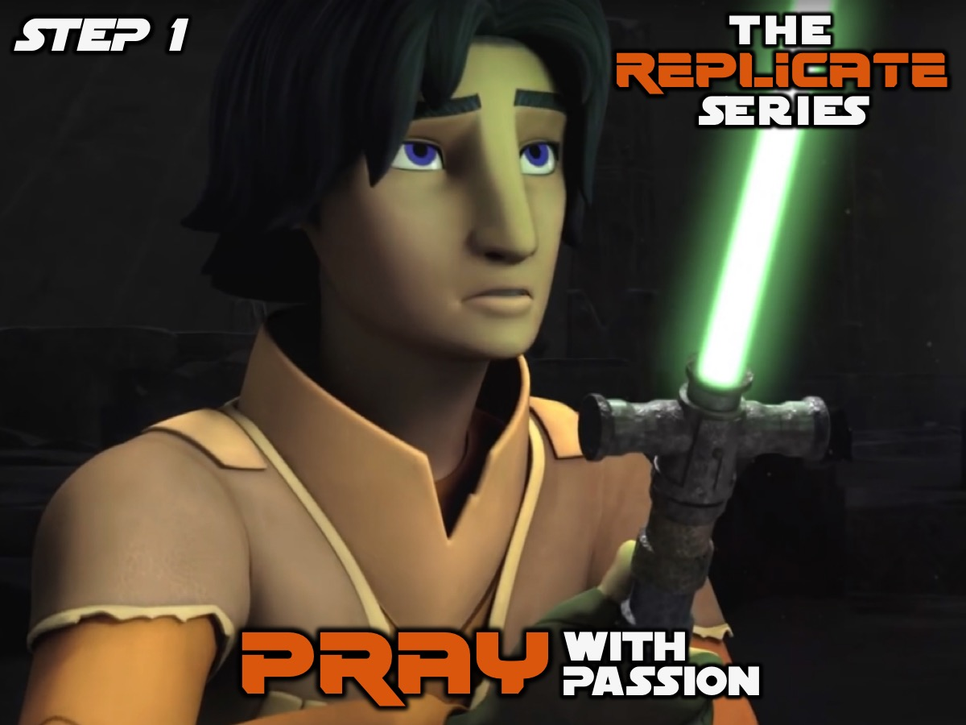
Notes:
The first step in the Replicate Circle is to Pray with Passion for our lost friends.

Slide 5
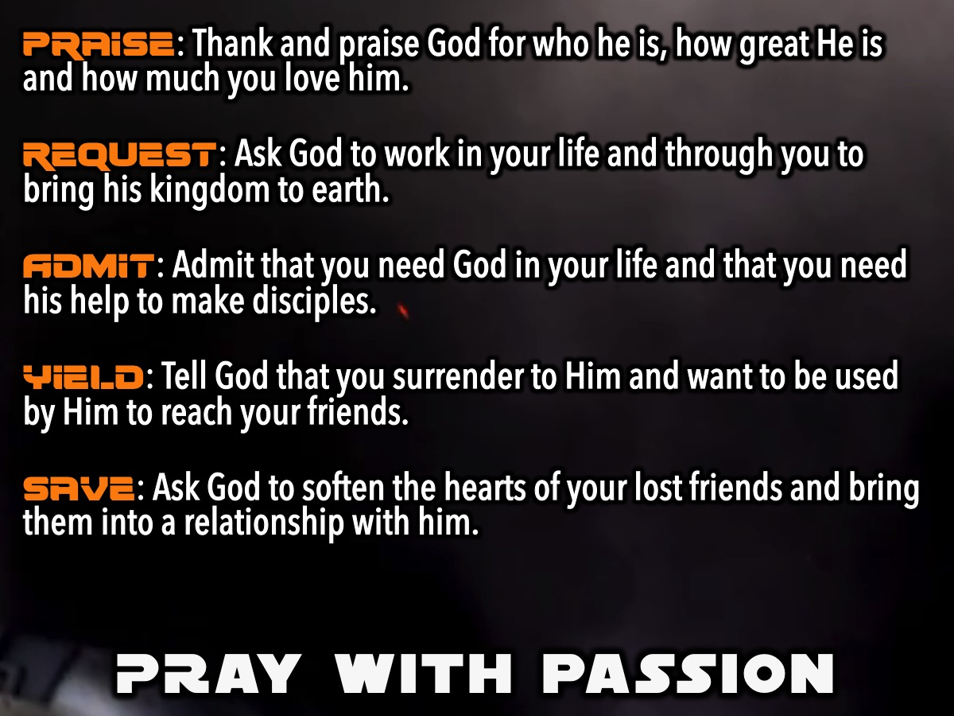
Notes:
We learnt how to pray with passion using this prayer outline:
1. Praise: Thank and praise God for who he is, how great He is and how much you love him.
2. Request: Ask God to work in your life and through you to bring his kingdom to earth.
3. Admit: Admit that you need God in your life and that you need his help to make disciples.
4. Yield: Tell God that you surrender to Him and want to be used by Him to reach your friends.
5. Save: Ask God to soften the hearts of your lost friends and bring them into a relationship with him.
And we also were challenged to have a Prayer Date @ 8 each night with God - and many of us participated on the Sunday Youth WhatsApp group between 8 and 8:30 each night of the week.

Slide 6
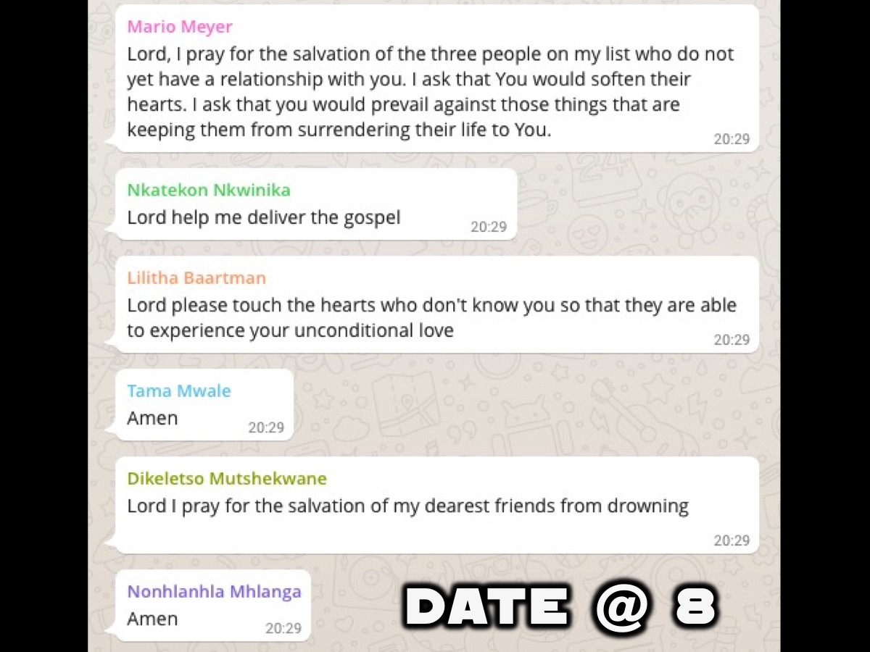
Notes:
And we challenged you to have a Prayer Date @ 8 each night with God - and many of us participated on the Sunday Youth WhatsApp group between 8 and 8:30 each night of the week. If you are not on the group (even if you gave your number last Sunday), then please sign up this morning before you leave!

Slide 7
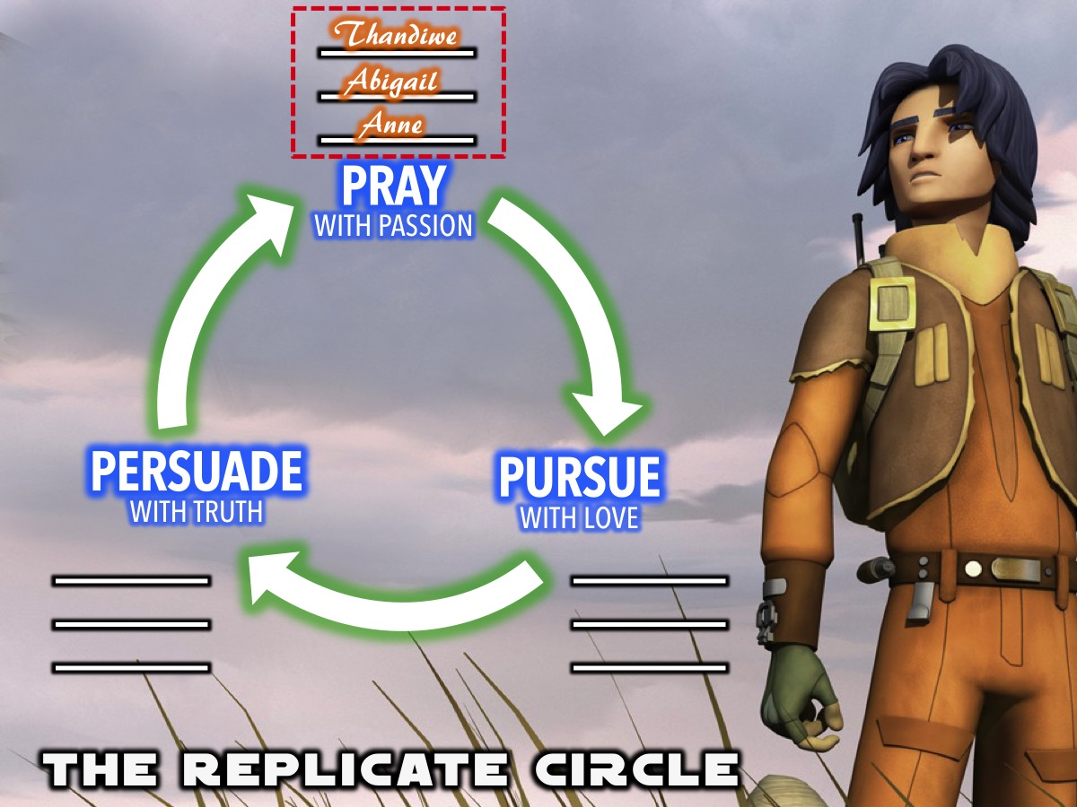
Notes:
On the handout we were given we wrote down the names of three lost friends on the Pray with Passion part of the circle.

Slide 8

Notes:
This week we are going to explore the second part of the Replicate Circle: Pursue With Love.

Slide 9
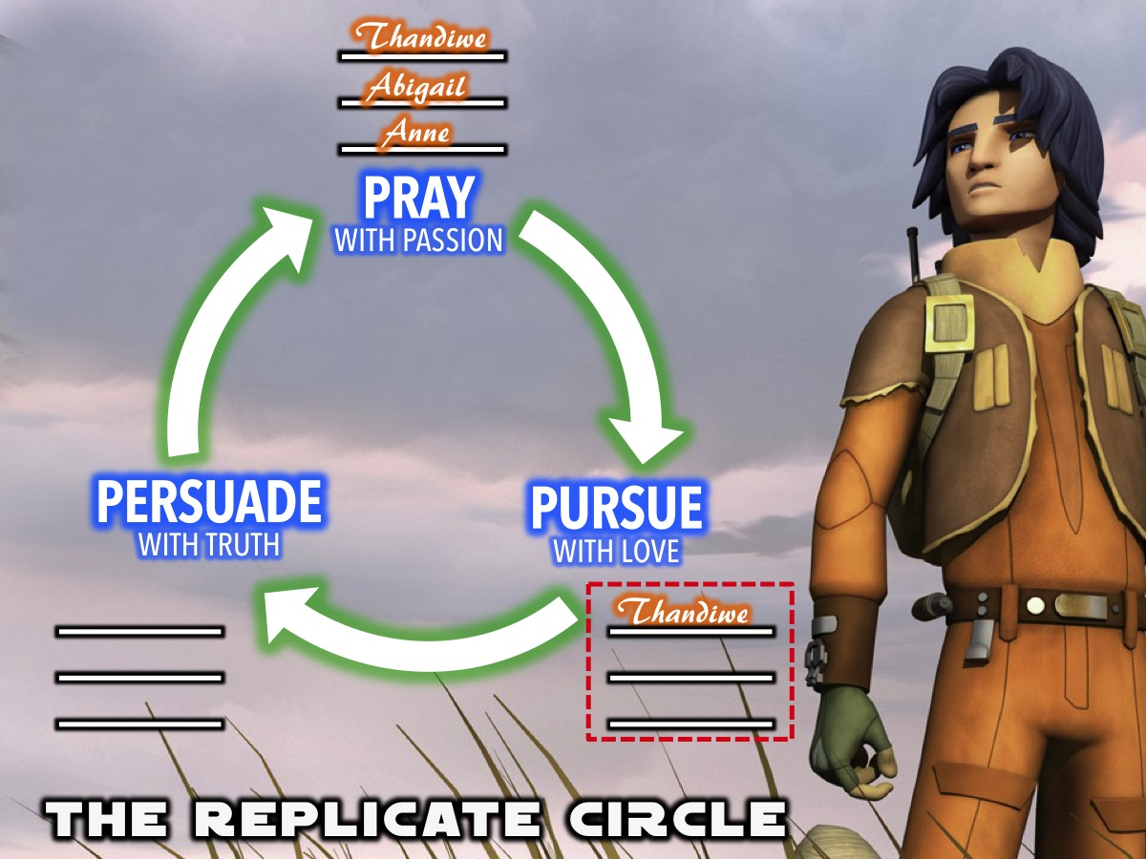
Notes:
Once you have started praying for three lost friends you begin to look for opportunities to take the next step which is to pursue them with love so you can start moving the names of your lost friends to the next section of the circle.

Slide 10
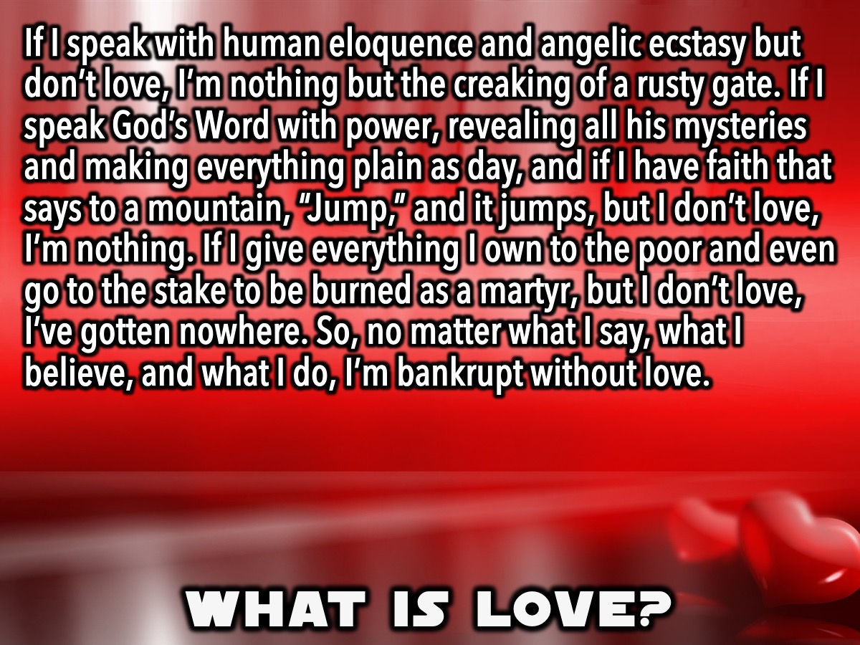
Notes:
But before we get ahead of ourselves, what is love actuallu? There is a very well know chapter in the Bible that is all about love - it is found in 1 Corinthians 13: “If I speak with human eloquence and angelic ecstasy but don’t love, I’m nothing but the creaking of a rusty gate. If I speak God’s Word with power, revealing all his mysteries and making everything plain as day, and if I have faith that says to a mountain, “Jump,” and it jumps, but I don’t love, I’m nothing. If I give everything I own to the poor and even go to the stake to be burned as a martyr, but I don’t love, I’ve gotten nowhere. So, no matter what I say, what I believe, and what I do, I’m bankrupt without love.”

Slide 11
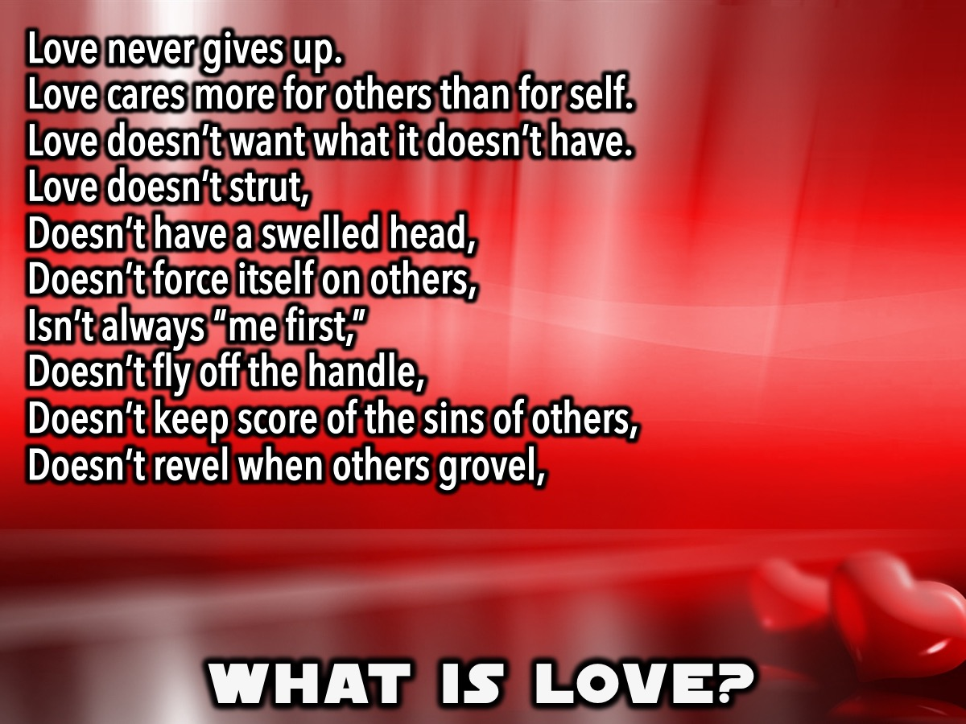
Notes:
Love never gives up.
Love cares more for others than for self.
Love doesn’t want what it doesn’t have.
Love doesn’t strut,
Doesn’t have a swelled head,
Doesn’t force itself on others,
Isn’t always “me first,”
Doesn’t fly off the handle,
Doesn’t keep score of the sins of others,
Doesn’t revel when others grovel,

Slide 12
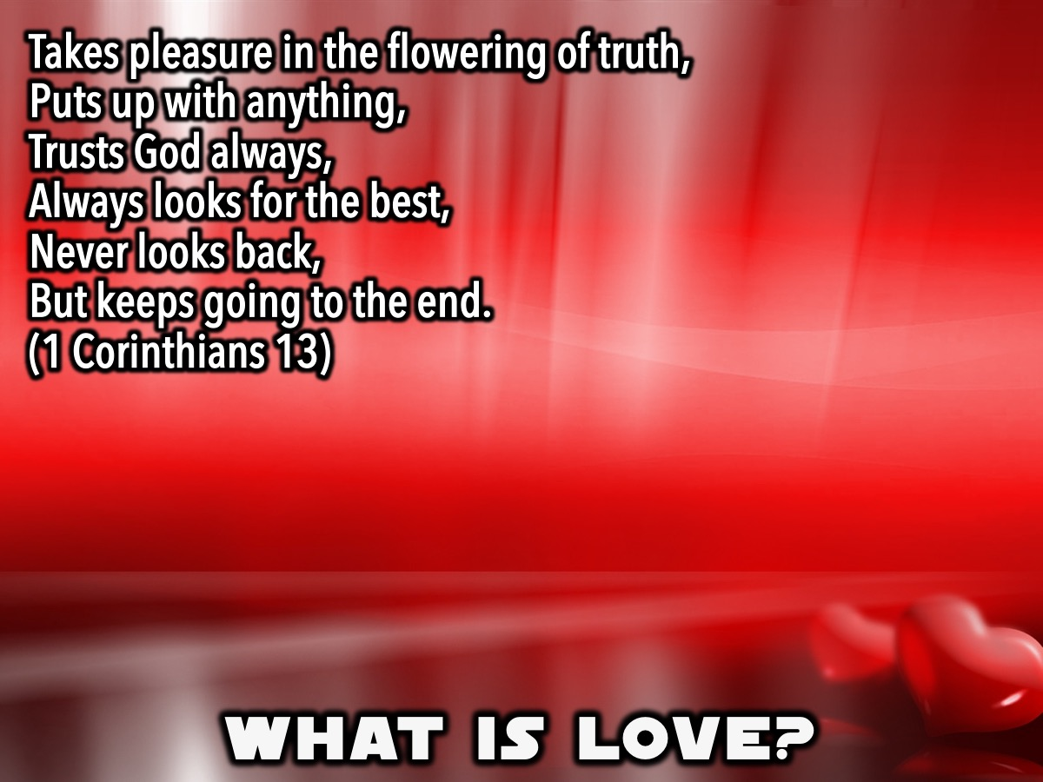
Notes:
Takes pleasure in the flowering of truth,
Puts up with anything,
Trusts God always,
Always looks for the best,
Never looks back,
But keeps going to the end.
(1 Corinthians 13)

Slide 13
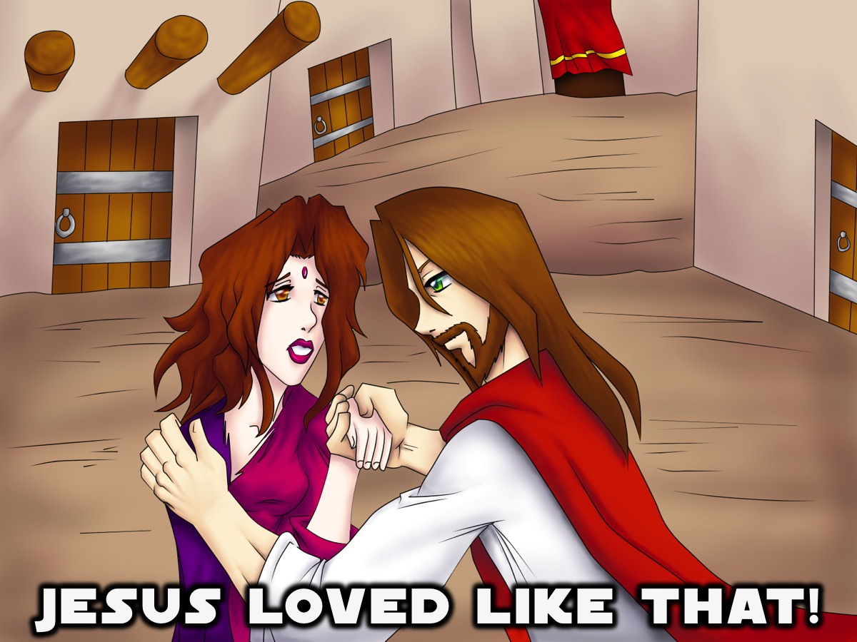
Notes:
There is someone who actually loved like this! It was Jesus.

Slide 14
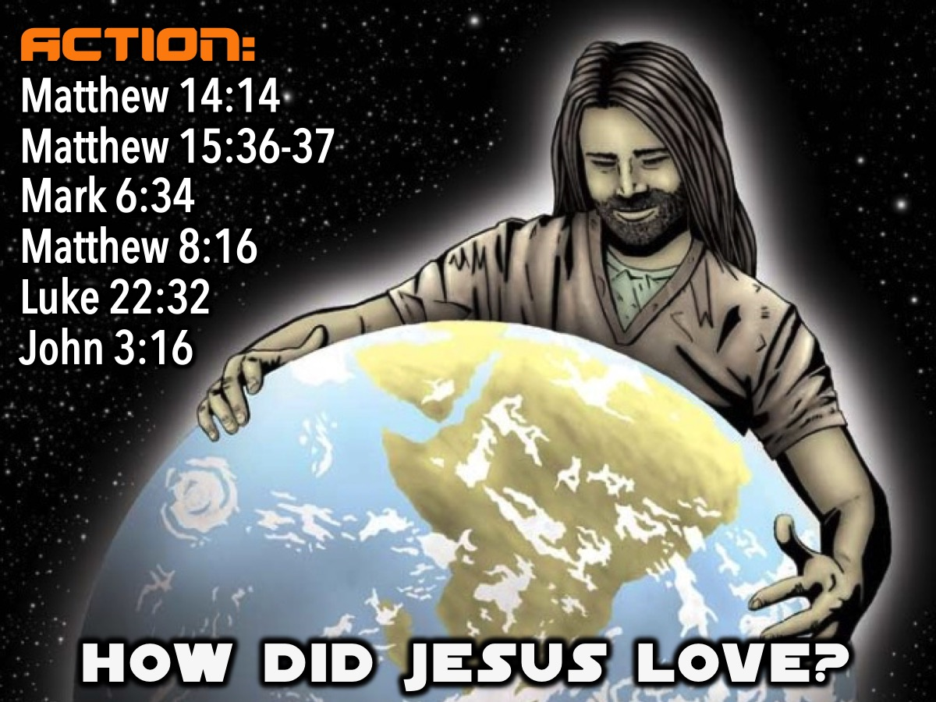
Notes:
Action: We are going to look at some verses where Jesus loved people practically - read the verses and find out how he loved:
When Jesus saw the large crowd, he had compassion on them and healed their sick. (Matthew 14:14)
Jesus took the seven loaves and the fish, and when he had given thanks, he broke them and gave them to the disciples, and they in turn to the people. They all ate and were satisfied. (Matthew 15:36-37)
When Jesus landed and saw a large crowd, he had compassion on them, because they were like sheep without a shepherd. So he began teaching them many things. (Mark 6:34)
When evening came, many who were demon-possessed were brought to him, and he drove out the spirits with a word and healed all the sick. (Matthew 8:16)
But I have prayed for you, Simon, that your faith may not fail. And when you have turned back, strengthen your brothers.” (Luke 22:32)
For God so loved the world that he gave his one and only Son, that whoever believes in him shall not perish but have eternal life. (John 3:16)

Slide 15
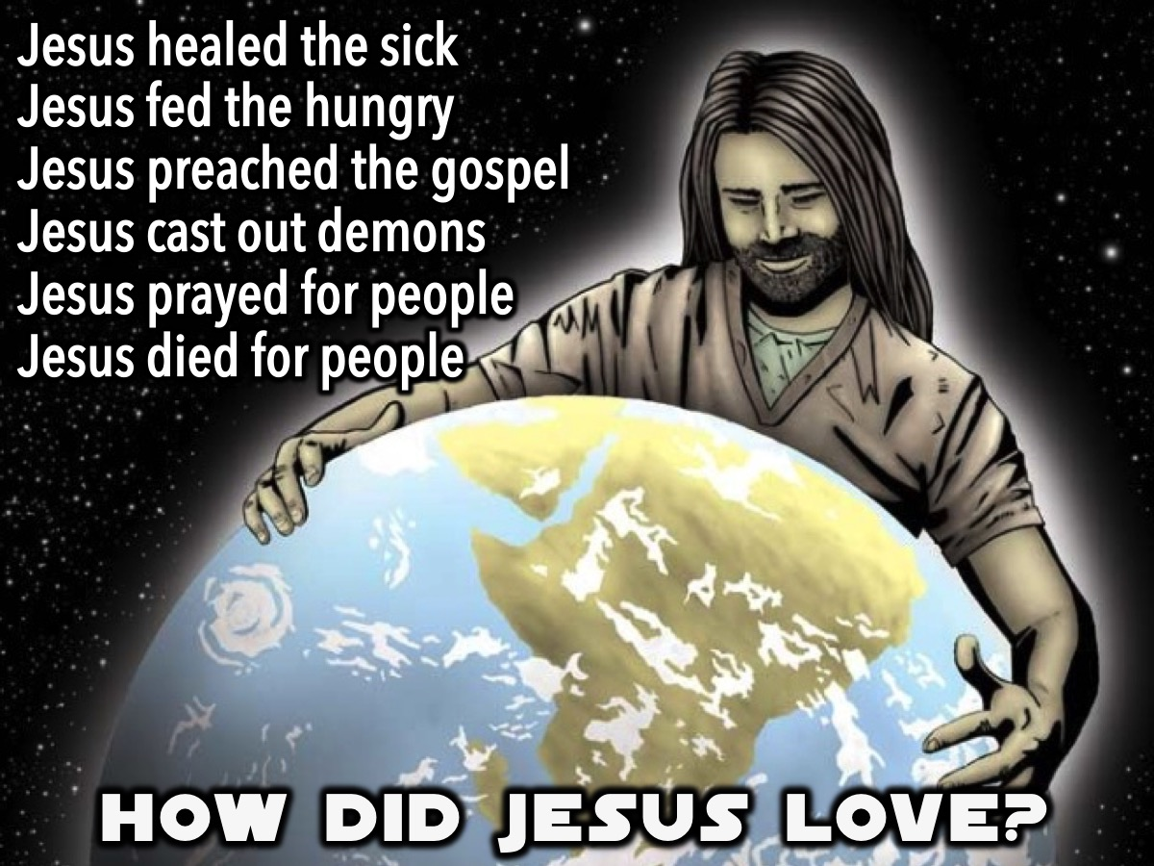
Notes:
Here are some of the ways that Jesus pursued people with love:
Jesus healed the sick - Matthew 14:14
Jesus fed the hungry - Matthew 15:32
Jesus preached the gospel – Mark 6:34
Jesus cast out demons - Matthew 8:16
Jesus prayed for people – John 17:20-21
Jesus gave his life for people - John 3:16

Slide 16
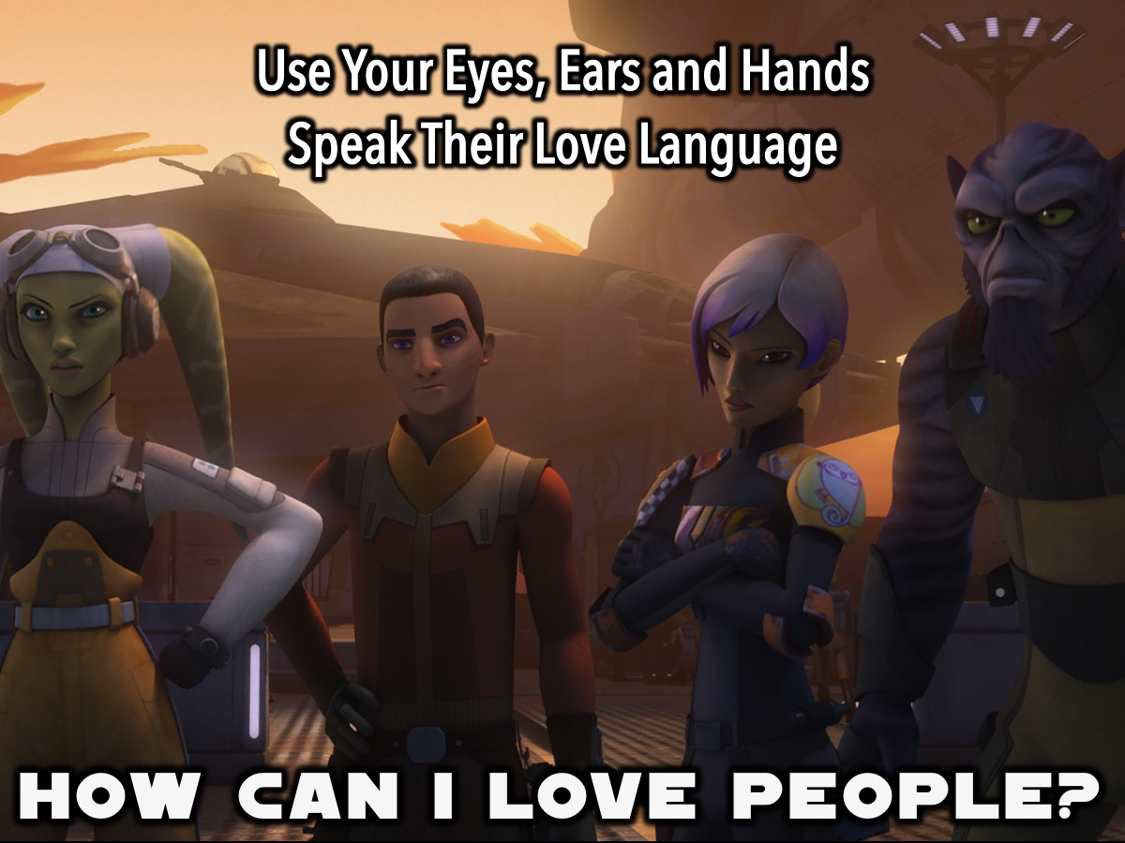
Notes:
How Can I Love People? I am going to give you two ways that you can love people: (1) Use Your Eyes, Ears and Hands and (2) Speak Their Love Language.

Slide 17
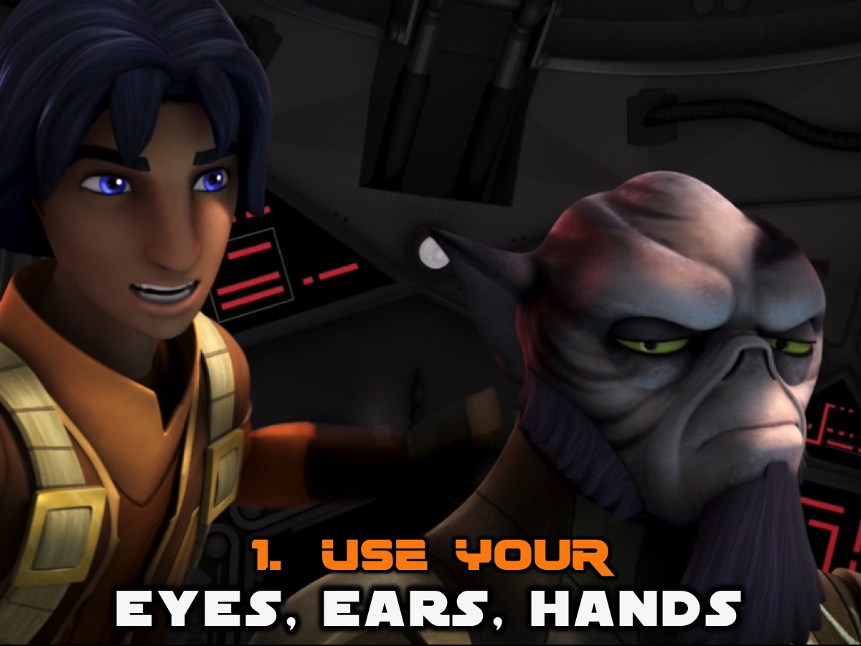
Notes:
1. Use Your Eyes, Ears and Hands.

Slide 18
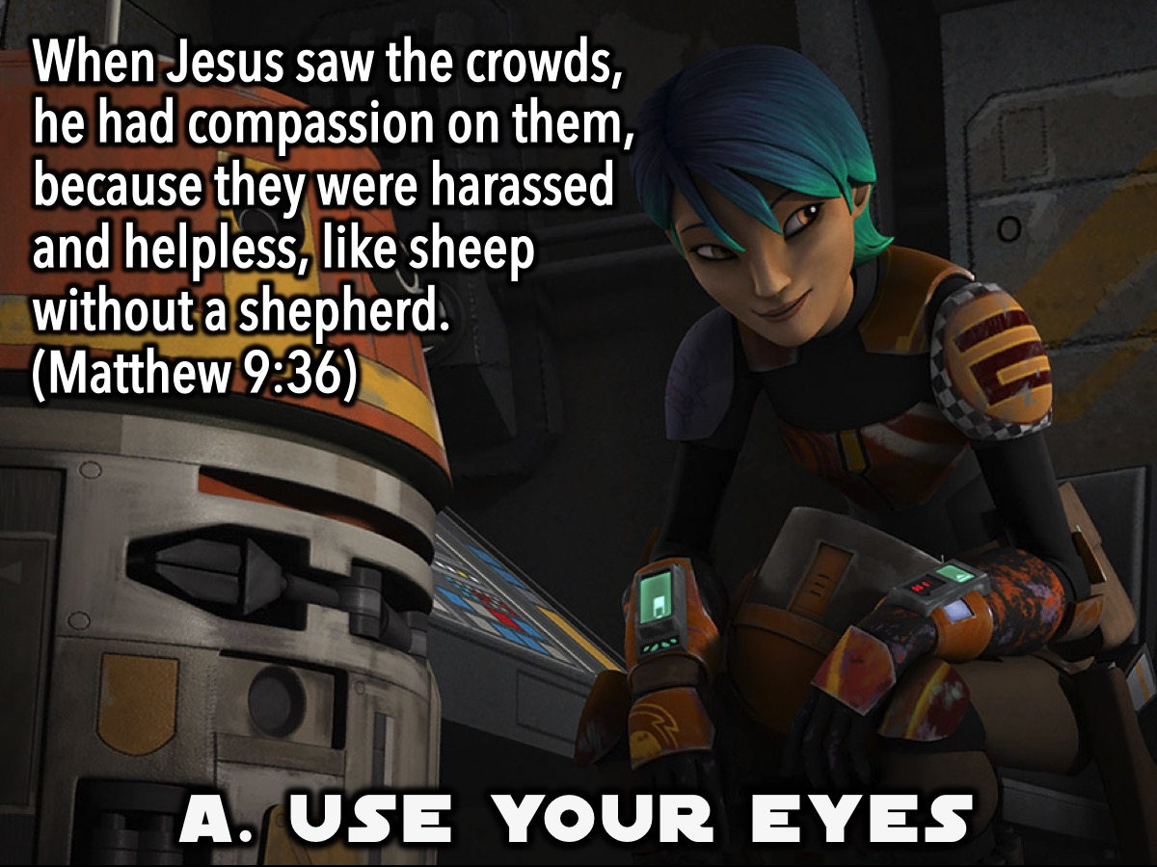
Notes:
A. Use Your Eyes: When Jesus saw the crowds, he had compassion on them, because they were harassed and helpless, like sheep without a shepherd. (Matthew 9:36)

Slide 19
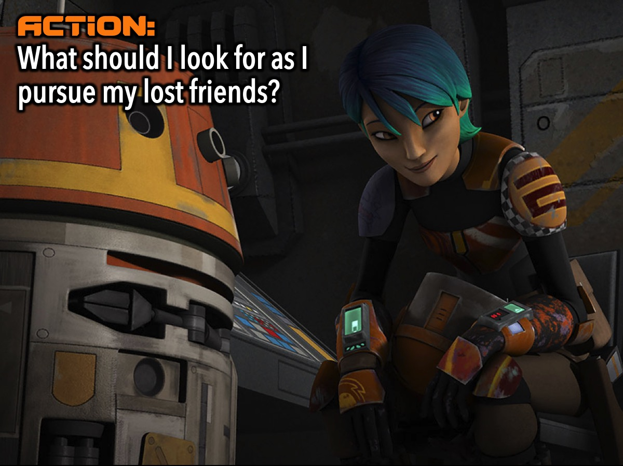
Notes:
Action: What do I need to look for as I pursue my lost friends? (What are their physical, emotion, or spiritual needs?)

Slide 20
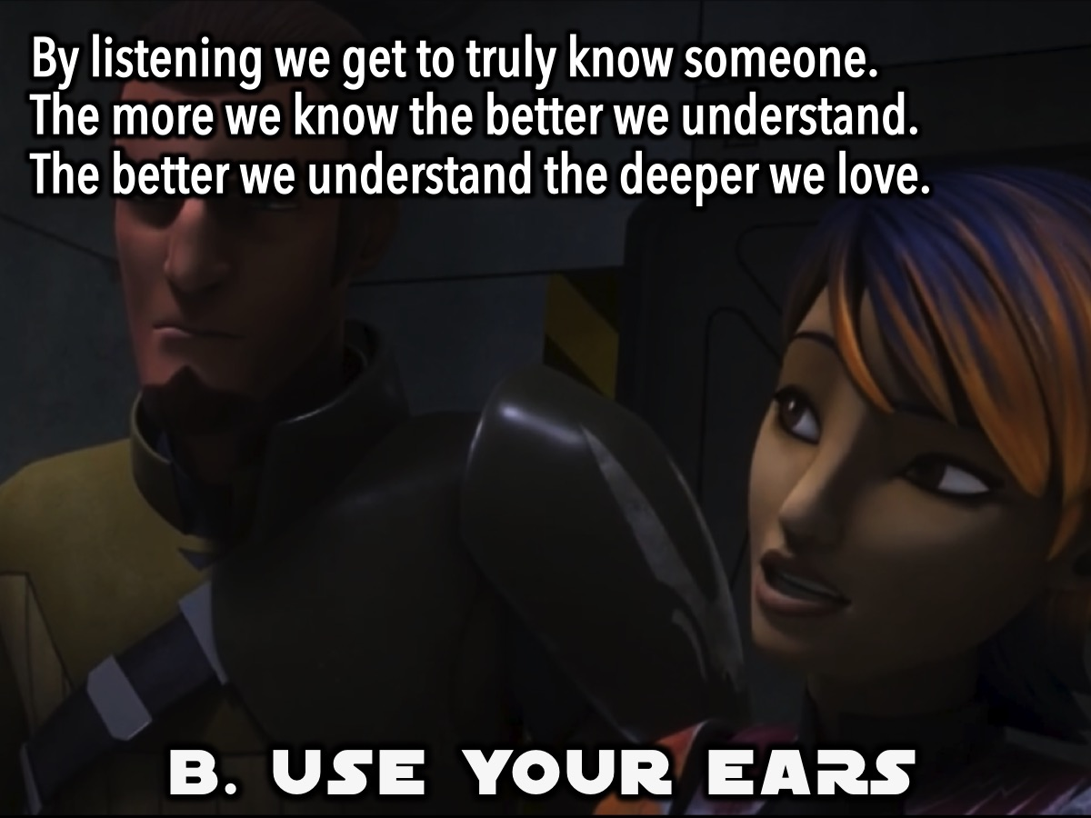
Notes:
B. Use Your Ears: By listening we get to truly know someone. The more we know the better we understand. The better we understand the deeper we love.

Slide 21
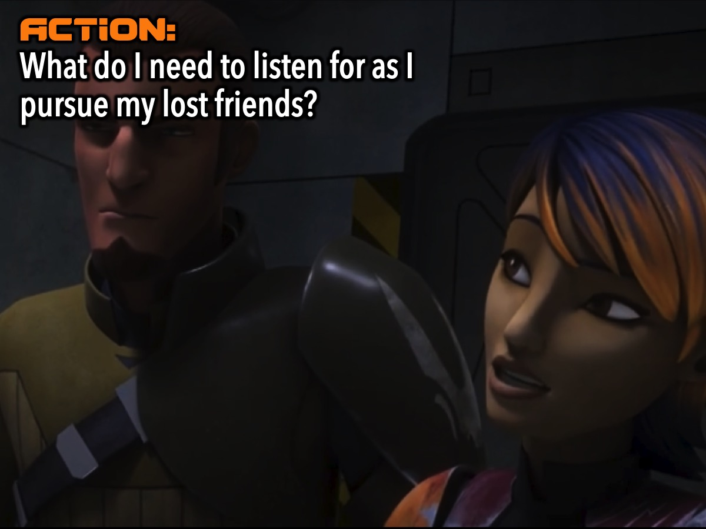
Notes:
Action: What do I need to listen for as I pursue my lost friends?

Slide 22
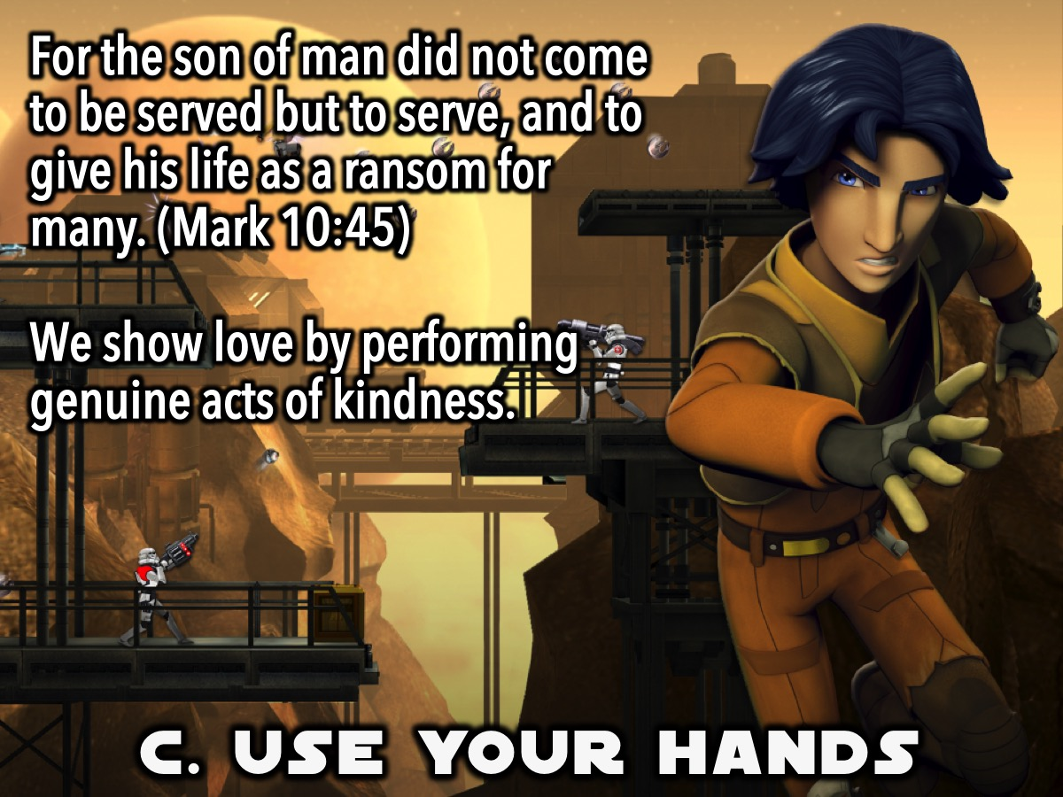
Notes:
C. Use Your Hands: “For the son of man did not come to be served but to serve, and to give his life as a ransom for many.“ (Mark 10:45). We show love by performing genuine acts of kindness to people.

Slide 23
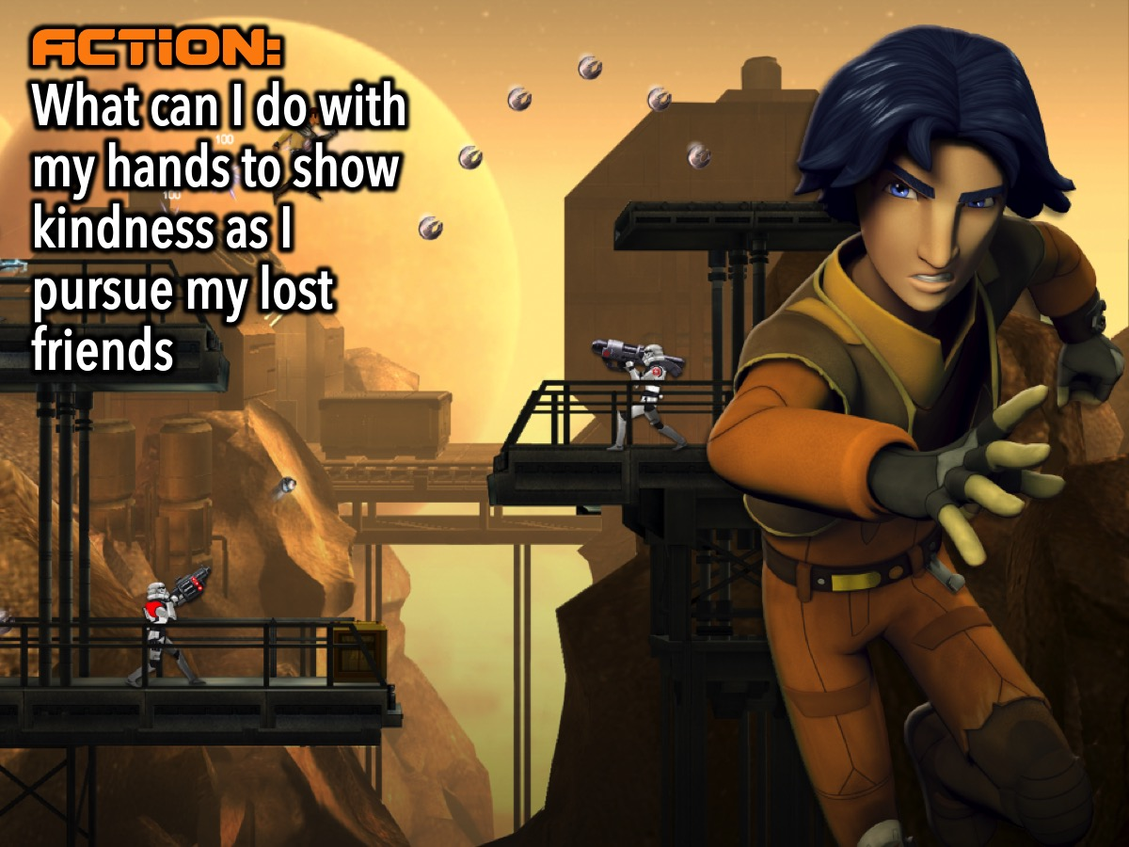
Notes:
Action: What can I do with my hands to show kindness as I pursue my lost friends?

Slide 24
Notes:
Video: Heartwarming Thai Commercial. Get it on YouTube at: https://www.youtube.com/watch?v=632CHpeHYZE

Slide 25
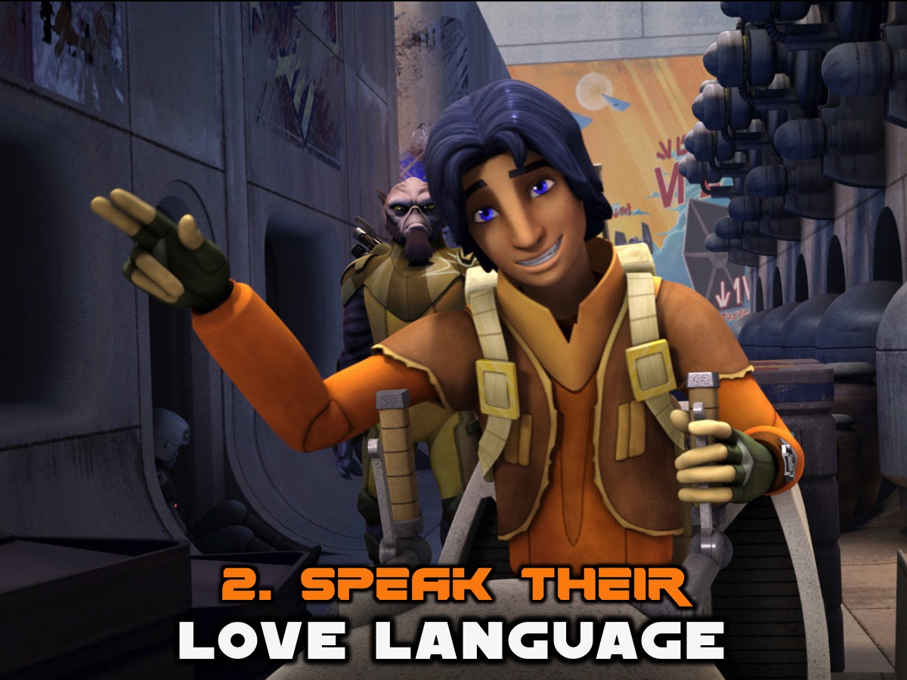
Notes:
2. Speak Their Love Language. Every person has their own love language. And if we find our lost friends’s love language we can love them in a way that makes them feel loved. There are 5 Basic Love Languages:

Slide 26
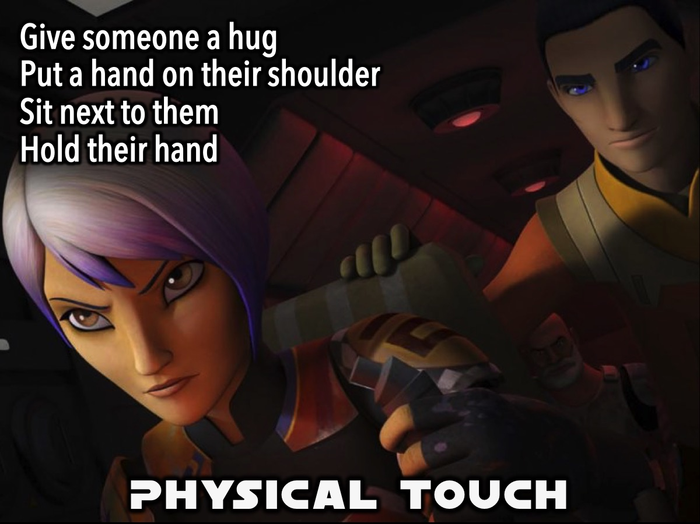
Notes:
A. Physical Touch. One of the ways to show love is through healthy physical touch. It could be giving someone a hug, or putting a hand on their shoulder or sitting next to them or holding their hand.

Slide 27
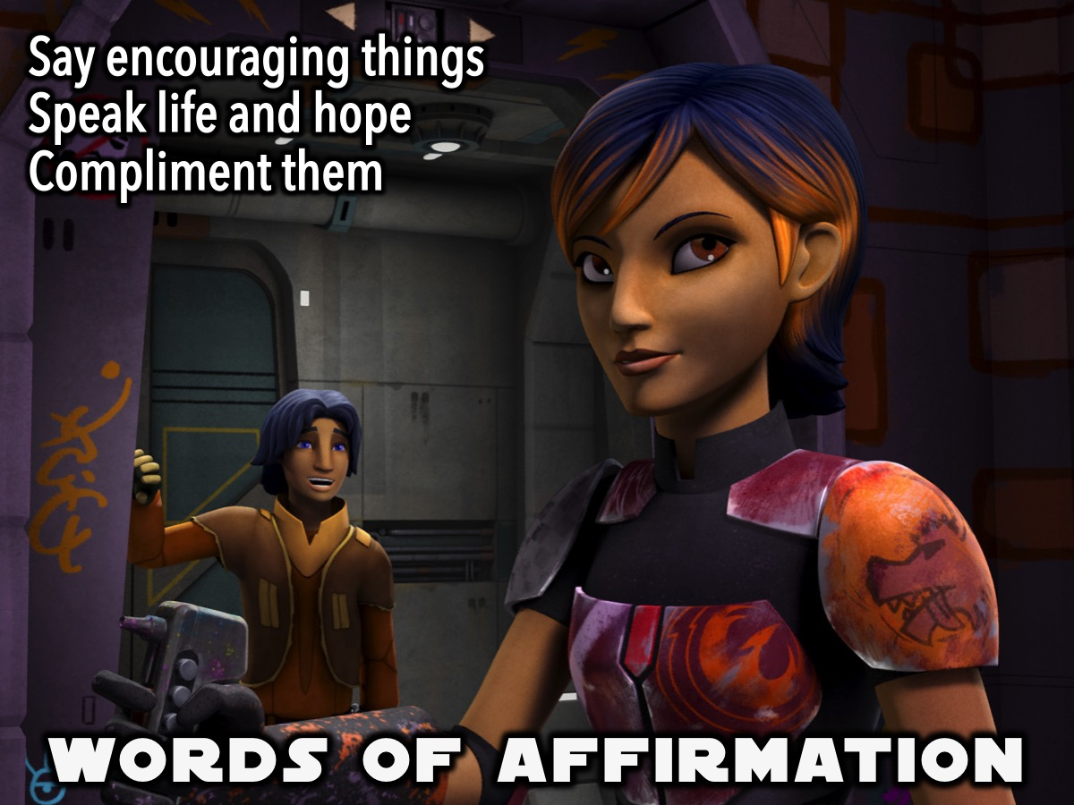
Notes:
B. Words of Affirmation. The second love language is speaking words that encourage the person. Remember that everything you say, and even how you say it, means something to the person you are pursuing.

Slide 28
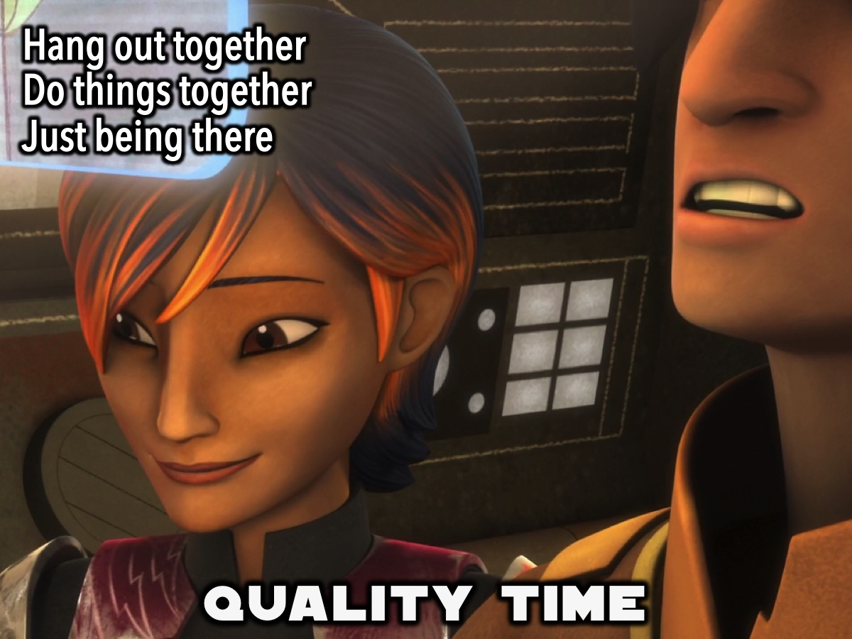
Notes:
C. Quality Time. Some people need you to be doing stuff with them but there are people as long as you are in the same room with them they are happy.

Slide 29
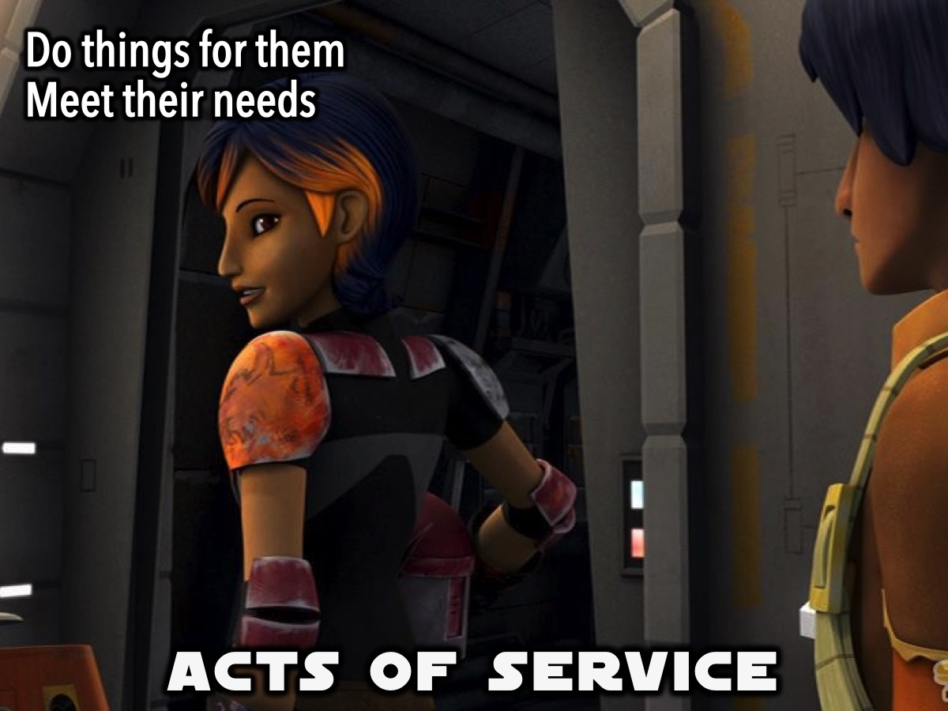
Notes:
D. Acts of Service. This is the act of doing things you know the other person would like you to do.

Slide 30
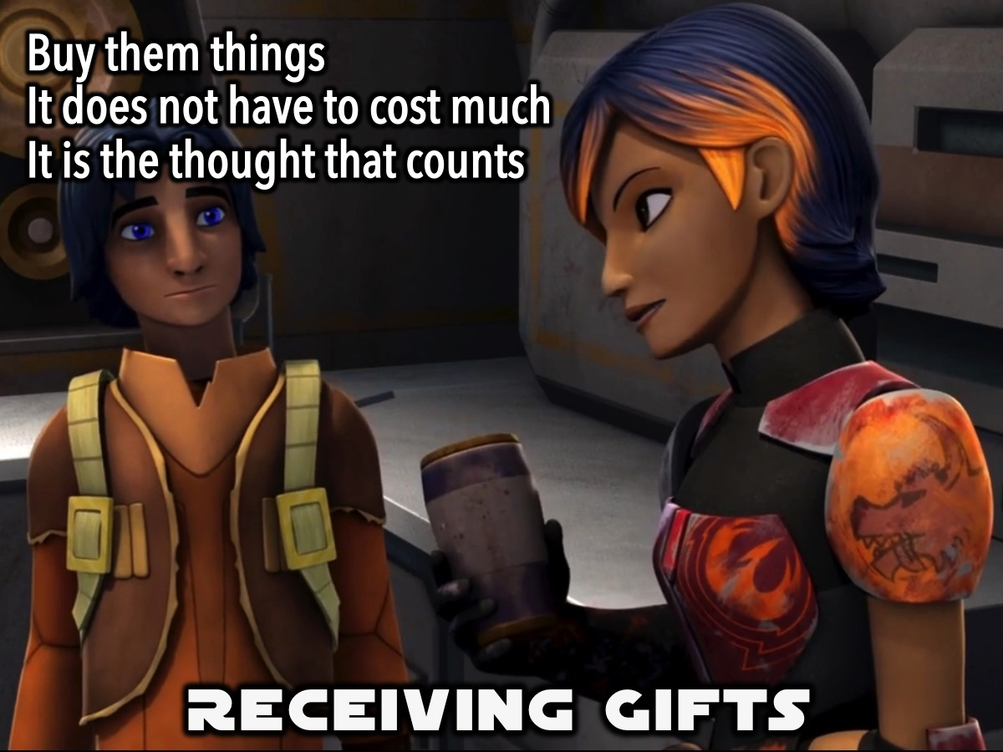
Notes:
E. Receiving Gifts. This doesn’t always require huge amount of money. Often it’s not the gift itself but the thought and time put into the gift that matters.

Slide 31
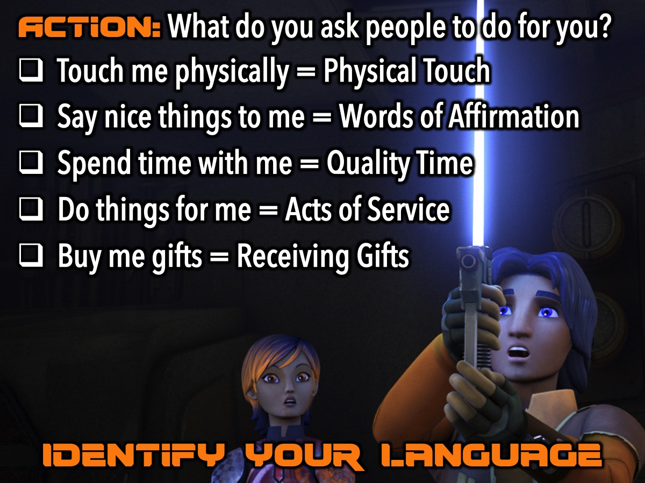
Notes:
Action: You can find out what your love language is by asking what it is that your normally ask people to do for you. Ie.
* Touch me physically = Physical Touch
* Say nice things to me = Words of Affirmation
* Spend more time with me = Quality Time
* Do things for me = Acts of Service
* Buy me things = Receiving Gifts

Slide 32
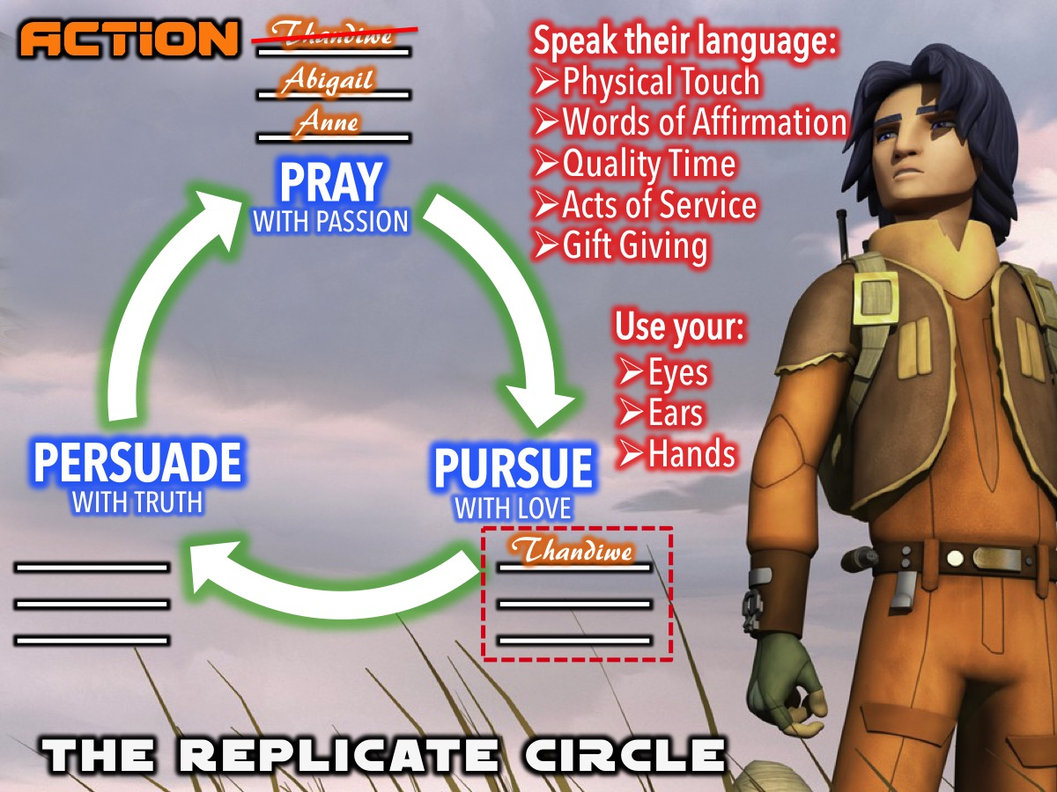
Notes:
Action: Think of one person on your Replicate Circle: Move their name down to the Pursue with Love section and think of what you can do to start loving them into the kingdom from tomorrow!

Slide 33
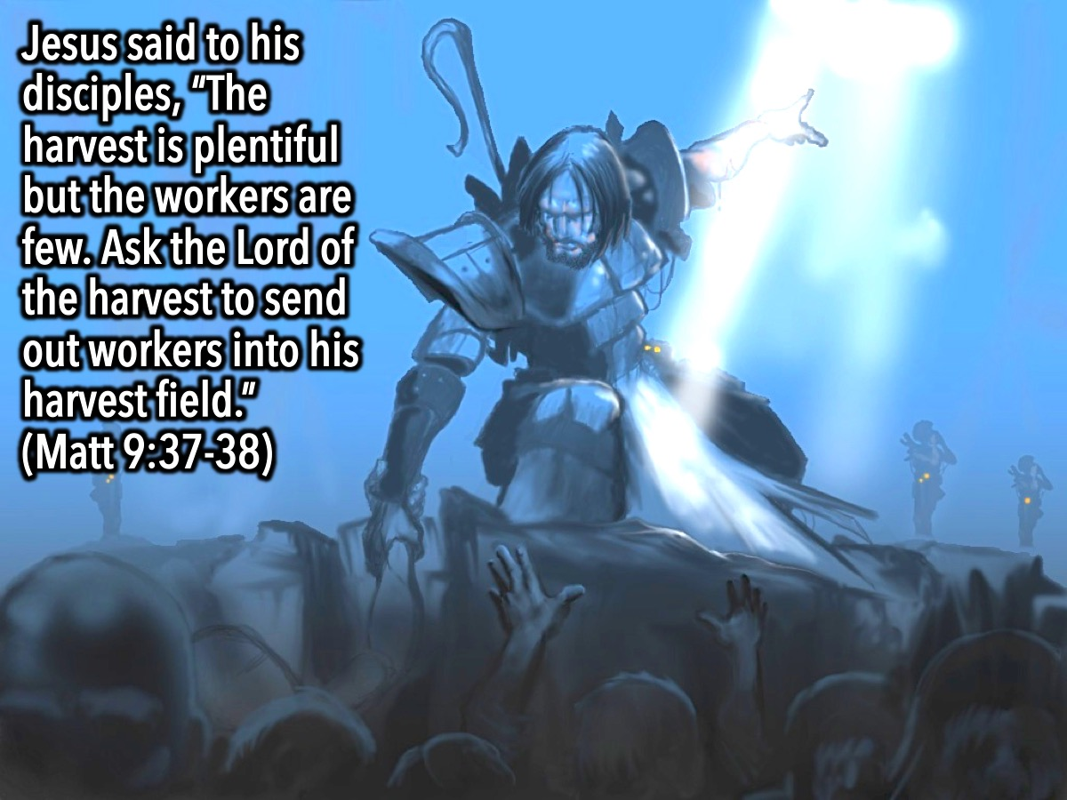
Notes:
Jesus said to his disciples, the harvest is plentiful but the workers are few. Ask the Lord of the harvest therefore to send out workers into his harvest field. (Matthew 9:35-38)

Slide 34
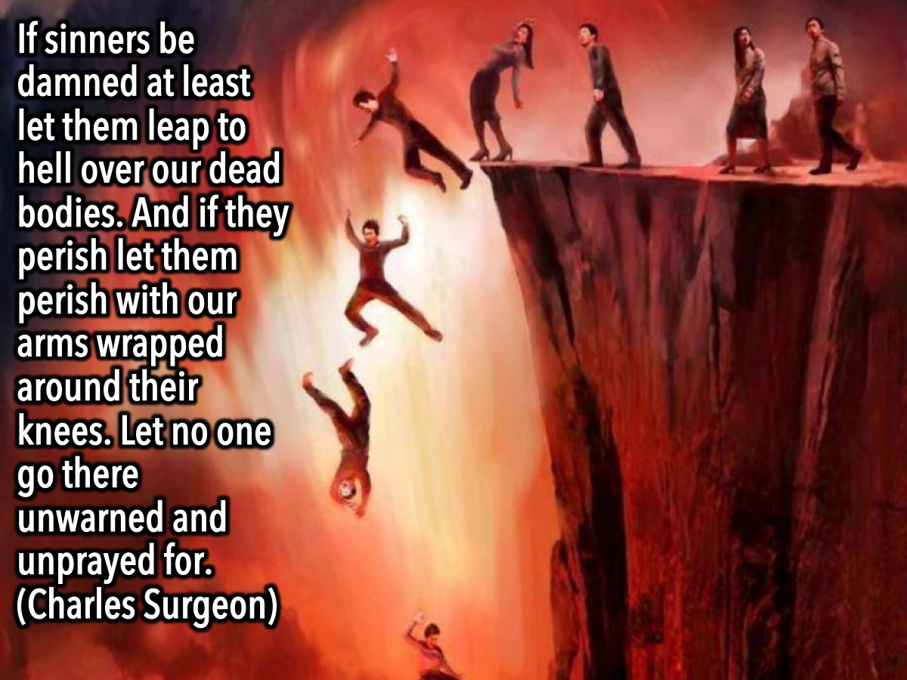
Notes:
If sinners be damned at least let them leap to hell over our dead bodies. And if they perish let them perish with our arms wrapped around their knees. Let no one go there unwarned and unprayed for. (Charles Surgeon)

Slide 35
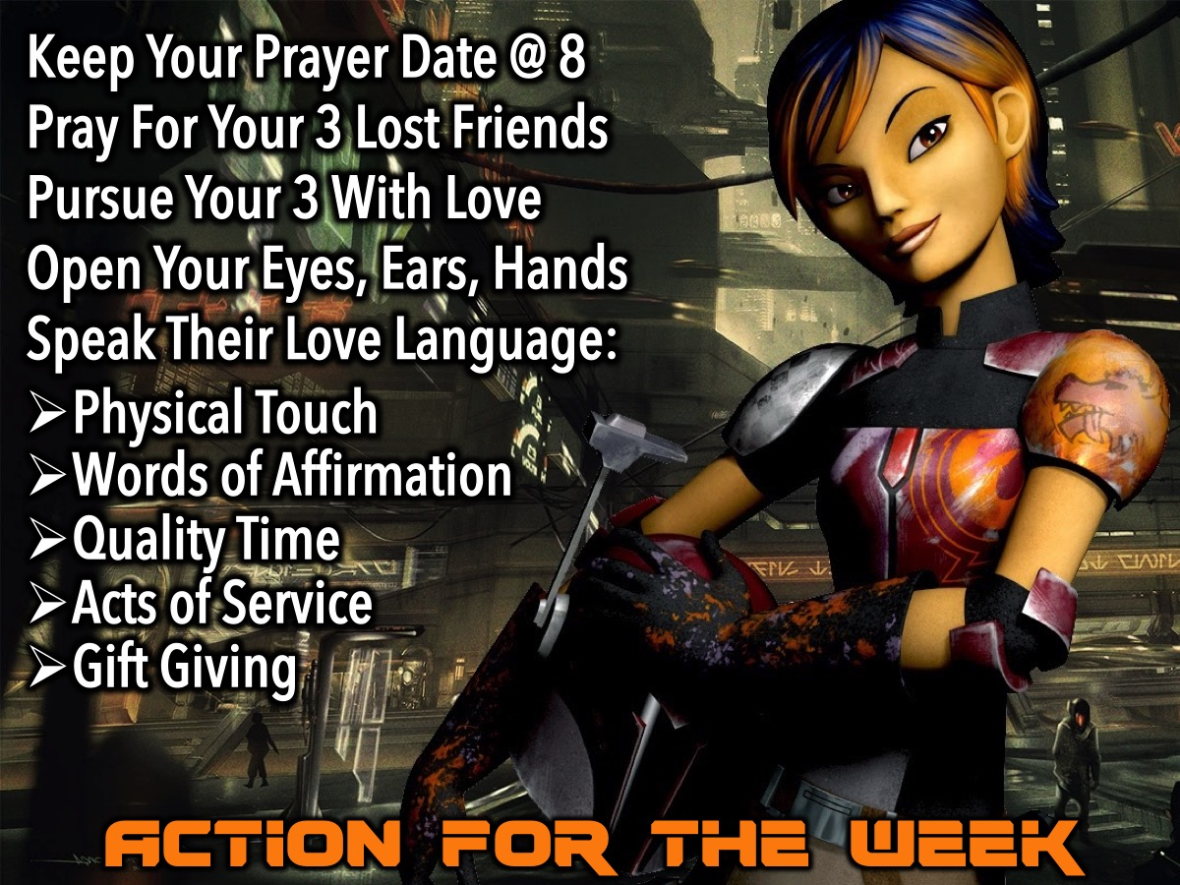
Notes:
Action For The Week: Keep Your Prayer Date @ 8. Pray For Your 3 Lost Friends. Pursue The Lost With Love. Open Your Eyes, Ears, Hands. Speak Their Love Languages: Physical Touch, Words of Affirmation, Quality Time, Acts of Service, Gift Giving.

Slide 36
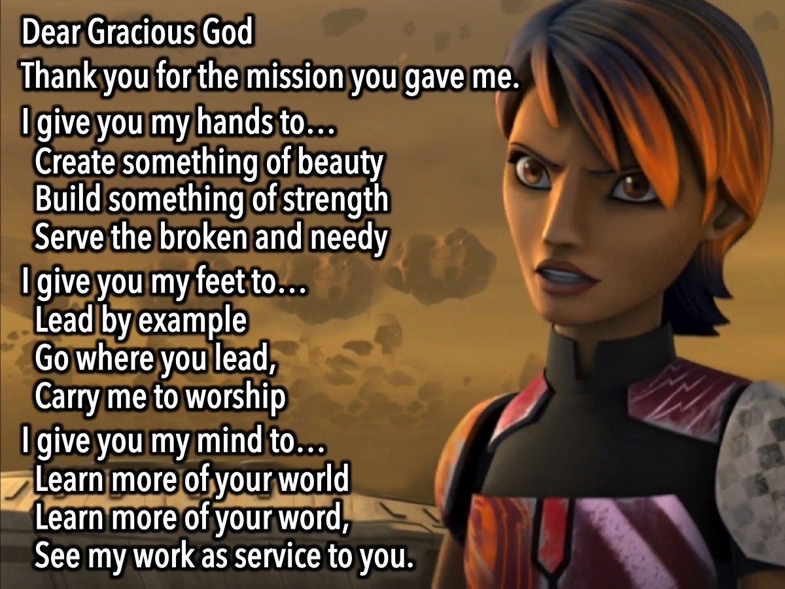
Notes:
The Prayer of Commitment:
Dear Gracious God
Thank you for the mission you have given me
I give you my hands to…
Create something of beauty
Build something of strength
Serve the broken and needy
I give you my feet to…
Lead by example
Go where you lead,
Carry me to worship
I give you my mind to…
Learn more of your world
Learn more of your word,
See my work as service to you.

Slide 37
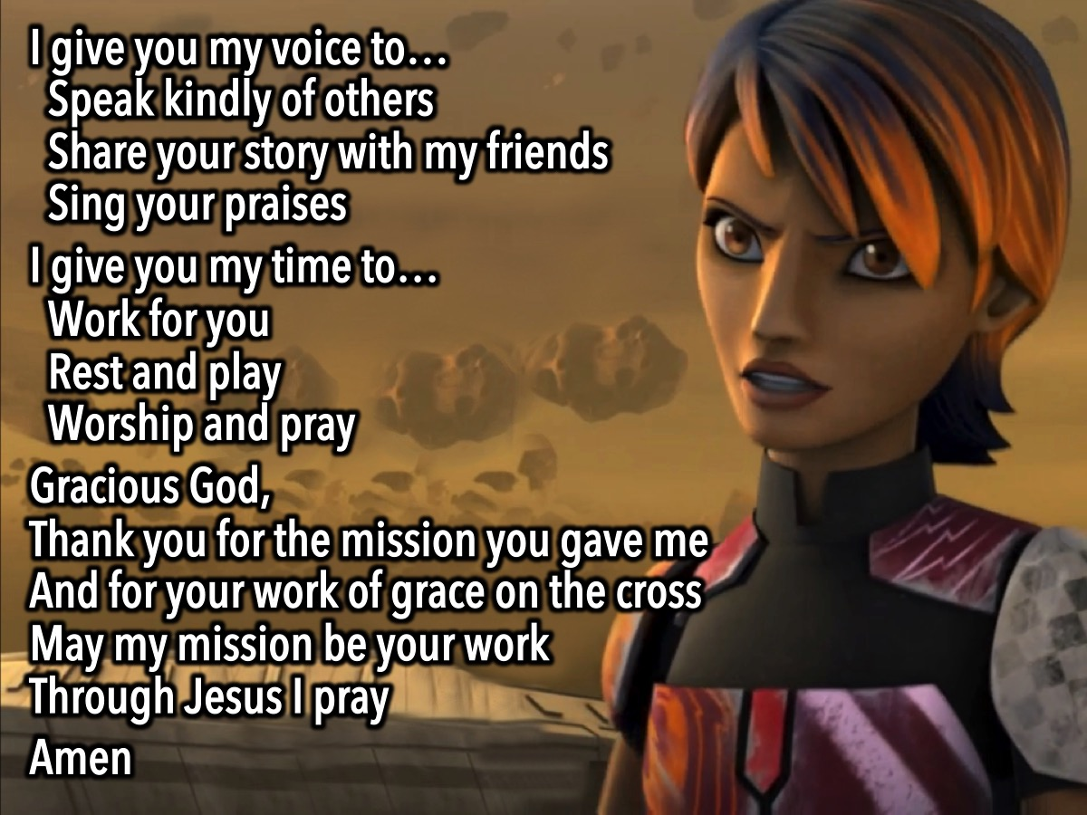
Notes:
I give you my voice to…
Speak kindly of others
Share your story with my friends
Sing your praises
I give you my time to…
Work for you
Rest and play
Worship and pray
Gracious God,
Thank you for the mission you have given me
And for your work of grace on the cross
May my mission be your work
Through Jesus I pray
Amen

Slide 38

Notes:
Closing Prayer

Slide 39

Notes:
Next week we will be looking at how to PERSUADE our lost friends with Truth.

