Slide 1

Notes:
Welcome to the Replicate Series. Let’s first watch another Star Wars Rebels video clip.

Slide 2
Notes:
Video: Star Wars Rebels Extended Trailer. Get it on YouTube at: https://www.youtube.com/watch?v=xg5YN3LAGw4

Slide 3
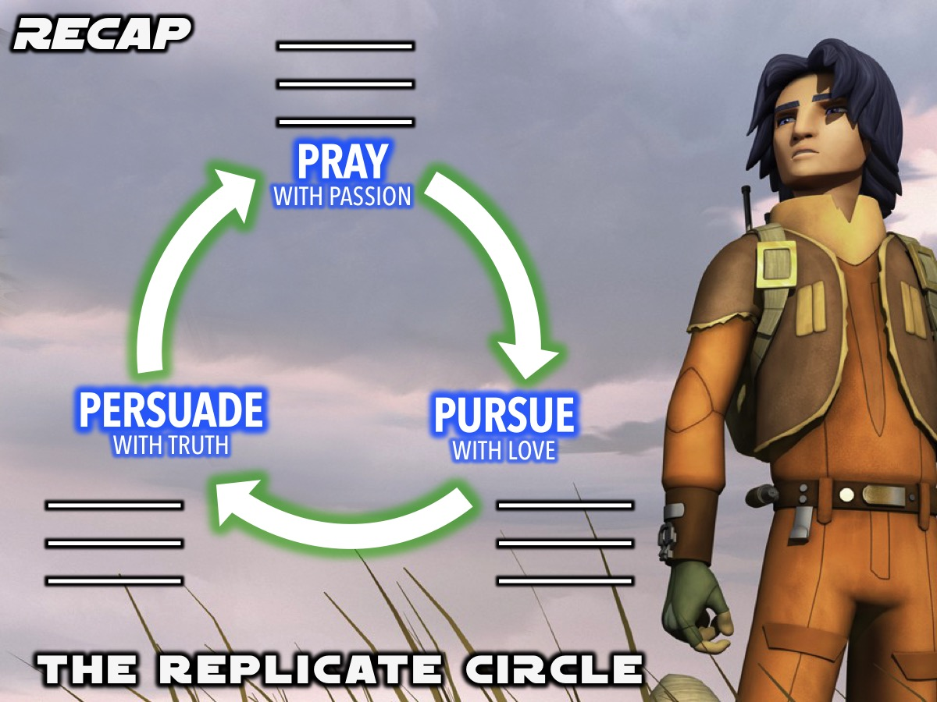
Notes:
Recap: We have been introduced to the Replicate Circle - a tool to help us lead our friends to Jesus.

Slide 4
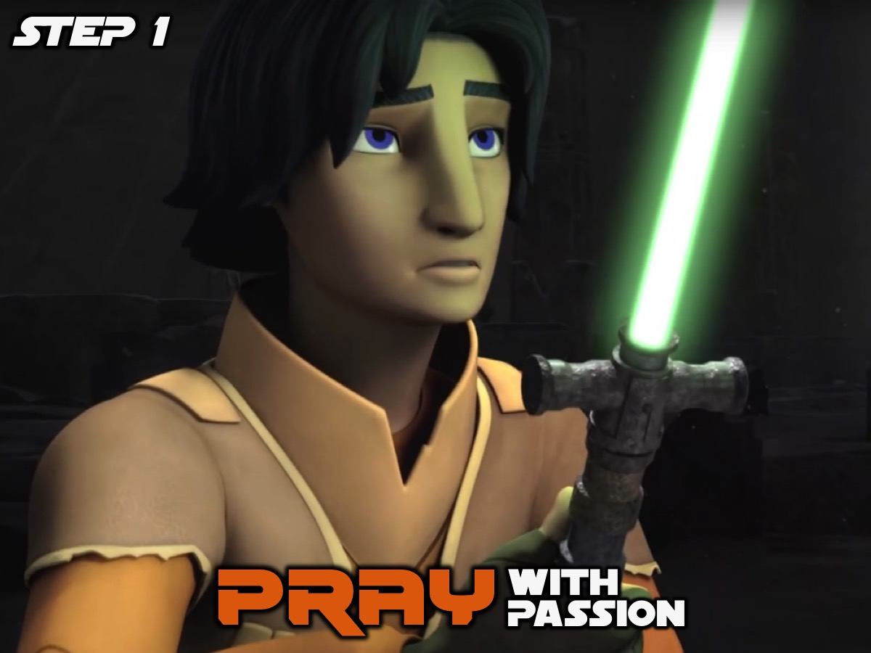
Notes:
The first step in the Replicate Circle is to Pray with Passion for our lost friends.

Slide 5
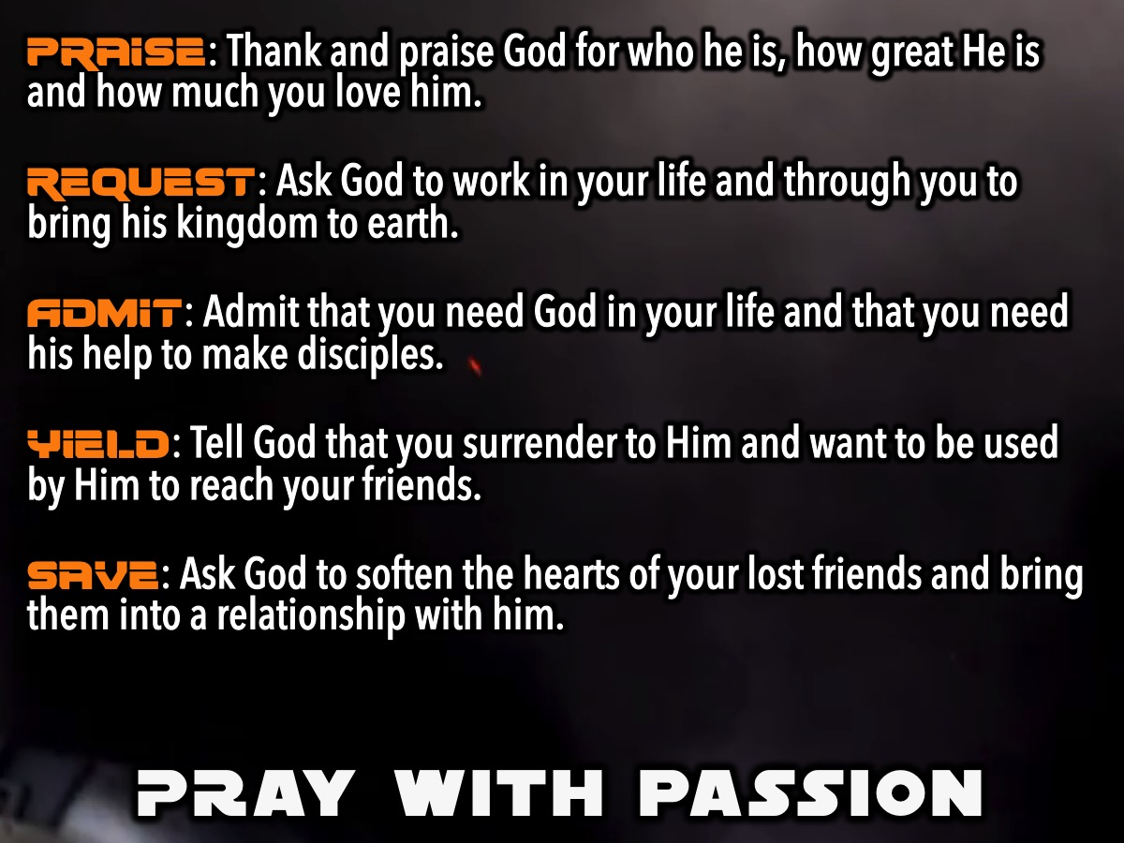
Notes:
We learnt how to pray with passion using this prayer outline:
1. Praise: Thank and praise God for who he is, how great He is and how much you love him.
2. Request: Ask God to work in your life and through you to bring his kingdom to earth.
3. Admit: Admit that you need God in your life and that you need his help to make disciples.
4. Yield: Tell God that you surrender to Him and want to be used by Him to reach your friends.
5. Save: Ask God to soften the hearts of your lost friends and bring them into a relationship with him.
And we also were challenged to have a Prayer Date @ 8 each night with God - and many of us participated on the Sunday Youth WhatsApp group between 8 and 8:30 each night of the week.

Slide 6
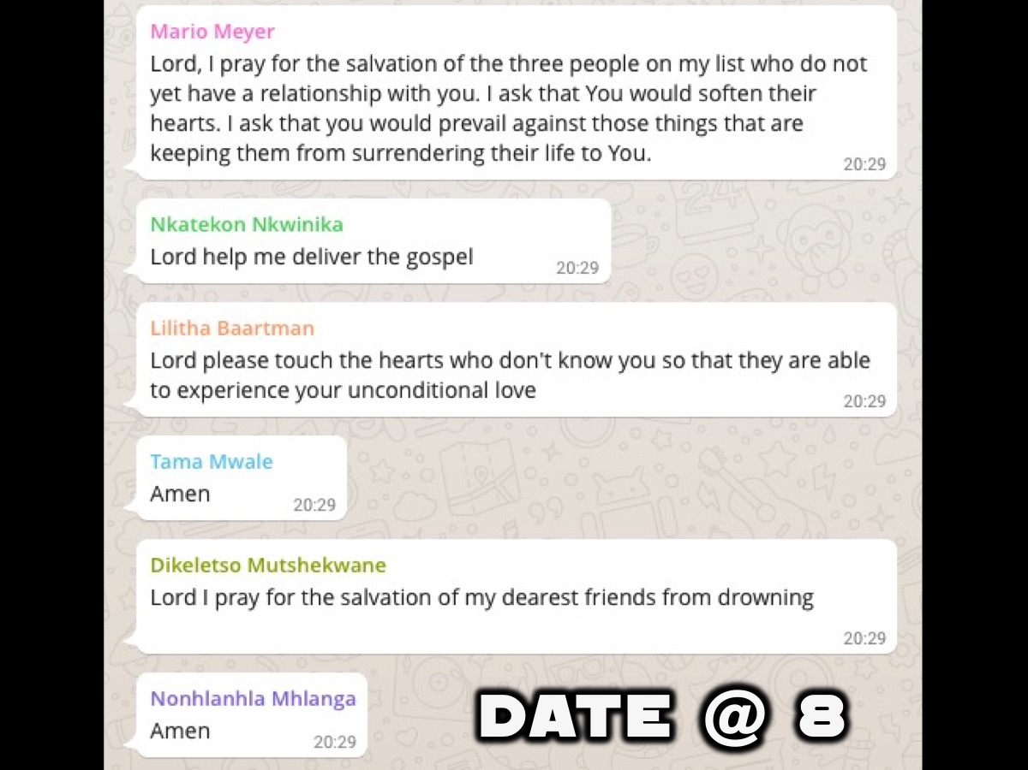
Notes:
And we challenged you to have a Prayer Date @ 8 each night with God - and many of us participated on the Sunday Youth WhatsApp group between 8 and 8:30 each night of the week. If you are not on the group (even if you gave your number last Sunday), then please sign up this morning before you leave!

Slide 7

Notes:
Last week we looked at the second part of the Replicate Circle: Pursue With Love.

Slide 8
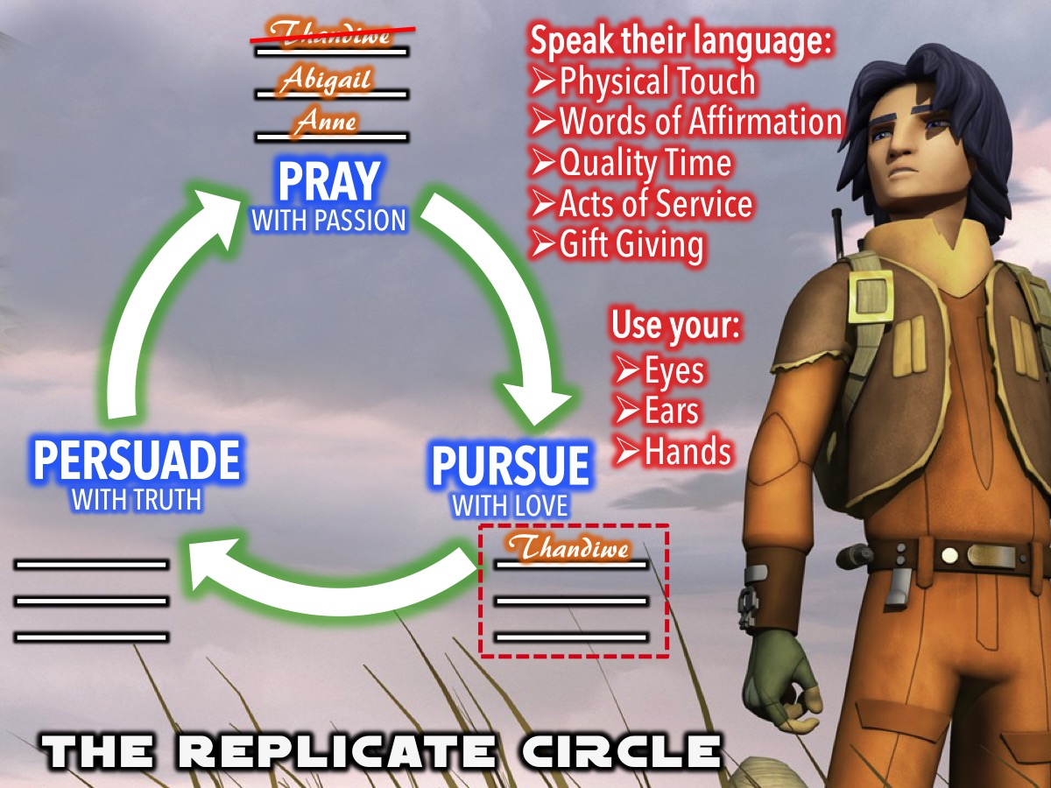
Notes:
After praying for our 3 lost friends we begin to Pursue them with love (moving their name down to the Pursue with Love section or the Replicate Circle) and we do this by (1) Using Your Eyes, Ears and Hands and (2) Speaking Their Love Language.

Slide 9

Notes:
This week we are looking at the third part of the Replicate Circle: Persuade With Truth.

Slide 10

Notes:
You have probably heard of The Clone Wars.

Slide 11

Notes:
But have you heard of The Table Wars? We are going to conduct an experiment to see how well you are able to persuade people from other tables to join your table. You have 2 minutes to prepare and then 2 minutes to move around the room to persuade people to join your table. The table with the most people around it at the end of the 2 minutes wins the first ever His Youth Table Wars. But first we are going to watch a video that will give you 6 secrets to persuasion that if used will give you a huge advantage in the game.

Slide 12
Notes:
Video: Science of Persuasion. An edited version of a YouTube clip: https://www.youtube.com/watch?v=cFdCzN7RYbw

Slide 13

Notes:
It is time for Table Wars to start. You have 2 minutes to prepare!

Slide 14

Notes:
You have 2 minutes to persuade people to join your table.

Slide 15
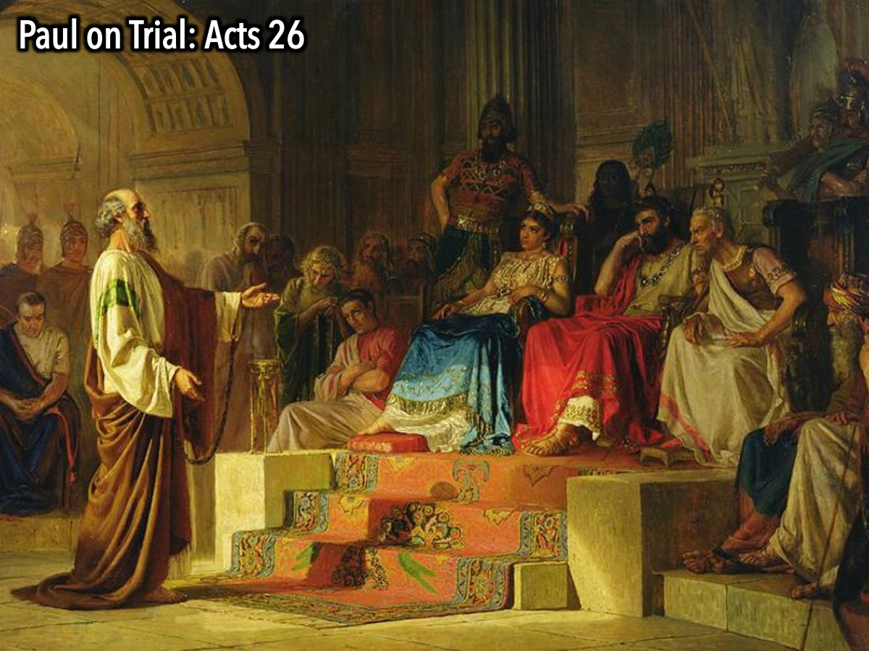
Notes:
The Apostle Paul also played Table Wars many years ago. He had been put in prison for telling people about Jesus and a trial was set when he appeared before King Agrippa. (Acts 26). He really needed to get the king, who did not follow Jesus, to changes “tables” (or sides) and become a follower of Jesus.

Slide 16
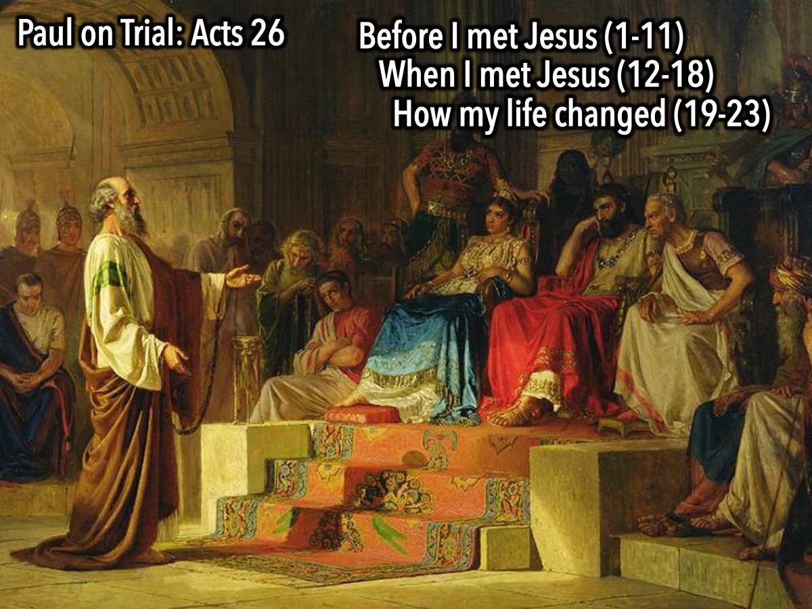
Notes:
His strategy of persuasion started when he told his story of what he was like before he met Jesus (1-11), he then spoke about how he met Jesus on the road to Damascus (12-18) and then about how that encounter with Jesus changed his life (19-23).

Slide 17
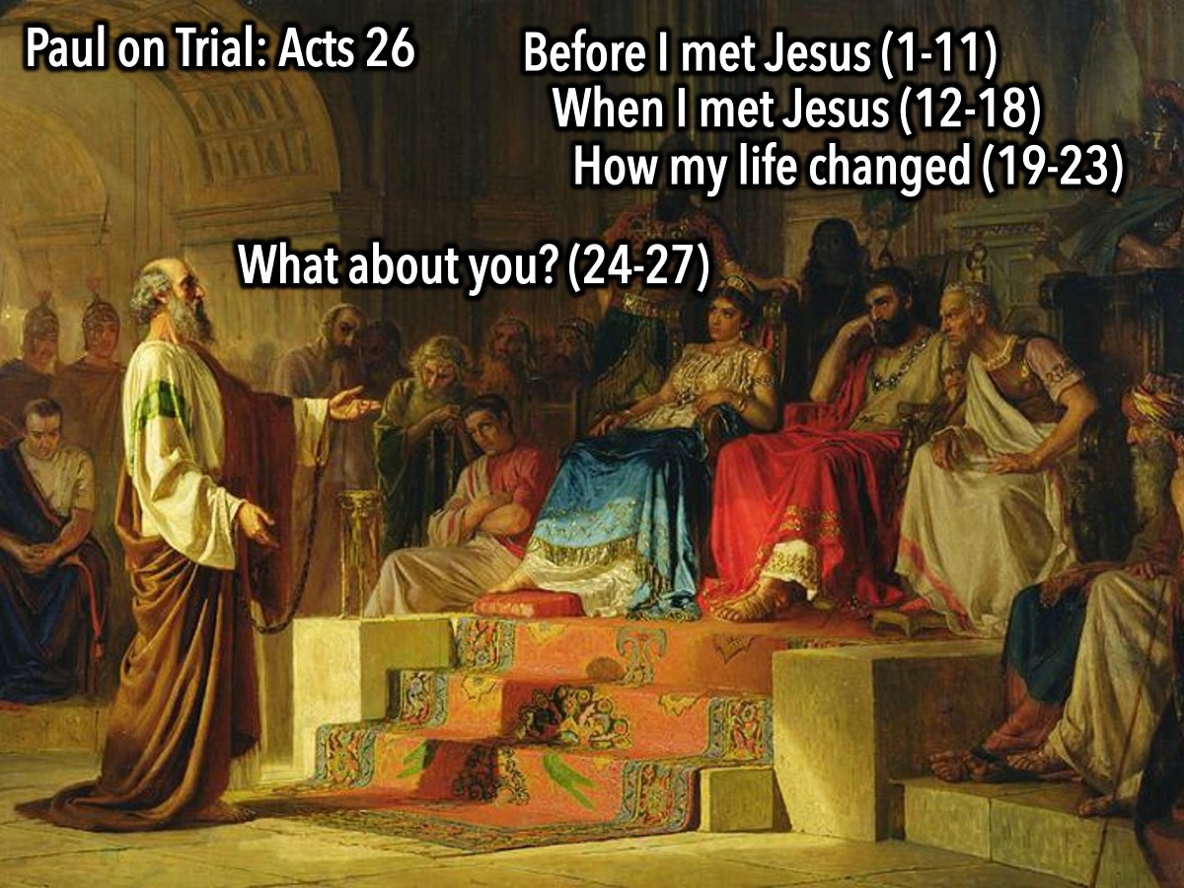
Notes:
Next he shared the truth with the king and challenged him (24-27)

Slide 18
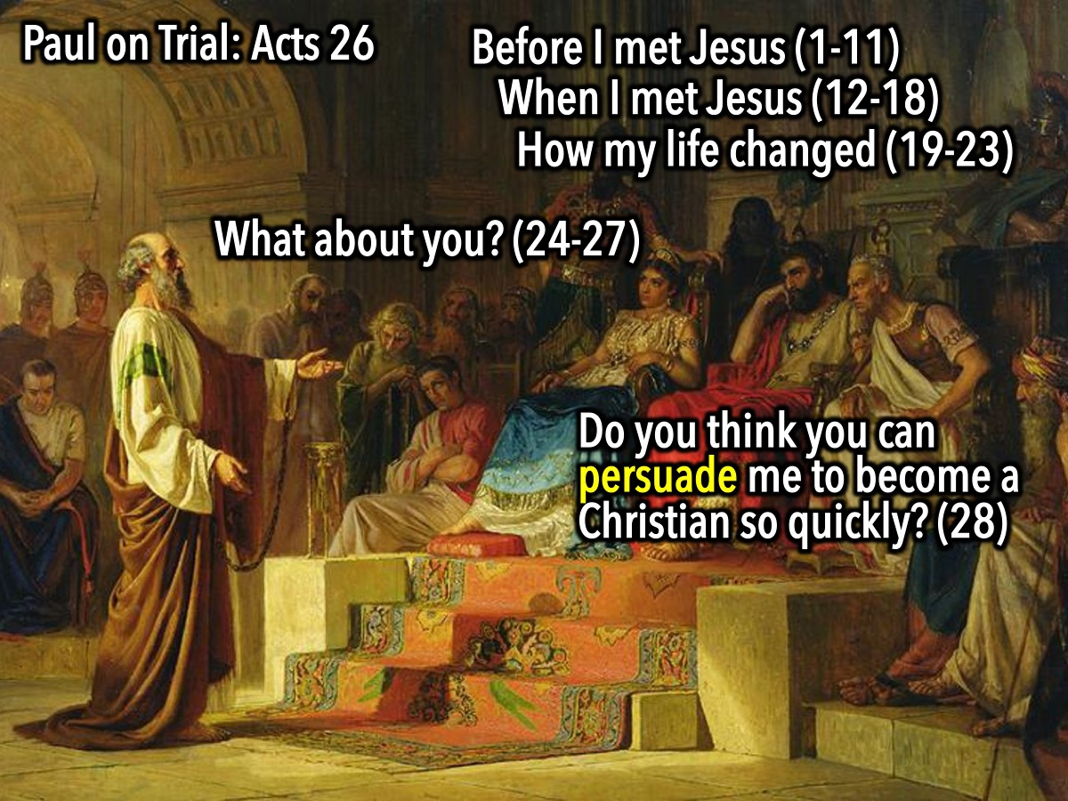
Notes:
The king responded: “Do you think you can persuade me to become a Christian so quickly?”

Slide 19
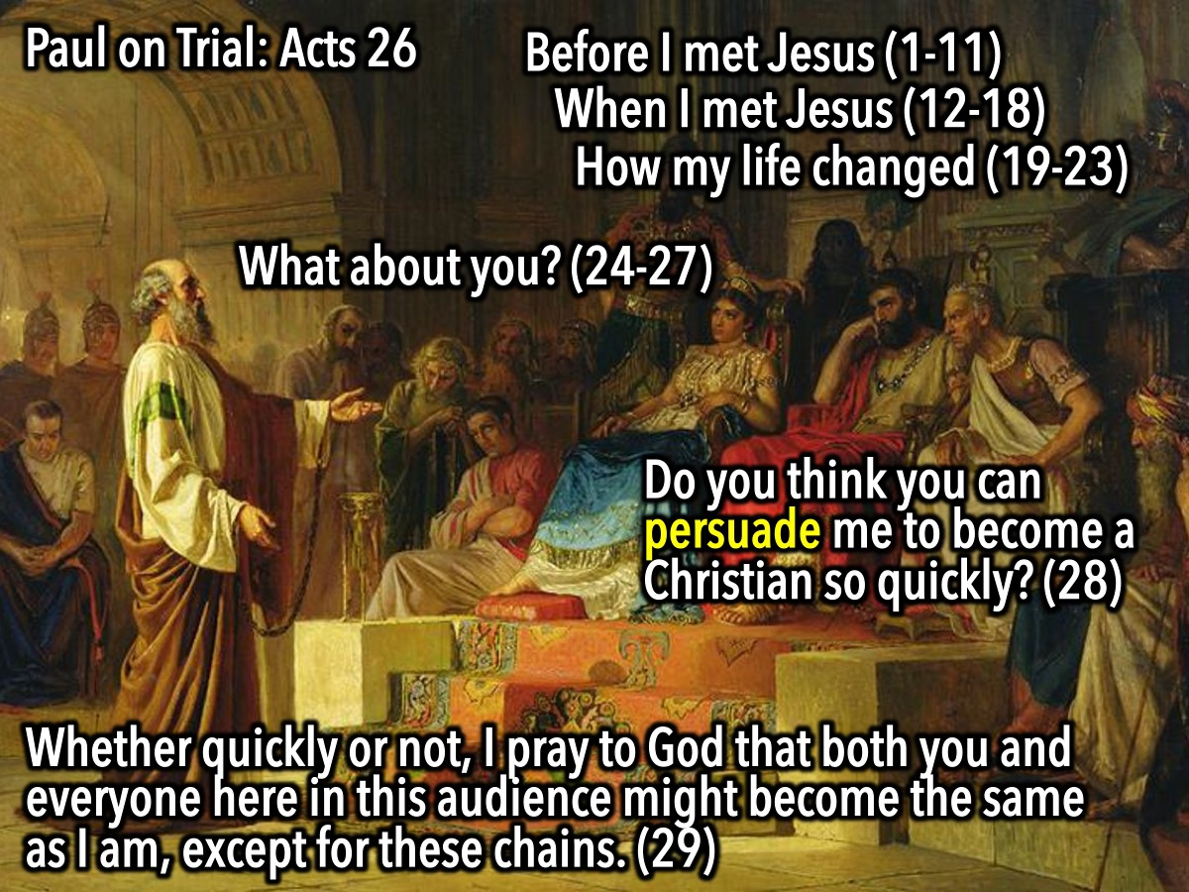
Notes:
Paul’s answered, “Whether quickly or not, I pray to God that both you and everyone here in this audience might become the same as I am, except for these chains.”

Slide 20
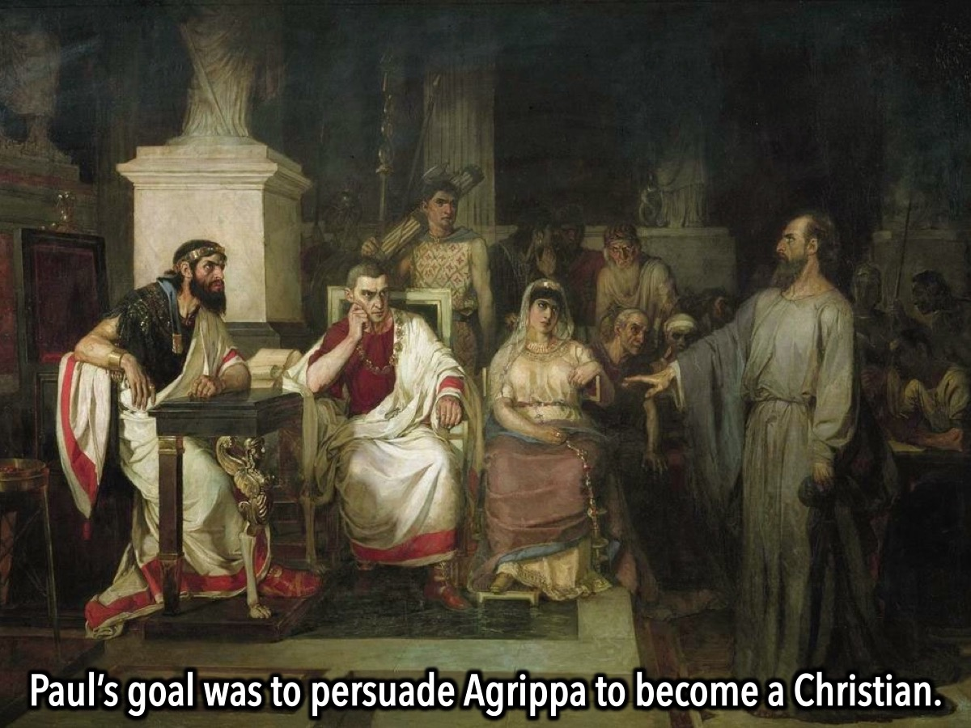
Notes:
Paul’s goal was to persuade King Agrippa to be a disciple of Christ. (Acts 26:28-29).

Slide 21
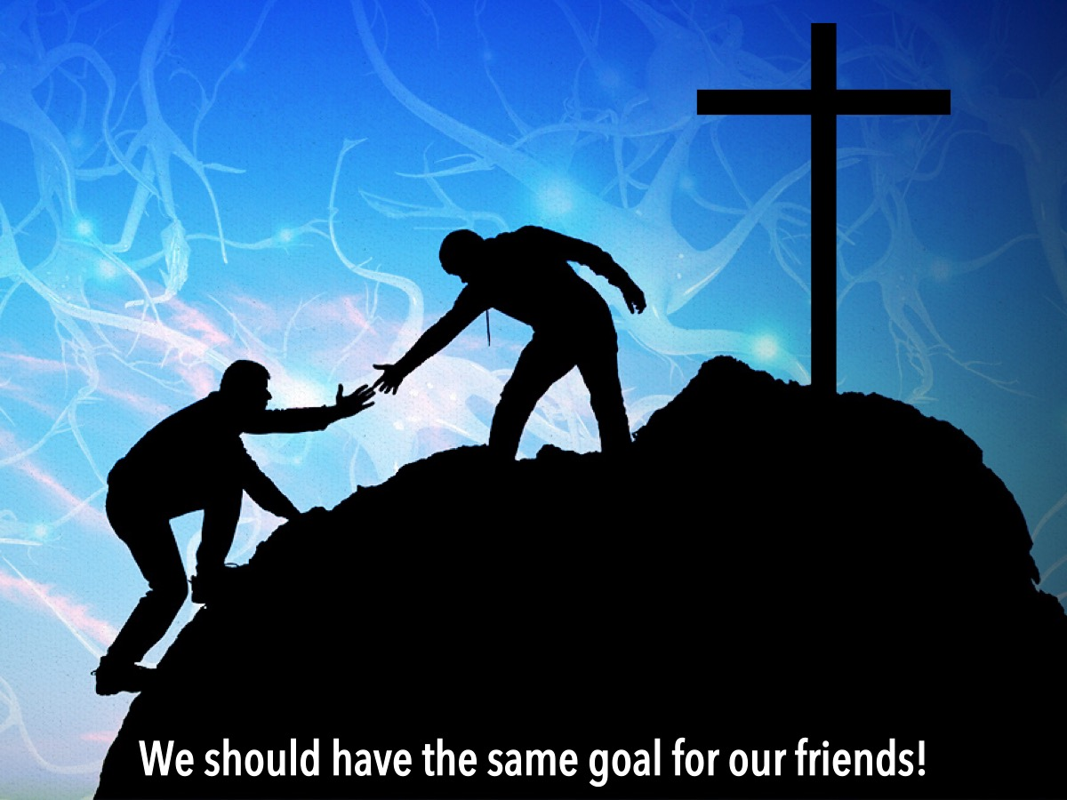
Notes:
We should have the same goal for our friends - to persuade them to join us as we follow Jesus.

Slide 22
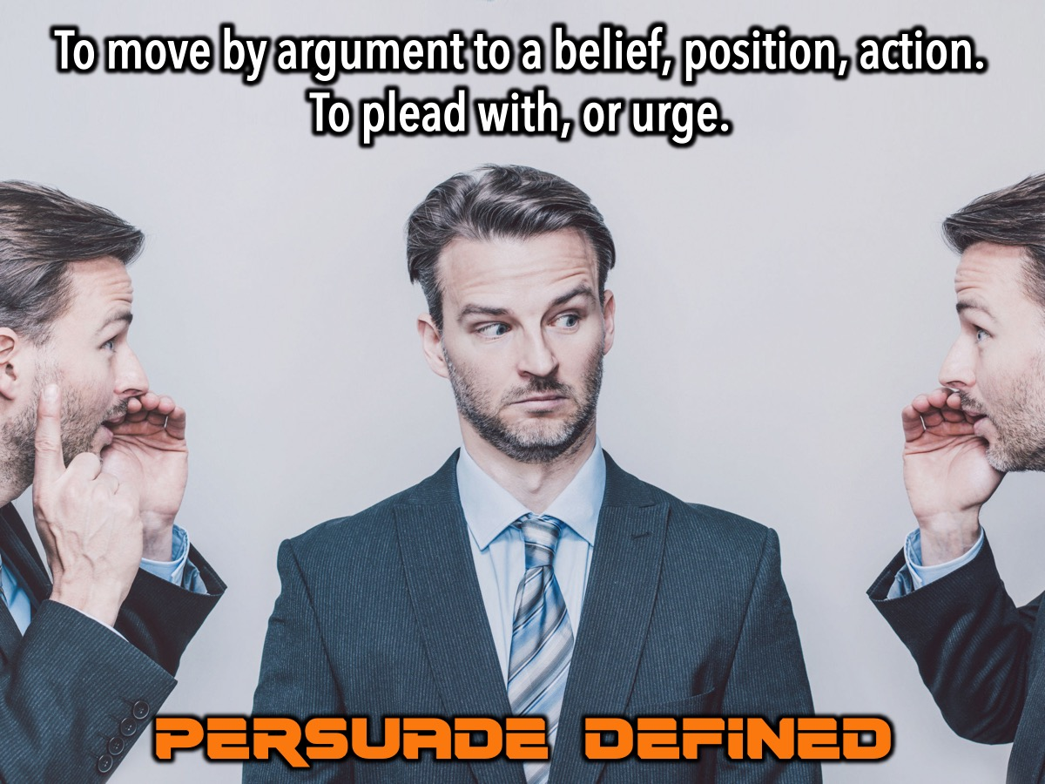
Notes:
The definition of the word “Persuade”: (1) to move by argument, entreaty, or expostulation to a belief, position, or course of action. (2) to plead with; URGE. (Source: merriam-webster.com).

Slide 23
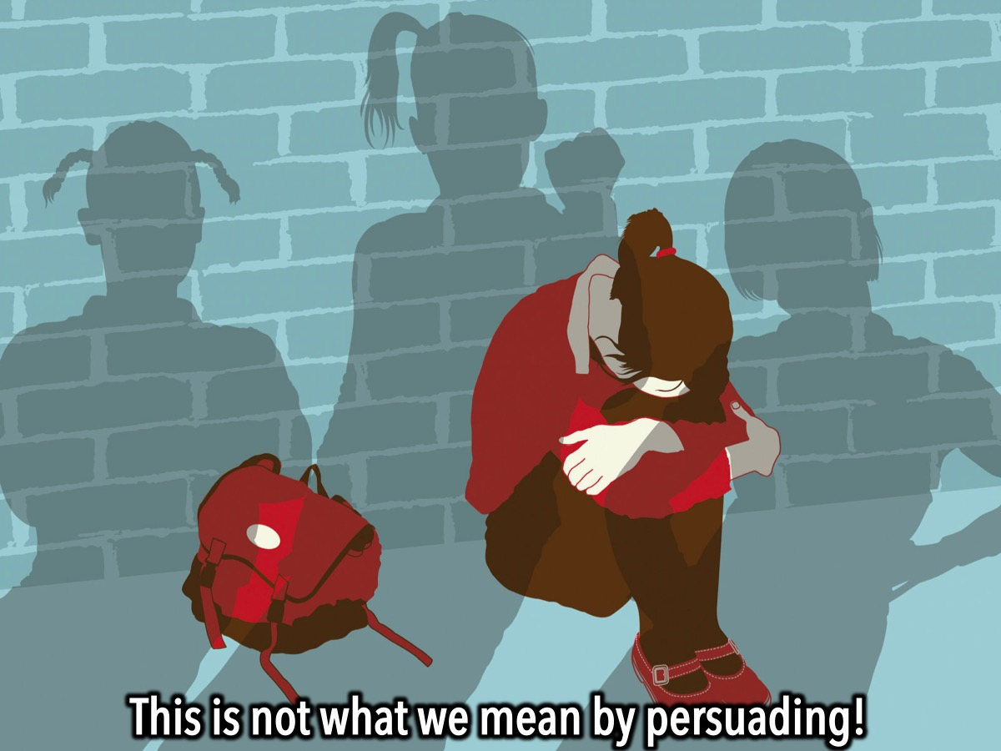
Notes:
This is not what we mean by persuade!!! It does not involve bullying people to embrace your beliefs!!!

Slide 24
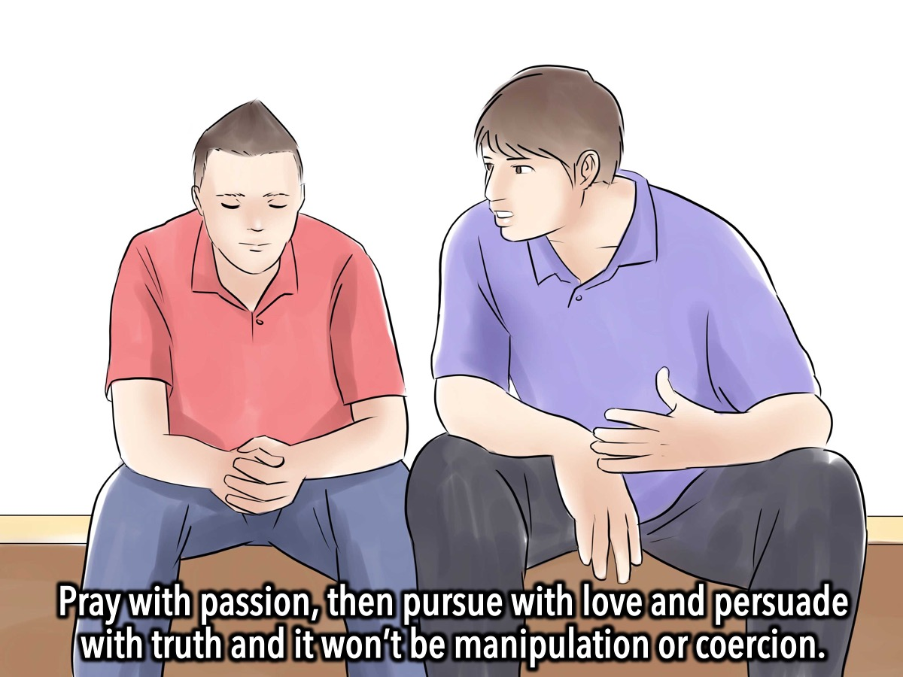
Notes:
When we pray with passion, then pursue with love and finally persuade with truth it won’t be manipulation or coercion because it will flow from a pure heart that is overflowing with the Spirit of God.

Slide 25

Notes:
In our “live-and-let-live” culture, persuade is a word that can sometimes feel out of synch with embracing diversity and nurturing individuality.

Slide 26
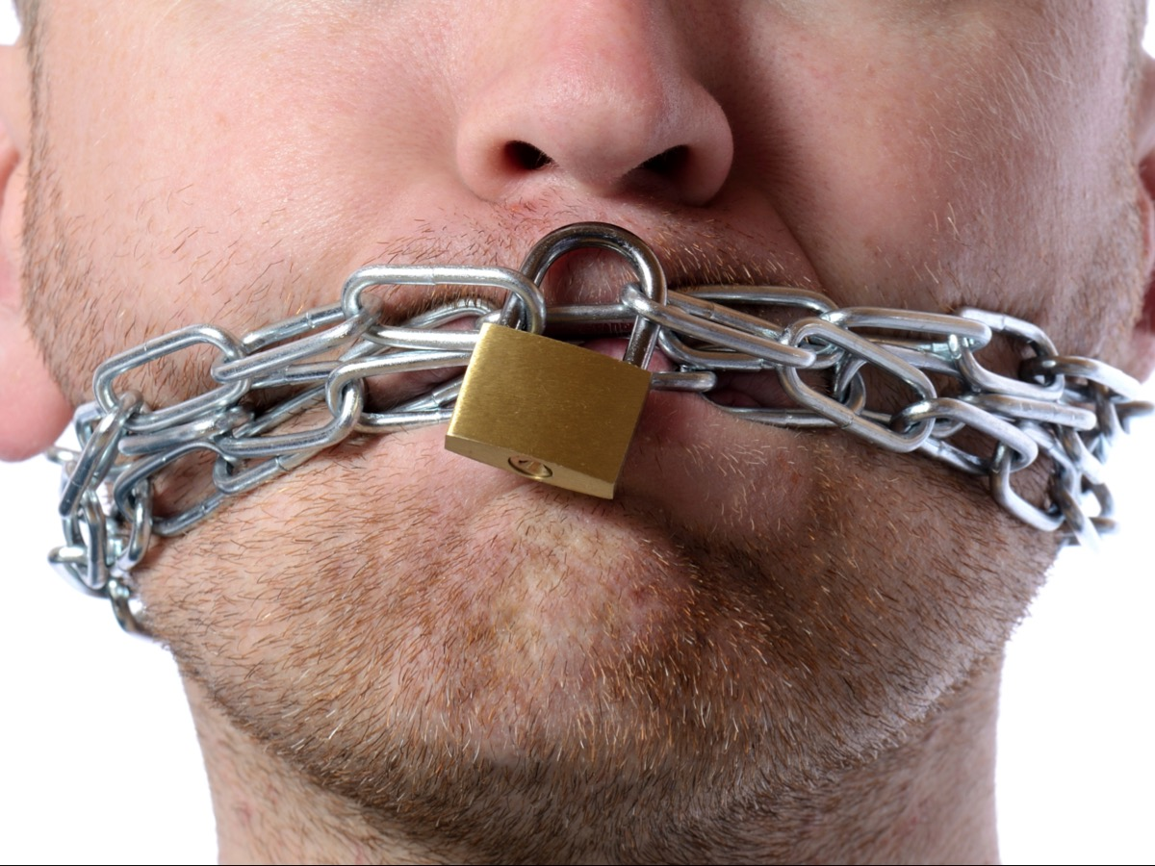
Notes:
Sometimes it makes us feel like we have no right to speak - that we have to accept everyone as they are and not try and change them.

Slide 27

Notes:
But we are ambassadors!

Slide 28
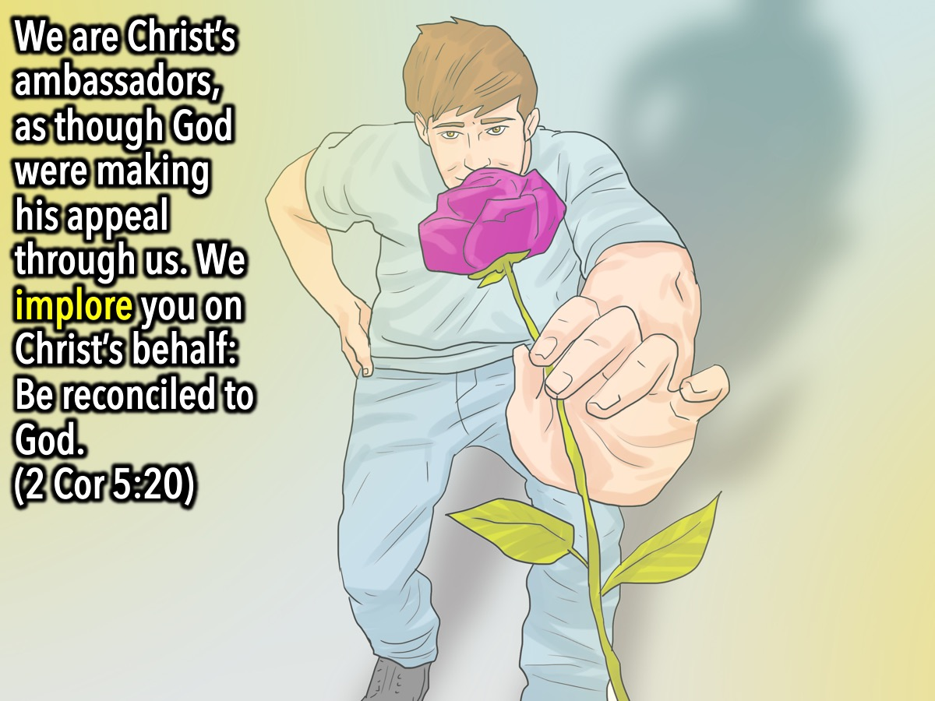
Notes:
We Implore You on Christ’s Behalf: The Greek word for persuade is used eight different times in the New Testament in direct connection with evangelism. This is not a used car salesman-type pitch, but a sincere, yet convincing appeal to the heart and mind of the unbeliever. It’s the same approach that Paul used when he wrote, “We are therefore Christ’s ambassadors, as though God were making his appeal through us. We implore you on Christ’s behalf: Be reconciled to God” (2 Corinthians 5:20).

Slide 29

Notes:
Imagine if you had done wrong to someone you really really loved, would you go out of your way to ask them to forgive you - even beg them for forgiveness - or would you just walk away? Of course you would try everything - saying sorry and even buying them gifts to try and persuade them to stay with you!

Slide 30
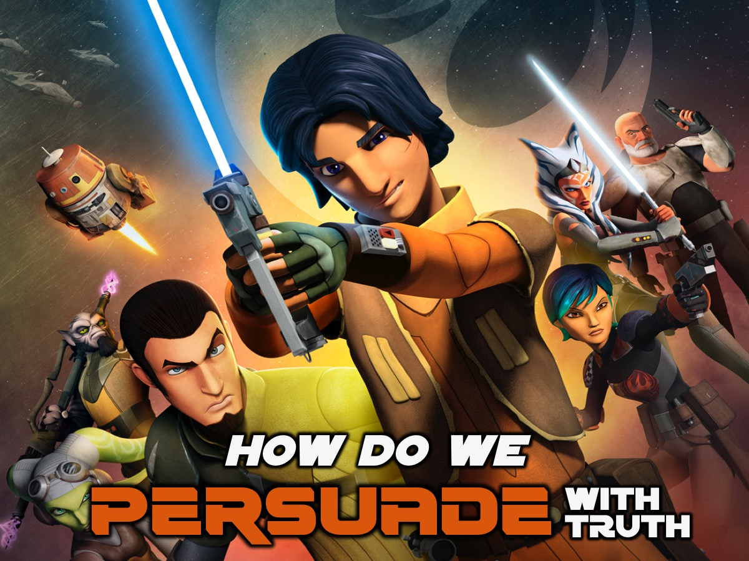
Notes:
So how do we persuade with truth? That is what the next few Sunday mornings are going to be all about.

Slide 31

Notes:
We are going to learn how to Start a Conversation with our Friend.

Slide 32
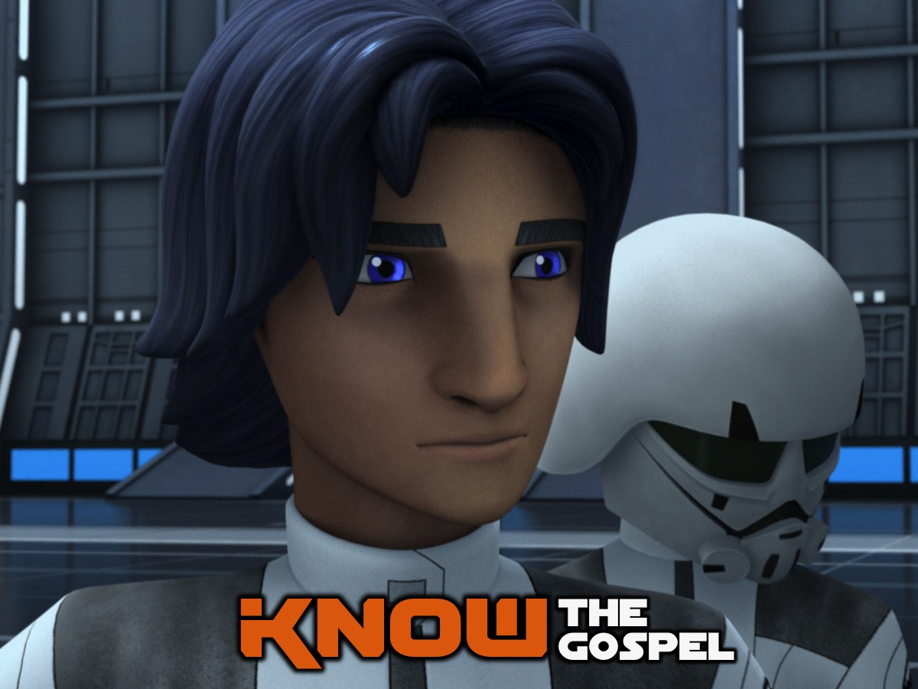
Notes:
How to know the gospel backwards…

Slide 33
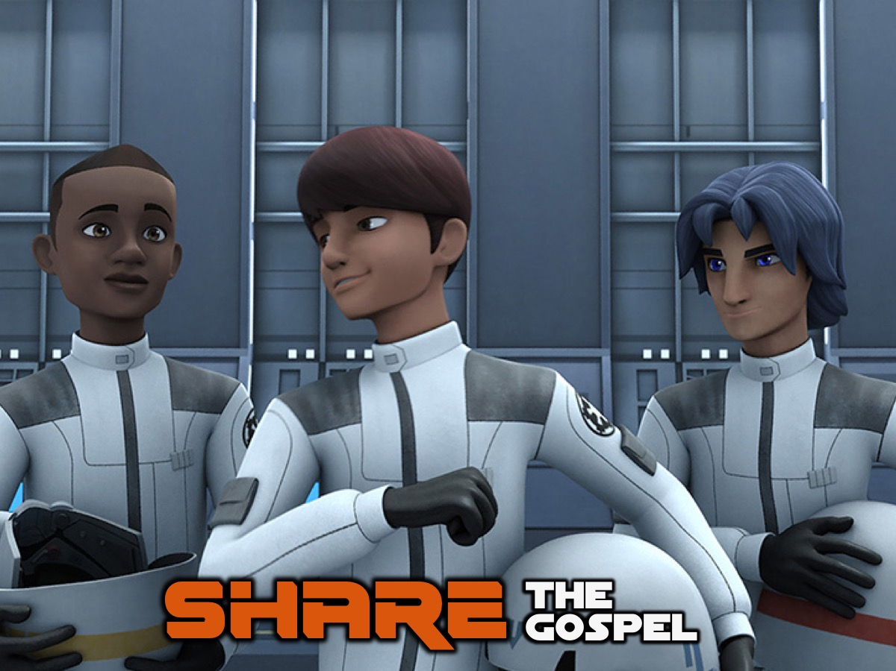
Notes:
And we will practise sharing it with eath other…

Slide 34
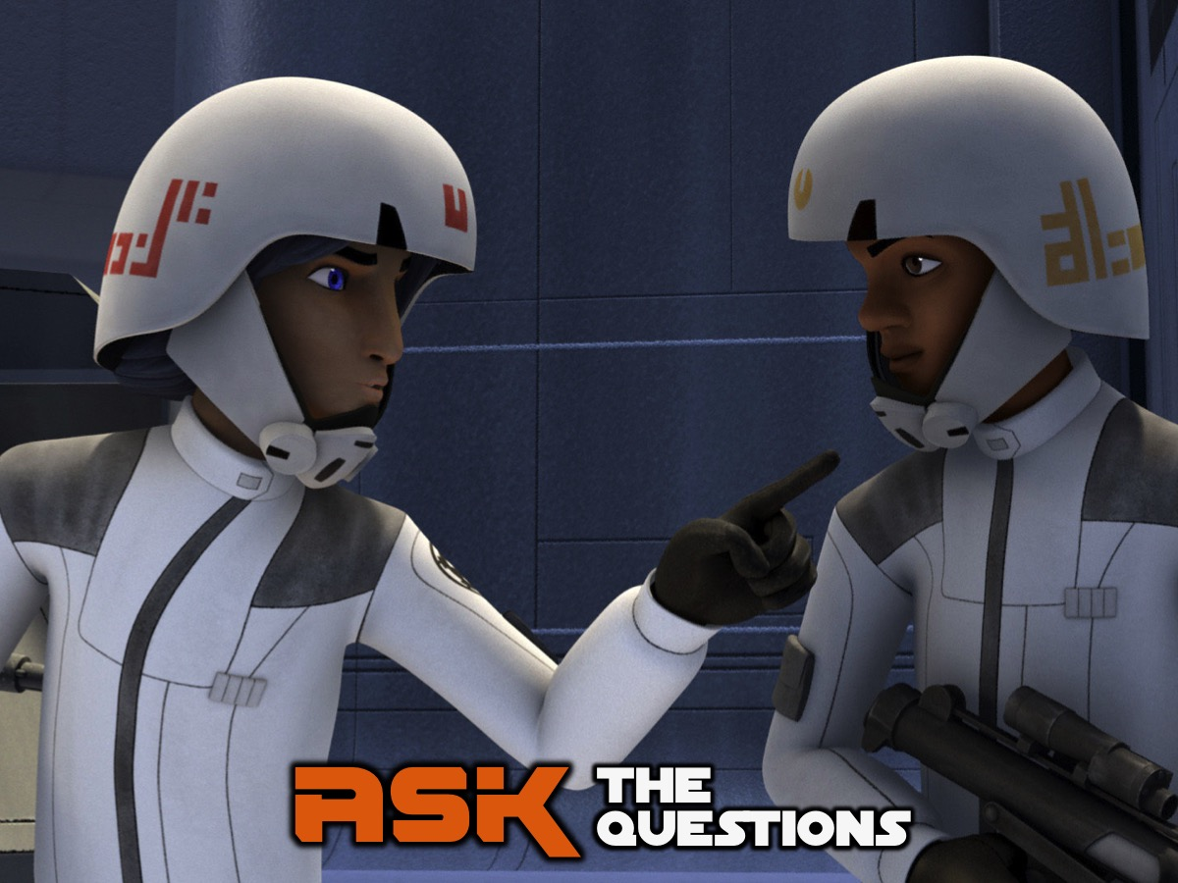
Notes:
And we will learn how to actually invite our friends to follow Jesus but asking the right questions after we have shared the gospel.

Slide 35
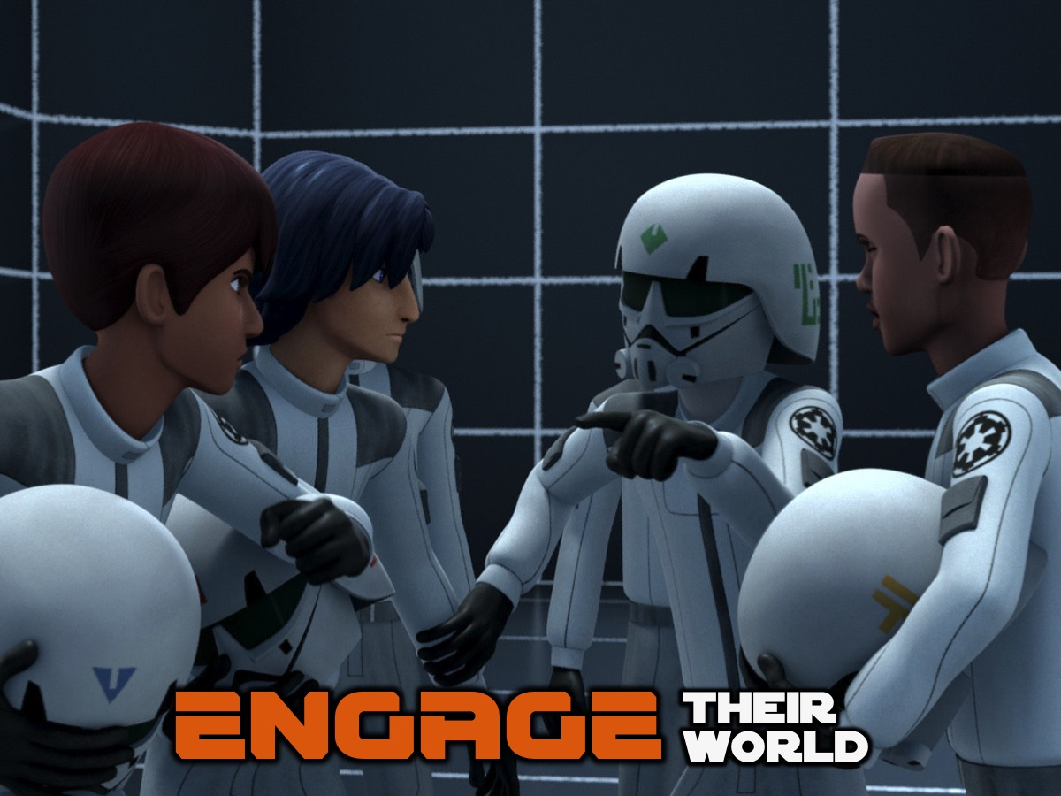
Notes:
And finally we will learn how to engage people who have different worldviews from ours.

Slide 36
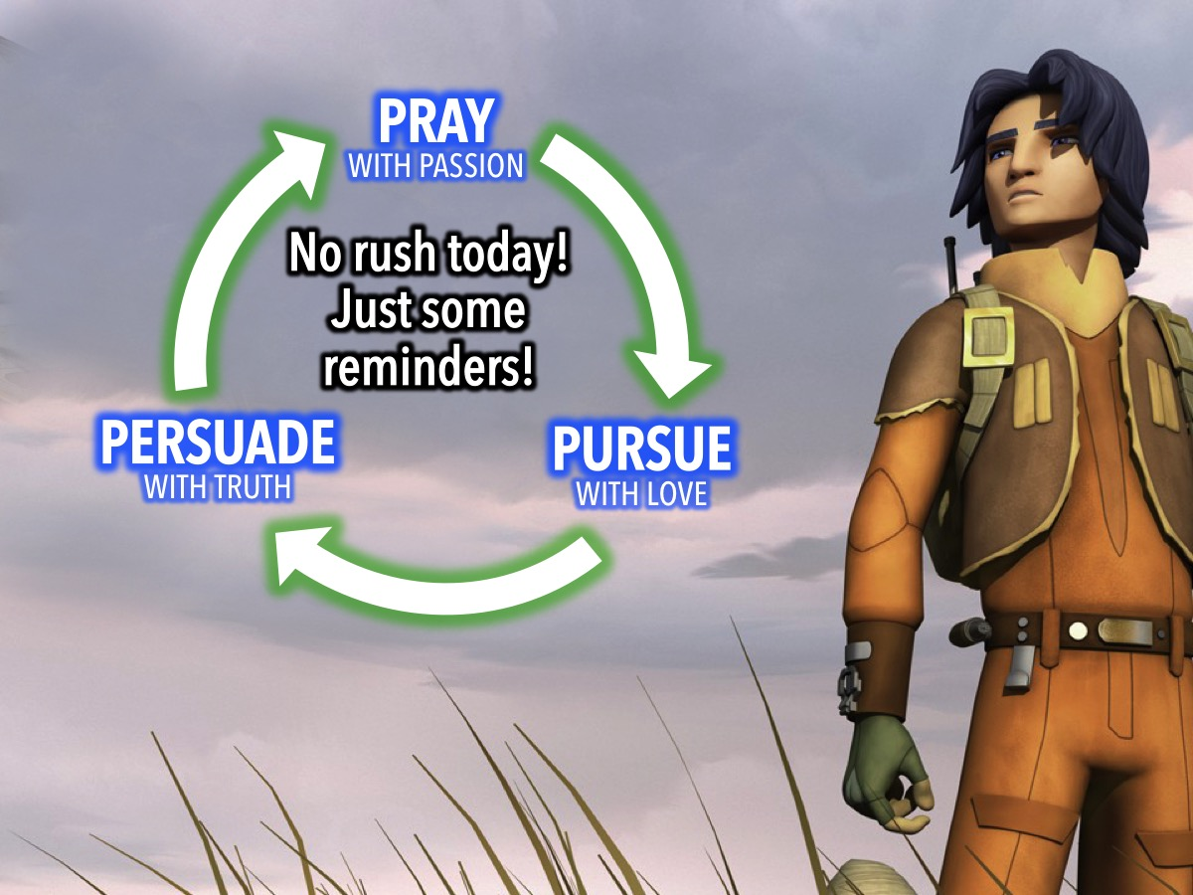
Notes:
So I am not going to ruch too far ahead today - but I do want you to know that as we pray for our lost friends, we cannot stop there - we have to start pursuing them with love, and finally we have to persuade them with truth.

Slide 37
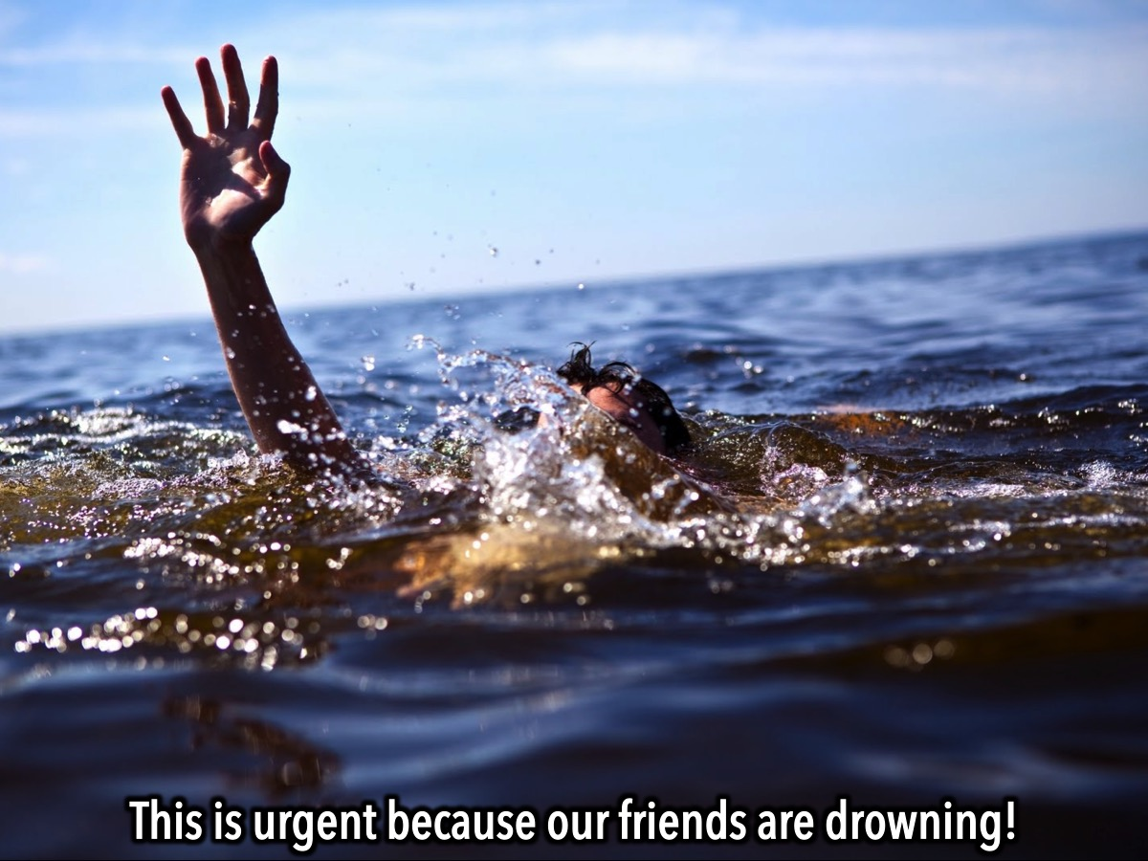
Notes:
Evangelism is urgent! Our friends are drowning.

Slide 38
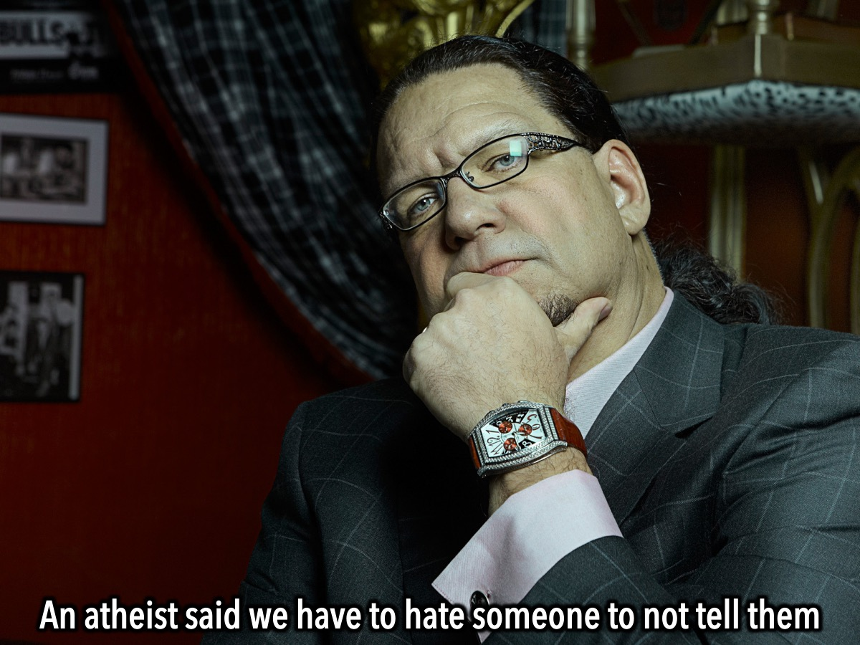
Notes:
In week 1 we watched a video by Penn Jillette, an atheist, who asked how much we have to hate someone to not tell them about hell if that is what we believe is real. You can check out the video on YouTube at: https://www.youtube.com/watch?v=6md638smQd8

Slide 39
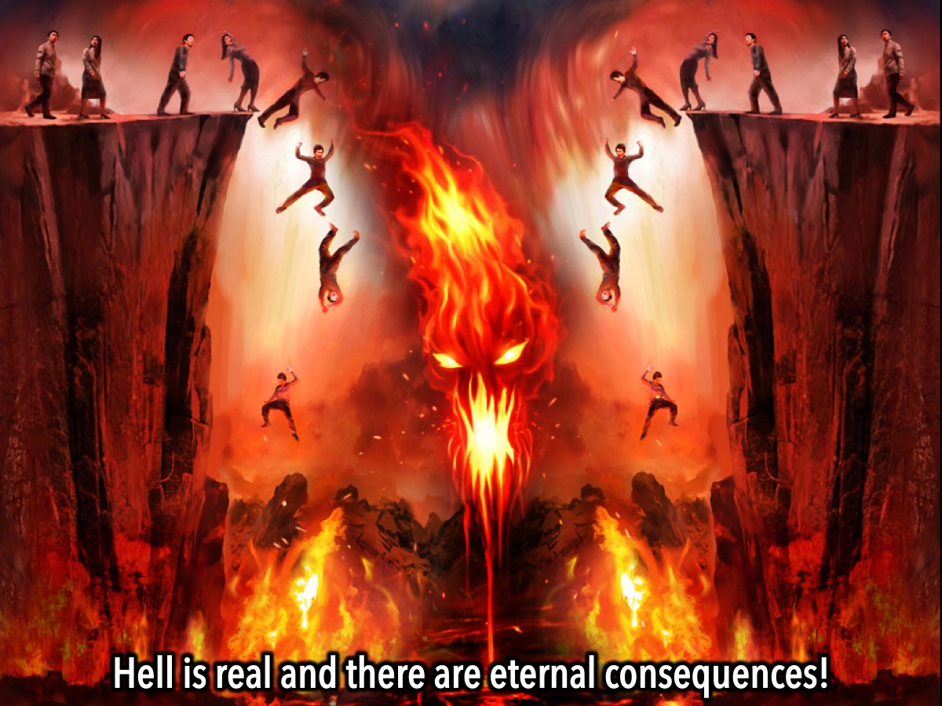
Notes:
Hell is a reality! For those around us who don’t know Jesus, being spiritually unprepared has eternal consequences that’s scope and breadth boggle the mind.

Slide 40
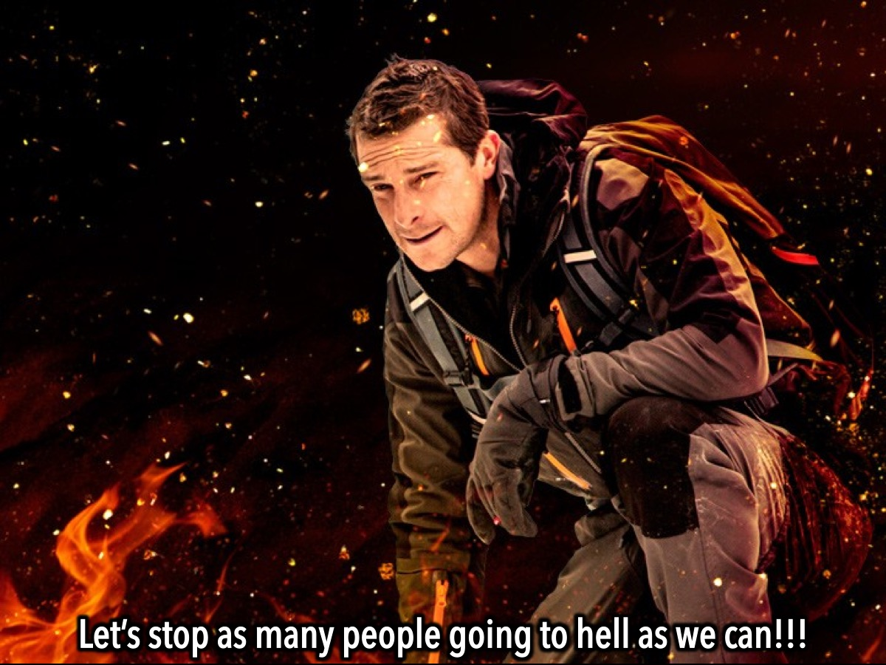
Notes:
So if Hell is real, then why aren’t we more intense, more aggressive, more intentional, more urgent? If we believe the Bible when it says that hell is real, then we should be motivated to keep as many people as we can out of it—friends, foes, teachers, classmates, teammates, family members, strangers… everybody.

Slide 41
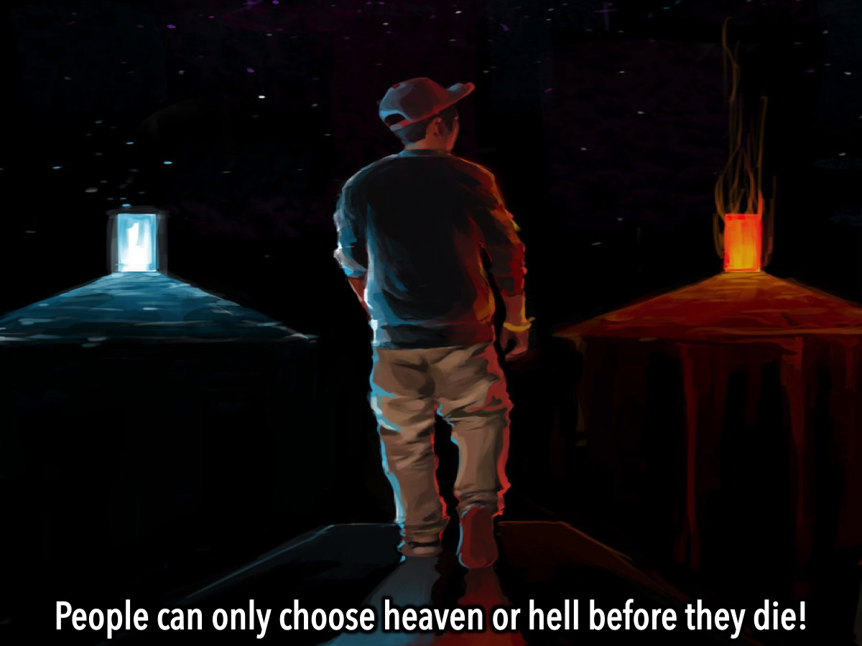
Notes:
We can only prepare for eternity while we are still alive - once we die it is too late.

Slide 42
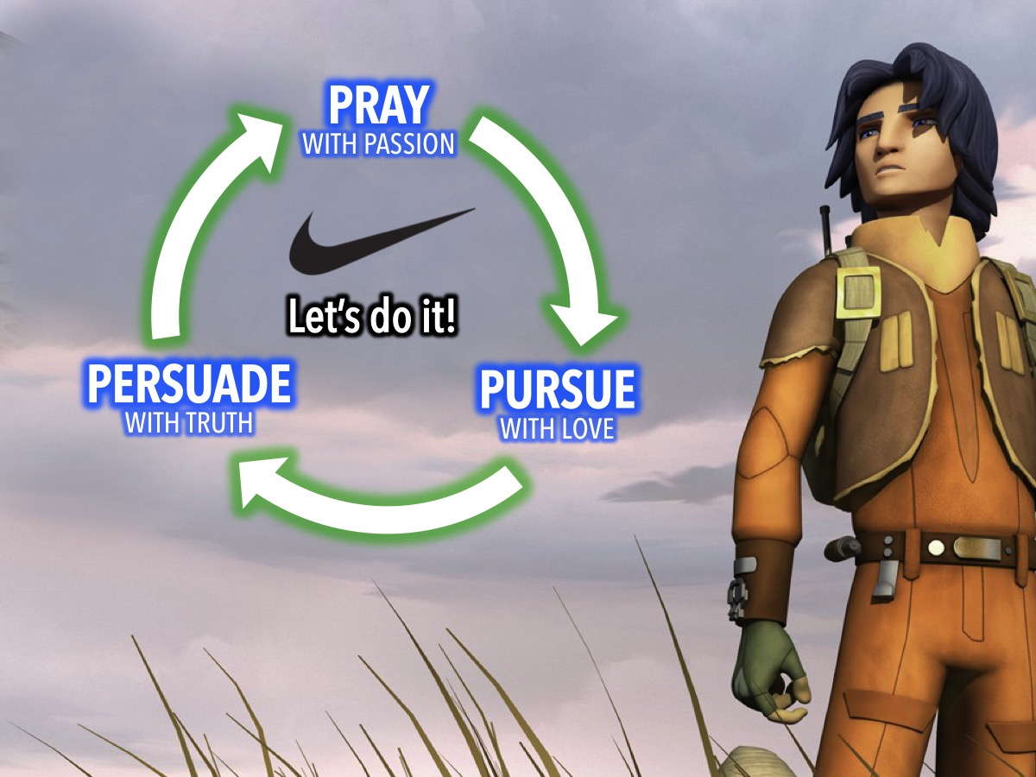
Notes:
So let’s do it! Let’s pray with passion for our lost friends, then pursue them with love and persuade them with truth.

Slide 43
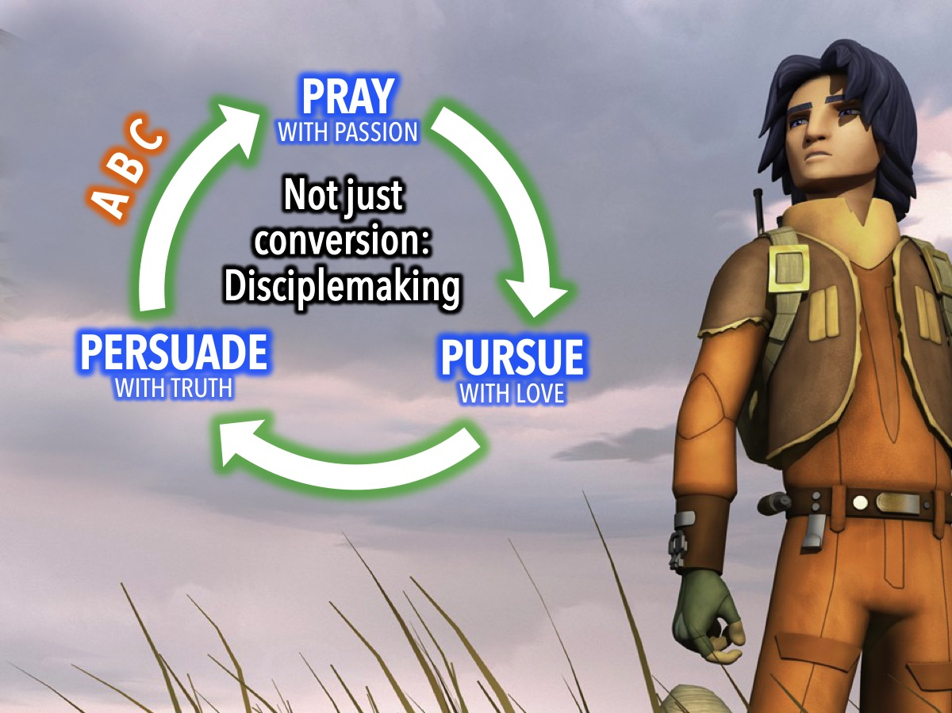
Notes:
In case you are wondering what happens when we persuade people with truth - then it is time to learn the ABCs: The Replicate Circle is about much more than “conversion” or getting people saved. God has called us to go and make disciples! In Matthew 28:19-20, Jesus tells us to “go and make disciples…teaching them to obey everything I have commanded you.” We don’t just bring people into a relationship with God but also help them become disciples who make disciples. This is where the ABC comes in on the Replicate Circle.

Slide 44
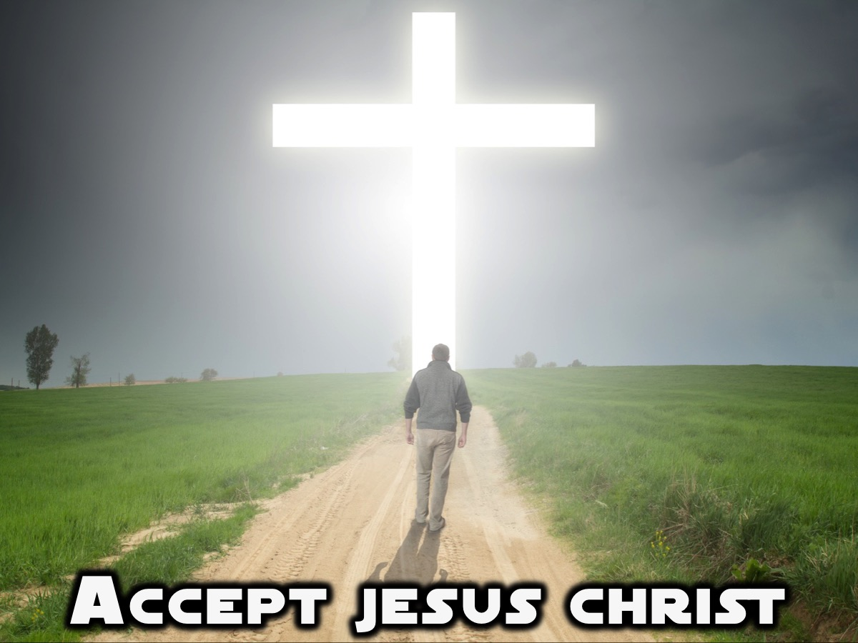
Notes:
A stands for Accept Jesus Christ. This is the point in time when someone believes the gospel message and trusts in Jesus as their only hope of salvation.

Slide 45
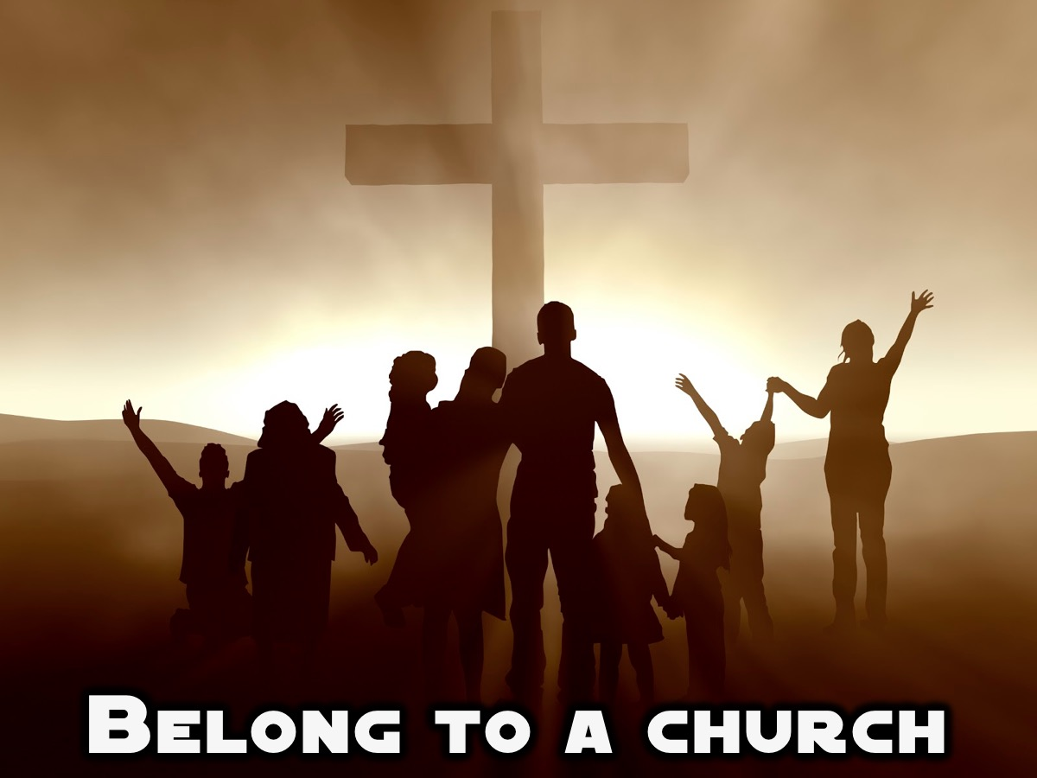
Notes:
B stands for Belong to a church. The Bible says in Hebrews 10:25 that we shouldn’t forsake the assembling of ourselves together. It is vitally important to help newly converted teenagers connect to other Christians so that they can learn how to follow Jesus and grow strong roots in their newfound faith.

Slide 46
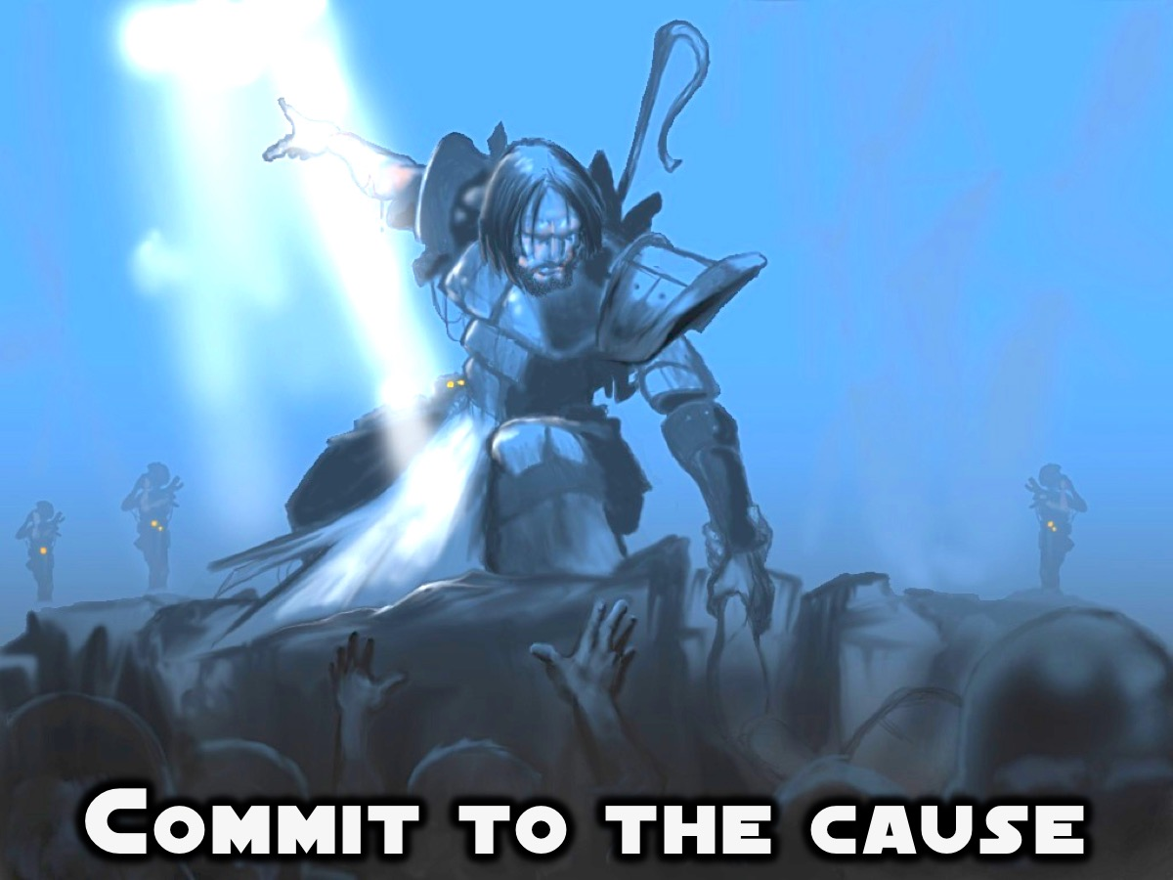
Notes:
C stands for Commit to the Cause. Teens who come to Christ and connect to a church should also be challenged to commit to the Cause of making disciples who make disciples. They must be motivated and equipped to live and give the gospel in word and deed and multiply. These are the ABC’s of making disciples who make disciples.

Slide 47

Notes:
The Difference Between Addition and Multiplication. (1) To demonstrate Addition I am going to touch someone in the front and ask them to stand. Then I will touch another person and then another and so on. So I have led 3 to 5 people to Jesus so far. But it is taking a while and I don’t really have time to follow them up properly or help them become disciples who make disciples. If I keep going like this we will never make disciples of all nations. (2) To demonstrate Multiplication I am going to touch a few people, but before I am done touching them I am going to equip them to do what I did to them and send them out to lead others to Jesus who will lead others, and so on. Let’s see how many people I need to touch before the whole congregation is standing! (Not: Generally I only touch about 4 people before the whole audience is standing)

Slide 48
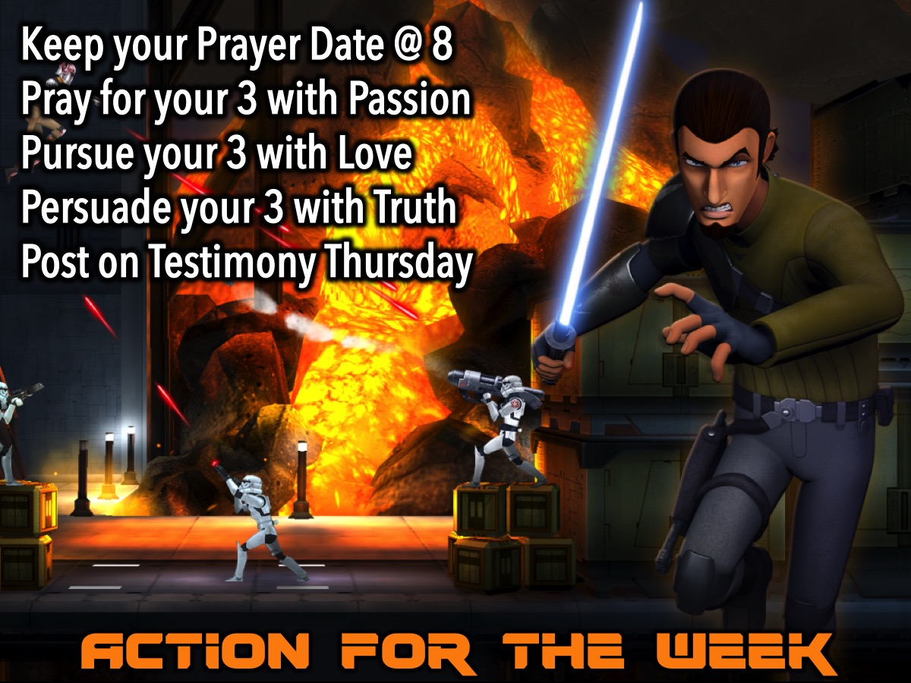
Notes:
Action For The Week: Keep Your Prayer Date @ 8. Pray For Your 3 With Passion. Pursue Your 3 With Love. Persuade Your 3 With Truth. Post on Testimony Thursday.

Slide 49

Notes:
Closing Prayer

Slide 50

Notes:
Next week we will be looking at how to START a Conversation.

