Slide 1

Notes:
Welcome to the Replicate Series. Let’s first watch another Star Wars Rebels video clip.

Slide 2
Notes:
Video: Star Wars Rebels Art Attack Short. Get it on YouTube at: https://www.youtube.com/watch?v=2dSJRKB8x9E

Slide 3
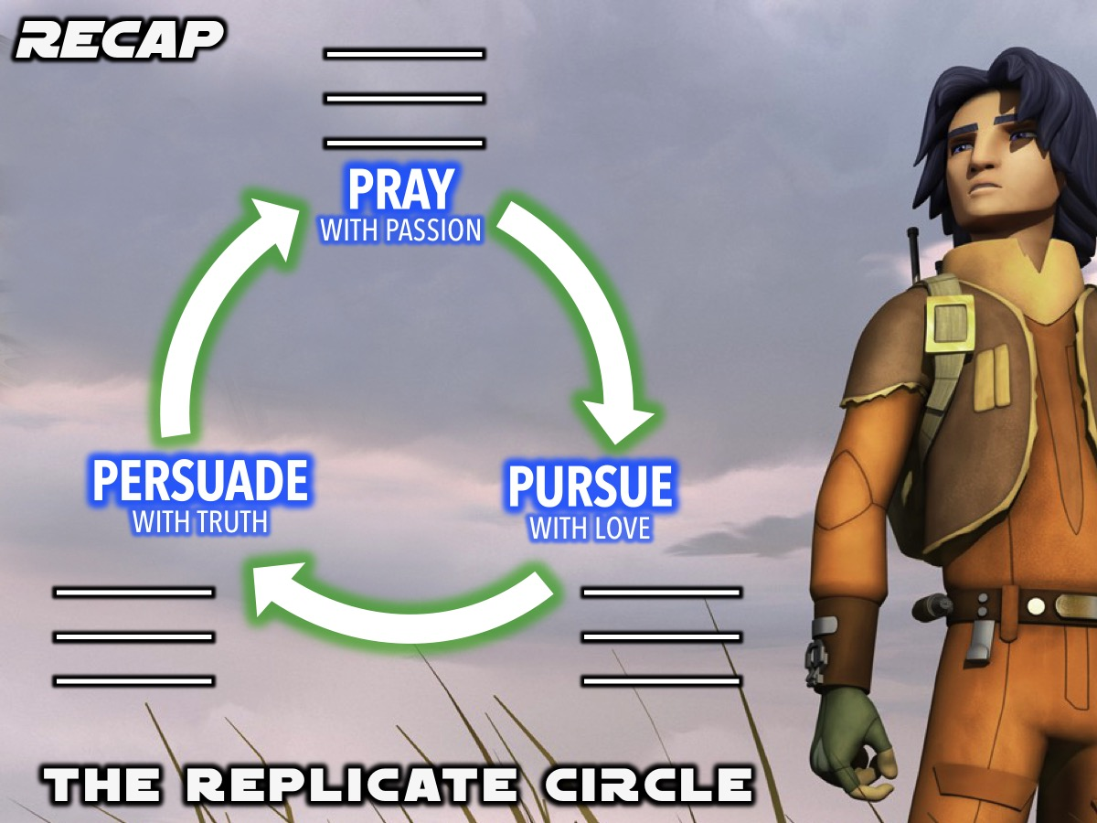
Notes:
Recap: We have been introduced to the Replicate Circle - a tool to help us lead our friends to Jesus.

Slide 4

Notes:
The first step in the Replicate Circle is to Pray with Passion for our lost friends.

Slide 5

Notes:
The second step is to Pursue our lost friends with Love.

Slide 6

Notes:
The third step is to Persuade our lost friends with Truth.

Slide 7

Notes:
This week we are going to learn how to START a Conversation with a lost friend.

Slide 8
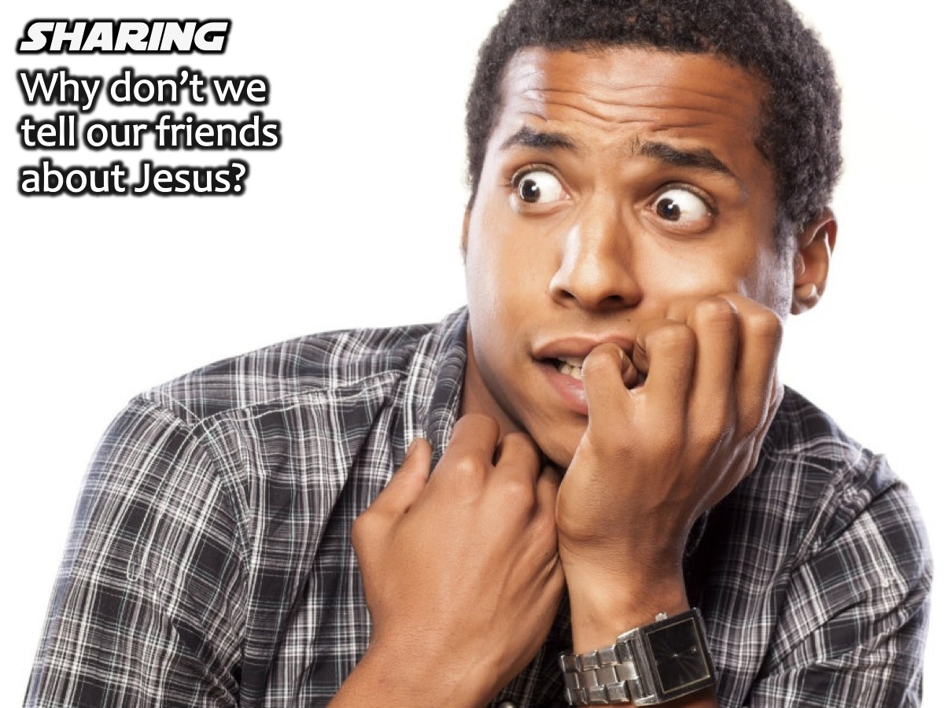
Notes:
Sharing: What is it that makes us not tell people especially our friends about Christ? Just think about it for a moment. (anyone care to share?)

Slide 9

Notes:
Barriers to Gospelising (Gospelising is a phrase we heard on the recent Lead The Cause weekend - a verb for sharing the gospel. Another word is Witnessing but Gospelising is a fresh word)
Here are some of the things I came up with.
1. Fear of Being Rejected. How are my friends going to look at me now? They know the bad things that I’ve done
2. Uncertainty of My Walk with Christ.
3. Unsure How to Start. Maybe we just don’t know how to start a spiritual conversation

Slide 10

Notes:
Steps Towards Gospelising. (1) The first step is to Believe in God’s protective power. (2) Be aware of God’s presence and never doubt that. (Deuteronomy 31:6). (3) Begin a Conversation.

Slide 11
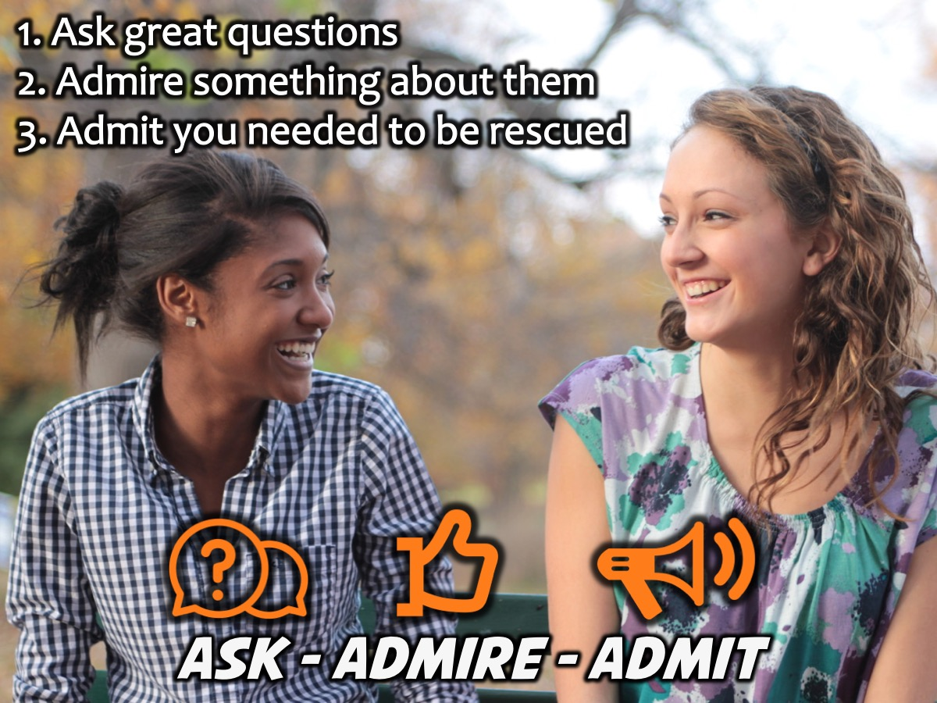
Notes:
Today we are going to learn how to begin a spiritual conversation. There are 3 steps to follow: Ask great questions. Admire something about them. Admit you needed to be rescued. These three steps will help us bring the gospel up more naturally.

Slide 12

Notes:
1. Ask Great Questions. This does 3 things: (a) It breaks down barriers and opens up hearts (John 4:7). (b) It helps you understand and emphasize with others (2 Timothy 2:23-26). (c) It gives you time to pray and ask God for help (Matthew 10:19-20). Learn to ask questions that engage, not enrage.

Slide 13
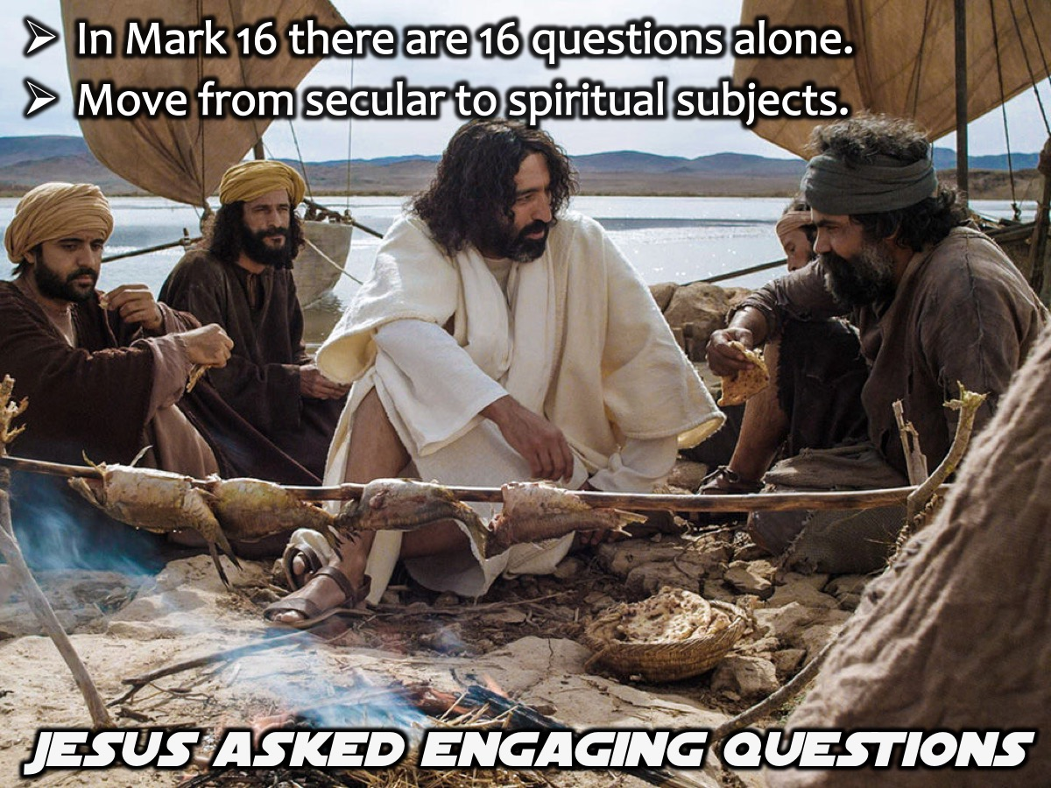
Notes:
Jesus asked engaging question (over 300) – in Mark 16 there are 16 questions alone. Move from secular subjects to spiritual subjects.

Slide 14

Notes:
Why do we need to ask great question? Because we need to seek first to understand and then to be understood.

Slide 15
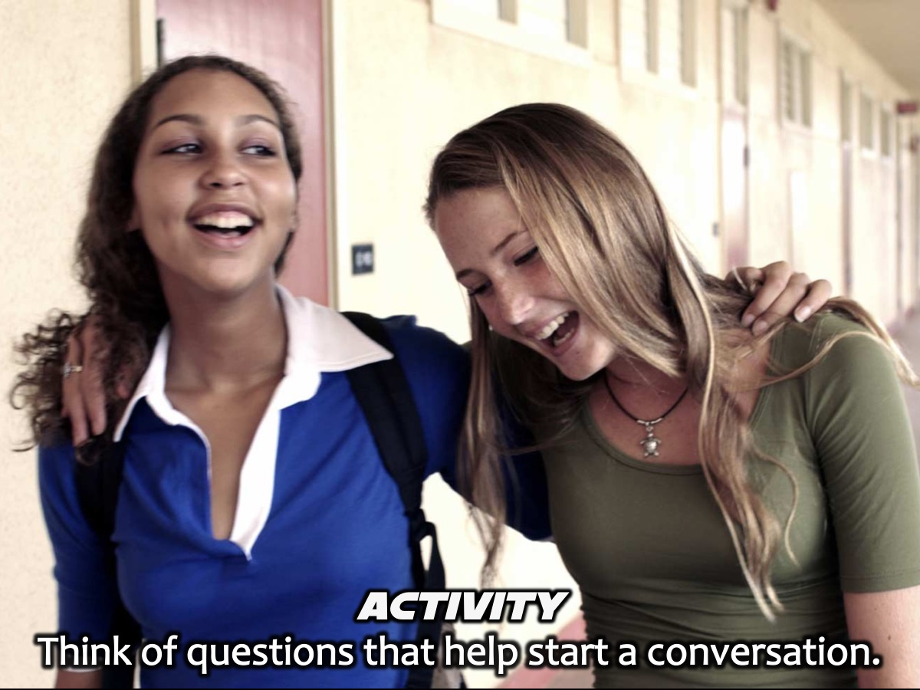
Notes:
Activity: At your tables write down questions that you think will great in starting a conversation. Share with the wider group.

Slide 16

Notes:
Here are some of the questions you can use as discussion starters.
* Do you believe in God?
* Do you have a spiritual background?
* Do you go to church anywhere?
* Have you ever wondered about the meaning of life?
* Have you ever experienced a sense of God’s presence in your life?

Slide 17

Notes:
2. Admire Something About Them. Focus on areas of commonality, not areas of difference (Acts 17:22-23). Admiring something about them will build bridges, not walls (Proverbs 15:1). Maybe admire them for being willing to talk with you about spiritual matters, or if they ask good questions, say how that is a real gift.

Slide 18
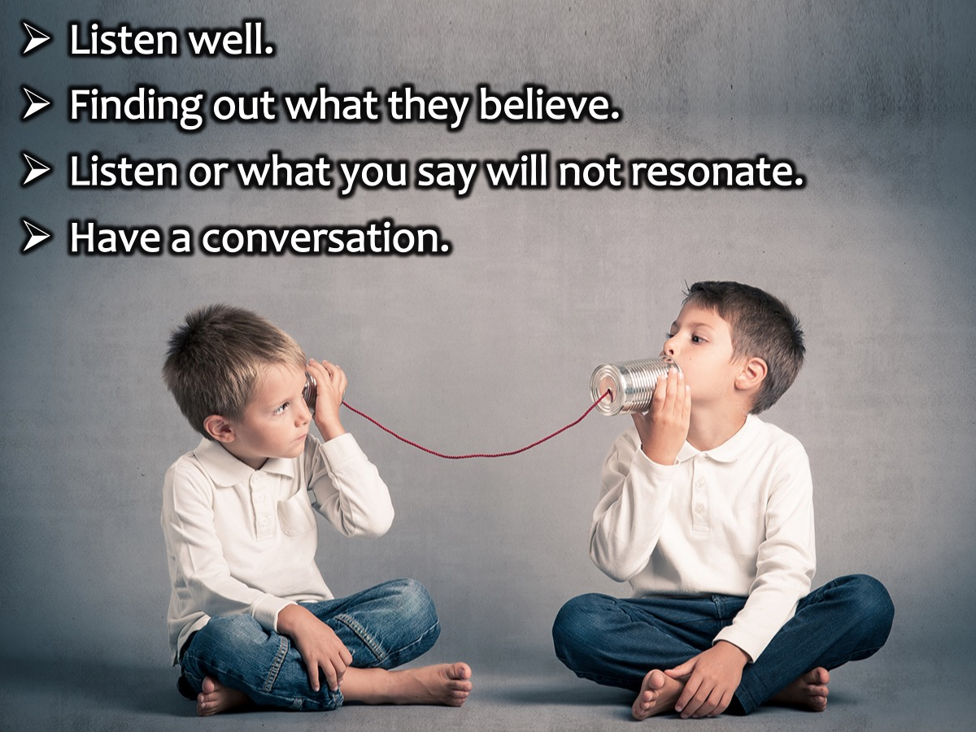
Notes:
Listen well. (This sounds easy enough, but the reality is that very few of us listen well. We get hung up on what they say rather than finding out what they deeply believe. If you don't listen well, what you say will not resonate. Engaging conversations are never one-sided. Show you value them by hearing their story. Allow the interaction to be a conversation, not a sermon.)

Slide 19
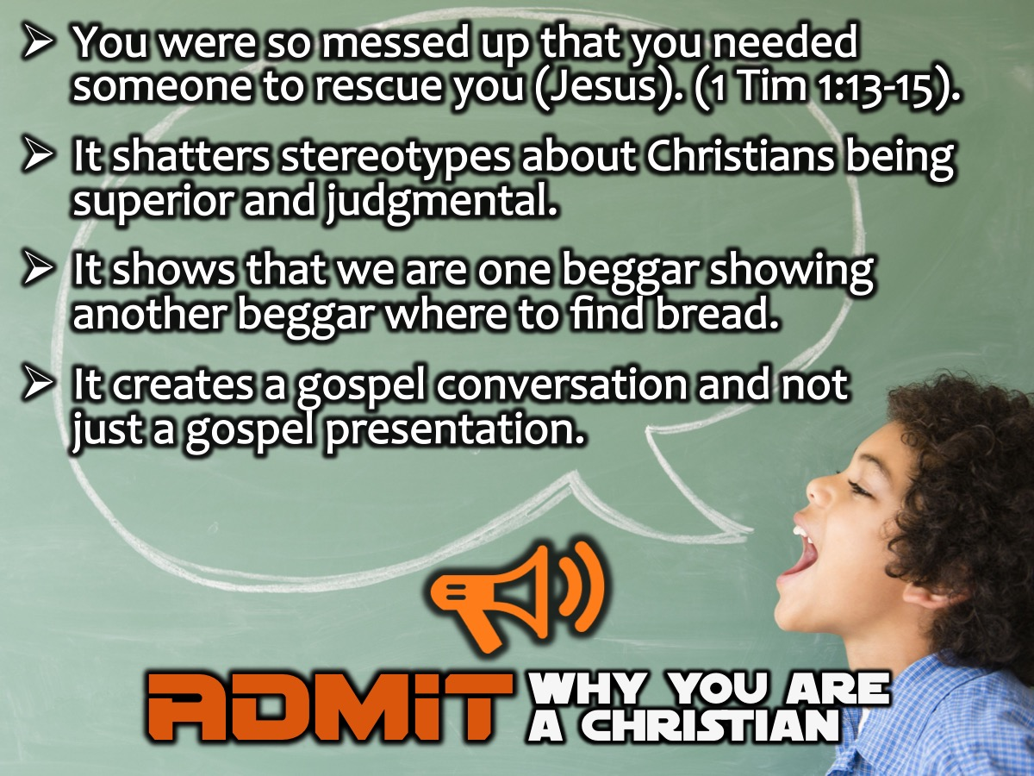
Notes:
3. Admit that the reason you’re a Christian is that you are so messed up you needed someone else to rescue you (Jesus). (1 Timothy 1:13-15). This humble strategy shatters stereotypes. It shows that we are one beggar showing another beggar where to find bread. It prepares the way for a real gospel-focused conversation as opposed to just an evangelistic presentation.

Slide 20
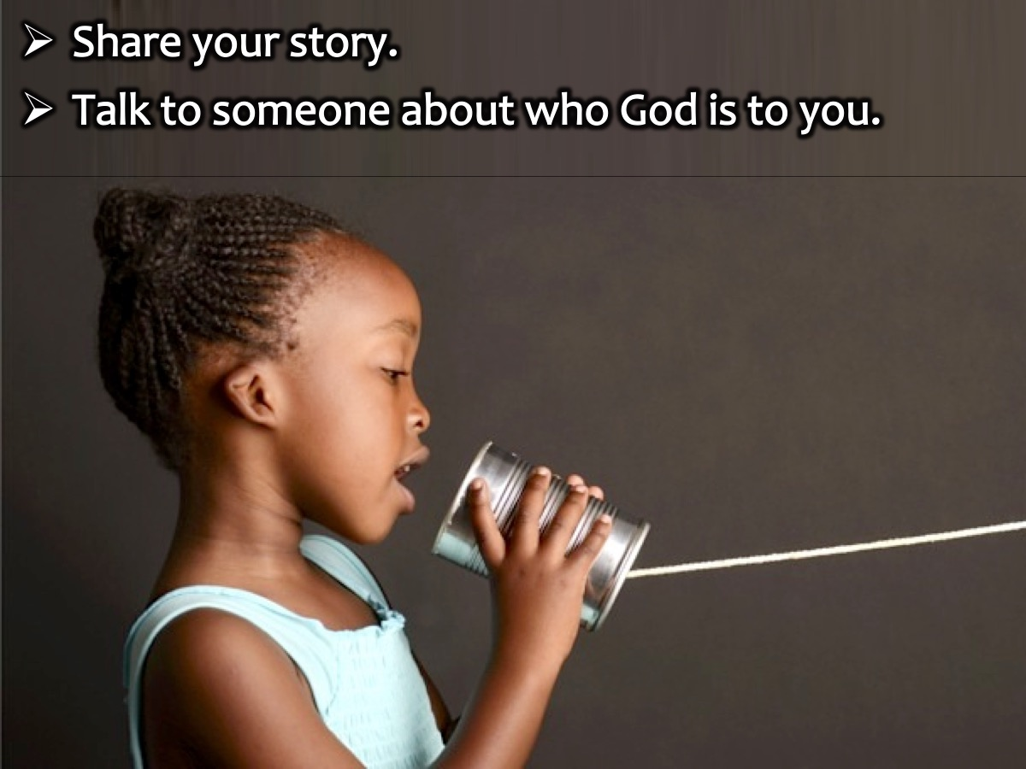
Notes:
(1) Share your story. Why is Jesus so special to you.
(2) Find one person and just talk about who is God to you.

Slide 21

Notes:
People like engaging in conversations, so the question is, what do you tell them about God?
1. God’s Mercy – God’s power to forgive. I don’t always do the right thing, but Jesus forgives me every time when I confess my sins to him. (how do you know that?) the Bible tells me He does.
2. God’s Love. God loves you because He is the reason you exist. Share your experience of God’s love.

Slide 22
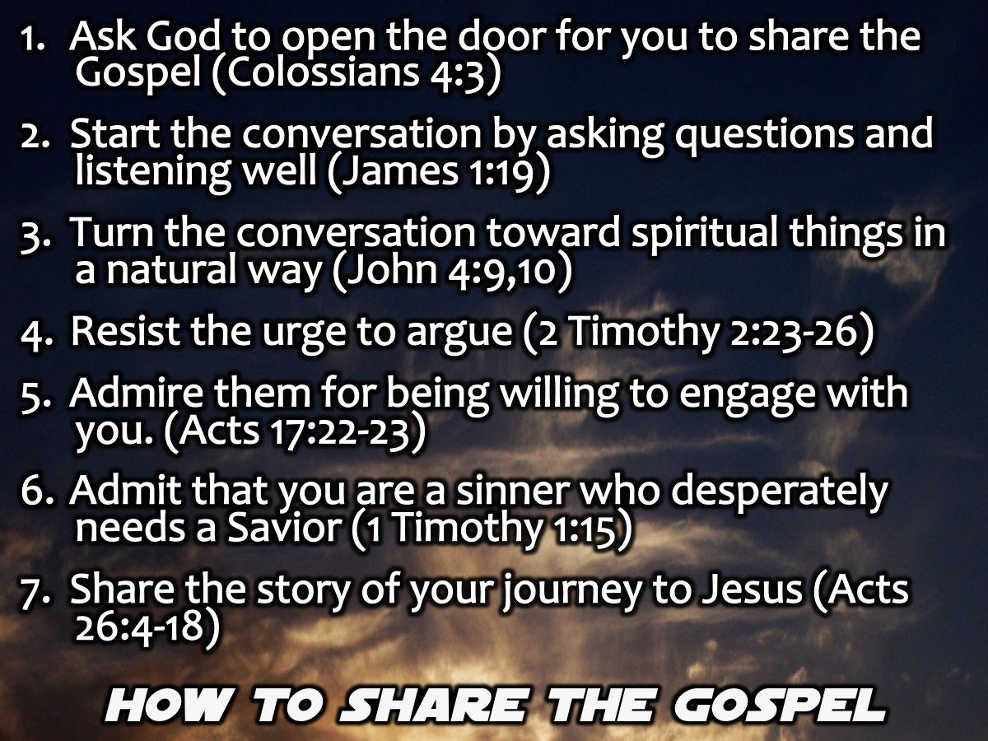
Notes:
Guidelines for Sharing the Gospel Effectively
1. Ask God to open the door for you to share the Gospel today (Colossians 4:3.)
2. Start the conversation by asking questions and listening well (James 1:19.)
3. Turn the conversation toward spiritual things in a natural way (John 4:9,10.)
4. Resist the urge to argue (2 Timothy 2:23-26.)
5. Share with them the areas you admire about their belief system (Acts 17:22-23.)
6. Admit that you are a sinner who desperately needs a Savior (1 Timothy 1:15.)
7. Share the story of your journey to Jesus (Acts 26:4-18.)

Slide 23

Notes:
The Salt Movies. Dare to Share has short Salt Movies on YouTube that you can show to your lost friends – these will help you to start a conversation with them. You can post one of the SALT movies on your Facebook page and chat about the Gospel conversations that will result or you can send a link to one of the movies to your friends.
Check out the playlist of 5 videos here:
https://www.youtube.com/watch?v=h4pWC9C4r14&list=PLn3K2gZDZ7h-ieKP9PMKDFlVh_l8l5PGk
Here is an easy to remember link: bitly.com/saltmovies

Slide 24
Notes:
Video: Then What? Get it on YouTube at: https://www.youtube.com/watch?v=6CyJYLFUjzU. This video raises the question: What do you think happens after we die?

Slide 25

Notes:
Challenge: (1) Pray before you share the gospel with someone. (2) Ask for God’s wisdom, strength and guidance. (3) Don’t forget to believe in God.

Slide 26
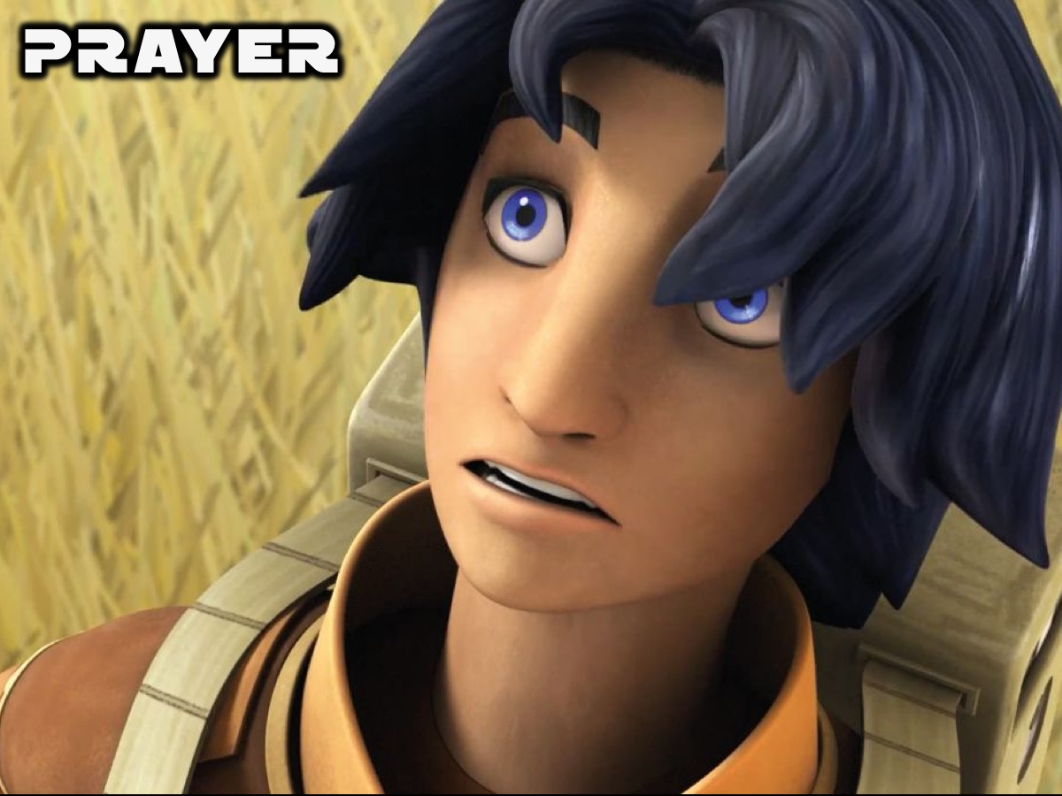
Notes:
Closing Prayer

Slide 27
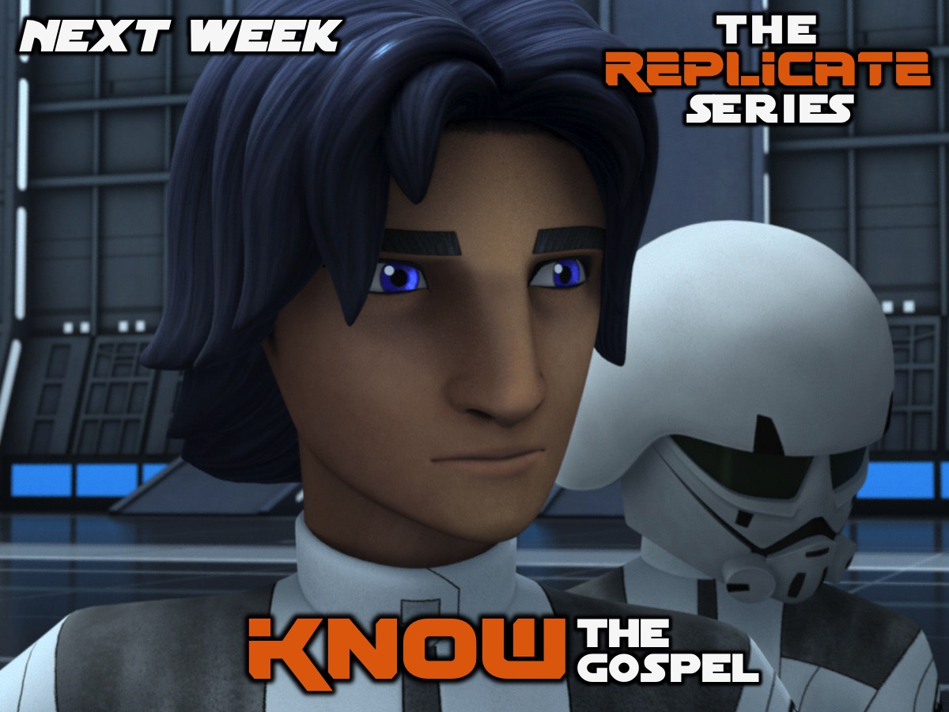
Notes:
Next week we will focus on how to know the Gospel.

