Slide 1

Notes:
Welcome to the Replicate Series. Let’s kick off with another cool Star Wars clip.

Slide 2
Notes:
Video: Star Wars The Clone Wars Yoda & Anakin vs. Dooku & Sidious. Get it on YouTube at: https://www.youtube.com/watch?v=ctN5s8z3E8E

Slide 3
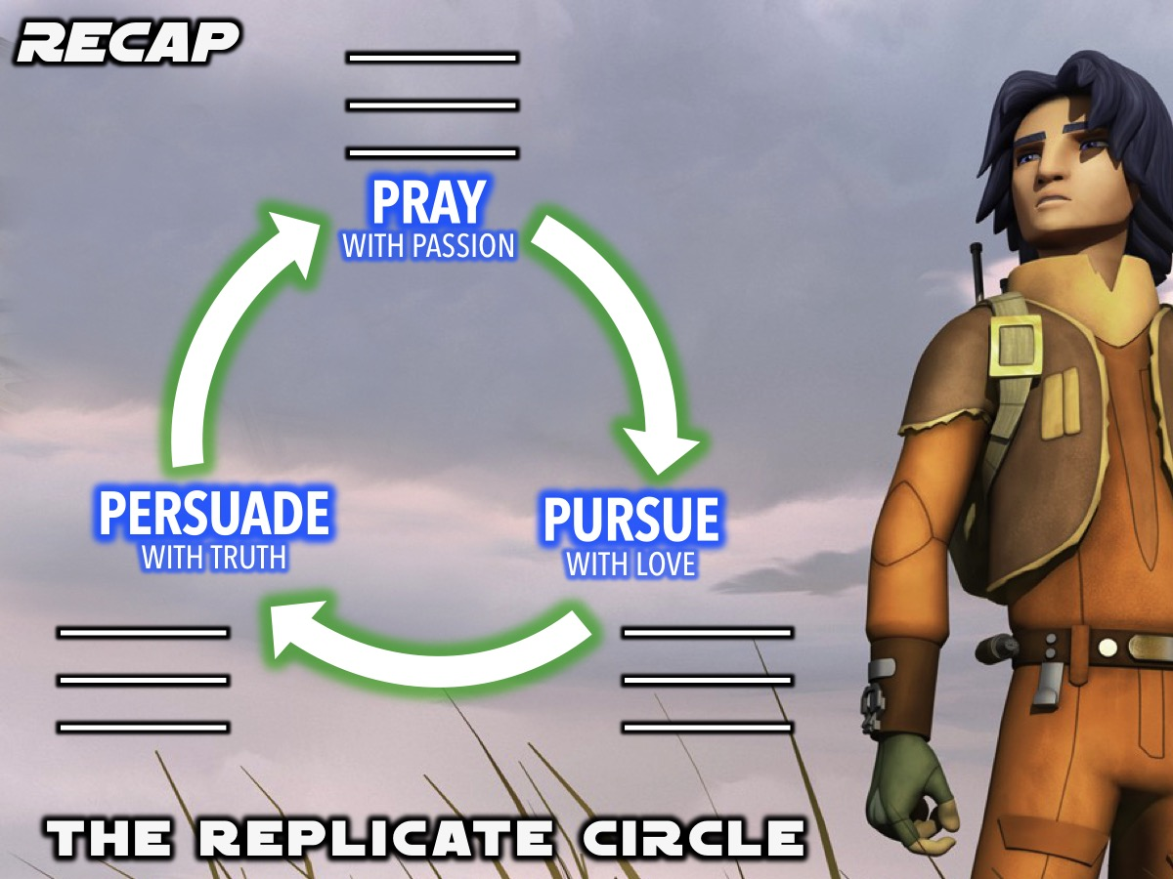
Notes:
Recap: We have been introduced to the Replicate Circle - a tool to help us lead our friends to Jesus.

Slide 4
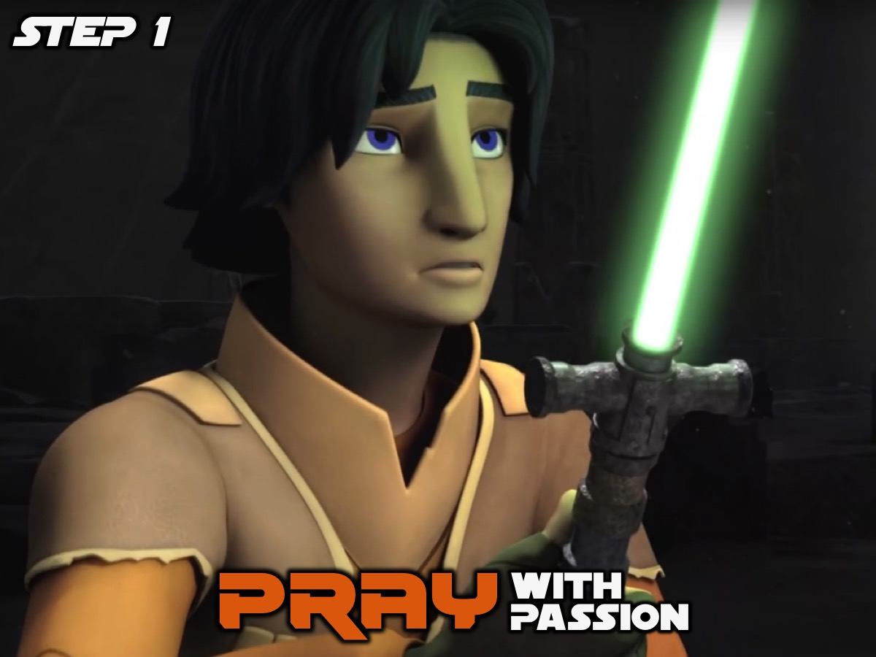
Notes:
The first step in the Replicate Circle is to Pray with Passion for our lost friends.

Slide 5

Notes:
The second step is to Pursue our lost friends with Love.

Slide 6

Notes:
The third step is to Persuade our lost friends with Truth.

Slide 7

Notes:
Last week we learnt how to START a Conversation with a lost friend.

Slide 8
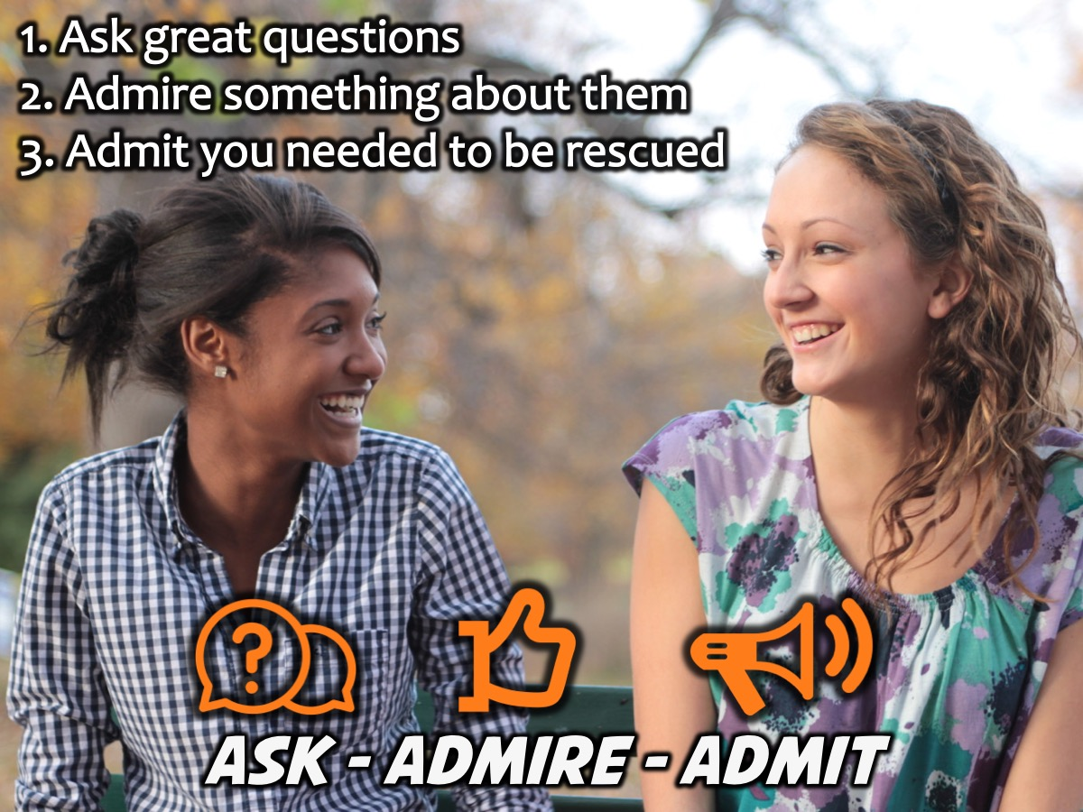
Notes:
We learnt to follow 3 steps to bring up the gospel naturally: Ask great questions. Admire something about them. Admit you needed to be rescued.

Slide 9
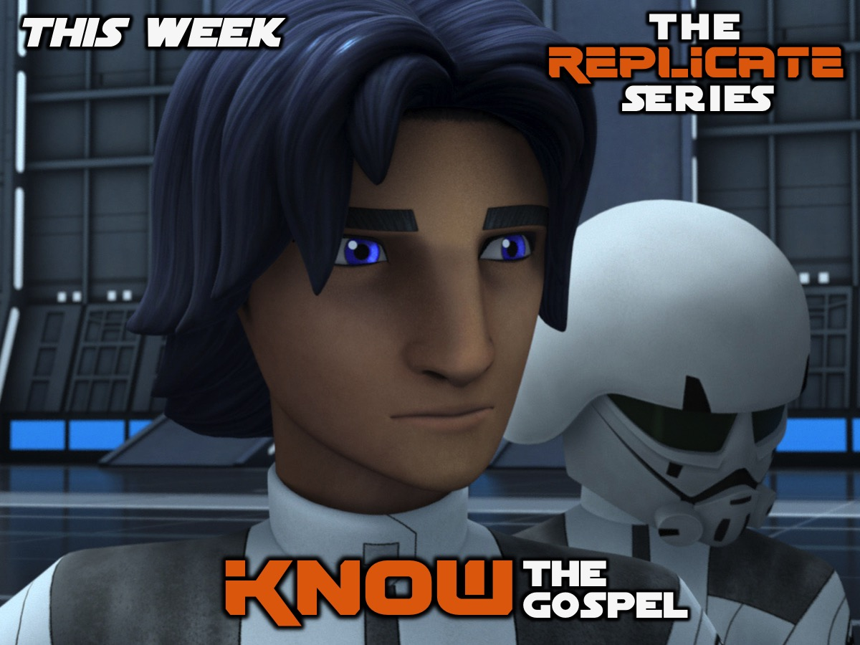
Notes:
This week we are going to find out what the gospel is all about so that we can really know it when we need to share it. But first a Star Wars video clip!

Slide 10
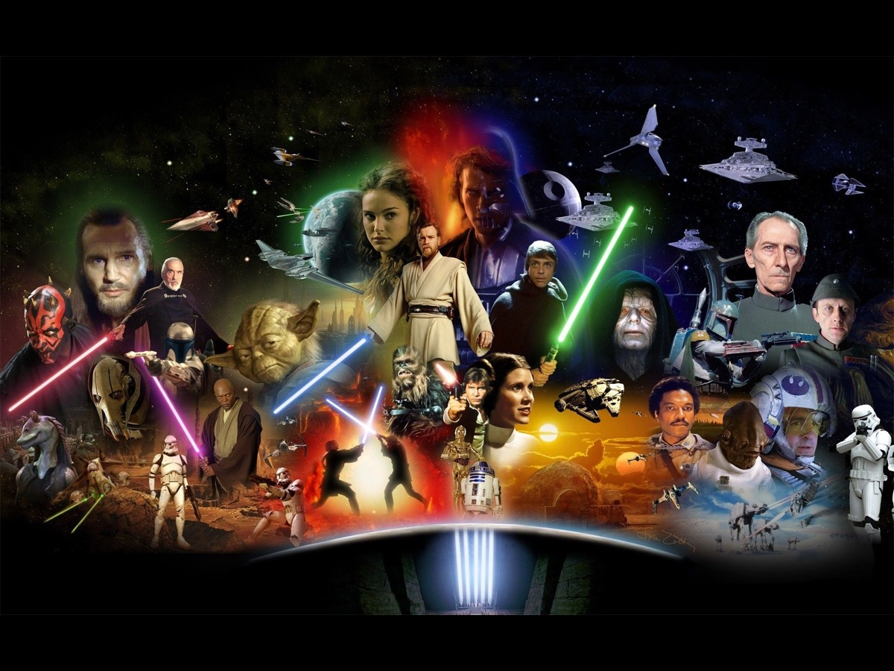
Notes:
I wonder what your favourite Star Wars character is.

Slide 11
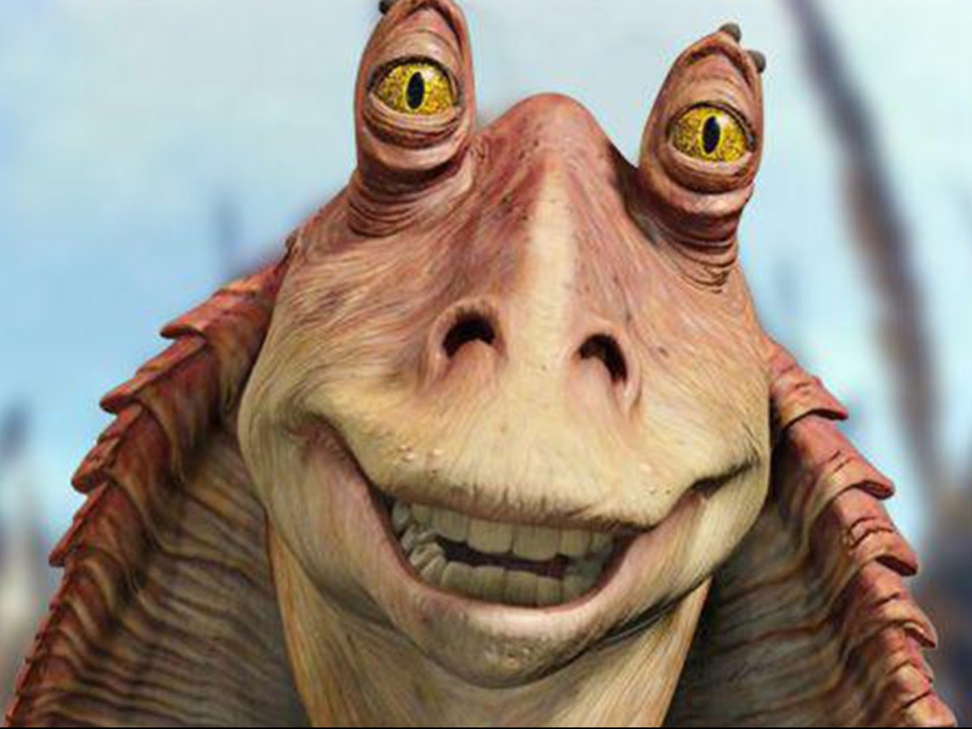
Notes:
I have always loved the more unusual characters like: Jar Jar Binks…

Slide 12
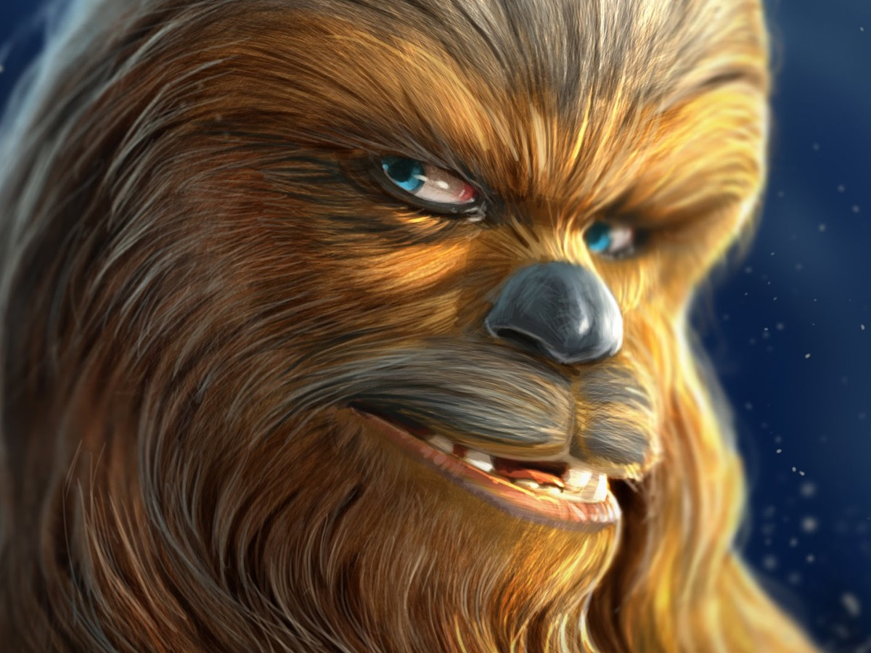
Notes:
Chewbacca…

Slide 13
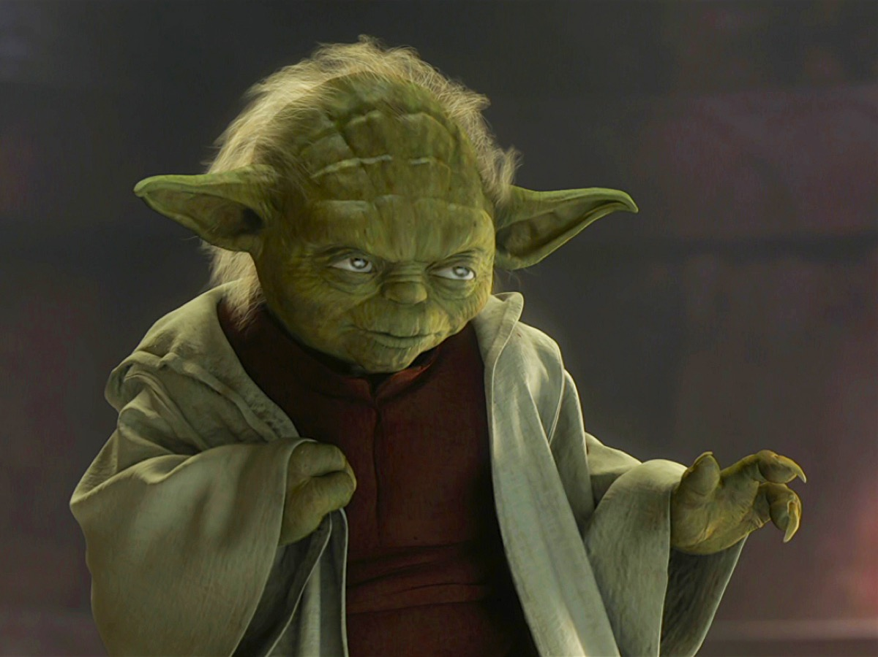
Notes:
But my all time favourite is Master Yoda. Here is a little tribute to this wise old man - a top ten of his most wise sayings.

Slide 14
Notes:
Video: Best Yoda Quotes - The StarWars.com 10 (Edited Down to 1 Minute). Get it on YouTube at: https://www.youtube.com/watch?v=kDoY_zXf7uQ

Slide 15
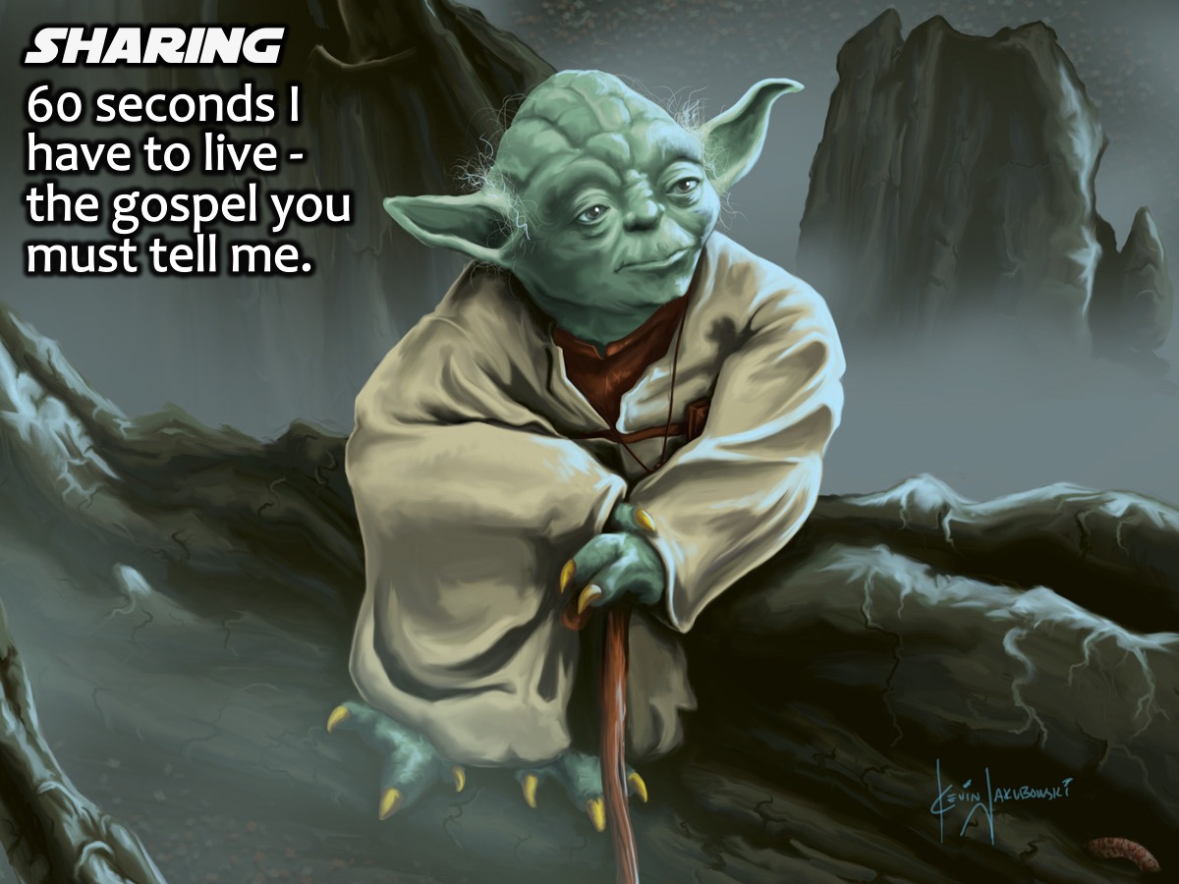
Notes:
Sharing: Turn to the person next to you and say to them in a Yoda voice and style: “60 seconds I have to live - the gospel you must tell me.”

Slide 16
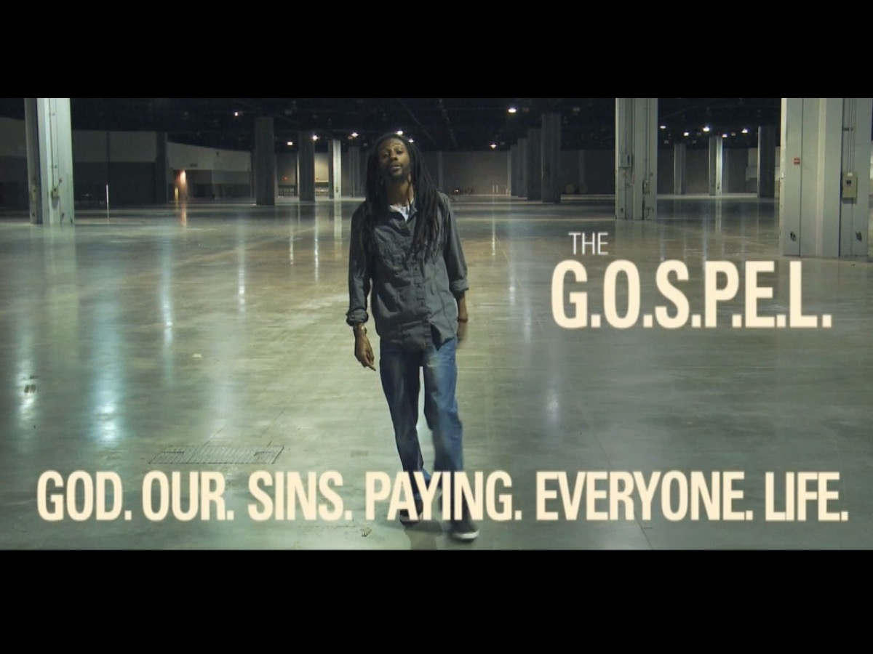
Notes:
Video: We are going to watch a video called: Life in 6 Words.

Slide 17
Notes:
Video: Life in 6 Words. Get it on YouTube at: https://www.youtube.com/watch?v=jyYFxp7apl4

Slide 18
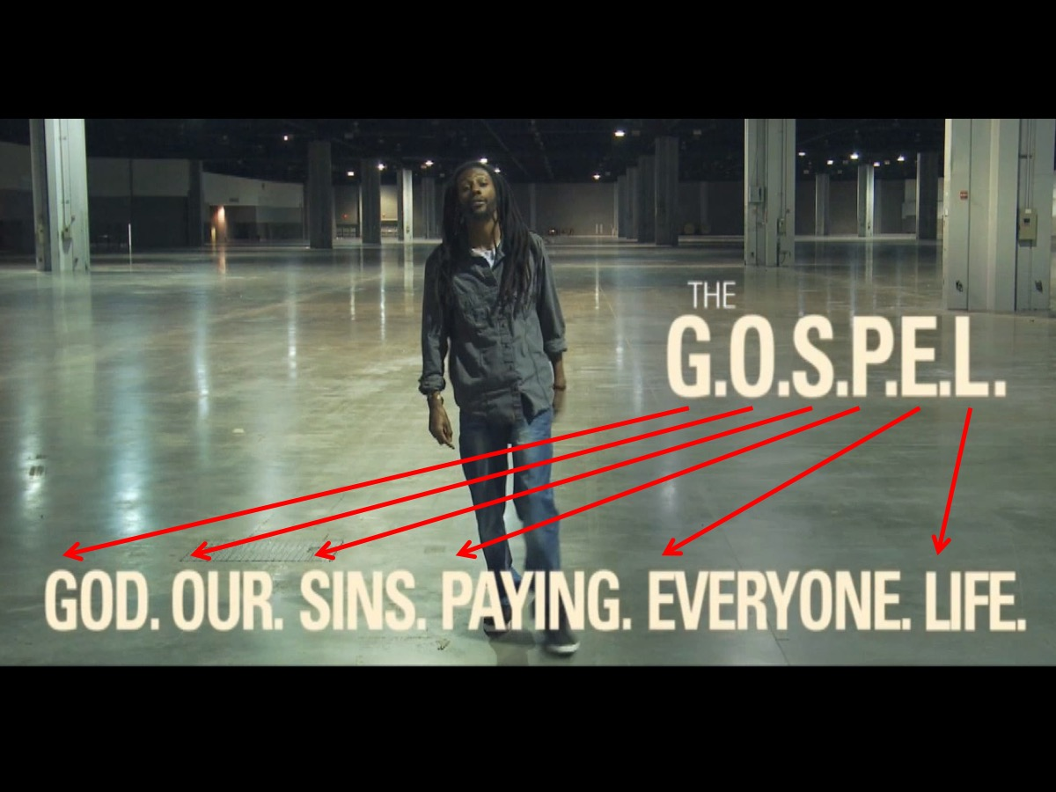
Notes:
Here are the 6 words that help us understand the Gospel - each word stands for a letter of the word GOSPEL to help you remember the words: God Our Sins Paying Everyone Life.

Slide 19
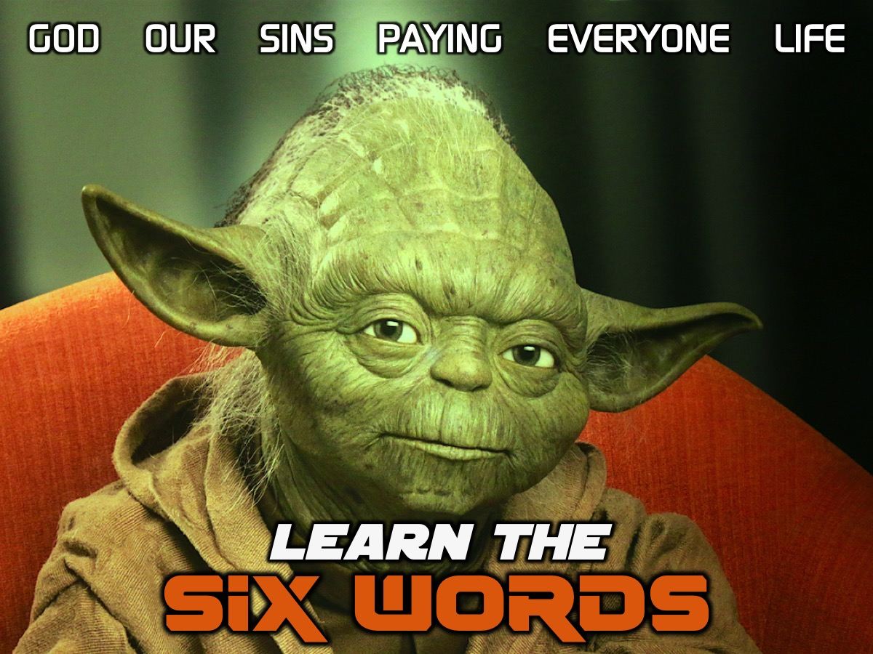
Notes:
Learn the Six Words: The first thing you need to do is actually learn the 6 words. Let’s go through them one at a time!

Slide 20
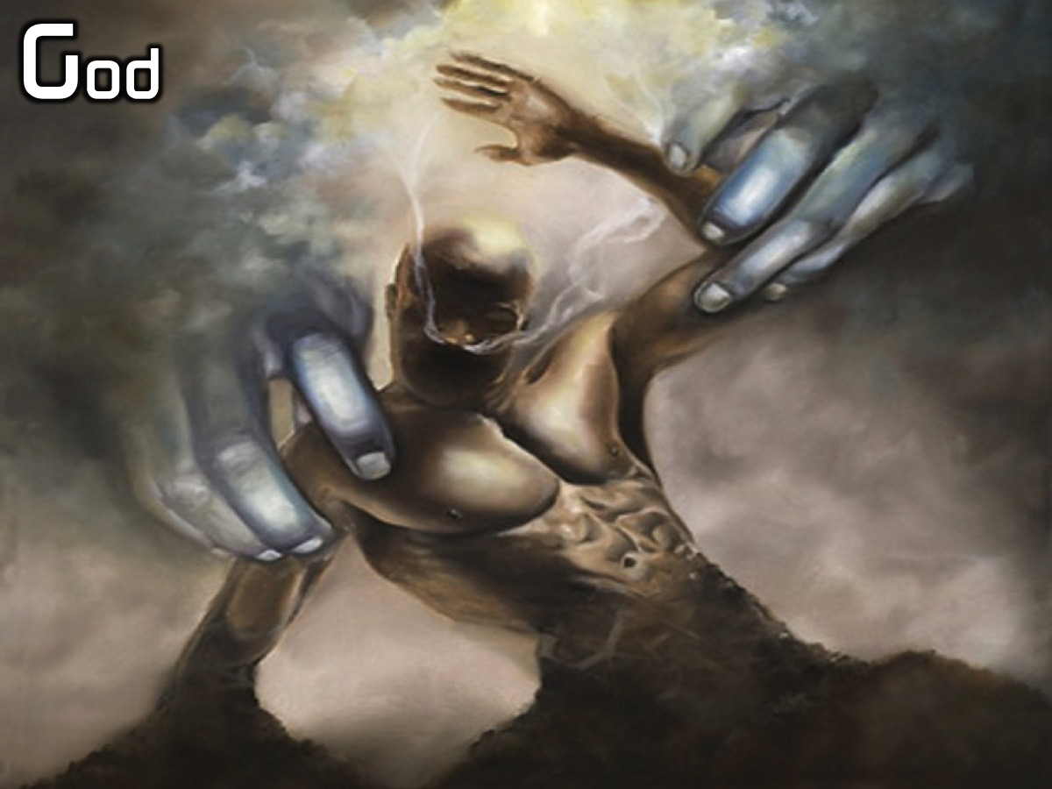
Notes:
God

Slide 21
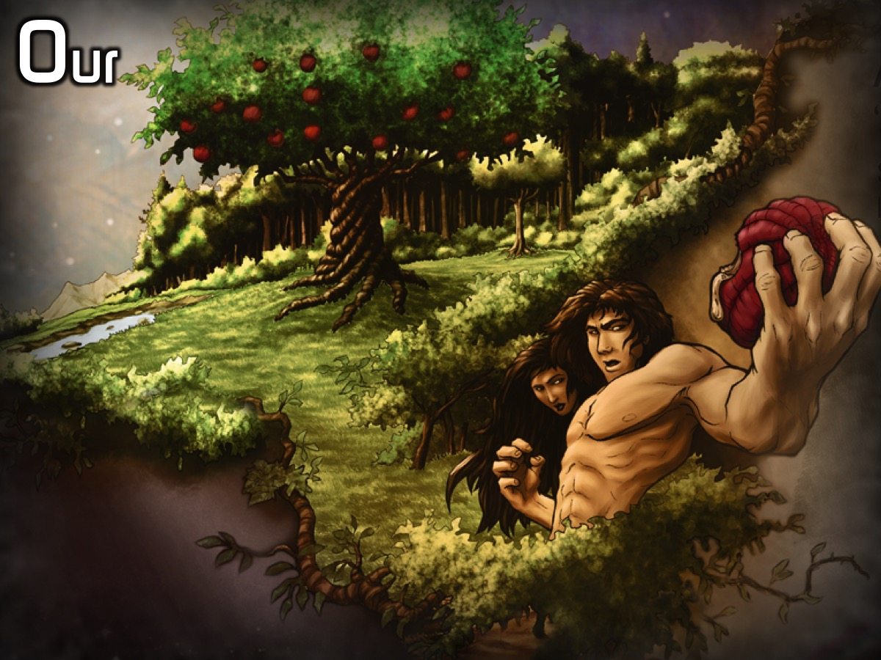
Notes:
Our

Slide 22
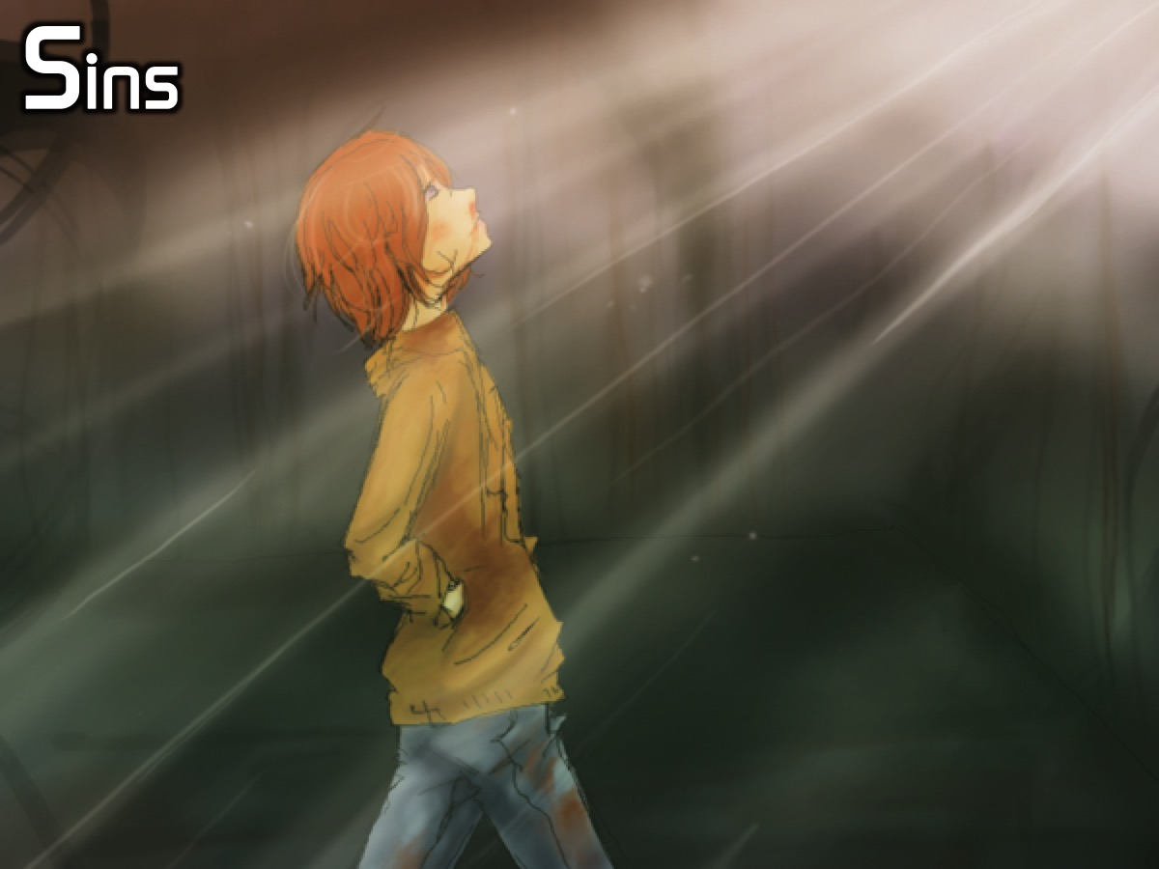
Notes:
Sins

Slide 23
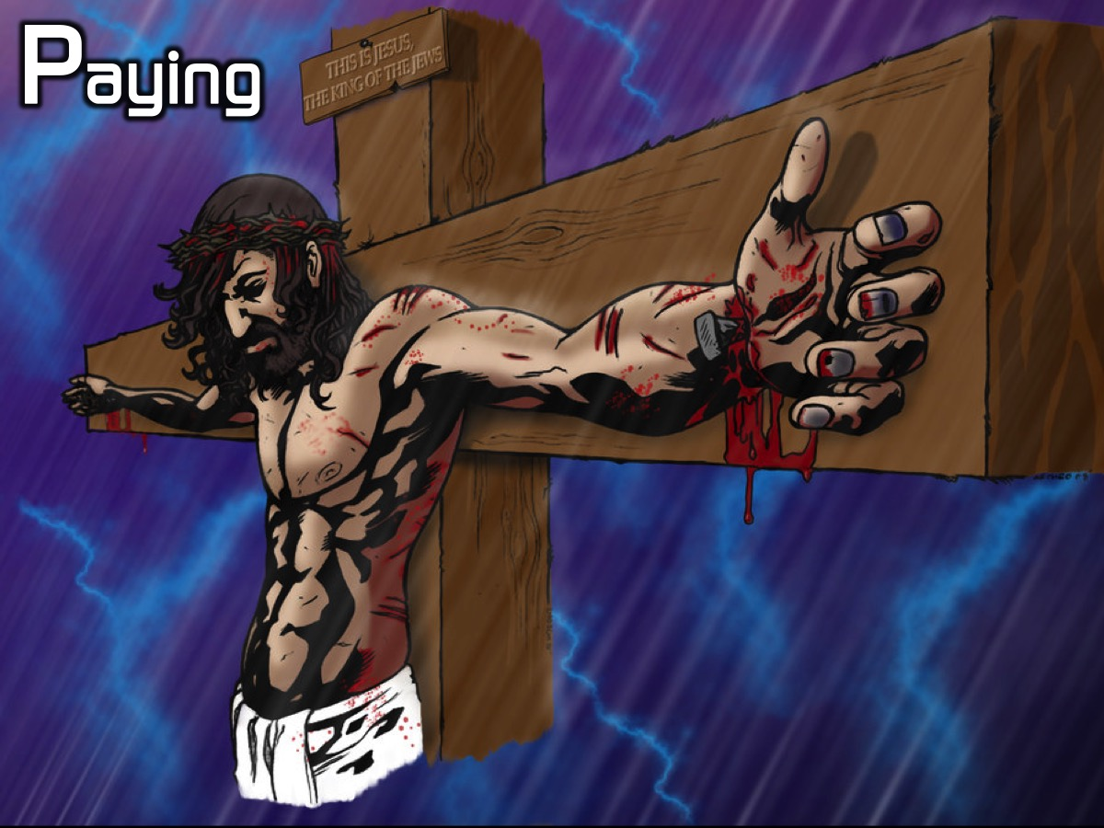
Notes:
Paying

Slide 24
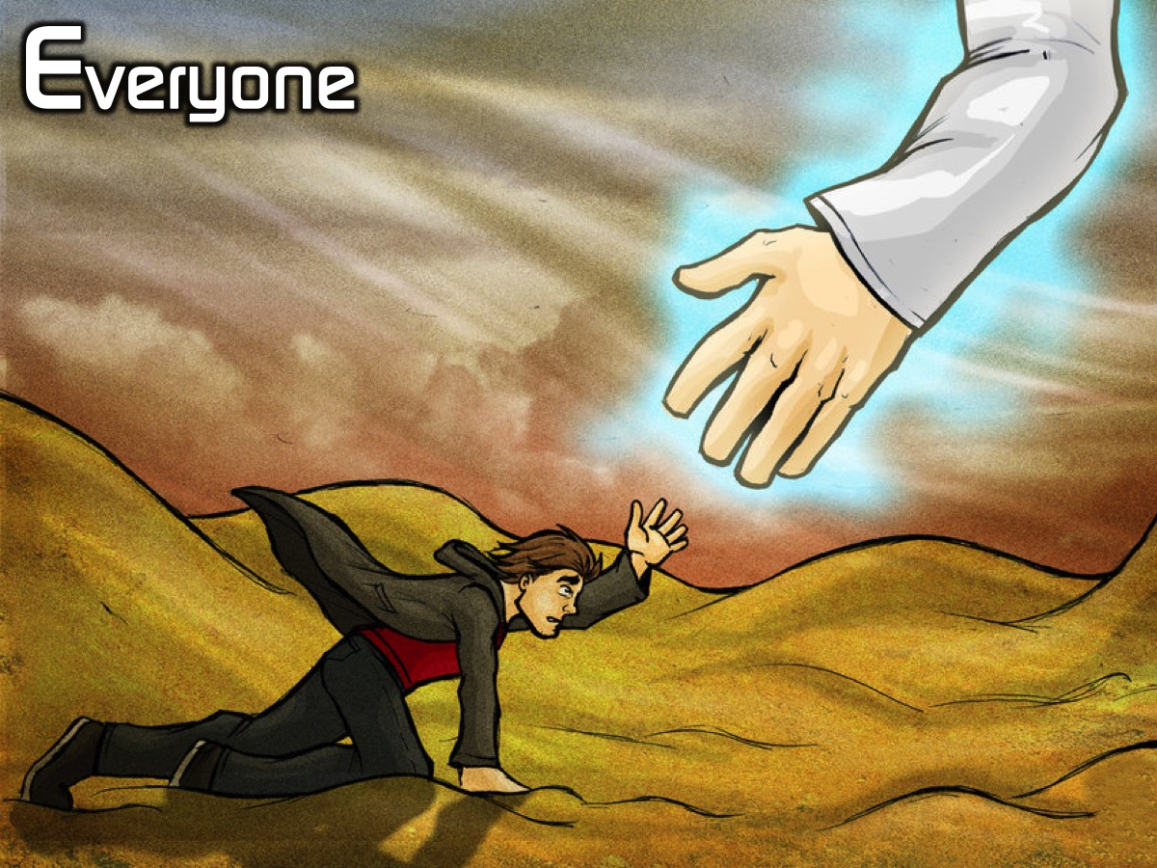
Notes:
Everyone

Slide 25
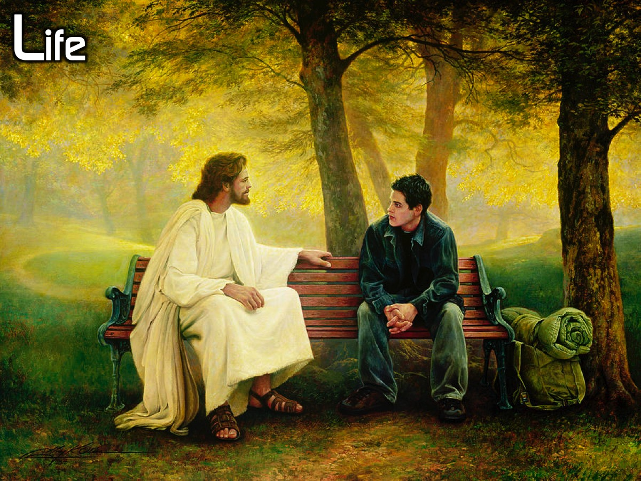
Notes:
Life

Slide 26
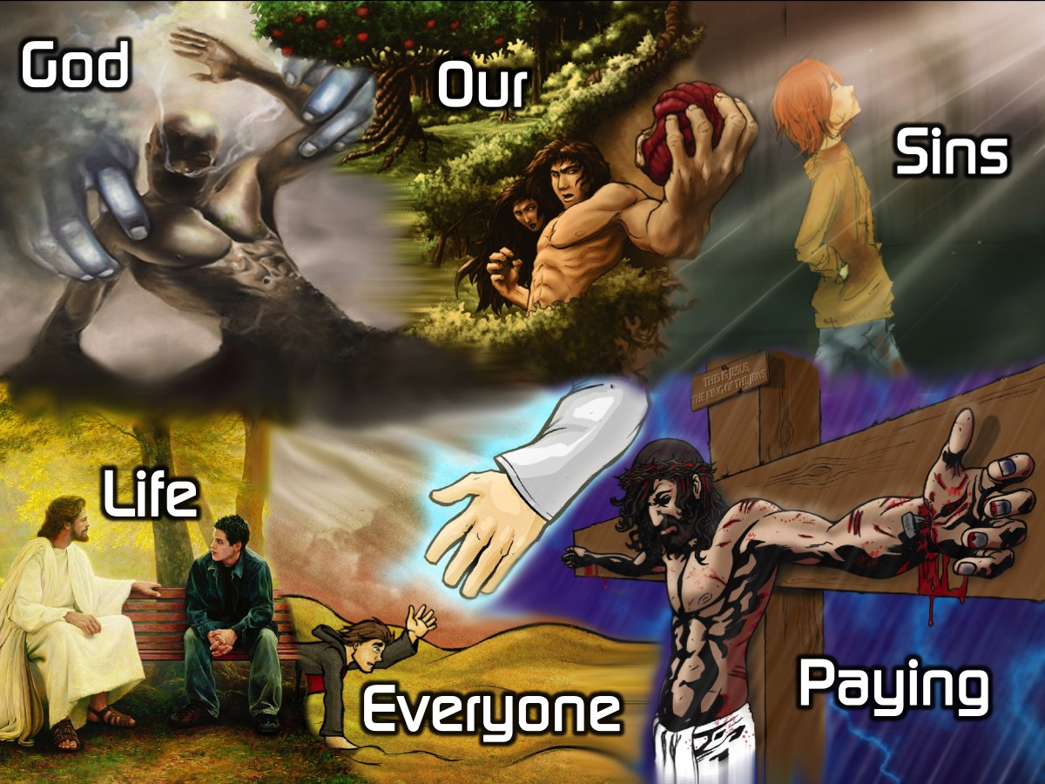
Notes:
Say them all at your own pace: God Our Sins Paying Everyone Life

Slide 27
Notes:
Say the words with me this time: God

Slide 28
Notes:
Our

Slide 29
Notes:
Sins

Slide 30
Notes:
Paying

Slide 31
Notes:
Everyone

Slide 32
Notes:
Life

Slide 33
Notes:
One more time, all together: God Our Sins Paying Everyone Life.

Slide 34
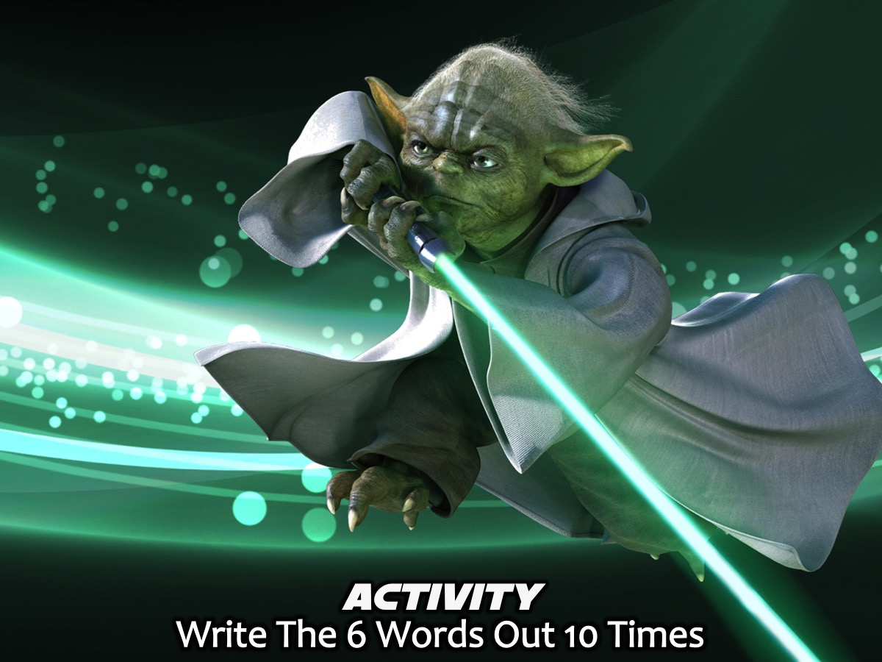
Notes:
Activity: Write The 6 Words Out 10 Times on the piece of paper you have been given.

Slide 35
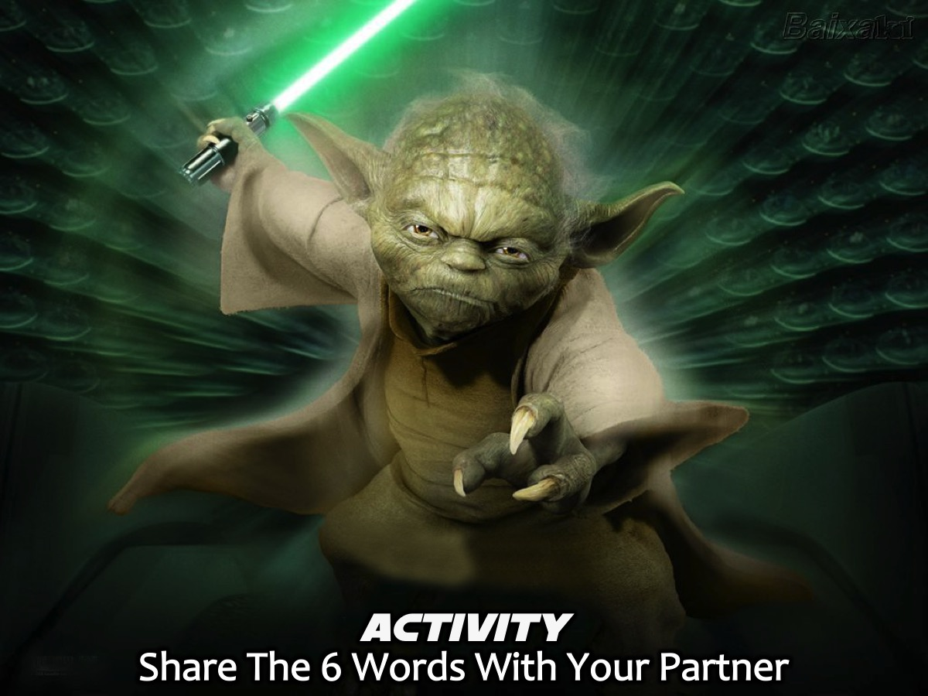
Notes:
Activity: Share The 6 Words With Your Partner and then let them share them with you.

Slide 36
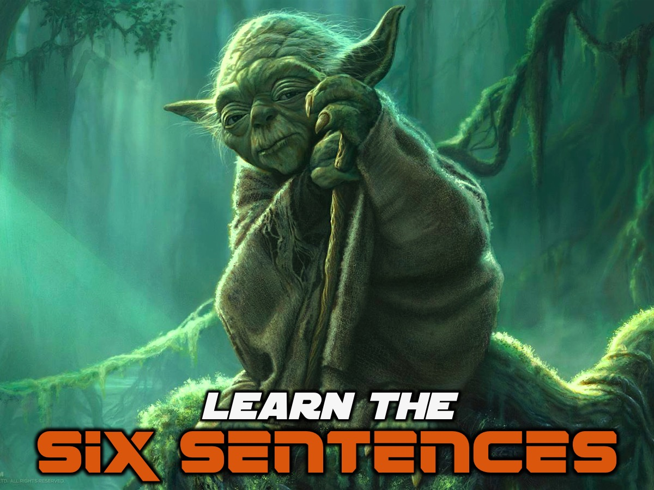
Notes:
Learn the 6 Sentences: Each of the 6 words you have just learnt are the start of a sentence and we are now going to start learning the 6 sentences.

Slide 37

Notes:
God created us to be with him.

Slide 38
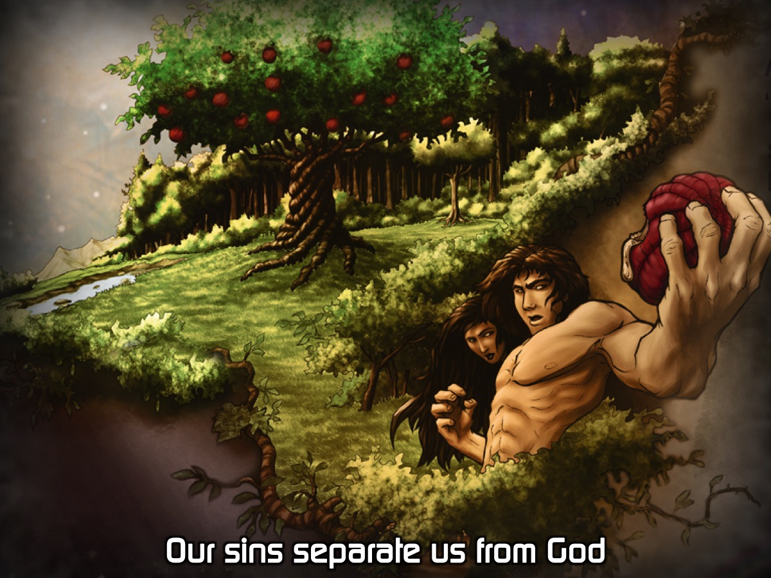
Notes:
Our sins separate us from God.

Slide 39
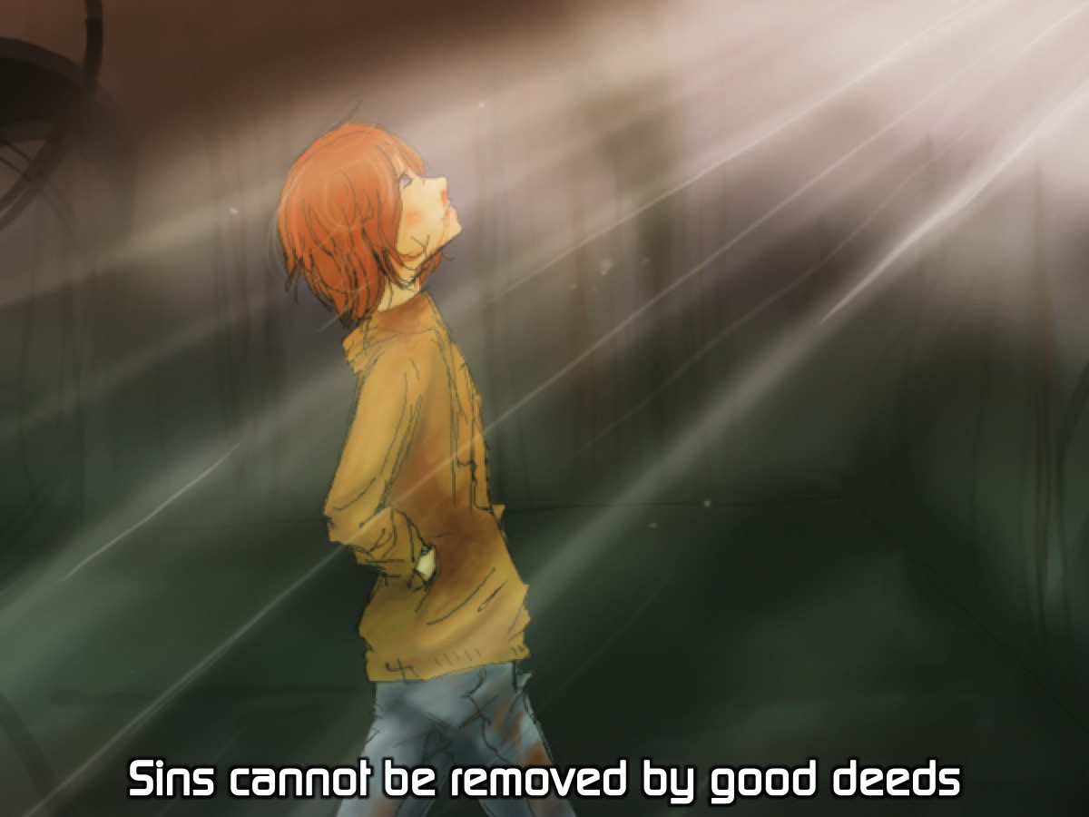
Notes:
Sins cannot be removed by good deeds.

Slide 40
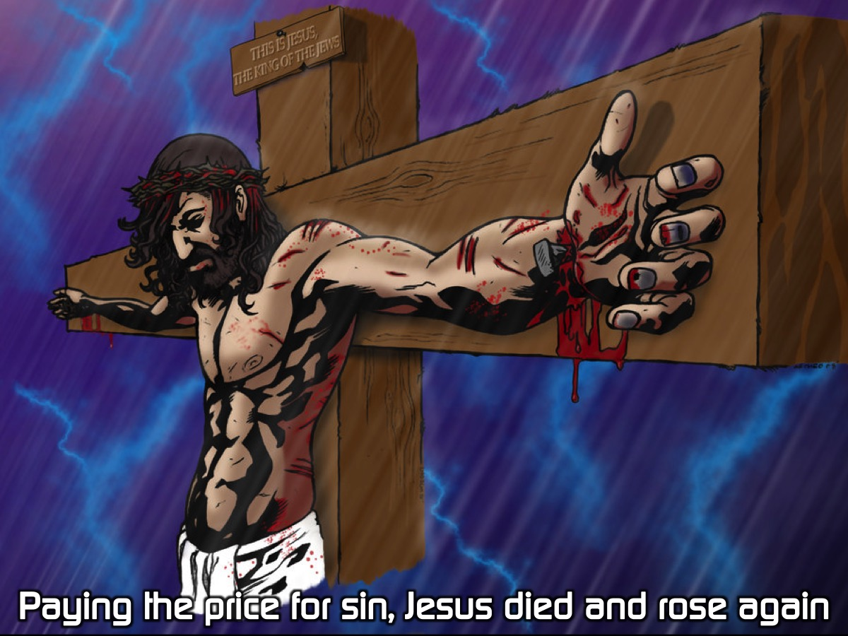
Notes:
Paying the price for sin, Jesus died and rose again.

Slide 41
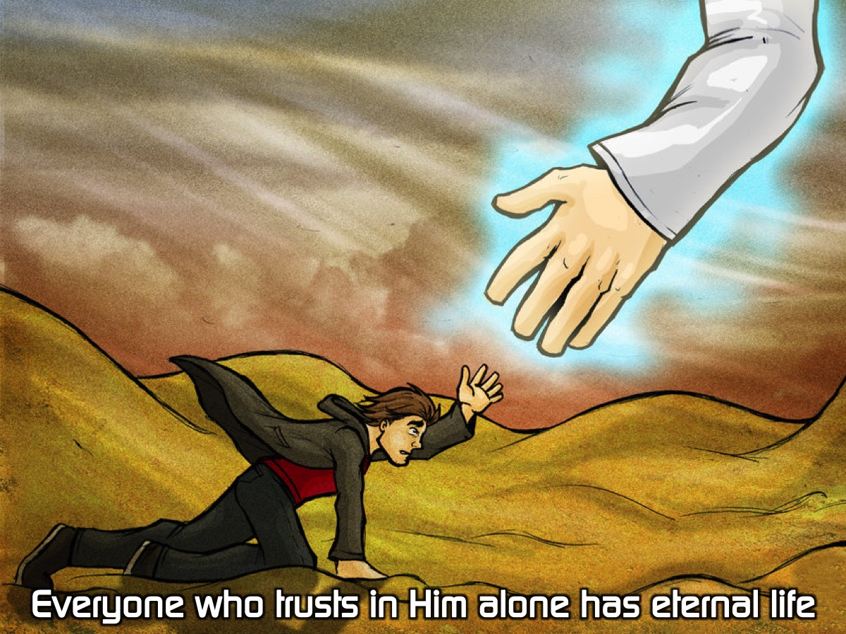
Notes:
Everyone who trusts in Him alone has eternal life.

Slide 42
Notes:
Life with Jesus starts now and lasts forever.

Slide 43
Notes:
Activity: We are going to say the 6 sentences out loud as the slides come up.

Slide 44
Notes:
God created us to be with him.

Slide 45
Notes:
Our sins separate us from God.

Slide 46
Notes:
Sins cannot be removed by good deeds.

Slide 47
Notes:
Paying the price for sin, Jesus died and rose again.

Slide 48
Notes:
Everyone who trusts in Him alone has eternal life.

Slide 49
Notes:
Life with Jesus starts now and lasts forever.

Slide 50
Notes:
God created us to be with him.

Slide 51
Notes:
Our sins separate us from God.

Slide 52
Notes:
Sins cannot be removed by good deeds.

Slide 53
Notes:
Paying the price for sin, Jesus died and rose again.

Slide 54
Notes:
Everyone who trusts in Him alone has eternal life.

Slide 55
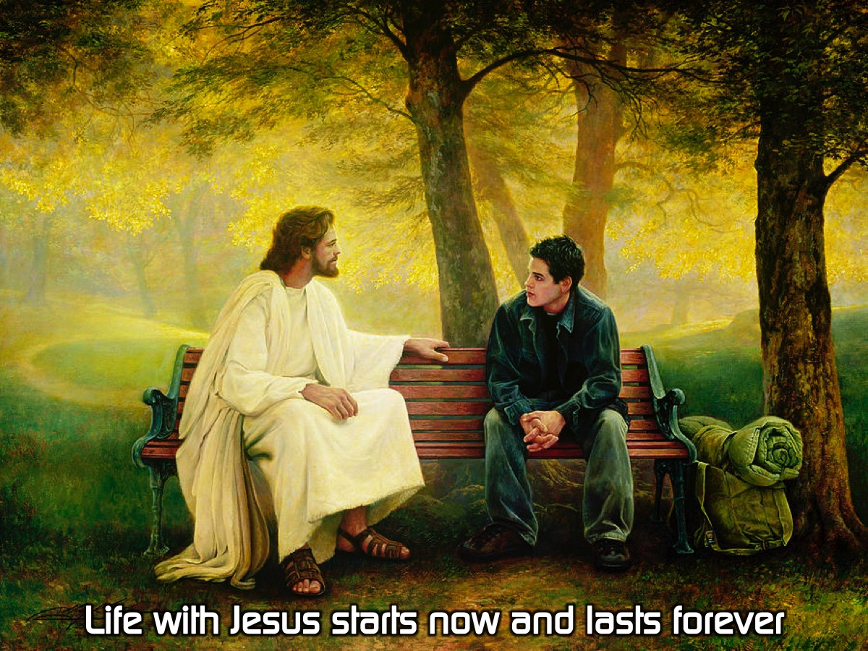
Notes:
Life with Jesus starts now and lasts forever.

Slide 56
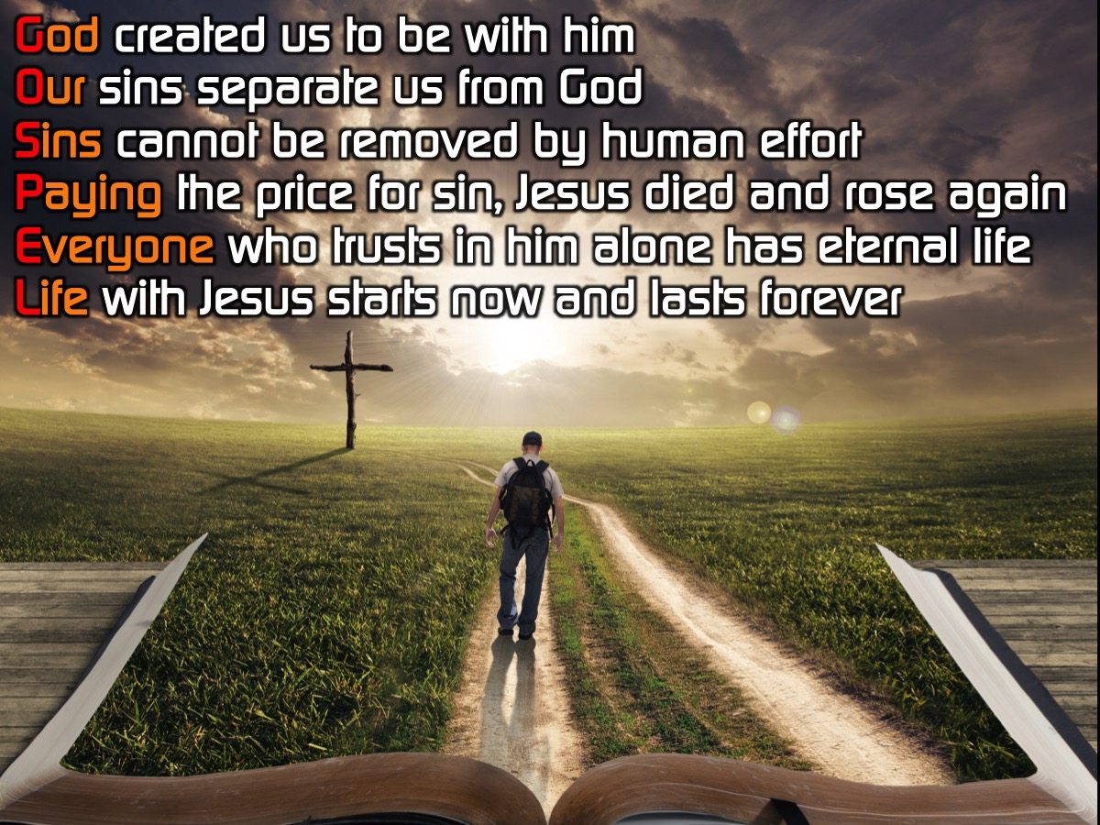
Notes:
Let’s say all the sentences together once more:
God created us to be with him.
Our sins separate us from God.
Sins cannot be removed by good deeds.
Paying the price for sin, Jesus died and rose again.
Everyone who trusts in Him alone has eternal life.
Life with Jesus starts now and lasts forever.

Slide 57
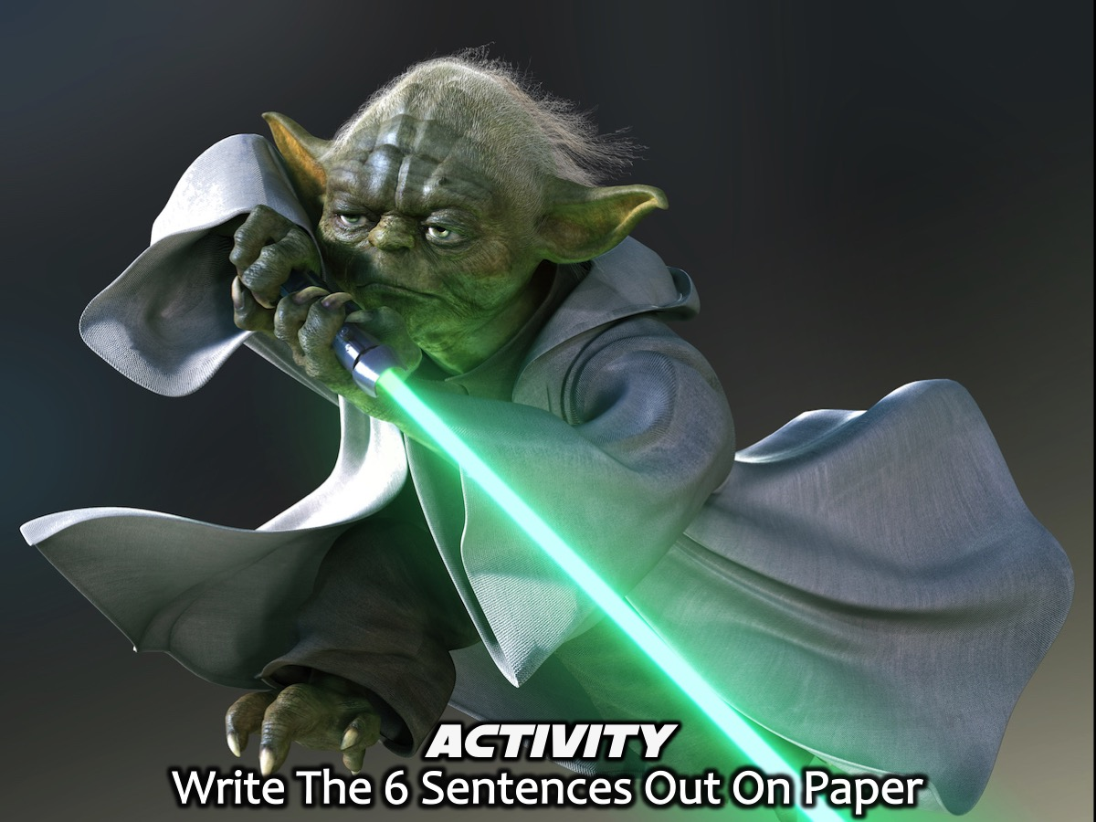
Notes:
Activity: Write The 6 Sentences Out On Paper - each person writes out the six sentences on a piece of paper.

Slide 58
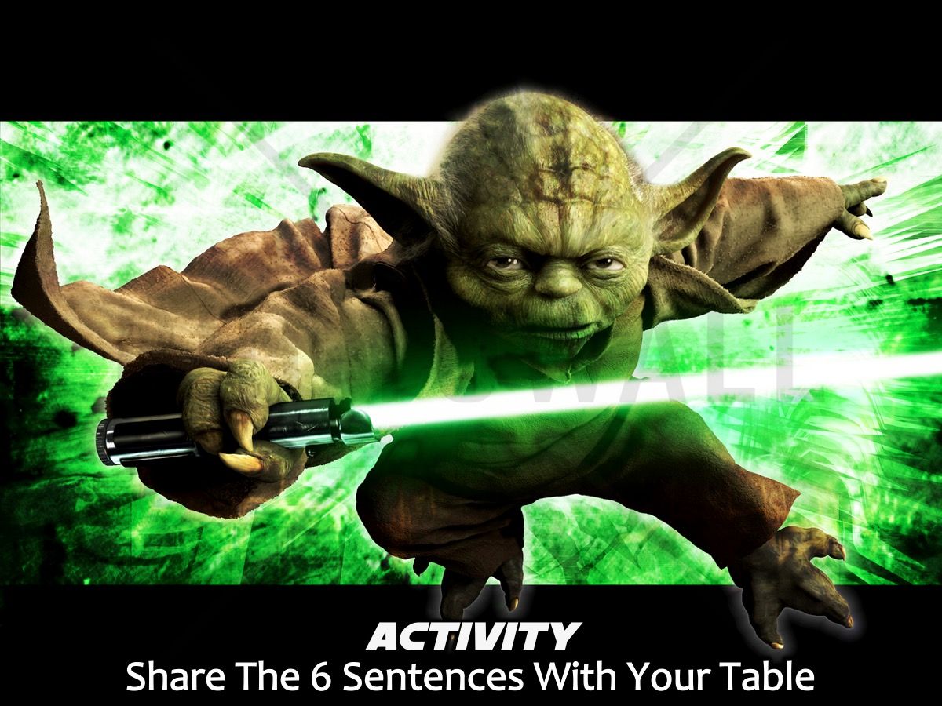
Notes:
Activity: Share The 6 Sentences With Your Table - each person takes a chance to stand in front of the group and to say the 6 sentences from memory.

Slide 59

Notes:
Learn the 6 Verses: You are going to be introduced to a verse for each of the 6 sentences.

Slide 60
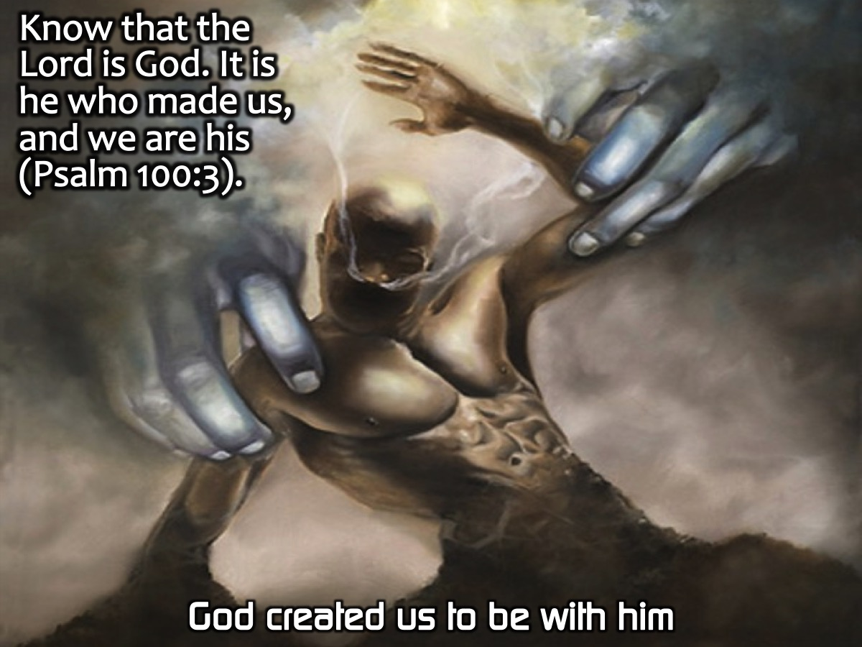
Notes:
God: Know that the Lord is God. It is he who made us, and we are his (Psalm 100:3).

Slide 61
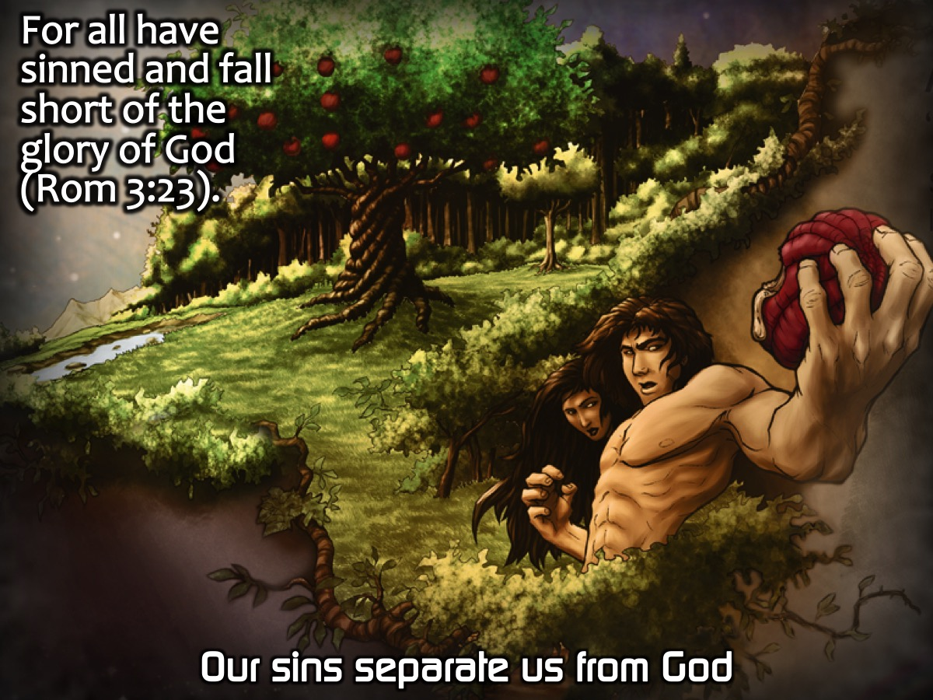
Notes:
Our: For all have sinned and fall short of the glory of God (Romans 3:23).

Slide 62
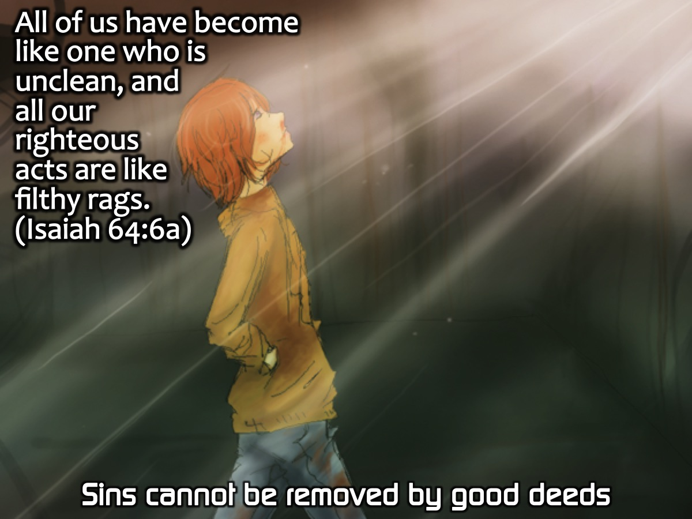
Notes:
Sins: All of us have become like one who is unclean, and all our righteous acts are like filthy rags. (Isaiah 64:6a)

Slide 63
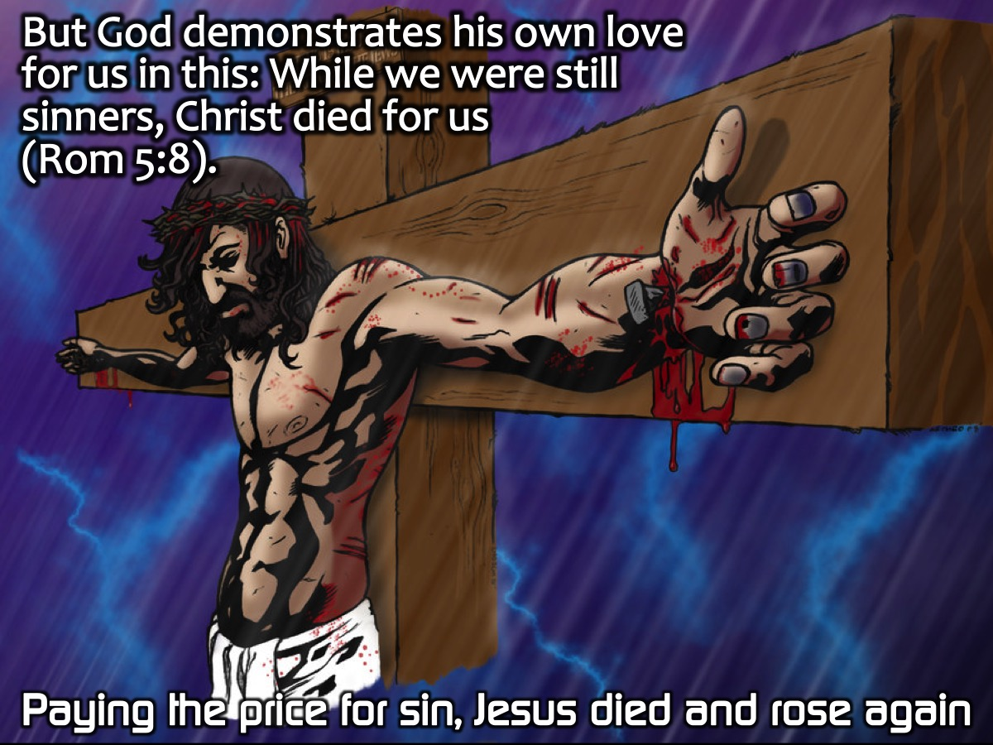
Notes:
Paying: But God demonstrates his own love for us in this: While we were still sinners, Christ died for us (Romans 5:8).

Slide 64
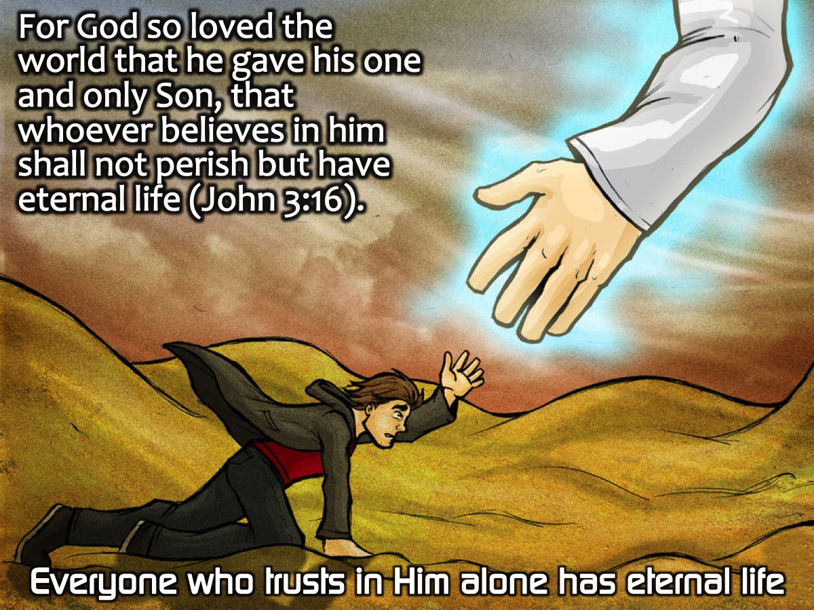
Notes:
Everyone: For God so loved the world that he gave his one and only Son, that whoever believes in him shall not perish but have eternal life (John 3:16).

Slide 65
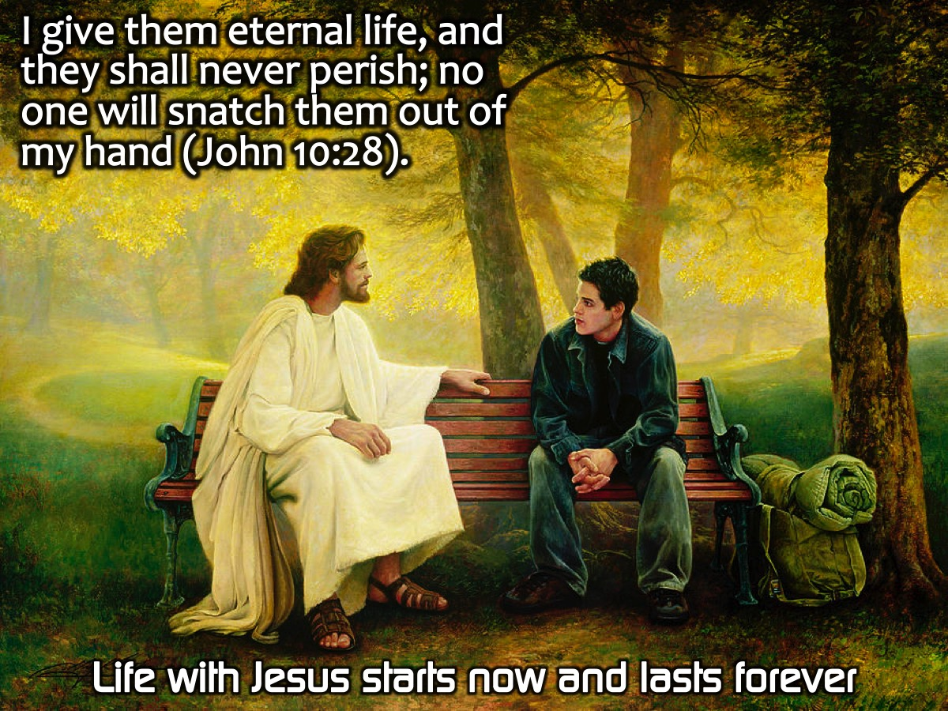
Notes:
Life: I give them eternal life, and they shall never perish; no one will snatch them out of my hand (John 10:28).

Slide 66
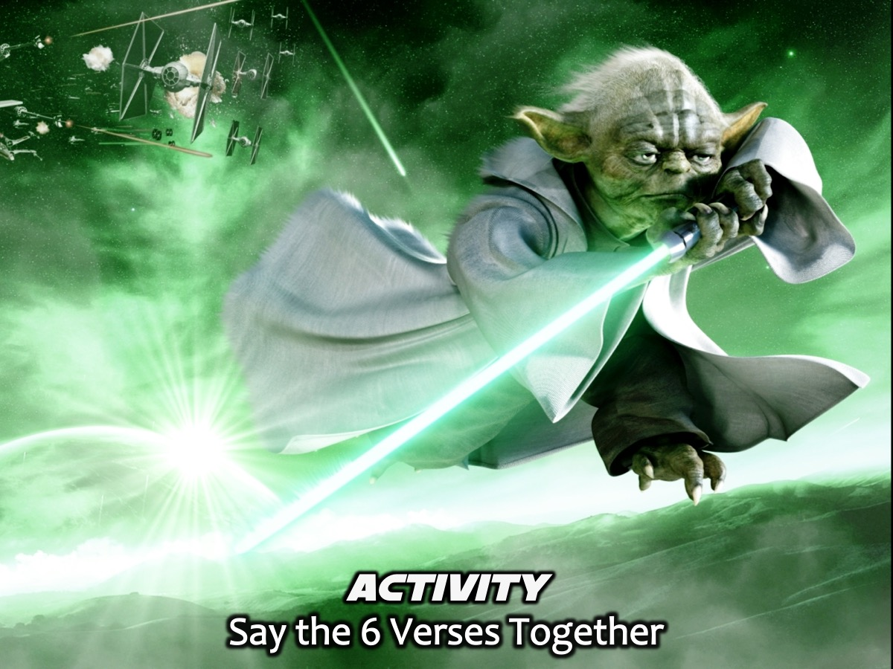
Notes:
Activity: Say the 6 Verses Together

Slide 67
Notes:
Know that the Lord is God. It is he who made us, and we are his (Psalm 100:3).

Slide 68
Notes:
For all have sinned and fall short of the glory of God (Romans 3:23).

Slide 69
Notes:
All of us have become like one who is unclean, and all our righteous acts are like filthy rags. (Isaiah 64:6a)

Slide 70
Notes:
But God demonstrates his own love for us in this: While we were still sinners, Christ died for us (Romans 5:8).

Slide 71
Notes:
For God so loved the world that he gave his one and only Son, that whoever believes in him shall not perish but have eternal life (John 3:16).

Slide 72
Notes:
I give them eternal life, and they shall never perish; no one will snatch them out of my hand (John 10:28).

Slide 73
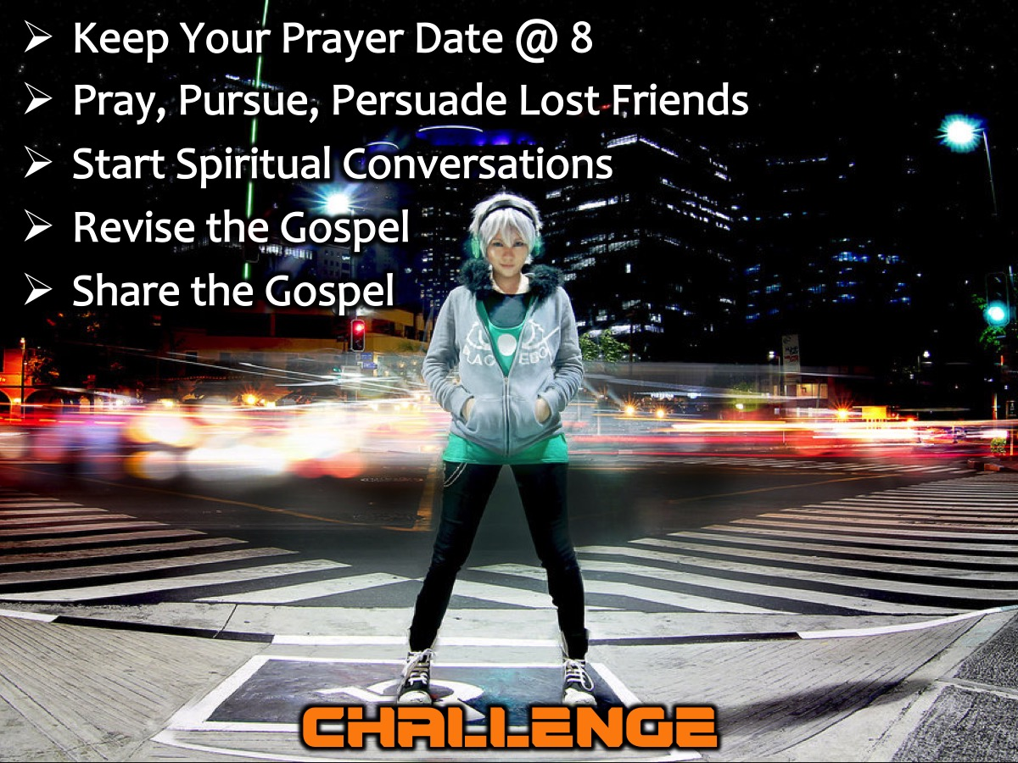
Notes:
Challenge: (1) Keep Your Prayer Date @ 8. (2) Pray, Pursue, Persuade Lost Friends. (3) Start Spiritual Conversations. (4) Revise the Gospel and (5) Share the Gospel.

Slide 74
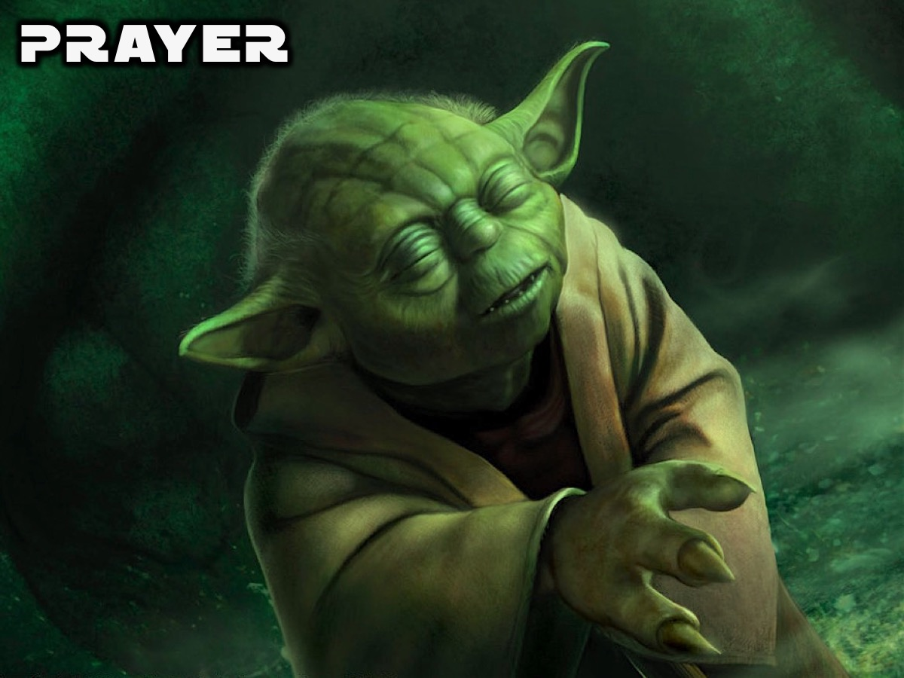
Notes:
Closing Prayer: Dear Lord, thank you for tonight, for reminding us that you created us to enjoy a close relationship with you. We realize that our sins separated us from you and that we cannot remove our sins through good deeds. We understand that Jesus died and rose again to pay for our sins and right now we put our trust in you and receive the free gift of eternal life. We are so excited about getting to start eternal life right now and know that it will never end. Amen.

Slide 75
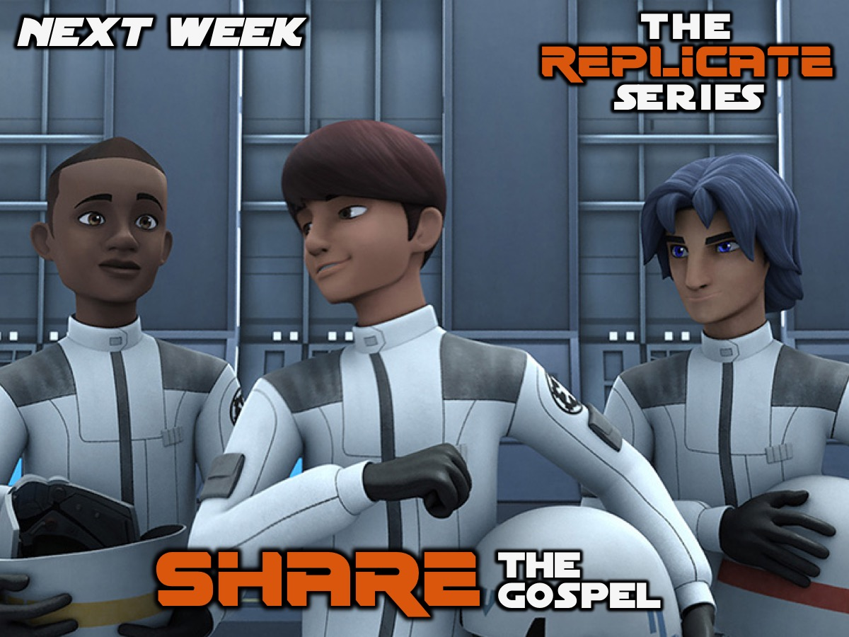
Notes:
Next week we will learn how to Share the Gospel.

