Slide 1
Notes:
Welcome to the Replicate Series. Before we dive into week 7 lets do a quick recap of what we’ve been through so far…

Slide 2
Notes:
Recap: We have been introduced to the Replicate Circle - a tool to help us lead our friends to Jesus.

Slide 3
Notes:
The first step in the Replicate Circle is to Pray with Passion for our lost friends. You guys wrote down 3 names of lost people you know. DON’T STOP PRAYING. It doesn’t say recognize our lost friends, it says pray with passion.

Slide 4
Notes:
The second step is to pursue our lost friends with Love. Take responsibility. YES, praying for them is SO important, but God has placed you. SPECIFICALLY you into those 3 peoples lives to be a light.

Slide 5
Notes:
The third step is to Persuade our lost friends with Truth.

Slide 6
Notes:
Two weeks ago we began equipping you to do this by talking out how it simply starts with beginning a conversation with a lost friend.

Slide 7
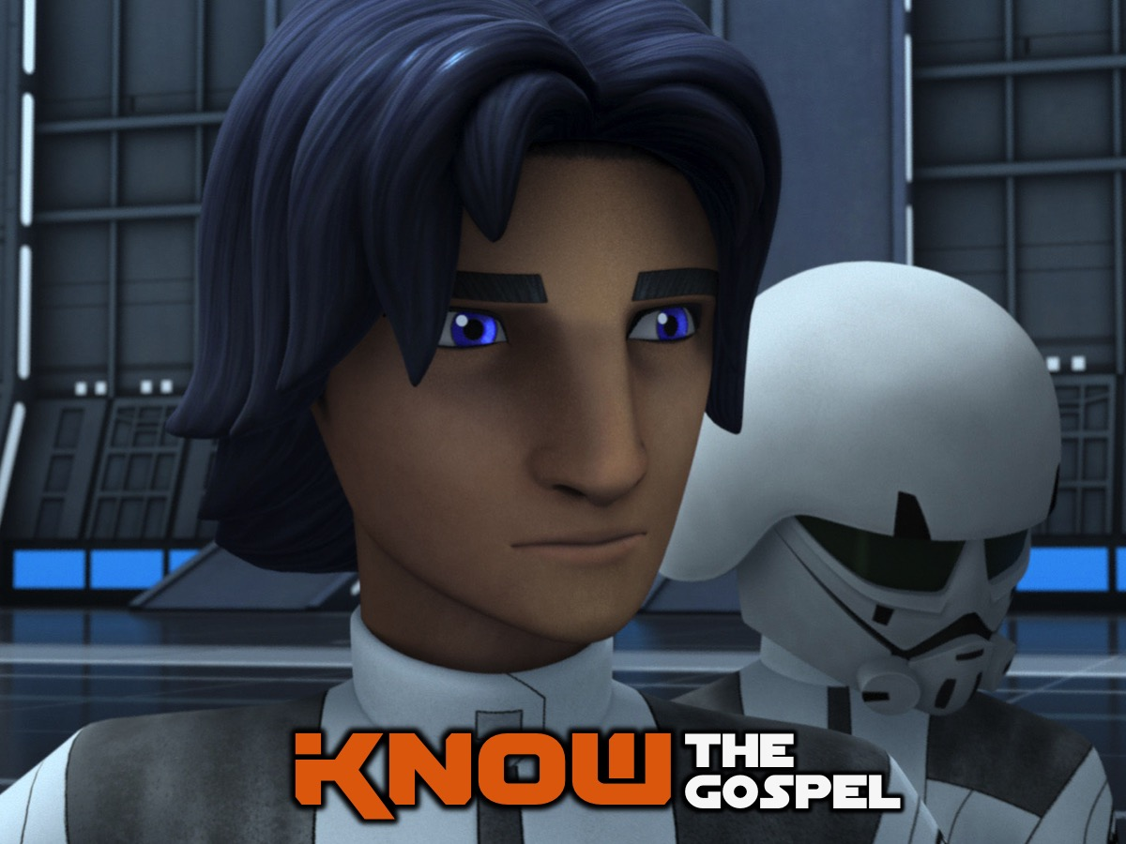
Notes:
Last week looked at what the gospel is all about so that we can really know it when we need to share it in those conversations you are having.

Slide 8
Notes:
Here are the 6 words that help us understand the Gospel - each word stands for a letter of the word GOSPEL to help you remember the words: God Our Sins Paying Everyone Life.

Slide 9
Notes:
One more time, all together: God Our Sins Paying Everyone Life. Lets break it down a little more…

Slide 10
Notes:
God: Know that the Lord is God. It is he who made us, and we are his (Psalm 100:3).

Slide 11
Notes:
Our: For all have sinned and fall short of the glory of God (Romans 3:23).

Slide 12
Notes:
Sins: All of us have become like one who is unclean, and all our righteous acts are like filthy rags. (Isaiah 64:6a)

Slide 13
Notes:
Paying: But God demonstrates his own love for us in this: While we were still sinners, Christ died for us (Romans 5:8).

Slide 14
Notes:
Everyone: For God so loved the world that he gave his one and only Son, that whoever believes in him shall not perish but have eternal life (John 3:16).

Slide 15
Notes:
Life: I give them eternal life, and they shall never perish; no one will snatch them out of my hand (John 10:28). So that is the GOSPEL. You all are going to remember it right?

Slide 16
Notes:
This week we are learning how to Share the Gospel.

Slide 17
Notes:
Here’s a promise I want you to remember as we go into sharing the Gospel: Proverbs 2:1-5 says: “My son, if you receive my words and treasure up my commandments with you, making your ear attentive to wisdom and inclining your heart to understanding; yes, if you call out for insight and raise your voice for understanding, if you seek it like silver and search for it as for hidden treasures, then you will understand the fear of the Lord and find the knowledge of God” You now know the Gospel, seek to understand it and live it out, and when the time comes for you to share it, God will bless you for that and give you the words to say.

Slide 18
Notes:
So first things first, before sharing the Gospel you have to believe it for yourself as the absolute Truth. Even though you know God, you need to know the Gospel so you are prepared at all times when the opportunity arises for you to have that conversation. When you are passionate about something and love something you want to tell everybody about it right? If you are a follower of Christ, you’ve experienced God in your own unique way and therefore you are equipped with the experience and you are now equipped with the knowledge to share the Gospel.

Slide 19
Notes:
ILLUSTRATION: Call up two volunteers and blindfold one of them and give them each a chocolate. Have them eat the chocolate. Ask the volunteers to explain what they have just eaten (Blind folded volunteer first and then the other). Share that it is much easier to tell people about something that we’ve experienced, AND tasted AND seen.

Slide 20
Notes:
Psalm 34:8 says “Taste and see that the Lord is good, blessed is the one who takes refuge in him”. It’s hard to explain something to somebody when you haven’t experienced it for yourself, or learned about it yourself. But you guys have, you’re equipped. Sharing the Gospel, is sharing a story. Its sharing your story, and Gods story.

Slide 21
Notes:
If you’re anything like me, witnessing comes super-easily. It seems I can just turn every conversation I have back to the foundations of the gospel, have people laughing, nodding their head in agreement, crying, and saying, “Amen!” within just a few minutes. I quote a verse, and people cry out, “Please, more truth!” I sing worship songs while walking down the sidewalk, and people never look at me like I’m a freak … They actually do the opposite and begin singing along, raising their hands in worship. I just have to encourage them not to close their eyes while they’re walking! I always have the perfect word to say, the perfect prayer to pray, the perfect timing, and the perfect closing. Don’t you?

Slide 22
Notes:
No?! Yeah, me neither. To me, witnessing is tough. It often feels awkward, forced, and unnatural. I never seem to have the right timing. And trying to perfectly remember each point about the gospel, combined with the fact that I’m nervous – that I feel like the other person hates me for bringing it up, that I feel inadequate to share, that I feel like I have no idea what I’m talking about Confession guys, I miss a whole lot of opportunities that the Lord gives me to share the Gospel, because I’m afraid And I have a feeling, I’m not the only one who feels like this.

Slide 23
Notes:
Reflect: In past weeks we have talked about some of the reasons that we are afraid to evangelize. Shout some of them out! Consider that some of our assumptions about sharing our faith are false. Nowhere does Scripture say that we have to have all the answers to every question people may raise. And the Bible does not tell us to share the gospel exactly the same way as others do it. Jesus’ disciples did not all share the gospel the exact same way. Even Jesus did not have just one method of sharing the gospel. When it comes to evangelism, let me offer you three steps to think through:

Slide 24
Notes:
1. Follow Christ. In Matthew 22 Jesus teaches that greatest commandment is to love God with all your heart soul and mind. That’s what He calls each of us to do. You, living the life God has called you to live and being the person God has uniquely gifted you to be – that’s a great testimony to God. Each of us are a walking billboard for the goodness of God and a testimony that God can redeem, and set straight a person’s life. You don’t have to be perfect. Nobody expects you to be flawless. (Gasp!). You don’t have to have a perfect testimony, but you do have to follow a perfect Savior. That’s essential!

Slide 25
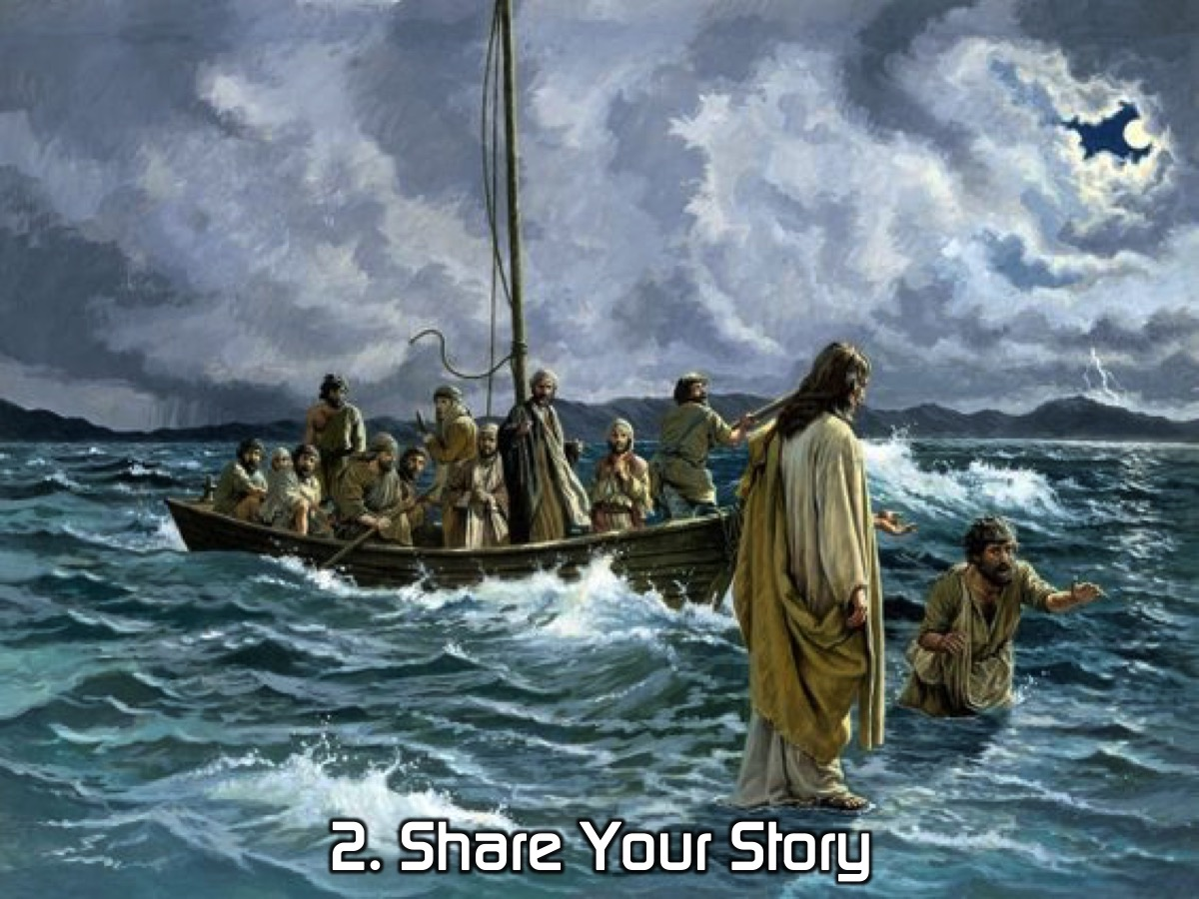
Notes:
2. Share Your Story. Who loves a good story? Your story is compelling. Riveting. Life-changing. Many times throughout the Gospels when Jesus heals somebody or does something miraculous and life changing, he tells the person “Go home and declare what the Lord has done for you” Your story is POWERFUL. Sharing your faith involves sharing your story. Be honest, transparent, and vulnerable. People will connect with your brokenness more quickly and fully than they ever will your “awesomeness.”

Slide 26
Notes:
3. Invite Other People Into God’s Story. Following the greatest commandment in Matthew 22, God says the second greatest commandment is to love our neighbor as ourselves. Genuinely love people. Invest in them. Be their friend. Listen to their stories. Value them as God’s creation. Look for ways to serve them, expecting nothing in return. In doing this, you’re inviting them into the story that God’s writing through you.

Slide 27
Notes:
I got these three points from the life of Jesus. Lets flip to a story in John 4:1-26 and look at a specific example from Jesus. As I read this really pay attention to how Jesus approached the woman, and how he embodied all of these things we have talked about.

Slide 28
Notes:
The Woman At The Well. From Jesus’ encounter with this woman we can learn how to share the gospel with others: (1) Take the initiative. He stepped across several barriers and took the initiative to engage this woman and share the gospel with her. He is speaking to a woman: It was a cultural norm for men not to address women in public if they were not related to them. He is speaking to a Samaritan and it was unheard of for a Jew to converse with Samaritans- let alone a Rabbi. He is speaking to an “adulteress:” the women of the village would come to get water in the morning or evening, but because she was a social outcast she was getting water at noon. Despite all of these things Jesus asks her for help – give me a drink. He is reaching out to her and expressing acceptance which gets her attention. We must step out of our selfishness and engage people. (2) Engage in dialogue. Jesus engaged in dialogue with her- the conversation went back and forth and he listened to her. People love to be listened too and taking a genuine interest in them is evidence of love, acceptance and a platform to share the gospel. A relational approach to sharing the gospel helps to facilitate viewing evangelism as more of a process than an event. Invest in relationships through love, prayer, service and sharing the gospel, genuine love and concern, even if there is no interest in the gospel, honors people and builds a platform from which they may be more open to Jesus Christ. (3) Point people to what Jesus Christ alone can do for us. Jesus pointed her to what he alone could do for her – give her living water. He simply told a story.

Slide 29
Notes:
When it all comes down to it: Sharing the GOSPEL takes time but it also takes initiative. We must be seeking to grow ourselves, and also seeking to engage in conversation

Slide 30
Notes:
Don’t let anyone look down on you because you are young, but set an example for the believers in speech, in conduct, in love, in faith and in purity. Until I come, devote yourself to the public reading of Scripture, to preaching and to teaching. (1 Timothy 4:12-13). It is important to preach and teach and share the gospel by example.

Slide 31
Notes:
By looking at the life of Jesus and all these points, here is how we can sum up sharing the Gospel:

Slide 32
Notes:
1. Follow Christ and Live the Gospel. It really is that simple!

Slide 33
Notes:
2. Build Real Relationships. People don’t care how much you know until they know how much you care.

Slide 34
Notes:
3. Share Your Story. Your personal experience is a really powerful tool in replicating your life.

Slide 35
Notes:
4. Ask, Admire, Admit. At the well, Jesus asks the woman for help – give me a drink. He is reaching out to her and expressing acceptance which gets her attention. Do you know that Jesus asked about 300 questions throughout the Gospels? He asked questions, listened deeply. Ask questions that get them talking and you listening. And, finally, admit that the reason you are a Christian is that you are a sinner in desperate need of the gospel. Just like Paul admitted that he was "the chief of sinners" we can do the same.

Slide 36
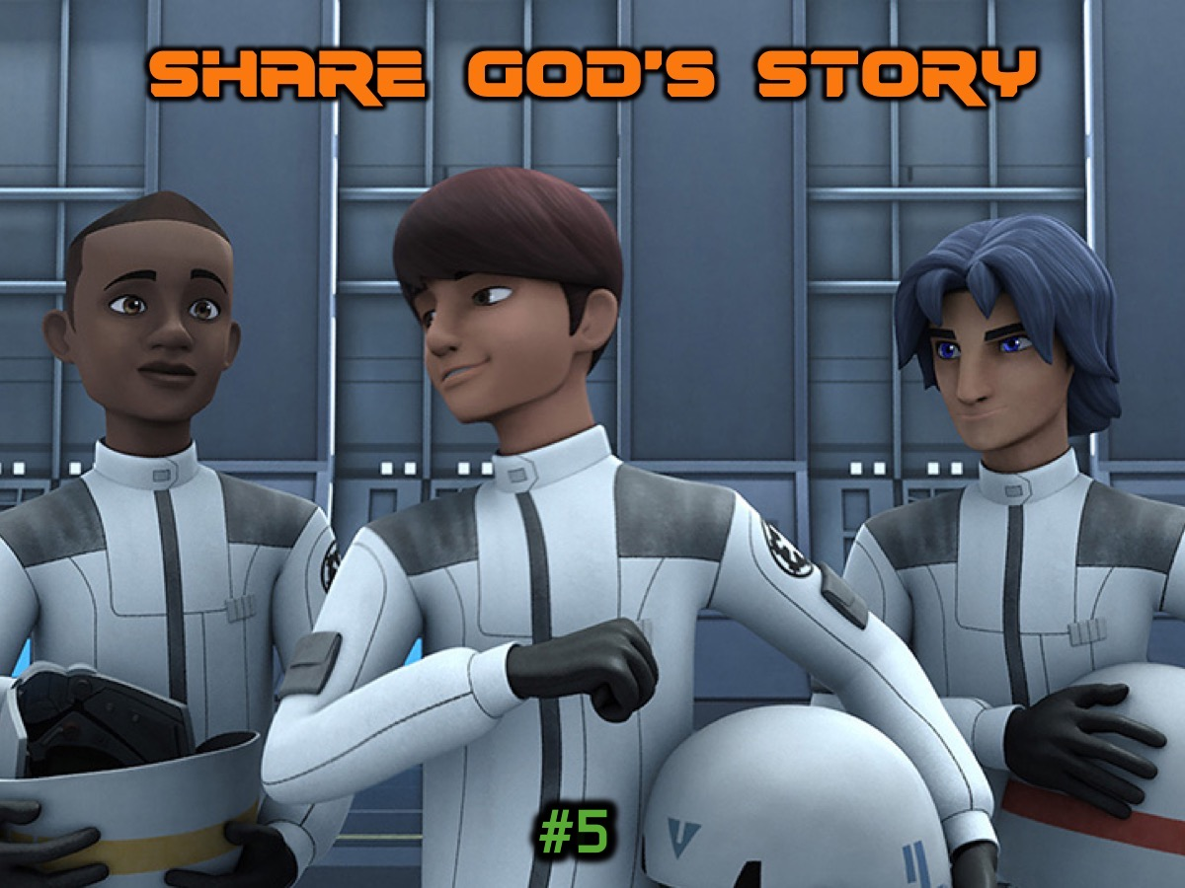
Notes:
5. Share God’s Story. The GOSPEL that we have learned, gives you a guide (not a script) to share.

Slide 37
Notes:
PRACTISE: (5 minutes prep 10 minute sharing: 15 total). Each group has a different scenario and they have to describe how they would go about sharing the Gospel with their allocated audience:
- I am your best friend
- I am your mom
- I am a stranger
- I am an outcast at school
- I am an atheist
- I am a classmate
Each group will share their method with the big group.

Slide 38
Notes:
Challenge: (1) Keep Your Prayer Date @ 8. (2) Pray, Pursue, Persuade Lost Friends. (3) Start Spiritual Conversations. (4) Know the Gospel and (5) Share the Gospel.

Slide 39
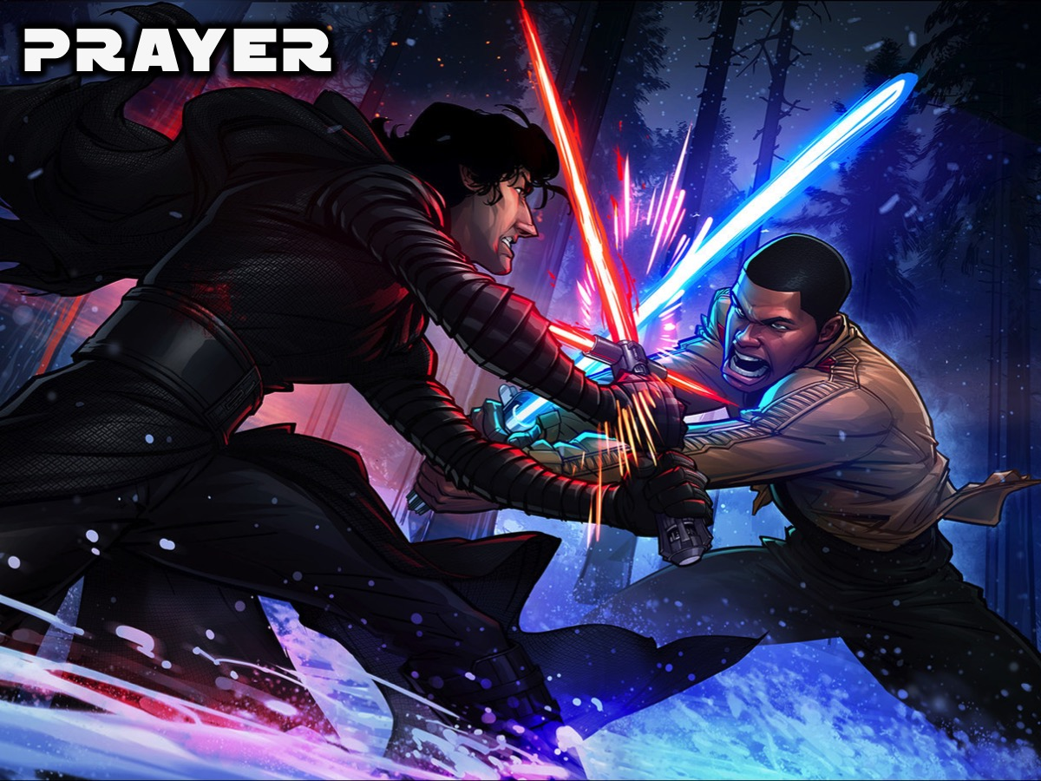
Notes:
Closing Prayer: Dear Lord, thank you for tonight, for reminding us that you created us to enjoy a close relationship with you. We realize that our sins separated us from you and that we cannot remove our sins through good deeds. We understand that Jesus died and rose again to pay for our sins and right now we put our trust in you and receive the free gift of eternal life. We are so excited about getting to start eternal life right now and know that it will never end. Amen.

Slide 40
Notes:
Next week in week 8 of the Replicate Series deal with what to do when someone is ready to accept the Gospel or if they are not ready.

