Slide 1

Notes:
Welcome to the Replicate Series. Before we dive into Week 8 lets do a quick recap of what we’ve been through so far…

Slide 2
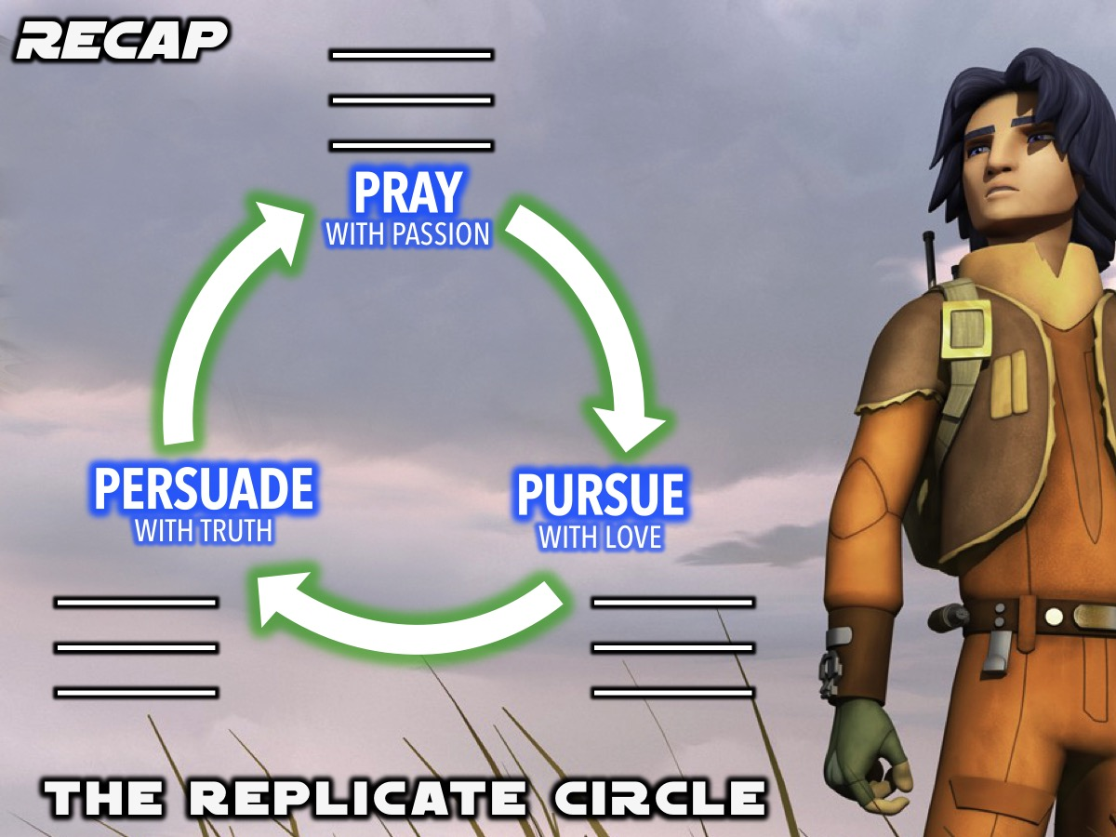
Notes:
We have been introduced to the Replicate Circle - a tool to help us lead our friends to Jesus.

Slide 3

Notes:
The first step in the Replicate Circle is to Pray with Passion for our lost friends. You guys wrote down 3 names of lost people you know. DON’T STOP PRAYING. It doesn’t say recognize our lost friends, it says pray with passion.

Slide 4

Notes:
The second step is to pursue our lost friends with Love. Take responsibility. YES, praying for them is SO important, but God has placed you into their lives to be a light.

Slide 5

Notes:
The third step is to Persuade our lost friends with Truth. There comes a time when we need to actually share the Gospel with our lost friends.

Slide 6

Notes:
We began equipping you to do this by talking out how it simply starts with beginning a conversation with a lost friend.

Slide 7
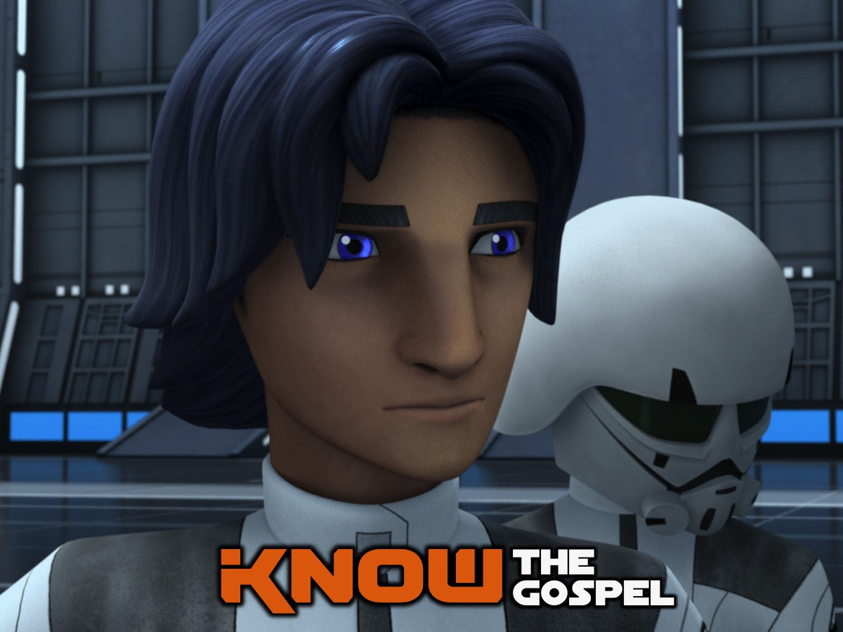
Notes:
We looked at what the gospel is all about so that we can really know it when we need to share it in those conversations you are having.

Slide 8
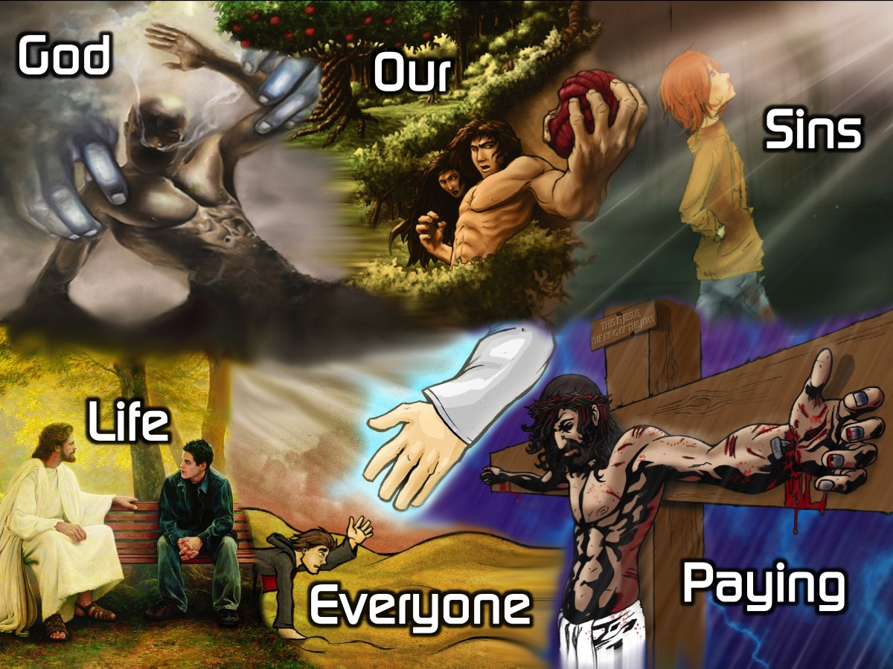
Notes:
Let’s say the six words together: God Our Sins Paying Everyone Life. Lets break it down a little more…

Slide 9
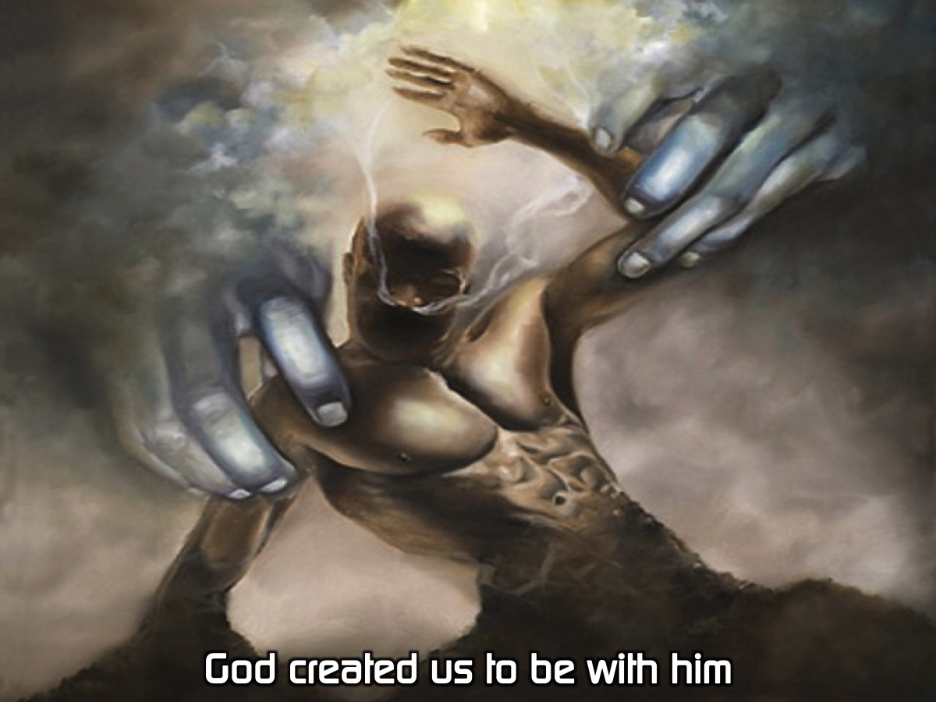
Notes:
Let’s say the 6 sentences together: God created us to be with him.

Slide 10
Notes:
Our sins separate us from God.

Slide 11
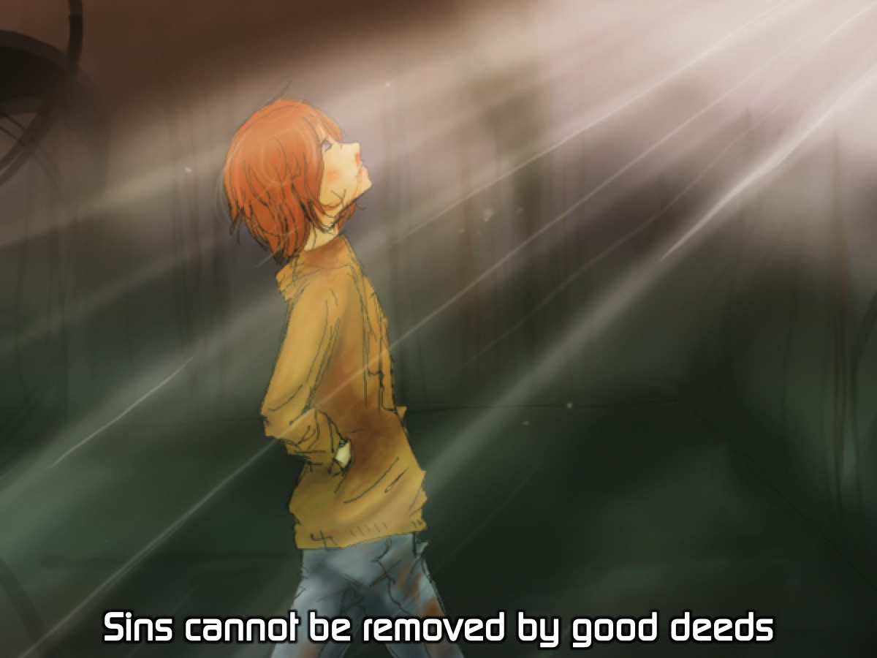
Notes:
Sins cannot be removed by good deeds.

Slide 12
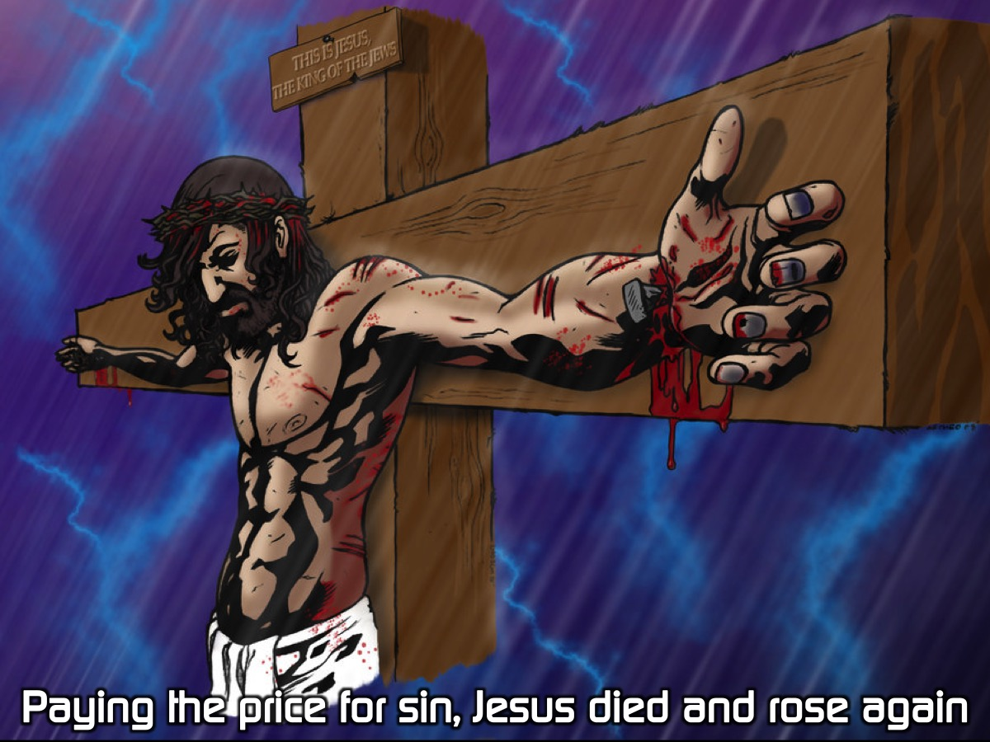
Notes:
Paying the price for sin, Jesus died and rose again.

Slide 13
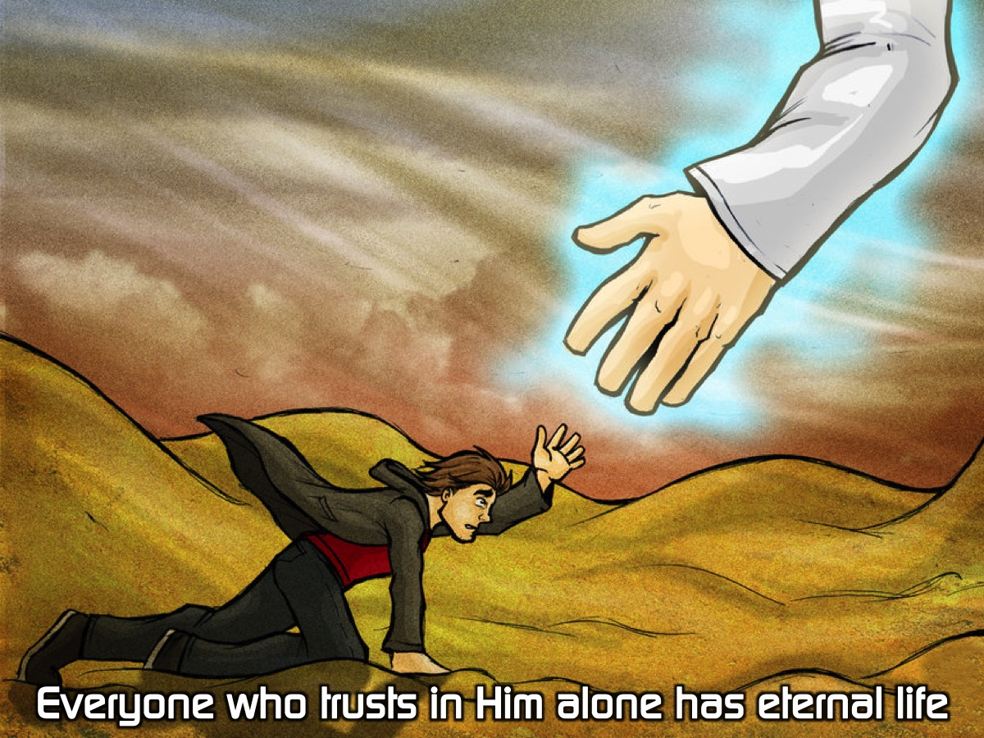
Notes:
Everyone who trusts in Him alone has eternal life.

Slide 14
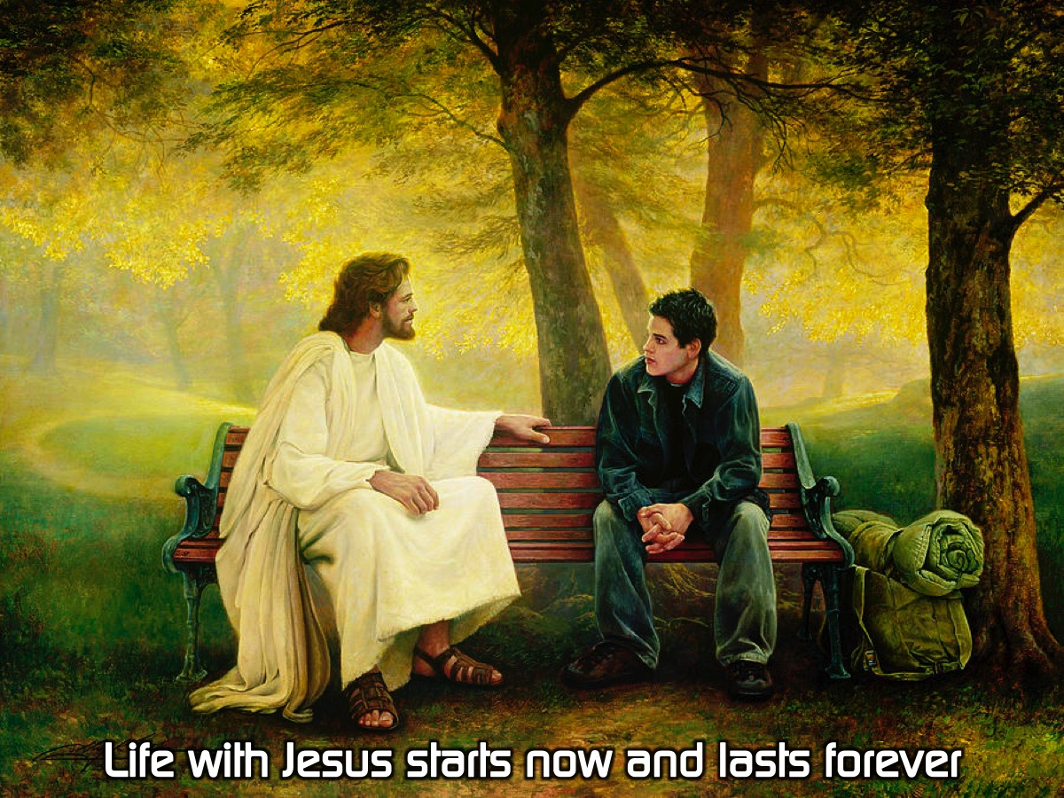
Notes:
Life with Jesus starts now and lasts forever.

Slide 15

Notes:
Last week we learnt how to actually share the gospel.

Slide 16
Notes:
Video: Young Austin’s tstimony of sharing his faith with his friend. Download it with this link: http://ymresourcer.com/Austin_Testimony.mp4

Slide 17

Notes:
Sharing: If your shared the G.O.S.P.E.L. with a friend and they asked if you could help them become a follower of Jesus - what would you say?

Slide 18

Notes:
This week we are going to look at what to do once we have shared the gospel with someone.

Slide 19
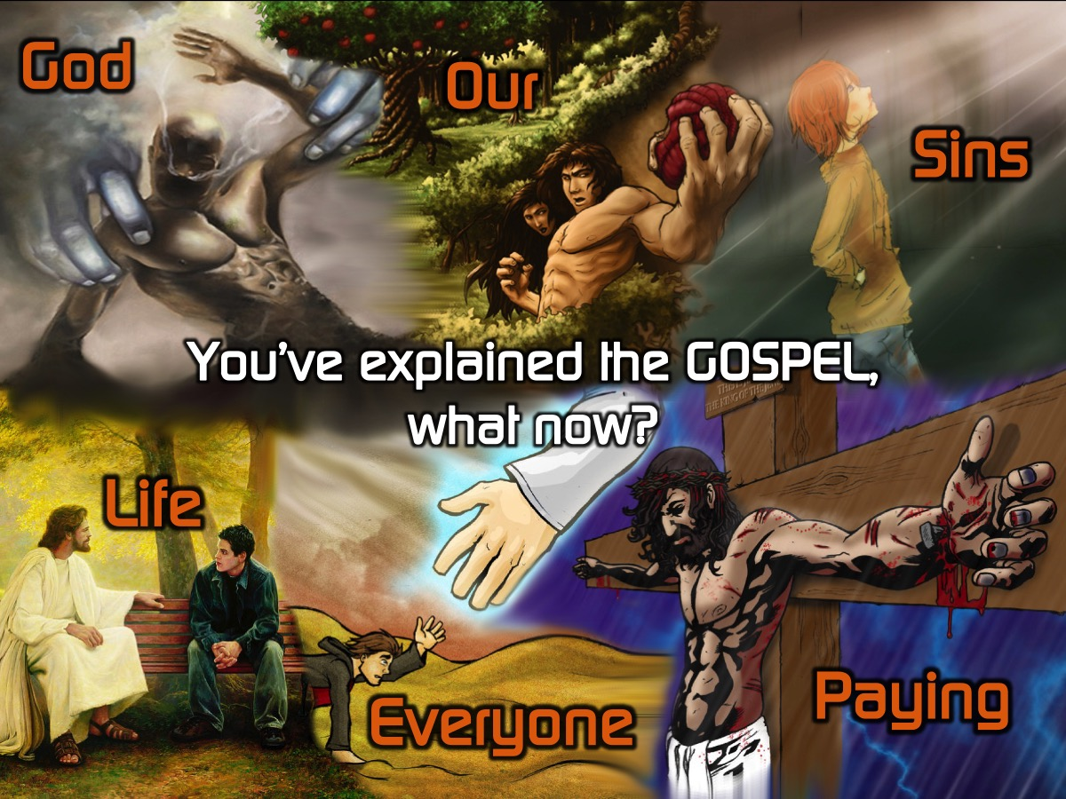
Notes:
So you have explained the gospel, what now?

Slide 20
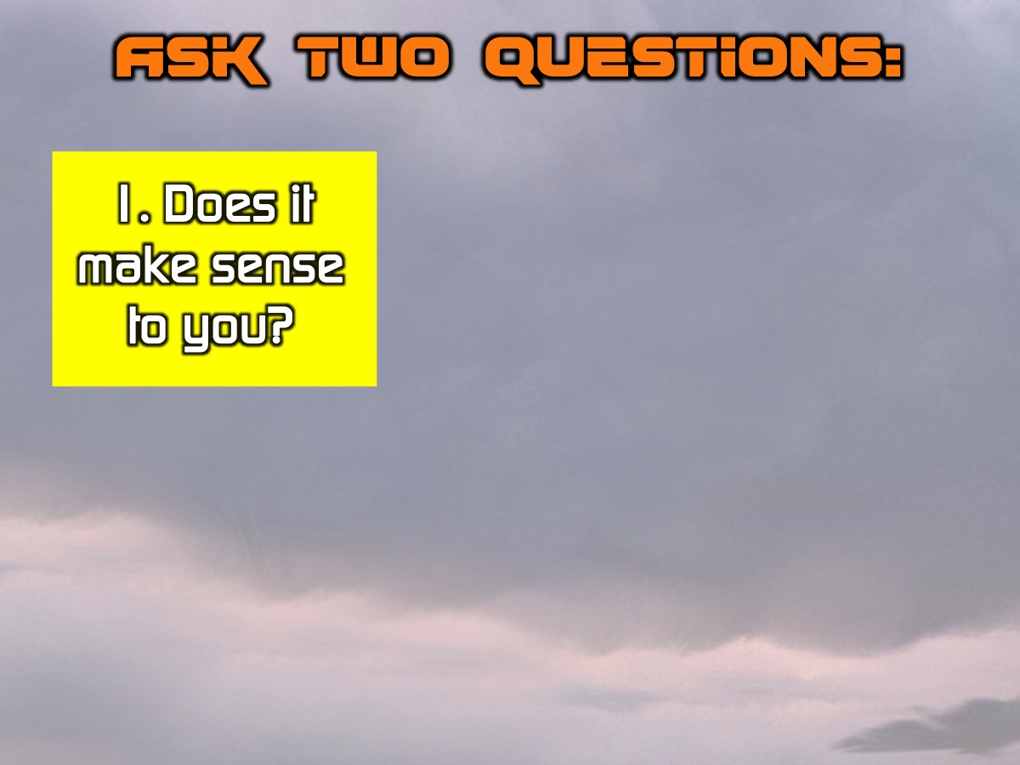
Notes:
Ask 2 Questions: The first question is: (1) Does this make sense? You want to check to see whether the GOSPEL makes sense to them.

Slide 21
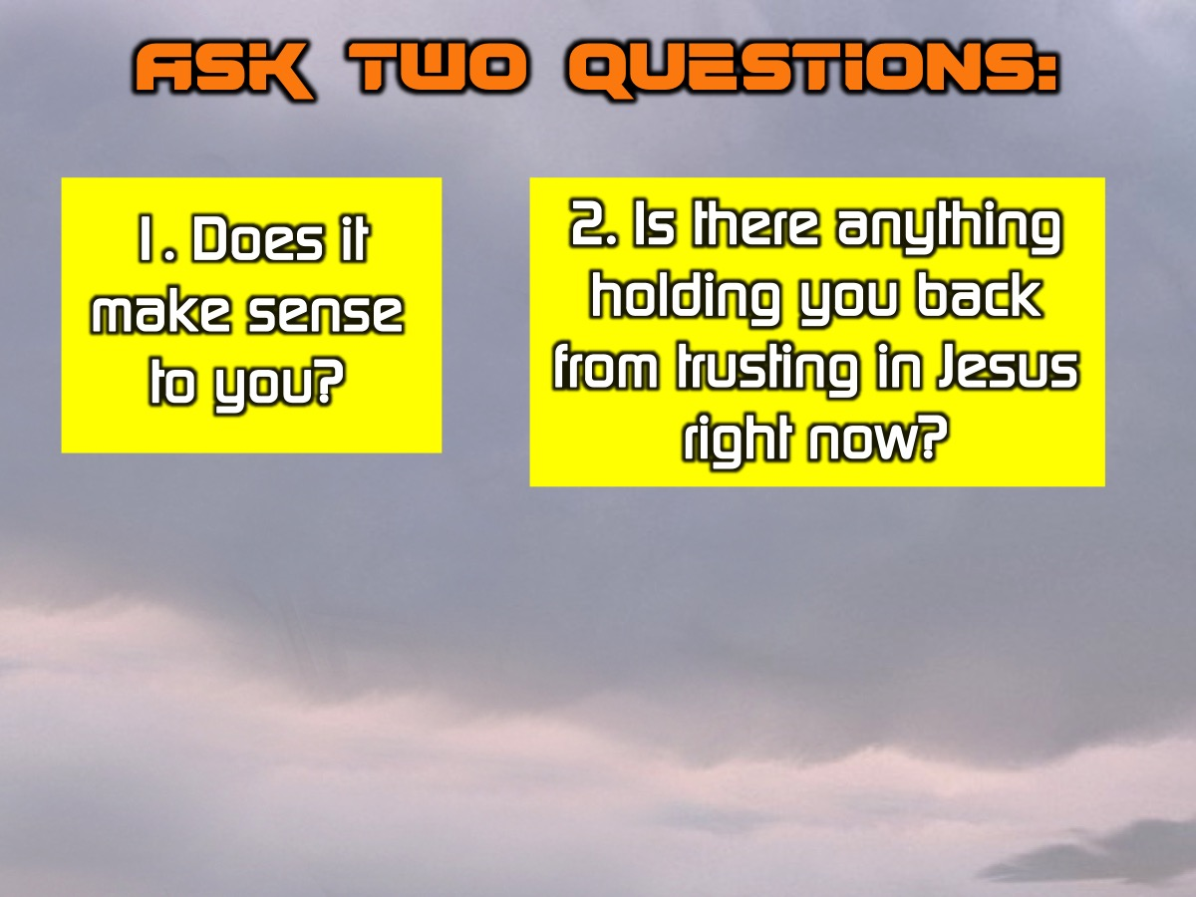
Notes:
The second question to ask is: (2) Is there anything holding you back from trusting in Jesus right now?

Slide 22
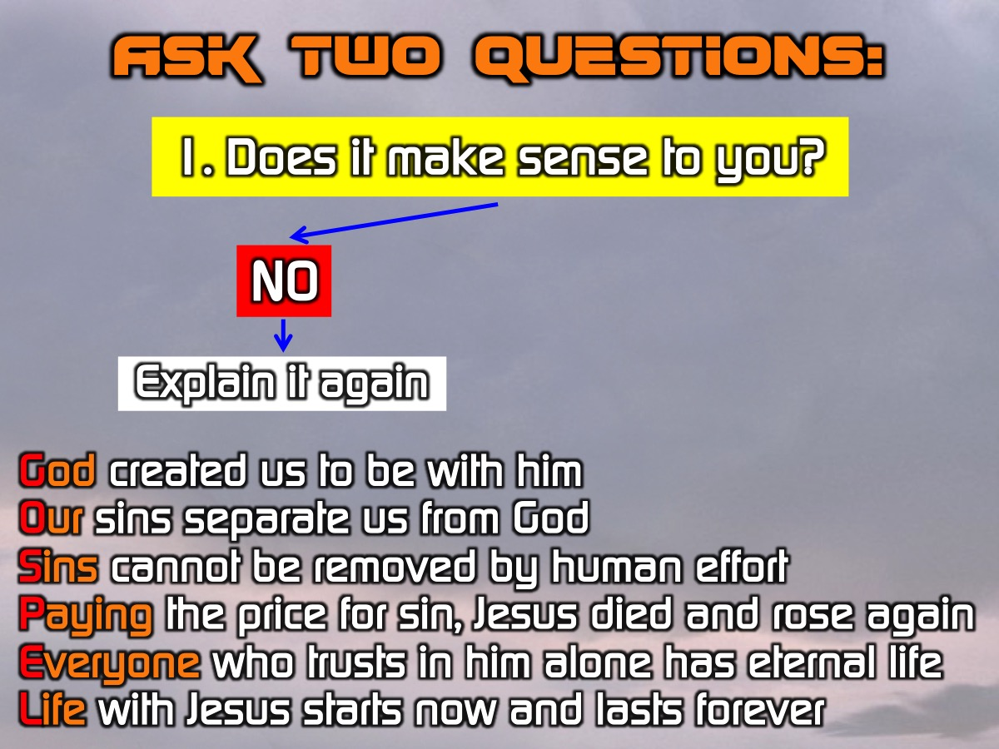
Notes:
So you ask the first question: “Does this make sense to you?” and if they say, “No” then you explain it again.

Slide 23
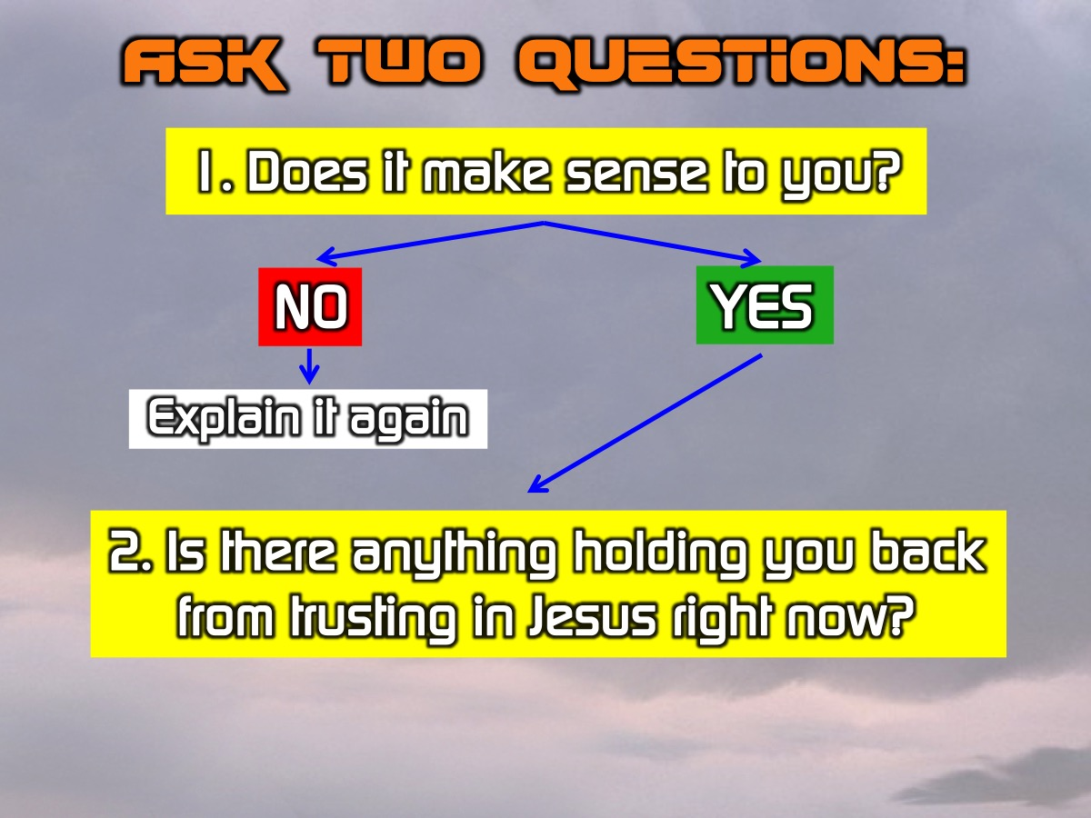
Notes:
If they say, “Yes”, move on to the next question: “Is there anything holding you back from trusting in Jesus right now?”

Slide 24
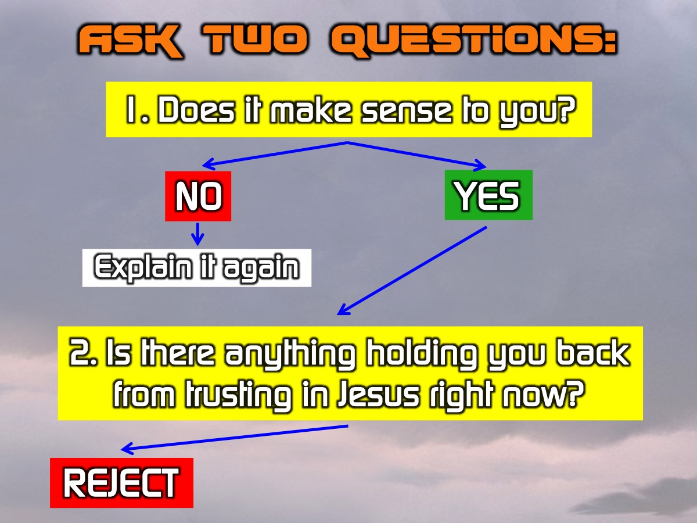
Notes:
From here the conversation can go in one of three different ways: They could Reject the message (or you)

Slide 25
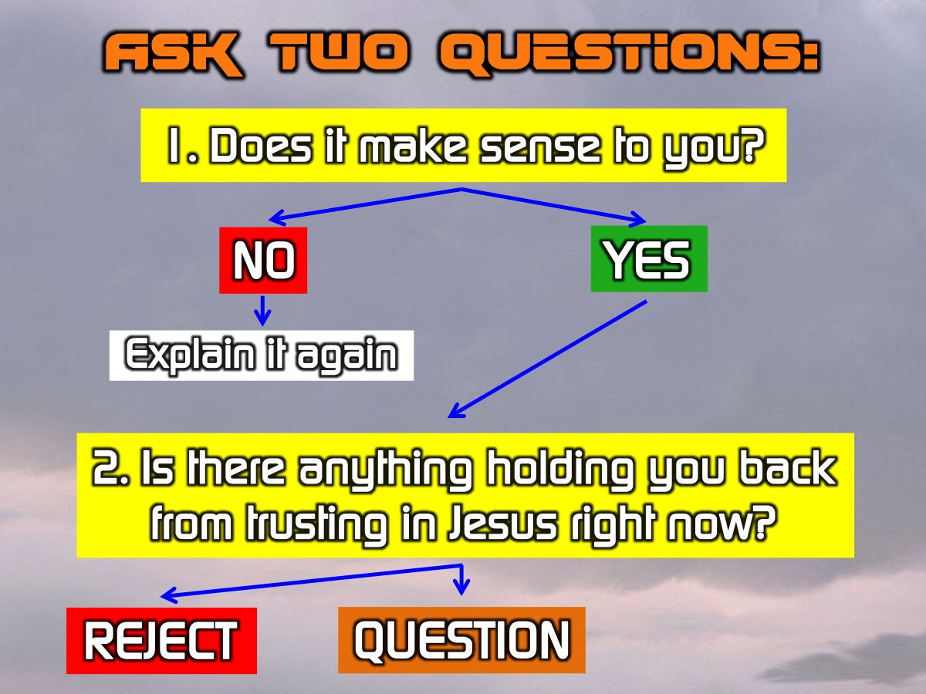
Notes:
They might Question the message and need more information.

Slide 26
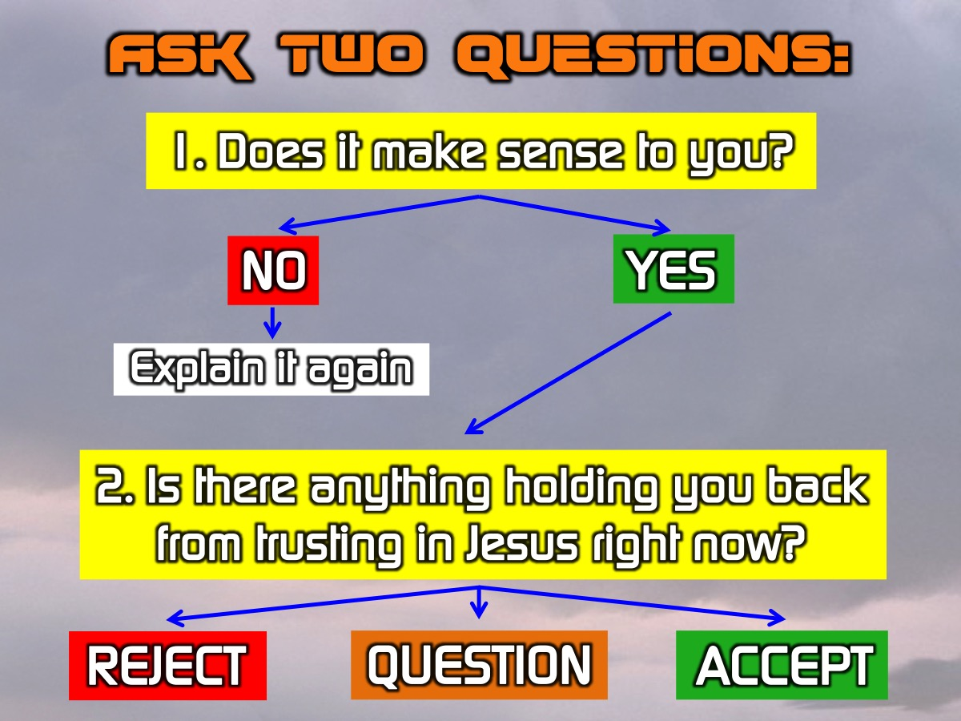
Notes:
Or they may be ready to Accept the message.

Slide 27
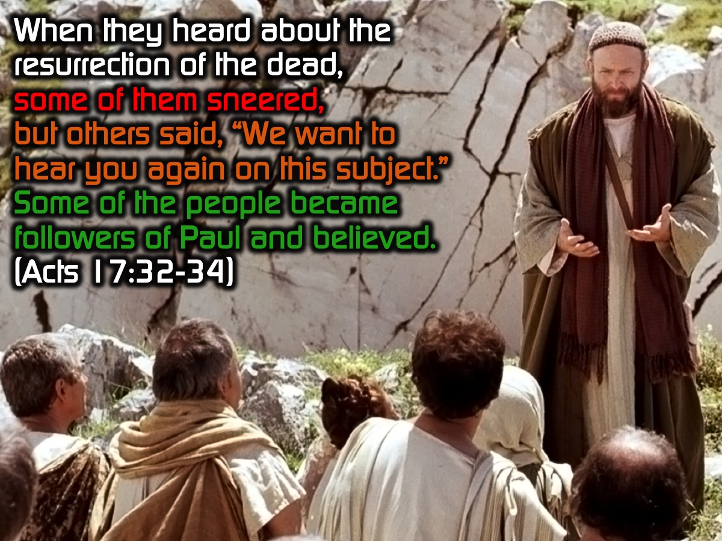
Notes:
We see these three responses in the book of Acts after Paul had preached: “When they heard about the resurrection of the dead, some of them sneered, but others said, “We want to hear you again on this subject.” Some of the people became followers of Paul and believed.” (Acts 17:32-34)

Slide 28

Notes:
1. Some will reject the gospel and mock you (so be Strong) (Acts 17:32).

Slide 29
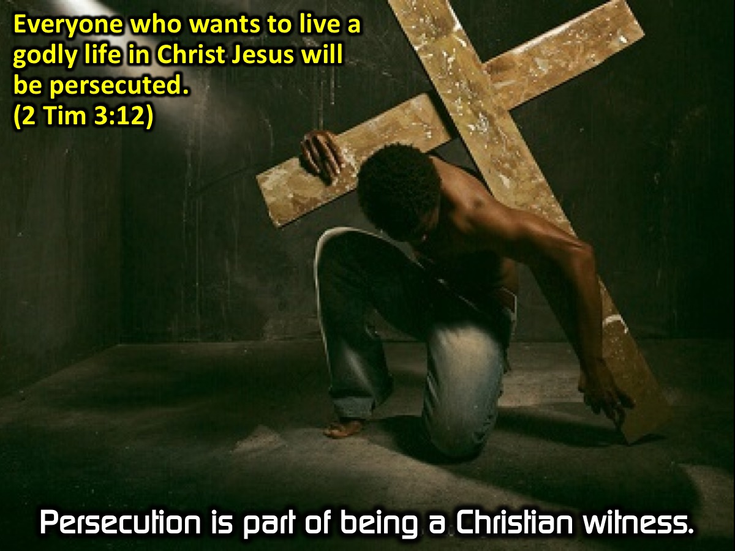
Notes:
(a) Remember that persecution is part of being a Christian witness. “Everyone who wants to live a godly life in Christ Jesus will be persecuted.” (2 Timothy 3:12)

Slide 30
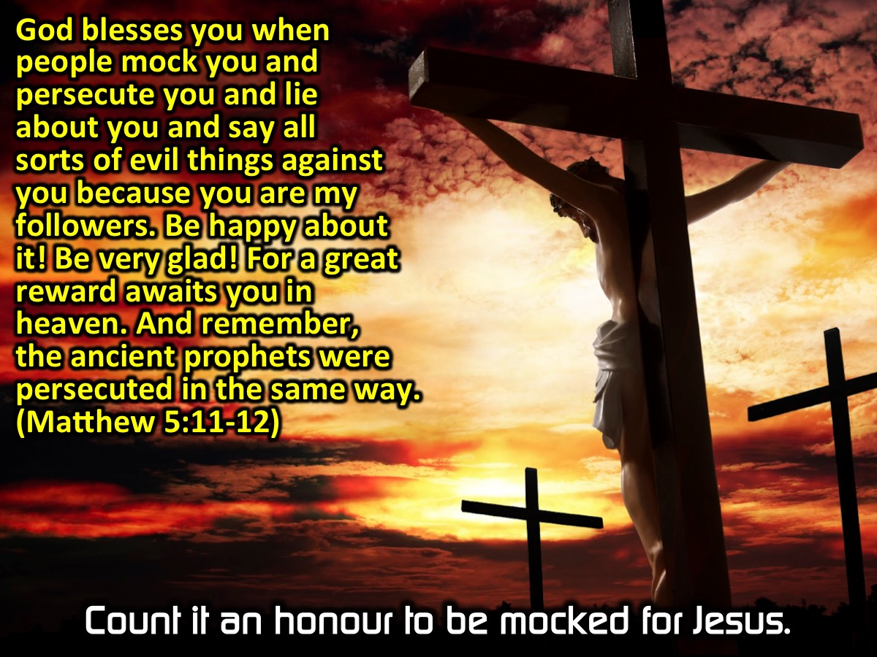
Notes:
(b) Count it an honour to be mocked or marginalized for Jesus. “God blesses you when people mock you and persecute you and lie about you and say all sorts of evil things against you because you are my followers. Be happy about it! Be very glad! For a great reward awaits you in heaven. And remember, the ancient prophets were persecuted in the same way. (Matthew 5:11-12)

Slide 31
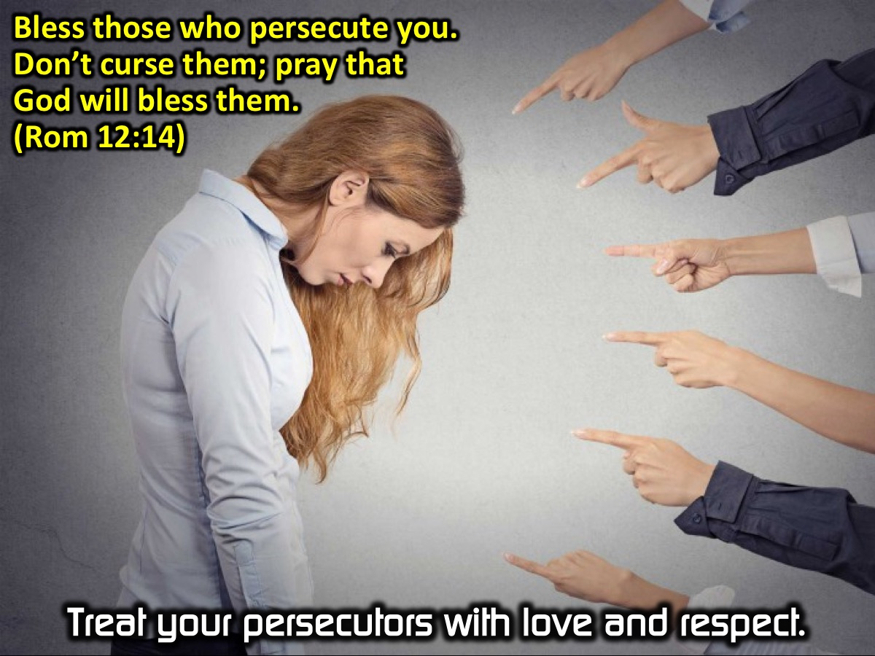
Notes:
(c) Treat your persecutors with love and respect. “Bless those who persecute you. Don’t curse them; pray that God will bless them. (Romans 12:14).

Slide 32
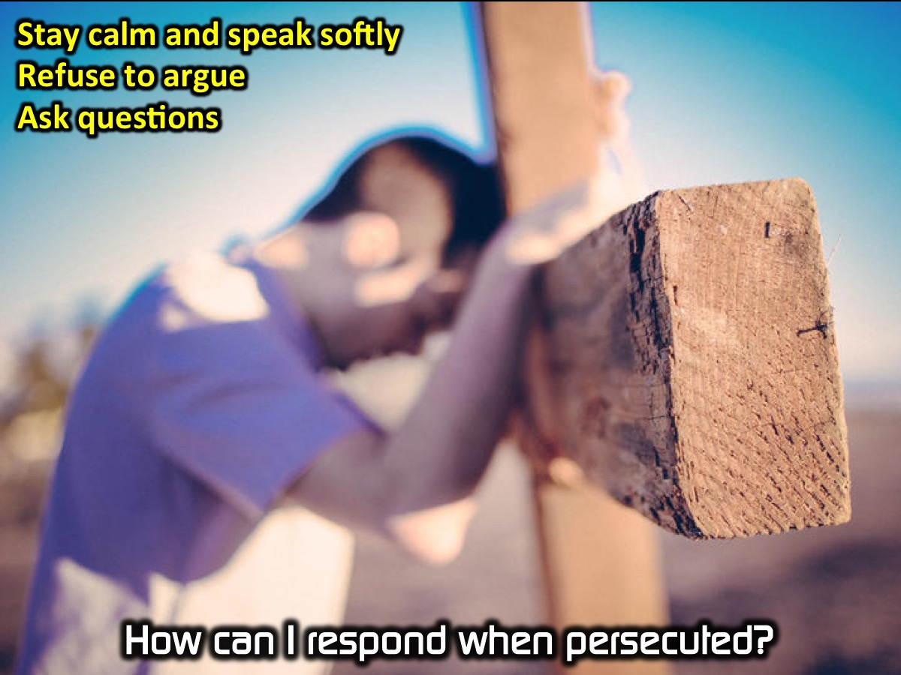
Notes:
Here are some guidelines on how to respond when persecuted: (1) Stay calm and speak softly (Proverbs 15:1), (2) Refuse to argue (2 Timothy 2:24), (3) Ask questions that make them think (Mark 12:13-17).

Slide 33

Notes:
2. Some will be intrigued and want to find our more (so be Sharp!).

Slide 34
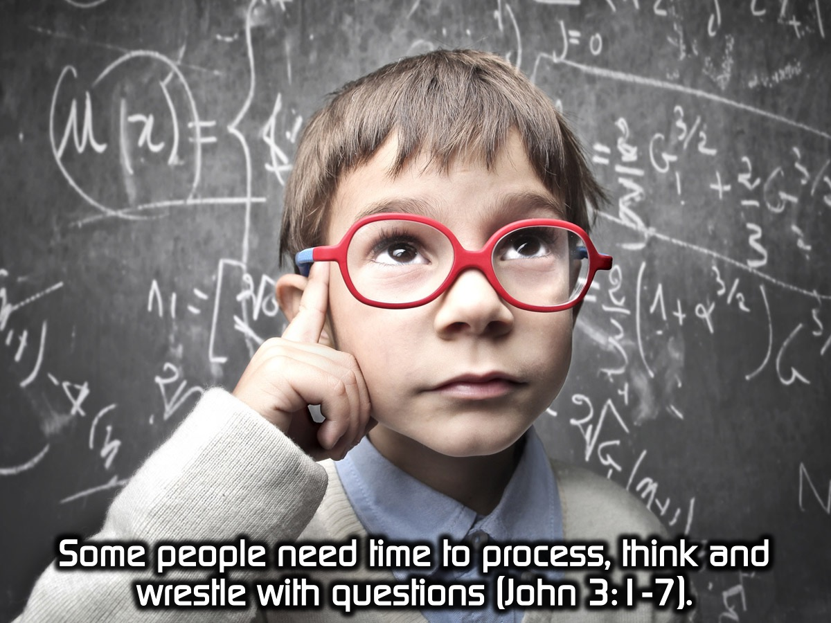
Notes:
(a) Some people need time to process, think and wrestle with questions (John 3:1-7).

Slide 35
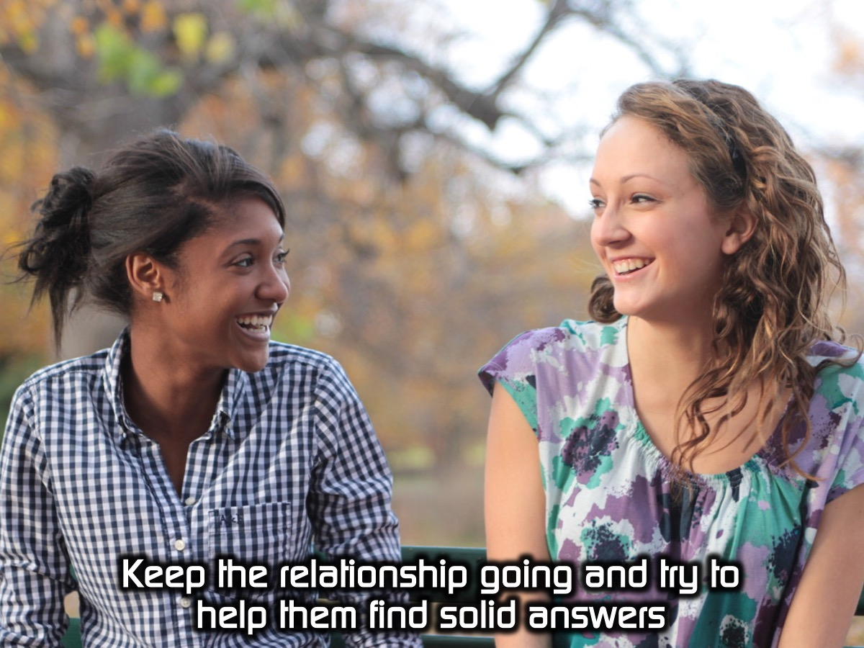
Notes:
(b) Keep the relationship going and try to help them find solid answers

Slide 36
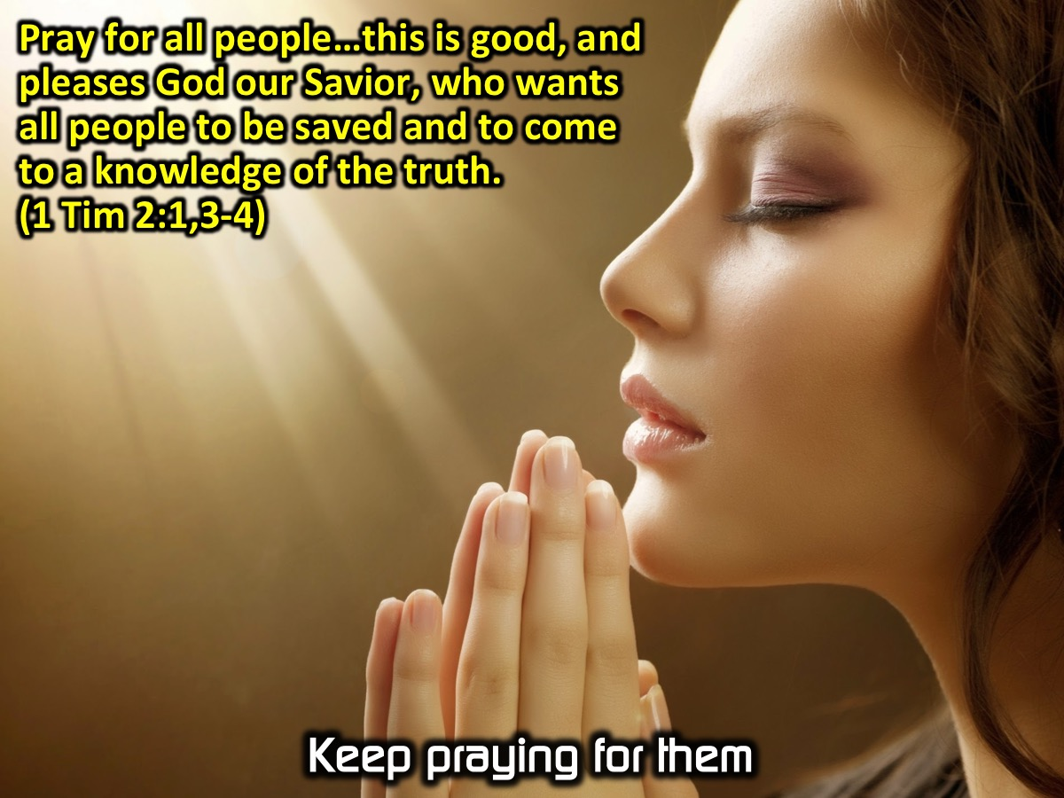
Notes:
(c) Keep praying for them. “Pray for all people…this is good, and pleases God our Savior, who wants all people to be saved and to come to a knowledge of the truth.” (1 Timothy 2:1,3-4)

Slide 37
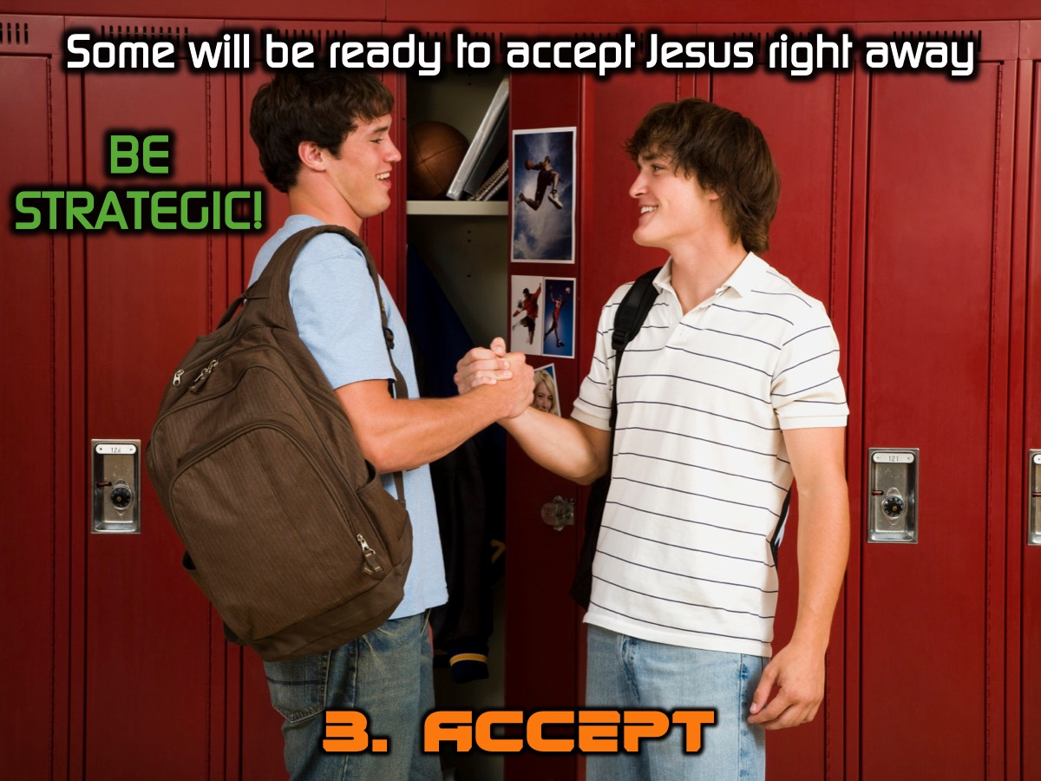
Notes:
3. Some will be ready to accept Jesus right away (so be Strategic!).

Slide 38
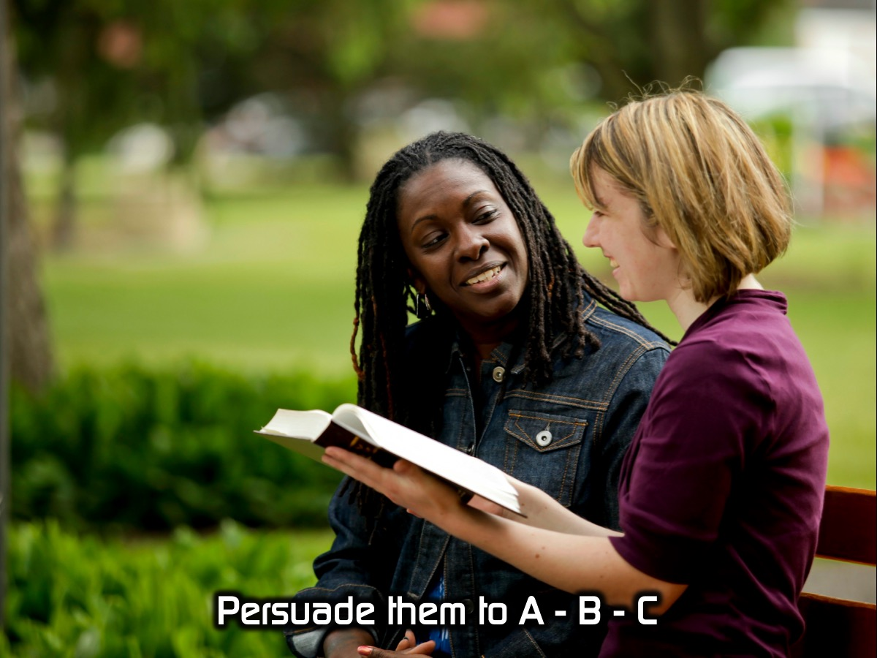
Notes:
Persuade them to A, B, C:

Slide 39
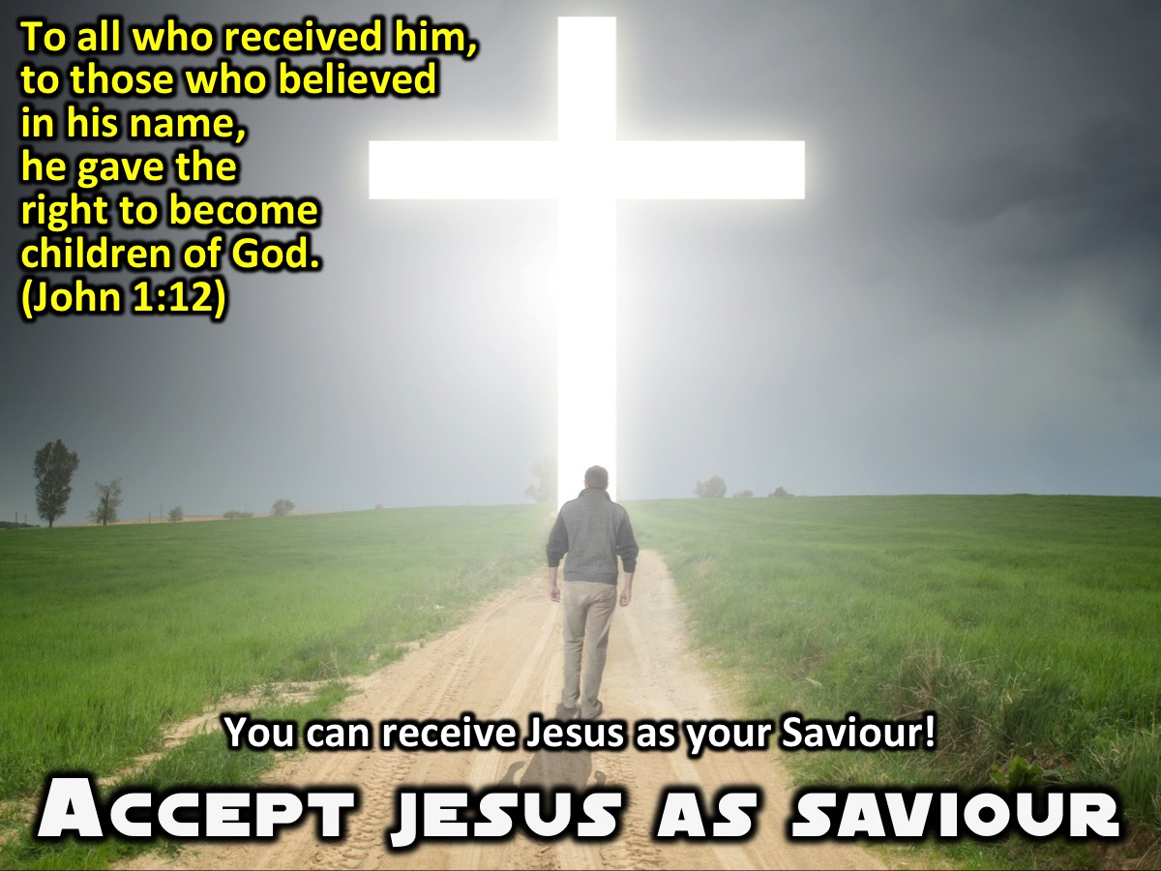
Notes:
Accept Jesus Christ. You can receive Jesus as your Saviour. “To all who received him, to those who believed in his name, he gave the right to become children of God.” (John 1:12)

Slide 40
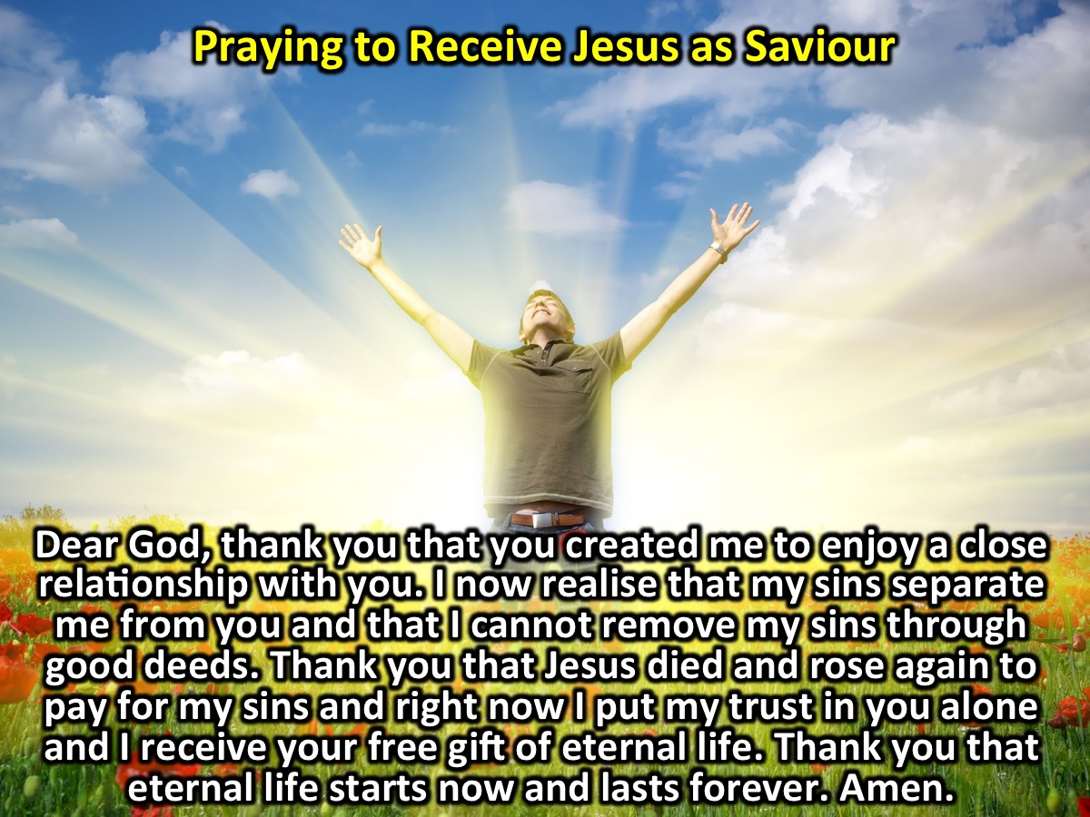
Notes:
You can lead them in a prayer to receive Jesus. Here is an example that I have created based on the G.O.S.P.E.L. outline - it is not a magic formula to get someone saved, but a chance for them to express their trust in what Jesus did on the cross to remove their sin and bring them into a relationship with God and to receive eternal life as a free gift: Dear God, thank you that you created me to enjoy a close relationship with you. I now realise that my sins separated me from you and that I cannot remove my sins through good deeds. Thank you that Jesus died and rose again to pay for my sins and right now I put my trust in you alone and I receive your free gift of eternal life. Thank you that eternal life starts now and lasts forever. Amen.

Slide 41
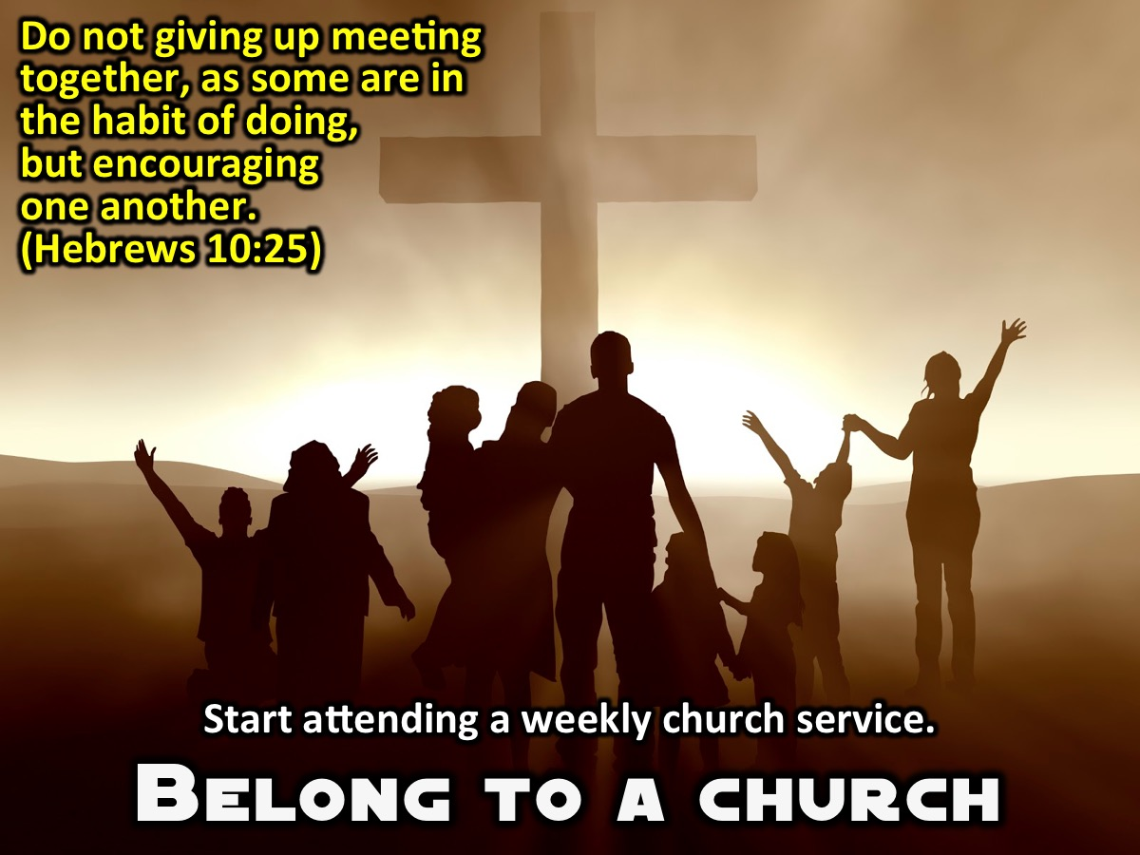
Notes:
Belong to a church. Invite them to start attending Youth or a church with their parents if they go. (Hebrews 10:25)

Slide 42
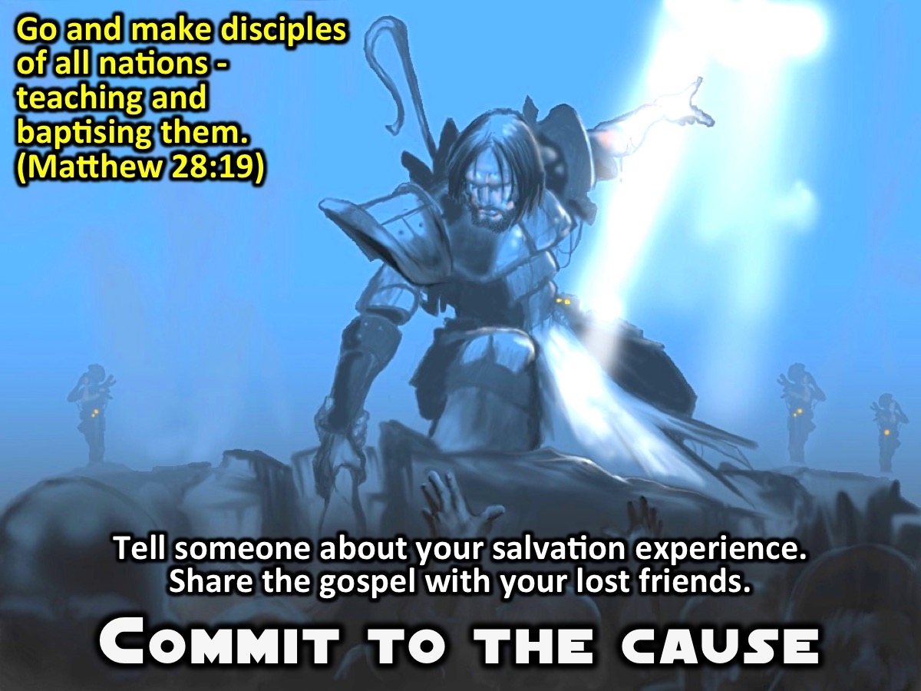
Notes:
Commit to the Cause. Encourage them to tell someone about their salvation experience and also to share the gospel with their lost friends. (Matthew 28:19)

Slide 43
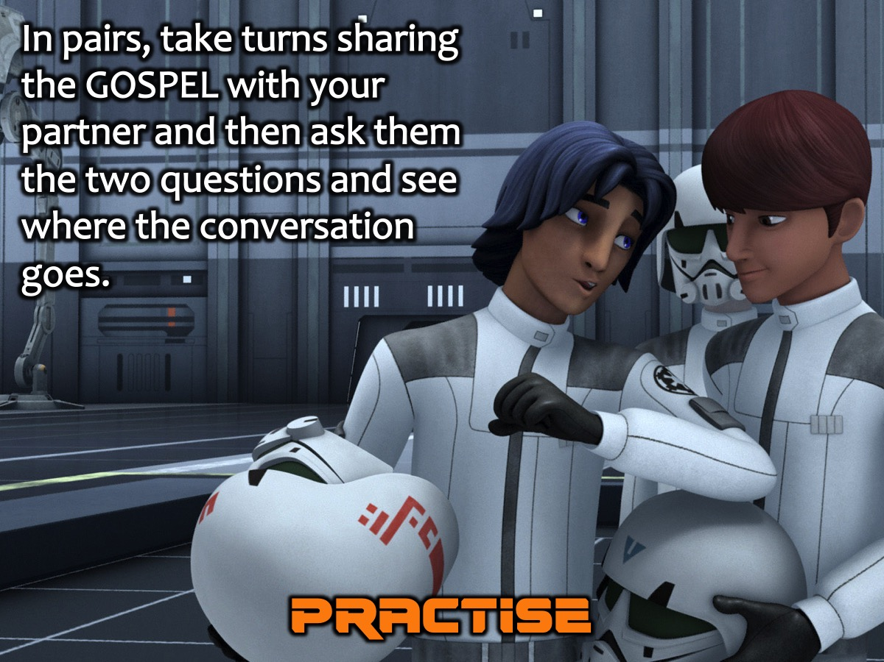
Notes:
Practise: In pairs, take turns sharing the GOSPEL with your partner and then ask them the two questions and see where the conversation goes.

Slide 44
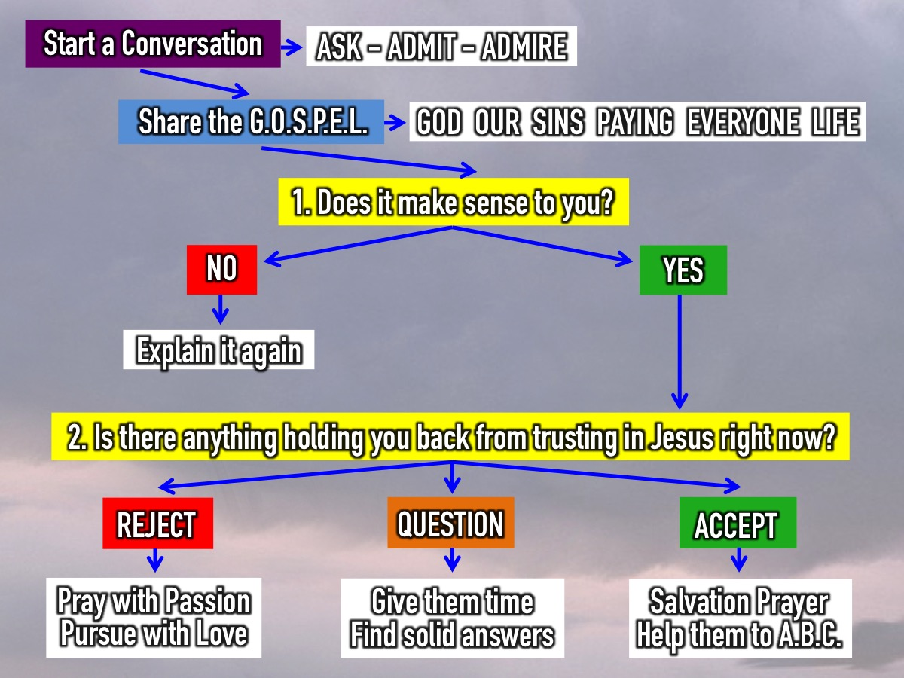
Notes:
As you practise in pairs, here is an outline you can follow:
Start a conversation (Ask-Admit-Admire),
Share the Gospel (God Our Sins Paying Everyone Life),
Ask the Two Questions: The first question is: Does it make sense to you. If they say. No: Explain the gospel again. If they say Yes: ask the second question: Is there anything holding you back from trusting in Jesus right now? There are generally three responses to the gospel: (1) Some will Reject the Gospel - keep on praying with passion for them and keep on pursuing them with love. (2) Some will have more Questions - give them time to think and find solid answers to their questions. (3) Some will be ready to Accept Jesus right away - you can lead them in a sinners prayer and walk them through the ABC’s: Accept Jesus as Saviour, Belong to a Church and Commit to the Cause.

Slide 45
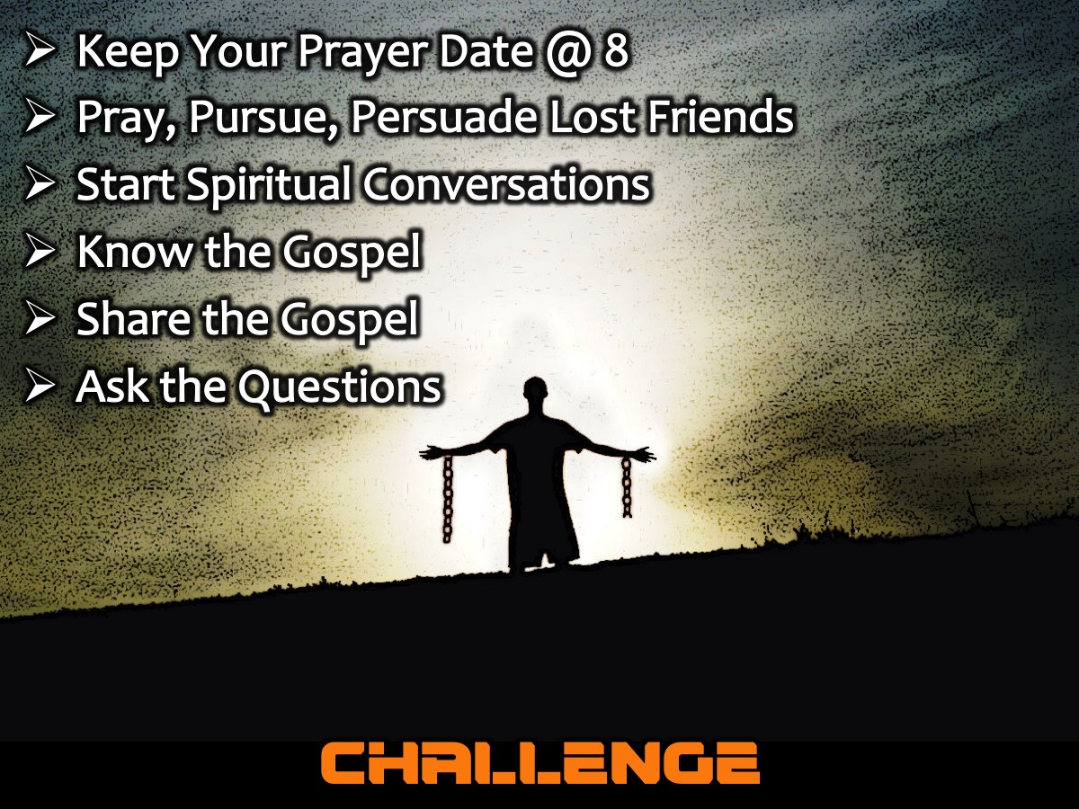
Notes:
Challenge: (1) Keep Your Prayer Date @ 8 on Tuesday, Thursdays and Sundays . (2) Pray, Pursue, Persuade Lost Friends. (3) Start Spiritual Conversations. (4) Know the Gospel, (5) Share the Gospel and (6) Ask the Questions.

Slide 46

Notes:
Closing Prayer:

Slide 47

Notes:
Next Sunday is week 9 of our series and we are going to get to practise sharing our faith in the real world.

