Slide 1
Notes:
Welcome to the Replicate Series. Before we dive into week 9 lets do a quick recap of what we’ve been through so far…

Slide 2
Notes:
In recent weeks we have learnt how to start a spiritual conversation…

Slide 3
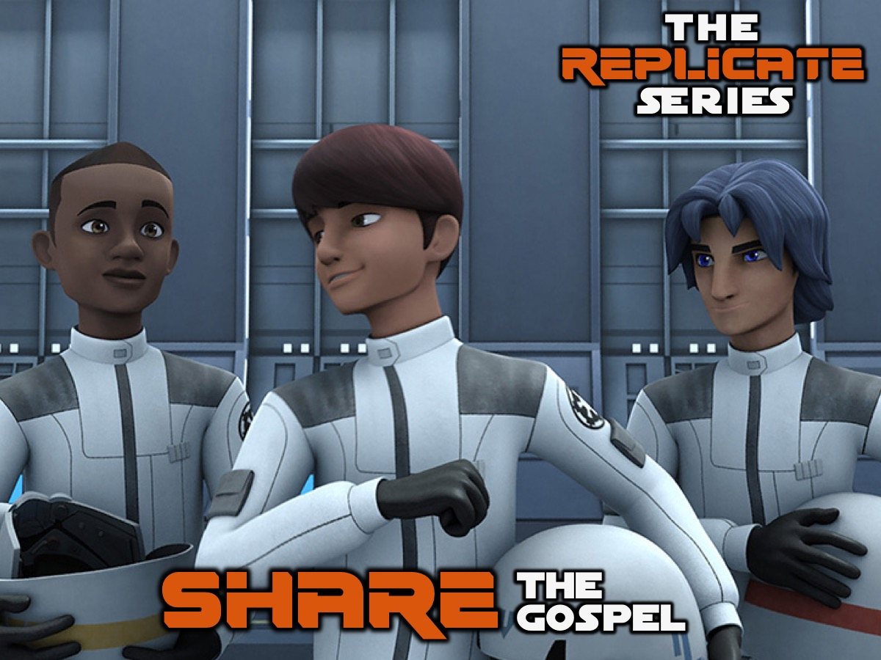
Notes:
We have learnt how to share the gospel with our lost friends.

Slide 4
Notes:
Let’s remember what the GOSPEL is all about - firstly, let’s say the six words together: God Our Sins Paying Everyone Life. And now let’s remember what the six sentences are…

Slide 5
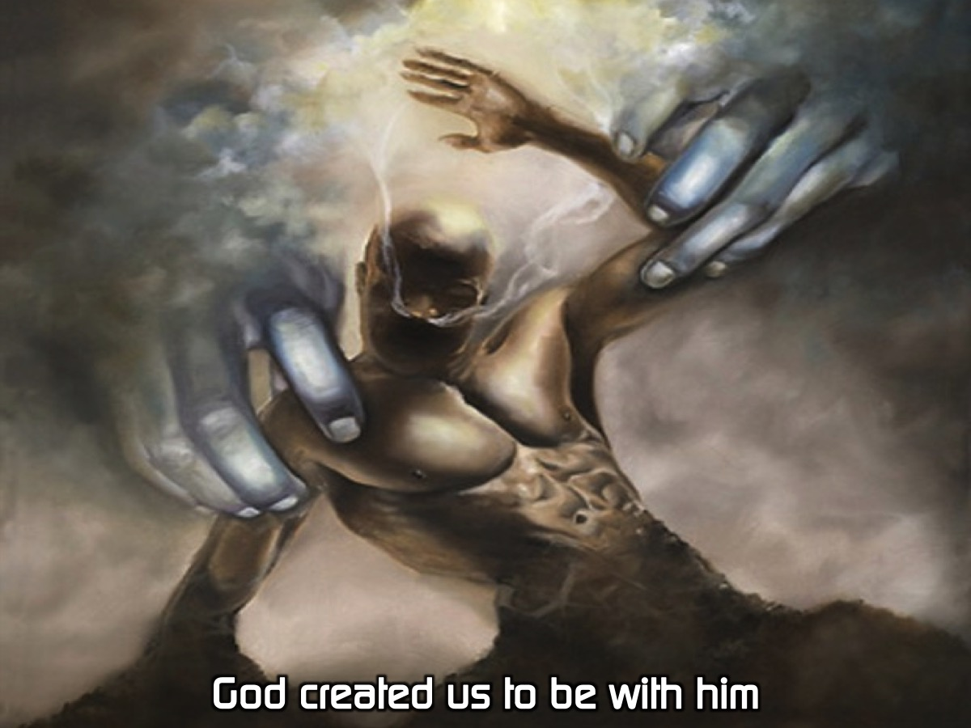
Notes:
God created us to be with him.

Slide 6
Notes:
Our sins separate us from God.

Slide 7
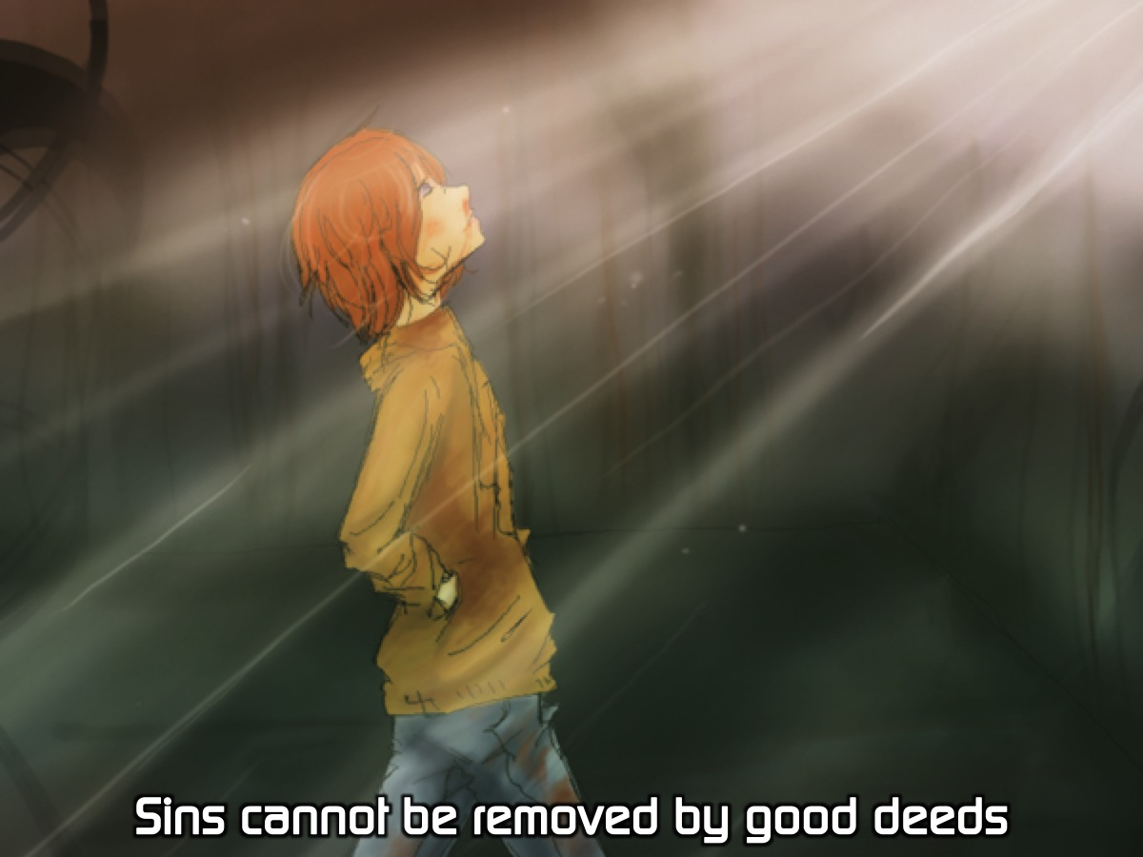
Notes:
Sins cannot be removed by good deeds.

Slide 8
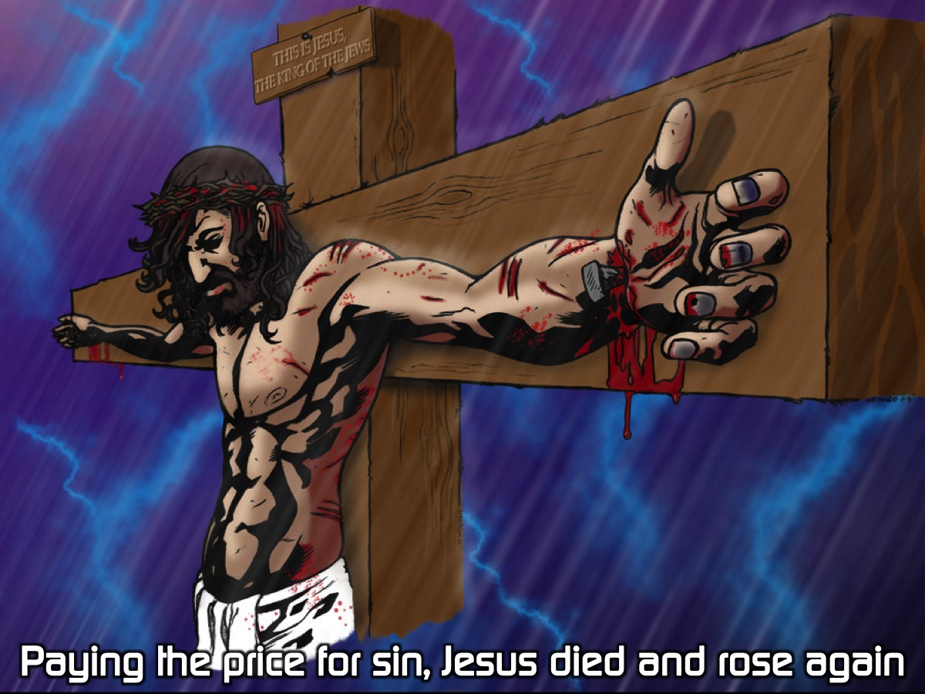
Notes:
Paying the price for sin, Jesus died and rose again.

Slide 9
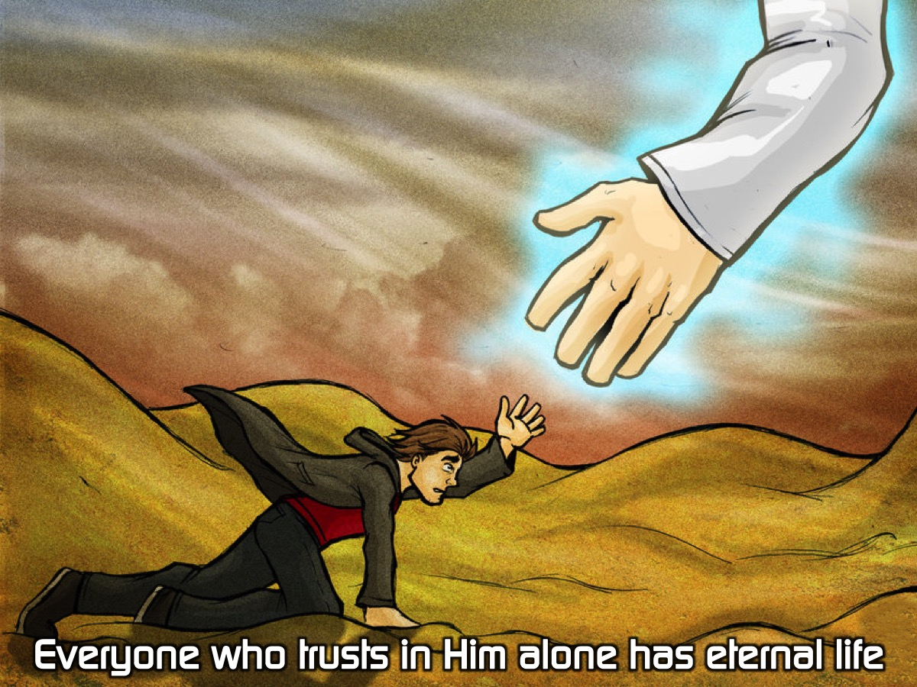
Notes:
Everyone who trusts in Him alone has eternal life.

Slide 10
Notes:
Life with Jesus starts now and lasts forever.

Slide 11
Notes:
Let’s say the 6 sentences one more time: God created us to be with him.

Slide 12
Notes:
Our sins separate us from God.

Slide 13
Notes:
Sins cannot be removed by good deeds.

Slide 14
Notes:
Paying the price for sin, Jesus died and rose again.

Slide 15
Notes:
Everyone who trusts in Him alone has eternal life.

Slide 16
Notes:
Life with Jesus starts now and lasts forever.

Slide 17
Notes:
We learnt that after we share the gospel with someone we should ask them the two questions:

Slide 18
Notes:
The first question is: Does it make sense to you. If they say. No: Explain the gospel again. If they say Yes: ask the second question: Is there anything holding you back from trusting in Jesus right now? There are generally three responses to the gospel: (1) Some will Reject the Gospel - thank them for their time and move on to find someone else to share with. (2) Some will have more Questions - you could invite them to attend church on a Sunday morning to get answers to their questions. (3) Some will be ready to Accept Jesus right away - you can lead them in a prayer of salvation using the GOSPEL sentences as an outline.

Slide 19
Notes:
We can them lead the person in a prayer to receive Jesus. Here is an example that I have created based on the G.O.S.P.E.L. outline - it is not a magic formula to get someone saved, but a chance for them to express their trust in what Jesus did on the cross to remove their sin and bring them into a relationship with God and to receive eternal life as a free gift: Dear God, thank you that you created me to enjoy a close relationship with you. I now realise that my sins separated me from you and that I cannot remove my sins through good deeds. Thank you that Jesus died and rose again to pay for my sins and right now I put my trust in you alone and I receive your free gift of eternal life. Thank you that eternal life starts now and lasts forever. Amen.

Slide 20
Notes:
This week we are going to practise sharing our faith in the real world - we are going to engage people in their world.

Slide 21
Notes:
Go and Make Disciples: So get into small groups of 3 or 4 with a leader and spend the next 20 minutes on the streets sharing the gospel with people you meet.

Slide 22
Notes:
Report Back: Each group can send one person to share a testimony of your experiences on the street sharing the gospel.

Slide 23
Notes:
Challenge: (1) Keep Your Prayer Date @ 8 on Tuesday, Thursdays and Sundays . (2) Pray, Pursue, Persuade Lost Friends. (3) Start Spiritual Conversations. (4) Know the Gospel, (5) Share the Gospel and (6) Ask the Questions.

Slide 24
Notes:
Closing Prayer:

Slide 25
Notes:
Next week we are going to Celebrate the Harvest as we wrap up our series.

