Slide 1
Notes:
Welcome to the Replicate Series. Before we dive into week 10 lets do a quick recap of what we’ve been through so far…

Slide 2
Notes:
We were introduced to the Replicate Circle - a tool to help us lead our friends to Jesus.

Slide 3
Notes:
We have learnt how to start a spiritual conversation…

Slide 4
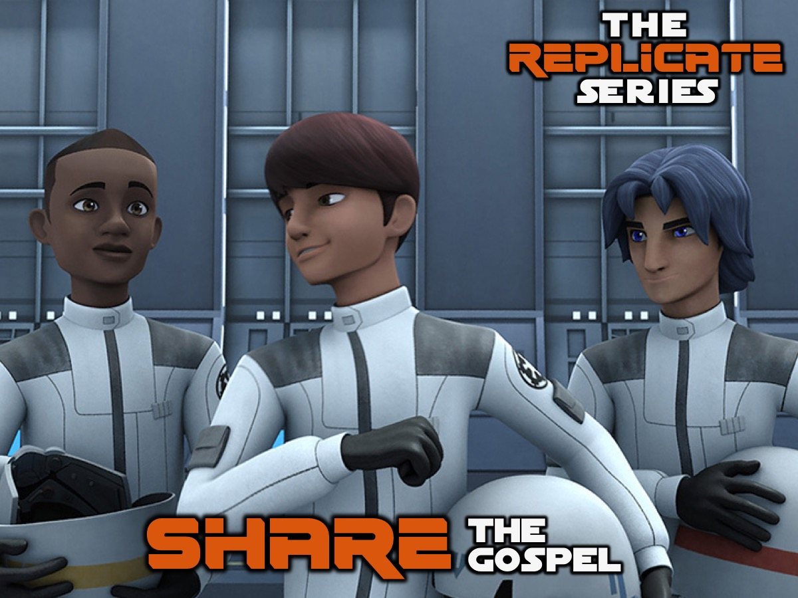
Notes:
We learnt how to share the gospel with our lost friends.

Slide 5
Notes:
We learnt how to Ask - Admire and Admit.

Slide 6
Notes:
Let’s remember what the GOSPEL is all about - firstly, let’s say the six words together: God Our Sins Paying Everyone Life. And now let’s remember what the six sentences are…

Slide 7
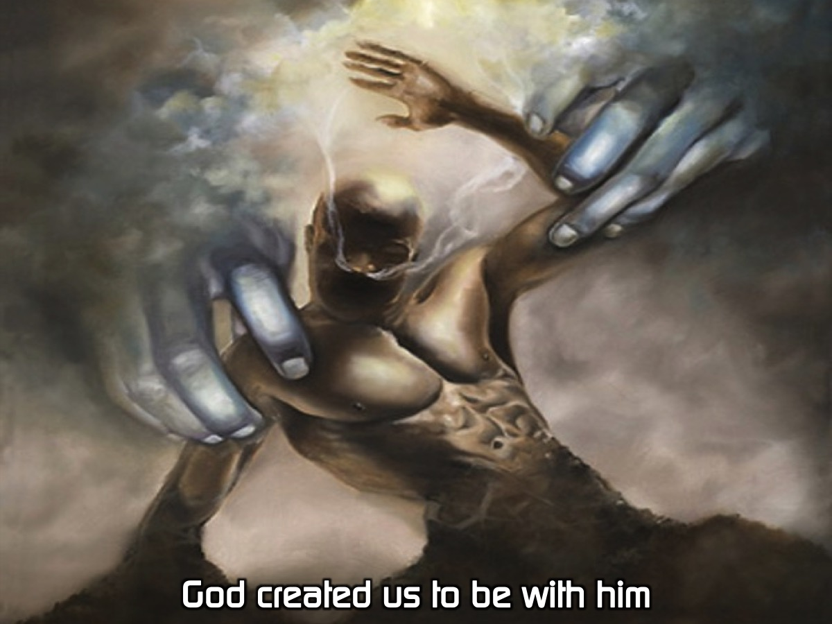
Notes:
God created us to be with him.

Slide 8
Notes:
Our sins separate us from God.

Slide 9
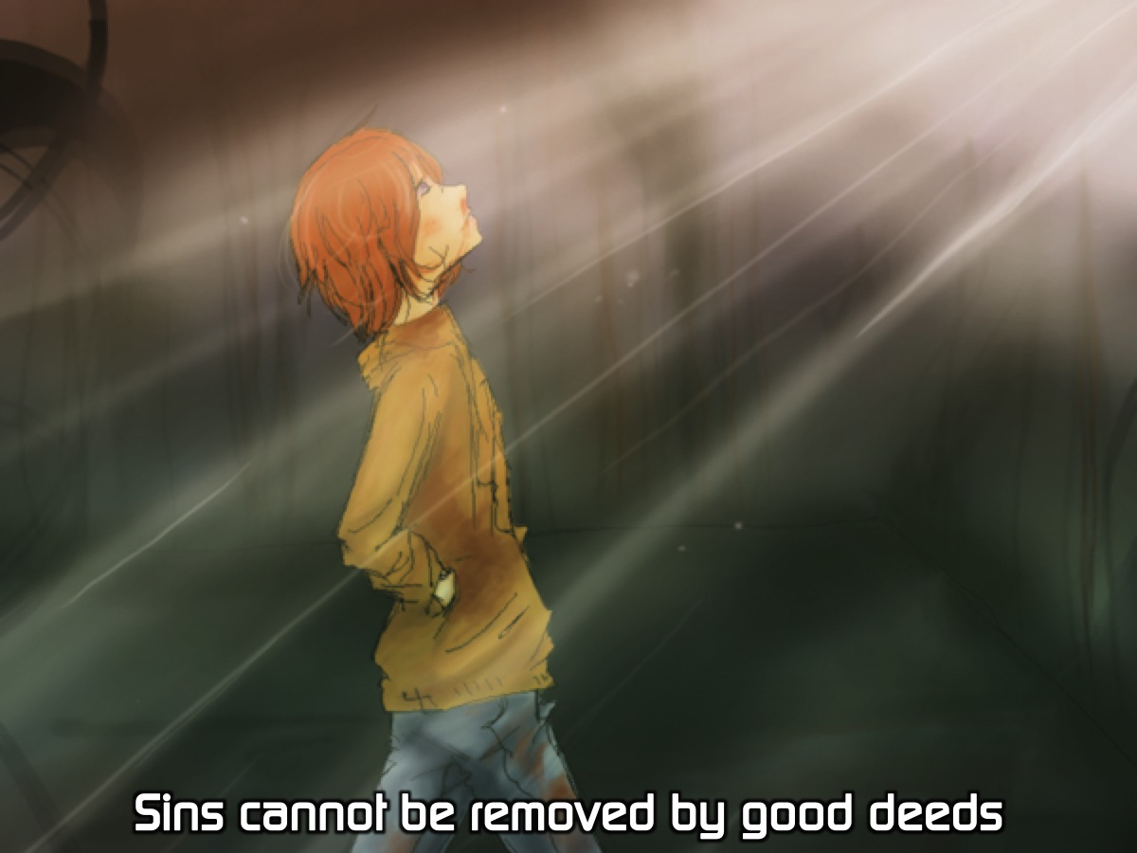
Notes:
Sins cannot be removed by good deeds.

Slide 10
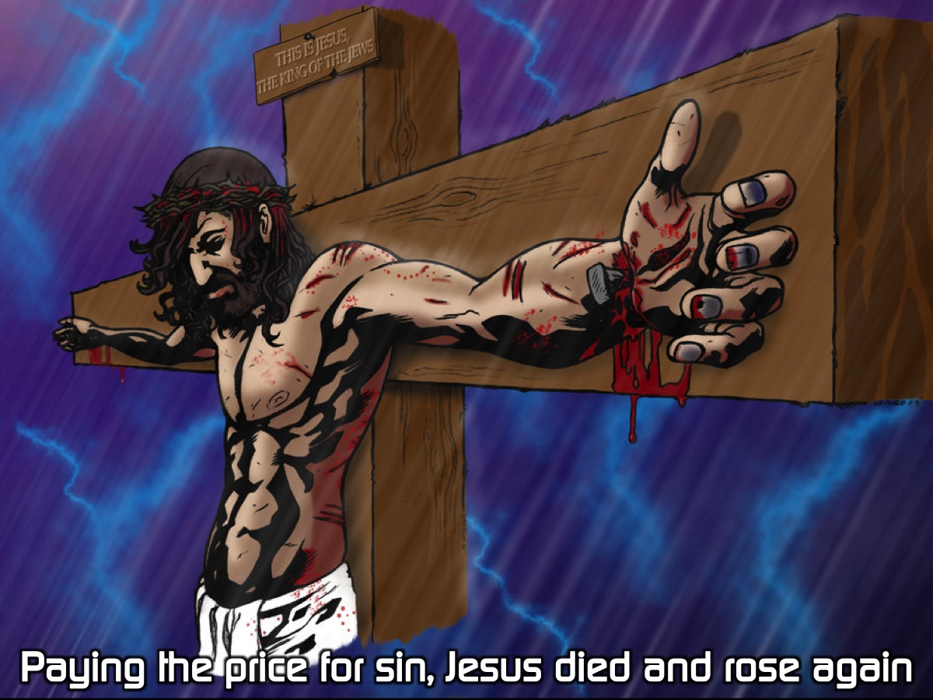
Notes:
Paying the price for sin, Jesus died and rose again.

Slide 11
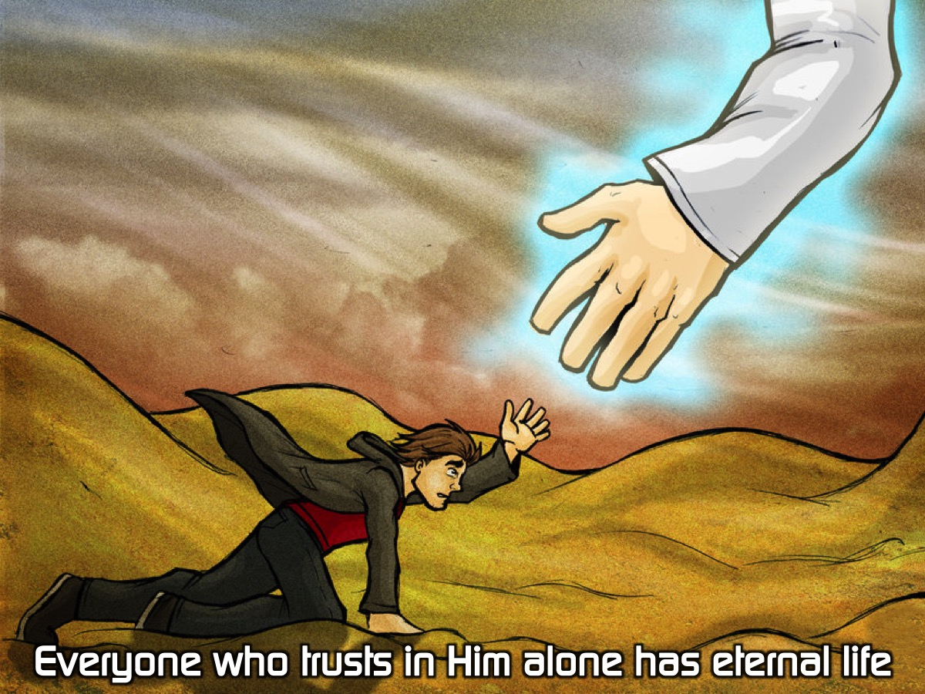
Notes:
Everyone who trusts in Him alone has eternal life.

Slide 12
Notes:
Life with Jesus starts now and lasts forever.

Slide 13
Notes:
We learnt that after we share the gospel with someone we should ask them the two questions:

Slide 14
Notes:
The first question is: Does it make sense to you. If they say. No: Explain the gospel again. If they say Yes: ask the second question: Is there anything holding you back from trusting in Jesus right now? There are generally three responses to the gospel: (1) Some will Reject the Gospel - thank them for their time and move on to find someone else to share with. (2) Some will have more Questions - you could invite them to attend church on a Sunday morning to get answers to their questions. (3) Some will be ready to Accept Jesus right away - you can lead them in a prayer of salvation using the GOSPEL sentences as an outline.

Slide 15
Notes:
We can them lead the person in a prayer to receive Jesus. Here is an example that I have created based on the G.O.S.P.E.L. outline - it is not a magic formula to get someone saved, but a chance for them to express their trust in what Jesus did on the cross to remove their sin and bring them into a relationship with God and to receive eternal life as a free gift: Dear God, thank you that you created me to enjoy a close relationship with you. I now realise that my sins separated me from you and that I cannot remove my sins through good deeds. Thank you that Jesus died and rose again to pay for my sins and right now I put my trust in you alone and I receive your free gift of eternal life. Thank you that eternal life starts now and lasts forever. Amen.

Slide 16
Notes:
This week we are going to wrap up the series by Celebrating the Harvest.

Slide 17
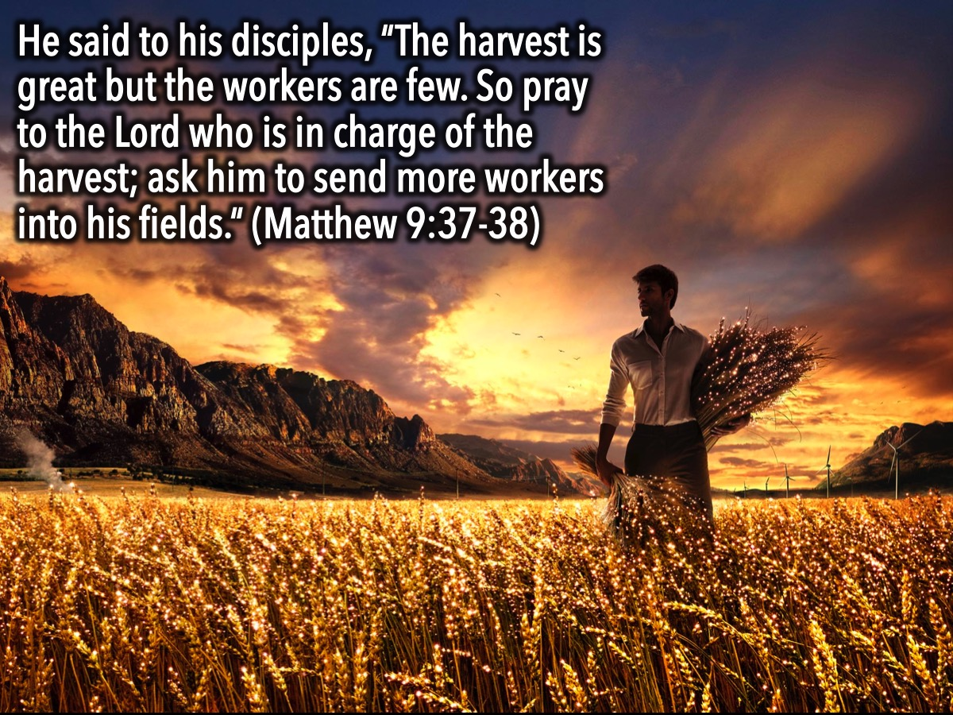
Notes:
Jesus said to his disciples, “The harvest is great but the workers are few. So pray to the Lord who is in charge of the harvest; ask him to send more workers into his fields.” (Matthew 9:37-38)

Slide 18
Notes:
Jesus’ Mission: For the Son of Man came to seek and save the lost. (Luke 19:10). Healthy people don’t need a doctor – sick people do. I have come to call not those who think they are righteous, but those who know they are sinners. (Mark 2:17)

Slide 19
Notes:
For God so loved the world that he gave his one and only son, that whoever believes in him should not perish but have eternal life. (John 3:16). Jesus came to earth so that He could get into the messy business of compassion and serving the down and out. Jesus came to relate to the broken, sick, and lost to lead them to eternity with God.

Slide 20
Notes:
Video: The Bible Project Video: Heaven and Earth. Get it on YouTube at: https://www.youtube.com/watch?v=Zy2AQlK6C5k. [End video at 5 minutes 52 seconds.]

Slide 21
Notes:
What is an Ambassador? An Ambassador is the highest ranking person who represents his or her own government while living in another country. Ambassadors are sent with all the authority of the person they represent, making the position of Ambassador one of high honour and responsibility.

Slide 22
Notes:
Our citizenship is in heaven. (Philippians 3:20)

Slide 23
Notes:
An Ambassador has two jobs: (1) To communicate effectively for the person or brand they represent. (2) To embody the ideals and principles of the person or brand they represents.

Slide 24
Notes:
We Are God’s Ambassadors

Slide 25
Notes:
“And God has given us this task of reconciling people to Him. For God was in Christ, reconciling the world to Himself, no longer counting people’s sins against them. And he gave us this wonderful message of reconciliation. So we are Christ’s ambassadors; God is making His appeal through us. We speak for Christ when we plead, ‘Come back to God!’ For God made Christ, who never sinned, to be the offering for our sin, so that we could be made right with God through Christ.” (2 Corinthians 5: 18-21)

Slide 26
Notes:
“You are the salt of the earth…You are the light of the world.” (Matthew 5: 13; 14)

Slide 27
Notes:
Video: Designed to Share. Get it on YouTube at: https://www.youtube.com/watch?v=V6o07uQIZ0s [End video at 1 minute 53 seconds.]

Slide 28
Notes:
Video: Sharing Something Beautiful. Get it on YouTube at: https://www.youtube.com/watch?v=MsedTcolDzM [End video at 1 minute 20 seconds.]

Slide 29
Notes:
Remember to Build Authentic Relationships & to SALT

Slide 30
Notes:
Start a Conversation.

Slide 31
Notes:
Ask Questions.

Slide 32
Notes:
Listen To Their Story.

Slide 33
Notes:
Tell Your Story.

Slide 34
Notes:
Tell God's Story.

Slide 35
Notes:
Being an effective witness is first and foremost living your life in a way that others will want to know more. But it is also about the verbal component of telling people about Jesus, sharing your testimony, and personally inviting people to church.

Slide 36
Notes:
We Need God’s Power: “But you will receive power when the Holy Spirit comes upon you. And you will be my witnesses, telling people about me everywhere…” (Acts 1:8). “My heart is filled with bitter sorrow and unending grief for my people, my Jewish brothers and sisters. I would be willing to be forever cursed – cut off from Christ! – if that would save them.” (Romans 9:2-3)

Slide 37
Notes:
God’s calling (to go to all the nations and make disciples) is also God’s enabling.
Activity: Pray for God to empower us, by the Holy Spirit, to be his witnesses (through our actions and words).

Slide 38
Notes:
Feedback/Testimonies: Provide an opportunity for teens to share about how the series has impacted them.

Slide 39
Notes:
Closing Prayer

Slide 40
Notes:
Next term we will be presenting two mini-series. The first four weeks will be The Spirit Series where we will be learning all about the Holy Spirit.

Slide 41
Notes:
The next four weeks will be the Hearing God series where we will learn how to hear God’s voice.

