Slide 1
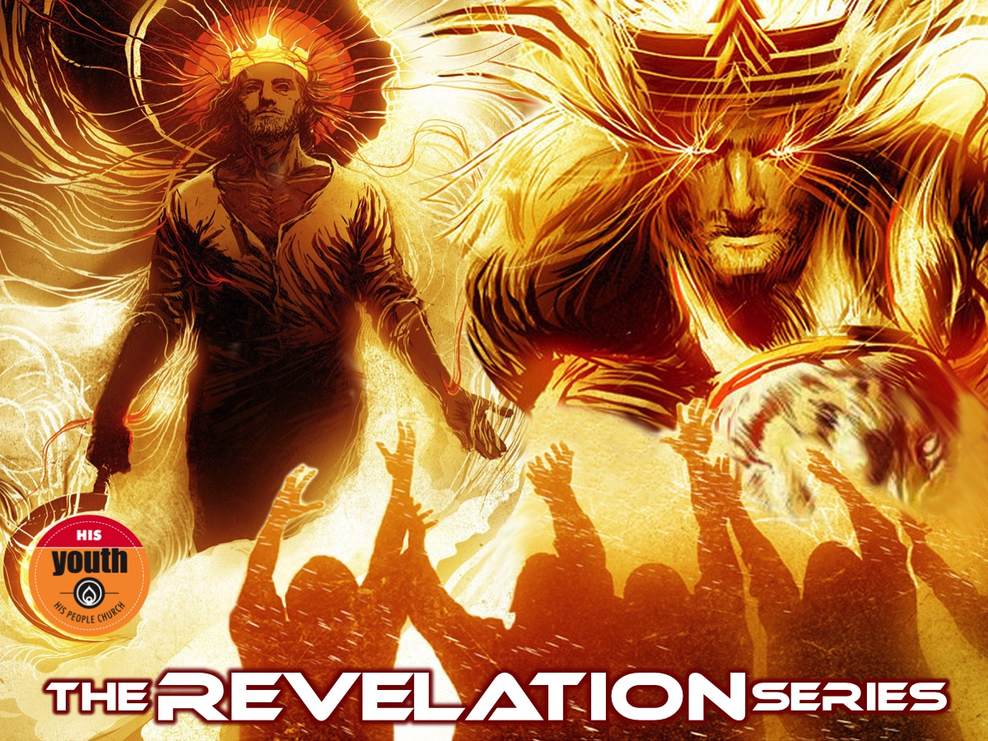
Notes:
Welcome to The Revelation Series.

Slide 2
Notes:
Video: Revelation Series Promo. Get it on YouTube at: https://www.youtube.com/watch?v=bfyrfBsFb-4

Slide 3
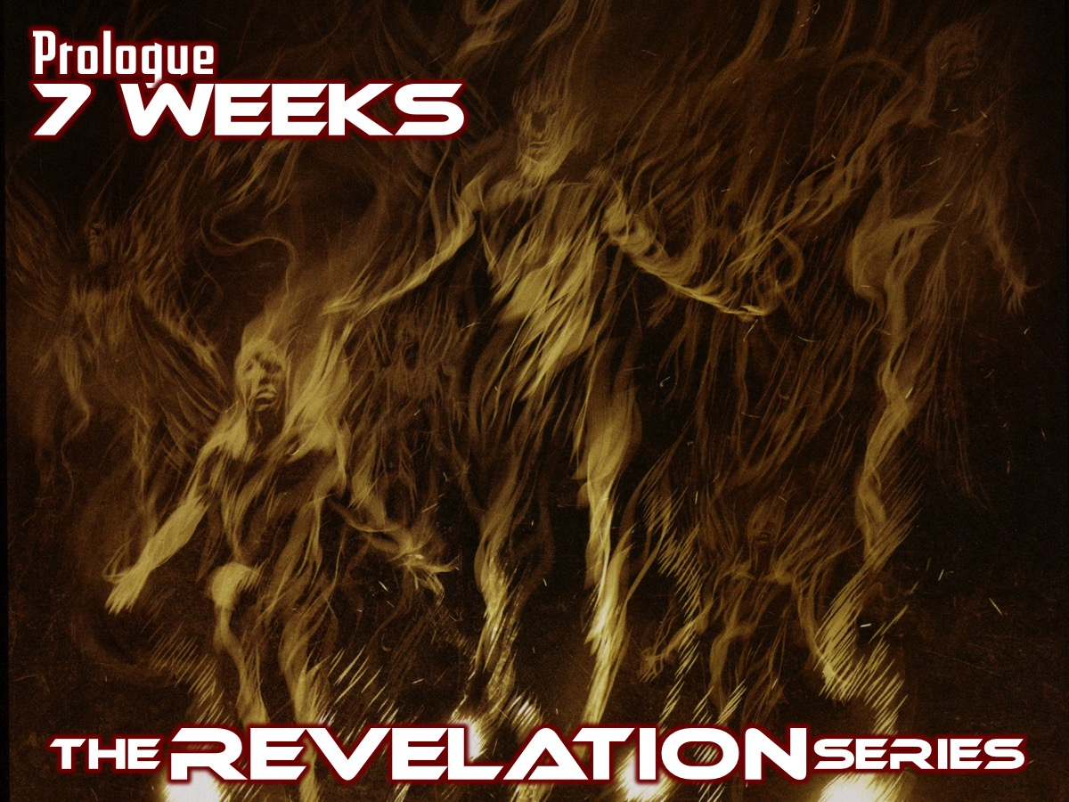
Notes:
Here is a preview of the next 8 weeks:
Prologue: 7 Weeks (Revelation 1:1-20)

Slide 4
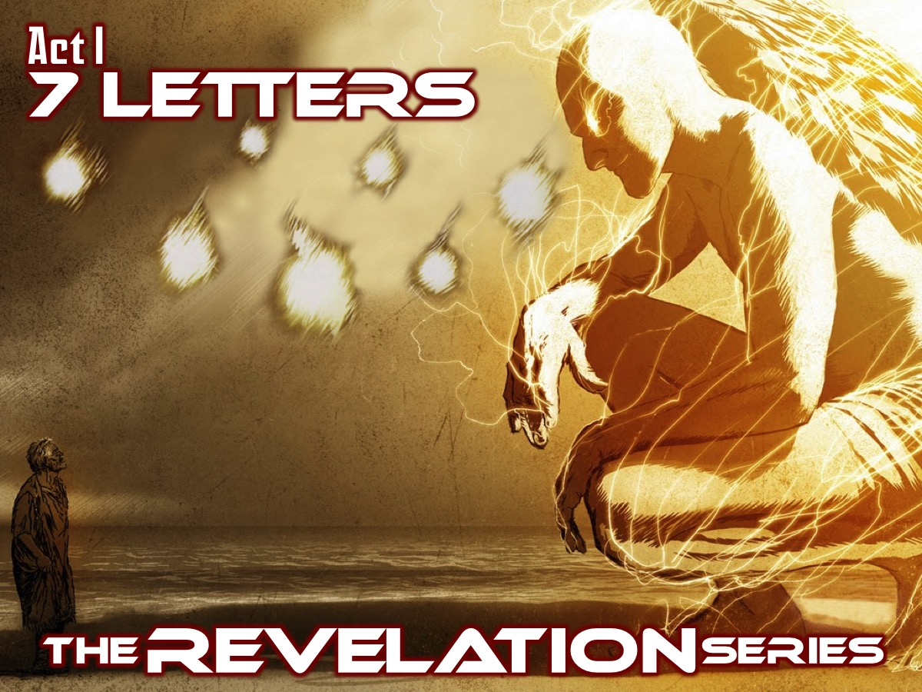
Notes:
Act I: 7 Letters (Revelation 2:1-3:22)

Slide 5
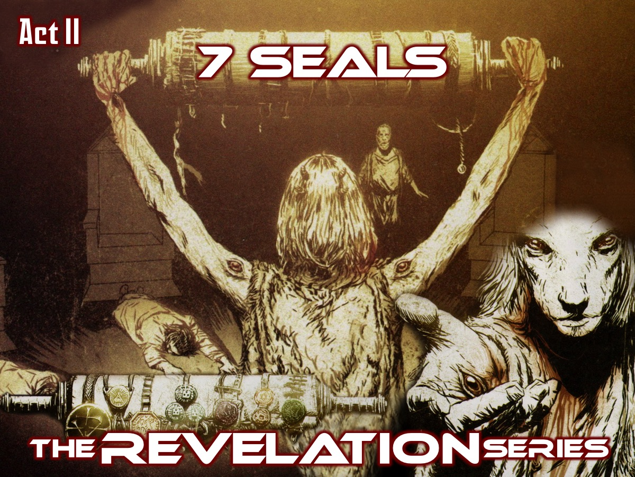
Notes:
Act II: 7 Seals (Revelation 4:1-8:1)

Slide 6
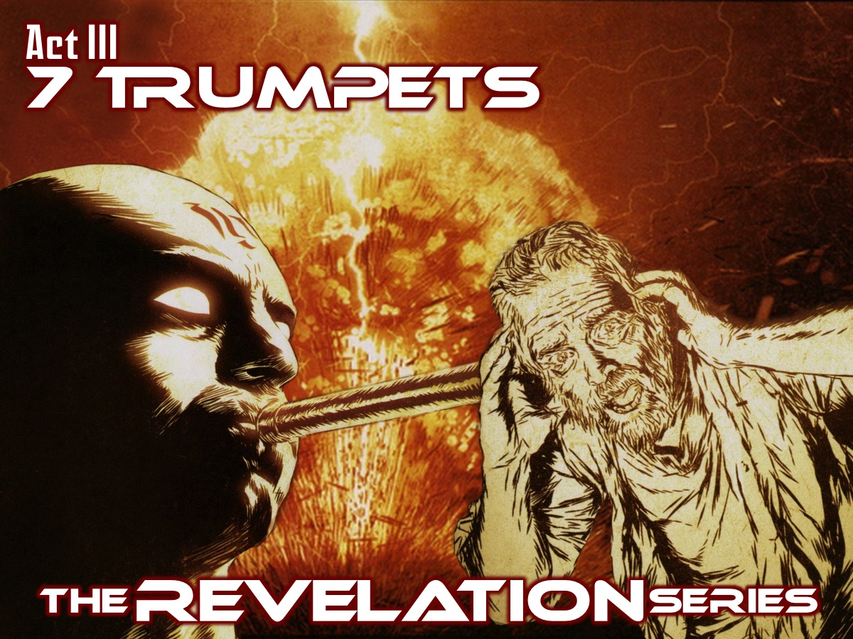
Notes:
Act III: 7 Trumpets (Revelation 8:2-11:18)

Slide 7
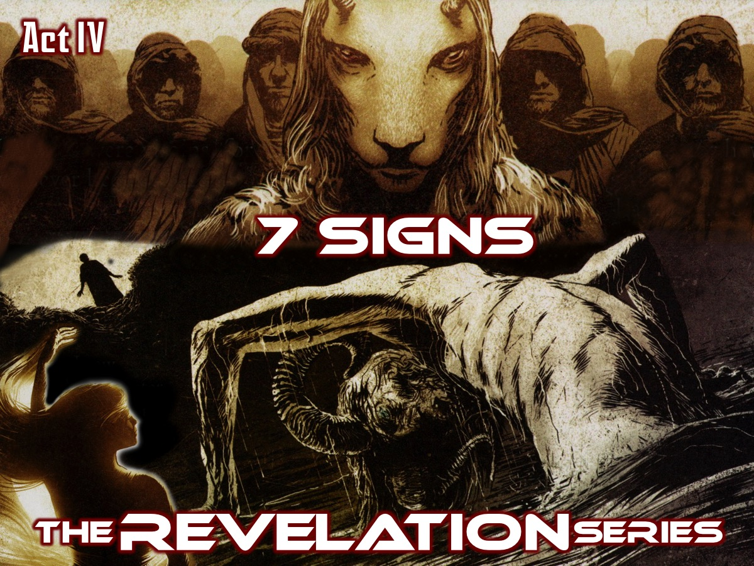
Notes:
Act IV: 7 Signs (Revelation 11:19-15:4)

Slide 8
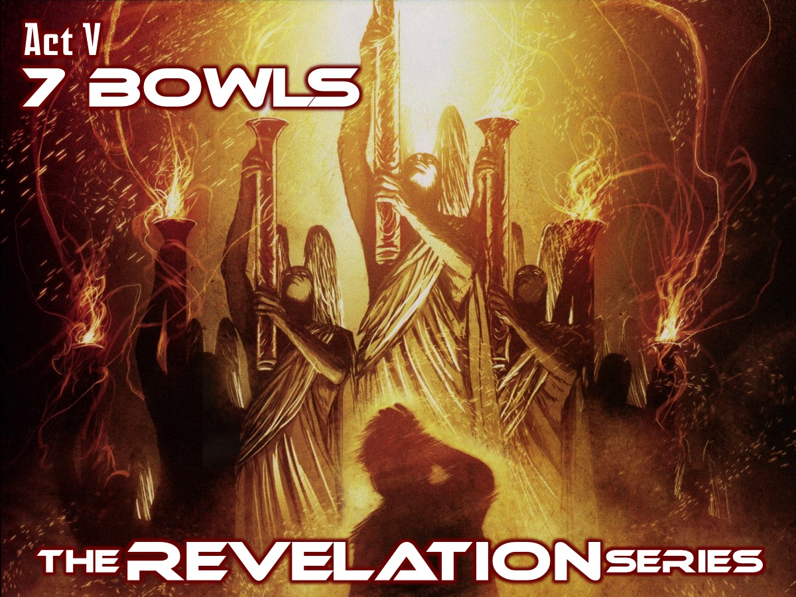
Notes:
Act V: 7 Bowls (Revelation 15:5-16:21)

Slide 9
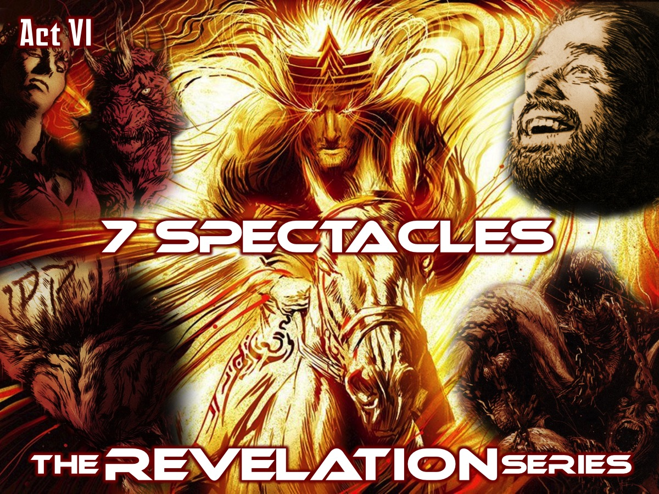
Notes:
Act VI: 7 Spectacles (Revelation 17:1-20:3)

Slide 10
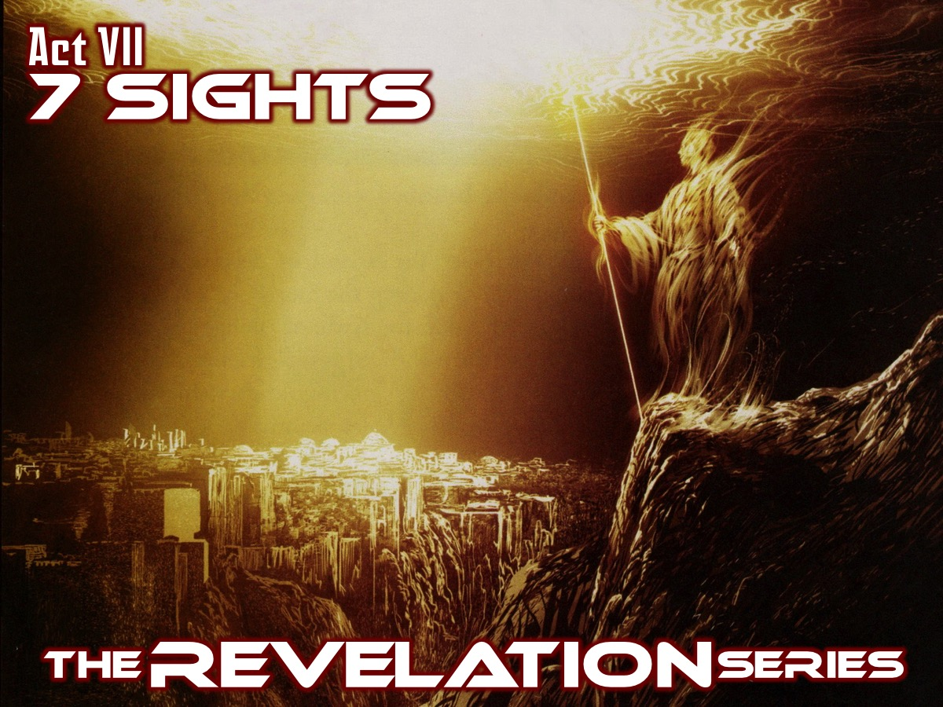
Notes:
Act VII: 7 Sights (Revelation 20:4-22:5)

Slide 11
Notes:
This is going to be an amazing series!!!

Slide 12
Notes:
Today we are going to set the scene for the next 7 weeks as we take a look at the Prologue - Revelation 1:1-20.

Slide 13
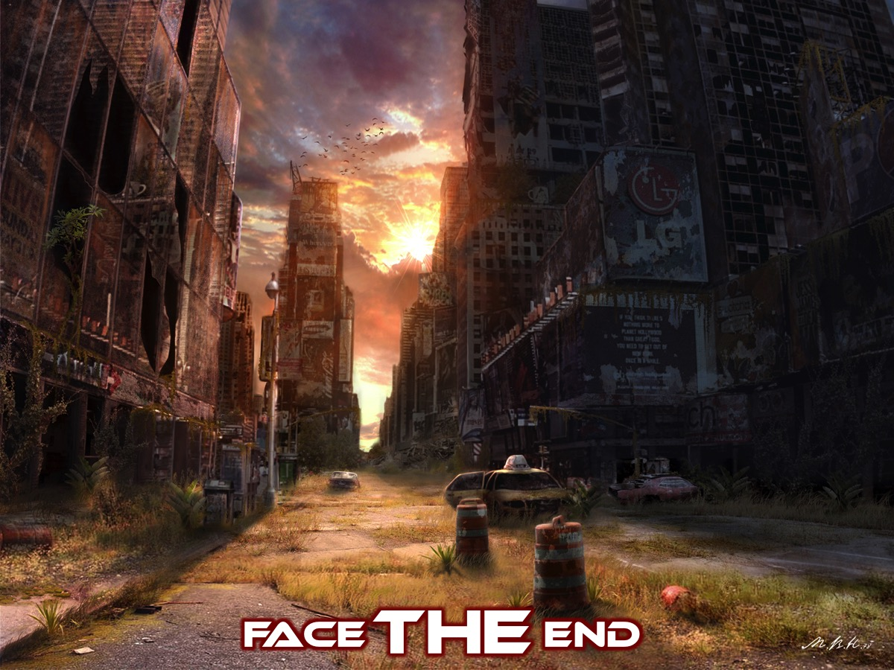
Notes:
Face THE End. Have you even though about how the world will end?

Slide 14
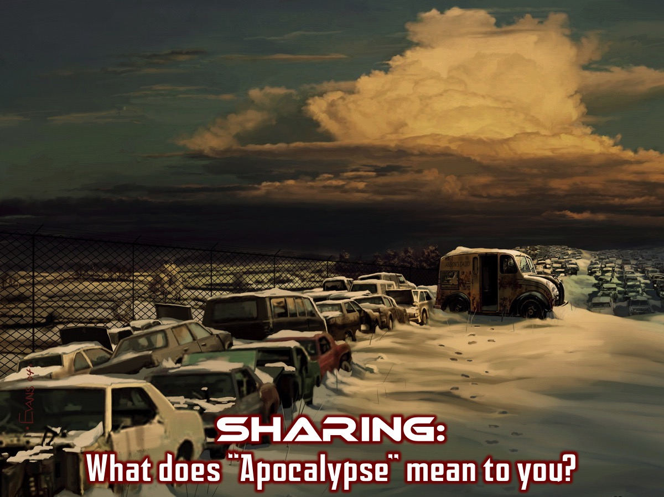
Notes:
Sharing: What images come to mind when you hear the word: “Apocalypse”?

Slide 15
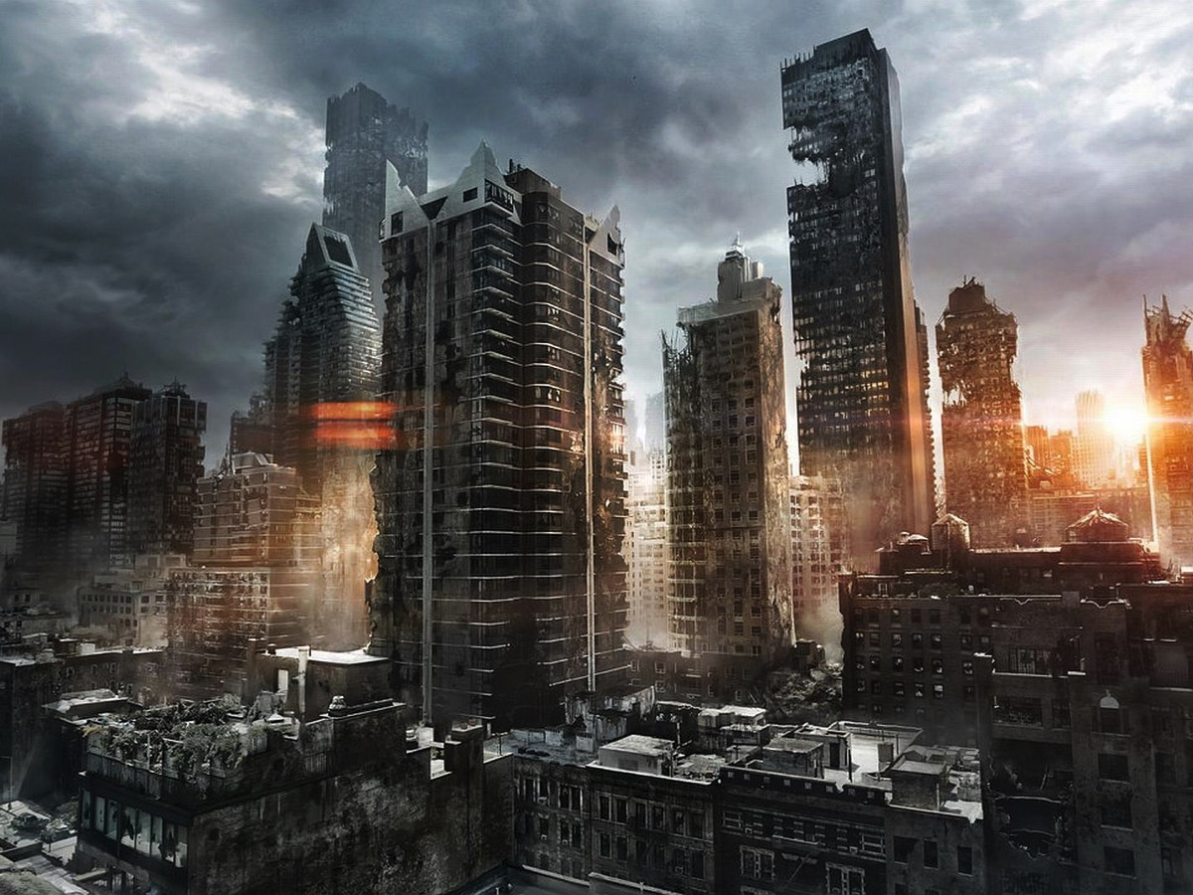
Notes:
Here are some of my favourite “Apocalypse” images that I found this week!

Slide 16
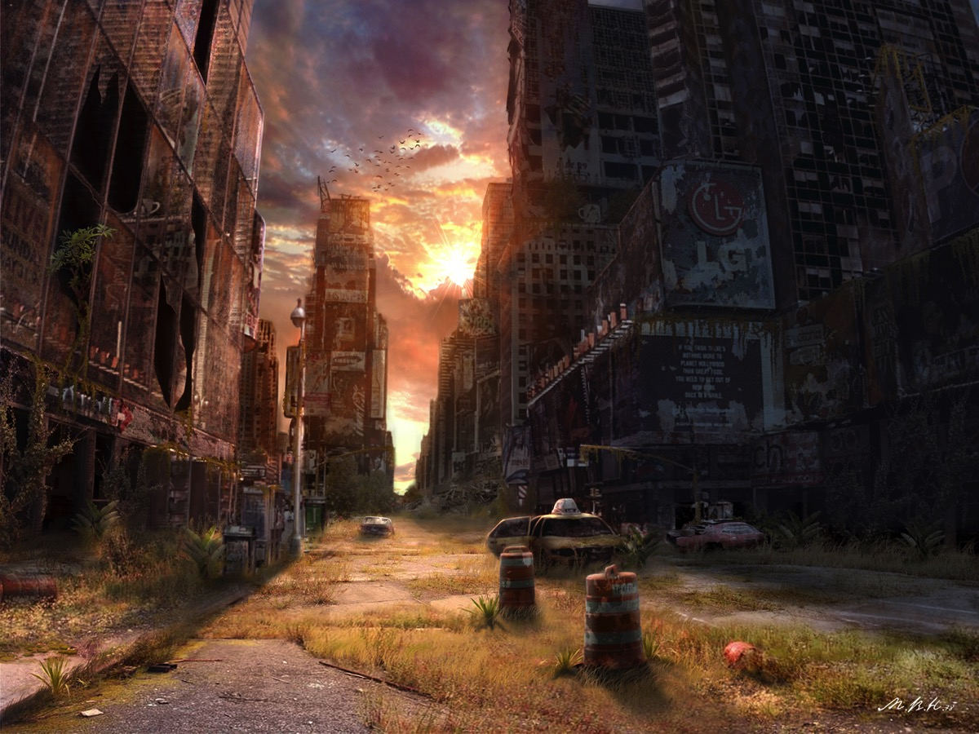
Notes:
An apocalypse image.

Slide 17
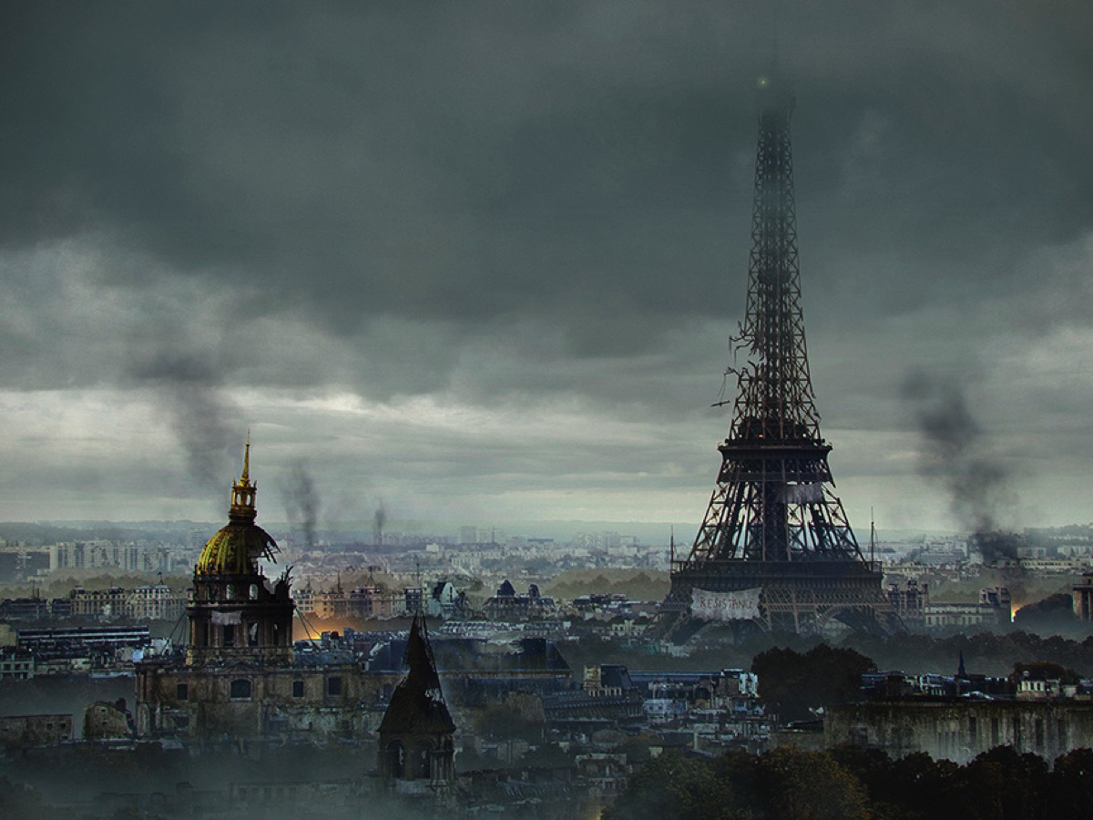
Notes:
How about Paris…

Slide 18
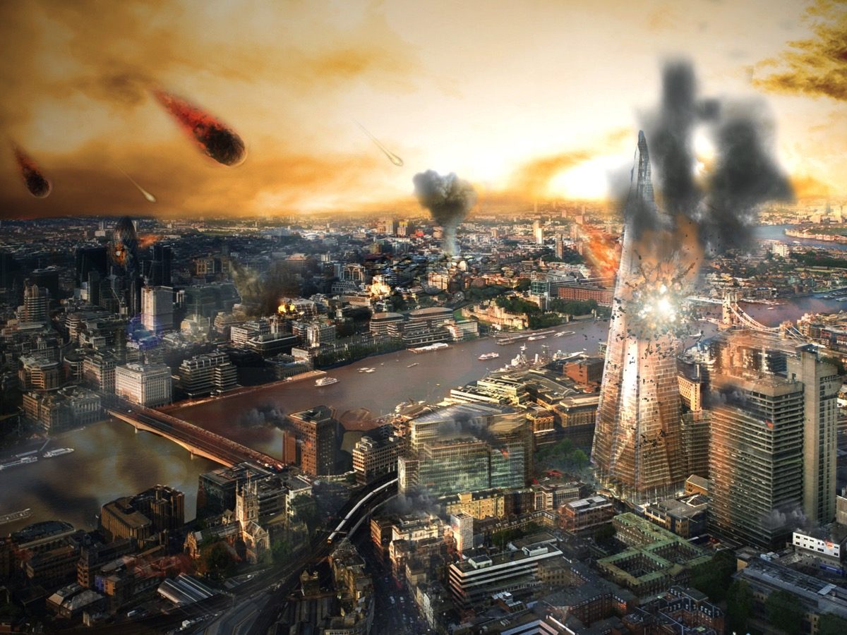
Notes:
Here is London facing the apocalypse

Slide 19
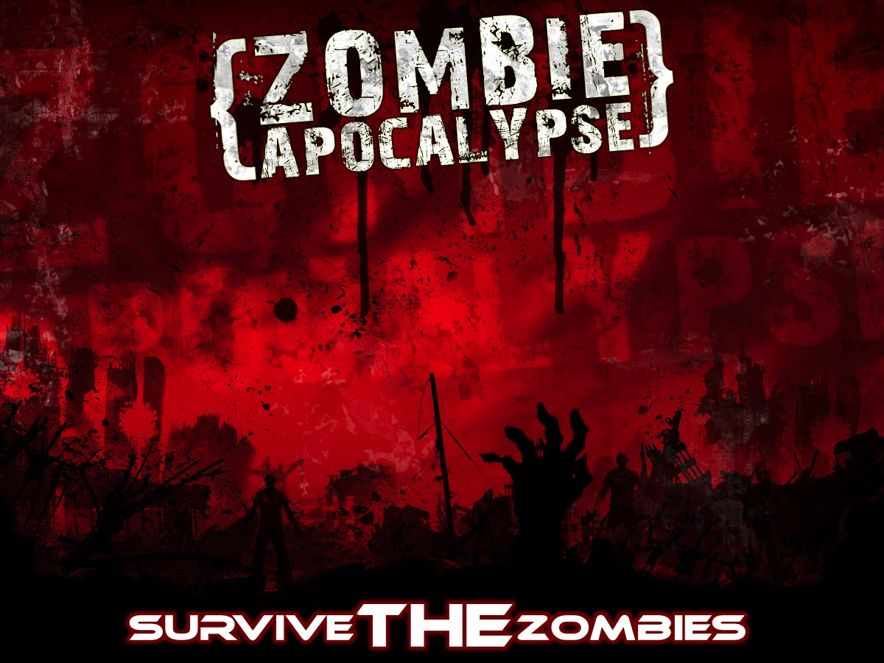
Notes:
Survive THE Zombies. The big question is whether you will be able to Survive THE Zombies

Slide 20
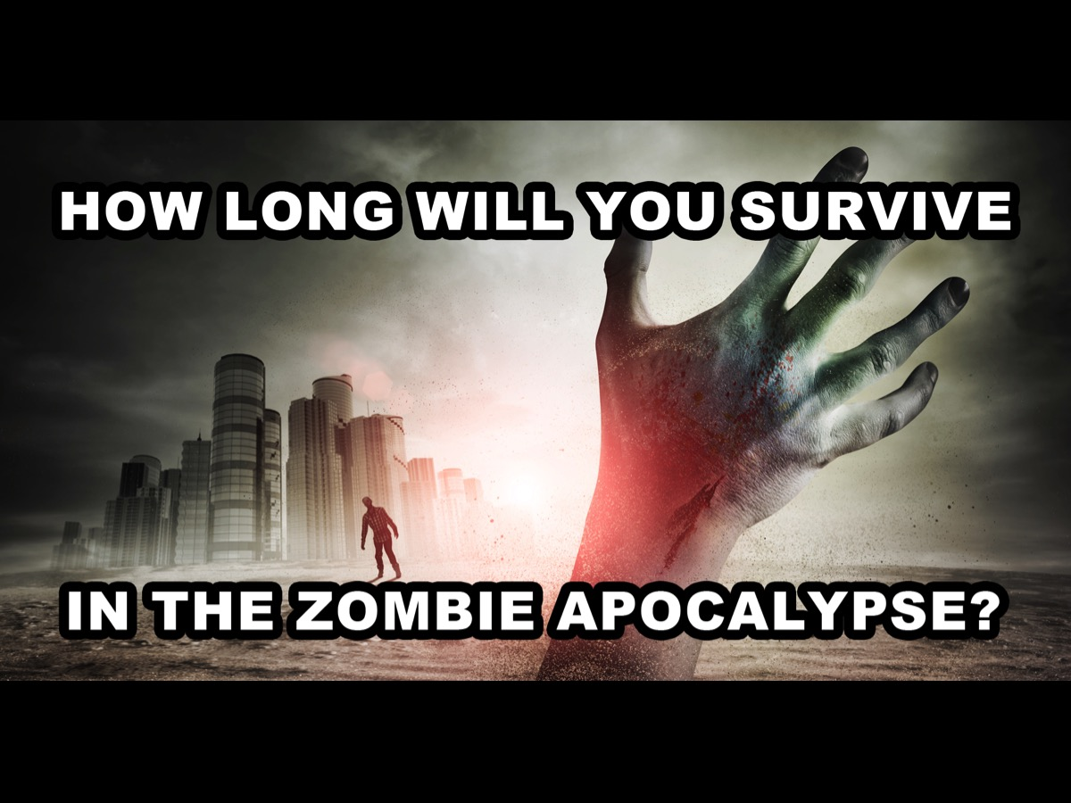
Notes:
How long will you survive in the zombie apocalypse? I took an online test this week and my results indicated that I would survive a few months.

Slide 21
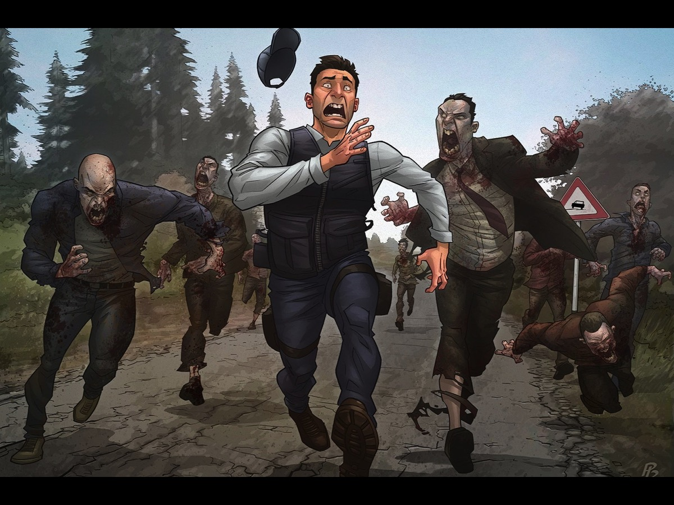
Notes:
Will you flee or will you fight?

Slide 22
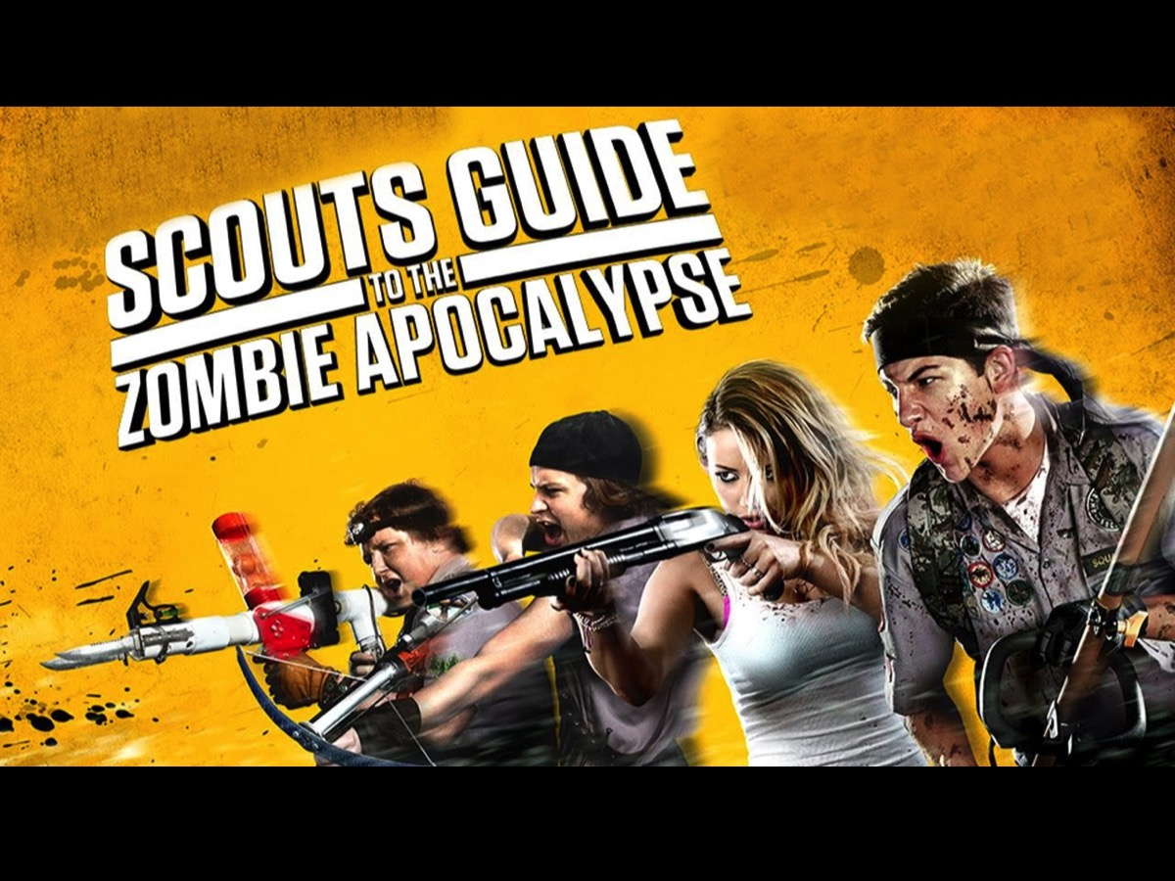
Notes:
There is even a movie out called the Scouts Guide to the Zombie Apocalypse.

Slide 23
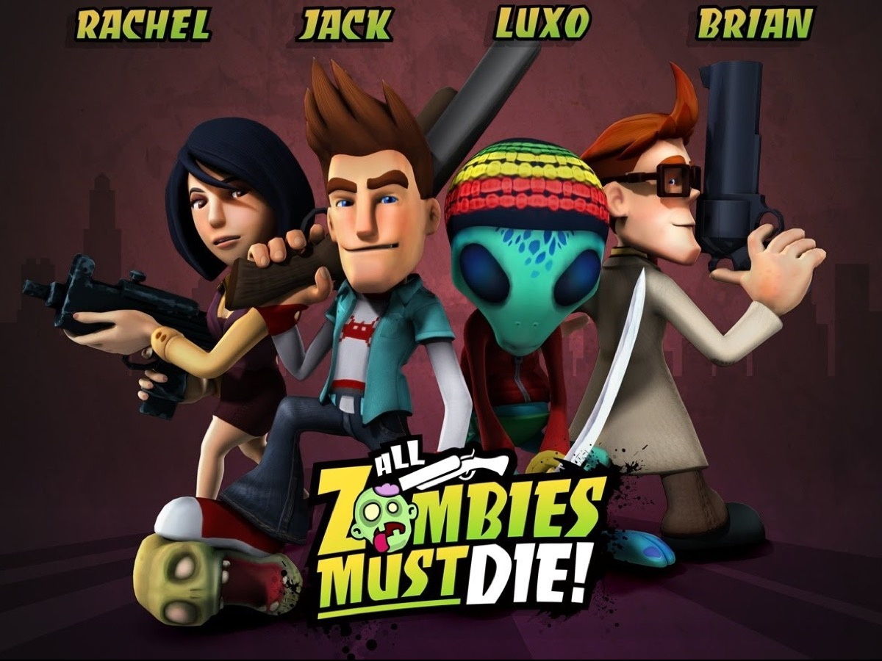
Notes:
Basically - all zombies must die!

Slide 24
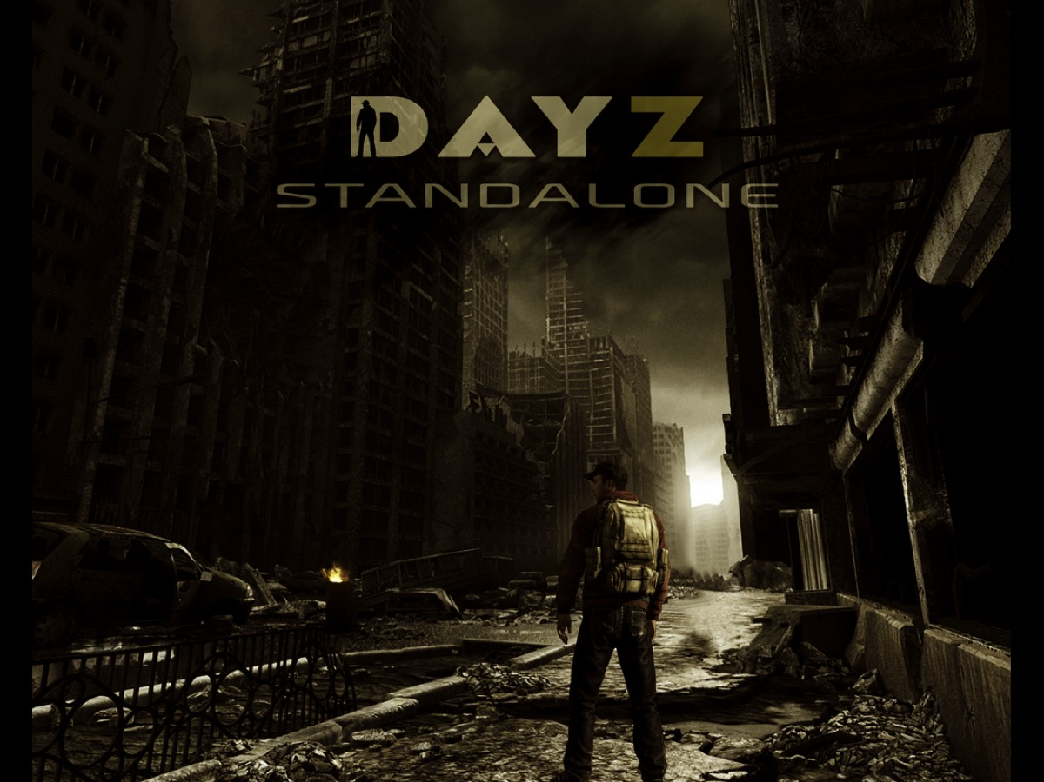
Notes:
And of course there are games about the Apocalypse like DayZ.

Slide 25
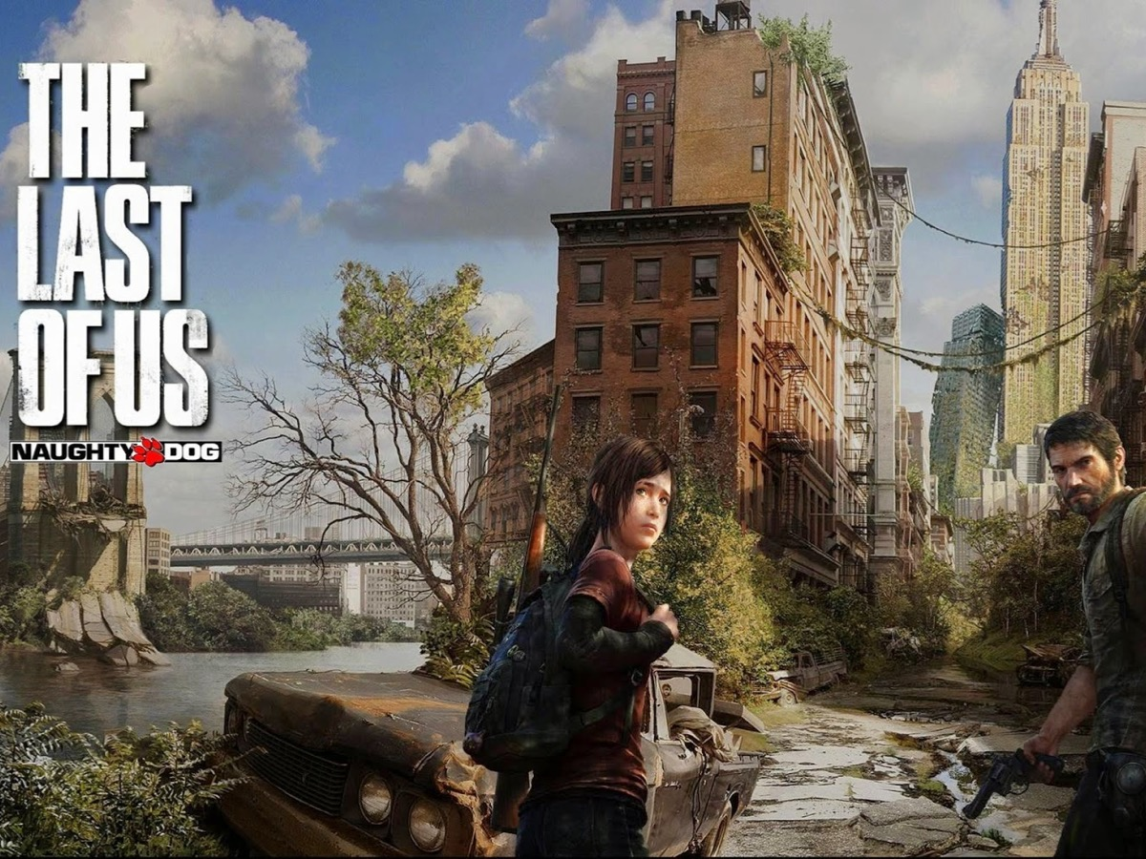
Notes:
Or The Last of Us

Slide 26
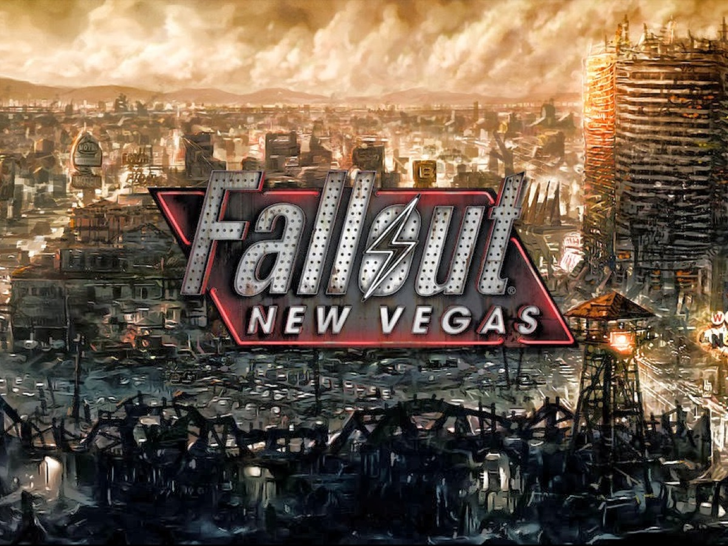
Notes:
And Fallout.

Slide 27
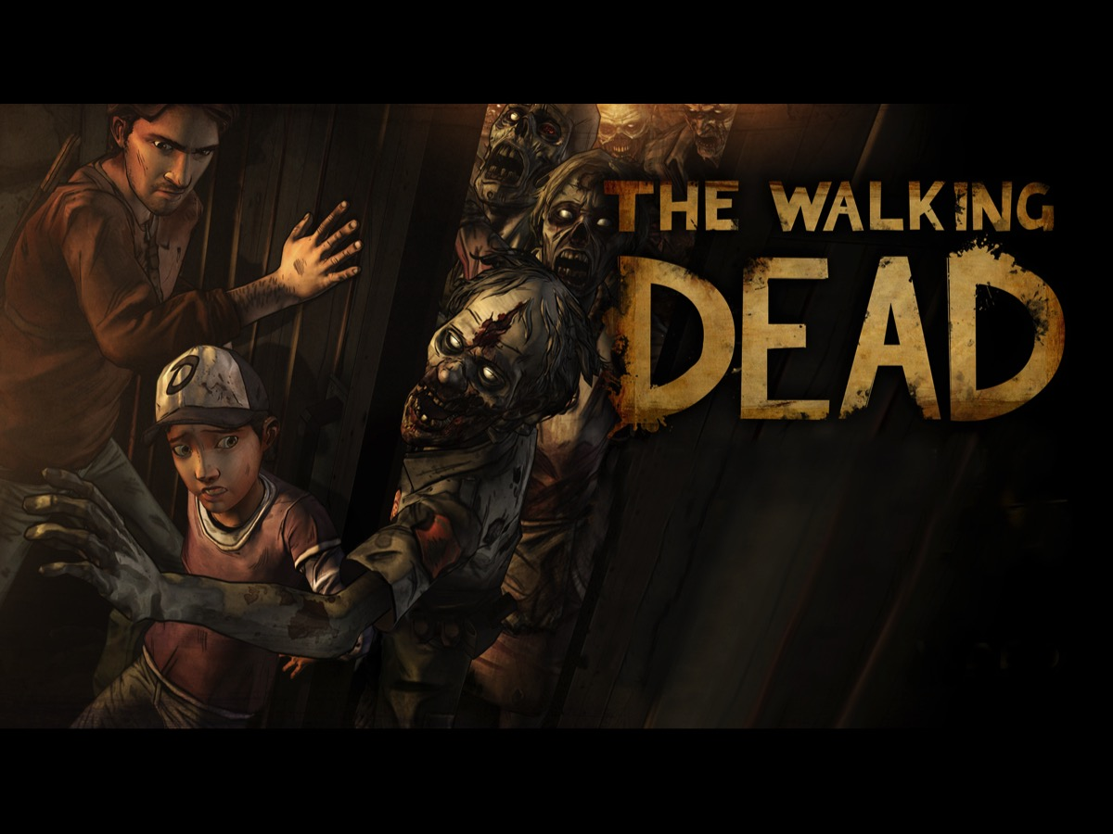
Notes:
And of course, there is the TV series - The Walking Dead - totally gross - I can barely look at the images online let alone consider watching an episode!

Slide 28
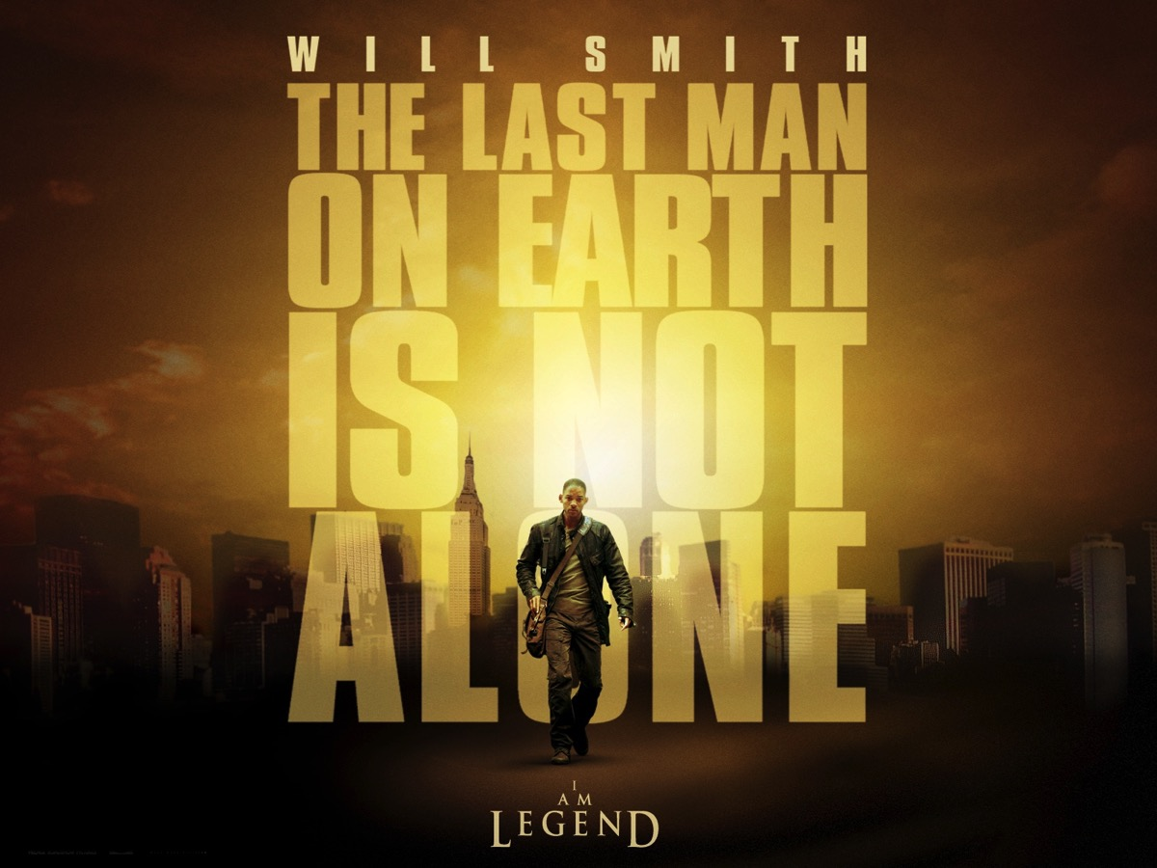
Notes:
And tons of movies about the end of the world like: I Am Legend

Slide 29
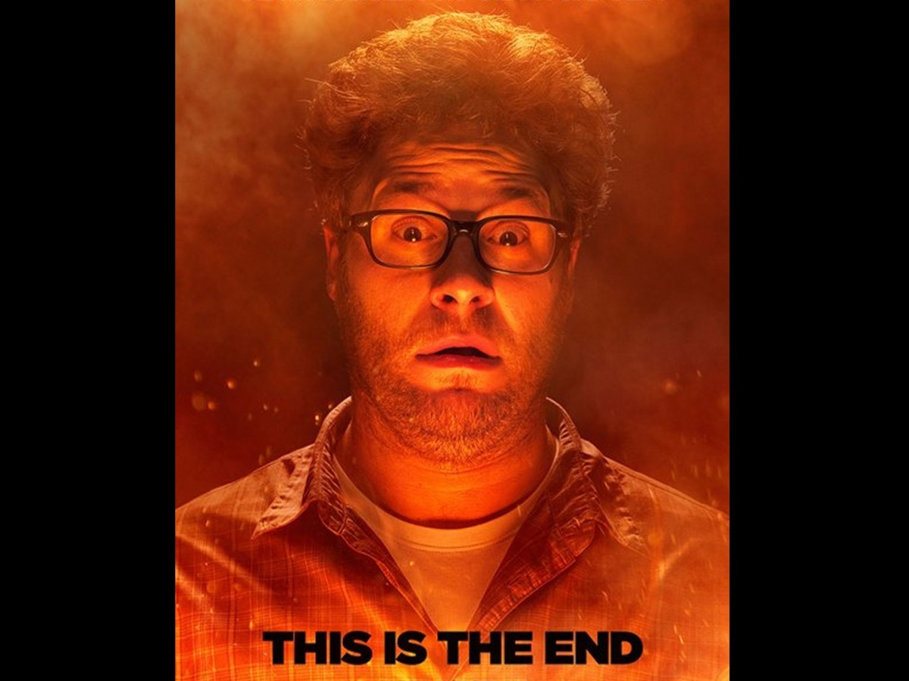
Notes:
And This is the End.

Slide 30
Notes:
This is the EndVideo: An very edited version of the trailer for This Is The End. Get it on YouTube at: https://www.youtube.com/watch?v=Yma-g4gTwlE

Slide 31
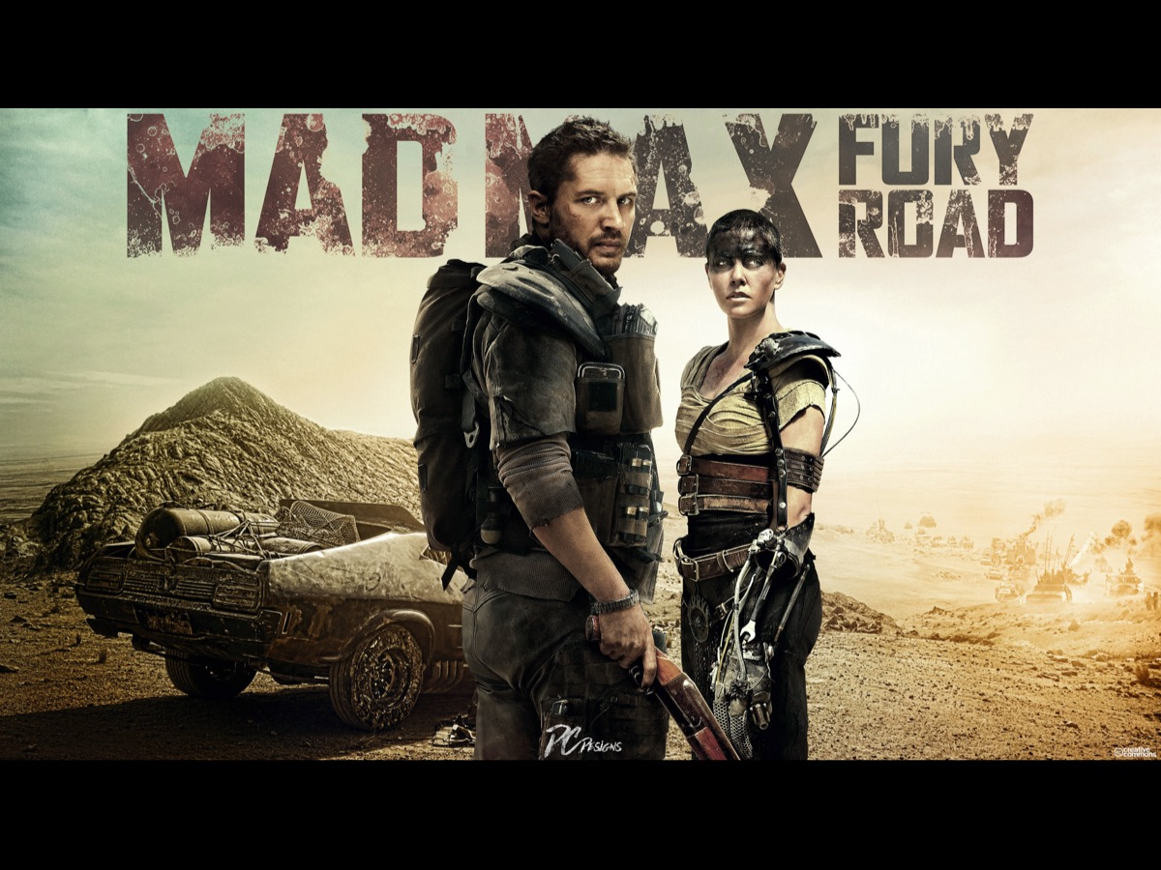
Notes:
And the movie Mad Max is also an apocalyptic tale.

Slide 32
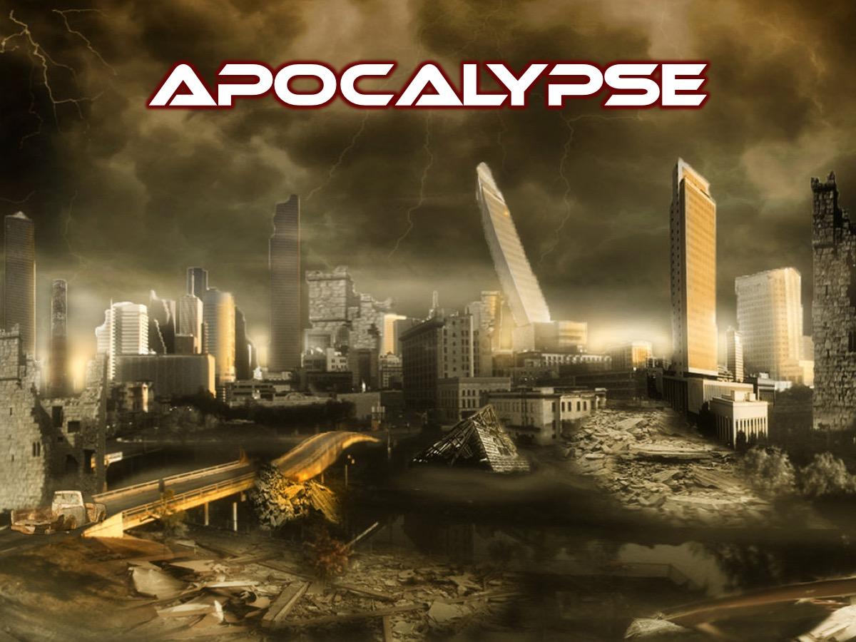
Notes:
To be honest the idea of Apocalypse is hectic and scary!!!

Slide 33
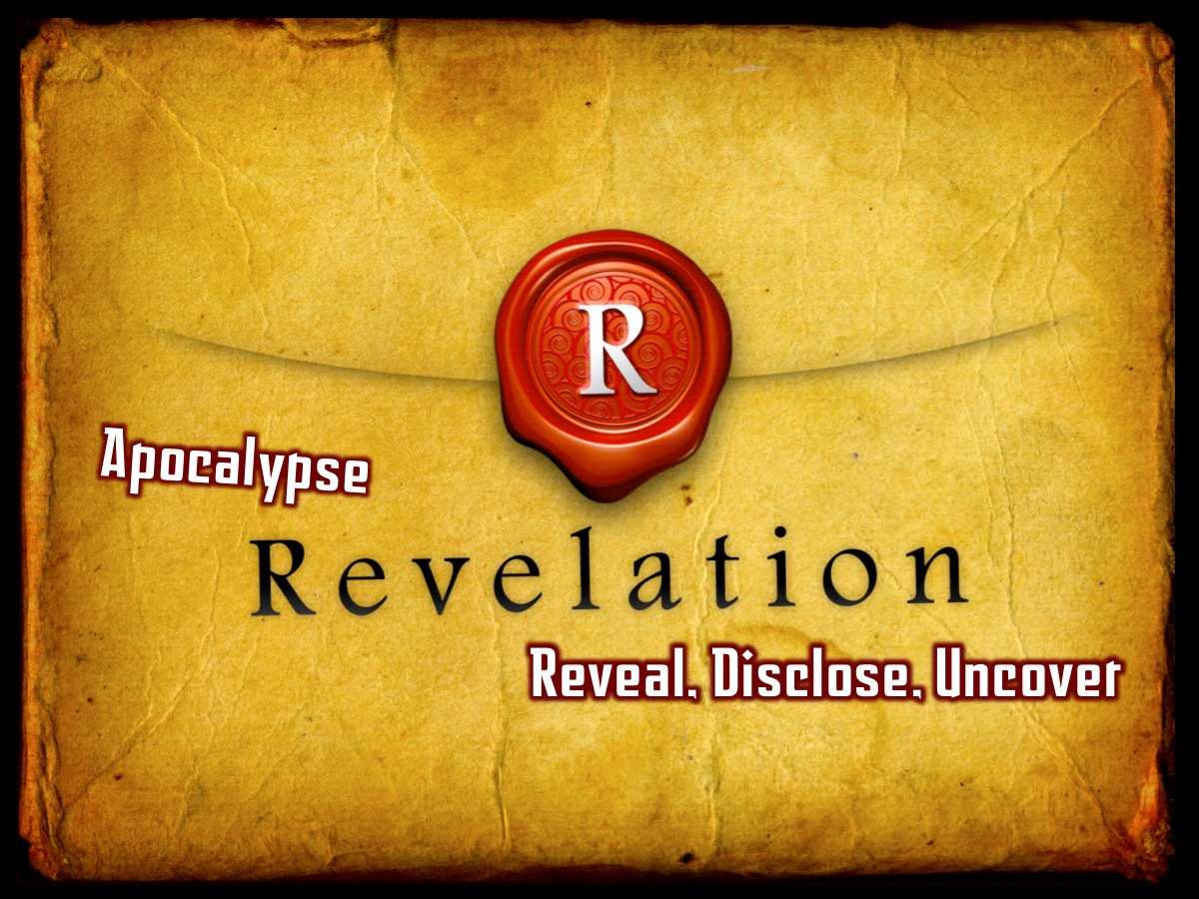
Notes:
The word Apocalypse is actually used in the first chapter of the book of Revelation. In fact, it is the actual word translated as Revelation - and it means to reveal, disciple, uncover.

Slide 34
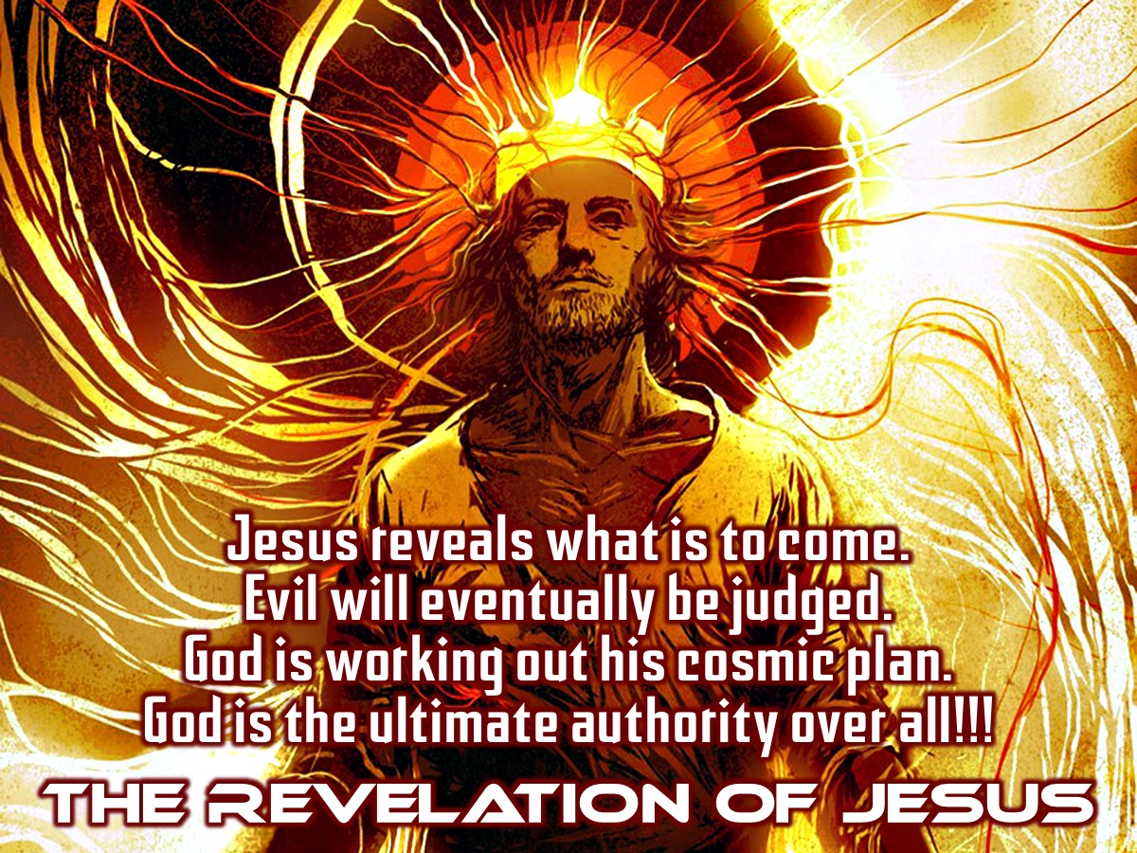
Notes:
It is the Revelation of Jesus Christ - Jesus reveals what is to come in the last book of the Bible. Evil will eventually be judged. God is working out His cosmic plan. God is the ultimate authority over all.

Slide 35
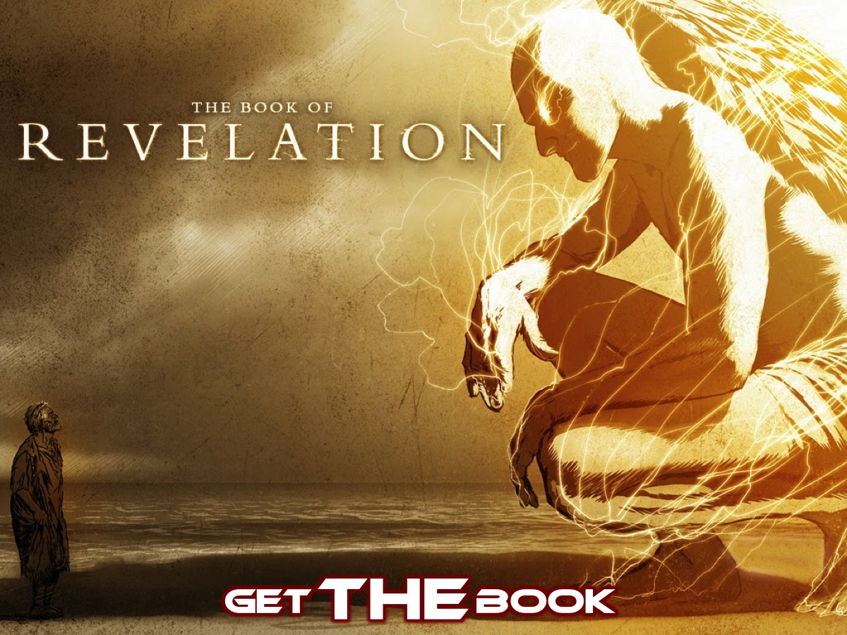
Notes:
Get THE Book. Before we jump into reading the first chapter let’s look at some guidelines to understanding the book of Revelation.
1. Revelation is the answer to a prayer
The Lord's Prayer, to be exact. 'Hallowed be Your name. Your kingdom come. Your will be done, on earth as it is in heaven.' Revelation describes what life looks like when these prayers are answered. 'The whole of Revelation could be regarded as a vision of the fulfillment of the first three petitions of the Lord's Prayer' (Bauckham, Theology of Revelation, 40).
2. Revelation is an invitation to worship
Even a quick reading of Revelation can't miss the way it breaks out into song, again and again. Fabulous songs. One of the great studies is to go through this book and ask, 'what is worth singing about?' For many of its first readers - it was midnight, but the message of the book is that dawn is on the way and so there is reason to sing and worship.
3. Revelation is a mixed genre
Read it carefully and Revelation is obviously a letter, a circular letter written to seven churches in Western Turkey. But it is also prophecy. So put Romans and Ezekiel into a big pot and give it a good stir and we are getting close... But then it is also 'apocalyptic literature', an odd type of writing that lasted 600 years and finished 1000 years ago. It is this combo that makes Revelation such a challenge for us. As we read we have to keep the principles for interpreting all three types of literature in our minds, all at the same time. And with 'apocalyptic' there are five features, expressed in a gradually expanding sentence, to keep in mind:
Revelation is a battle.
Revelation is a battle on a big stage.
Revelation is a battle on a big stage which comes as a vision.
Revelation is a battle on a big stage which comes as a vision filled with symbols.
Revelation is a battle on a big stage which comes as a vision filled with symbols in which there is a victor.
4. Revelation is a letter - all of it.
This was a huge discovery. It is not just ch2-3 that is letter-material. The whole book is a letter (1.4-8; 22.21). That means that the entire letter needs to make sense to its first readers, before we ask what it means to us. Just like it is when we come to 1 Corinthians or 1 Peter. Boy, in one simple observation we have swept away a lot of rubbish in the interpretation of Revelation. But then it is not just for those seven churches in the first century. Given the significance of the number seven (a symbol that suggests completeness), these are not just real churches, they are representative churches. They 'embody every major issue with which the church has struggled in every age in every cultural setting' (D Johnson, Discipleship on the Edge, 51).
And one more thing... Don't think that Revelation is just for persecuted peoples. Not all its first readers in ch2-3 were being persecuted. Revelation is not just about comforting the persecuted, it is also about persecuting the comfortable. There is a message here for everyone. 'It is the complex relationship between the presence, or absence, of accommodation and persecution that drives this letter' (M Gorman, Reading Revelation Responsibly, 25).
5. Revelation is more like a circle, than a straight line
Here we are talking about its structure. The view which sees Revelation as kinda like recording history before it happens is not true enough. It is more likely that the chapters circle around the same events at the end of the age, rather than follow a sequential, straight line toward those events. 'What is revealed next does not happen next' (D Johnson, Discipleship on the Edge, 182). There is no need to get tied in knots about the sequence of events in Revelation.
Two images help me so much here. It is like multiple action replays from different angles and in slow motion, as the same events repeat and resound with growing intensity. Alternatively, if you are more into music than sport, it is like a symphony - with its themes, bridges, variations played by different instruments in the orchestra, before a final climactic flourish. Revelation is so symphonic. It is uncanny.
6. Revelation is more political cartoon, than cryptic crossword
There are symbols everywhere in Revelation. Numbers, colours, animals... We need to resist the impulse to decode them. Don't come at them trying to solve them like a cryptic crossword. Leave them as they are, and then live in the ancient world a bit. Listen for the biblical echoes. Tune your ears to what is going on, a bit like fine-tuning a radio that is a little off the channel. Read up a bit on what the symbols may suggest in the first century.
It is like being impacted by a political cartoon. On a NZ news website a cartoon (like this one) may mean a little to someone in the USA. They will recognise 'Rosa Parks' and the bus - but they still won't 'get it'. What is the padre doing? Who is Louisa Wall? They are listening to another channel. They are living in a different world. And if the cartoon has to be explained to them, or decoded, it will be ruined. The impact is lost. Far better for the American to learn a bit about NZ, tune themselves to this channel, with the issues engaging the attention of its citizens. Then the impact will be felt with a glimpse, in an instant - as it should be. This is kinda like how we need to approach the symbols in Revelation. Remember, Remember. 'To interpret a symbol literally ... is simply to misinterpret' ( R Tate, Biblical Interpretation, 137).
7. Revelation is about two spaces - down here and up there
Any teaching from this letter engages the present situation which the readers face ('down here') with its injustice and idolatry - but it also lifts people to focus on how things look from another transcendent perspective - God's perspective ('up there'). Grasping the forest, not just the trees. The message of Revelation - to which we return in every single sermon - is that God's perspective is the real one, the one that matters.
8. Revelation is about two times - now and then
The Bible may be read forwards, but it is to be lived backwards. It is the certainties of the end ('then') - the Christian hope - which can transform things for us 'now'. Fear and despair may be real, but hope can really triumph. 'Things are not as they seem' (D Johnson). I love the way Greg Liston uses the movie imagery to grasp this. We are to live a 'now showing' life in light of the 'coming soon' reality.
9. Revelation is about two people - 'our Lord and his Christ' (11.15)
Every single sermon comes back to two truths: God is in control and Jesus wins. We must not shy away from the judgement of God. It may be bad news for some, but it is also good news for so many. Their hope is in the judgement of God, that he is in control and able to deal with evil finally and fully. 'God spoke creation into existence ... (and will be) speaking evil into non-existence' (M Gorman, Reading Revelation Responsibly, 152-153). And Jesus wins - not as the mighty Lion, but as the vulnerable Lamb (5.6). 'We have been redeemed from a culture of death by the death of the Lamb for faithfulness to death ... conquering the temptation to give up or give in' (M Gorman, Reading Revelation Responsibly, 177).
10. Revelation is about big truths sweeping across time, not just little details for our own time.
I love the flourish Craig Keener gives to this in the opening pages of his NIVAC commentary on Revelation. This is the stuff which must capture our sermons and fill our preaching...
'God is awesomely majestic, as well as sovereign, in our troubles
Jesus' sacrifice as the lamb ultimately brings complete deliverance to those who trust him
God's judgements on the world are often to serve notice that he will avenge his people
Regardless of how things appear, sin will not go unpunished and God will judge
God accomplishes his purposes through a small and persecuted and powerless remnant
Worship leads us from grief over our sufferings to God's purposes from an eternal perspective
Proclaiming Christ invites persecution which is the normal state of believers in this age
Jesus Christ is worth dying for
A radical contrast exists between God's kingdom and the world's values
The hope God has in mind for us far exceeds our present sufferings
God's plan and church ultimately include representatives of all peoples' (41)
PS - Why Revelation?
to inspire people to hope, faith and courage
to call people to remain faithful and to persevere
to refresh people as imagination and emotion is engaged
to 'follow a slaughtered Lamb wherever he goes'

Slide 36
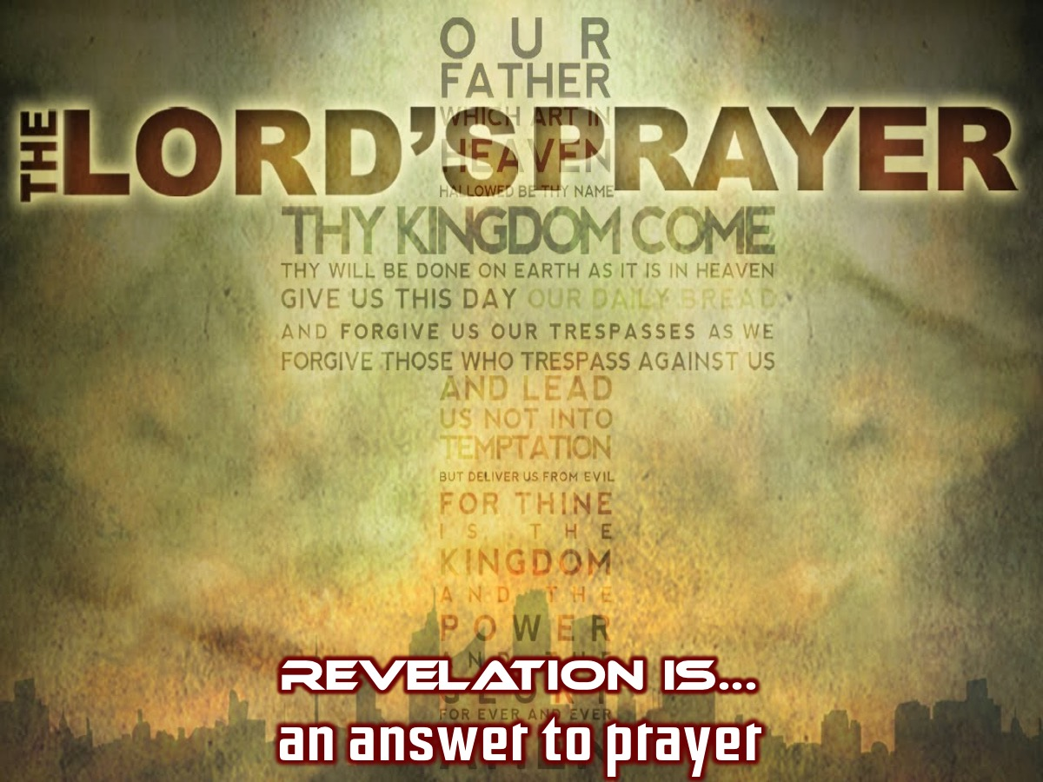
Notes:
1. Revelation is the answer to a prayer. The Lord's Prayer, to be exact. 'Hallowed be Your name. Your kingdom come. Your will be done, on earth as it is in heaven.' Revelation describes what life looks like when these prayers are answered.

Slide 37
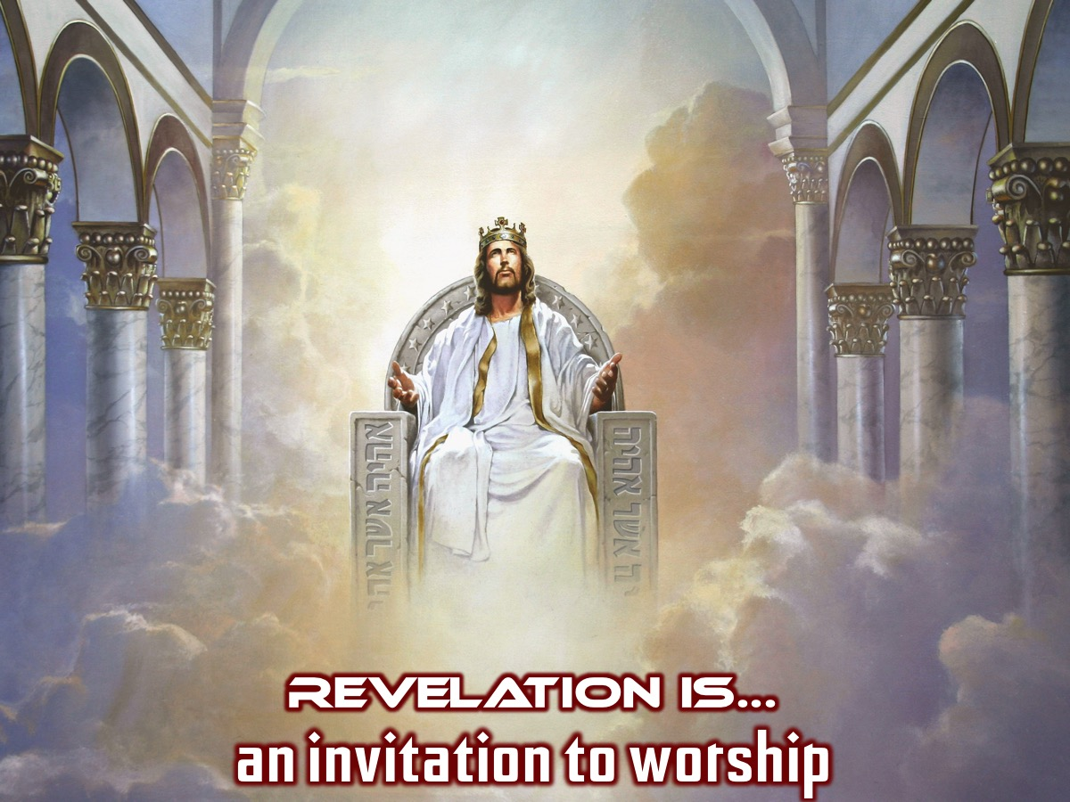
Notes:
2. Revelation is an invitation to worship. Even a quick reading of Revelation can't miss the way it breaks out into song, again and again. One of the great studies is to go through this book and ask, 'what is worth singing about?’ It may be midnight but dawn is on the way and so there is reason to sing and worship.

Slide 38
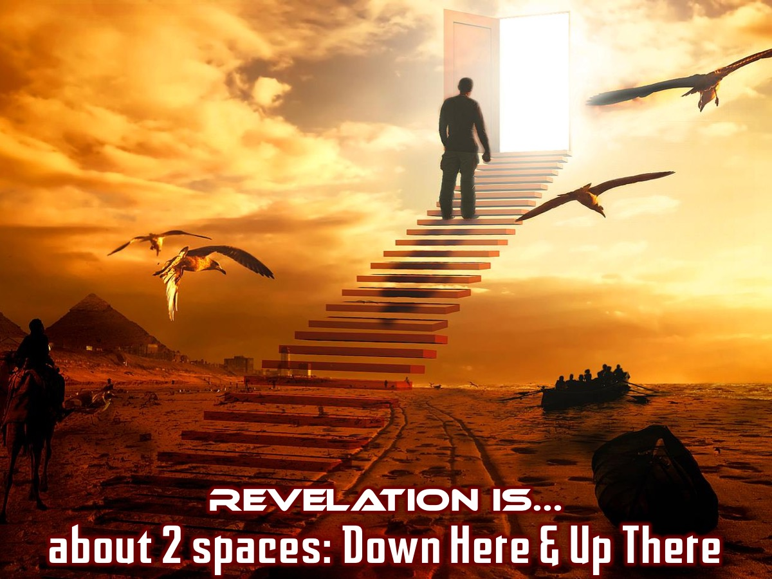
Notes:
3. Revelation is about two spaces - down here and up there. Any teaching from this letter engages the present situation which the readers face ('down here') with its injustice and idolatry - but it also lifts people to focus on how things look from another transcendent perspective - God's perspective ('up there'). The message of Revelation is that God's perspective is the real one, the one that matters.

Slide 39
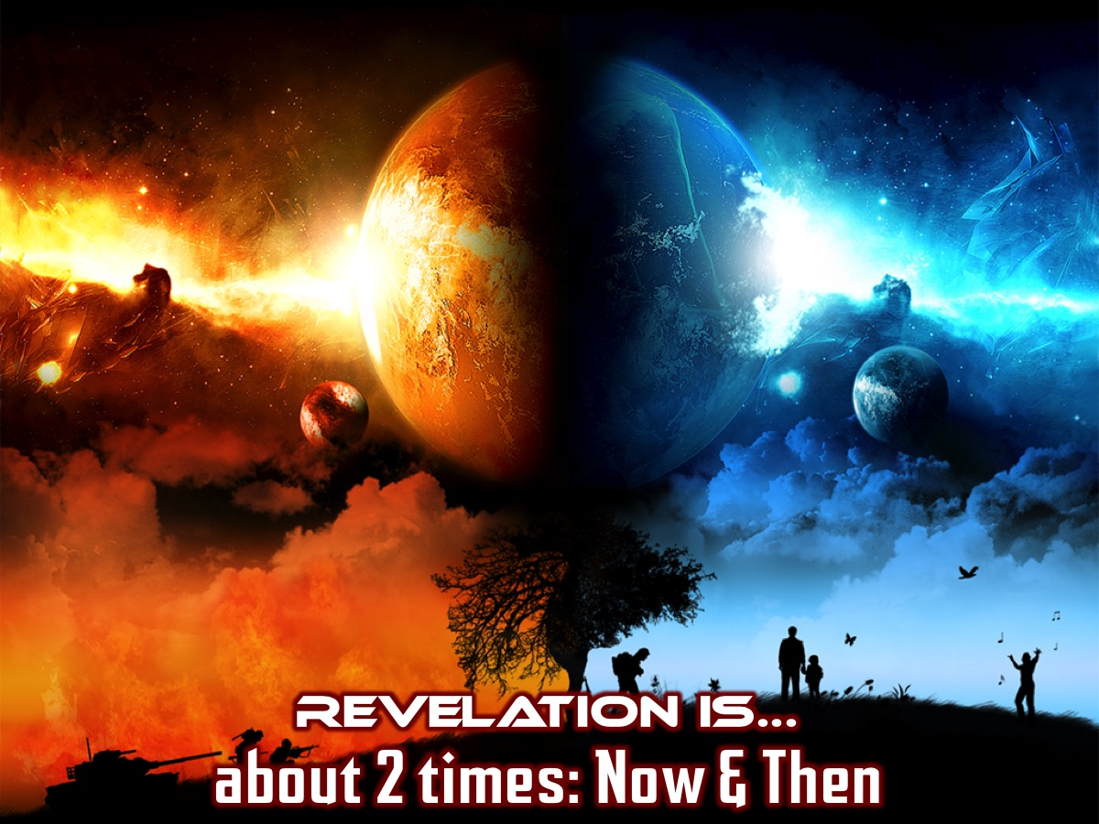
Notes:
4. Revelation is about two times - now and then. The Bible may be read forwards, but it is to be lived backwards. It is the certainties of the end ('then') - the Christian hope - which can transform things for us 'now'. Fear and despair may be real, but hope can really triumph. We are to live a 'now showing' life in light of the 'coming soon' reality.

Slide 40
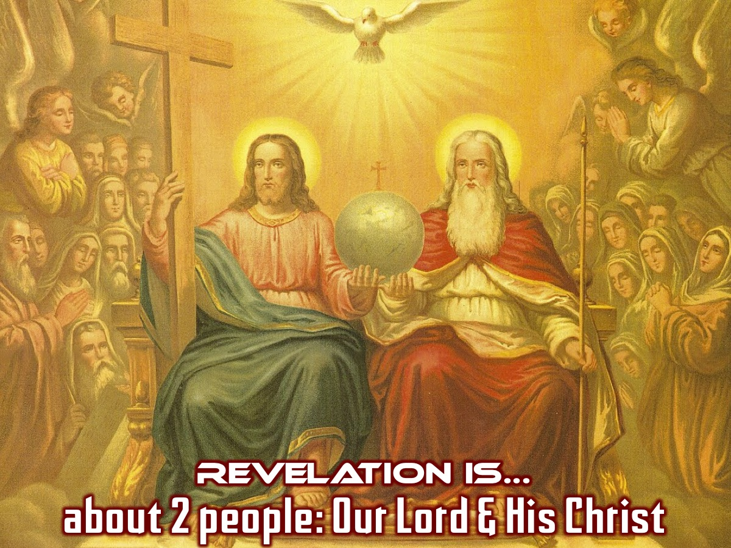
Notes:
5. Revelation is about two people - 'our Lord and his Christ' (11.15). Every single sermon comes back to two truths: God is in control and Jesus wins. We must not shy away from the judgement of God. It may be bad news for some, but it is also good news for so many. Their hope is in the judgement of God, that he is in control and able to deal with evil finally and fully.

Slide 41
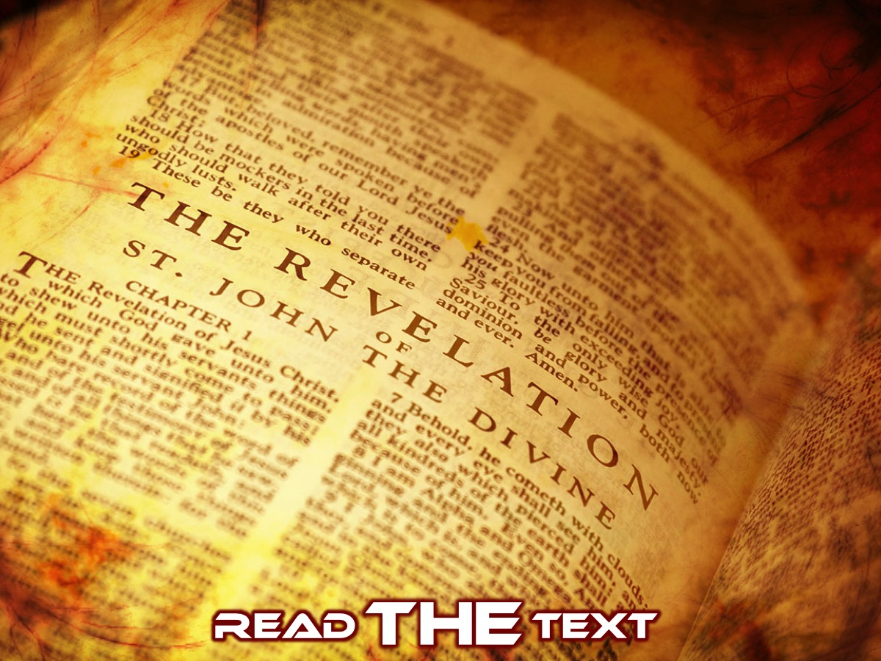
Notes:
Read THE Text. Let’s read the first chapter of the book of Revelation:
1 This is a revelation from Jesus Christ, which God gave him to show his servants the events that must soon take place. He sent an angel to present this revelation to his servant John, 2 who faithfully reported everything he saw. This is his report of the word of God and the testimony of Jesus Christ.
3 God blesses the one who reads the words of this prophecy to the church, and he blesses all who listen to its message and obey what it says, for the time is near.
4 This letter is from John to the seven churches in the province of Asia. Grace and peace to you from the one who is, who always was, and who is still to come; from the sevenfold Spirit[d] before his throne; 5 and from Jesus Christ. He is the faithful witness to these things, the first to rise from the dead, and the ruler of all the kings of the world. All glory to him who loves us and has freed us from our sins by shedding his blood for us. 6 He has made us a Kingdom of priests for God his Father. All glory and power to him forever and ever! Amen.
7 Look! He comes with the clouds of heaven. And everyone will see him even those who pierced him. And all the nations of the world will mourn for him. Yes! Amen!
8 “I am the Alpha and the Omega—the beginning and the end,”[e] says the Lord God. “I am the one who is, who always was, and who is still to come—the Almighty One.”
9 I, John, am your brother and your partner in suffering and in God’s Kingdom and in the patient endurance to which Jesus calls us. I was exiled to the island of Patmos for preaching the word of God and for my testimony about Jesus. 10 It was the Lord’s Day, and I was worshiping in the Spirit. Suddenly, I heard behind me a loud voice like a trumpet blast. 11 It said, “Write in a book everything you see, and send it to the seven churches in the cities of Ephesus, Smyrna, Pergamum, Thyatira, Sardis, Philadelphia, and Laodicea.”
12 When I turned to see who was speaking to me, I saw seven gold lampstands. 13 And standing in the middle of the lampstands was someone like the Son of Man. He was wearing a long robe with a gold sash across his chest. 14 His head and his hair were white like wool, as white as snow. And his eyes were like flames of fire. 15 His feet were like polished bronze refined in a furnace, and his voice thundered like mighty ocean waves. 16 He held seven stars in his right hand, and a sharp two-edged sword came from his mouth. And his face was like the sun in all its brilliance.
17 When I saw him, I fell at his feet as if I were dead. But he laid his right hand on me and said, “Don’t be afraid! I am the First and the Last. 18 I am the living one. I died, but look—I am alive forever and ever! And I hold the keys of death and the grave.
19 “Write down what you have seen—both the things that are now happening and the things that will happen. 20 This is the meaning of the mystery of the seven stars you saw in my right hand and the seven gold lampstands: The seven stars are the angels of the seven churches, and the seven lampstands are the seven churches.

Slide 42
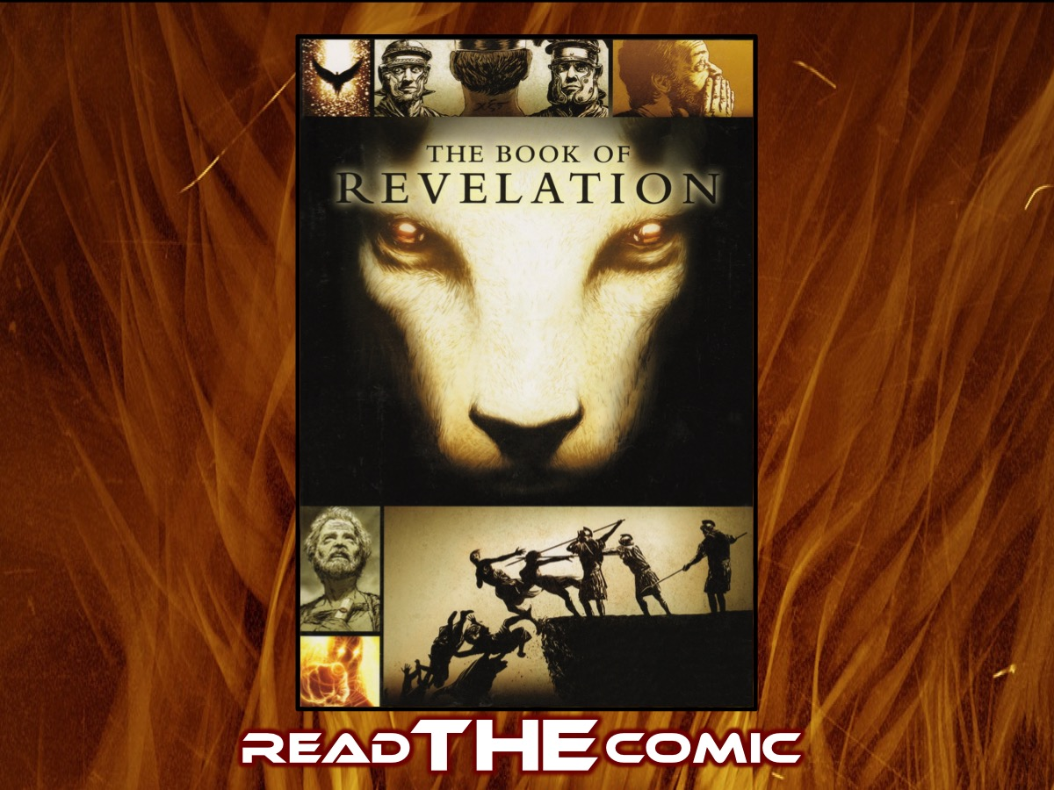
Notes:
Read THE Comic. We have placed copies of a Graphic Novel on the walls around the youth room - you have a few minutes to find one of the stations and read it through.

Slide 43
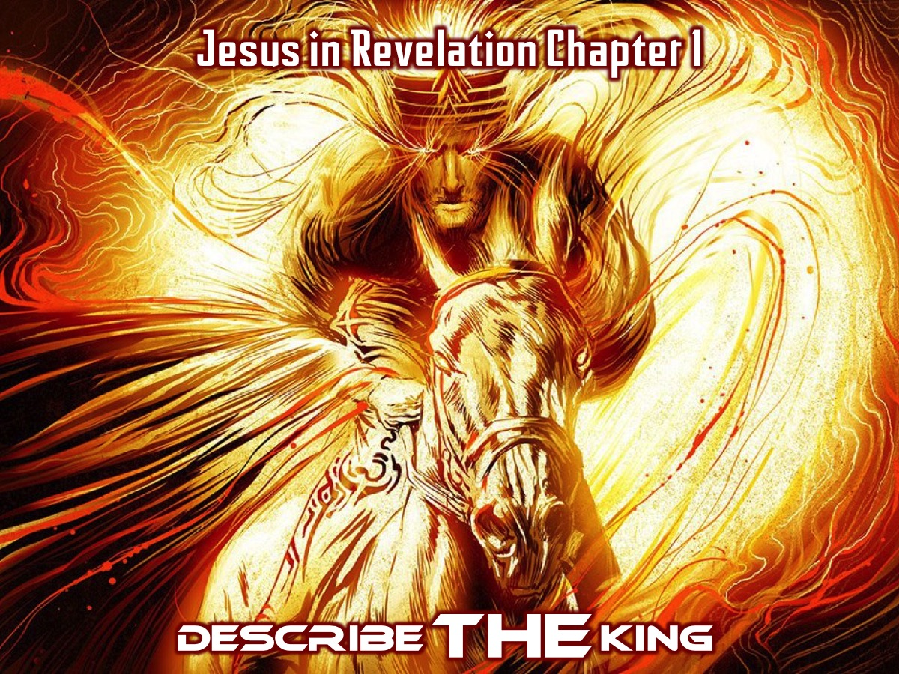
Notes:
Describe THE King. We have a graffiti wall where you are going to go and write down what chapter 1 of Revelation says about Jesus.

Slide 44
Notes:
To inspire you, here is a video that tries to bring the vision that John had of Jesus to life…
Video: Revelations REVEALED Chapter 1 Mini Series. Get it on YouTube at: https://www.youtube.com/watch?v=60Pv2st-R50
(The video was edited to focus on Jesus)

Slide 45
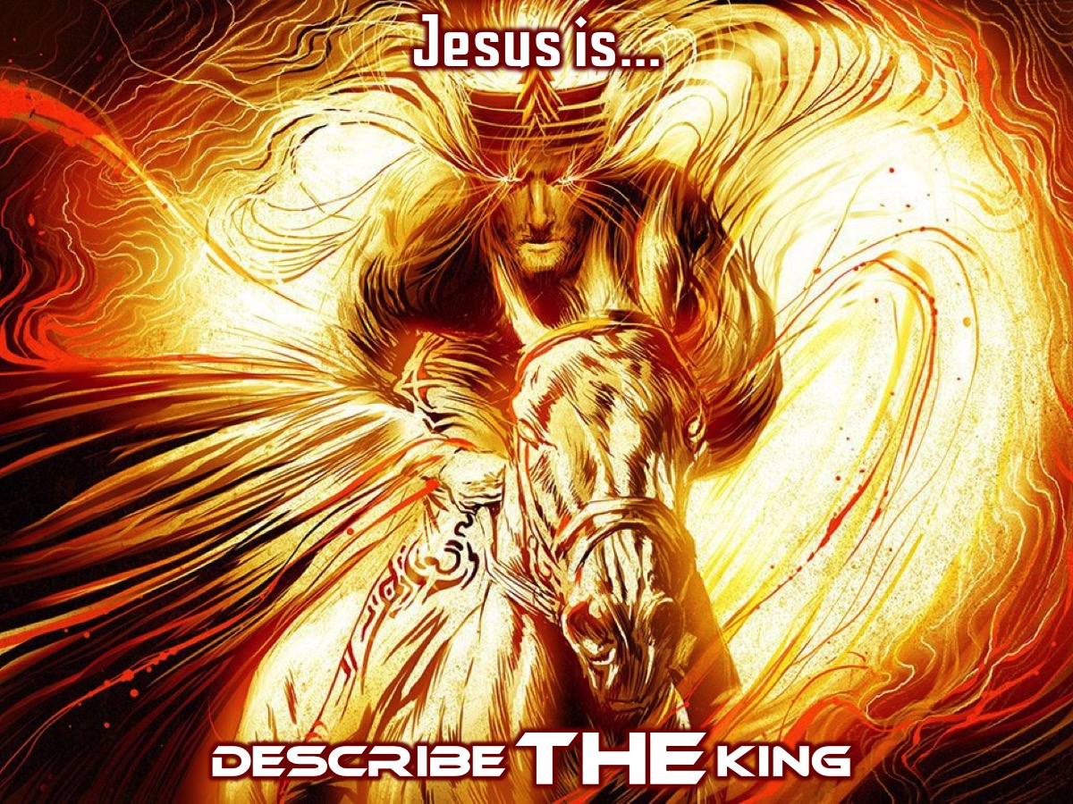
Notes:
So go to the wall and write something about who Jesus is revealed in Revelation chapter 1. There are posters on the wall with the text that you can take a look at to remember some of the features.

Slide 46
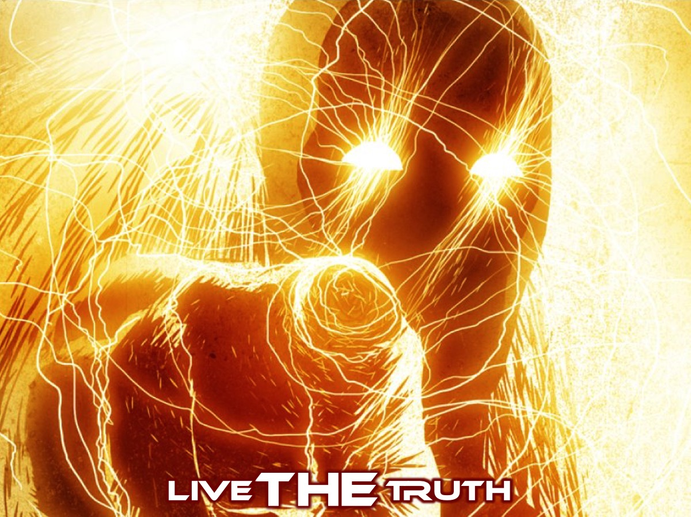
Notes:
Live THE Truth. I want you to take something away with you this morning - this is your chance to reflect on something we have explored this morning. You can go to the graffiti wall or to the comic walls or to the readings and see what you can live out this coming week. What is the Lord saying to you?

Slide 47
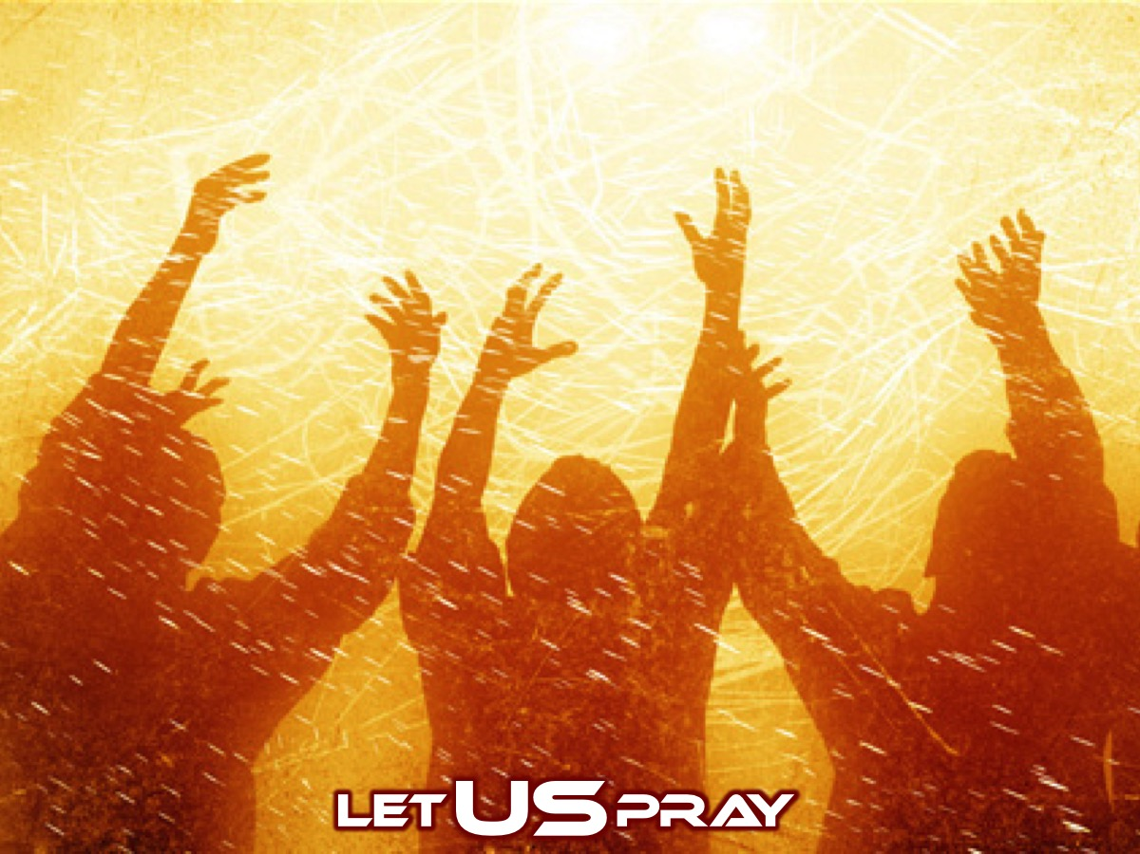
Notes:
Let US Pray

Slide 48
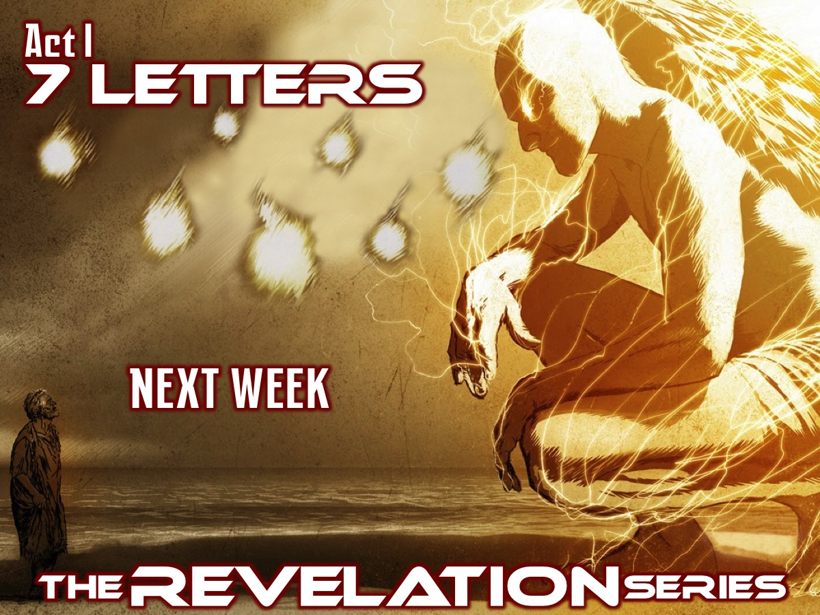
Notes:
Next week we will look at Act I: 7 Letters (Revelation 2:1-3:22).

