Slide 1

Notes:
Welcome to The Revelation Series.

Slide 2
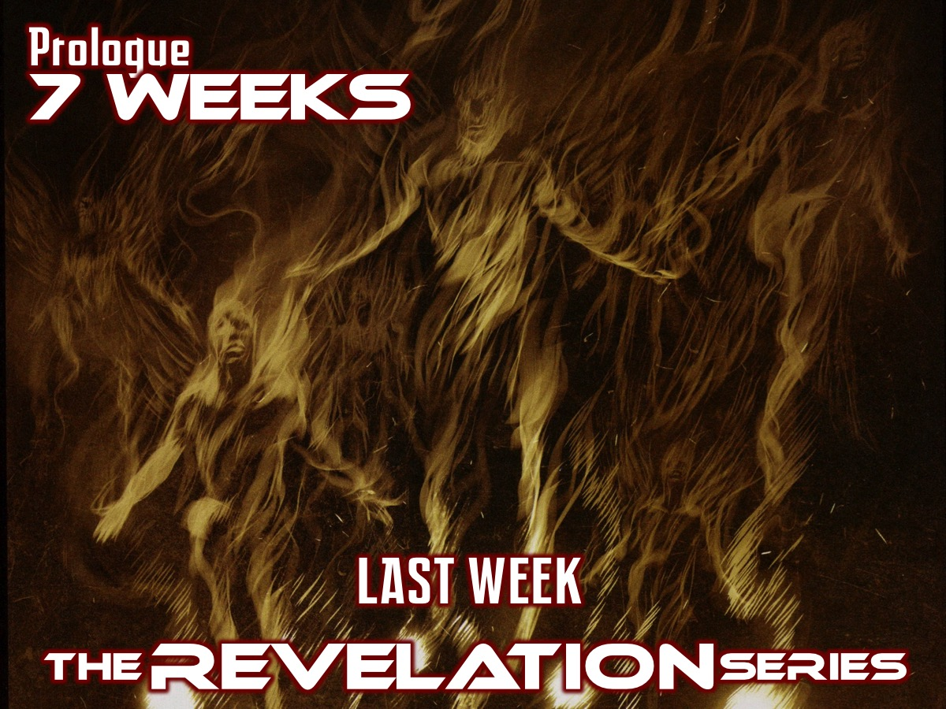
Notes:
Last week we explored the Prologue (Revelation 1:1-20) and introduced the next 7 Weeks in this series.

Slide 3
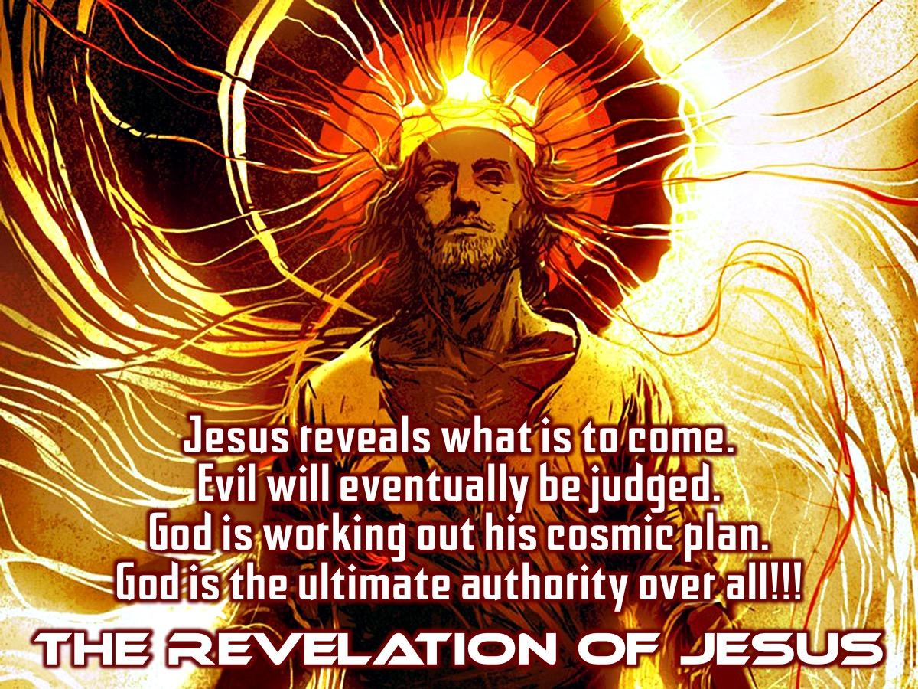
Notes:
This book of Revelation is actually the Revelation of Jesus Christ - Jesus reveals what is to come in the last book of the Bible. Evil will eventually be judged. God is working out His cosmic plan. God is the ultimate authority over all.

Slide 4
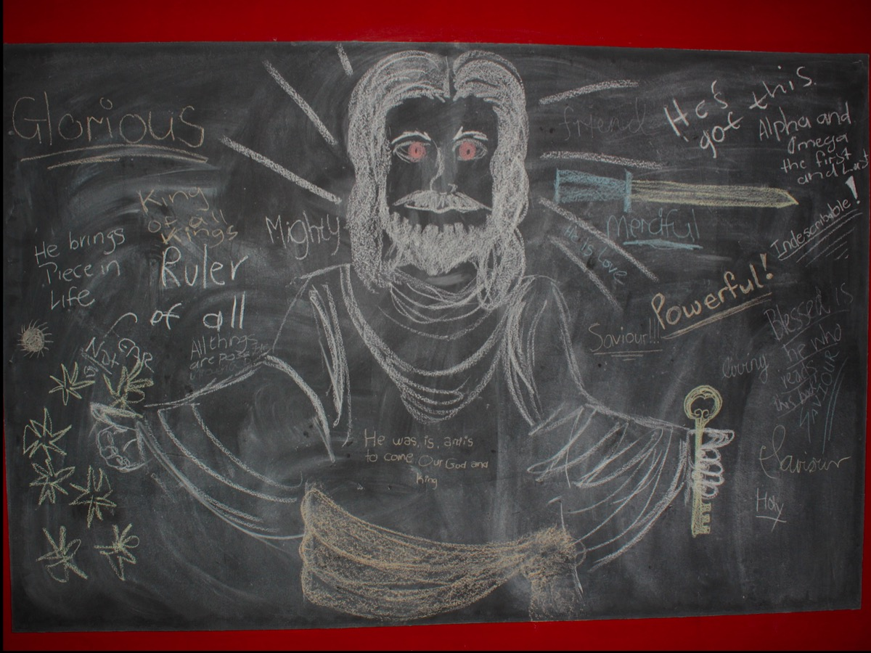
Notes:
We had a graffiti wall where you got to write down who Jesus is from chapter 1 of Revelation.

Slide 5
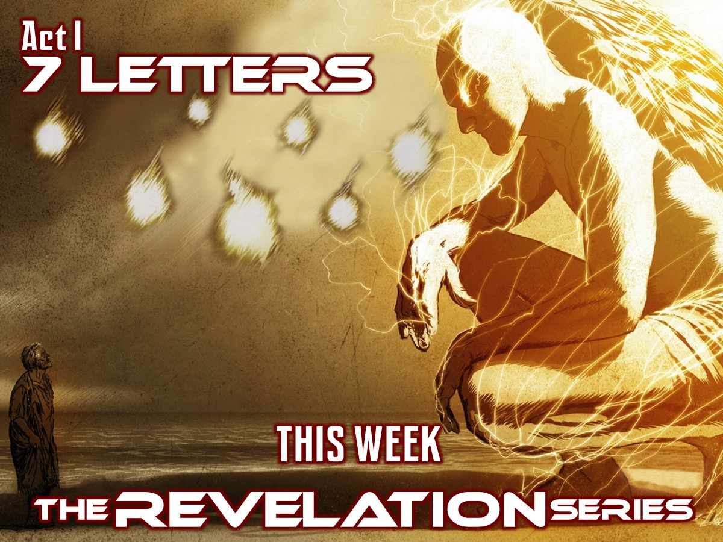
Notes:
This week we are going to experience Act I: 7 Letters (Revelation 2:1-3:22).

Slide 6

Notes:
Ask YOUR Friend: What “letter” have you received that meant the world to you?

Slide 7
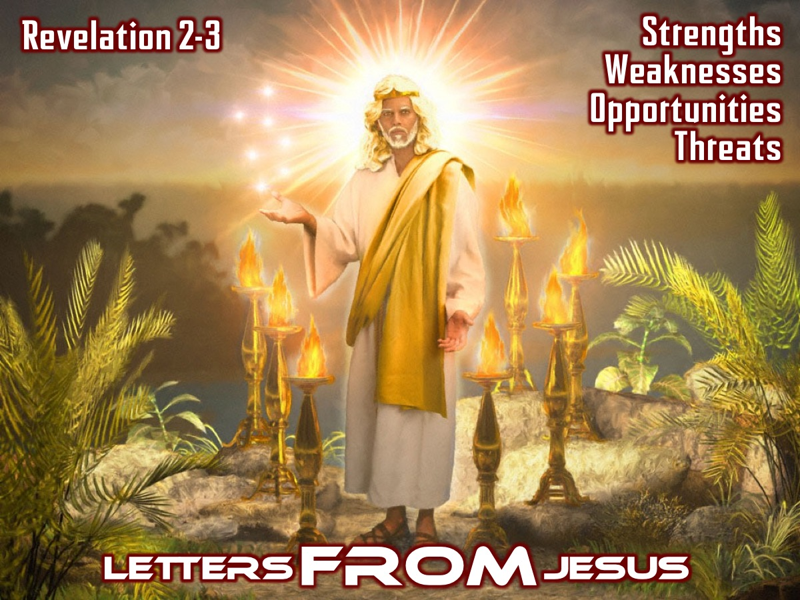
Notes:
Letters FROM Jesus. Jesus wrote letters to 7 churches in Asia Minor recorded for us in revelation chapter 2 and 3. The structure of each letter is similar - Jesus looks at their strengths, weaknesses, opportunities and threats.

Slide 8
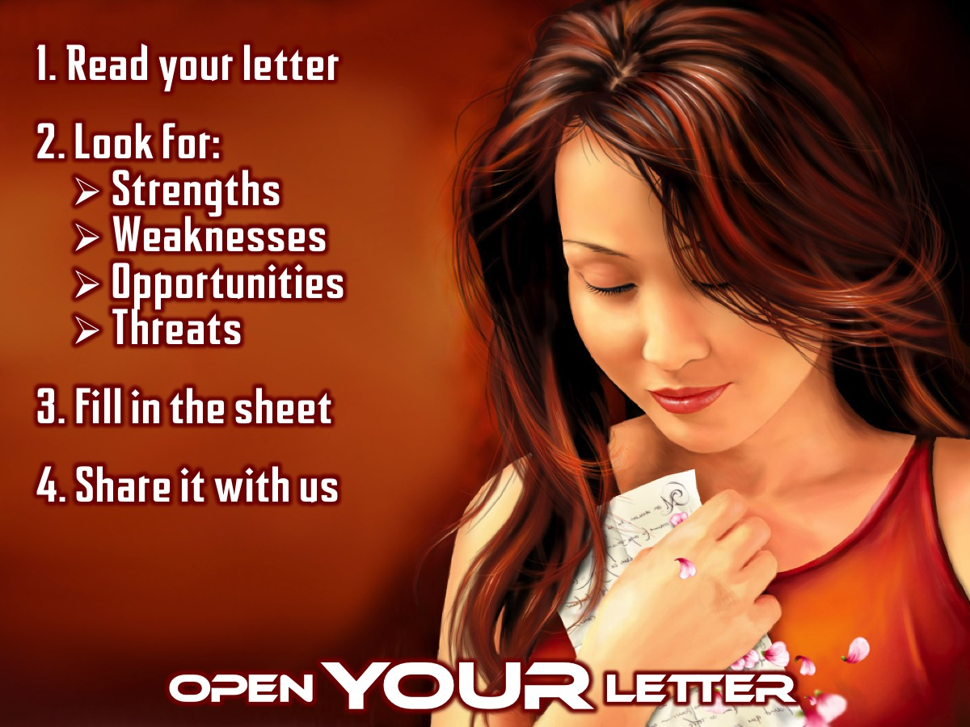
Notes:
Open YOUR Letter. You are seated at one of the 7 tables and you have been given one of the letters to open - you need to read the letter (there is a text version on your table and a comic version) and fill in the handout where you will write down any strengths, weaknesses, opportunities and threats that you find.

Slide 9
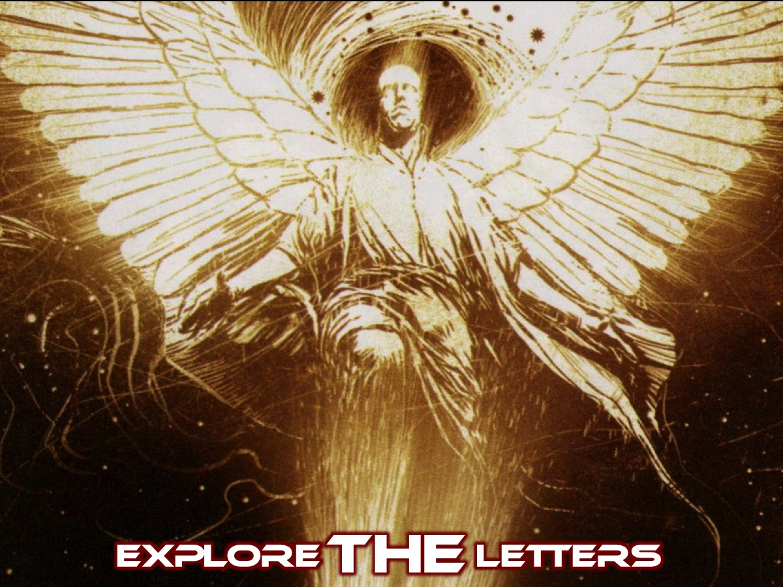
Notes:
Explore THE Letters. Each group is going to share ONE strength, weakness, opportunity and threat from their church and we will dig a bit deeper into each church along the way.

Slide 10
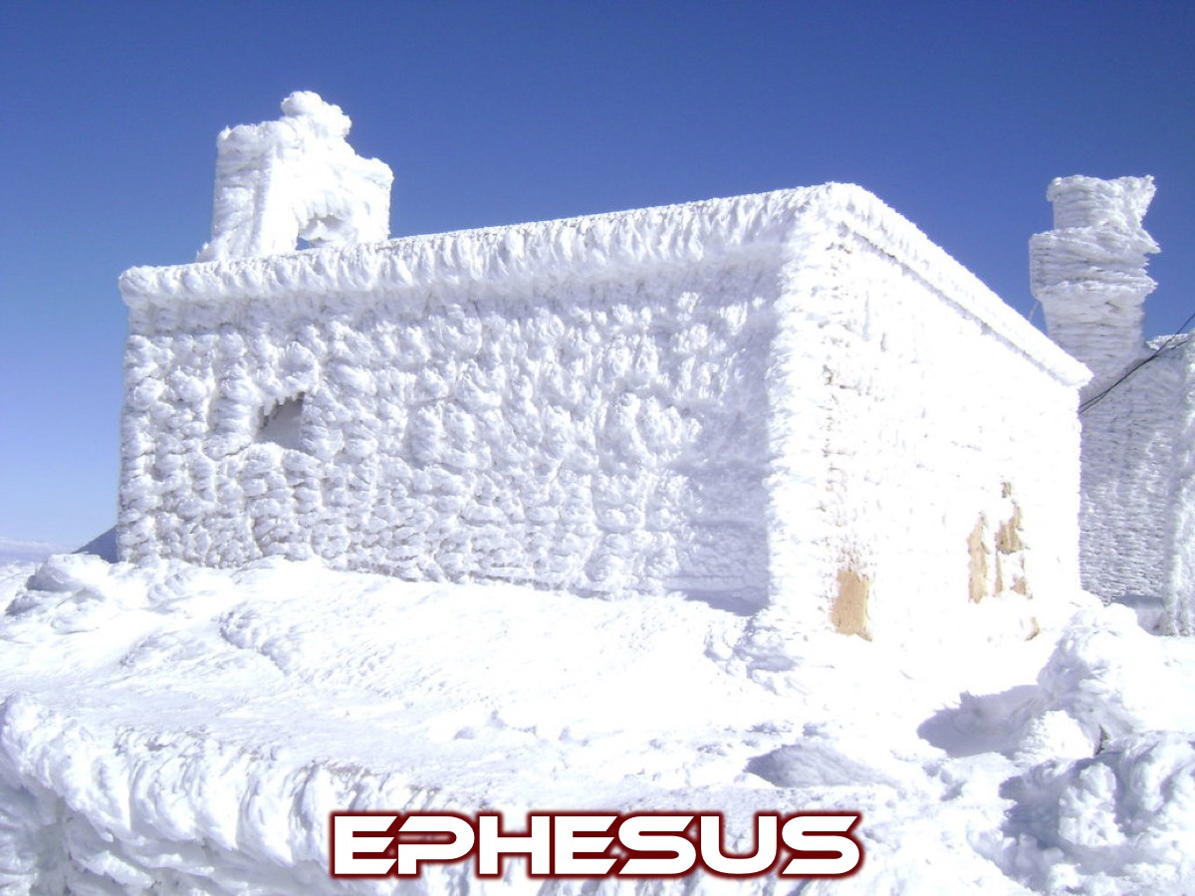
Notes:
1. Ephesus. The Ephesus group will share ONE strength, weakness, opportunity and threat from this church.

Slide 11
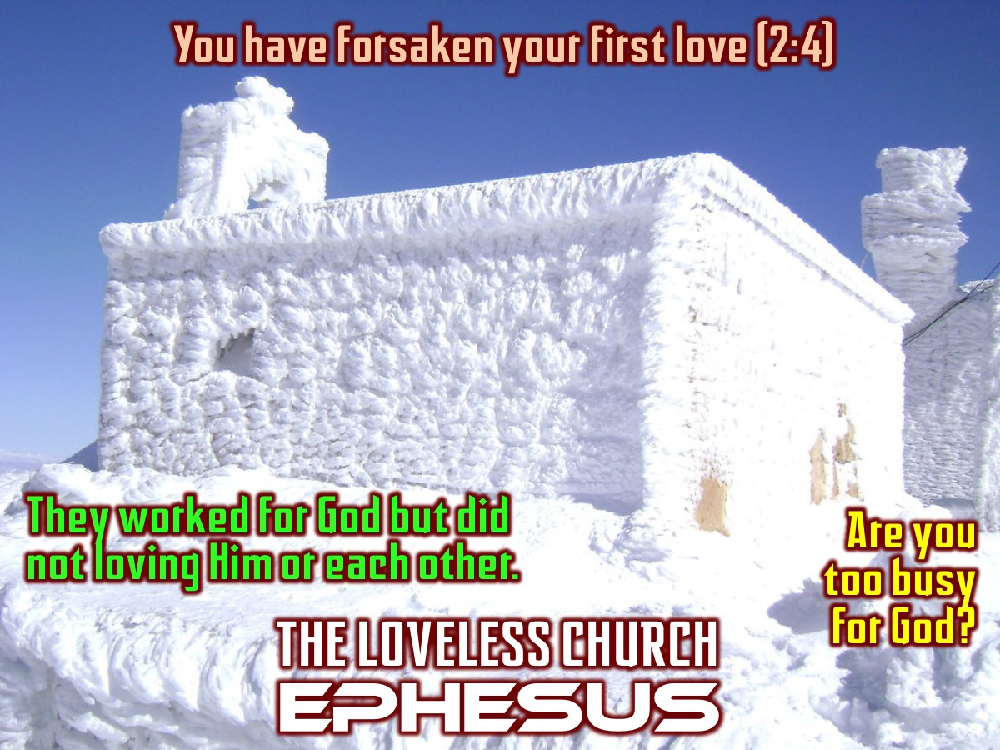
Notes:
Ephesus was the Loveless Church.
Verse: “You have forsaken your first love.” (2:4)
Challenge: This church was so busy with Gods work that they forgot to love God or each other.
Implication: We can become so busy doing God’s work - even reading and studying Gods word - that we forgot to spend time talking to God. If you can think of a time you loved and felt closer to God than you do now then this letter was written to you!

Slide 12
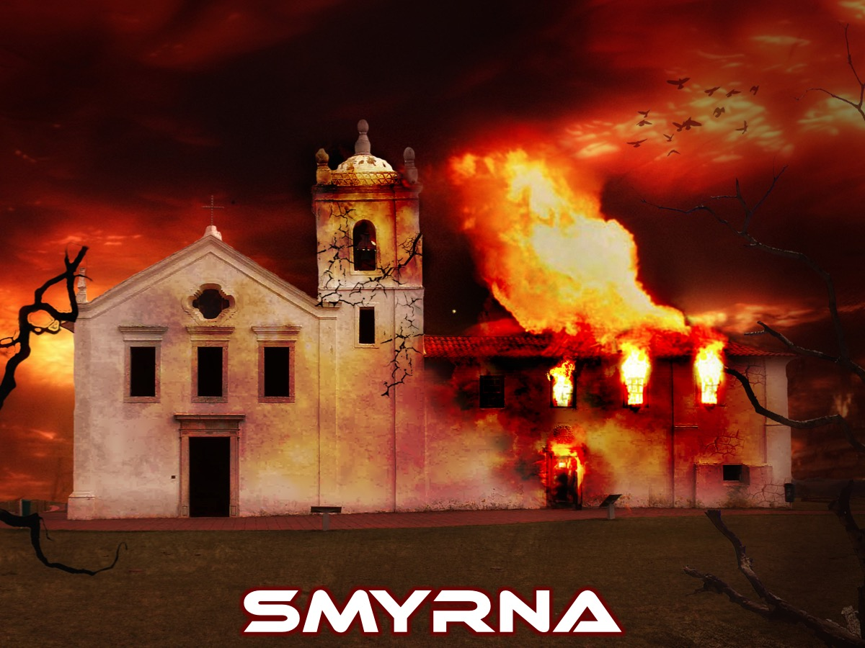
Notes:
2. Smyrna. The Smyrna group will share ONE strength, weakness, opportunity and threat from this church.

Slide 13
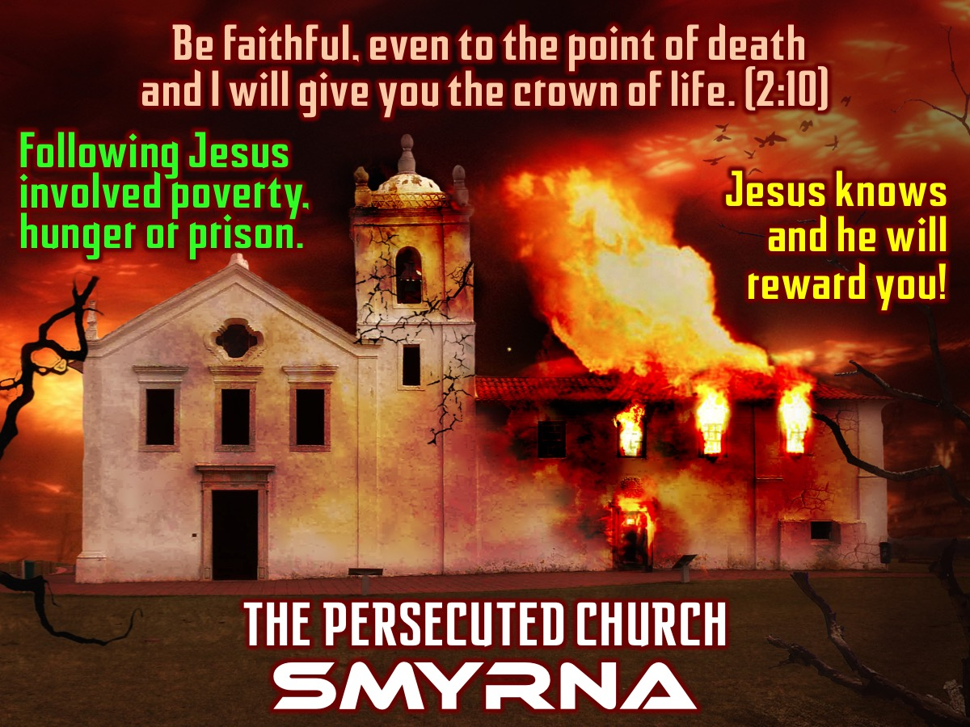
Notes:
Smyrna was the Persecuted Church.
Verse: “Be faithful, even to the point of death and I will give you the crown of life.” (2:10)
Encouragement: Many of the people who were a part of this church because of their conversion to Christianity lost their jobs resulting in poverty, hunger and imprisonment which often ended at being burned on a stake or ripped apart by beasts!
Implication: knowing that Jesus knows us and he knows what we are going through because he himself has suffered much. And that God would give you life as your victors crown.

Slide 14
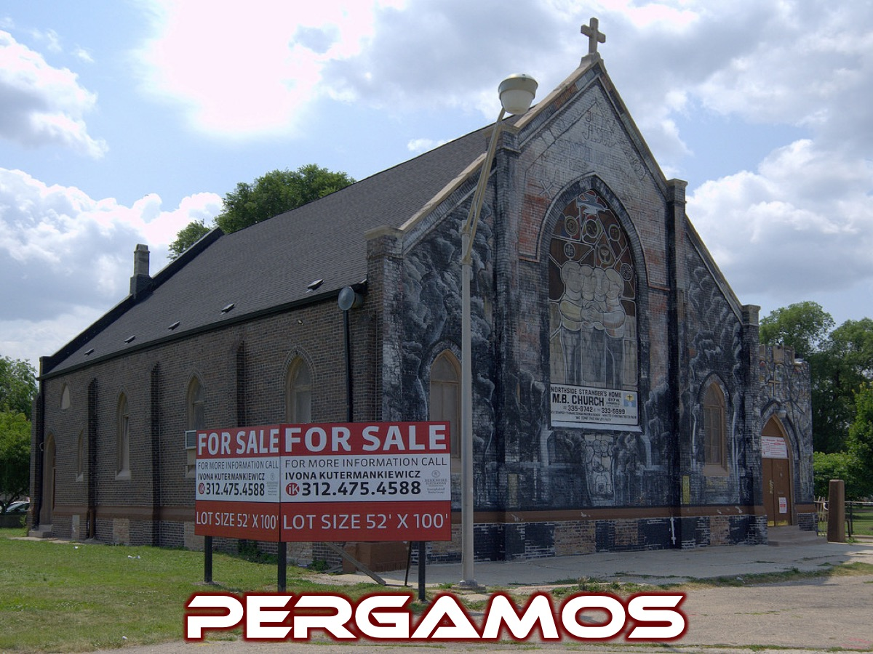
Notes:
3. Pergamos. The Pergamos group will share ONE strength, weakness, opportunity and threat from this church.

Slide 15
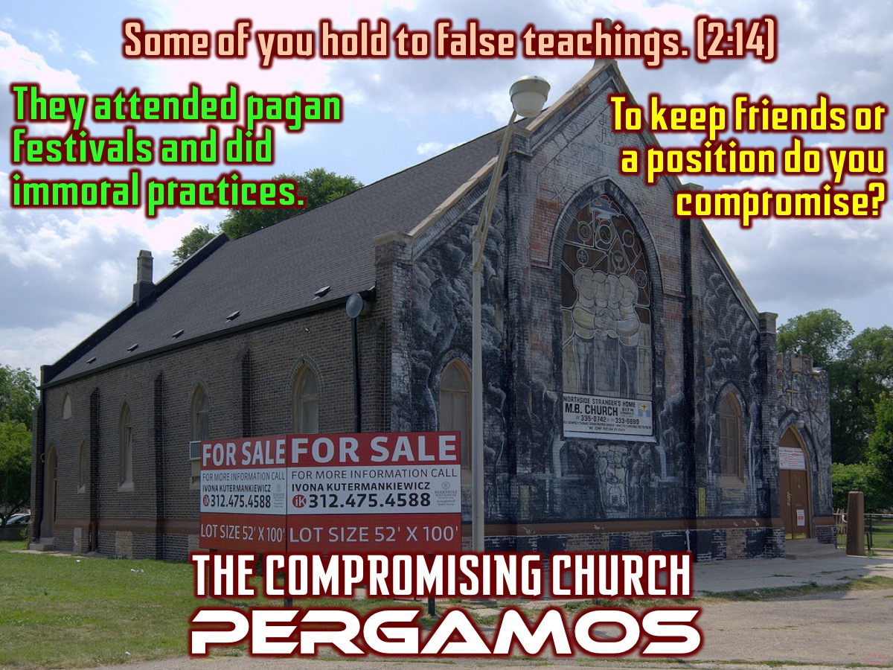
Notes:
Pergamos was the Compromising Church.
Verse: “There are some among you who hold to the teaching of Balaam, who taught Balak to entice the Israelites to sin so that they ate food sacrificed to idols and committed sexual immorality.” (2:14).
Challenge: Some of these believers had attended pagan festivals and even practised some of their immoral practises. It was really hard not to be tempted into these elaborate festivals. Others felt it was ok to attend these festivals as long as they didn’t participate in any of the rituals.
Implication: Are we afraid to lose friends our position in our school so we compromise our beliefs just a little to keep face?

Slide 16
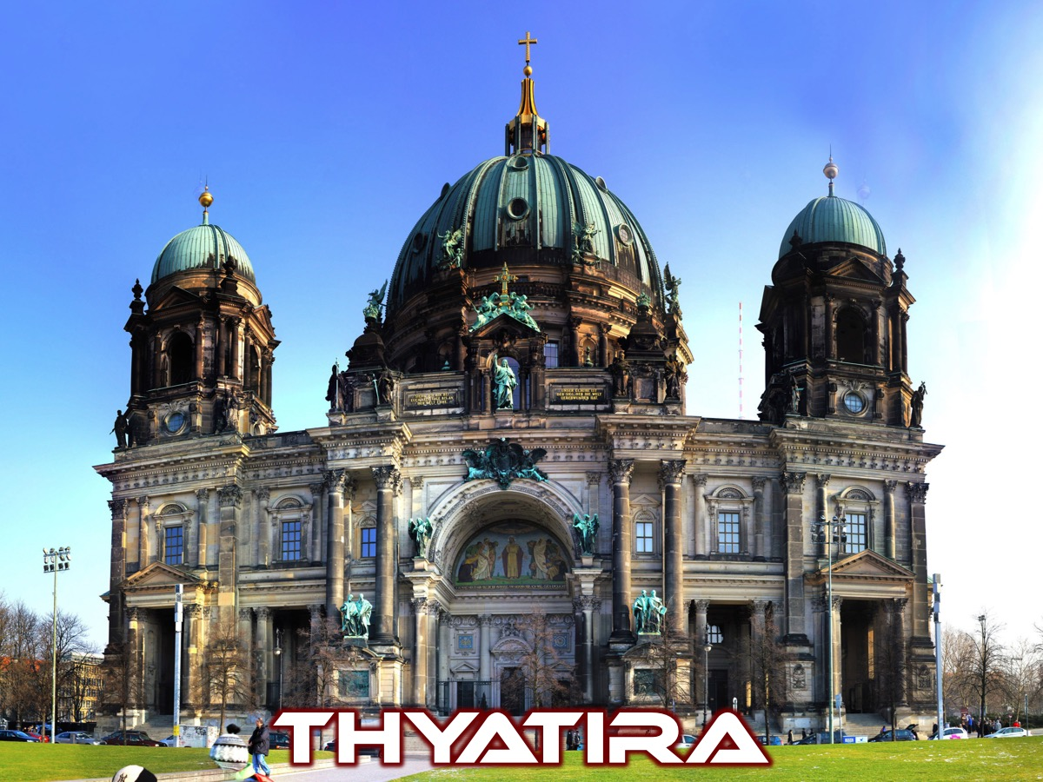
Notes:
4. Thyatira. The Thyatira group will share one strength, weakness, opportunity and threat from this church.

Slide 17
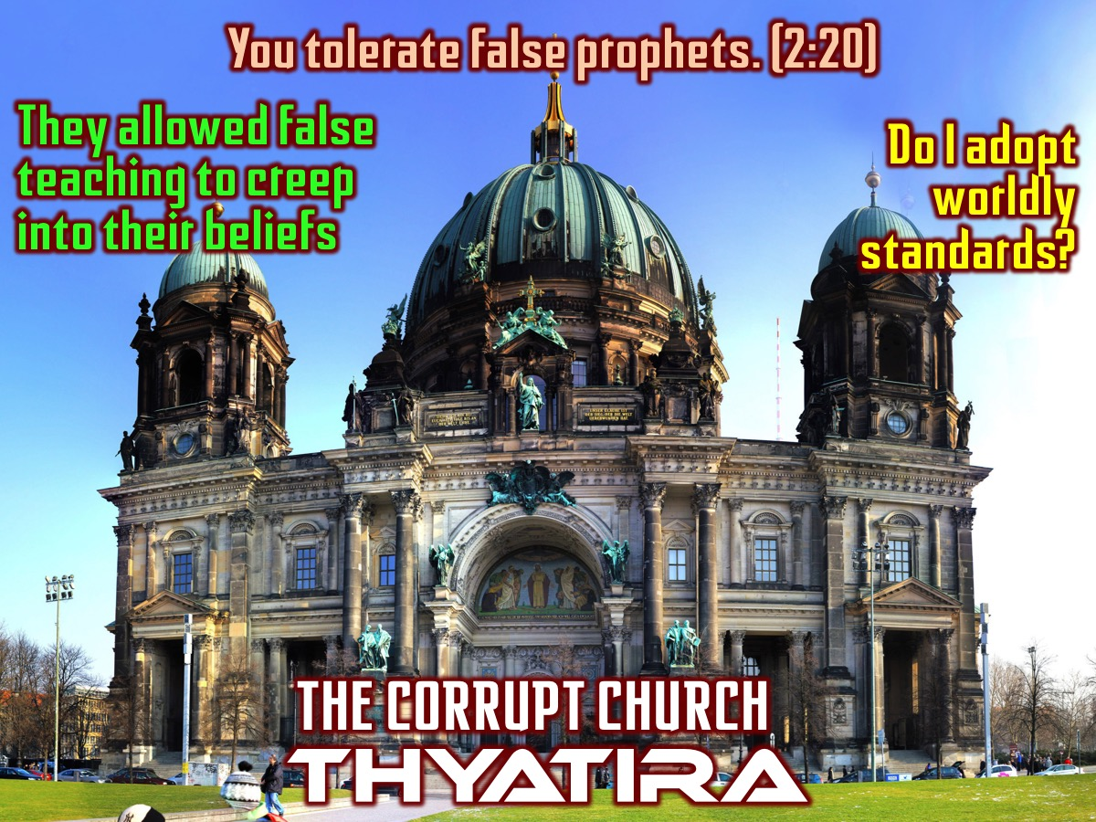
Notes:
Thyatira was the Corrupt Church.
Verse: “Never the less I have this against you; You tolerate that woman Jesebel, who calls herself a prophet, by her teaching she misleads my servants into sexual immorality and the eating of food sacrificed to idols.” (2:20)
Challenge: This church was good at Charity work, they ran good services, that believed in Jesus and they had endurance as they too faced persecution. So what is wrong? They allowed false teachings to creep into their beliefs like sleeping around was OK.
Implication: So today we have to ask ourselves how much should I accept and adopt worldly standard and practises. (Romans 12:2)

Slide 18
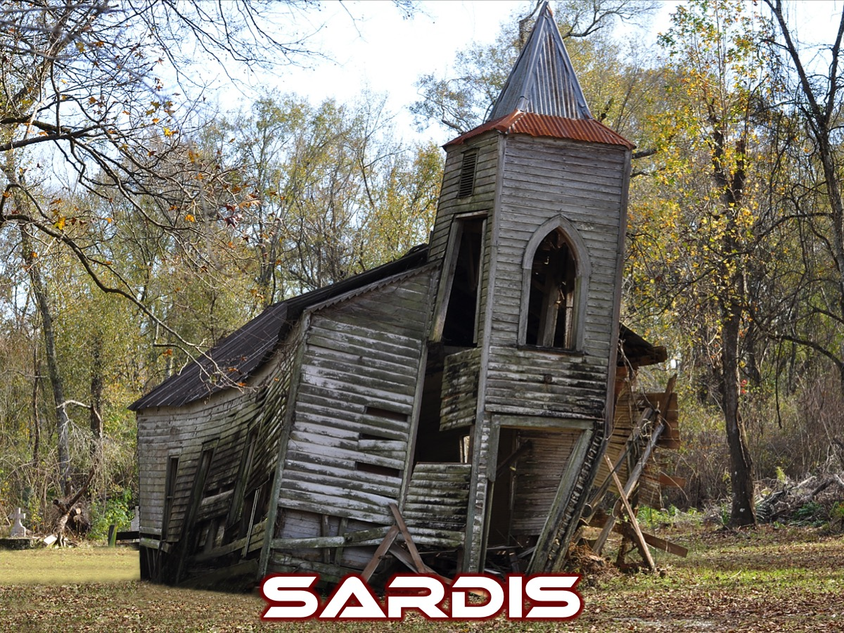
Notes:
5. Sardis. The Sardis group will share one strength, weakness, opportunity and threat from this church.

Slide 19
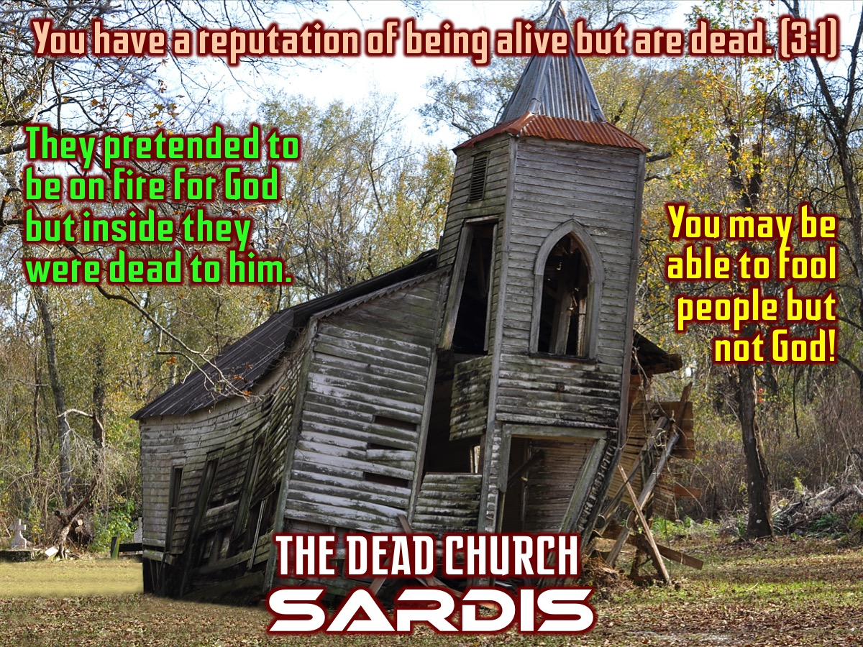
Notes:
Sardis was the Dead Church.
Verse: “I know your deeds, you have a reputation of being alive, but you are dead. Wake up!!!” (3:1)
Challenge: Do you have a reputation of being alive and on fire for God. And yet in the inside you are dead to him.
Implication: You may be able to fool others but you cannot fool yourself or God!

Slide 20
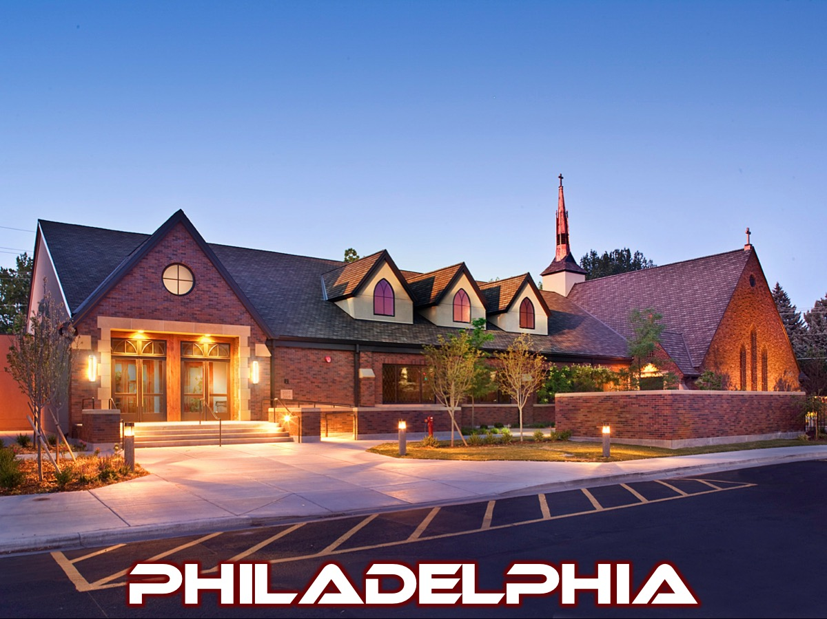
Notes:
6. Philadelphia. The Philadelphia group will share one strength, weakness, opportunity and threat from this church.

Slide 21
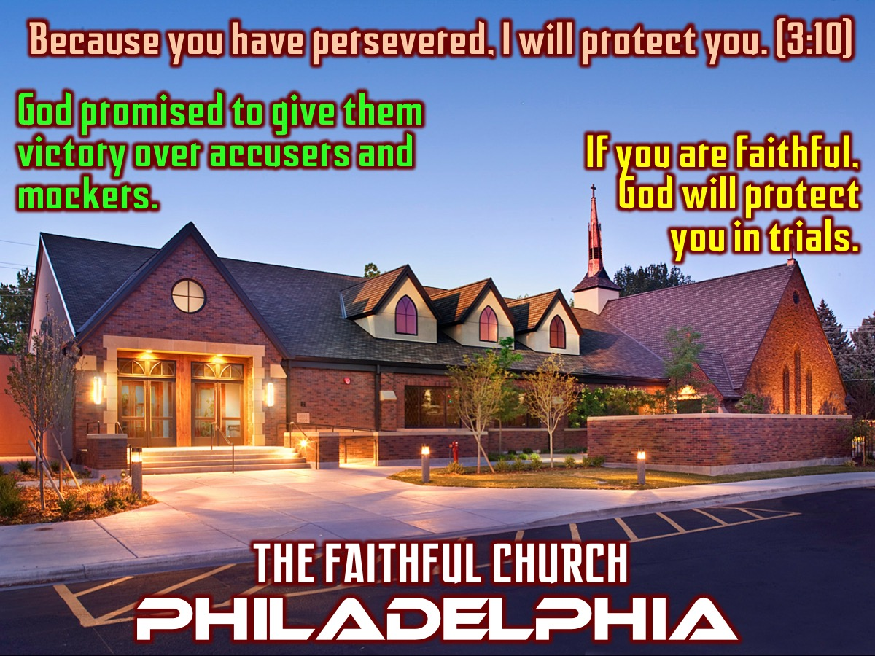
Notes:
Philadelphia was the Faithful Church.
Verse: “Because you have obeyed my command to persevere, I will protect you from the great time of testing that will come upon the whole world to test those who belong to this world.” (3:10)
Challenge: God promised to give them victory over accusers and mockers.
Implication: If you are faithful, God will protect you in trials.

Slide 22
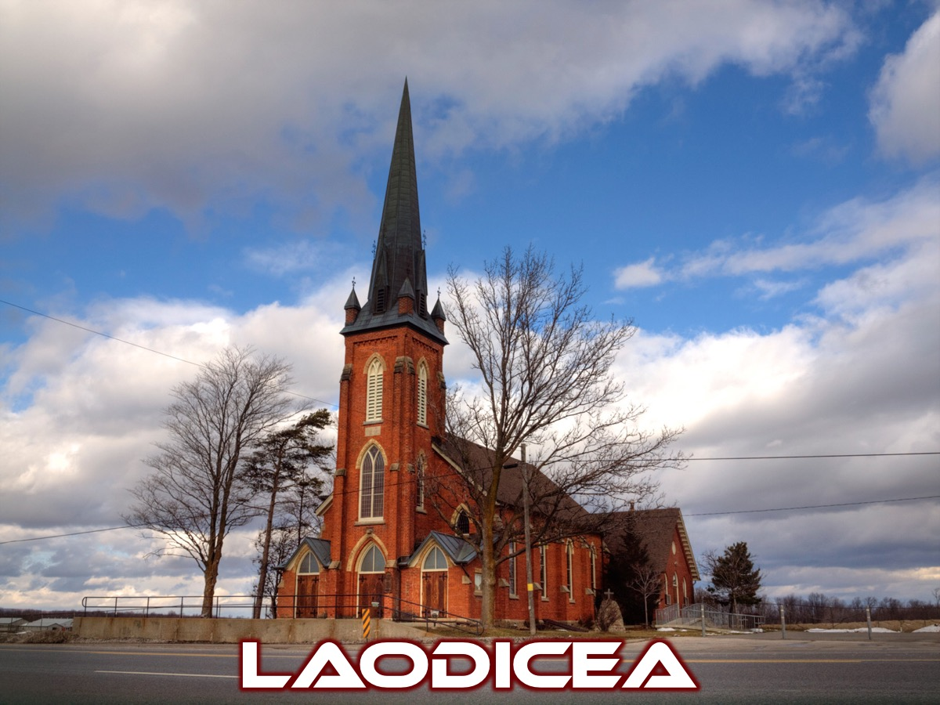
Notes:
7. Laodicea. The Laodicea group will share ONE strength, weakness, opportunity and threat from this church.

Slide 23
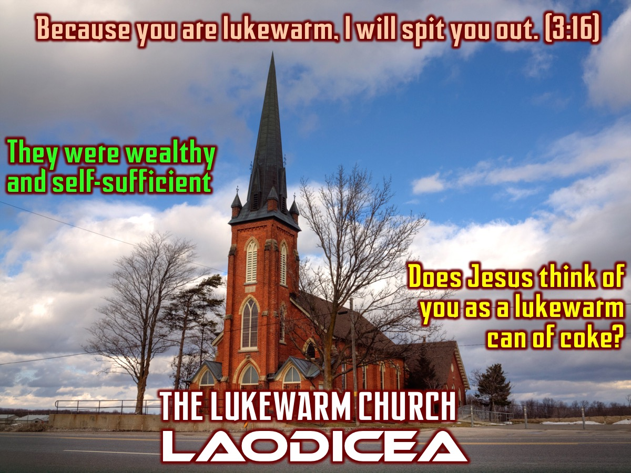
Notes:
Laodicea was the Lukewarm Church.
Verse: “So because you are neither hot nor cold I am about to spit you out of my mouth.” (3:16)
Challenge: This church was wealthy and thought it was Gods blessing and they were self-sufficient so did not think they needed anything - an independent church.
Implication: Jesus saw them as a lukewarm church neither hot nor cold – like a lukewarm can of coke!

Slide 24
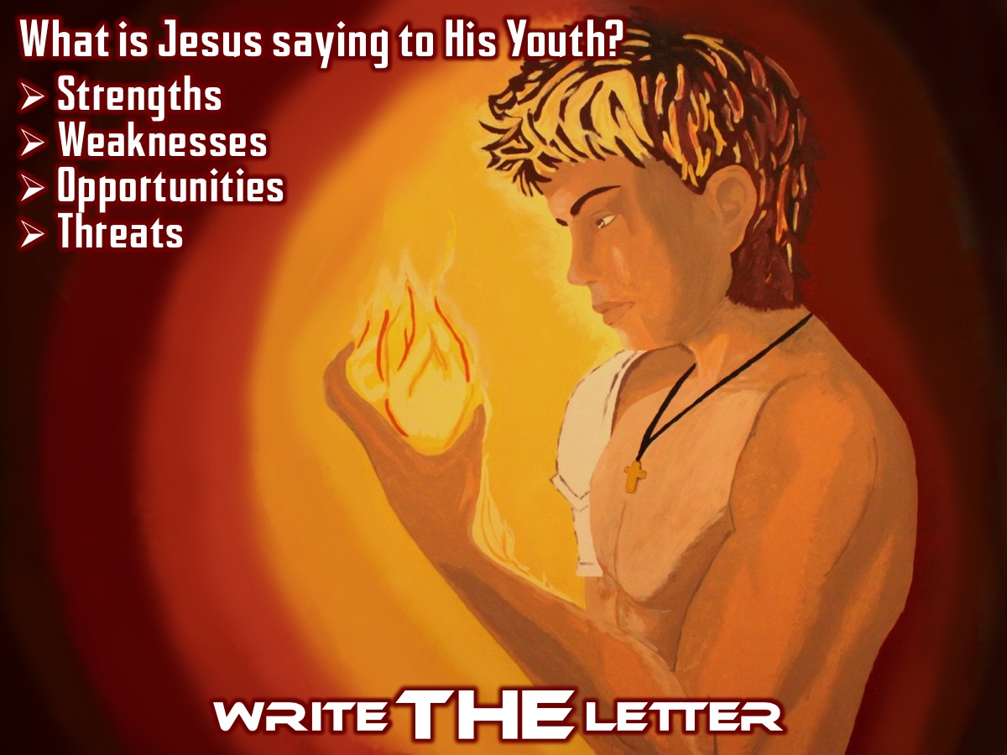
Notes:
Write THE Letter. This is your chance to write a letter from Jesus to His Youth - what do you think Jesus is saying to us? Use the same structure Jesus used - look for strengths, weaknesses, opportunities and threats.

Slide 25
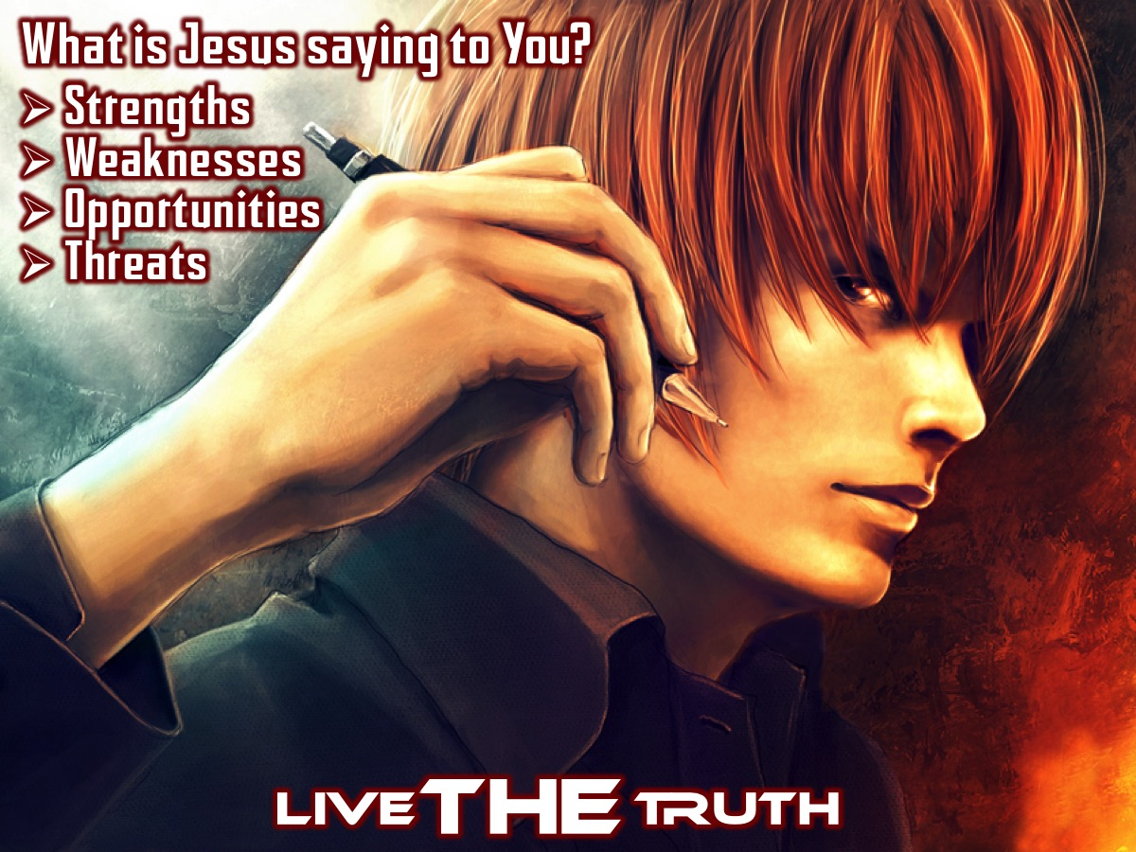
Notes:
Live THE Truth. I want you to take something away with you this morning - this is your chance to reflect on something we have explored this morning. What is the Lord saying to you? Would a few of you come to the mic and share with the big group?

Slide 26
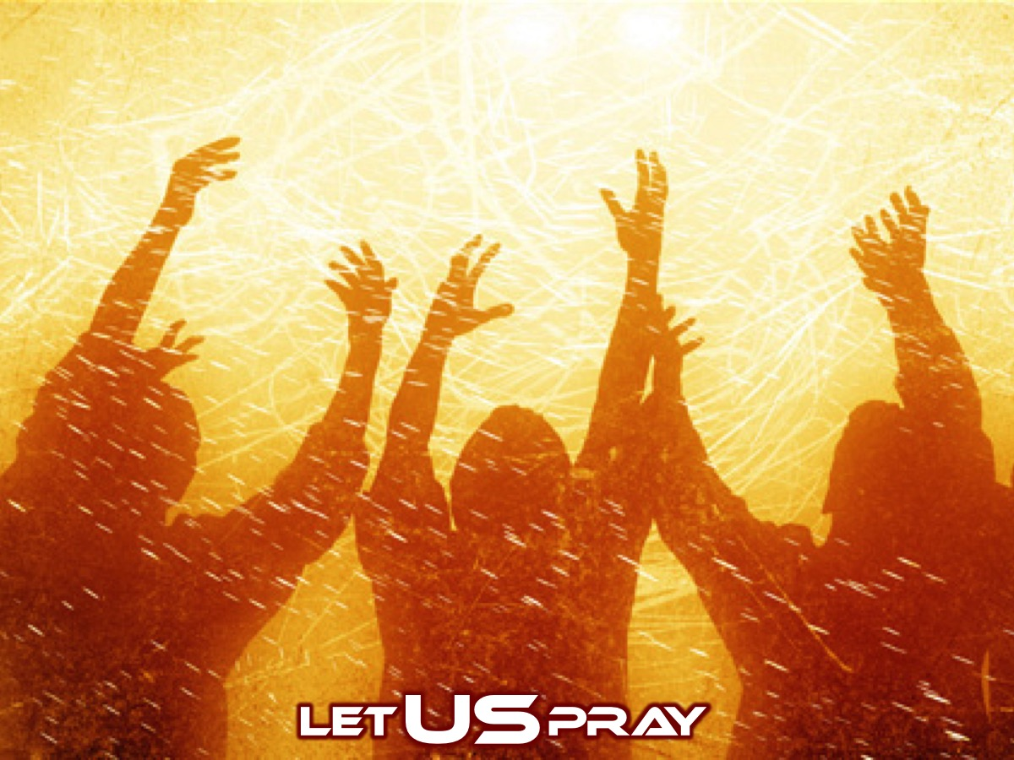
Notes:
Let US Pray

Slide 27
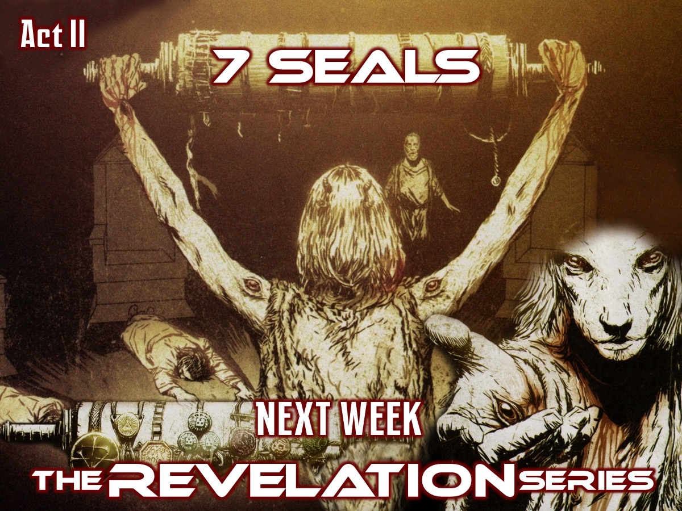
Notes:
Next week we will experience Act II: 7 Seals (Revelation 4:1-8:1)

