Slide 1
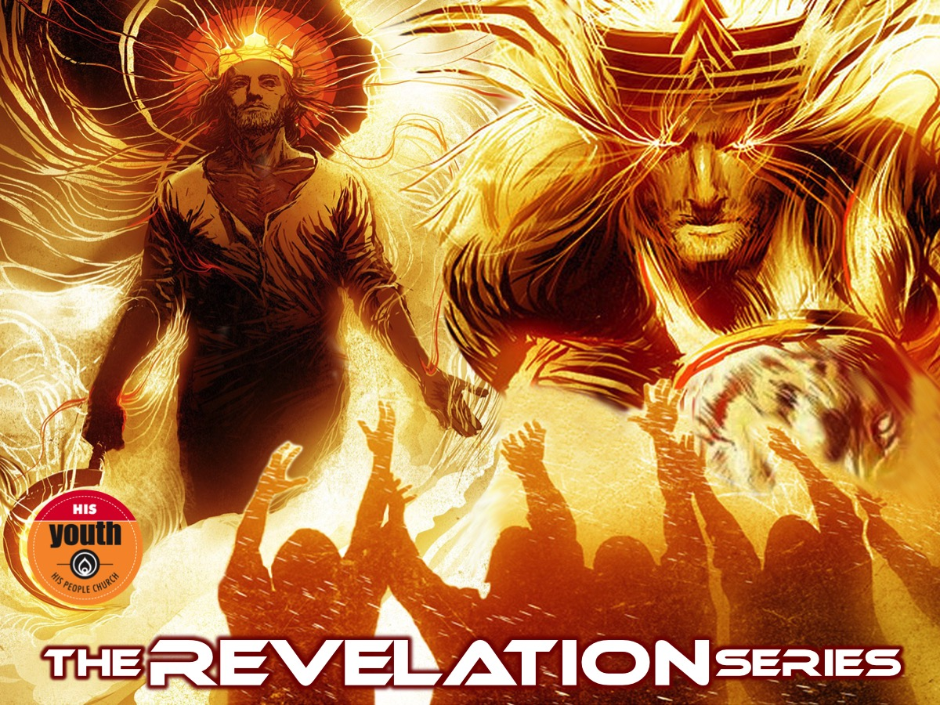
Notes:
Welcome to The Revelation Series.

Slide 2
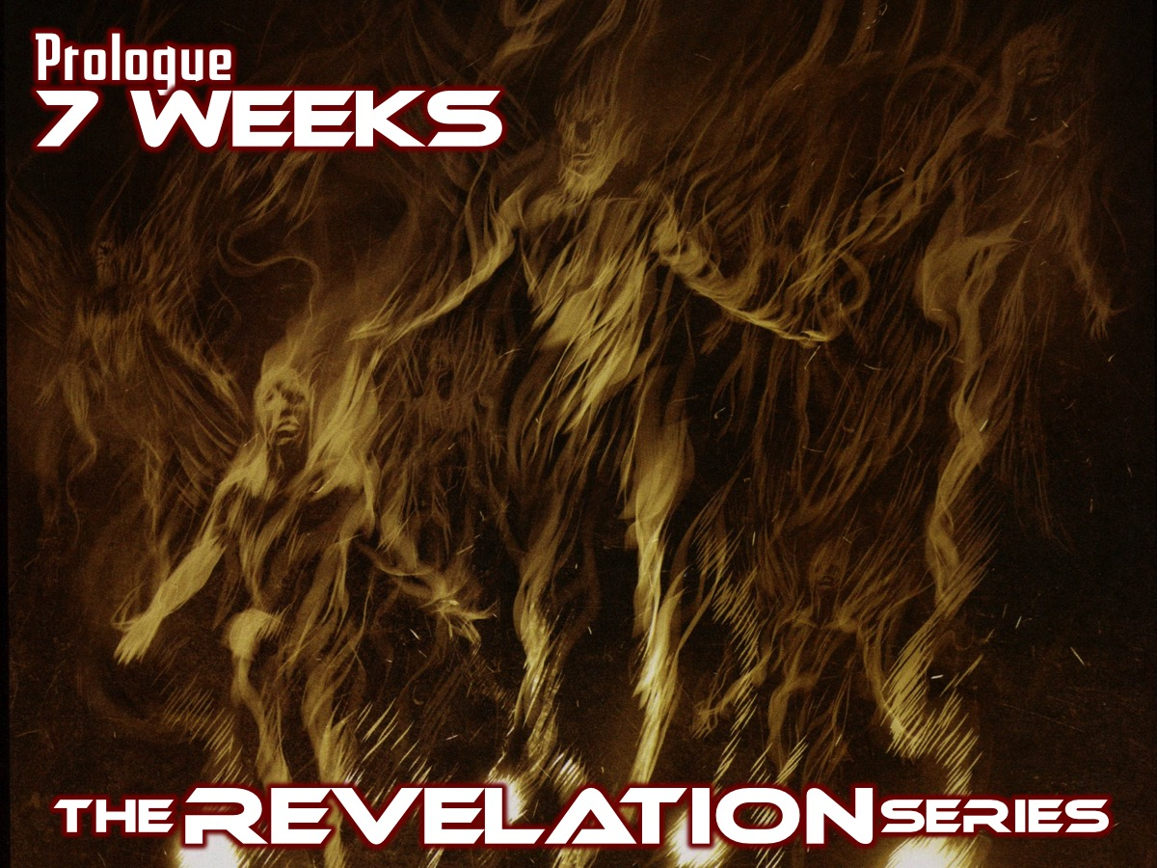
Notes:
Two weeks ago we launched this series in the book of Revelation.

Slide 3
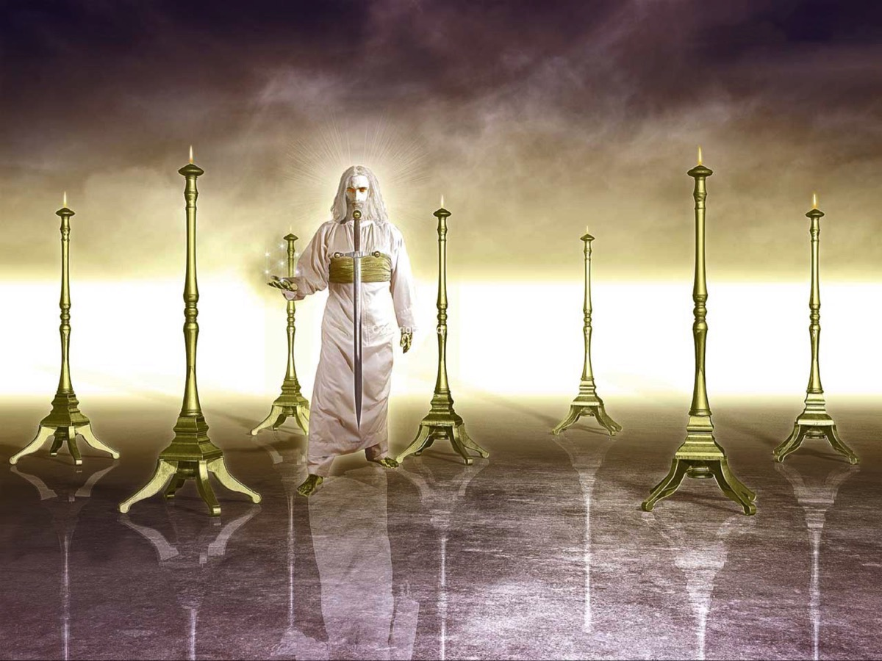
Notes:
In week 1 we saw an incredible revelation of Jesus!

Slide 4
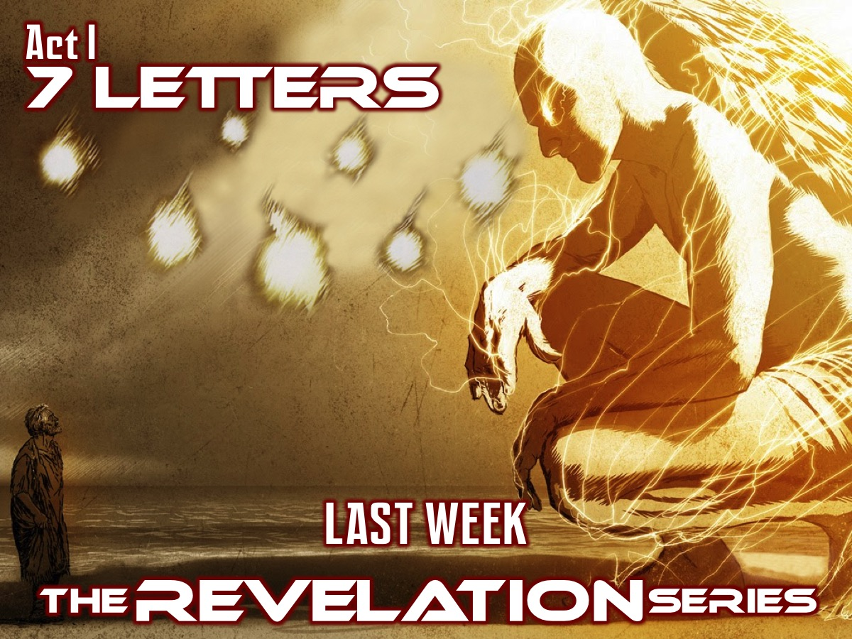
Notes:
Last week we looked at the first act of the drama that is the book of Revelation

Slide 5
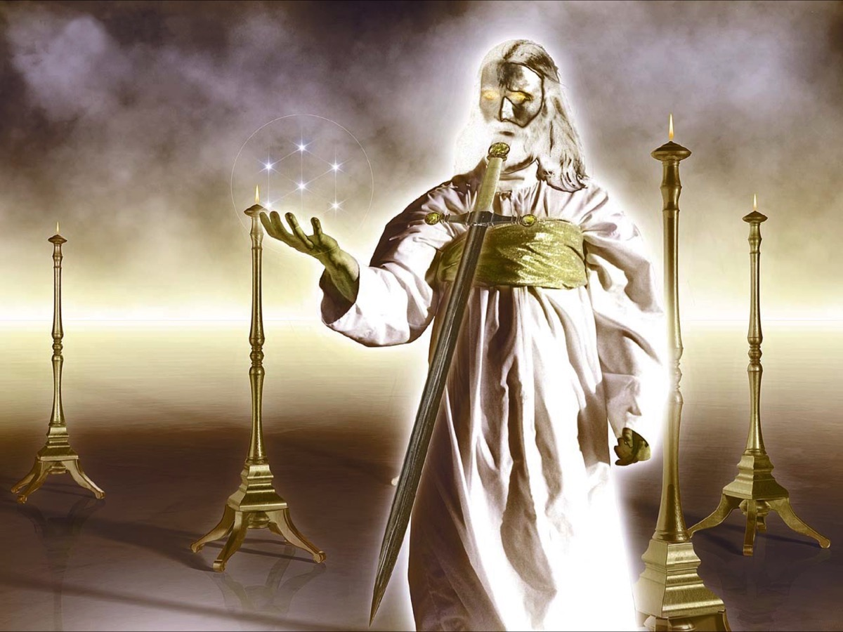
Notes:
We read the seven letters that Jesus sent to seven churches in Asia Minor and reflected on what Jesus thinks about His Youth and also what our personal strengths, weaknesses, opportunities and threats are.

Slide 6
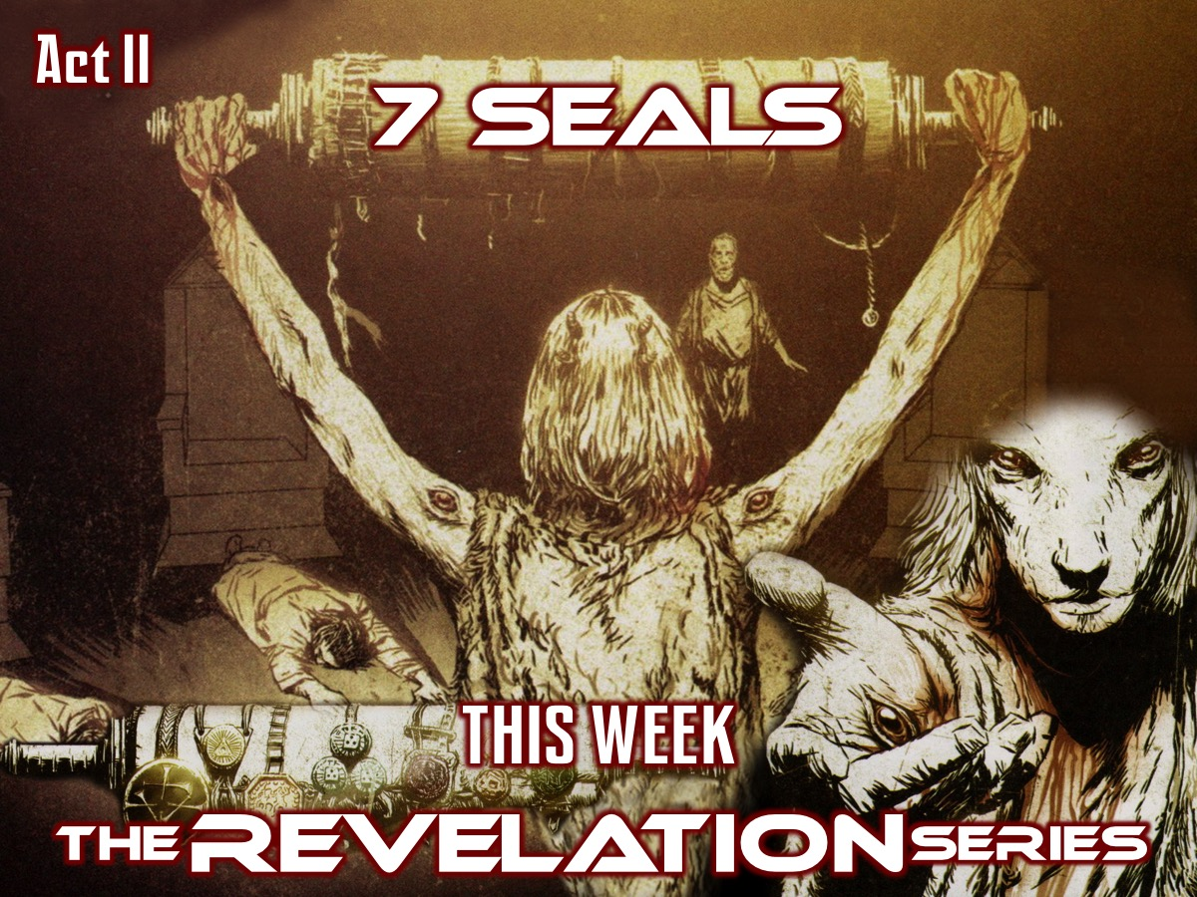
Notes:
Today we are going to look at the second act of the drama that is the book of Revelation: The 7 Seals (Revelation 4:1-8:5)

Slide 7
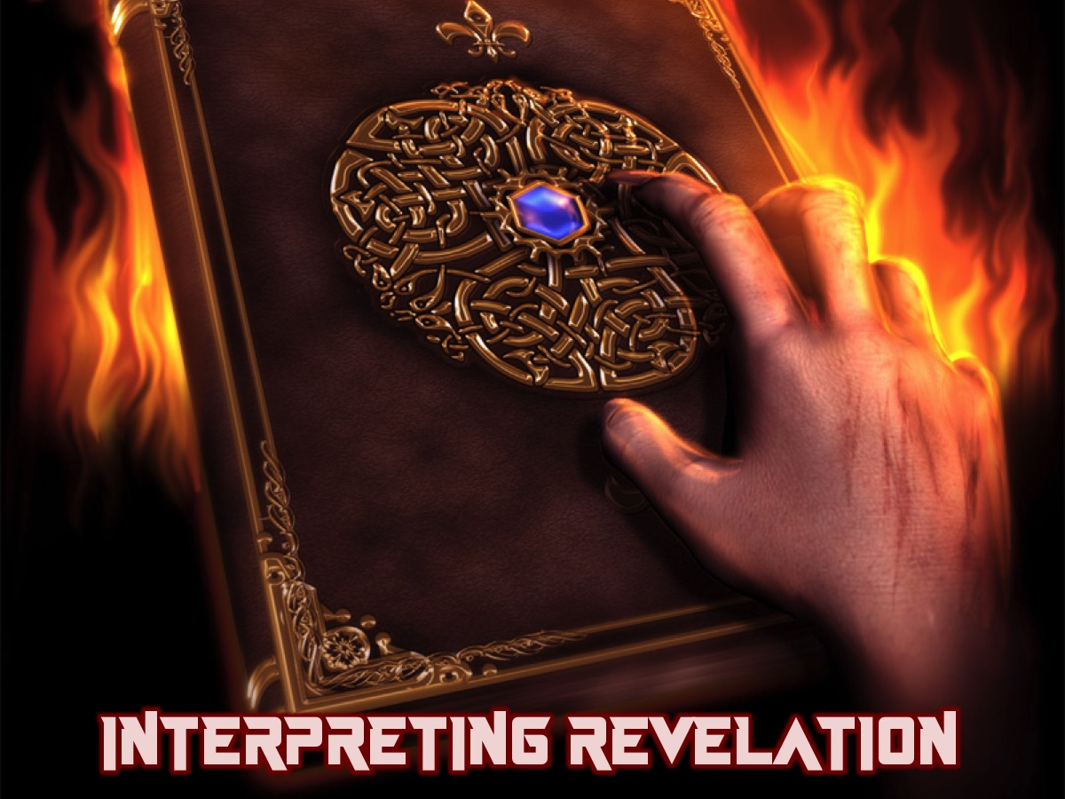
Notes:
Before we launch into our session today, let me first say that there are basically 4 views when it comes to interpreting the book of Revelation.

Slide 8
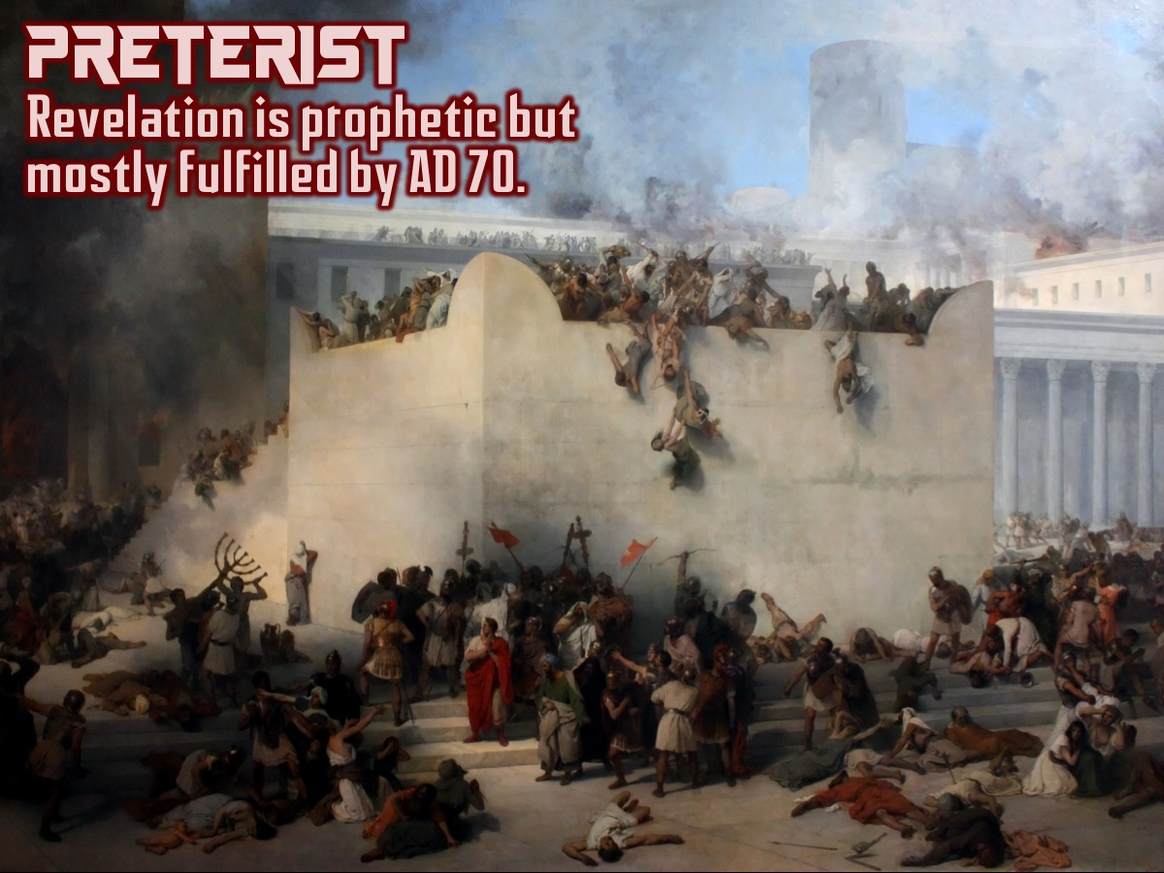
Notes:
Preterist: Revelation is prophetic but most fulfilled by AD 70 when Jerusalem was destroyed by the Romans.

Slide 9
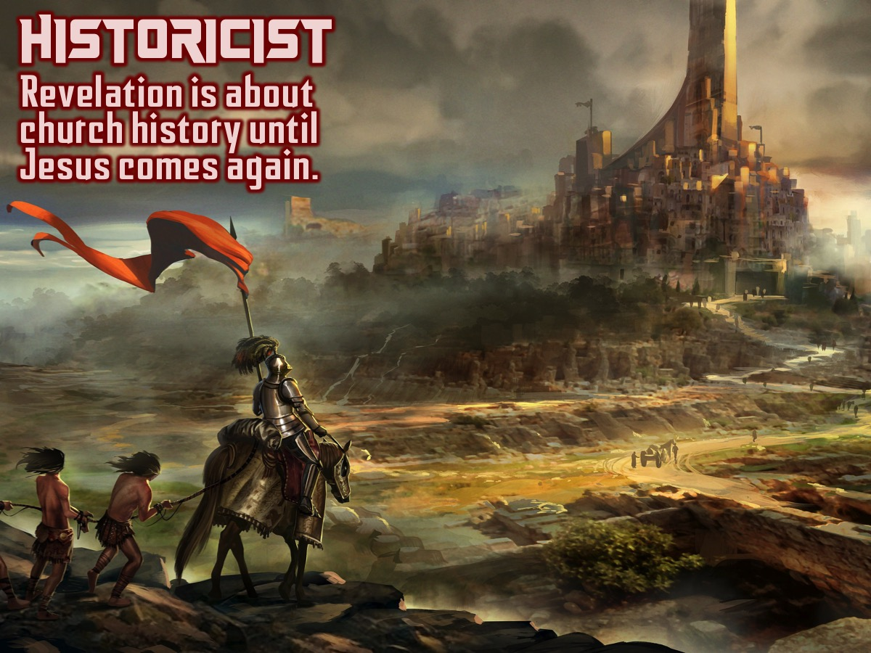
Notes:
Historicist: Revelation is about church church history from John’s time until Jesus comes again.

Slide 10
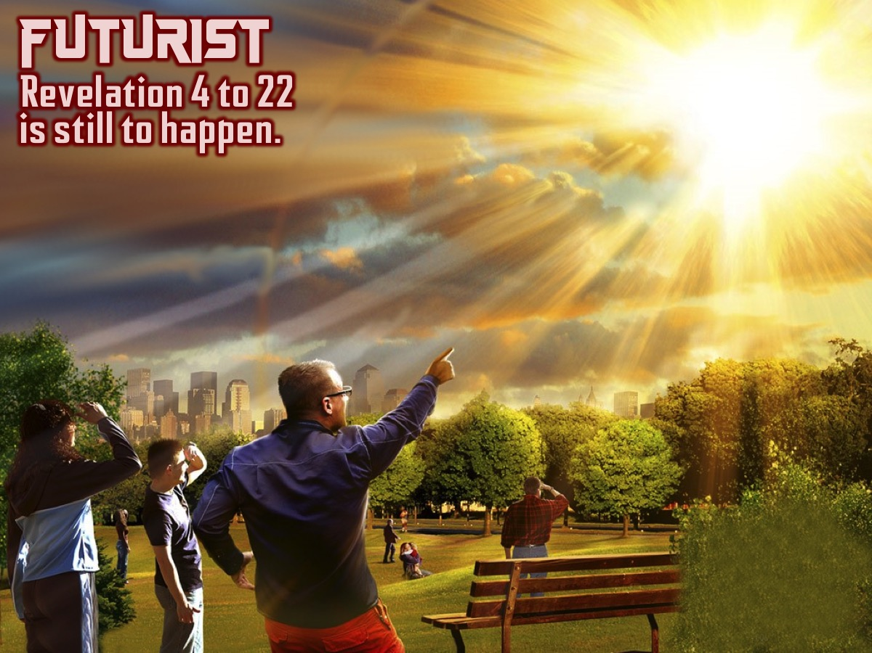
Notes:
Futurist: Revelation 4 to 22 is still to happen.

Slide 11
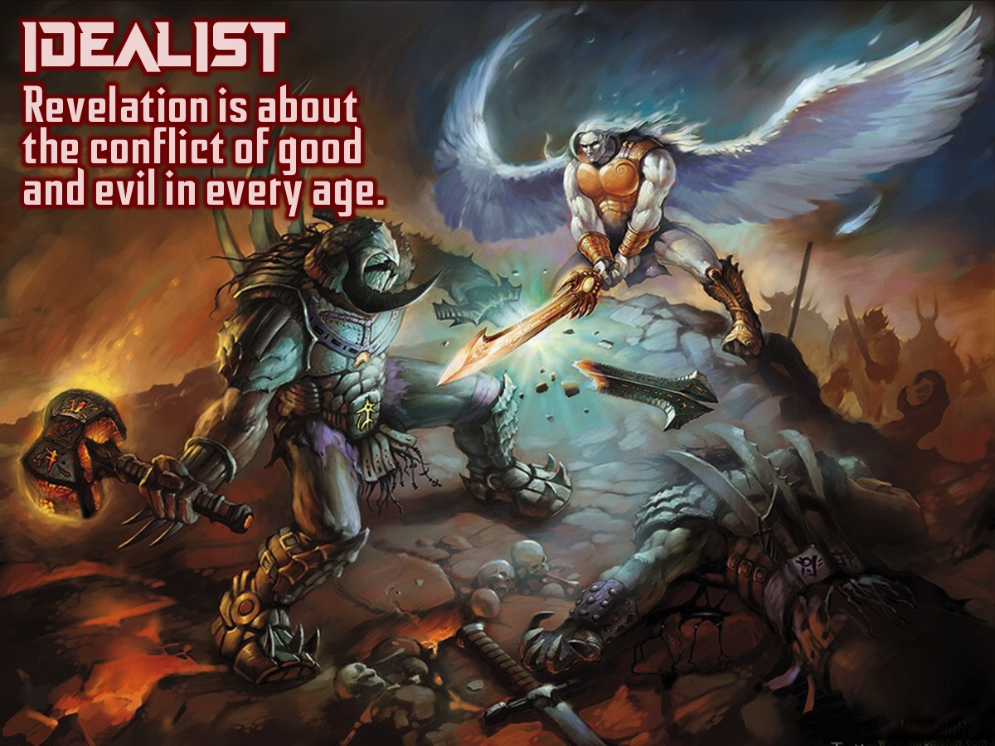
Notes:
Idealist: Revelation is about the confict of good and evil in every age.

Slide 12
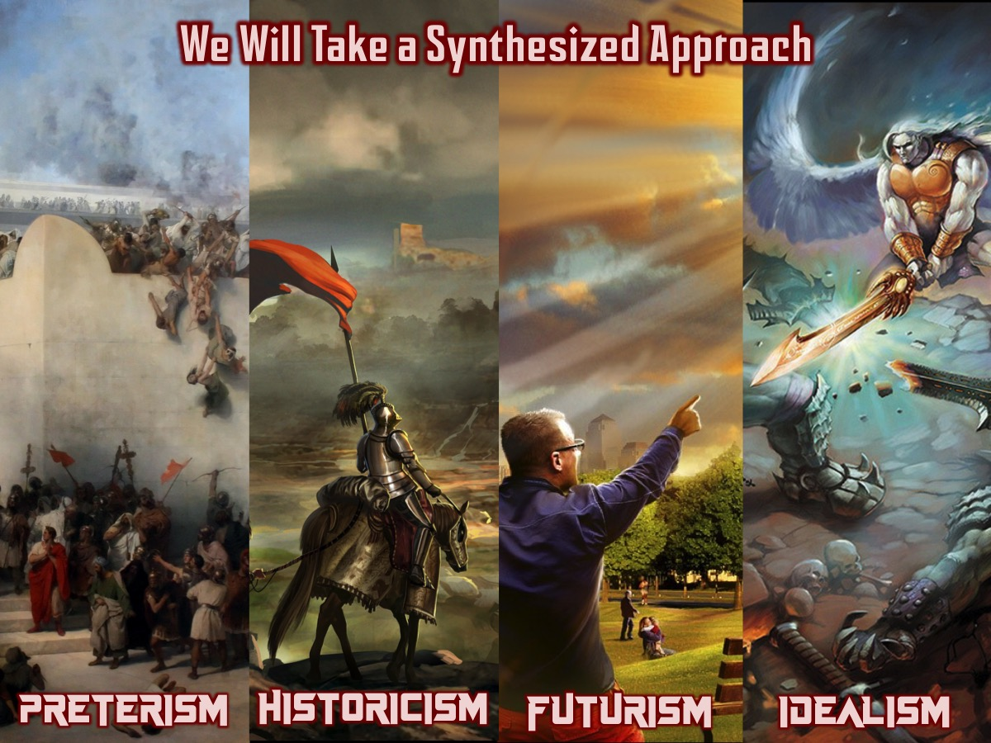
Notes:
OUR APPROACH: All the views have some merit so we will be taking a synthesized approach: We will take a little PRETERISM (because the book did have meaning to the early Christians and the seven churches), add some HISTORICISM (because the book has relevance for us and we are somewhere in church history), add some FUTURISM (it is about the return of Jesus and what happens before and after that) and also take a little IDEALISM (the book is also about the battle between good and evil across all ages). Here is the combined picture we see: The major symbols of Revelation represent a repeated pattern. This pattern has a realization in the first century situation of the seven churches. It also has an embodiment in the final crisis. And it has an embodiment now. We pay special attention to the embodiment now, because we must apply the lessons of Revelation to where we are.

Slide 13
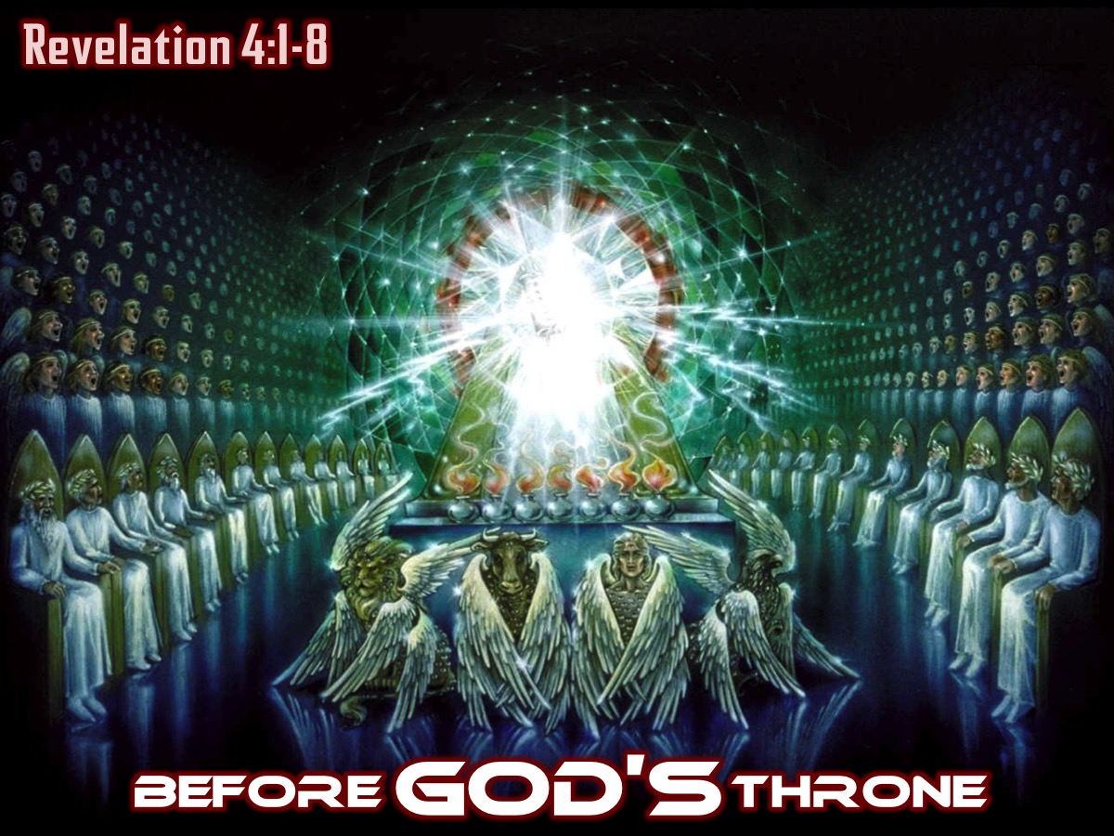
Notes:
Before GOD’S Throne (Revelation 4:1-8)
After the letters are sent to the churches, John is suddenly invited to step into the throne room of God in the heavenly realm that exists alongside earth – he is seeing heaven as it is now and not in the future. He tries to describe what he sees in words and uses images and concepts that were presented in the Old Testament. John sees a vision like that of Micaiah in 1 King 22 – where God is sitting on the throne with his hosts around him and John hears their discussions and plans. The vision reminds us of the vision in Ezekiel 1 where God’s throne-chariot is carried between heaven and earth on turning, fiery wheels and there is a rainbow that reminds us of Genesis 9 where the great bow in the sky was a promise of God’s mercy never to destroy the earth with a flood again. How the rainbow is mixed with an emerald is hard to understand but the effect is a combination of mercy, awe and beauty.
John sees God’s council: 24 elders sitting on separate thrones – probably representing a combination of the 12 tribes of Israel and the 12 apostles of Jesus. They stand for the perfect people of God who share in the rule of God over the world. Their white robes indicate purity and victory; their crowns identify them as the representatives of the royal priesthood. The scene is dramatic as lightning; thunder and fire are sparkling and booming (it happens throughout the book: 8:5; 11:19 and 16:18).
In front of the throne there is a sea of glass – reminding us of the “sea” in front of Solomon’s Temple (the huge bronze bowl in 1 Kings 7:23-26) but which in 15:2 becomes more like the Red Sea through which the children of Israel passed to safety. In 12:18 a Dragon stands looking at a sea and in 13:1 the great Beast emerges from the sea. In the new Jerusalem there will no longer be a sea. All this seems to indicate that in the current world evil is present and dangerous – but is contained within God’s purposes and will eventually be overthrown.
In John’s day the court of Caesar was also a throne room with power – but looking at the heavenly scene we realize that worldly courts are just a cheap imitation of the One true Power who rules in heaven and on earth. There is a heavenly throne room in which the Creator and Lord remains sovereign.

Slide 14
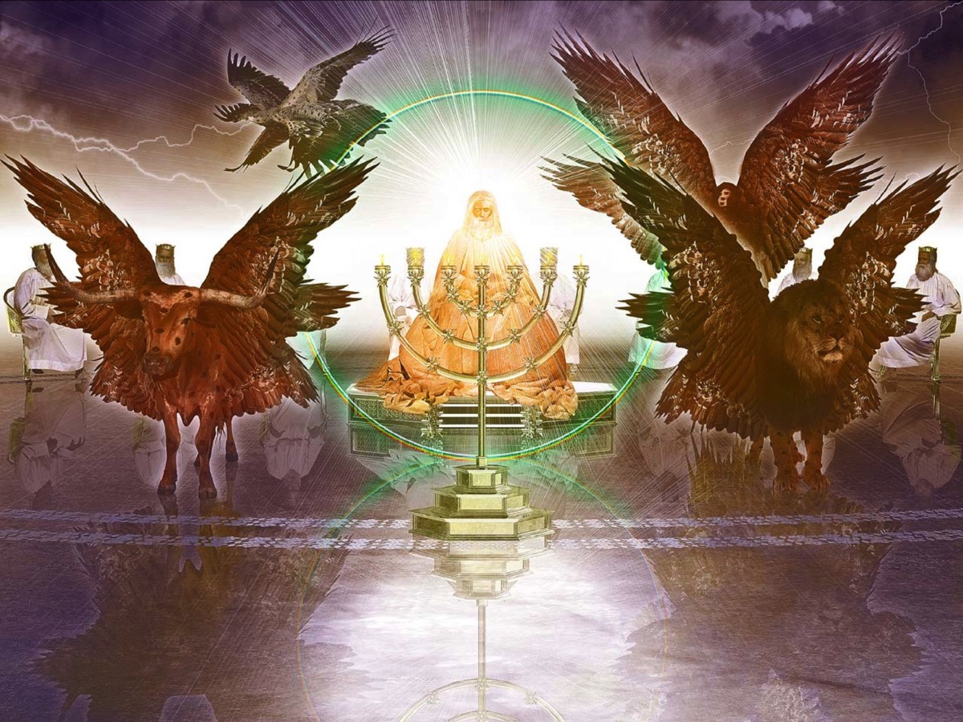
Notes:
There are four living creatures that sing God’s praises all day long (verse 8 and 11) – calling him the holy one and the everlasting one. These creatures resemble the seraphim in the temple in Isaiah’s vision (Isaiah 6) and the four creatures in Ezekiel’s vision (Ezekiel 1). They resemble the animal and human creation:

Slide 15
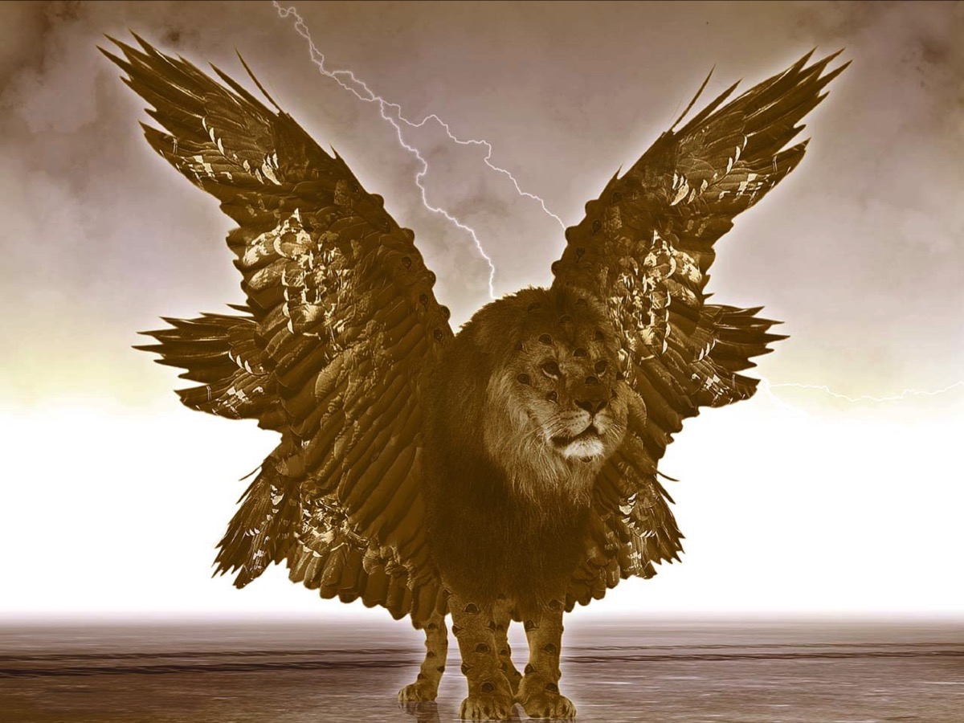
Notes:
there is the king of the wild beasts (the lion),

Slide 16
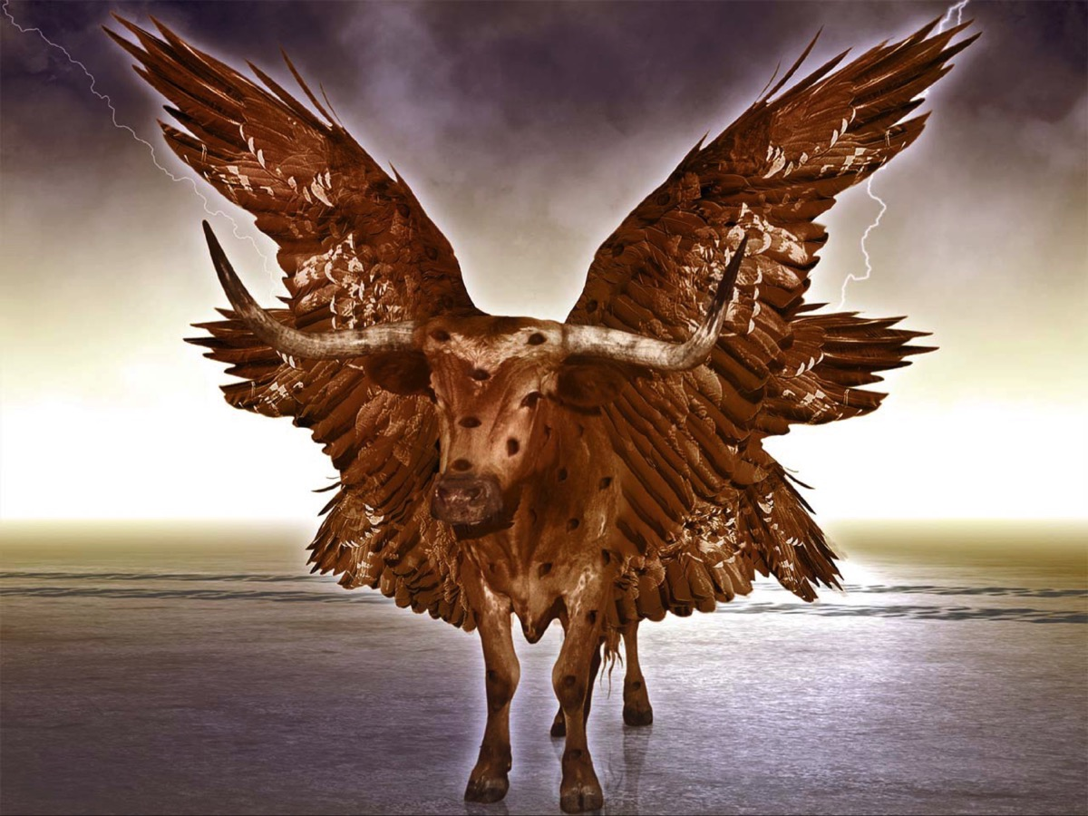
Notes:
the massive leader of tamed animals (the Ox),

Slide 17
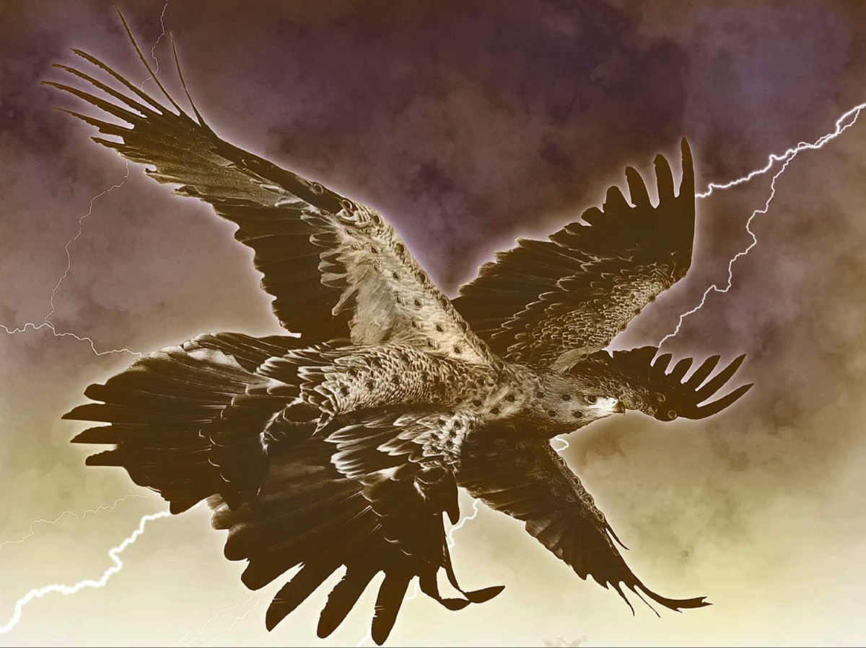
Notes:
the undisputed king of the birds – the Eagle,

Slide 18
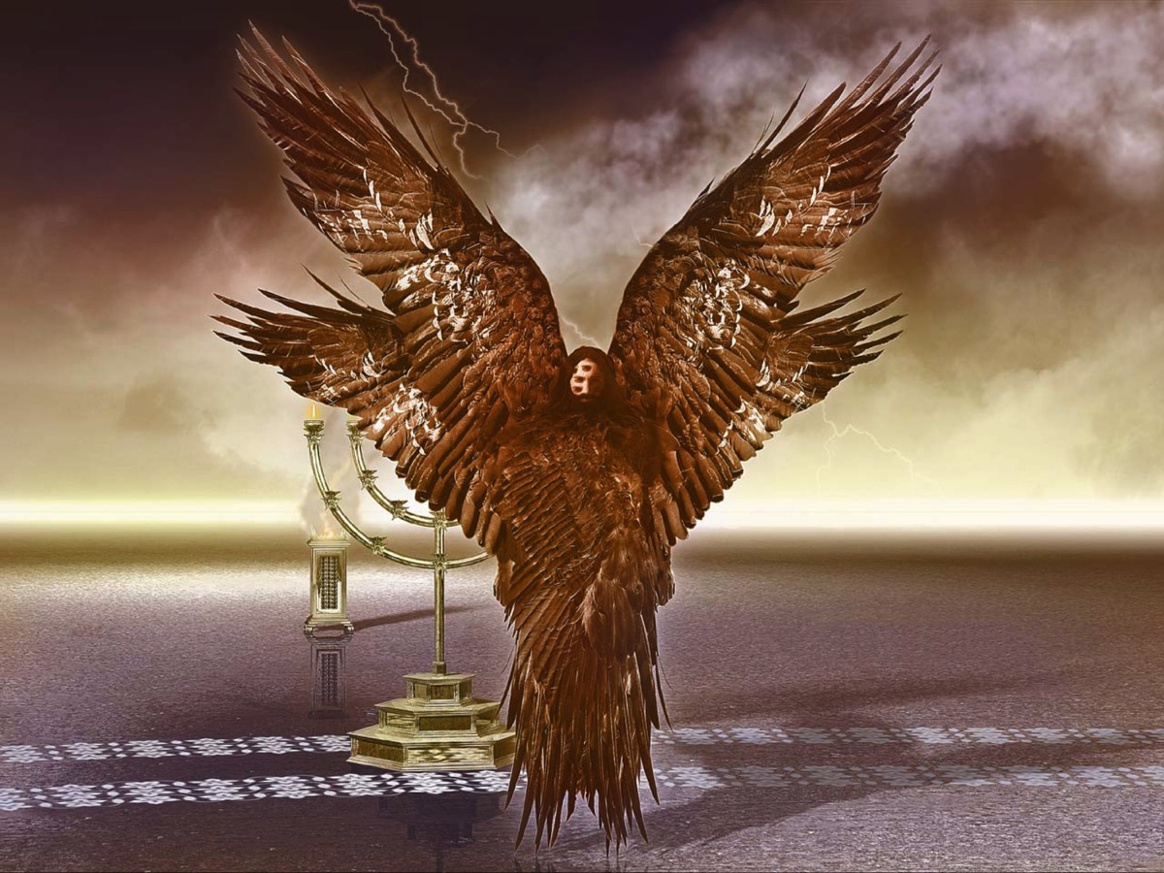
Notes:
And man, who is the ruler over all animals.
Notes: The living creatures are respectively like a lion, an ox, a man, and an eagle. The living creatures in Ezekiel 1 each have four faces, of a lion, an ox, a man, an eagle. The list is the same, but the creatures in Ezekiel are all identical, with four faces each, whereas the ones in Revelation are different, each with only one face. So are these creatures in Revelation distinct from or substantially identical with the ones in Ezekiel? Revelation constantly utilizes earlier Scripture, but uses it creatively, in new configurations. Any vision of God and his throne room is less like a photograph than an artistic impression. It is a vision, which symbolizes rather than photographs the realities that it presents (cf. Num. 12:6-8). Symbolization shows us the meaning, rather than merely the physical appearance. But symbolization also warns us that we never fathom to the bottom who God is. Yes, these are the heavenly beings of Ezekiel 1; but in a new configuration, so that we do not exhaustive understand.
Why the four faces, lion, ox, man, and eagle? It is impossible to say for certain. But most likely they continue the theme of imaging: created things display something of the glory of God. Among earthly creatures, the lion is the greatest and fiercest of the wild animals, the ox the strongest of the domestic animals, the eagle the most majestic of birds, and man the ruler over all animals. God is the Original, the great and strong and majestic ruler over all. His heavenly assistants reflect his attributes. And these heavenly models in turn are reflected in what God has created on earth, not only in the creation of human beings but of animals as well. We may often admire and be fascinated by the capacities and skills and strengths that God has given to earthly animals. How much more it is so with respect to awesome heavenly beings, and how much more of God himself! The heavenly beings even now praise God with reverence and eloquence (4:8). Likewise, the destiny of earthly beings, both man and beast, is to join in praise (5:13-14).

Slide 19
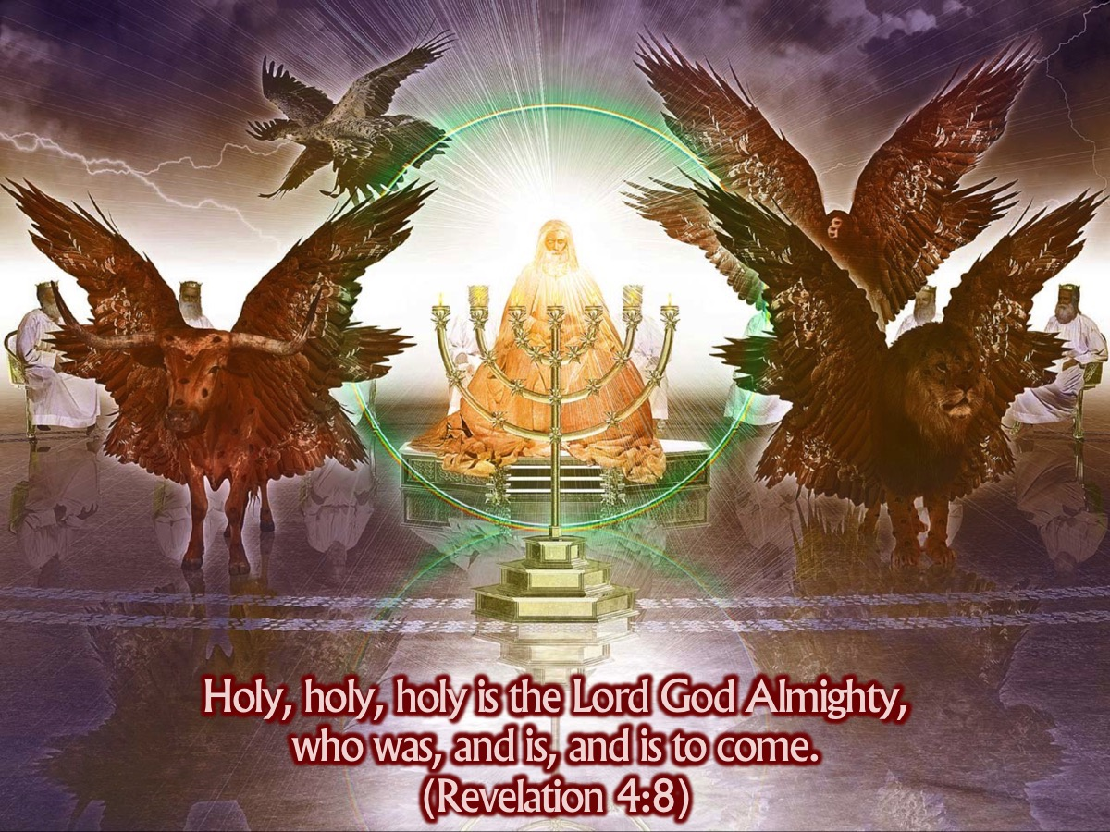
Notes:
They not only surround God’s throne but they are ready to do his bidding - they are full of eyes to watch over God’s creation and they never sleep. Their song is one of adoring praise: “Holy, holy, holy is the Lord God Almighty, who was, and is, and is to come.” (4:8)

Slide 20
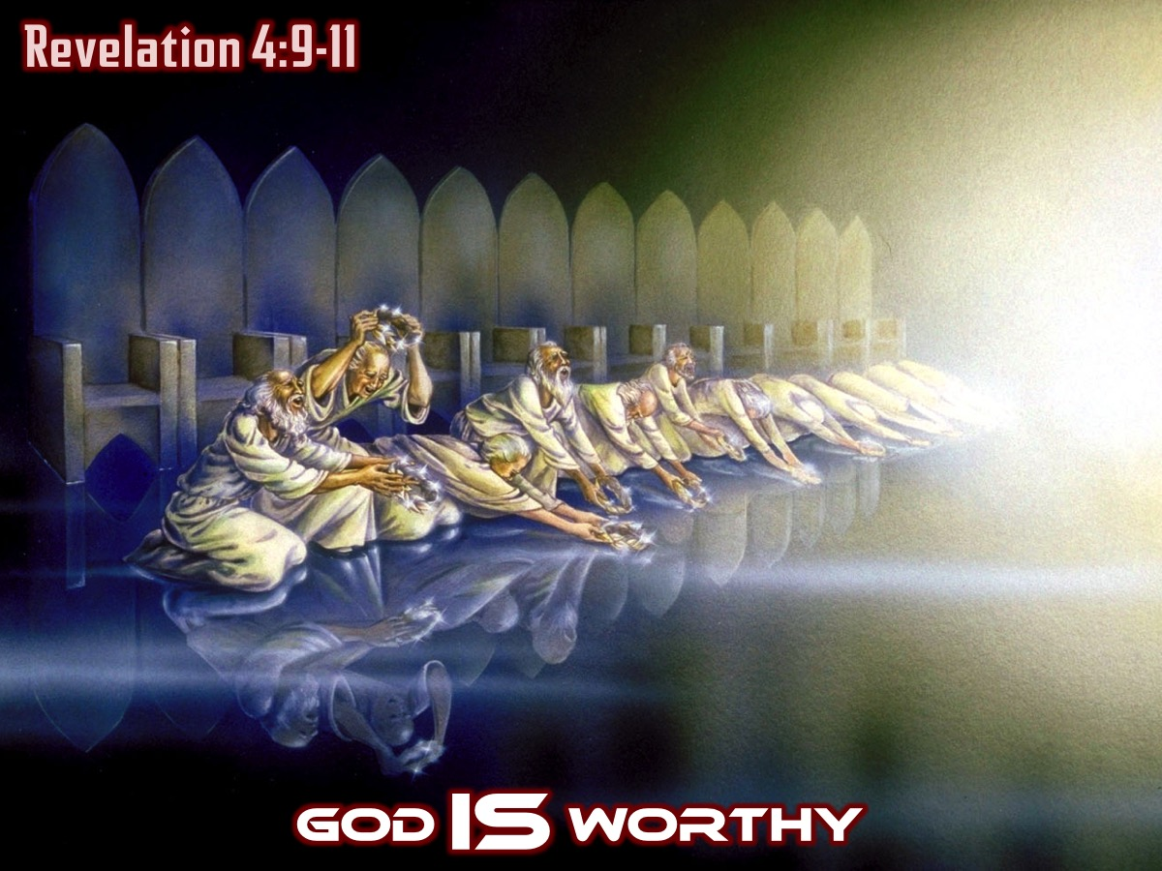
Notes:
God IS Worthy (Revelation 4:9-11)
“Whenever the living beings give glory and honor and thanks to the one sitting on the throne (the one who lives forever and ever), the twenty-four elders fall down and worship the one sitting on the throne (the one who lives forever and ever). And they lay their crowns before the throne.”

Slide 21
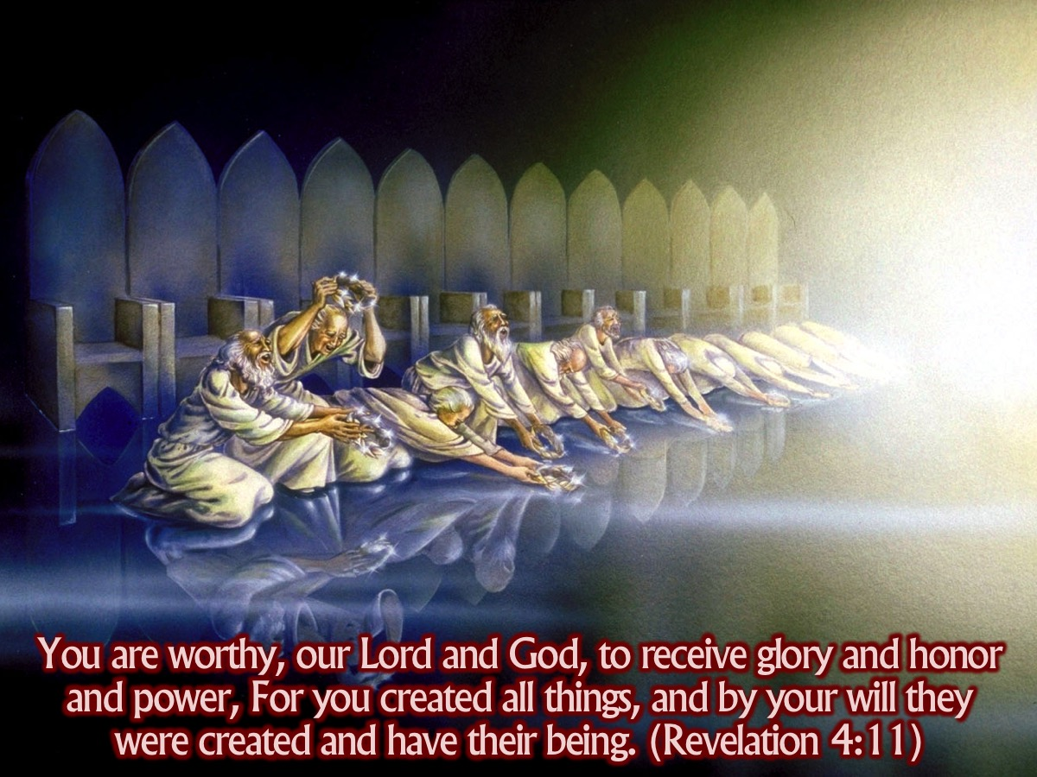
Notes:
And they say: “You are worthy, O Lord our God, to receive glory and honor and power. For you created all things, and they exist because you created what you pleased.” (Revelation 4:9-11)
Notes: “As evidence of the supreme worthiness of God, the elders single out his action of creation (v. 11). As Creator, God has absolute mastery, ownership, and control over what he has created. In creation, every speck, every atom, every detail of pattern, the very being of everything, derived from the hand of God. His triumph was absolute, his power and wisdom unfathomable, his glory superb. Such, then, are so many displays of God’s character in creation. They form a wonderful guarantee that he will continue to be Master, up until the full achievement of his purposes in the consummation (21:5-6; see 1:8). God himself is the ultimate guarantee and refuge for saints in distress or discouragement (Heb. 6:13).”
Challenge: What is happening in heaven should be happening on earth! Do we in our personal lives, our prayer and public gatherings focus on worshipping God as the creator of all things? Does our thinking about who God is and what he has done for us inform our praise? Do we remember that God deserves glory, honour and power because of what he has done?

Slide 22
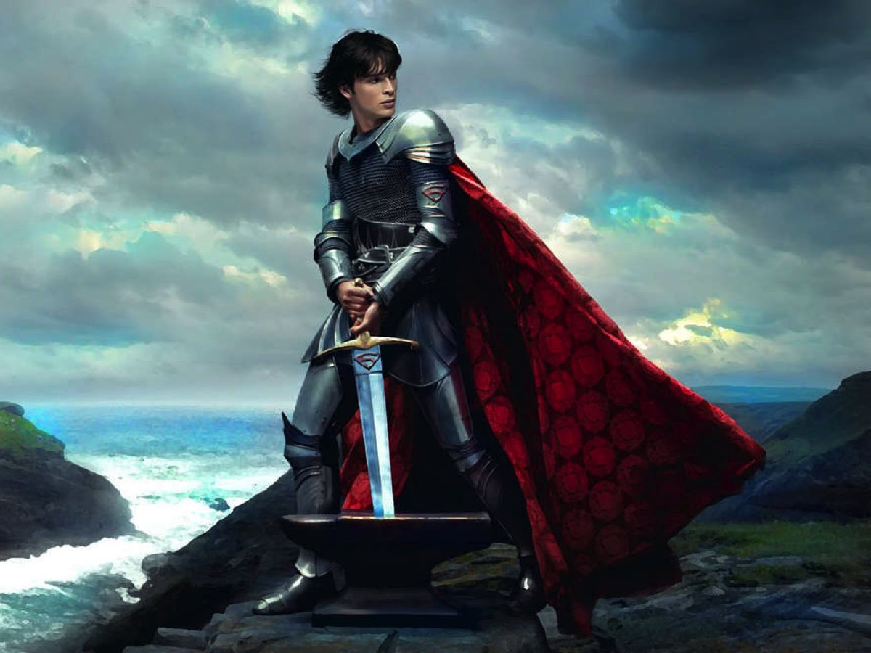
Notes:
Illustration: I love stories where the hero has to be found worthy before he can save the day: Like the sword in the stone in the story of King Arthur.

Slide 23
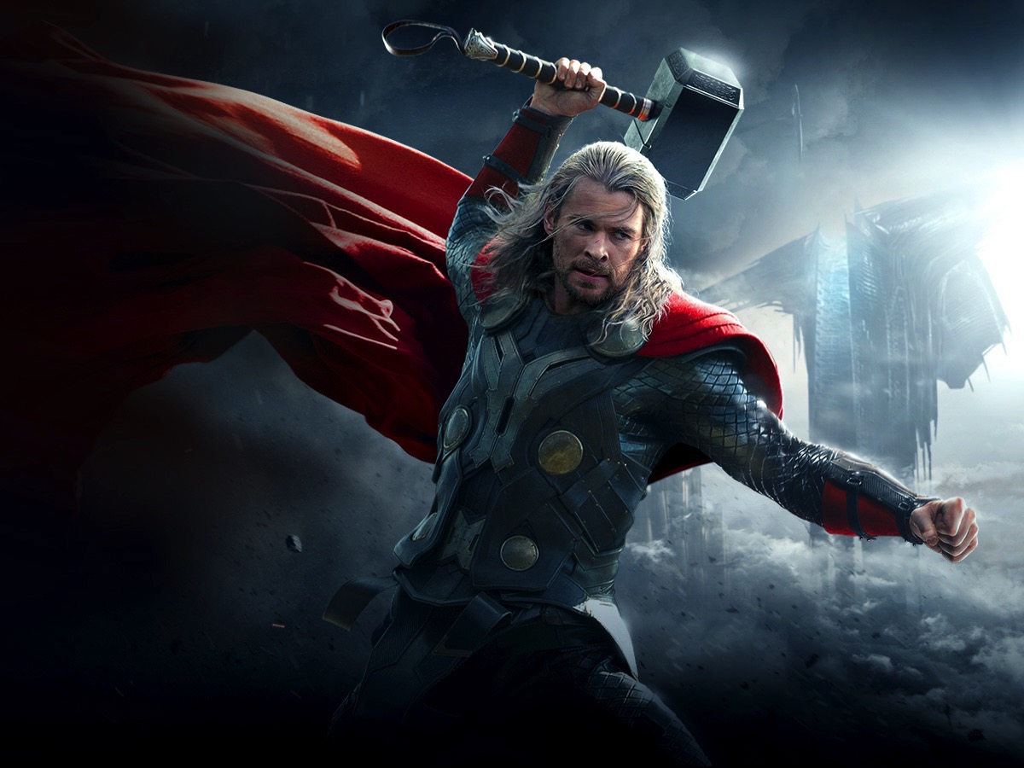
Notes:
Or the hammer in the story of Thor.

Slide 24
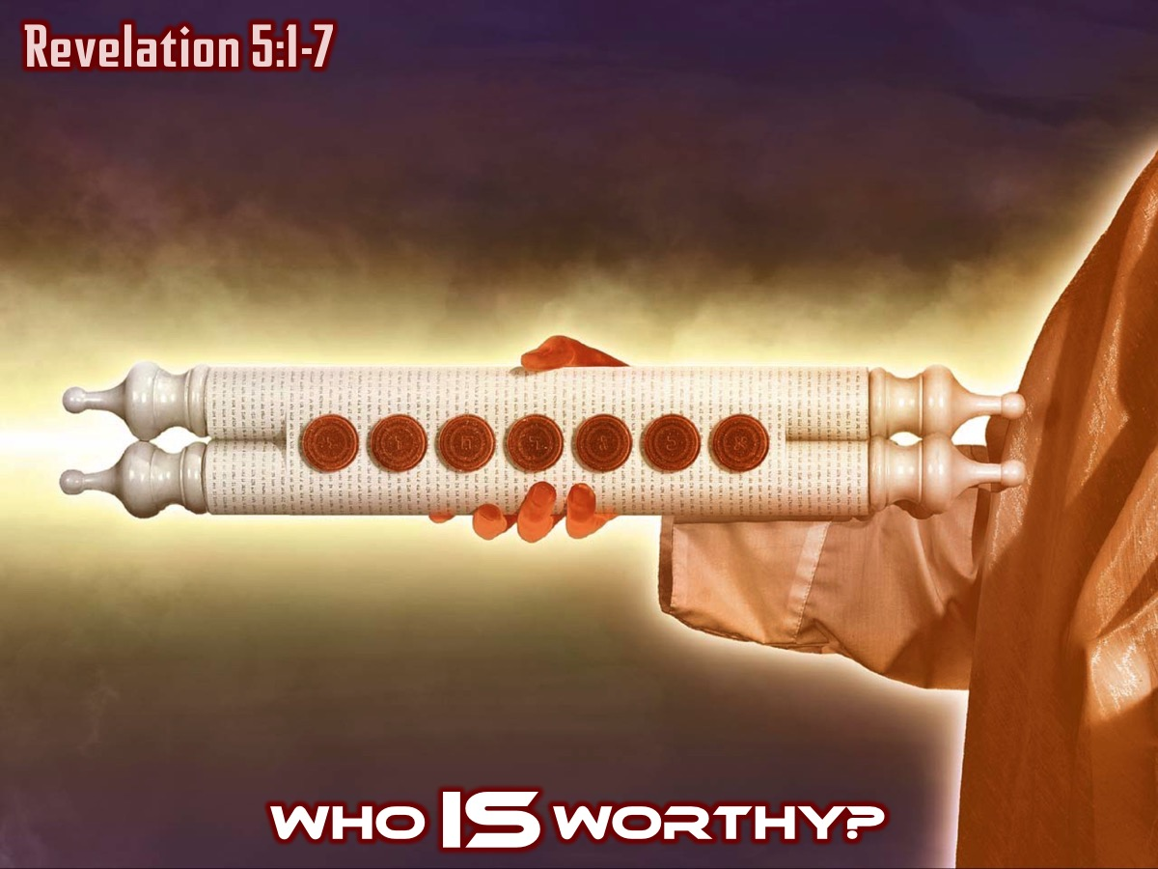
Notes:
Who IS Worthy? (Revelation 5:1-7)
There is work to be done in this throne room – to rescue the creation from the deadly dangers that have taken root within it. Work must be done to overthrow the evil forces that are out to destroy God’s creation. But we are all part of the problem and can’t help. God holds in his hands a scroll – like an architect with a rolled up design for a building or a general with a rolled-up plan for a campaign. The scroll is sealed with 7 seals – it is God’s secret plan to undo and overthrow the world destroying projects that have already gained ground. Is there anyone who deserves to open the scroll? Is anyone innocent of trashing God’s beautiful world? Sadly nobody deserves to open the scroll.
Notes: The close parallel with Daniel 12:4 makes it most likely that the scroll is a heavenly book containing God’s plan and the destiny of the world. The unsealing of the book implies the accomplishment of the things God has purposed. The scroll in verse 1 contains God’s plan for history. It is written on both sides, analogous to the prophetic plans and judgments of Ezekiel 2:9-10. The writing on both sides suggests that the scroll is completely filled, with maximal contents. God’s plan contains all the details. But it is inaccessible, as the seven seals indicate.

Slide 25
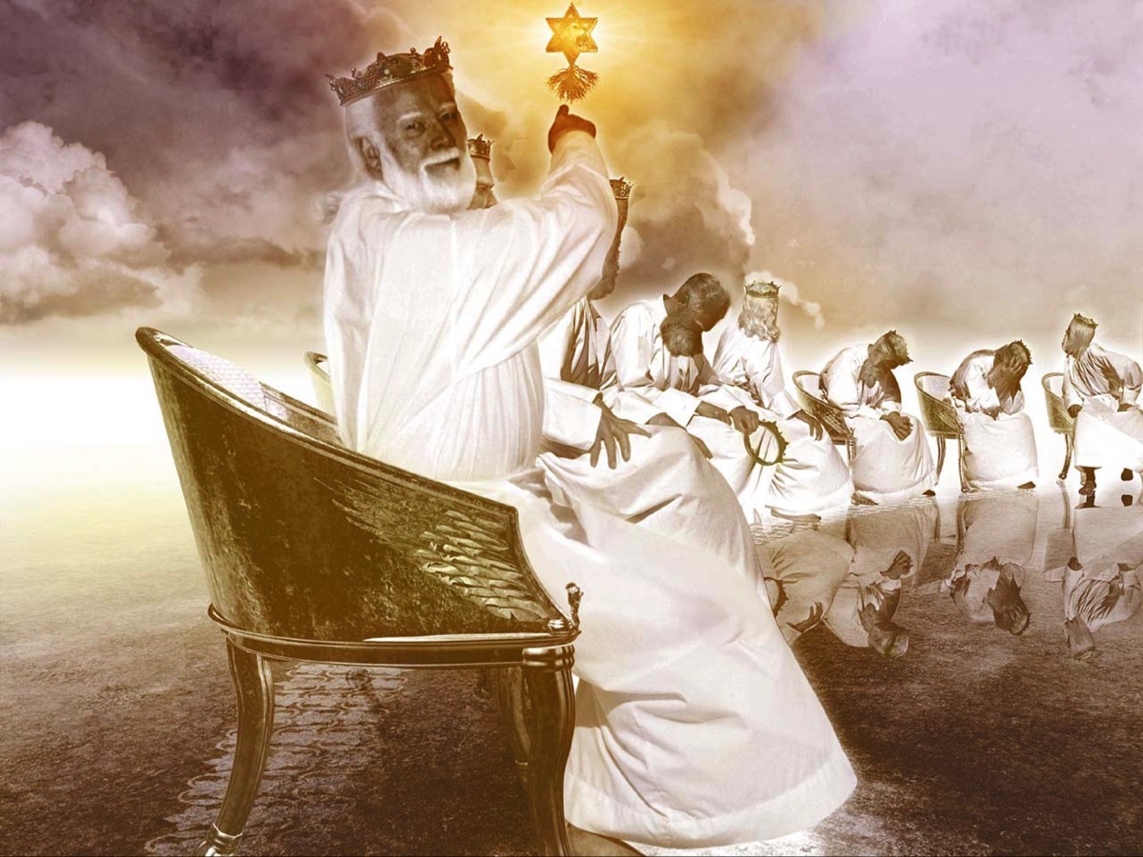
Notes:
Suddenly one of the elders speaks up - there is someone who is worthy! (Revelation 5:5)

Slide 26
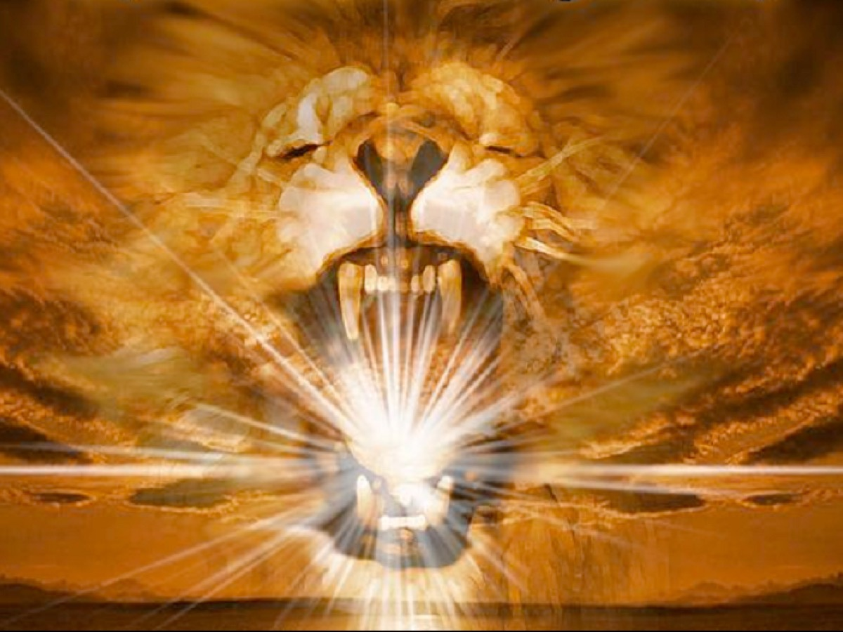
Notes:
It is the Lion from the tribe of Judah, the Root of David. This reminds us of the prophecies that Messiah will come from David’s tribe, the tribe of Judah – Judah was described as a lion’s cub (Genesis 49:9). The root of David reminds us of the prophecy in Isaiah 11:1-10. Not only does he deserve to open the scroll he has also won the victory.
Notes: An elder points to some of the qualifications of Christ (v. 5). He is the Lion of the tribe of Judah, alluding to the prophecy of Genesis 49:9-10. Jacob, looking toward the future of his twelve sons, prophesies that the ruler will come from Judah. His lion-like characteristics assure all the people of God that he will be strong and fierce and triumphant in fighting enemies. He is also the Root of David, alluding to Isaiah 6:13; 11:1. God indicated to David, who belonged to the tribe of Judah, that the line of rule would come through him and his descendants (2 Sam. 7:12-16). The line of descendants beginning with Solomon looks forward to a single great, everlasting king, as Isaiah makes clear. But Jesus is not merely a descendant of David, which would make him merely a branch out of the root. He is himself the root! If we reckon merely by human physical descent, the descendant would be expected to be subject to the ancestor. But Jesus is Son of God as well as son of David, and has the primacy over David himself in terms of his being, his spiritual qualifications, and his worthiness (cf. Matt. 22:41-46; Ps. 110:1; Isa. 9:6). In fact, in term of ultimate reckoning, the love of God the Father for his Son is the basis on which God set his love on David and raised him to be king. David exists for the sake of Christ rather than the other way around.

Slide 27
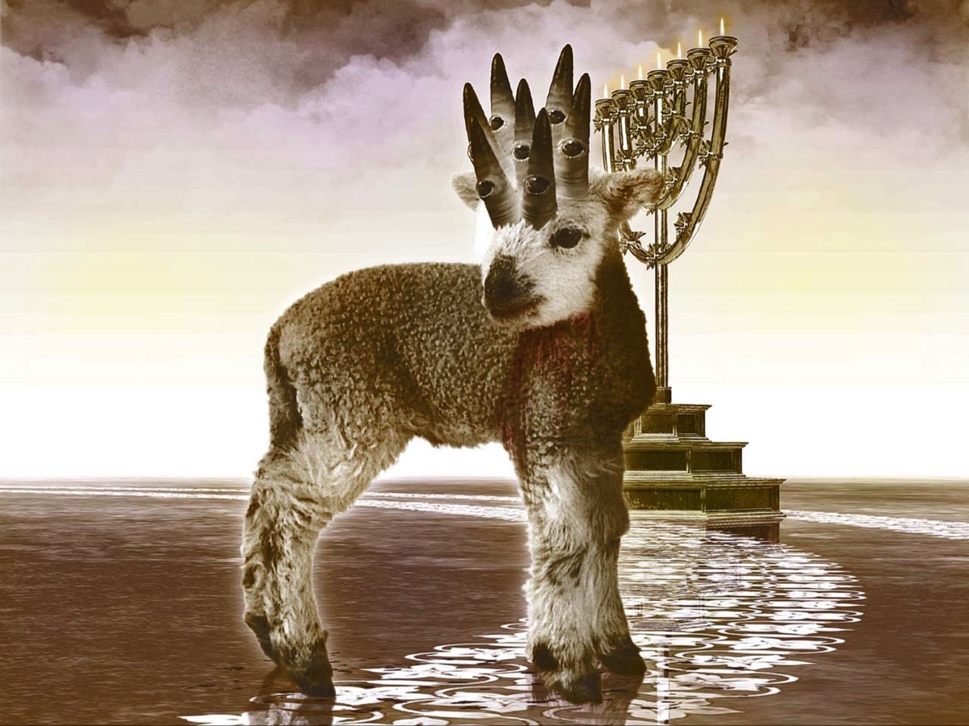
Notes:
While a Lion is announced, it is a Lamb that John sees. The lion symbolized ultimate power and supreme royalty while the lamb symbolizes gentle vulnerability and through sacrifice the ultimate weakness of death. These two are fused together. The victory won by the Lion is accomplished through the sacrifice of the lamb. The victory that the lamb won is Gods Lion-like victory – total victory over everything that would destroy God’s creation. The lamb has 7 horns and 7 eyes – he is all powerful and all seeing – and he has the right to take the scroll and open it.

Slide 28
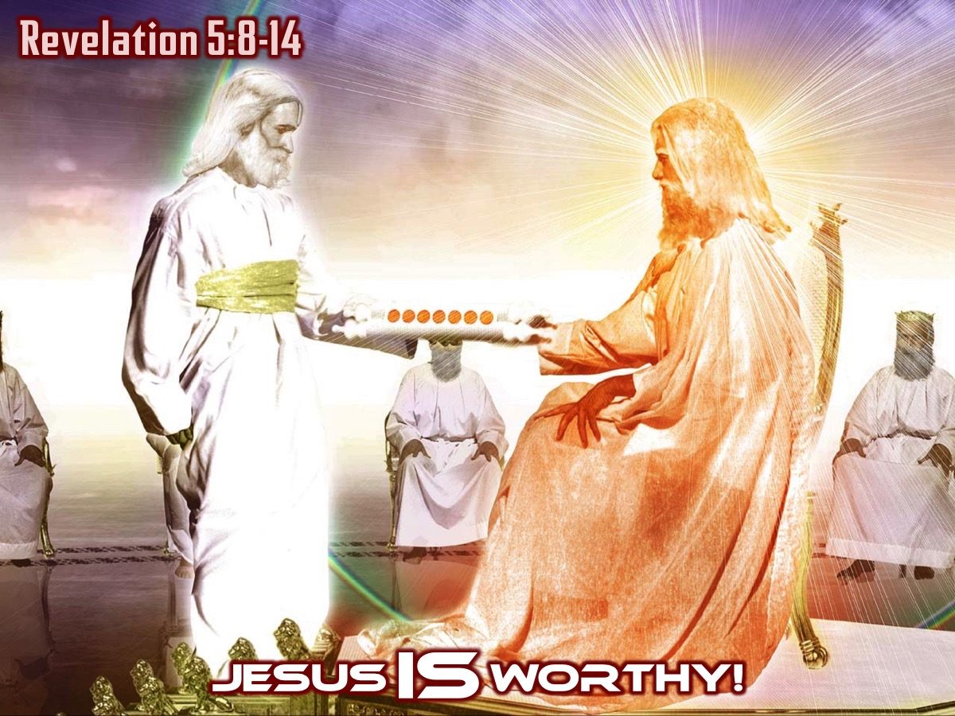
Notes:
Jesus IS worthy (Revelation 5:8-14)
Jesus steps up and takes the scroll from the father. (Revelation 5:7)

Slide 29
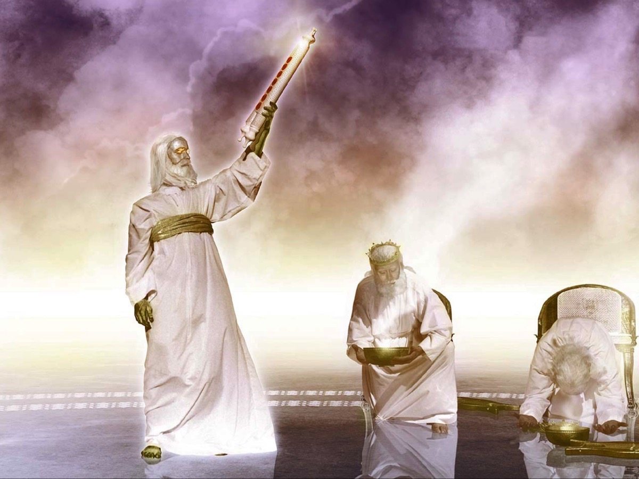
Notes:
And the 24 elders and the creatures fall down and worship him.

Slide 30
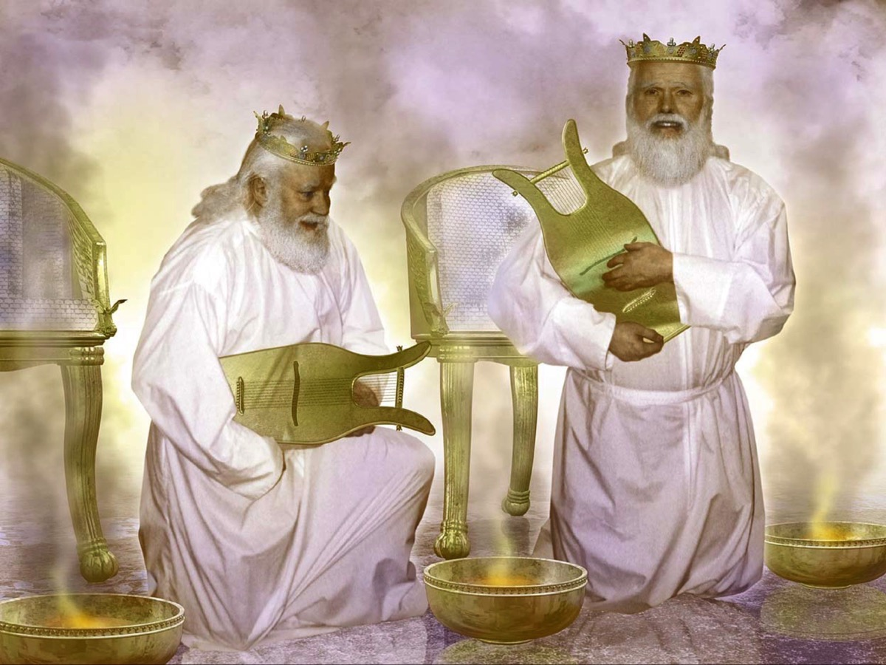
Notes:
Suddenly in the drama we realize that we are actually involved. The elders have harps and bowls – it is our prayers which fill the bowls and our worship here on earth that plays through their harps – we are actually a part of God’s great plan to defeat evil.

Slide 31
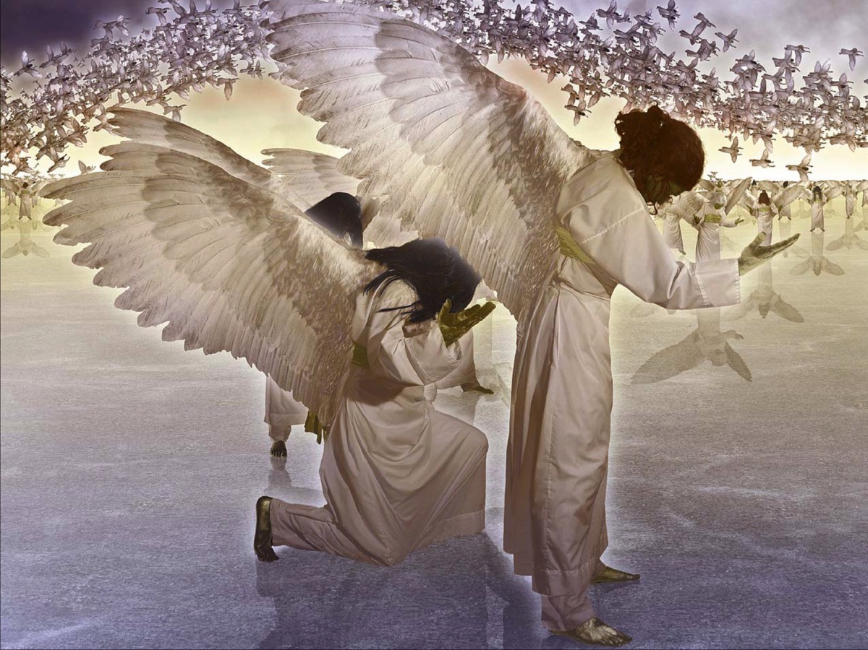
Notes:
The angels join in the singing of songs that worship God and the lamb.

Slide 32
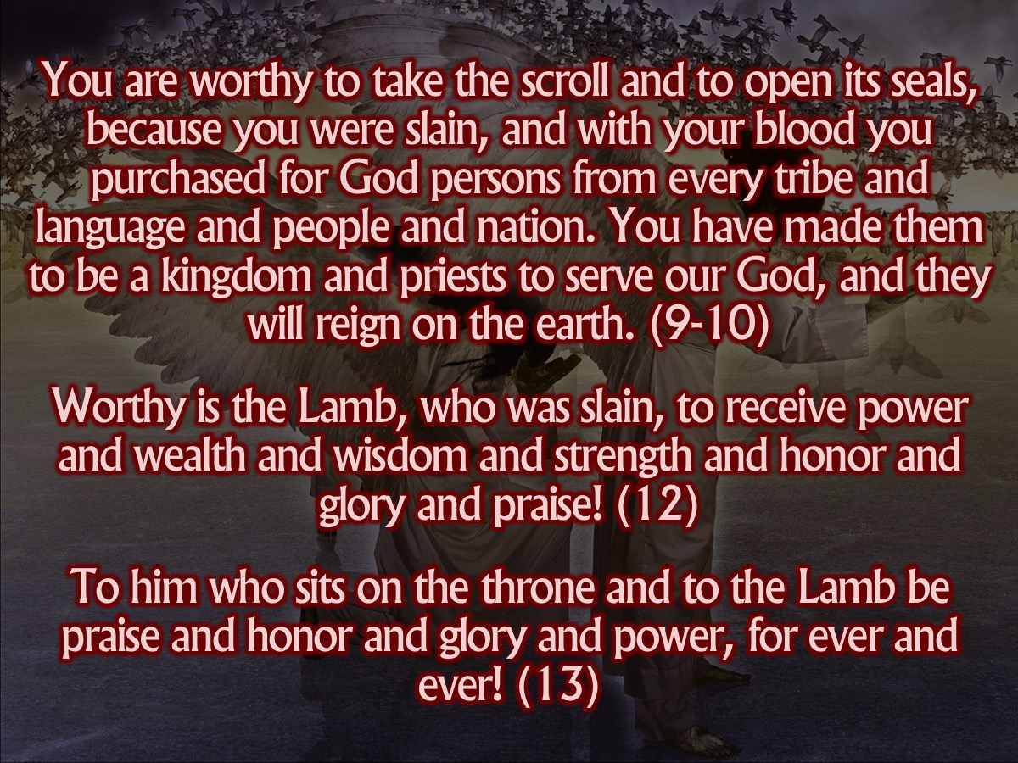
Notes:
The 3 Songs of Worship:
1. You are worthy to take the scroll and to open its seals, because you were slain, and with your blood you purchased for God persons from every tribe and language and people and nation. You have made them to be a kingdom and priests to serve our God, and they will reign on the earth. (9-10)
The first song praises the lamb for rescuing God’s people so they could take forwards God’s royal and redemptive purposes (kingdom and priests) for the wider world.
2. Worthy is the Lamb, who was slain, to receive power and wealth and wisdom and strength and honor and glory and praise! (12)
The second song has the angels joining in to focus not on what the lamb has achieved but to what he has deserved – all the honour and glory of which creation is capable. Everything is laid at his feet – the wealth and strength of the nations – he deserves it all!
3. To him who sits on the throne and to the Lamb be praise and honor and glory and power, for ever and ever! (13)
The third song is sung by every creature in every part of God’s creation – they praise the One on the throne and the lamb. And the lamb shares the praise which belongs to the one and only God!
Clearly we are involved in bringing his rescuing rule to bear on the world.

Slide 33
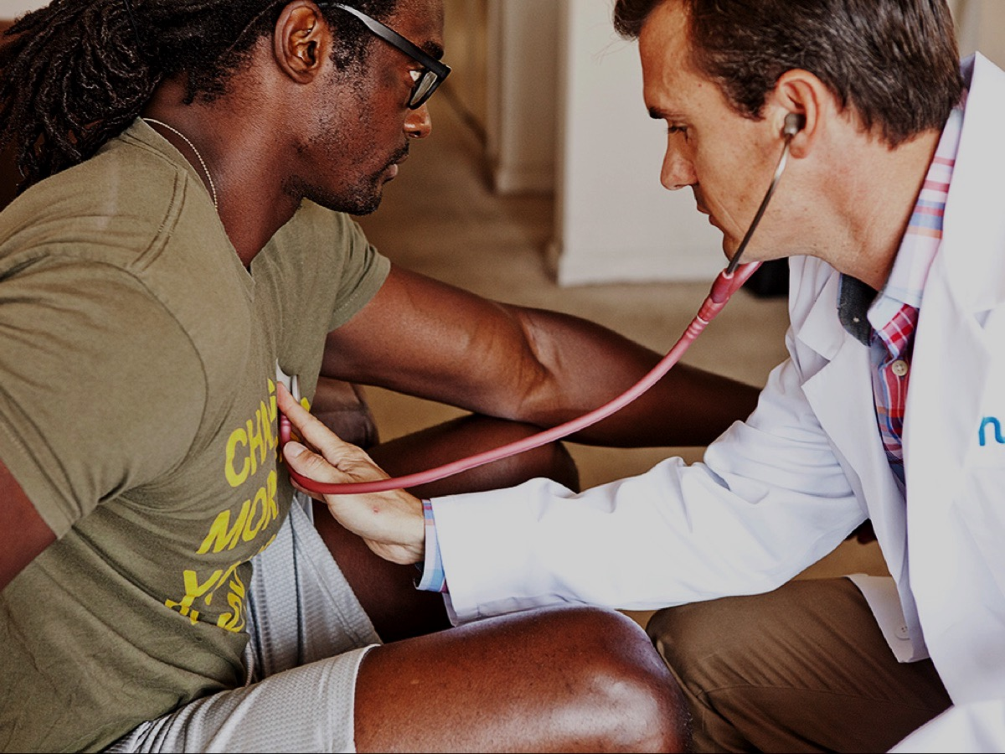
Notes:
Illustration: The guy in pain goes to a doctor - hoping to get a pill that will fix it immediately.

Slide 34
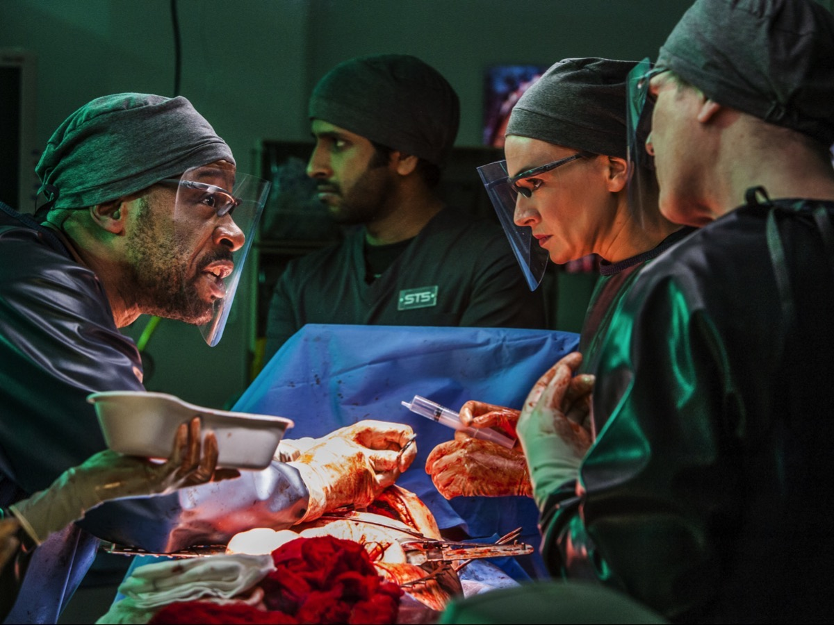
Notes:
Sadly, he has cancer and there is no quick fix or cure. He is going to need surgery and radiation treatment and will probably end up feeling a lot worse before he starts to feel better.

Slide 35
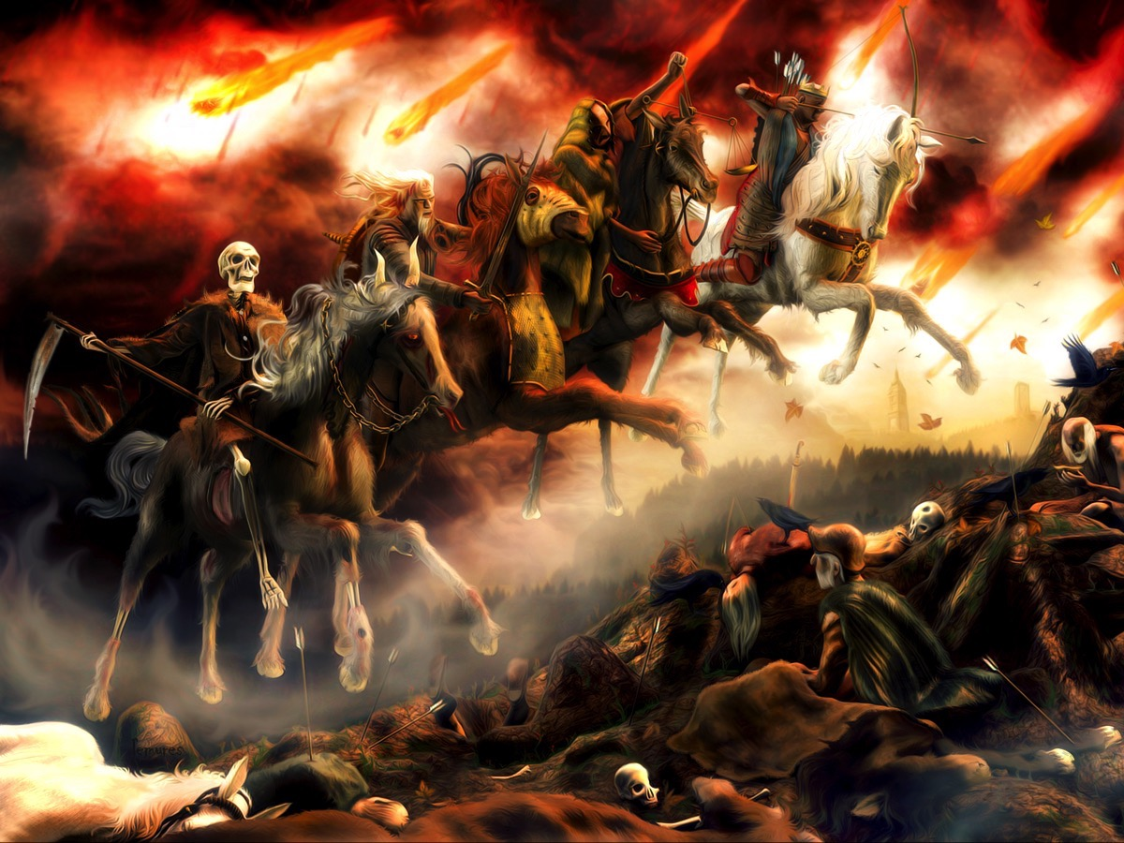
Notes:
Application: So when Jesus opens the seals we might expect four remedies to solve what is wrong with the world but instead we see four horsemen ride out and seemingly make things worse. Like the guy in pain - to bring healing often there will be pain involved as the problem is exposed and the remedy is applied. There is no Band-Aid for this world – no quick and painless cure – a patch up won’t be enough for eternity. Things are going to get worse on earth before they get better!

Slide 36
Notes:
Video: The Four Horsemen (Extract of the four horse sequence). Get it on YouTube at: https://www.youtube.com/watch?v=_ER2fm22G1U

Slide 37
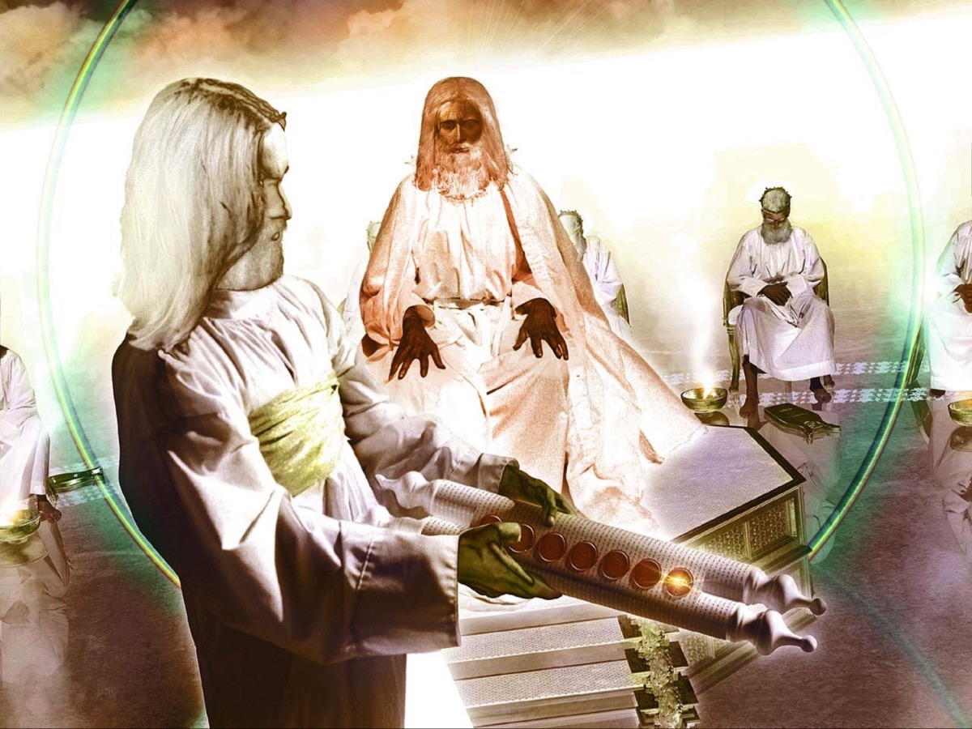
Notes:
Jesus opens the first seal

Slide 38
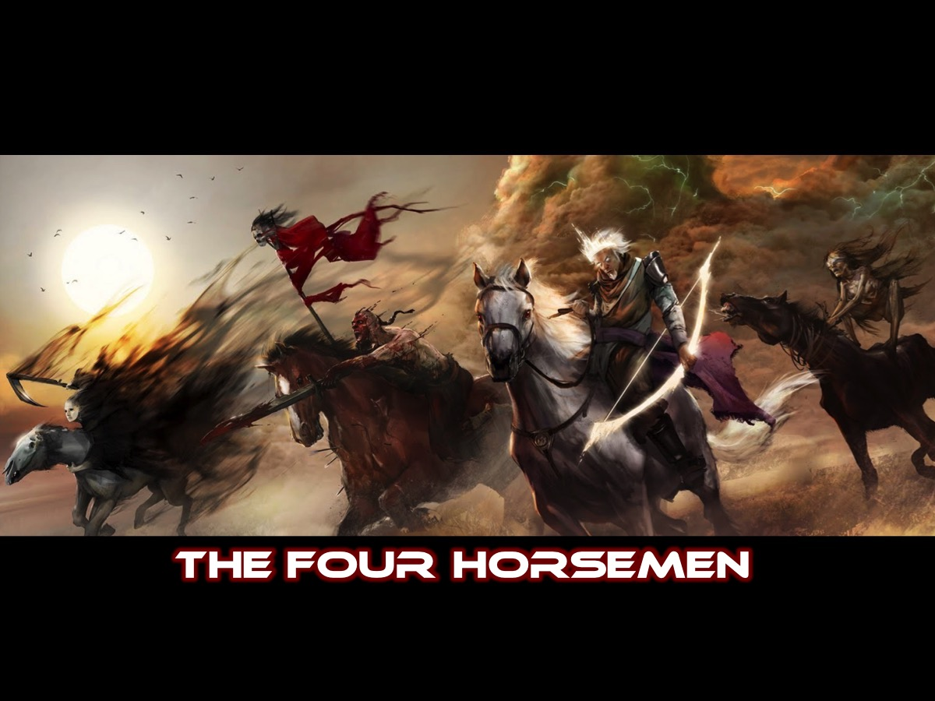
Notes:
The first four seals (of seven) unleash the four horsemen.

Slide 39
Notes:
Video: The White Horse (Extract of the white horse clip). Get it on YouTube at: https://www.youtube.com/watch?v=_ER2fm22G1U

Slide 40
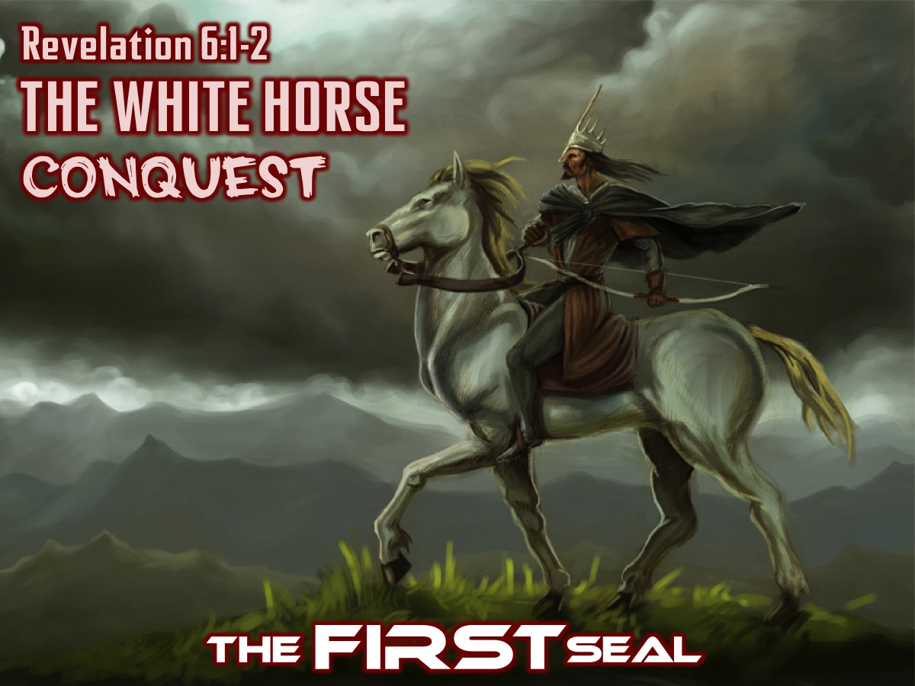
Notes:
The FIRST Seal: The White horse with the rider and his bow represents the kings of the earth who have charged to and fro overcoming nations and claiming sovereignty over them (it is not Jesus on the horse as some think). This Horse stands for Conquest.
It can also stand for False Christs (Matthew 24:24) - imposters, seductive imitators of Jesus who go about conquering and winning converts. The coming antichrist?

Slide 41
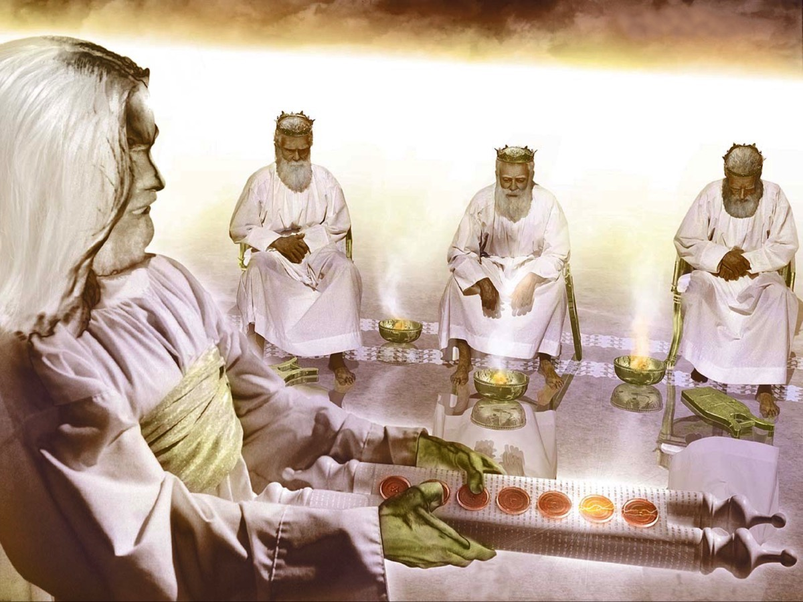
Notes:
Jesus opens the second seal.

Slide 42
Notes:
Video: The Red Horse (Extract of the red horse clip). Get it on YouTube at: https://www.youtube.com/watch?v=_ER2fm22G1U

Slide 43
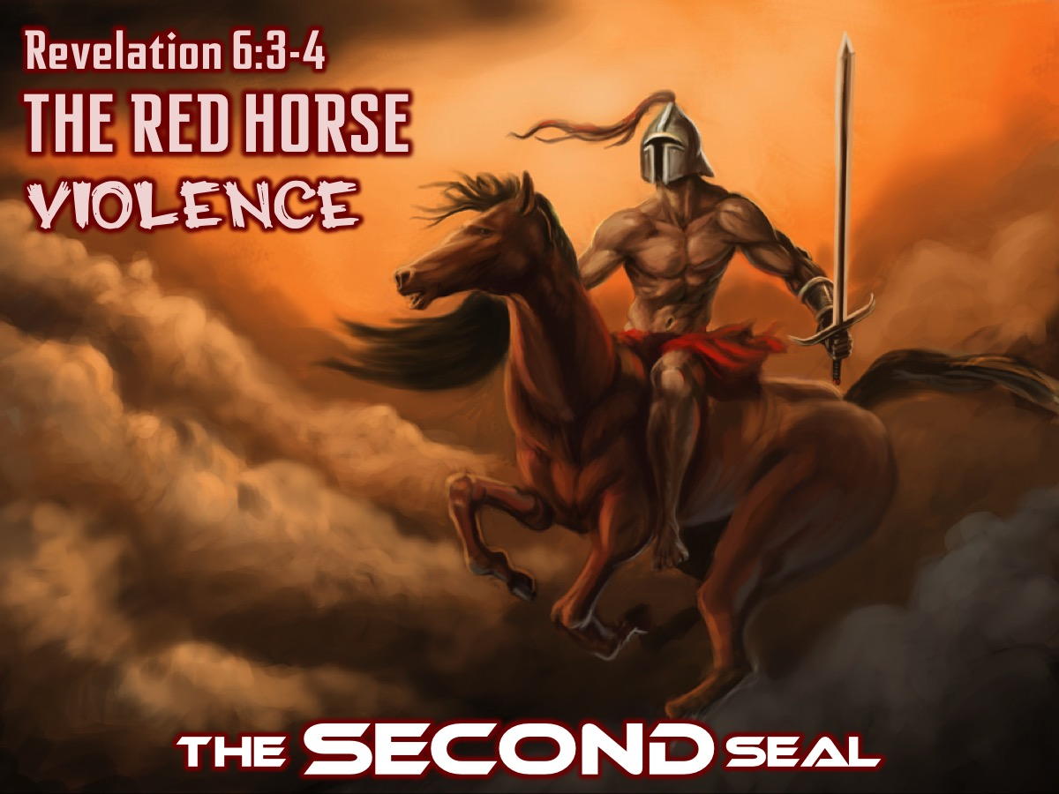
Notes:
The SECOND Seal: The fiery Red horse whose rider causes wars on earth that takes peace away. This Horse stands for Violence.
Isaiah 3:25 - war takes peace from the earth.
Matthew 24:6-7 - nations rising against nations.

Slide 44
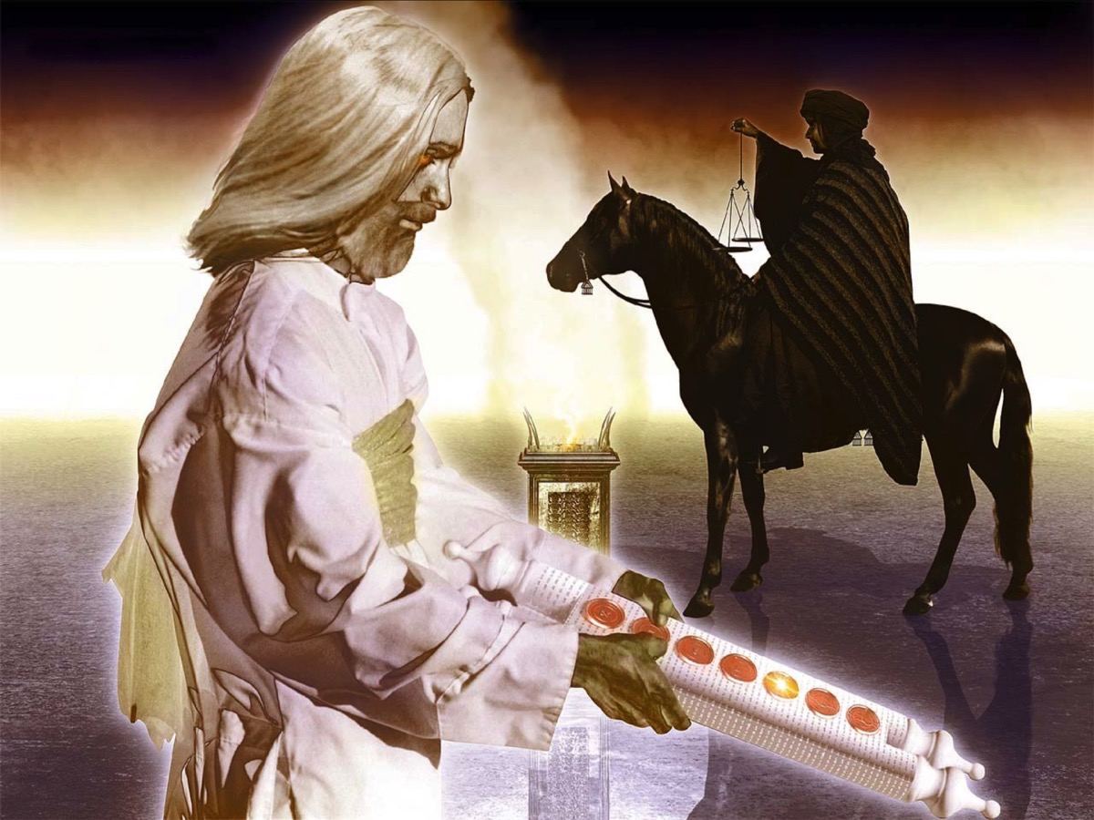
Notes:
Jesus opens the third seal.

Slide 45
Notes:
Video: The Black Horse (Extract of the black horse clip). Get it on YouTube at: https://www.youtube.com/watch?v=_ER2fm22G1U

Slide 46
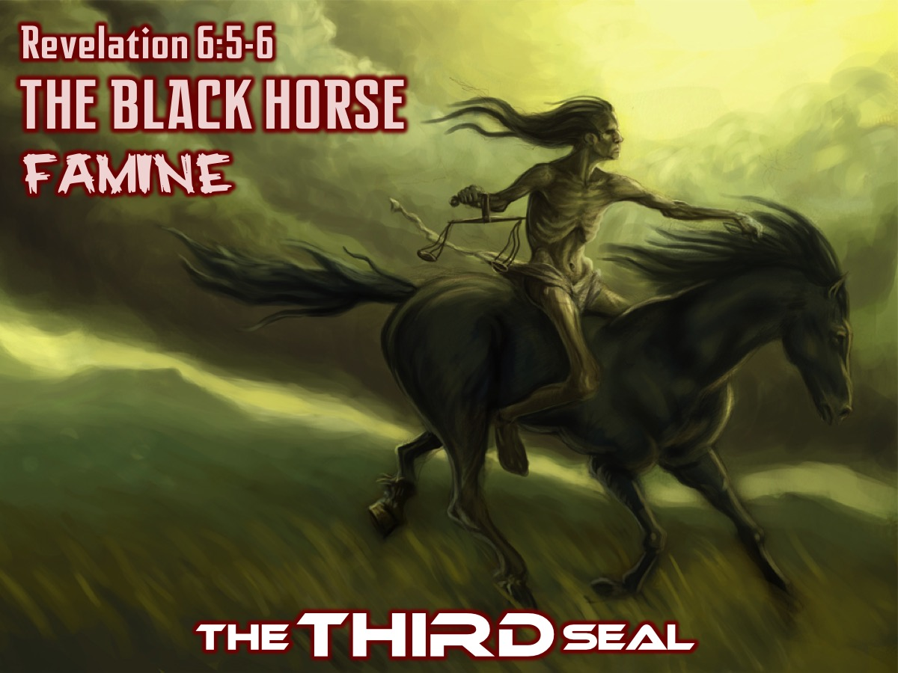
Notes:
The THIRD Seal: The black horse signifies the economic problems which so often lie at the root of violence within and among nations – ordinary items (the staple diet of the poor) shoot up in price which the luxury items (the oil and wine) stay the same allowing the rich once more to get richer at the expense of the poor. This Horse stands for Economic Disaster. Inflation. A quart of wheat is a daily wage of a person. A days ration of food will costs a workers total daily wage.

Slide 47
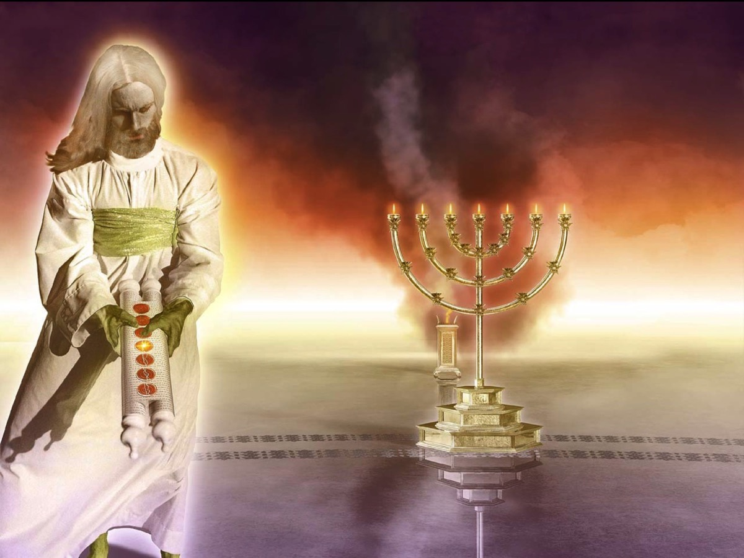
Notes:
Jesus opens the fourth seal.

Slide 48
Notes:
Video: The Pale Horse (Extract of the pale horse clip). Get it on YouTube at: https://www.youtube.com/watch?v=_ER2fm22G1U

Slide 49
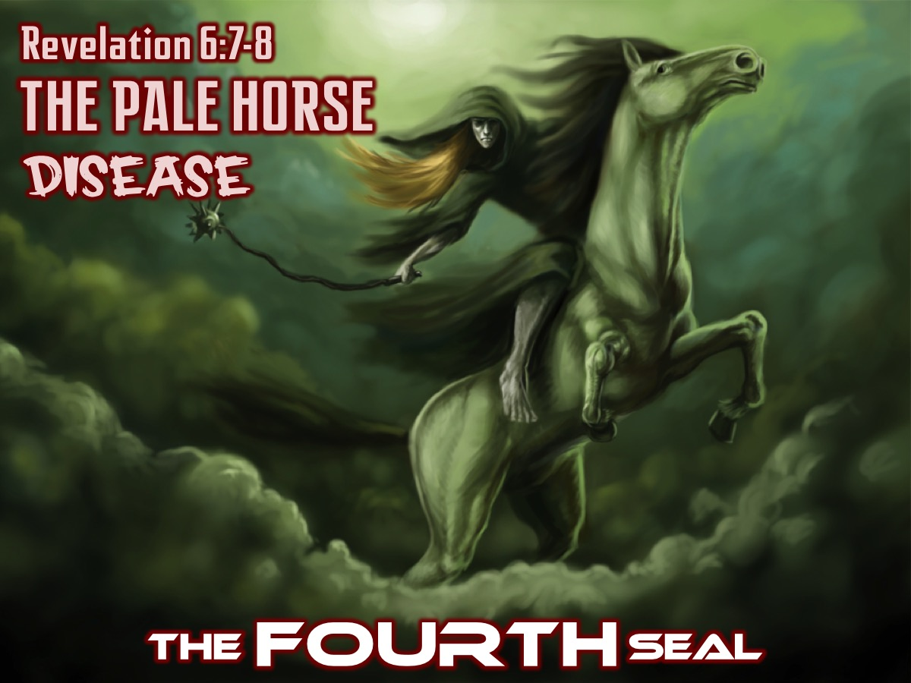
Notes:
The FOURTH Seal: The Pale horse carrying Death on its back and with Hades, the place of the dead represent how war and famine have ended people’s lives. These four are the basic ills that humans inflict on each other. This Horse stands for Death by Pestilence or Deadly Diseases. (Matthew 24:7)

Slide 50
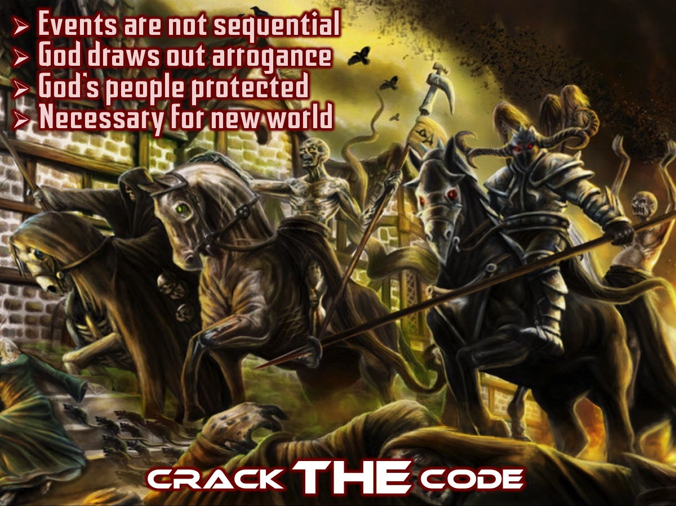
Notes:
Crack THE Code
We should not actually look for hour horsemen, nor think that the order is important. The 7 signs are not chronological but rather an expression of a sevenfold reality. We should also not think that the seals are open and THEN the trumpets sound and then the bowls are poured out – rather each of the sequences (and what happens in between) is a fresh angle on a very complex vision. If we look at the problem and pains of the world from God’s angle we see that his answer is to draw out the arrogant wickedness of humans to it’s full extent and show that he is bringing his people safely through. In the next angle of the vision (chapters 8 to 11) we see that God allows the forces of darkness to do their worst so that he can establish his kingdom fully and finally over the world! And if we then look at the next angle of the vision (chapter 12 to 13) we will see the full depth and horror of the problem to which God’s answer will be to inflict the rebellious world the equivalent of the plagues of Egypt – before finally rescuing his people and judging the dark powers that have for so long enslaved them (chapters 12-19). Then and only then can the darkest power of all be dealt with (chapter 20) and only then can the new heaven and new earth be establish – without any fear of lingering sickness still unhealed, buried sadness still to produce grief.
Revelation 6-20 is not what we want to hear – just like we don’t want the bad news from the doctor that surgery is necessary to bring healing. But it is what we must hear if the world is to be healed.

Slide 51
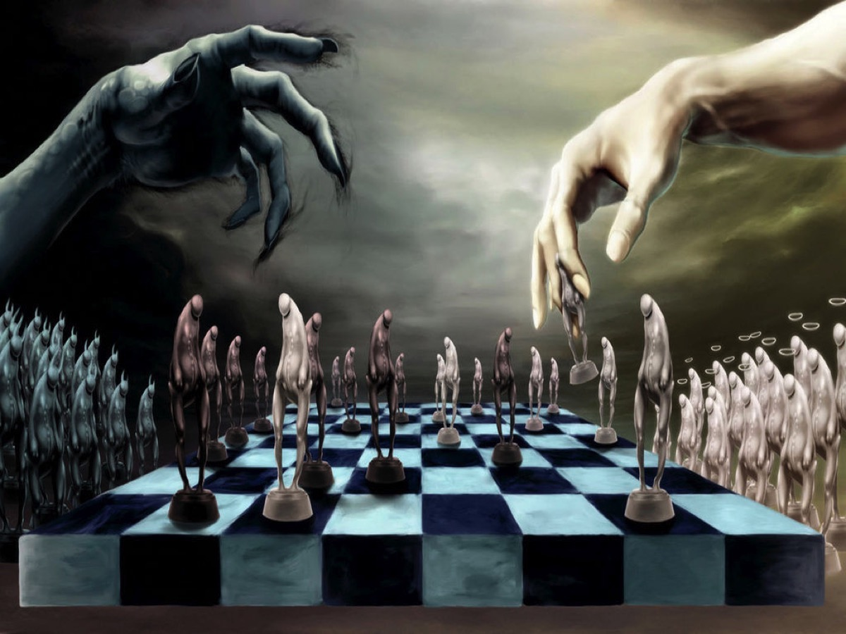
Notes:
Illustration: In a game of chess one person can win, or it can be a draw or someone can knock over the board in anger.
God plays fair. God is not one to draw a chess match or kick over the table – he is playing the long game and will go all out for the win.

Slide 52
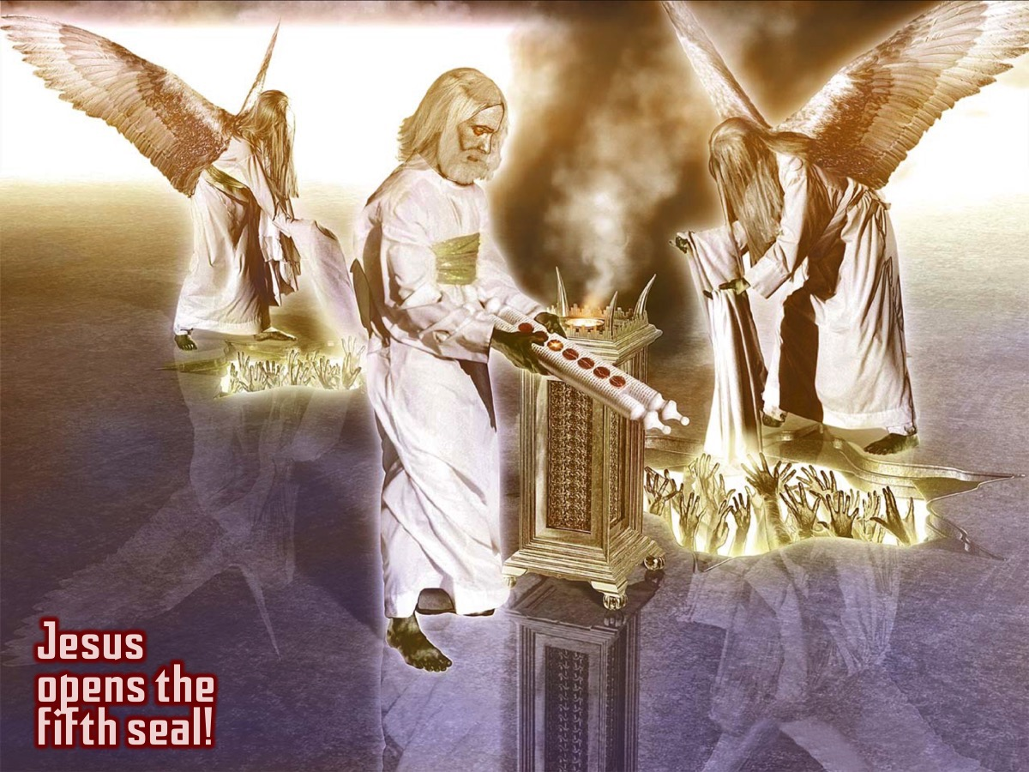
Notes:
Jesus opens the fifth seal.

Slide 53
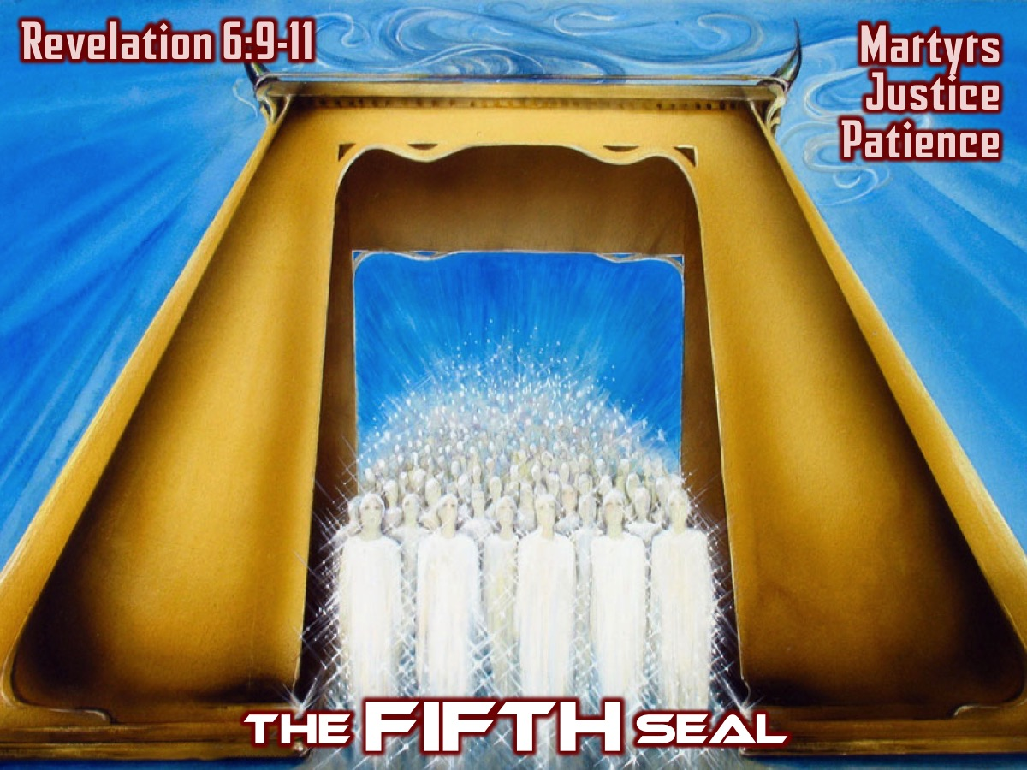
Notes:
The Fifth Seal (Revelation 6:9-11)
When the fifth seal is opened there is not another horseman or other violent image but the souls of those who have been killed because they were witnesses to God’s word. This is the only passage in the NT that speaks about the place of the Christian dead. They are “under the altar” – the throne room is the heavenly temple. These souls are aware that the world is still unjudged and unhealed – wickedness that caused their death and that afflicts the world has not being dealt with and they long for justice. But they are told to wait – to be patient. They are given white robes which indicates purity and victory and told that something else will need to happen before God’s justice will be seen. God is not one to draw a chess match or kick over the table – he is playing the long game and will go all out for the win. What has to happen? Evil has to do it’s worst, reach it’s height and be ripe for judgment.

Slide 54
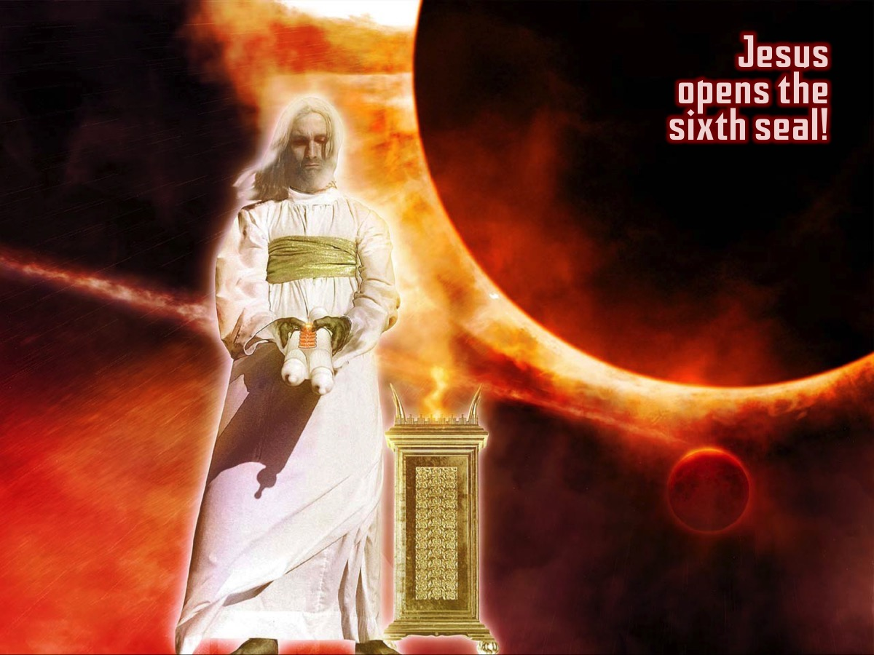
Notes:
Jesus opens the Sixth seal.

Slide 55
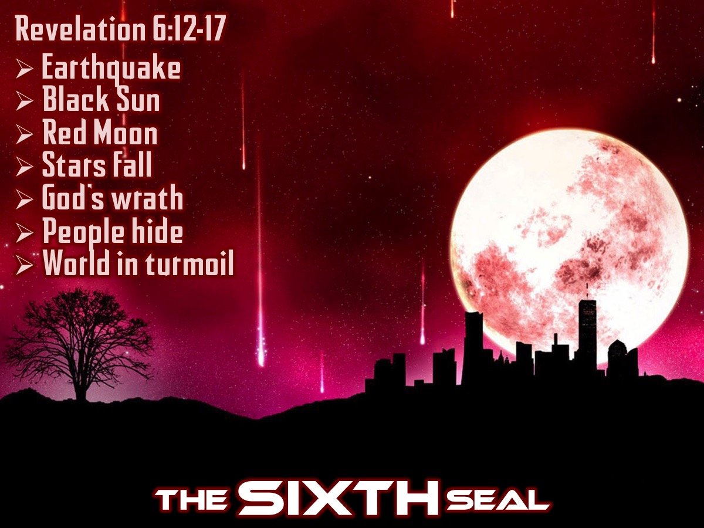
Notes:
The Sixth Seal (Revelation 6:12-17)
The next seal is not just more bad news for God’s people. In the ancient world eclipses, earthquakes and shooting stars were seen as signs – earth-shattering events like the fall of the Berlin Wall or the end of Apartheid. Clearly the world is not ending or the rich and famous would not be hiding in caves. This is actually a time of political and social turbulence resulting in a scene that has been described by prophets (Hosea 10:8). The great and the good realize that they are at the mercy of the God who rules the world – they face the Creator’s gaze and the lamb’s anger (almost a contradiction). The Creator is calling the world to account but people do not recognize him as God. God is calling the world to account – he is angry at everything that has spoiled his wonderful world – his gaze is a mixture of sorrow and anger. But the only people who should be afraid are those who are determined to resist the call of love.

Slide 56

Notes:
Jesus prophesied that all this would take place: “For nation will rise against nation, and kingdom against kingdom, and there will be famines and earthquakes in various places. All these are but the beginning of the birth pains. Immediately after the tribulation of those days the sun will be darkened, and the moon will not give its light, and the stars will fall from heaven, and the powers of the heavens will be shaken. Then will appear in heaven the sign of the Son of Man, and then all the tribes of the earth will mourn, and they will see the Son of Man coming on the clouds of heaven with power and great glory. And he will send out his angels with a loud trumpet call, and they will gather his elect from the four winds, from one end of heaven to the other.” (Matthew 24:7, 29-31)

Slide 57

Notes:
The Earth Shaken (Revelation 7:1)
The created order needs to be purified by a violent wind which scorches the earth – stirs up the sea and uproots trees. This is also symbolic of the shaking that will pass through all of human affairs as God’s judgment starts to take hold. It is strange that the earth, sea and trees are harmed after they were proclaimed good by God in Genesis 1 – but maybe the very stuff of the natural world has been inflicted with the disease of human rebellion and wickedness and they have to be purified and shaken hard. But what about the people of God? What is going to happen to them?

Slide 58

Notes:
The angel with the seal.

Slide 59

Notes:
In he ancient world seals were often used to keep things secret…

Slide 60

Notes:
but a seal was also used to indicate ownership - like a stamp in a library book so people know who thebook belongs to.

Slide 61

Notes:
God’s People Sealed (Revelation 7:1-8)
God’s people are sealed so they can be rescued from what is to come. Just as the children of Israel were spared the attack of the angel of death by the blood of the Passover lamb on their door posts (Exodus 12) so these people will be spared the suffering which will come on the whole world as evil is allowed to do its worst. God’s people need to be reassured that they will come through safely so they are marked on their foreheads with the special seal that says they belong to God and are not to be harmed. This does not mean they won’t suffer. These are the people referred to in verse 4-8 and 9-17 – the 144,000 represent the complete people of God (twelve thousand twelves) – actually a great number that no one can count – which include people who have not escaped suffering. They came through it safely to the other side as Jesus did by passing through death and resurrection. These are people from all nations – not just Jews - and represent all the renewed and rescued people of God. Even though the events happening around the people of God may be terrifying, they can rest assured that God has then in his care.

Slide 62

Notes:
God’s Great Rescue (Revelation 7:9-17)
John is writing to communities who are about to experience horrific persecution and they have to get ready for it. He offers them here a part of his continuing vision – a heavenly reality that we must hold on to for dear life as we plunge back into the nightmare. While God has won the victory we will still need to endure times of suffering before we find ourselves in the throne room of God worshiping him! John sees the complete people of God who are clothed in white speaking of victory and purity – carrying palm branches speaking of celebration – and they cannot contain their enthusiasm as they shout their delight and praise to God and the lamb because they have won the victory which has brought they their rescue. The word salvation (verse 10) literally means rescue. They realize that everything good, noble, powerful and wise comes from God himself. John is asked a question by one of the twenty-four elders about who these people are and is told that they are the ones who have come through the suffering and who God has personally wiped their tears away and he will protect them and provide for them for ever.

Slide 63

Notes:
Silence in Heaven (Revelation 8:1)
When the lamb opened the seventh seal there was silence in heaven for half an hour. A sense of awe, expectation and anticipation. The ceaseless praise of the 4 creatures, the 24 elders and the huge countless crowd falls away and everyone seems to be holding their breath. This is the moment they have all been waiting for.

Slide 64

Notes:
In chapter 6 the lamb removed the first four scrolls and the horsemen were dispatched, then the fifth seal as the souls under the altar were seen and then the sixth seal as terror seized earth’s inhabitants. Then there was a pause where God’s people were sealed so that the great damage that was done upon the earth when God’s judgment swept through it did not harm them – and in that pause we saw the vision of the heavenly reality in which God’s people appeared as a huge crowd celebrating God’s victory and their own deliverance with God himself looking after them and protecting them.

Slide 65

Notes:
The Seventh Seal (Revelation 8:2)
But now we come to the seventh seal and the silence suggests that something powerful and utterly decisive is about to happen. And once again we realize that the way has to be prepared for what must come next and we are introduced to the next cycle of sevens. After the seals and as part of the fulfillment of the seventh seal we have the seven trumpets. Trumpets were used for various purposes in ancient Judaism – in worship (especially at festivals) and in battle like when the Israelites circled Jericho and at the blast of the trumpets, the walls fell down (Joshua 6). More generally trumpets were blown for warnings, to sound the alarm (Joel 2:1, Amos 2:2; 3:6) – which seems to be the point here because the trumpets signal great plagues, a worldwide version of the plagues of Egypt at the time when God was getting ready to rescue his people.

Slide 66

Notes:
Our PRAYERS Count (Revelation 8:3-5)
But before the trumpets can sound and to complete the sequence of the seven seals, something else must happen – and an angel appears carrying a golden censer. In 5:8 we saw that the prayers of God’s people on earth are presented before God like incense. Now the angel approaches once more and he is given a large amount of incense. The prayers are probably the coals on which the incense will burn. The prayers of God’s people – including the prayers of the martyrs (6:9-11) are coming before the throne of God. The seven trumpets will be, at least in part, God’s answer to the prayers of his people. God is committed to working in the world so there is a partnership with his people on earth through their prayers. The angel fills the censer with fire from the altar and thrown it on the earth. Until evil has been judged, condemned and radically uprooted from the earth, the only word that earth can hear from heaven is judgment. The thunder, rumblings, lighting and earthquake come at the close of the each section of the book – picking up from when they first appeared in front of the throne of God (4:5). Here they appear at the close of the seven seals (8:1-5), then after the 7 trumpets have sounded (11:19), and after the 7 Bowls of wrath have been poured out (16:18). As long as God is sovereign and earth is full of evil his only answer to it must be fire. Jesus said he had come to throw fire on the earth (Luke 12:49). So the angel is continuing the strange work of the Lamb.

Slide 67

Notes:
Ultimately, this is the revelation of Jesus - and can you imagine the celebration that took place in heaven as he successfully opened every one of the seven seals!

Slide 68

Notes:
Let US Pray

Slide 69

Notes:
Handout: Your homework this week is to read Revelation chapter 4 to 7. We are giving you a handout to guide you as you read.

Slide 70

Notes:
Next week we will experience Act III: 7 Trumpets (Revelation 8:2-11:18)

