Slide 1
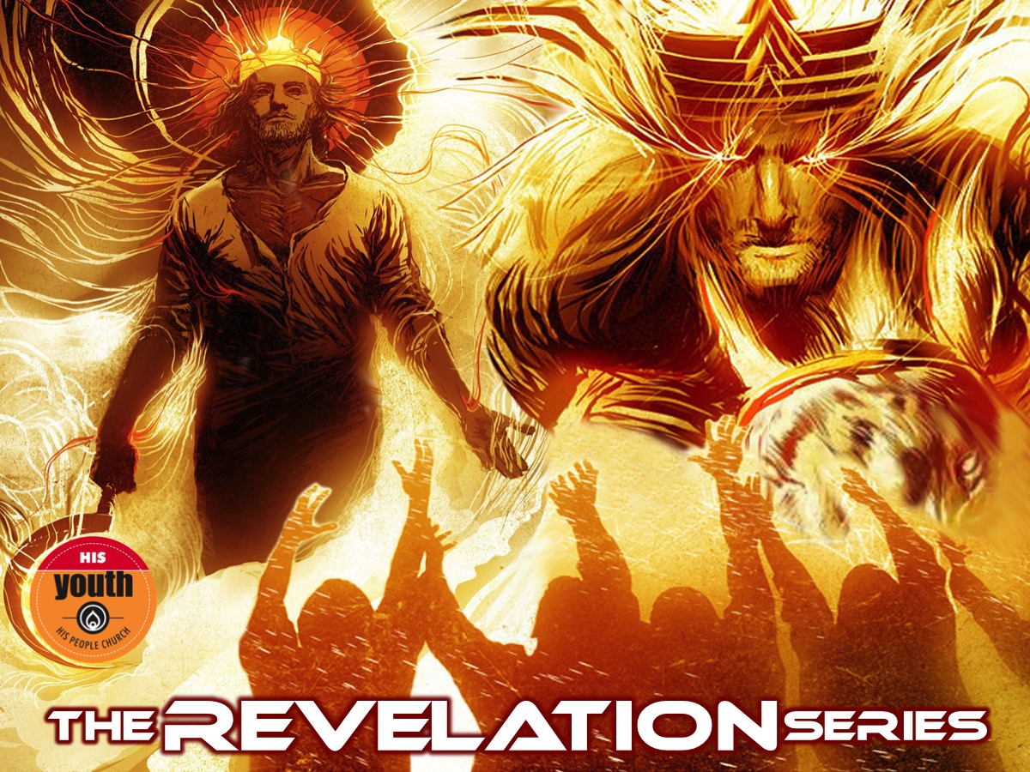
Notes:
Welcome to the Revelation Series.

Slide 2
Notes:
Video: Edited from The Book of Revelation Pastor Rony Tan. Get it on YouTube at: https://www.youtube.com/watch?v=dug1FgoW5e0

Slide 3
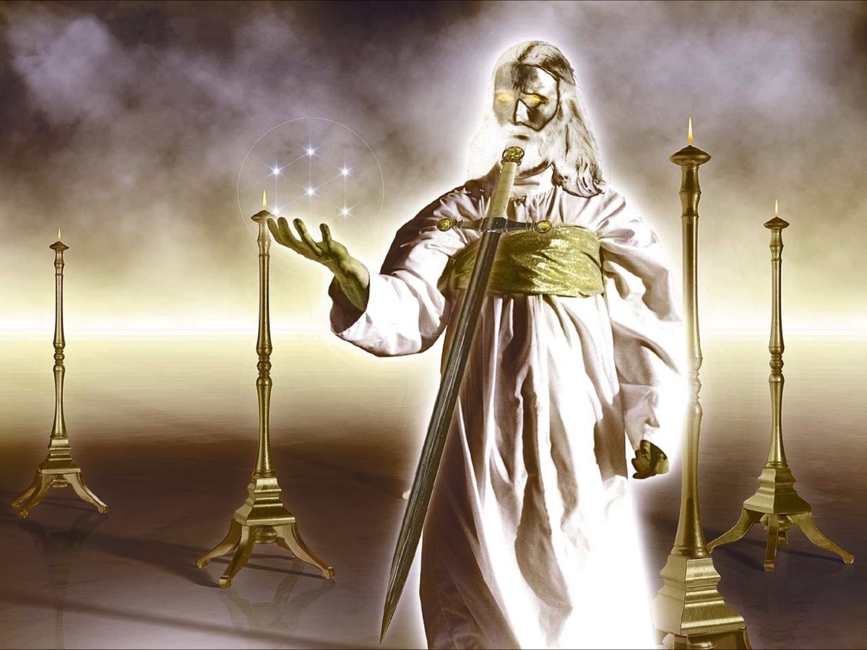
Notes:
In the first two weeks we saw an incredible revelation of Jesus and we read the seven letters that Jesus sent to seven churches in Asia Minor and reflected on what Jesus thinks about His Youth and also what our personal strengths, weaknesses, opportunities and threats are.

Slide 4
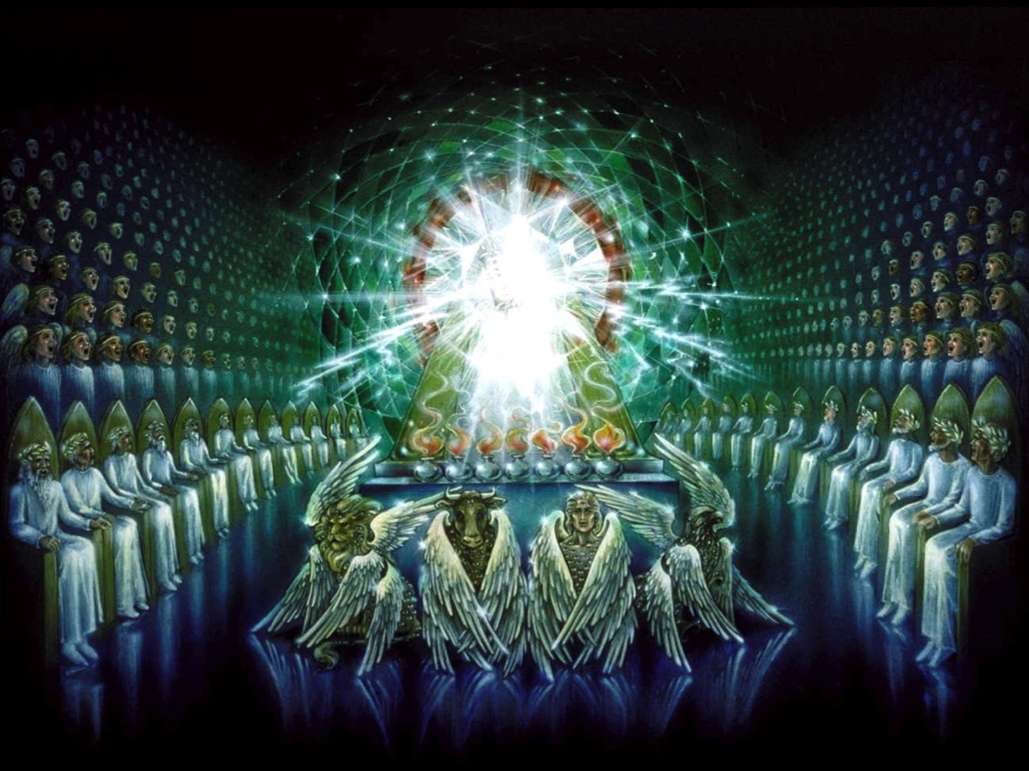
Notes:
In week three we had a vision of God’s throne room and realised that he is worthy to be worshipped. (Revelation 4)

Slide 5
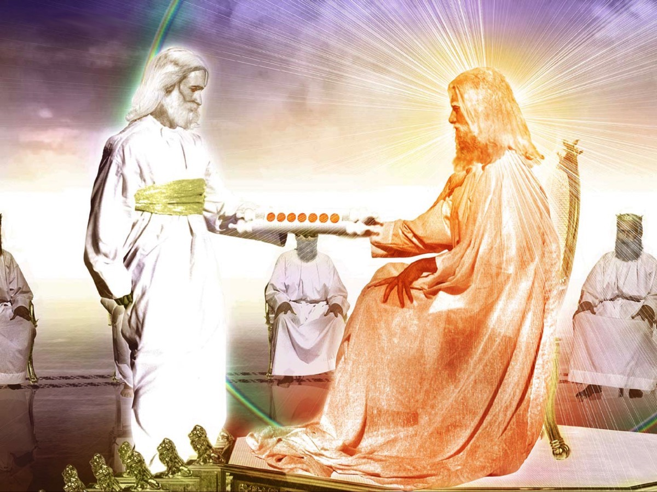
Notes:
We saw that only Jesus was found to be worthy to take the scroll from his father and open it each of the seven seals (Revelation 5:8-14):

Slide 6
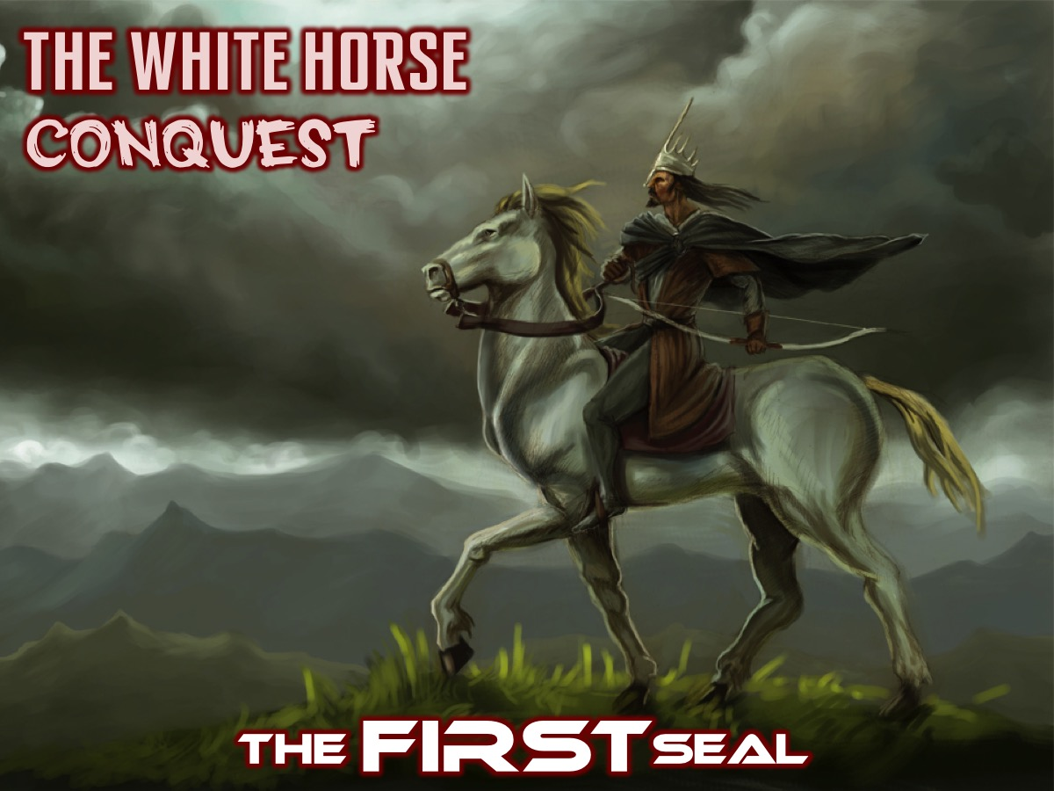
Notes:
The FIRST Seal: The White horse was a time of conquest.

Slide 7
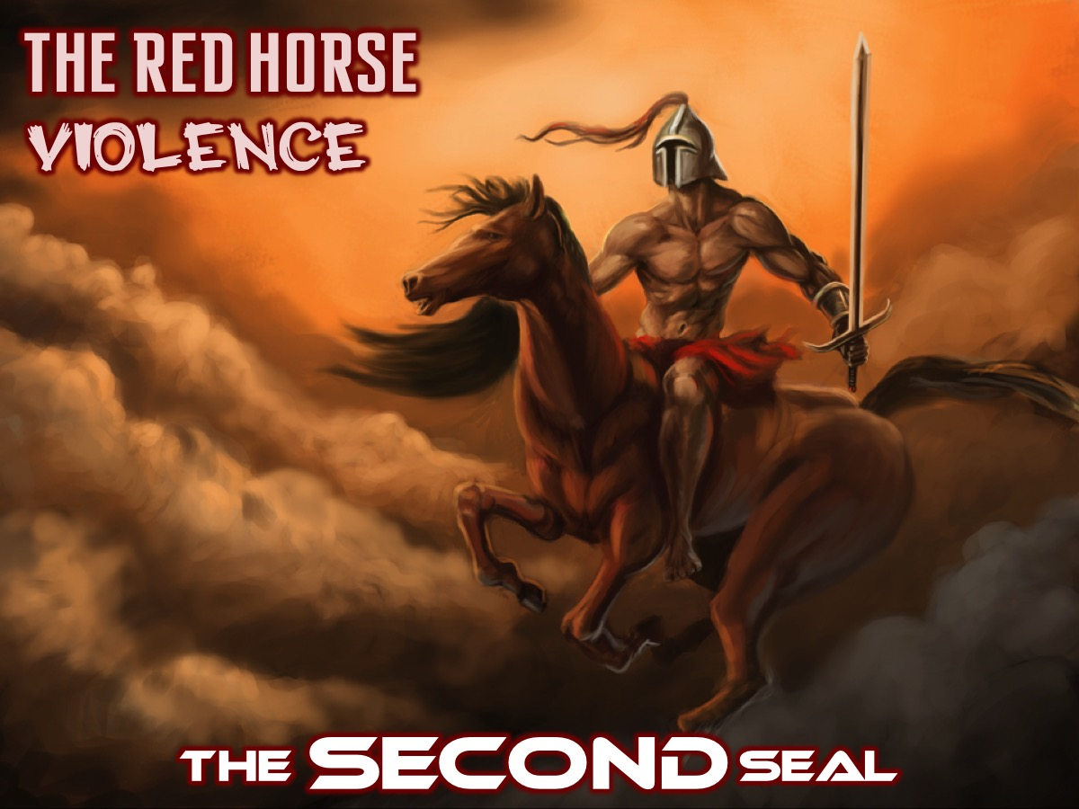
Notes:
The SECOND Seal: The Red horse was a time when peace was taken from the earth.

Slide 8
Notes:
The THIRD Seal: The black horse was a time of famine.

Slide 9
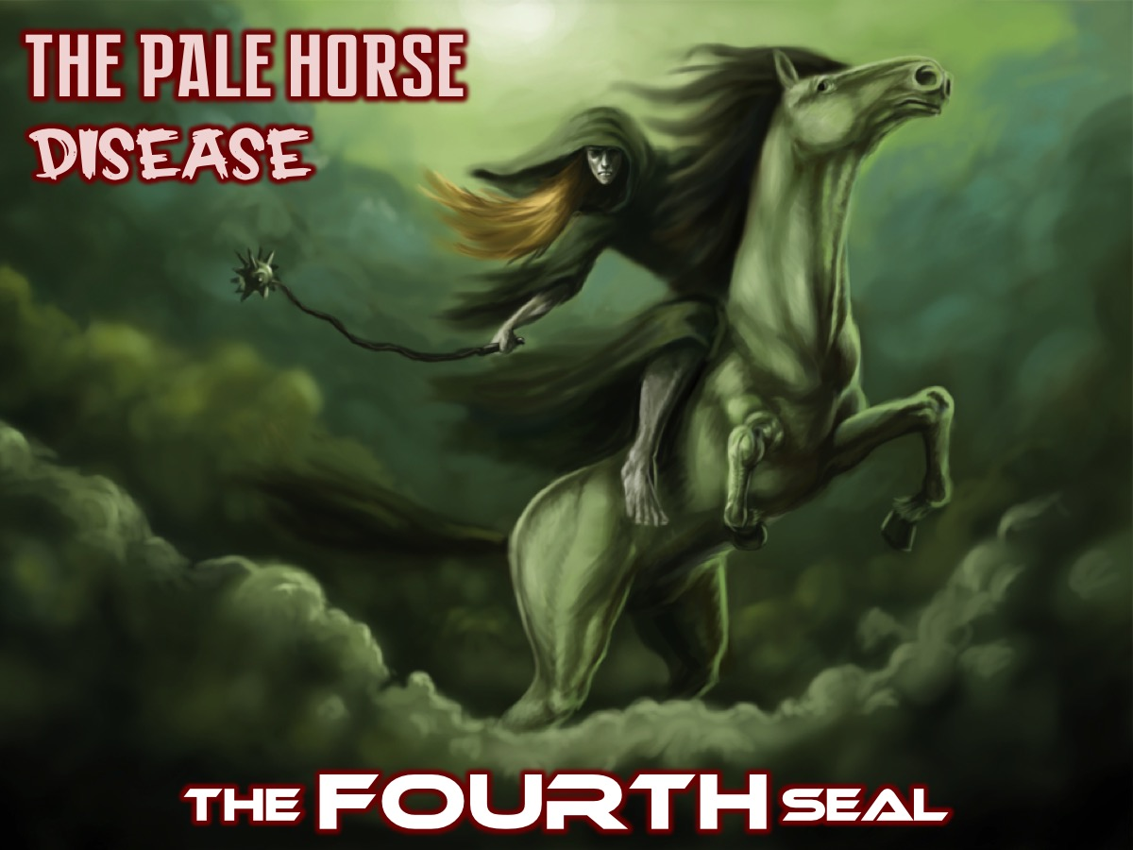
Notes:
The FOURTH Seal: The Pale horse was a time of disease.

Slide 10
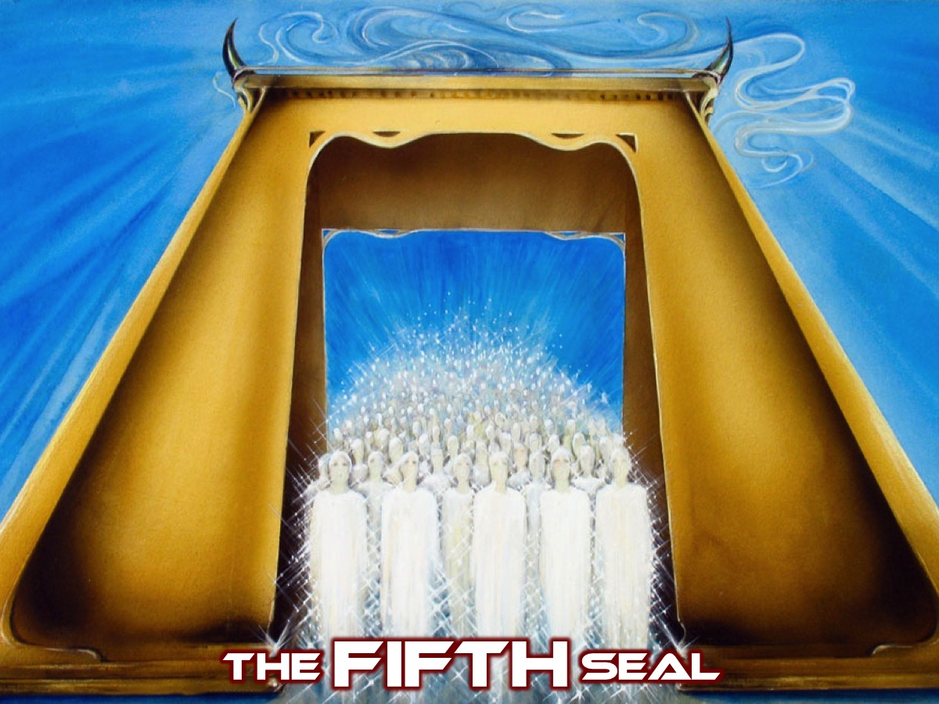
Notes:
The FIFTH Seal: When the Fifth Seal was opened (Revelation 6:9-11) we saw those who had been killed because they were witnesses to God’s word and they cry out for justice but are told to be patient.

Slide 11
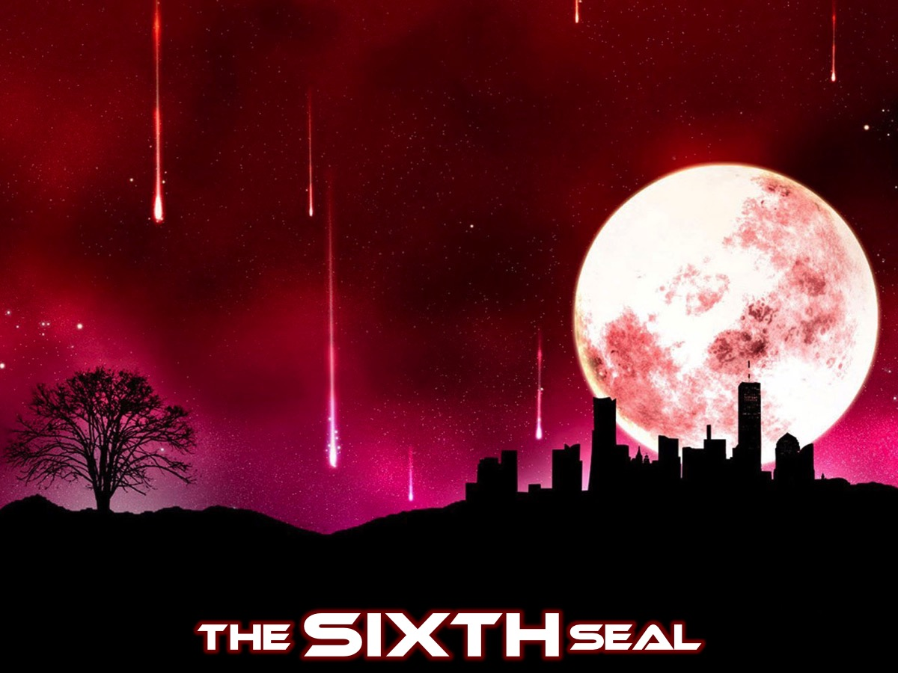
Notes:
The SIXTH Seal: When the Sixth Seal (Revelation 6:12-17) was opened there were signs in the heavens - probably representing a time of political and social turbulence.

Slide 12
Notes:
Next there was silence in heaven (Revelation 8:1).

Slide 13
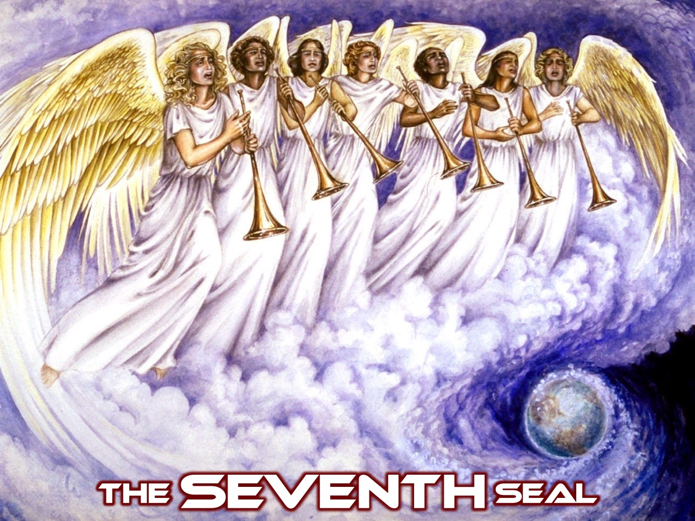
Notes:
The SEVENTH Seal: This Seal (Revelation 8:2) introduced the seven angels with their trumpets - but first…

Slide 14
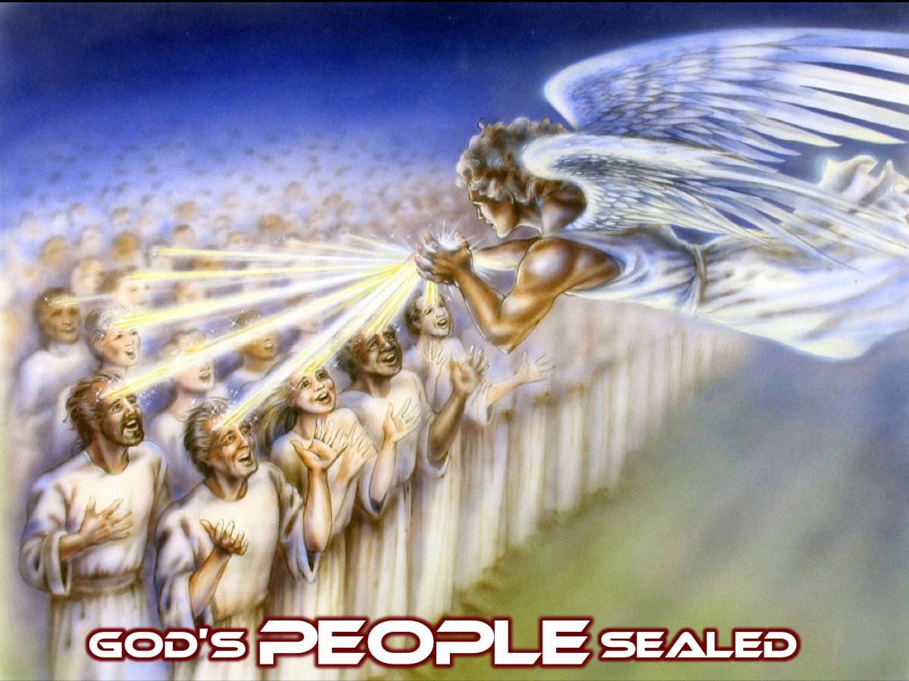
Notes:
God’s people are sealed (Revelation 7:1-8) to protect them from what was to come.

Slide 15
Notes:
This brings us to our session today which is Act III and the blowing of the 7 Trumpets (Revelation 8:2-11:18).

Slide 16
Notes:
Last week, in chapter 4 and 5 we saw how the 4 living creatures and the 24 elders and all the angels praised God for his amazing creation…

Slide 17
Notes:
Is God Angry (Revelation 8:6-13) …but then we witness God starting to destroy creation. Is God having a bad day? No!!! Here are some thoughts to help us understand what is going on…

Slide 18
Notes:
1. Sin is serious! We don’t realize how serious sin is! Even after world wars, terror and genocide we still tend to think that the world is a pleasant place with evil just a ‘blip’ on the horizon that we can deal with. We mistakenly believe that we can get rid of evil in our world and create Utopia. But from God’s perspective – this world is in serious trouble and evil can’t be swept under the carpet.

Slide 19
Notes:
2. Revelation is full of symbolism. We must understand the symbolism in the book of Revelation. When we realize that the book is a certain type of literature – apocalyptic writings – we realize that we need to decode what happens in the book and that just maybe a third of the world or the sea won’t be destroyed as it says. God is going to take drastic action to purify the world – to prune it like you would a tree that has become diseased – removing the cancer to the rest of the tree can be saved. God is about to radically upset the human system by which millions have been enslaved and degraded yet kept in place by structures of apparent beauty, nobility and high culture. A slight modification will not do – only major surgery will do!

Slide 20
Notes:
3. History is Repeating! It Happened Before. We see a parallel to the plagues of Egypt in the Old Testament. Starting with these trumpets and then continuing with the bowls of wrath that are poured out in chapter 16 we see a connection with the plagues that hit the Egyptians at the end of the Israelites 400 years of slavery. In Exodus there were ten plagues that hit both the people and the land to warn the Egyptians of the power of the God of Israel and as the dramatic means by which Israel would escape to the Promised Land. These plagues will have the same effect as those ones did – they will server as a warning and a means of deliverance – through these events the world will be warned to deliver God’s people.
The first ten plagues of Egypt were as follows: First the waters were turned to blood, then there were frogs and then gnats and then flies. But each time Pharaoh hardened his heart and would not let God’s people go. Then a deadly disease struck their cattle, then people were afflicted with boils, then lightning and hailstorms devastated the crops, then came a plague of locusts, and then the final terror where the angel of death passed through the land and killed the firstborn of the Egyptians while the Israelites were spared because of the Lamb’s blood on the doorposts of the houses. That was the final straw and Pharaoh drove them out of the land, only to change his mind and chase the Israelites only to drown in the Red Sear while the Israelites passed through on dry ground.

Slide 21
Notes:
Video: Exodus Gods and Kings - 10 Plagues in Egypt. Get it on YouTube at: https://www.youtube.com/watch?v=L7o0o2QTJfM

Slide 22
Notes:
4. God is Merciful. The intensity of judgment has moved up. Yet still some things are spared: most of the trumpet plagues fall on a third and not on all; the locust plague of 9:1-12 is over after five months; some people survive the collapse of the city in 11:13.

Slide 23
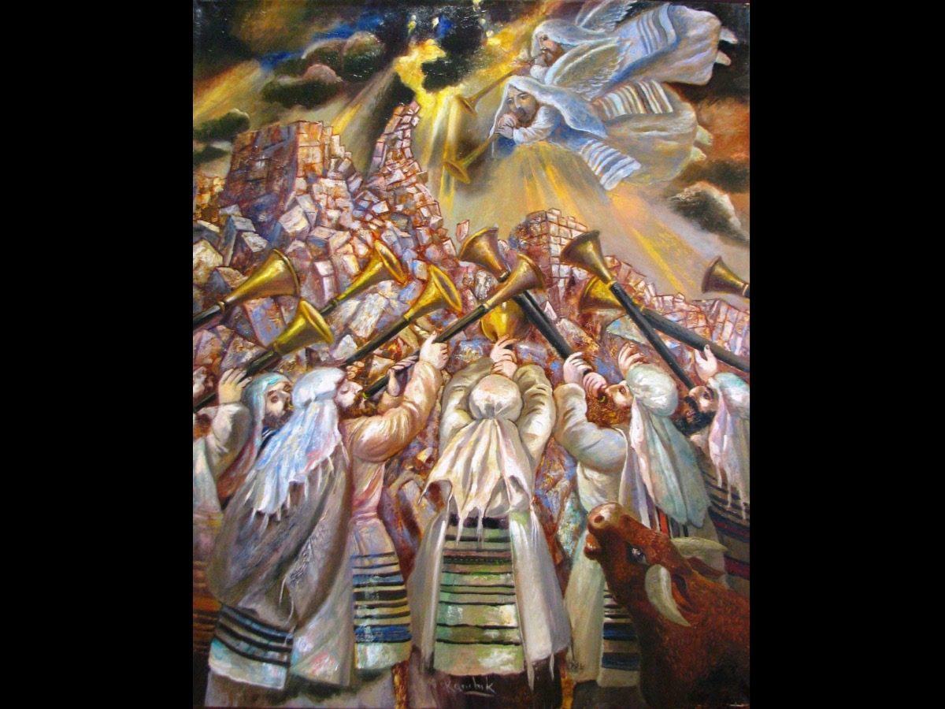
Notes:
Like the trumpets used in the battle of Jericho (Josh. 6), these trumpets lead up to the fall of the worldly city (11:13), and in the seventh trumpet the complete victory of God arrives.

Slide 24
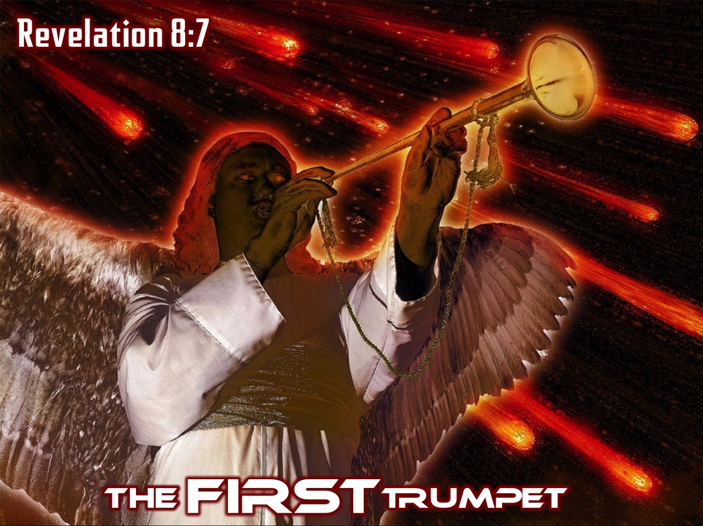
Notes:
The FIRST Trumpet (Revelation 8:7)

Slide 25
Notes:
The first trumpet causes hail and fire that destroys much of the plant life in the world. “The first angel sounded his trumpet, and there came hail and fire mixed with blood, and it was hurled down on the earth. A third of the earth was burned up, a third of the trees were burned up, and all the green grass was burned up.” (Revelation 8:7)

Slide 26
Notes:
The SECOND Trumpet (Revelation 8:8-9)

Slide 27
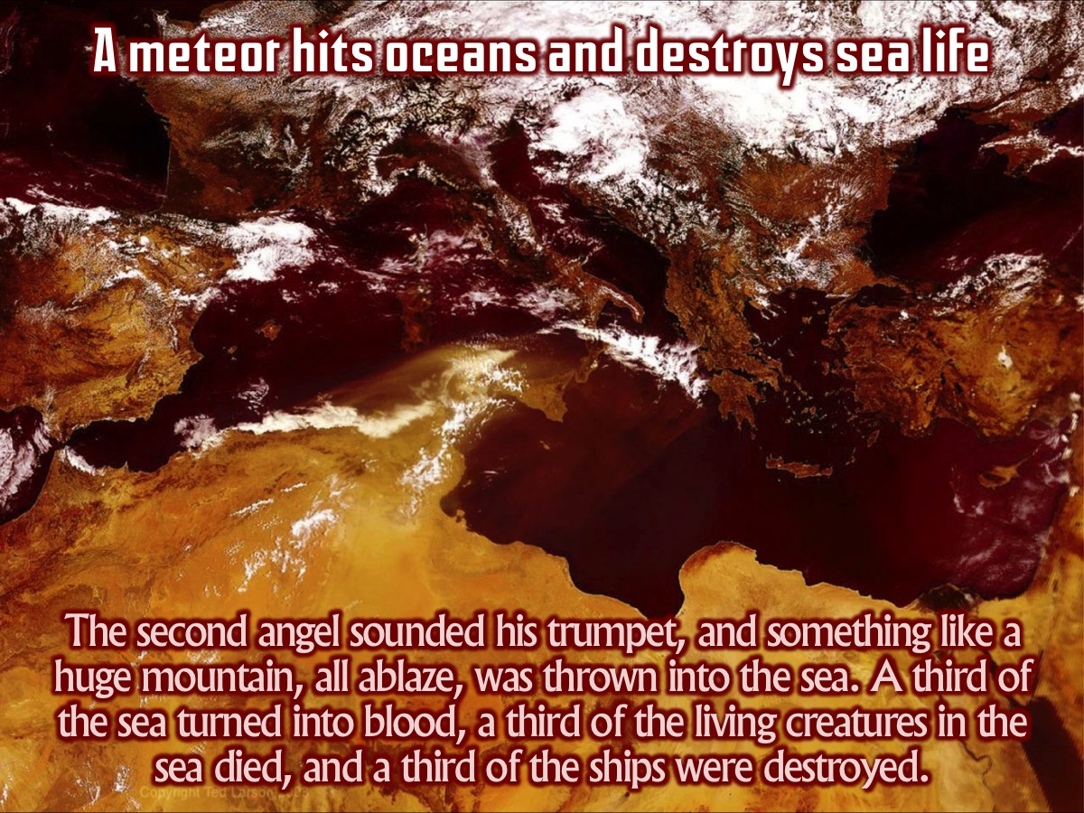
Notes:
The second trumpet brings about what seems to be a meteor hitting the oceans and causing the death of much of the world’s sea life. “The second angel sounded his trumpet, and something like a huge mountain, all ablaze, was thrown into the sea. A third of the sea turned into blood, a third of the living creatures in the sea died, and a third of the ships were destroyed.” (Revelation 8:8-9)

Slide 28
Notes:
Even ships on the ocean are destroyed.

Slide 29
Notes:
The THIRD Trumpet (Revelation 8:10-11)

Slide 30
Notes:
The third trumpet is similar to the second, except it affects the world’s lakes and rivers instead of the oceans. “The third angel sounded his trumpet, and a great star, blazing like a torch, fell from the sky on a third of the rivers and on the springs of water - the name of the star is Wormwood. A third of the waters turned bitter, and many people died from the waters that had become bitter.” (Revelation 8:10-11)

Slide 31
Notes:
The FOURTH Trumpet (Revelation 8:12)

Slide 32
Notes:
The fourth of the seven trumpets causes the sun and moon to be darkened. “The fourth angel sounded his trumpet, and a third of the sun was struck, a third of the moon, and a third of the stars, so that a third of them turned dark. A third of the day was without light, and also a third of the night.” (Revelation 8:12)

Slide 33
Notes:
The WARNING Angel (Revelation 8:13) - suddenly there is an angel flying through the sky warning the inhabitants of the earth about the next three trumpet that are about to sound.

Slide 34
Notes:
The FIFTH Trumpet (Revelation 9:1-11) - The fifth trumpet sounds and a star falls from the sky to the earth…

Slide 35
Notes:
The star is given a key and it opens the Abyss which releases a horrific army of locusts, energized by demonic sources (9:1-2) and they attack the wicked (those who do not have the seal of God on their forehead), while the saints are spared (9:4). The imagery derives from Exodus 10:13-15 and from Joel 2:1-11, where a literal locust plague foreshadows even more devastating judgment coming from a divinely commissioned army (Joel 2:11). Their terrorizing powers compare only to those of the Beast (13:1-10).
Extra Notes: The fifth trumpet has allowed another falling star to play a role in the drama. The ultimate source of evil and terror is normally kept locked up in a bottomless pit (like a black hole – symbolic of all the wickedness, murder, greed, envy, pride that you can image – what Jesus spoke about when he said that this is what lurks inside people even though they try and wash the outside clean). Humans were made to reflect their wise, loving creator but they hearts became full of rebellion, filth and wickedness. The world itself has become affected too – it was made by God and loved by God but it has come to harbor within it such rebellion, an anti-creation destructiveness, that even though God normally has it restrained, if it is to be dealt with it my be allowed to come out and show it’s true colours. The vision depicts the self-defeating and tormenting nature of wickedness in the human soul. This general principle has multiple fulfillments. Within the Roman Empire, it represents how people giving themselves to the worship of idols and the worship of the Emperor suffer torments of soul. In addition, as God brings the structures of the Empire under judgment, people may experience suffering through social, political, and military failures as well. In the future, just before the Second Coming, judgments of God against the wicked will intensify. The general principle applies to the entire period of the church age. Wickedness brings suffering rather than the hoped-for success (cf. Prov. 10:6, 7, 9, 11, etc.). Like Proverbs, Revelation delineates a general pattern. But it is also honest about the fact that the saints may for a time suffer grievously (6:9-10). Within this world order, justice does not always triumph quickly.

Slide 36
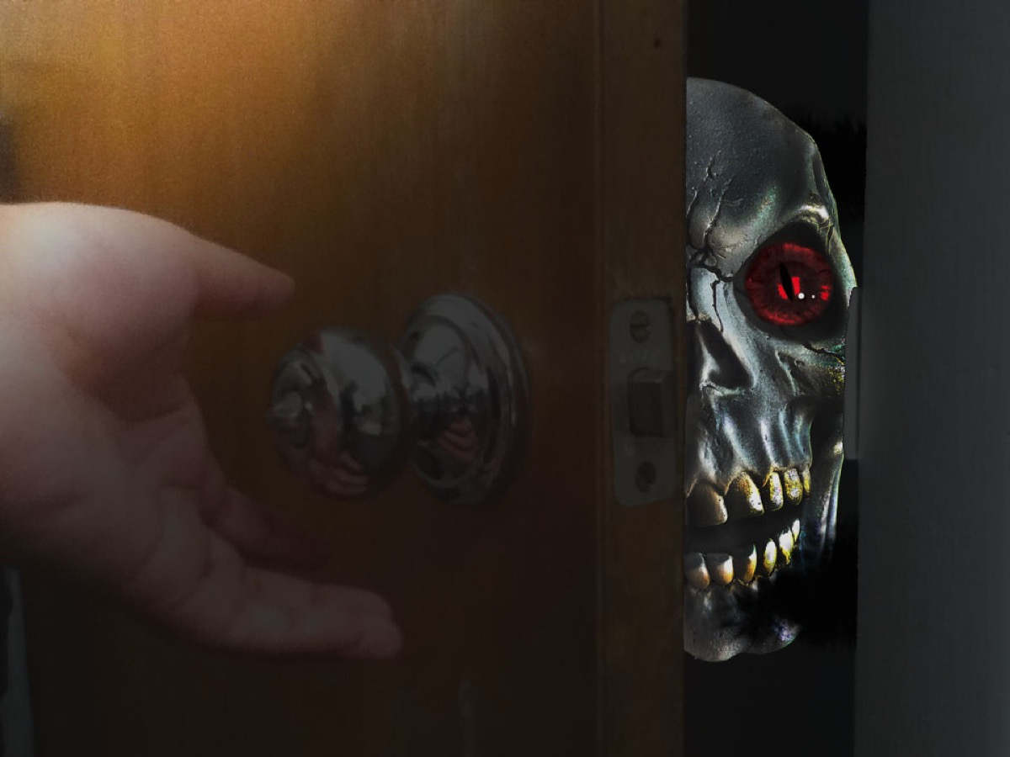
Notes:
Illustration: Think of a horror movie that has a creature outside the house that you can hear and that is imminently about to break into the house and eat you alive. You are terrified! When John wrote about the vision of the locusts – he probably intended for it to have a similar effect on those who read the book. The point of this nightmare is that all your worst dreams have been realized in an instant – the angel sounding the fifth trumpet has unleashed something truly monstrous - hellish!

Slide 37
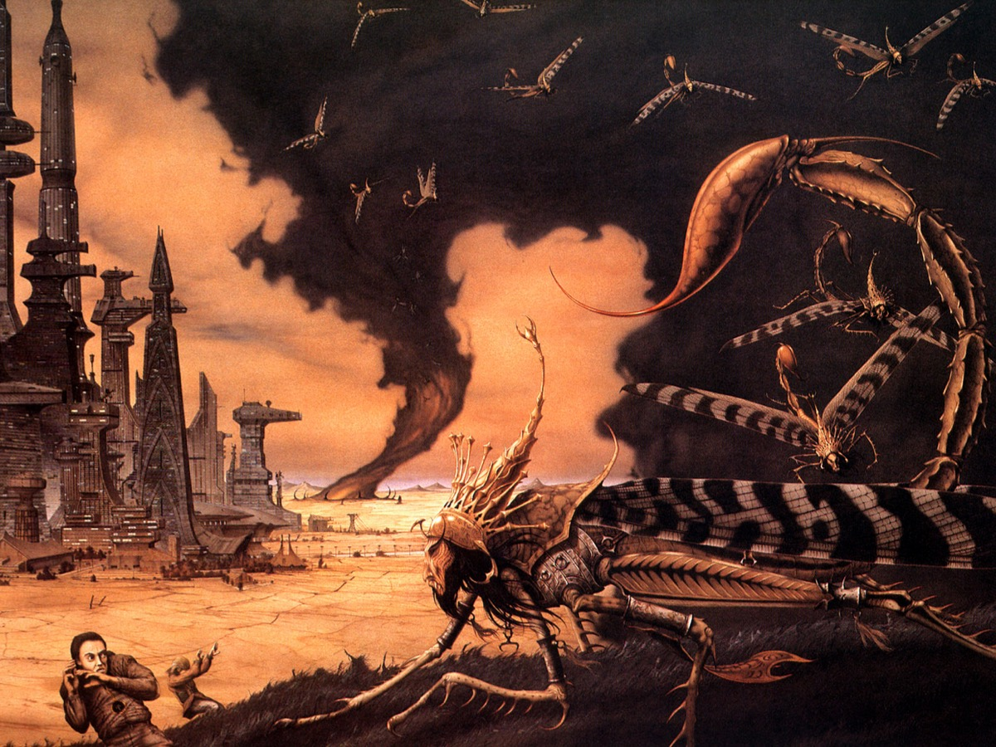
Notes:
John spends a long time describing the locusts (Revelation 9:7-10). The locusts are like those in the plague of locusts in Egypt or the terrible army of locusts in the book of Joel but there are man-eating or man-torturing locusts, with heavy equipment and armour that make then impregnable and irresistible yet they act under strict and limiting instructions.
Extra Notes: John says they will torture people for five months – probably a reference to the normal life cycle of a locust. But their work, though horrible, is limited. God is in control and he is allowing evil to come into the open for a period of time – so it can do it’s worst, but then face judgment and destruction. “The locusts looked like horses prepared for battle. On their heads they wore something like crowns of gold, and their faces resembled human faces. Their hair was like women’s hair, and their teeth were like lions’ teeth. They had breastplates like breastplates of iron, and the sound of their wings was like the thundering of many horses and chariots rushing into battle. They had tails with stingers, like scorpions, and in their tails they had power to torment people for five months.” (Revelation 9:7-10)

Slide 38
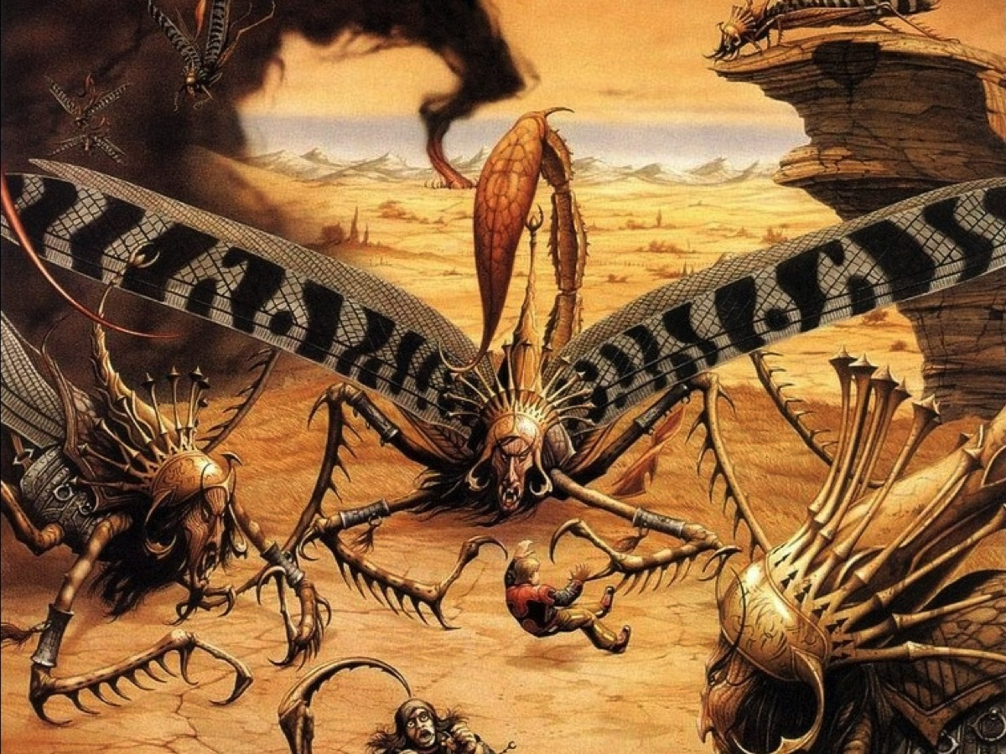
Notes:
They are not allowed to harm neither the vegetation (as locusts normally would) nor the people sealed with God’s simply – but simply everyone else.

Slide 39
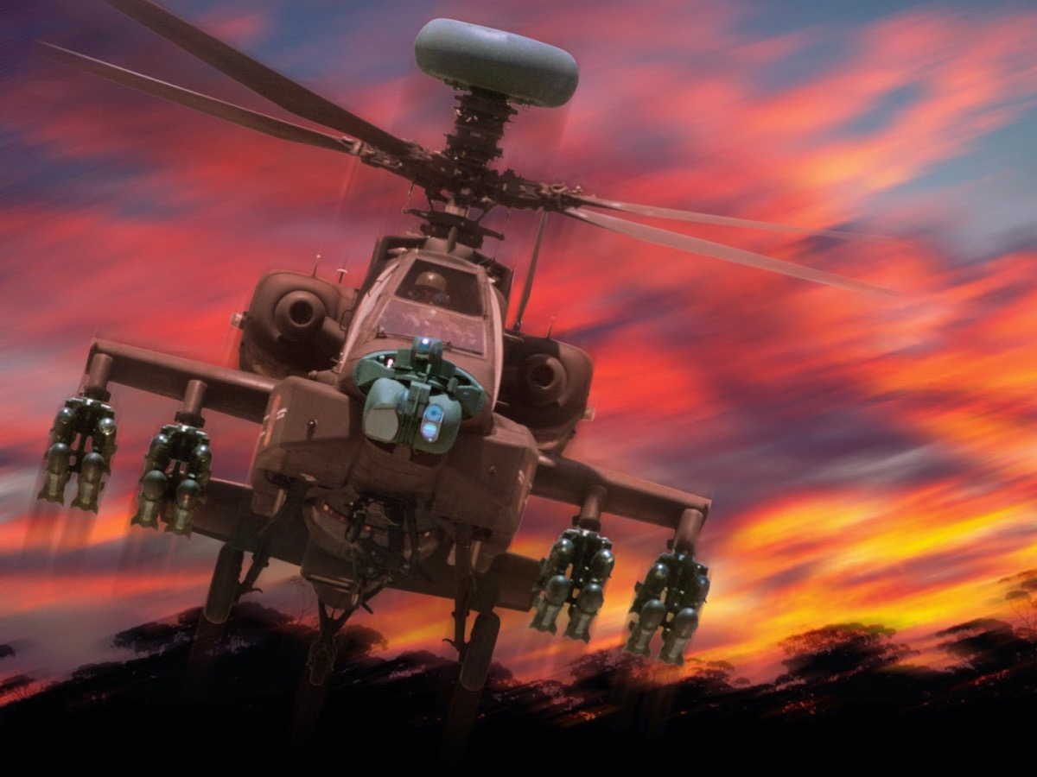
Notes:
Some people have suggested that these locusts are military attack helicopters. But it is wise to see the big picture in the book of Revelation rather than trying to make too many specific connections which gets us into trouble and we have to later backtrack on what we thought.

Slide 40
Notes:
The King Demon - Destroyer (Revelation 9:11). In case we have any doubt about the locusts being symbolic - we are introduced to their leader - a demon called destroyer! “They had as king over them the angel of the Abyss, whose name in Hebrew is Abaddon and in Greek is Apollyon (that is, Destroyer).” (Rev 9:11)

Slide 41
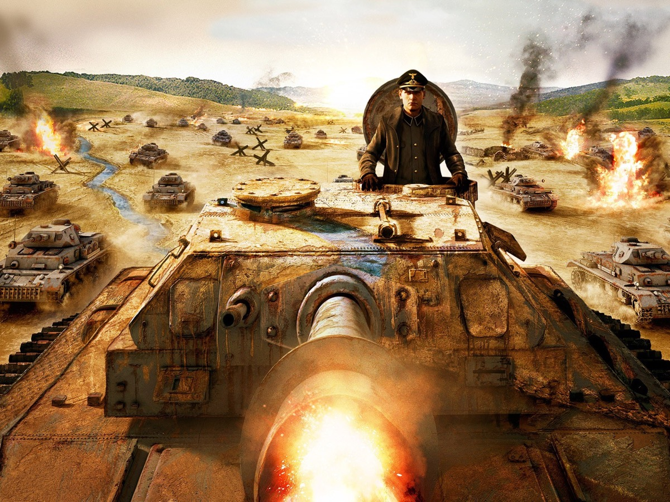
Notes:
Illustration: The thought of a dark creature at night time outside your door is a scary thought, but even worse is the thought that our country might by under threat from a fierce and ruthless enemy whose army is massing on the borders ready to advance and swallow up defenseless towns and cities in its path. For years we lived in fear that communists would invade western countries, and today people fear Muslims will take over their countries.

Slide 42
Notes:
The SIXTH Trumpet (Revelation 9:13-19) - the four angels are released to kill a third of mankind.

Slide 43
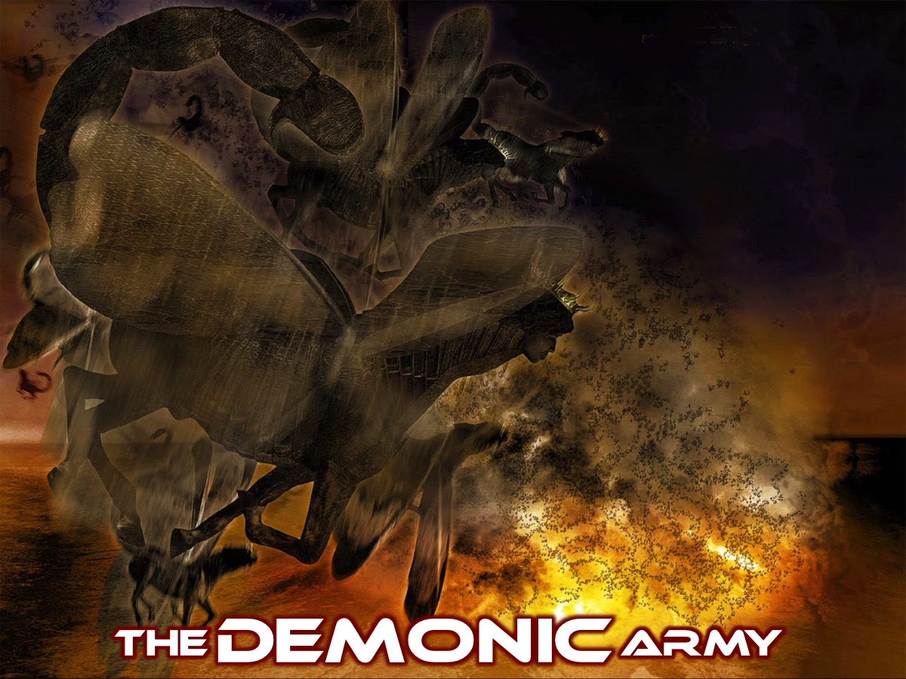
Notes:
The DEMONIC Army: The four angels do their work of killing a third of humankind by releasing a demonic army that actually does the killing.
Extra Notes: So what do the locusts and fiery riders stand for if they are symbolic? One possible key is to remember that John is writing these vision as a prophetic letter to the churches, to encourage them when they face persecution. He has already warned them in the vision of the first four of the seven seals about human-made disasters which come upon the world. Now with the seven trumpets, he seems to suggest natural disasters or “plagues” coming which do their work without human intervention. But in the fifth and sixth plagues he is warning his hearers that the plagues to come will, from one point of view, consist of foul, hellish, destructive forces and then massive terrifying armies charging against defenseless people. So the sixth trumpet corresponds to the first seal – the rider on the white horse going out to conquer. The last verses of chapter 9 reveal what John understands about the plight of humanity. He believed that human evil emerged from idolatry – you become like what you worship – so if you worship something other than God you become something other than the image-bearing human being you were meant to be and made to be. Verse 20 and 21 suggest that when we worship idols – blind, deaf, lifeless things – you become bling, deaf and lifeless yourself. Murder, magic, fornication and theft are all forms of blindness, deafness and deadliness – a quick fix for gain, power or pleasure. Repentance is not just feeling sorry – but a radical, gut-wrenching turning away from the idols which promise delight but provide death. God longs for this kind of repentance. He will do anything to coax it out of his rebellious but still image-bearing creatures. Six trumpets later it still has not happened, what about the seventh? Once more, John makes us wait.

Slide 44
Notes:
As with the plagues of Egypt the aim here is to challenge the inhabitants of the earth to repent (verse 20-21). Once more the depths of sin and destruction on earth and how God deals with it leaves us breathless and maybe even dismayed.

Slide 45
Notes:
Illustration: A famous baseball umpire, Bill Klem, earned a reputation for insisting that the umpire’s word is not only final but creative. On once occasion, he waited a long time to make a call about a pitch. Some umpires would say that they merely acknowledge the facts by saying that the pitch is either a ball or a strike. But when asked by the player, “Is it a ball or a strike?” Bill replied, “It ain’t nothing ‘til I call it.” The idea of speaking words which create a new reality is an ancient one. Prophets speaks words which don’t only speak of what is to come but the words they speak somehow generate the new situation. God’s words (Psalm 33:4,9) actually perform actions. So, when God puts words in the mouth of a prophet the same thing happens – they don’t just describe what is going to happen, they actually bring things to pass by speaking it. Prophecy makes things happen.

Slide 46
Notes:
The Little Scroll (Revelation 10:1-11) - Before the seventh trumpet sounds a mighty angel appears with a small scroll that is given to John who has to eat it and then prophesy against the kings of the earth.
Extra Notes:
Now, John is in the hot seat – there are new things that are still to happen as part of God’s purpose, and his words will actually bring them to pass. This is the meaning of the little scroll from heaven. This is why John was invited into the heavenly throne room – God’s words are to become John’s words so they can become reality. This is like sharing in God’s rule over the world (which God’s people are called to do). Here, God’s word is given to the prophet to eat, to digest and then to speak. The scroll is sweet as honey to the taste, but once digested it has a bitter message – the message contains dire warnings. To eat a scroll reminds us that God’s words become a part of the prophet’s own life. They are nourishing and bitter. This all takes place as we are waiting for the seventh trumpet. Which, according to the angel will come soon and then rime will have run out for all of those presuming on God’s patience. This reminds us that the seals, the trumpets and the bowls don’t run in sequence, but are all part of one sequence – looked at from different angles or perspectives. We are building up at the end of chapter 11 to what could be the climax of the book but we are only half way through the book – and in the second half we will approach the story from a different angle, spelling out in depth all sorts of aspects of the story which cannot be told until these preliminary tellings have done their work. So the angel bursts onto the scene in a blaze of light – he comes from heaven with God’s word for the earth, dressed in a cloud which is a sign that God himself is present but hidden in the message. The rainbow over his head reminds us of the vision of the throne in chapter 4 and of the ancient ideas awoken there. His face is like the sun (as was that of the son of man in chapter 1) and his feet like fiery pillars reminds us of the pillar of fire in the desert, the flaming sign of God’s personal presence). This is no ordinary angel – when he speaks it is a like a lion roaring. He comes with the words of the lion-lamb, the messiah. He embodies the sovereignity of the creator God over the whole creation: the sea and the land (2,5). The message he bring is from the creator since he swears an oath (6) by the one who made heaven, earth and sea and all that they contain. There is no way that this message is going to wipe out the earth and replace it with something different – when God’s mystery is complete, it will be the fulfillment of creation, not its abolition. As we race ourselves for the seventh trumpet, we realize that the churches that John is writing to need to know where they stand in this great cosmic scenario. Are they just spectators or do they have a role to play?
Other Notes:
10:1-11 has parallels to Daniel 10:5-6 and to the call of Ezekiel in Ezekiel 2:1-3:11. John receives the prophetic messages of a “little scroll.” Some have thought that the scroll contains the contents of 12:1-22:5, and that 12:1 begins a new major division in the structure of Revelation More likely, the vision of 10:1-11 speaks in a general fashion of John’s being empowered to continue to prophesy. Though John’s role is unique, he is still in many ways an example and pattern for the church’s witness (see 1:2). We must take to heart the message of John (1:3), live by it, and be ready to communicate its implications to “peoples, nations, languages and kings” (10:11).
A mighty angel appears reflecting the very glory of God and his throne room (vv. 1-2; cf. 1:14-16; Dan. 10:5-6; Ezek. 1:27-28). His majesty underlines the authority and divine source of the message.
Seven thunders speak, but John cannot tell us what is their content (vv. 3-4). In Revelation God reveals the substance of his plan, but reserves many aspects and details in his secret counsel (Deut. 29:29). We must be content to trust God in the midst of our own partial knowledge, confident that he knows all and governs all for our benefit (Rom. 8:28-39).
The announcement of no more delay (v. 6) indicates that the consummation of all God’s prophetic plans comes with the seventh trumpet. Like the cycle of seven seals, the cycle of trumpets leads up to the Second Coming. Here, the angel underlines explicitly the significance of the Second Coming as the wrapping up of God’s plan for history (Eph. 1:10).
John takes and eats the little scroll, in a manner parallel to Ezekiel 2:3-3:9, indicating that God commissions him with an Ezekiel-like task of prophesying woe in the face of an unrepentant world. The scroll will turn your stomach sour. The contents of the scroll contain much news of suffering. At the same time, it is sweet as honey in the mouth (cf. Ezek. 2:3; Ps. 119:103; 19:10). The word of God provides communion with God and his goodness; hence sweetness accompanies even a message of woe.

Slide 47
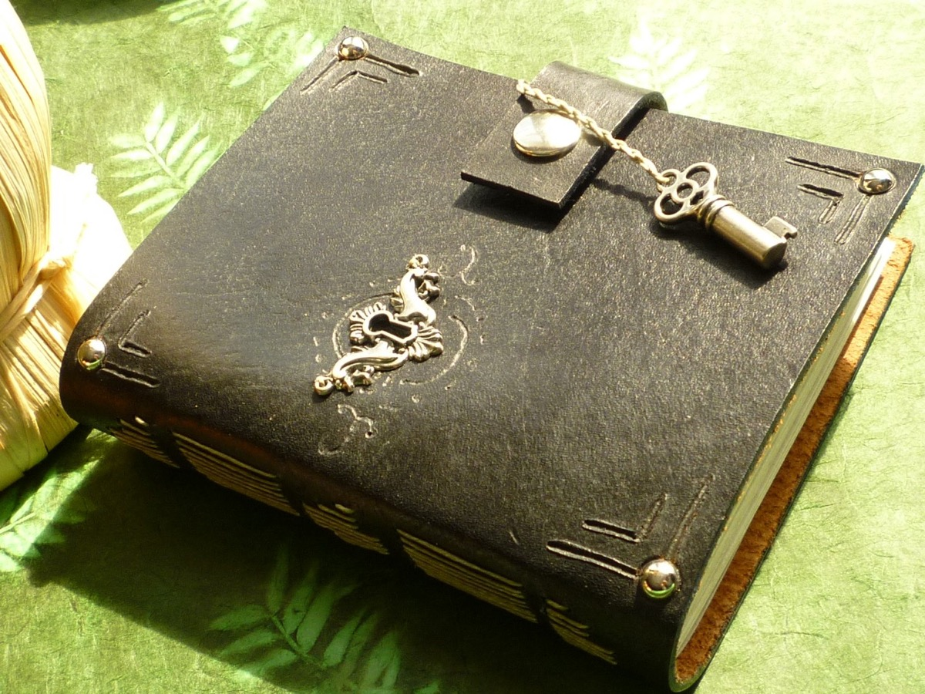
Notes:
Illustration: So many books are puzzling. People find parts of the Bible really puzzling as well) especially the book of Revelation) – and the first half of Revelation 11 is probably the most puzzling of all! What is the first half of Revelation 11 about? On one level it is clear: John is told to measure the temple. Then two witnesses emerge, doing great and strange deeds before being killed, lying unburied, and then being raised to new life and exalted to heaven. The tone of this section is really different – a story among the terrifying scenes of horsemen and man-eating locusts. So what is it all about and how does it take the story forward?

Slide 48
Notes:
Measuring THE Temple (Revelation 11:1-2). John’s measuring of the temple has nothing to do with the Jerusalem temple or the heavenly temple/throne room in chapters 4 and 5.

Slide 49
Notes:
Do you remember after the sixth seal was opened last week that God’s people were sealed (Revelation 7:1-8) to protect them from what was to come? Well it seems like a similar thing is happening here with the measuring or marking out of the church (God’s Temple) so they are not harmed by what the next 3 trumpets unleash on the earth.
Extra Notes: By the time John wrote this book, believers had come to see themselves as the true temple – the place where God now lived through his powerful spirit. John is commanded to mark out this community so that (like in chapter 7) they may be protected against ultimate harm. They do have a period of being vulnerable – a half of seven years – or 3 and a half years, or 42 months or 1260 days – when the pagan nations will trample on them. But God intends to honour and bless his people with his presence. What is the task and role of this people? Throughout the book of Revelation, the call of God’s people is to be faithful witness to Jesus, even though it means suffering and quite possibly a shameful death. We see this in chapter 2 and 3 where special rewards were promised to those who following Jesus were willing to be martyred rather than compromise.

Slide 50
Notes:
The Two Witnesses (Revelation 11:1-12) - we are still in the pause between the blowing of the sixth and seventh trumpet. The two witnesses appear…
Extra Notes: The two witnesses appear to represent the whole church in it’s prophetic witness, it’s faithful death and it’s vindication by God. The church as a whole is symbolized by the lampstands (1:20), and is to prophesy while clothed in sackcloth as a sign of mourning for the wickedness of the world and the evil that it will bring on itself. There are two witnesses partly because John has in mind two great biblical stories as the backdrop: (1) The story of Moses who stood up to Pharaoh, the pagan king of Egypt and demonstrated God’s power by the plagues echoed in chapters 8 and 9. (2) The story of Elijah who stood up to Ahab the paganized king of Israel and demonstrate God’s power by successfully praying for a drought and then calling down fire from heaven. John did not mean that Moses and Elijah would literally return to earth and carry out what chapter 11 says. Rather the church by its prophetic witness, in the spirit of Moses and Elijah, will perform powerful signs and thereby torment the surrounding unbelievers, but the climax of their work will be their martyrdom at the hands of “the monster that comes up from the Abyss”. We have not met this monster yet, nor have we discovered “the great city which is spiritually called Sodom and Egypt, where their lord was crucified” – later chapters will make this clear (the monster is the might of the pagan empire, presently embodied by Rome, and the city is Rome itself, or maybe in this case the public world of the entire Roman empire. John is saying the our God-given calling to bear faithful prophetic witness will not mean that one will be spared from suffering and death but like Jesus endured – it will be a prophetic sign through which the world will be brought to glorify God. For 3 and a half days (the half of seven symbol again) the world will celebrate a victory over the church, but suddenly God will act in a new way. Just like in Ezekiel 37 where God’s breath came into the dead corpses. The world looking on will be converted (13) – they will tremble and turn to God. The martyr-witness of the church will succeed where the plagues failed. This is how the kingdoms of the world will become the kingdom of our Lord and his Messiah (15). Summary: The lamb has opened the seals on the scroll, and all kinds of terrifying things happened. The trumpets have blown and terrors of a different sort have come to pass, but now the scroll has been handed to John and John proesies in symbolic action (measuring the temple and the parabolic story of the two witnesses) and this is the how the kingdom of God (already spoken of in chapters 4 and 5) is to become a reality on earth as in heaven.

Slide 51
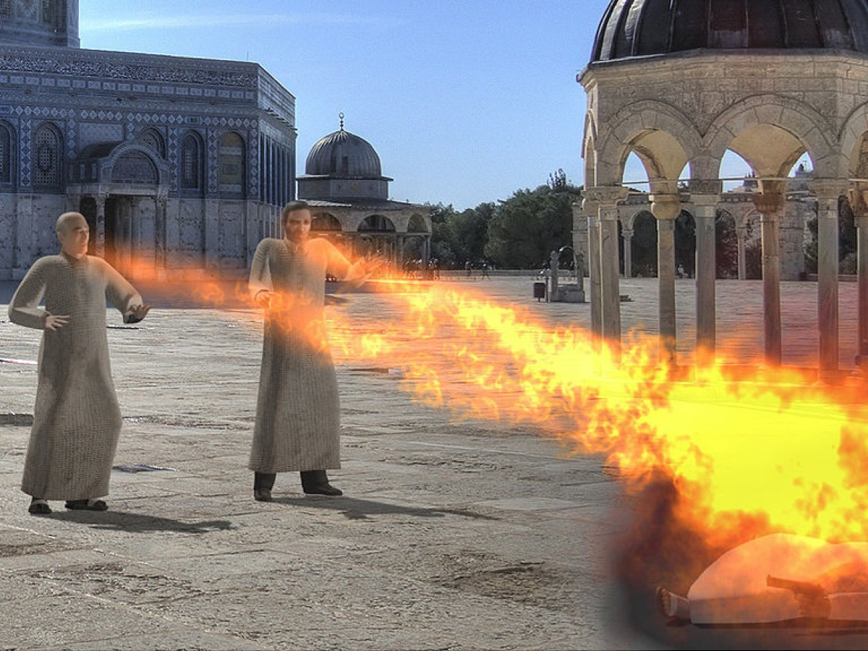
Notes:
Like Moses and Elijah, these witnesses (or the followers of Jesus – the church) perform striking miracles (vv. 5-6). The symbolism of the olive trees and lampstands suggests that they fulfill a priestly role as God’s representatives.

Slide 52
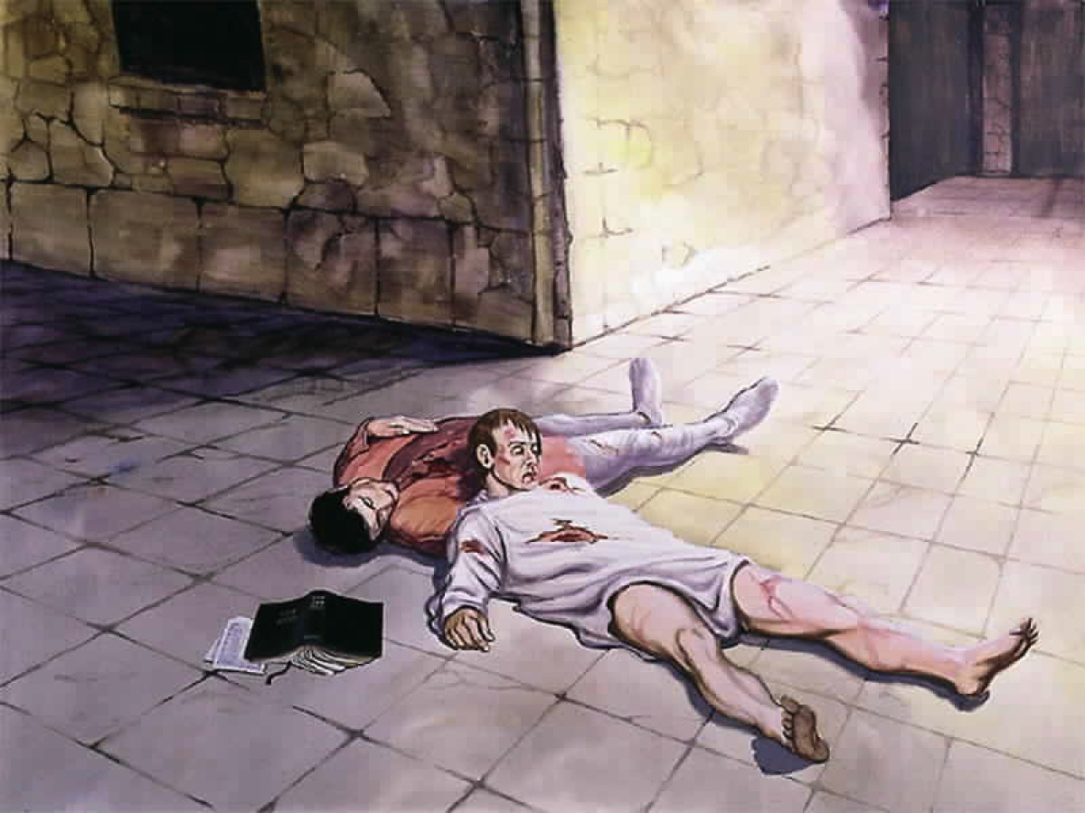
Notes:
The men are killed by the forces of darkness – symbolized by a beast here. The church has always faced persecution and even though we live in a country that is relatively open to the gospel, there are still ways that we will suffer ridicule and persecution for what we believe in.

Slide 53
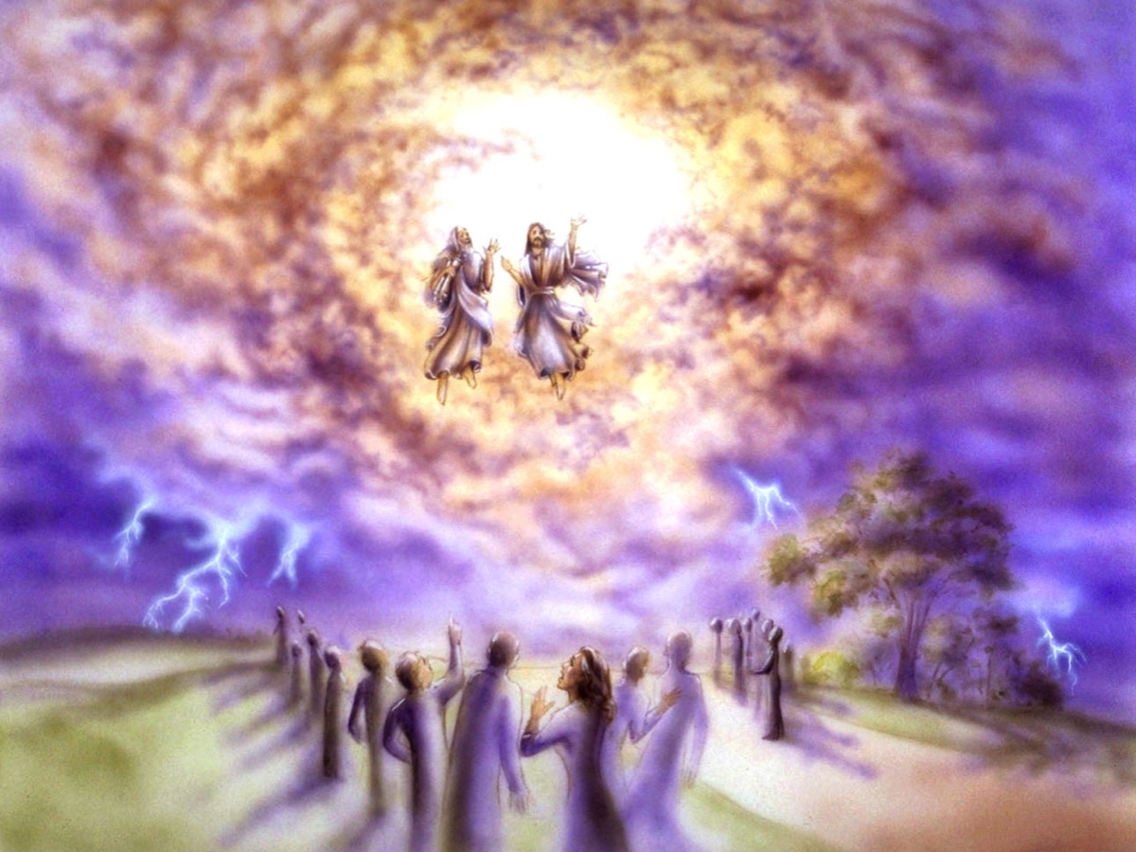
Notes:
The men are raised to life after 3 and a half days (or half of seven). The good news is that even if the worst should happen – that we lose our lives – we will be resurrected just like Jesus was raised from the dead. Death is not the end.

Slide 54
Notes:
The Great Earthquake (Revelation 11:13). There is powerful symbolism in verse 13: (1) When God judged Sodom and Gomorrah he would have spared it if ten righteous people were found there. Now, only one tenth of the city is to fall and nine-tenths are to be saved. (2) When God was judging Israel through Elijah, only seven thousand were left who had not bowed the knee to the pagan god Baal, but now it is only 7000 who are killed and the great majority are to be rescued. A new vision is emerging of the creator God as the God of mercy, grieving over the rebellion and corruption of the world but determined to restore it and do so through the faithful death of the lamb and now through the faithful death of the lamb’s faithful followers. The way stands clear for the glorious celebration at the end of the chapter, which rounds off the first half of this very carefully structured book.

Slide 55
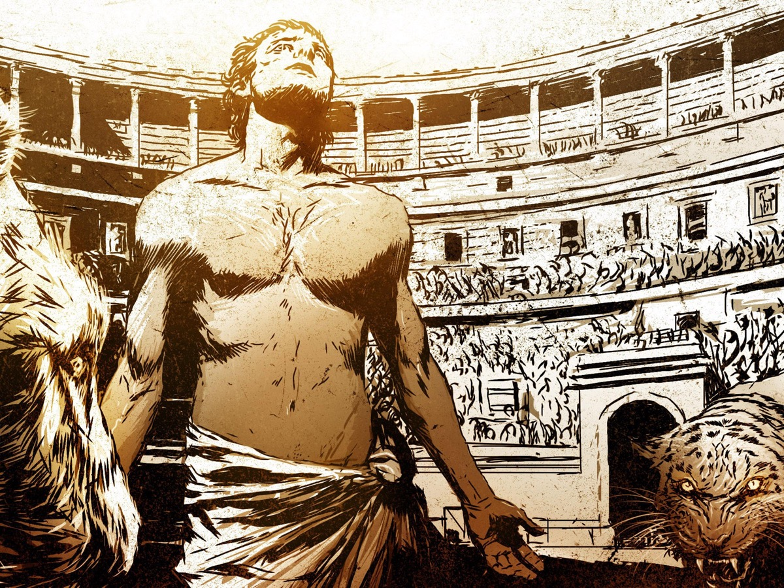
Notes:
We are called to be faithful witnesses to Jesus – doing great deeds and miracles like Jesus did and even being willing to suffer for our faith as happens in this story.

Slide 56
Notes:
Video: Widow’s Joy - He Didn’t Deny Christ When Beheaded. Get it on YouTube at: https://www.youtube.com/watch?v=OD16TqLaZe0

Slide 57
Notes:
The SEVENTH Trumpet (Revelation 11:15-18). The seventh trumpet calls forth the seven angels with the seven bowls of God’s wrath.

Slide 58
Notes:
The TRIUMPHANT Song (Revelation 11:15-18). God is creating a kingdom – he is not content just to rule over many kingdoms. It is his universal rule scooping up the kingdoms of the world into a sing entity and claiming it back as his own rightful property. This seems like it should be the end of the book – so we are reminded once again that it is not a single sequence of events (seals followed by trumpets followed by bowls, etc) but rather different angles of the same reality – where through the awful turmoil an trouble of the world, God is establishing though Jesus a people who, following the lamb, are to bear witness to God’s kingdom through their own suffering, through which the world will be brought to repentance and faith, so that ultimately God will be king over all. God’s kingdom is not about heaven – but God’s rule on the earth – he is the creator of the whole world and he is going to restore it to his original intention before human rebellion pulled it so disastrously off track.

Slide 59
Notes:
“The kingdom of the world has become the kingdom of our Lord and of his Messiah, and he will reign for ever and ever. (Revelation 11:19)

Slide 60
Notes:
We give thanks to you, Lord God Almighty, the One who is and who was, cause you have taken your great power and have begun to reign. The nations were angry, and your wrath has come. The time has come for judging the dead, and for rewarding your servants the prophets and your people who revere your name, both great and small and destroying those who destroy the earth. (Revelation 11:19)

Slide 61
Notes:
“Then God’s temple in heaven was opened, and within his temple was seen the ark of his covenant. As this section closes we see the temple of God in heaven opened and catch a glimpse of the Ark of the Covenant! The ark was the most holy object in the tabernacle (Exod. 25:10-22). It was normally concealed from sight behind the tabernacle curtains. The revealing of this innermost object signifies that God has fully revealed his glory, both the glory of his law (the covenant words) and of his mercy (as signified by the atonement cover).

Slide 62
Notes:
And there came flashes of lightning, rumblings, peals of thunder, an earthquake and a severe hailstorm.” (Revelation 11:19). The song of the elders causes another experience of lighting and thunder (like in 4:5) – these are moments of transition – when earth itself trembles at the power of the heavenly revelation. God has been true to his covenant promises (seen in the opening of the temple and the box containing the ten commandments and other key symbols of God’s ancient covenant). What he said he will do, he has now began to do – he has taken his power and he has begun to reign!

Slide 63
Notes:
Video: Clip from the movie Tomorrowland - a challenge to respond to the news of what is coming in the future!

Slide 64
Notes:
Challenge: (1) Follow Jesus (make sure you have accepted Jesus as your Lord and Saviour); (2) Fellowship (hang out with other believers as much as possible) and (3) Fish (tell other people about Jesus so they too can follow him).

Slide 65
Notes:
Let US Pray

Slide 66
Notes:
Next week we will look at Act IV in the drama of Revelation: The 7 Signs (Revelation 11:19-15:4)

