Slide 1
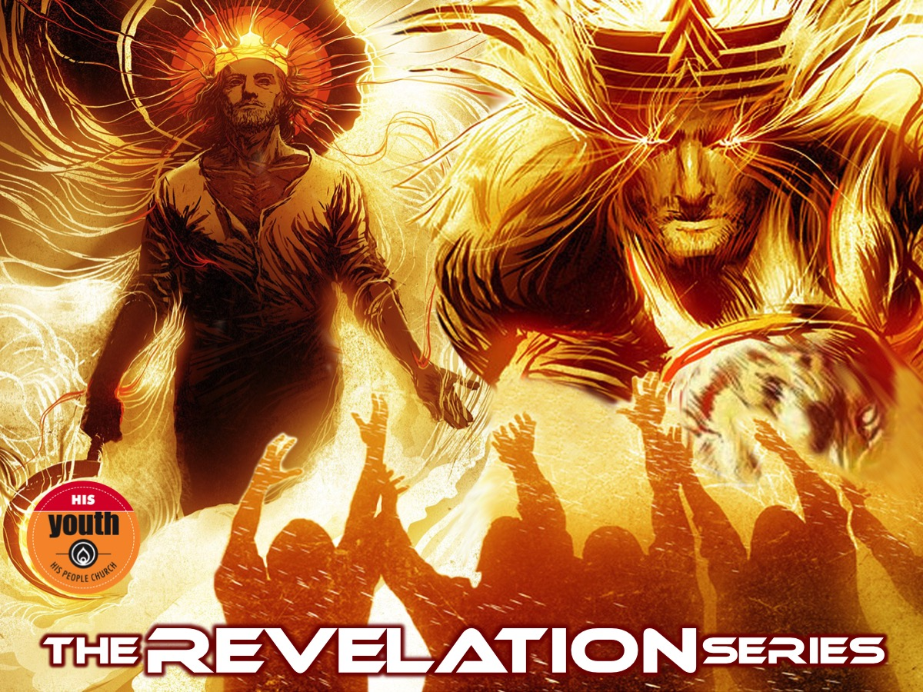
Notes:
Welcome to the Revelation Series.

Slide 2
Notes:
Video: Total War Rome 2 - Launch Trailer. Get it on YouTube at: https://www.youtube.com/watch?v=y3Zu4MHu29k

Slide 3
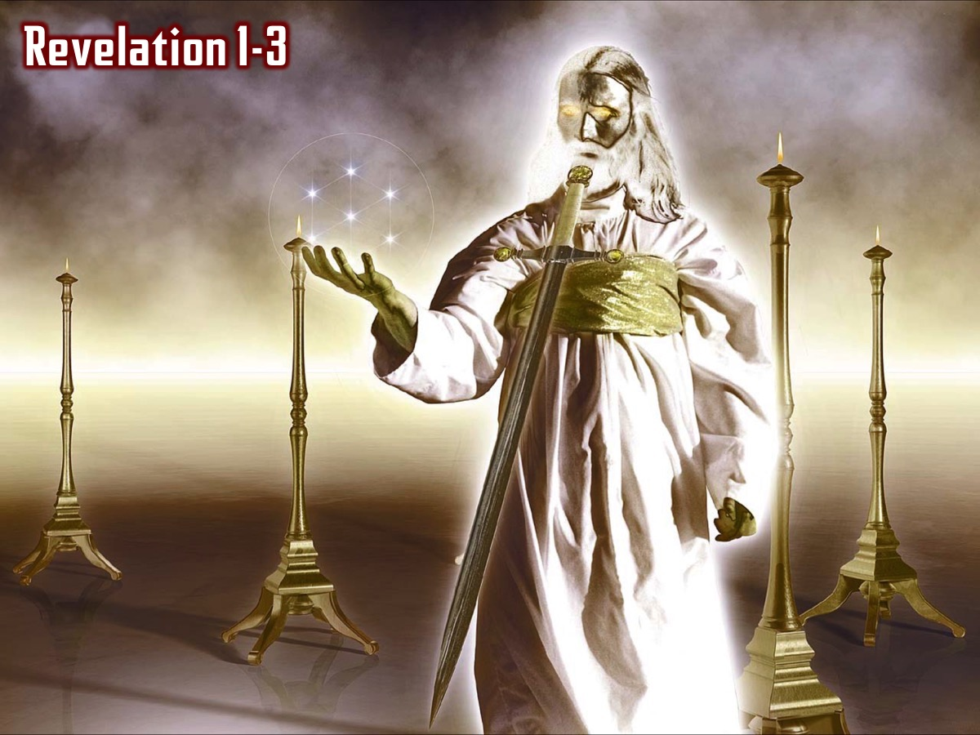
Notes:
In the first two weeks we saw an incredible revelation of Jesus and we read the seven letters that Jesus sent to seven churches in Asia Minor and reflected on what Jesus thinks about His Youth and also what our personal strengths, weaknesses, opportunities and threats are.

Slide 4
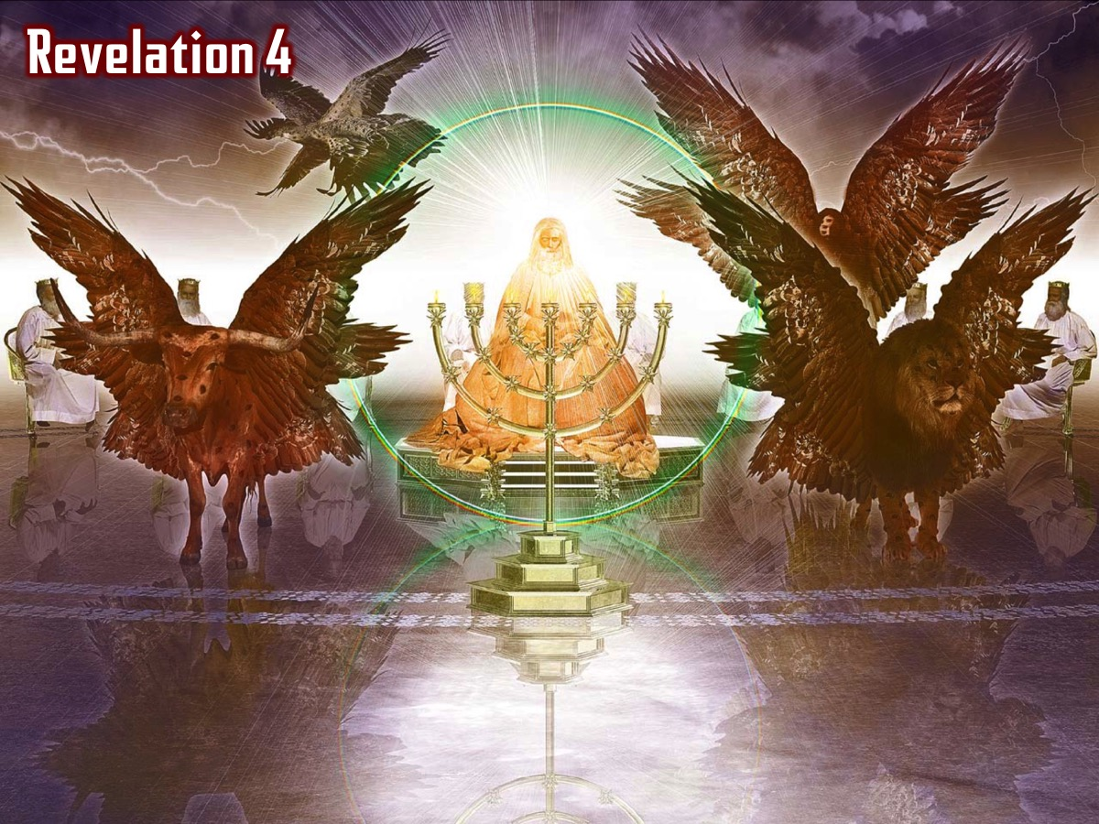
Notes:
In chapter 4 and 5 we saw how the 4 living creatures and the 24 elders and all the angels praised God for his amazing creation…

Slide 5
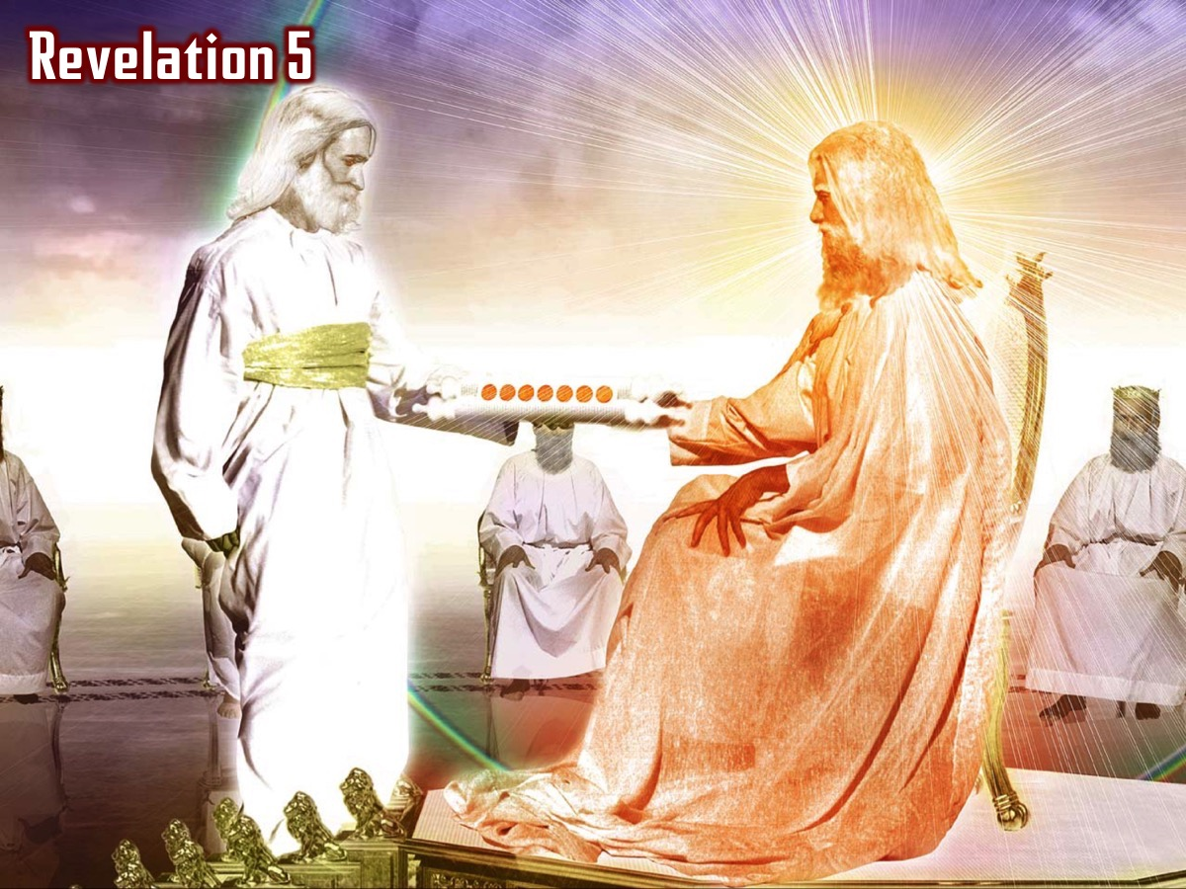
Notes:
We saw that only Jesus was found to be worthy to take the scroll from his father and open each of the seven seals (Revelation 5:8-14):

Slide 6
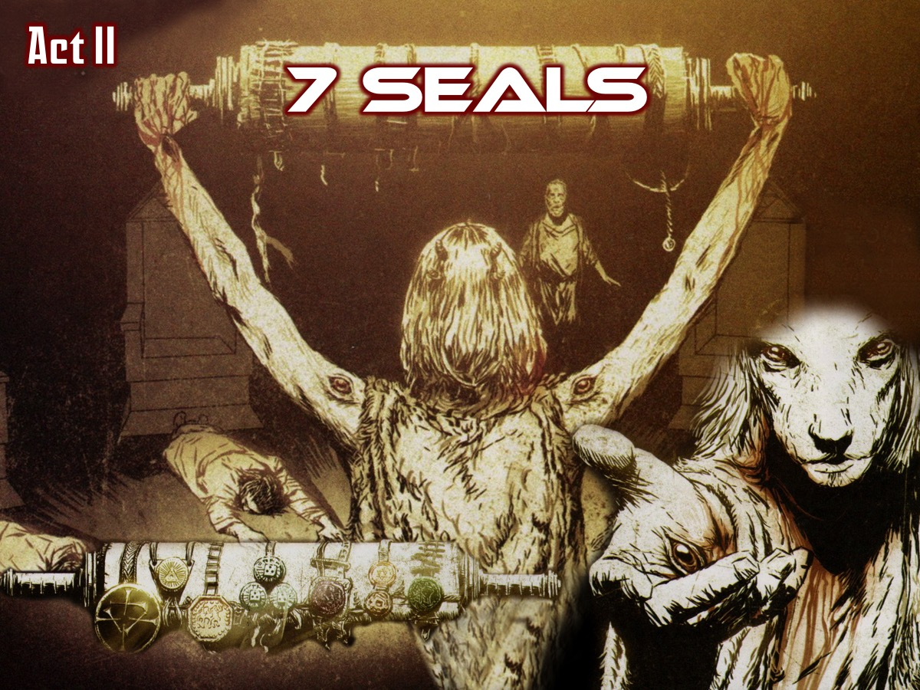
Notes:
Two weeks ago we looked at the 7 seals in Act II.

Slide 7
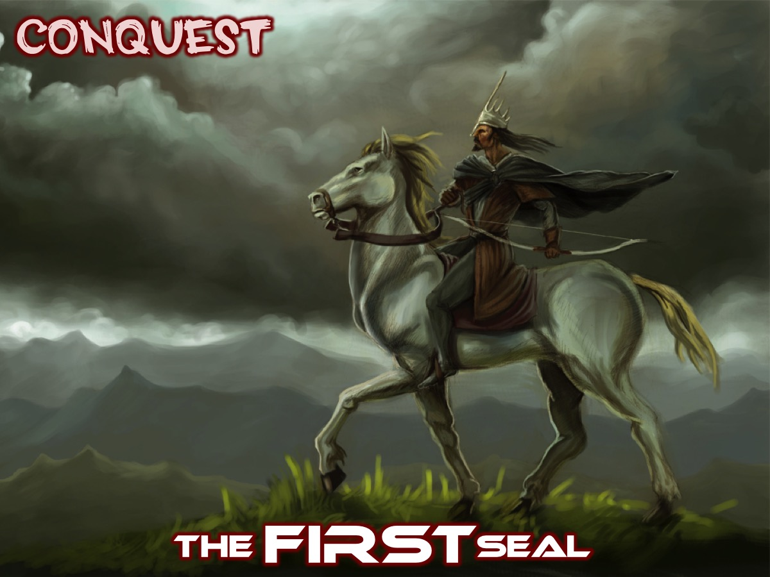
Notes:
The FIRST Seal: The White horse was a time of conquest.

Slide 8
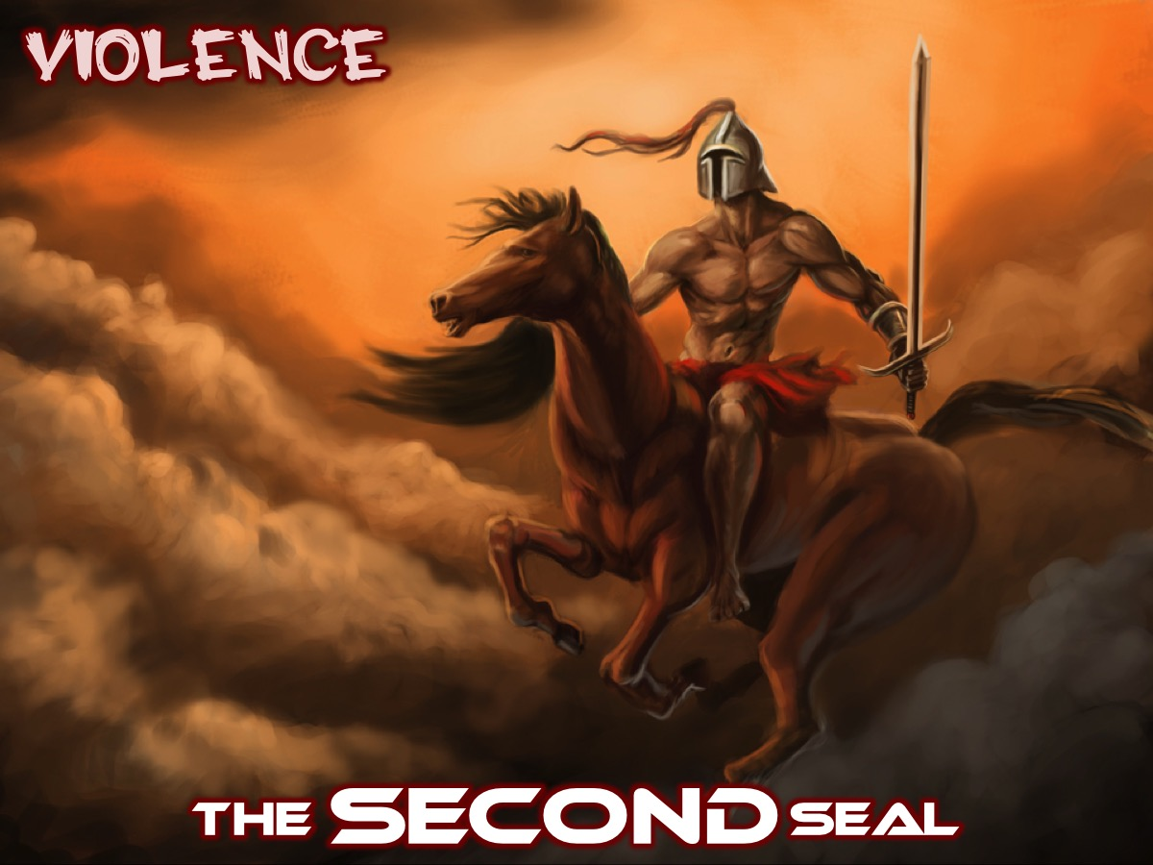
Notes:
The SECOND Seal: The Red horse was a time when peace was taken from the earth.

Slide 9
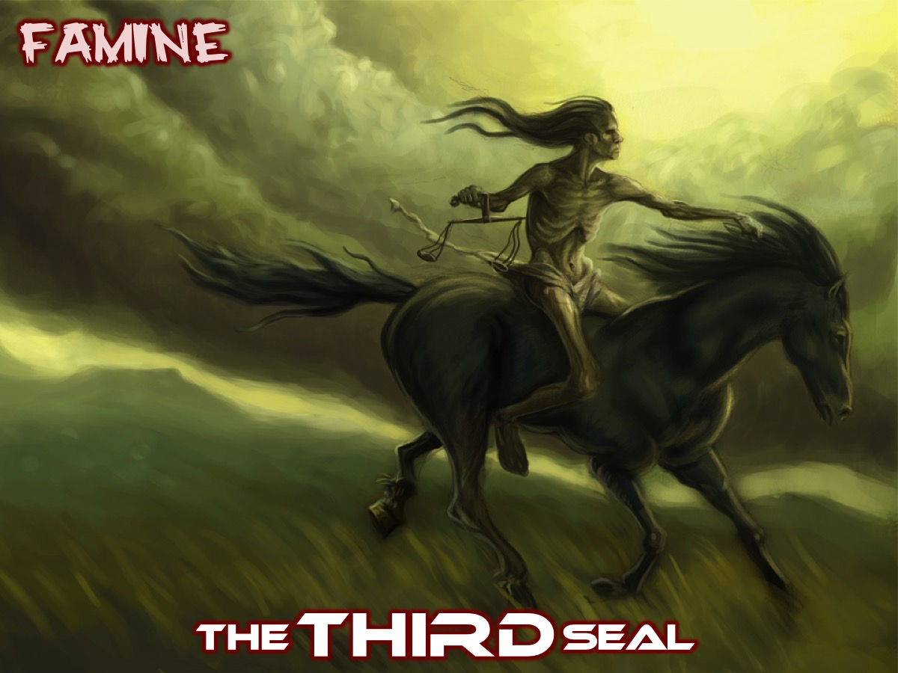
Notes:
The THIRD Seal: The black horse was a time of famine.

Slide 10
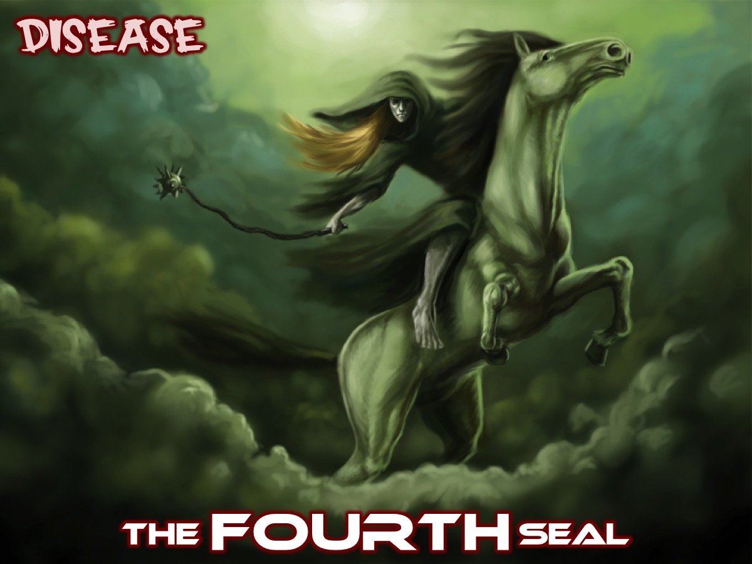
Notes:
The FOURTH Seal: The Pale horse was a time of disease.

Slide 11
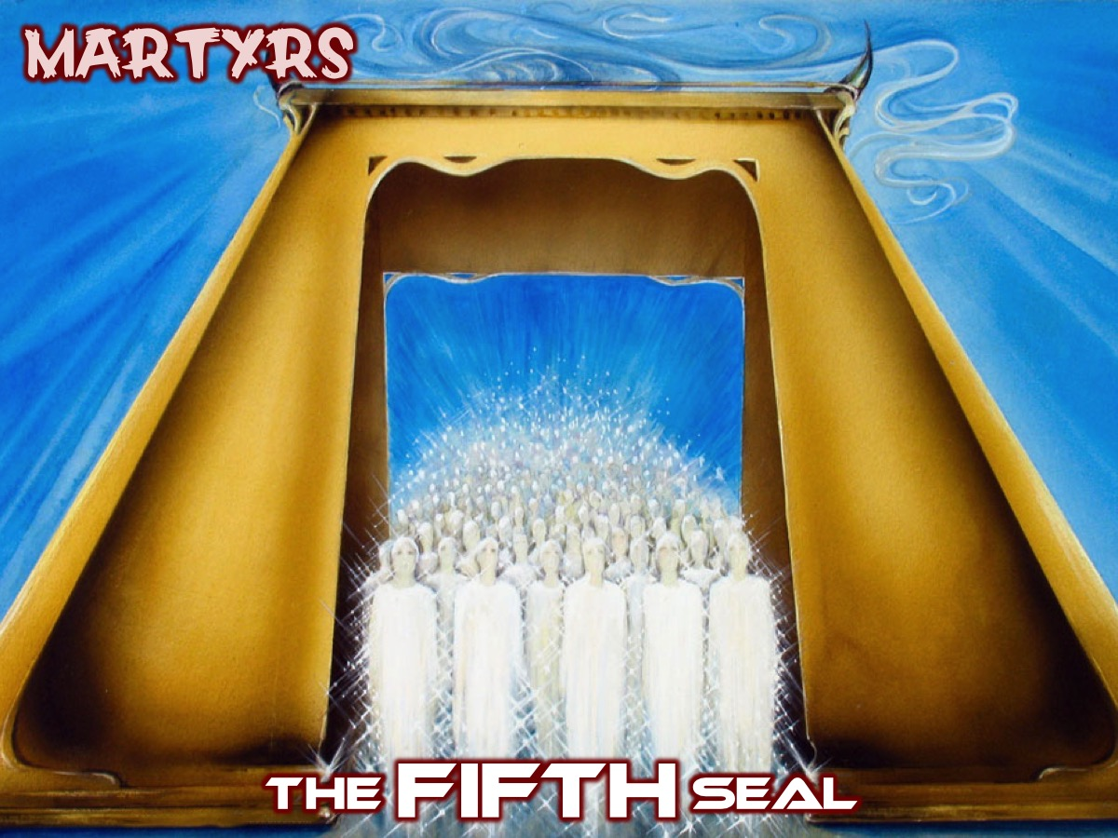
Notes:
The FIFTH Seal: When the Fifth Seal was opened (Revelation 6:9-11) we saw those who had been killed because they were witnesses to God’s word and they cry out for justice but are told to be patient.

Slide 12
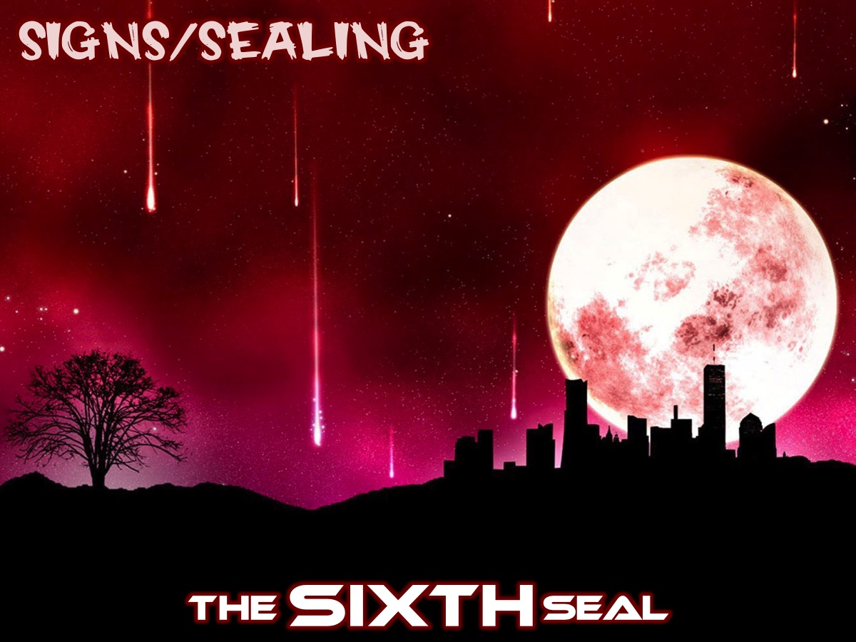
Notes:
The SIXTH Seal: When the Sixth Seal (Revelation 6:12-17) was opened there were signs in the heavens - probably representing a time of political and social turbulence.

Slide 13
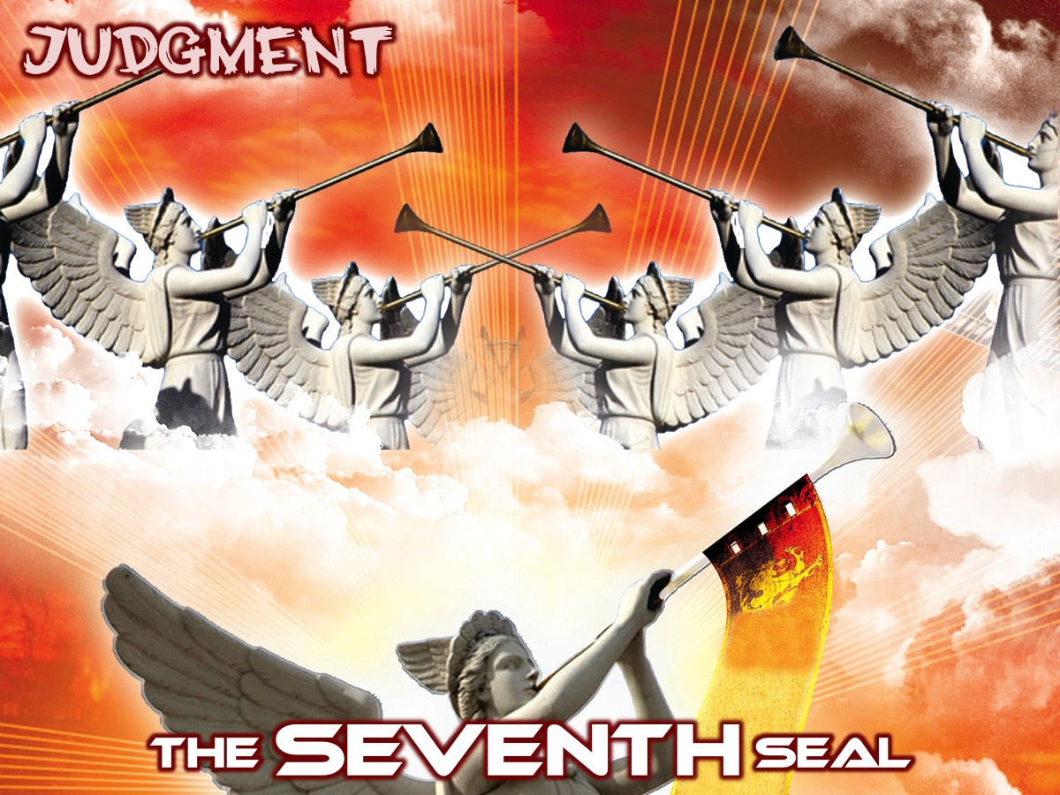
Notes:
The SEVENTH Seal: This Seal (Revelation 8:2) introduced the seven angels with their trumpets - but first…

Slide 14
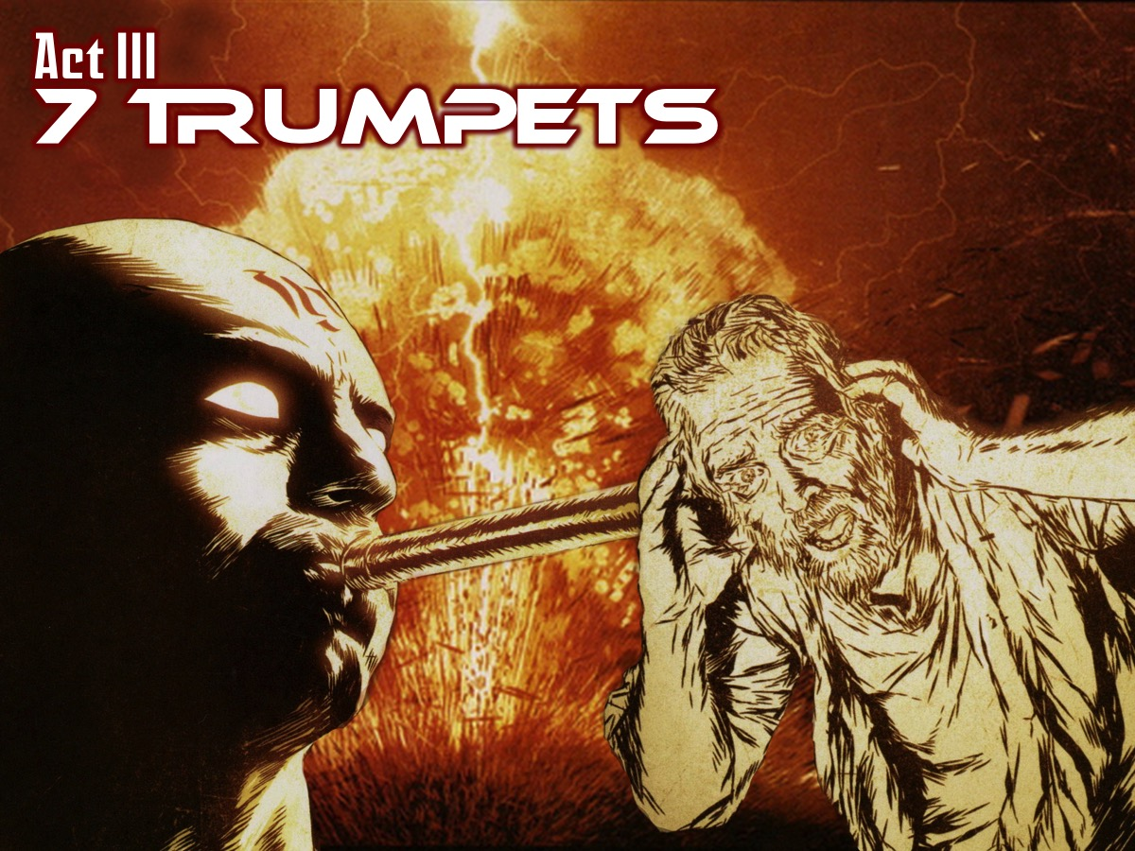
Notes:
Last week we looked at Act III which was all about the blowing of the 7 Trumpets.

Slide 15
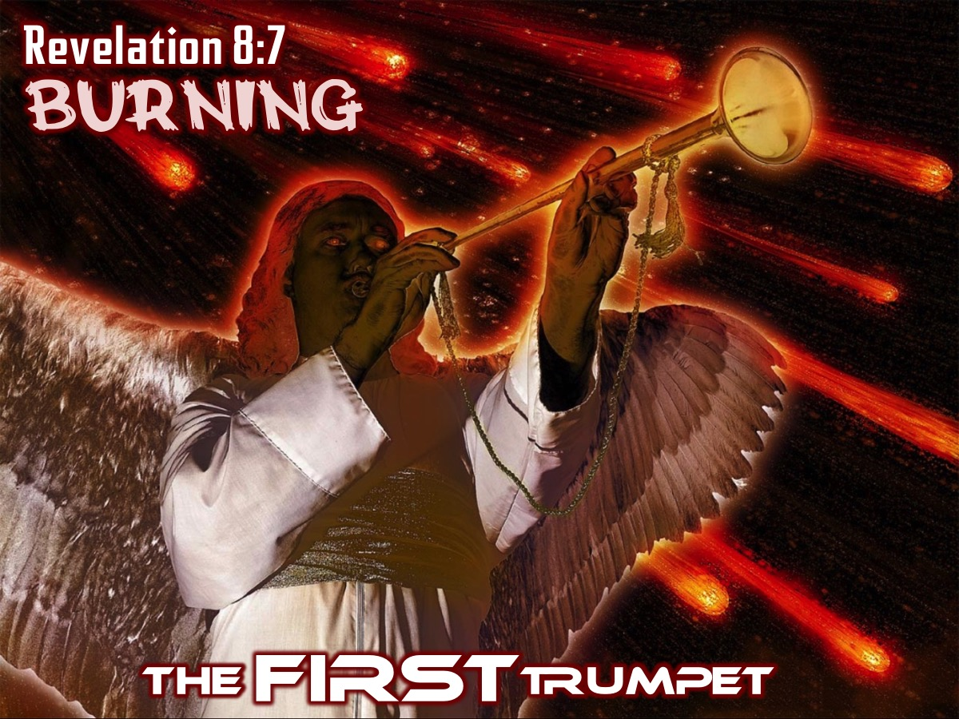
Notes:
The FIRST Trumpet (Revelation 8:7) brought fires to the earth.

Slide 16
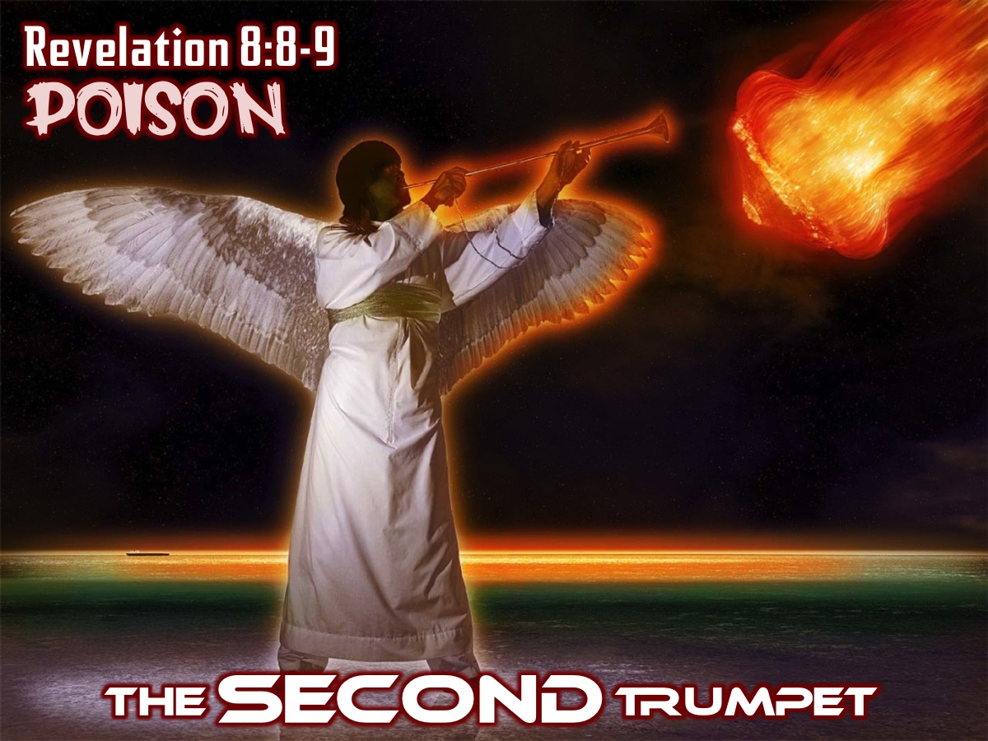
Notes:
The SECOND Trumpet (Revelation 8:8-9) brought poison to the sea.

Slide 17
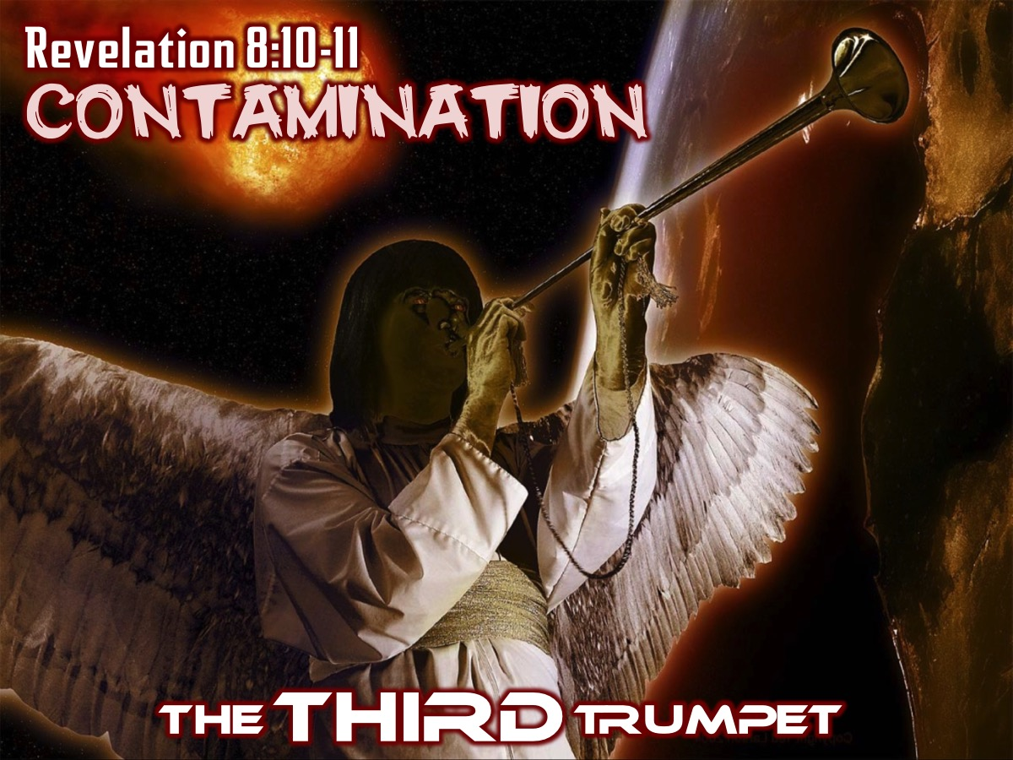
Notes:
The THIRD Trumpet (Revelation 8:10-11) brought contamination to the rivers.

Slide 18
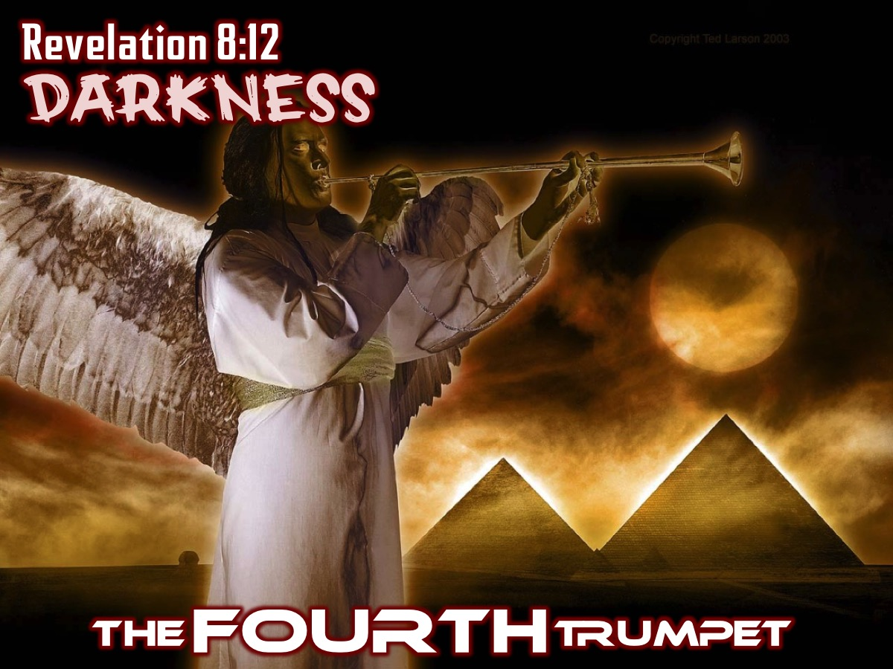
Notes:
The FOURTH Trumpet (Revelation 8:12) brought darkness to the earth.

Slide 19
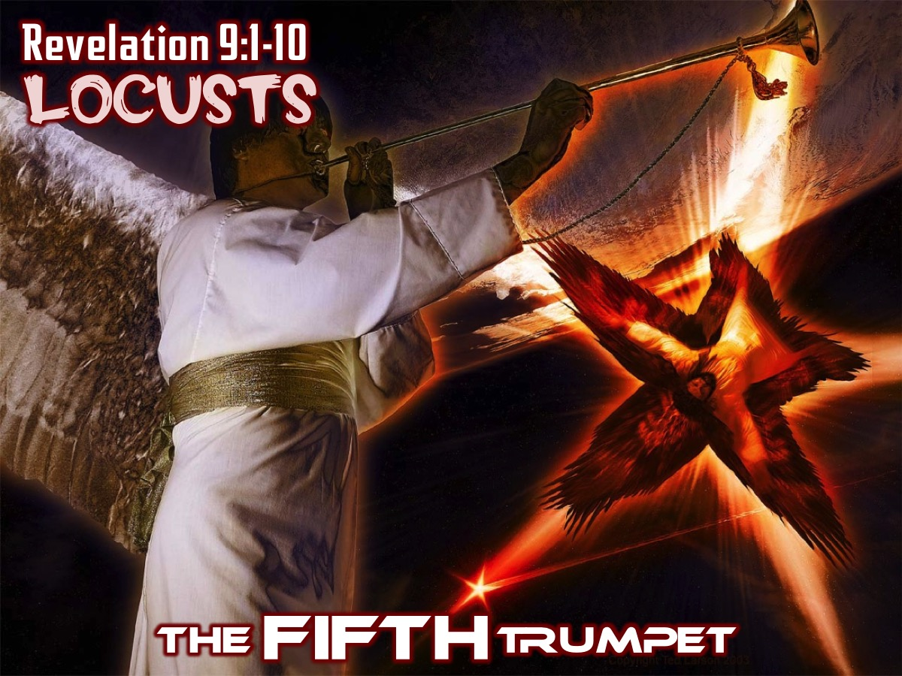
Notes:
The FIFTH Trumpet (Revelation 9:1-11) unleashed locusts on the earth.

Slide 20
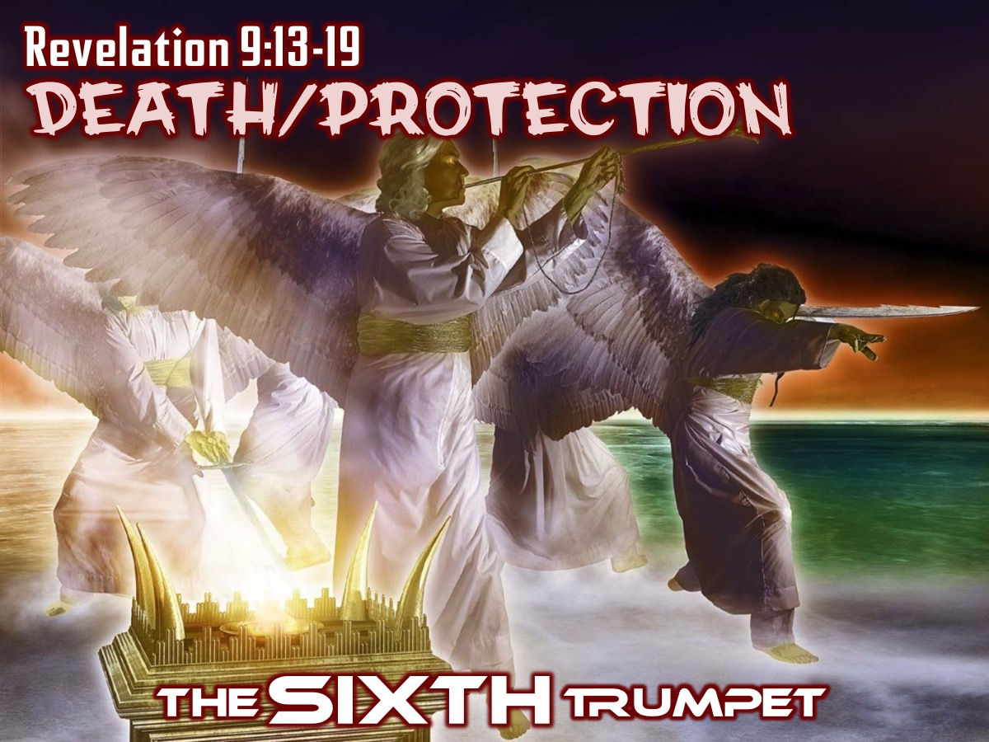
Notes:
The SIXTH Trumpet (Revelation 9:13-19) saw angels released to kill a third of mankind but God’s people were protected.

Slide 21
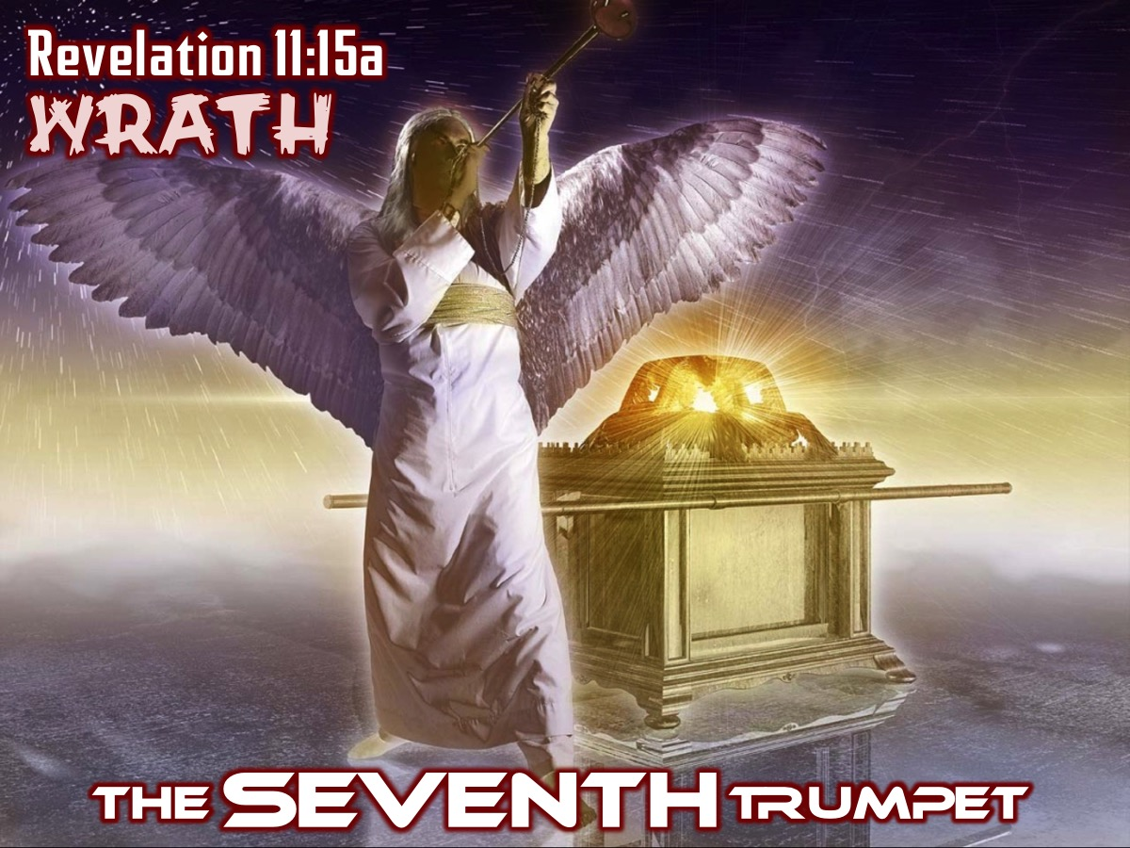
Notes:
The SEVENTH Trumpet (Revelation 11:15-18) saw the seven angels prepared to pour out God’s wrath.

Slide 22
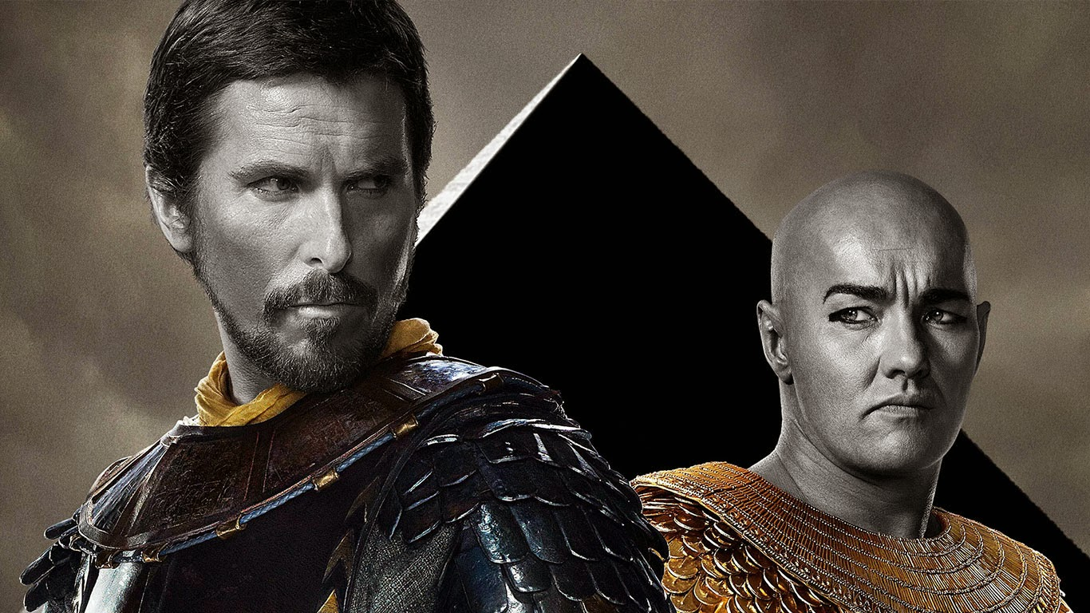
Notes:
These Seals and Trumpets unleashed terrors on the earth to challenge people to repent and pursue righteousness instead of wickedness - just like what happened in the story the Israelites in Egypt which led to a show down between Moses and Pharaoh.

Slide 23
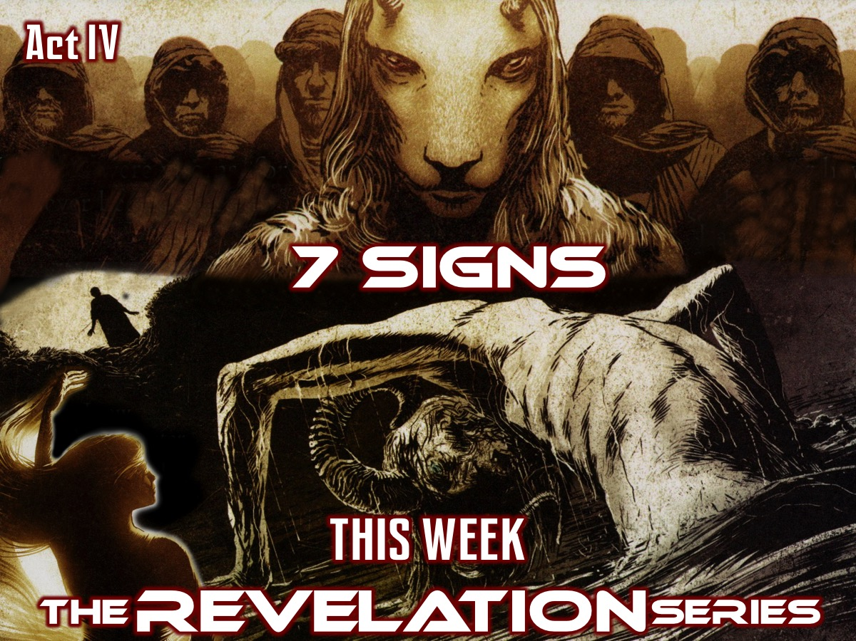
Notes:
Today we look at Act IV of the book of Revelation that deals with 7 Signs (Revelation 11:19-15:4).

Slide 24
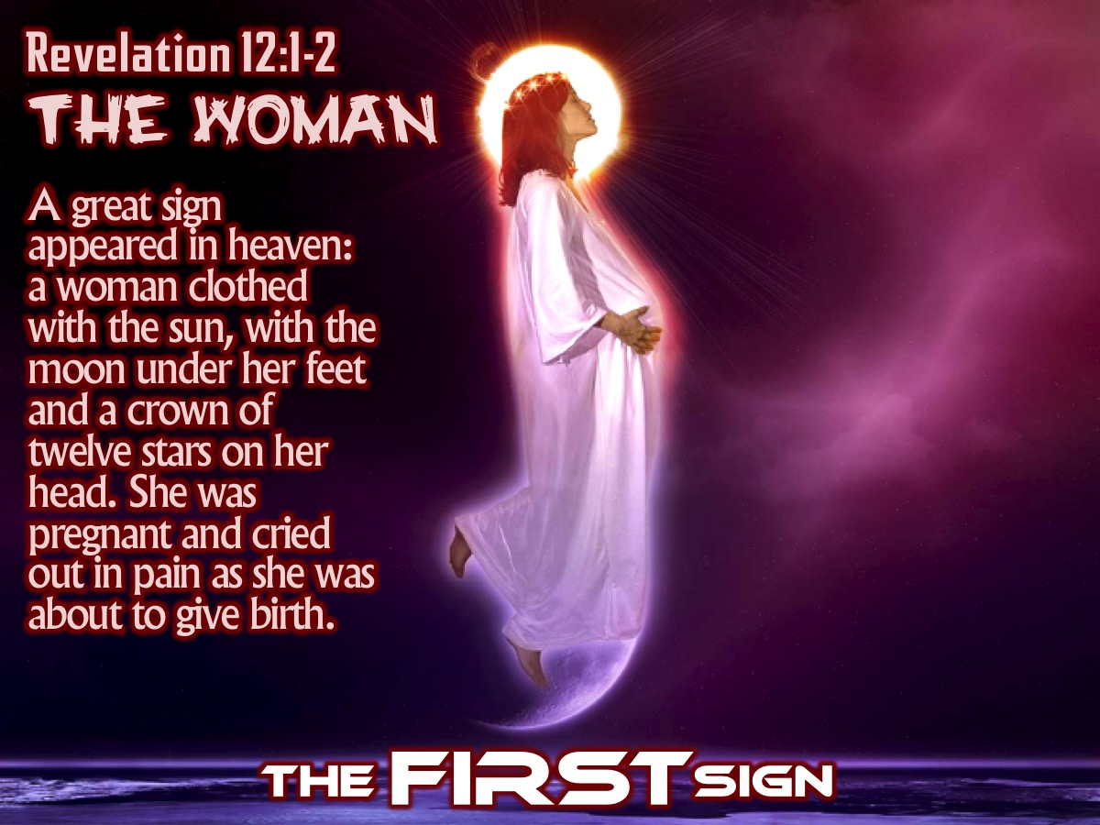
Notes:
The FIRST Sign: The Woman (Revelation 12:1-2) - “A great sign appeared in heaven: a woman clothed with the sun, with the moon under her feet and a crown of twelve stars on her head. 2 She was pregnant and cried out in pain as she was about to give birth.”

Slide 25
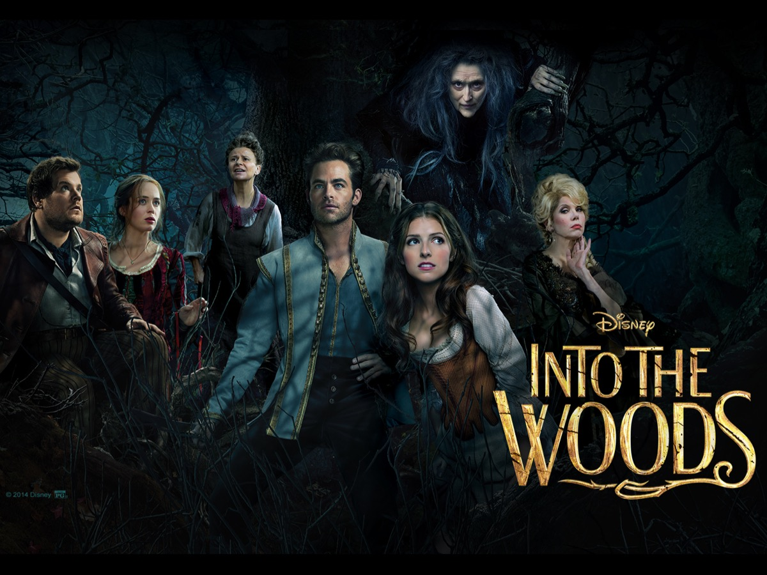
Notes:
Illustration: Watching a movie – trying to identify who are the real-life actors playing the different characters. Sometimes it can be really difficult. Here is a little quiz to see if you know who played the following characters in these different movies:

Slide 26
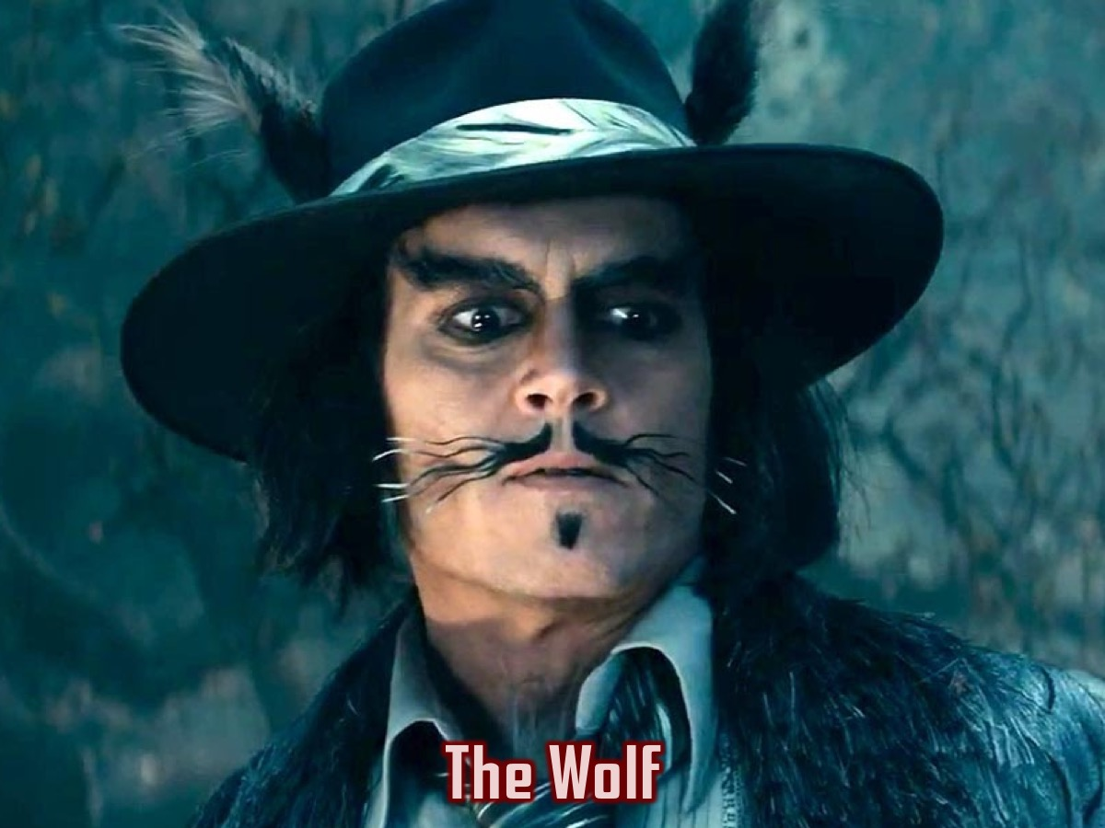
Notes:
Who plays The Wolf in Into The Woods?
Answer: Johnny Depp

Slide 27
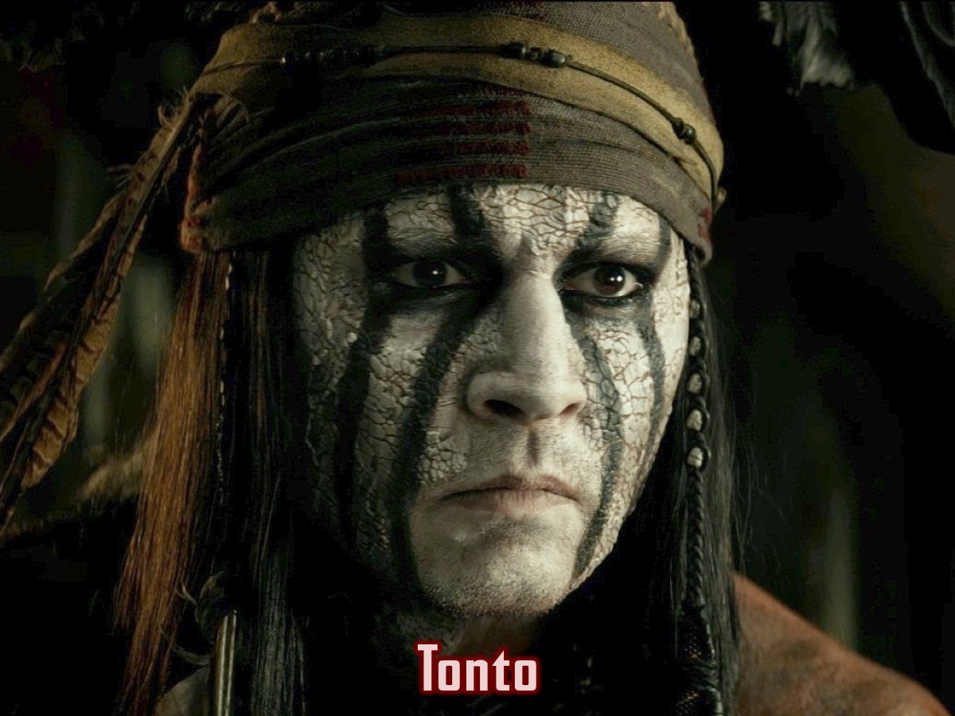
Notes:
Who plays Tonto in the Lone Ranger?
Answer: Johnny Depp

Slide 28
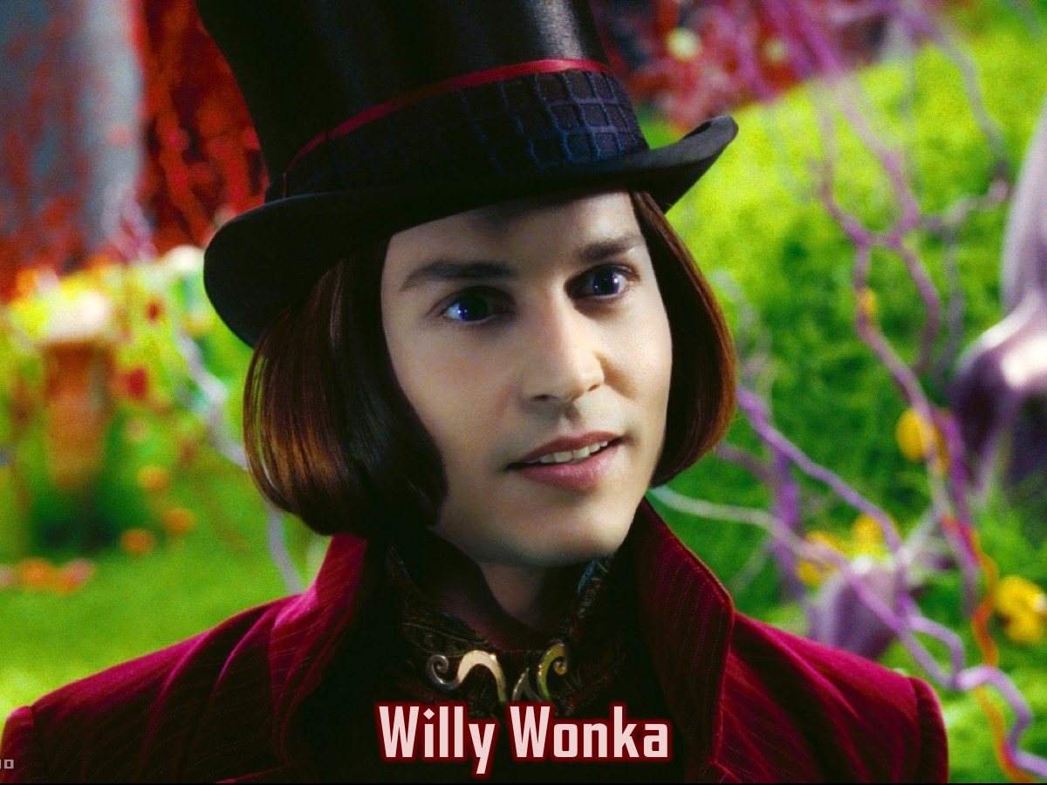
Notes:
Who plays Willy Wonka in Charlie and the Chocolate Factory?
Answer: Johnny Depp

Slide 29

Notes:
Who plays Captain Jack Sparrow in The Pirates of the Caribbean? Answer: Johnny Depp

Slide 30
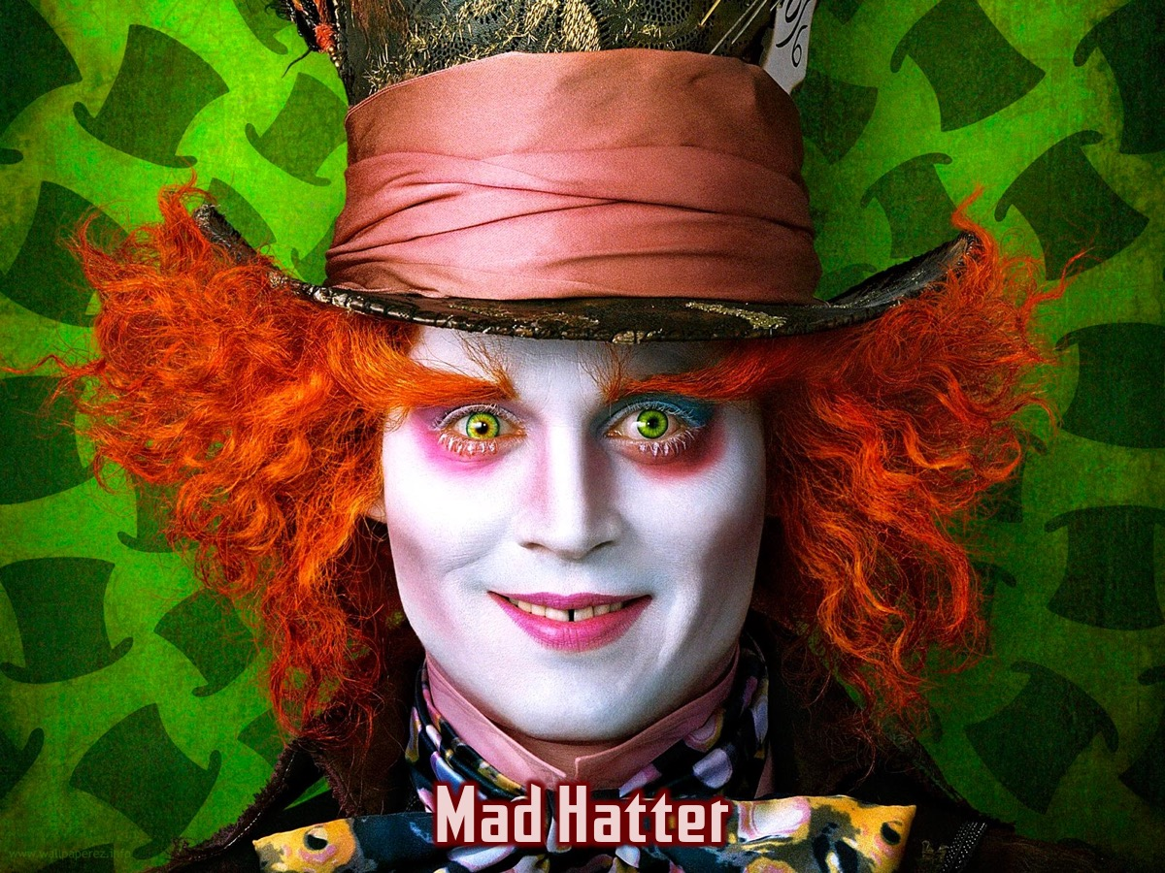
Notes:
Who plays The Mad Hatter in Alice in Wonderland?
Answer: Johnny Depp

Slide 31
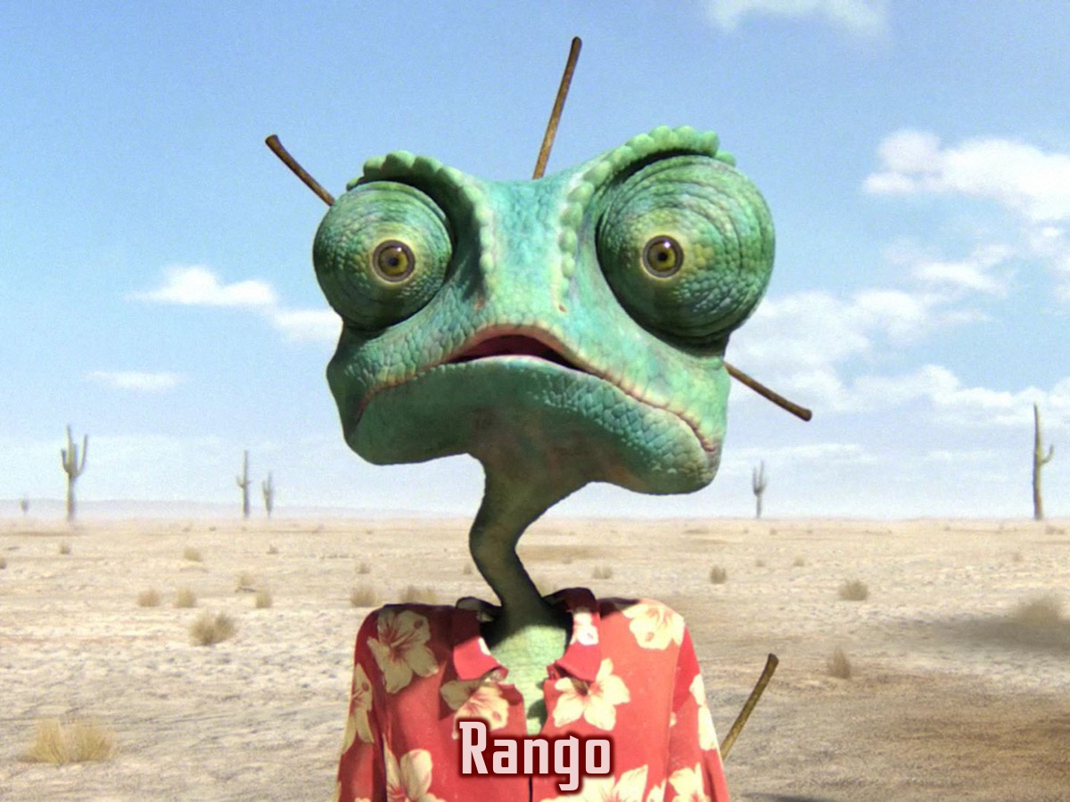
Notes:
Who plays Rango in Rango?
Answer: Johnny Depp

Slide 32
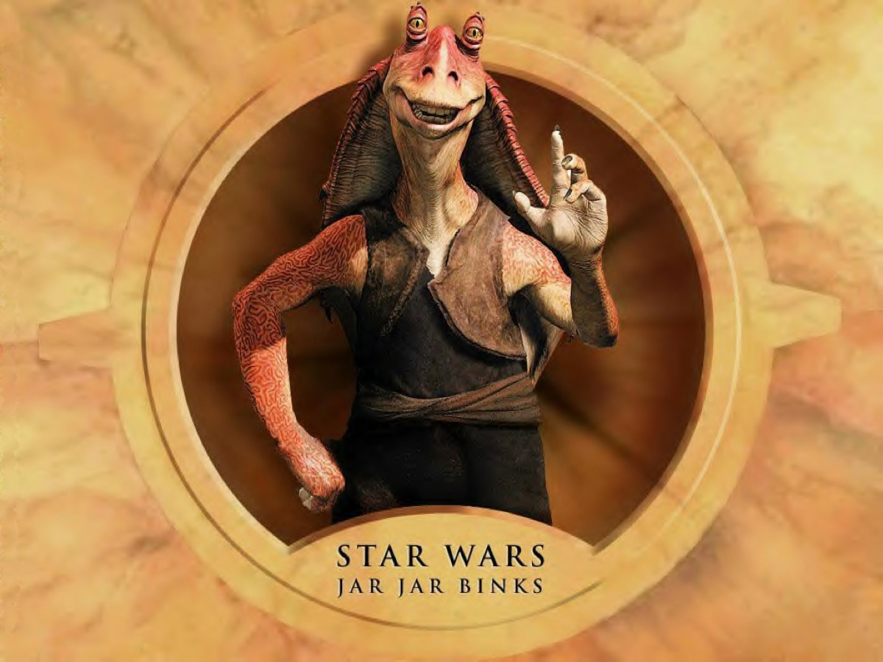
Notes:
But some times it is difficult or nearly impossible to figure out who the actor is… Like who played Jar Jar Binks in Star Wars?
Answer: Ahmed Best

Slide 33
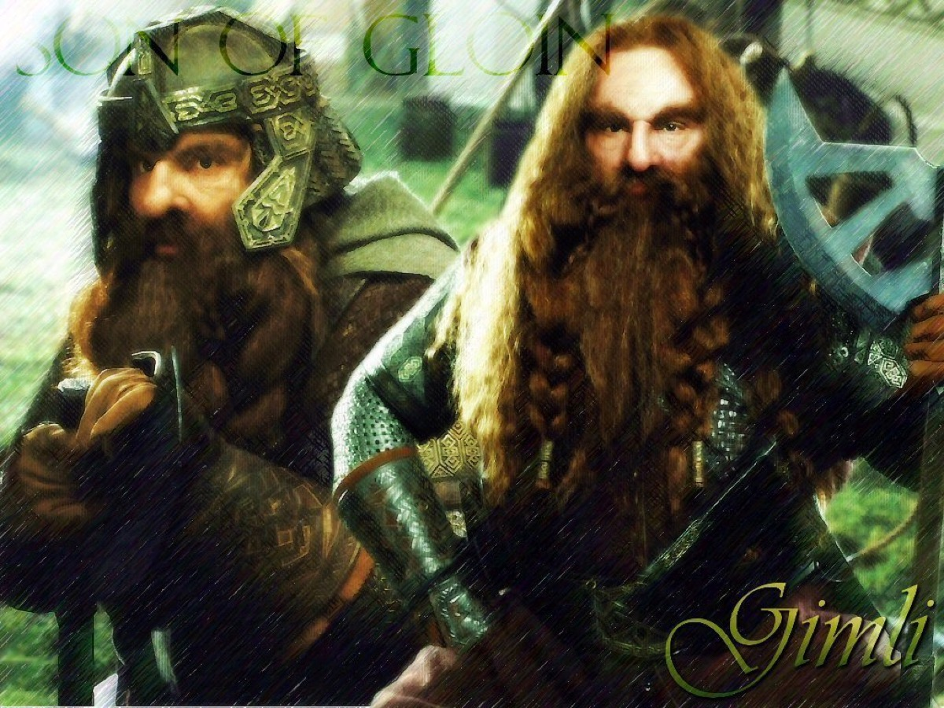
Notes:
Who played Gimli in The Lord of the Rings.
Answer: John Rhys-Davies

Slide 34
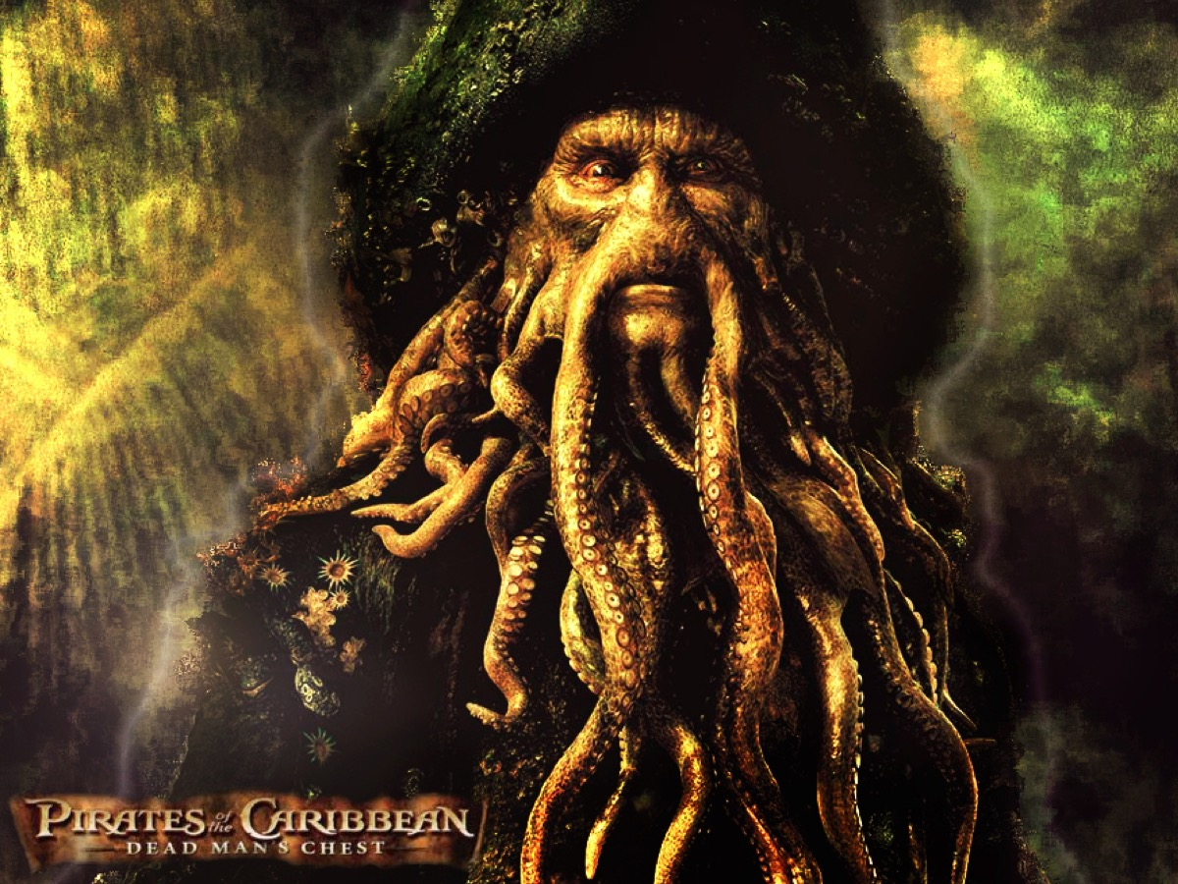
Notes:
Who played Davy Jones in Pirates of the Caribbean?
Answer: Bill Nighy

Slide 35
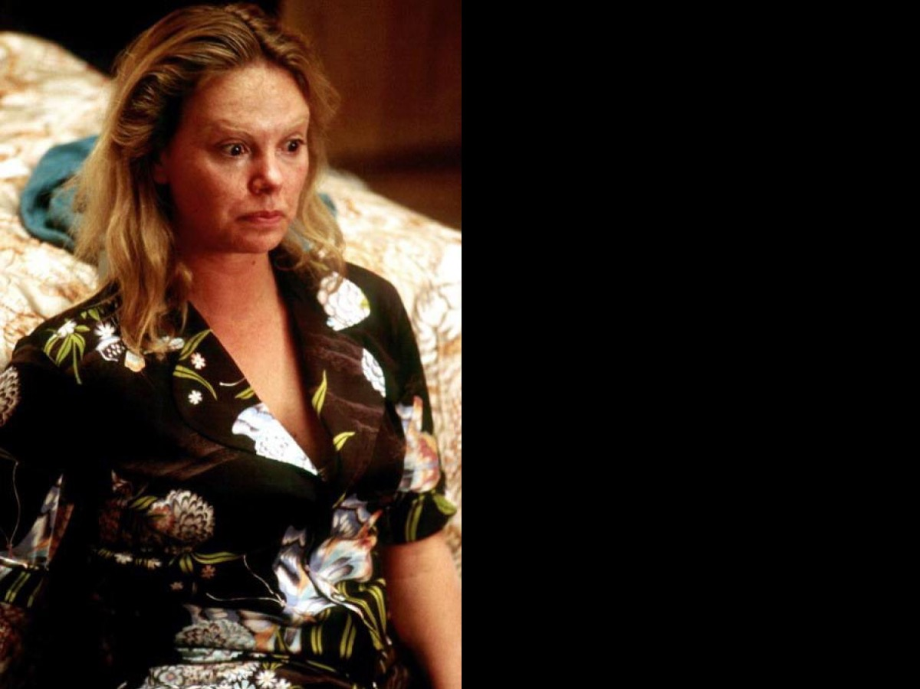
Notes:
Who played serial killer Aileen Wuornos in the movie Monster?

Slide 36
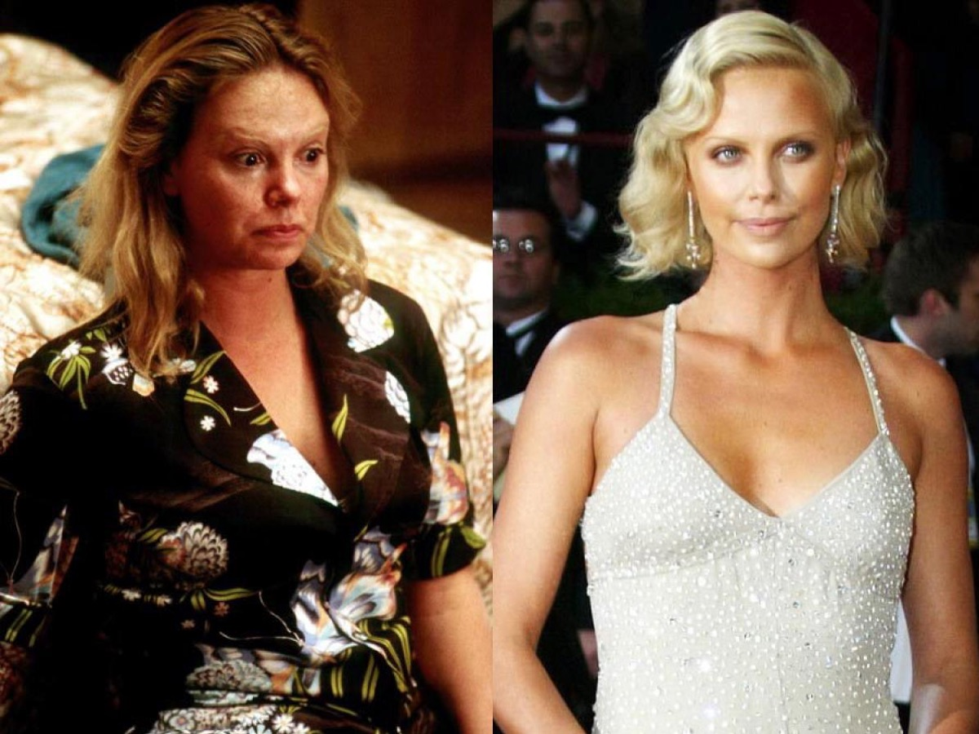
Notes:
Answer: Charlize Theron

Slide 37
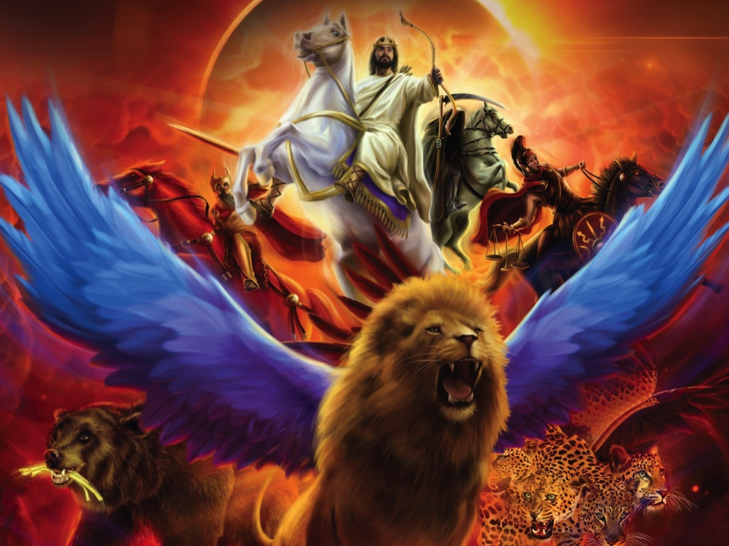
Notes:
When you read the book of Revelation the challenge is to identify the characters who come and go in the 22 chapters. We know that it is highly likely that John expects us to know that they are symbolic representations so it can be quite a challenge. In Revelation 12 there are any characters we need to identify - thankfully John gives us some clues and the rest of the Bible can help us too!

Slide 38
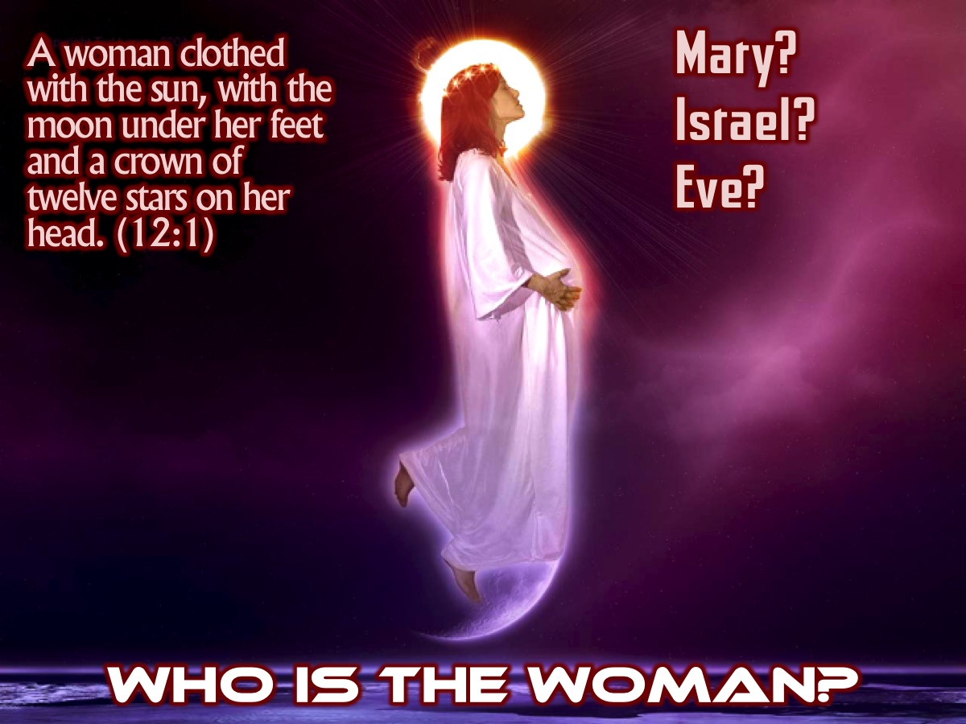
Notes:
Who is the Woman? Some people think that the woman is Mary – but John says that she is a ‘sign’ not a literal mother. It is more likely that two figures stand behind her. First, there is Israel – often referred to as ‘daughter Israel’, the bride of God. Here she is the true faithful Israel, the nation that had struggled to stay in God’s path. It is from this nation (although through the virgin daughter of Israel, Mary) that the Messiah was born. She was the ‘priestly kingdom, holy nation’ of Exodus 19:6. The other character who can stand behind the woman is Eve – the original mother of all human life. She was told that her seed would crush the serpent’s head (Genesis 3:15).

Slide 39
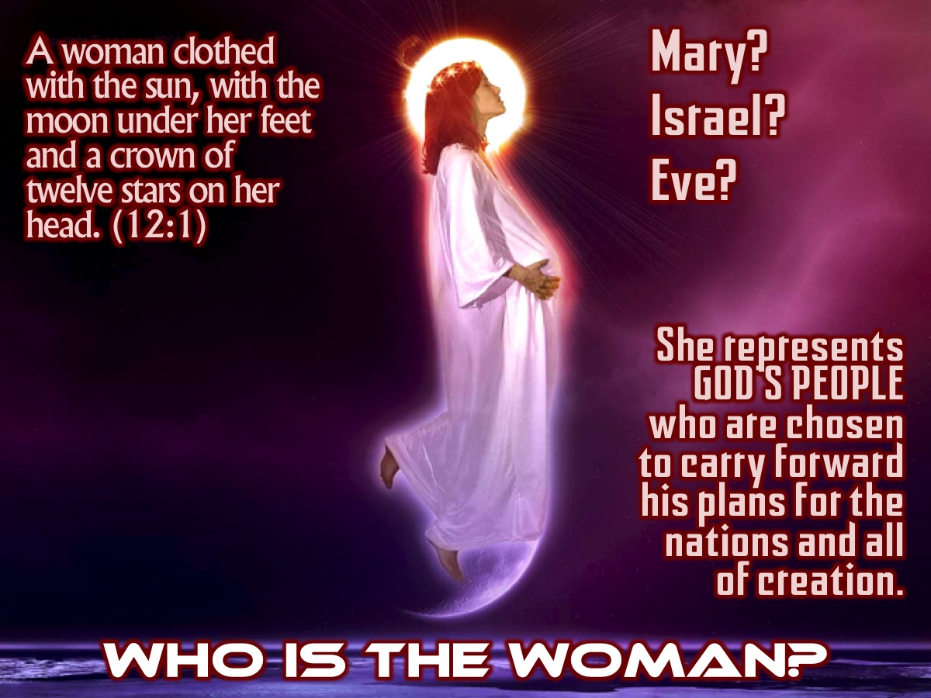
Notes:
This woman represents God’s people, chosen to carry forward his plans for the nations and all of creation. This is why the sun, moon and stars form her robe, her footstool and her crown. This is why the forces that are against the creator God are determined to strike at her and at her child.

Slide 40
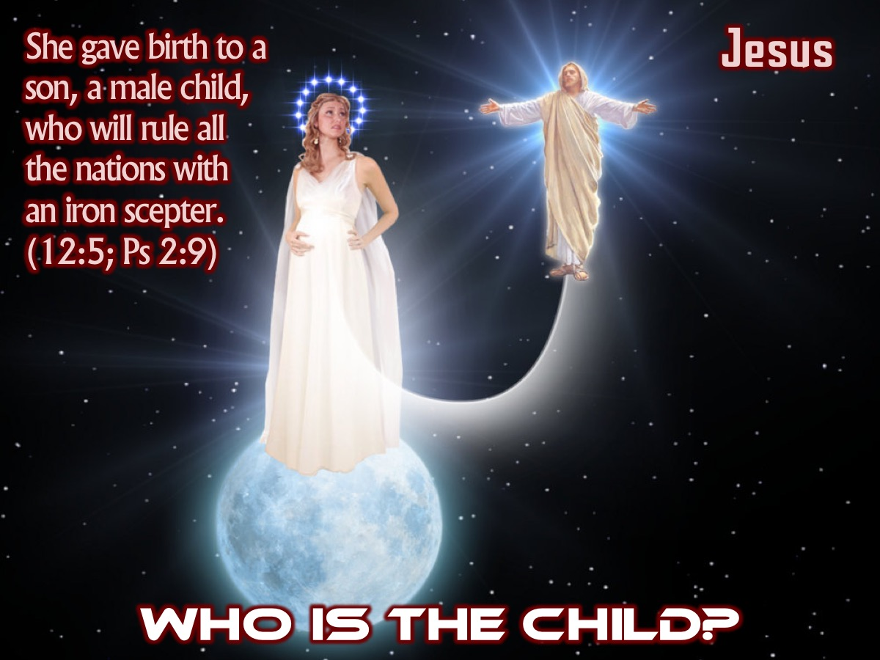
Notes:
Who is the Child? The child that the woman gives bird to is the boy “who is going to rule all the nations with an iron rod’ (5). This is an obvious reference to Psalm 2:9. Most early Christians applied that Psalm to Jesus – he is the Messiah, the one God calls to bring the nations into line.

Slide 41
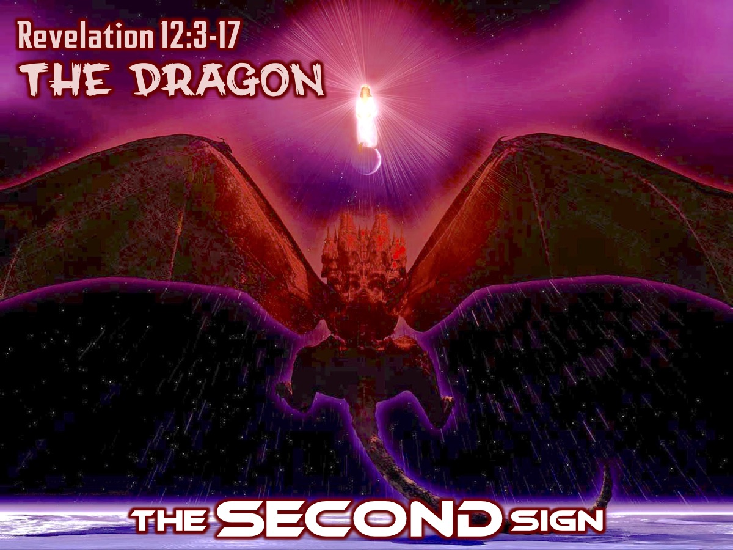
Notes:
The SECOND Sign: The Dragon (Revelation 12:3-17). “Then another sign appeared in heaven: an enormous red dragon with seven heads and ten horns and seven crowns on its heads. Its tail swept a third of the stars out of the sky and flung them to the earth.”

Slide 42
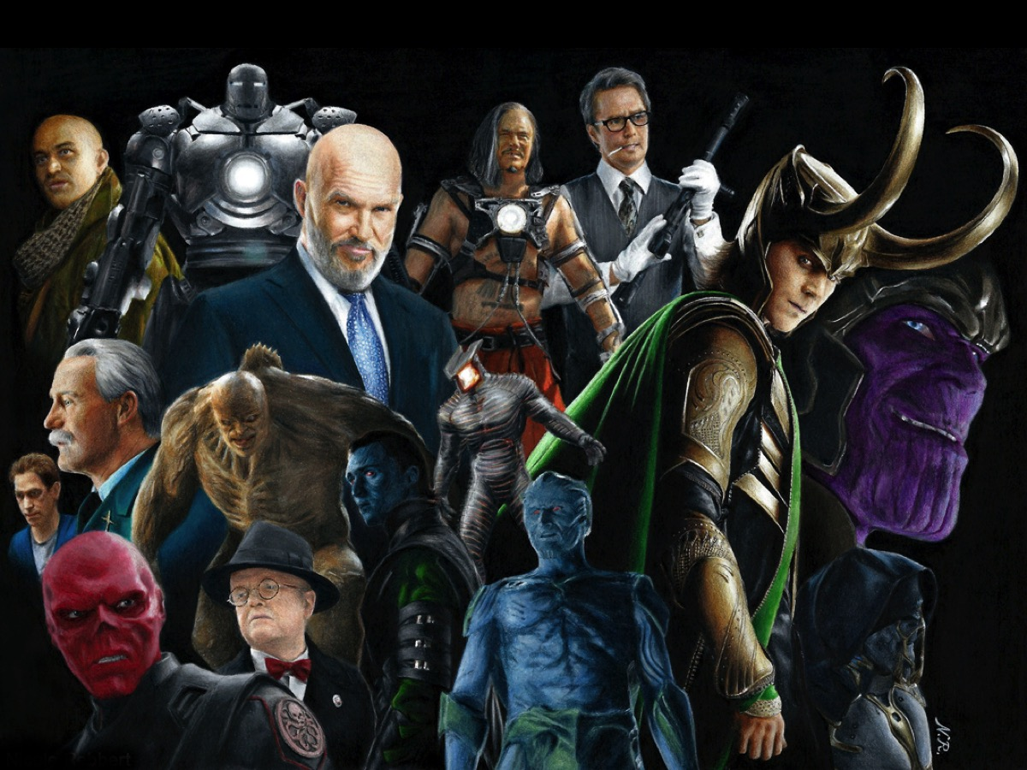
Notes:
Illustration: That moment in movies when the villain appears and you know that you are in for a hectic time:

Slide 43
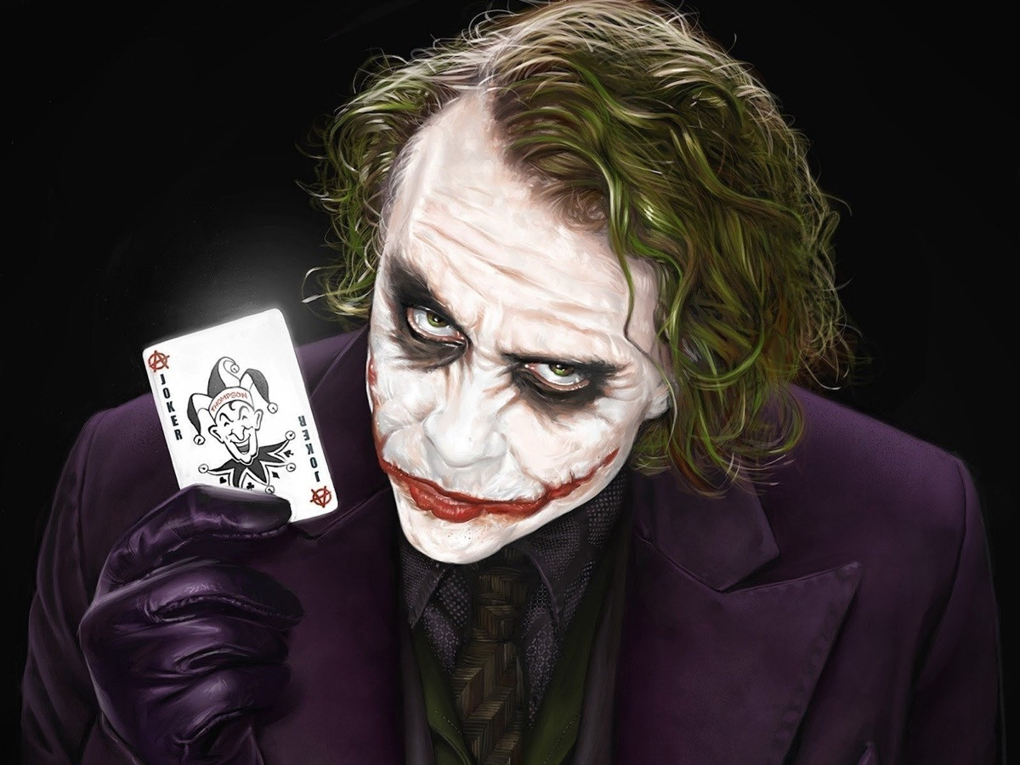
Notes:
The Joker

Slide 44
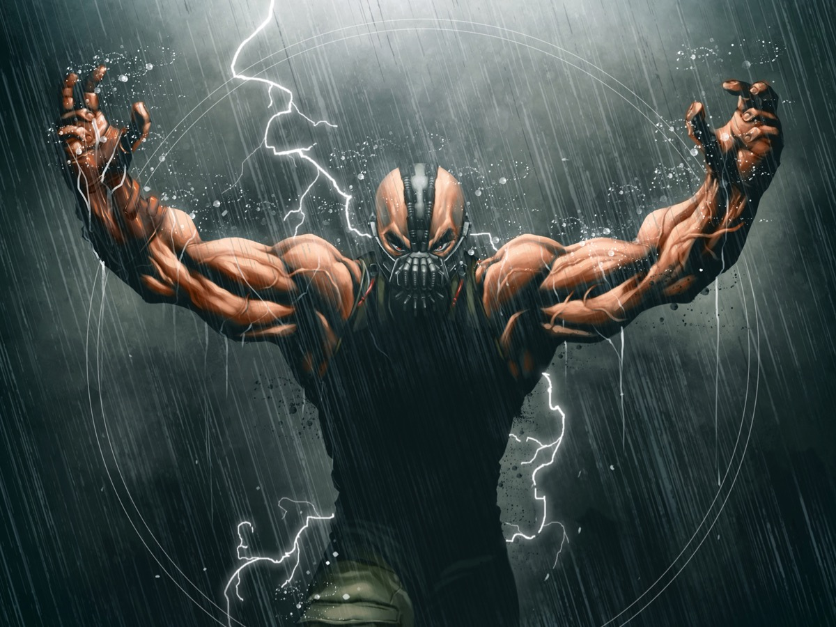
Notes:
Bane

Slide 45
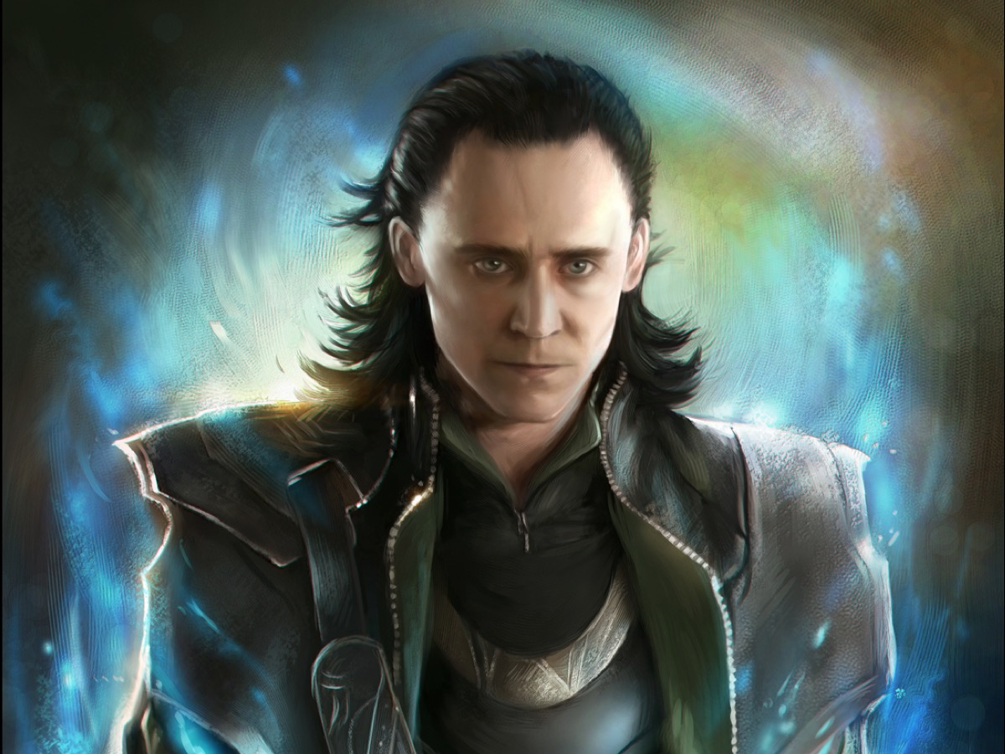
Notes:
Loki

Slide 46
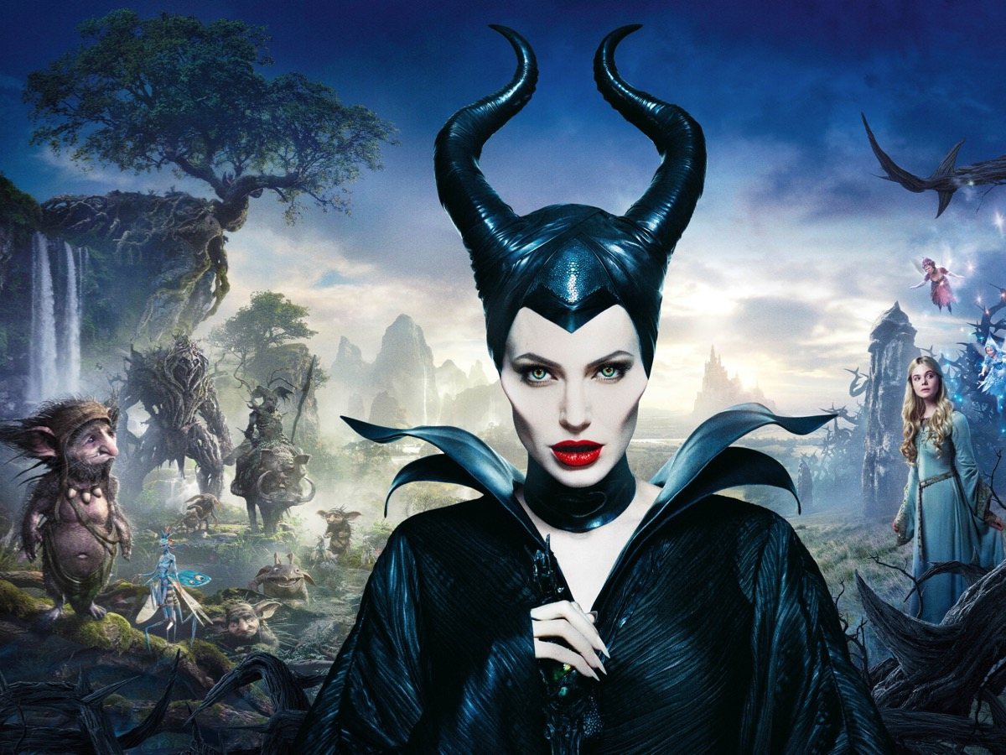
Notes:
Maleficent

Slide 47
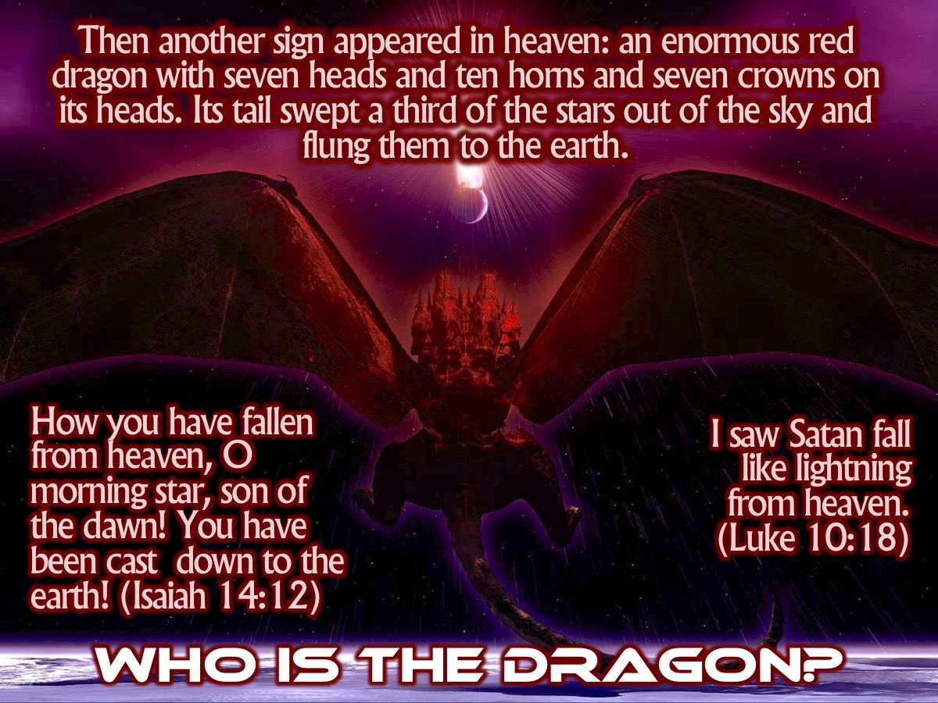
Notes:
Who is the Dragon? “Then another sign appeared in heaven: an enormous red dragon with seven heads and ten horns and seven crowns on its heads. Its tail swept a third of the stars out of the sky and flung them to the earth.” (Revelation 12:3-4). Finally, with a swish of his majestic tail, the villain appears on stage – this is the villain than stands behind all the trouble that we have seen in previous chapters. The identity of the dragon will be more revealed later on which the mystery of the seven heads and ten horns are made clearer. But already we see that he is a figure of considerable power. He is “in heaven”, just like in the Old Testament, the Adversary, Satan (this is who he is as we discover in verse 9), where he was part of the heavenly court when he rebelled against the creator’s plans for his world. There have always been attacks against the people of God – and especially against the birth of Jesus when Herod had the small children killed (Matthew 2). He tried to have Jesus killed throughout his life. And then Jesus was snatched away to God and his throne (5). Through his death, resurrection and ascension, Jesus won the victory.

Slide 48
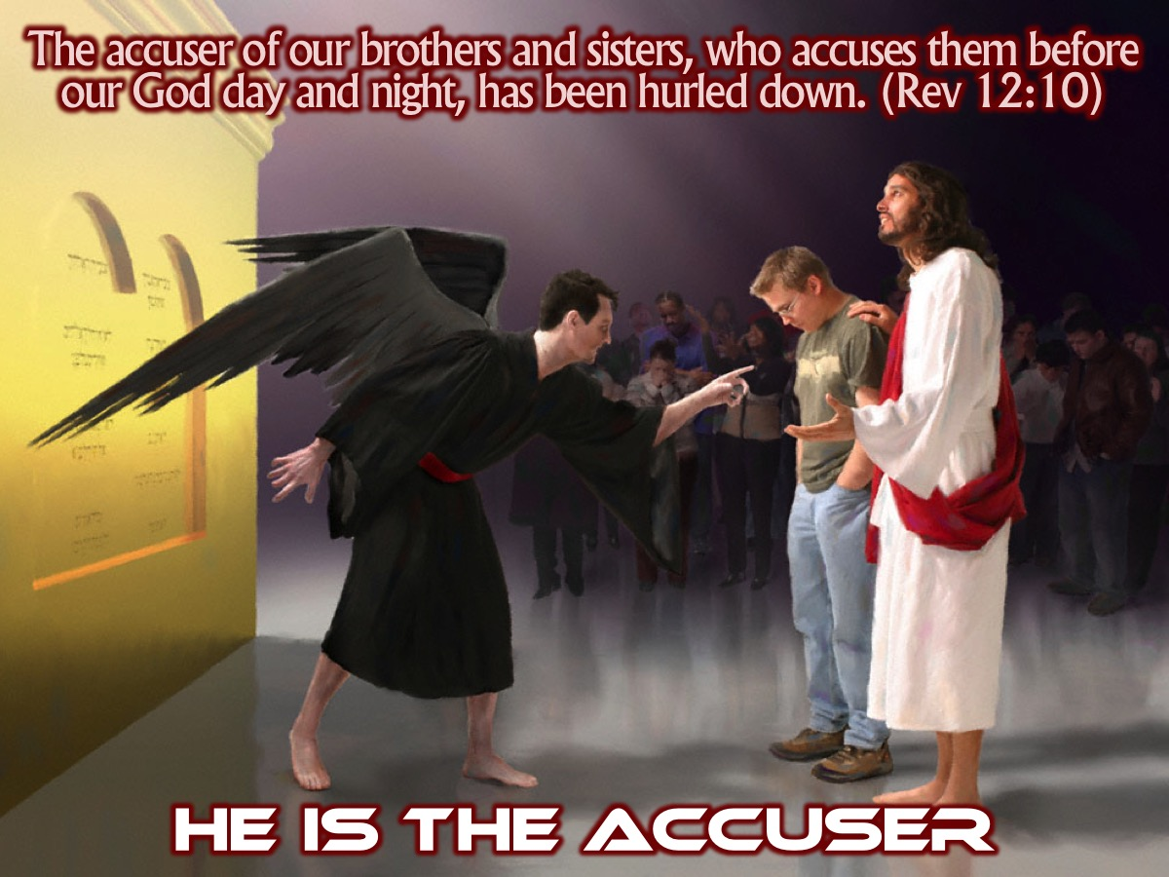
Notes:
He is the Accuser. The early believers experienced this daily. Their neighbours questions why they did not join in the pagan festivals – especially the imperial religion which carried a penalty of death. All sorts of slander and lies were told about the early church and the believers need to see they for what they were – accusations from the father of lies (John 8:44). So John is once again positioning his hearers on the map of the great cosmic drama. They must know, and celebrate, the great victory which has already been won – “the accuser” has no place anymore in the heaven, because the death of Jesus has defeated him (Jesus said that he saw Satan fall like lightning from heaven – Luke 10:18).

Slide 49
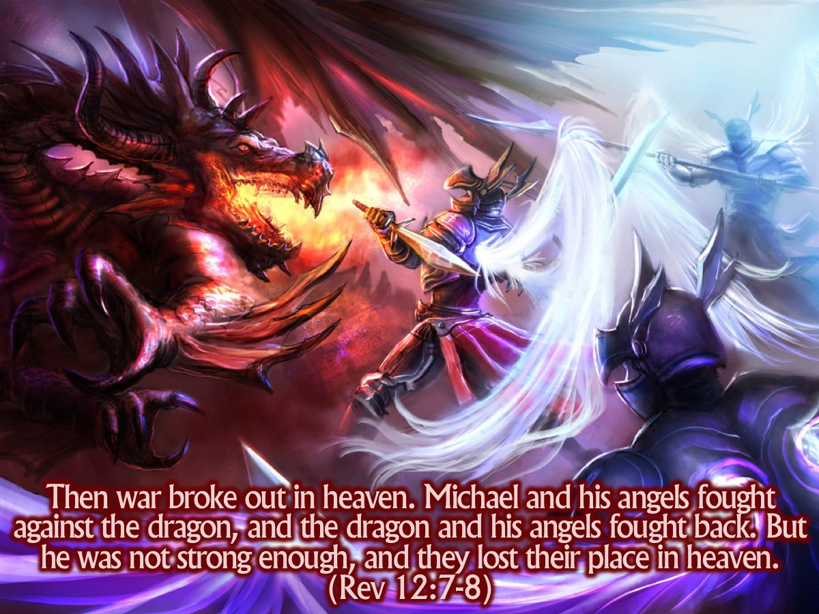
Notes:
“Then war broke out in heaven. Michael and his angels fought against the dragon, and the dragon and his angels fought back. But he was not strong enough, and they lost their place in heaven”. (Rev 12:7-8)

Slide 50
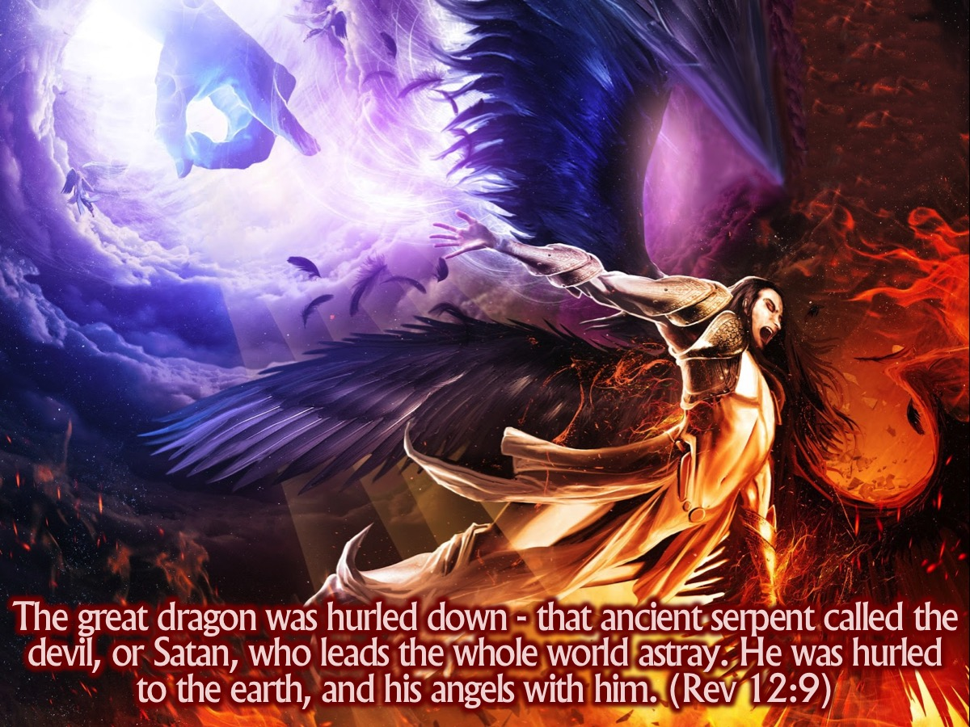
Notes:
“The great dragon was hurled down—that ancient serpent called the devil, or Satan, who leads the whole world astray. He was hurled to the earth, and his angels with him.” (Revelation 12:9)

Slide 51
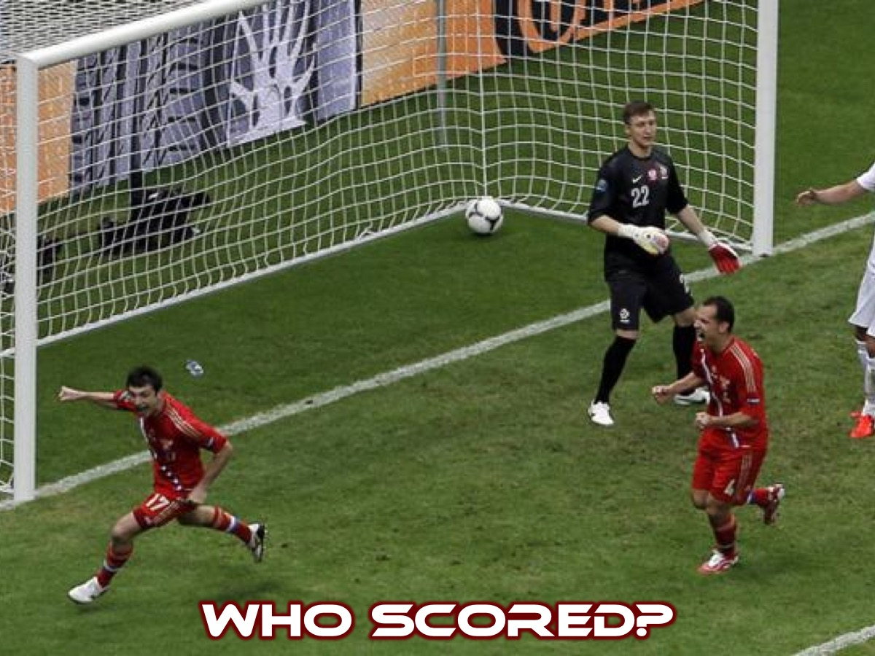
Notes:
Illustration: After a soccer match an argument broke out about who had scored the winning goal. There was a scramble in the goalmouth – the ball bounced around and two attacking players both tried to score simultaneously. Both felt the ball on their foot and next second the ball was in the net and the match was won. So who scored the goal?

Slide 52
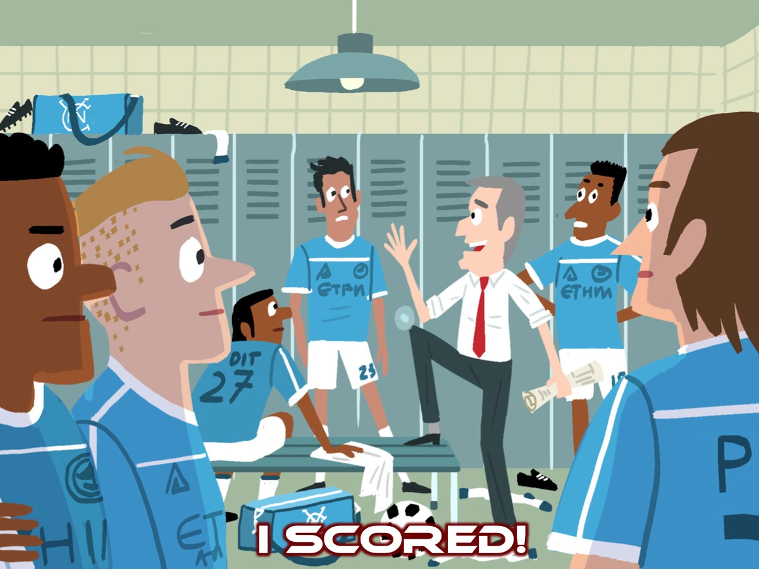
Notes:
In the change room the manager heard they arguing about who had scored the goal and he said: “Actually, I scored the goal.” They asked: “What do you mean?” He answered: “Think about it, I chose you both to play today. I taught the others how to get the ball up front in just that situation and I taught both of you to get past the defenders and be there at the right moment. Without that, the goal wouldn’t have happened. I scored that goal.” Eventually, it was credited to both players, but the manager had made his point and they knew it. There are more levels than at first appear to the question of who won the decisive victory.

Slide 53

Notes:
Who Won The War? In this section, a war has been won, but there are two groups of people who were involved in winning it.

Slide 54

Notes:
There is the war in heaven – Michael the great archangel (from Daniel 10) calls all his angels to fight against the dragon and his angels – a primeval battle that took place in the spiritual realm. Michael had won and the dragon had lost. As a result the dragon was thrown down to earth – ejected from heaven.

Slide 55

Notes:
But the song of victory which follows from this great event gives credit for the victory, not to Michael but to God’s people on earth.

Slide 56

Notes:
“For the accuser of our brothers and sisters, who accuses them before our God day and night, has been hurled down. They triumphed over him by the blood of the Lamb and by the word of their testimony; they did not love their lives so much as to shrink from death.” (Rev 12:10-11)

Slide 57

Notes:
So who defeated the dragon, was it Michael or the martyrs? In a sense it was both – the heavenly reality of the victorious battle is umbilically joined to the earthly reality of the martyr’s deaths. They had been saved by the blood of the lamb and his self-sacrificial death is the pattern that they follow. And that is what wins the battle.

Slide 58

Notes:
What comes next is like a cosmic car chase…

Slide 59

Notes:
“The dragon stood in front of the woman who was about to give birth, so that it might devour her child the moment he was born.” (Revelation 12:4)

Slide 60

Notes:
She gave birth to a son, a male child, who “will rule all the nations with an iron scepter.” And her child was snatched up to God and to his throne. (12:5)

Slide 61

Notes:
But he will do his best in the time remaining, to attack the woman who had fled to the wilderness, even though as in Exodus 19:4, God has given her eagles wins so that she could fly away. “The woman fled into the wilderness to a place prepared for her by God, where she might be taken care of for 1,260 days.” (12:6)
But meanwhile, the women, the faithful people of God, remain in danger – which means that it can’t refer to Mary of the ethnic people of Israel. The woman who flees to the desert to be looked after by God for a temporary period (3 and a half years or 1260 days) must be the church itself. So once again we realize that this is not a story in which we are spectators – we are actively involved. We are those (in the woman) that the dragon is pursuing (12:13) and who need to be looked after. The desert could refer to the Exodus story where the people of Israel went to escape Pharaoh.
We need to know that our present struggles does not mean that God is asleep on the job! They are signs that a great, cosmic drama is being staged in which we are being given a vital though terrible role to play.

Slide 62

Notes:
The dragon spits out a jet of water like a river to carry the woman off; the earth opens its mouth to swallow up the river; the woman escapes and the dragon, angry, turns his attention elsewhere – to the woman’s children who are defined as “those who keep God’s commands and the testimony of Jesus:”

Slide 63

Notes:
So once again, John reminds his readers that they are a part of this drama. Don’t be surprised that the dragon is out to get you with more of his foul powerful accusations, spat out like a flood. Trust that the God of creation will look after you. It is fascinating that the earth comes to her rescue - creation itself is shown to be on the side of God and his people – rather than working with the dragon.
But there are more persecution and attacks to come – more false accusation – (verse 12) because the devil has come down to you in great anger, knowing that he only has a short time. The decisive battle has been won and the devil knows it; but his basic nature as accuser is driving him now more and more frantically attack – to accuse and drag down and slander the truth of what the creator God and his son, the lamb have accomplished and are accomplishing. This is the ongoing battle that we are involved in whether we know it or not. The picture John has sketched in this chapter to encourage and warn his readers is just the opening scene. More is to come. The dragon ends up standing beside the sea – which all ancient Jews knew was the dark place out of which monsters might emerge.

Slide 64

Notes:
The THIRD Sign: The Sea Beast (Revelation 13:1-10)
The dragon stood on the shore of the sea. And I saw a beast coming out of the sea. It had ten horns and seven heads, with ten crowns on its horns, and on each head a blasphemous name. ² The beast I saw resembled a leopard, but had feet like those of a bear and a mouth like that of a lion. The dragon gave the beast his power and his throne and great authority. ³ One of the heads of the beast seemed to have had a fatal wound, but the fatal wound had been healed. The whole world was filled with wonder and followed the beast. ⁴ People worshiped the dragon because he had given authority to the beast, and they also worshiped the beast and asked, “Who is like the beast? Who can wage war against it?” ⁵ The beast was given a mouth to utter proud words and blasphemies and to exercise its authority for forty-two months. ⁶ It opened its mouth to blaspheme God, and to slander his name and his dwelling place and those who live in heaven. ⁷ It was given power to wage war against God’s holy people and to conquer them. And it was given authority over every tribe, people, language and nation. ⁸ All inhabitants of the earth will worship the beast—all whose names have not been written in the Lamb’s book of life, the Lamb who was slain from the creation of the world. ⁹ Whoever has ears, let them hear. ¹⁰ “If anyone is to go into captivity, into captivity they will go.
If anyone is to be killed with the sword, with the sword they will be killed.” This calls for patient endurance and faithfulness on the part of God’s people.” (Revelation 13:1-10)

Slide 65

Notes:
The dragon stood on the shore of the sea. And I saw a beast coming out of the sea. It had ten horns and seven heads, with ten crowns on its horns, and on each head a blasphemous name. ² The beast I saw resembled a leopard, but had feet like those of a bear and a mouth like that of a lion. The dragon gave the beast his power and his throne and great authority. ³ One of the heads of the beast seemed to have had a fatal wound, but the fatal wound had been healed. The whole world was filled with wonder and followed the beast. ⁴ People worshiped the dragon because he had given authority to the beast, and they also worshiped the beast and asked, “Who is like the beast? Who can wage war against it?” ⁵ The beast was given a mouth to utter proud words and blasphemies and to exercise its authority for forty-two months. ⁶ It opened its mouth to blaspheme God, and to slander his name and his dwelling place and those who live in heaven. ⁷ It was given power to wage war against God’s holy people and to conquer them. And it was given authority over every tribe, people, language and nation. ⁸ All inhabitants of the earth will worship the beast—all whose names have not been written in the Lamb’s book of life, the Lamb who was slain from the creation of the world. ⁹ Whoever has ears, let them hear. ¹⁰ “If anyone is to go into captivity, into captivity they will go. If anyone is to be killed with the sword, with the sword they will be killed.” This calls for patient endurance and faithfulness on the part of God’s people.” (Revelation 13:1-10)

Slide 66

Notes:
Illustration: A crime has taken place – a diplomat has been killed – the suspect has been arrested but under cross examination it becomes clear that the accused did not act alone – there were dark forces behind it all. Which forces, which country hired or bribed this young man to kill the diplomat?

Slide 67

Notes:
Just like in our world, so in the world of spiritual warfare – the ultimate powers prefer not to show themselves but to act through others. They give some power to secondary agents and back them up where necessary.

Slide 68

Notes:
Daniel’s Monsters. This chapter draws on language drawn from Daniel 7 which predicted the overthrow of pagan empire and the ascent to power of God’s people, Israel. In Daniel 7 there are four monsters that come out of the sea – they are the stuff of nightmares. The first is a winged lion, the second is a bear with 3 tusks in its moth, the third is a leopard with four wings and four heads, then comes the fourth beast, greater and more terrible, with iron teeth and bronze claws – it has ten horns with a further little horn growing up beside them. The interpretation is quite clear: the monsters represent four kingdoms (the Babylonian Empire; the Medo-Persian Empire; the Greek Empire of Alexander and the Roman Empire). Then comes the great reversal: “the ancient of Days” takes his seat for a court hearing, sitting in condemnation over the last great monster and destroying his power, giving it instead to “one like a son of man” who comes to be presented before the Ancient of Days and to receive an everlasting, universal sovereignty.

Slide 69

Notes:
John’s Monster. People who read this book were not thinking about real monsters crawling up out of the Mediterranean Sea to attack the holy land. They were interested in what these monsters represented. John’s single monster has telescoped Daniel’s four into one – part leopard, part bear, part lion, with ten horns and seven heads.

Slide 70

Notes:
The Monster is Rome. Or rather, as we will see, the monster is the dark power of pagan empire. Crushing everything in its path, blaspheming other gods who get in the way so that it along (and the dragon who gives it power) may be worshipped properly. This is perhaps why Pergamum was described in 2:13 as “where Satan has his throne” – it was a center of imperial rule and cult which John sees behind the pomp and the purple to the dark spiritual side of satanic rule which was enabled the empire to impose itself across so much of the world. Rome is the obvious and only “monster” candidate in the first century. But sadly the heartless, dehumanizing pagan empire did not end with the decline and fall of Rome – this is why this picture is relevant to us today.

Slide 71

Notes:
Did Nero Come Back to Life? Verse 3 focuses on specific features of Roman rule in the second half of the first century. It had become an empire under Augusts, a hundred years before the murder of his adopted father Julius Caesar (44 BC) and the ensuing civil wars. After the death of Nero (AD 69) one would have thought that the precarious, self-glorifying, top-heavy world empire come crashing down under its own weight. Four would-be emperors marched on Rome in quick succession claiming the crown – and each, except the last, was killed by the next army to arrive. Galba, Otho, Vitellius came and went, Vespian came and stayed for a while – and finally Titus’ legions destroyed Jerusalem burning the temple to the group. To most people it must have seemed like the end of the world. Then came rumours that Nero had not died or died but had come back to life – and would be “Nero-alive-again” leaders emerged and though none lasted long the rumours continued. “He was, is not, but is to come”, they said (17:8). Maybe this is what John is referring to when he says that one of the monster’s heads appeared to have been killed, but its fatal wound had been healed (3).

Slide 72

Notes:
Who Will You Worship? But the central and important feature is that the monster claimed worship and shared that worship with the dark pagan gods that stood behind it. A glance at Roman coins of the period shows who one emperor after another not only claimed to be “son of god” but dressed up like that ancient pagan divinity. And once an emperor becomes a god, there is no room for other gods. If one refused – like the Christians had to do – to worship the Roman god, then a collision course was set. Like in Daniel – it seemed like the whole world was worshipping the monster. Only the faithful few, those described here as having their names written in the lamb’s book of life, refuse to do so. Some are going to be taken captive, other will be killed with the sword – that is just the way it is going to be. The proper response is not to kick and scream but to hold firm with faith and perseverance. Chapter 11 meant what it said: it is through the faithful witness unto death that the lamb wins the victor, that God’s kingdom replaces the kingdom of the monster, that the dragon himself is to lose the last remains of his power. Only when we remember the dragon and the monster do we realize what a deadly serious thing Christian faith, patience and holiness really is.

Slide 73

Notes:
The FOURTH Sign: The Earth Beast (Revelation 13:11-18)
Then I saw a second beast, coming out of the earth. It had two horns like a lamb, but it spoke like a dragon.

Slide 74

Notes:
Illustration: A room in a hotel with self after shelf of books – until you look closer and it is all fake. It was all an inch deep – these were books but they had their spines and first few centimeters of the book cut off and glued to a back wall to make it look like the room was a genuine library. Surely it would have been easier to create the same thing with the same books. It was not the real thing but a parody. A parody is what you get when someone produces a fake which looks real but isn’t. Sometimes this is done deliberately for comic effect – sometimes it is done to deceive.

Slide 75

Notes:
The Reality is that the one sitting on the throne is the all powerful, sovereign lord of all creation – that the lamb, his son, was the one whose death had conquered the world and rescued people from their slavery to sin in order to appoint them as rulers and priests in God’s new creation and that the spirit of God was at work in and through these people to accomplish God’s work.

Slide 76

Notes:
The Parody in the first century was that the Roman empire, gaining its ultimate authority from the satanic dragon, was putting itself up as the world ruler. This was the first monster. And the second like it, but subordinate, seems to be the local elites, in city after city who do their best not only to copy the monster at a local level but insist that everyone has to worship the monster. Cities were competing with each other for the right to build a temple to Rome, to the emperor or a member of the emperor’s family. These local power-brokers are there second monster “coming up from the earth” (arising locally rather than coming from the sea). This completes the Unholy Trinity – the dragon, the first monster and the second monster – combining to be a ghastly parody of God, Jesus and the Spirit. Christians spoke about the death and resurrection of Jesus - the true lamb – believing that he had defeated the dragon himself. But Rome had its parody of how it come back from the brink of death. And through trickery that made the statues of gods move about, weep and even speak many people were taken in and through the work of these local “monsters” they came to worship the dragon itself.

Slide 77

Notes:
The Mark of the Beast. “It also forced all people, great and small, rich and poor, free and slave, to receive a mark on their right hands or on their foreheads, so that they could not buy or sell unless they had the mark, which is the name of the beast or the number of its name. This calls for wisdom. Let the person who has insight calculate the number of the beast, for it is the number of a man. That number is 666.” (Revelation 13:16-18). The final verse of the chapter is one of the most famous in the whole book. It offers the greatest parody of all. It is more or less certain that the number 666 represents the name NERO Caesar when written in Hebrew characters (people have always done this in each language where for example A=1 and B=2 and C=3, etc). But the number isn’t just a cryptogram – it is also a parody. The number of perfection would be 777 – some even suggest that name of Jesus comes out as 888 – a kind of super-perfection. For John, Nero and the system he represented and embodied, was a parody of the real thing, one short of the right number three times over. Jesus was the reality; Nero was a dangerous, blasphemous copy. We must search our own consciences and our own societies and enquire to what extend we too have been deceived by fakes posing as the real thing.

Slide 78

Notes:
So much speculation has taken place around what the mark of the beast is going to be. When I was growing up people spoke about chips that would be implanted into your hand - without which you would not be able to buy or sell anything. Who know what it will end up being.

Slide 79

Notes:
In Roman times laws were passed that made it a formal requirement that unless you had offered sacrifices you were not allowed in the market. There were various kinds of marks and visible signs used to set people apart either as “able to trade” or as “not able to trade”. The early Christians had the choice: stay true to the lamb and risk losing your livelihood, the ability to sell or buy; or capitulate to the monster, sacrifice to Caesar at the demands of the local officials and then everything was alright – except your integrity as one of the lambs followers.

Slide 80

Notes:
Our Challenges. We would like to think that we would always have the wisdom and courage to choose the reality and reject the parody but would be? We face similar challenges today like that faced in the first century. Do we buy an album with cool songs but some that blatantly attack God and the Christian way of life? Do we vote for a party that is corrupt or anti-Christian? Do we take a job with a company that pollutes lakes and rivers and destroys wildlife? Or wear clothes that are made in sweatshops? Or buy fake items? We too face choices that are not as clear-cut as we would like them to be!

Slide 81

Notes:
The FiFTH Sign: The Warriors (Revelation 14:1-13).

Slide 82

Notes:
Who Are They? “Then I looked, and there before me was the Lamb, standing on Mount Zion, and with him 144,000 who had his name and his Father’s name written on their foreheads. They did not defile themselves with women, for they remained virgins. They follow the Lamb wherever he goes. They were purchased from among mankind and offered as firstfruits to God and the Lamb. No lie was found in their mouths; they are blameless.” (Revelation 14:1-5). Who are these elite warriors? Why are they revealed at this point in the story? The answer is that once again John is working with Psalm 2 in the background. The nations rage, the people imagine foolish things but God’s answer is to set his king, his son, on the holy mountain, mount Zion. So we see the lamb standing on Mount Zion (1) and he is not alone – but he is surrounded by his crack troops, his elite warriors. There is no doubt of their victory. John refers to them as celibate or virgins. Ancient Israel had a clear policy about people going to war – they had to obey special rules of purity and abstain from sexual relationships (Deut 23:9-10; 1 Samuel 21:5). There is another symbol here: there are 144000 (we met them before in chapter 7) and they sing a new song, they have abstained from sexual relations. They are, in other words, the ideal representatives of the people of God, permanently ready for battle. They are a great company which nobody could count – they sing songs which all Christians would know – and some of them may be married or single – but they are all permanently ready for the real battle – which is the engagement with the monsters and their demands; which could mean that they will be required to suffer or even to die. These elite warriors encourage the small Christian groups who when faced with the monstrous might of Rome and it’s local supporters would probably feel powerless and helpless. No way, says John! The lamb has been enthroned, just as God promised, and his elite stand around him, ready for battle in which, following the lamb himself they are going to win the victory. They will be the conquerors. These are the ones who instead of the brand of the monster, receive (not a mark but actually) the name of God and the lamb on their foreheads. This will mark them out in pagan society once it is known that they are loyal to Jesus and not to Caesar. But it will also mark them out in God’s presence as those whom the Messiah will acknowledge to be his (Matthew 10:32). This great crowd, surrounding the lamb, is not the sum total of all believers. It is the beginning, the advance sign of an even greater harvest to come. They are first fruits (4). At the ancient Jewish harvest time, the first sheaf of wheat was offered to God as the first fruits – signifying an expectation that there would be much more on the way. The 144000 remind us that the lamb is winning the victory – we can carry on patiently! And we do this by following him. Rejecting the lie and holding on to truth!

Slide 83

Notes:
Illustration: In the Middle East the shepherd walks ahead of his sheep – and they follow him.

Slide 84

Notes:
Following Jesus. In the bible the idea of following Jesus is the basic phrase that describes someone who belongs to Jesus who believes in him. (Matthew 4:19; 8:22; 9:9; Luke 9:62; John 21; etc.)

Slide 85

Notes:
Take Up Your Cross. This is the background for the lamb’s elite warriors – they follow the lamb wherever he goes (4). The lamb has won the victory over the dragon and his sidekicks, through his own sacrificial death. Now he calls his people to put that victory into practice, by following him down the same path. Jesus warned people during his ministry that those who want to come after him had to take up their cross and follow him. Somehow, the way to victory is the way of the cross.

Slide 86

Notes:
Babylon has Fallen. (Revelation 14:6-13). To get the force of the symbols in this section we have to think back to Babylon.

Slide 87

Notes:
The capital of the great empore that swallowed up the remaining Israelite tribes in 597 BC. This city remained for ever after that in Jewish memory as the paradigm of wickedness, immoprality and sheer cruelty. Babylon is used later in the book as a symbol (chapter 16-18).
In Isaiah 40-55 it seemed like Babylon’s gods had won but God makes it clear that Babylon had not won and that God would rescue his people and renew the whole creation. This would all be done through the work of his Servant. Around the prophecies of the Servant are oracles of doom on Babylon. The oppressors will fall victim to the wicked systems they have devised (51:17-23). The fourth servant poem speaks of the arrival of a herald with good news (52:7) – and here John tells us that he seens an angel carrying “an eternal gospel”. What is this good news. For many people today the gospel is just a person thing – their salvation from sin and death and their place in heaven. But biblically it is so much more that this: (1) Your God reigns – this announcements to the exiles in Babylon means that God has won victory over Babylon and you are now free to go home – Jerusalem will be rebuilt (52:7,9). (2) Your God is coming back – it seemed like God had abandoned the Temple in Jerusalem but now he would return publically and visibly (52:8; 40:5). (3) God is doing a powerful and public work of rescue (51:10). All the nations would see that Israel’s God had saved his people from their plight. So Babylon fell, the exiles went back home – but nobody ever said that God had come back – but the eary Christians beieve that God had come back in Jesus. His glory was fully and finally revealed when Jesus died on the cross as the innocent lamb (Isaiah 53:7). All this is vital to the background of Revelation 14.
The other passage is from Jeremiah. He spent his time living in the terror of the Babyalonian invasion and the sorrow of exile. At the end of his book he announced God’s judgment on the nations that brought this to pass – reaching Babylon in chapter 50 – two long chapters of condemnation (only really understood by someone who had endured what the Israelites endured in exile).
This chapter says that there is good news for those living under “Babylonian” rule:
(1) God the creator is at last going to sort everything out. (7)
(2) Babylon is fallen – after all her efforts to make the nations drunk with her immoral wine (8)
(3) God’s judgment will be just, thorough and complete (9-11).
This is all good news for those who have lived in a world of horror, torture and squalor. God is going to sort it all out. That is what the Psalmist too thought of as good news. Psalm 96:10-13; 98:7-9).

Slide 88

Notes:
A third angel followed them and said in a loud voice: “If anyone worships the beast and its image and receives its mark on their forehead or on their hand, they, too, will drink the wine of God’s fury, which has been poured full strength into the cup of his wrath. They will be tormented with burning sulfur in the presence of the holy angels and of the Lamb. And the smoke of their torment will rise for ever and ever. There will be no rest day or night for those who worship the beast and its image, or for anyone who receives the mark of its name.” (Revelation 14:9-11)
We don’t know who comes into the category described in verses 9-11 - these verses are probably symbolic and evoke more biblical passages – can only be heard with awe and the recognition that the deep seduction of evil really can swallow people up whole. John is concerned that none of Jesus’ followed get sucked down nto that dark whirlpool of death. They need to be patient, obedient and faithful, knowing that death itself, has been defeated, so as to become a source now not of curse of blessing. Their labours in the present are not in vane (see also 1 Corinthians 15:58).

Slide 89

Notes:
The SIXTH Sign: The Harvest (Revelation 14:14-20).

Slide 90

Notes:
“I looked, and there before me was a white cloud, and seated on the cloud was one like a son of man with a crown of gold on his head and a sharp sickle in his hand. Then another angel came out of the temple and called in a loud voice to him who was sitting on the cloud, “Take your sickle and reap, because the time to reap has come, for the harvest of the earth is ripe.” So he who was seated on the cloud swung his sickle over the earth, and the earth was harvested.” (Revelation 14:14-16)

Slide 91

Notes:
Illustration: In rural communities, reapers have urgent labour – to harvest the crop in as short a period of time as possible – and can often see seen working right through the night. There is a sense of satisfaction when the job is done – and great joy at the harvest festival designed to celebrate the whole process.

Slide 92

Notes:
The Wicked As Harvest. Traditionally this passage has been interpreted as the son of man, Jesus, executing God’s wrath with his sickle (14-16) and an angel from heaven gathering up the “grapes of wrath” – understood as the wicked nations who about about to suffer God’s eternal anger (which is actually described in chapter 19) - yet this could represent something totally different!

Slide 93

Notes:
Believers as Harvest. The previous chapter warned God’s people against worshipping the monster; the next chapter will see those same people, with victory won, singing the new song by the sea of glass. How have they come from the one place to the other? By being themselves the harvest of the Lord. These are images of salvation, not of condemnation. But it is always salvation through suffering.
John is encouraging his readers to face the prospect of persecution in faith and patience. When “one like a son of man” is encouraged by the angel to “put in your sickle and reap” (a reference to Joel 3), we should it is terms of the faithful people who are white for harvest (John 4:35). Jesus uses human wickedness as his means of bringing in the harvest – these are not just random or vicious attacks of a brutral regime.
Vines, grapes and the wine which they produce are regulary seen as an image of Israel – God’s people. Only when the grapes go wild is there a problem. So why does John speak of the grapes being thrown into the winepress of God’s anger (19)?
This sends us to Isaiah 63 – here the Messiah is trampling down the grapes by himself – getting his clothes splattered with juice in the process. In that case he is bent on vengeance – on crushing and trampling the peoples who have ruined God’s earth and enslaved God’s people. Because of that passage we might think this passage is also about collecting grapes and throwing them into the winepress as a sign of the coming judgment.
But when John appeals to Isaiah 63 later in the book, the staining on the clothes of the Messiah is from his own blood (19:13-16). We are told again and again that the lamb has conquered through his own blood, his sacrifical death, and that his followers are to conquer in the same way.

Slide 94

Notes:
The Blood of Martyrs. The winepress is where God’s wrath is being prepared for Babylon and all monster-worshippers to drink, but the wine itself is the lifeblood of the martyrs who are being harvested. This is clear because the winepress is being trodden “outside the city” (20). If this was a picture of God’s judgment on impenitent Babylon, or any other city, one would expect the winepress to be at the heart of the city; or perhaps even that the whole city would become a great winepress for the avenging angel, or even the Messiah himself, to trampel. But outside the city (Hebrews 13:11-14) is a statement used of Jesus being crucified out the city. Stephen the first martyr was killed outside the city (Acts 7:58). What about the blood flowing out of the winepress – as high as a horses bridal for about 200 miles (20)? There have been many battles where people speak about great quantities of blood flowing. But this is a symbolic reference. The idea of something flowing away from a city, and being measured for depth, reminds us of the water of life that flows from the city at the end of Ezekiel. Maybe John sees this swelling river of blood effecting a further work of grace or judgment. It certainly means that God’s time will come - God will take the wickedness and rebellion of the world and make it turn to his praise and to the salvation of his people. In the meantime people are to be encouraged in their suffering. Martyrdom itself will be part of God’s purpose to bring his wise healing order, which includes his relentless judgment on relentless sinners to bear upon the world. As with the Exodus from Egypt, the plagues which were inflicted merely served to heighten the glory of God’s eventual redeeming act.

Slide 95

Notes:
The SEVENTH Sign: The Seven Bowls (Revelation 15:1-8). “I saw in heaven another great and marvelous sign: seven angels with the seven last plagues—last, because with them God’s wrath is completed.” The seventh sign is seen by John as seven angels appear each carrying seven bowls of wrath which they are going to pour out on the world. And to find out more about this sign you have to come back next week when we will be looking at the seven bowls of wrath!

Slide 96

Notes:
I saw in heaven another great and marvelous sign: seven angels with the seven last plagues—last, because with them God’s wrath is completed. And I saw what looked like a sea of glass glowing with fire and, standing beside the sea, those who had been victorious over the beast and its image and over the number of its name. They held harps given them by God and sang the song of God’s servant Moses and of the Lamb: “Great and marvelous are your deeds, Lord God Almighty. Just and true are your ways, King of the nations. Who will not fear you, Lord, and bring glory to your name? For you alone are holy. All nations will come and worship before you, for your righteous acts have been revealed.” (Revelation 15:1-4)

Slide 97

Notes:
One thing we can know for sure - Satan’s reign is temporary!!!

Slide 98
Notes:
Video: What Will You Say Spoken Word. Get it on YouTube at: https://www.youtube.com/watch?v=JfeSgUo-5zA

Slide 99

Notes:
Let US Pray

Slide 100

Notes:
Next week we will look at Act V and explore the 7 Bowls (Revelation 15:5-16:21).

