Slide 1
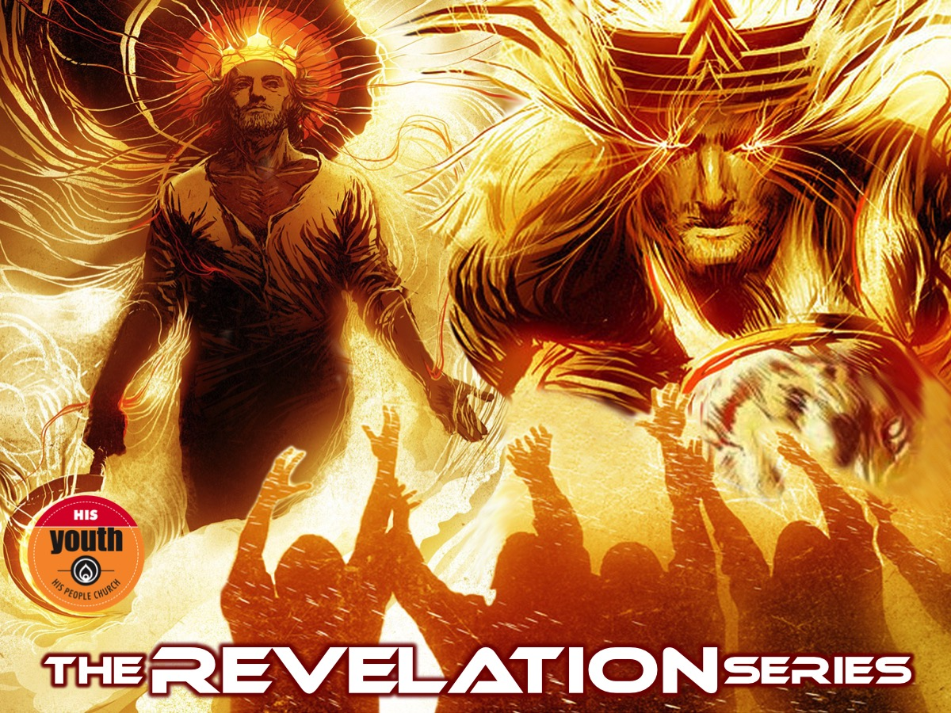
Notes:
Welcome to the Revelation Series.

Slide 2
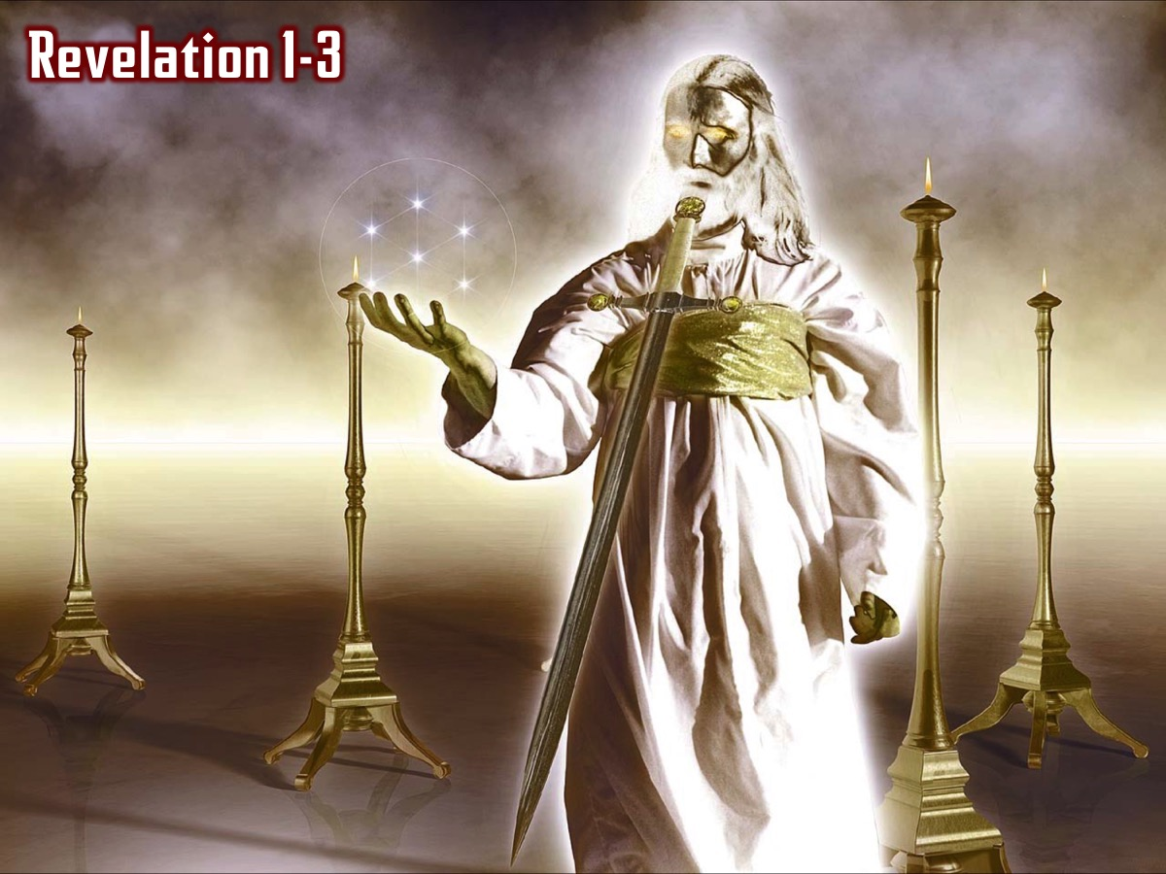
Notes:
In the first two weeks we saw an incredible revelation of Jesus and we read the seven letters that Jesus sent to seven churches in Asia Minor and reflected on what Jesus thinks about His Youth and also what our personal strengths, weaknesses, opportunities and threats are.

Slide 3
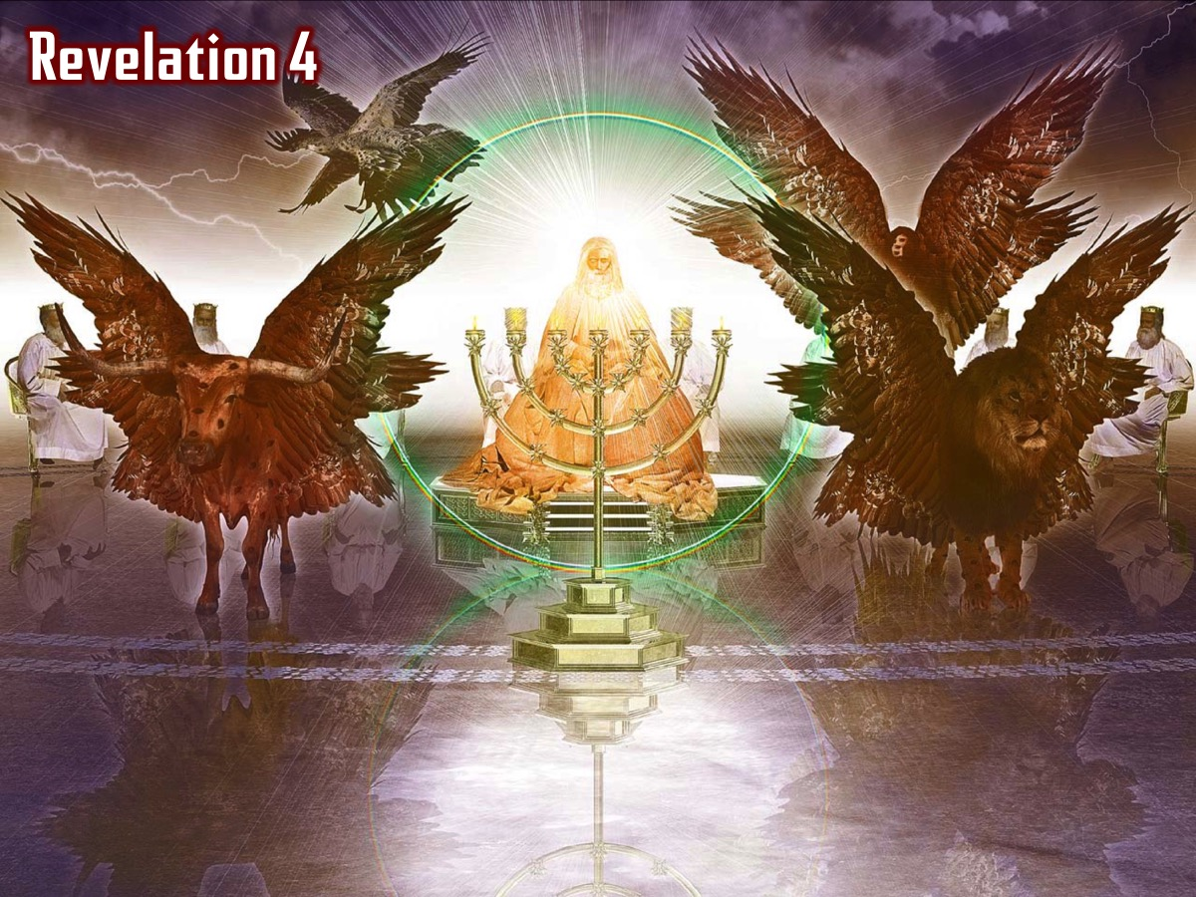
Notes:
In chapter 4 we saw how the 4 living creatures and the 24 elders and all the angels praised God for his amazing creation…

Slide 4
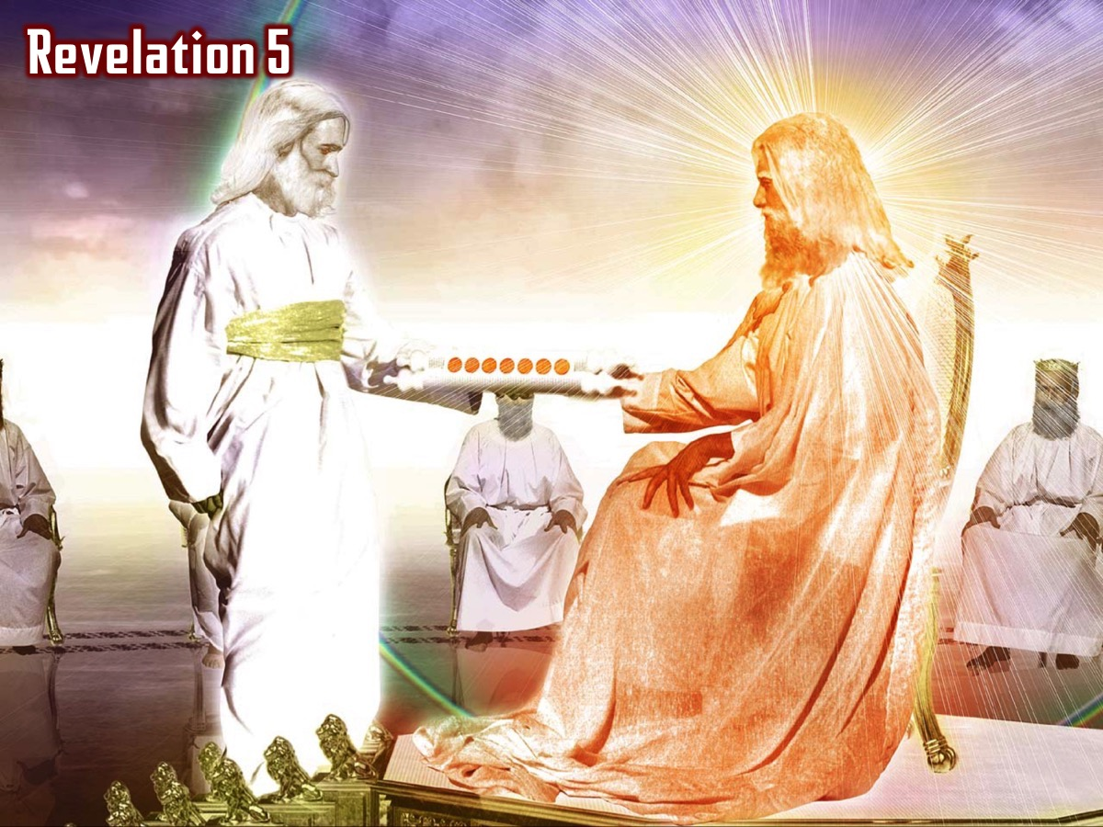
Notes:
In chapter 5 we saw that only Jesus was found to be worthy to take the scroll from his father and open it each of the seven seals (Revelation 5:8-14):

Slide 5
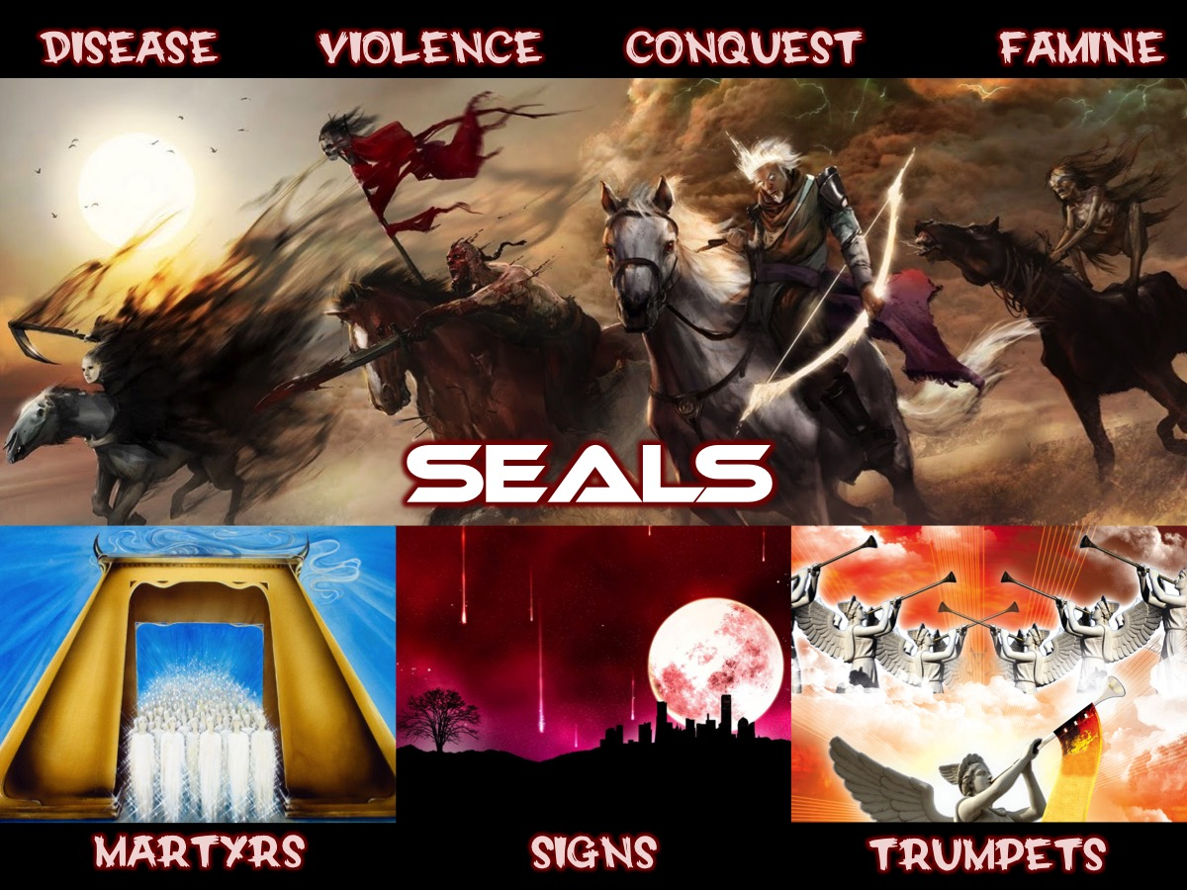
Notes:
Two weeks ago we looked at the 7 seals in Act II.

Slide 6
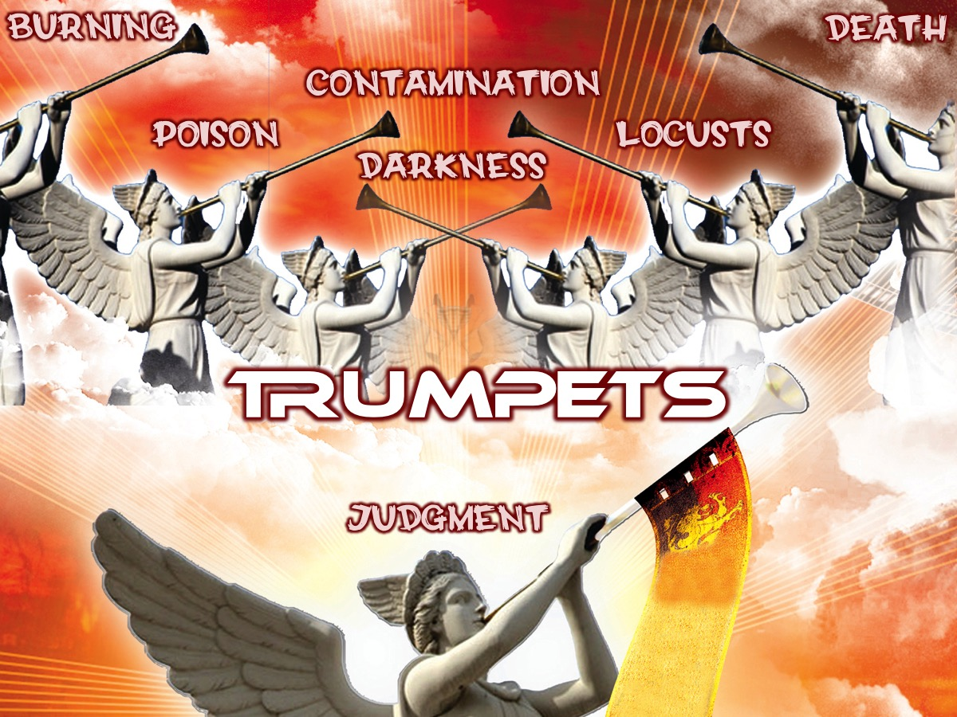
Notes:
Last week we looked at the seven trumpets that unleashed terror on the earth.

Slide 7
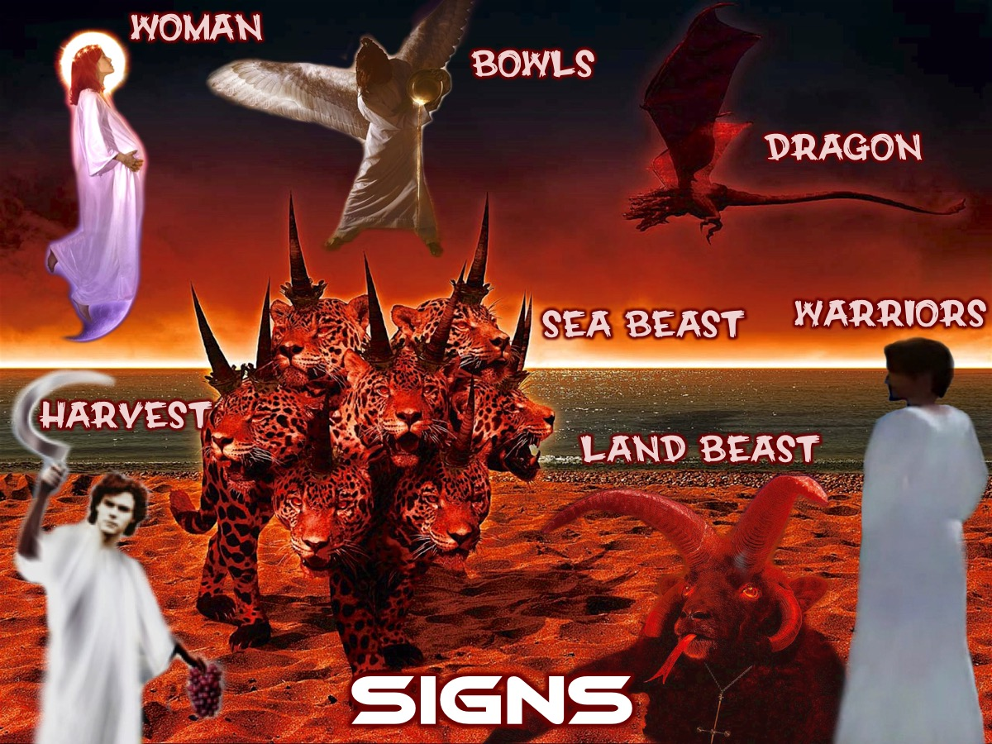
Notes:
Last week we looked at Act IV of the book of Revelation that deals with 7 Signs (Revelation 11:19-15:4).

Slide 8
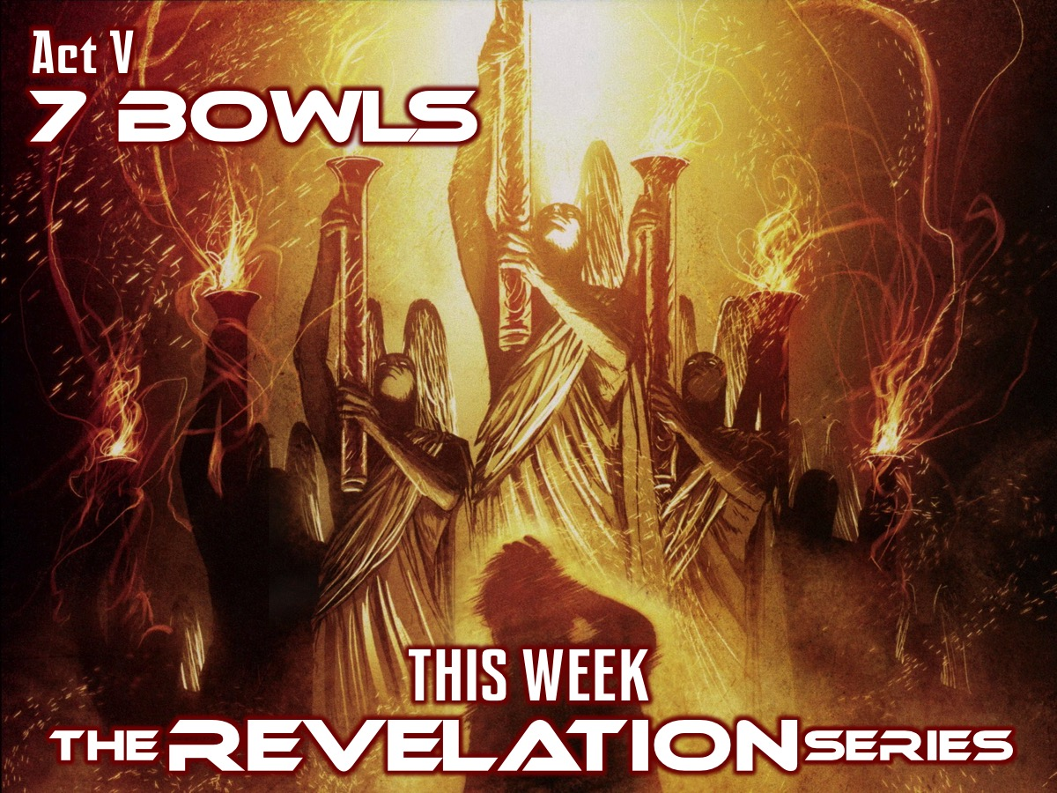
Notes:
This week we will be taking a look at the 7 Bowls of Wrath that are poured out on the world in Revelation chapter 16.

Slide 9
Notes:
Video: Wrath of the Titans Kronos Trailer. Get it on YouTube at: https://www.youtube.com/watch?v=wIxWFL9tWKg

Slide 10
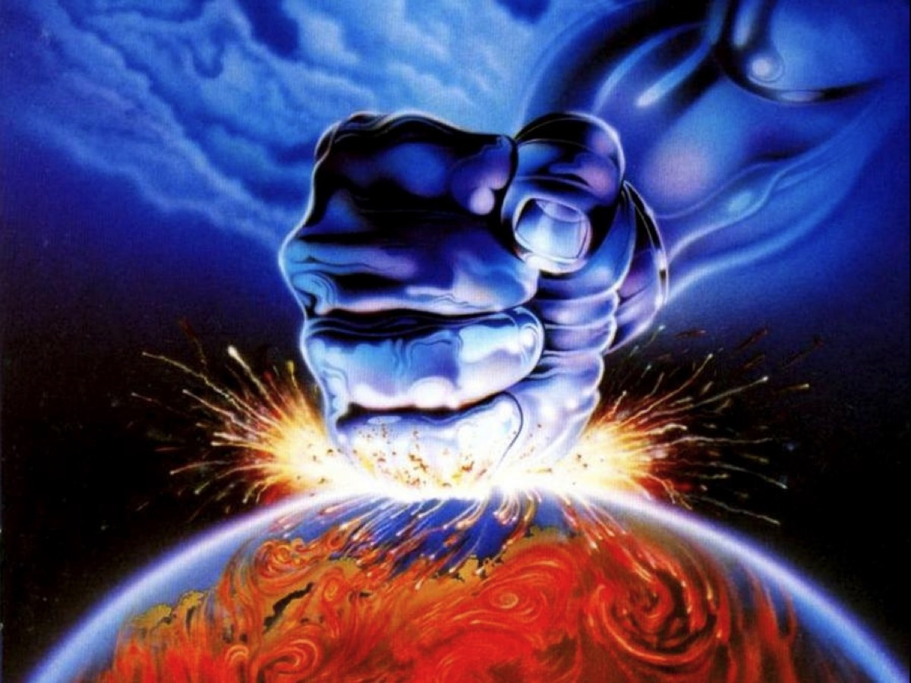
Notes:
Illustration: Struggling with God’s wrath. We would all much rather live in a world without wrath. We would all rather imagine a God without wrath.

Slide 11
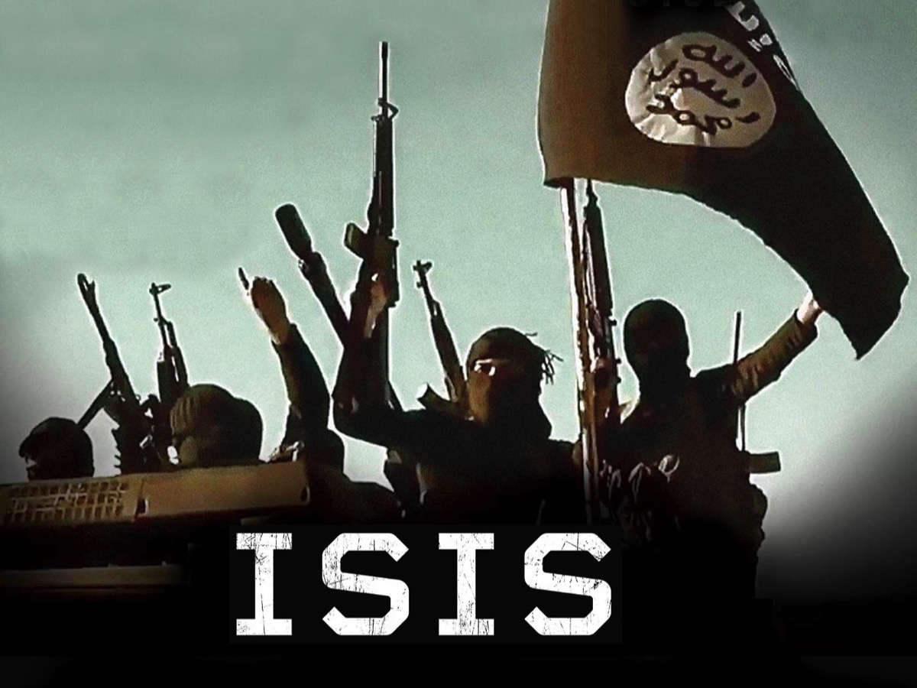
Notes:
When militant groups, like ISIS, kill innocent people - we cry out for justice!

Slide 12
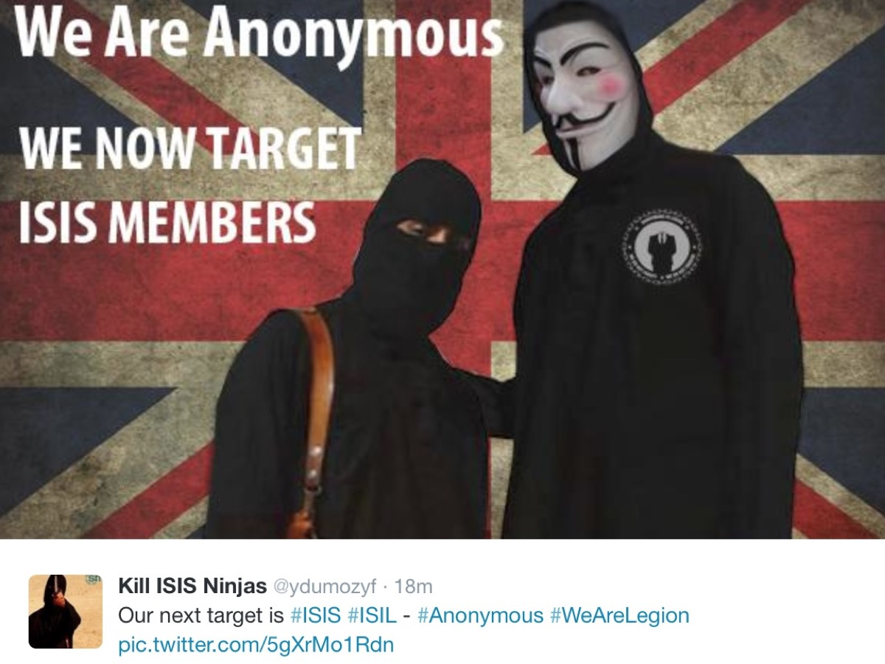
Notes:
A group of hackers calling themselves Anonymous have taken the law into their own hands and they are acting against ISIS.

Slide 13
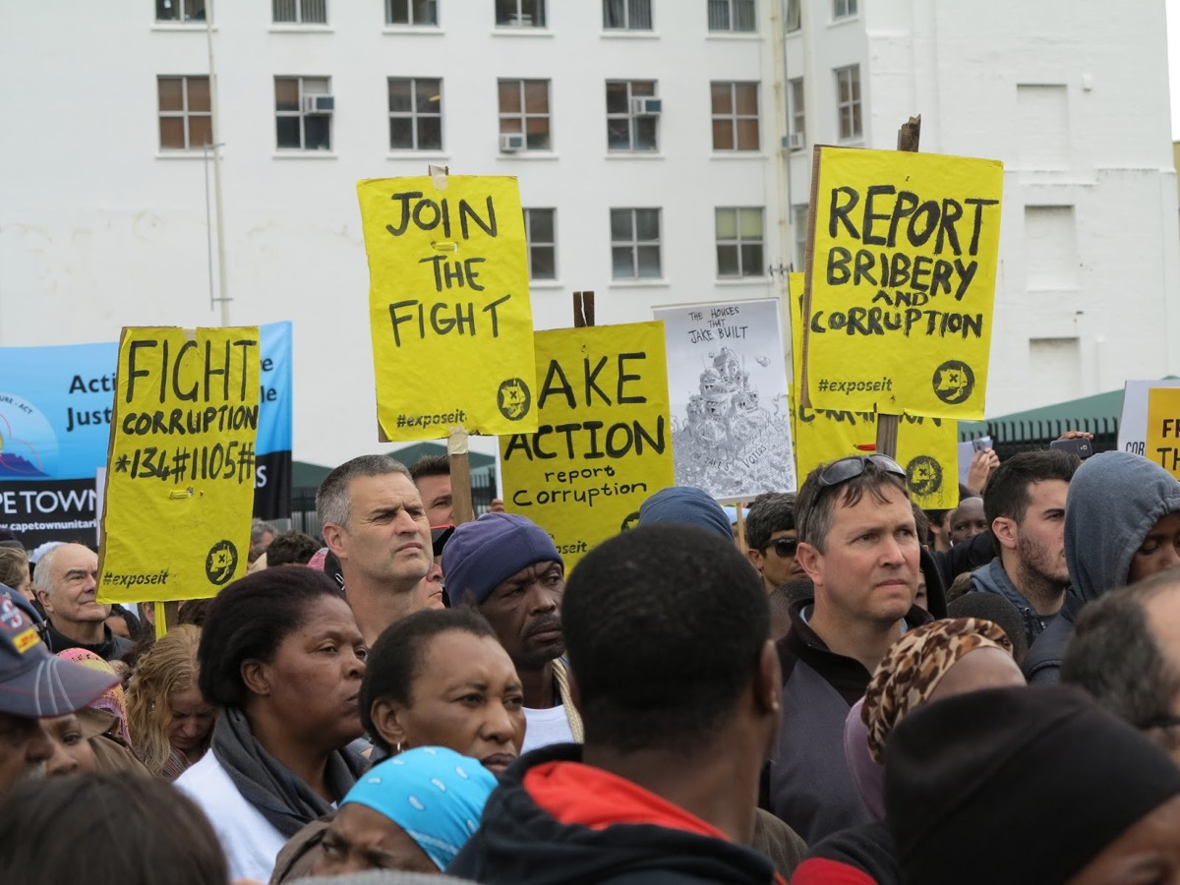
Notes:
When politicians are corrupt we cry out for justice!

Slide 14

Notes:
When people are bullied at school we cry out for justice!

Slide 15
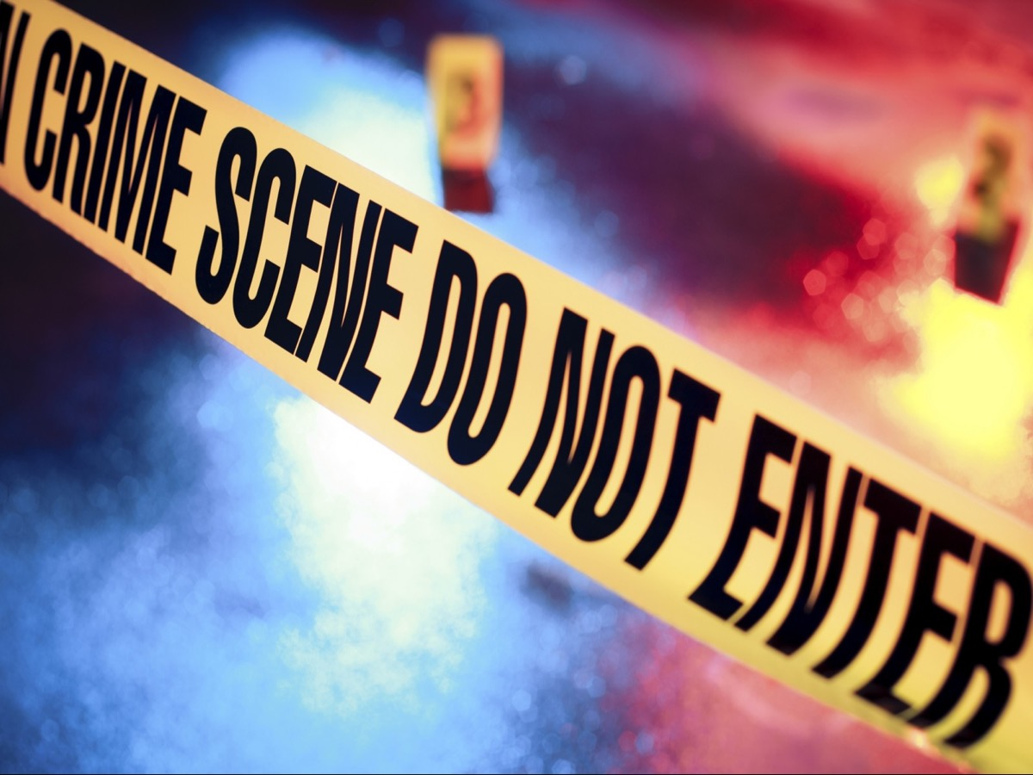
Notes:
When someone is murdered we cry out for justice!

Slide 16
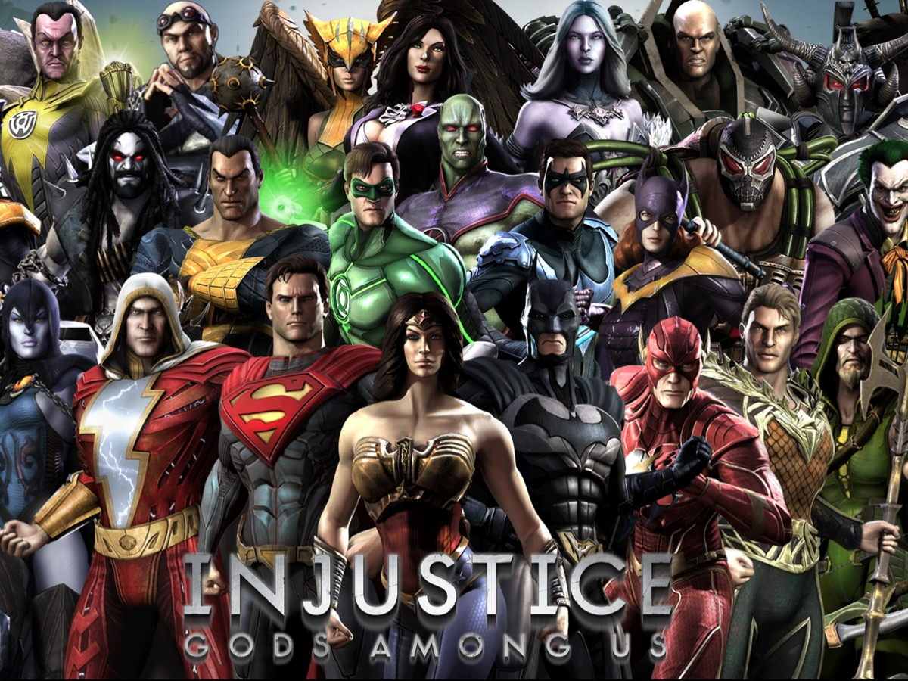
Notes:
Wherever there is injustice we cry out for gods among us to change the situation.

Slide 17
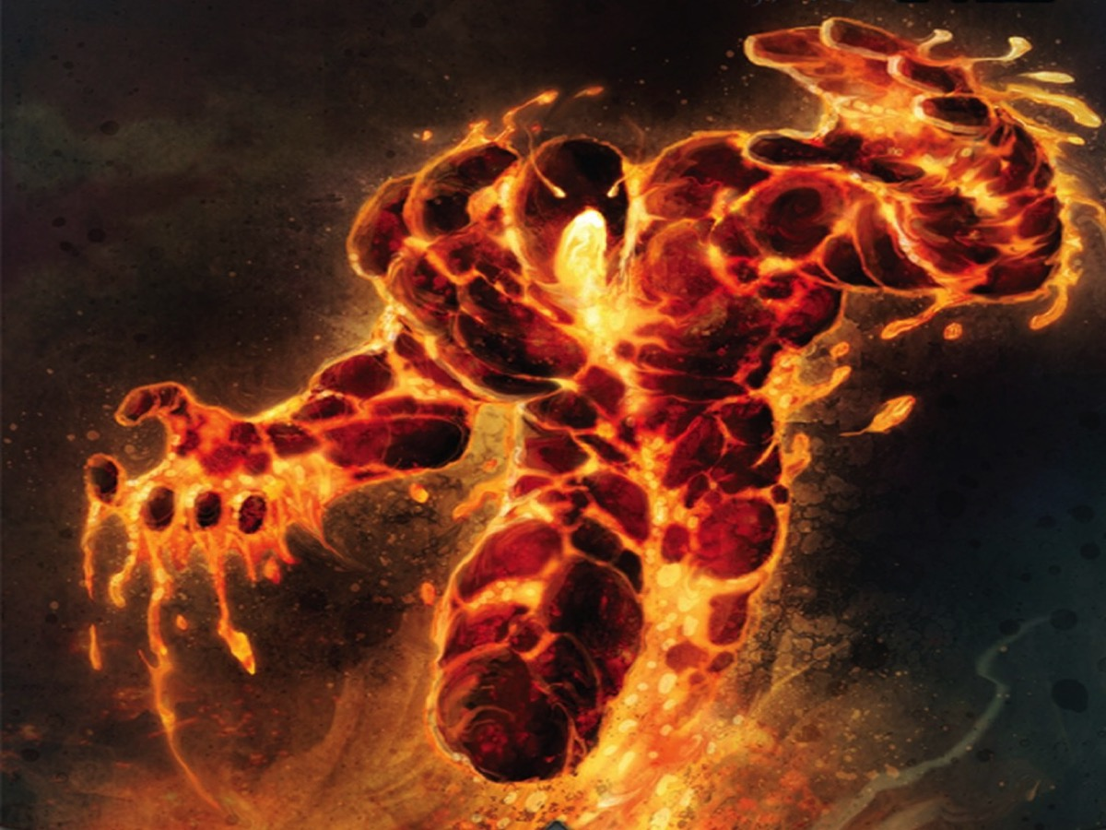
Notes:
If I was God, this is what I would look like considering all that people have done to the world…

Slide 18
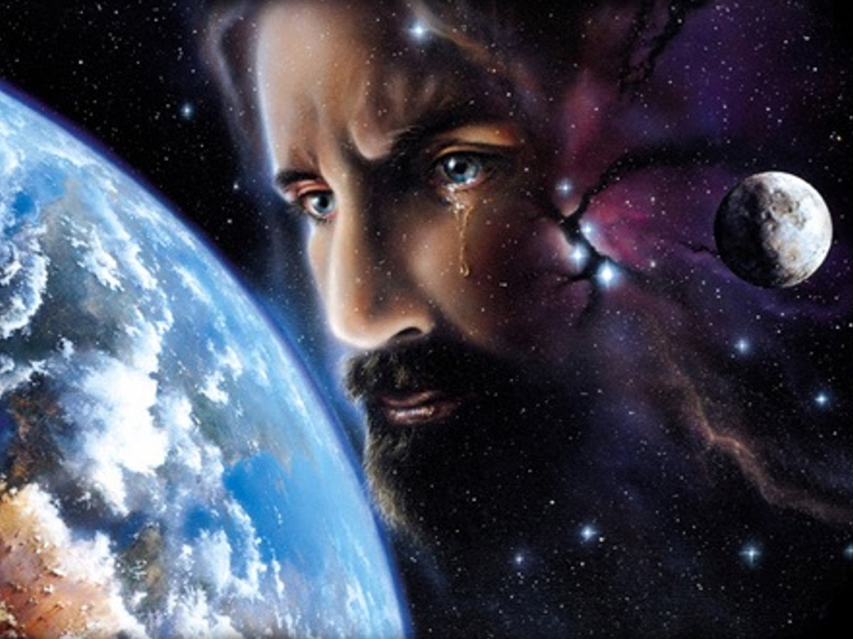
Notes:
But I am not God, and is is more like it - God weeps over his messed up creation and waits until the last hour to react - and even then there is always a chance for mercy in the midst of judgment.

Slide 19
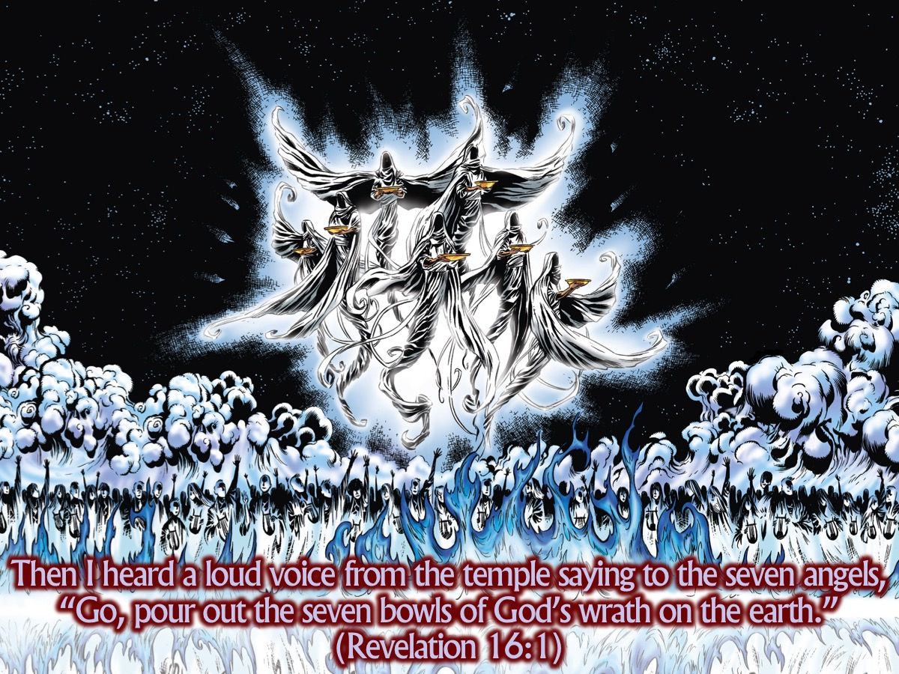
Notes:
This brings us to our passage today - Revelation The seventh sign is seen by John as seven angels appear each carrying seven bowls of wrath which they are going to pour out on the world.
The wrath of God consists of two things: (1) God allows human wickedness to work itself out, to reap its own destruction. (2) He steps in more directly to stop it, to call time on it when it gets out of hand. What we see in the first four of the plagues is a mixture of both kinds of wrath.

Slide 20
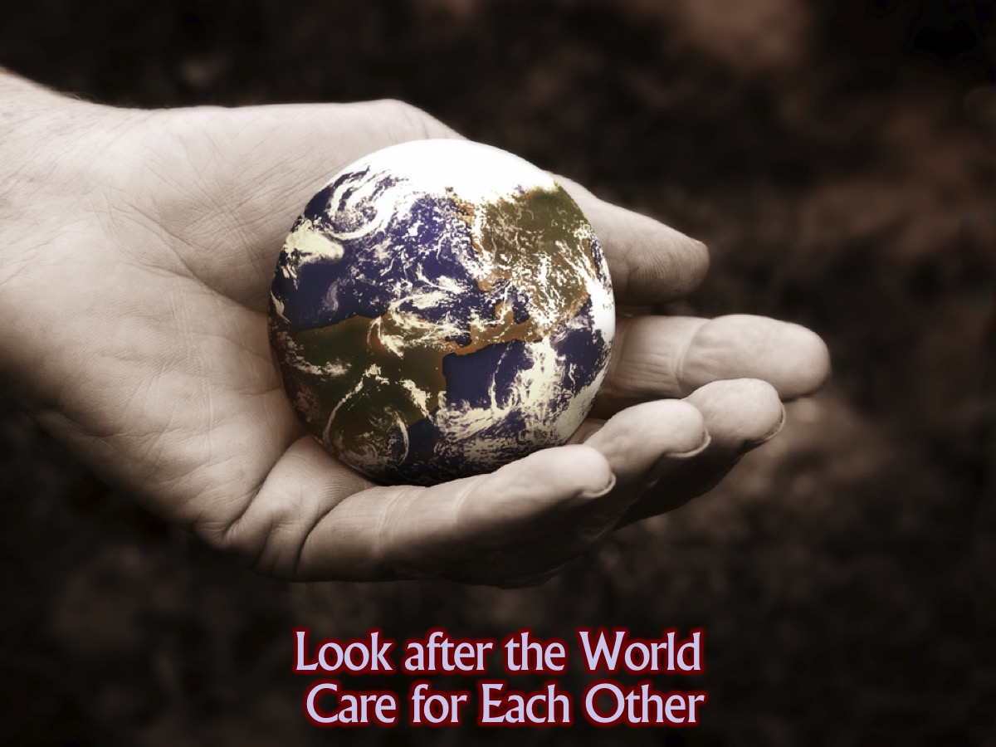
Notes:
From the beginning we were supposed to look after the world and care for each other...

Slide 21
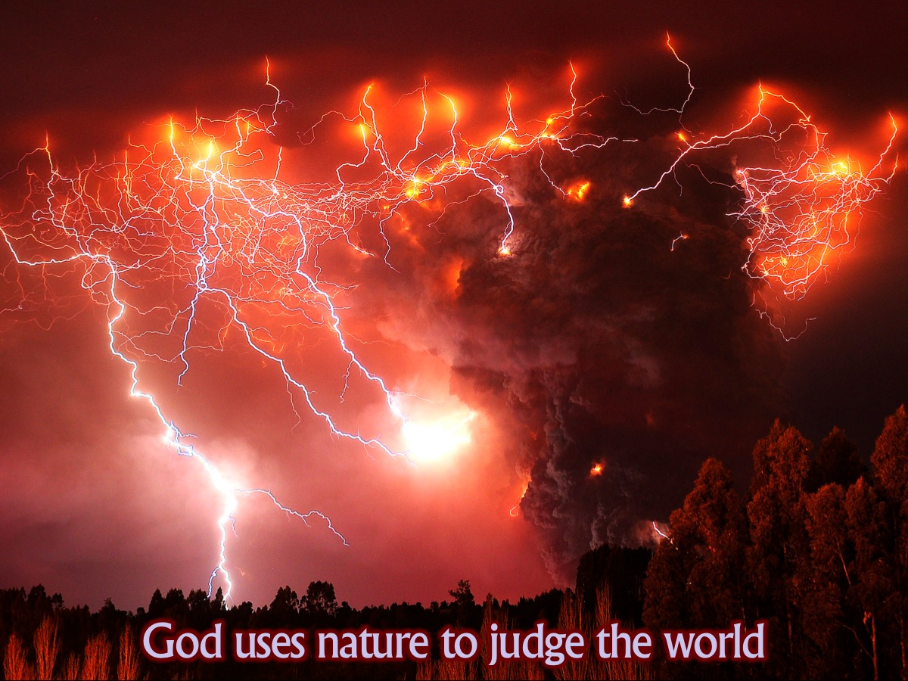
Notes:
God allows natural elements themselves (earth, sea, rivers and sun) to pass judgment on human beings who have so grievously abused their position as God’s image-bearers within creation. Because humans did not care for the world and for each other, God will call the natural elements to turn on them and judge them for their wickedness.

Slide 22
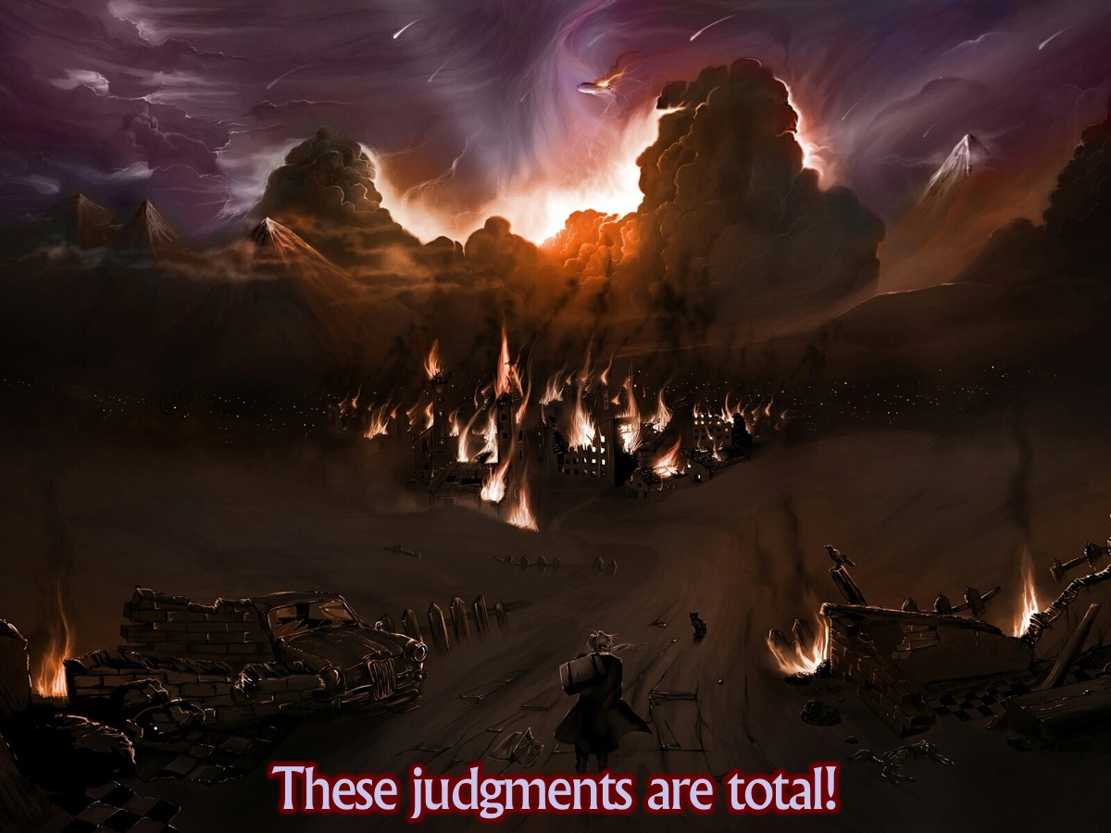
Notes:
These judgments are total. With the seals and the trumpets only a part of the world was harmed or destroyed (remember it is all symbolic) which gave people time to repent. Here that is absent – this time everything in the sea dies and all the rivers turn to blood. There is no more space for repentance. These plagues are the beginning of a long process that will end in chapter 20, by which God will rid his beautiful world of (1) those who have assisted in its destruction and decay, and then of (2) the great imperial systems that have set up massive structures of injustice, and finally of (3) the dark powers that live behind those systems themselves ending with Death and Hades themselves.

Slide 23
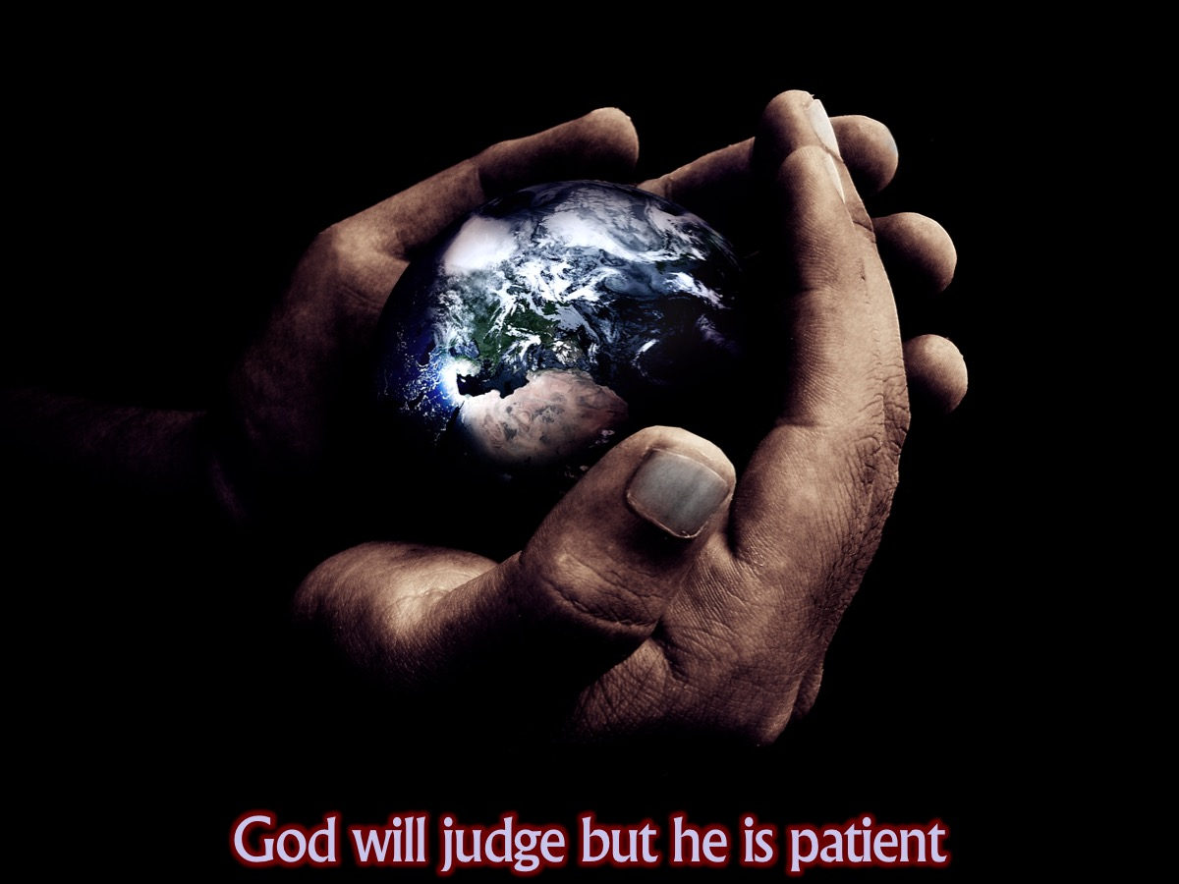
Notes:
All of this shows that God is not a capricious or careless, laissez-faire world ruler. God made the world and his generous love is most clearly seen in the sacrifice of his only son, the lamb, the one who shares the throne. If this God does not hate the communist, facist or apartheid systems that caused so much harm then he is not a good or loving God! Because he is loving he does not step in to deal with things before the time is right. He is still hoping that many will repent and be rescued. But at the right time he will step in and bring closure to the world’s wrongs! This is what happens when the angels pour out the bowls of his wrath on the earth, the sea, the rivers and the sun!

Slide 24
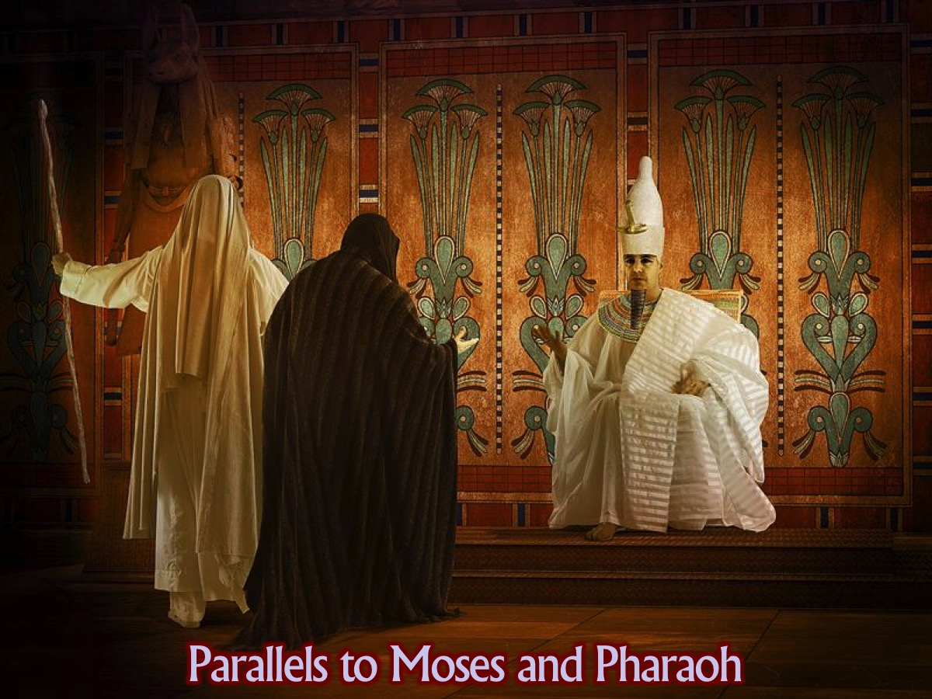
Notes:
We will see once again that there are many parallels with what happened in the show down between Moses and Pharaoh in Egypt - where God sent 10 plagues to get Pharaoh to repent and give God’s people their freedom.

Slide 25
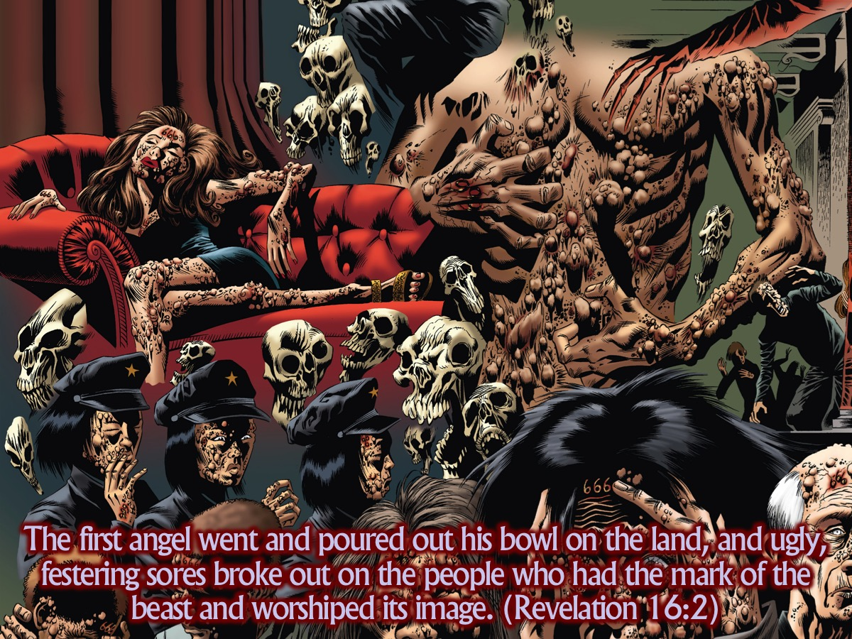
Notes:
“The first angel went and poured out his bowl on the land, and ugly, festering sores broke out on the people who had the mark of the beast and worshiped its image.” (Revelation 16:2)

Slide 26
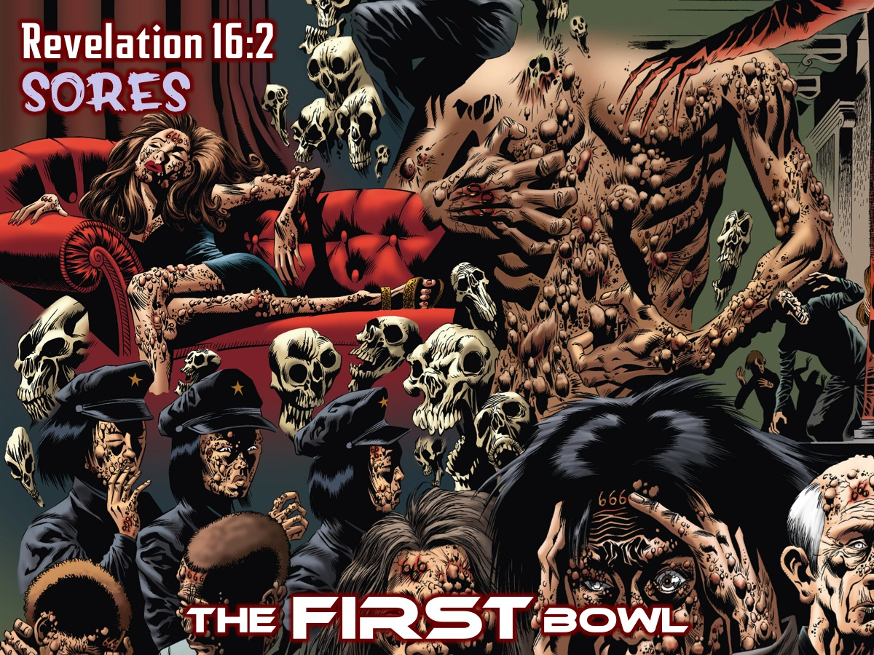
Notes:
The FIRST Bowl (Revelation 16:2).

Slide 27
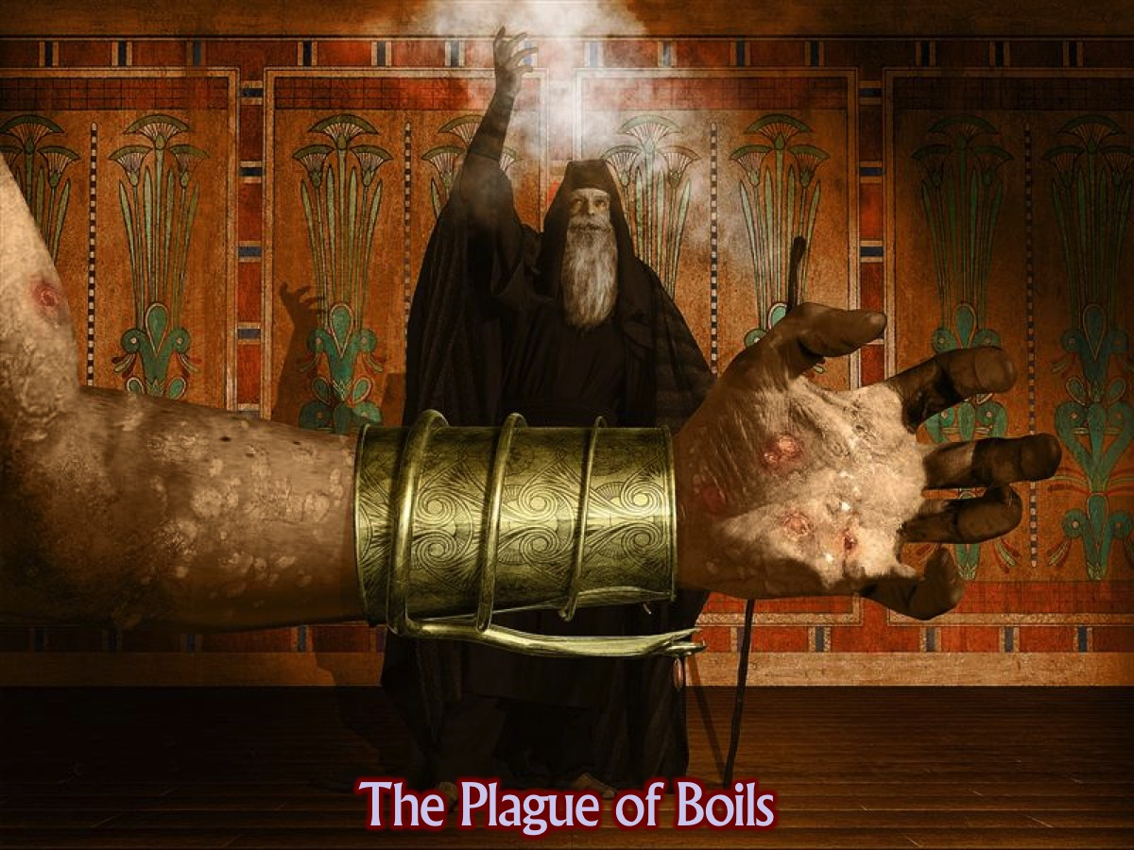
Notes:
Similar to the boils upon the Egyptians during the great exodus, God will again send sores. The plague of sores on the Egyptians was the first plague to actually threaten the life of the Egyptians. However, there is no indication that life is threatened by the sores. The purpose of the sores seems to be unparalleled suffering. On the people who had the mark of the beast and who worshiped his image = clearly indicates who is the target of the first bowl judgment. The beast-marked worshipers are the target of the first bowl judgment. The Greek says literally, "upon the men." Clearly, "men" is used in a generic sense. For women and children are not excluded from the punishment of God for taking the mark.

Slide 28
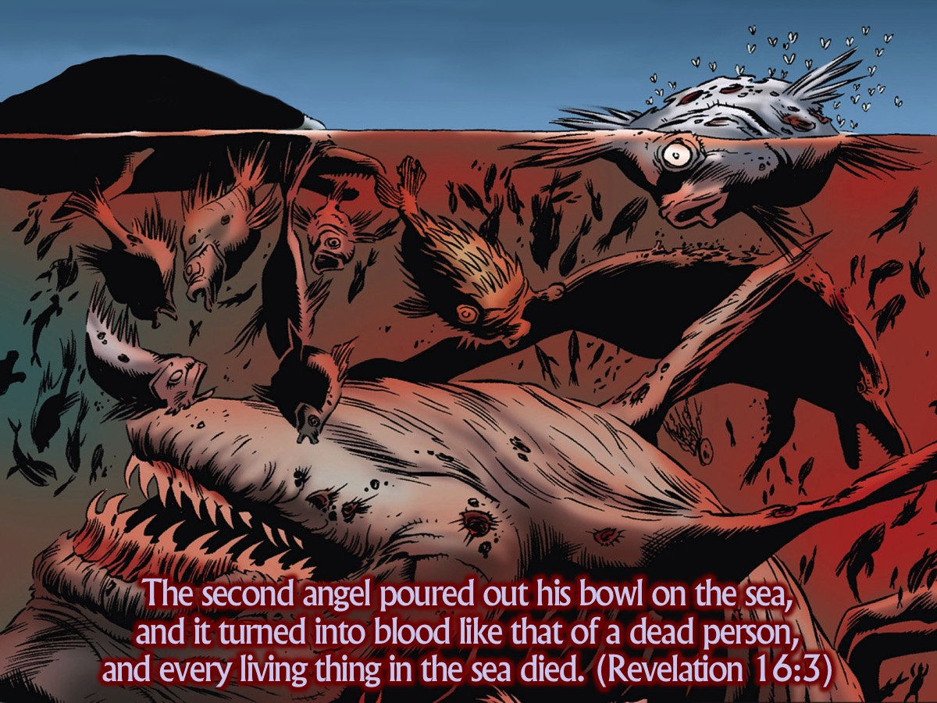
Notes:
The second angel poured out his bowl on the sea, and it turned into blood like that of a dead person, and every living thing in the sea died. (Revelation 16:3)

Slide 29
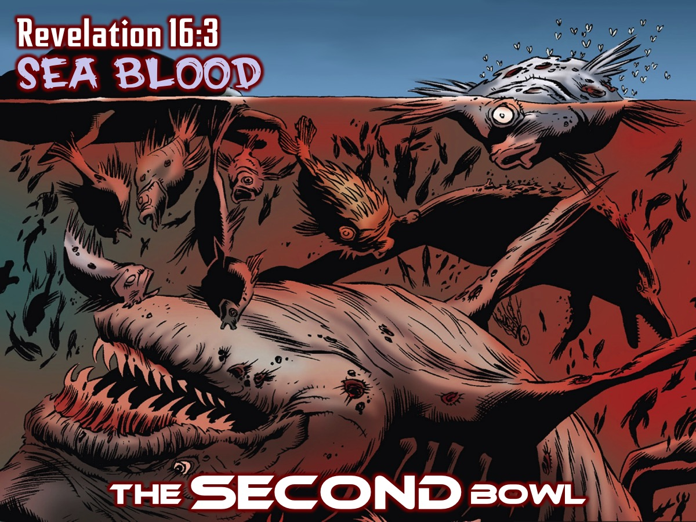
Notes:
The SECOND Bowl (Revelation 16:3) The whole of salt-water sources is the object of the second bowl. It became blood means that it is no longer capable of supporting life. Every living thing in the sea died.

Slide 30
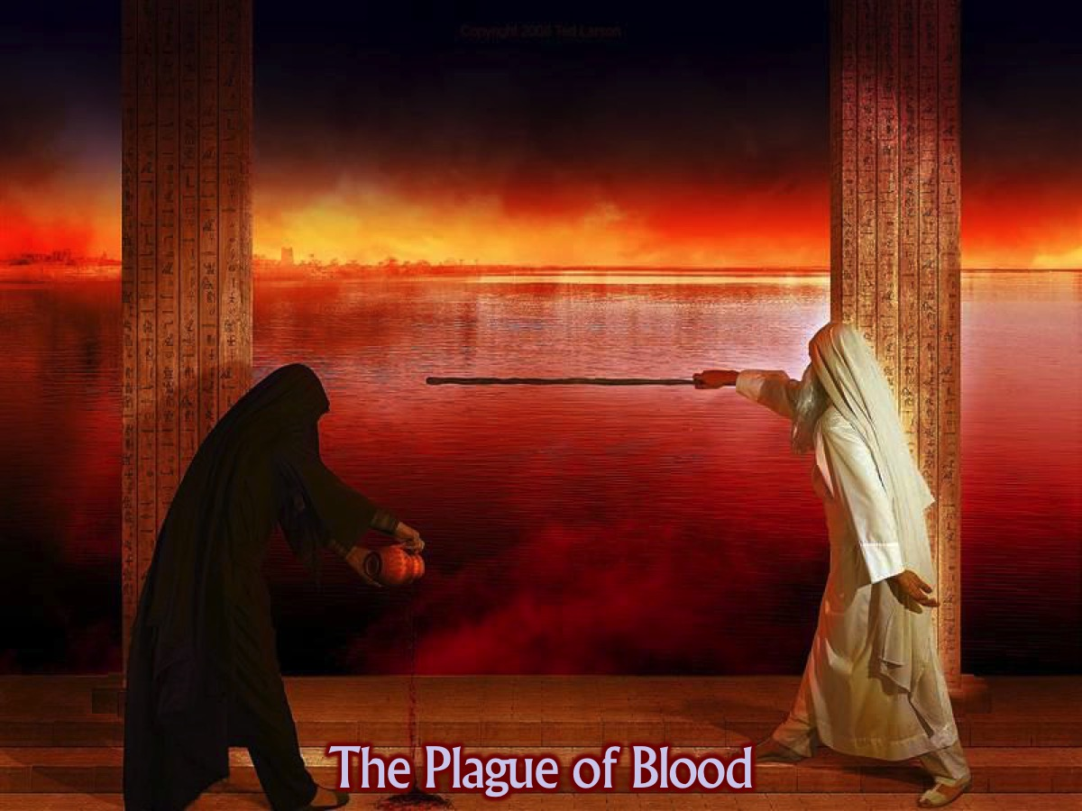
Notes:
This judgment reminds us of the first plague in Egypt where the river Nile was turned to blood - but this time it is the whole of the sea and not just a river!

Slide 31
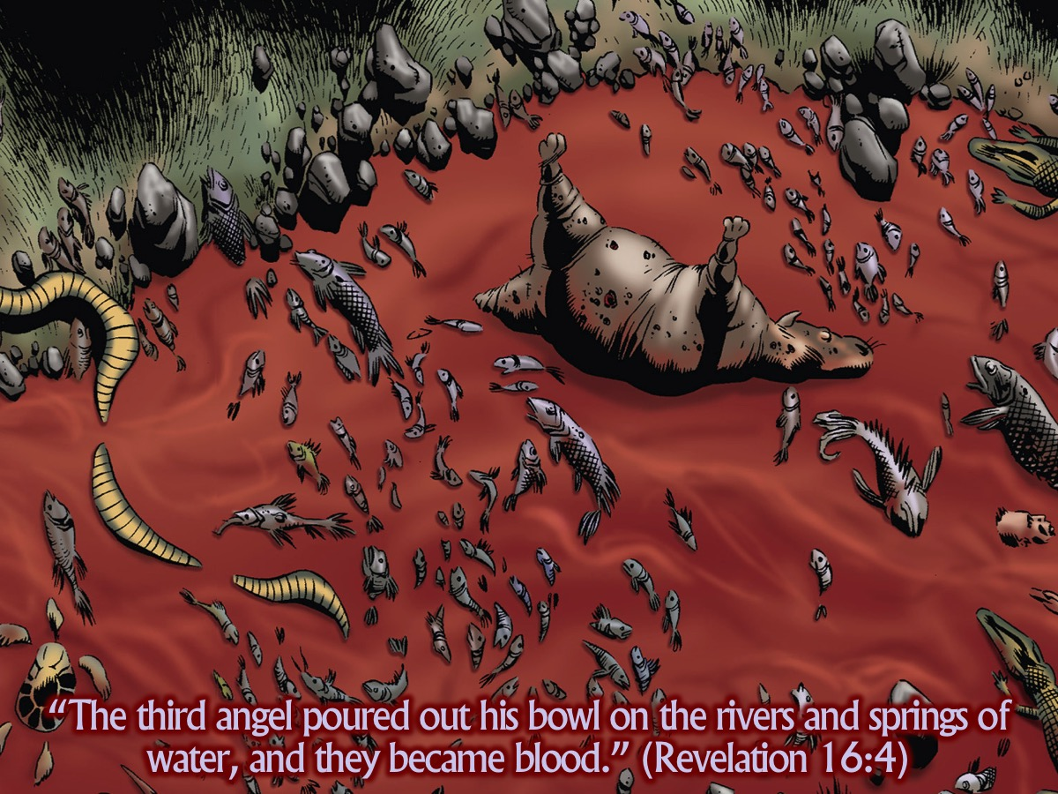
Notes:
The third angel poured out his bowl on the rivers and springs of water, and they became blood. (Revelation 16:4)

Slide 32
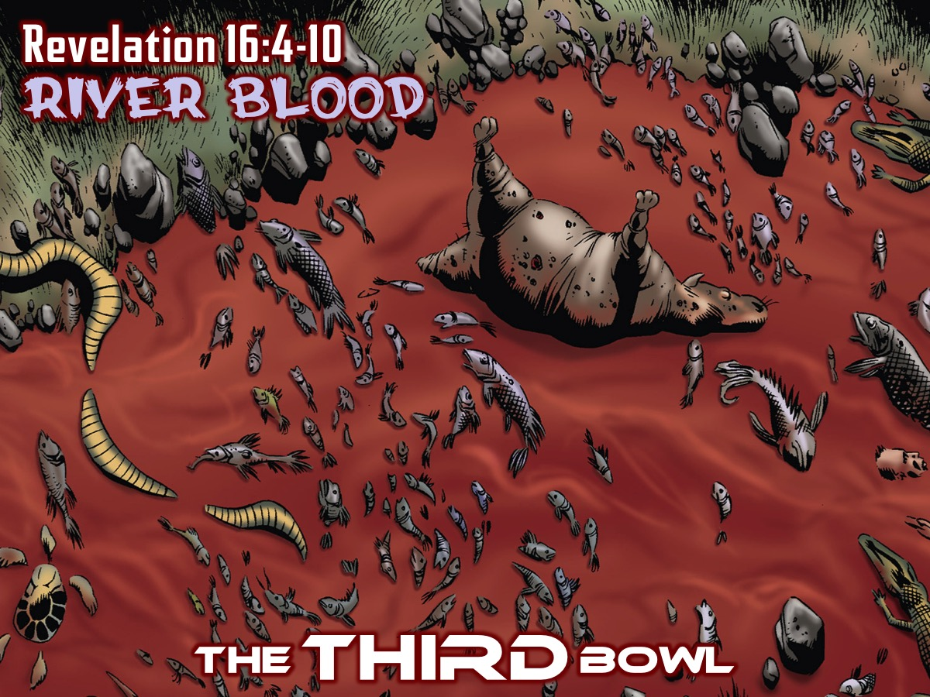
Notes:
The THIRD Bowl (Revelation 16:4-10).

Slide 33
Notes:
Again this is just like in the first plague in Egypt where fresh water turns to blood.

Slide 34
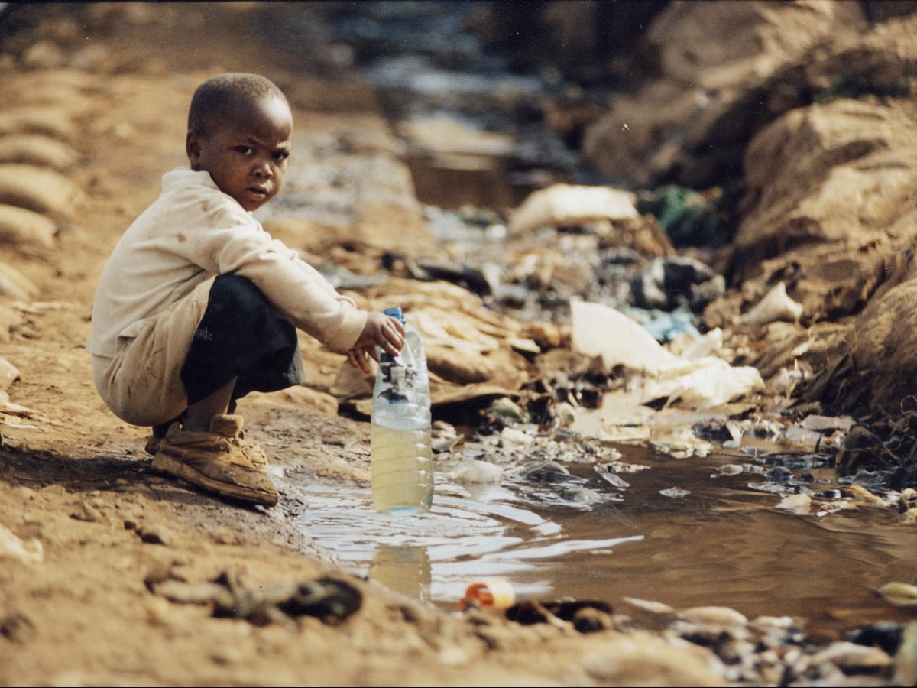
Notes:
We are facing some water shortages in our country - just imagine what we would do if all the fresh water turned to blood!

Slide 35
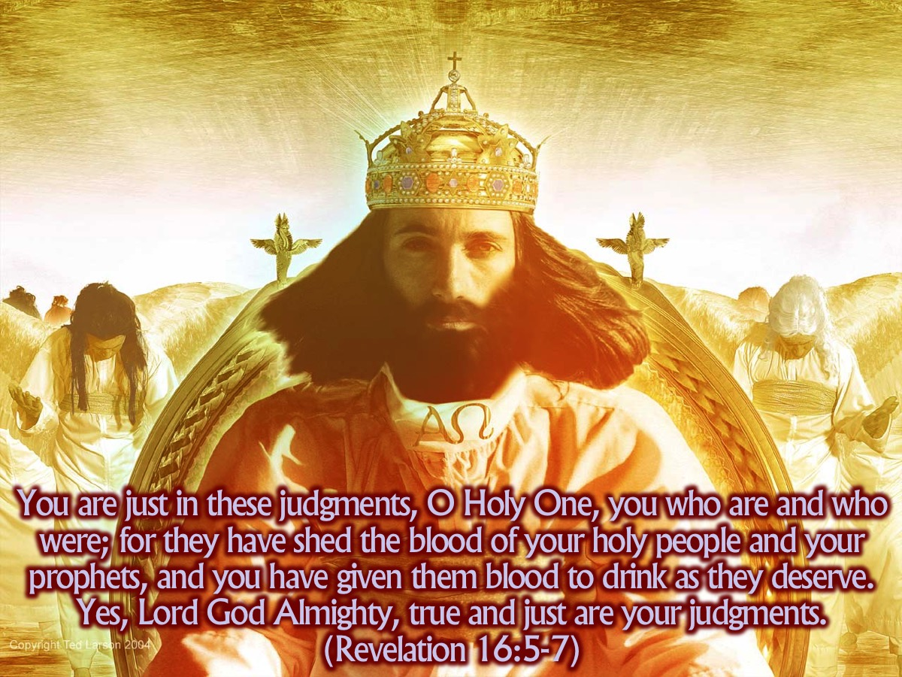
Notes:
You are just in these judgments, O Holy One, you who are and who were; for they have shed the blood of your holy people and your prophets, and you have given them blood to drink as they deserve. “Yes, Lord God Almighty, true and just are your judgments. (Revelation 16:5-7)
An angel steps forward to remind us that despite the judgments raining down on earth, God’s actions are righteous, just and holy. Actually if God had not judged these things, He would be in contradiction of His own nature. It is because the people have shed the blood of God’s people and the prophets that this judgment has come upon them.

Slide 36
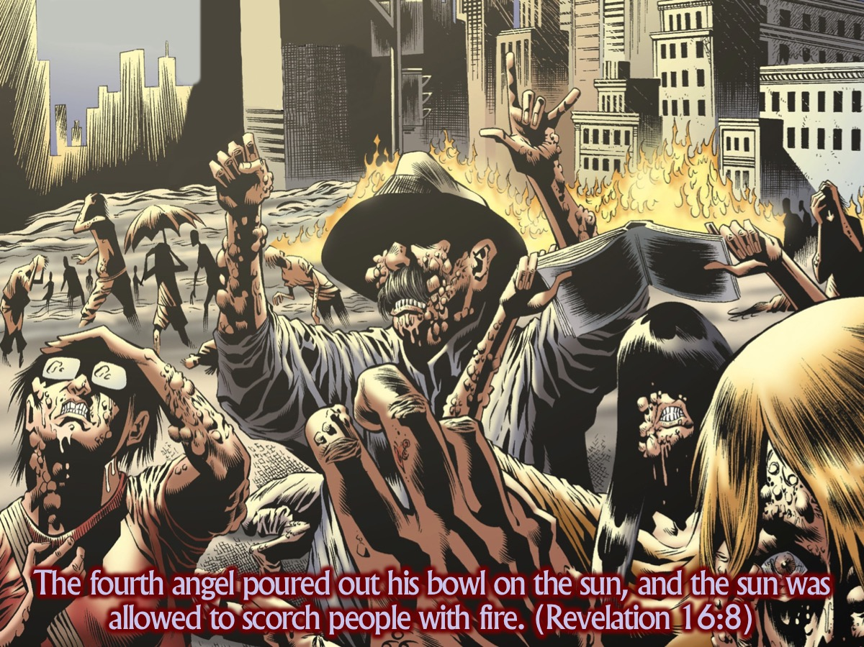
Notes:
The fourth angel poured out his bowl on the sun, and the sun was allowed to scorch people with fire. (Revelation 16:8)

Slide 37
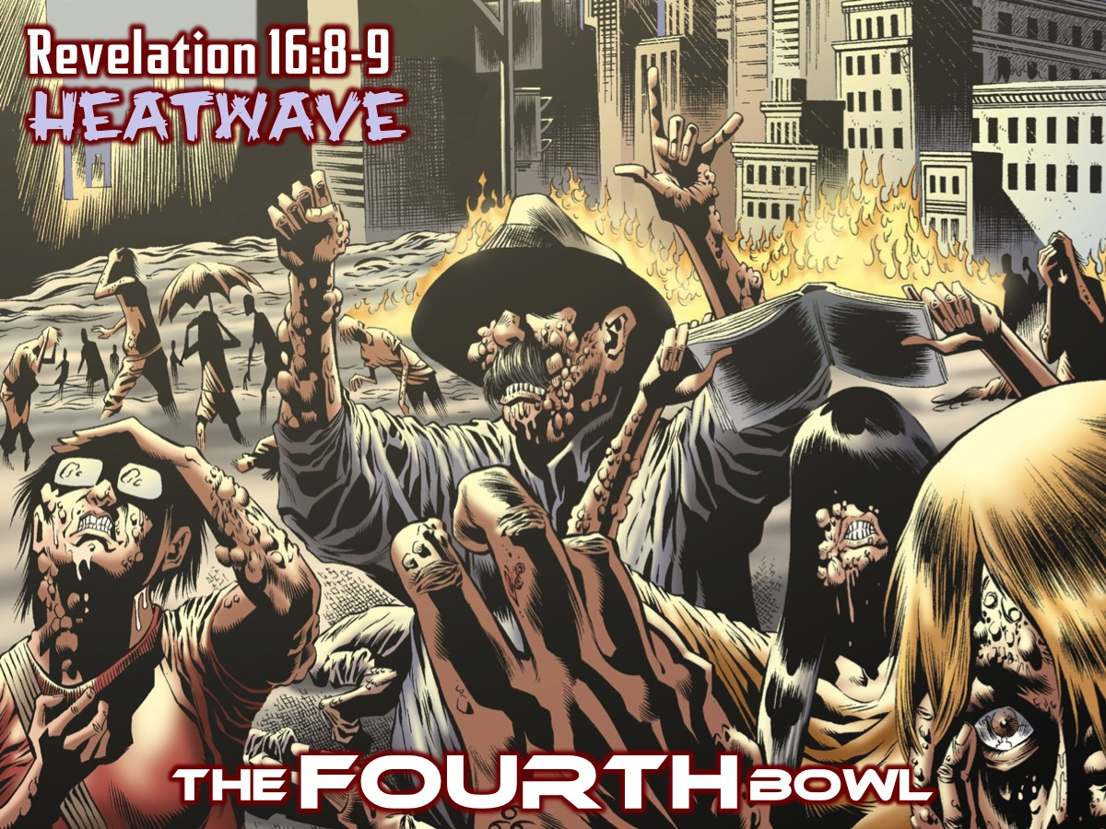
Notes:
The FOURTH Bowl (Revelation 16:8-9)

Slide 38
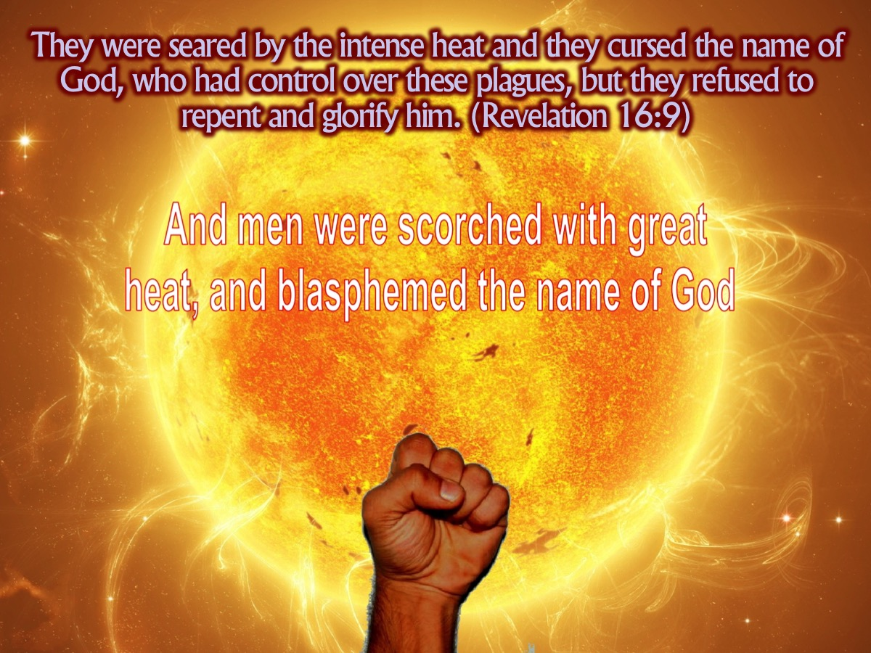
Notes:
They were seared by the intense heat and they cursed the name of God, who had control over these plagues, but they refused to repent and glorify him. (Revelation 16:9). Just like with Pharaoh - people refuse to repent and instead curse God!

Slide 39
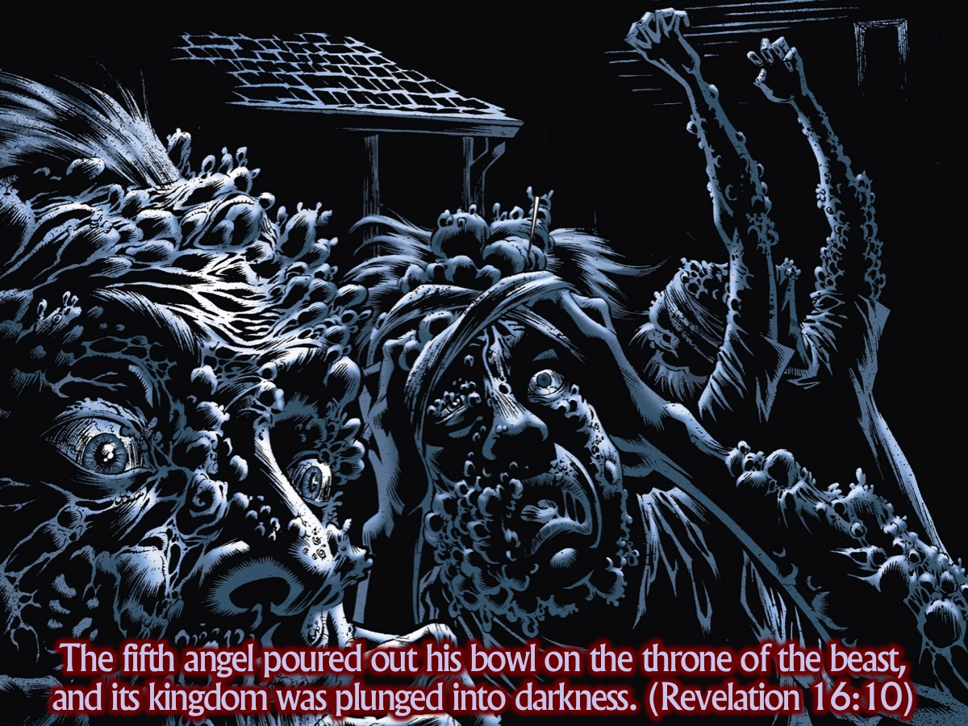
Notes:
The fifth angel poured out his bowl on the throne of the beast, and its kingdom was plunged into darkness. (Revelation 16:10)

Slide 40
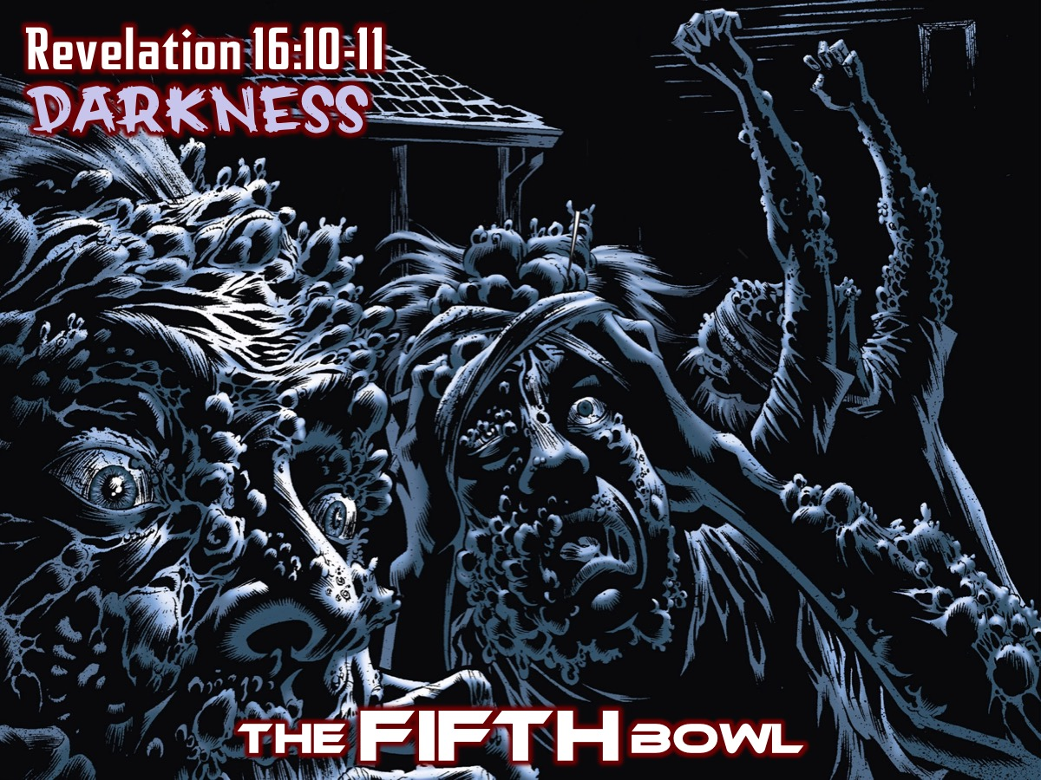
Notes:
The FIFTH Bowl (Revelation 16:10-11)

Slide 41
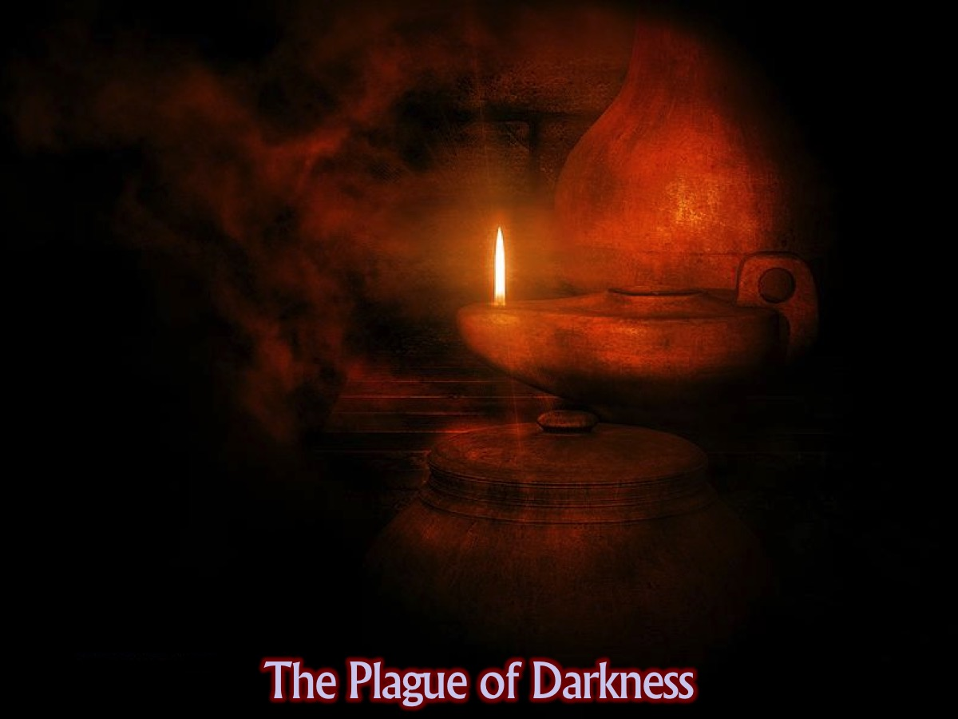
Notes:
This reminds us of the 9th plague on Egypt where darkness covered the city.

Slide 42
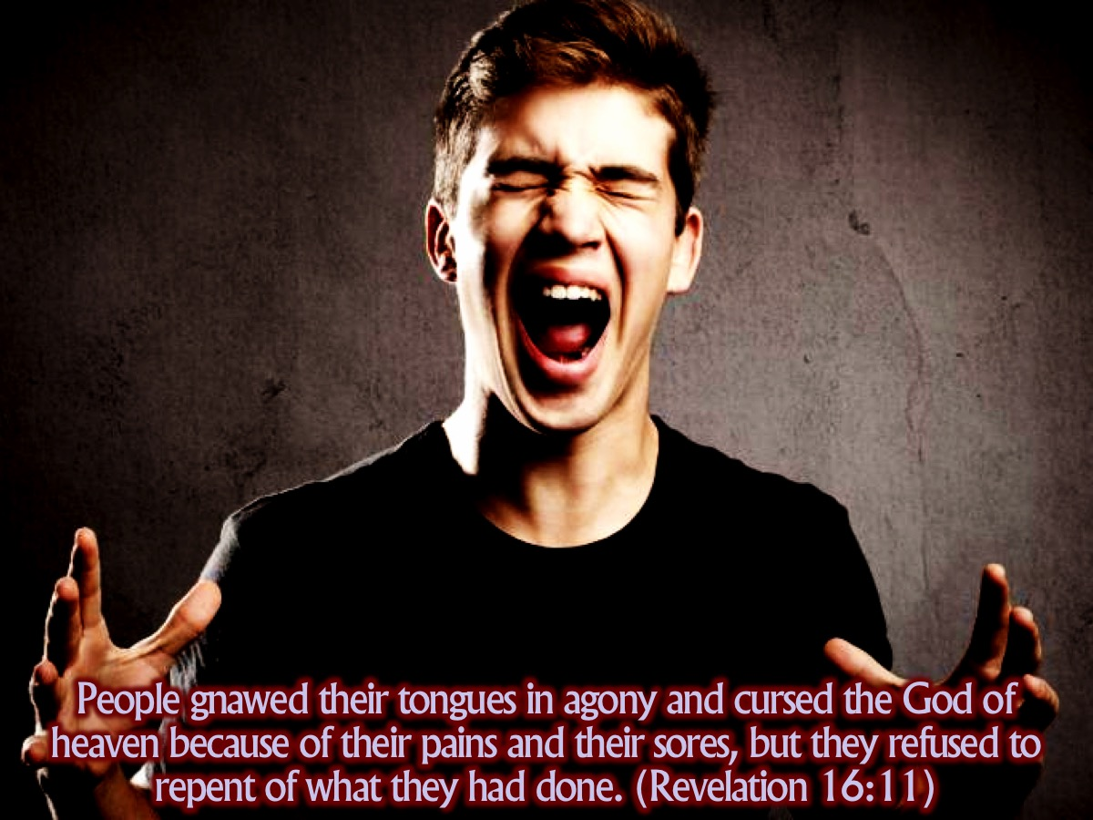
Notes:
People gnawed their tongues in agony and cursed the God of heaven because of their pains and their sores, but they refused to repent of what they had done. (Revelation 16:11)

Slide 43
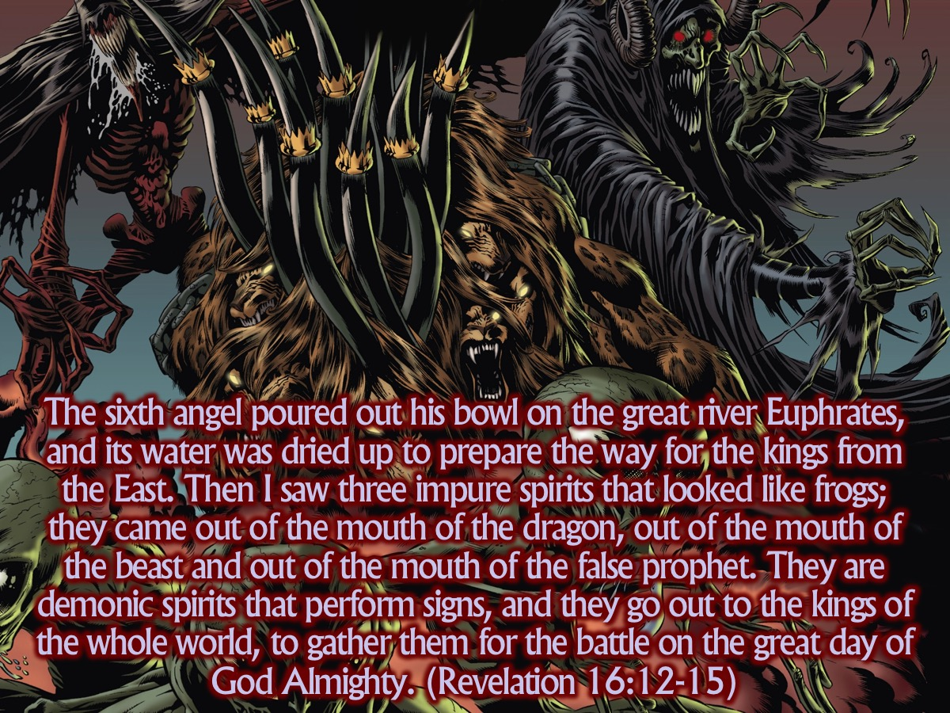
Notes:
The sixth angel poured out his bowl on the great river Euphrates, and its water was dried up to prepare the way for the kings from the East. Then I saw three impure spirits that looked like frogs; they came out of the mouth of the dragon, out of the mouth of the beast and out of the mouth of the false prophet. They are demonic spirits that perform signs, and they go out to the kings of the whole world, to gather them for the battle on the great day of God Almighty. (Revelation 16:12-15)

Slide 44
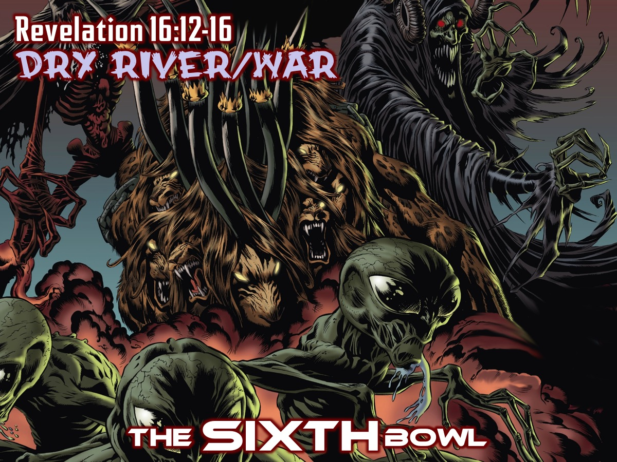
Notes:
The SIXTH Bowl (Revelation 16:12-16).

Slide 45
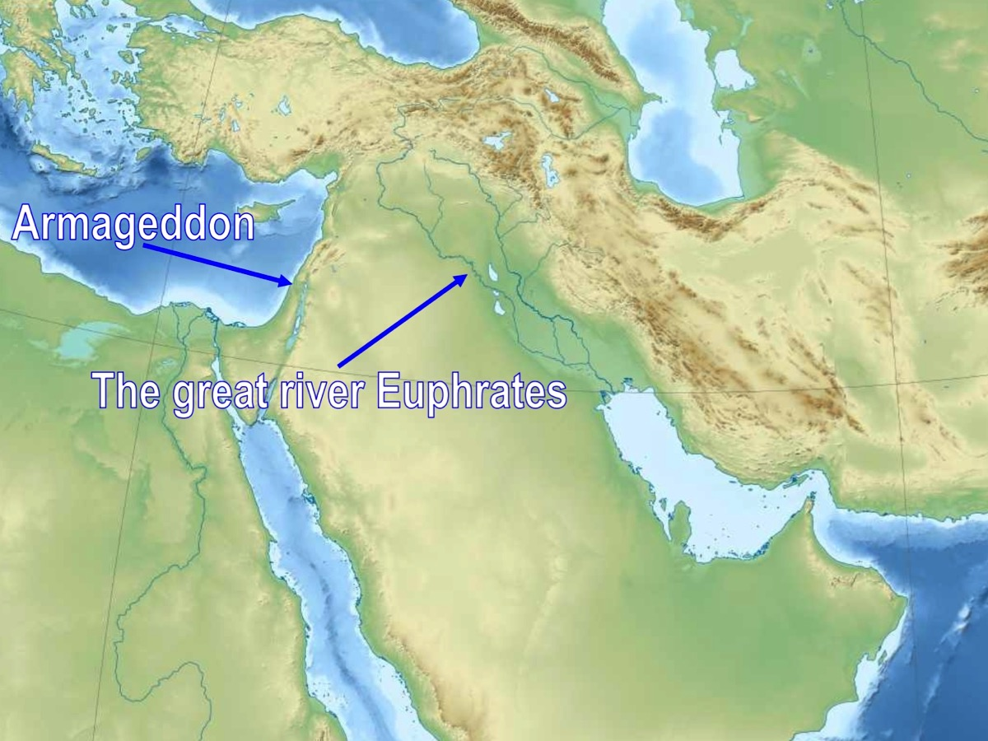
Notes:
The Euphrates River formed the boundary - like the river Rhine in Europe – a natural boundary that was easy to defend. The sixth bowl dries up the river – so as to prepare the way for a different kind of “Exodus” – instead of the childred of Israel walking through the Red Sea, the kings from the east can now charge with their armies across the river – ready to attack.

Slide 46
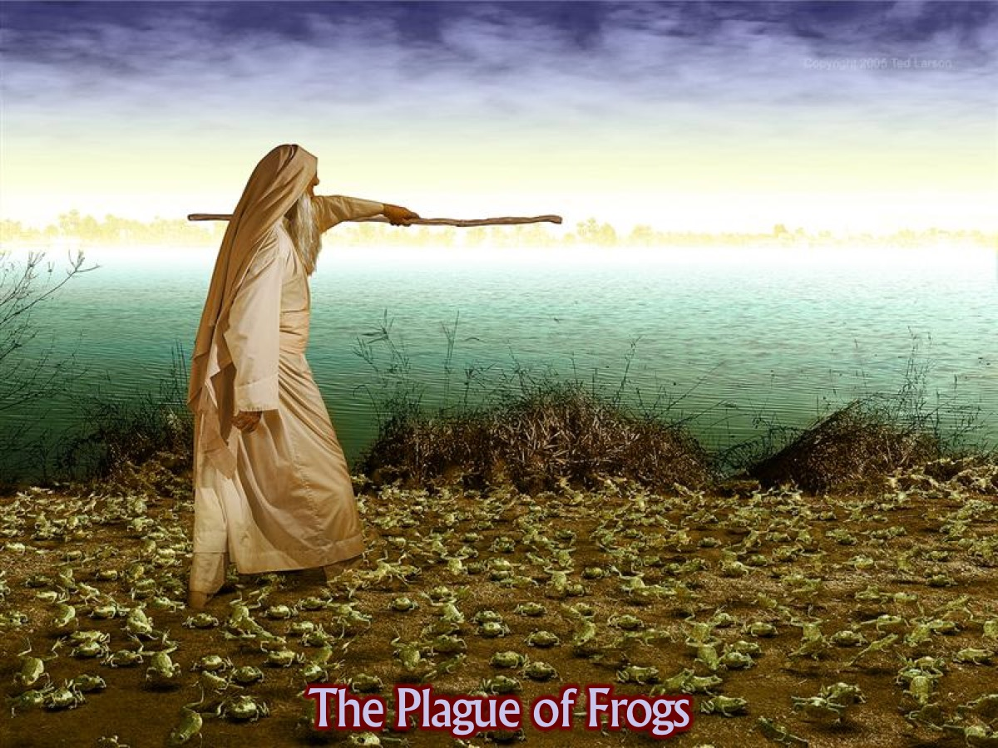
Notes:
Again there is an echo of the plagyes of Egypt as the “unclean spiritus” that come out of the mouths of the Unholy Trinity appear like frogs, able to hop to and fro with their false stories and powerful argument, persuading the great and poweful to commitments to a hopeless cause. In the build up to a war public opinion due to all the media coverage goes along with the prevailing mood.

Slide 47
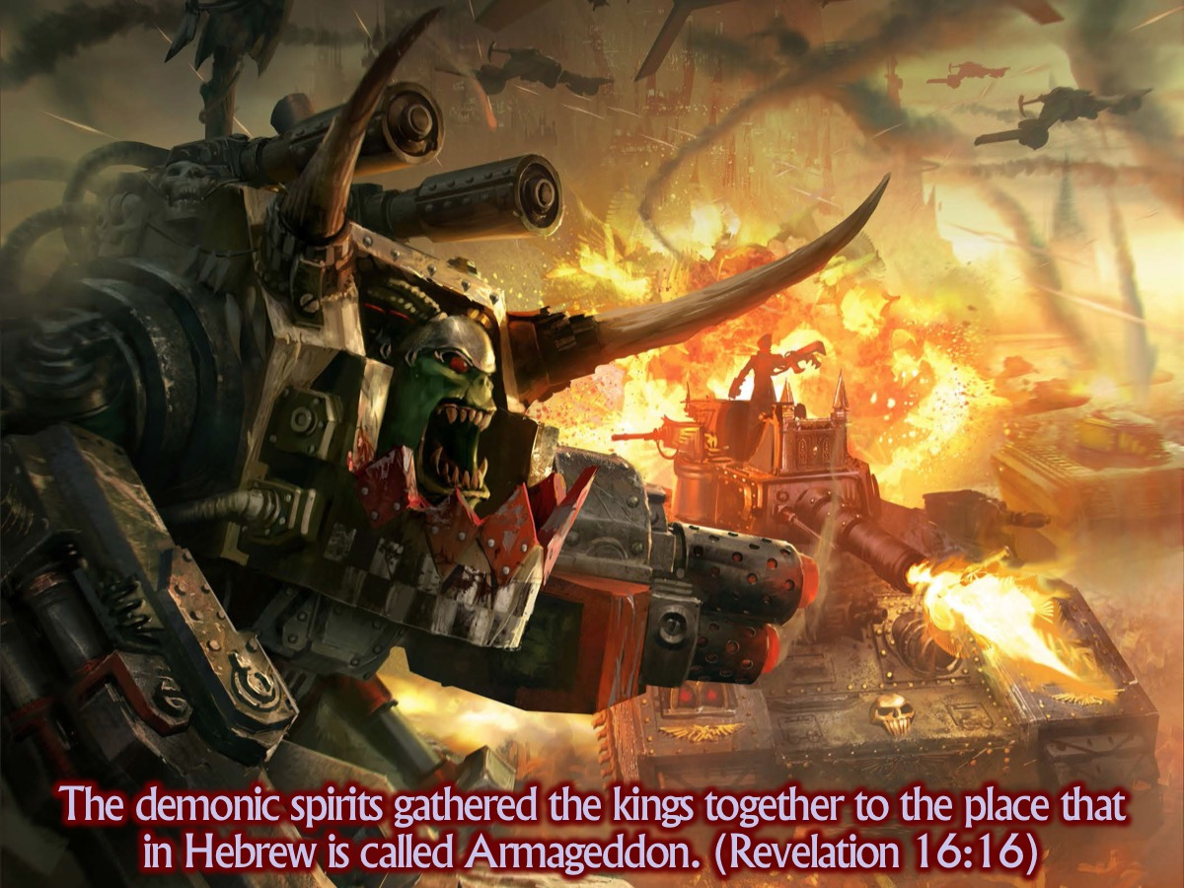
Notes:
Why are the kings of the east drawn into such a foolish confrontation? The dragon, the monster from the sea and the monster from the land – who is now described as a false prophet (13) will deceive the kings of the earth and lure them to this great and disastrous battle.

Slide 48
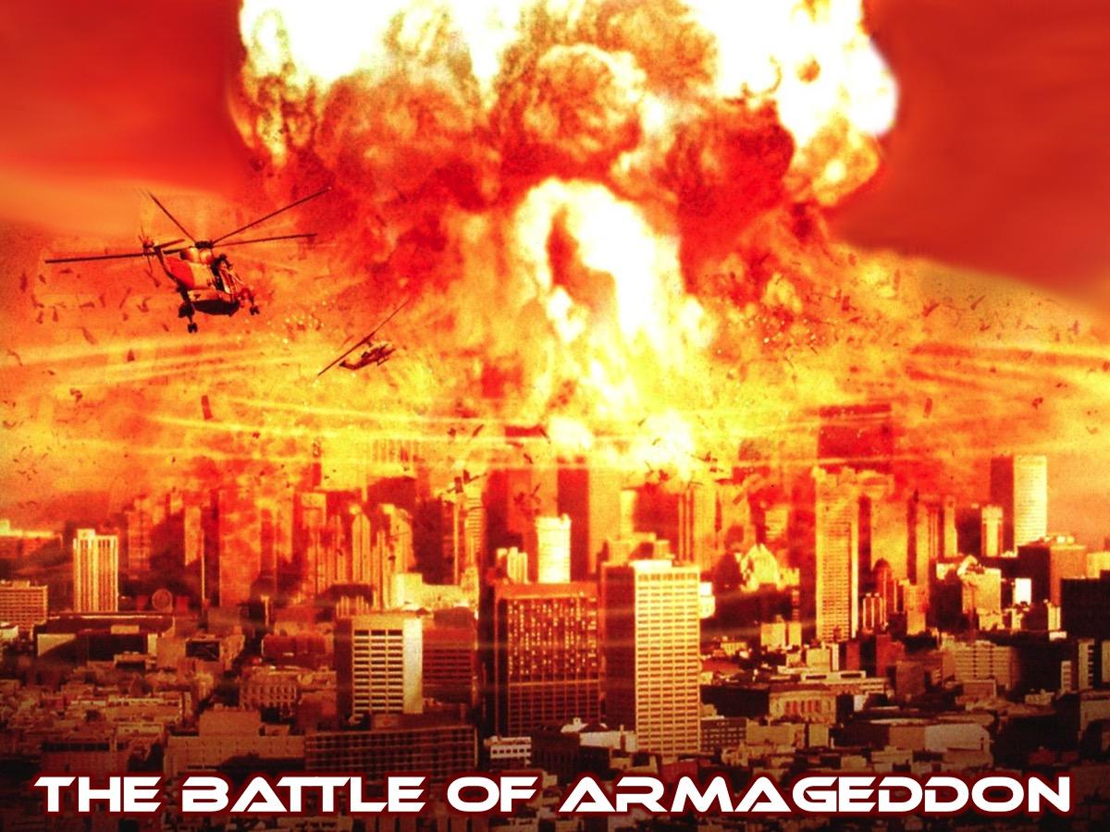
Notes:
John refers to a place - near Mount Megiddo where this great battle will take place. Again we are reminded that this book is full of symbolish so we are not necessarily looking for this battle to happen in palestine - but it could. John’s point is that all the powers of evil must be brought together to one place, so that they can be dealt with there. This is why the three frogs are allowed to perform their deceits.

Slide 49
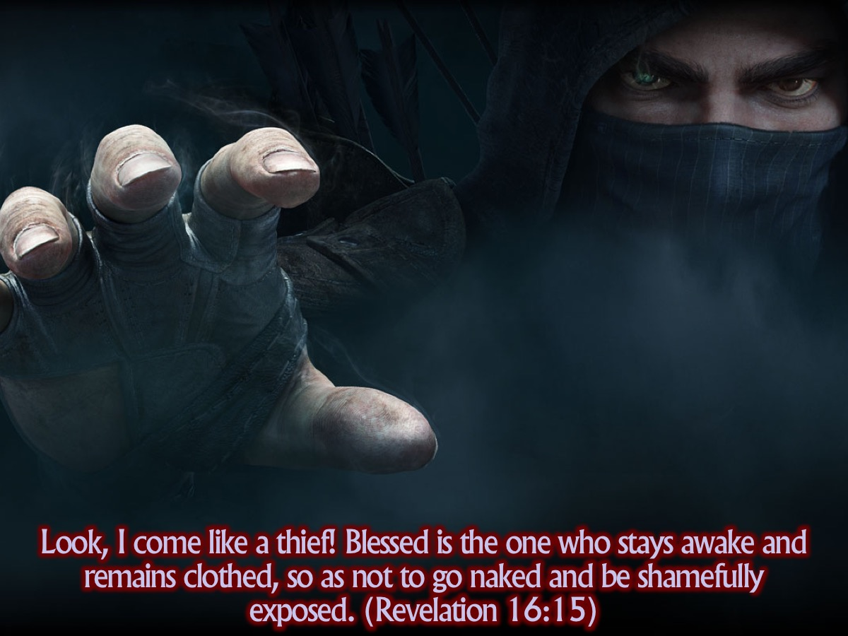
Notes:
In the middle of describing the plagues, John warns his readers to stay awake. The image of a man having disrobed and fallen asleep who is then caught sleeping, awakened by surprise and forced to parade about naked is clear. I was talking to one of the youth pastors in our fraternal (from a church in Linden) and he said that when he was in Israel this year, a rabbis told him a story of how that a Temple-guard found a guard asleep at their post; and he set the person’s clothes on fire as a punishment for falling asleep. Usually you would just get a beating - but it certainly forced people to stay awake because they had no idea when the temple guard would come around. The point is obvious: the Lord will suddenly appear and the unprepared will suffer a great disaster.

Slide 50
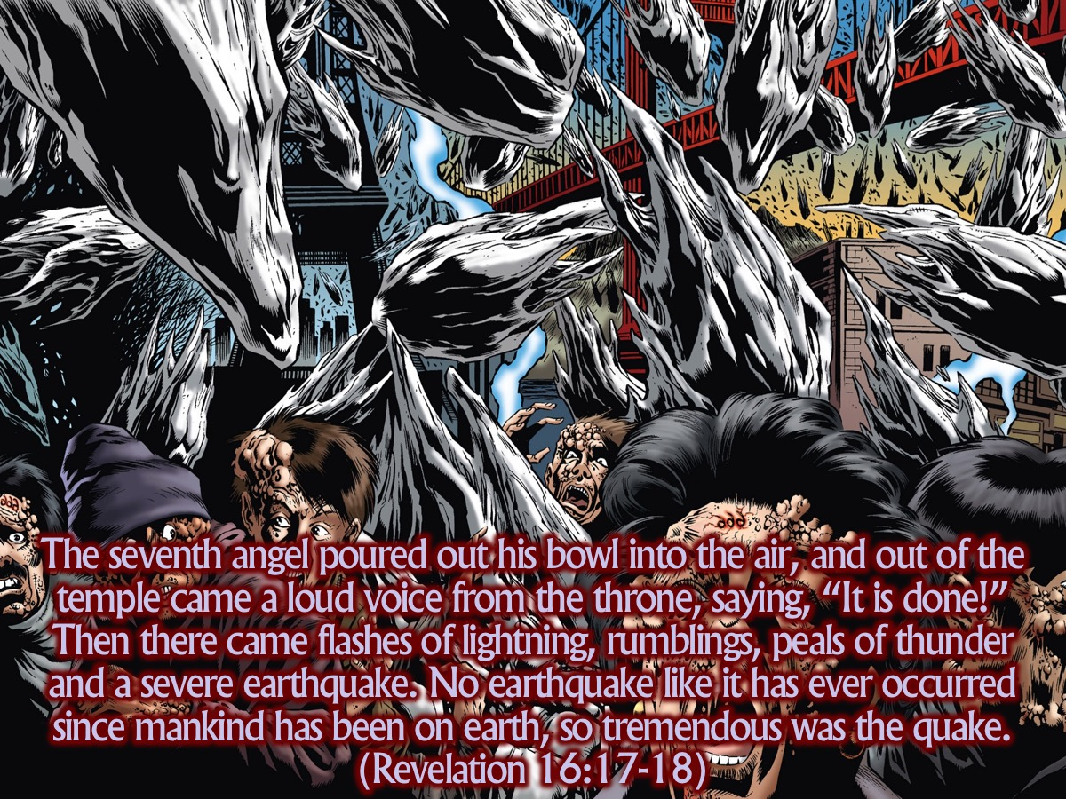
Notes:
The seventh angel poured out his bowl into the air, and out of the temple came a loud voice from the throne, saying, “It is done!” Then there came flashes of lightning, rumblings, peals of thunder and a severe earthquake. No earthquake like it has ever occurred since mankind has been on earth, so tremendous was the quake. (Revelation 16:17-18)

Slide 51
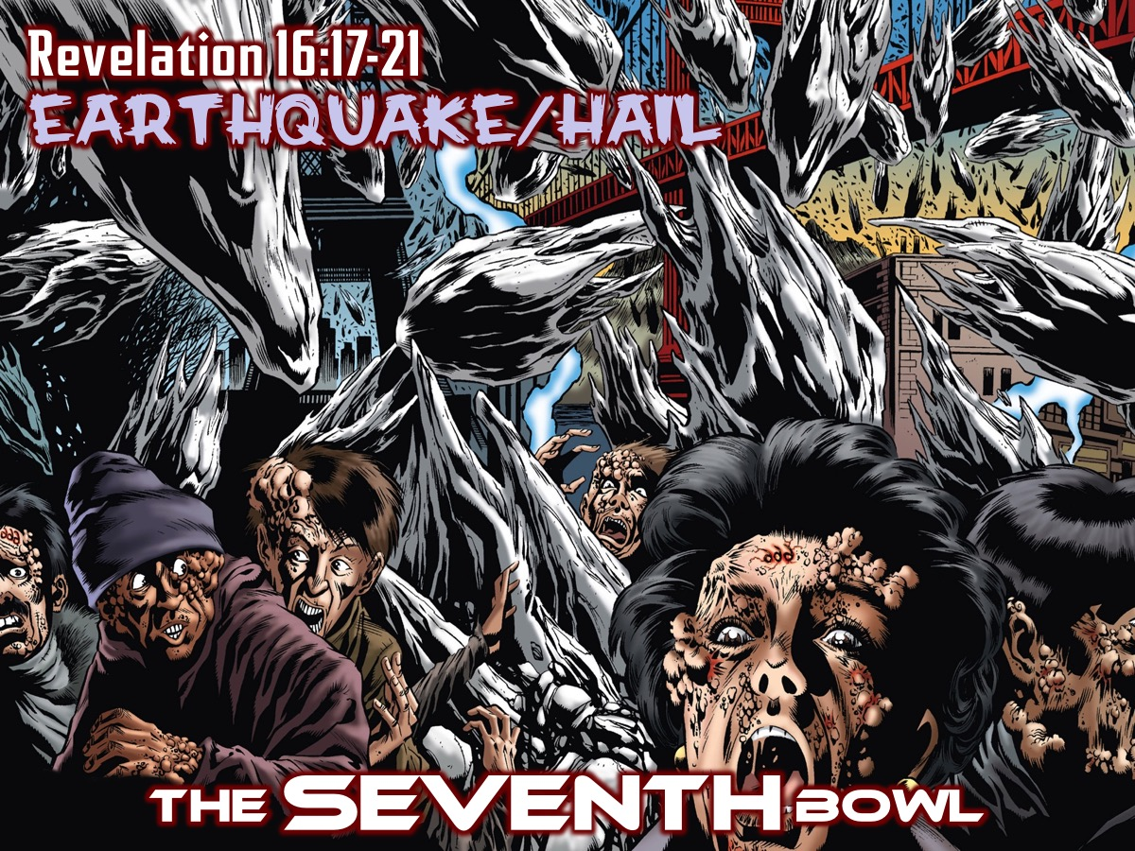
Notes:
The SEVENTH Bowl (Revelation 16-17-21)

Slide 52
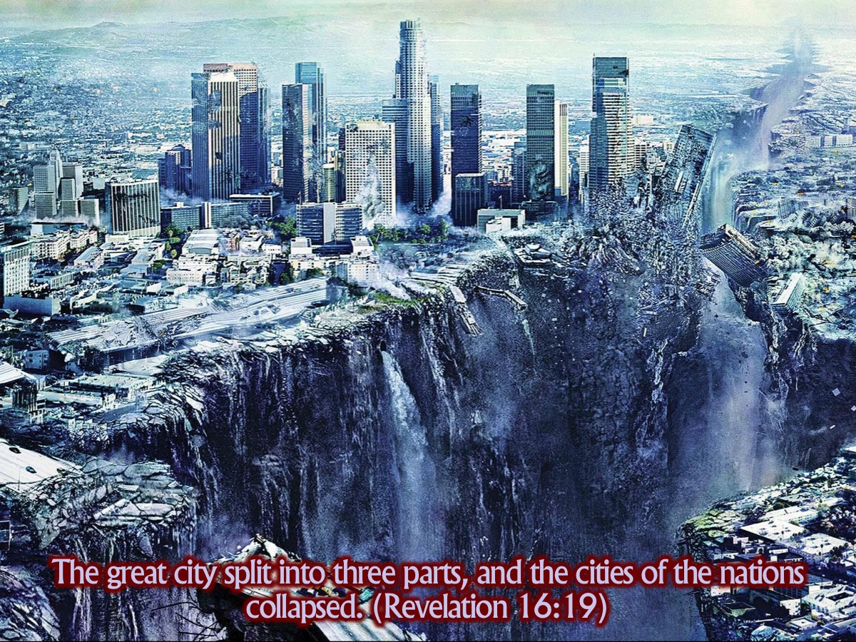
Notes:
As in Zechariah 12 where Jerusalem is split apart by an earthquake, the great city is split into three and the other cities collapse, like Jericho before the trumpets of Joshua – Islands flee away, mountains disappear. John is not talking about the collapse of the physical earth – this is the only way to descrobe the collapse of the entire social and political system on the earth. Terrible things will happen on the earth and the only fitting metaphor will be earthquakes and huge hailstones. God will allow the lie at the heart of pagan society, like a crack in the earth’s crust, finally to be exposed. The tectonic plates of different idolatrous human systems will move against one another one more time, and nothing will ever be the same again.

Slide 53
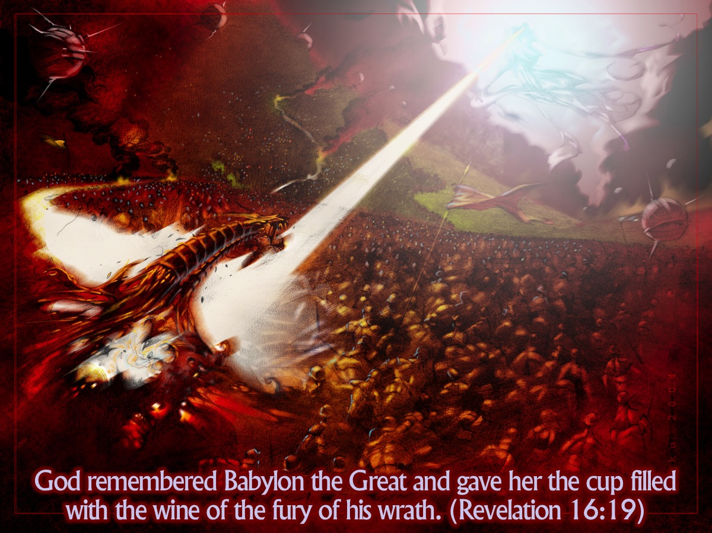
Notes:
And in the middle of it, God will remember Babylon (19b). Chapters 17 and 18 belong at this point. Part of the last bowl is judgment against the city that has become the world’s whore. Only when her ghastly parody has been unveilved and destroyed can we appreciate what it means to belong to the people John calls the bride.

Slide 54

Notes:
This judgment reminds us of the seventh plague in Egypt where the hail caused devastation in Egypt. 100 pounds is about 50 kilograms!!! That is what some of you weigh!!! Like big bags of cement falling from the sky!

Slide 55

Notes:
We had some pretty big hail in Johannesburg last week - not quite this size - more like the size of a tennis ball. Imagine what damage hail this size would do to the world!!!

Slide 56

Notes:
People cursed God because of the damage that the hail stones - they still refuse to repent - just like Pharaoh in Egypt! (Revelation 16:21)

Slide 57
Notes:
Video: Exodus Gods and Kings - 10 Plagues in Modern Cities. Get it on YouTube at: https://www.youtube.com/watch?v=lDsqsk7coHg

Slide 58

Notes:
1. Know God is Both Just and Kind. He is full of mercy even in the midst of judgment!

Slide 59

Notes:
2. Keep Following Jesus - don’t let anything tempt you to turn back- let this book be a warning of what happens when people turn against God!!!

Slide 60

Notes:
3. Keep Confessing Sin! When I was growing up I was taught the importance of keeping short account of sin - this will ensure that the devil does not get a foothold in your life!

Slide 61

Notes:
Video: The G.O.S.P.E.L. Rap. Get it on YouTube at: https://www.youtube.com/watch?v=d2BW_yButTk

Slide 62

Notes:
Let US Pray

Slide 63

Notes:
Next week we will look at Act 6 and explore 7 Spectacles (Revelation 17:1-20:3)

