Slide 1
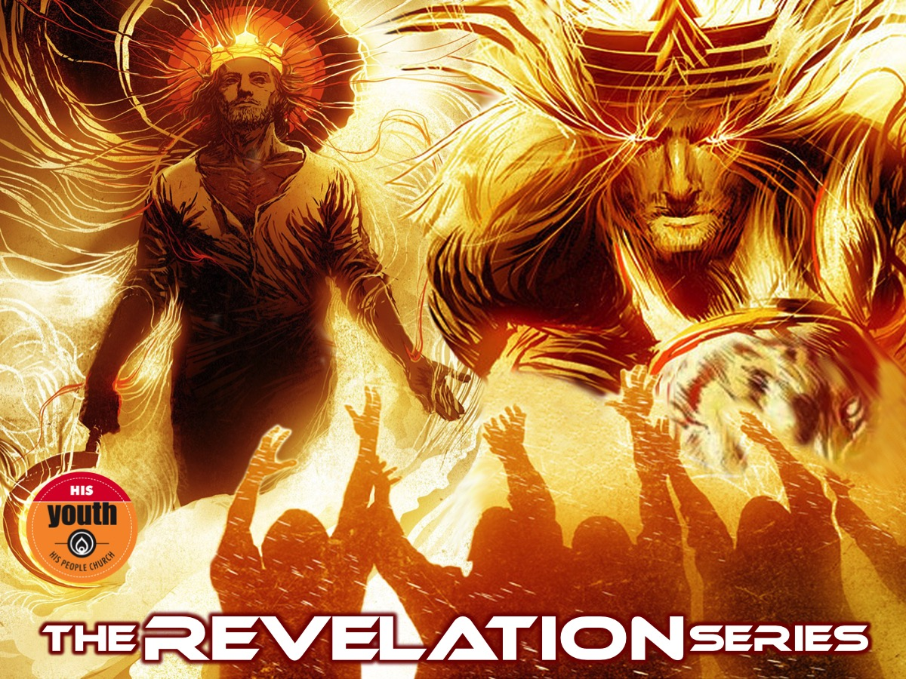
Notes:
Welcome to the Revelation Series.

Slide 2
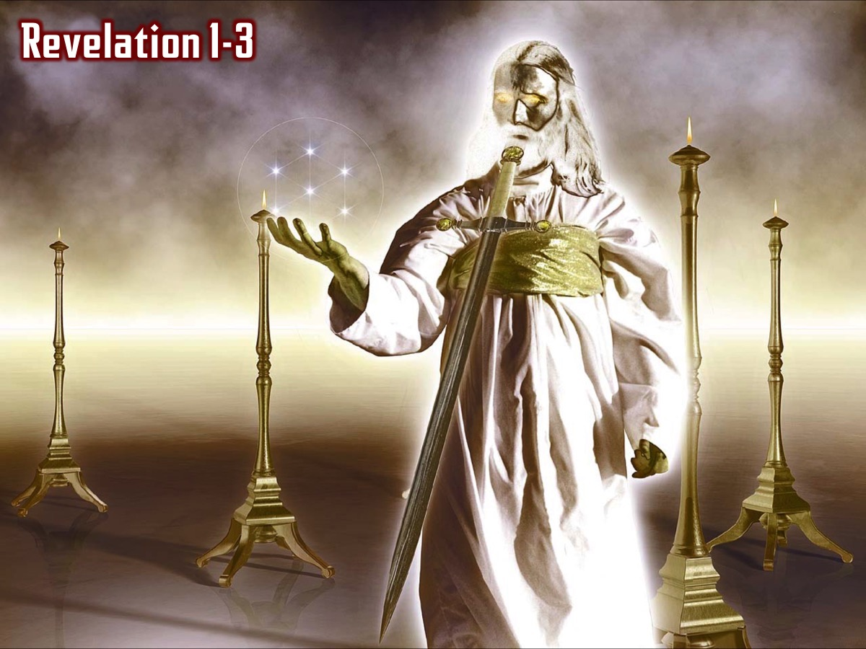
Notes:
In the first two weeks we saw an incredible revelation of Jesus and we read the seven letters that Jesus sent to seven churches in Asia Minor and reflected on what Jesus thinks about His Youth and also what our personal strengths, weaknesses, opportunities and threats are.

Slide 3
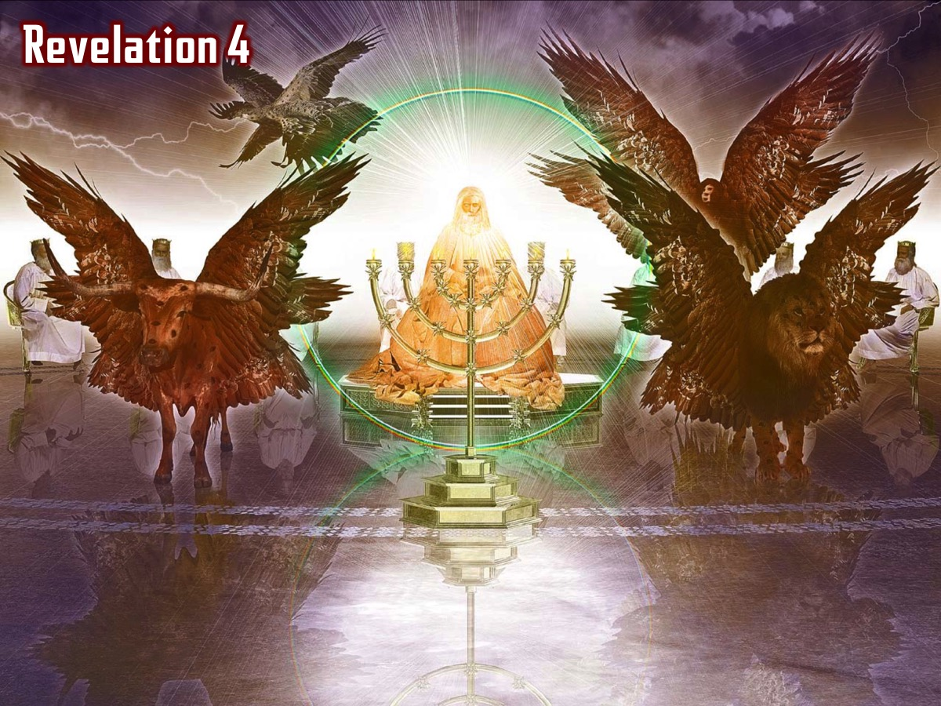
Notes:
In chapter 4 we saw how the 4 living creatures and the 24 elders and all the angels praised God for his amazing creation…

Slide 4
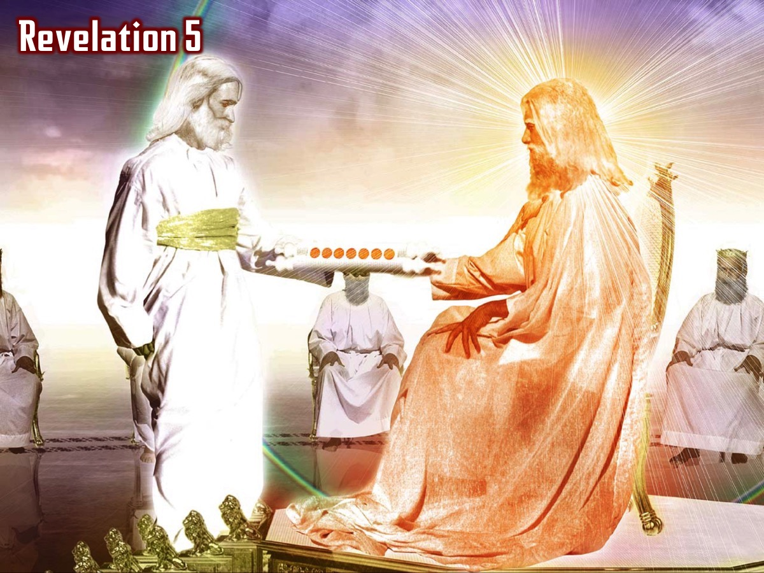
Notes:
In chapter 5 we saw that only Jesus was found to be worthy to take the scroll from his father and open it each of the seven seals (Revelation 5:8-14):

Slide 5
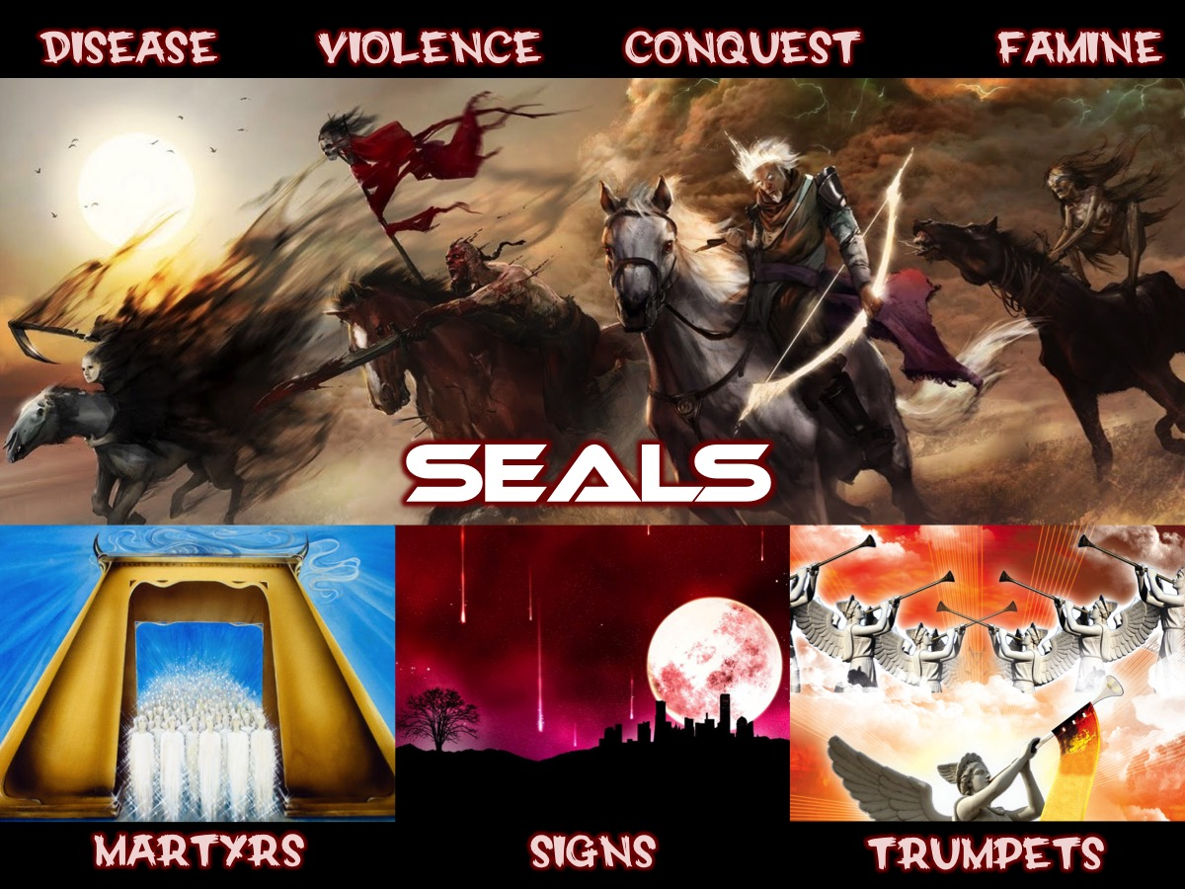
Notes:
We explored the 7 seals that Jesus opened that brought destruction to earth.

Slide 6
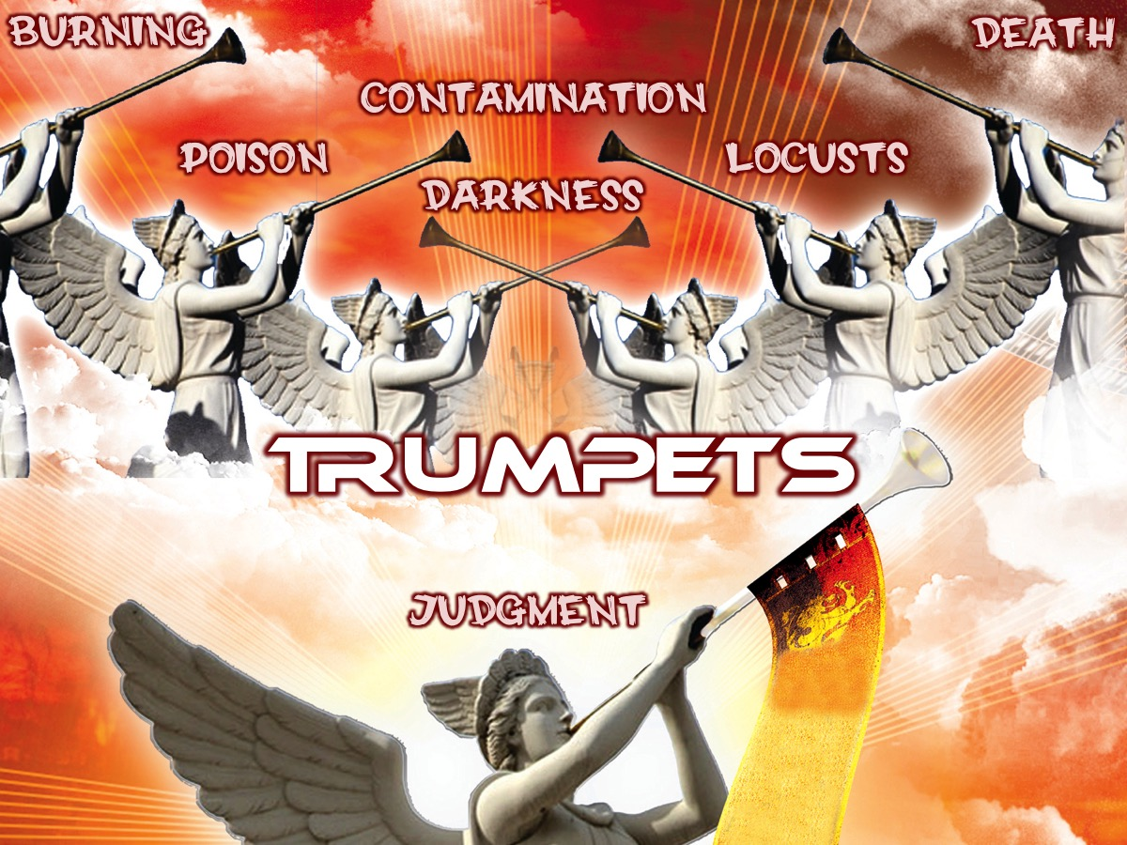
Notes:
We then looked at the seven trumpets that unleashed terror on the earth.

Slide 7
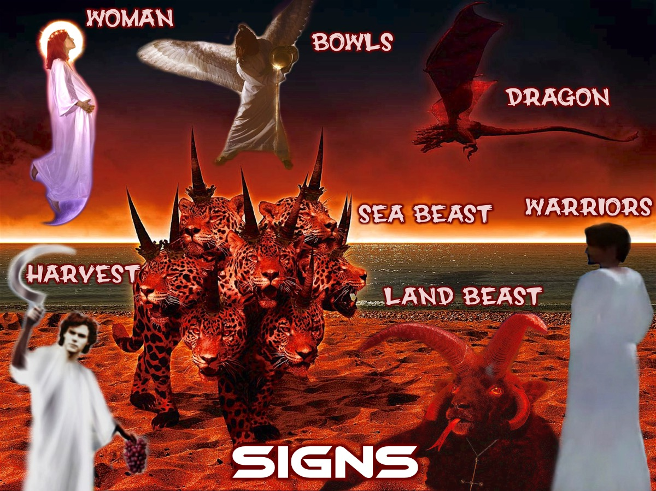
Notes:
We then looked at 7 Signs in Revelation 11:19-15:4.

Slide 8
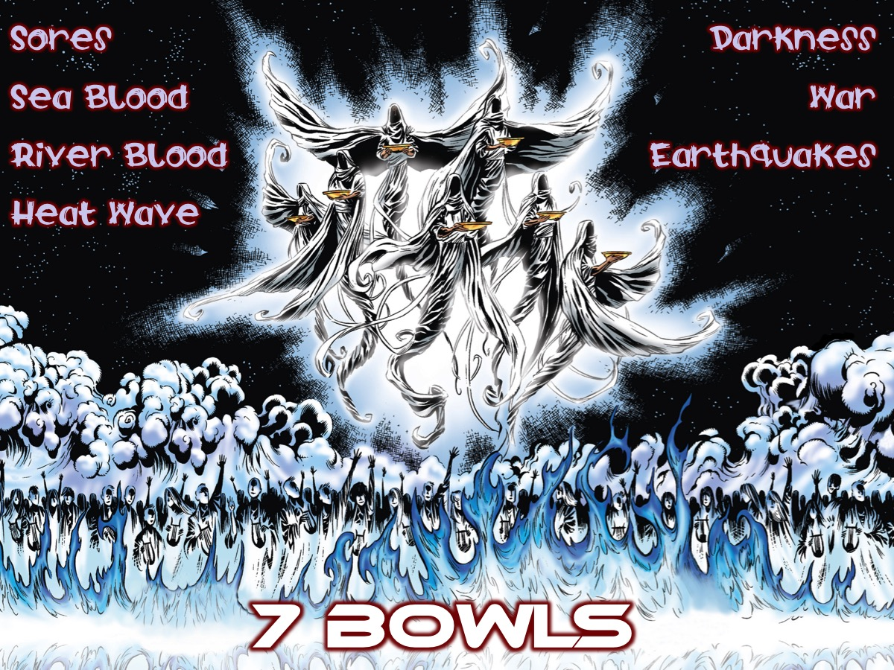
Notes:
Last week we looked at the 7 Bowls of Wrath that were poured out on the world in Revelation chapter 16.

Slide 9
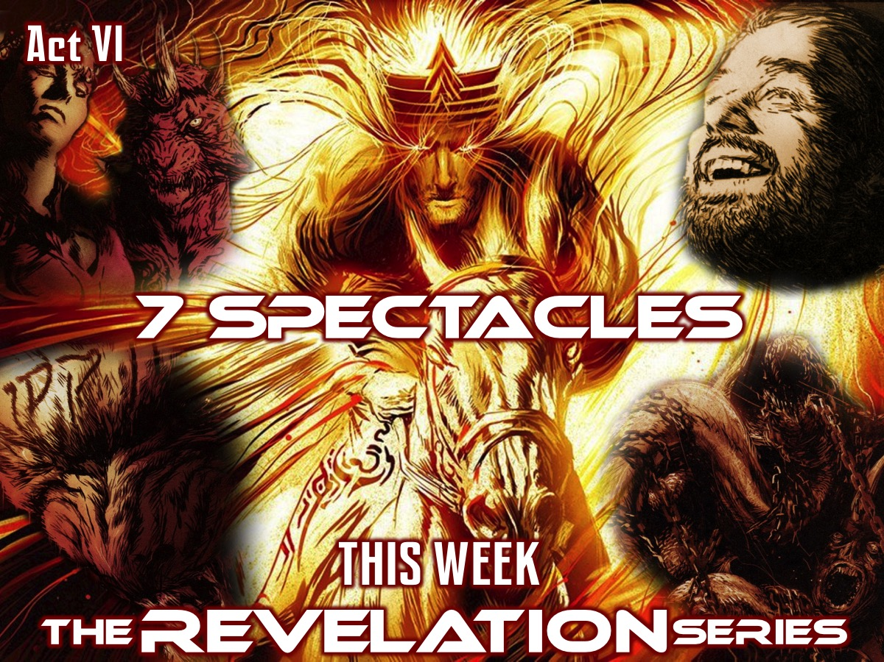
Notes:
This week in Act VI, we are going to explore 7 Spectacles (Revelation 17:1-20:3)

Slide 10
Notes:
Video: Star Wars The Force Awakens Trailer. Get it on YouTube at: https://www.youtube.com/watch?v=sGbxmsDFVnE

Slide 11
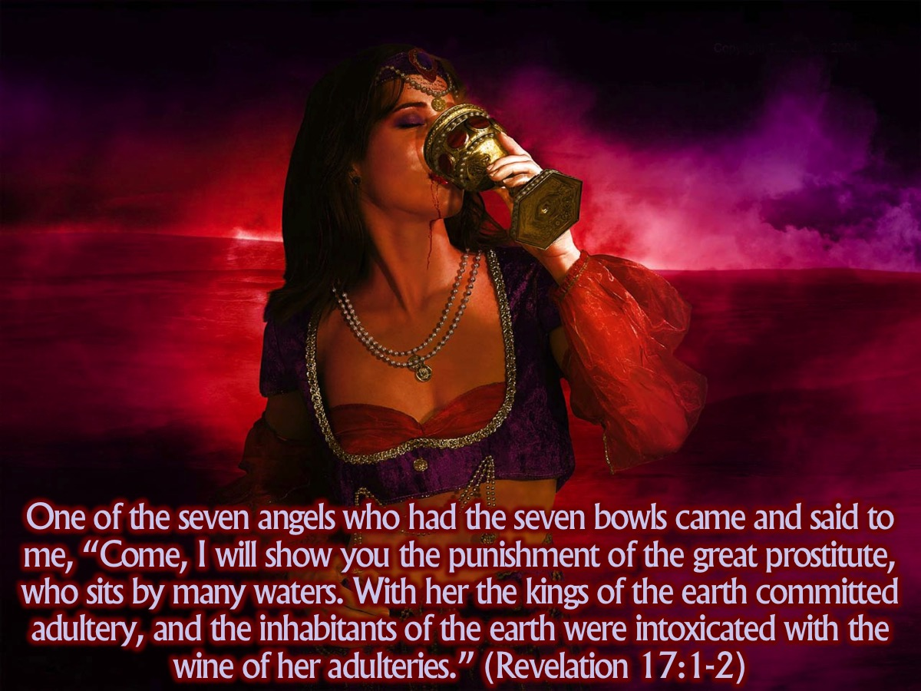
Notes:
One of the seven angels who had the seven bowls came and said to me, “Come, I will show you the punishment of the great prostitute, who sits by many waters. With her the kings of the earth committed adultery, and the inhabitants of the earth were intoxicated with the wine of her adulteries. (Revelation 17:1-2)

Slide 12
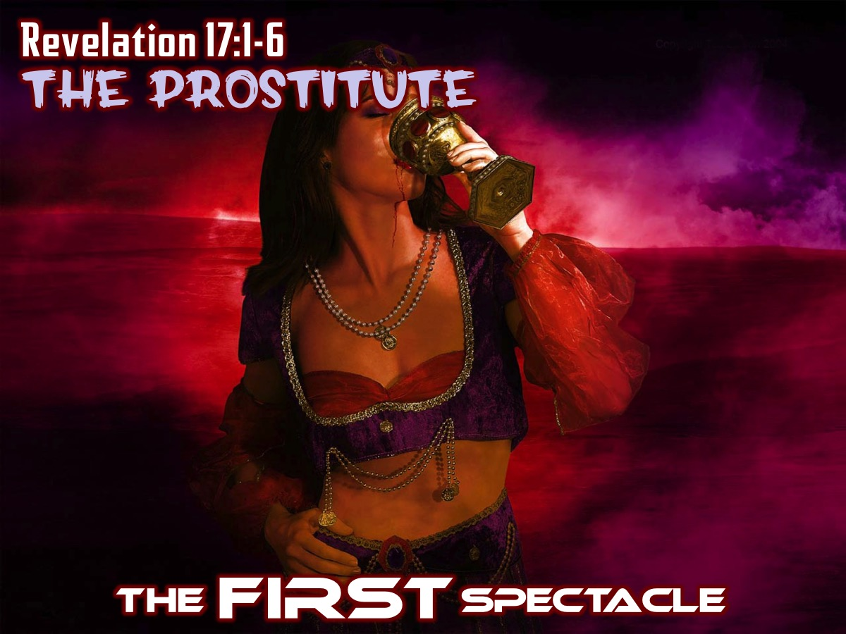
Notes:
The FIRST Spectacle: The Prostitute (Revelation 17:1-8)

Slide 13
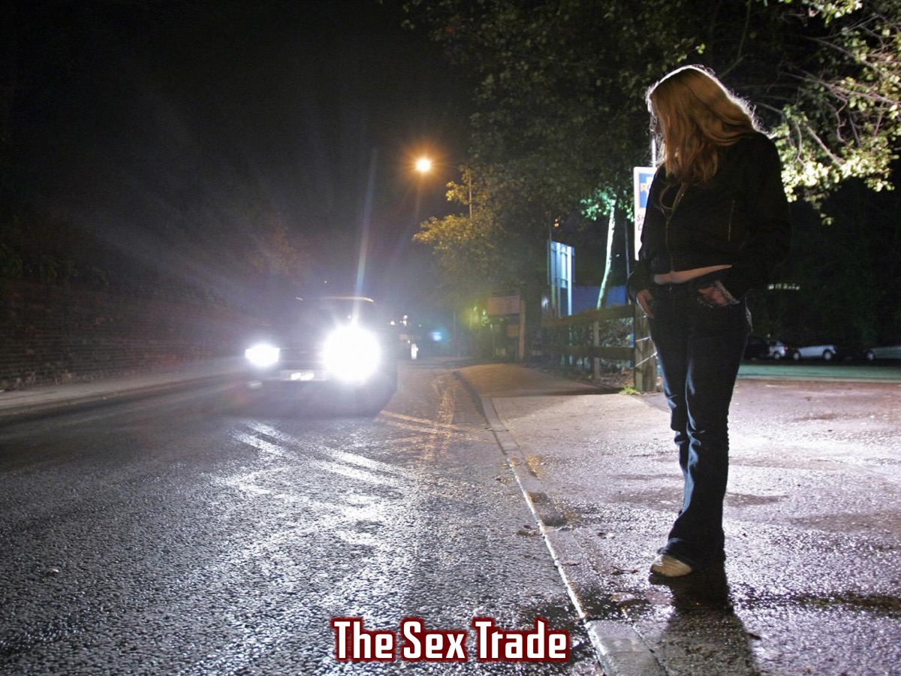
Notes:
Illustration: Sex trafficing – either captured by force or lured by the promise of a better life. Beaten, threathened and raped. They are the new slaves – abused both physically and emotionally and mentally. They are the new prostitutes. There are many like them in the ancient world – girls and boys with no other means of livlihood. Other today get into prostitution seeing it as a quick way to make money. If you play your cards right you can have a high social status, with fancy clothes, jewels and pearls. They have a discrete clientelle among the rich and famous – that is mutually satisfying.

Slide 14

Notes:
But it is ultimately destructive for everyne involved.

Slide 15
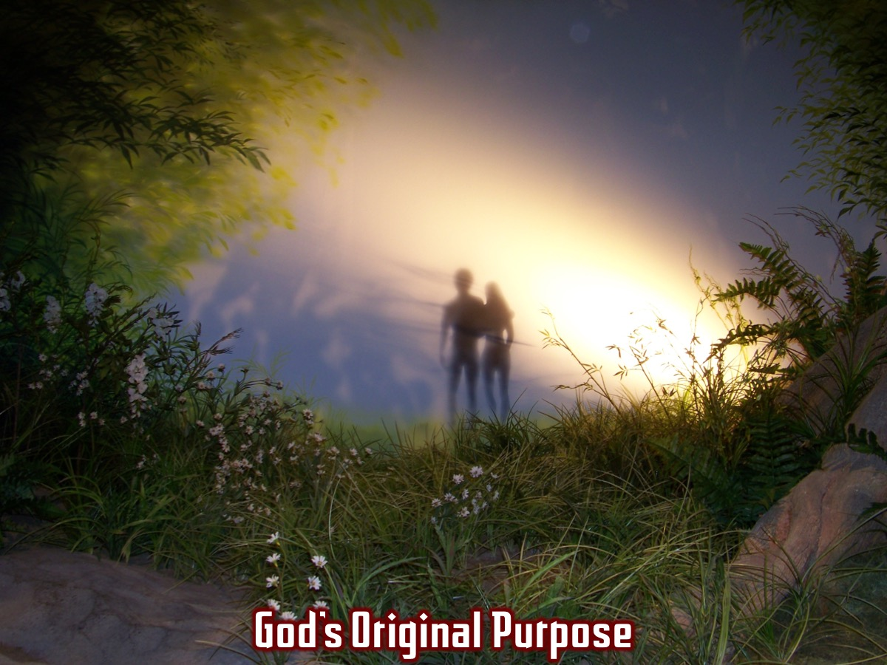
Notes:
God has called us to either celibacy or marital fidelity. This is why the great final image in the book is the marriage of the lamb to his bride in the garden city – reminding us of God’s original purpose for humans in the original garden.

Slide 16
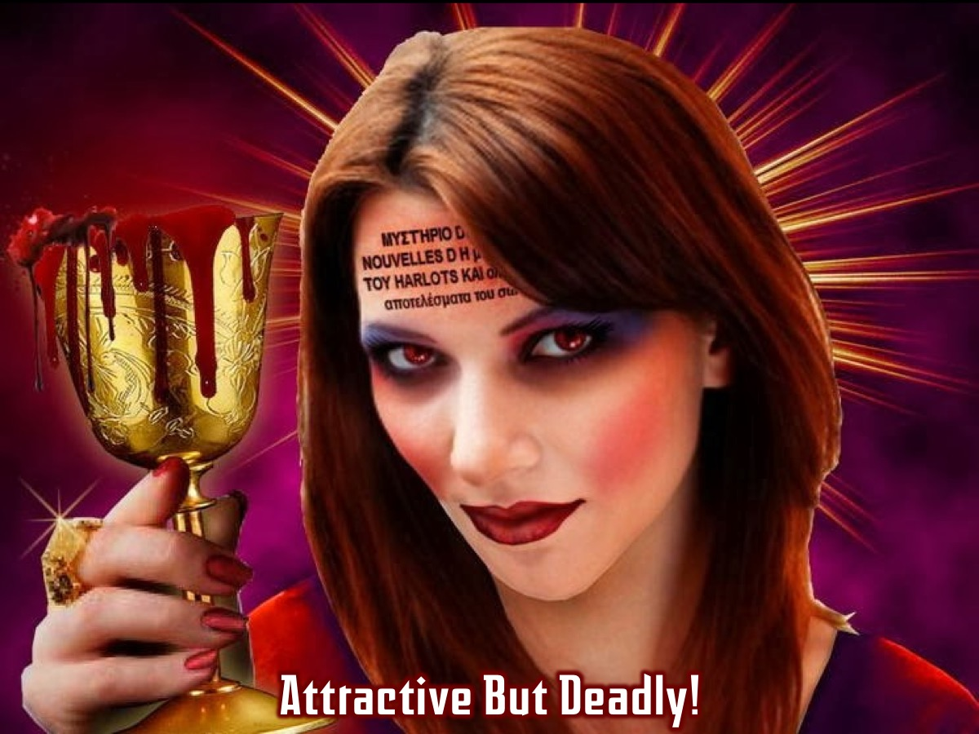
Notes:
The prostitute dresses up finely, puts on a great show and holds out a wonderful golden goblet as though she’s inviting you to a rich banquet. But the eye of faith recognises that the goblet is full of urine, dung and blood! She looks stunning from the outside, but inside she is filthy.

Slide 17
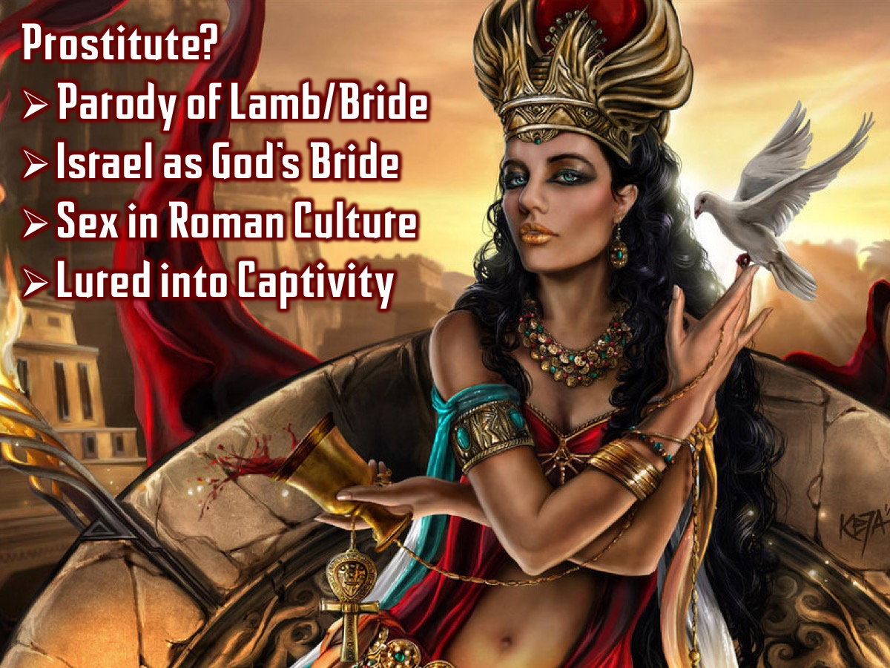
Notes:
Why the use of the prostitute imagery? (1) Babylon is a terrible parody of God’s lamb and his bride – the husband and the wife – faithful and loving to each other. She is like a whore who runs after many different men. (2) One of the great images of Israel in the OT is that of Israel as God’s bride – which is contrasted in the story of Hosea where Israel goes off and plays the whore by going after idols. Babylon has worshipped idols – the quick-fix pseudo-divinities that promise the earth, take all you have to give and then leave you with nothing. (3) The Roman world thrived on sexual irregularity – when you have money and power you have access to ilicit sex as well. (4) There is something like prostitution happening when the rich empire lures others into its den. It sounds like there are no strings attached, but the moment you are lured in you find that there is a price to pay. Once you take the golden cup offered by Babylon, you have to drink it.

Slide 18

Notes:
Illustration: The drug lord who offers a vulnerable young person some free drugs – seemingly at no price until they are addicted and they become slaves and have to do whatever they ask!

Slide 19
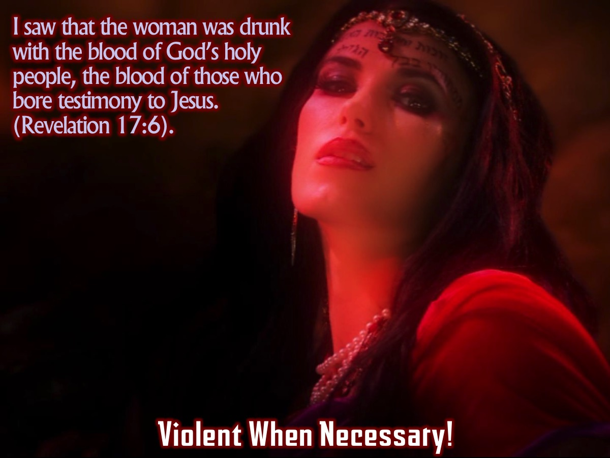
Notes:
“I saw that the woman was drunk with the blood of God’s holy people, the blood of those who bore testimony to Jesus.” (Revelation 17:6). Those who stand up for truth are normally those who get hurt by the woman – (6) She can turn violent when necessary.

Slide 20
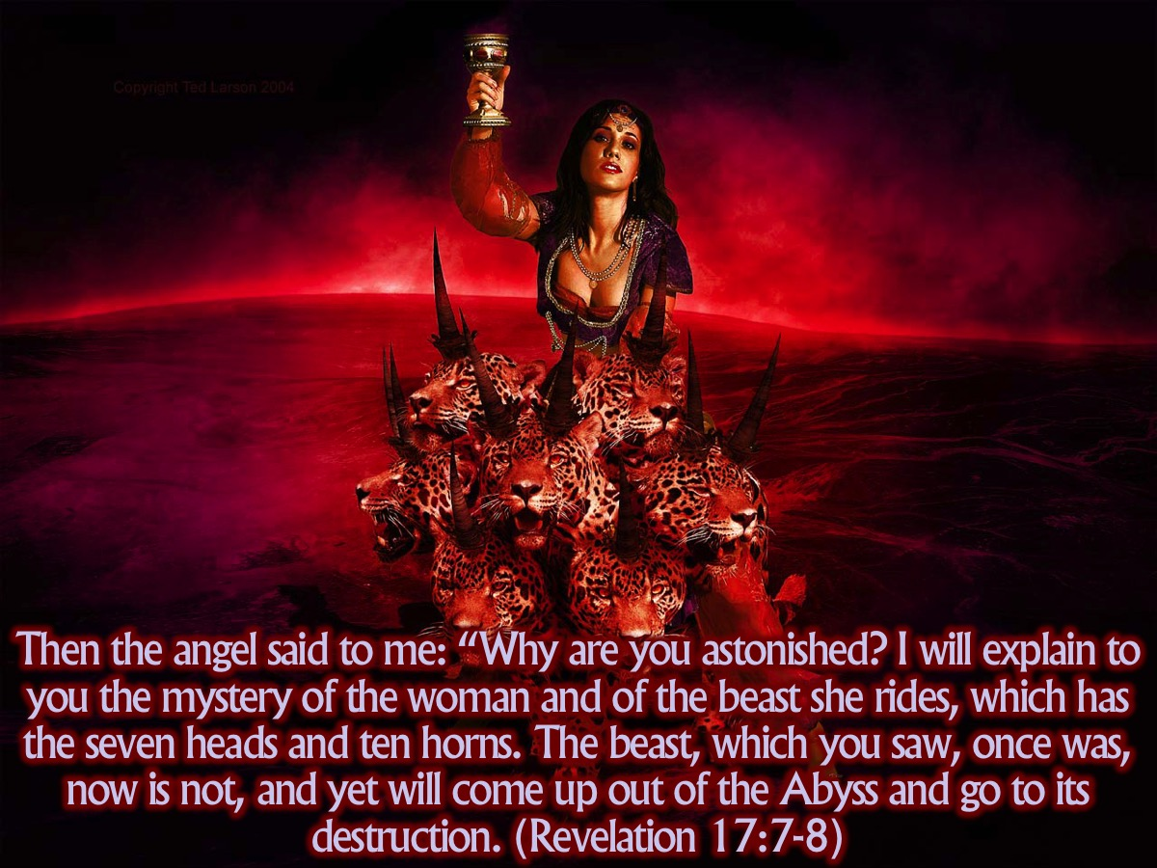
Notes:
Then the angel said to me: “Why are you astonished? I will explain to you the mystery of the woman and of the beast she rides, which has the seven heads and ten horns. The beast, which you saw, once was, now is not, and yet will come up out of the Abyss and go to its destruction. (Revelation 17:7-8)

Slide 21
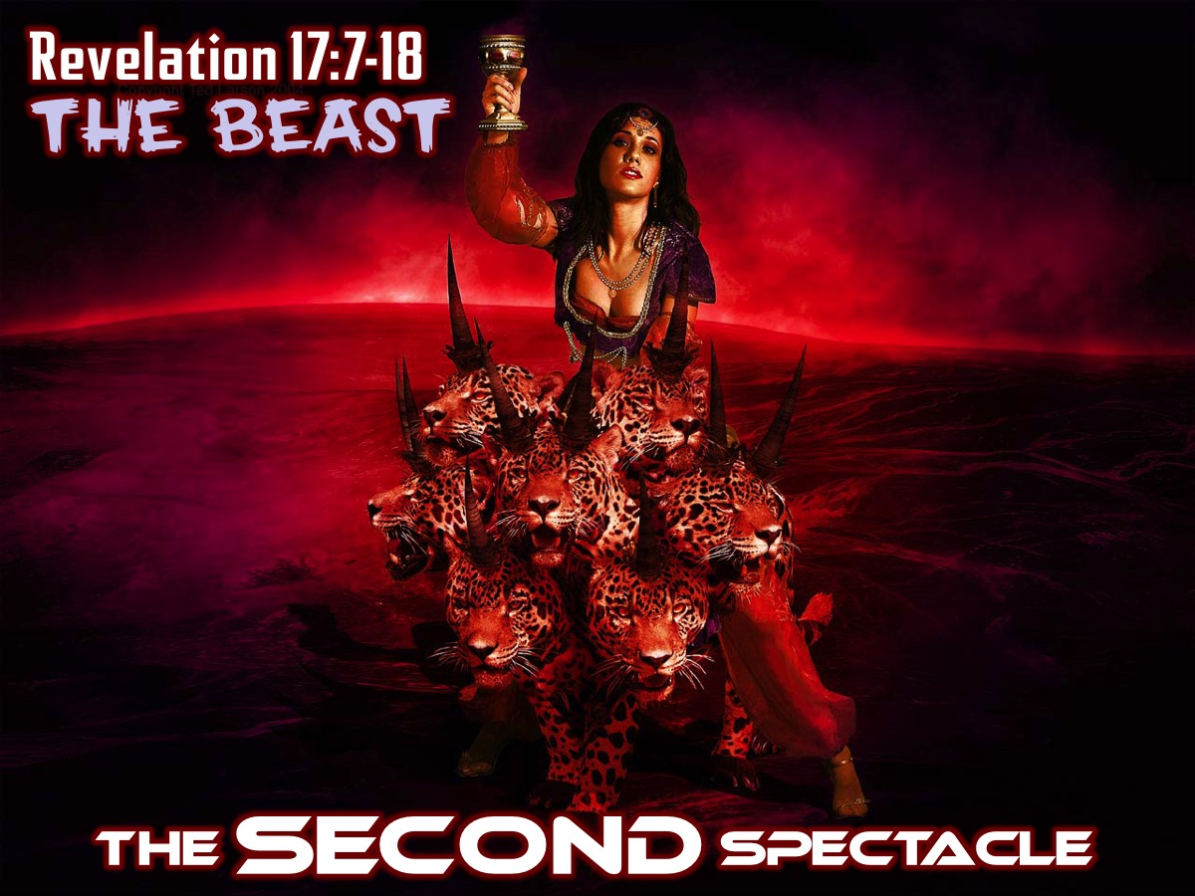
Notes:
The SECOND Spectacle: The Beast (Revelation 17:9-18)

Slide 22
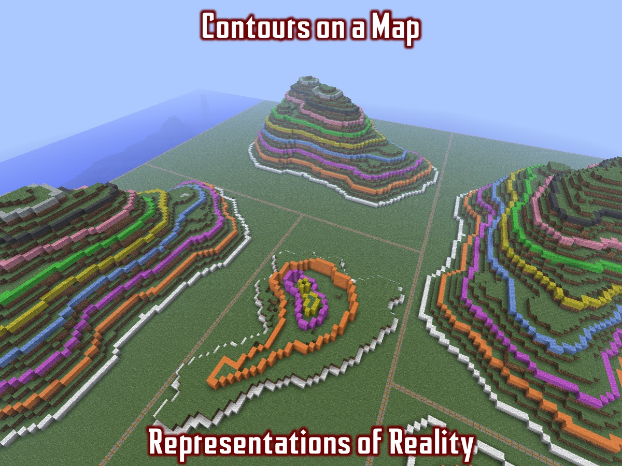
Notes:
Illustration: A contour map uses lines spaced closely for steep gradients and widely spaced for slight gradients. You won’t find these lines on the ground – they are just a representation of the reality. John has already given us a symbolic picture of the monster and the whore. Now he tells us what it all means.

Slide 23
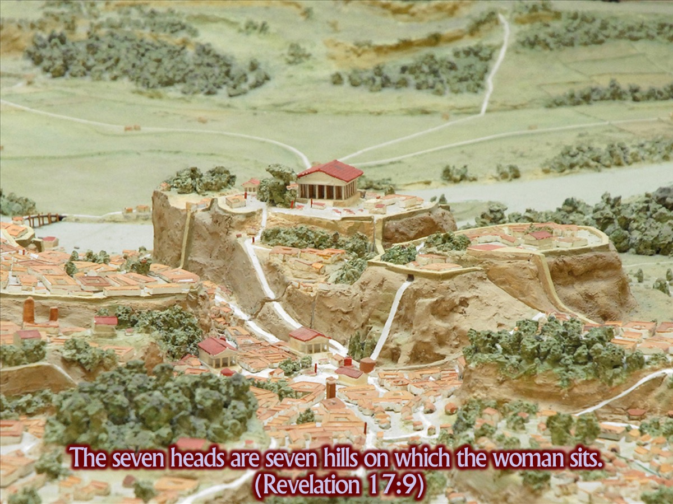
Notes:
The seven heads are seven hills on which the woman sits. (Revelation 17:9). This could be a reference to Rome which was a city on 7 hills.

Slide 24
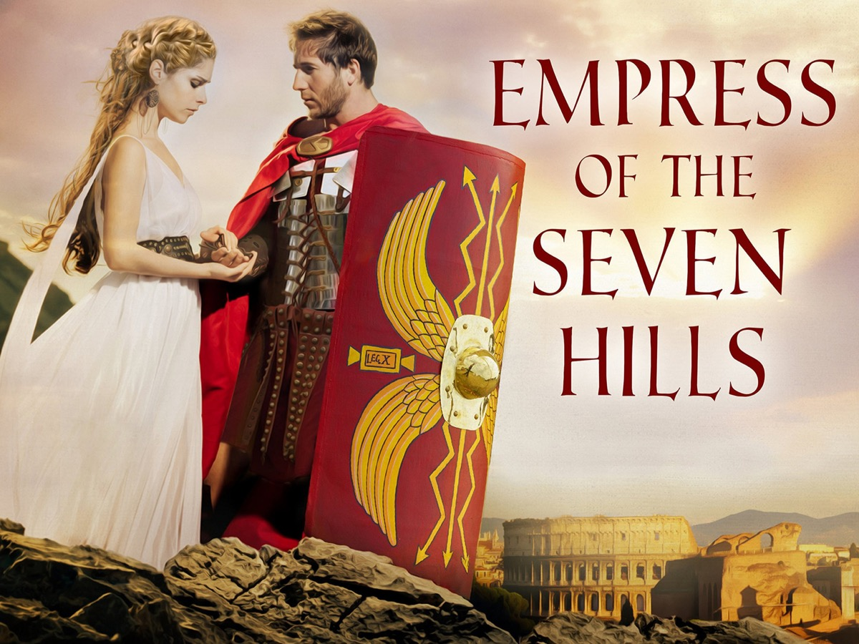
Notes:
There is an audio book you can get that reminds us that Rome was thoughts of a the city of seven hills.

Slide 25
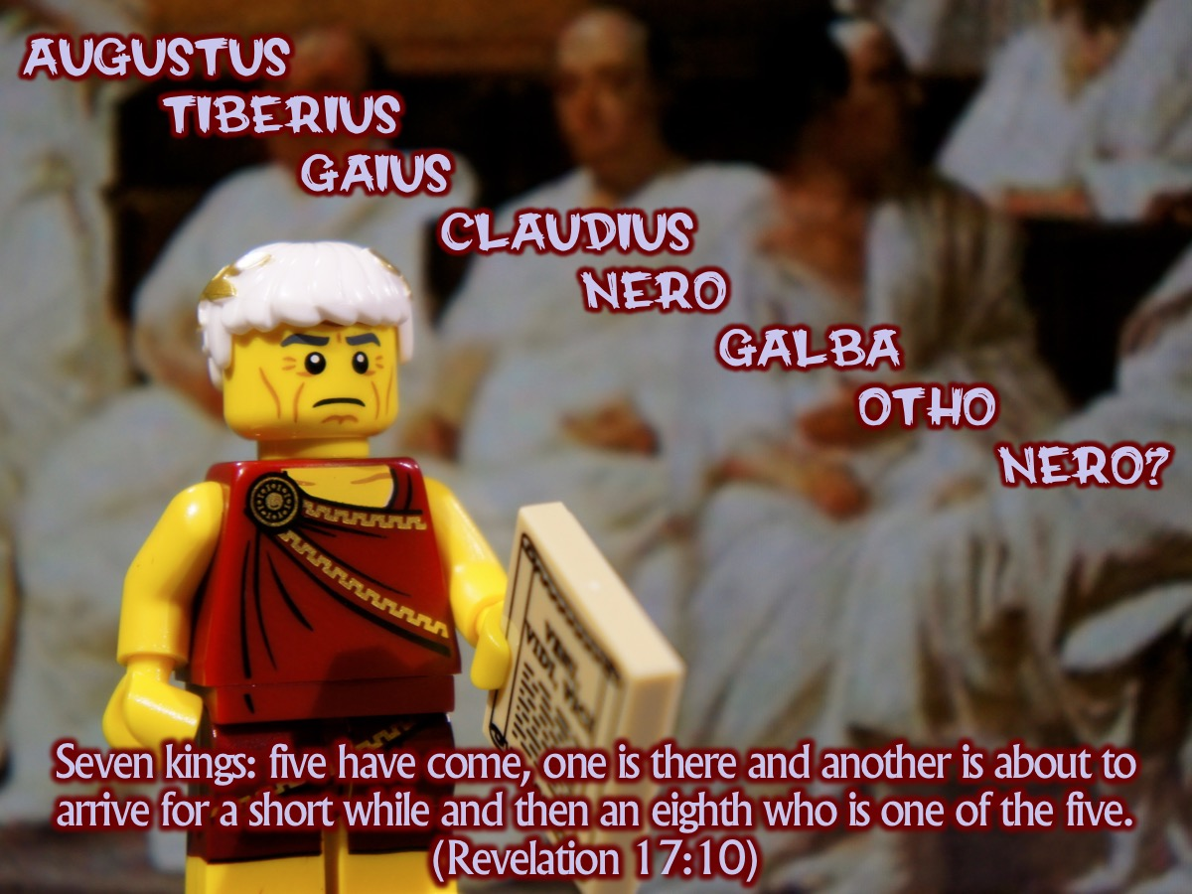
Notes:
Seven kings: five have come, one is there and another is about to arrive for a short while and then an eighth who is one of the five. (Revelation 17:7-8). Here are the Roman emperors this seems to refer to: Augustus, Tiberius, Gaius, Claudius, Nero (5) who died in AD 68 (and some believe he died but would come back to life and take back the throne. Then came Galba, then Otho who snatched the throne but did not keep it for long – and maybe John is referring to the returning Nero the monster who was and is not and is to come: the eighth who was one of the seven.

Slide 26
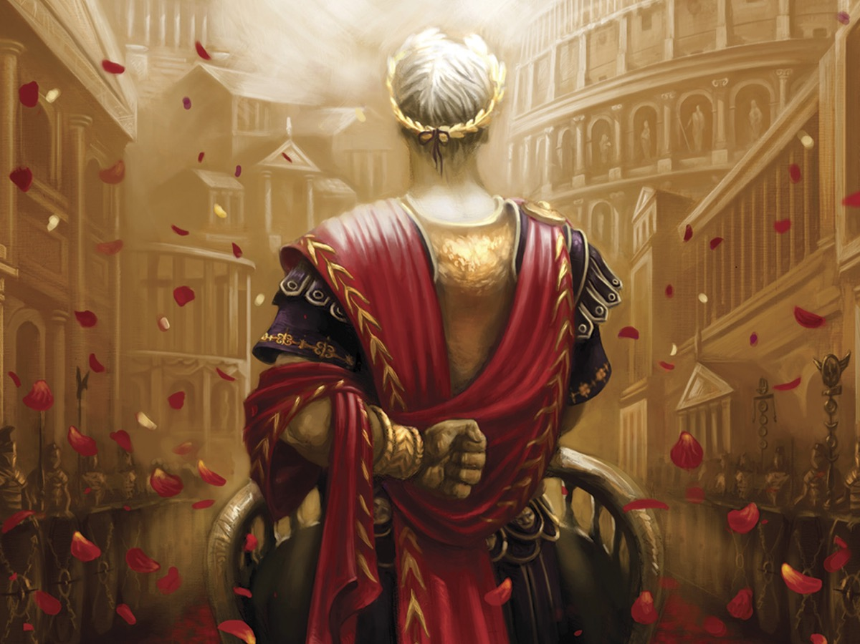
Notes:
Then again, maybe John is being symbolic – 7 kings stand for the perfection of the monstrous kingdom, with the eight (though one of the 7) who would appear to take it into a new day but who leads it to its destruction. While the kingdom looks perfect and impregnable, there are forces from within its own ranks who will destroy it.
Then comes ten more kings – clearly we are not meant to work through a list of emperors. Maybe these are different ruling elites within the larger Roman empire – kings and princes from the far reaches of the world where Rome ruled. They would get tired of mistress Rome and use here own power to attack the city that was sycking in all the wealth and glory that was being gained. These rebel forces will also presecute the followers of Jesus (14) – they must do this because the monster’s rule depends on his being absolute – with no space for rivals. Especially not a rival who claims absolute and unique allegiance and worship. The lamb will conquer them by his own blood and by the blood of his followers – those who remain faithful. The ten kings who are given authority for a short period of time will be God’s instruments to bring down the monster. Evil will turn on itself and destroy itself in the process.

Slide 27
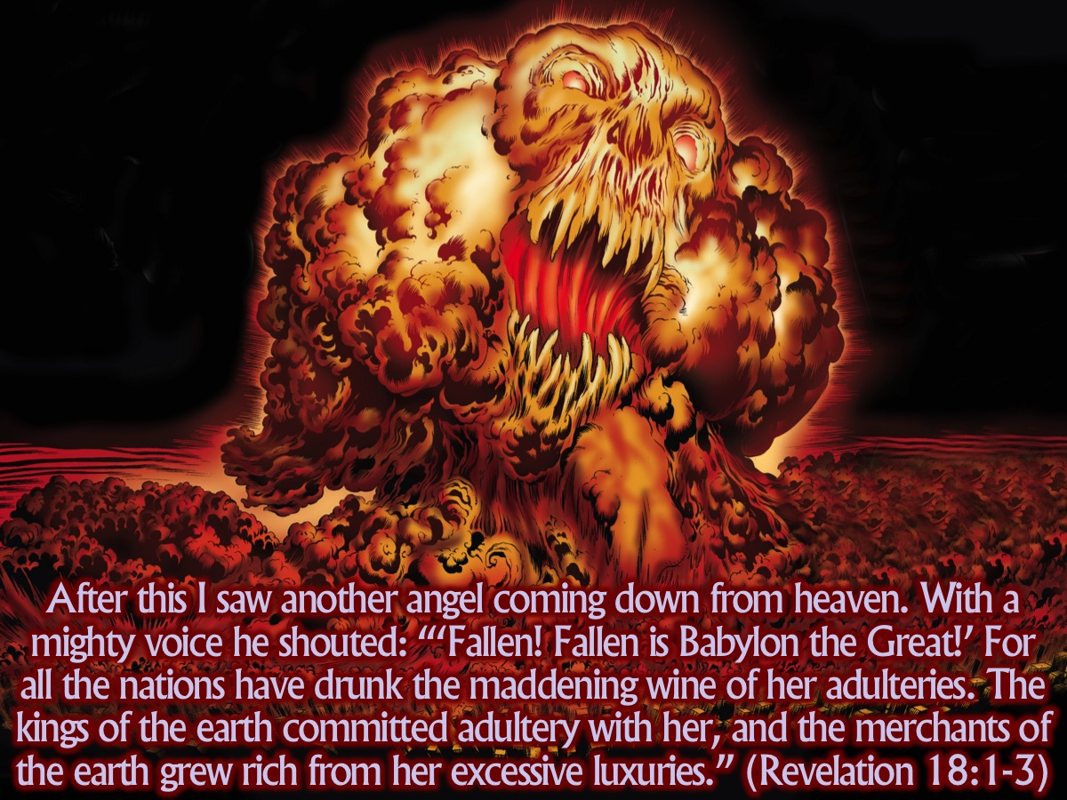
Notes:
After this I saw another angel coming down from heaven. He had great authority, and the earth was illuminated by his splendor. With a mighty voice he shouted: “‘Fallen! Fallen is Babylon the Great!’ For all the nations have drunk the maddening wine of her adulteries. The kings of the earth committed adultery with her, and the merchants of the earth grew rich from her excessive luxuries.” (Revelation 18:1-3)

Slide 28

Notes:
The THIRD Spectacle: The FALL (Revelation 18:1-18)

Slide 29
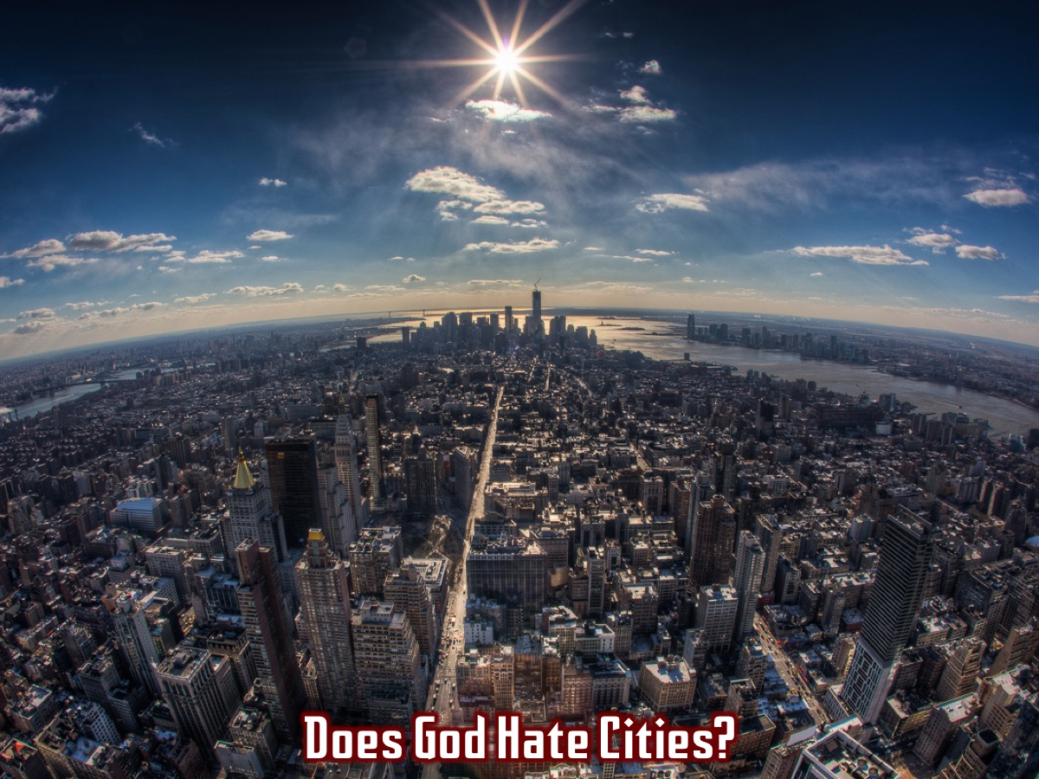
Notes:
Does God hate cities?

Slide 30

Notes:
Here is the problem! Cities can become violent places that don’t protect people but harm them - and that God does not like!

Slide 31
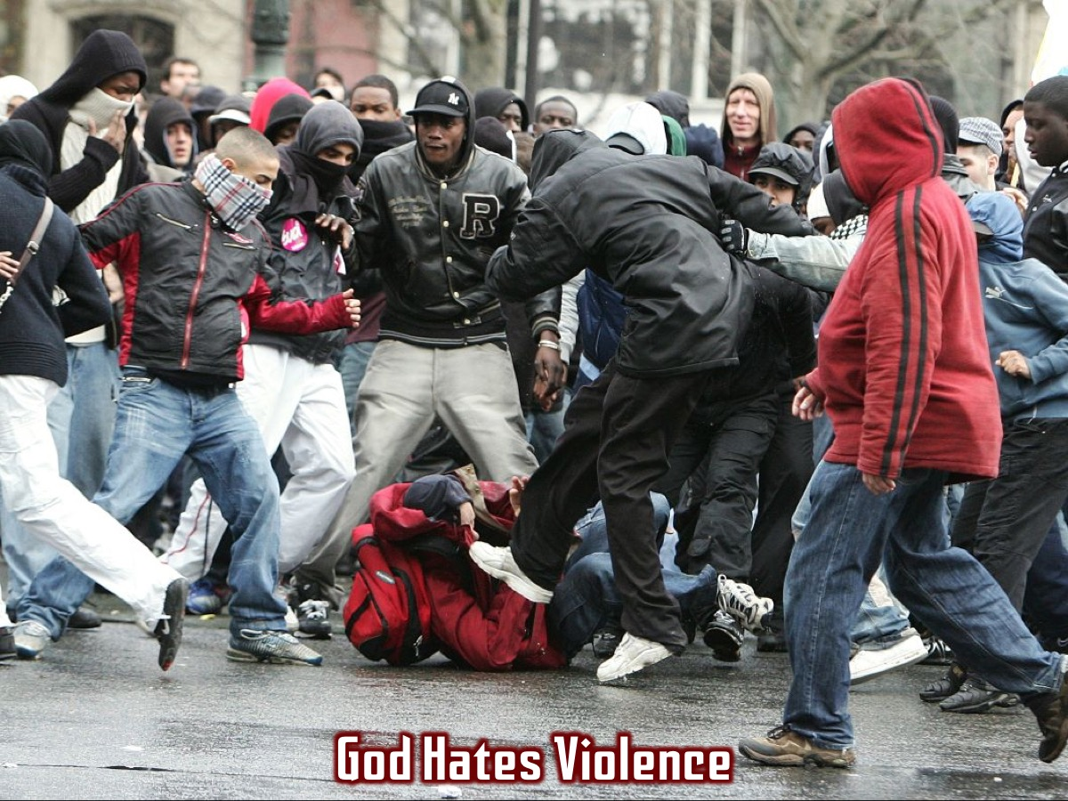
Notes:
God Hates Violence

Slide 32
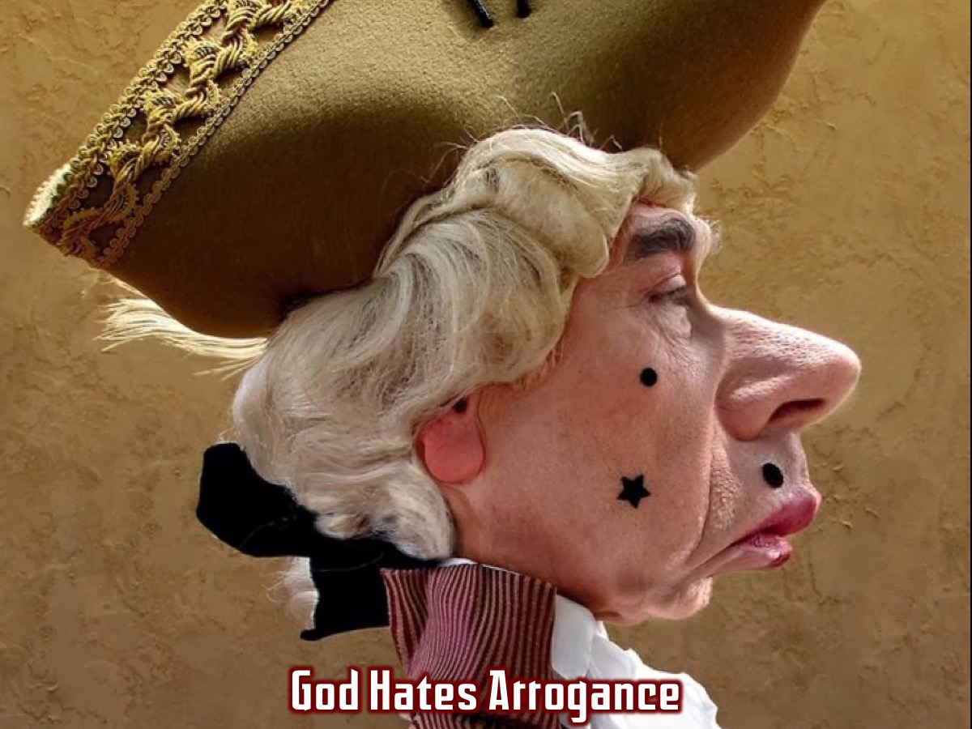
Notes:
God Hates Arrogance

Slide 33
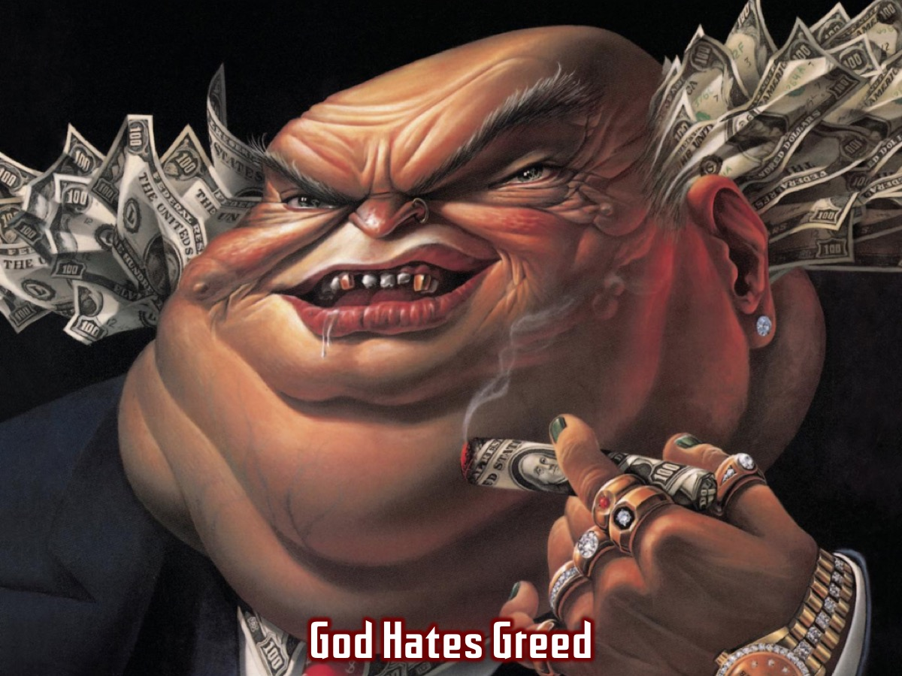
Notes:
God Hates Greed

Slide 34
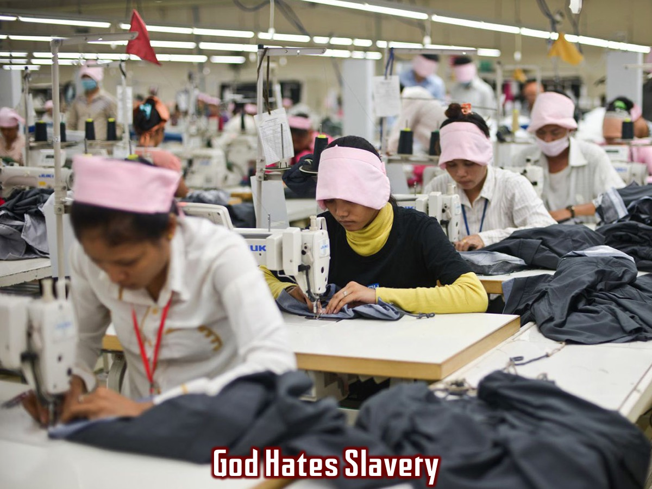
Notes:
God Hates Slavery

Slide 35
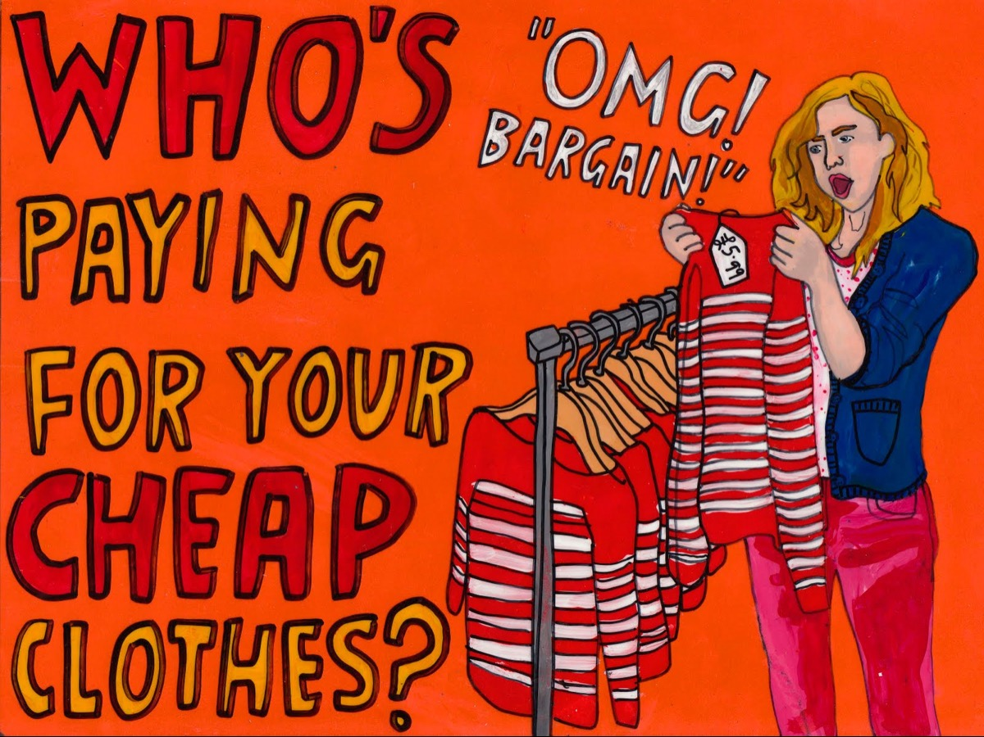
Notes:
“Who’s paying for your cheap clothes?” This cartoon really challenges whether we support the dark side of cities!

Slide 36
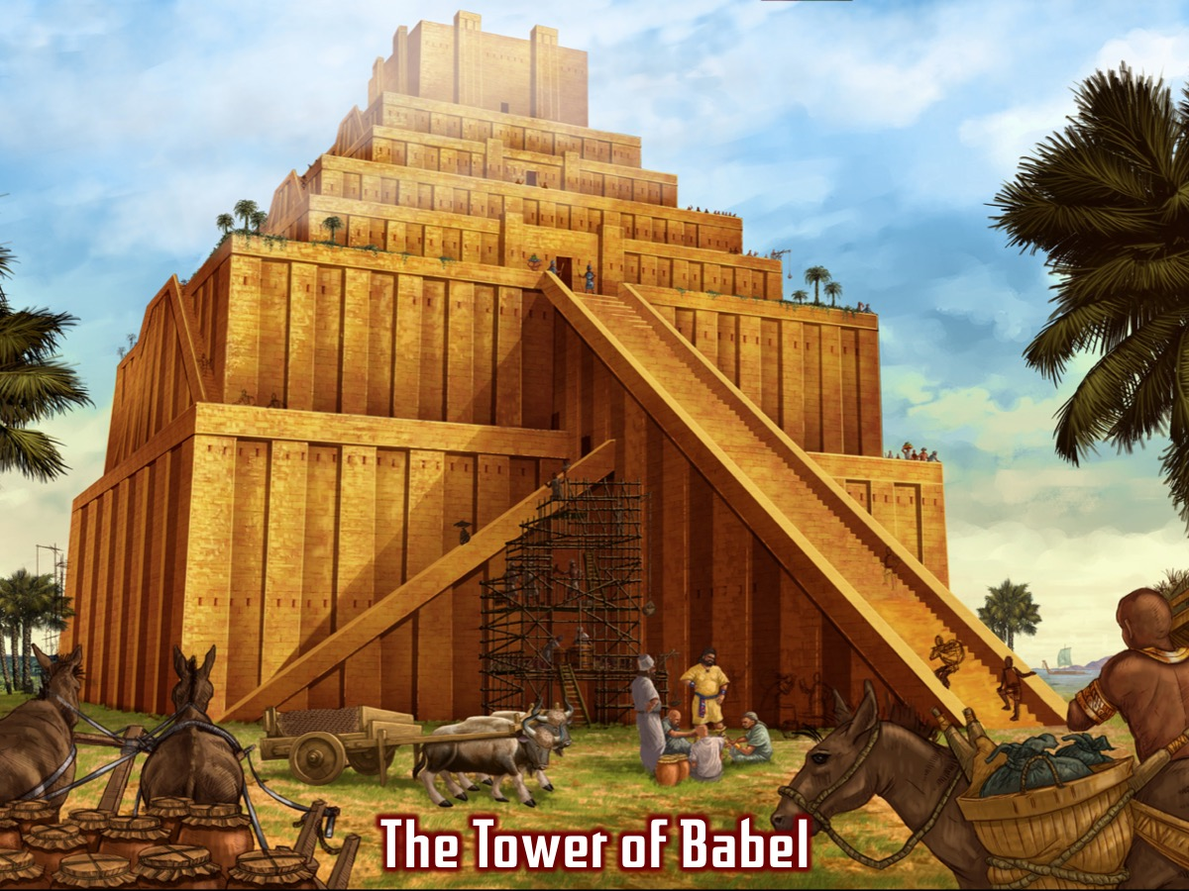
Notes:
The description of the fall of babylon is drawn from various scriptures: The punishment for a prostitute (Lev 21:9) and from Isaiah’s description of the fall of the original Babylon (Isaiah 47). This is all very complex – but the lesson is clear: The brutal but seductive civilisations and national empires which ensnare the world by promising luxury and delibering slavery, gain their power from the monest, the System of Imperial Power. Some have called this the domination system – a system which transcends geographical limitations and which reappears again and again in every century. This system gains its power from the dragon – from satan. Those who are caught up in the resultant battles are part of the lambs victorious armies engagles in battle – and they conquer by the blood of the lamb and the word of their faithful testimony.
Extra Notes:
The judgments described in 6-8 are carefully structured to emphasize that what happens to the wicked city is what she has brought on herself. It is not done by Gods people. God works by turning wickedness back on itself – allowing wickedness to reach a great height and then crash helpless to earth (verse 7, echoing Isaiah 47:8-9), She gets the medicine she has mixed for others - she will drink her own poison.

Slide 37
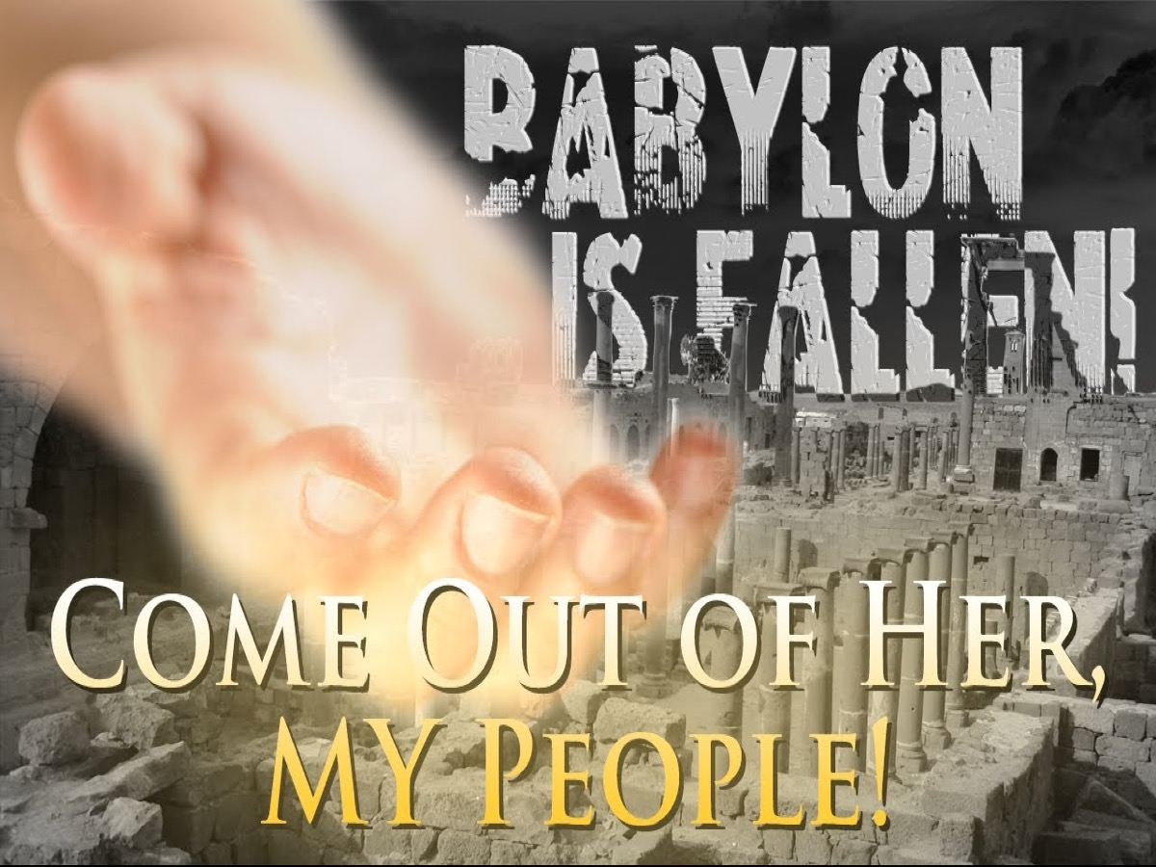
Notes:
So God’s people are summoned to come out of her. See also Isaiah 48:20 and 52:11-12 and Jeremiah 51:45. We must run from the city as we would from a great fire. We are not talking about an actual city here – this is not Rome which was sacked and burnt to the ground only to be rebuilt later. It is the heart of the empire dispensing favours, giving royal treatment to those who can be useful or who have substantial bank balances and tossings aside as trash those wgo can’t have haven’t. While tyrants need to be toppled, God does not want anarchy. Human rulers are there because this is who God wants to run the world. These structures are part of the good creation but the problem comes when they cease to be humble servants of God’s good purposes for his world. Our job is to discern when one passes into the other and when they happens to leave either physically or spiritually.
Extra Notes: Babylon’s Judgment (Revelation 18:9-24)
Illustration: Imagine a whole city on fire – burned to the ground. Millionaires become paupers overnight. Here we have reference to Babylon’s sudden downfall (drawing from Isaiah 23 and Ezekiel 27 with fresh ideas added by John). John describes all the luxury goods that have been brought into the city through trade with others cities or countries and at the end of the list we find among the goods are bodies – human lives. When you worship idols, the idols demand sacrifices. If you worship Mammon the money-god, or Mars the war-god, or Aphrodite the sex-god they will demand sacrifices. Amd some of those sacrifices will be human. This is slavery – the buying, selling and using and abusing of human beings as those they were on a par with gold and silver, ivory and marble. Slavery was to the ancient world what steam, oil, gas, electricity and nuclear power are to the moden world. Slavery was how things got done. Life was unthinkable without it. Yet John believed in the God of the exodus, the God who sets slaves free. Just like God’s work to free theslaves in Egypt – God is doing it again! The basic act of slave-freeing took place when Jesus died to set the captives free (5:9) – slaves were bought to set them free. John looks at Rome/Babylon and sees the slave market. The system is rotten and it affects everything that happens in the city. He has no sympathy becayse of what she was and how she treated people. Babylon gained her power from the monster and the monster from the accuser, Satan the old dragon who though out of sight at the moment will shortly reappear. The whole system is built on lies – we have to learn how to tell the different between truth and lies. The only way to overthrow Babylon is through the blood of the lamb and the faithful witness of his followers.

Slide 38
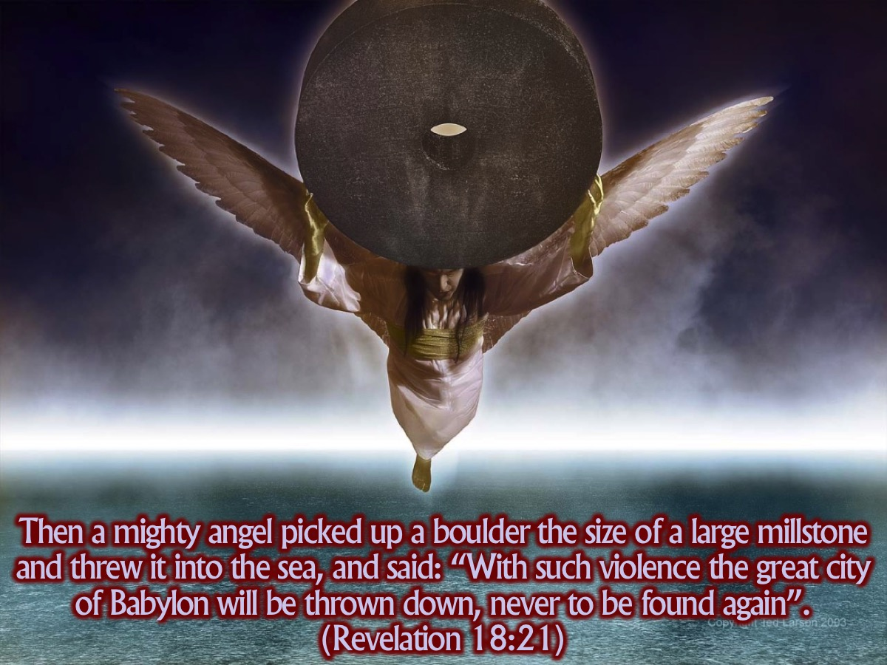
Notes:
John sees an angel performing a act of great and powerful prophetic symbolism. Babylon is to be hurled into the sea, never to rise again. An enormous splash and she sinks like a stone, never to be seen again.

Slide 39
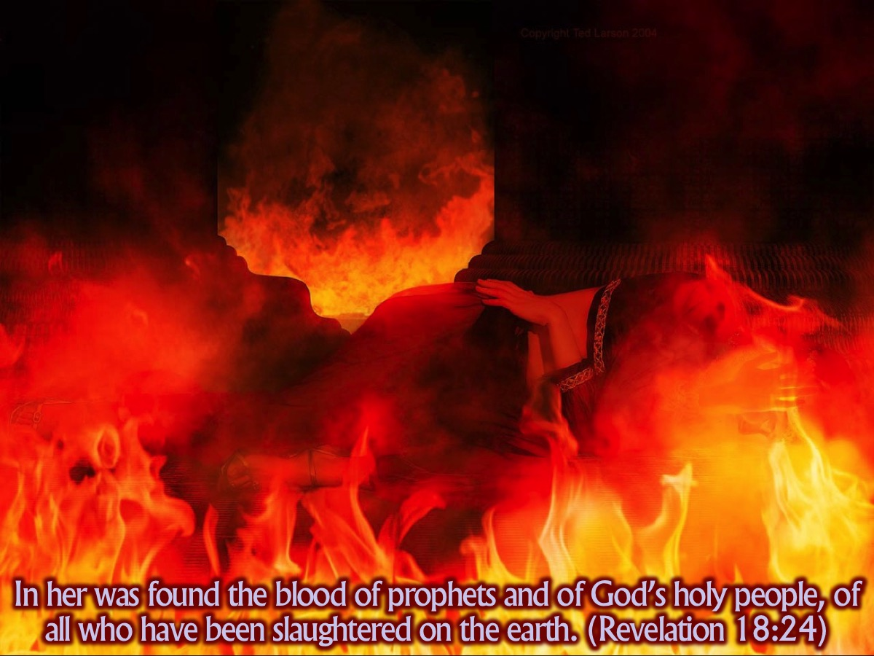
Notes:
Why does this happen? Verse 24 says that Babylon was a city founded on violence – everyone who has been slaughtered since the beginning in a sense have been slaughtered at the behest of Babylon.

Slide 40
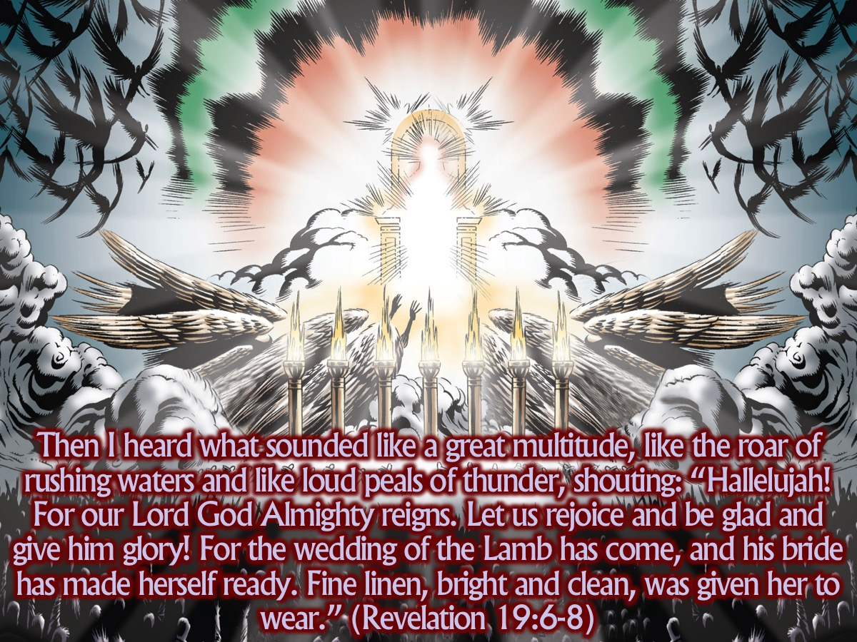
Notes:
Then I heard what sounded like a great multitude, like the roar of rushing waters and like loud peals of thunder, shouting: “Hallelujah! For our Lord God Almighty reigns. Let us rejoice and be glad and give him glory! For the wedding of the Lamb has come, and his bride has made herself ready. Fine linen, bright and clean, was given her to wear.” (Revelation 19:6-8)

Slide 41
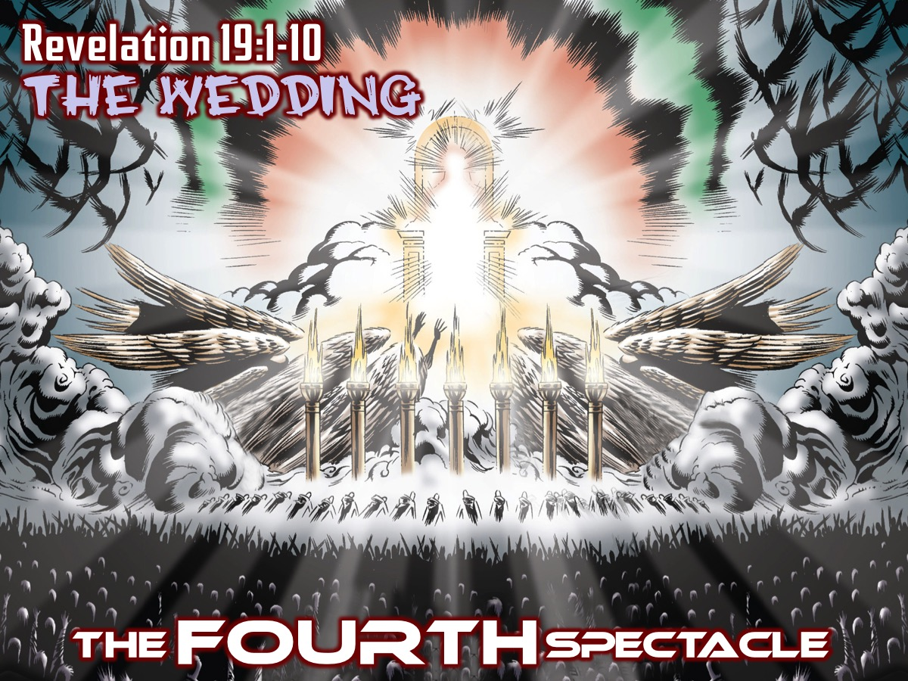
Notes:
The FOURTH Spectacle: The Wedding (Revelation 19:1-10)

Slide 42
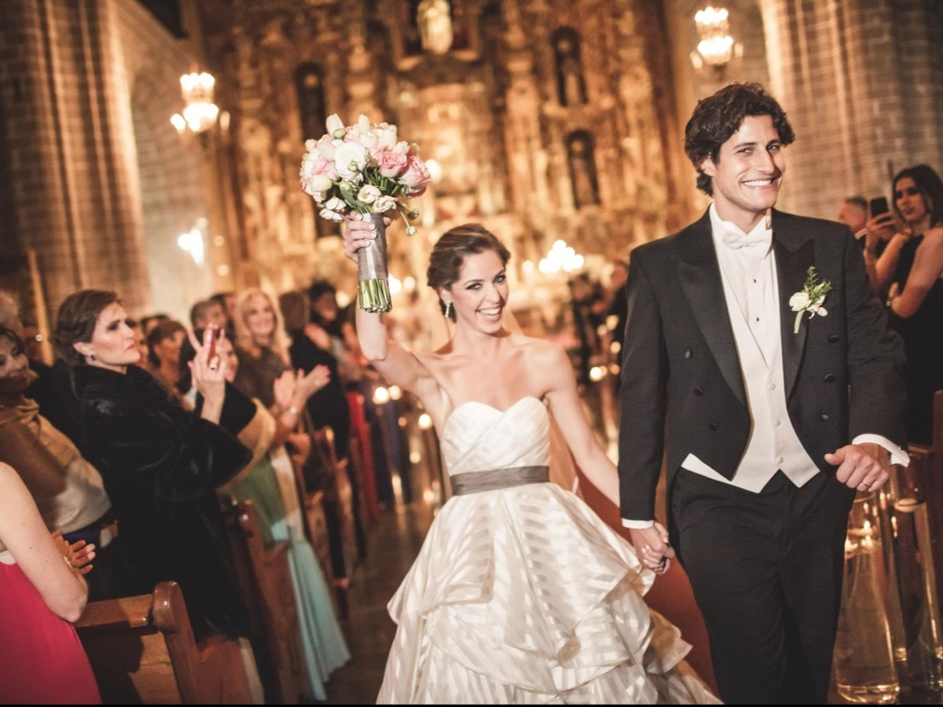
Notes:
Illustration: Weddings are special, but very expensive. We are after all made male and female in the image of God and in Genesis this union in marriage is the climax of the whole story of creation. The promises made at a wedding – to be faithful through thick and thin and a reflection of God’s plan for the world. A wedding is a symbol.

Slide 43
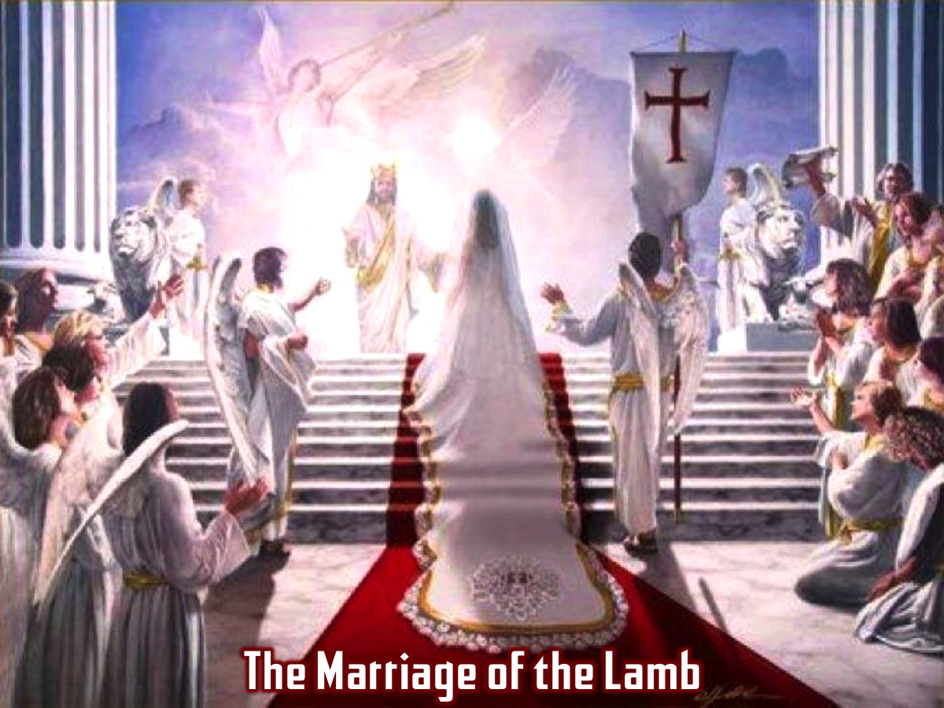
Notes:
Suddenly we are back in the throne room and there is great rejoicing and celebration - because the time has come for the marriage between the lamb and his bride - Jesus and the church will be forever united in unity (never to be separated) and now the great feast can begin.
Extra Notes: All of this is in the background of the great reversal that takes place in the book of Revelation. The whore has been judged, the bride steps forward. The glossy, glitzy world of Babylon has been overthrown. God’s people emerge with shining, pure linen to wear as God’s own gift. The marriage of the lamb and his bride is the focal point of the marriage of heaven and earth – and Babylon, the symbolic equivalent of the ancient Babel which tried to climb up to heaven by its own energy, is shown to be a futile parody of the real thing, a human effort to get by sheer greed, what God proposed to give by sheer grace. We find ourselves back in the throne room and again see the elders and living creatures worshipping God on the throne. There is a huge crowd that they lead in worship – probably the same crowd that we heard at the end of chapter 5 and again in chapter 7. They give God praise for his victory over the whore, celebrating that her destruction is final (the smoke goes up for ever and ever and preparing the way for the marriage of the lamb and its bride. The idea of the marriage goes back to Jewish tradition of Israel as God’s bride – wooed in the wilderness, married at Sinail, unfaitjful for many generations, and sent into exile, but then wooed and won all over again in a covenant renewal that would result in the renewal of the whole of creation (Isaiah 54-55). Song of Songs is a story of the love between God and his people. Now there is to be a banquet, God’s great feast, to which he will invite everybody (Isaiah 25:6-10). Jesus also spoke of a king’s marriage-supper for his son (Matthew 22:1-14 and 25:1-13) and spoke about appropriate clothing to wear. John says that this great moment has come at last – this is what the world has been waiting for since Genesis 1 and since the covenant with Abraham and Moses and promised at the time of the exile. Marriage is the ultimate covenant and Jesus is the ultimate bridegroom. Now that wickedness, pride and arrogrance has run its course, celebration can start! John is so excited by all this that he starts to worship the angel – but that is confussing the messenger with the message. That would be idolatry. Maybe he is reminding us how easy it is to get tempted to worship idols instead of God.

Slide 44
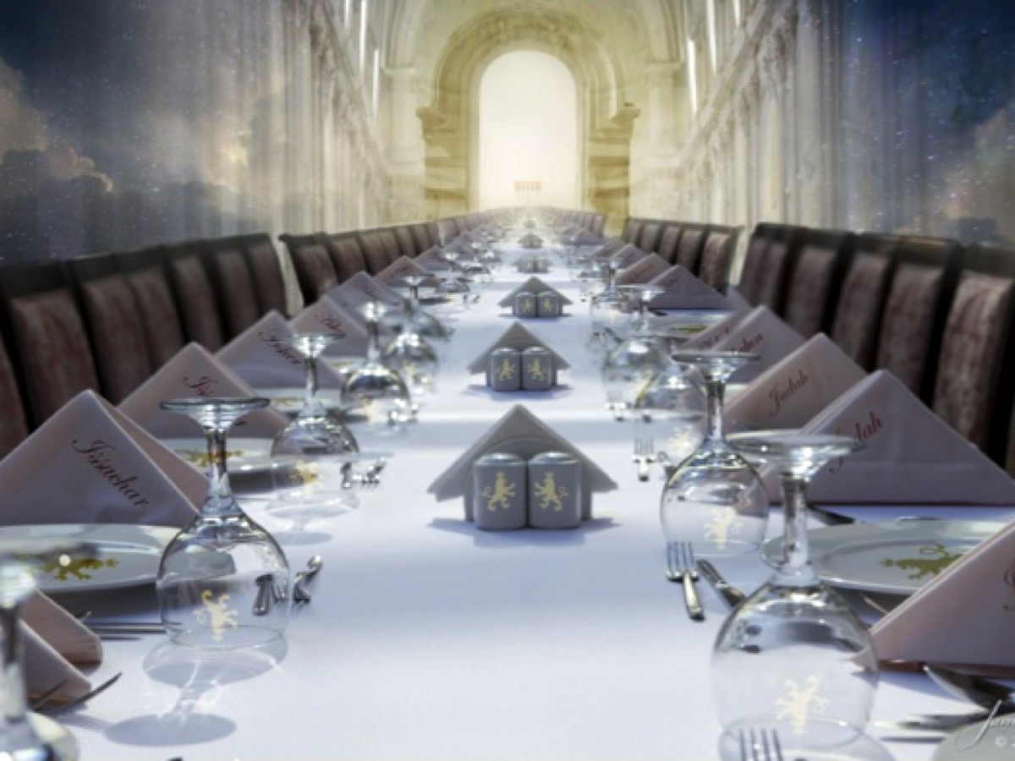
Notes:
I am looking forward to taking my place at this table one day - when as part of the church - the followers of Jesus - we will enjoy this meal to celebrate our union with Jesus!

Slide 45
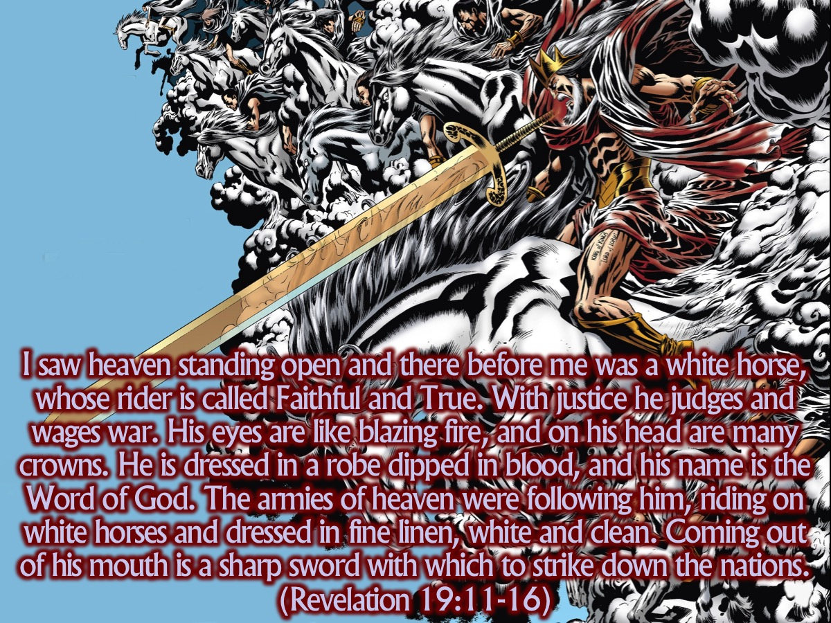
Notes:
I saw heaven standing open and there before me was a white horse, whose rider is called Faithful and True. With justice he judges and wages war. His eyes are like blazing fire, and on his head are many crowns. He is dressed in a robe dipped in blood, and his name is the Word of God. The armies of heaven were following him, riding on white horses and dressed in fine linen, white and clean. Coming out of his mouth is a sharp sword with which to strike down the nations. “He will rule them with an iron scepter.” He treads the winepress of the fury of the wrath of God Almighty. On his robe and on his thigh he has this name written: King of Kings and Lord of Lords. (Revelation 19:11-16)

Slide 46
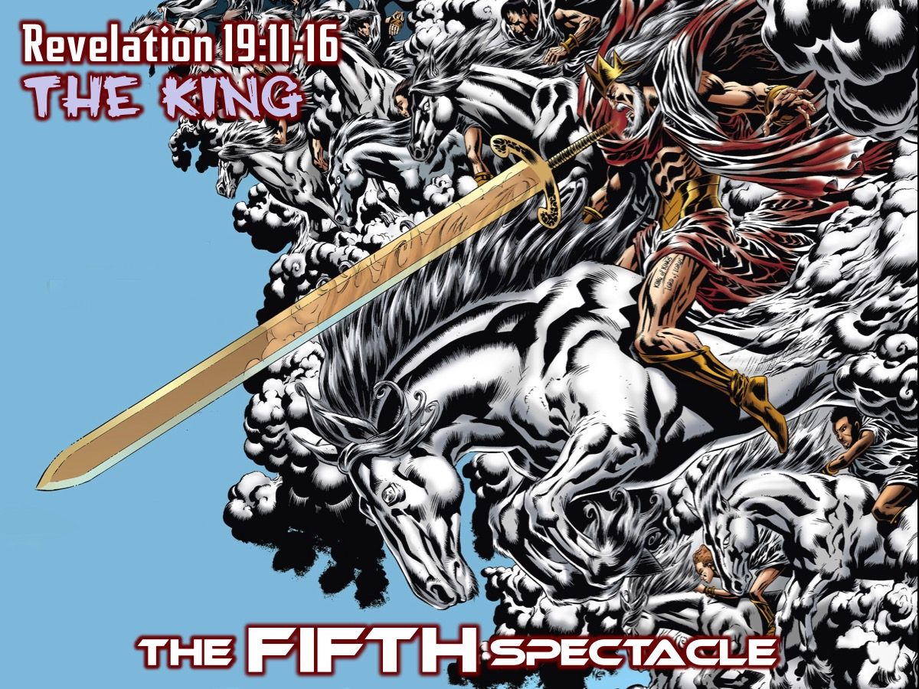
Notes:
The FIFTH Spectacle: The King (Revelation 19:11-16)

Slide 47
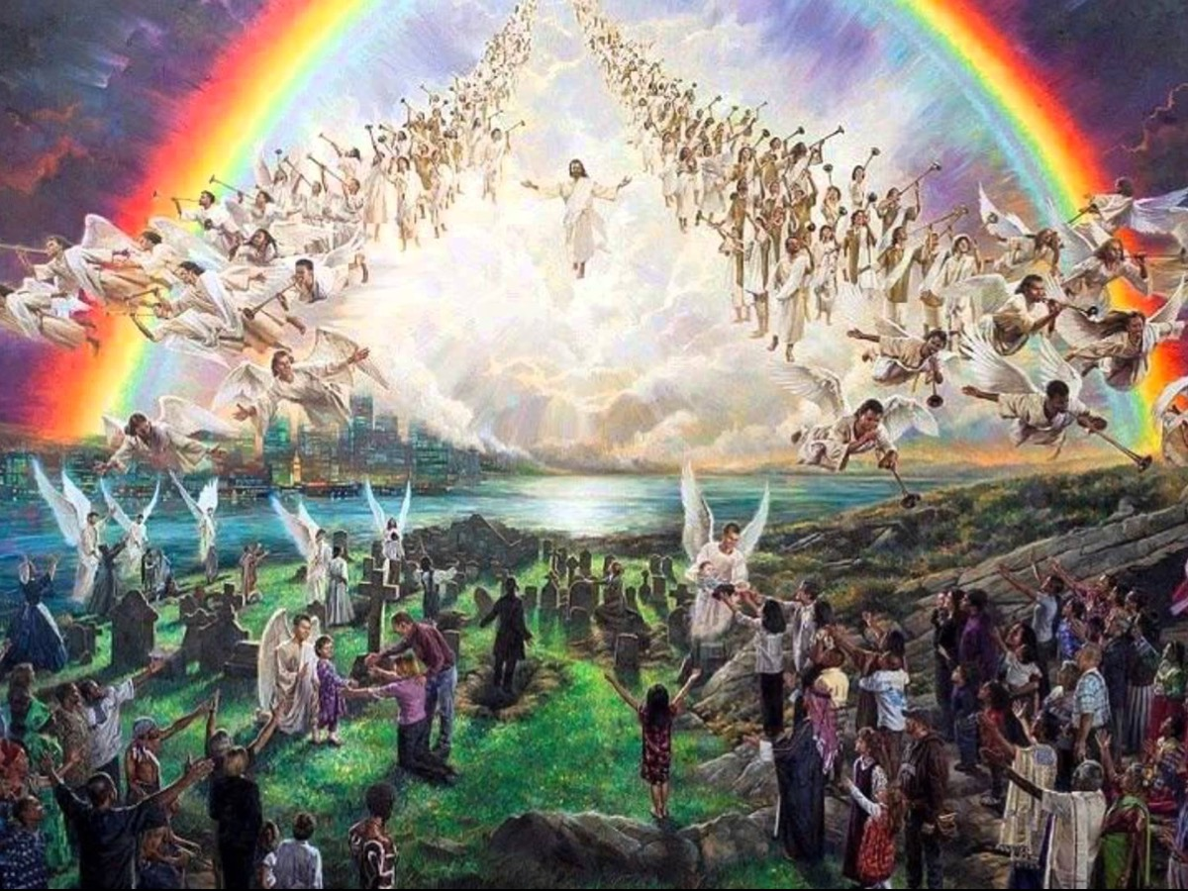
Notes:
What a moment this is going to be when Jesus, surrounded by the armies of heaven, will appear to restore order to the world!
Extra Notes: Jews did not see Jesus as the Messiah because he did not fight against their enemies during his lifetime, nor did he restore the temple and temple worship. Yet Jesus spoke throughout his life and ministry about the kingdom of God – and how that he was bringing it to earth. For Jesus, the dark powers behind Rome and pagan empires was the focus of the real battle – the Satan – the one who leads humanity into rebellion against the creator. Ultimately, he believed that to fight this true battle meant giving up his life. There is rich symbolish here as victory here is victory over all pagan power and violence. There are echoes of the triumph of the Messiah from Isaiah 11 (where he will judge the nations) and Psalm 2 (where he will rule over them with an iron rod) and Isaiah 63 (where he will tread the winepress of the wrath of God). The actual weapons Jesus used to win the battle were his own blood, his own loving self-sacrifice. The ultimate justice which drives his victorious battle (11) is the justice of God’s love, which works through the word (13,15) and is dressed in purity and holiness (14). Love will win the day, because in the person of Jesus it has trampled the grapes of wrath once and for all (15).

Slide 48
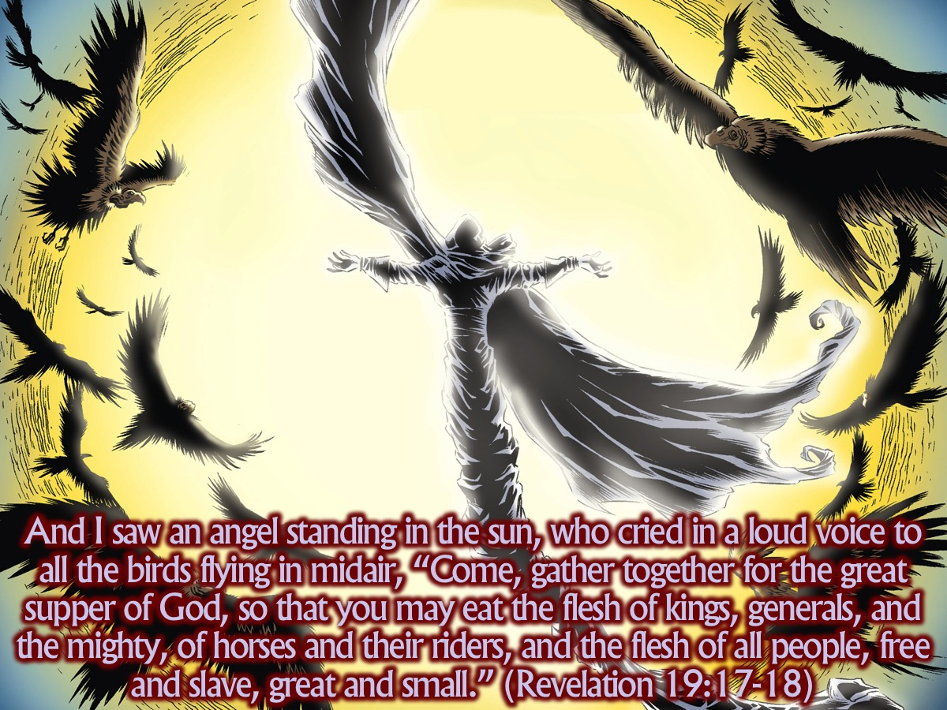
Notes:
And I saw an angel standing in the sun, who cried in a loud voice to all the birds flying in midair, “Come, gather together for the great supper of God, so that you may eat the flesh of kings, generals, and the mighty, of horses and their riders, and the flesh of all people, free and slave, great and small.” (Revelation 19:17-18)

Slide 49
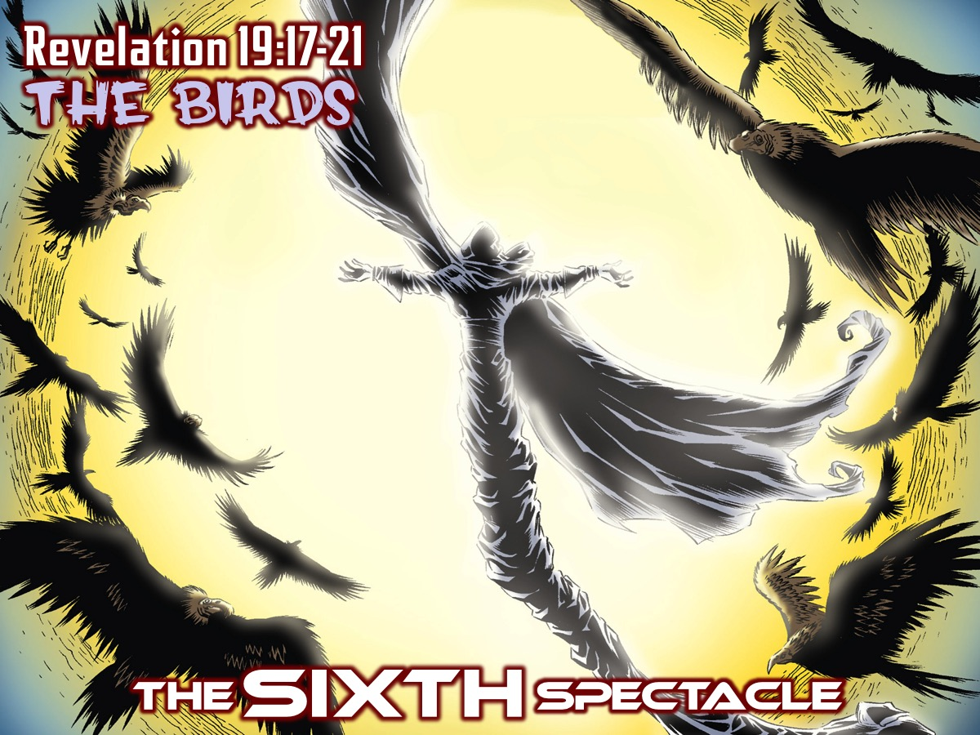
Notes:
The SIXTH Spectacle: The Birds (Revelation 19:11-21)

Slide 50
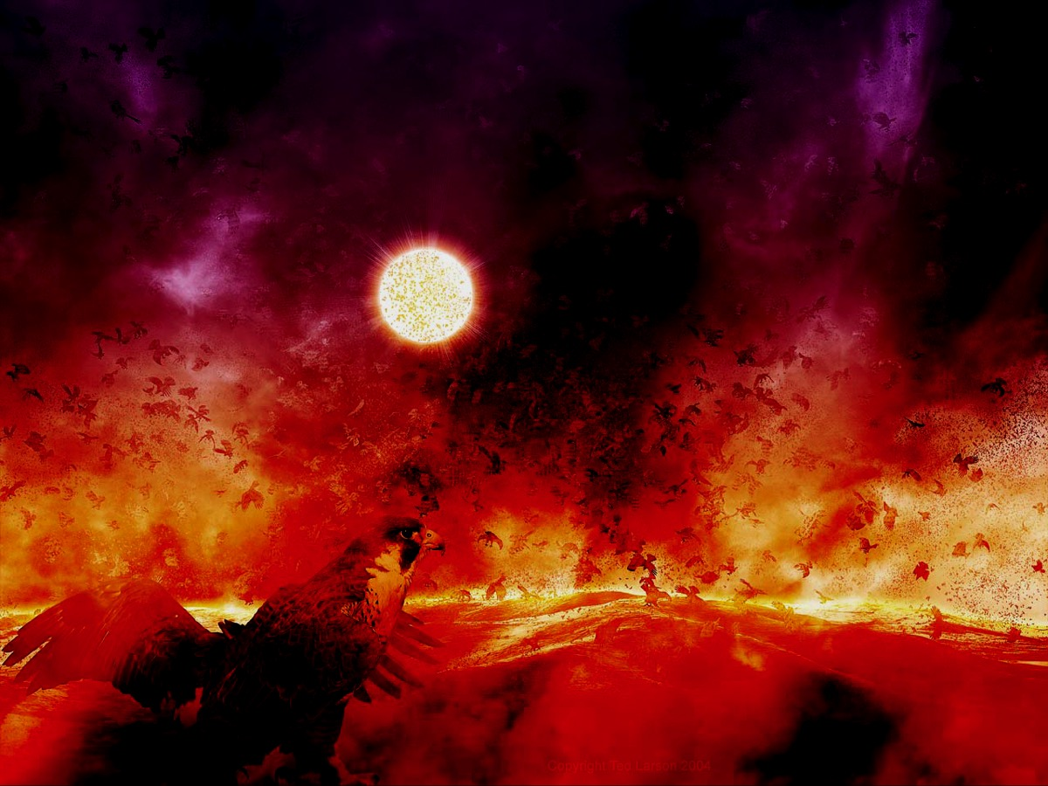
Notes:
The birds that sweep in are probably also symbolic – as they feast on the monster and the false prophet. The prostitute was dealt with in chapter 17 and 18 and now it is their turn (the great imperial system and the local elites who promote it and deceive the nations). In the end they get thrown into the lake of fire which burns with sulphur – an echo of the fate of Sodom and Gomorrah.
Extra Notes:
The angel summons birds to a horrific supper. Building on the imagery of Ezekiel 39:4, 17-20, it depicts God’s curse on rebels. The curse includes not only death and utter powerlessness, but dishonoring of the bodies after death. Instead of receiving the honorable burial that the great men covet, the bodies are devoured by birds (cf. Gen. 40:19; Deut. 28:26; 1 Sam. 17:44; 2 Sam. 21:10; 1 Kings 14:11). It is the antithetical counterpart to the blessed supper of the Lamb in 19:9. On the Beast and the False Prophet, see 13:1-18. The gathering armies fill out the picture already introduce in 16:14.

Slide 51
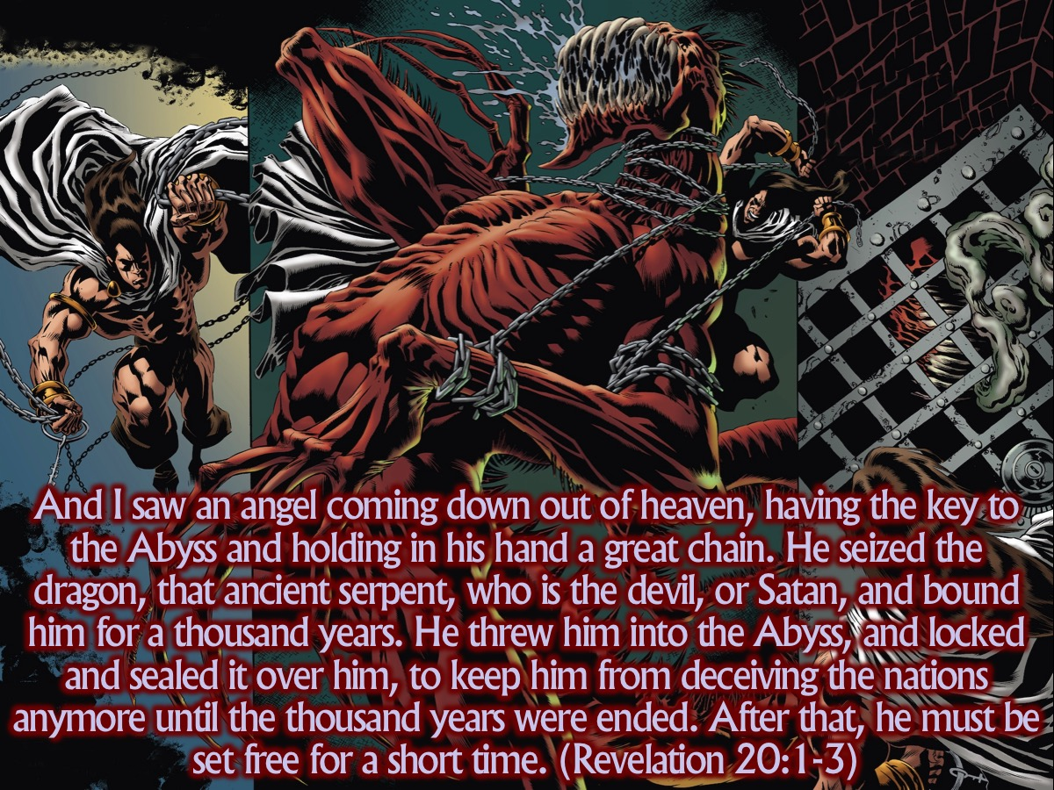
Notes:
And I saw an angel coming down out of heaven, having the key to the Abyss and holding in his hand a great chain. He seized the dragon, that ancient serpent, who is the devil, or Satan, and bound him for a thousand years. He threw him into the Abyss, and locked and sealed it over him, to keep him from deceiving the nations anymore until the thousand years were ended. After that, he must be set free for a short time. (Revelation 20:1-3)

Slide 52
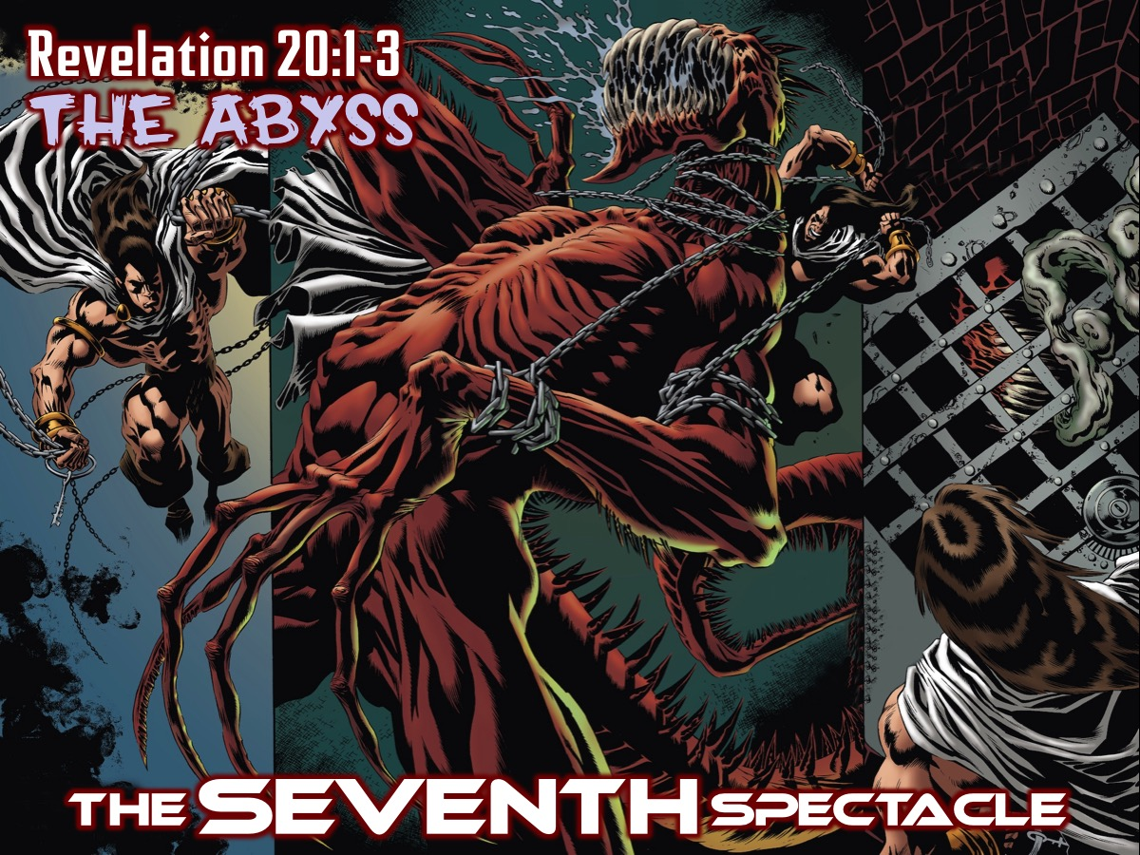
Notes:
The SEVENTH Spectacle: The Abyss (Revelation 20:1-3)

Slide 53
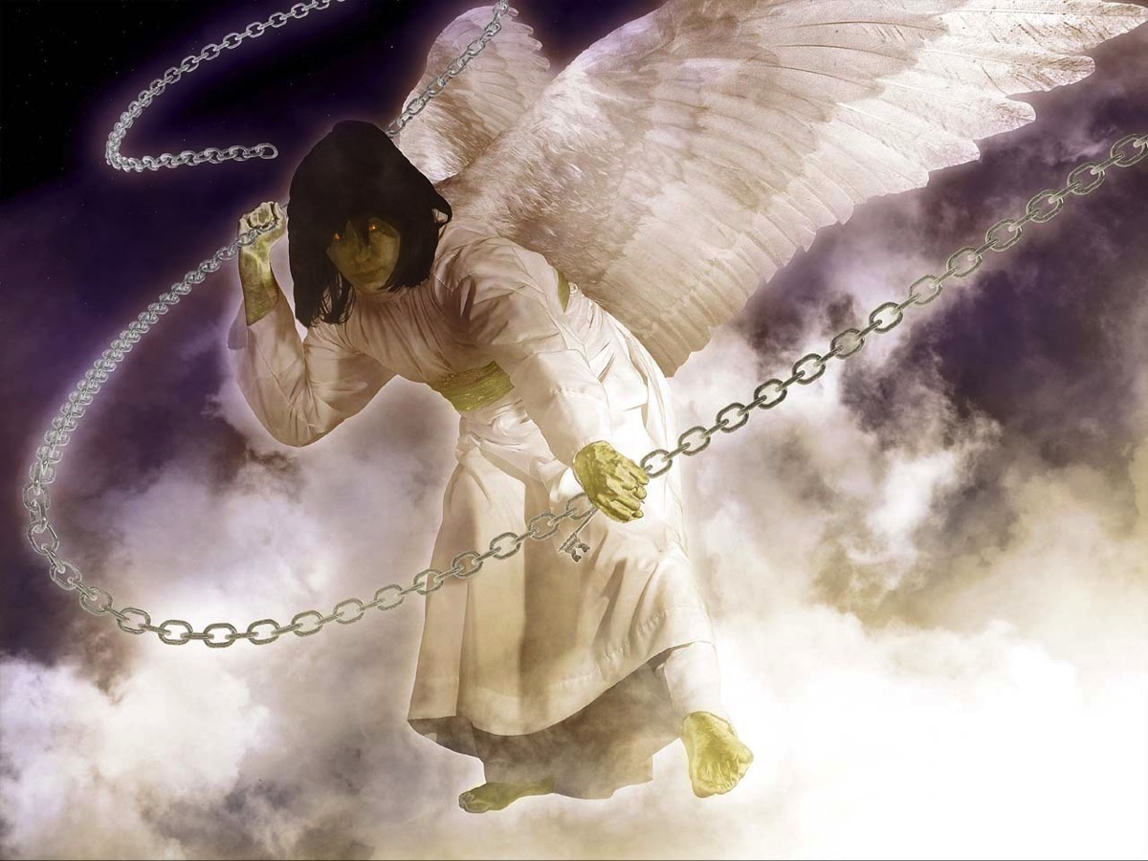
Notes:
It is time for evil to be defeated - and an angel appears with a key and a chain…

Slide 54
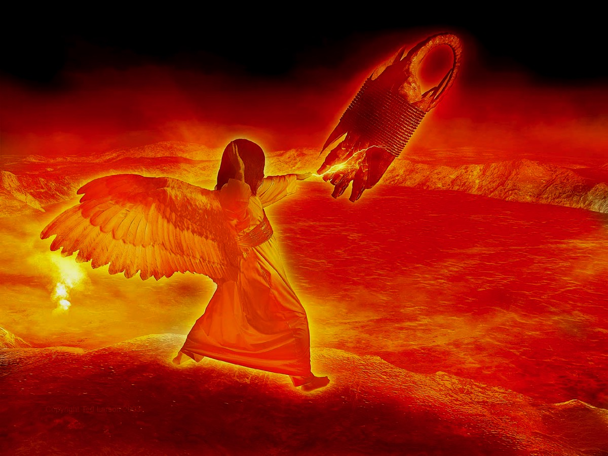
Notes:
He binds up the dragon, Satan, and throws him into a bottomless pit!

Slide 55
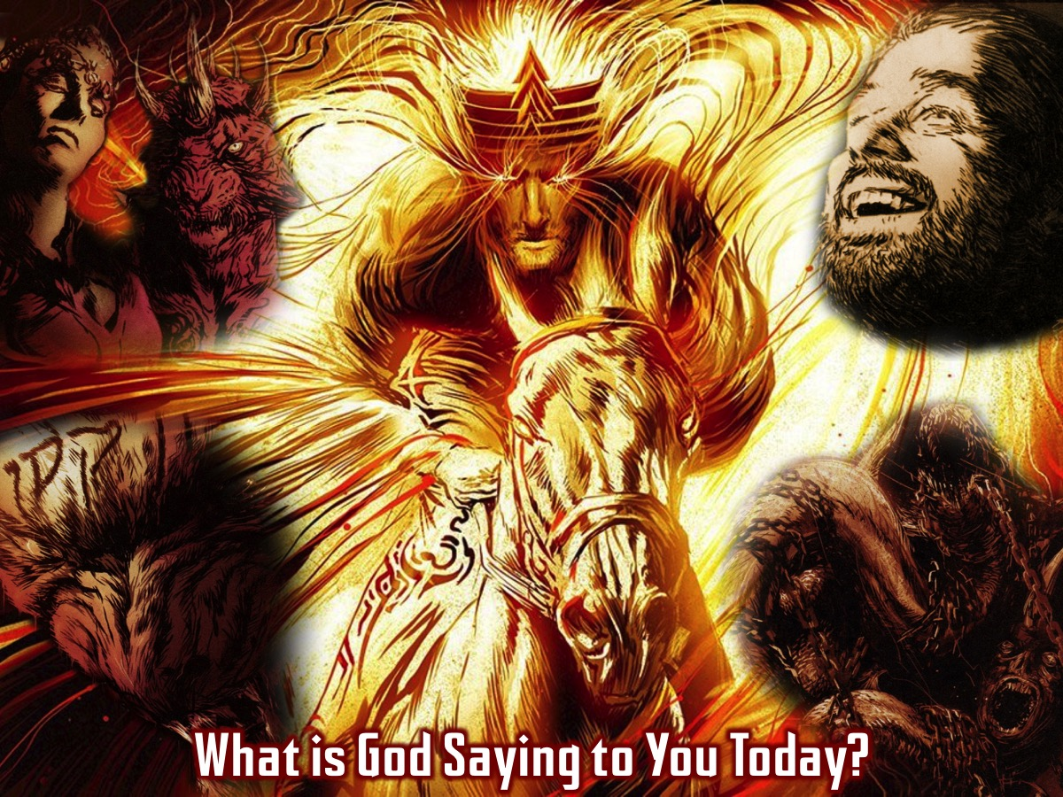
Notes:
What is God Saying to You Today?

Slide 56

Notes:
Let US Pray

Slide 57

Notes:
Next week we finish the Revelation series as we look at the 7 Sights in Revelation 20:4-22:5.

