Slide 1
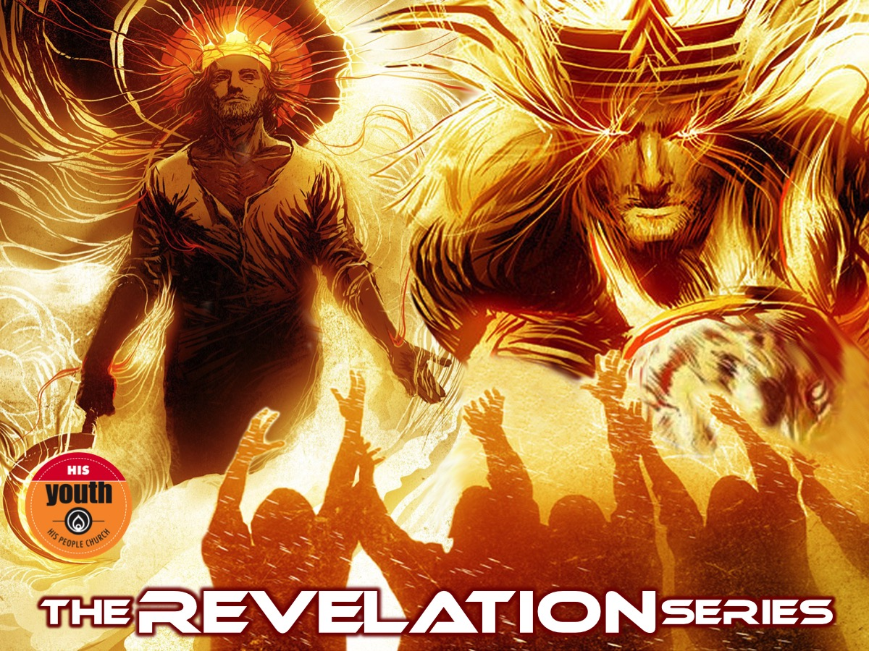
Notes:
Welcome to the Revelation Series.

Slide 2
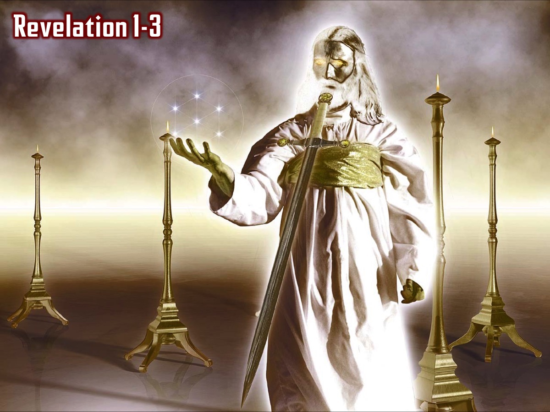
Notes:
In the first two weeks we saw an incredible revelation of Jesus and we read the seven letters that Jesus sent to seven churches in Asia Minor and reflected on what Jesus thinks about His Youth and also what our personal strengths, weaknesses, opportunities and threats are.

Slide 3
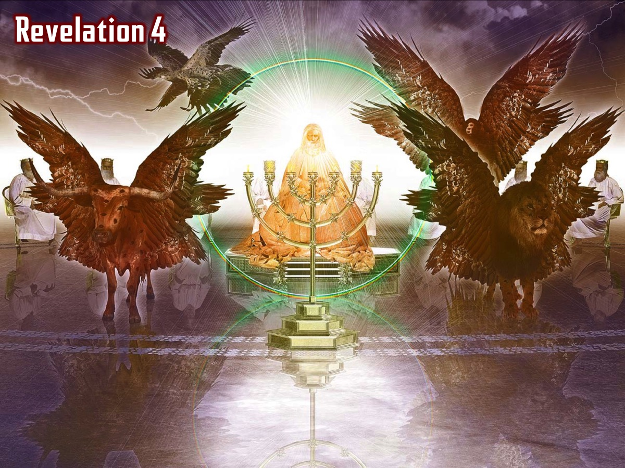
Notes:
In chapter 4 we saw how the 4 living creatures and the 24 elders and all the angels praised God for his amazing creation…

Slide 4
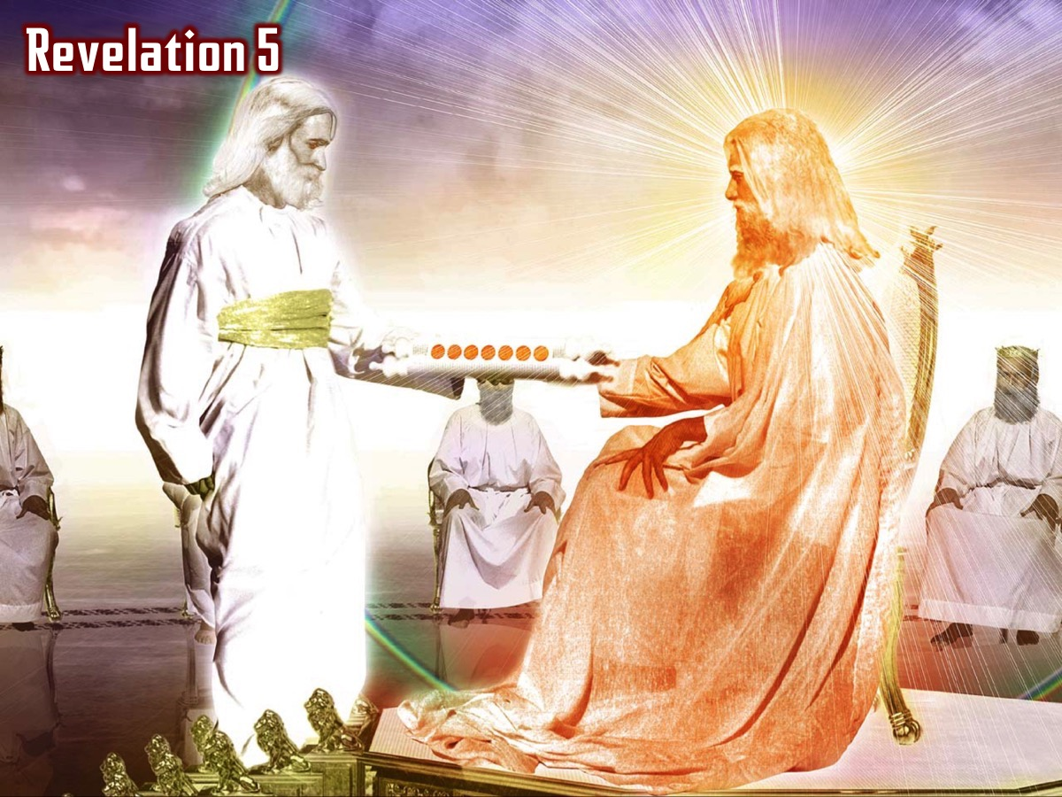
Notes:
In chapter 5 we saw that only Jesus was found to be worthy to take the scroll from his father and open it each of the seven seals (Revelation 5:8-14).

Slide 5
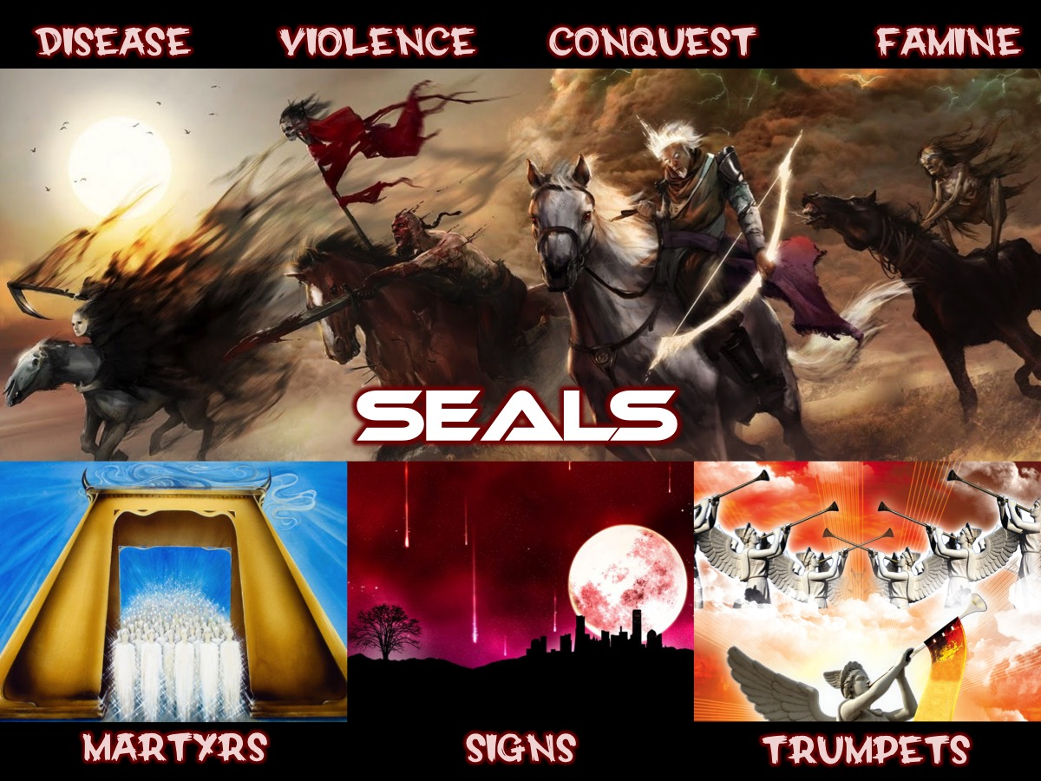
Notes:
We explored the 7 Seals that Jesus opened that brought destruction to earth.

Slide 6
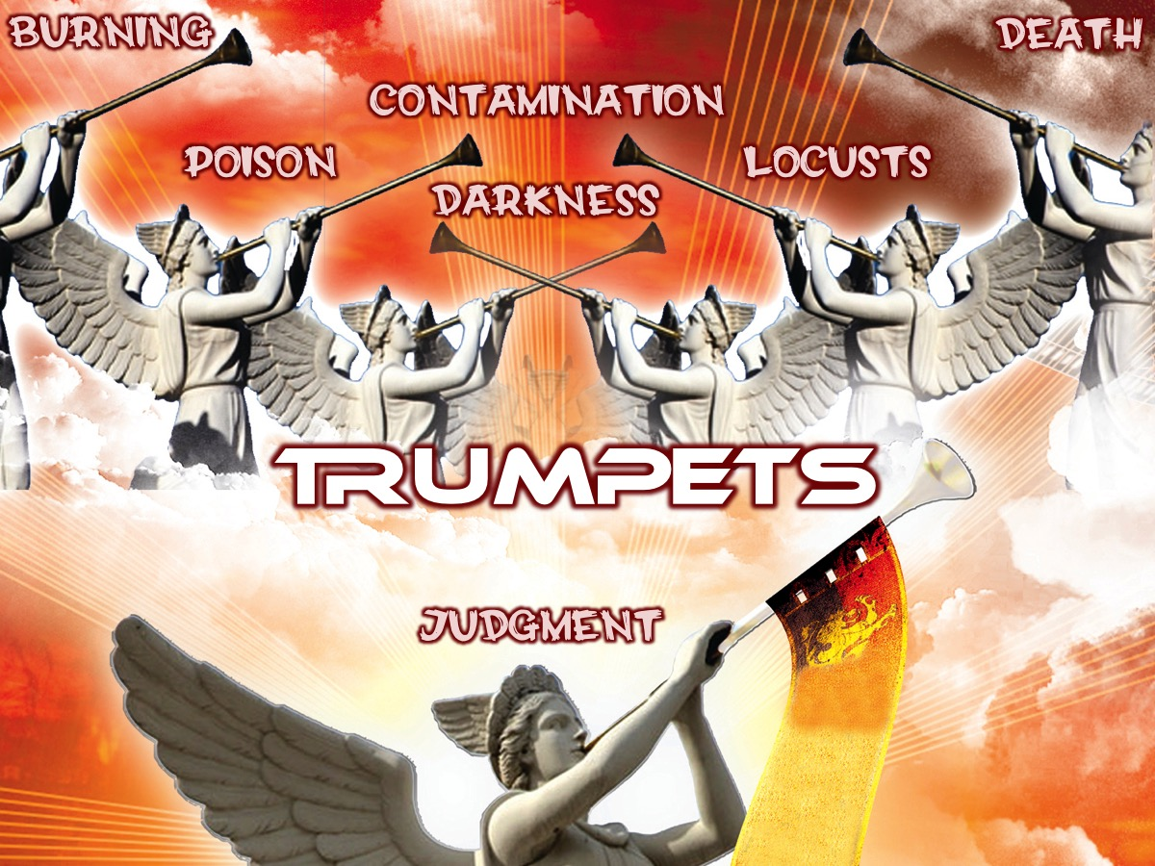
Notes:
We then looked at the 7 Trumpets that unleashed terror on the earth.

Slide 7
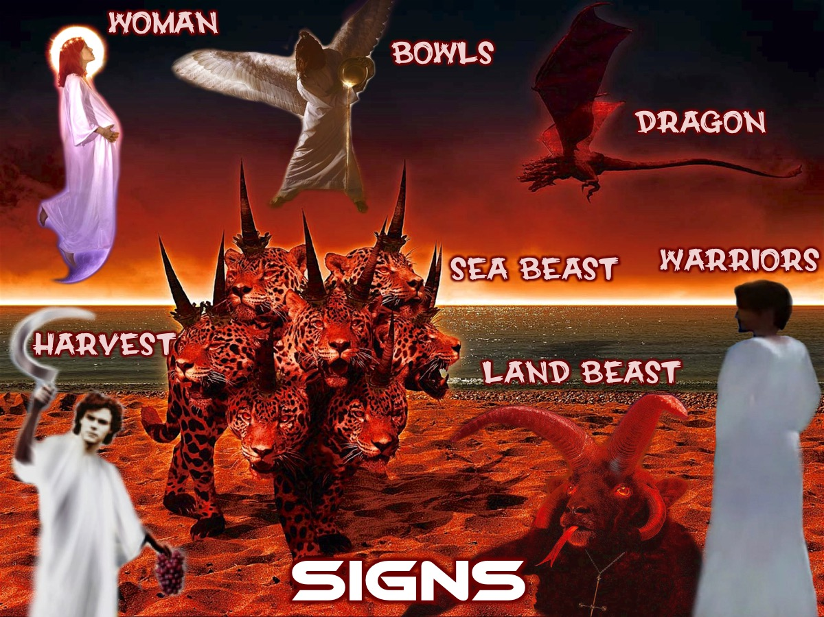
Notes:
We then looked at 7 Signs in Revelation 11:19-15:4.

Slide 8
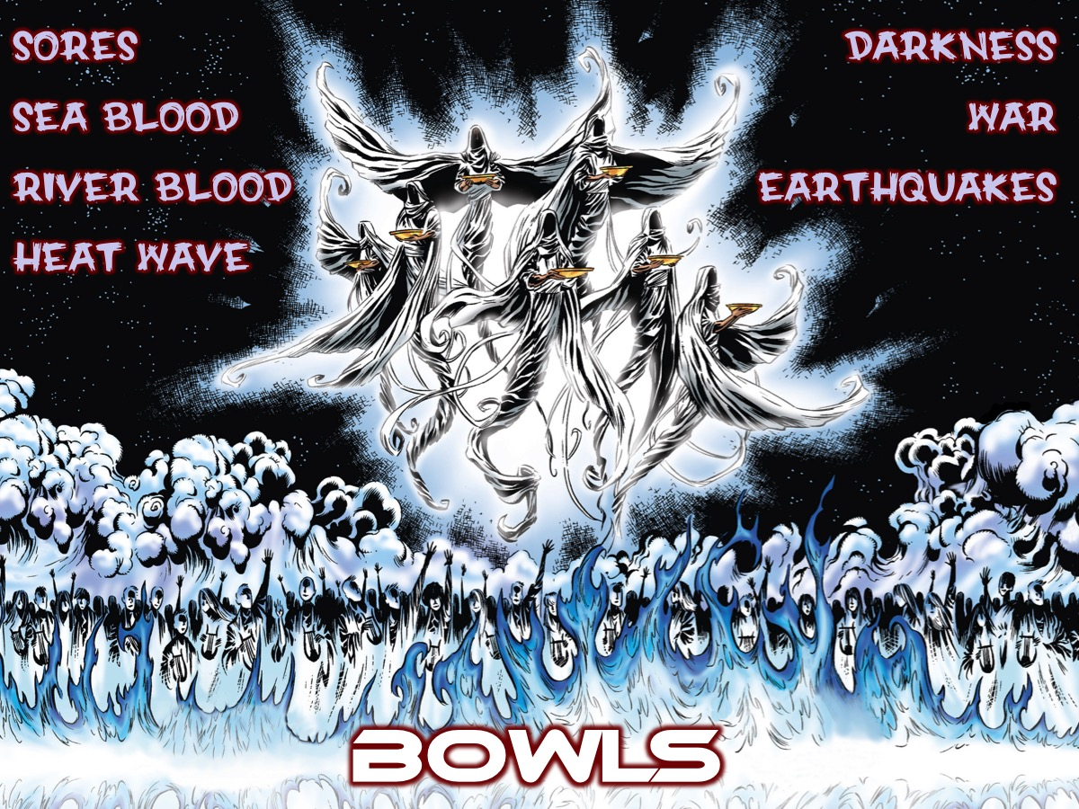
Notes:
We then looked at the 7 Bowls of Wrath in Revelation chapter 16.

Slide 9
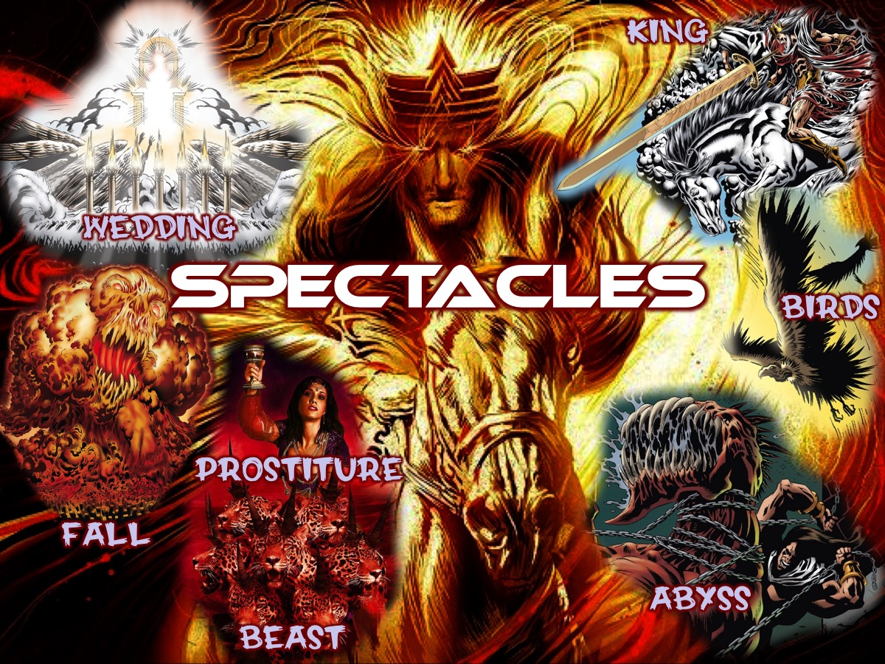
Notes:
Last week we looked at the Spectacles (Revelation 17:1-20:3)

Slide 10
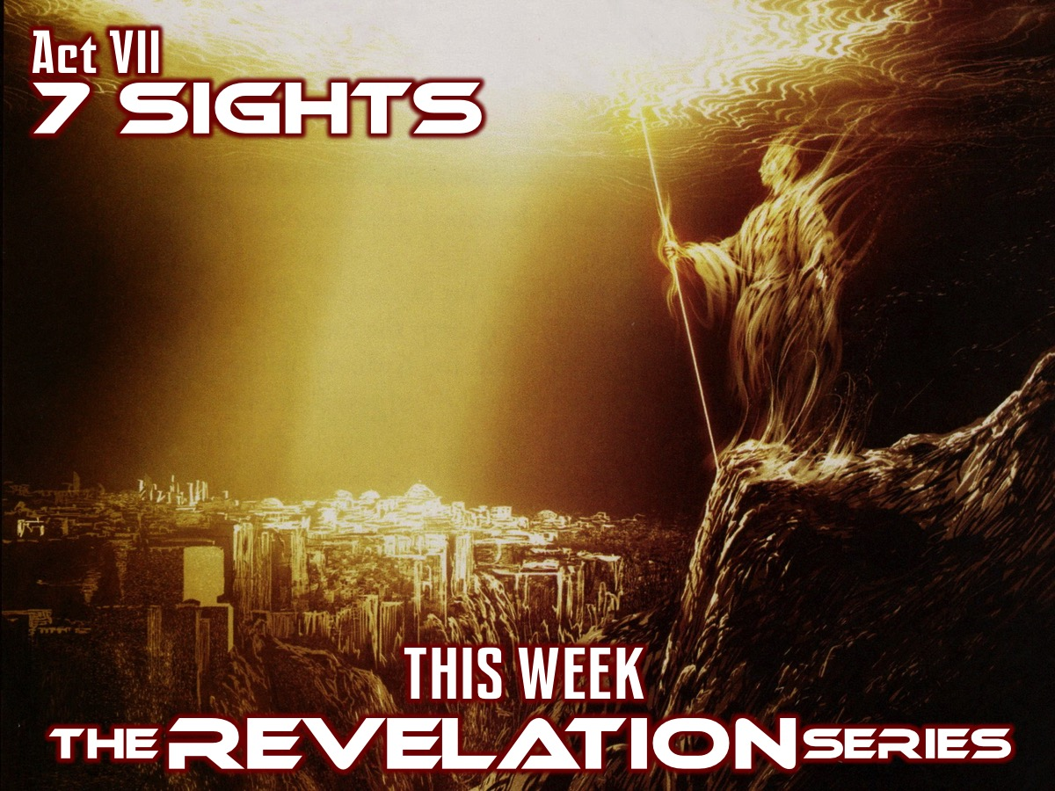
Notes:
Today we wrap up the Revelation series as we look at the 7 Sights in Revelation 20:4-22:5.

Slide 11
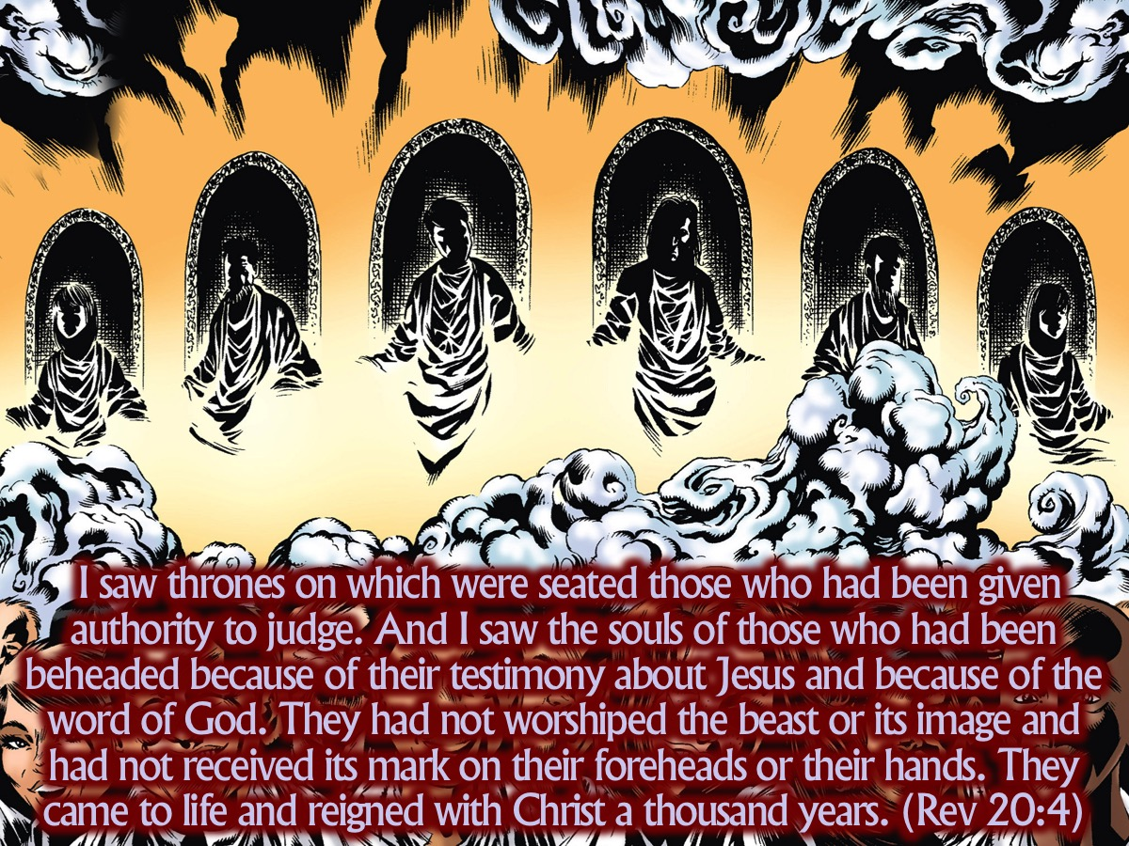
Notes:
I saw thrones on which were seated those who had been given authority to judge. And I saw the souls of those who had been beheaded because of their testimony about Jesus and because of the word of God. They had not worshiped the beast or its image and had not received its mark on their foreheads or their hands. They came to life and reigned with Christ a thousand years. (Revelation 20:4)

Slide 12
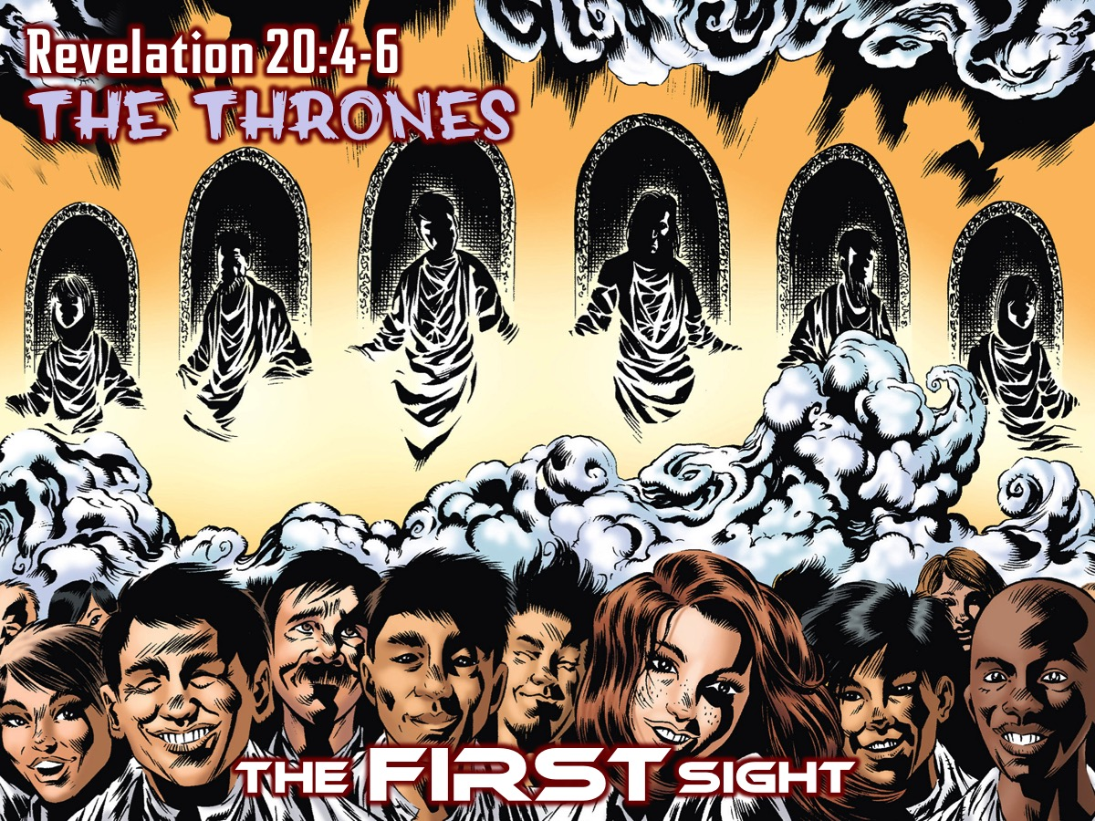
Notes:
The FIRST Sight: The Thrones (Revelation 20:4-6)

Slide 13
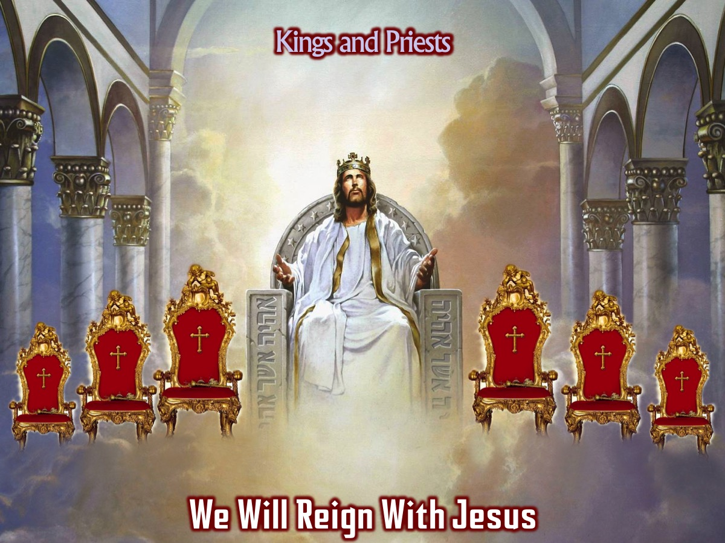
Notes:
We will one day reign with Jesus for a thousand years - most likely a symbolic amount of time - that is how much Jesus loves his followers and believes in them.
Extra Notes: It does seem strange that even after the monster and the false prophet are thrown into the lake of fire there is a delay before Satan joins them and then also a temporary respite in which he is let out of jail one last time to do his worst before he is finally overthrown. It would be more tidy if the battle in chapter 19 had seen the end of all the baddies. Yet, the book is not tidy and there are often interruptions. Especially so that God’s people can be sealed or fulfil their mission. Here again the delay involves a celebration of the suffering and martyred people of God as the true witnesses – the priest-kings who will share the Messiah’s rule (6). This is the only passage in scripture where a millenium is mentioned. And we should probably take it symbolically. The reign of Jesus with and through his millenial people must be established by the first resurrection. They are martyrs or those who have been beheaded for their witness. This is probably symbolic. Roman citizens were beheaded and not crucified. It is unlikely that the 1000 years relates to the church age (there have been satanic attacks and deceiving of the nations for the past 2000 years). The clue is in the passage: “I saw thrones, with people sitting on them, who were given authority to judge.” This is straight out of Daniel 7. This implies that the millenium is referring to not a 1000 year period on earth but to the heavenly reality taking place during a particular period. Jesus is already reigning and the martyrs are already reigning with him.

Slide 14
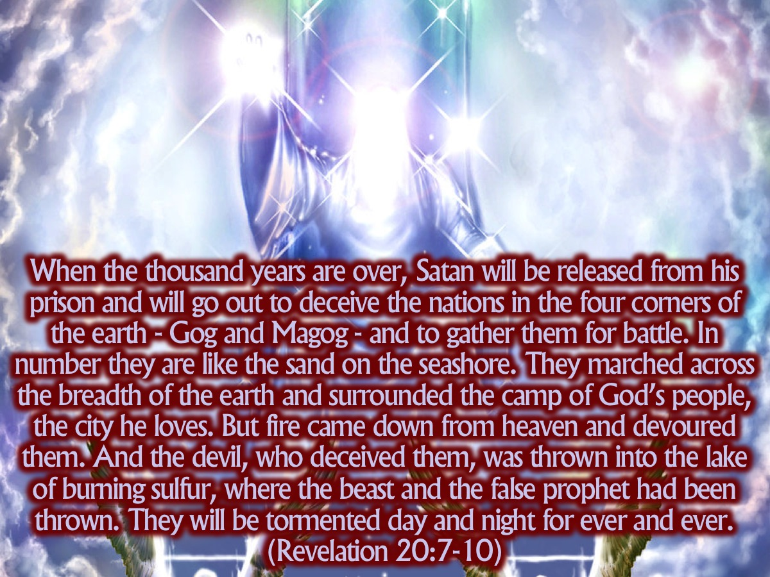
Notes:
When the thousand years are over, Satan will be released from his prison and will go out to deceive the nations in the four corners of the earth - Gog and Magog - and to gather them for battle. In number they are like the sand on the seashore. They marched across the breadth of the earth and surrounded the camp of God’s people, the city he loves. But fire came down from heaven and devoured them. And the devil, who deceived them, was thrown into the lake of burning sulfur, where the beast and the false prophet had been thrown. They will be tormented day and night for ever and ever. (Revelation 20:7-10)

Slide 15
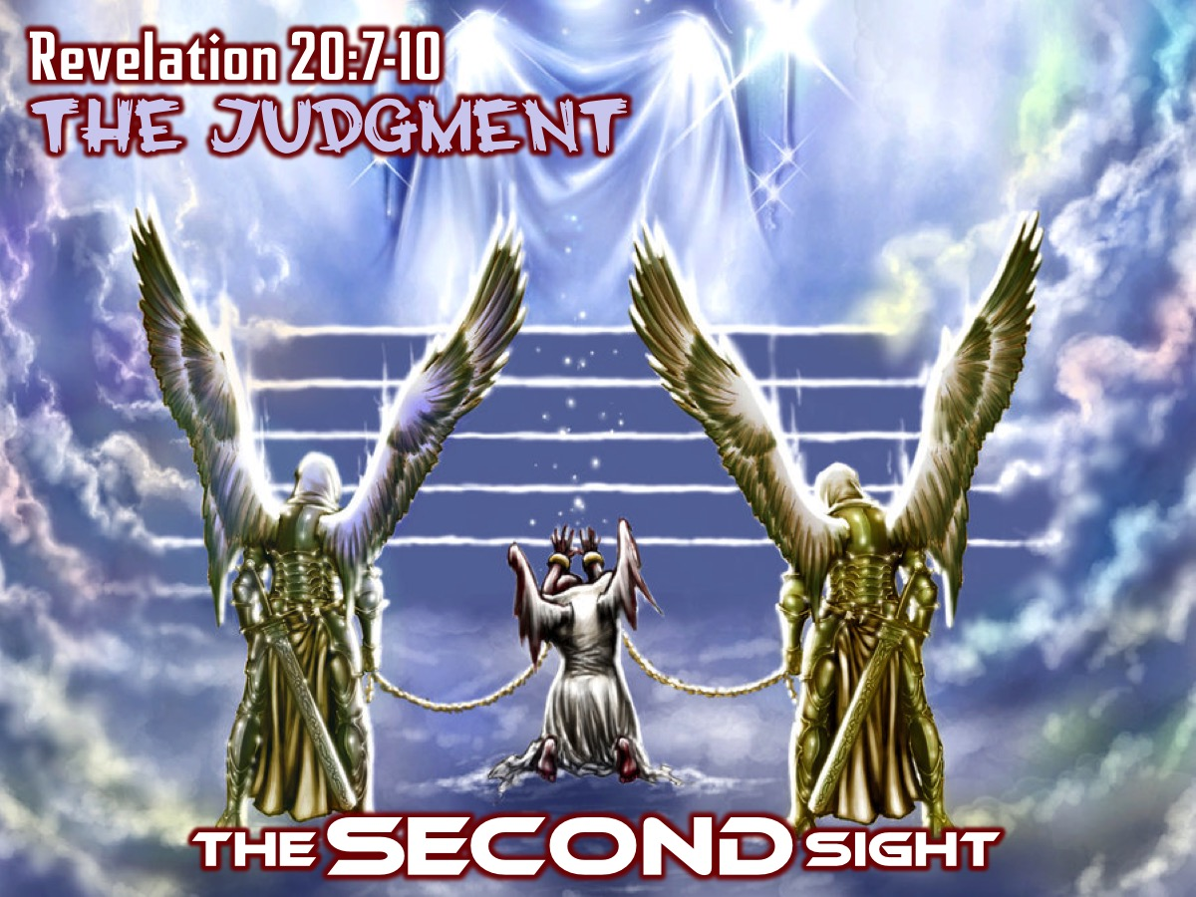
Notes:
The SECOND Sight: The Judgment (Revelation 20:7-10)

Slide 16
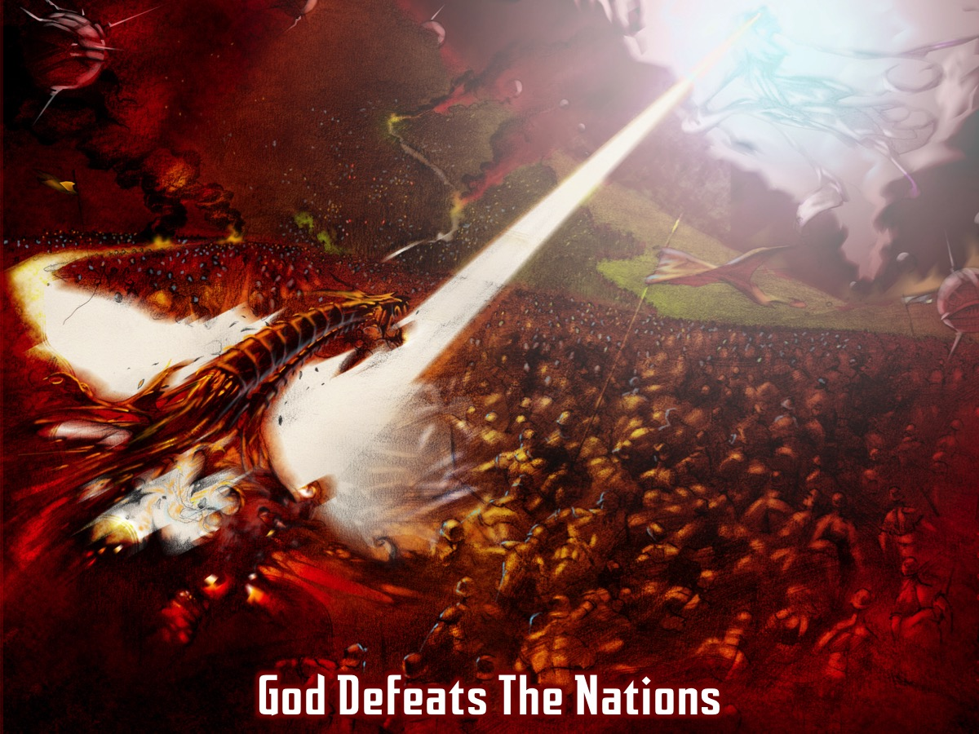
Notes:
Gog and Magog (mentioned previously in Ezekiel 38) represent the nations from the corners of the earth who are gathered together to fight against God. They will launch a last, vain attack on God’s people. Even though Satan summons the nations for a battle – no battle actually takes place. In an Elijah-like move, fire comes down from heaven and consumes them.

Slide 17
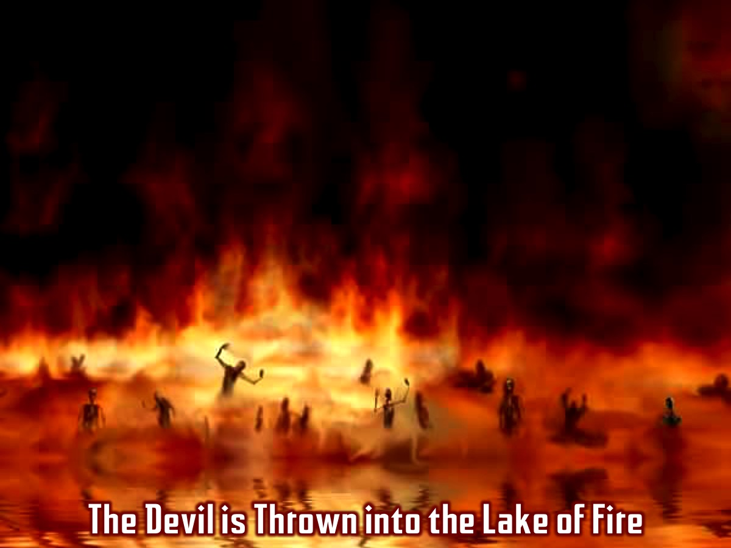
Notes:
Then and only then is the devil thrown into the lake of fire and sulphur along with the monster and the false prophet (they met their doom in chapter 19 and now at last the dragon has been overthrown and he joins them). The release of Satan seems to be part of the divine plan to ensure that all evil, every trace is rooted out of the world, allowing the great transformation into “new heaven and new earth” to take place.

Slide 18
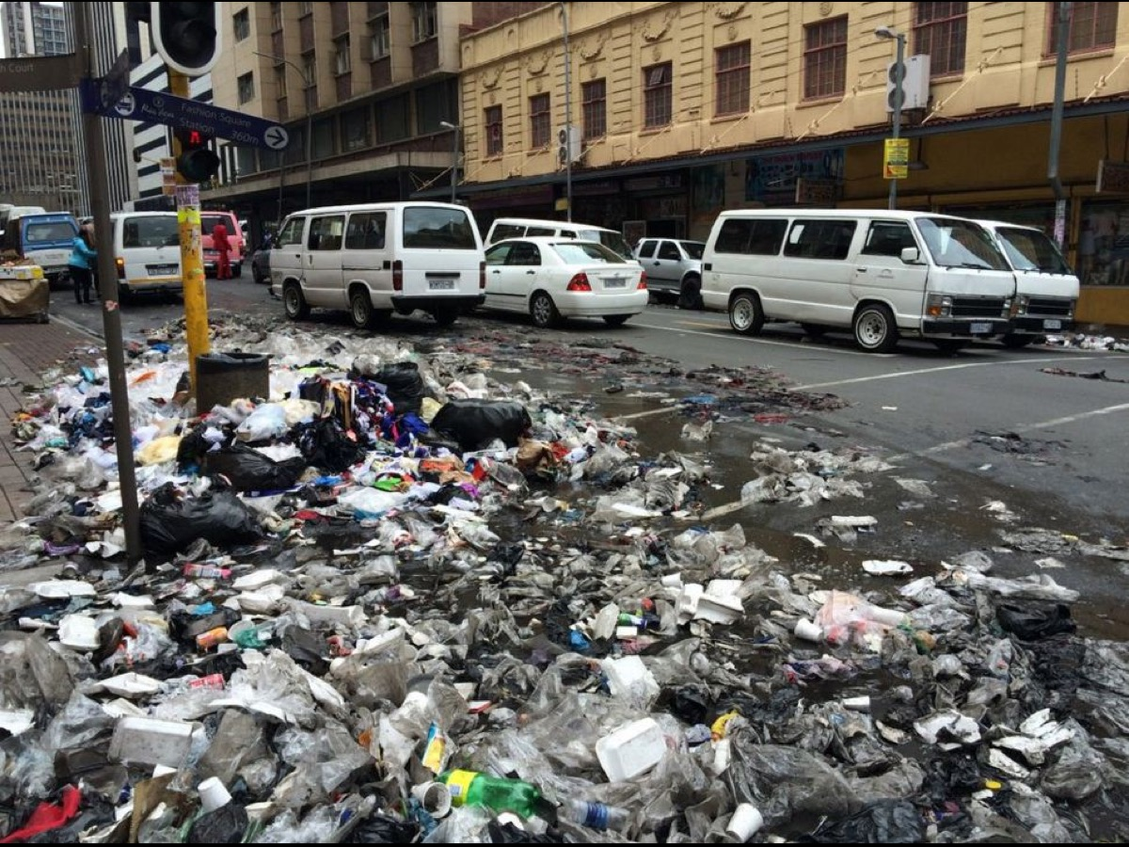
Notes:
Illustration: It is like sweeping a yard clean with a broom and then you throw the broom itself into the fire when it’s horrible work is done.

Slide 19
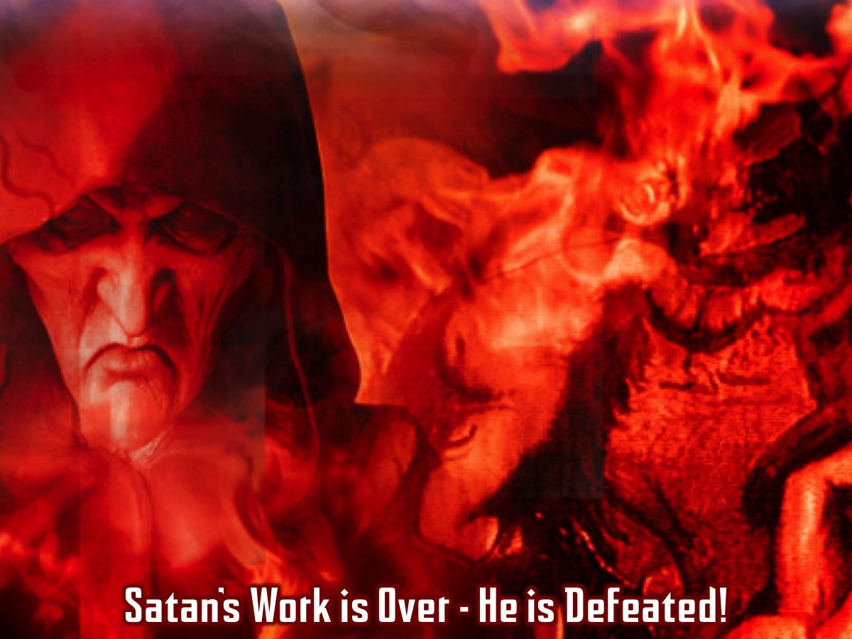
Notes:
Amazingly Satan is still on the scene doing work that God need to have done – and then punished for it. Evil has to be allowed to do its work (with controls in place) so that it can at last be defeated.

Slide 20
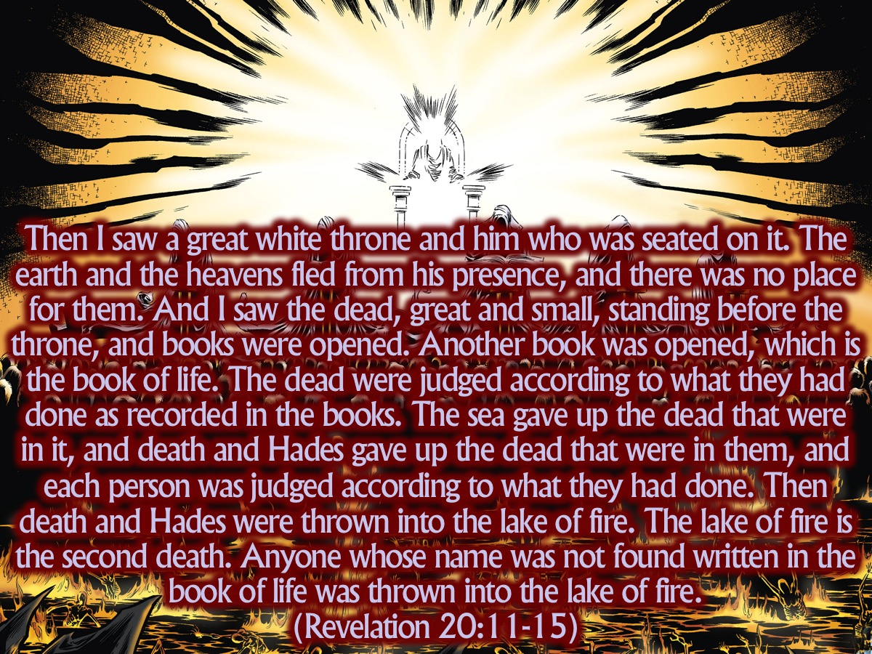
Notes:
Then I saw a great white throne and him who was seated on it. The earth and the heavens fled from his presence, and there was no place for them. And I saw the dead, great and small, standing before the throne, and books were opened. Another book was opened, which is the book of life. The dead were judged according to what they had done as recorded in the books. The sea gave up the dead that were in it, and death and Hades gave up the dead that were in them, and each person was judged according to what they had done. Then death and Hades were thrown into the lake of fire. The lake of fire is the second death. Anyone whose name was not found written in the book of life was thrown into the lake of fire. (Revelation 20:11-15)

Slide 21
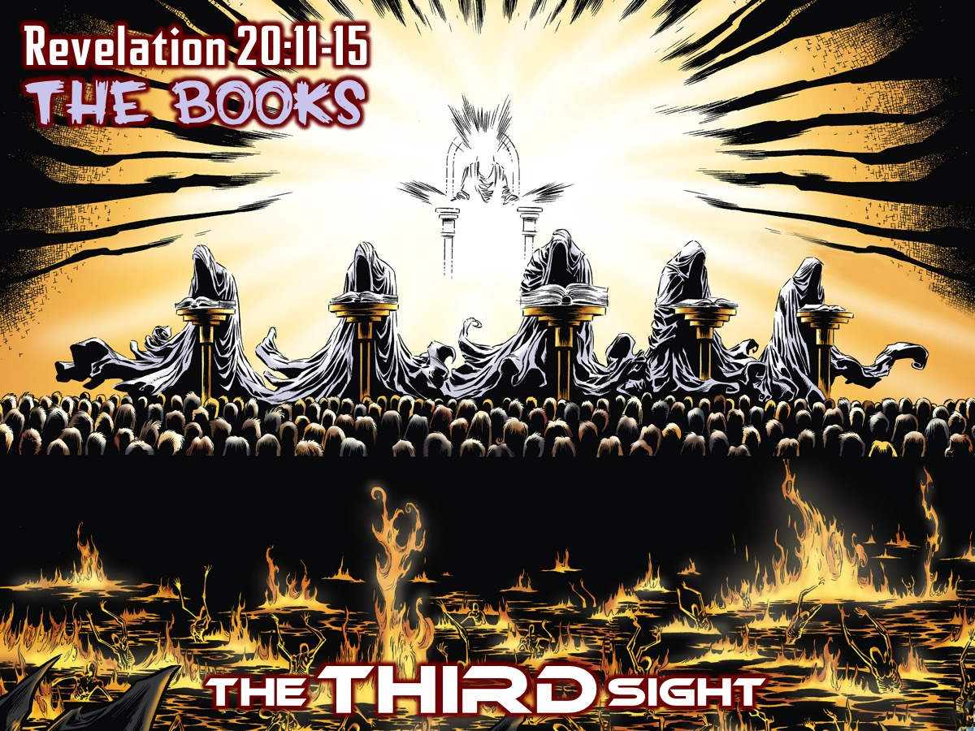
Notes:
The THIRD Sight: The Books (Revelation 20:11-15)

Slide 22
Notes:
Video: Great White Throne Judgment. Get it on YouTube at: https://www.youtube.com/watch?v=5_VONBGx-Pw

Slide 23
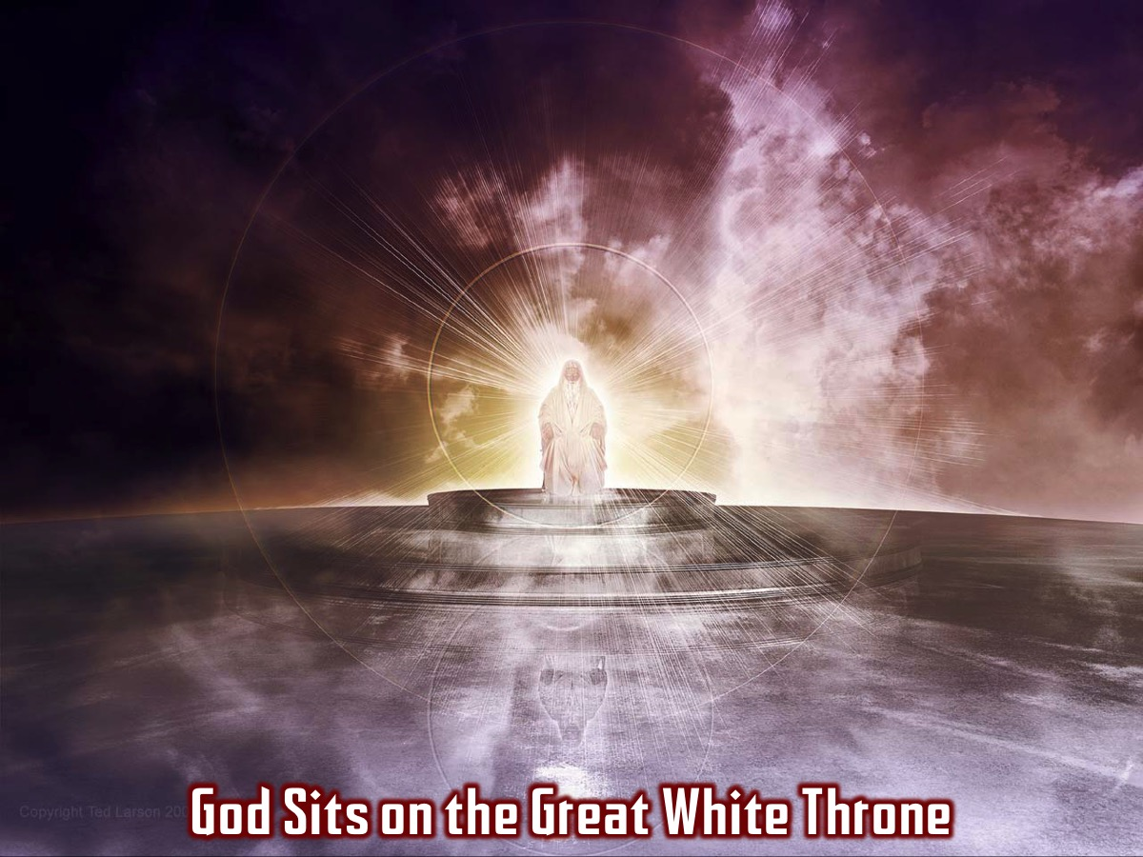
Notes:
God, the creator, at last takes his seat on the great white throne.

Slide 24
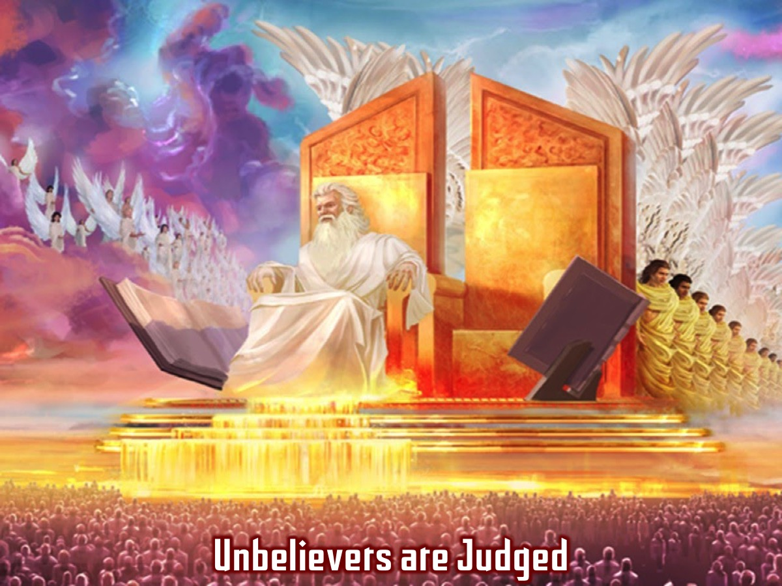
Notes:
Unbelievers are Judged: It is time for the final judgment and unbelievers are judged by their actions. The books are opened in which are recorded everything that has ever happened on earth and unbelievers who have not received Jesus as their Saviour (their names not being found in the book of life) are judged by their actions.

Slide 25
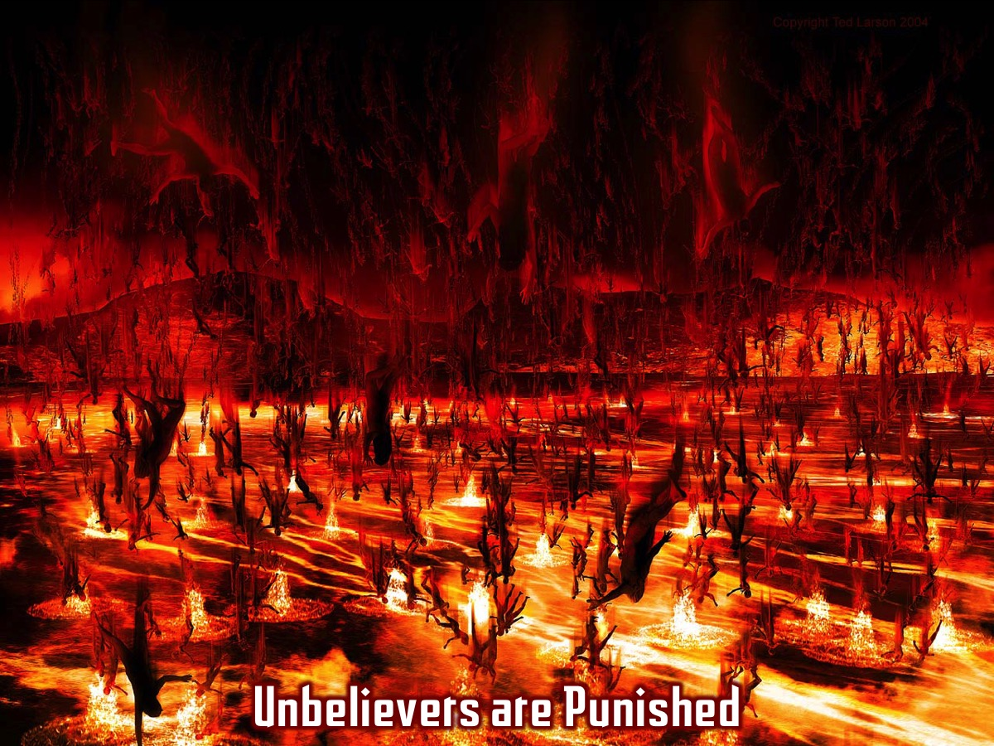
Notes:
Unbelievers are Punished: Unbelievers are thrown into the lake of fire. (20:15 15)

Slide 26
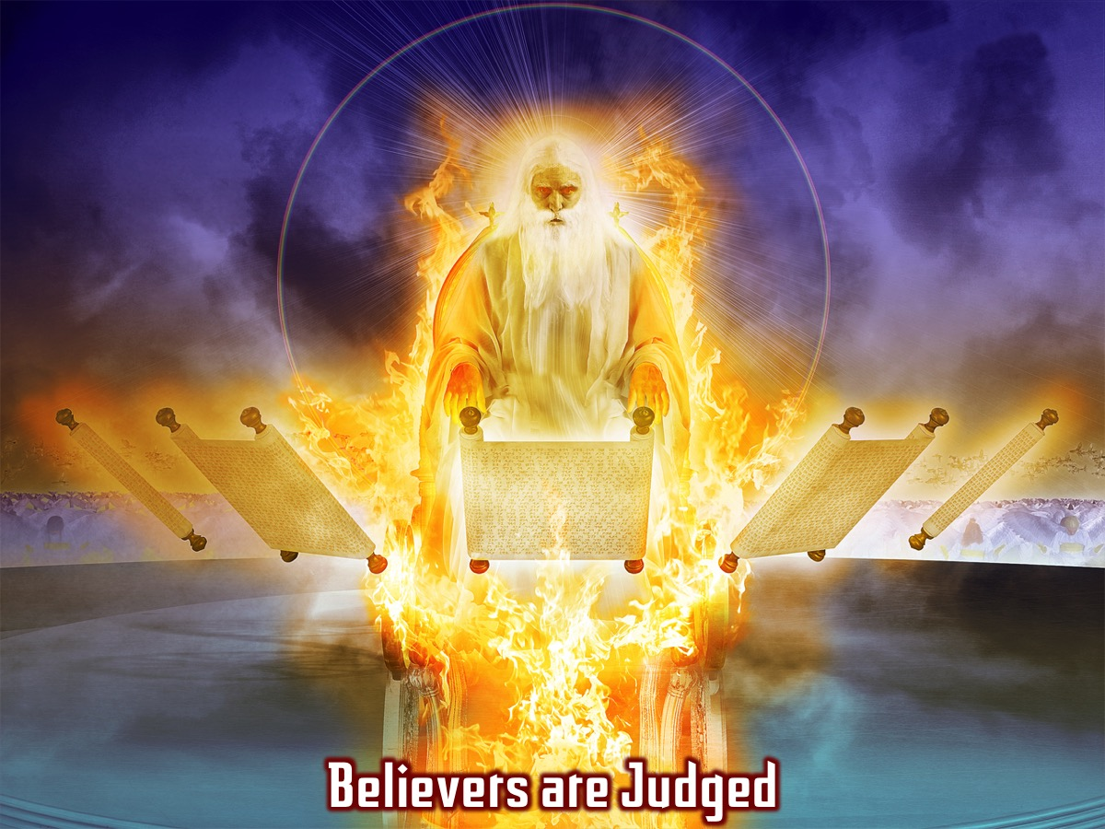
Notes:
Believers are Judged: Those whose names were found written in “the book of Life” (mentioned already in 3:5; 13:8 and 17:8) also called the Lamb’s book of life which contains the names of all those who are followers of Jesus.

Slide 27
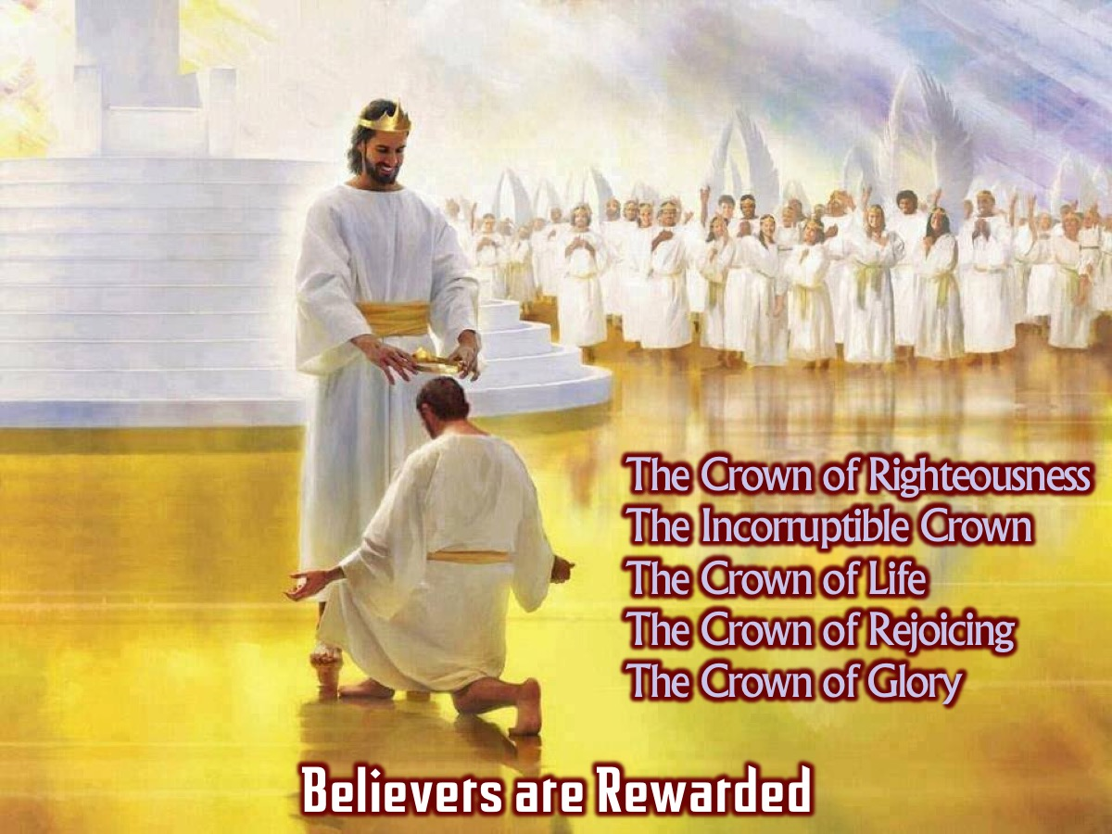
Notes:
Believers are Rewarded: They are given rewards - in the form of crowns that they will weak - and be able to cast them down at the feet of Jesus - because he is the reason why we exist and achieve anything.
Extra Notes: There are at least five Crowns mentioned for believers: (1) The Crown of Righteousness - This crown will be given to those who have look forward to the coming of Jesus. “I have fought the good fight, I have finished the race, I have kept the faith. Finally, there is laid up for me the CROWN OF RIGHTEOUSNESS, which the Lord, the righteous Judge, will give to me on that Day, and not to me only but also to all who have loved His appearing.” (2 Timothy 4:7-8). (2) The Incorruptible Crown - This crown if for those who do things that require sacrifice and effort. “Do you not know that those who run in a race all run, but one receives the prize? Run in such a way that you may obtain it. And everyone who competes for the prize is temperate in all things. Now they do it to obtain a perishable crown, but we for an IMPERISHABLE CROWN. Therefore I run thus: not with uncertainty. Thus I fight: not as one who beats the air. But I discipline my body and bring it into subjection, lest, when I have preached to others, I myself should become disqualified.” (1 Corinthians 9:24-27). (3) The Crown of Life - This crown is for those who to undergo severe hardship, testing, tribulation, and/or physical death on His behalf. “Do not fear any of those things which you are about to suffer. Indeed, the devil is about to throw some of you into prison, that you may be tested, and you will have tribulation ten days. Be faithful until death, and I will give you the CROWN OF LIFE.” (Revelation 2:10). (4) The Crown of Rejoicing - This crown has been called the “soul winner’s crown.” and is for those who have been instrumental in getting other people saved. “For what is our hope, or joy, or CROWN OF REJOICING? Is it not even you in the presence of our Lord Jesus Christ at His coming? For you are our glory and joy.” (1 Thessalonians 2:19-20). (5) The Crown of Glory - this crown is for those who shepherd God’s flock into the ways and knowledge of God. “The elders who are among you I exhort, I who am a fellow elder and a witness of the sufferings of Christ, and also a partaker of the glory that will be revealed. SHEPHERD THE FLOCK OF GOD which is among you, serving as overseers, not by constraint but willingly, not for dishonest gain but eagerly; nor as being lords over those entrusted to you, but being examples to the flock; and when the Chief Shepherd appears, you will receive the CROWN OF GLORY that does not fade away.” (1 Peter 5:1-4).

Slide 28
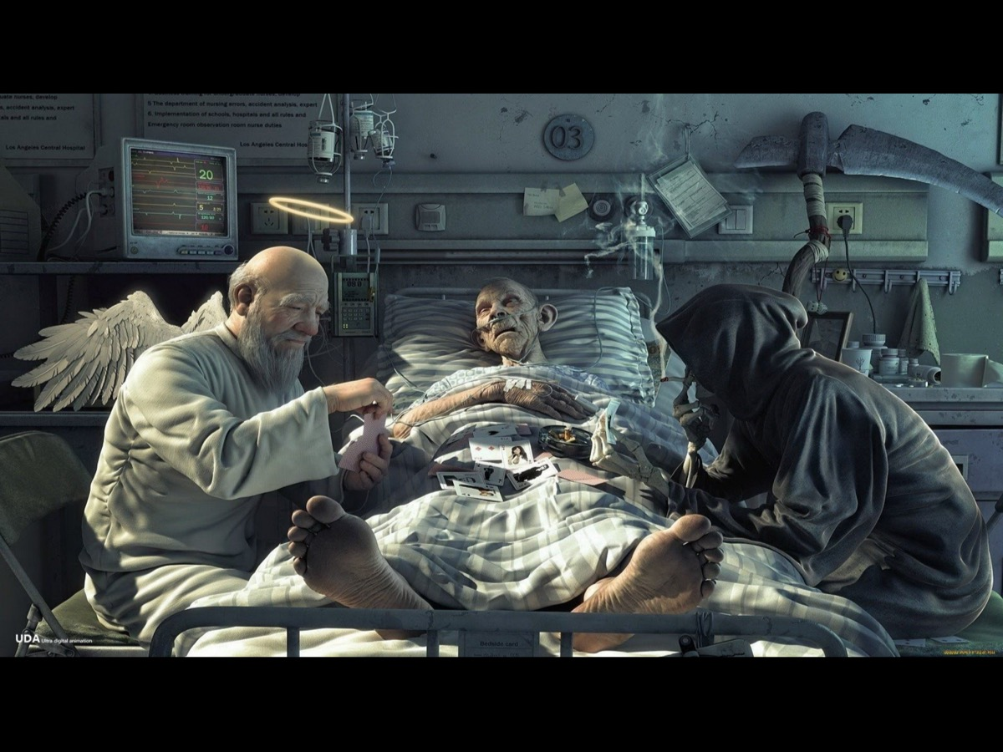
Notes:
No one really likes talking about death - but it is an inescapable reality.

Slide 29
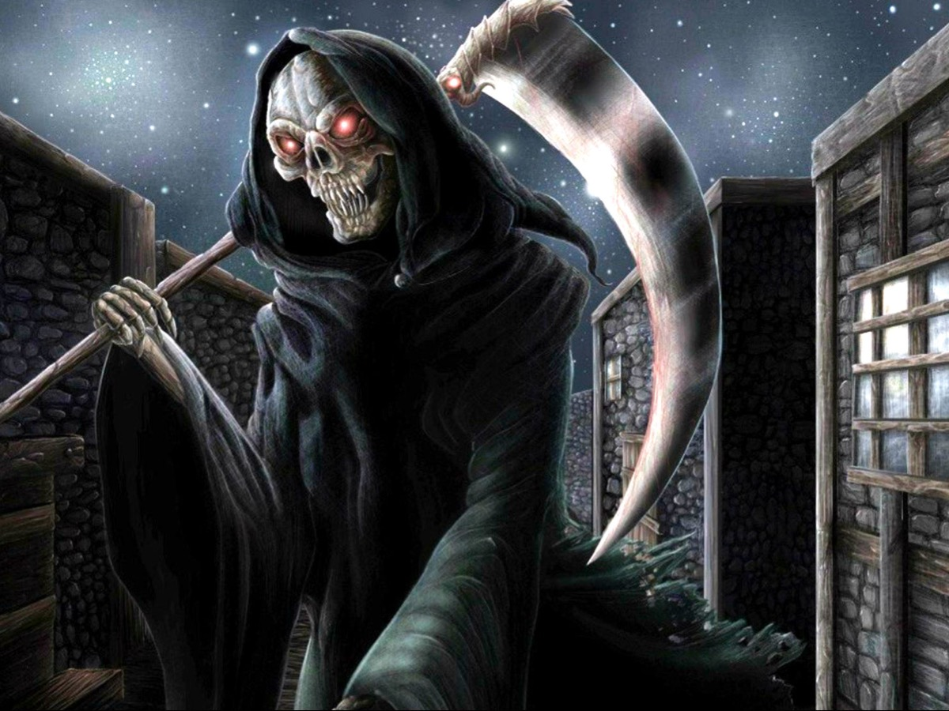
Notes:
I am sure that the Grim Reaper is fictional character but he stands for the reality of death.

Slide 30
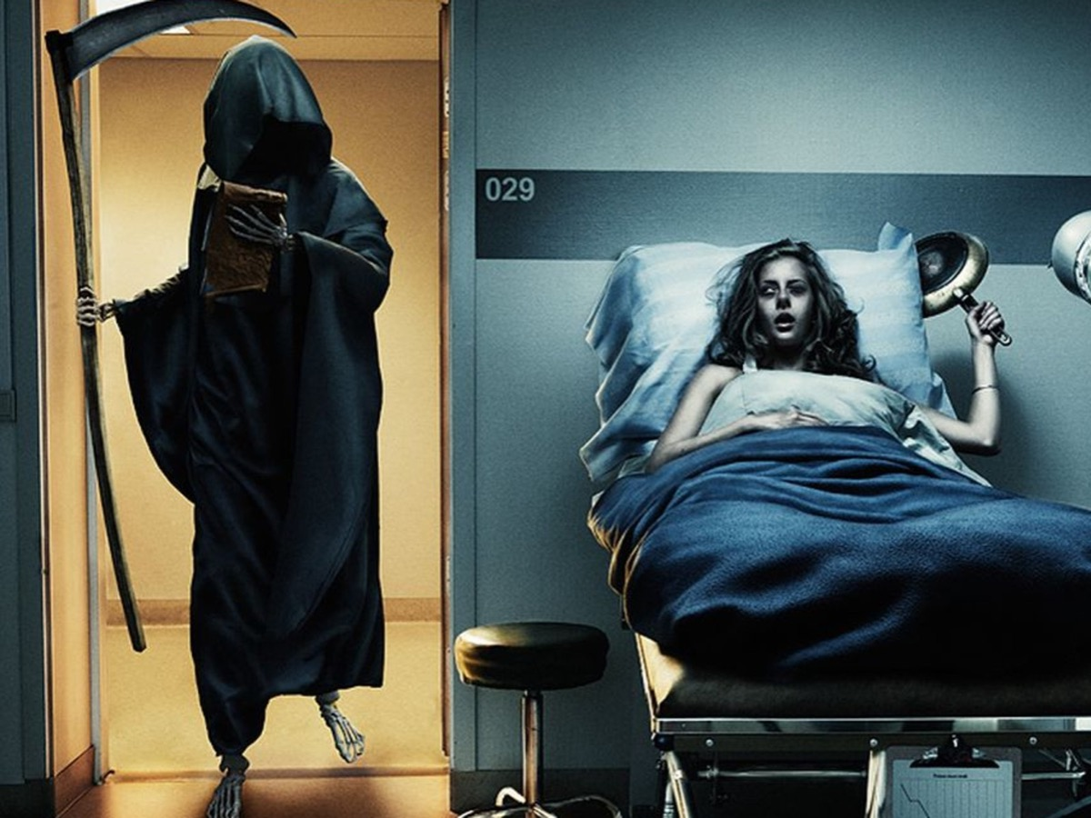
Notes:
This woman shows us something of what will take place one day - when the Grim Reaper will be the one to be killed!

Slide 31
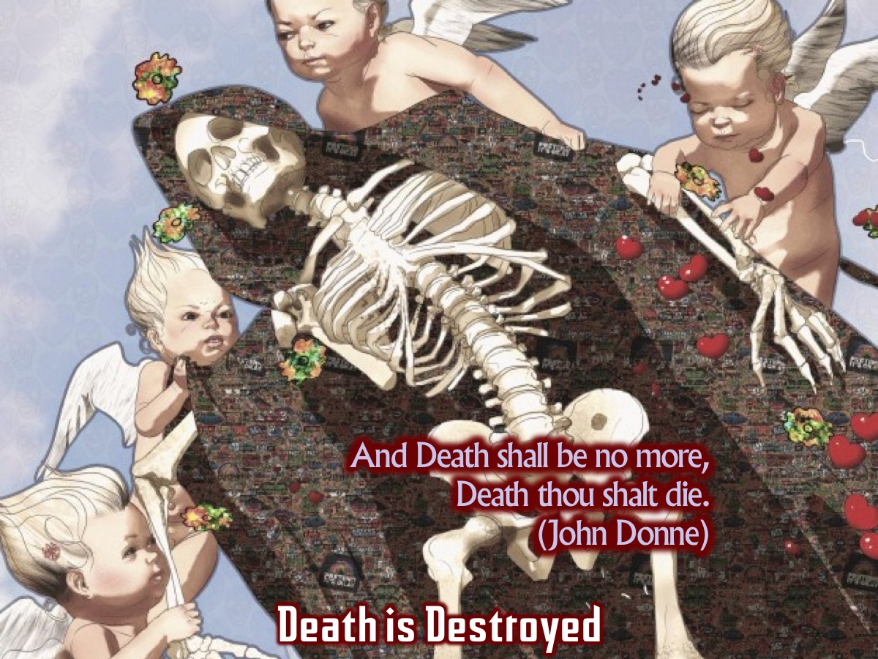
Notes:
Death is Destroyed. Death, along with it’s home base, Hades, is finally destroyed. John Donne’s poem: “Death, be not proud”, ends with the majestic line: “And Death shall be no more, Death thou shalt die.” Resurrection is the undoing of death and not just a reinterpretation of death. It means that the process of bodily corruption and decay are reversed, producing a new physical body with immortal properties.
Extra Notes: There remain the last great powers: Death and Hades. Death, here, is both the fact and the power of death; Hades is the living place of the dead, they place from which they cannot escape except by a great new act of God. In ancient cosmology, the sea was not thought of as part of Hades so they who died by drowning in the sea, and never recovered for burial, formed a separate category of the dead. But they too are now brought to stand before the great white throne – which seems to have replaced the throne in chapter 4 and 5. Heaven and earth are being shaken and the throne room itself seems to be under reconstruction.
Extra Notes: Why do “earth and heaven flee away from God’s presence?” It seems that earth has been corrupted by the evil done within it and heaven too had been the place from which Satan had conducted his initial rebellion. The first earth and heaven were the pilot project. Now, with all obstacles to the ultimate goal having removed, they can be dismantled, so that the final reality to which they were advance signposts can be revealed. The whore has been overthrown and it is time for the bride to appear. The dragon, the monster and the dragon have been destroyed, and it is time for God and the lamb to be revealed, with the spirit enabling the bridge to say, “Come”. The rule of death is at an end; the rule of life is about to begin.

Slide 32
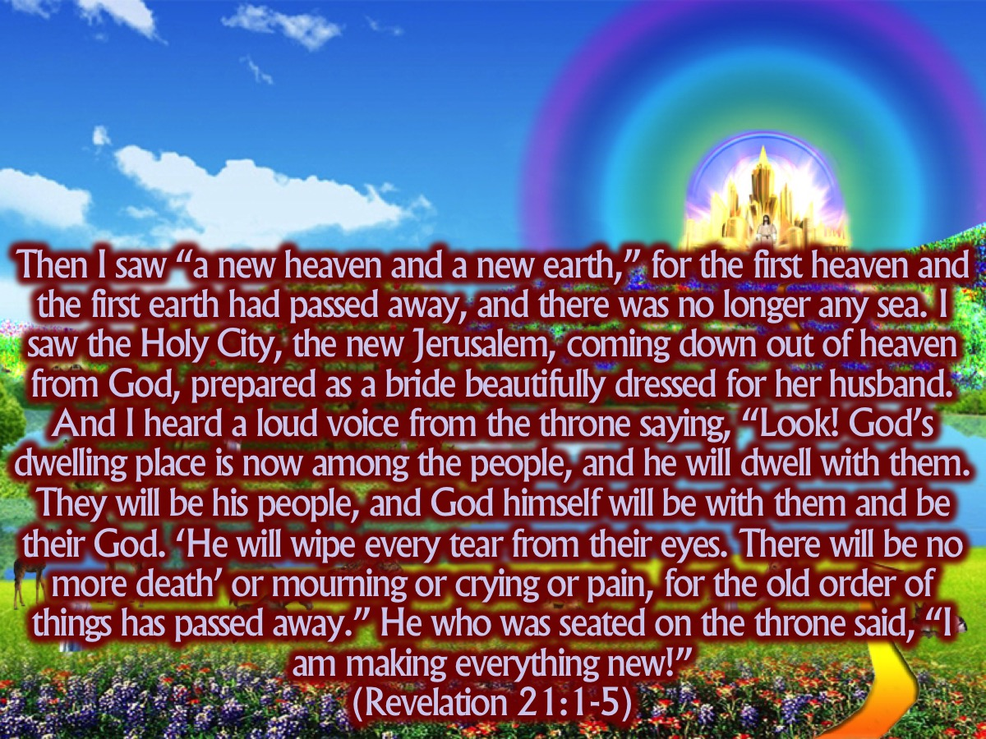
Notes:
Then I saw “a new heaven and a new earth,” for the first heaven and the first earth had passed away, and there was no longer any sea. I saw the Holy City, the new Jerusalem, coming down out of heaven from God, prepared as a bride beautifully dressed for her husband. And I heard a loud voice from the throne saying, “Look! God’s dwelling place is now among the people, and he will dwell with them. They will be his people, and God himself will be with them and be their God. ‘He will wipe every tear from their eyes. There will be no more death’ or mourning or crying or pain, for the old order of things has passed away.” He who was seated on the throne said, “I am making everything new!” Then he said, “Write this down, for these words are trustworthy and true.” He said to me: “It is done. I am the Alpha and the Omega, the Beginning and the End. To the thirsty I will give water without cost from the spring of the water of life. Those who are victorious will inherit all this, and I will be their God and they will be my children. But the cowardly, the unbelieving, the vile, the murderers, the sexually immoral, those who practice magic arts, the idolaters and all liars—they will be consigned to the fiery lake of burning sulfur. This is the second death.” (Revelation 21:1-8)

Slide 33
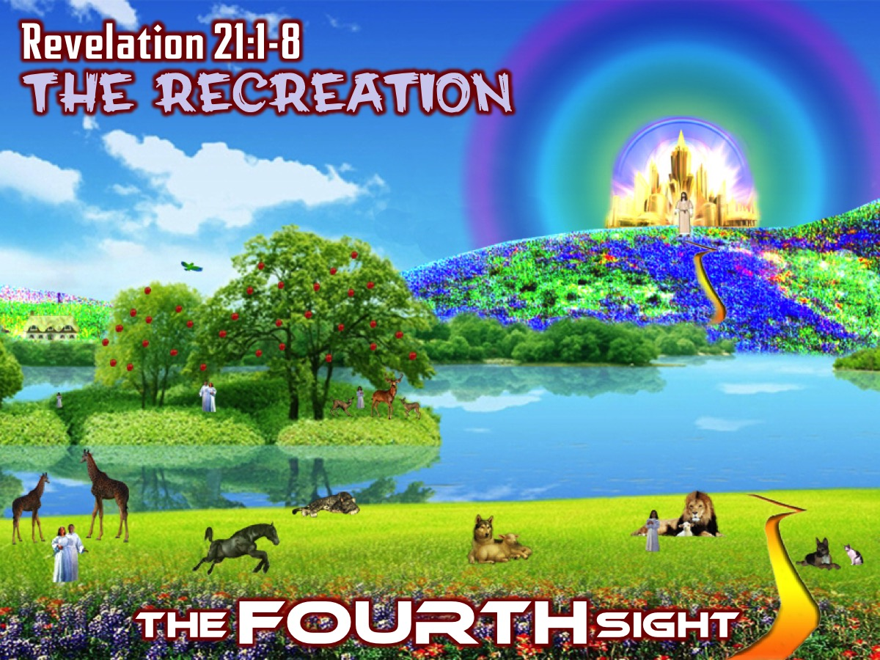
Notes:
The FOURTH Sight: The Recreation (Revelation 21:1-8)

Slide 34

Notes:
Illustration: Have you ever found yourself thinking: “This is new!” Maybe a major life experience in which we think to ourselves, “Everything is going to be different now. This is quire new. This is a whole new world opening up.” These could be major life-events: birth, marriage, full recovery from a long and dangerous illness, someone coming to live with you, etc.

Slide 35
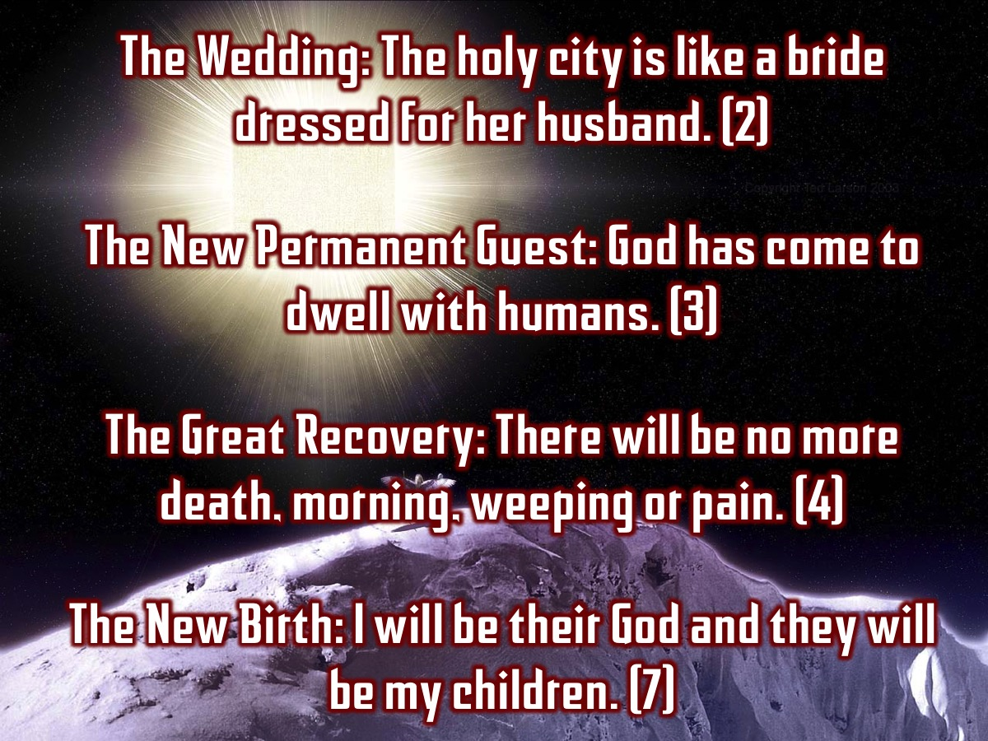
Notes:
These all feature in the list of images that John uses as he builds up this breathtaking picture of the new heaven and new earth:
“The holy city is like a bride dressed for her husband” (2): a wedding.
“God has come to dwell with humans” (3): The new permanent guest.
“There will be no more death or morning or weeping or pain any more” (4): the great recovery.
“I will be their God and they will be my children” (7): a new birth.

Slide 36
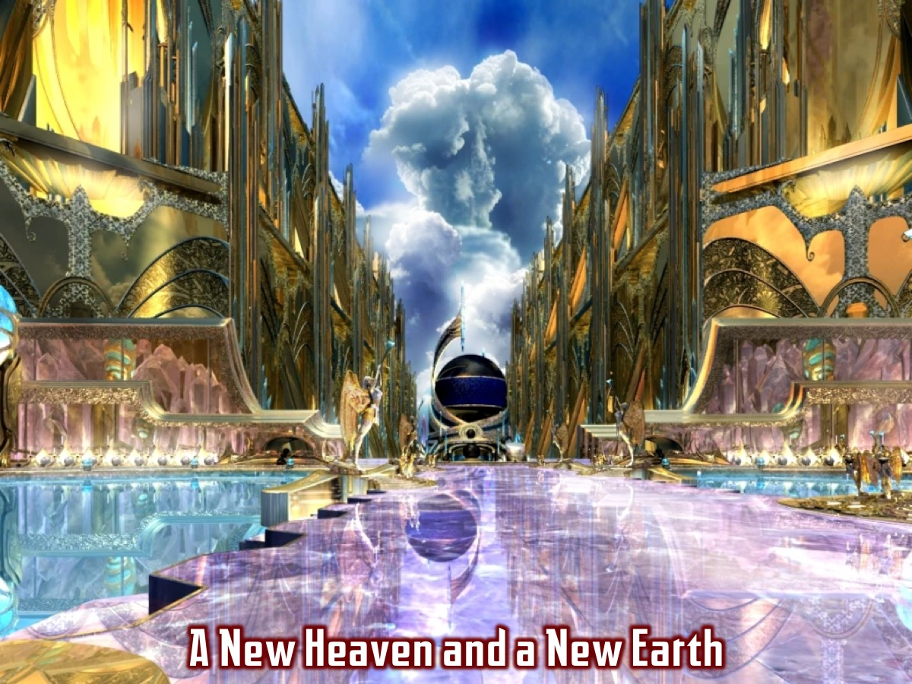
Notes:
This does not begin to describe what the new future will actually be like, but it is a step in the right direction. The new heaven and new earth will be new in a new way: newness itself will be renewed, so that instead of a mere transition within ongoing human life, what God has planned will be the renewal of all things. “Look, I am making all things new.”
Everything thing is new: the new heaven, new earth, new Jerusalem, new Temple (the whole city is now the temple). And the new people – people who have woken up to find themselves beyond the reach of death, tears and pain. “The first things have passed away.”

Slide 37
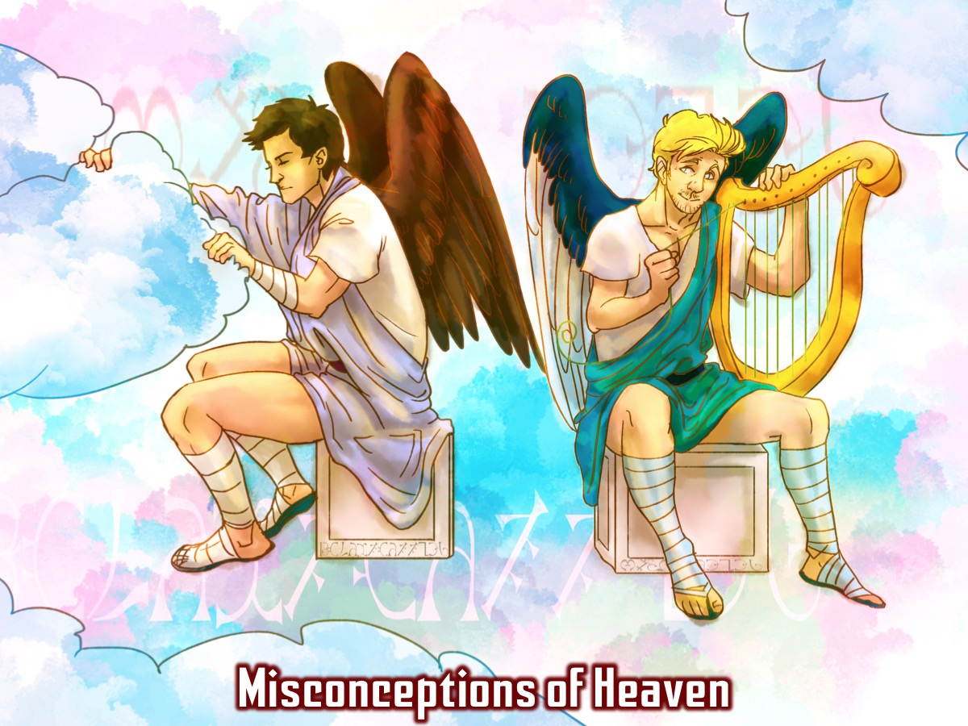
Notes:
Misconceptions of Heaven. As we read the ending to the book of revelation many are surprised to read that the picture of “heaven” is so different to what we have been expecting.

Slide 38
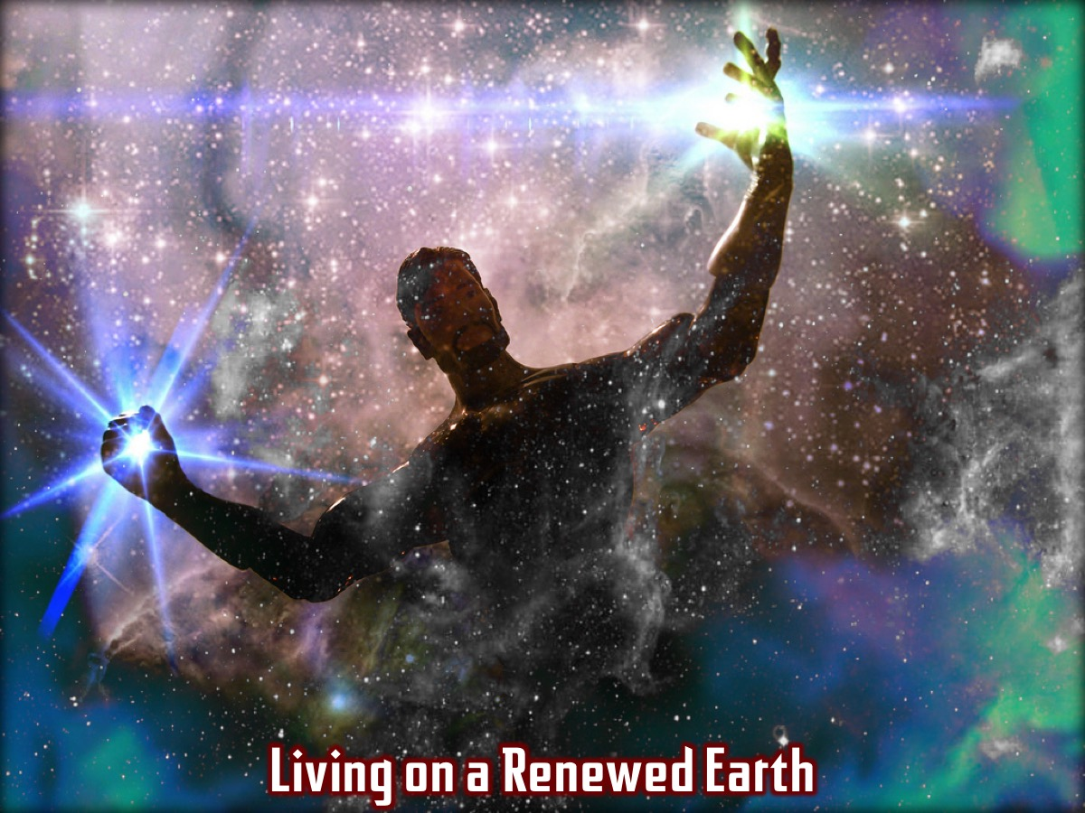
Notes:
Earth is not the second rate shabby temporary dwelling that we will escape from one day to go to heaven for good. Earth is a glorious part of God’s glorious creation and heaven though God’s own abode, is also the place where the sea stands as a reminder of the power of evil, so much so that a one point there is a war in heaven. Both elements of God’s two level world need renewing. But when they are renewed we are left with a new heaven and a new earth that are joined together completely and forever.

Slide 39
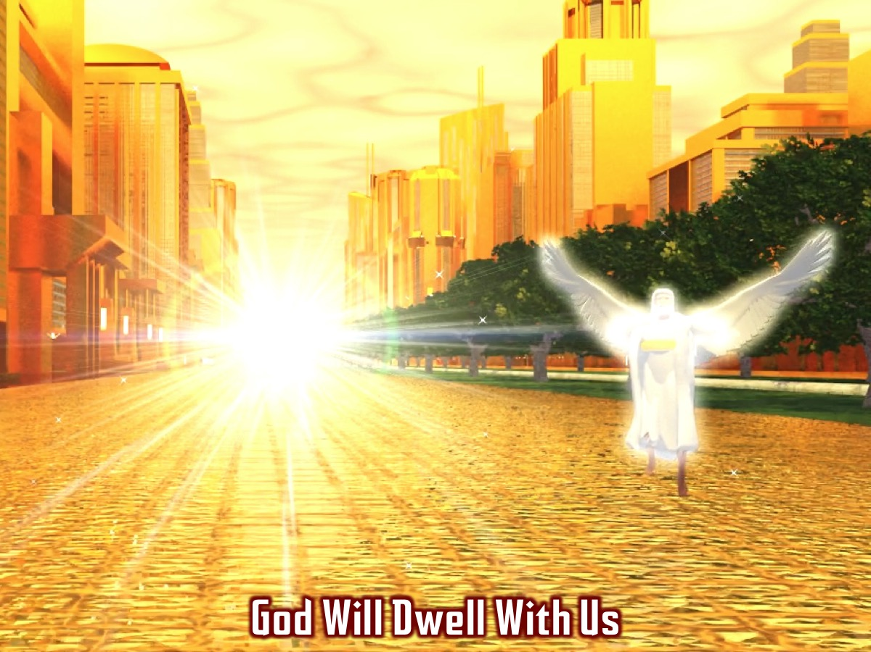
Notes:
The word “Dwell” (3) is critical because it reminds us of God dwelling in the temple in Jerusalem., revealing his glory in the midst of his people. John says that the Word (Jesus) became flesh and lived, dwelt, pitched his tent, tabernacled in our midst and we gazed upon his glory. What God did there in coming to an unknowing world and an unwelcoming people he is doing on a cosmic scale. He is coming to live forever, in our midst, a healing, comforting and celebrating presence. Heaven and earth were joined in Jesus but one day they will be joined fully and forever. Paul says the same thing in Ephesians 1:10.
Extra Notes: This is why this closing scene is not a vision of human beings going up to heaven but the New Jerusalem coming down from heaven to earth. How can this be – surely the New Jerusalem, the bride of the lamb, consists of God’s people and surely they are on earth already? How can they have been in heaven as well? Our life is hidden with Christ in God (Colossians 3:3) – when we belong to God we continue with our life on earth but we have a secret life as well, a fresh gift from God, which becomes a part of the hidden reality that will be revealed at the last day (Colossians 3:4; 1 John 3:2). This is why in the scenes in Revelation 5, 7 and 19 there is a great crowd standing around God’s throne in heaven, singing songs and shouting out their praises. And one day this hidden reality will be revealed – the true partner of the lamb, now transformed, Cinderella-like, from slave-girl to bride.

Slide 40
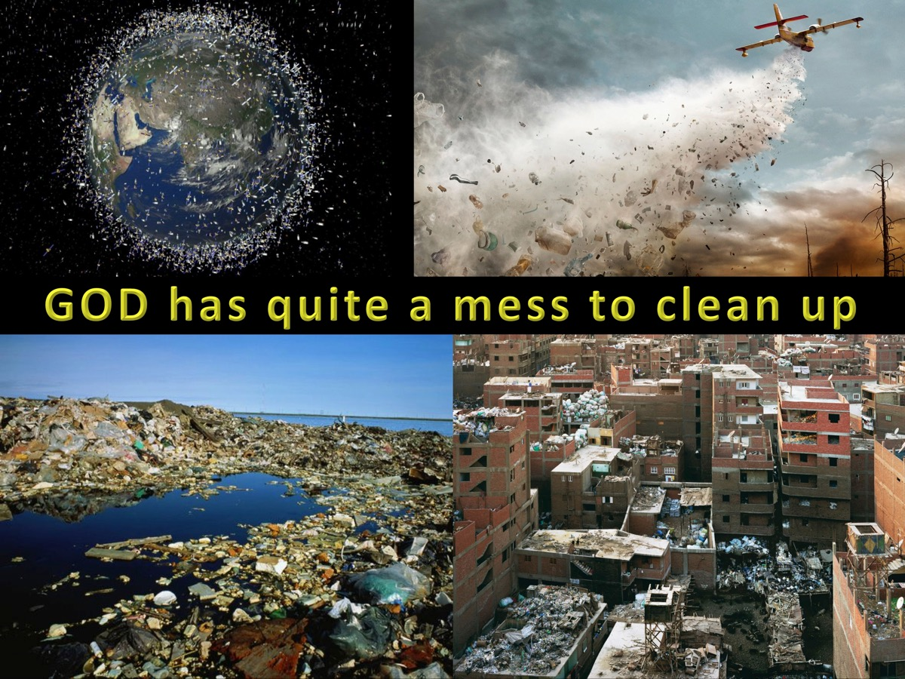
Notes:
God is not throwing away his creation and having another shot to see if he can get it right! Here in Revelation 21 and 22 we have the utter transformation of heaven and earth by means of God abolishing, from within both heaven and earth, everything that has to do his as yet incomplete plan for creation and with the more horrible, disgusting and tragic effects of human sin. The new world will be in a sense like the present one in that it is a world full of beauty, power, delight, tenderness and glory. In this new world the temple will be abolished not because it was a bad idea but there is a new plan for the cosmos. The new world will be like the present one but without all death, tears and everything that caused them. This is what it means about there being no more sea. In the Bible the sea is the dark force of chaos which threatens God’s plans and God’s people. It is the element from which the monster first emerged. It is contained in the first heaven – ie. As part of the furniture, but also because it’s boundary is strictly limited. Evil is only allowed to do enough to overreach itself and to bring about its new downfall. In this new creation there will be no more sea, no more chaos, no place from which monsters might again emerge.

Slide 41
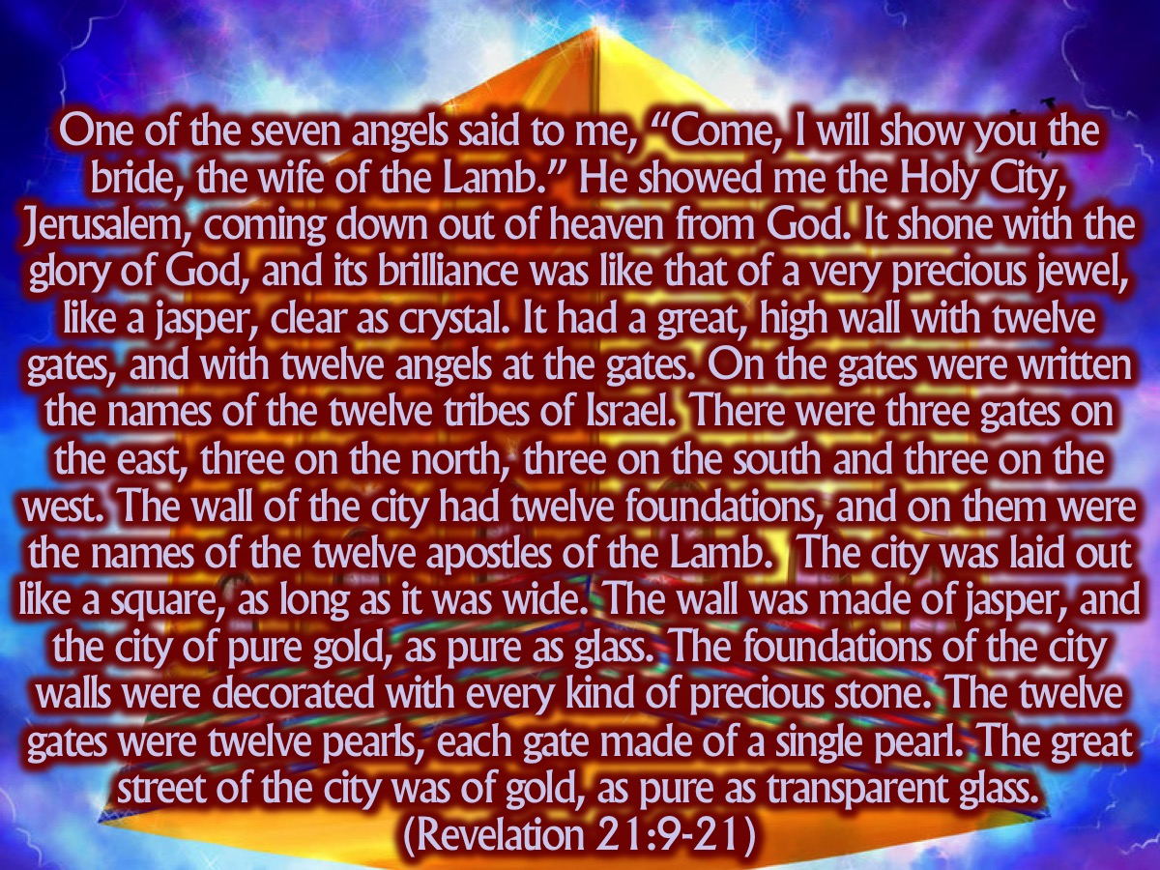
Notes:
One of the seven angels who had the seven bowls full of the seven last plagues came and said to me, “Come, I will show you the bride, the wife of the Lamb.” ¹⁰ And he carried me away in the Spirit to a mountain great and high, and showed me the Holy City, Jerusalem, coming down out of heaven from God. ¹¹ It shone with the glory of God, and its brilliance was like that of a very precious jewel, like a jasper, clear as crystal. ¹² It had a great, high wall with twelve gates, and with twelve angels at the gates. On the gates were written the names of the twelve tribes of Israel. ¹³ There were three gates on the east, three on the north, three on the south and three on the west. ¹⁴ The wall of the city had twelve foundations, and on them were the names of the twelve apostles of the Lamb. ¹⁵ The angel who talked with me had a measuring rod of gold to measure the city, its gates and its walls. ¹⁶ The city was laid out like a square, as long as it was wide. He measured the city with the rod and found it to be 12,000 stadia in length, and as wide and high as it is long. ¹⁷ The angel measured the wall using human measurement, and it was 144 cubits thick. ¹⁸ The wall was made of jasper, and the city of pure gold, as pure as glass. ¹⁹ The foundations of the city walls were decorated with every kind of precious stone. The first foundation was jasper, the second sapphire, the third agate, the fourth emerald, ²⁰ the fifth onyx, the sixth ruby, the seventh chrysolite, the eighth beryl, the ninth topaz, the tenth turquoise, the eleventh jacinth, and the twelfth amethyst. ²¹ The twelve gates were twelve pearls, each gate made of a single pearl. The great street of the city was of gold, as pure as transparent glass.
(Revelation 21:9-21)
One of the seven angels said to me, “Come, I will show you the bride, the wife of the Lamb.” He showed me the Holy City, Jerusalem, coming down out of heaven from God. It shone with the glory of God, and its brilliance was like that of a very precious jewel, like a jasper, clear as crystal. It had a great, high wall with twelve gates, and with twelve angels at the gates. On the gates were written the names of the twelve tribes of Israel. There were three gates on the east, three on the north, three on the south and three on the west. The wall of the city had twelve foundations, and on them were the names of the twelve apostles of the Lamb. The city was laid out like a square, as long as it was wide. He measured the city with the rod and found it to be 12,000 stadia in length, and as wide and high as it is long. The wall was made of jasper, and the city of pure gold, as pure as glass. The foundations of the city walls were decorated with every kind of precious stone. The twelve gates were twelve pearls, each gate made of a single pearl. The great street of the city was of gold, as pure as transparent glass. (Revelation 21:9-21)

Slide 42
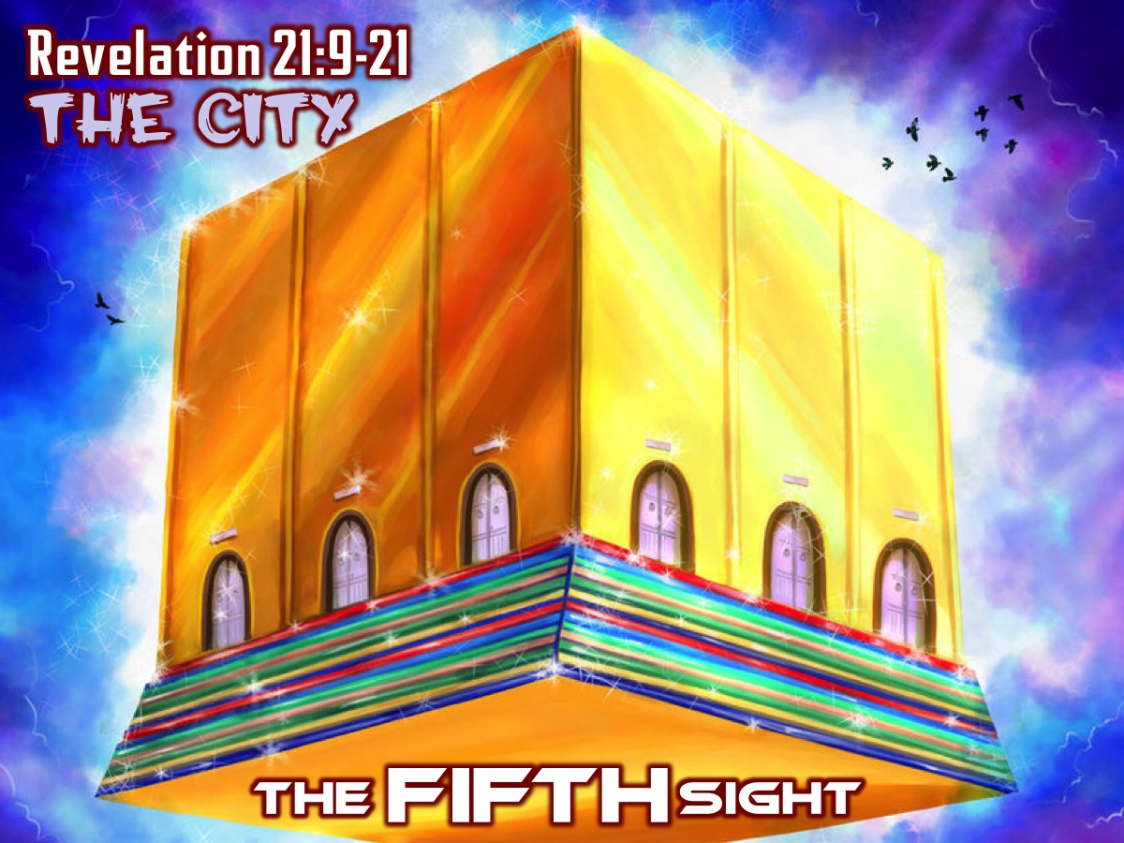
Notes:
The FIFTH Sight: The City (Revelation 21:9-21)

Slide 43
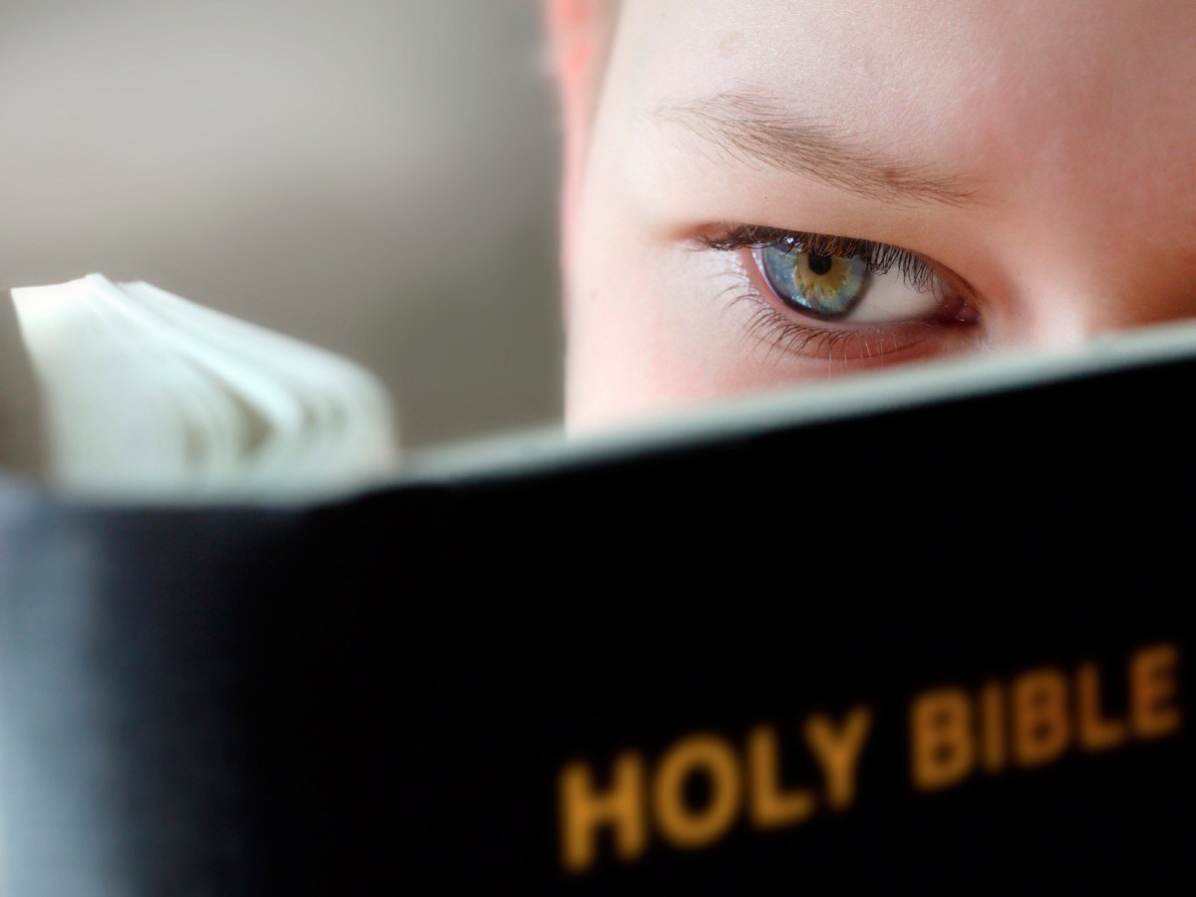
Notes:
Illustration: Someone starts reading the bible and they are amazed at the fast paced story with drama, incidents and passion,

Slide 44
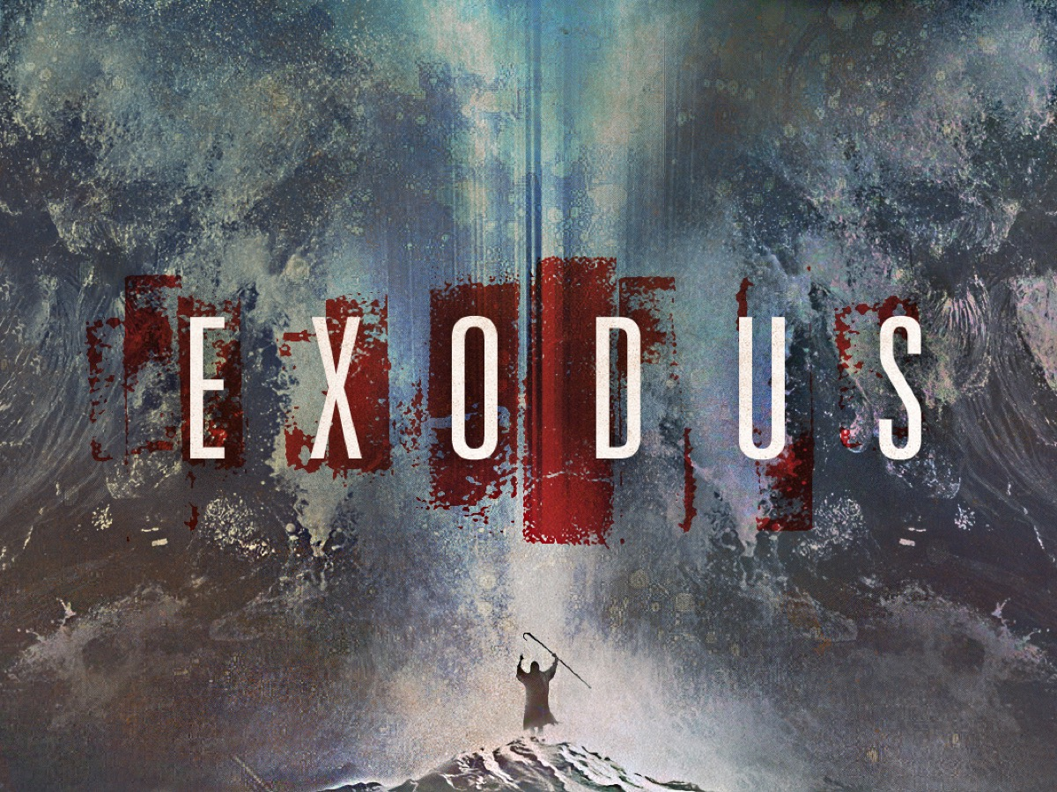
Notes:
and they go into the book of Exodus and it is gripping for the first 20 chapters – here are some of the highlights:

Slide 45
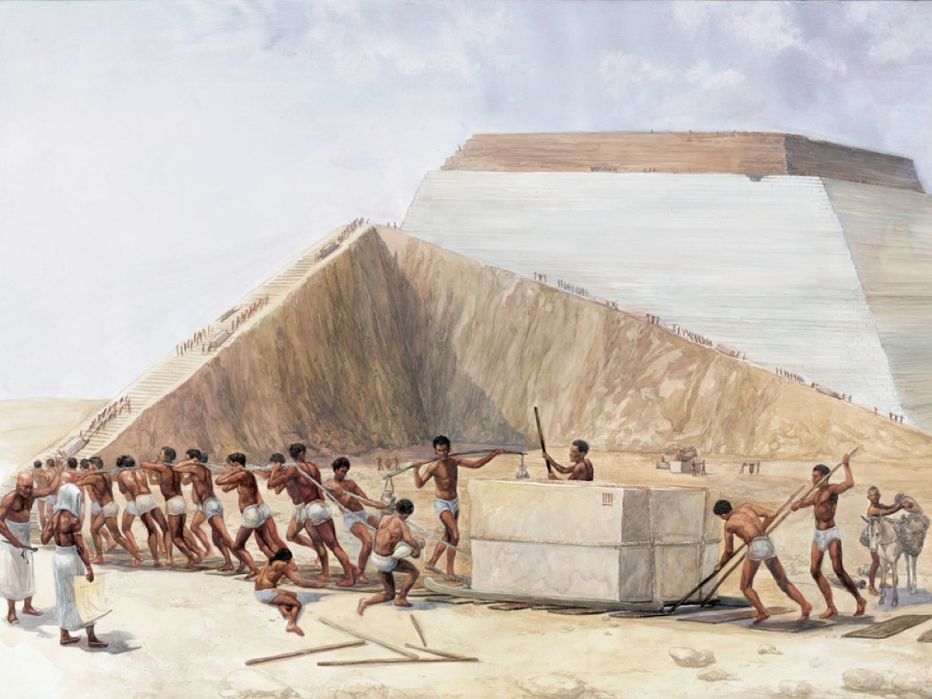
Notes:
Israel in Slavery

Slide 46
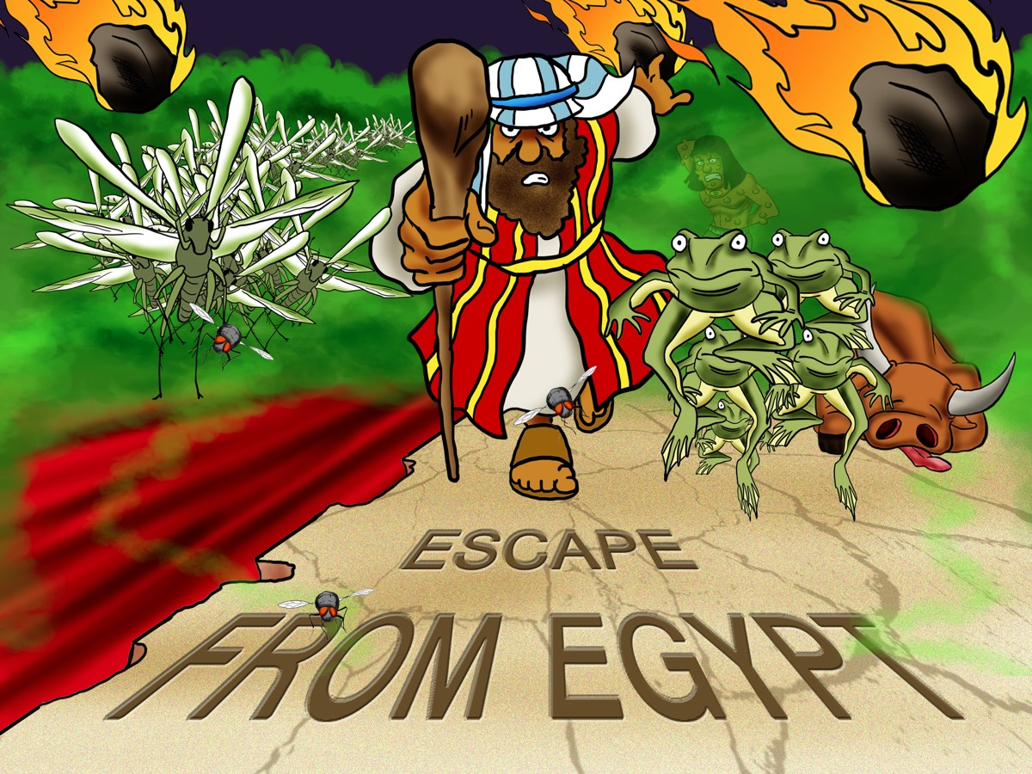
Notes:
The ten plagues and then the escape from Egypt!

Slide 47
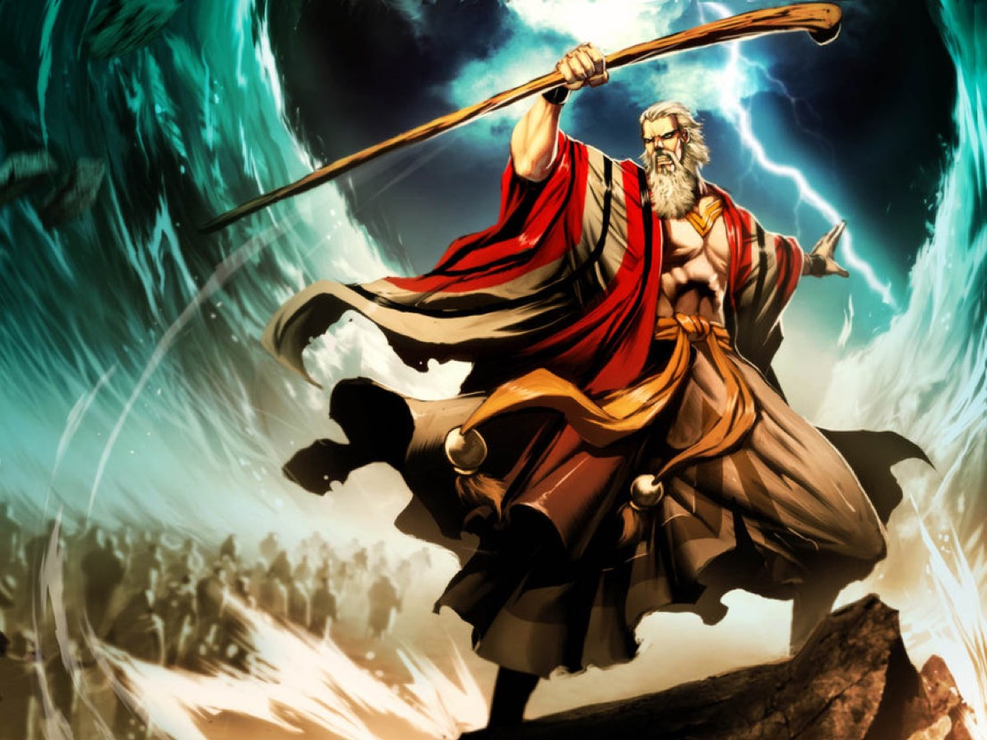
Notes:
Passing through the Red Sea

Slide 48
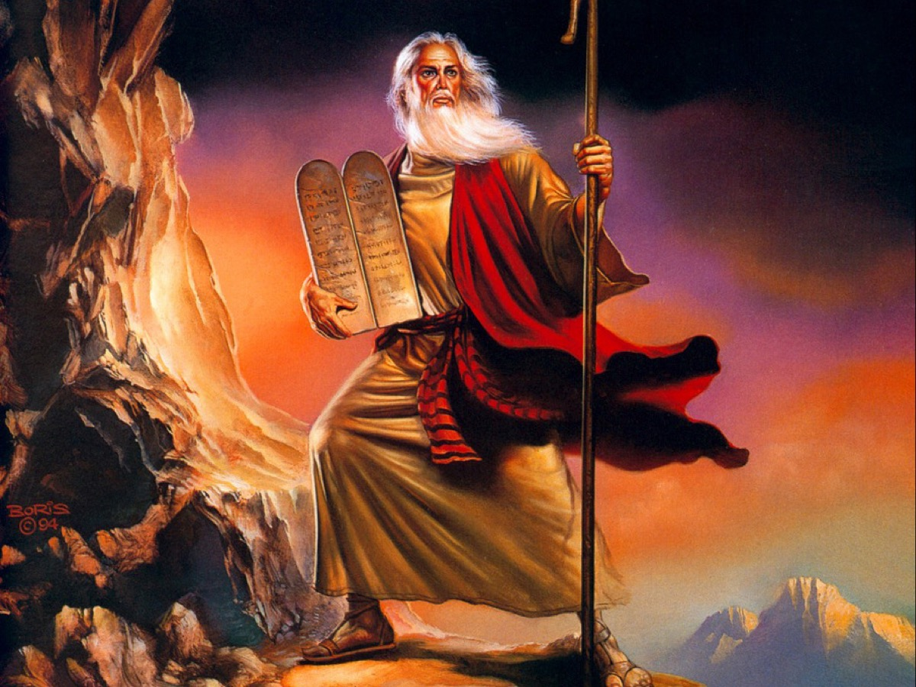
Notes:
Getting the Law at Mount Sinai

Slide 49
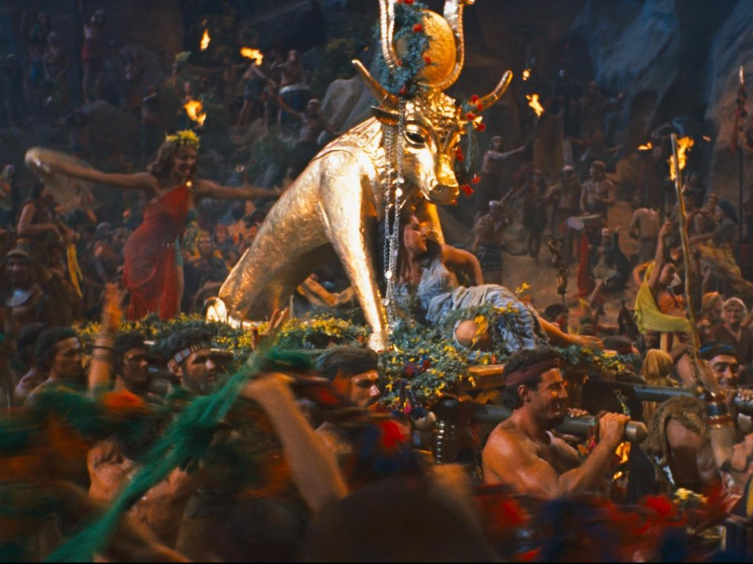
Notes:
Making the Golden Calf to Worship

Slide 50
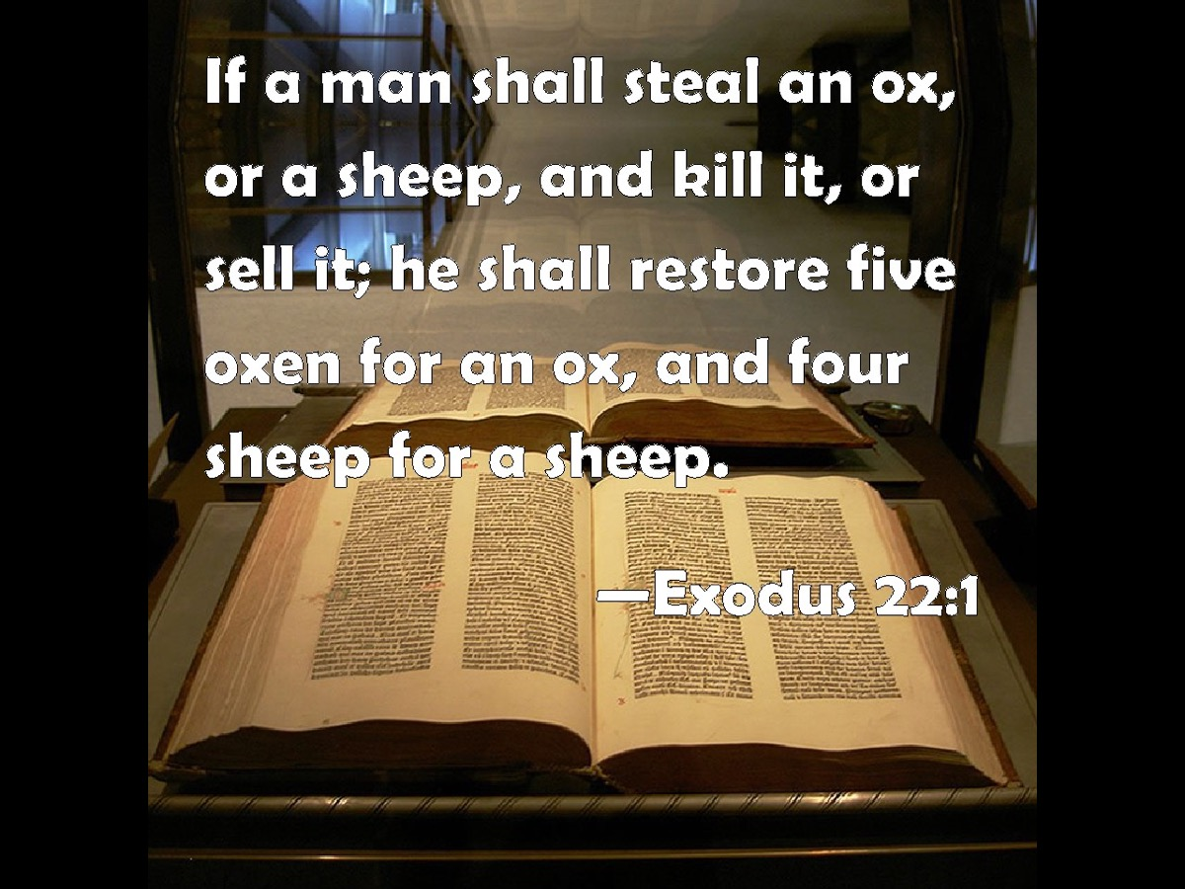
Notes:
But then it gets weird – a load of detailed instructions about what to if you want to sell your daughter as a slave (21:7), or what happens when an ox gores someone to death (21:28), what you should do when your enemy’s donkey has collapsed (23:5), etc. Interesting but not quite what you had expected. And they are tempted to give up reading. What a pity because the rest of the book from chapter 24 onwards is one long drama about God dwelling in the midst of his people. The book is all about how the God who rescued his people from Egypt through the plagues, and brought them to the awesome vision of Sinai and gave them the Law, then commanded his own dwelling to be build to specific instructions. And by the end of the book it was done. But not without a titanic struggle. It always takes an act of grace, overcoming enormous resistance, for God’s dwelling to be set up on earth. There is always a struggle when God’s kingdom arrives on earth as in heaven.

Slide 51
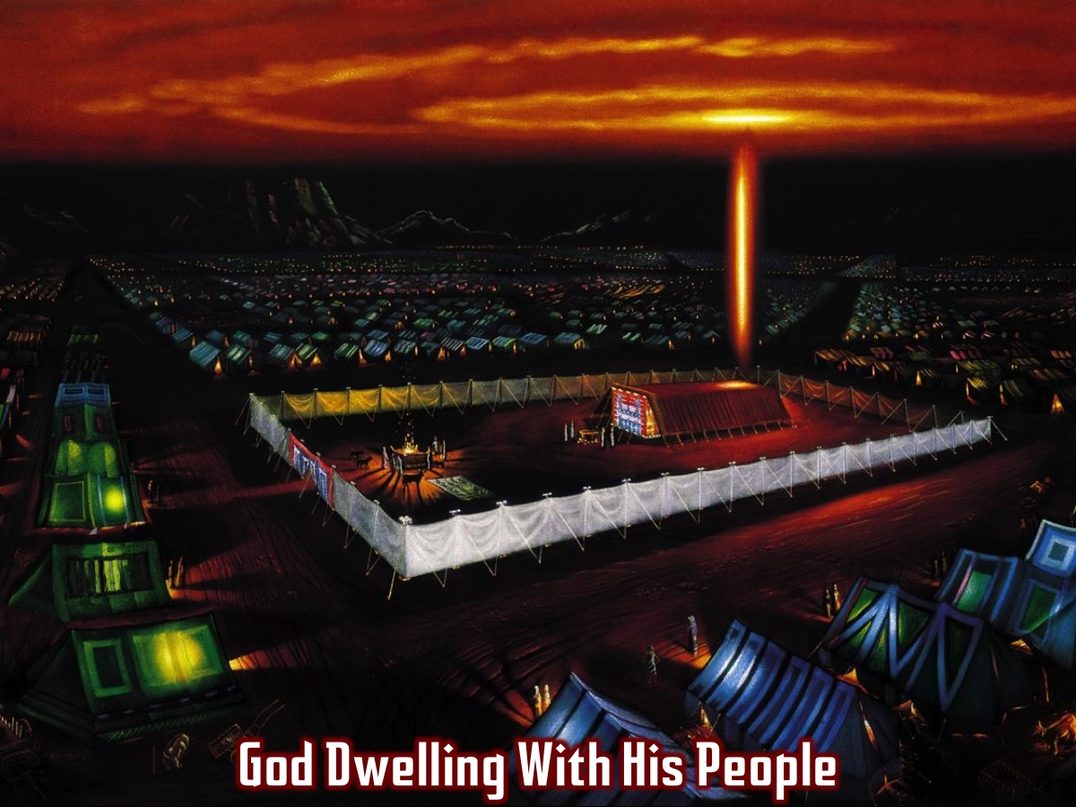
Notes:
What a pity because the rest of the book from chapter 24 onwards is one long drama about God dwelling in the midst of his people. The book is all about how the God who rescued his people from Egypt through the plagues, and brought them to the awesome vision of Sinai and gave them the Law, then commanded his own dwelling to be build to specific instructions. And by the end of the book it was done. But not without a titanic struggle. It always takes an act of grace, overcoming enormous resistance, for God’s dwelling to be set up on earth. There is always a struggle when God’s kingdom arrives on earth as in heaven.

Slide 52
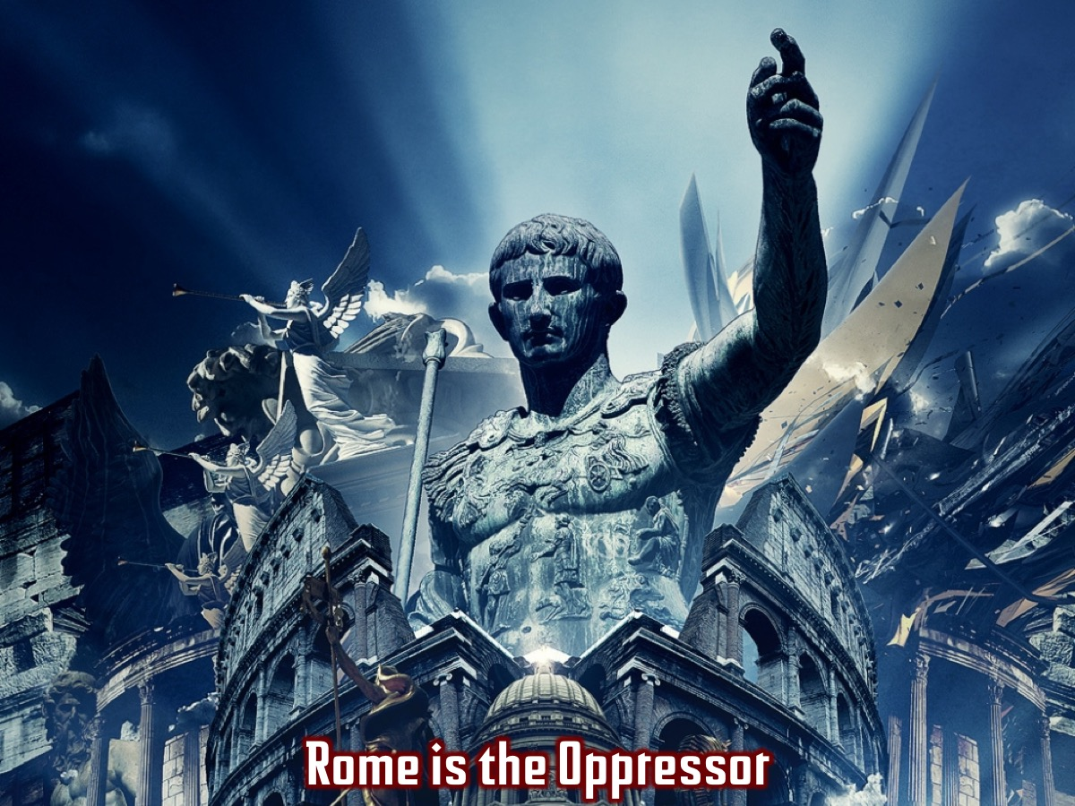
Notes:
We have seen that Revelation has much in common with the book of Exodus. Rome is the Oppressor!

Slide 53

Notes:
God Rescues His People

Slide 54

Notes:
God Comes To Dwell Among His People

Slide 55

Notes:
I did not see a temple in the city, because the Lord God Almighty and the Lamb are its temple. The city does not need the sun or the moon to shine on it, for the glory of God gives it light, and the Lamb is its lamp. The nations will walk by its light, and the kings of the earth will bring their splendor into it. On no day will its gates ever be shut, for there will be no night there. The glory and honor of the nations will be brought into it. Nothing impure will ever enter it, nor will anyone who does what is shameful or deceitful, but only those whose names are written in the Lamb’s book of life. (Revelation 21:22-27)

Slide 56

Notes:
The SIXTH Sight: The Presence (Revelation 21:22-27)

Slide 57

Notes:
Illustration: Scaffolding around an old stone building. It can be quite ugly although it is functional – it is made to do a job and not look pretty. Imagine if a builder created really beautiful scaffolding people came to admire the scaffolding without realizing that there was something far more impressive being built behind it. The builder would insist that it has to be taken away – however splendid it was – that was the point of it in the first place, to do its job and then be dismantled so that the ultimate reality, the real new building, could be seen in all its glory.

Slide 58

Notes:
This is the picture we must have in mind where we read verse 22 and 23. There is now no temple in the new city. Now the whole earth is going to be filled with the knowledge of the glory of the Lord as the waters cover the sea (Habakkuk 2:14). This is the goal that so much of scripture is point towards: heaven has come down to earth, we have the reality, we don’t need the signpost anymore. It is not only the temple that is not needed anymore – verse 23 says that neither the sun nor the moon is needed any longer. They too are part of the scaffolding – signposts to the fact that God himself is the light of his people. We are realising that even the glorious world of Genesis 1 was the beginning of something, rather than an end in itself. Creation points to the new creation. Human sin has meant that God’s eventual design has had to be arrived at by a long, winding and often tear-stained and blood-splattered route – the most important tears and blood being those of God himself, in the person of the lamb. As in Exodus, the goal is achieved through mercy and grace which means that creation is not abolished but fulfilled, not thrown away and replaced but renewed from top to bottom.

Slide 59

Notes:
Next we have the nations coming in procession to give glory to God. This city is not a static picture with people simply gazing at the glorious streets of gold or even at God himself and the lamb. It is a bustling community, filled with activity as the nations come to worship and do homage.

Slide 60

Notes:
Illustration: Not allowing smoking in a library or allowing the playing of radios in a concert hall. John is careful to add that this inclusivity does not stretch to those who practice abomination or tell lies. That which ruins the beauty and holiness of God’s new city is ruled out by definition. Nothing impure will ever enter it, nor will anyone who does what is shameful or deceitful, but only those whose names are written in the Lamb’s book of life. (Revelation 21:27)

Slide 61

Notes:
Then the angel showed me the river of the water of life, as clear as crystal, flowing from the throne of God and of the Lamb down the middle of the great street of the city. On each side of the river stood the tree of life, bearing twelve crops of fruit, yielding its fruit every month. And the leaves of the tree are for the healing of the nations. No longer will there be any curse. The throne of God and of the Lamb will be in the city, and his servants will serve him. They will see his face, and his name will be on their foreheads. There will be no more night. They will not need the light of a lamp or the light of the sun, for the Lord God will give them light. And they will reign for ever and ever. (Revelation 21:1-5)

Slide 62

Notes:
The SEVENTH Sight: The River (Revelation 22:1-5)

Slide 63

Notes:
It is not just a matter of people coming into the city from the outside. Life, liquid life, the water of life, is flowing from the city to the world around. God’s generous love is the source and the goal of all things. How can the city where he and the lamb are personally present be other than the great wellspring of life, flowing out to those who need it? So from the ultimate fulfillment of Genesis 1 via Isaiah 60, John turns to the ultimate fulfillment of Genesis 2 via Ezekiel 47. When God’s glory returned to the newly built Temple in Ezekiel 43, we discover that this temple is actually a new kind of Eden, from which a river will flow out to irrigate the world around. In Genesis there were four rivers flowing from the garden, but in Ezekiel’s new Eden there is only one and it grows deeper and deeper until it pours itself down the great Judean escarpment to make even the Dead Sea fresh. Ezekiel saw in his vision fruit trees on either bank of the river (47:12). John in one of the most moving reworking of biblical imagery in the whole book, sees the river of the water of life flowing, sparkling on its way through the city streets and out into the countryside beyond. The tree that is growing well on either bank of the river is the tree of life – the tree that Adam and Eve were forbidden to touch as they were expelled from the Garden. These trees have the goal of healing the nations. This city is a project! God has established this city not just so the nations can come and do homage, but they can come for healing. It is priestly in that it gathers up the praises of the rest of creation and it is royal in that it is the means through which God’s rule is to be established. So this new city is not the whole of the new creation – it is the centerpiece and glory of it – the fountain from which there flows freely all that the world needs. From the start of the book we were told that the lambs followers would be a royal priesthood – it is from the city, the city which is the bride, the bride which is the lambs followers, that healing, restorative stewardship is to flow. This is how the creator God will show once and for all that his creation is good and that he himself is fill of mercy. John’s vision is of a new Eden but it is a city and not simply a garden. All the elements of the garden are still there but enshrined and enhanced within and around the city. We know in our bones that we were made for both – the city and the countryside. One day, humans in community with one another and with God will exercise their delighted and wise stewardship over the earth and its fruits, in the glorious light that comes from the throne.

Slide 64

Notes:
The EPILOGUE (Revelation 22:8-21)

Slide 65

Notes:
Illustration: Coming to the end of a gripping book where the story comes to a climax.

Slide 66

Notes:
I saw this cool fake movie poster this week…

Slide 67

Notes:
The books ends with Jesus reminding us that he is coming soon and he will reward each person according to what they have done!

Slide 68

Notes:
There is also a chilling challenge that we should ensure that we have had out clothes washed in the blood of the lamb… “Blessed are those who wash their robes, that they may have the right to the tree of life and may go through the gates into the city.” (Revelation 22:14)

Slide 69

Notes:
Because outside of the city there are those who are not permitted to enter the city: Outside are the dogs, those who practice magic arts, the sexually immoral, the murderers, the idolaters and everyone who loves and practices falsehood. (Revelation 22:15)

Slide 70

Notes:
How Has God Spoken To You Through This Series Book? Through the Book of Revelation? Think about it and then share with the person sitting next to you!

Slide 71

Notes:
Let US Pray

Slide 72

Notes:
In the first term of 2016 we will most likely be launching the Breakout Series!

