Slide 1
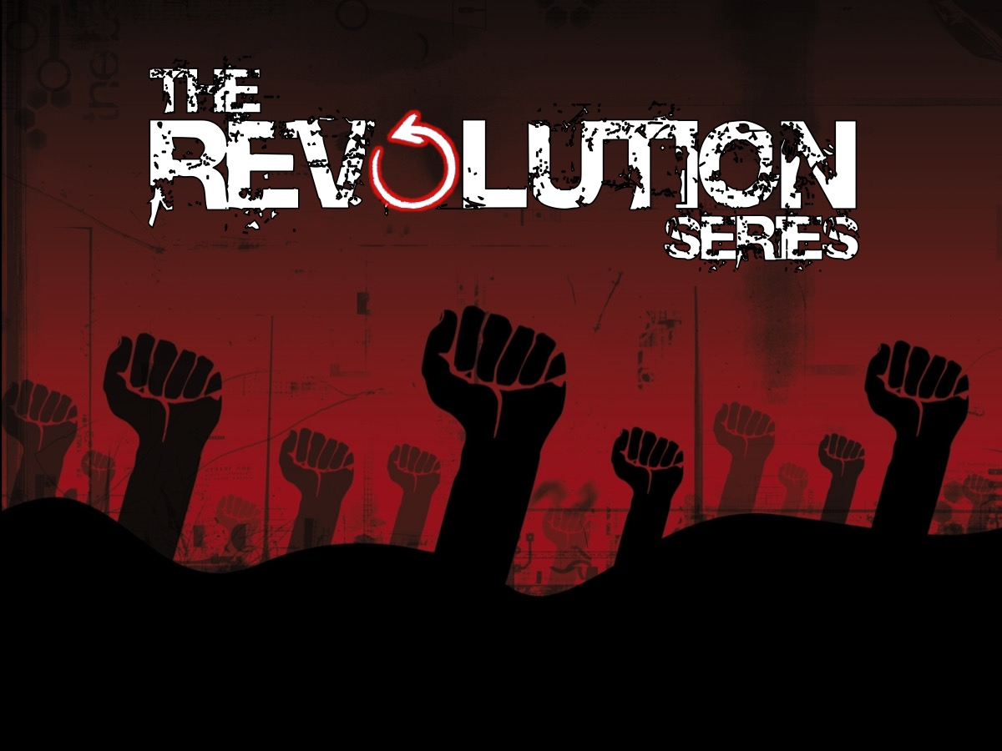
Notes:
This term we have launching the Revolution series!

Slide 2
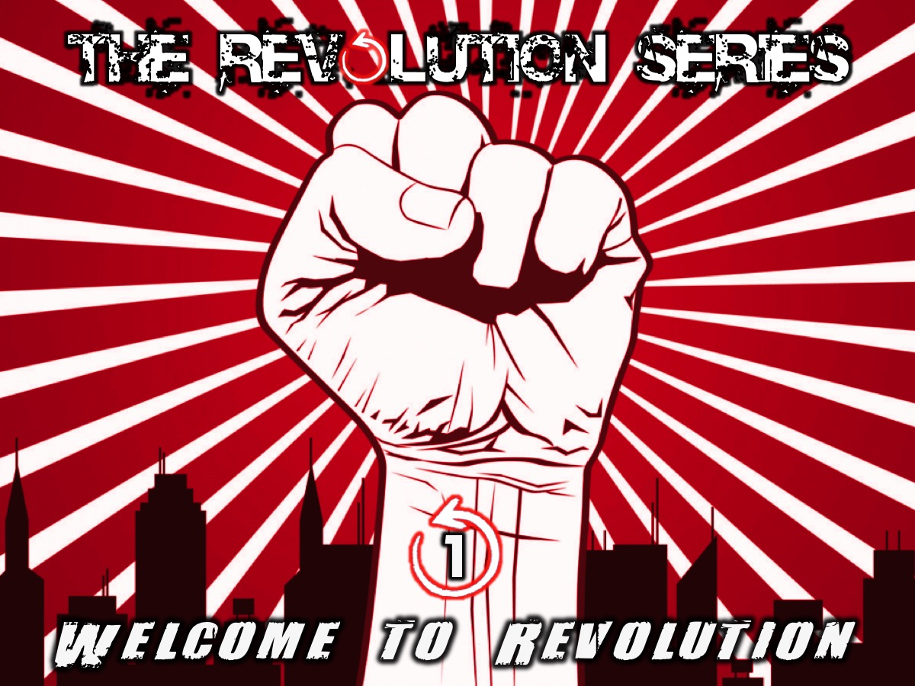
Notes:
Last week our theme was: Welcome to the Revolution

Slide 3
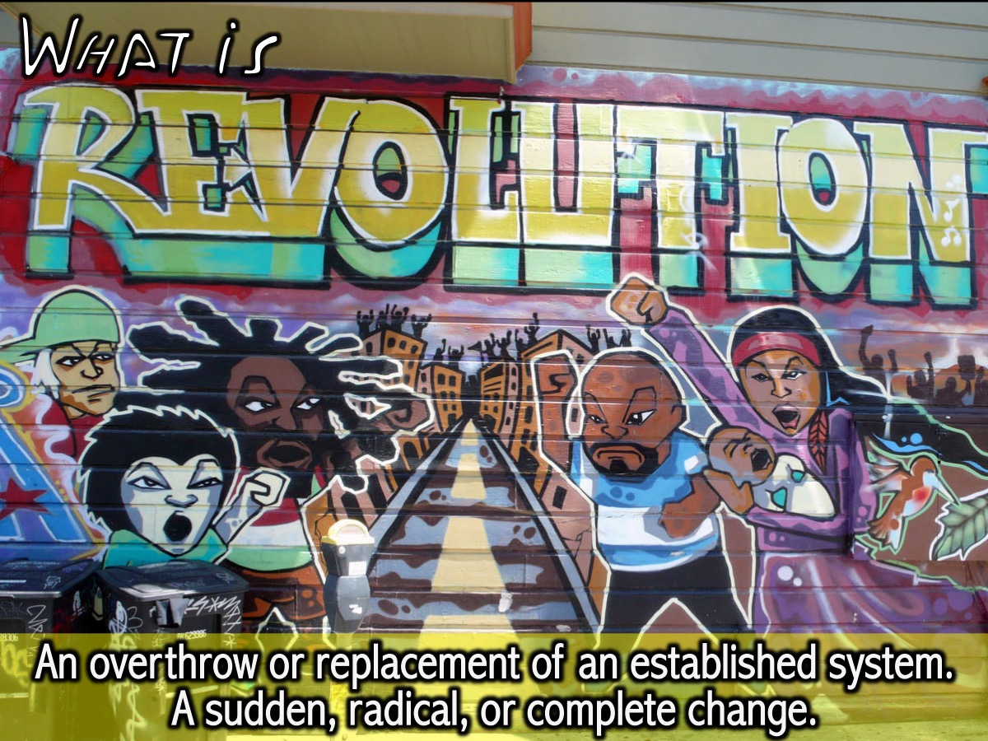
Notes:
We learnt that Revolution is an overthrow or replacement of an established system, a sudden, radical, or complete change.

Slide 4
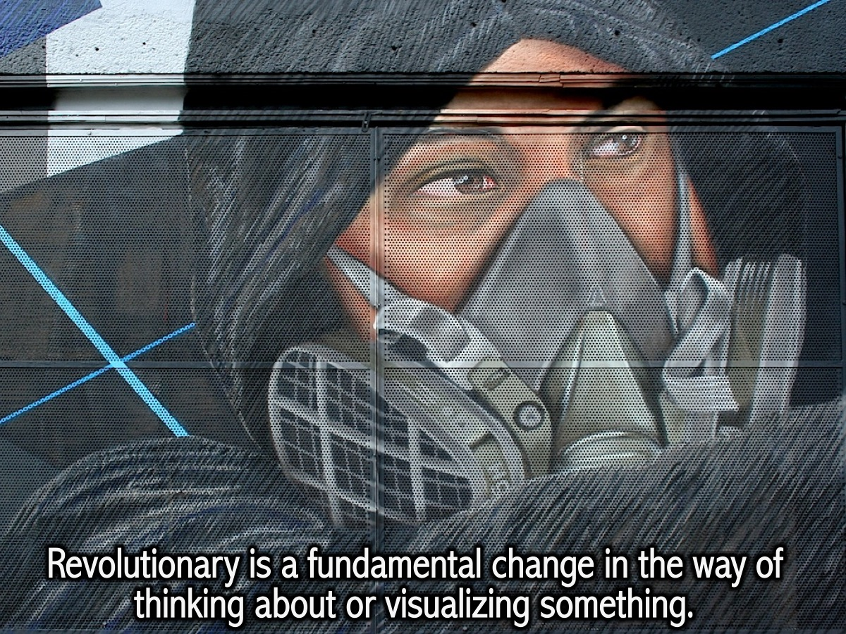
Notes:
We also saw that Revolutionary is a fundamental change in the way of thinking about or visualizing something.

Slide 5
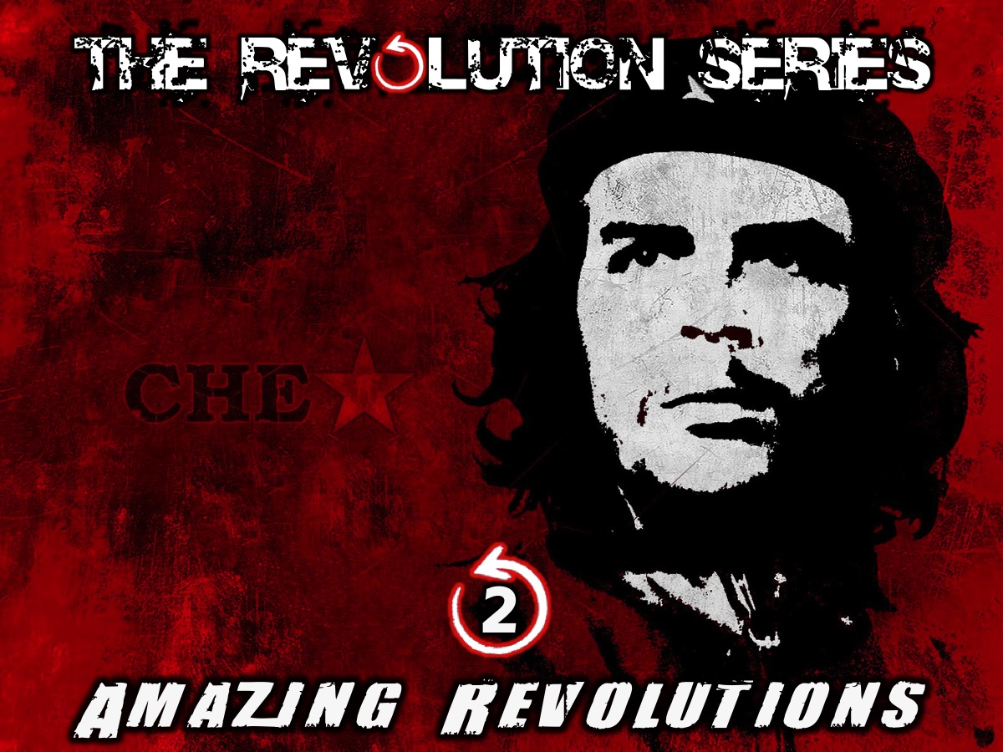
Notes:
This week we are going to look at some Amazing Revolutions and see what we can learn from them.

Slide 6
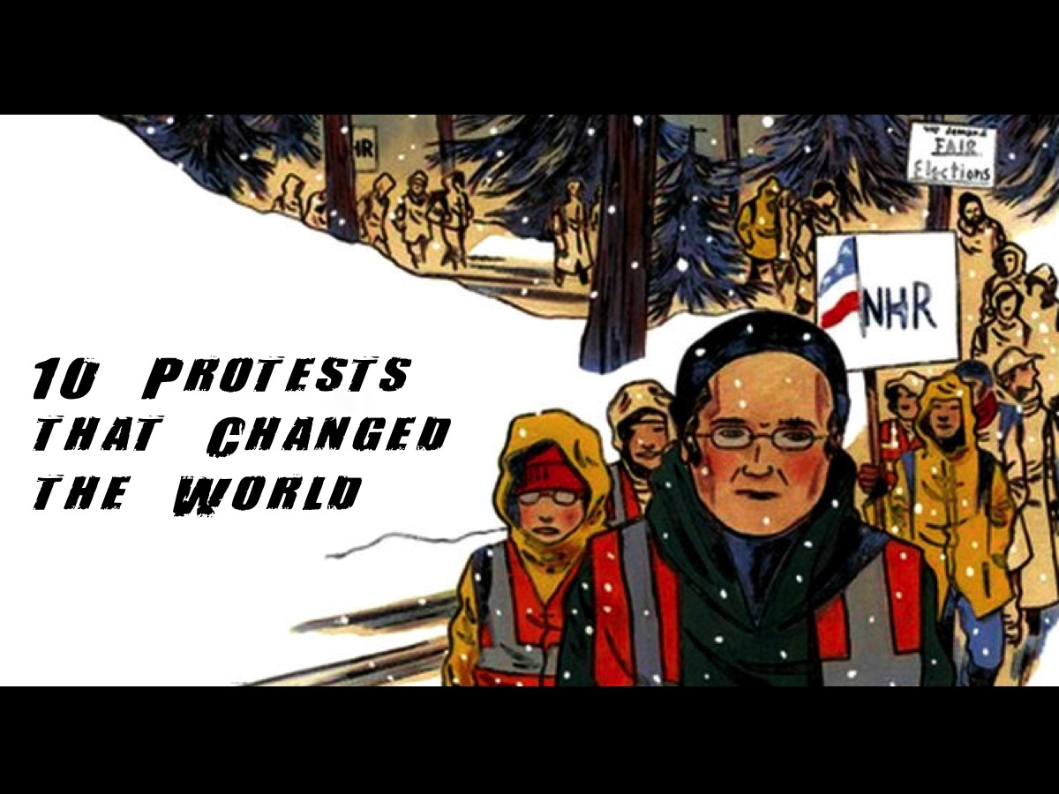
Notes:
Let’s take a closer look at 10 Protests that Changed the World.

Slide 7
Notes:
Video: 10 Protests that Changed the World. Get it on YouTube at: https://www.youtube.com/watch?v=o8RIBjEQmTM

Slide 8
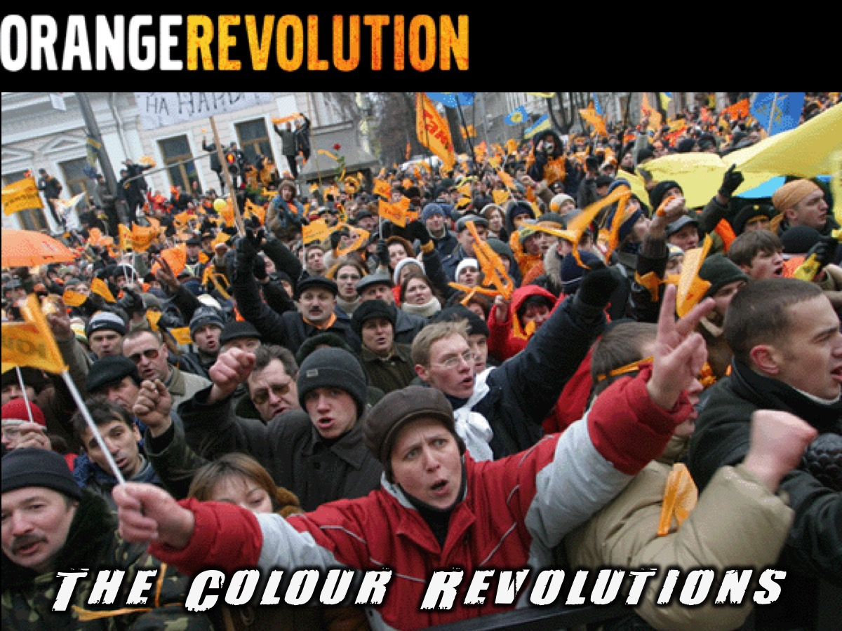
Notes:
Have you heard of the Colour Revolutions?

Slide 9

Notes:
It has nothing to do with new shades of makeup!

Slide 10

Notes:
Nor high definition television in millions of colours.

Slide 11

Notes:
Nor full-coloured wallpapers to download for your desktop.

Slide 12
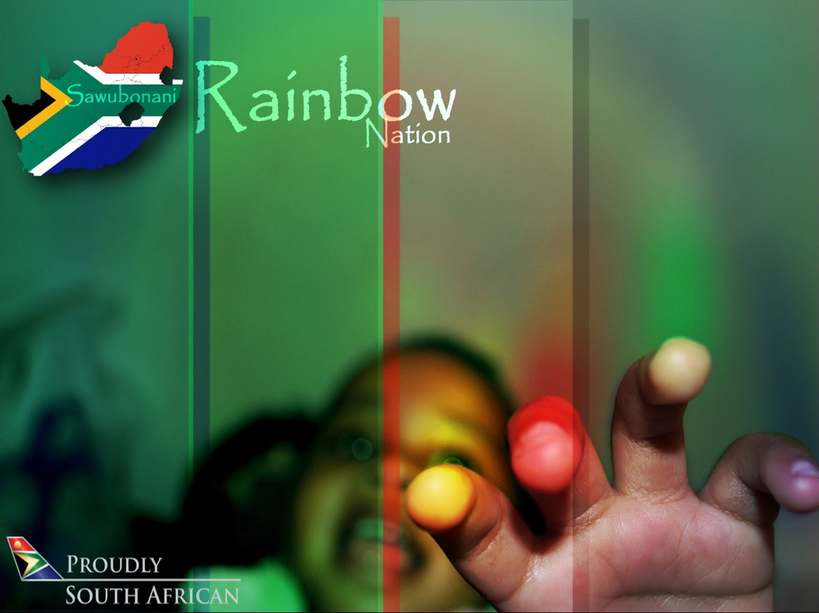
Notes:
Nor the rainbow nation called South Africa.

Slide 13
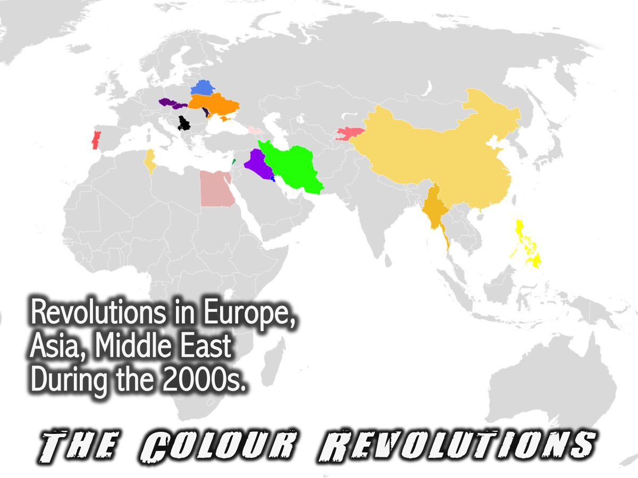
Notes:
The Colour Revolutions (sometimes called the coloured revolution) is a term that was widely used by worldwide media to describe various related movements that developed in several societies in the former Soviet Union and the Balkans during the early 2000s. The term has also been applied to a number of revolutions elsewhere, including in the Middle East. Some observers have called the events a revolutionary wave, the origins of which can be traced back to the 1986 People Power Revolution (also known as the "Yellow Revolution") in the Philippines. Participants in the colour revolutions have mostly used nonviolent resistance, also called civil resistance. Such methods as demonstrations, strikes and interventions have been intended protest against governments seen as corrupt and/or authoritarian, and to advocate democracy; and they have also created strong pressure for change. These movements generally adopted a specific colour or flower as their symbol. The colour revolutions are notable for the important role of non-governmental organisations (NGOs) and particularly student activists in organising creative non-violent resistance.

Slide 14
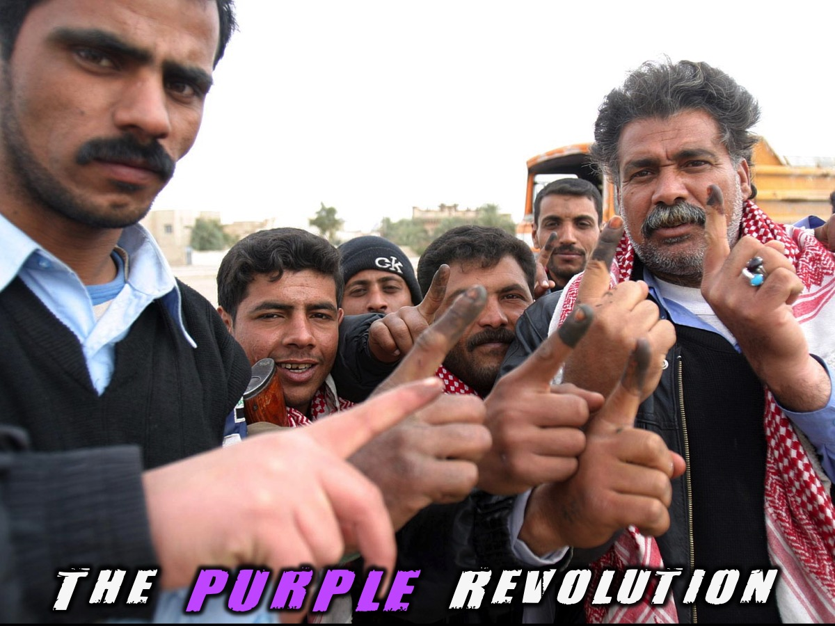
Notes:
For example there was The Purple Revolution: Purple Revolution is a term that some have given to the end of Saddam Hussein's governance in Iraq and the coming of democracy to the nation. The purple referred to the use of ink to stain the forefingers of people who voted in the 2005 Iraqi legislative election to prevent them from voting a second time.

Slide 15
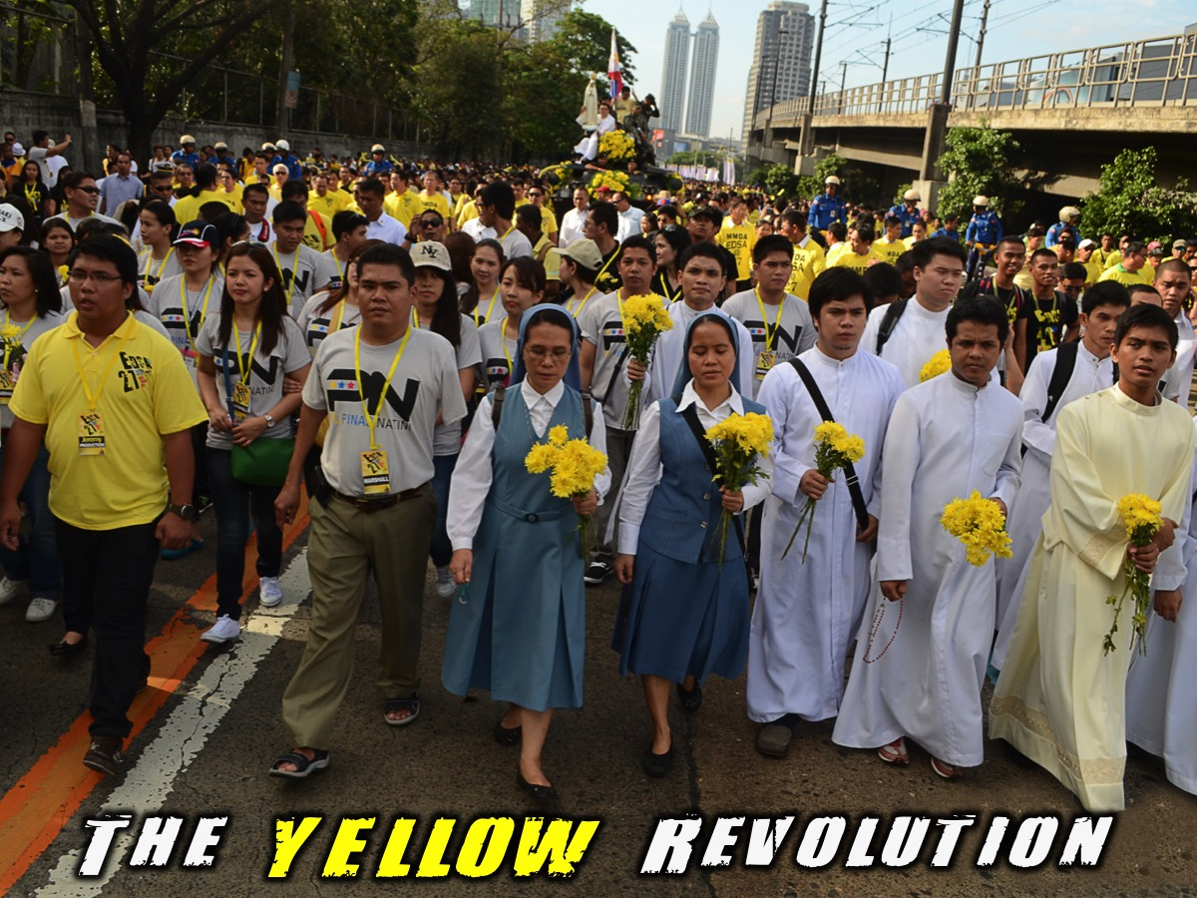
Notes:
There was also The Yellow Revolution: The People Power Revolution was a series of popular demonstrations in the Philippines that began in 1983 and culminated in 1986. The methods used amounted to a sustained campaign of civil resistance against regime violence and electoral fraud. This case of nonviolent revolution led to the departure of President Ferdinand Marcos and the restoration of the country's democracy. It was called the Yellow Revolution due to the presence of yellow ribbons during the demonstrations following the assassination of Benigno Aquino, Jr. It was widely seen as a victory of the people against the 20-year running authoritarian, repressive regime of then president Ferdinand Marcos and made news headlines as "the revolution that surprised the world”.

Slide 16
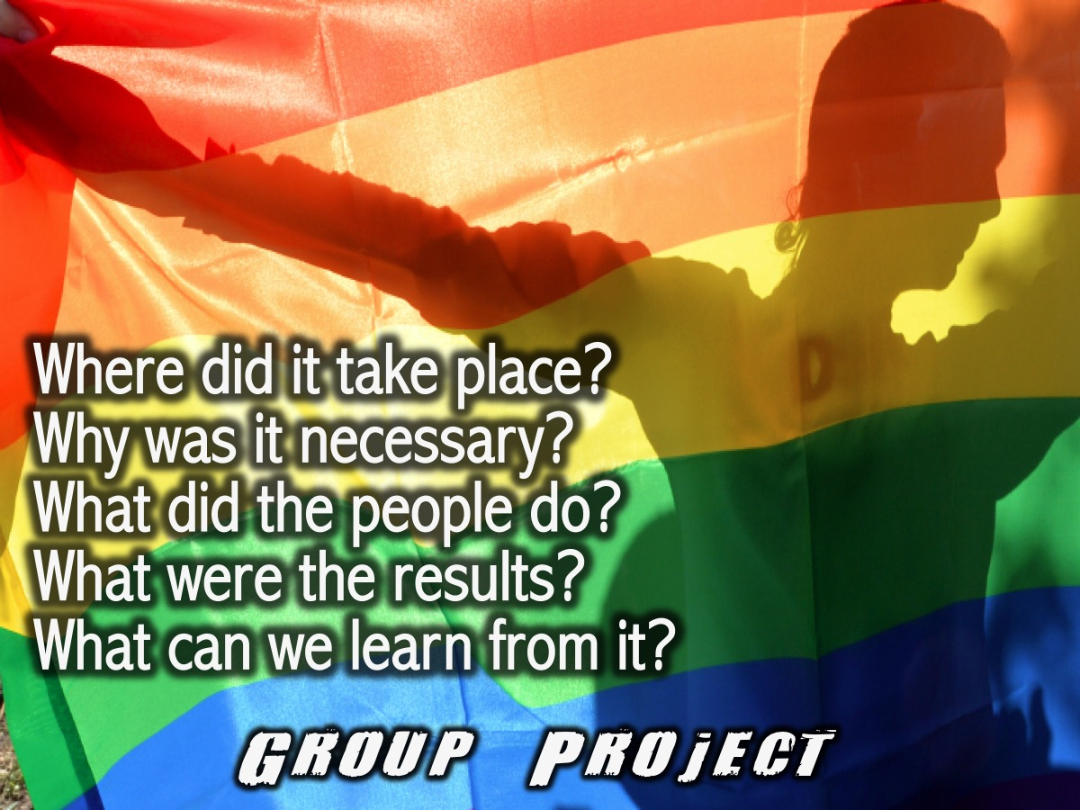
Notes:
Group Project: Each small group will take one of the Colour revolutions and put together a report back on these five questions: (1) Where did it take place? (2) Why was it necessary? (3) What did the people do? (4) What were the results? (5) What can we learn from it?

Slide 17
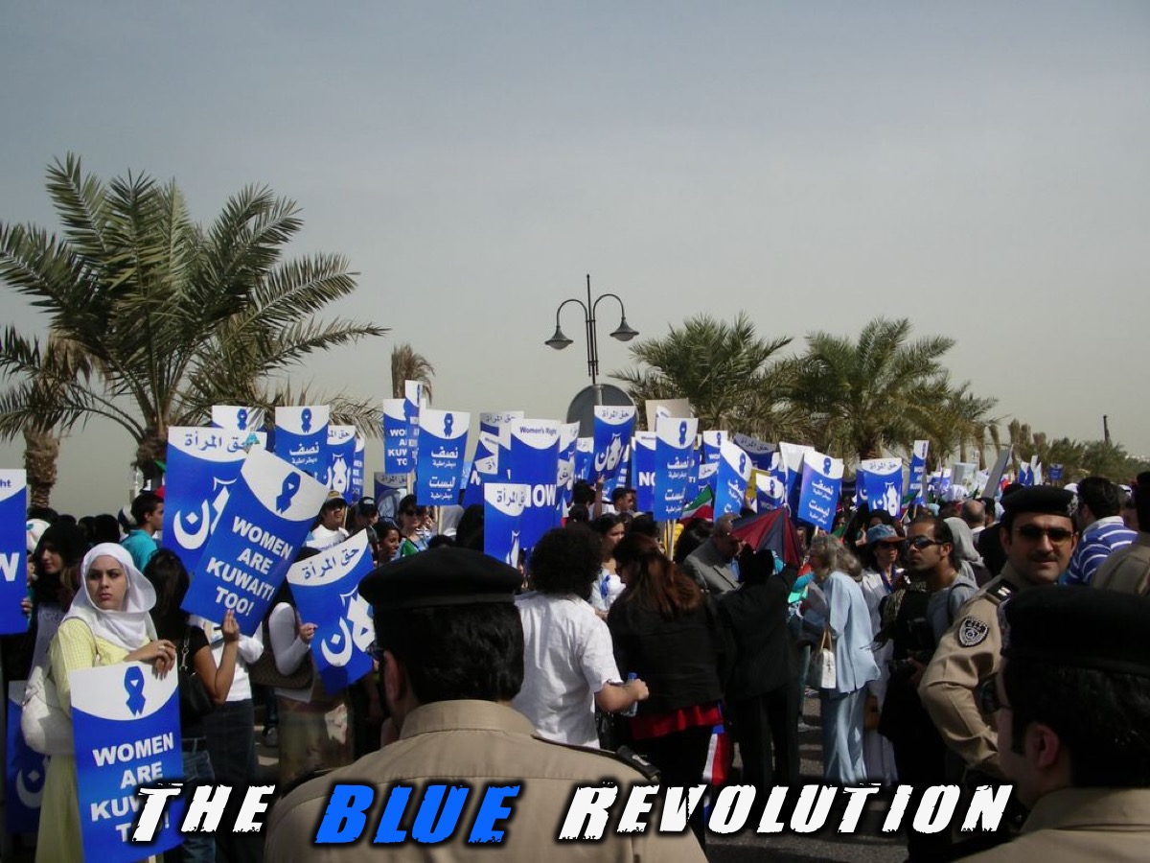
Notes:
The Blue Revolution: The country of Kuwait acquired independence from the United Kingdom in 1961. With the country feeling a sense of liberation, the women in particular seized the moment to seek further liberation. As an act of defiance, many women burned their robes. In doing so, they rejected notions of female dress and began to adopt a more Western wardrobe. A year later, a significant obstacle to their campaign appeared; the Kuwaiti parliament passed new election laws in 1962 that limited the electorate to a select few. Only men over the age of 21 whose families lived in Kuwait prior to 1920 were eligible to vote. Additionally, the election laws stipulated that members of the police and military could not vote. The result of the laws was a very exclusive electorate that excluded all groups of women from participation in the political process.
Blue Revolution was a term used by some Kuwaitis to refer to demonstrations in Kuwait in support of women's right to vote beginning in March 2005; it was named after the colour of the signs the protesters used. In May of that year the Kuwaiti government acceded to their demands, granting women the right to vote beginning in the 2007 parliamentary elections. The demonstrators did not aim to overthrow the government. Their objective was to win the right to vote for women, which they did.
Building on the energy of previous years, the campaign really captured the attention of the entire nation in 2005. So much so that a nonviolent anti-women’s rights campaign came into existence in Kuwait. Mostly consisting of staunch Islamists, the campaign organized rallies and criticized foreign influence. The women’s campaign, however, also received some new support in 2005 from the Kuwaiti Islamist Ummah Party, which became the first Sunni Muslim group in the Persian Gulf region to publicly support women’s right to vote.
In March, 1,000 demonstrators gathered peacefully outside of the Kuwaiti parliament to reinforce their demand for the right to vote. A small group of male anti-suffrage protesters made their presence felt at the demonstration, but were largely overshadowed by the pro-vote group. Many of the women involved in the demonstration wore pale blue to represent the struggle for suffrage. On May 17, after relentless resistance from conservatives, the Kuwaiti parliament passed a bill, granting the women the right to vote and run for elected office. The final vote in parliament saw 37 votes in favor and 21 votes against.

Slide 18
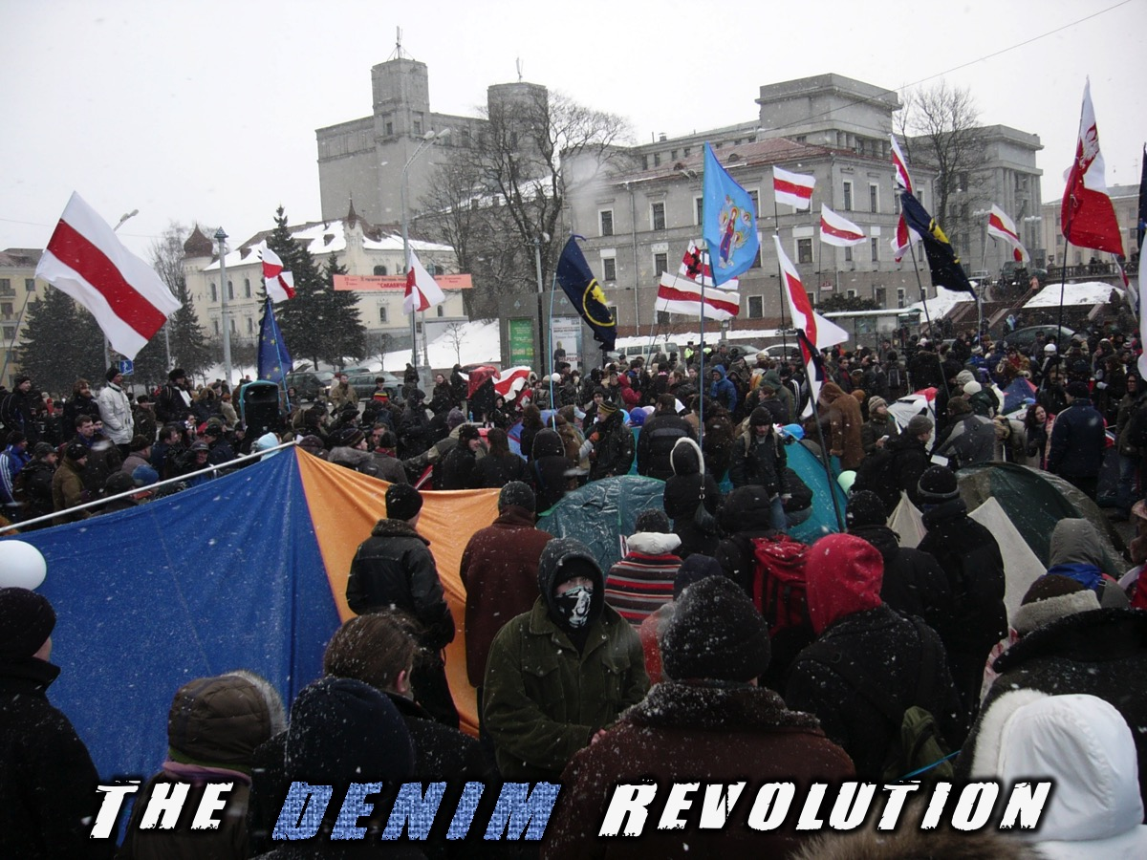
Notes:
The Denim Revolution: The Denim or Jeans Revolution was a term used by Belarus' democratic opposition to describe their protests following the 2006 Belarusian presidential election. The term was coined after a September 16, 2005 public demonstration against the policies of Alexander Lukashenko. On September 16, 1999, popular opposition leader Viktor Gonchar disappeared. The Belarusian police seized the white-red-white flags used by the opposition and banned in the state, and an activist of the youth movement Zubr, Mikita Sasim raised his denim shirt, announcing this will be their flag instead. This spontaneous incident was recognized to have a symbolic meaning. In the former Soviet Union jeans were a symbol of the Western culture, and hence jeans were immediately recognized by Belarusian opposition as a symbol of protest against Lukashenko's Soviet-like policies, as well as the symbol that Belarusians are "not isolated" from the West. Subsequently, Zubr suggested to wear jeans on 16th day of each month, in remembrance of alleged disappearances in Belarus.
The term "Jeans Revolution" was brought to worldwide attention in reference to the demonstrations held in Minsk, the capital of Belarus, disputing the elections. Up to 40,000 protesters gathered in October Square on March 19, 2006, it is believed. The protest against the outcome of the March 19 election began as soon as polls closed late Sunday, with more than 10,000 people gathering in the square.
On March 24, authorities sent in riot police to clear out the makeshift tent camp in October Square and told them to disperse. State television emphasized a report from city police stating that no one was hurt in the operation.
President Alexander Lukashenko earlier announced that protests similar to what occurred during other revolutions in the region would not take place in Belarus, stating that "force will not be used" to claim the presidency. Belarus authorities vowed to crush unrest in the event of large-scale protests following the election. Despite the government's prediction, the rally after the election was the biggest the opposition had mustered in years, reaching at least 10,000.
On March 20, Alaksandar Milinkievič said to 7,000 supporters that they faced a long haul with their protests: "We, free people of Belarus, will never recognise the election. They are afraid of us. Their power is based on lies". However, Lukashenko renewed charges that his rivals had planned pro-Western revolts like those in ex-Soviet Ukraine and Georgia. "Let me say that the revolution that so many people talked about and some were preparing, has failed and it could not be otherwise", he stated during the news conference on his victory.
On March 25, the 45,000 protesters in Belarus met police that did not clash with them, because they were waiting for riot police, but they did not interfere. However the protesters clashed with riot police and were eventually driven back. The riot police arrested more than 100 people along with Alexander Kozulin, a supporter of the protests and a candidate against Lukashenko. Kozulin was allegedly assaulted by the police during his arrest and on July 14, 2006, was sentenced to five-and-a-half years imprisonment for his actions in the protests.
Belarus is an autocratic state where KGB-like surveillance rules and the media have no rights. Protesting is considered a criminal activity and any writing that is critical of the regime can land a person in jail for three years.
Sadly democracy in Belarus still remains far off in the distance.

Slide 19
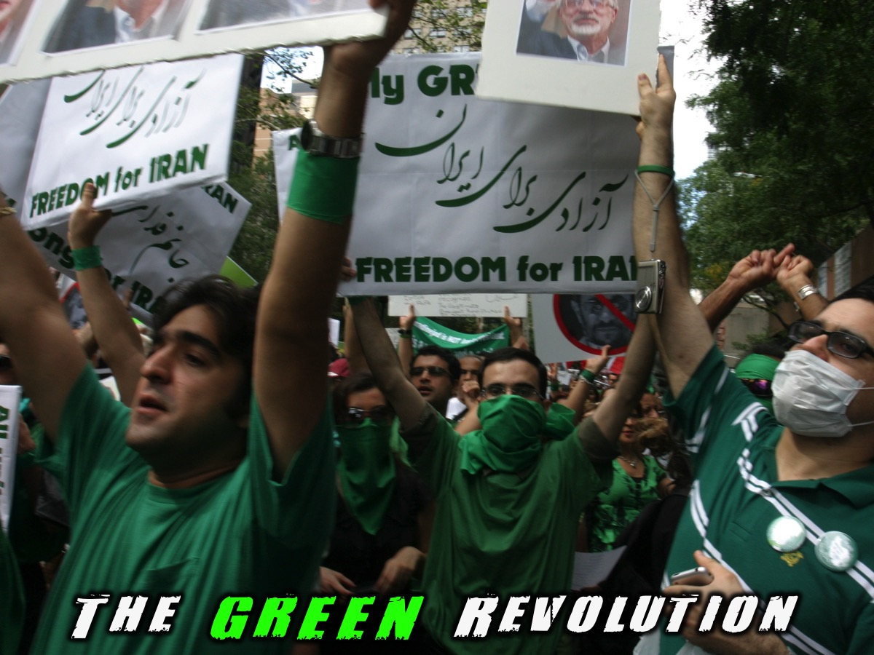
Notes:
The Green Revolution: The 2009–10 Iranian election protests were a series of protests following the 2009 Iranian presidential election against the disputed victory of Iranian President Mahmoud Ahmadinejad and in support of the opposition candidates that occurred in major cities in Iran. The protests were given several titles by their proponents including the Green Revolution, the Green Wave or the Sea of Green, reflecting presidential candidate Mousavi's campaign color.
The protests began the night of 12 June 2009, following the announcement that incumbent President Mahmoud Ahmadinejad had won nearly 60 percent despite several reported irregularities. However, all three opposition candidates claimed that the votes were manipulated and the election was rigged, and candidates Mohsen Rezaee and Mousavi have lodged official complaints. Mousavi announced that he "won't surrender to this manipulation" before lodging an official appeal against the result to the Guardian Council on 14 June. Ayatollah Ali Khamenei ordered an investigation into the claims of voting fraud and irregularities as per the request of the Green movement leaders. Ahmadinejad called the election "completely free" and the outcome "a great victory" for Iran, dismissing the protests as little more than "passions after a soccer match".
Despite the relative peaceful nature of the protests, the Police and the Basij (a paramilitary group) suppressed them by using batons, pepper spray, sticks and, in some cases, firearms; the most widely known victim was Neda Agha-Soltan, who was shot by a Basij and her last moments were uploaded to YouTube and was broadcast around the world. Opposition groups have also reported that thousands more have been arrested and tortured in prisons around the country, with former inmates alleging mass rape of men, women, and children by the Iranian Revolutionary Guards in prisons. The Iranian government has confirmed the deaths of 36 people during the protests, while unconfirmed reports by supporters of Mousavi allege that there have been 72 deaths (twice as many) in the three months following the disputed election, with a possibly higher number, since relatives of the deceased are forced to sign documents claiming they had died of heart attack or meningitis. Iranian authorities have closed universities in Tehran, blocked web sites, blocked cell phone transmissions and text messaging, and banned rallies.
The events have also been nicknamed the "Twitter Revolution" because of the protesters' reliance on Twitter and other social-networking Internet sites to communicate with each other.
The Islamic Republic has not escaped popular opposition in the past. During the 1980s, the Marxist-Islamist, Mojahedin Khalq was instrumental in opposing Ayatollah Khomeini through large protests and bombings against politicians such as Mohammad-Ali Rajai, Shahid Beheshti, and Khamenei himself, who escaped an assassination attempt that left his right arm paralyzed. Following the 1981 Hafte Tir bombing, Ayatollah Khomeini declared the Mojahedin and anyone opposed to the Islamic republic, "enemies of god" and pursued a mass campaign of torture, rape, and execution against members of the Mojahedin, Fadaiyan, and Tudeh parties as well as their families, close friends, and even anyone who was accused of insufficient Islamic behavior, resulting in the deaths of thousands of Iranians who were usually tried in secret kangaroo courts run by hard line clerics. Following the failed Operation Mersad in 1988, Khomeini ordered all prisons to execute those still in captivity, resulting in an estimated 30,000 dead. Since then, no organized opposition has surfaced in Iran and following this experience, the Iranian Government usually employs heavy handed tactics to marginalize any attempt at regime removal and usually justifies this with the "enemy of god" classification.

Slide 20
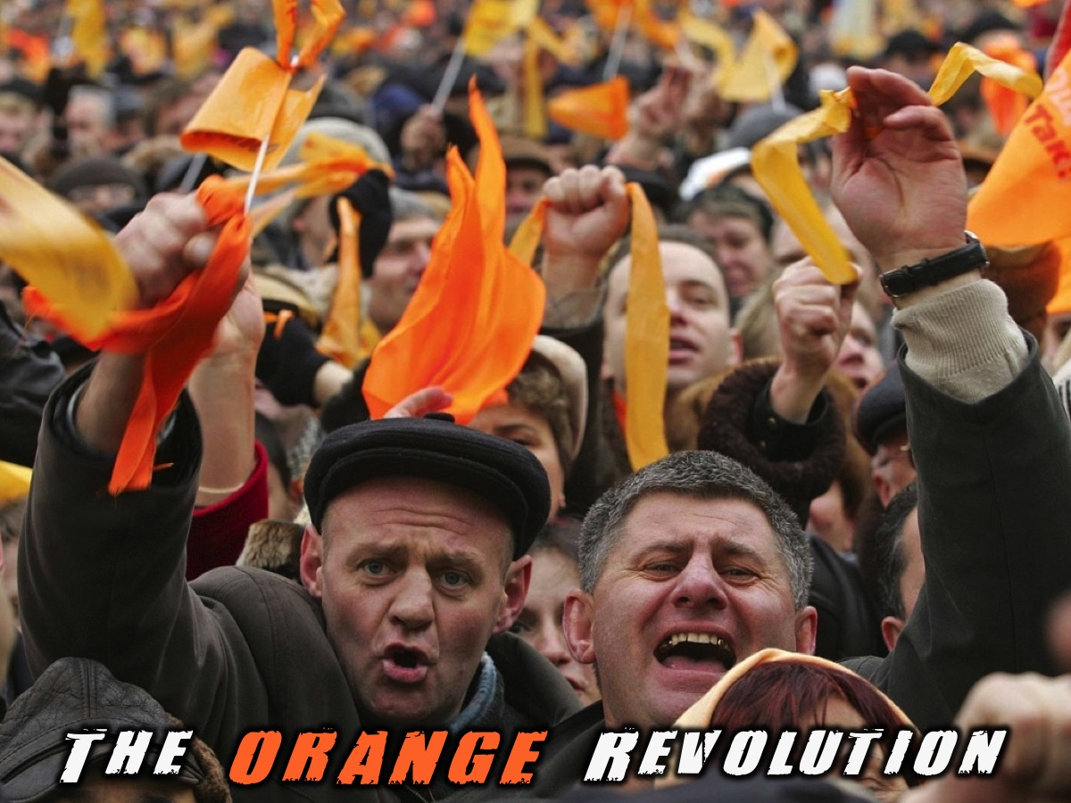
Notes:
The Orange Revolution: The Orange Revolution was a series of protests and political events that took place in Ukraine from late November 2004 to January 2005, in the immediate aftermath of the run-off vote of the 2004 Ukrainian presidential election which was claimed to be marred by massive corruption, voter intimidation and direct electoral fraud. Kiev, the Ukrainian capital, was the focal point of the movement's campaign of civil resistance, with thousands of protesters demonstrating daily. Nationwide, the democratic revolution was highlighted by a series of acts of civil disobedience, sit-ins, and general strikes organized by the opposition movement.
The protests were prompted by reports from several domestic and foreign election monitors as well as the widespread public perception that the results of the run-off vote of 21 November 2004 between leading candidates Viktor Yushchenko and Viktor Yanukovych were rigged by the authorities in favour of the latter. The nationwide protests succeeded when the results of the original run-off were annulled, and a revote was ordered by Ukraine's Supreme Court for 26 December 2004. Under intense scrutiny by domestic and international observers, the second run-off was declared to be "fair and free". The final results showed a clear victory for Yushchenko, who received about 52% of the vote, compared to Yanukovych's 44%. Yushchenko was declared the official winner and with his inauguration on 23 January 2005 in Kiev, the Orange Revolution ended.
In the 2010 presidential election Yanukovych became Yushchenko's successor as Ukrainian President after the Central Election Commission and international observers declared that the presidential election was conducted fairly. Yanukovych was ousted from power four years later following the February 2014 Euromaidan clashes in Kiev's Independence Square. Unlike the bloodless Orange Revolution, these protests resulted in more than 100 deaths, occurring mostly between 18 and 20 February.
The state of Ukraine during the 2004 presidential election is considered an “ideal condition” for an outburst from the public. During this time Ukrainians were impatient while waiting for economic and political transformation. The results of the election were thought to be fraudulent and considered “a nail in the coffin” of the preceding events.
The Ukrainian regime was in power before the Orange Revolution created a path for a democratic society to emerge. It was based on a “competitive authoritarian regime” that allowed for a democracy and market economy to come to life. The election fraud definitely emphasised the Ukrainian citizens’ desire for a more pluralistic type of government. The president was embroiled in a scandal that undermined the peoples’ respect for him as president, but also for the elite ruling class in general. Because of Kuchma’s scandalous behaviour, he lost many of his supporters with high ranking government positions. Many of the government officials who were on his side went on to fully support the election campaign of Yuschenko and well as his ideas in general. After a clear lack of faith in the government had been instilled in the Ukrainian population, Yushchenko’s role had never been more important to the revolution. Yushchenko was a charismatic candidate who showed no signs of being corrupt. Yuschenko was on the same level as his constituents and presented his ideas in a “non-Soviet” way. Young Ukrainian voters were extremely important to the outcome of the 2004 Presidential election. This new wave of younger people had different views of the main figures in Ukraine. The abundance of younger people who participated showed an increasing sense of nationalism that was developing in the country. The Orange Revolution was impactful enough to interest people of all ages.
The Orange Revolution was first called the Chestnut Revolution, after the trees along the main avenue in Kiev, the nation’s capital, the more vivid orange was adopted by backers of the opposition candidate, Viktor Yushchenko, who finally gained office after two run-off elections.

Slide 21
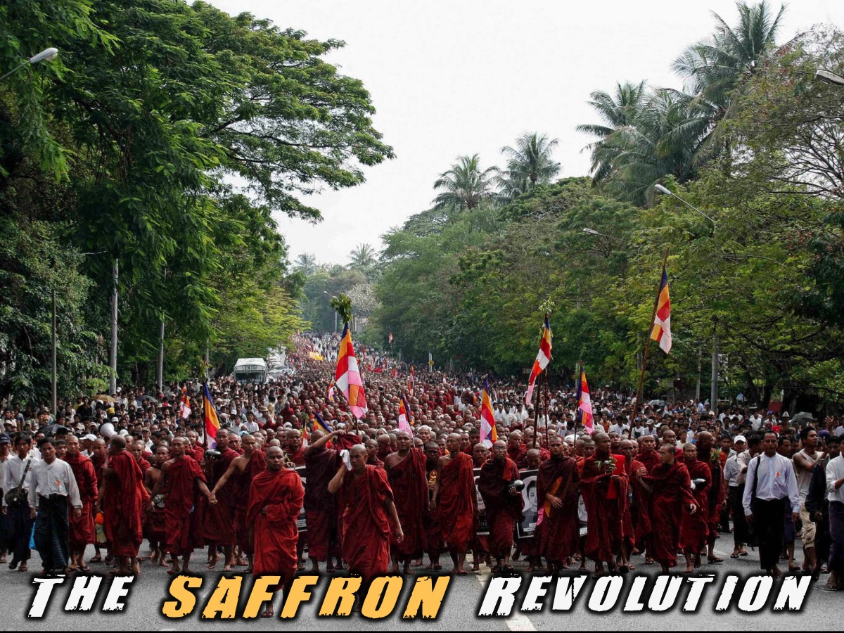
Notes:
The Saffron Revolution: Saffron Revolution is a term used to describe a series of economic and political protests and demonstrations that took place from August to October of 2007 in Burma (also known as Myanmar). The protests were triggered by the decision of the national military government to remove subsidies on the sales prices of fuel. The national government is the only supplier of fuels and the removal of the price subsidy immediately caused diesel and petrol prices to increase by 66%-100% and the price of compressed natural gas for buses to increase 500% in less than a week.
The various protests were led by students, political activists, including women, and Buddhist monks and took the form of a campaign of nonviolent resistance, sometimes also called civil resistance.
In response to the protests dozens of protesters were arrested or detained. Starting in September 2007 the protests were led by thousands of Buddhist monks, and those protests were allowed to proceed until a renewed government crackdown in late September 2007. Some news reports referred to the protests as the Saffron Revolution.
The exact number of casualties is not known, but estimates range from 13-31 deaths resulting from the protests and reprisals by the government. Several hundred people were arrested or detained, many, but not all, of whom were released.
The phrase "Saffron Revolution" connects the protests against Myanmar's military dictatorship to the saffron-colored robes widely associated with Buddhist monks, who were at the forefront of the demonstrations.
Democratic Voice of Burma puts the number of deaths at 138, basing their figure on a list compiled by the 88 Student Generation group in Myanmar. The Executive Director of the DVB, Aye Chan Naing, told the Associated Press that "this 138 figure is quite credible because it is based on names of victims, I also think the figure is accurate because of the pictures coming from inside Burma. The way they were shooting into the crowds with machine guns means dozens of people could have died."
A report in the Daily Mail states that "thousands of protesters are dead and the bodies of hundreds of executed monks have been dumped in the jungle", the report is based on information provided by Colonel Hla Win, who defected from the army some days prior to the report, he is quoted as having said "Many more people have been killed in recent days than you've heard about. The bodies can be counted in several thousand."
Australia's The Age reports that, after two non-protesters were shot in northwest Yangon, "the army came back, gave the families less than $20 each and took away the corpses."
On 11 November 2008, a court in Insein Prison sentenced Students Group members arrested during the anti-government protests to 65 years in prison. The government used a variety of laws including the foreign exchange act and the video and electronics act which prohibit Burmese nationals from holding foreign currency or from owning electronic and video equipment without a permit.
The government attempted to block all websites and services that could carry news or information about Myanmar, barring access to web-based email. However protesters were able to access the Internet anyway and as a result the protests received a never before seen level of international news coverage. Bloggers in Yangon succeeded in circumventing the censors, posting pictures and videos on blogs almost as soon as the protests began. Many of these images were picked up by mainstream news organizations, because bloggers had managed to capture images that no one else was able to get. When Aung San Suu Kyi stepped outside her home in Yangon to greet marching monks and supporters on Saturday, the only pictures of the landmark moment were posted on blogs. On 28 September it was reported that the government had blocked all access to the Internet. The official explanation is that maintenance is being carried out but Sky News reports that all Internet cafés have also been closed.

Slide 22
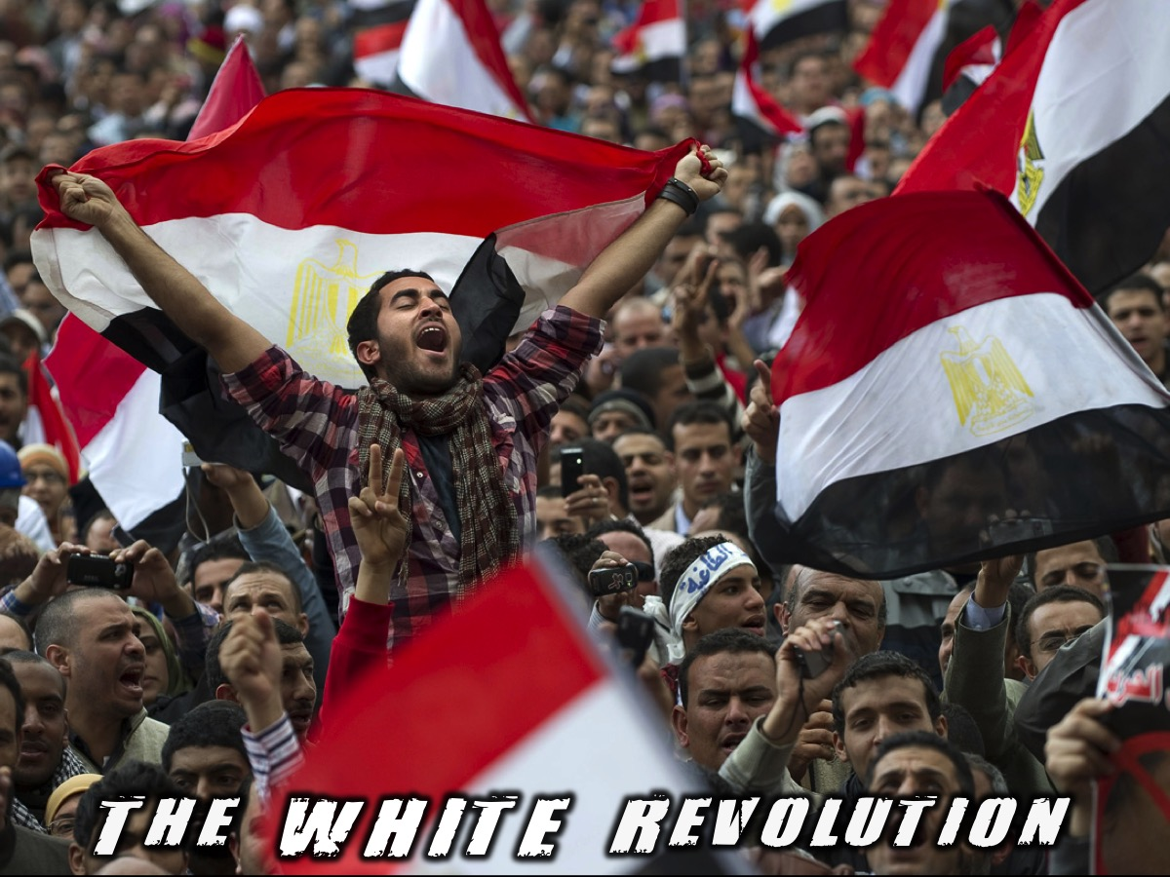
Notes:
The White Revolution: The Egyptian Revolution of 2011, locally known as the January 25 Revolution (or the Lotus revolution after the national flower of Egypt), was a movement following a popular uprising which began on 25 January 2011. It consisted of demonstrations, marches, plaza occupations, riots, non-violent civil resistance, acts of civil disobedience and strikes. Millions of protesters from a range of socio-economic and religious backgrounds demanded the overthrow of Egyptian President Hosni Mubarak. The revolution included Islamic, liberal, anti-capitalist, nationalist and feminist elements. Violent clashes between security forces and protesters resulted in at least 846 people killed and over 6,000 injured. Protesters burned over 90 police stations. The protests, which took place in Cairo, Alexandria and other cities, followed the Tunisian revolution which resulted in the overthrow of longtime Tunisian president Ben Ali.
The Egyptian protesters' grievances focused on legal and political issues, including police brutality, state-of-emergency laws, lack of free elections and freedom of speech, corruption, and economic issues including high unemployment, food-price inflation and low wages. The protesters' primary demands were the end of the Mubarak regime and emergency law, freedom, justice, a responsive non-military government and a voice in managing Egypt's resources. Strikes by labour unions added to the pressure on government officials.
During the uprising the capital, Cairo, was described as "a war zone" and the port city of Suez saw frequent violent clashes. Protesters defied a government-imposed curfew, which was unenforced by the police and military. Egypt's Central Security Forces police, loyal to Mubarak, was gradually replaced by military troops. In the chaos, there was looting by gangs which was instigated (according to opposition sources) by plainclothes police officers. In response, watch groups were organized by civilians to protect neighbourhoods.
Mubarak dissolved his government, appointing former head of the Egyptian General Intelligence Directorate Omar Suleiman vice-president in an attempt to quell dissent. Mubarak asked aviation minister and former chief of Egypt's air force Ahmed Shafik to form a new government. Mohamed ElBaradei became a major opposition figure, with all major opposition groups supporting his role as negotiator for a transitional unity government.
On 11 February 2011 Vice President Omar Suleiman announced that Mubarak would resign as president, turning power over to the Supreme Council of the Armed Forces (SCAF). The military junta, headed by effective head of state Mohamed Hussein Tantawi, announced on 13 February that the constitution would be suspended, both houses of parliament dissolved and the military would rule for six months (until elections could be held). The previous cabinet, including Prime Minister Ahmed Shafik, would serve as a caretaker government until a new one was formed. Shafik resigned on 3 March, a day before major protests to force him to step down were planned, and was replaced by former transport minister Essam Sharaf. On 24 May 2011, Mubarak was ordered to stand trial on charges of premeditated murder of peaceful protesters and, if convicted, could face the death penalty. On 2 June 2012 Mubarak was found guilty of complicity in the murder of protesters and sentenced to life imprisonment.
After the revolution against Mubarak and a period of rule by the Supreme Council of the Armed Forces, the Muslim Brotherhood took power in Egypt through a series of popular elections, with Egyptians electing Islamist Mohamed Morsi to the presidency in June 2012. However, Morsi's government encountered fierce opposition from secularists and members of the military, and mass protests broke out against his rule in June 2013. On 3 July 2013, Morsi was deposed by a coup d'état led by the minister of defense, General Abdel Fattah El-Sisi, who became Egypt's de facto strongman and was eventually elected president himself in a disputed 2014 election.
In Egypt and the Arab world, the protests and governmental changes are also known as the 25 January Revolution, Freedom Revolution or Rage Revolution, and the Youth Revolution, Lotus Revolution or White Revolution.

Slide 23
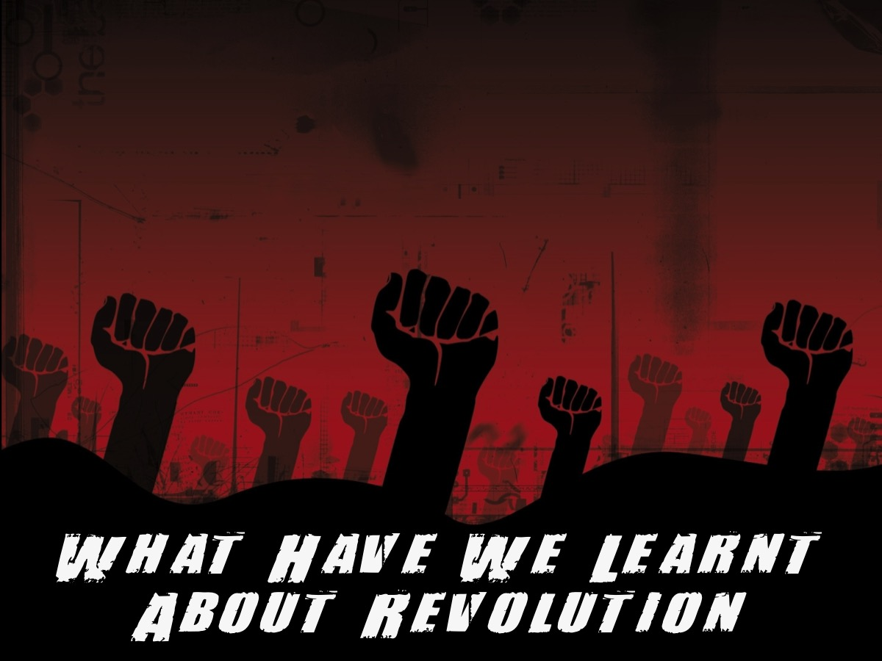
Notes:
So what have we learnt about revolution today?

Slide 24

Notes:
1. Change is Possible – Audrey Hepburn said: “Nothing is impossible, the word itself says ‘I’m possible’!” Revolutions in situations where it must have seemed to be totally impossible to change a corrupt regime teaches us that change is possible.

Slide 25

Notes:
2. Change is Costly. Bonnie Pfiester said: “You will begin to succeed when you begin to realise your goal is worth the sacrifice.” Change does not come cheaply! Anything that ends us being changed will require hard work and even sacrifice.

Slide 26
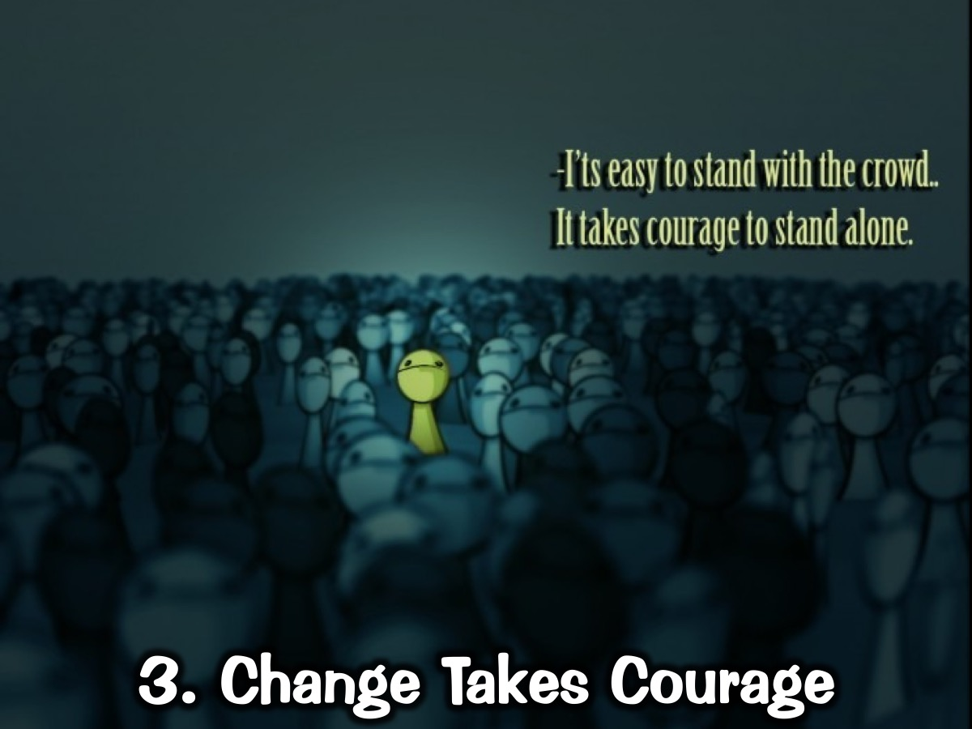
Notes:
3. Change Takes Courage. Someone said that it’s easy to stand with the crowd but it takes courage to stand alone. Think of the revolutions we have explored today – each person who participated in one of the protests needed courage to leave the safety of their homes and march against the regime. Boldness and fearlessness are needed or we won’t participate and see change in our lives or the world around us!

Slide 27
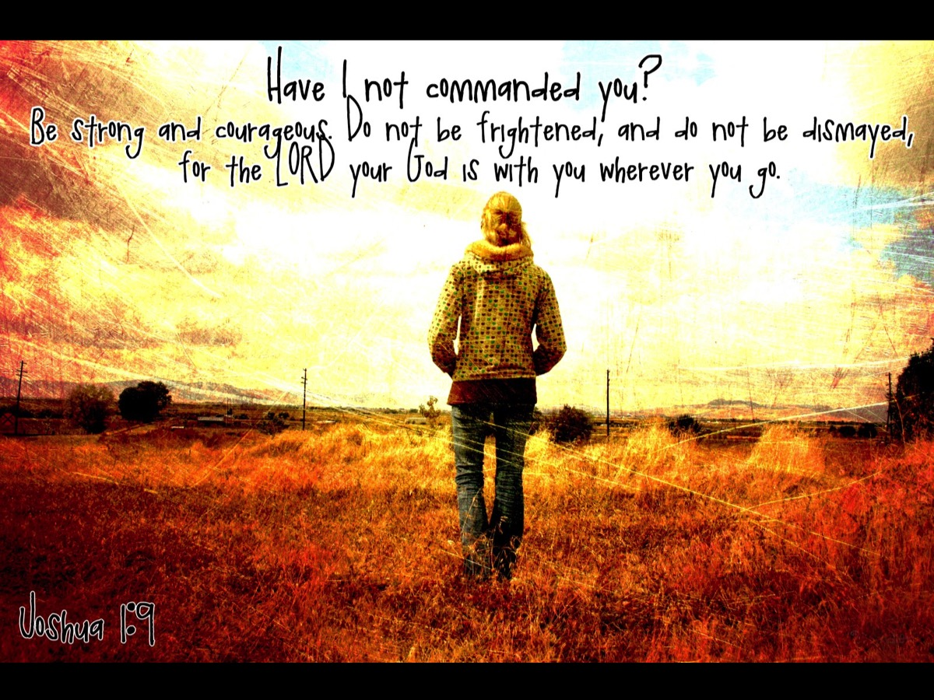
Notes:
In Joshua 1: 9, God says, “Have I not commanded you? Be strong and courageous. Do not be frightened and do not be dismayed, for the Lord your God is with you wherever you go.”

Slide 28
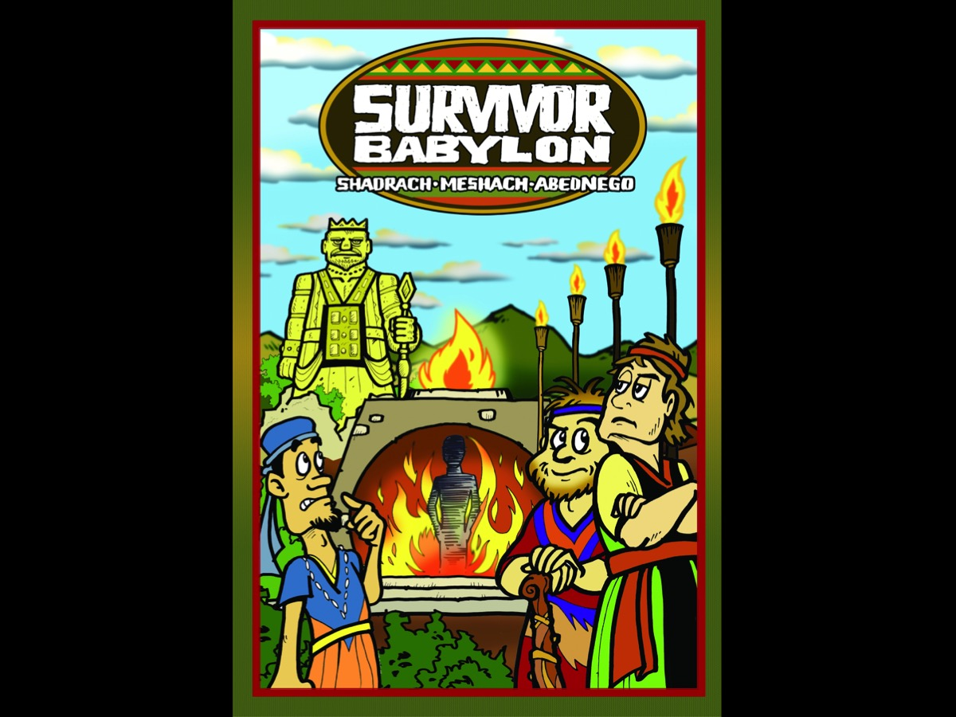
Notes:
Have you heard about Survivor Babylon? It took place many years before Jesus was born! We read about it in Daniel 3.

Slide 29
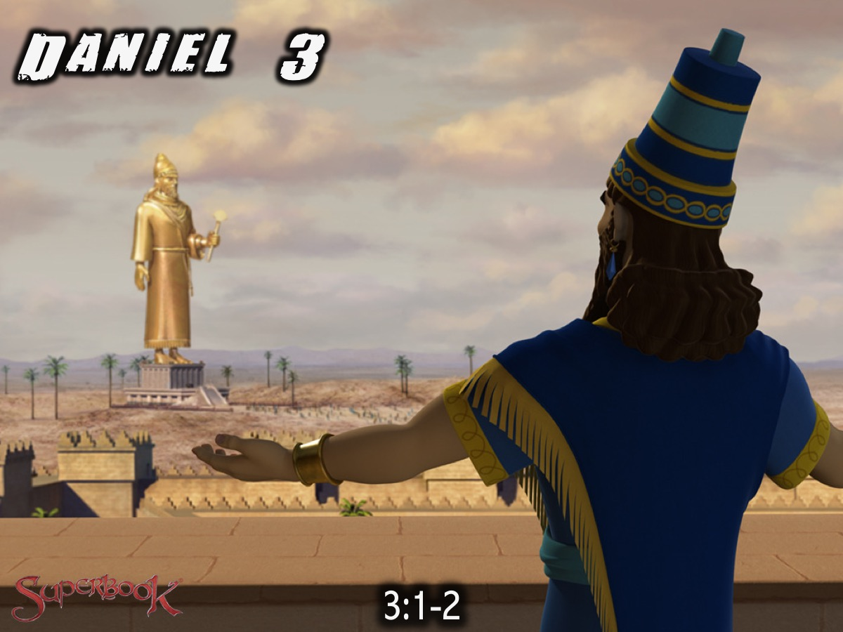
Notes:
¹ King Nebuchadnezzar made an image of gold, sixty cubits high and six cubits wide, and set it up on the plain of Dura in the province of Babylon. ² He then summoned the satraps, prefects, governors, advisors, treasurers, judges, magistrates and all the other provincial officials to come to the dedication of the image he had set up.

Slide 30
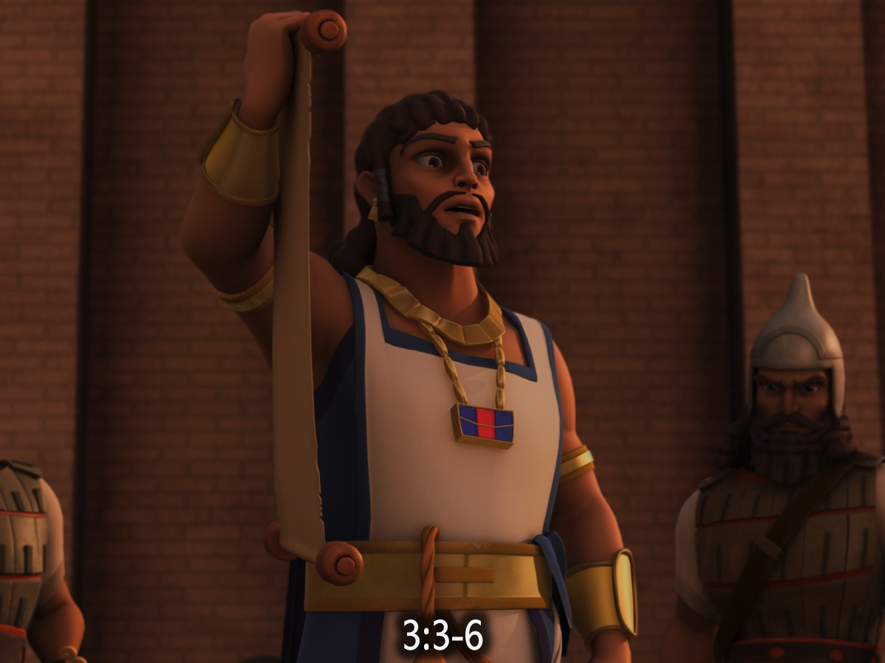
Notes:
³ So the satraps, prefects, governors, advisors, treasurers, judges, magistrates and all the other provincial officials assembled for the dedication of the image that King Nebuchadnezzar had set up, and they stood before it. ⁴ Then the herald loudly proclaimed, ‘Nations and peoples of every language, this is what you are commanded to do: ⁵ as soon as you hear the sound of the horn, flute, zither, lyre, harp, pipe and all kinds of music, you must fall down and worship the image of gold that King Nebuchadnezzar has set up. ⁶ Whoever does not fall down and worship will immediately be thrown into a blazing furnace.’

Slide 31
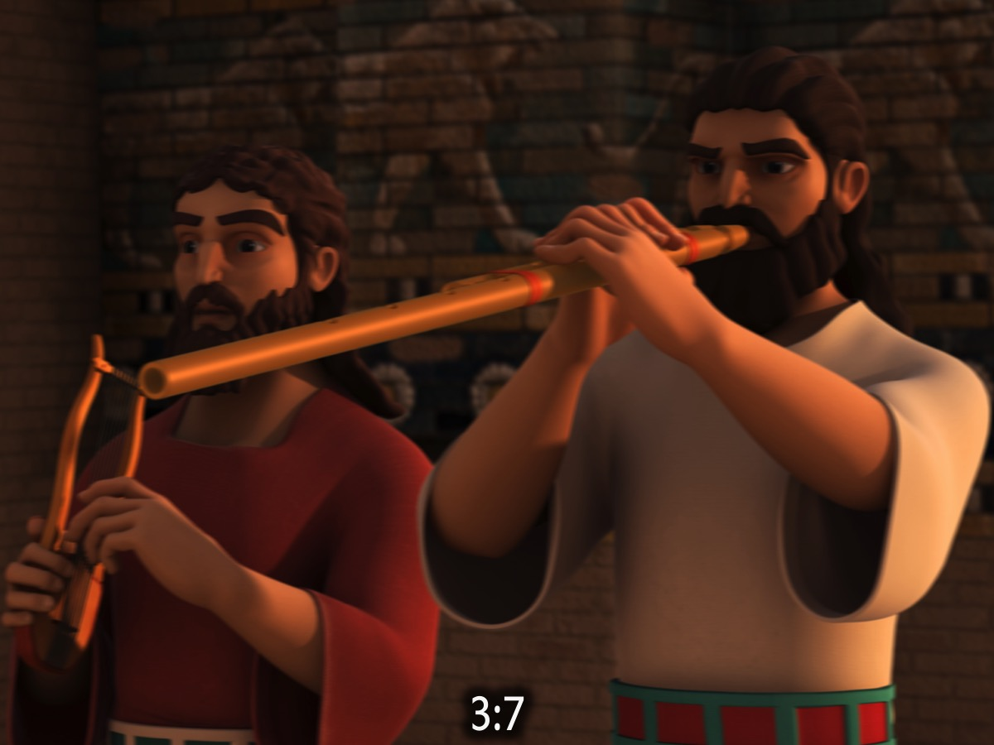
Notes:
⁷ Therefore, as soon as they heard the sound of the horn, flute, zither, lyre, harp and all kinds of music, all the nations and peoples of every language fell down and worshipped the image of gold that King Nebuchadnezzar had set up.

Slide 32
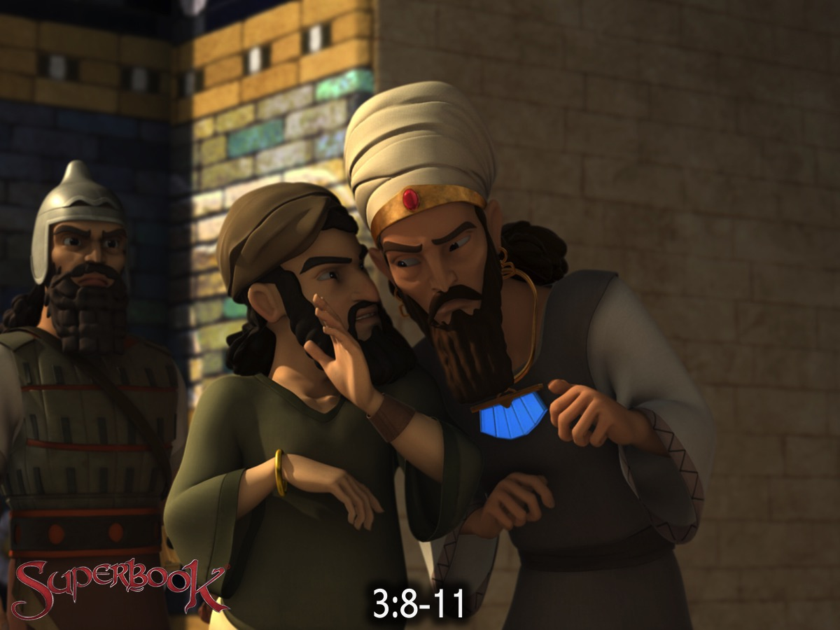
Notes:
⁸ At this time some astrologers came forward and denounced the Jews. ⁹ They said to King Nebuchadnezzar, ‘May the king live for ever! ¹⁰ Your Majesty has issued a decree that everyone who hears the sound of the horn, flute, zither, lyre, harp, pipe and all kinds of music must fall down and worship the image of gold, ¹¹ and that whoever does not fall down and worship will be thrown into a blazing furnace.

Slide 33
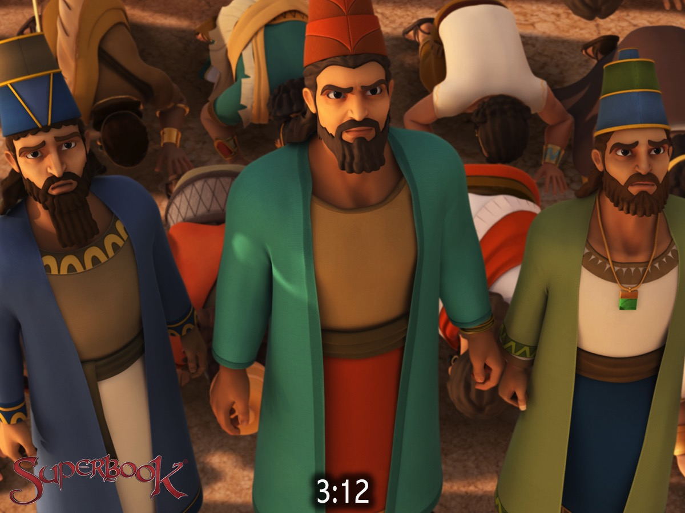
Notes:
¹² But there are some Jews whom you have set over the affairs of the province of Babylon – Shadrach, Meshach and Abednego – who pay no attention to you, Your Majesty. They neither serve your gods nor worship the image of gold you have set up.’

Slide 34
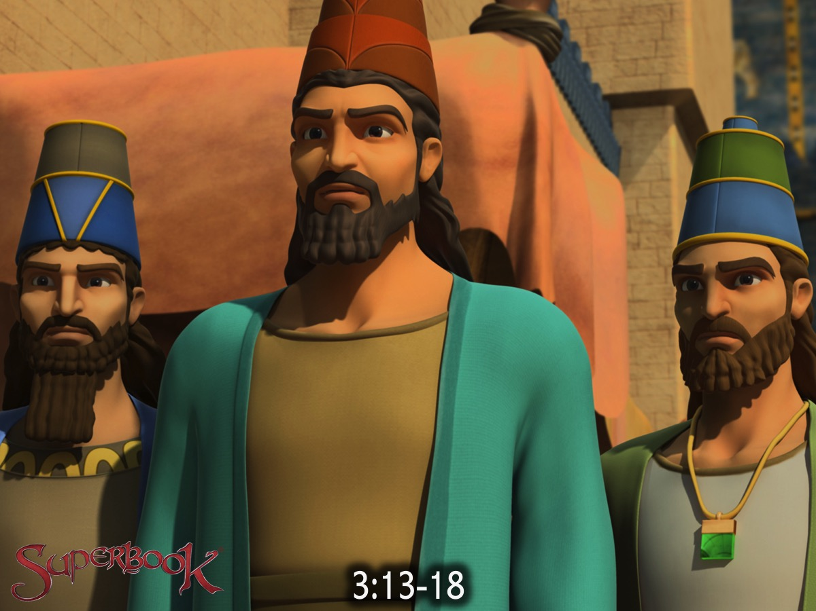
Notes:
¹³ Furious with rage, Nebuchadnezzar summoned Shadrach, Meshach and Abednego. So these men were brought before the king, ¹⁴ and Nebuchadnezzar said to them, ‘Is it true, Shadrach, Meshach and Abednego, that you do not serve my gods or worship the image of gold I have set up? ¹⁵ Now when you hear the sound of the horn, flute, zither, lyre, harp, pipe and all kinds of music, if you are ready to fall down and worship the image I made, very good. But if you do not worship it, you will be thrown immediately into a blazing furnace. Then what god will be able to rescue you from my hand?’ ¹⁶ Shadrach, Meshach and Abednego replied to him, ‘King Nebuchadnezzar, we do not need to defend ourselves before you in this matter. ¹⁷ If we are thrown into the blazing furnace, the God we serve is able to deliver us from it, and he will deliver us from Your Majesty’s hand. ¹⁸ But even if he does not, we want you to know, Your Majesty, that we will not serve your gods or worship the image of gold you have set up.’

Slide 35
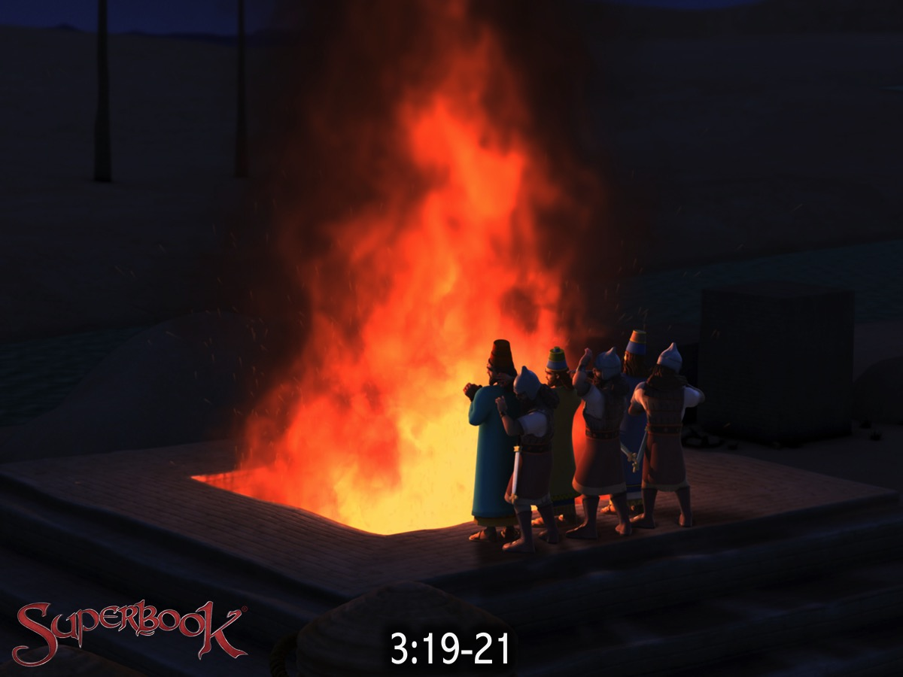
Notes:
¹⁹ Then Nebuchadnezzar was furious with Shadrach, Meshach and Abednego, and his attitude towards them changed. He ordered the furnace to be heated seven times hotter than usual ²⁰ and commanded some of the strongest soldiers in his army to tie up Shadrach, Meshach and Abednego and throw them into the blazing furnace. ²¹ So these men, wearing their robes, trousers, turbans and other clothes, were bound and thrown into the blazing furnace.

Slide 36
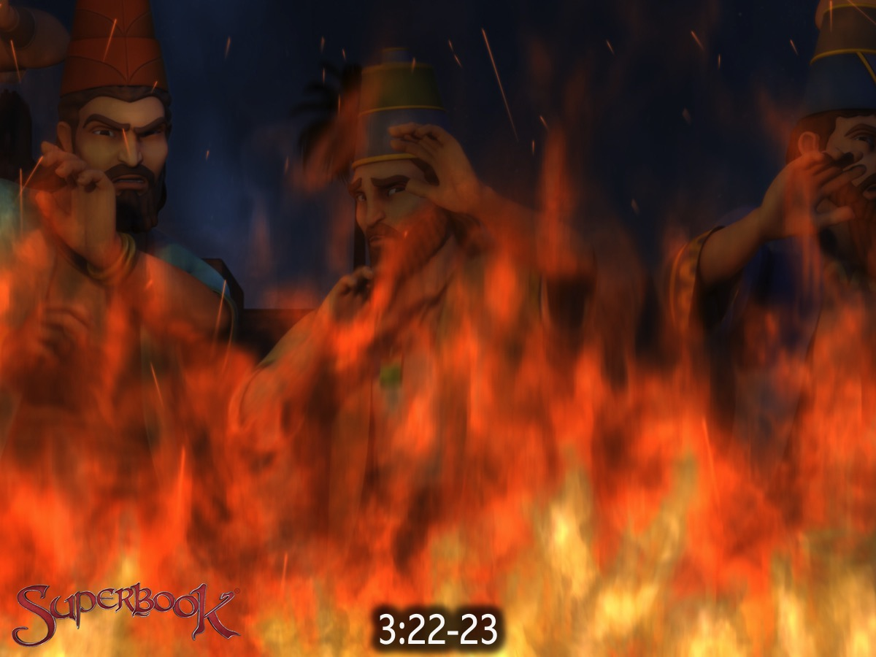
Notes:
²² The king’s command was so urgent and the furnace so hot that the flames of the fire killed the soldiers who took up Shadrach, Meshach and Abednego, ²³ and these three men, firmly tied, fell into the blazing furnace.

Slide 37
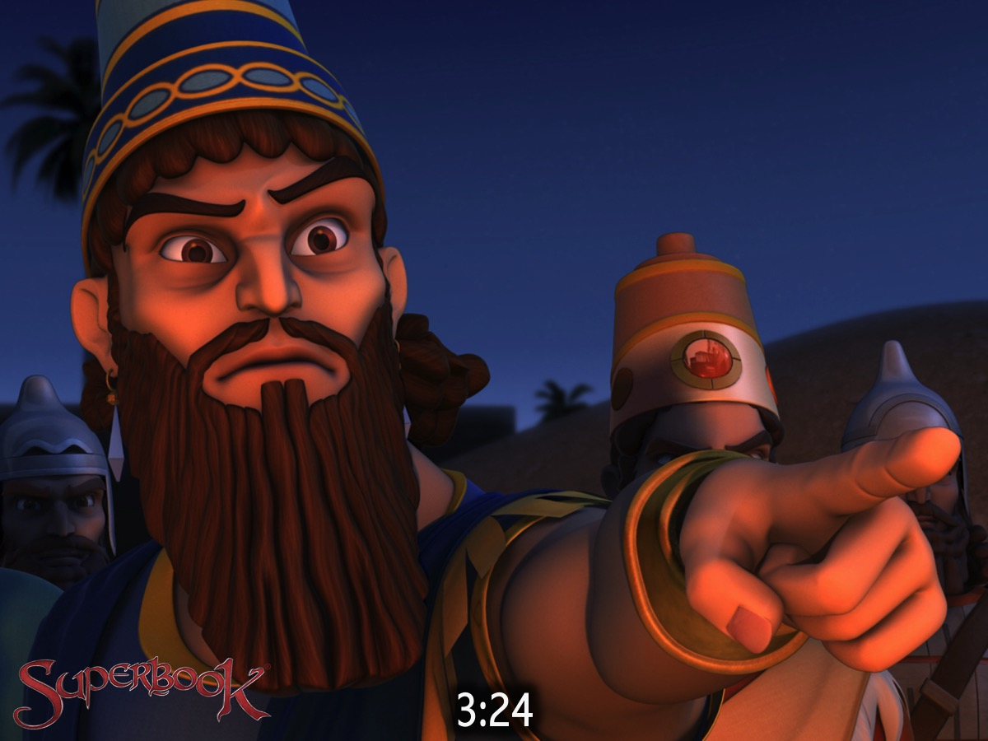
Notes:
²⁴ Then King Nebuchadnezzar leaped to his feet in amazement and asked his advisors, ‘Weren’t there three men that we tied up and threw into the fire?’ They replied, ‘Certainly, Your Majesty.’

Slide 38
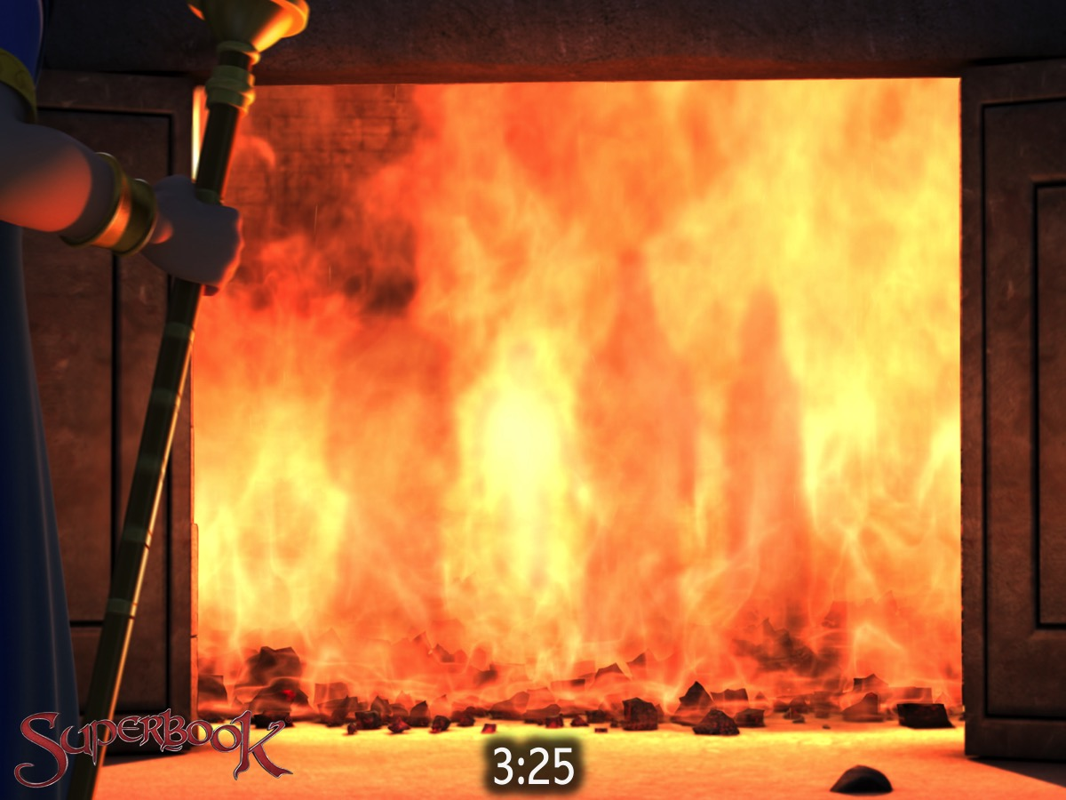
Notes:
²⁵ He said, ‘Look! I see four men walking around in the fire, unbound and unharmed, and the fourth looks like a son of the gods.’

Slide 39
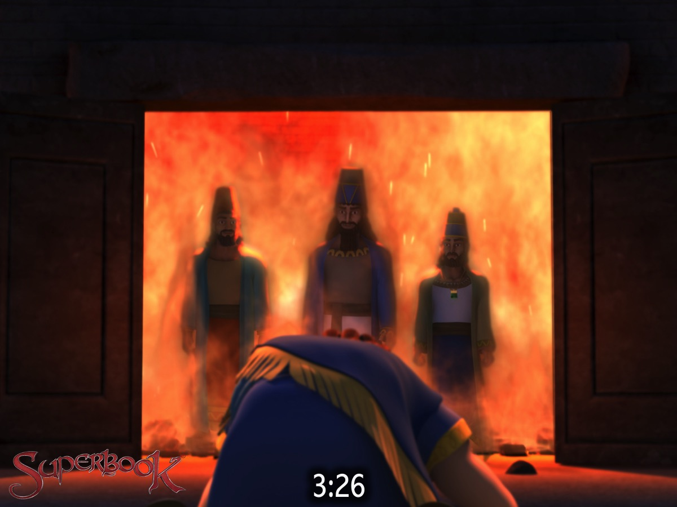
Notes:
²⁶ Nebuchadnezzar then approached the opening of the blazing furnace and shouted, ‘Shadrach, Meshach and Abednego, servants of the Most High God, come out! Come here!’ So Shadrach, Meshach and Abednego came out of the fire,

Slide 40
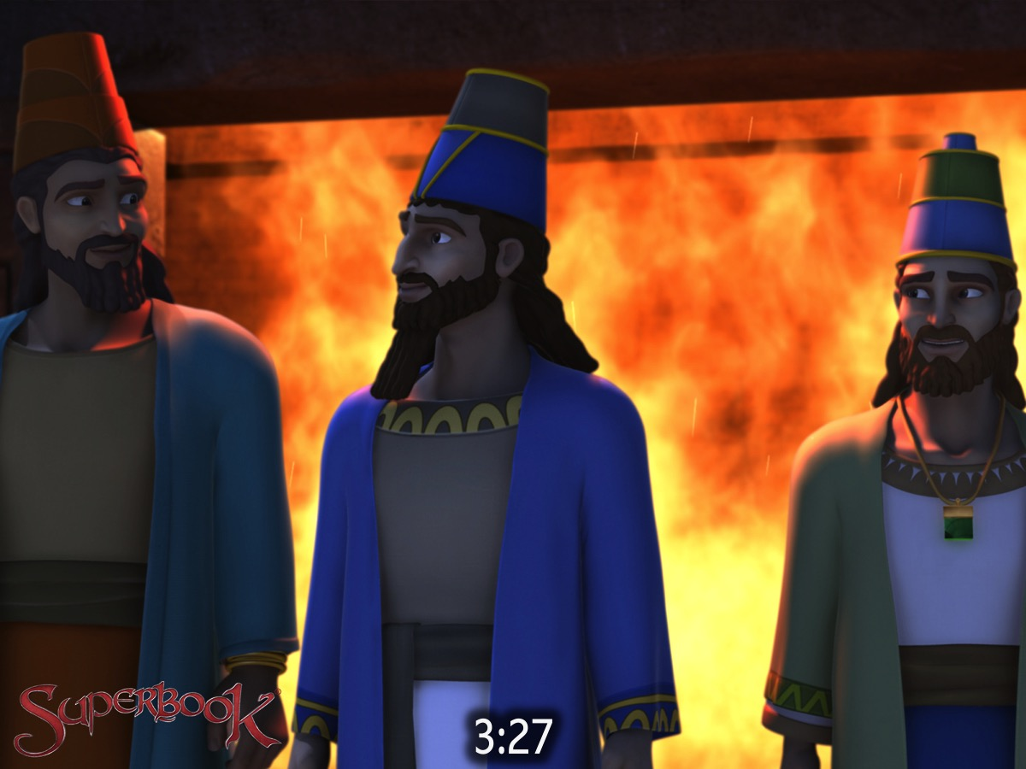
Notes:
²⁷ and the satraps, prefects, governors and royal advisors crowded around them. They saw that the fire had not harmed their bodies, nor was a hair of their heads singed; their robes were not scorched, and there was no smell of fire on them.

Slide 41
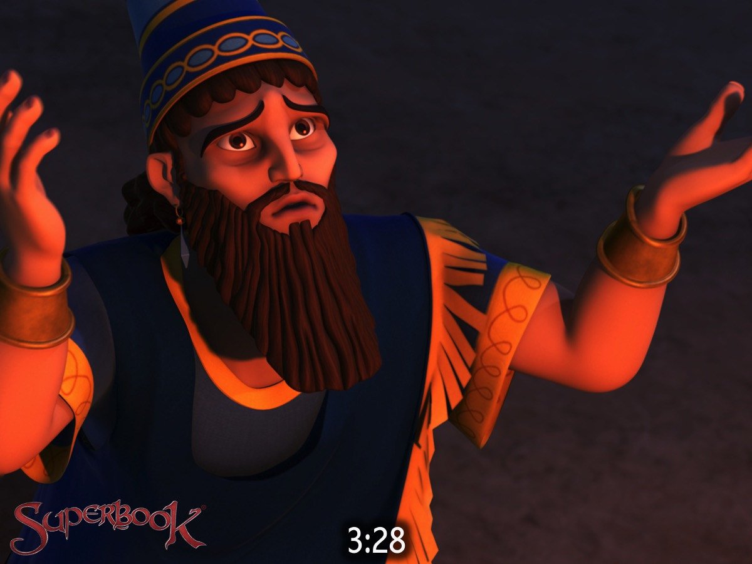
Notes:
²⁸ Then Nebuchadnezzar said, ‘Praise be to the God of Shadrach, Meshach and Abednego, who has sent his angel and rescued his servants! They trusted in him and defied the king’s command and were willing to give up their lives rather than serve or worship any god except their own God.

Slide 42
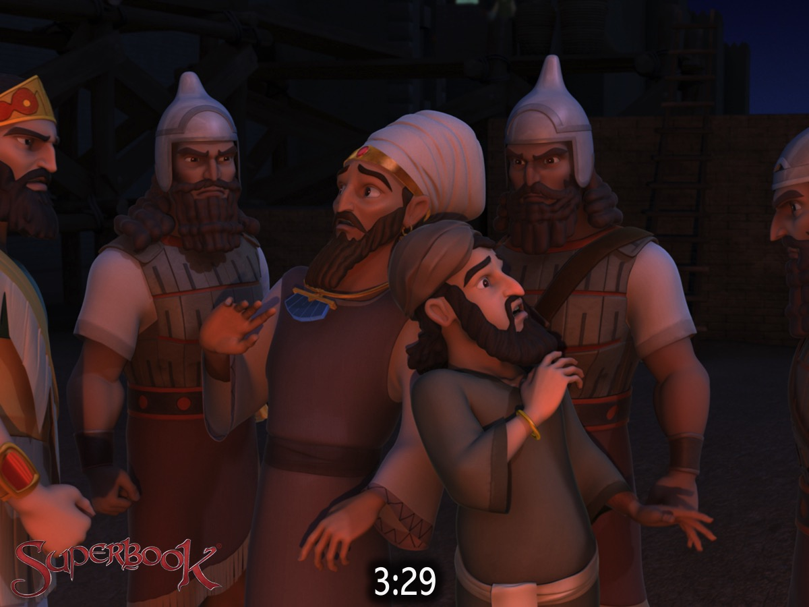
Notes:
²⁹ Therefore I decree that the people of any nation or language who say anything against the God of Shadrach, Meshach and Abednego be cut into pieces and their houses be turned into piles of rubble, for no other god can save in this way.’

Slide 43
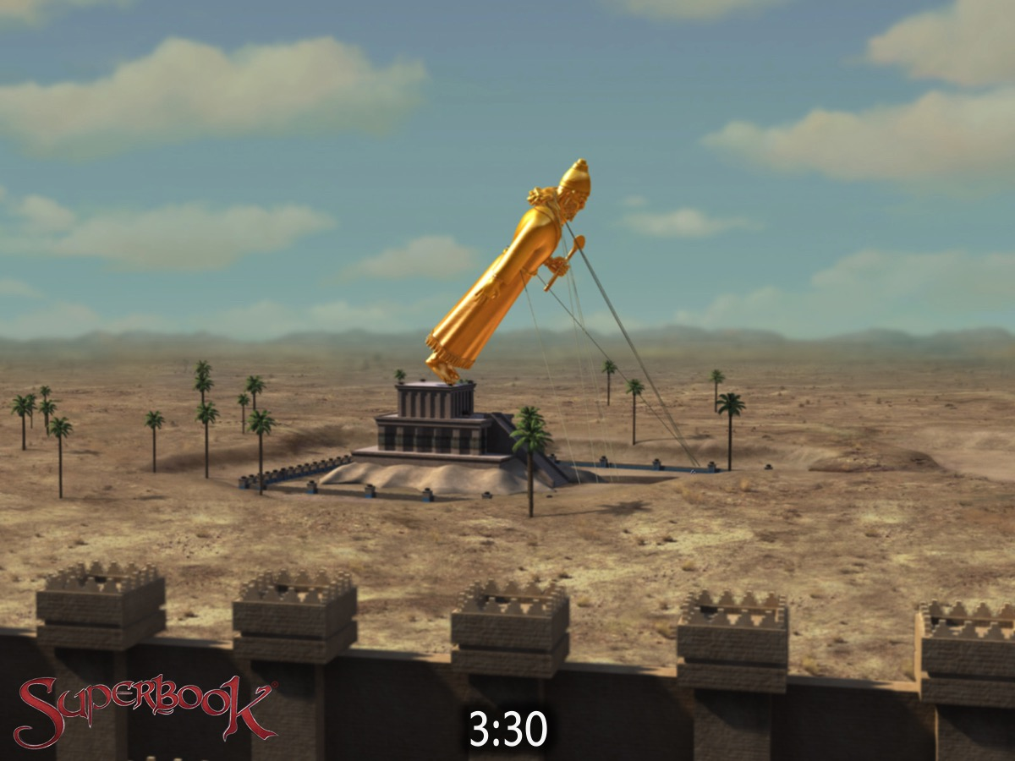
Notes:
³⁰ Then the king promoted Shadrach, Meshach and Abednego in the province of Babylon.

Slide 44
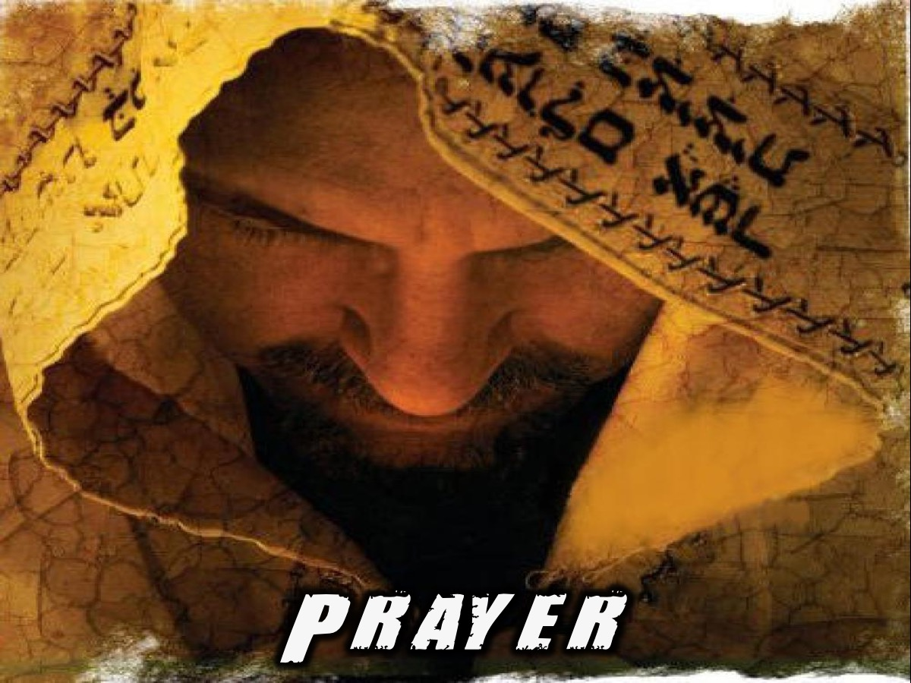
Notes:
Prayer

Slide 45
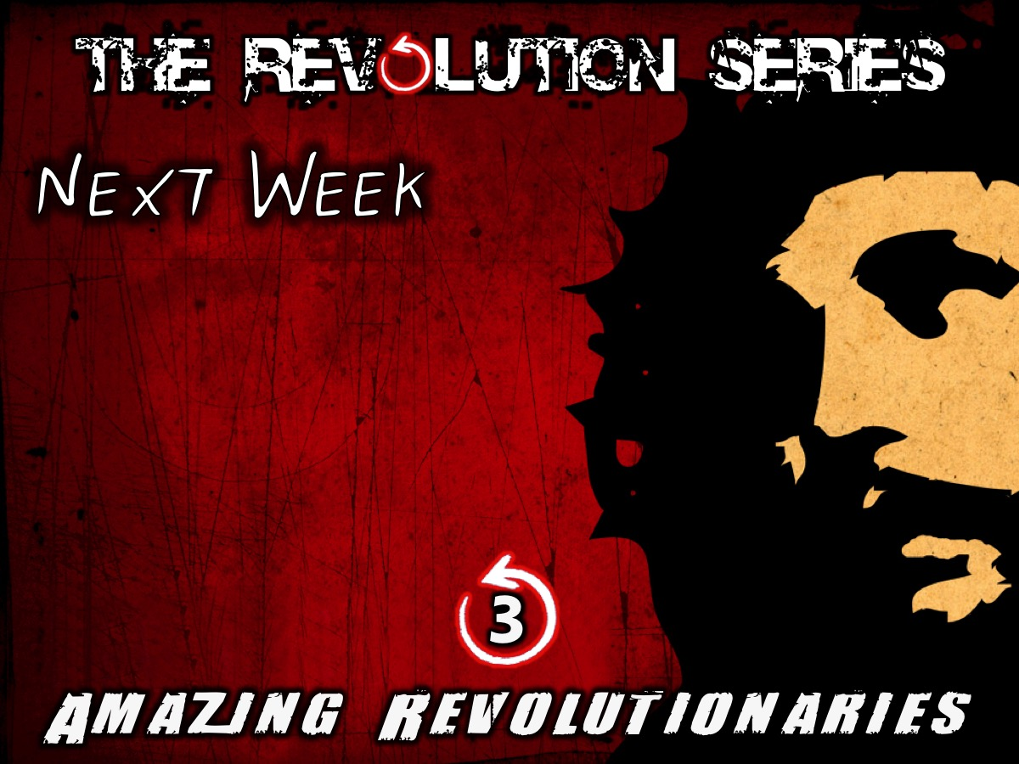
Notes:
Next week we are going to look at Amazing Revolutionaries in history.
1. Moses
Originally, Israel’s belief in one God was not so much a statement about the “being” of God, or the exclusivity of God. Rather it was about the decisive difference of Israel’s God from all the rest.
We hear this “difference” in the first commandment given to Moses. Israel is to have no other gods besides the one who brought them out of the land of bondage (Exod. 20:2–3; Deut. 5:7; 6:14). Notice what this does not say. It does not say that there are no other gods in the world. It says instead that Israel cannot worship any of these other gods, though these gods are worshipped by the peoples around them.
When Israel claims that it must serve its God and not the Pharaoh’s gods, it is an assertion of religious liberty and at the same time a declaration of political liberation.
The command, “You shall have no other gods before me,” challenges the authority and legitimacy of every earthly kingdom because those “other gods” are the gods of empires and kingdoms. Israel’s monotheistic revolution, continued by Christianity, was a “critique and delegitimization of the political super powers of the ancient world: Egypt, Assyria, Babylonia, the Seleucid and, above all the Roman Empire.
Unlike the other gods of the Ancient Near East, the God of Moses was not content to claim primacy in a heavenly pantheon. And the Israelites who worshipped this God did not see themselves as just any people. The God proclaimed by Moses was believed to be the Creator and Lord of history.
2. Jesus of Nazareth
His teaching was revolutionary - it upset the establishment and He made them look fools in public, He went to people they were afraid to touch (eg lepers), and actually spoke to and healed Gentiles, of all people.
The scribes and Pharisees hated his parables, which always seemed to put them in the wrong.
He called the religious leaders (the Scribes, Pharisees, and Sadduccees), hypocrites. The hated and detested Roman conquerors permitted these men to keep their power and authority so long as they kept their people in line. ( A modern parallel would be with the occupying German conquerors of France using French collaborators to rule their own people, who hated them [and killed many when their German protectors left.] ) Along comes this young Rabbi who tells the crowd that they are hypocrites, blind, serpents, and vipers: not exactly tactful - they would have hated Him for it - but the crowd would have lapped it up.
The rulers plotted to kill Jesus, and you don't do this unless you are a threat to the establishment that cannot be dealt with any other way.
The establishment tried to prevent His followers of this sect with revolutionary beliefs spreading their message and getting more adherents.
Jesus proved His revolutionary doctrines and beliefs through His own resurrection from the dead . A revolution is basically where old ideas are replaced by new. In the same way, the establishment refuses to believe that they are often the cause of revolutions in the first place, and deals with revolutionaries by killing them and their followers.
In summary, Jesus had greatly upset the ruling caste, cost them a lot of money and custom, made people think, upset the status-quo, pleased the masses, stressed their hypocrisy, beat their arguments, and most of all He was always right, so He had to go. Active planning on how to set Him up and kill Him had already started a year before His arrest.
Jesus was a revolutionary in the sense that He introduced new ideas, new thoughts and ways of doing things, and upset the establishment. In that sense He was most definitely a revolutionary, and had to die.
3. Mahatma Gandhi
Mahatma Gandhi is one of the most respected leaders of modern history. A Hindu, Gandhi nevertheless admired Jesus and often quoted from the Sermon on the Mount. Once when the missionary E. Stanley Jones met with Gandhi he asked him, “Mr. Gandhi, though you quote the words of Christ often, why is that you appear to so adamantly reject becoming his follower?”
Gandhi replied, “Oh, I don’t reject your Christ. I love your Christ. It’s just that so many of you Christians are so unlike your Christ.”
Gandhi may truly be said to be the prophetic voice of the twentieth century. Violence inflicts upon its practitioners physical and spiritual wounds; the way of non-violence, said Gandhi, "blesses him who uses it and him against whom it is used. "Again, "non-violence is the law of our species as violence is the law of the brute. The spirit lies dormant in the brute and he knows no law but that of physical might. The dignity of man requires obedience to a higher law -- to the strength of the spirit
A practitioner of the non-violent way of life, far from being passive, is the most active person in the world. He is ready to join the fray -non-violently -- wherever and whenever there is injustice or wrong. He neither tolerates nor compromises with injustice, wrong, tyranny, authoritarianism, totalitarianism, dictatorship. His task in life is not to destroy the evildoer but to redeem and to convert the evildoer by love. " 'With malice toward none, with charity for all; with firmness in the right, as God gives us to see the right," he is ever ready to "bind up" humanity's "wounds," to minister to the underprivileged and to the misguided.
Use truth as your anvil, nonviolence as your hammer and anything that does not stand the test when it is brought to the anvil of truth and hammered with nonviolence, reject it.
4. Dr. Martin Luther King Jr.
An American Baptist minister, activist, and prominent leader in the African American civil rights movement. He is best known for being an iconic figure in the advancement of civil rights in the United States and around the world, using nonviolent methods following the teachings of Mahatma Gandhi.
King's efforts led to the 1963 March on Washington, where King delivered his "I Have a Dream" speech. There, he expanded American values to include the vision of a color blind society, and established his reputation as one of the greatest orators in American history.
In 1964, King became the youngest person to receive the Nobel Peace Prize for his work to end racial segregation and racial discrimination through civil disobedience and other nonviolent means. By the time of his death in 1968, he had refocused his efforts on ending poverty and stopping the Vietnam War.
Dr. King often pointed out that it was Jesus' Sermon on the Mount that inspired the "dignified social action" of the civil rights movement. His notion of "creative suffering" – borne by civil rights activists who endured persecution and police brutality – came from his Christian faith in the redemptive suffering of Jesus.
Dr. King dreamed of a day when America lives up to its creed, when all people sit together at one table, and when freedom and justice reign. His famous "I have a dream" speech reaches its highest point with echoes of the prophet Isaiah: "I have a dream that one day every valley shall be exalted, every hill and mountain shall be made low ... and the glory of the Lord shall be revealed, and all flesh shall see it together."
King was assassinated on April 4, 1968, in Memphis, Tennessee. He was posthumously awarded the Presidential Medal of Freedom in 1977 and Congressional Gold Medal in 2004; Martin Luther King, Jr. Day was established as a U.S. national holiday in 1986.
In what was to be his last speech, Dr. King drew from the biblical story of Moses: "Like anybody, I would like to live a long life ... But I'm not concerned about that now. I just want to do God's will. And He's allowed me to go up to the mountain, and I've looked over, and I've seen the promised land. I may not get there with you, but I want you to know tonight that we as a people will get to the promised land."

