Slide 1

Notes:
This term we are doing the Revolution series!

Slide 2
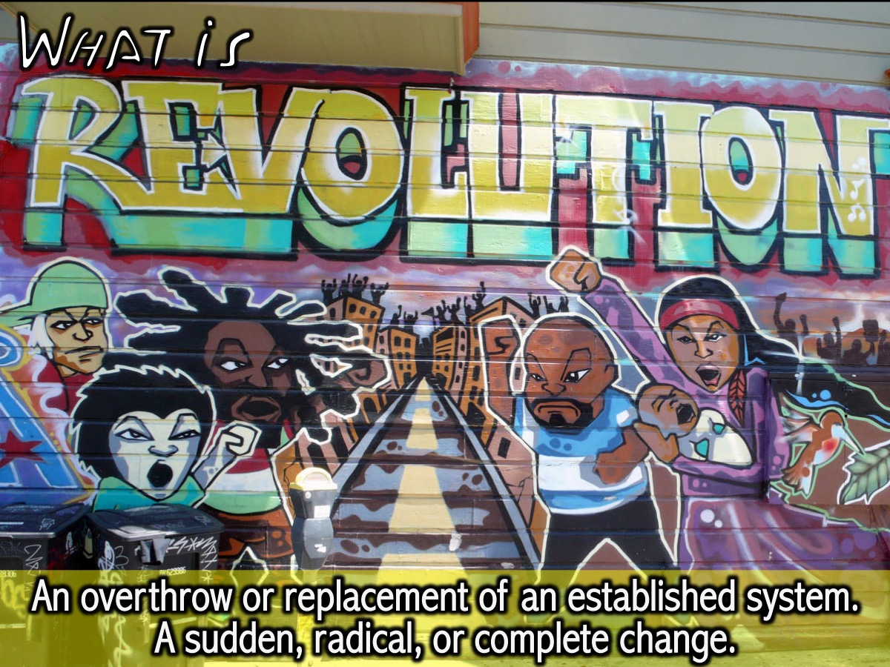
Notes:
We learnt that Revolution is an overthrow or replacement of an established system, a sudden, radical, or complete change.

Slide 3

Notes:
Last week our theme was: Amazing Revolutions

Slide 4

Notes:
This week we are going to look at some Amazing Revolutionaries and see what we can learn from them.

Slide 5
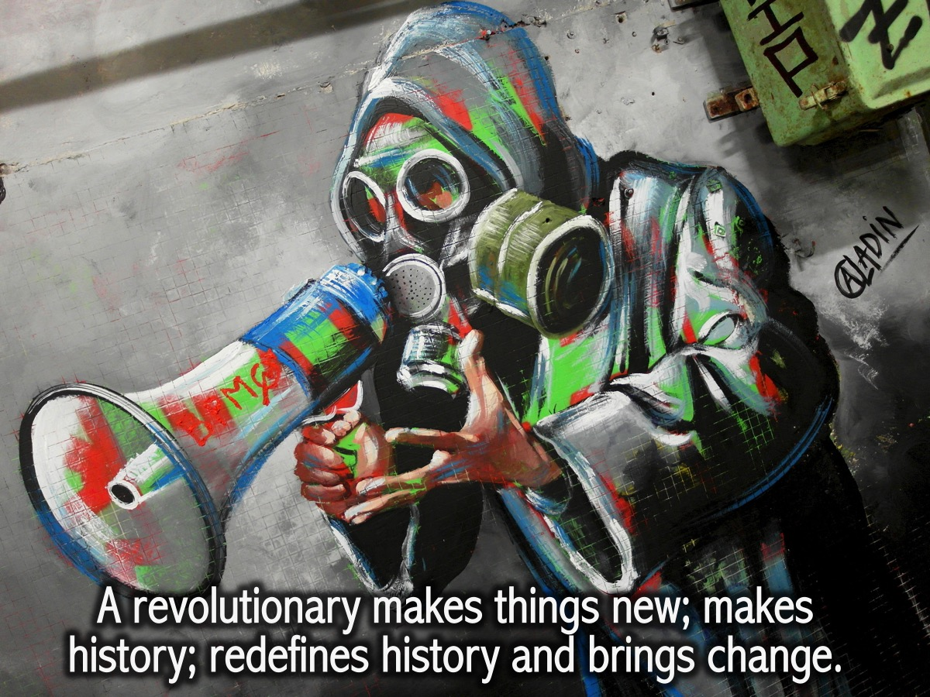
Notes:
A revolutionary makes things new; makes history; redefines history and brings change.

Slide 6
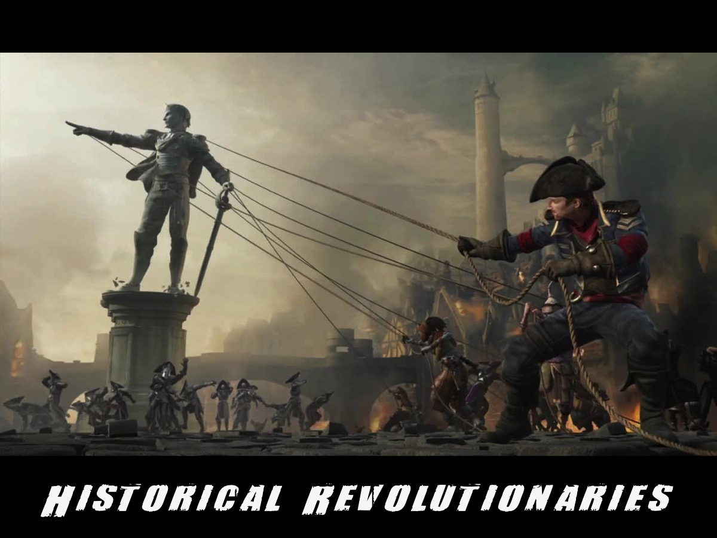
Notes:
Historic examples of revolutionaries (good and bad): Some were strong, others were weak. Some were good, others were bad. But they all had a revolutionary effect. (Scales)

Slide 7

Notes:
Pop quiz – Which countries were these revolutionaries from?

Slide 8
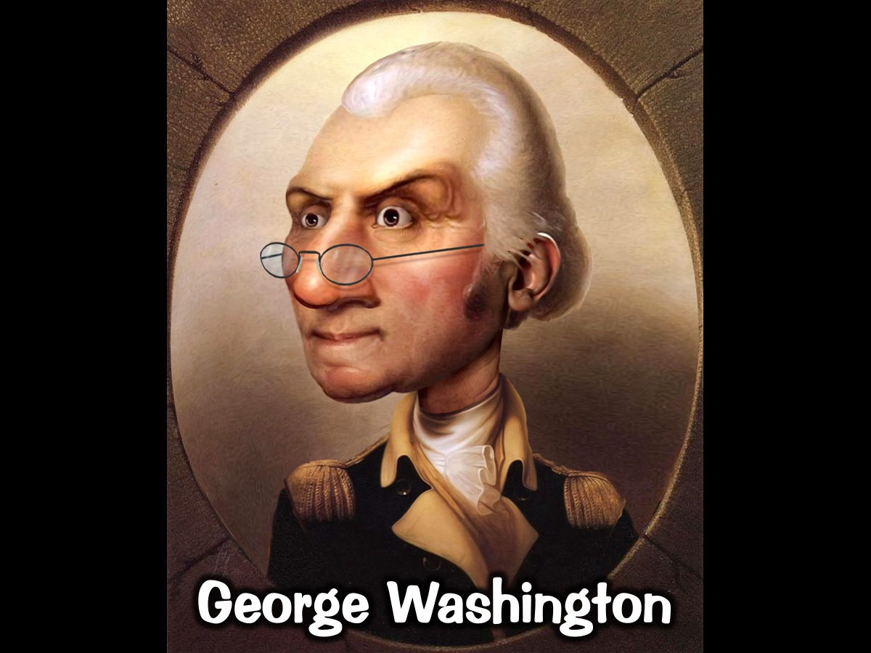
Notes:
George Washington: First president of the US (1789). Commander-and-chief of the continental army in the American Revolutionary war. One of the founding fathers of the US.

Slide 9

Notes:
Adolf Hitler – Nazi Germany; World War 2

Slide 10

Notes:
Corazon Aquino – Leader of the peaceful “Peoples Power Revolution” in the Philippines against Ferdinand Marcos.

Slide 11
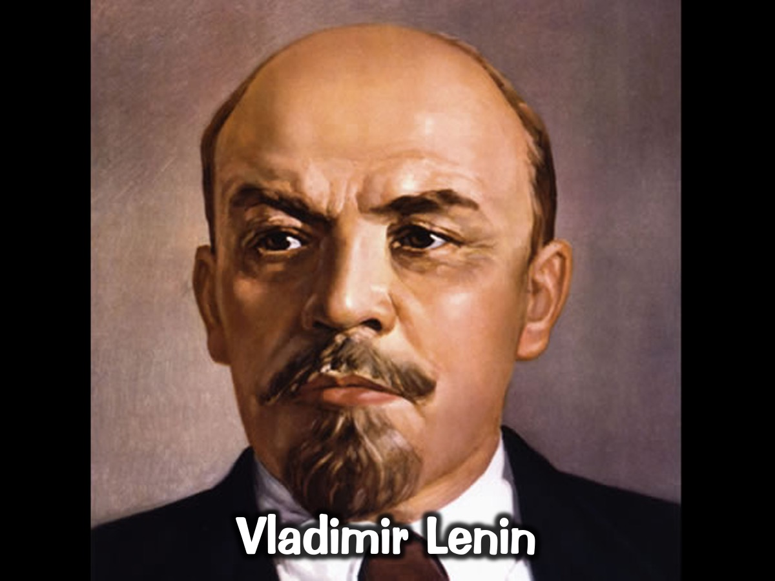
Notes:
Vladimir Lenin - Communist Revolutionary – Russian Empire replaced by Soviet Union

Slide 12
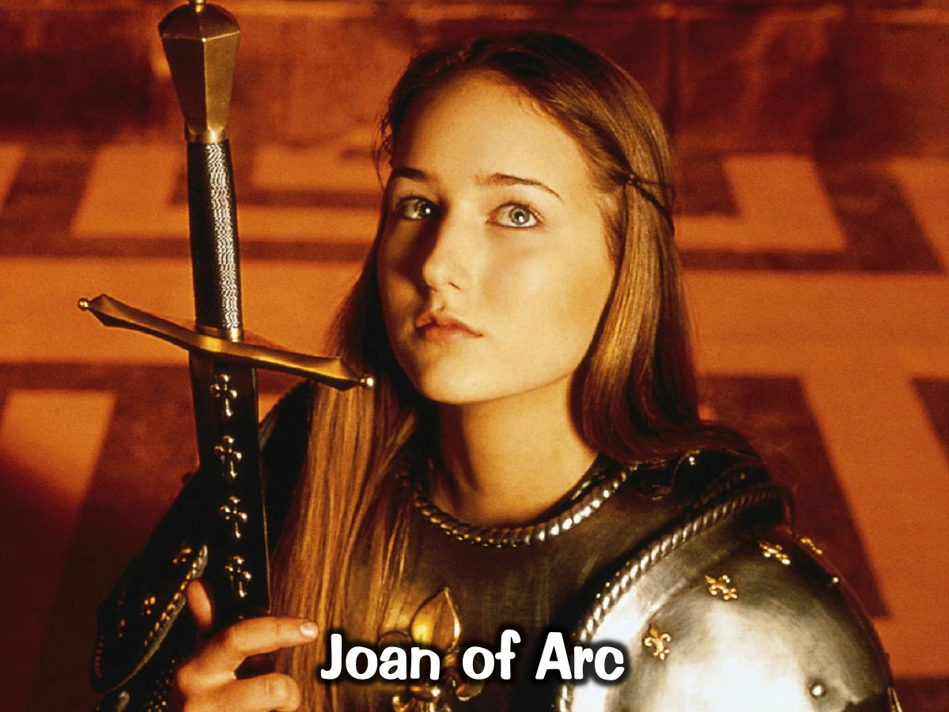
Notes:
Joan of Arc – French peasant girl. Dreams – visited by saints who urged her to take up the fight against the English. Defeated the English at Orleans in 1429.

Slide 13
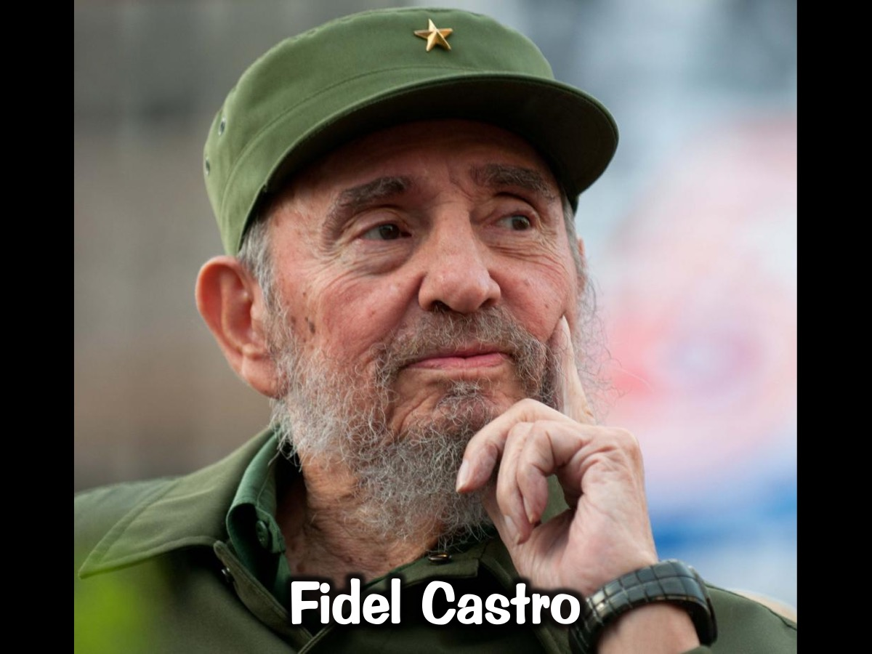
Notes:
Fidel Castro – Leading role in the Cuban Revolution. Ousted president Batista in 1959. Remained in power until 2008.

Slide 14
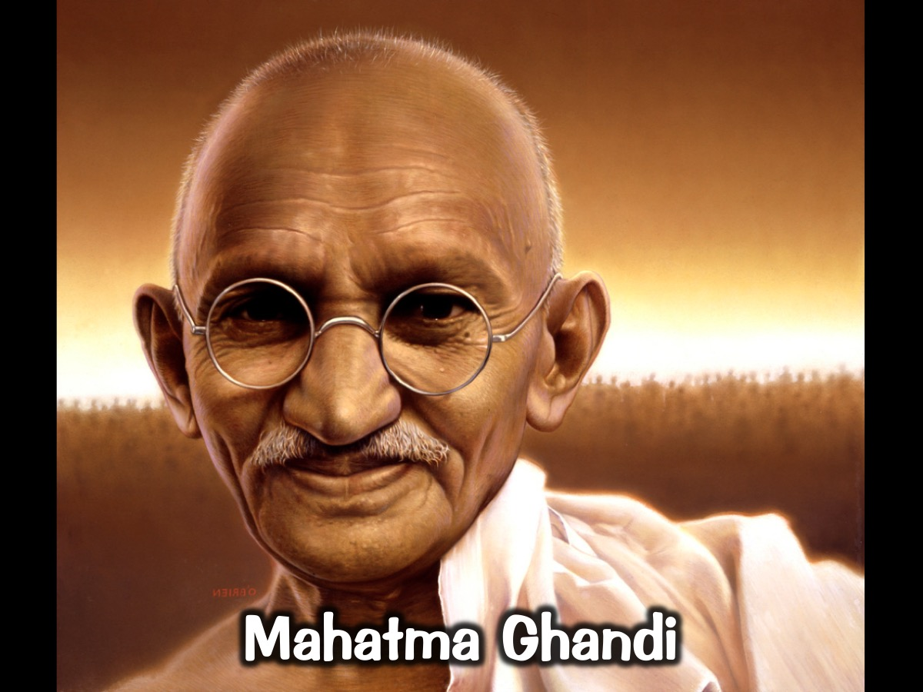
Notes:
Mahatma Ghandi – Led India to independence and inspired movements for civil rights and freedom across the world.

Slide 15
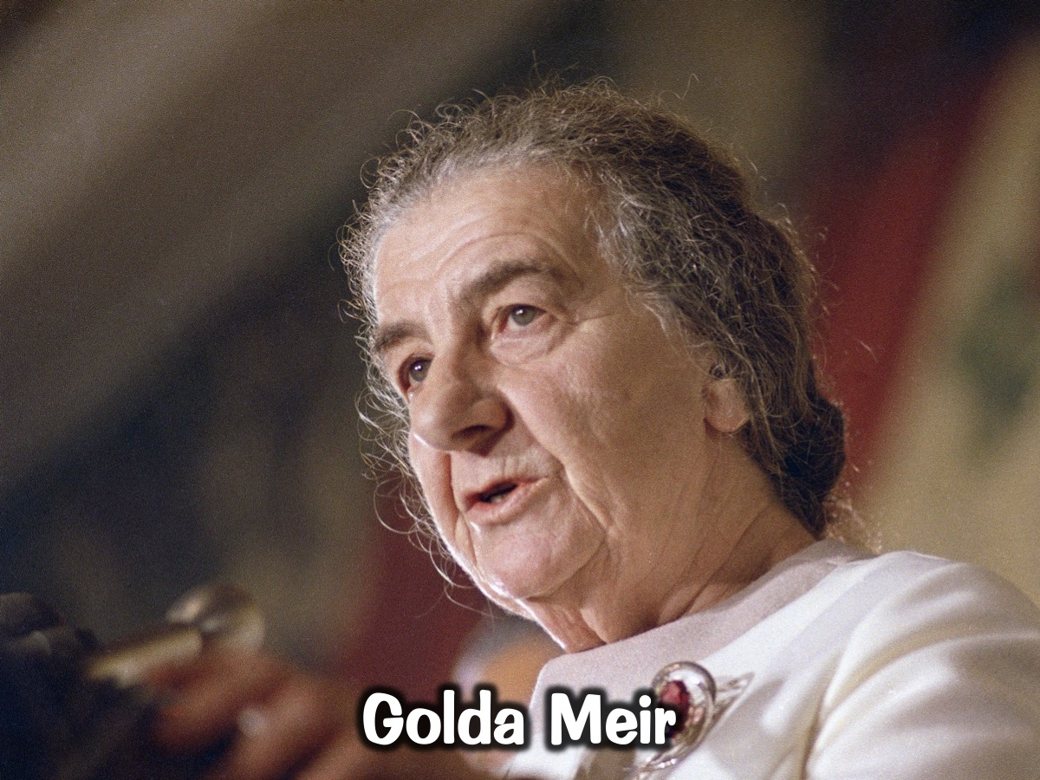
Notes:
Golda Meir – Raised money in the US for Israel’s independence in 1948 and was the primary negotiator between the Jews and the British. Became Israel’s prime minister during 1973 Yom Kipur War.

Slide 16
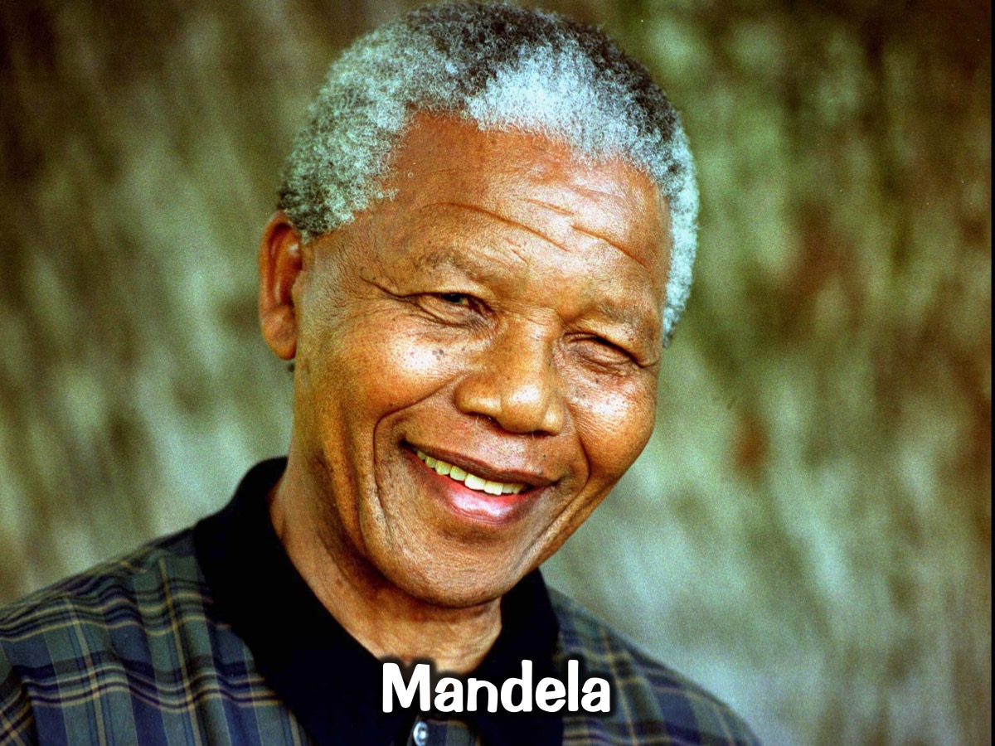
Notes:
Mandela

Slide 17
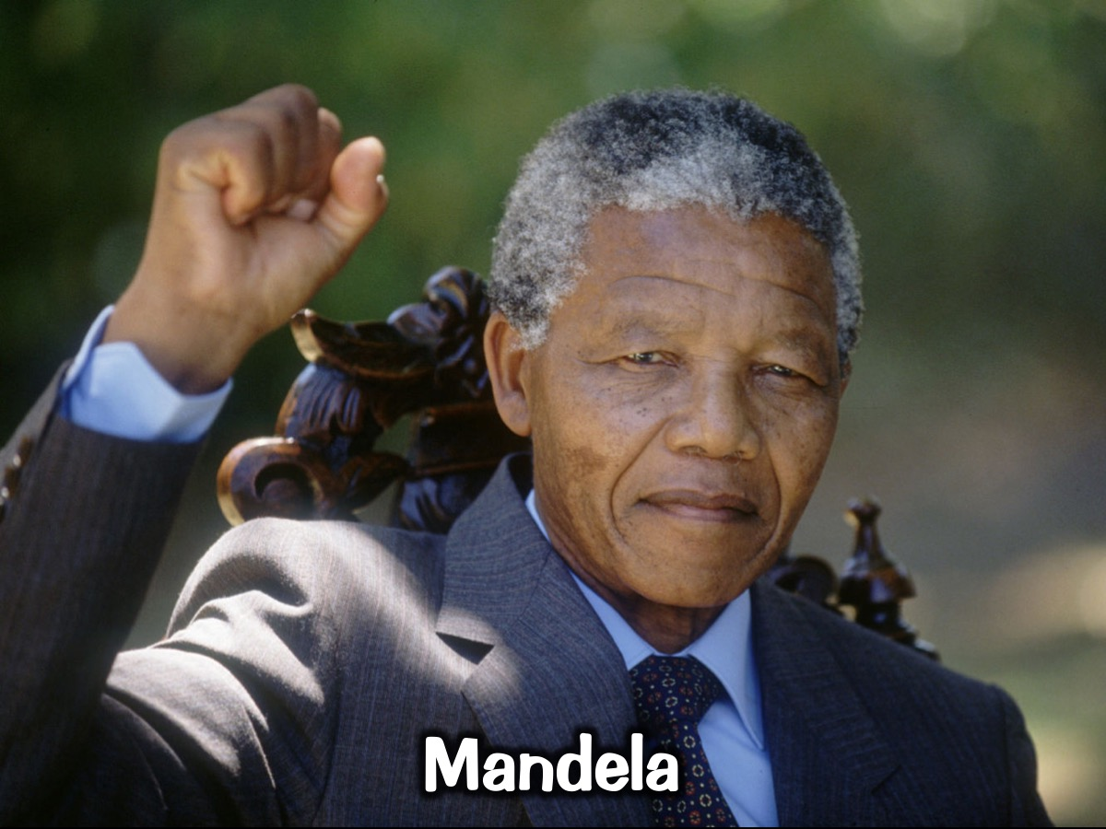
Notes:
Mandela

Slide 18
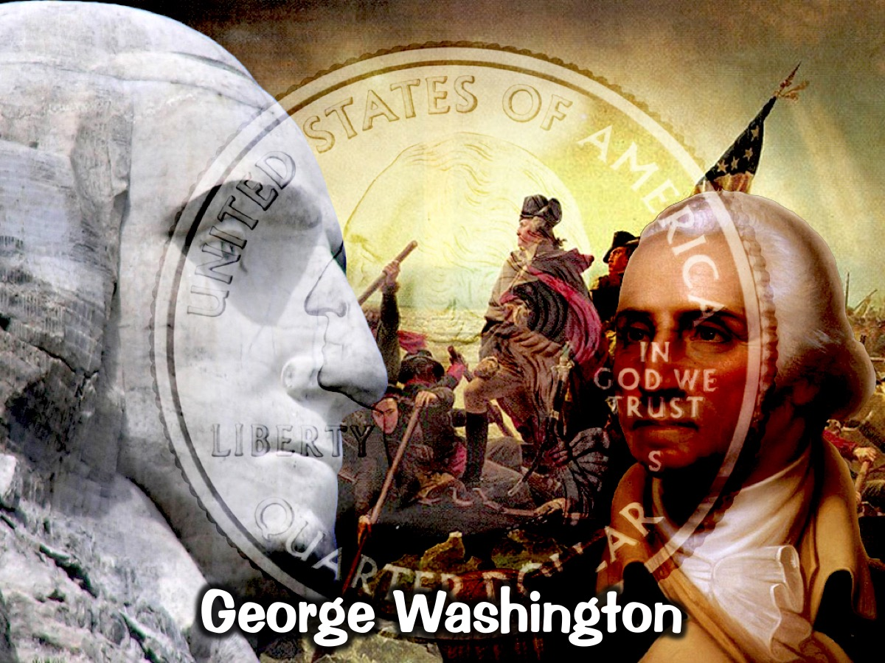
Notes:
George Washington

Slide 19
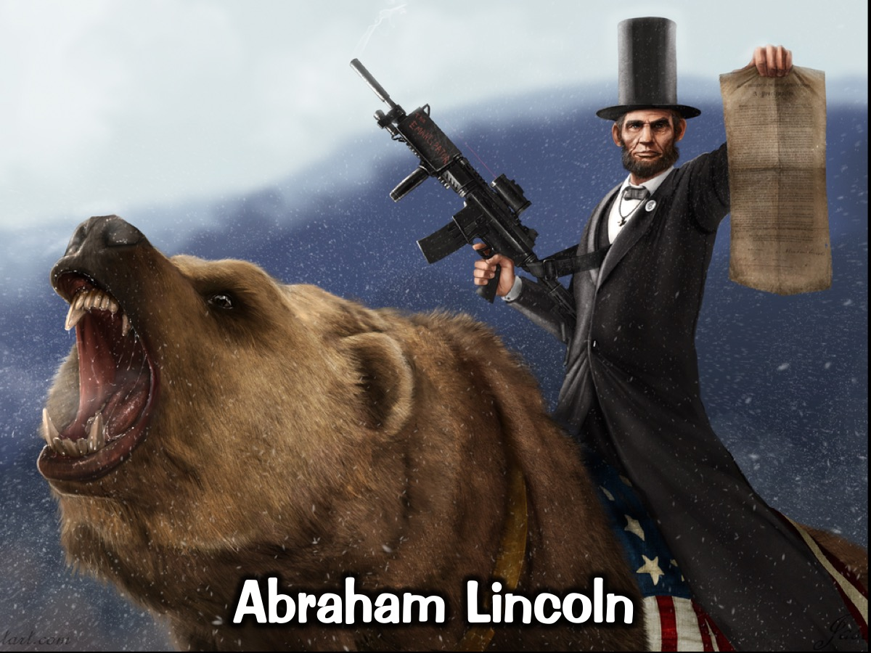
Notes:
Abraham Lincoln

Slide 20
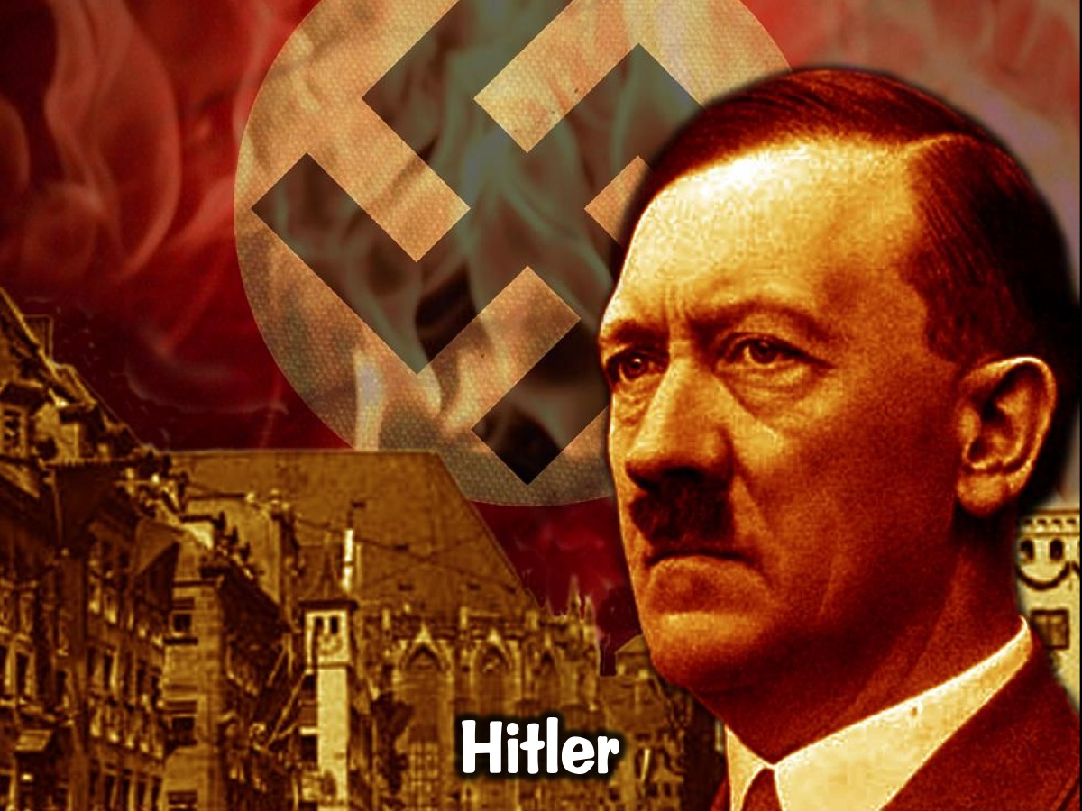
Notes:
Hitler

Slide 21
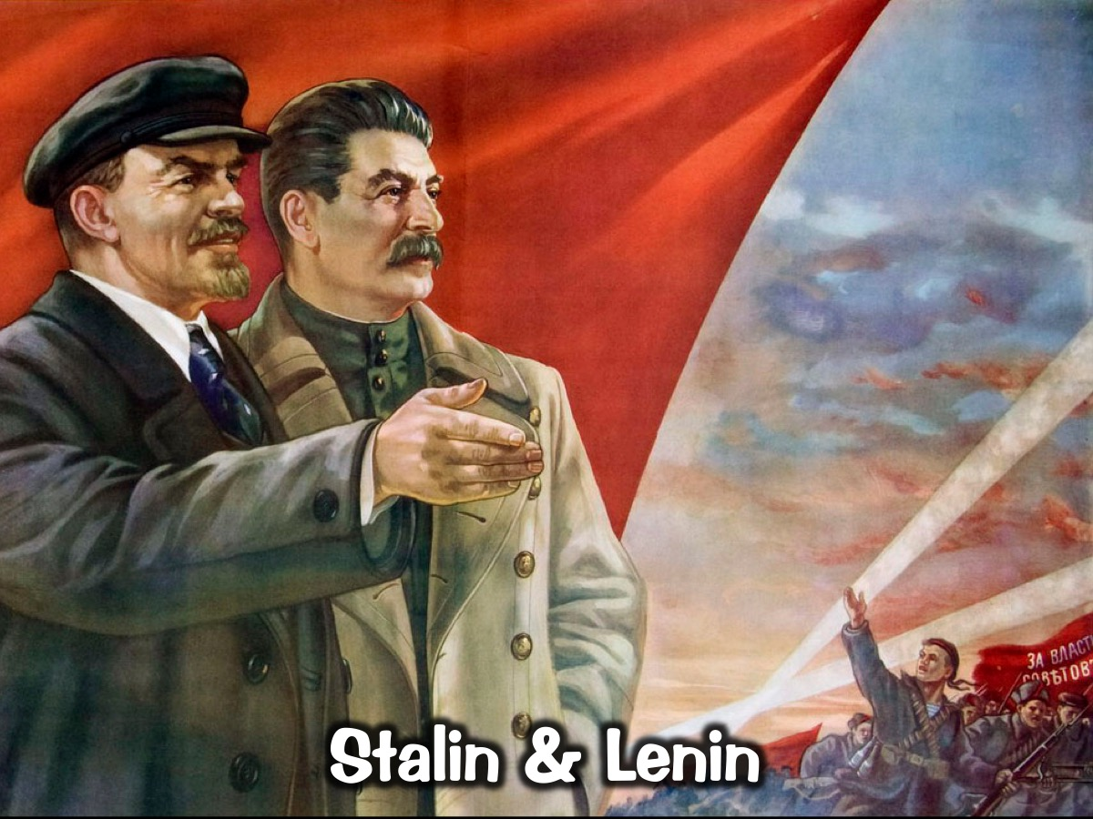
Notes:
Stalin & Lenin

Slide 22
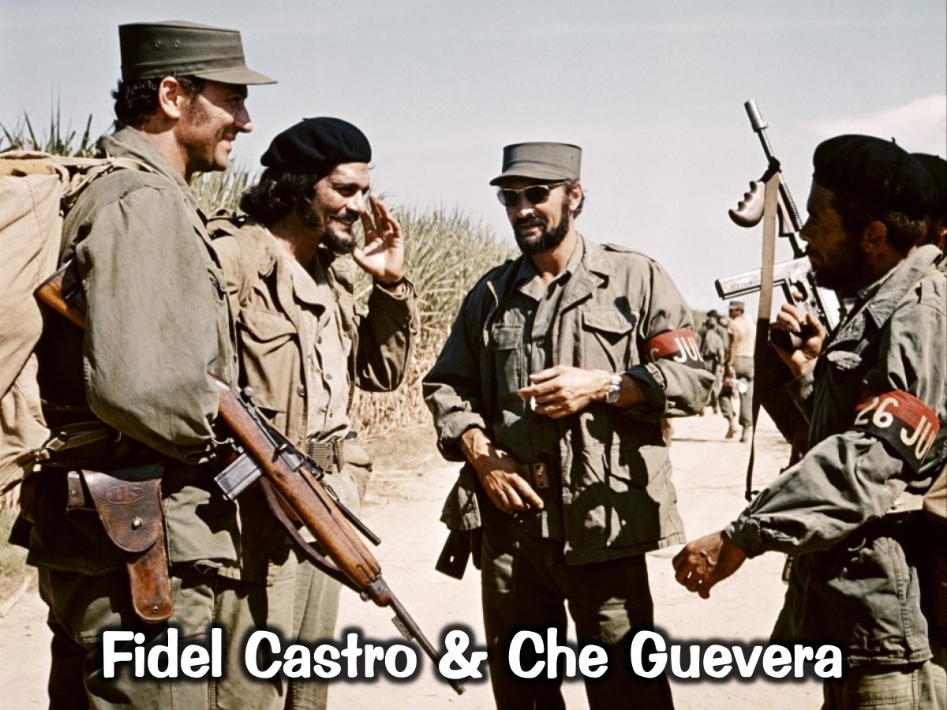
Notes:
Fidel Castro & Che Guevara

Slide 23
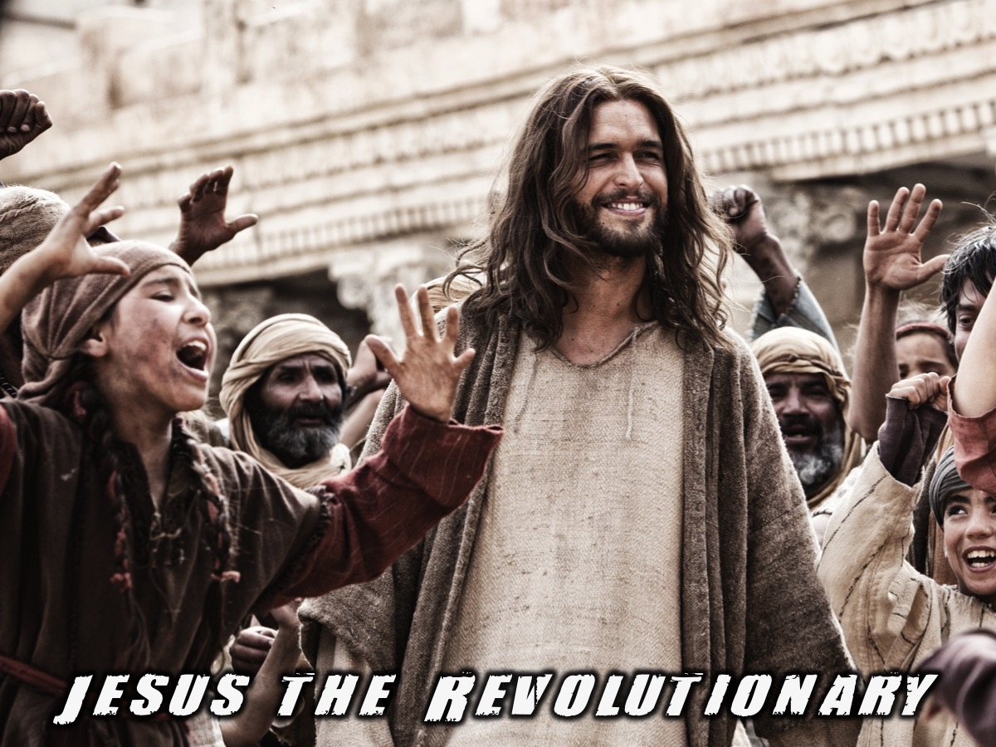
Notes:
Jesus as revolutionary. People were faced with the same dilemma – Who is this Jesus?

Slide 24
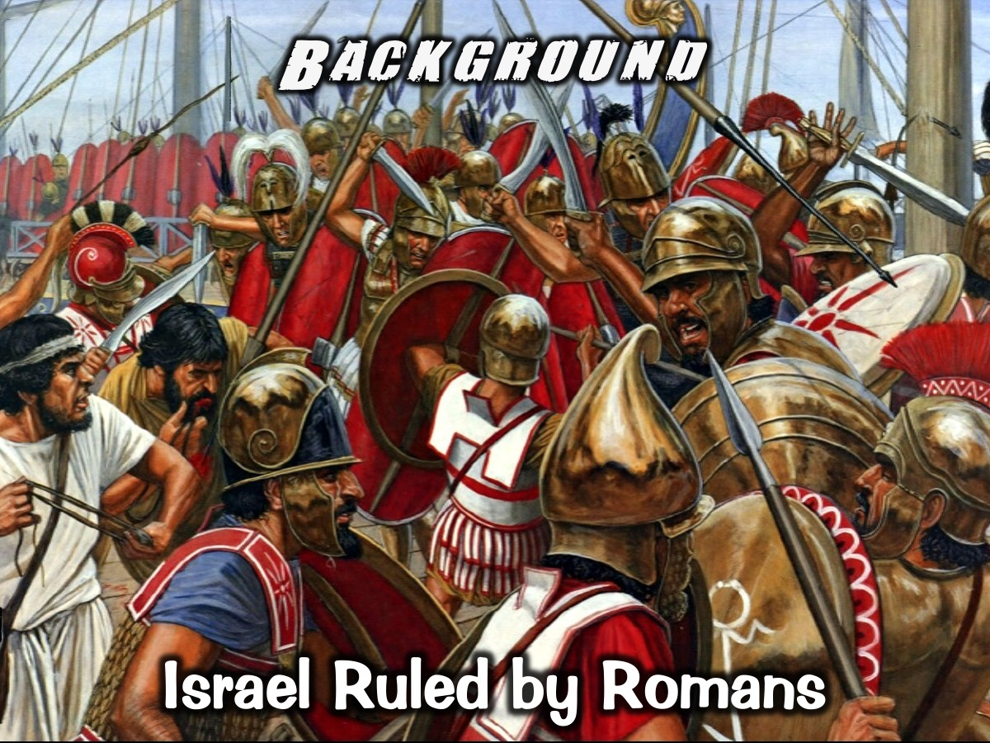
Notes:
Background: Israel Ruled by Romans.

Slide 25
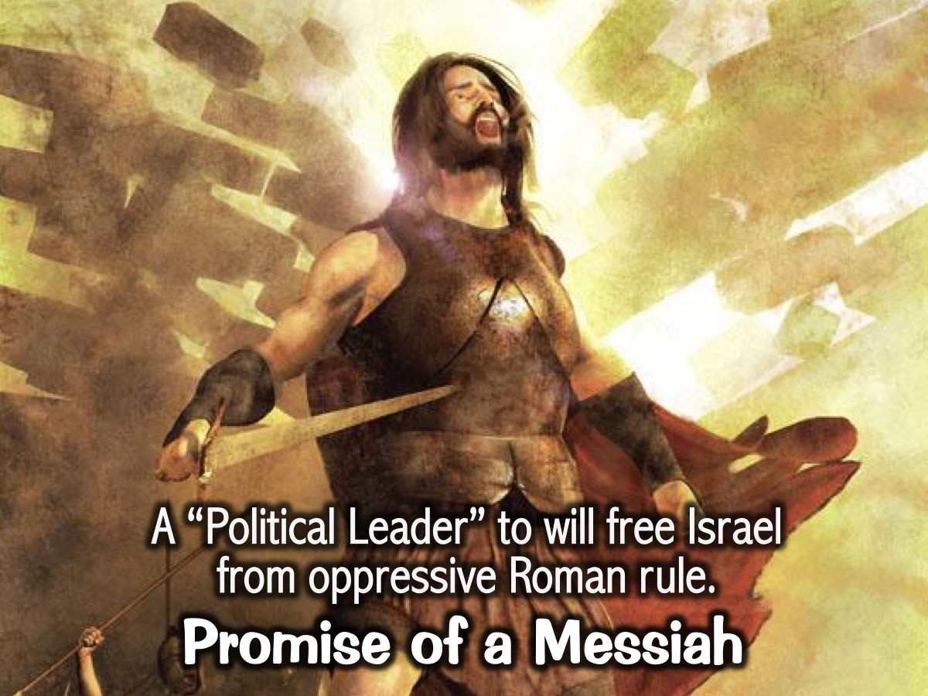
Notes:
Long awaited promise of the “Messiah”/Saviour. They are thinking “Political Leader” that will free them from oppressive rule by Romans.

Slide 26

Notes:
Jesus Appears: Miraculously Conceived

Slide 27
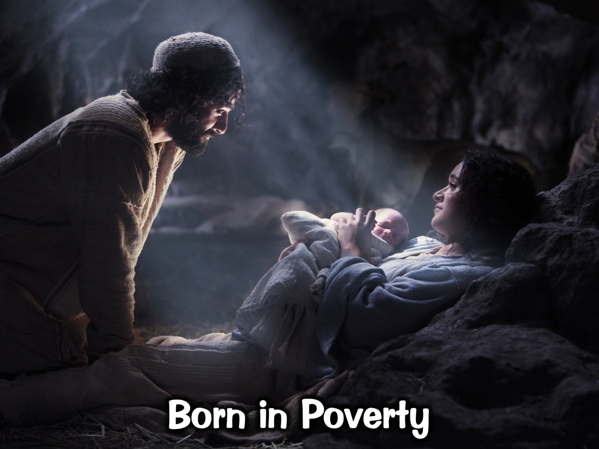
Notes:
Born in poverty

Slide 28
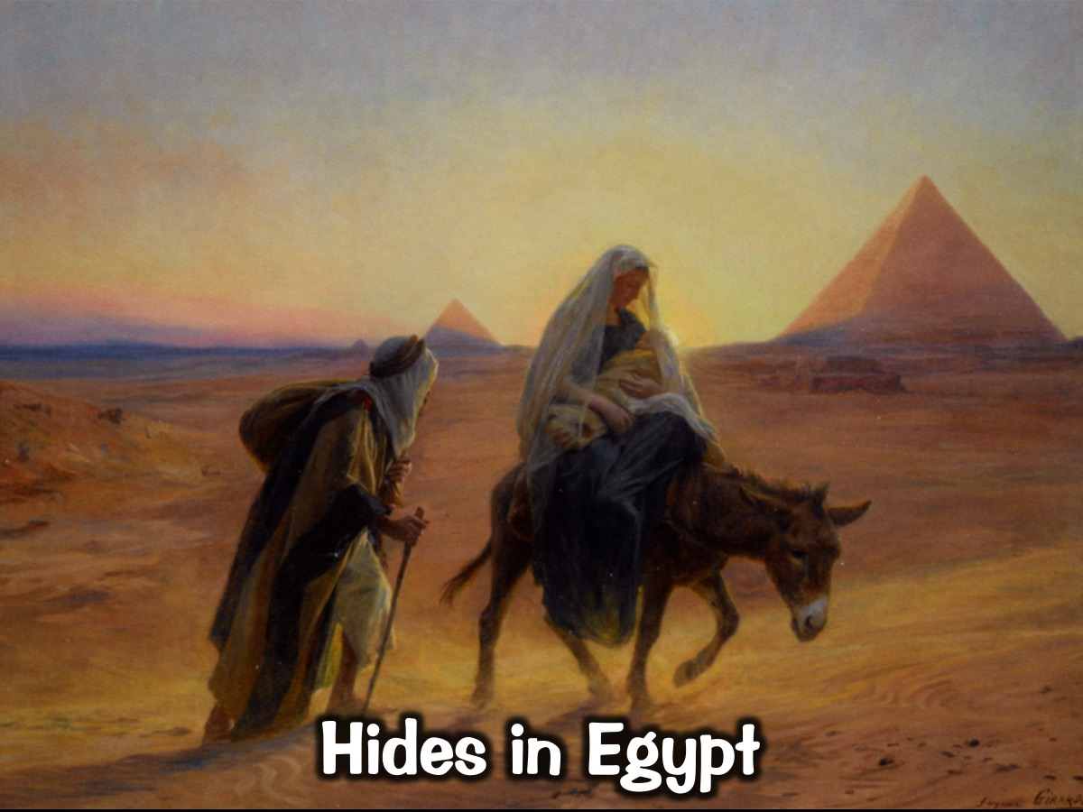
Notes:
Flees from Herod spends early childhood in Egypt

Slide 29
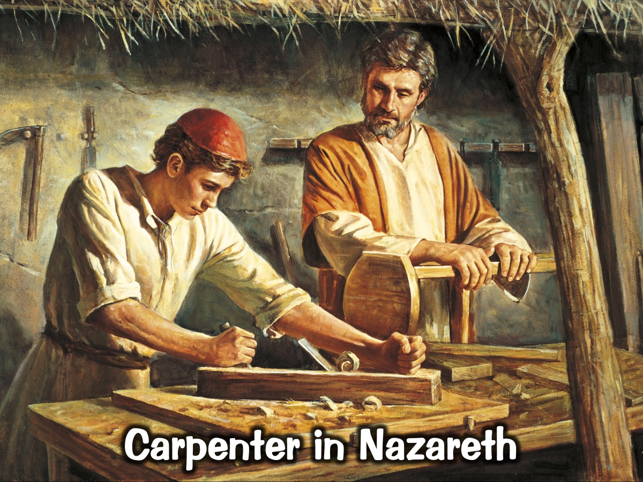
Notes:
Becomes a carpenter in Nazareth

Slide 30
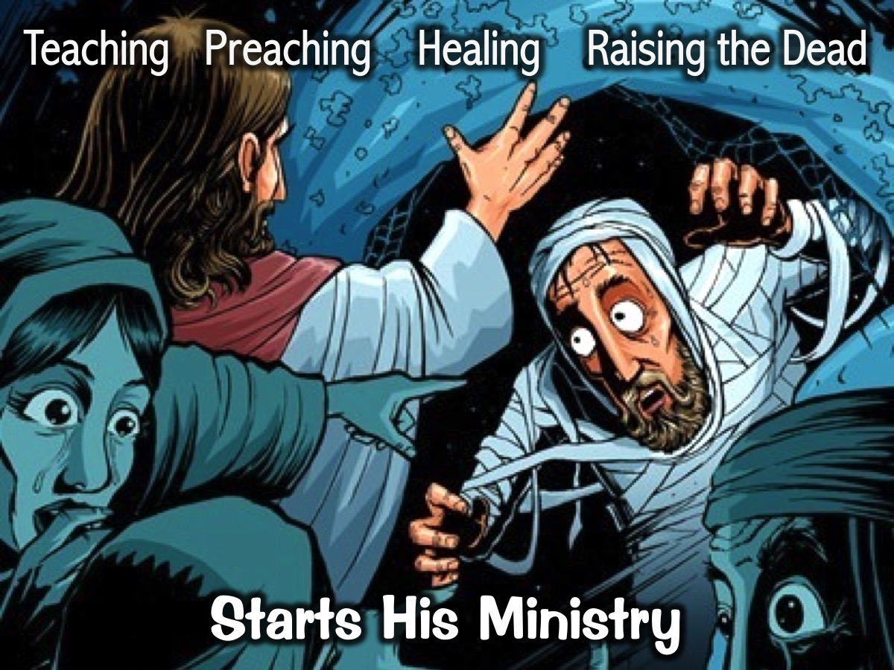
Notes:
Starts his ministry by teaching, preaching, healing, raising people from the dead

Slide 31
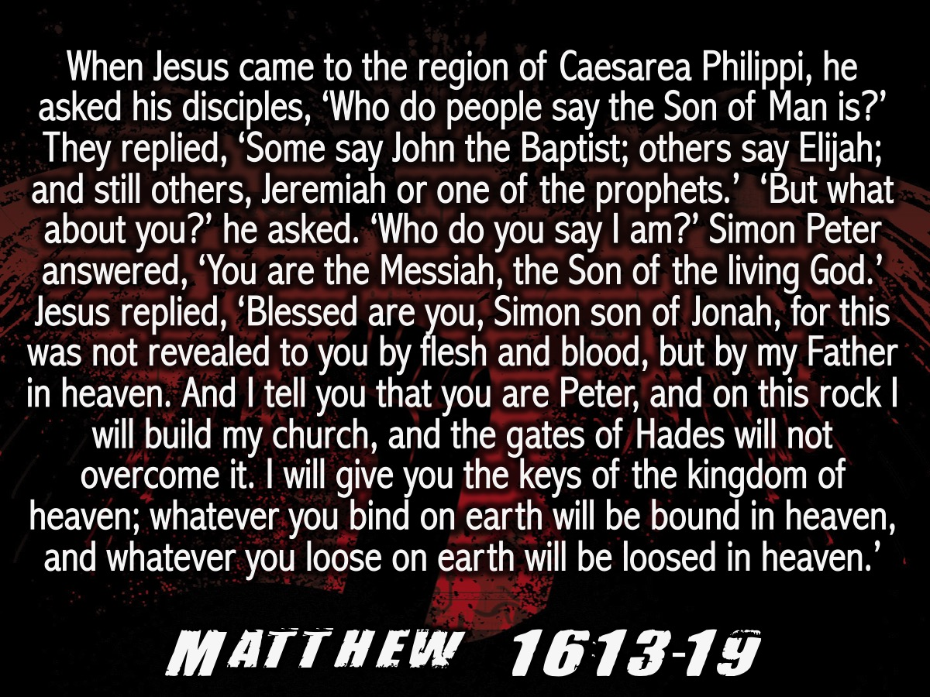
Notes:
When Jesus came to the region of Caesarea Philippi, he asked his disciples, ‘Who do people say the Son of Man is?’ They replied, ‘Some say John the Baptist; others say Elijah; and still others, Jeremiah or one of the prophets.’ ‘But what about you?’ he asked. ‘Who do you say I am?’ Simon Peter answered, ‘You are the Messiah, the Son of the living God.’ Jesus replied, ‘Blessed are you, Simon son of Jonah, for this was not revealed to you by flesh and blood, but by my Father in heaven. And I tell you that you are Peter, and on this rock I will build my church, and the gates of Hades will not overcome it. I will give you the keys of the kingdom of heaven; whatever you bind on earth will be[c] bound in heaven, and whatever you loose on earth will be loosed in heaven.’ (Matthew 16:13-19)
Background: Israel – Ruled by Romans. Long awaited promise of the “Messiah”/Saviour. They are thinking “Political Leader” that will free them from oppressive rule by Romans.
Jesus appears: Miraculously conceived; Born in poverty; Flees from Herod and spends early childhood in Egypt. Grows up in Nazareth. Baptised by John. Starts his ministry by preaching , teaching, healing, raising people from the dead (Matthew 4:23–25)

Slide 32

Notes:
Says Revolutionary Things

Slide 33
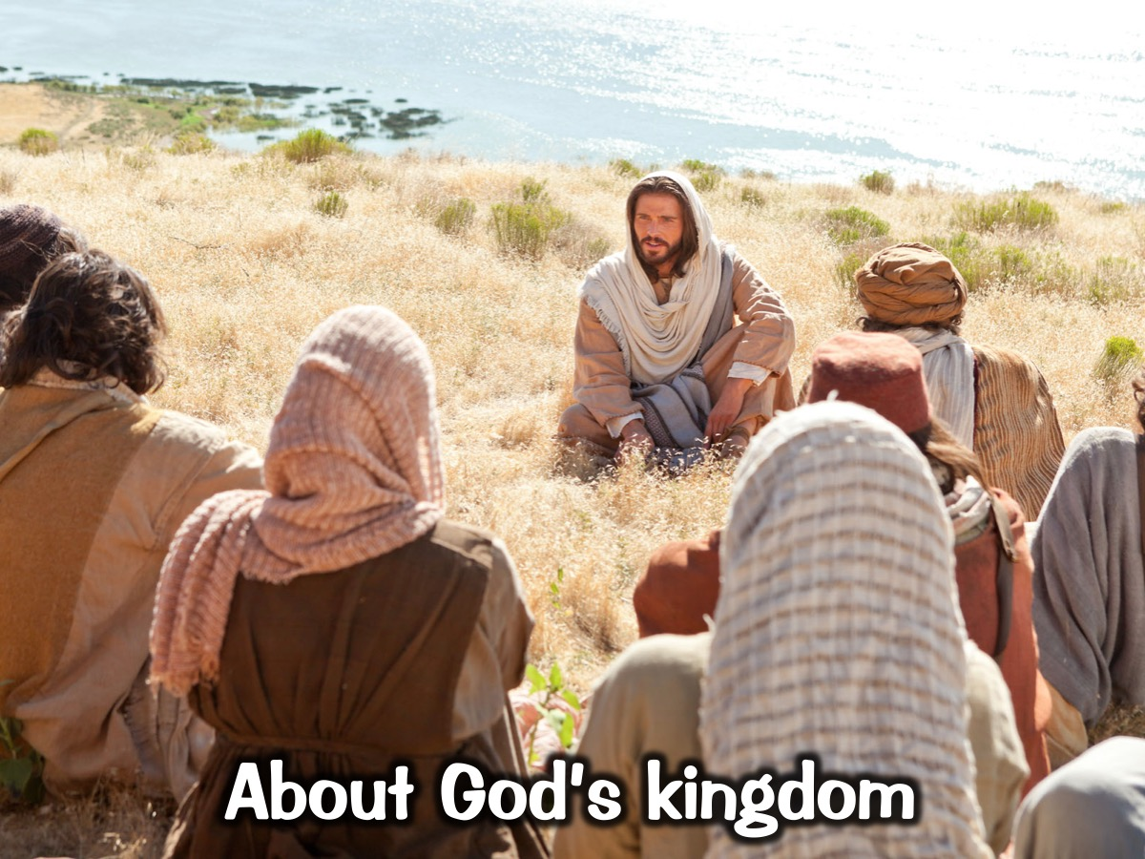
Notes:
1. About God’s kingdom – Sermon on the mount. (Mat 5). He challenges societal norms about power, sin, revenge.

Slide 34
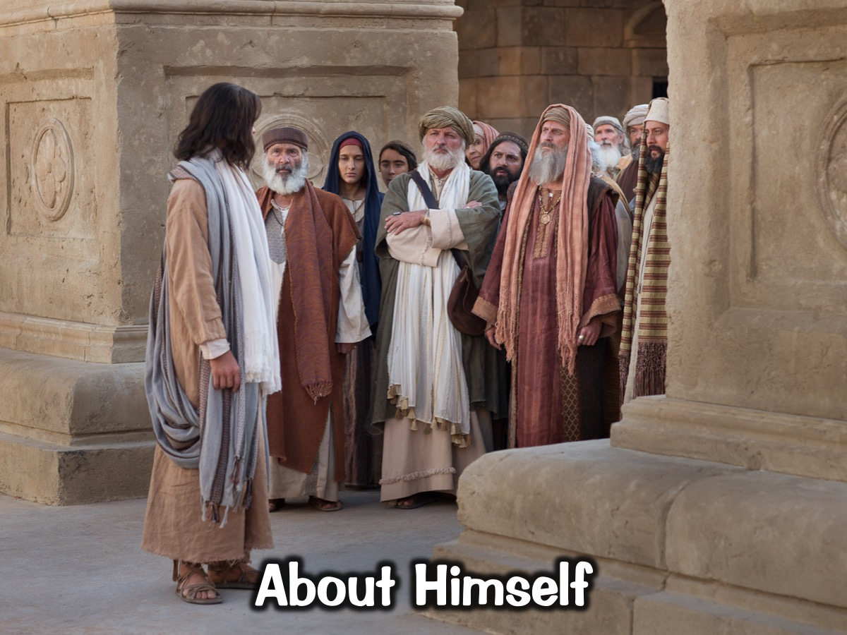
Notes:
2. About himself – I am the way the truth and the life.

Slide 35
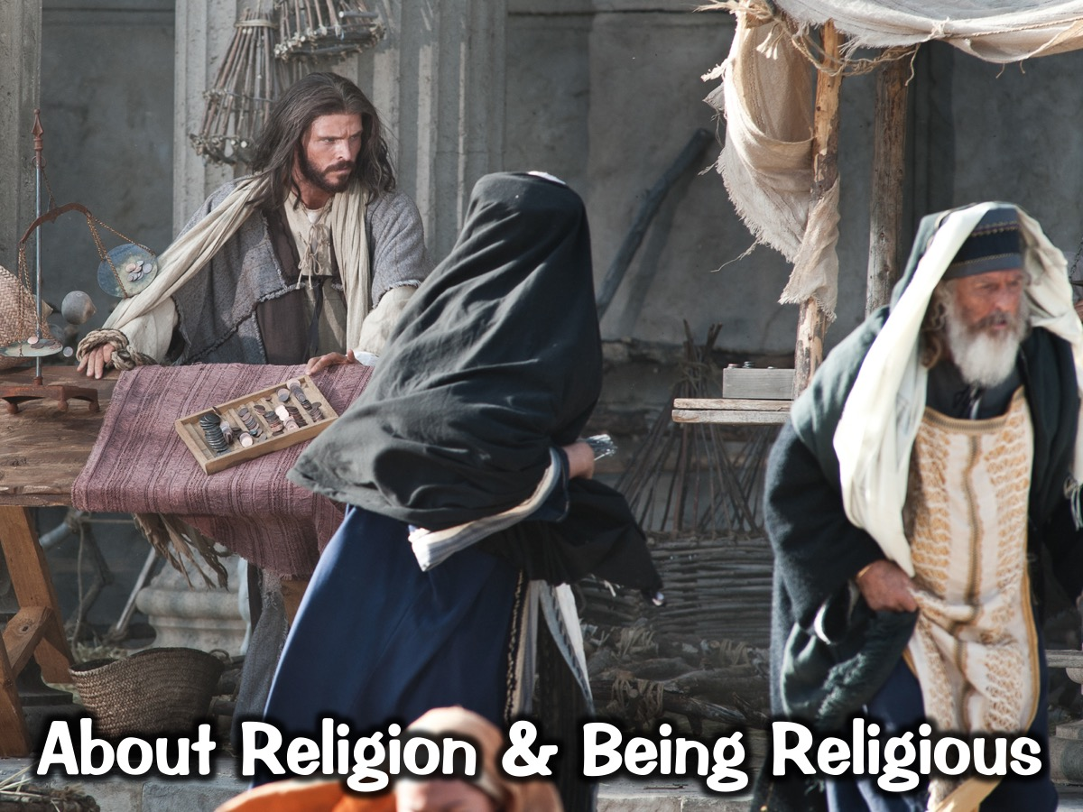
Notes:
3. About religion and being religious – Speaks out against hypocritical leaders, chases money collectors out of temple

Slide 36
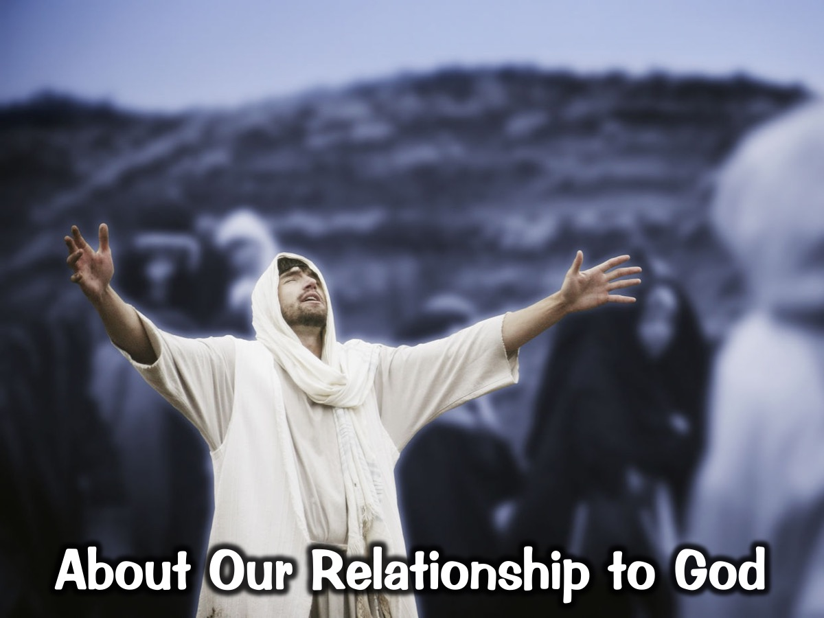
Notes:
4. About our relationship to God – He forgives people of their sins and restores a right relationship with God. Luk 7:47-48 (prostitute); Mark 2:5 (paralysed man through roof);

Slide 37
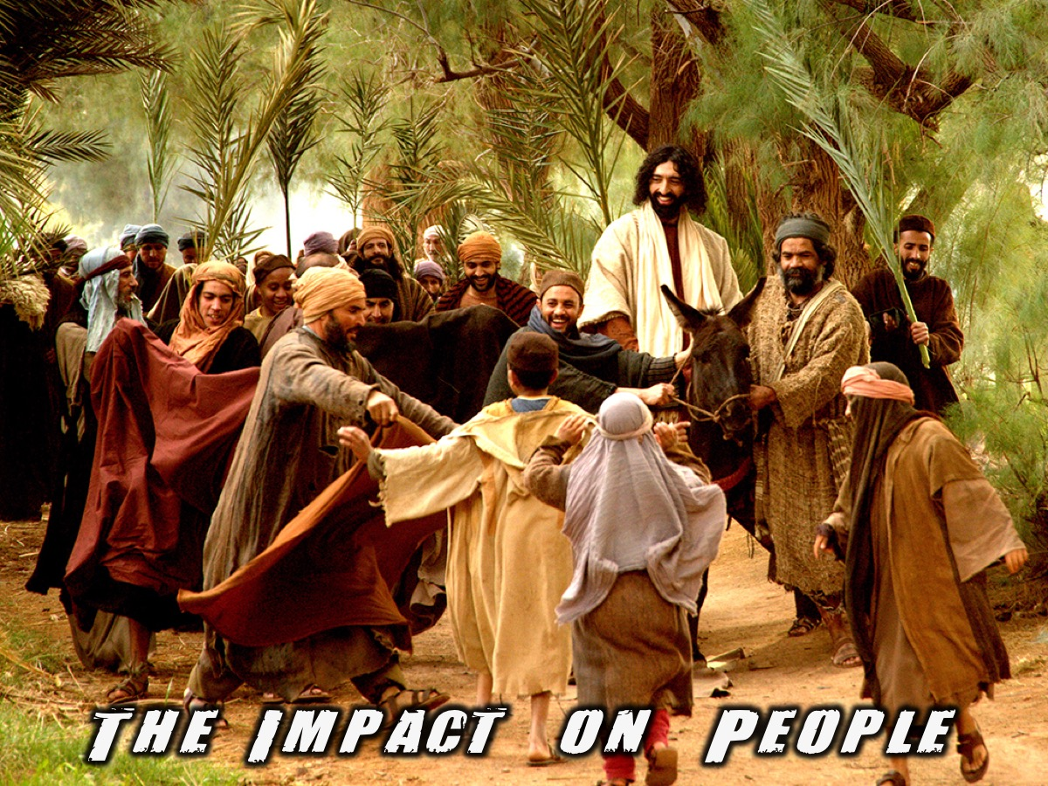
Notes:
People who chose Jesus’ revolutionary message and the impact on their lives

Slide 38
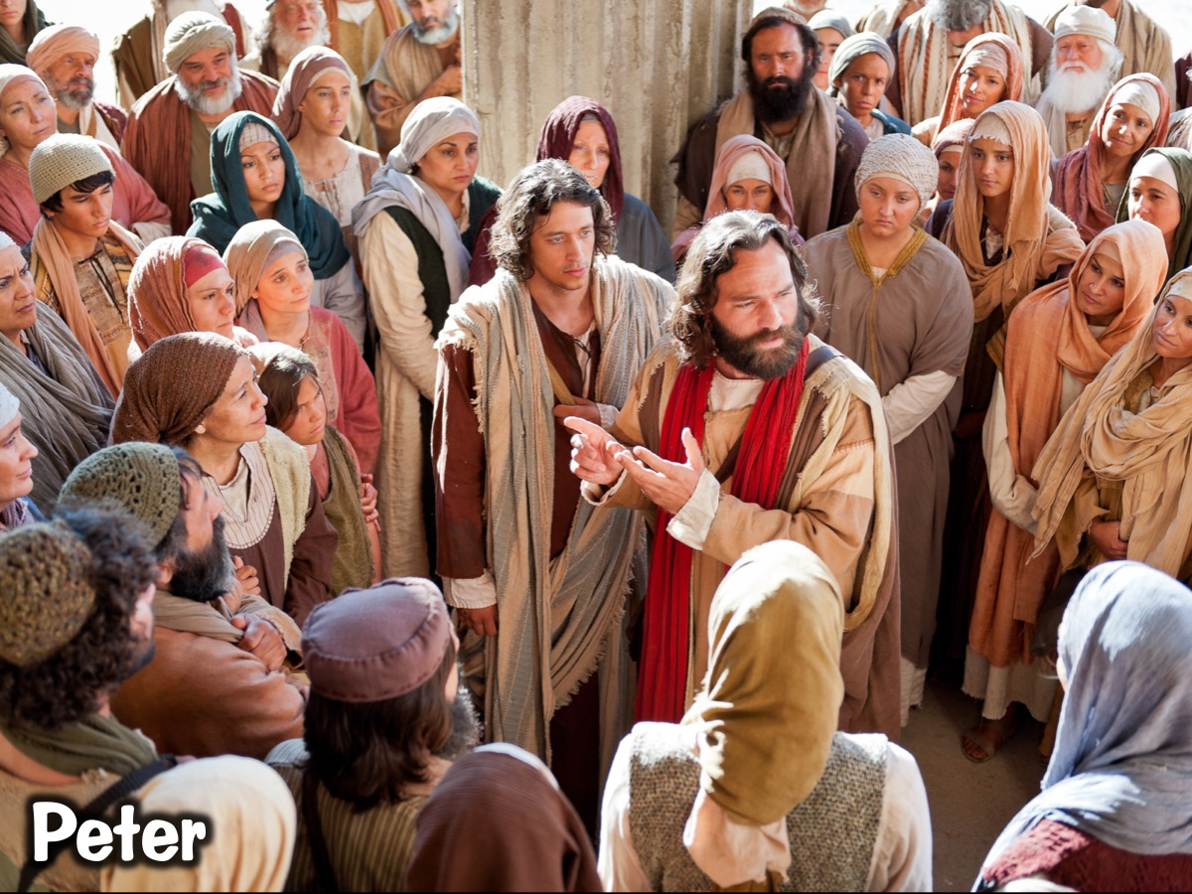
Notes:
1. Peter – From a fisherman that were not dependable to the rock on which Jesus built his church. A church that still exists today

Slide 39
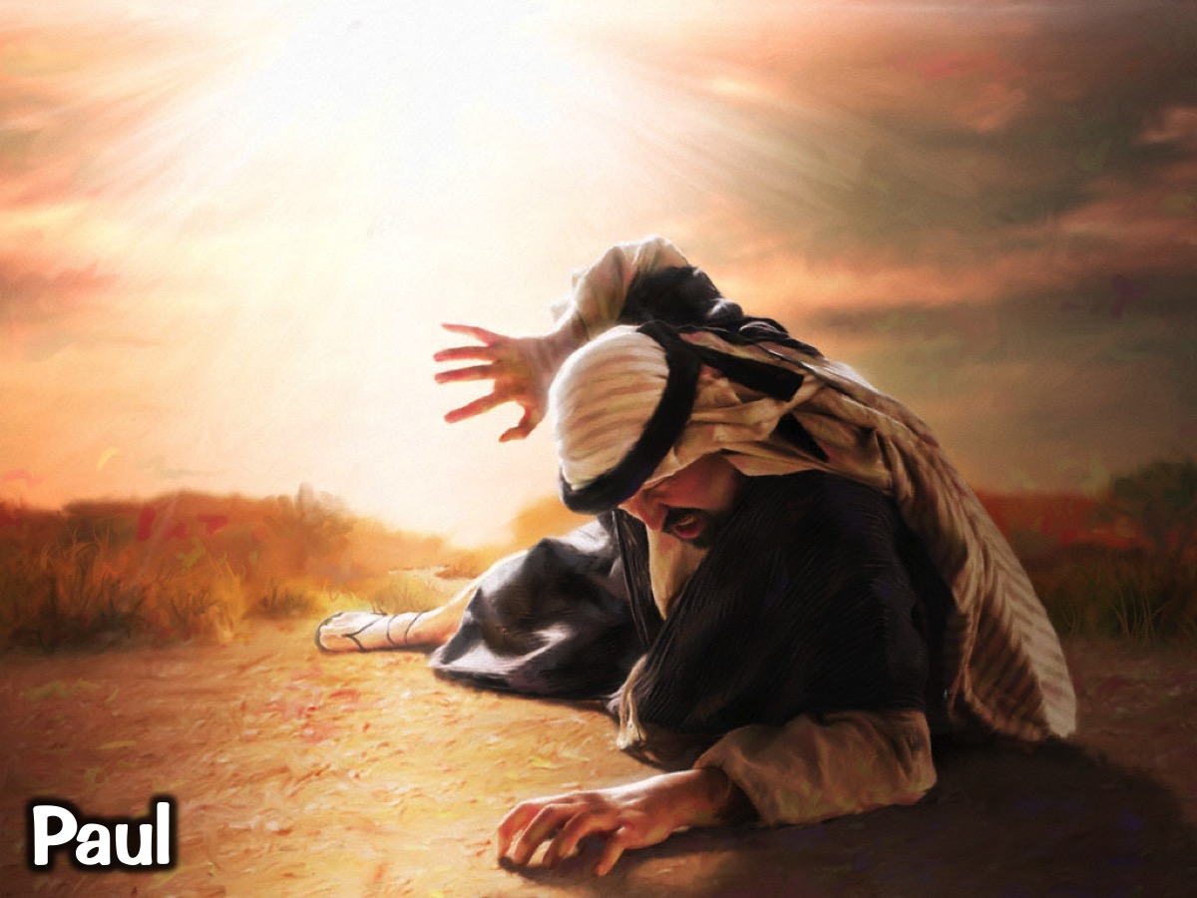
Notes:
2. Paul – On a mission against Christians, meets Jesus on the road to Damascus who sends him on a mission in the exact opposite way and he evangelised most of the known world at the time, plants churches, writes big portion of the New Testament.

Slide 40
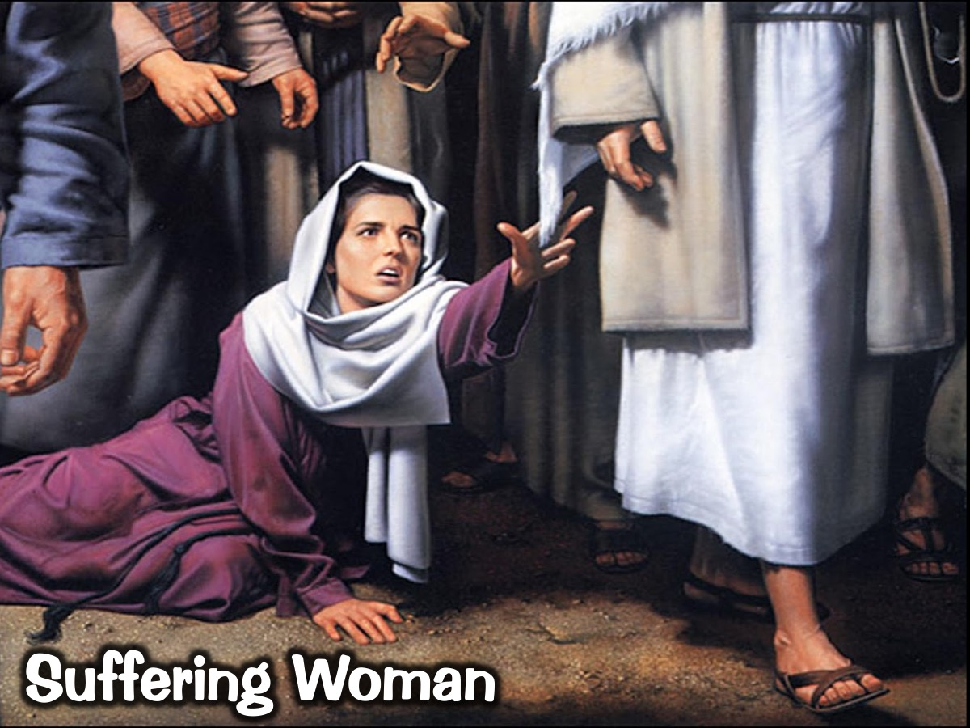
Notes:
3. Woman who suffered from bleeding (Mark 5:25) The world has cast her out, pushed her aside, completely overlooked her, nothing left. Jesus acknowledges her, heals her gives her back dignity and life.

Slide 41
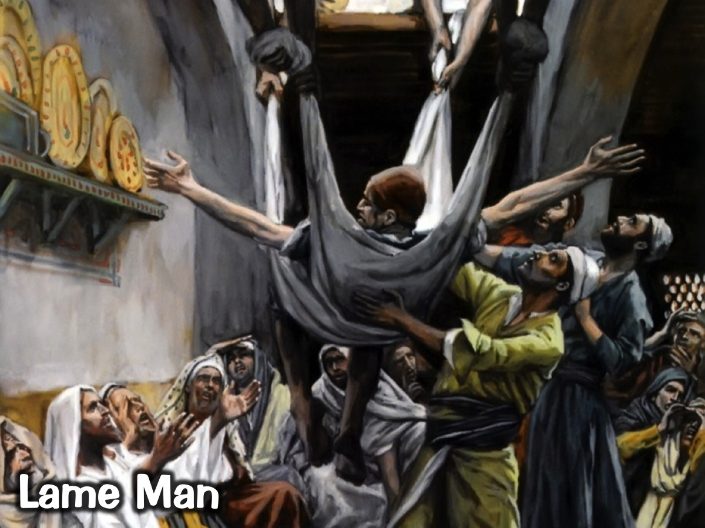
Notes:
4. Lame man walking – Sins are forgiven; He can walk again. (Mat 9:5/Mark2:5). Jesus removes his shame and puts him in right relationship with God but also heals him physically.

Slide 42
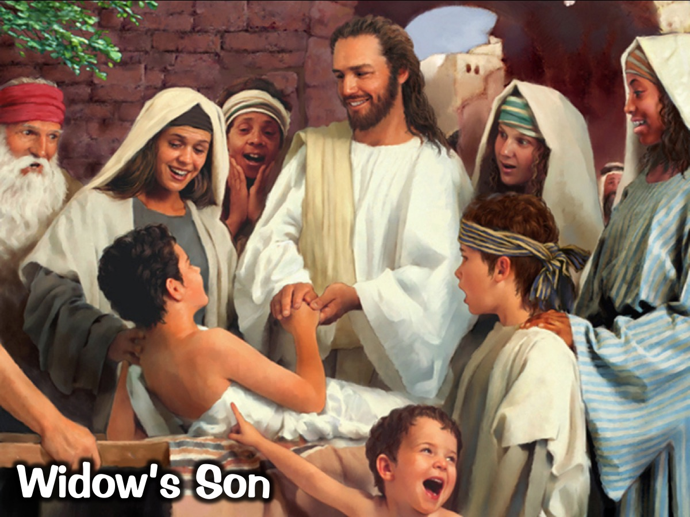
Notes:
5. Jesus raises a widow’s son (Luke 7:9). Jesus has compassion on the widow and gives her, her son back. Showing that God loves us, that he cares about us, that he wants the best for us.

Slide 43
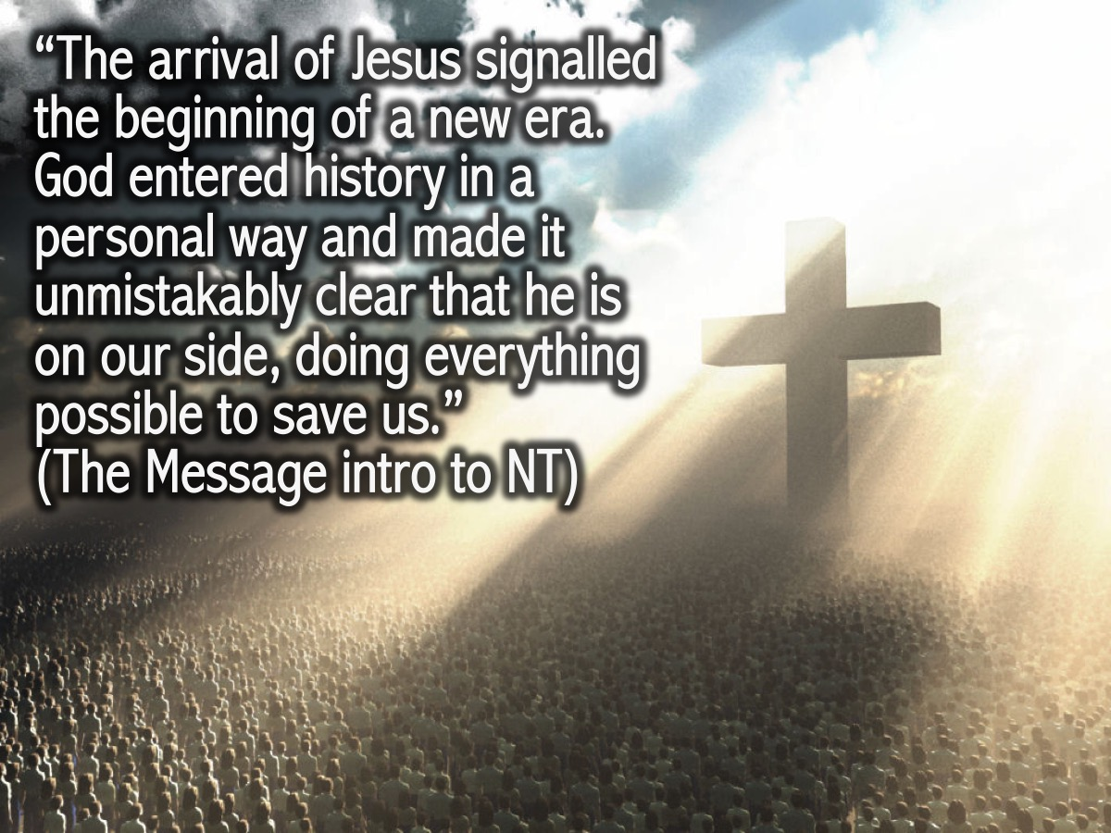
Notes:
Testimony: What was the impact on our lives?
Conclusion: “The arrival of Jesus signaled the beginning of a new era. God entered history in a personal way and made it unmistakably clear that he is on our side, doing everything possible to save us.” (Message introduction to New Testament)

Slide 44

Notes:
Matthew 16:13-19. Personal Challenge - What do you make of Jesus?

Slide 45
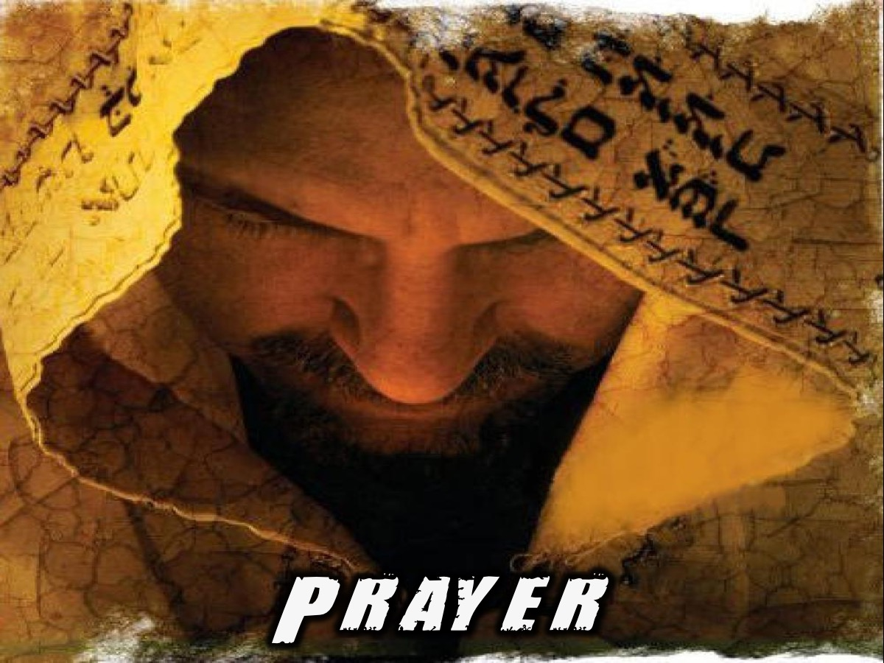
Notes:
Prayer

Slide 46

Notes:
Next week we are going to look at how we can start preparing for Revolution.

