Slide 1
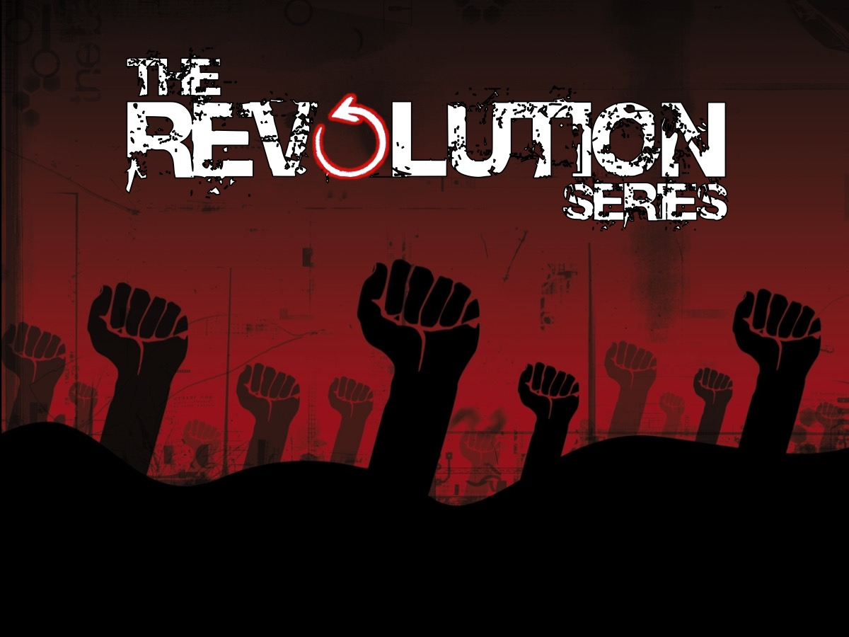
Notes:
Today is week 4 in our Revolution series!

Slide 2
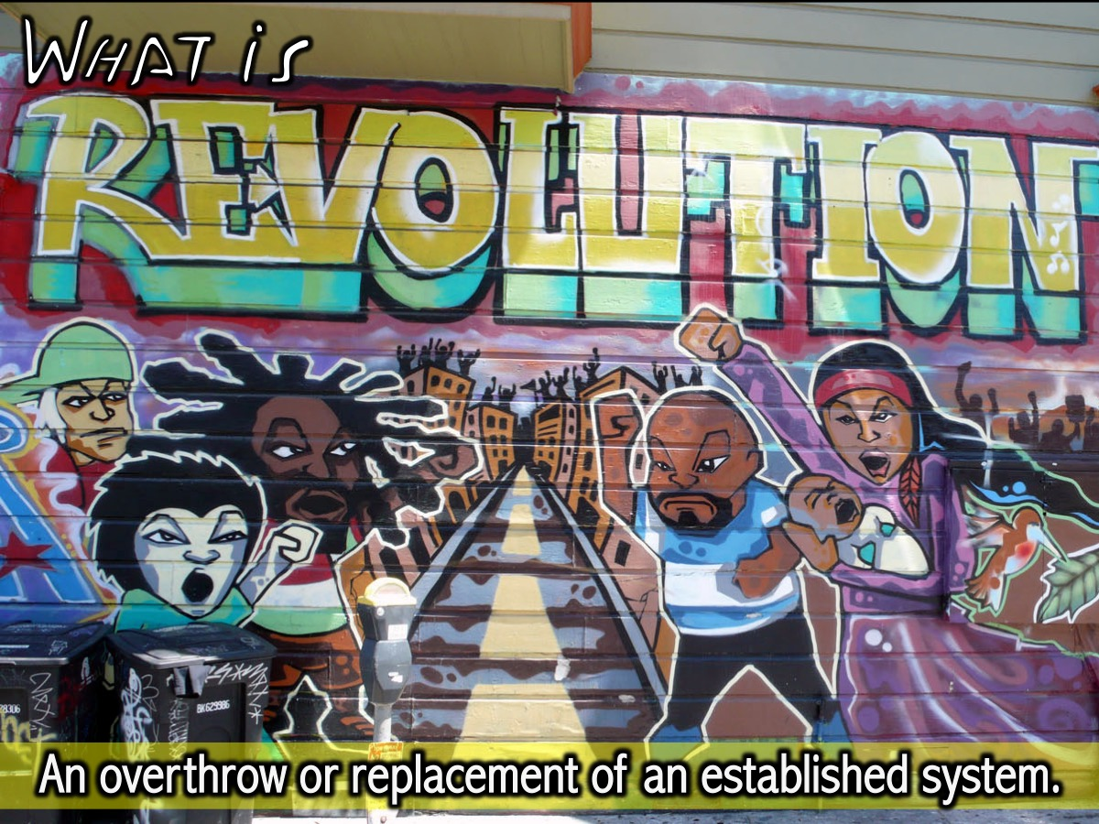
Notes:
We learnt that Revolution is an overthrow or replacement of an established system.

Slide 3

Notes:
Last week we are looked at some Amazing Revolutionaries.

Slide 4
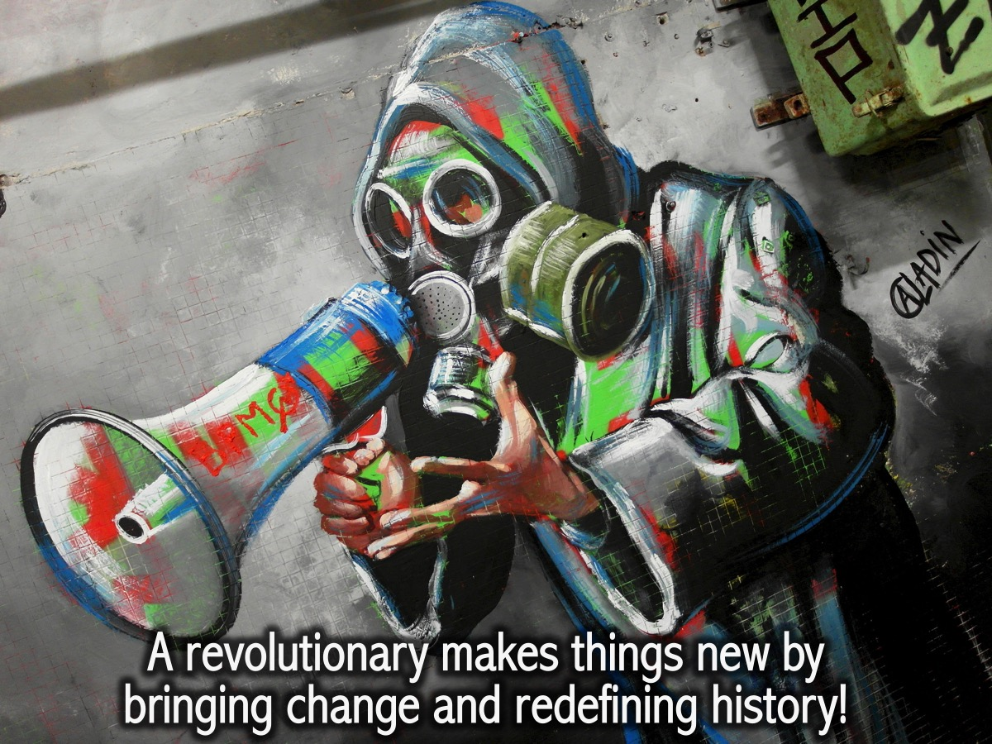
Notes:
A revolutionary makes things new by bringing change and redefining history!

Slide 5

Notes:
This week we are going to explore how to prepare for a revolution.

Slide 6
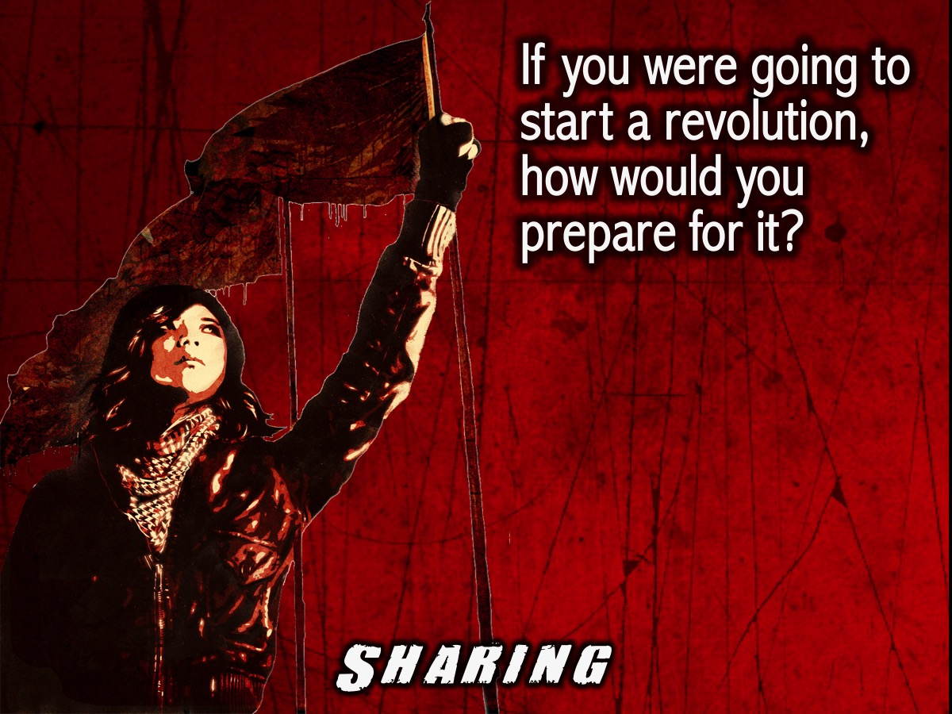
Notes:
Sharing: Turn to the person next to you and ask them this question: If you were going to start a revolution, how would you prepare for it?

Slide 7

Notes:
The Regime Change Game. We are going to play a game that is all about bringing about a regime change. Here is the scenario: you live in a country that is run by a minority who are oppressing the majority. You are going to design a process and implement a plan to bring about a regime change.

Slide 8
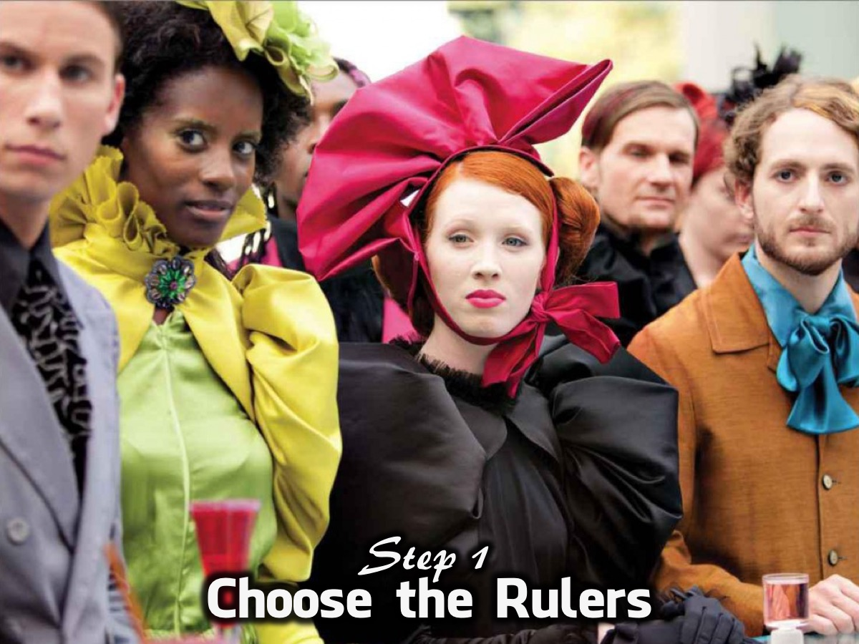
Notes:
1. Choose the Rulers. We are going to appoint a group of individuals to be the ruling class – the oppressors who run the country but keep all the benefits and wealth for themselves.

Slide 9
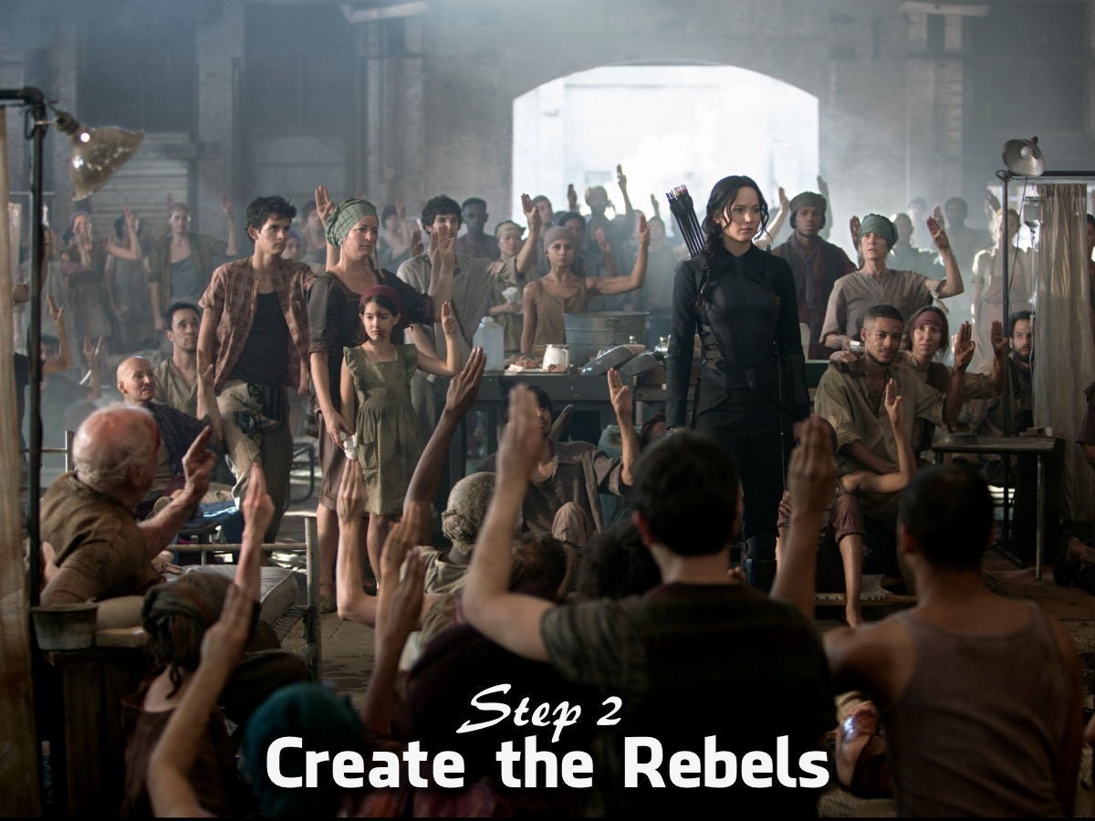
Notes:
2. Create the Rebels – We are going to divide the rest of the group into two smaller groups and you have the task of bringing about a change of regime in the country.

Slide 10
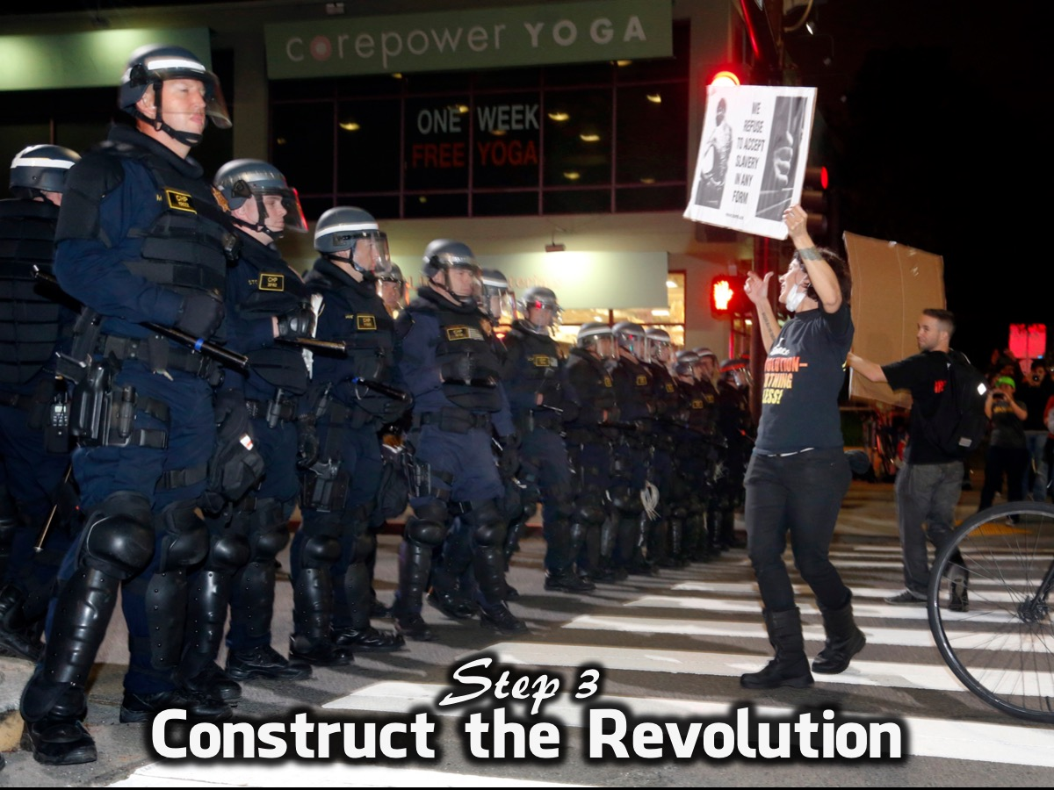
Notes:
3. Construct the Revolution – We are going to following 8 steps in our process of non-violent regime change:

Slide 11
Notes:
(1) Why do you want Change? Find out what is driving your community crazy, limiting your freedom and causing you pain.

Slide 12
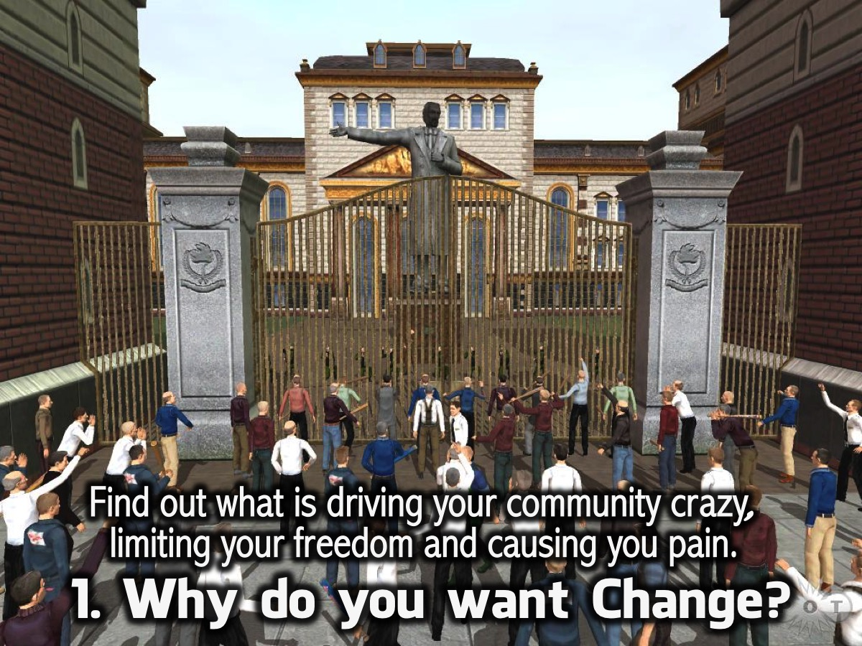
Notes:
(2) Who Is the Dictator? Identify who is responsible for your pain and hardship and who needs to be removed.

Slide 13
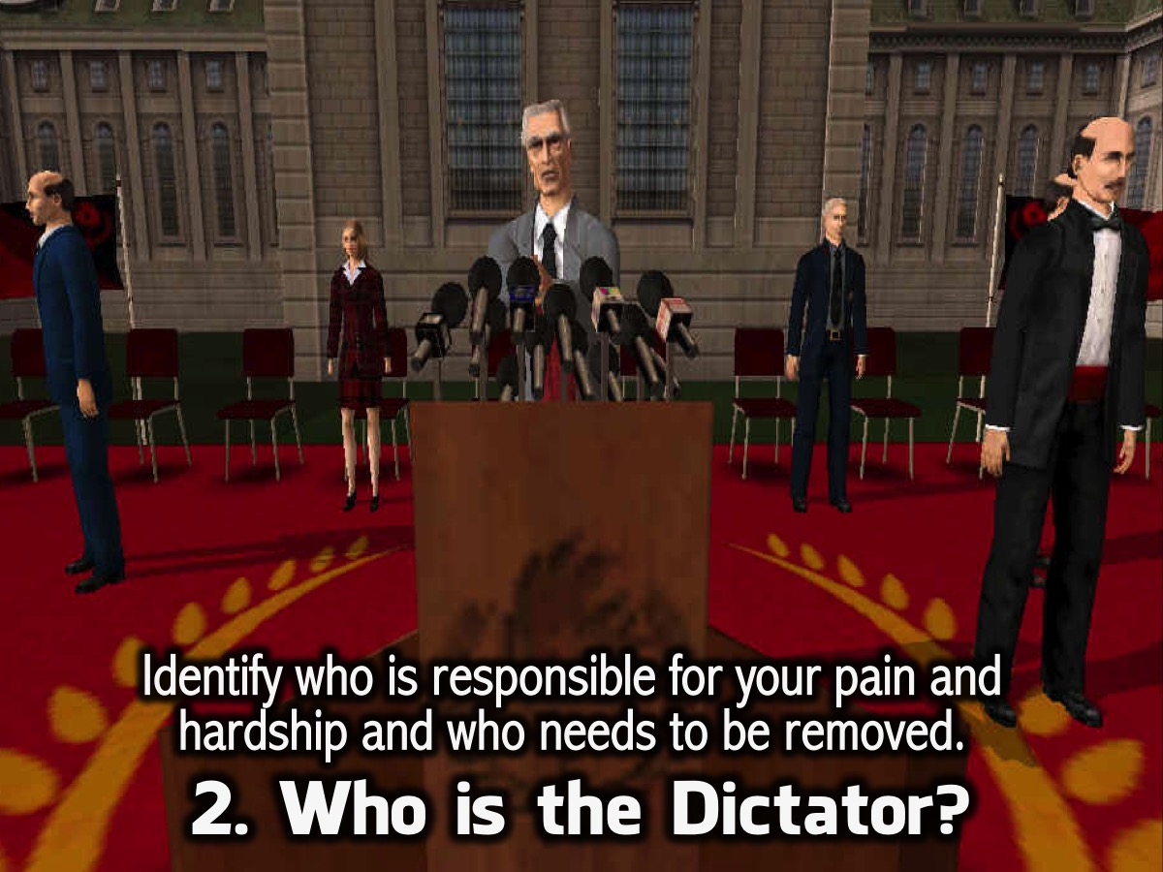
Notes:
(3) Who is your Leader? Someone has to lead your movement and they must most share your beliefs, be humble, feel your pain, be truthful and serve you.

Slide 14
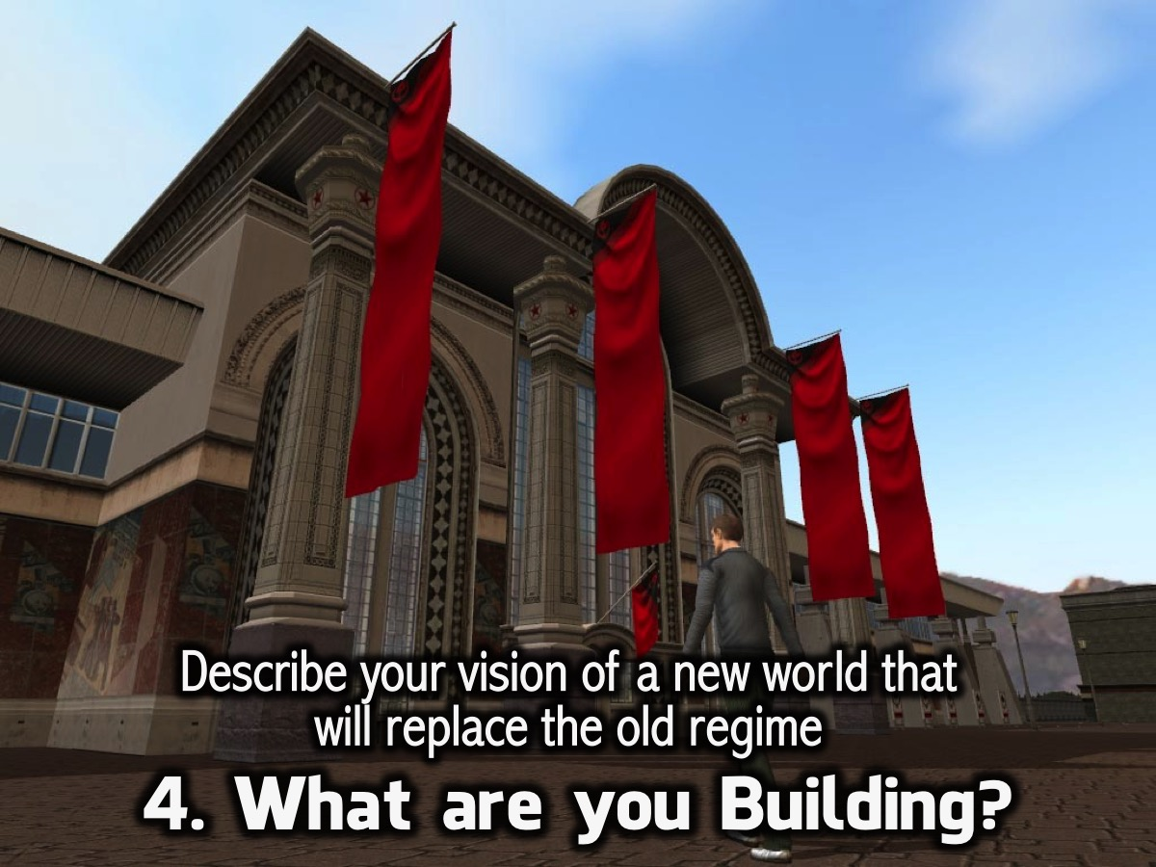
Notes:
(4) What are you Building? To replace the old regime you need a crystal clear vision of the new world that you are going to build.

Slide 15
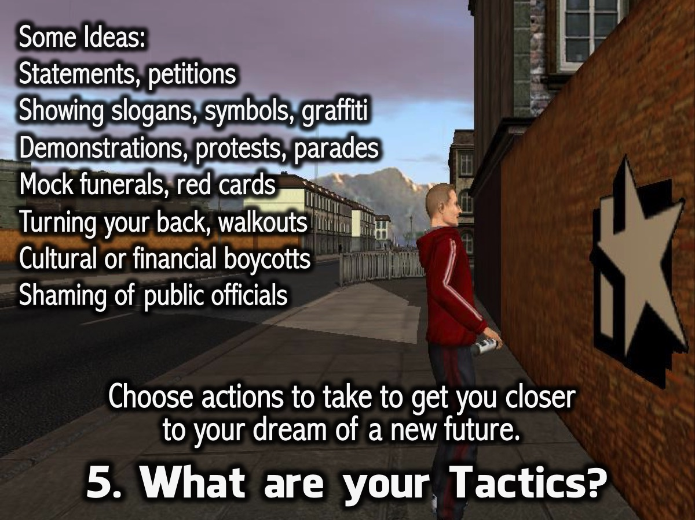
Notes:
(5) What are your Tactics? Identify actions to take to get you closer to your dream of a new future. Here are some ideas: Statements, petitions. Showing slogans, symbols, graffiti. Demonstrations, protests, parades. Mock funerals, red cards. Turning your back, walkouts. Cultural or financial boycotts. Shaming of public officials.

Slide 16
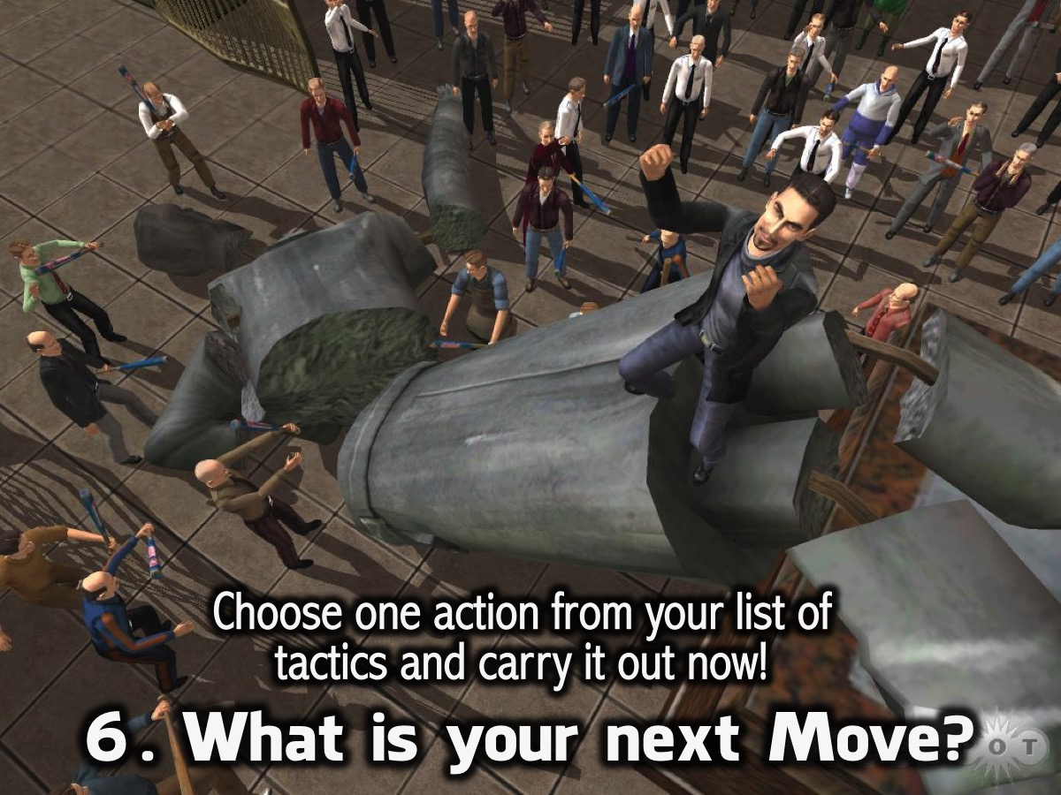
Notes:
(6) What is your next Move? Choose one action from your list of tactics and carry it out now!

Slide 17
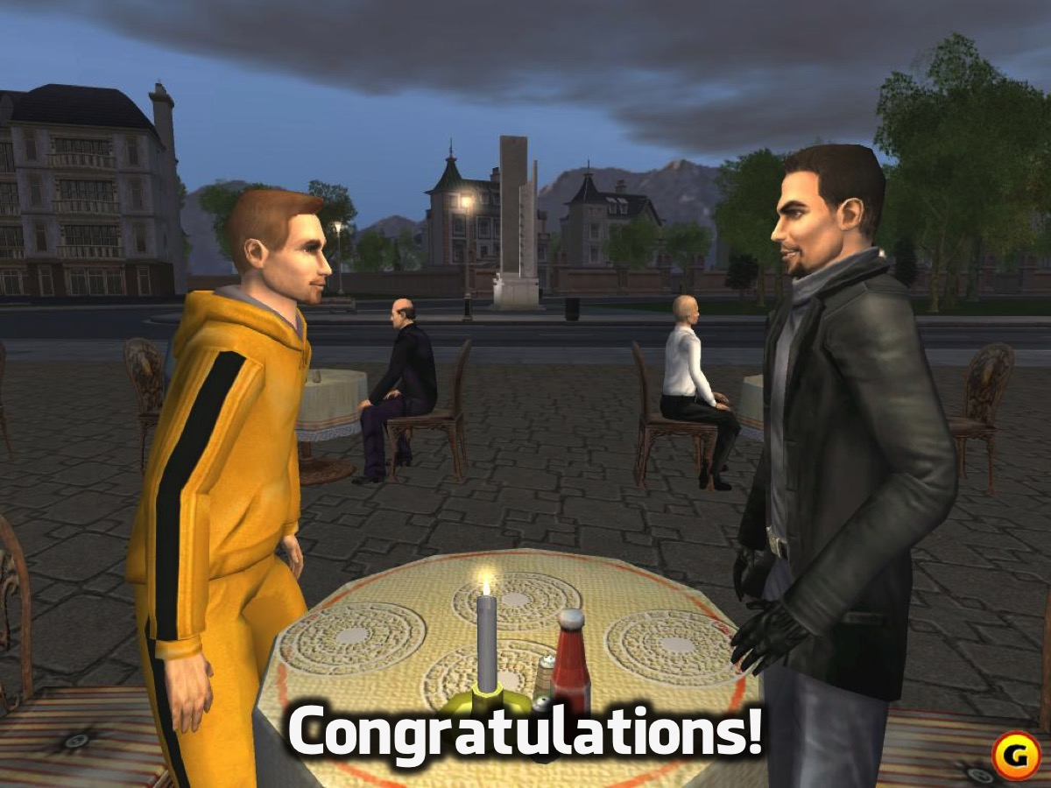
Notes:
Congratulations on working together to bring about a regime change.

Slide 18

Notes:
Let’s go back in time. The Israelites found themselves living under an oppressive regime – the Egyptians. They had become slaves in Egypt and were suffering unbelievably. Here is a trailer from the movie: Exodus: Gods and King

Slide 19

Notes:
Video: Exodus: Gods and Kings Official Trailer #3. Get it on YouTube at: https://www.youtube.com/watch?v=RhCzcde8__g

Slide 20
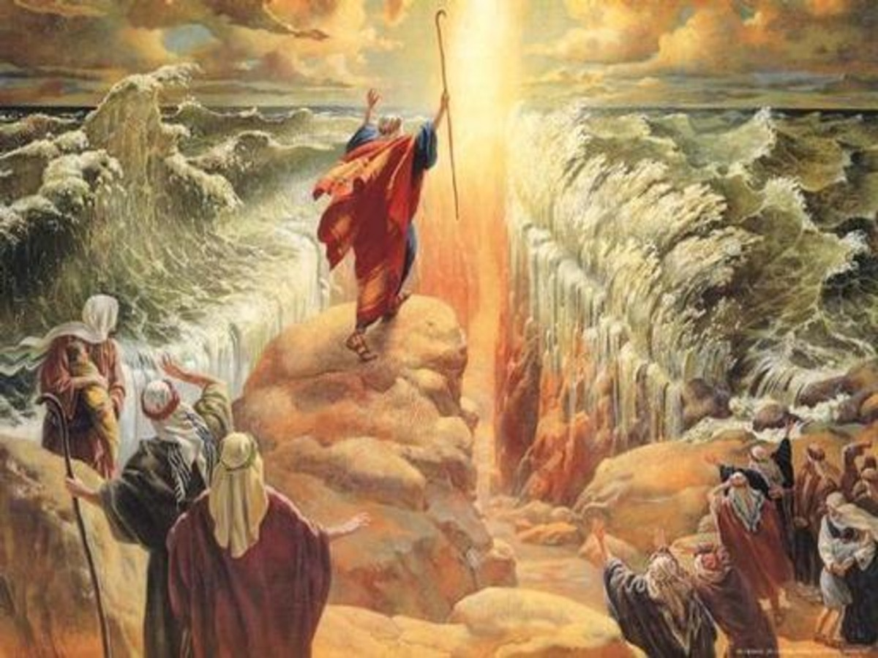
Notes:
Talk about needing a regime change!!! They called out to God and He implemented a process to get them out of Egypt and into the promised land. But they had to be prepared to leave. Before they could do anything they needed to accept God as their God. Only way to prepare themselves for the revolution they had to acknowledge and believe that He is the One God.

Slide 21

Notes:
So how do we prepare for revolution? What are the steps to personal regime change in our lives? We are going to look at three steps we need to take to personal revolution:

Slide 22
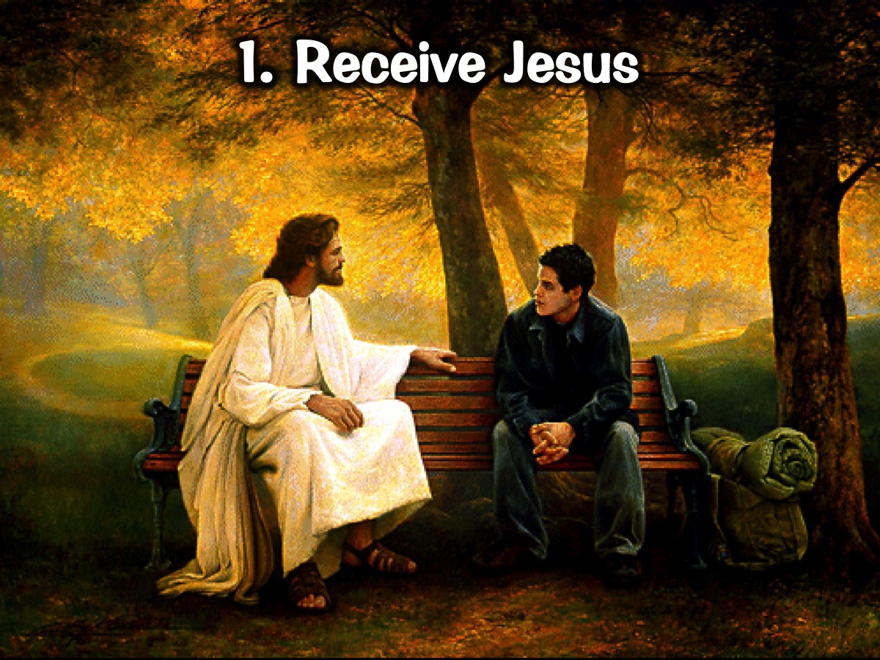
Notes:
1. Receive Jesus – the first step in preparing for revolution is to receive Jesus as your Lord and Saviour.

Slide 23
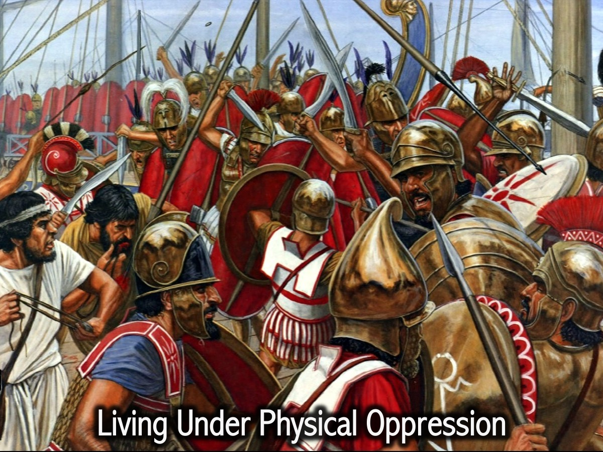
Notes:
We find a similar idea in Jesus’ day! Do you remember last week Hannes spoke about how that the people in Jesus day were living under an oppressive regime – the Romans. But this was actually just a physical oppression. And there is a far worse oppression to be under…

Slide 24
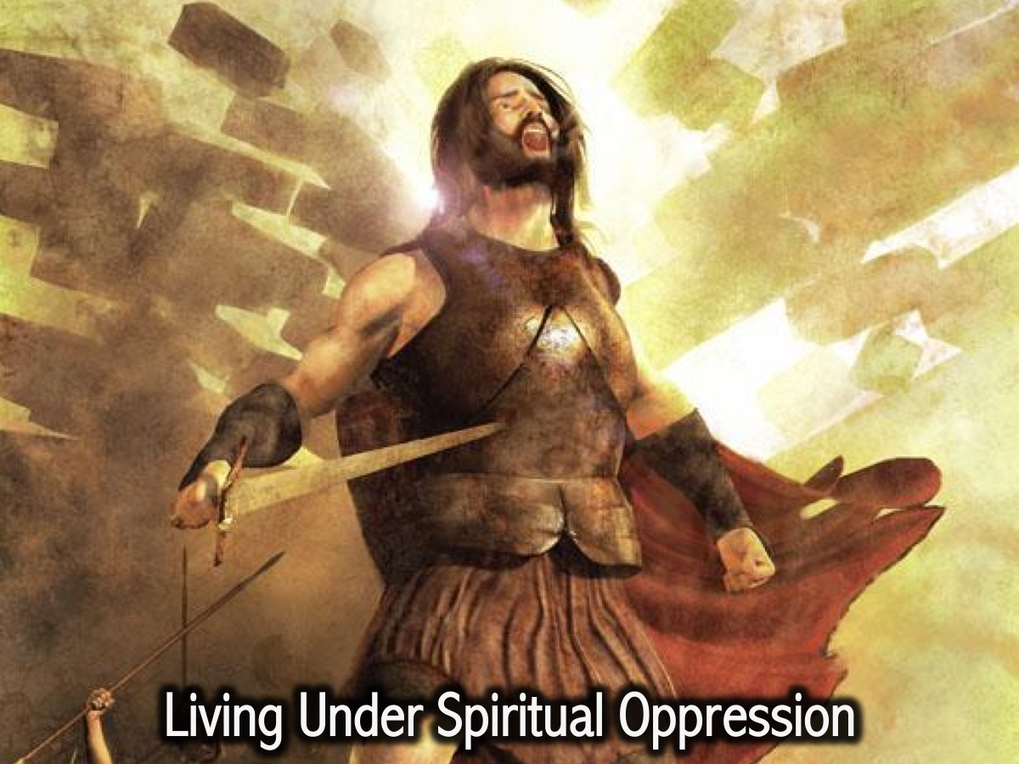
Notes:
There is a more serious and deadly regime. People are actually slaves to sin – to the evil one – to the darkness and they needed liberation.

Slide 25
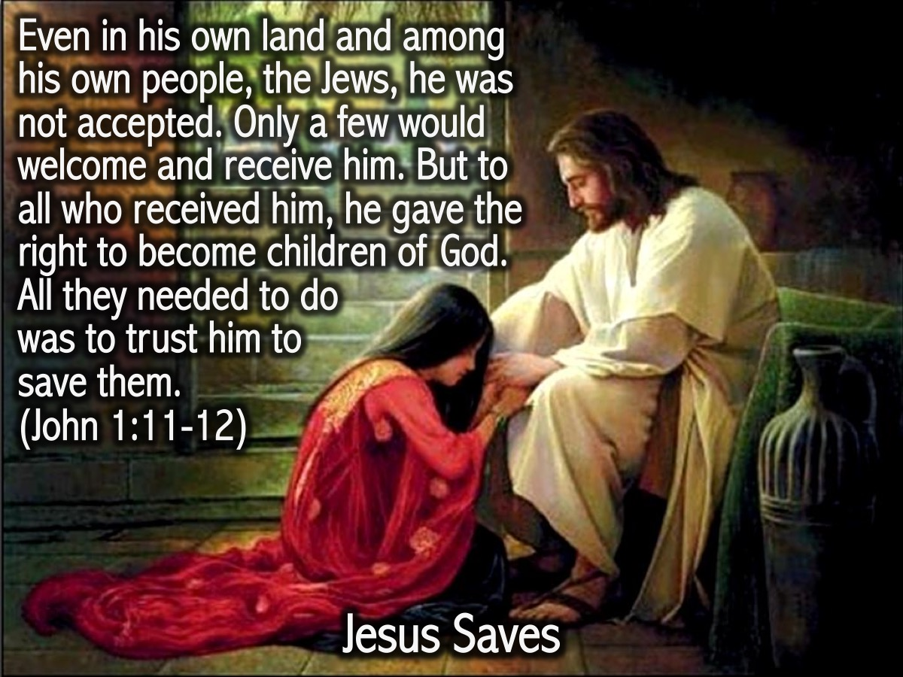
Notes:
People cannot get free from spiritual oppression without outside intervention! In John 1:12 we read that they were given an opportunity to receive Jesus, the light – and this would make them children of God and move them from the regime of darkness into the kingdom of God.

Slide 26

Notes:
If you have never received Jesus as your Lord and Saviour then here is your chance as you repent, confess your sins and believe in Jesus for salvation. Let’s pray.

Slide 27
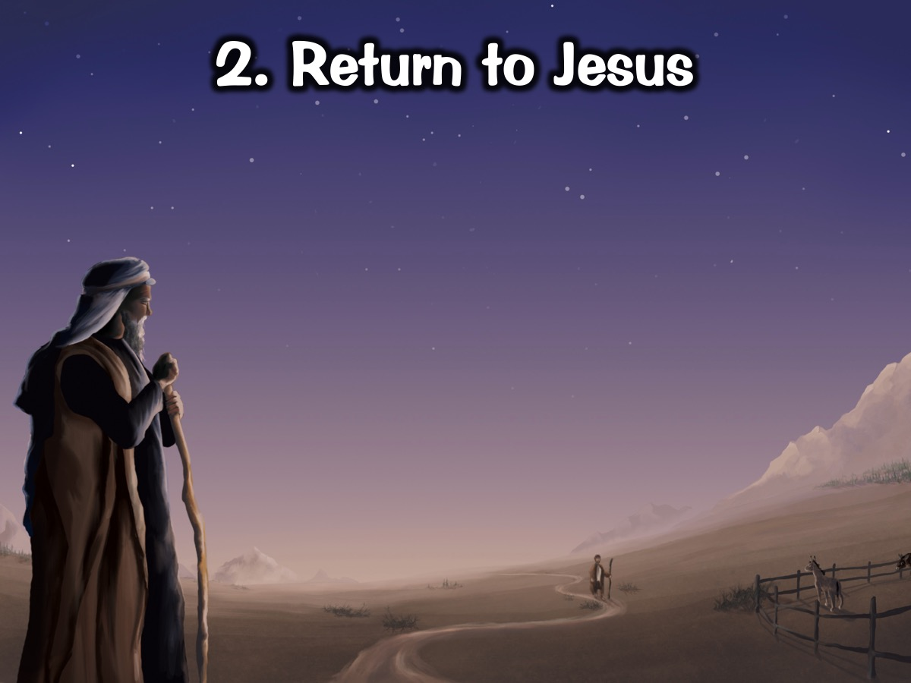
Notes:
2. Return to Jesus. For some of us today – preparing for revolution means that we need to return to Jesus. Like the prodigan son – in Luke 15 – we can wander away from God.

Slide 28
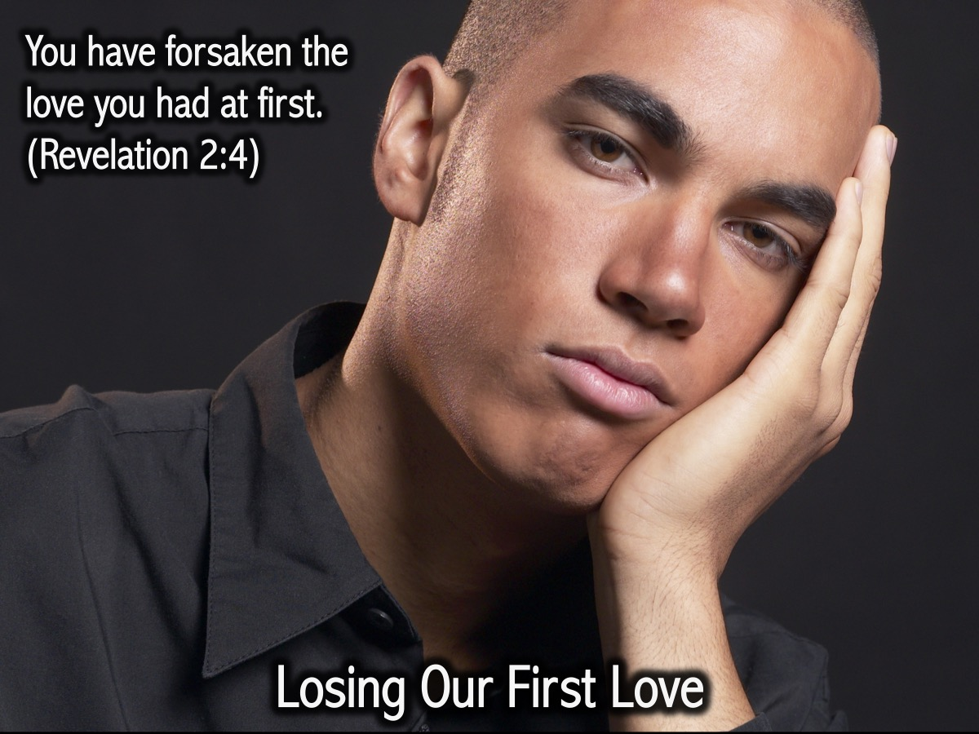
Notes:
2. Return to Jesus. For some of us today – preparing for revolution means that we need to return to Jesus. Like the prodigan son – in Luke 15 – we can wander away from God.

Slide 29
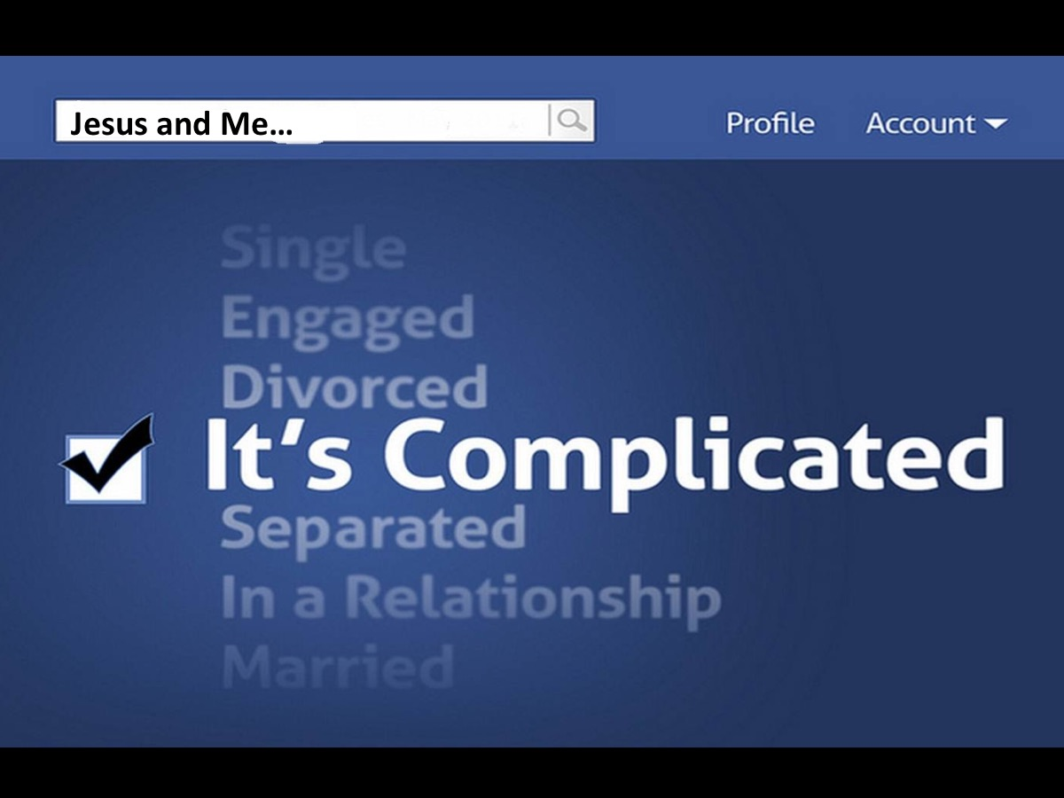
Notes:
Sometimes we lose our first love. You have forsaken the love you had at first. (Revelation 2:4)

Slide 30
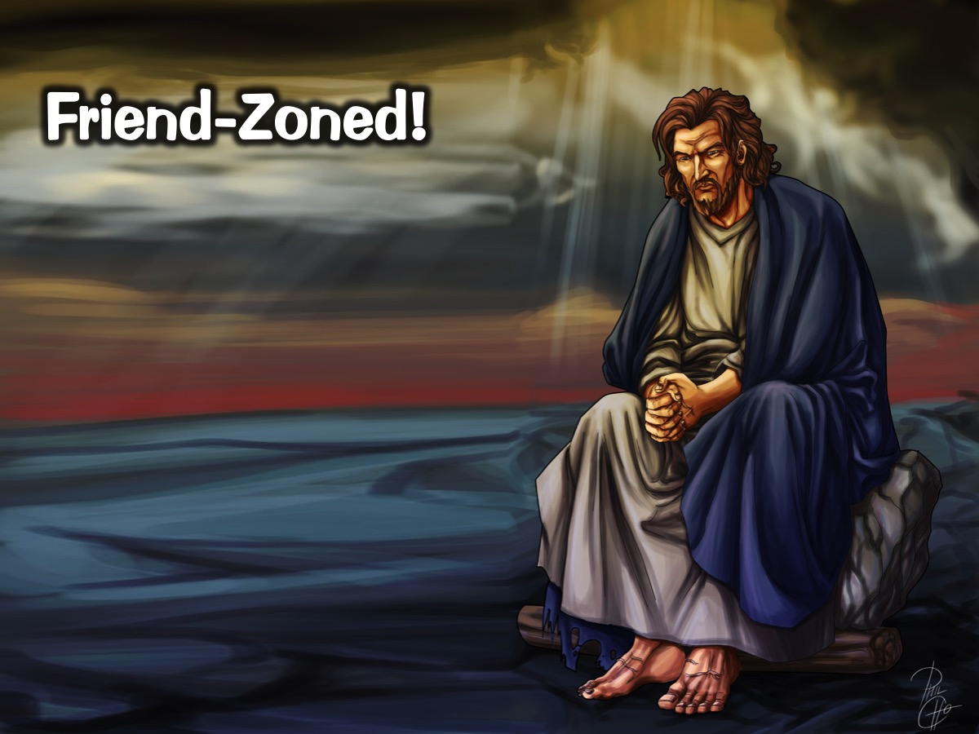
Notes:
and the relationship we have with Jesus becomes complicated.

Slide 31
Notes:
And Jesus gets friend-zoned!

Slide 32

Notes:
Maybe today it is your moment to come back to Jesus – to your first love! Let’s pray and ask God to help us return to our first love.

Slide 33
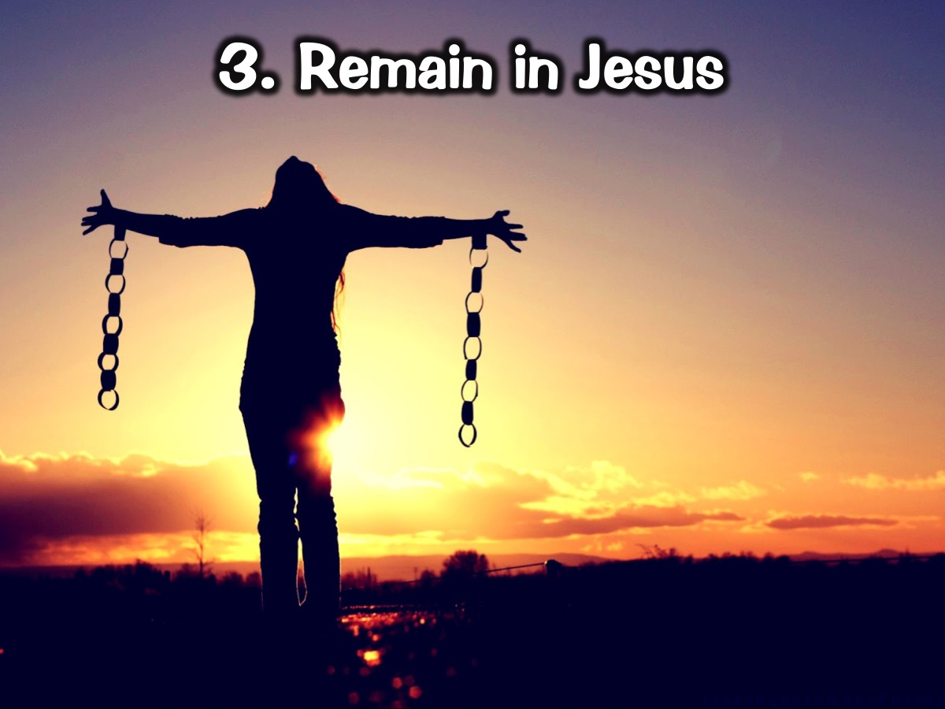
Notes:
3. Remain in Jesus

Slide 34
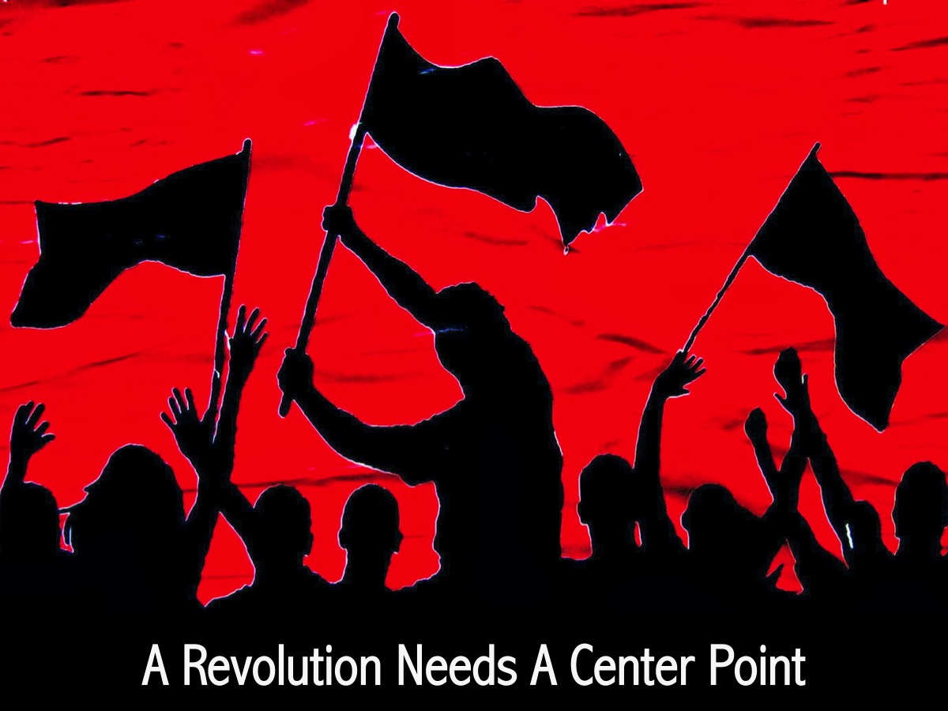
Notes:
A Revolution Needs a Center Point. To start a revolution needs a central point around which you prepare: an idea or belief or religious system.

Slide 35
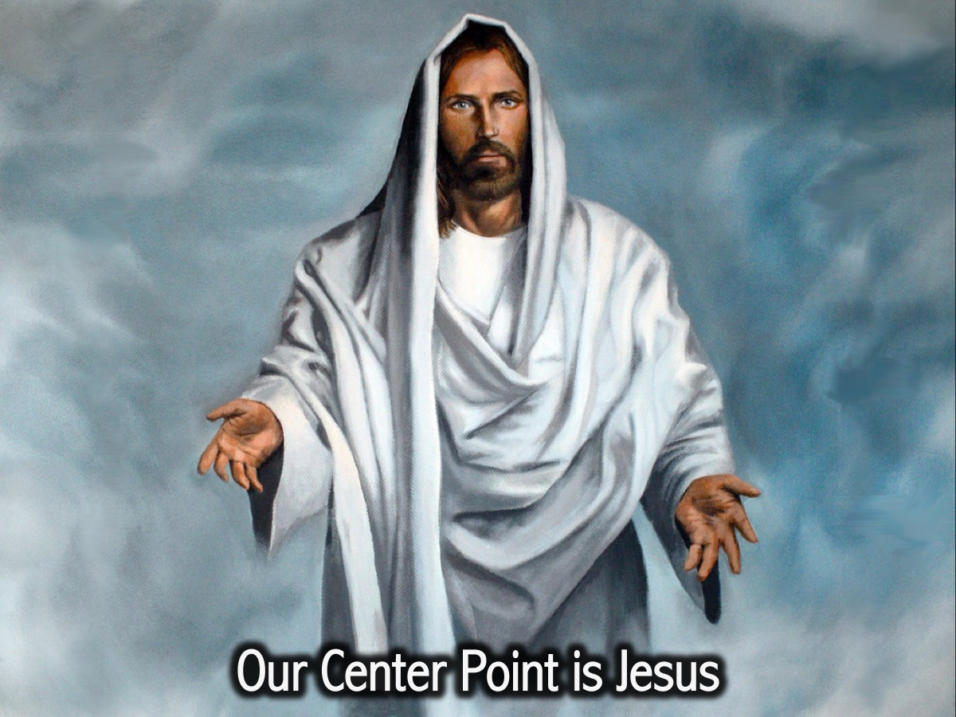
Notes:
Our Center Point is Jesus. Christ-centered. To prepare yourself for the revolution you need to know what you’re fighting for and what you believe in. Jesus is the source and He is the one who prepares us.

Slide 36
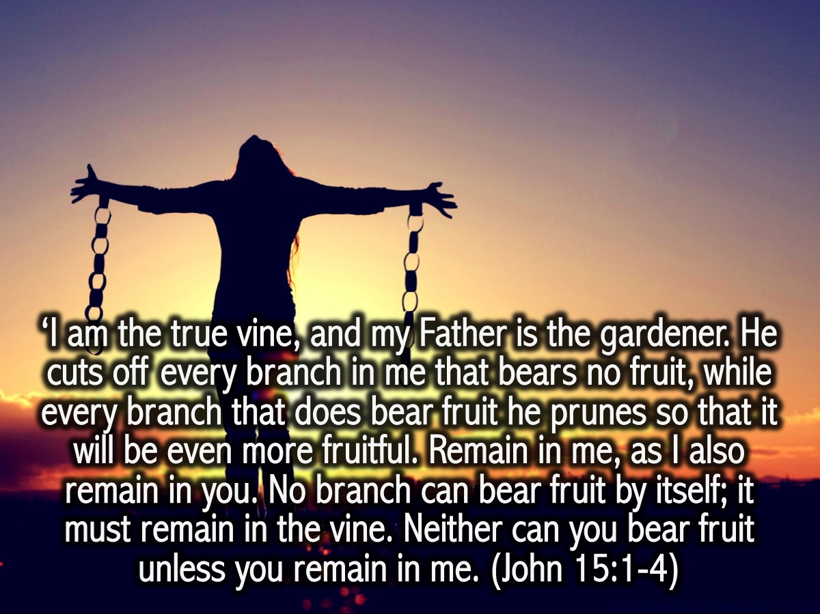
Notes:
‘I am the true vine, and my Father is the gardener. He cuts off every branch in me that bears no fruit, while every branch that does bear fruit he prunes so that it will be even more fruitful. Remain in me, as I also remain in you. No branch can bear fruit by itself; it must remain in the vine. Neither can you bear fruit unless you remain in me. (John 15:1-4)

Slide 37

Notes:
“I am the vine, you are the branches. If a man remains in me and I in him, he will bear much fruit; apart from me you can do nothing.” (John 15:5) He calls us to come to Him and dwell in Him. To remain in Him so we may bear much fruit which is the qualities he teaches us when we remain in Him and His words in us. What does that mean? It means we practice what He teaches us. God is preparing our hearts for His revolution and our hearts need to become Christ-centered. Jesus is the true vine in Him we must remain, so He can prepare us for the revolution not only in other peoples' lives but the revolution of your life, your mind, your heart.

Slide 38
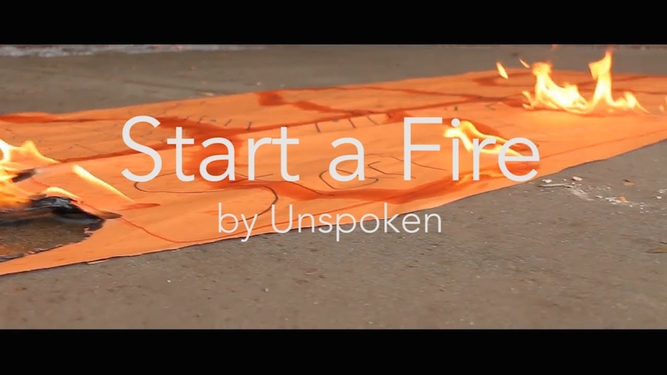
Notes:
Video: Here is a great video by a band called Unspoken – entitled: Start a Fire. Get it on YouTube at: https://www.youtube.com/watch?v=xrEzr-rWwe8

Slide 39

Notes:
Prayer

Slide 40

Notes:
Next week is Prophetic Sunday.

