Slide 1

Notes:
Today is week 5 in our Revolution series!

Slide 2
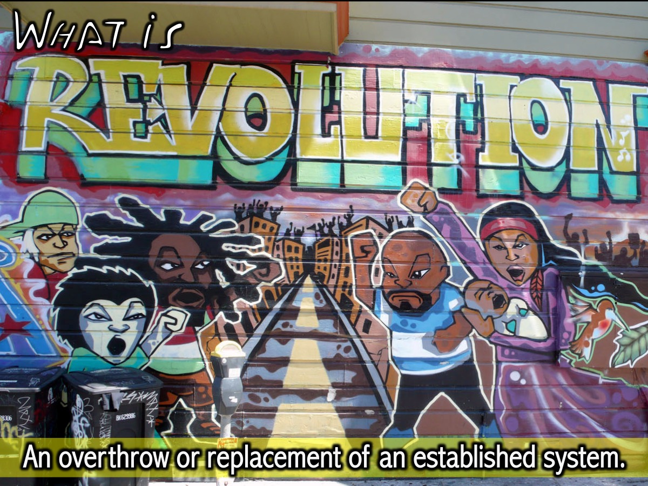
Notes:
We have learnt that a revolution is an overthrow or replacement of an established system.

Slide 3
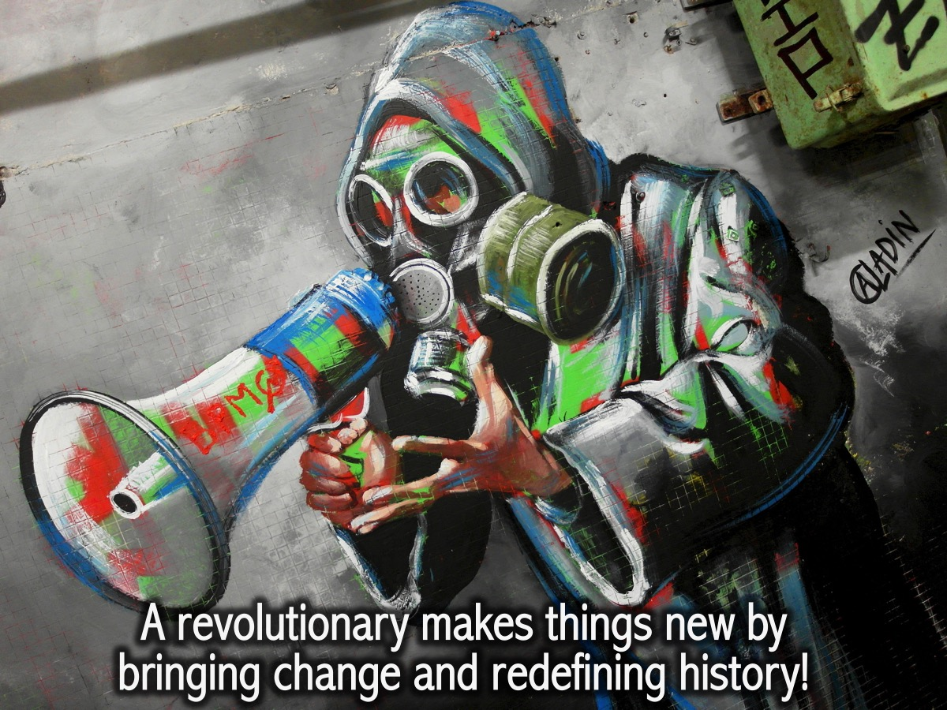
Notes:
And that a revolutionary makes things new by bringing change and redefining history!

Slide 4

Notes:
This week is all about becoming revolutionary! You are going to figure out what it means to become revolutionary.

Slide 5

Notes:
I am sure that most of you have seen the first Divergent movie and are eagerly awaiting the second movie, Insurgent, in March!

Slide 6
Notes:
Video: Insurgent Official Trailer – Fight Back. Get it on YouTube at: https://www.youtube.com/watch?v=Gf3HZaB57Jk

Slide 7
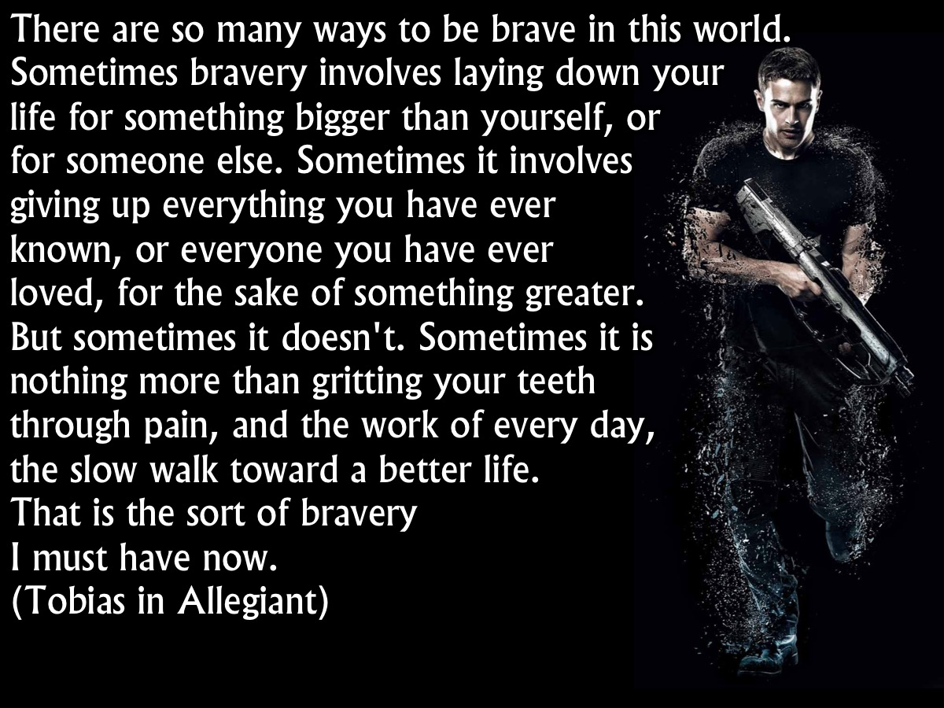
Notes:
Here is a great quote from the third book in the trilogy, Allegiant, where Tobias says: “There are so many ways to be brave in this world. Sometimes bravery involves laying down your life for something bigger than yourself, or for someone else. Sometimes it involves giving up everything you have ever known, or everyone you have ever loved, for the sake of something greater. But sometimes it doesn't. Sometimes it is nothing more than gritting your teeth through pain, and the work of every day, the slow walk toward a better life. That is the sort of bravery I must have now.” (Tobias in Allegiant)

Slide 8
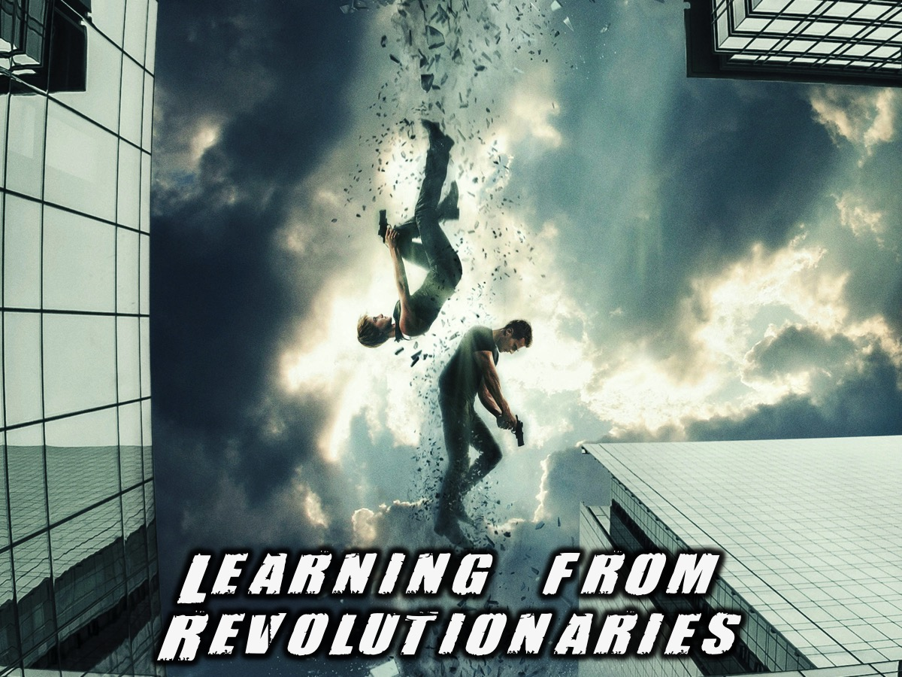
Notes:
Learning from Revolutionaries. You are going to divide into 6 groups and each group will be given a quote from a famous revolutionary and you will try and figure out it has to say about being a revolutionary.

Slide 9
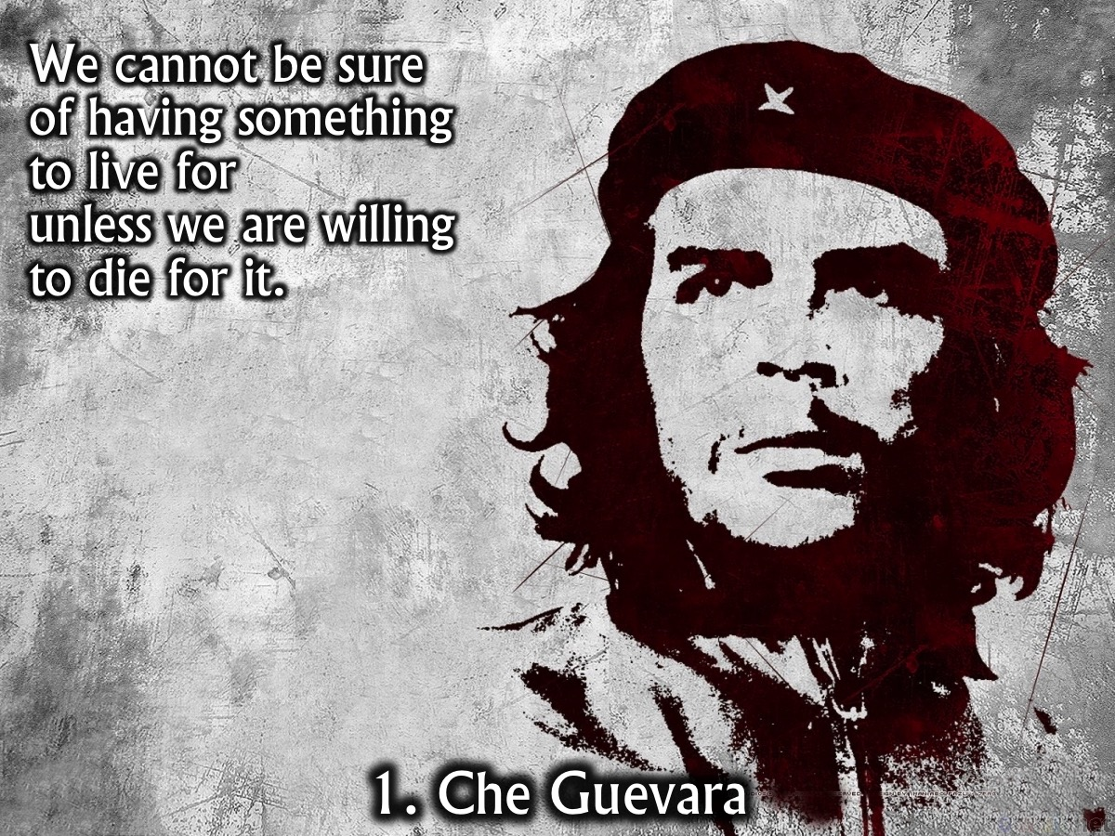
Notes:
We cannot be sure of having something to live for unless we are willing to die for it. (Che Guevara)

Slide 10
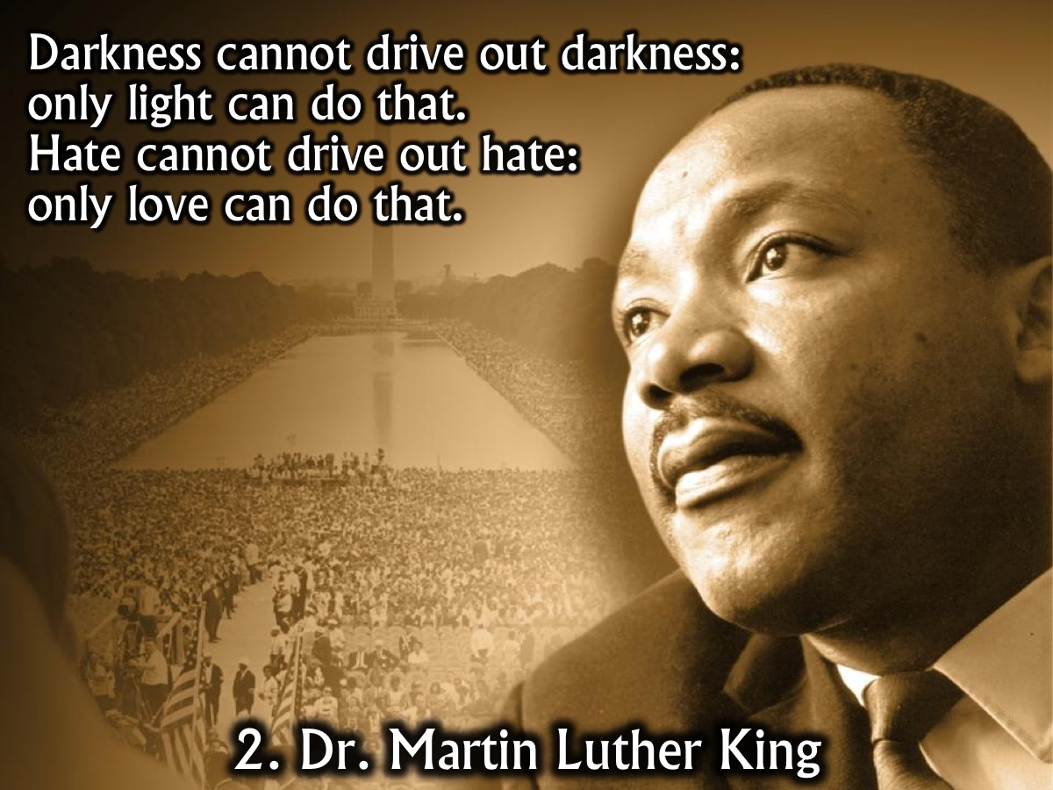
Notes:
Darkness cannot drive out darkness: only light can do that. Hate cannot drive out hate: only love can do that. (Dr. Martin Luther King)

Slide 11
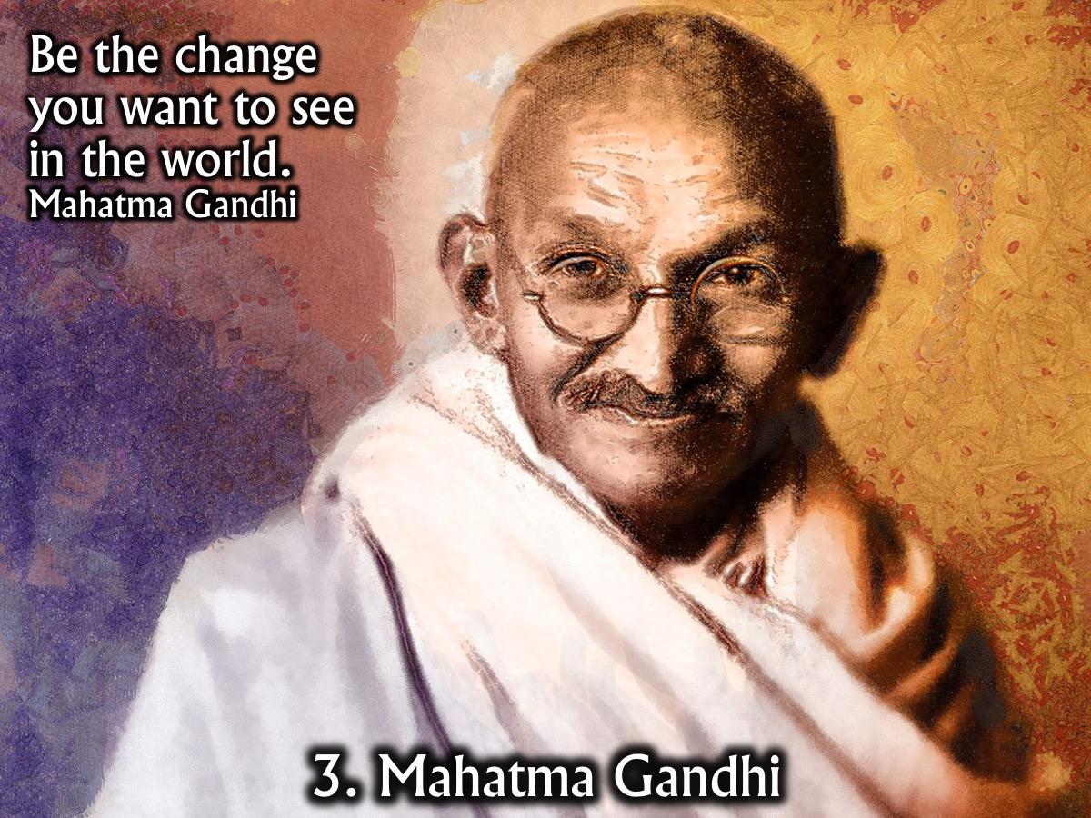
Notes:
Be the change you want to see in the world. (Mahatma Gandhi)

Slide 12
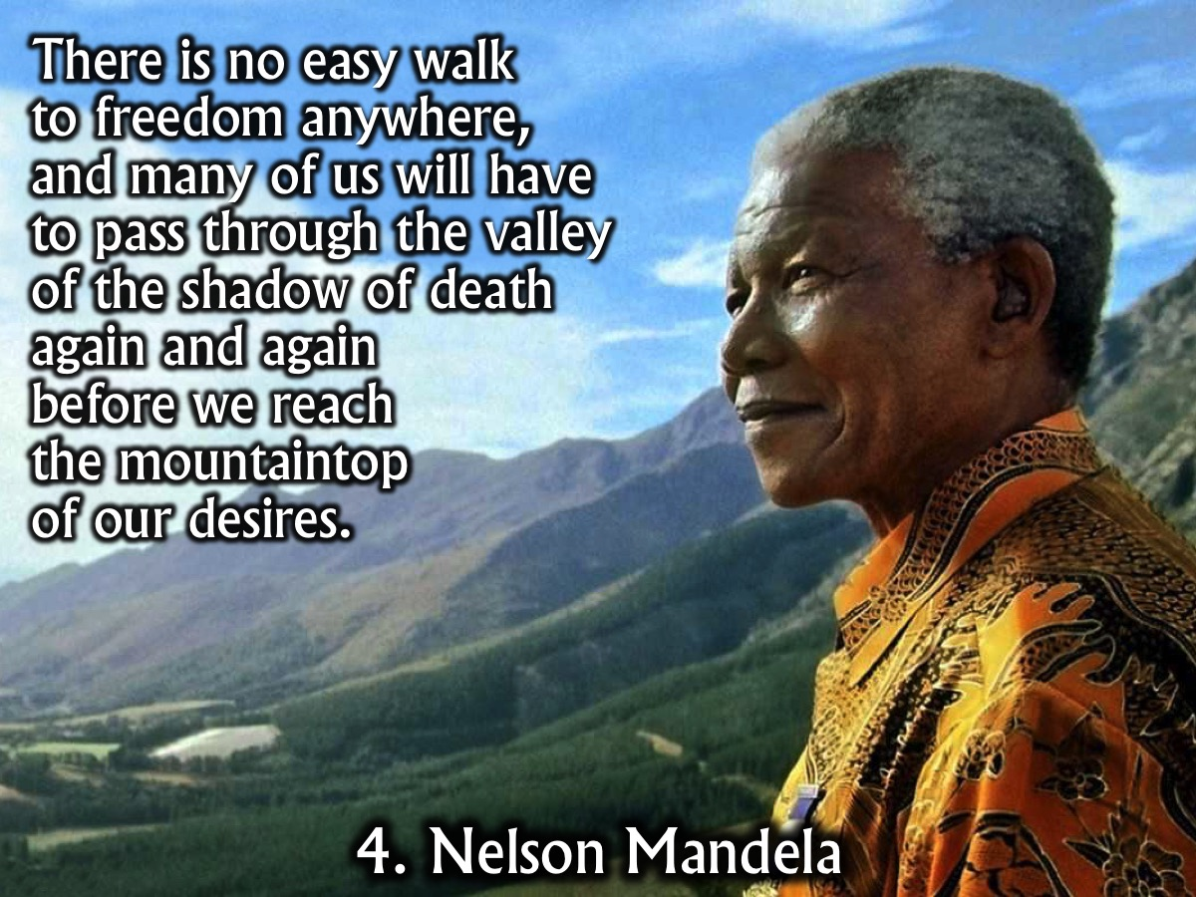
Notes:
There is no easy walk to freedom anywhere, and many of us will have to pass through the valley of the shadow of death again and again before we reach the mountaintop of our desires. (Nelson Mandela)

Slide 13
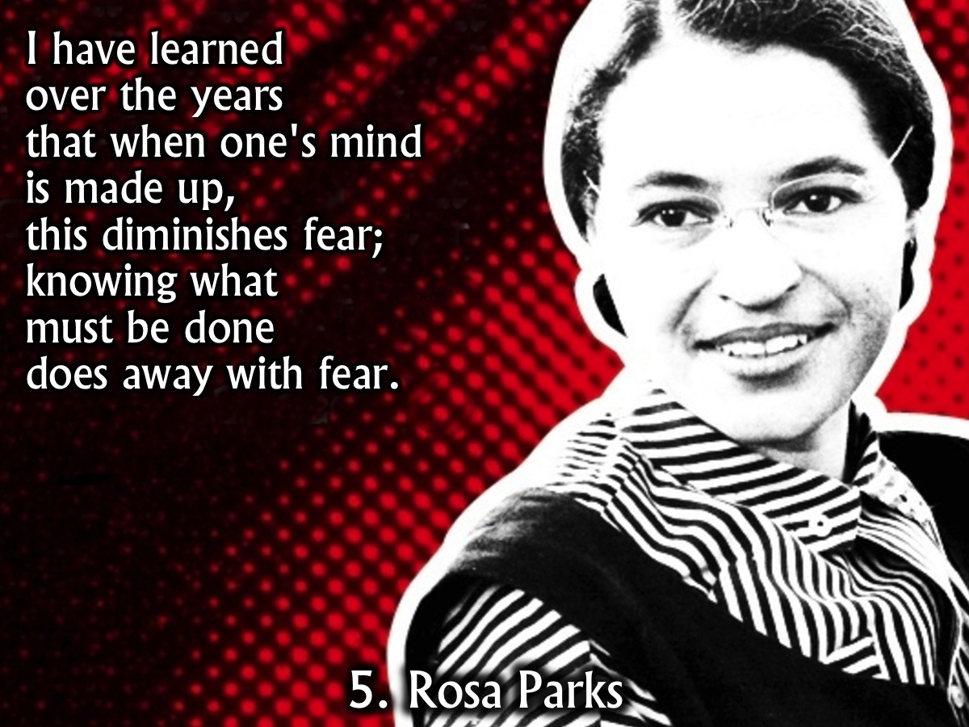
Notes:
I have learned over the years that when one's mind is made up, this diminishes fear; knowing what must be done does away with fear. (Rosa Parks)

Slide 14
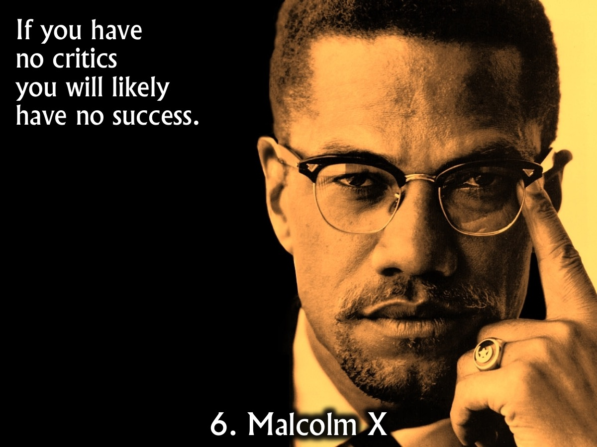
Notes:
If you have no critics you will likely have no success. (Malcolm X)

Slide 15
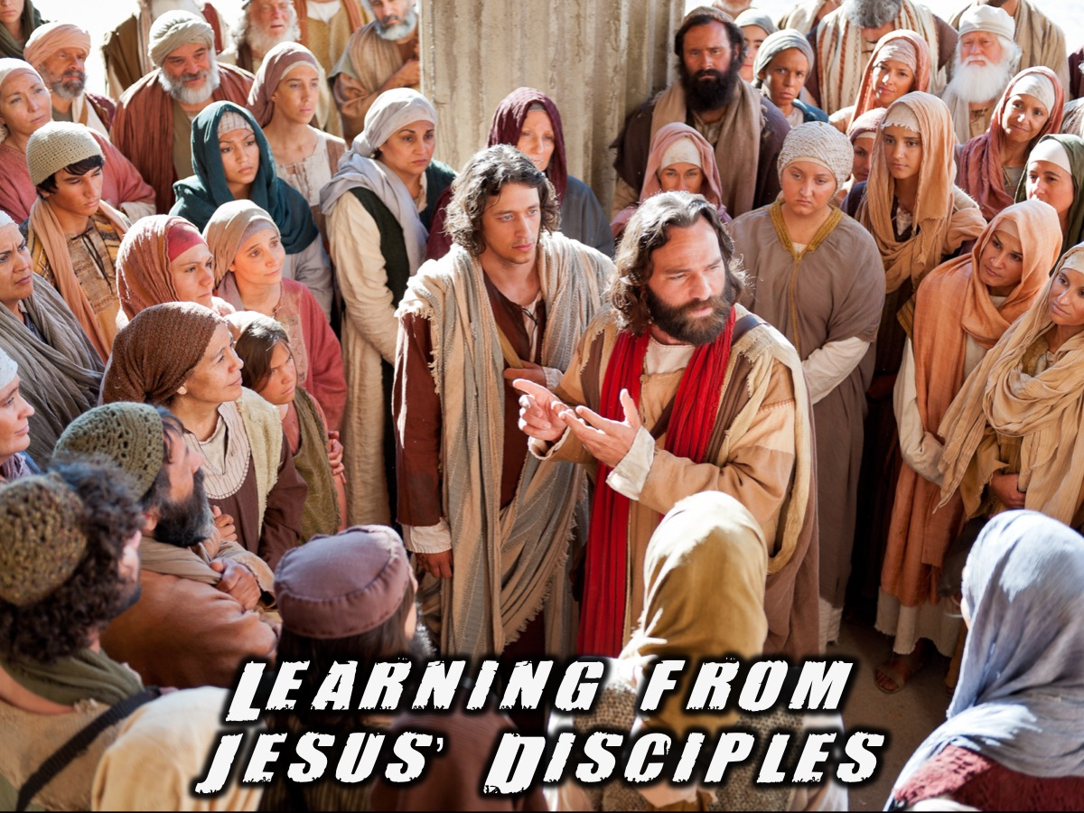
Notes:
Learning from Jesus’ Disciples – in your six different groups you will read through a passage from the book of Acts and find out what the disciples of Jesus teach you about being a revolutionary.

Slide 16
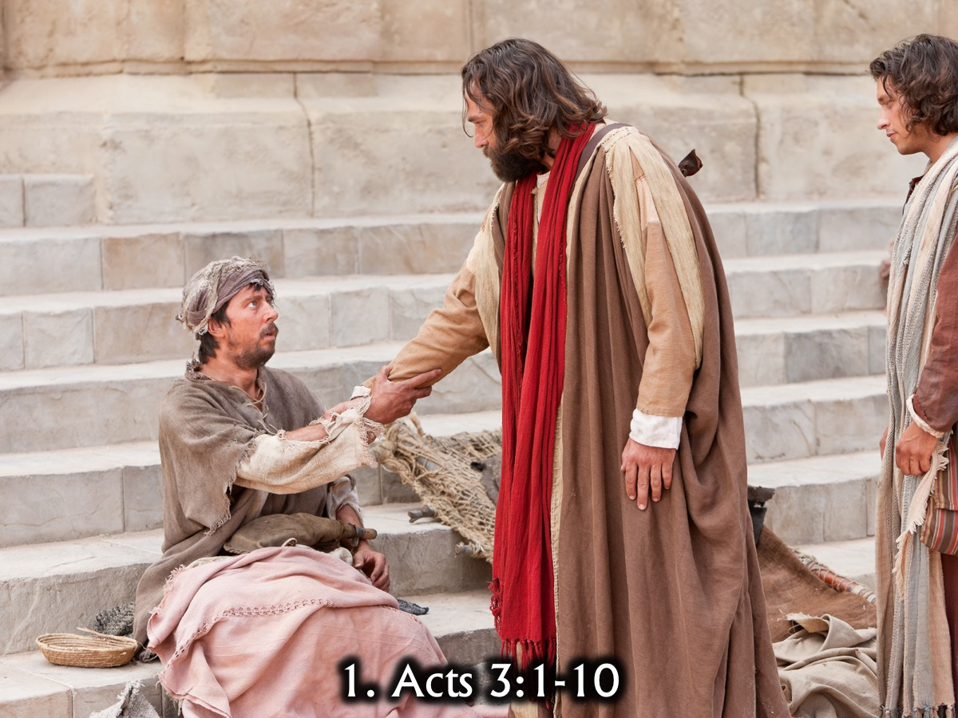
Notes:
1. Acts 3:1-10. Now Peter and John were going up to the temple at the hour of prayer, the ninth hour. And a man lame from birth was being carried, whom they laid daily at the gate of the temple that is called the Beautiful Gate to ask alms of those entering the temple. Seeing Peter and John about to go into the temple, he asked to receive alms. And Peter directed his gaze at him, as did John, and said, “Look at us.” And he fixed his attention on them, expecting to receive something from them. But Peter said, “I have no silver and gold, but what I do have I give to you. In the name of Jesus Christ of Nazareth, rise up and walk!” And he took him by the right hand and raised him up, and immediately his feet and ankles were made strong. And leaping up he stood and began to walk, and entered the temple with them, walking and leaping and praising God. And all the people saw him walking and praising God, and recognized him as the one who sat at the Beautiful Gate of the temple, asking for alms. And they were filled with wonder and amazement at what had happened to him.

Slide 17
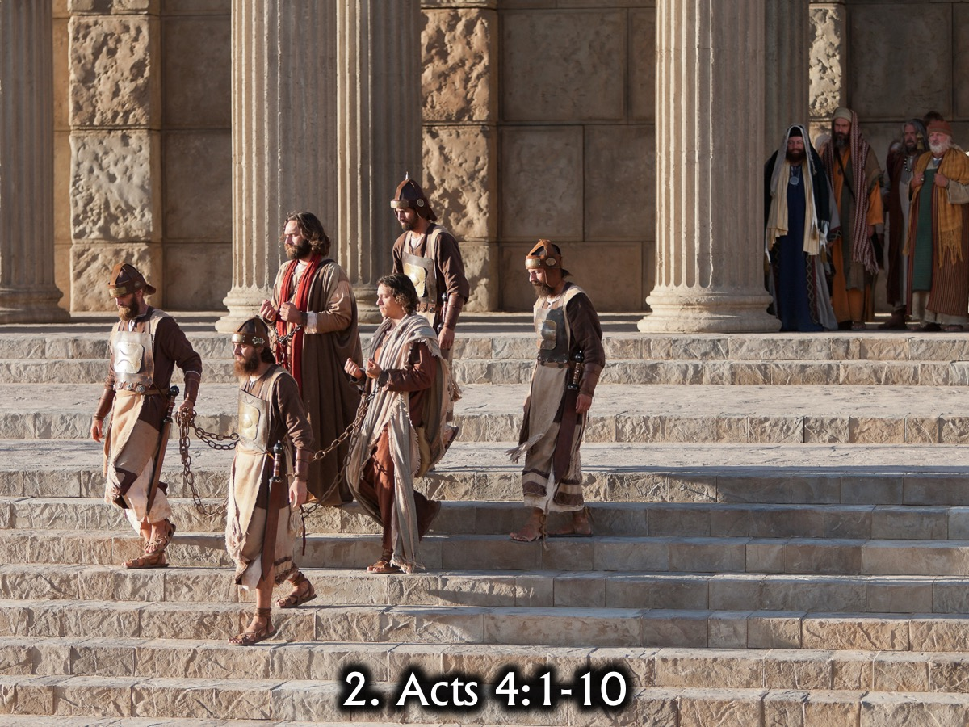
Notes:
2. Acts 4:1-10. And as they were speaking to the people, the priests and the captain of the temple and the Sadducees came upon them, greatly annoyed because they were teaching the people and proclaiming in Jesus the resurrection from the dead. And they arrested them and put them in custody until the next day, for it was already evening. But many of those who had heard the word believed, and the number of the men came to about five thousand. On the next day their rulers and elders and scribes gathered together in Jerusalem, with Annas the high priest and Caiaphas and John and Alexander, and all who were of the high-priestly family. And when they had set them in the midst, they inquired, “By what power or by what name did you do this?” Then Peter, filled with the Holy Spirit, said to them, “Rulers of the people and elders, if we are being examined today concerning a good deed done to a crippled man, by what means this man has been healed, let it be known to all of you and to all the people of Israel that by the name of Jesus Christ of Nazareth, whom you crucified, whom God raised from the dead—by him this man is standing before you well.

Slide 18
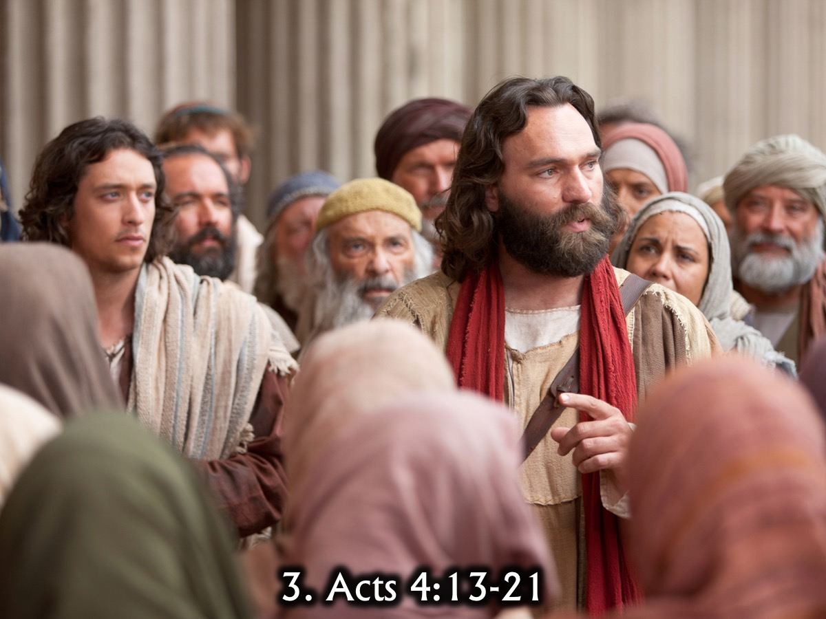
Notes:
3. Acts 4:13-21. Now when they saw the boldness of Peter and John, and perceived that they were uneducated, common men, they were astonished. And they recognized that they had been with Jesus. But seeing the man who was healed standing beside them, they had nothing to say in opposition. But when they had commanded them to leave the council, they conferred with one another, saying, “What shall we do with these men? For that a notable sign has been performed through them is evident to all the inhabitants of Jerusalem, and we cannot deny it. But in order that it may spread no further among the people, let us warn them to speak no more to anyone in this name.” So they called them and charged them not to speak or teach at all in the name of Jesus. But Peter and John answered them, “Whether it is right in the sight of God to listen to you rather than to God, you must judge, for we cannot but speak of what we have seen and heard.” And when they had further threatened them, they let them go, finding no way to punish them, because of the people, for all were praising God for what had happened.

Slide 19
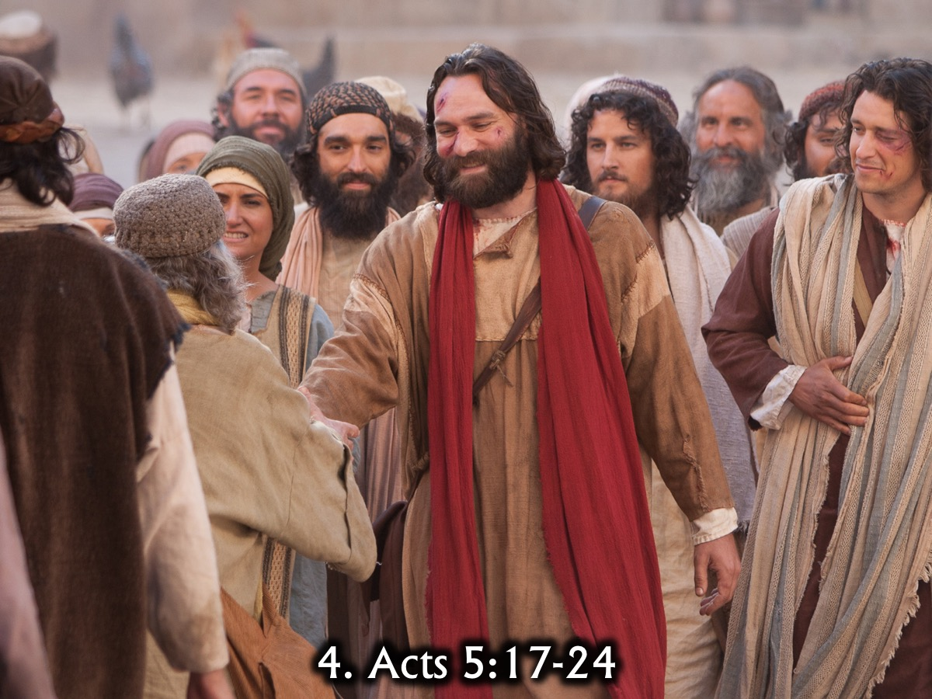
Notes:
4. Acts 5:17-24. But the high priest rose up, and all who were with him, and filled with jealousy they arrested the apostles and put them in the public prison. But during the night an angel of the Lord opened the prison doors and brought them out, and said, “Go and stand in the temple and speak to the people all the words of this Life.” And when they heard this, they entered the temple at daybreak and began to teach. Now when the high priest came, and those who were with him, they called together the council, all the senate of the people of Israel, and sent to the prison to have them brought. But when the officers came, they did not find them in the prison, so they returned and reported, “We found the prison securely locked and the guards standing at the doors, but when we opened them we found no one inside.” Now when the captain of the temple and the chief priests heard these words, they were greatly perplexed about them, wondering what this would come to.

Slide 20
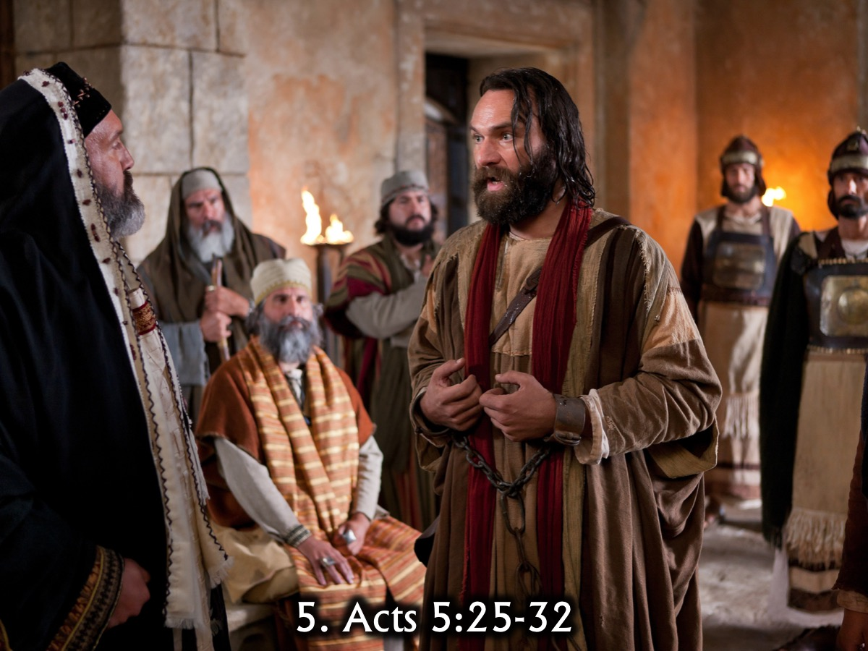
Notes:
5. Acts 5:25-32. And someone came and told them, “Look! The men whom you put in prison are standing in the temple and teaching the people.” Then the captain with the officers went and brought them, but not by force, for they were afraid of being stoned by the people. And when they had brought them, they set them before the council. And the high priest questioned them, saying, “We strictly charged you not to teach in this name, yet here you have filled Jerusalem with your teaching, and you intend to bring this man's blood upon us.” But Peter and the apostles answered, “We must obey God rather than men. The God of our fathers raised Jesus, whom you killed by hanging him on a tree. God exalted him at his right hand as Leader and Savior, to give repentance to Israel and forgiveness of sins. And we are witnesses to these things, and so is the Holy Spirit, whom God has given to those who obey him.”

Slide 21
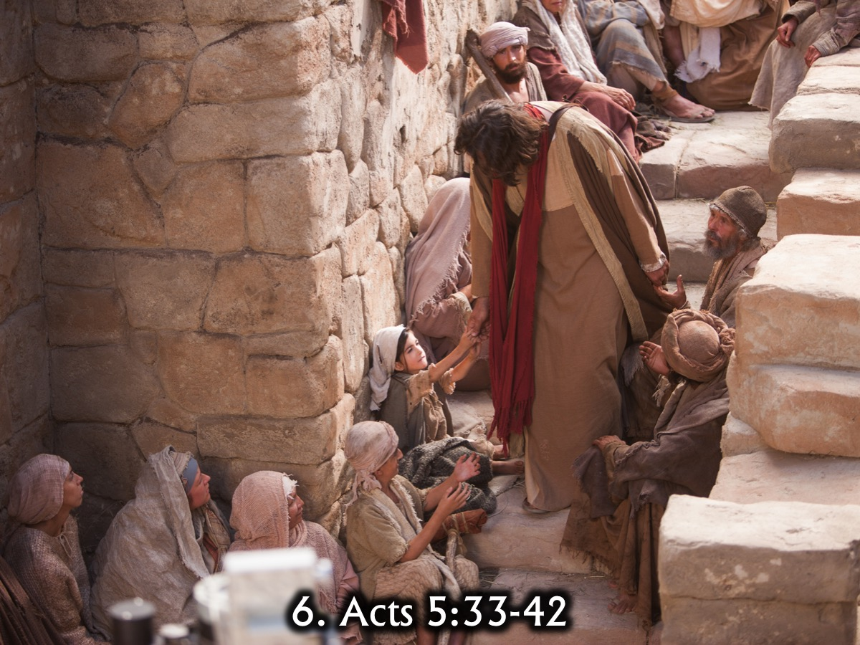
Notes:
6. Acts 5:33-42. When they heard this, they were enraged and wanted to kill them. But a Pharisee in the council named Gamaliel, a teacher of the law held in honor by all the people, stood up and gave orders to put the men outside for a little while. And he said to them, “Men of Israel, take care what you are about to do with these men. For before these days Theudas rose up, claiming to be somebody, and a number of men, about four hundred, joined him. He was killed, and all who followed him were dispersed and came to nothing. After him Judas the Galilean rose up in the days of the census and drew away some of the people after him. He too perished, and all who followed him were scattered. So in the present case I tell you, keep away from these men and let them alone, for if this plan or this undertaking is of man, it will fail; but if it is of God, you will not be able to overthrow them. You might even be found opposing God!” So they took his advice, and when they had called in the apostles, they beat them and charged them not to speak in the name of Jesus, and let them go. Then they left the presence of the council, rejoicing that they were counted worthy to suffer dishonor for the name. And every day, in the temple and from house to house, they did not cease teaching and preaching that the Christ is Jesus.

Slide 22
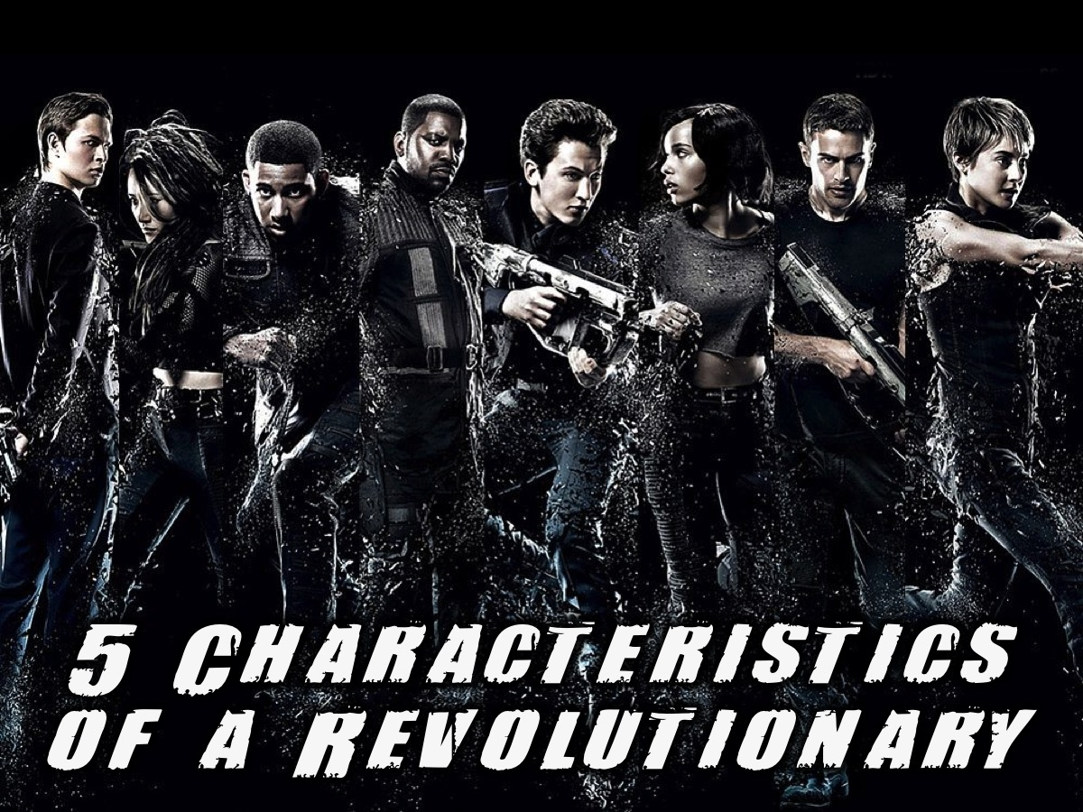
Notes:
I want to share with you five characteristics of a revolutionary – all five are critical if you have any hope of becoming a revolutionary!

Slide 23
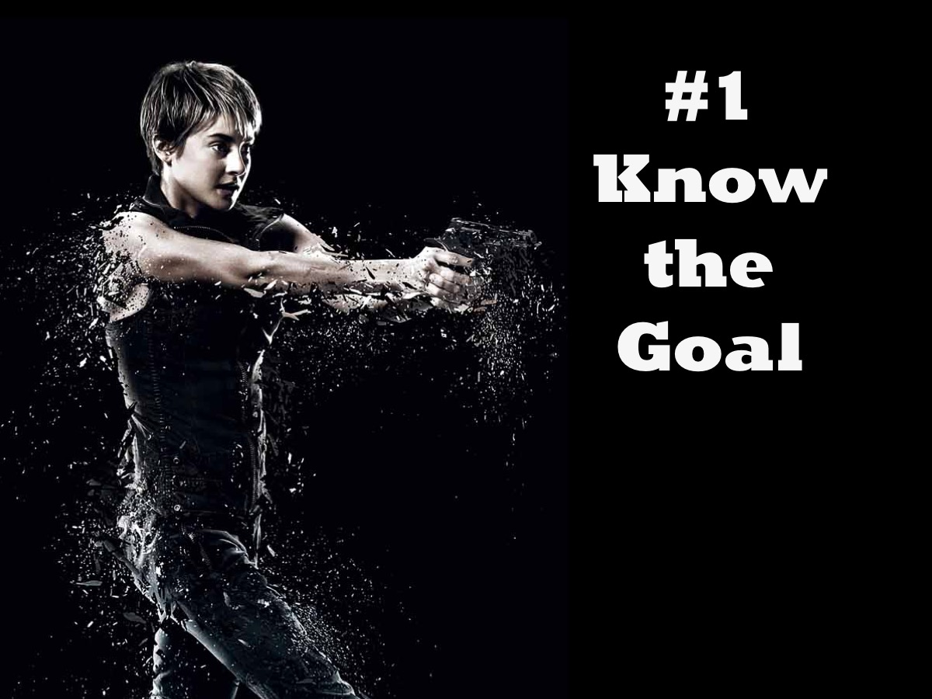
Notes:
1. Know the Goal.

Slide 24
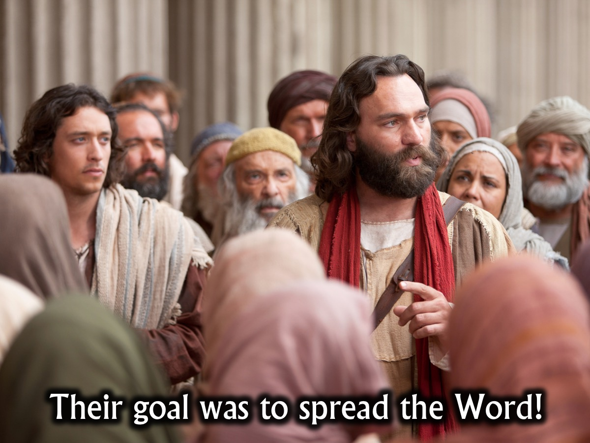
Notes:
The Apostle's goal was clear and simple "spread the word" they understood it well.

Slide 25
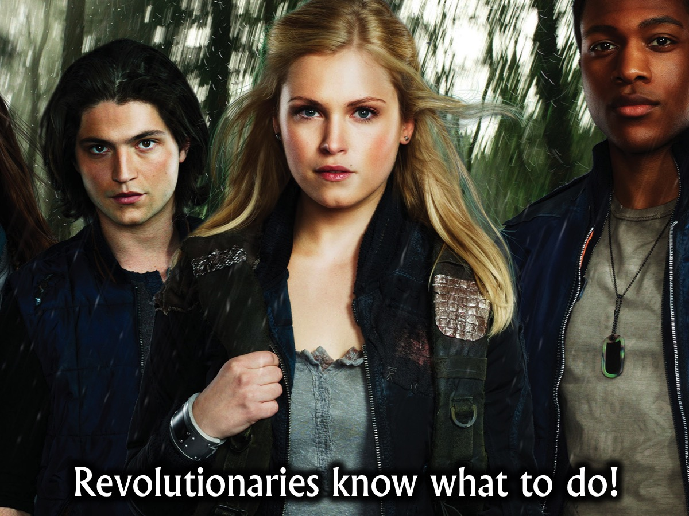
Notes:
Revolutionaries know what to do!

Slide 26
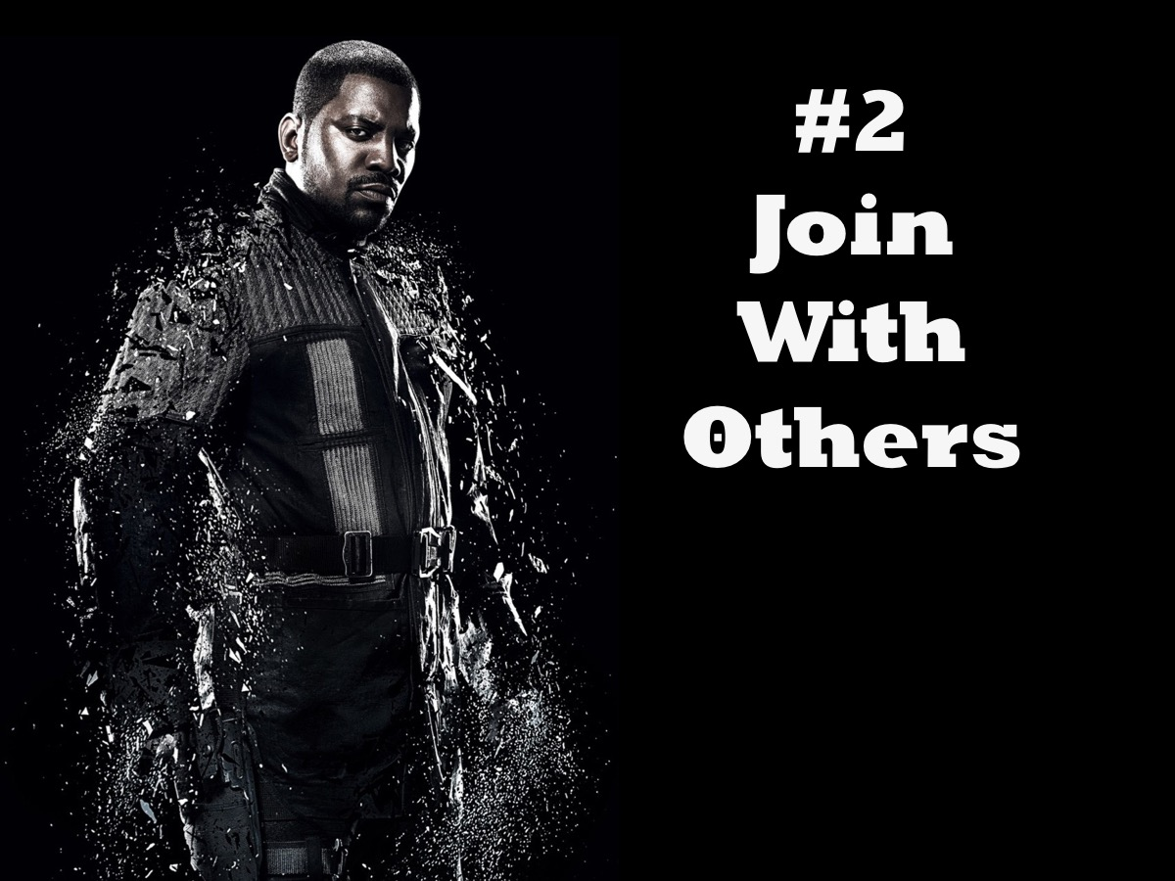
Notes:
2. Join with Others. You need support. Get people who have the same mind as you to support you. The apostles had each other, and other believers. Most of all they had God.

Slide 27
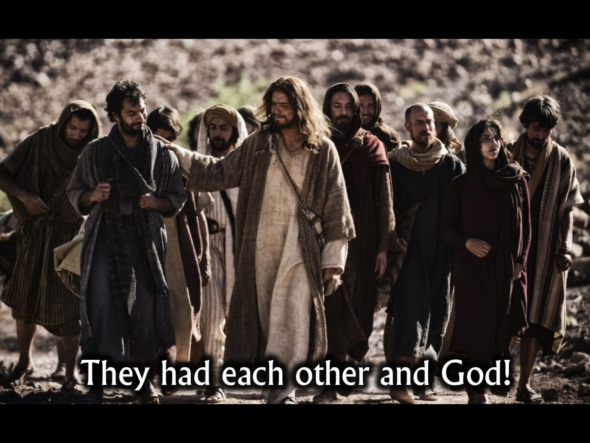
Notes:
The apostles had each other, and other believers. Most of all they had God.

Slide 28

Notes:
Video: Insurgent TV Spot. Get it on YouTube at: https://www.youtube.com/watch?v=87PlydtcjXA

Slide 29
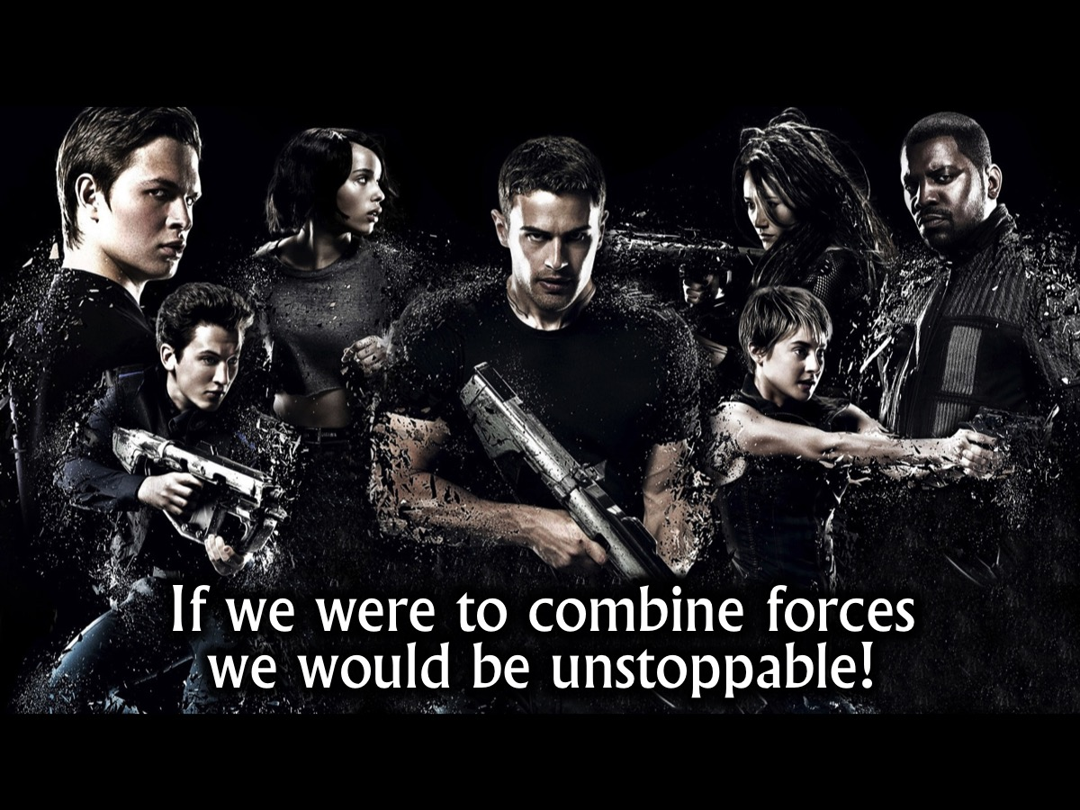
Notes:
Quote from the trailer: “If we were to combine forces we would be unstoppable!”

Slide 30
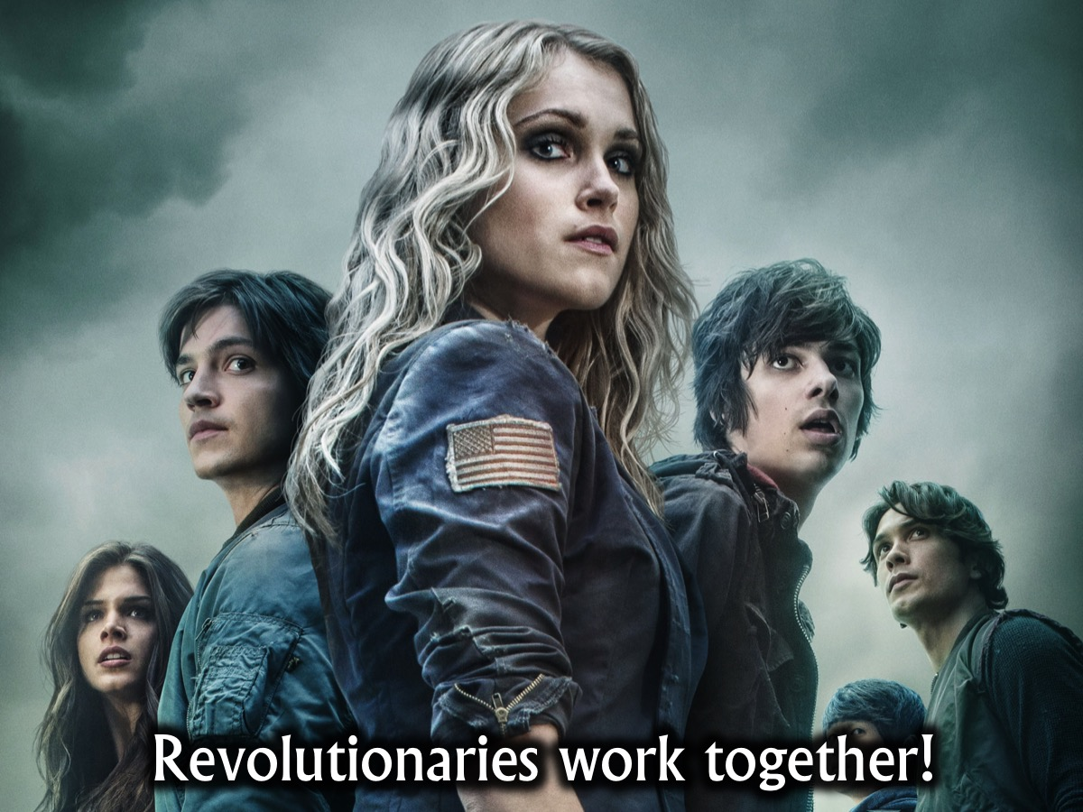
Notes:
Revolutionaries work together!

Slide 31

Notes:
3. Pay the Price.

Slide 32
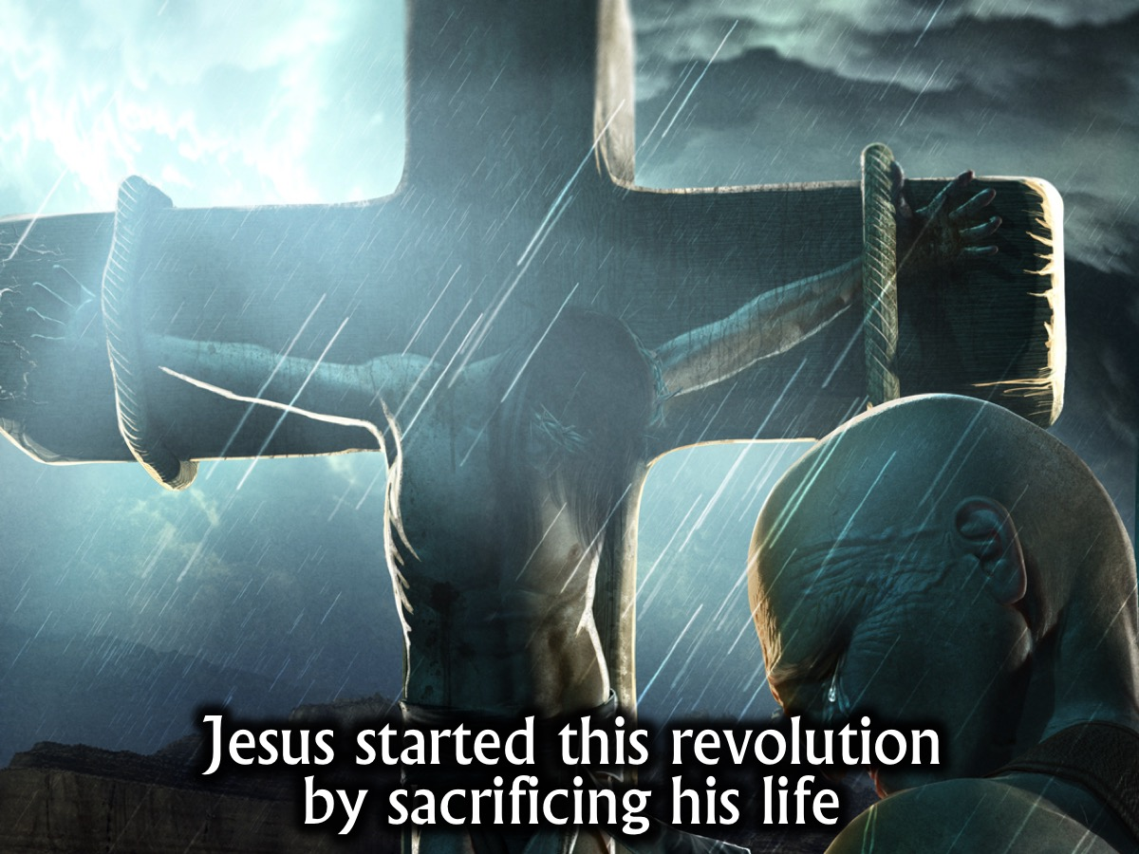
Notes:
Jesus Christ who started this revolution sacrificed his life. The apostles got arrested more than once but it did not stop them spreading the Word.

Slide 33
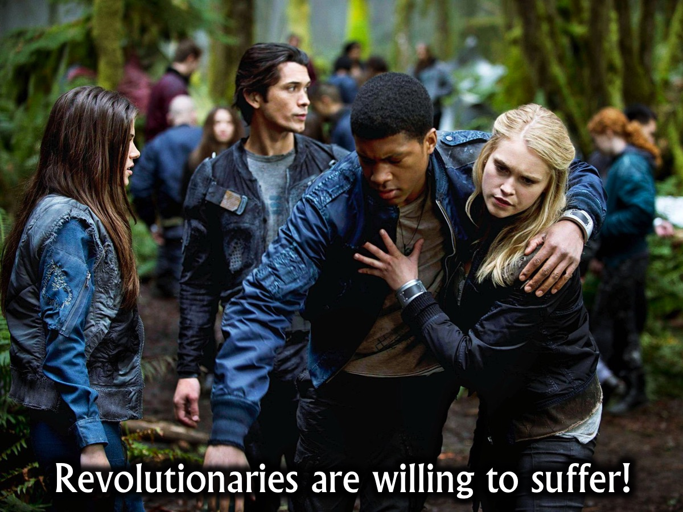
Notes:
Revolutionaries are willing to suffer!

Slide 34
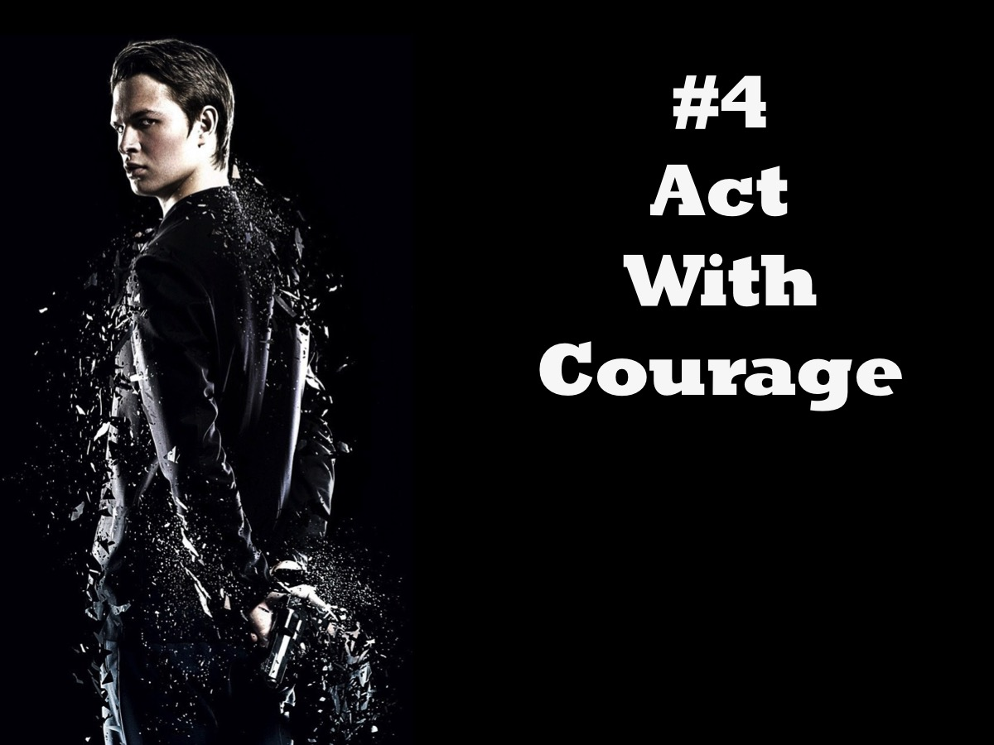
Notes:
4. Act with Courage.

Slide 35
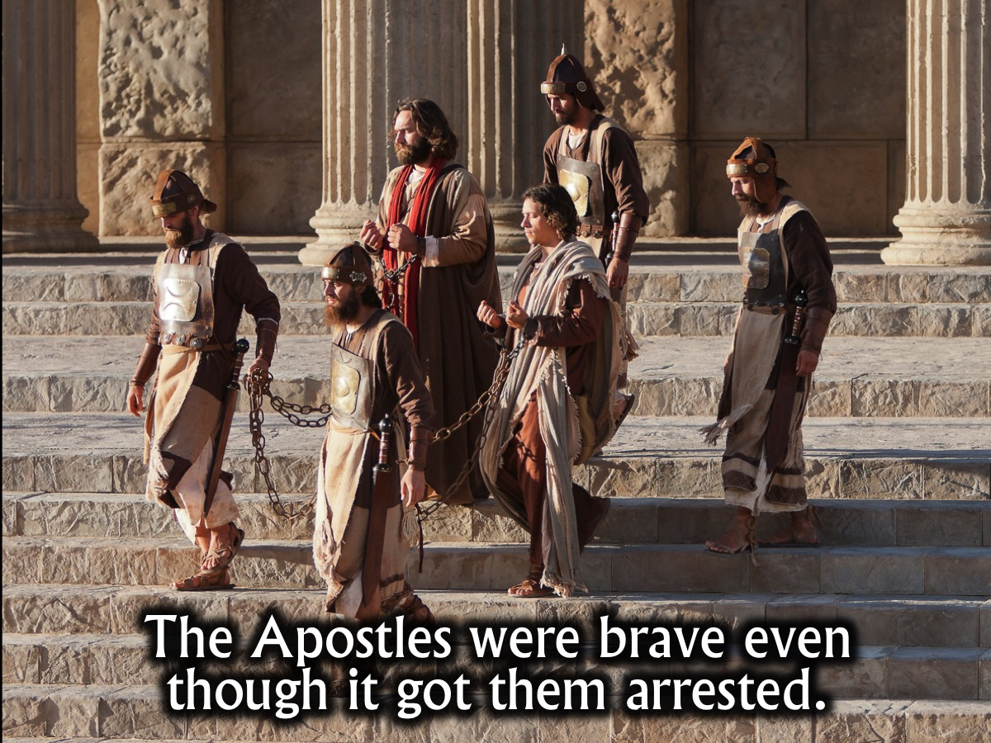
Notes:
The Apostles never gave up. Immediately after being released from prison, the go and do the very thing that got them arrested.

Slide 36
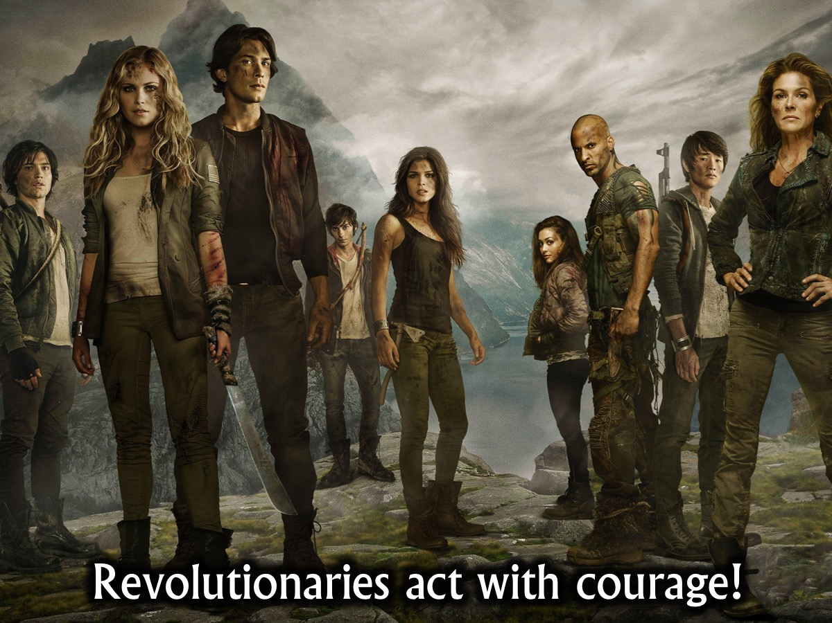
Notes:
Revolutionaries act with courage!

Slide 37
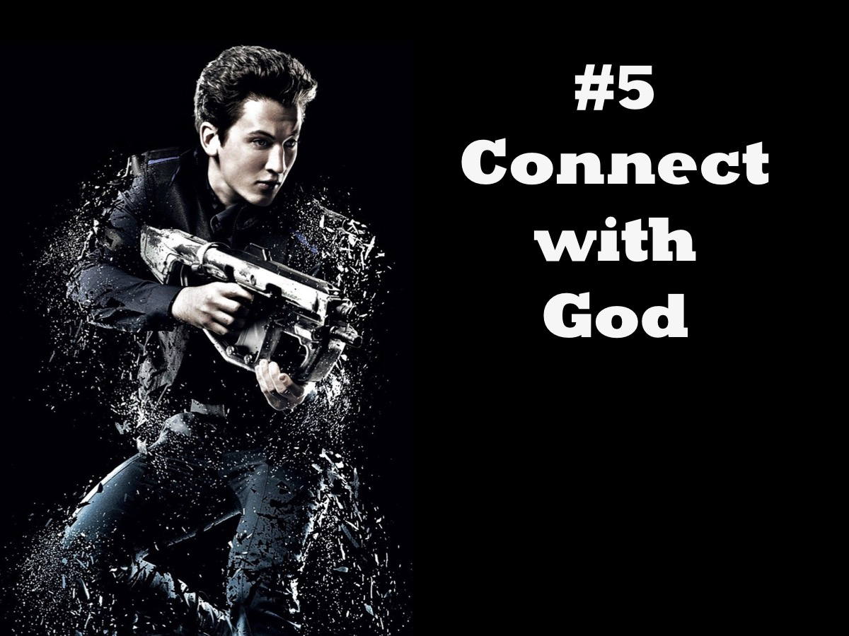
Notes:
5. Connect with God.

Slide 38
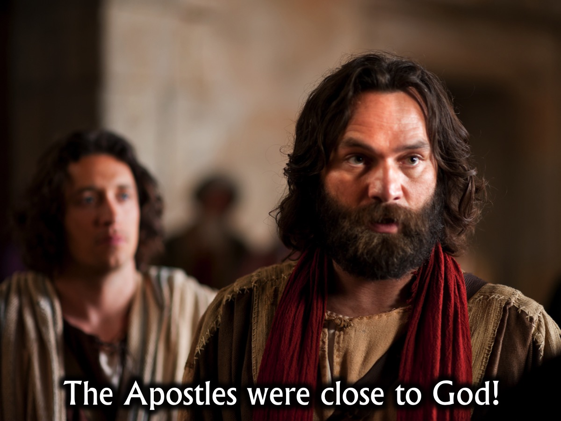
Notes:
The Apostles stayed close to God – they had an intimate relationship with Him!

Slide 39
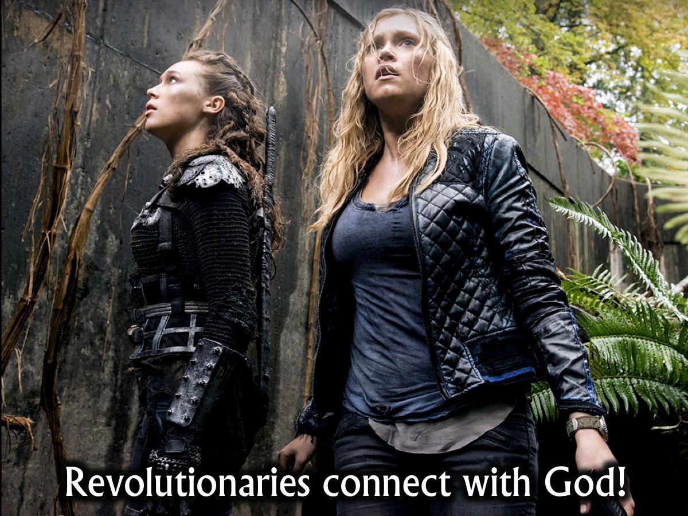
Notes:
Revolutionaries connect with God. Have a relationship with God. Then you will have the wisdom you need, to succeed in your revolution.

Slide 40
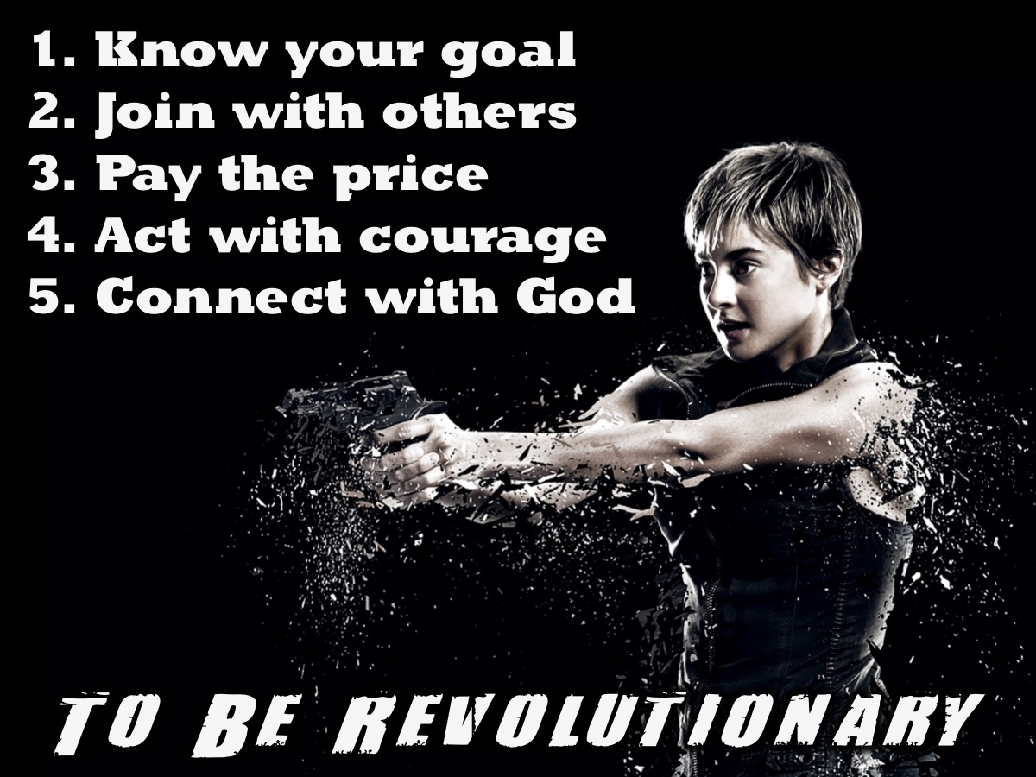
Notes:
Summary: So, if you are going to be revolutionary you must: (1) Know your goal; (2) Join with others; (3) Pay the price; (4) Act with courage and (5) Connect with God.

Slide 41
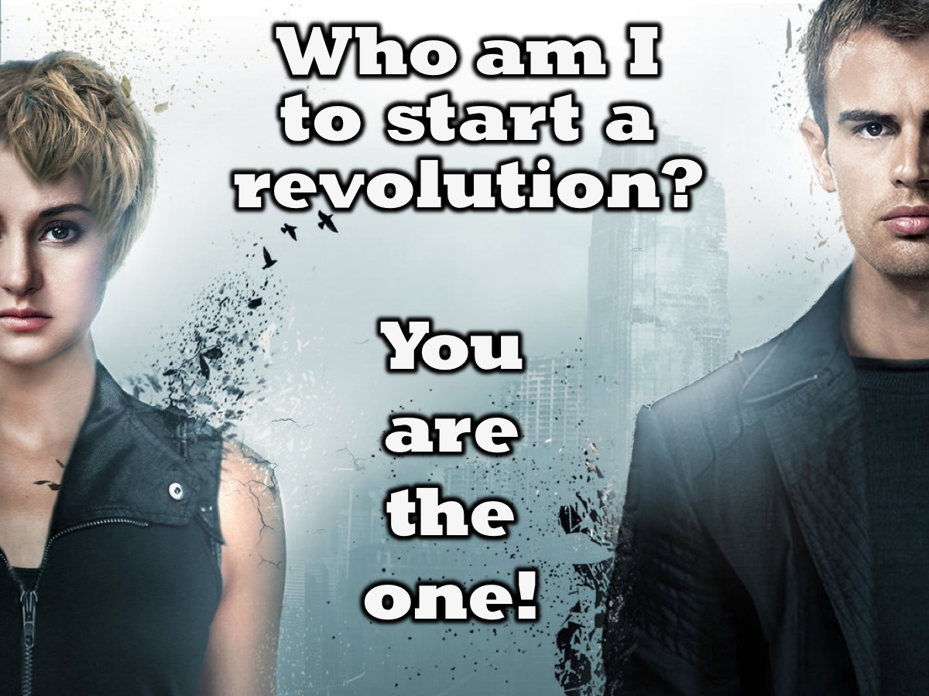
Notes:
You may ask yourself this question: "Who am I to even think of starting a revolution?” Well most of the men we read about earlier from the book of Acts were uneducated fisher men. Yet they spoke well and had wisdom, which only God can provide. So if you feel inadequate, then you are the one to start a Revolution.

Slide 42
Notes:
Video: You’re Revolutionary. Get it on YouTube at: https://www.youtube.com/watch?v=MSZ_j6VBcTo

Slide 43
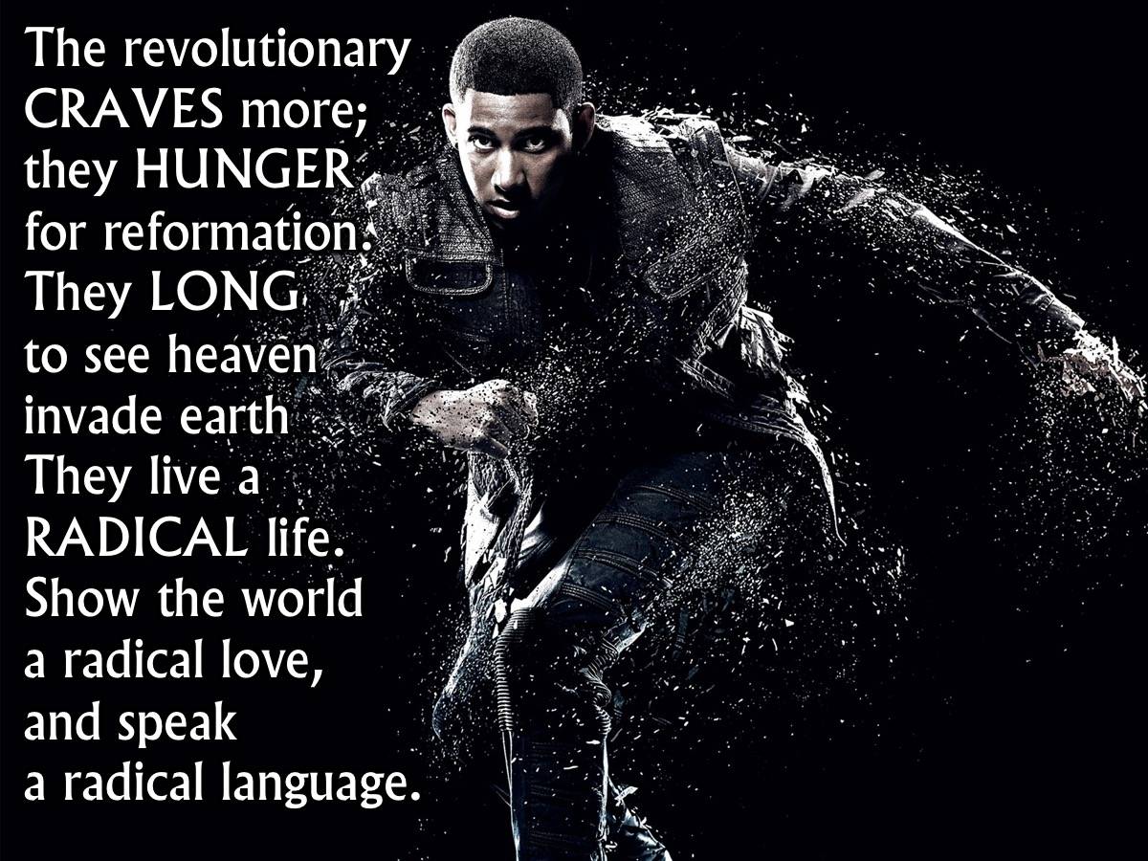
Notes:
Here is an extract from that video: “The revolutionary CRAVES more; they HUNGER for reformation. True revolutionaries LONG to see heaven invade earth. … CHOOSE to fall out of line. Live a RADICAL life. Show the world a radical love, and speak a radical language…

Slide 44
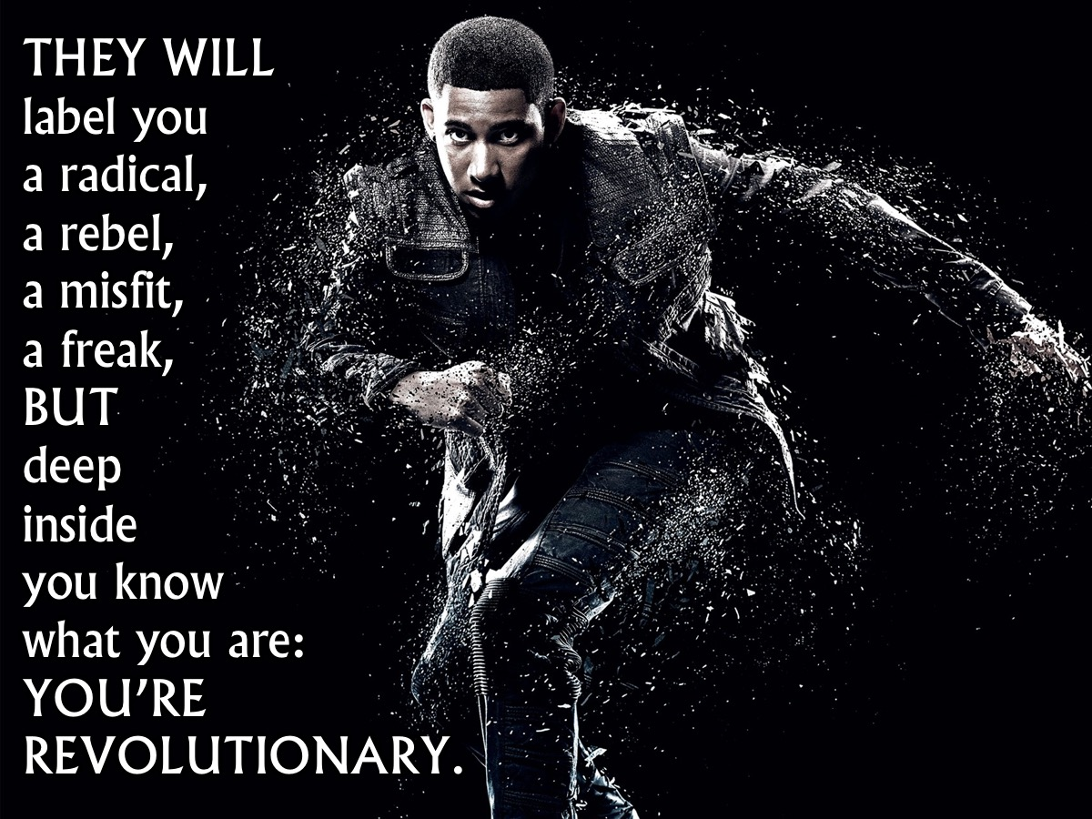
Notes:
THEY WILL label you a radical, a rebel, a misfit, a freak — BUT deep inside you know what you are — YOU’RE REVOLUTIONARY.

Slide 45

Notes:
Prayer

Slide 46
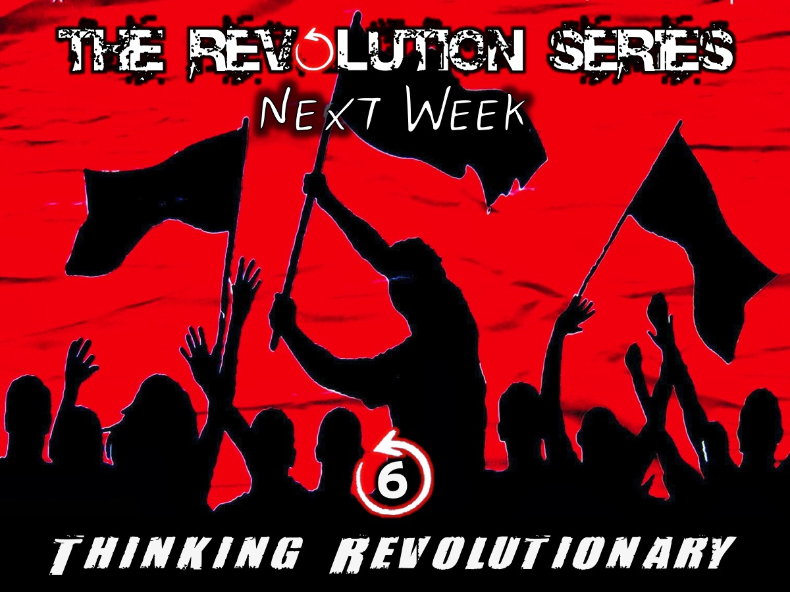
Notes:
Next week we are going to learn how to thinking revolutionary!

