Slide 1

Notes:
Today is week 6 in our Revolution series!

Slide 2
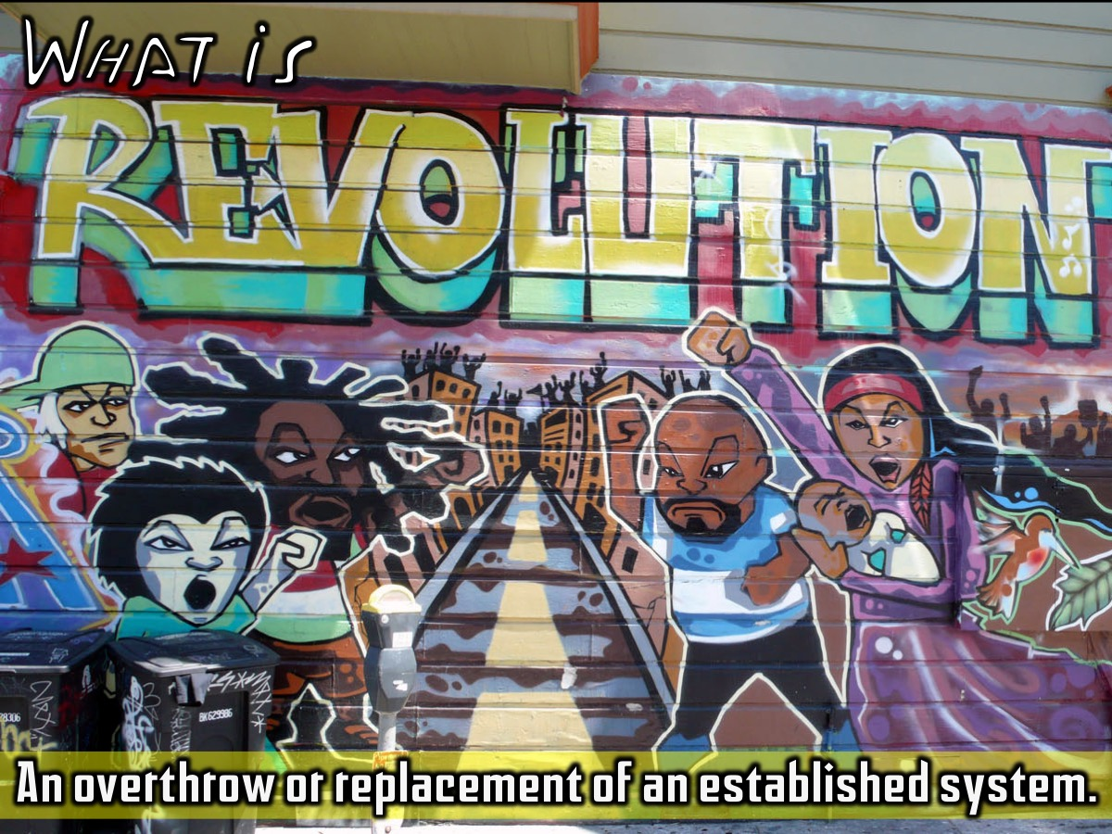
Notes:
We have learnt that a revolution is an overthrow or replacement of an established system.

Slide 3
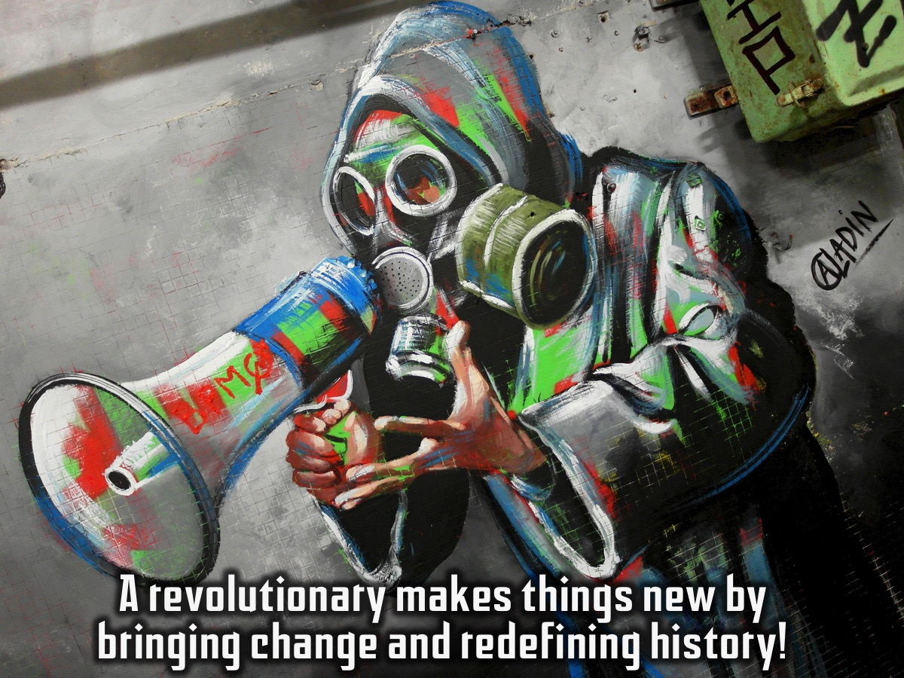
Notes:
And that a revolutionary makes things new by bringing change and redefining history!

Slide 4

Notes:
Last week was all about becoming revolutionary…

Slide 5
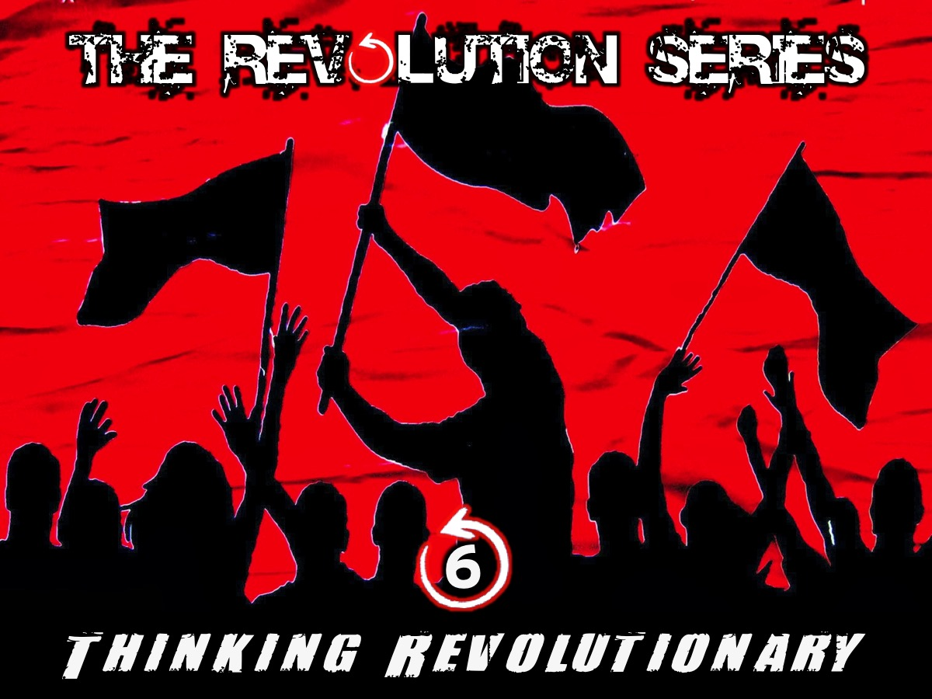
Notes:
And this week is all about thinking revolutionary…

Slide 6
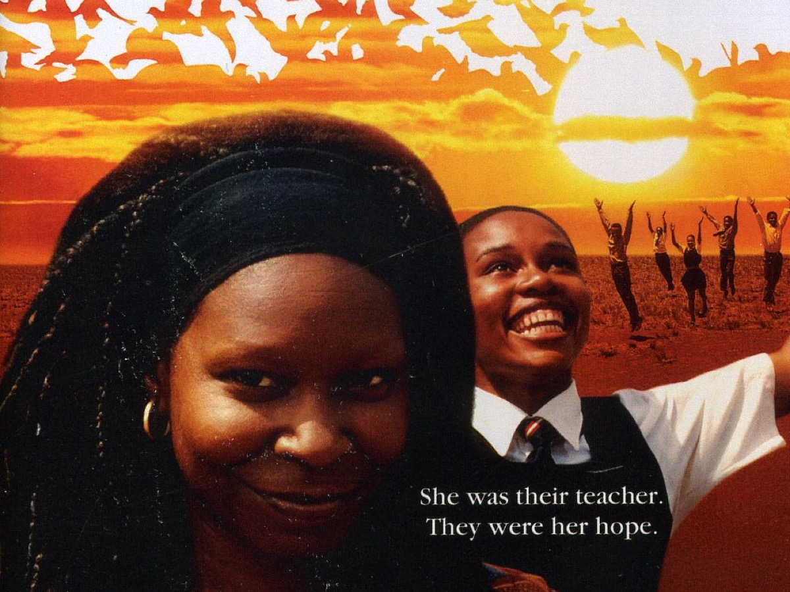
Notes:
Have any of you ever seen this movie? It is Sarafina.

Slide 7
Notes:
Video: Sarafina. Get it on YouTube at: https://www.youtube.com/watch?v=tpYaGfnnnYI

Slide 8
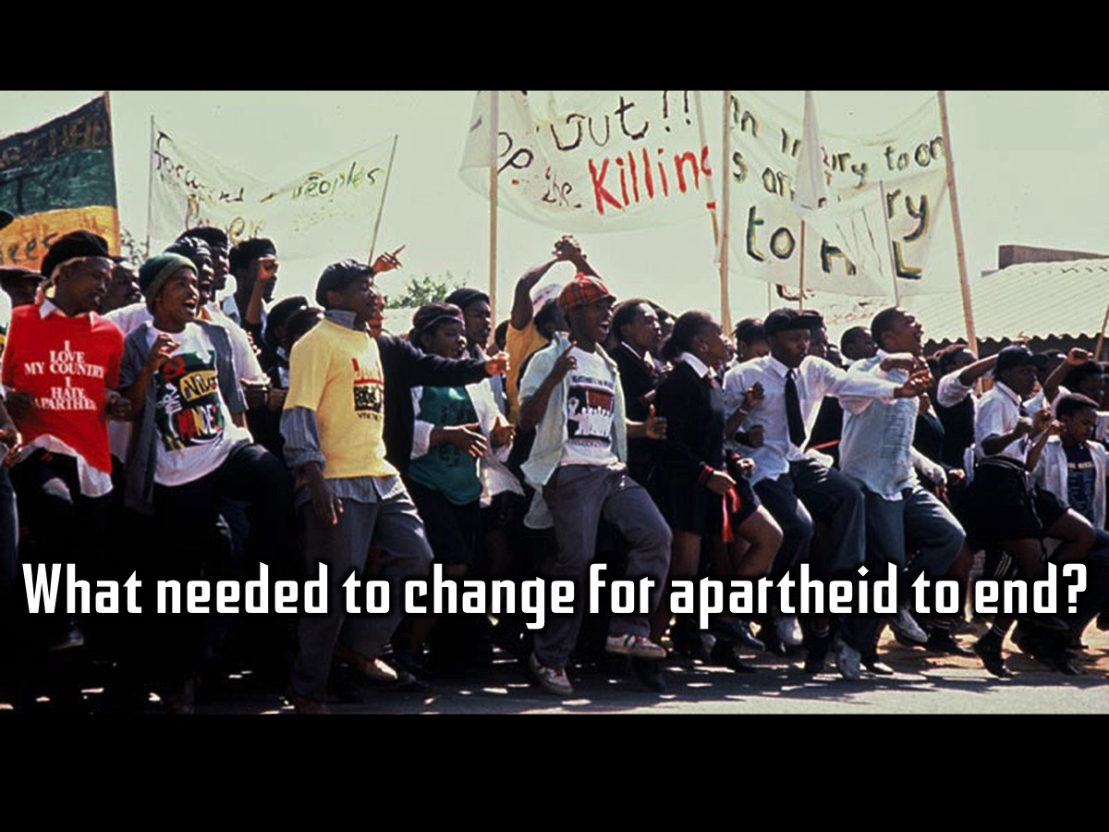
Notes:
Here is a question for you to think about: What needed to change for apartheid to end?

Slide 9
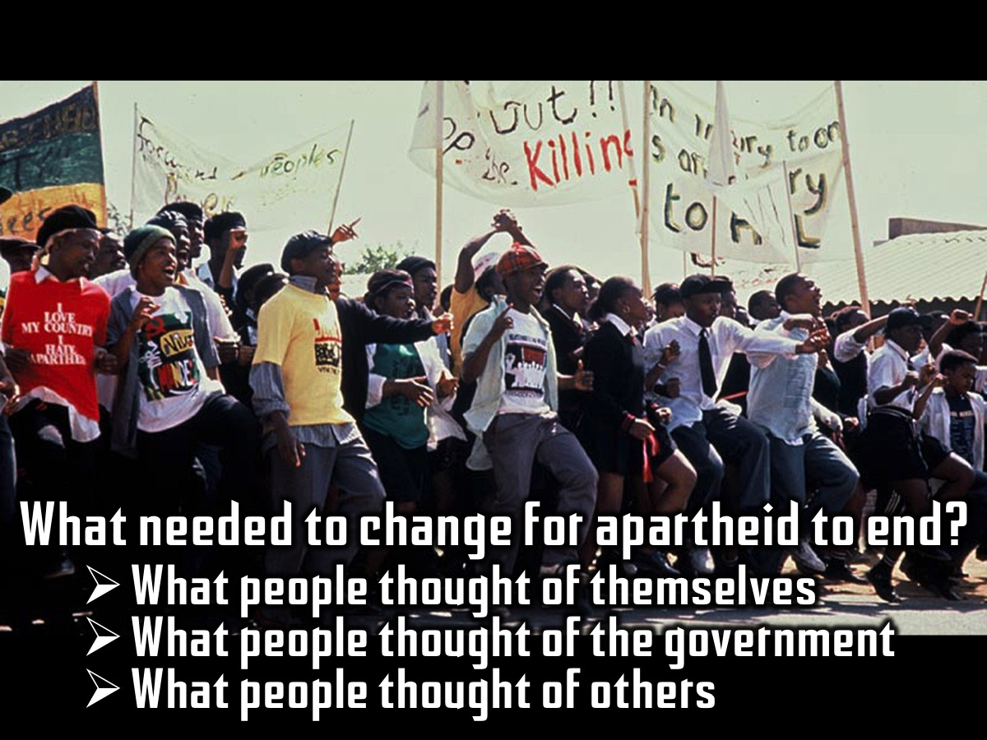
Notes:
For me it was: (1) What people thought of themselves (their worth, their role as citizens; whether they thought they deserved to vote and determine their own future), (2) What people thought of the government (whether it could be defeated and that even if they could break their body they could not break their beliefs or their spirit); and (3) What people thought of others (alone they were not strong but together they could achieve anything).

Slide 10

Notes:
Who Were Great Historical Revolutionary Thinkers?

Slide 11
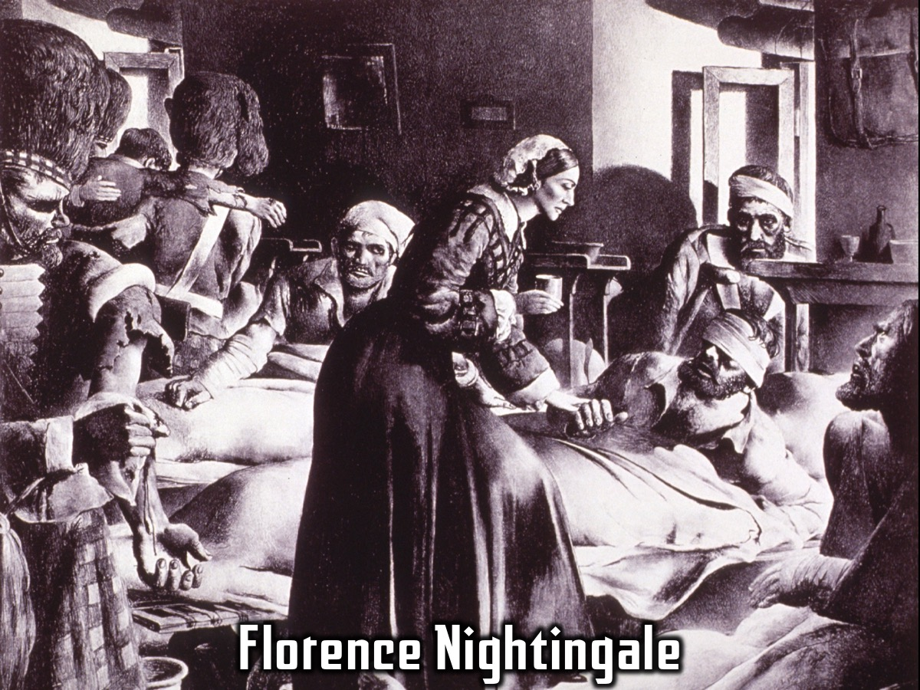
Notes:
1. Florence Nightingale. She is considered the pioneer of modern nursing. She and her team of nurses reduced the death rate at a British base hospital by two-thirds during the Crimean War in the 1850s.

Slide 12
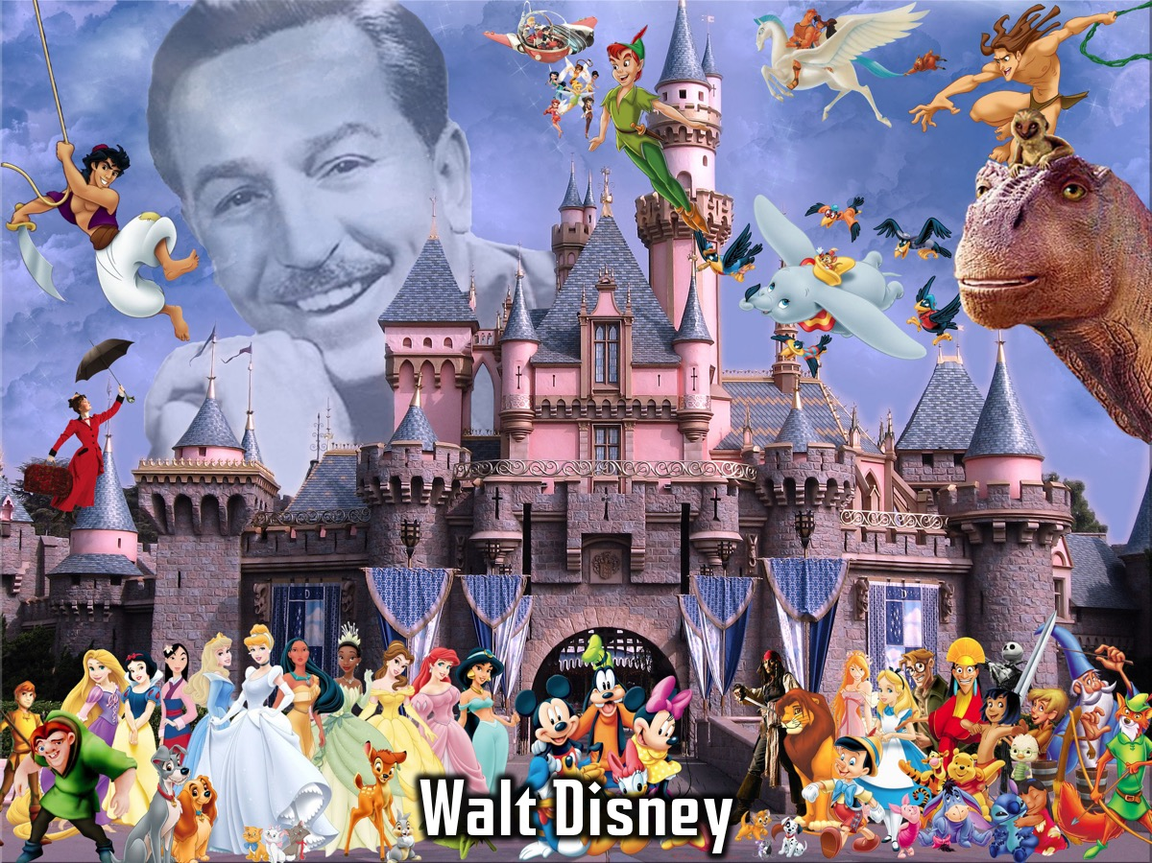
Notes:
2. Walt Disney - Walter Elias "Walt" Disney was a prominent figure within the American animation industry and throughout the world, he is regarded as a cultural icon, known for his influence and contributions to entertainment during the 20th century. As an animator and entrepreneur, Disney was particularly noted as a filmmaker and a popular showman, as well as an innovator in animation and theme park design. He and his staff created numerous fictional characters including Mickey Mouse, Donald Duck, and Goofy.

Slide 13
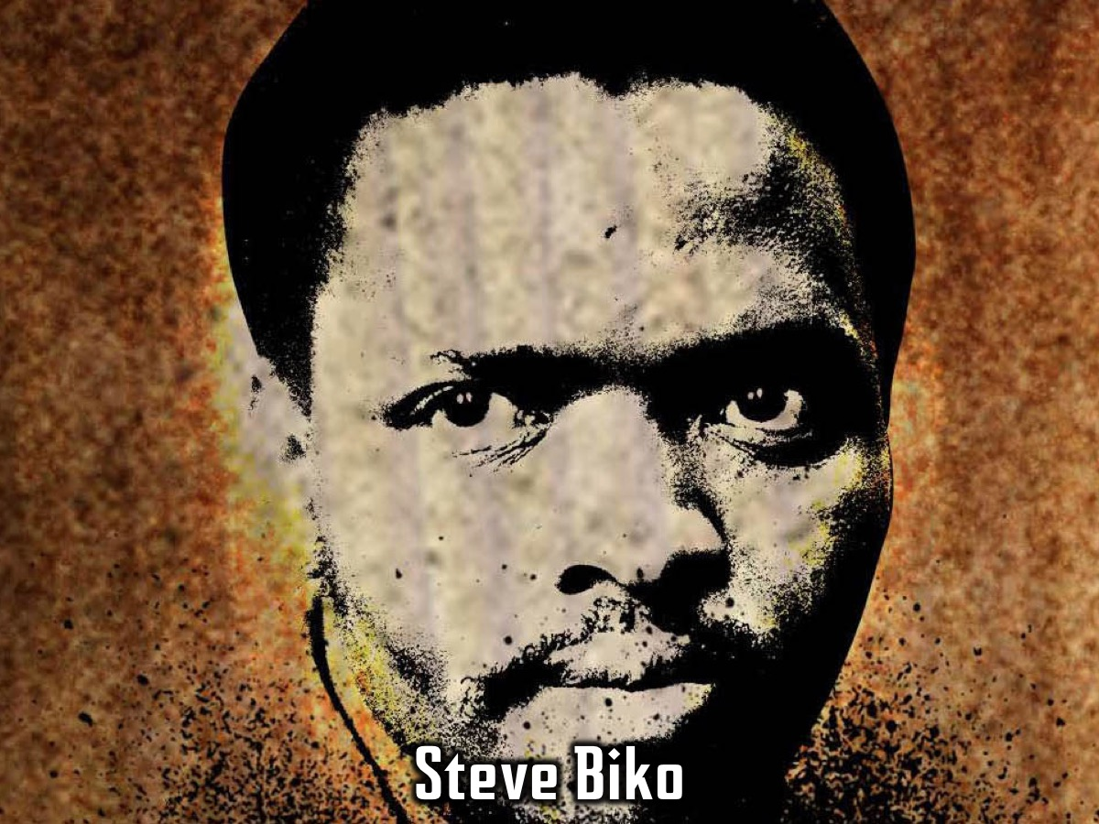
Notes:
3. Steve Biko- Stephen Bantu Biko (18 December 1946 – 12 September 1977) was an anti-apartheid activist in South Africa in the 1960s and 1970s. A student leader, he later founded the Black Consciousness Movement which would empower and mobilize much of the urban black population. While living, his writings and activism attempted to empower black people, and he was famous for his slogan "black is beautiful", which he described as meaning: "man, you are okay as you are, begin to look upon yourself as a human being”.

Slide 14

Notes:
4. Thomas J. Watson - Thomas J Watson was the first CEO of IBM he changed the name from Computing Tabulating Recording Company (CTR) to International Business Machines back in 1924 when the company was still making type writing machines and punch cards.

Slide 15

Notes:
Who Were Great Biblical Revolutionary Thinkers?

Slide 16
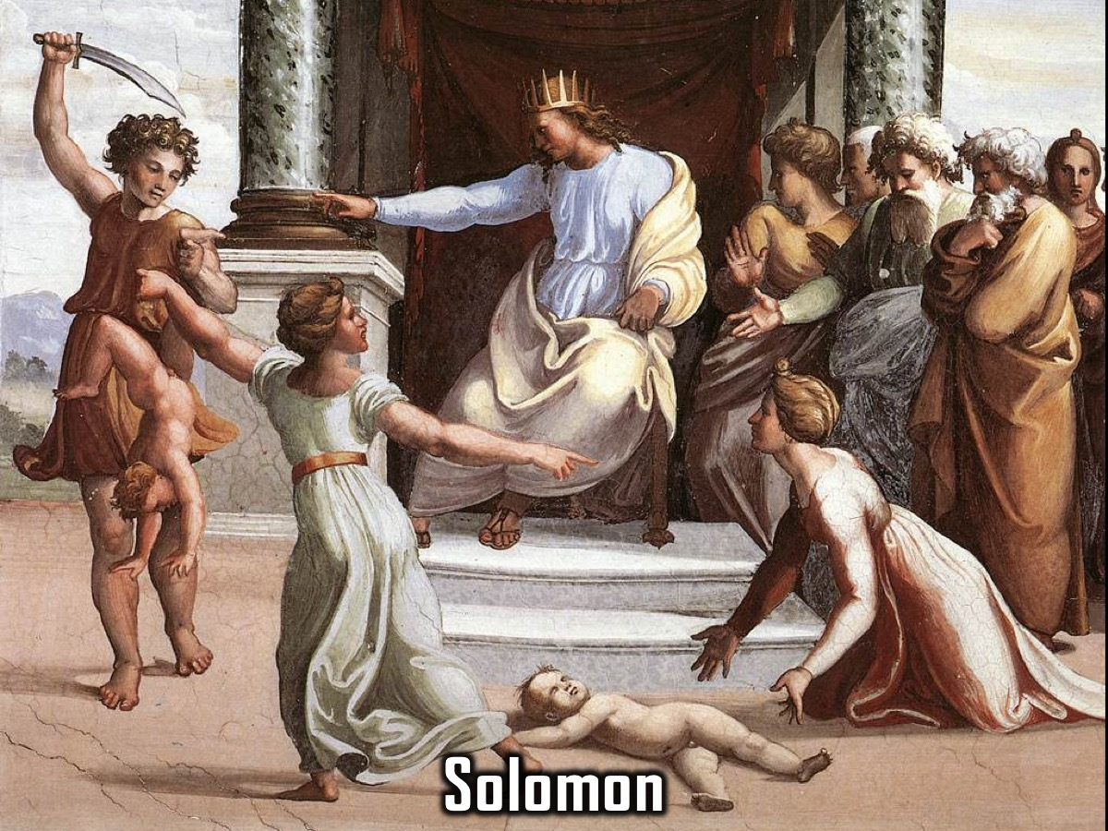
Notes:
1. Solomon: He was definitely one of the wisest kings in the history of Israel. One day two women came to him and had a dispute about which baby had been killed and who should get the one that was still alive. He suggested that the baby should be cut in halt. One woman said he should do that, but when the other woman said He should give the baby to the other woman Solomon knew that she was the real mom and gave her the baby.

Slide 17
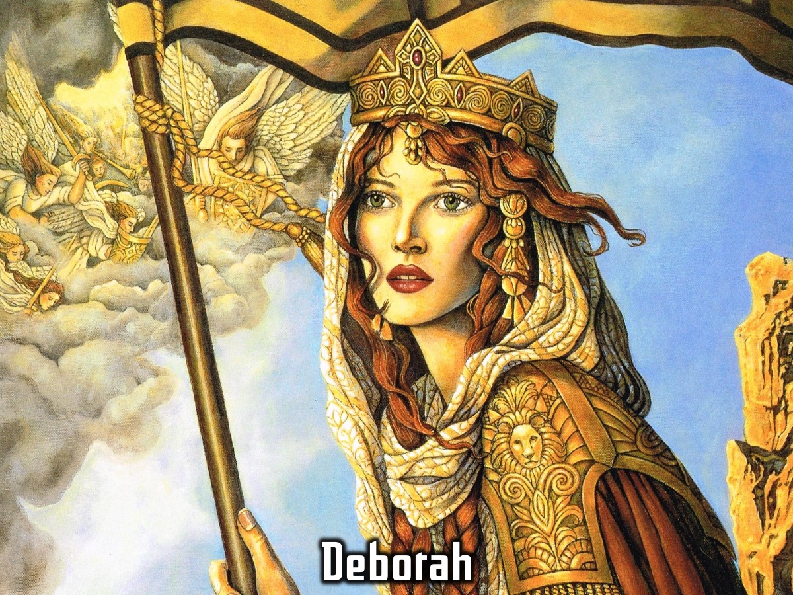
Notes:
2. Deborah: She was one of the smartest Judges in Israel (you can read her story in Judges 4 and 5).

Slide 18
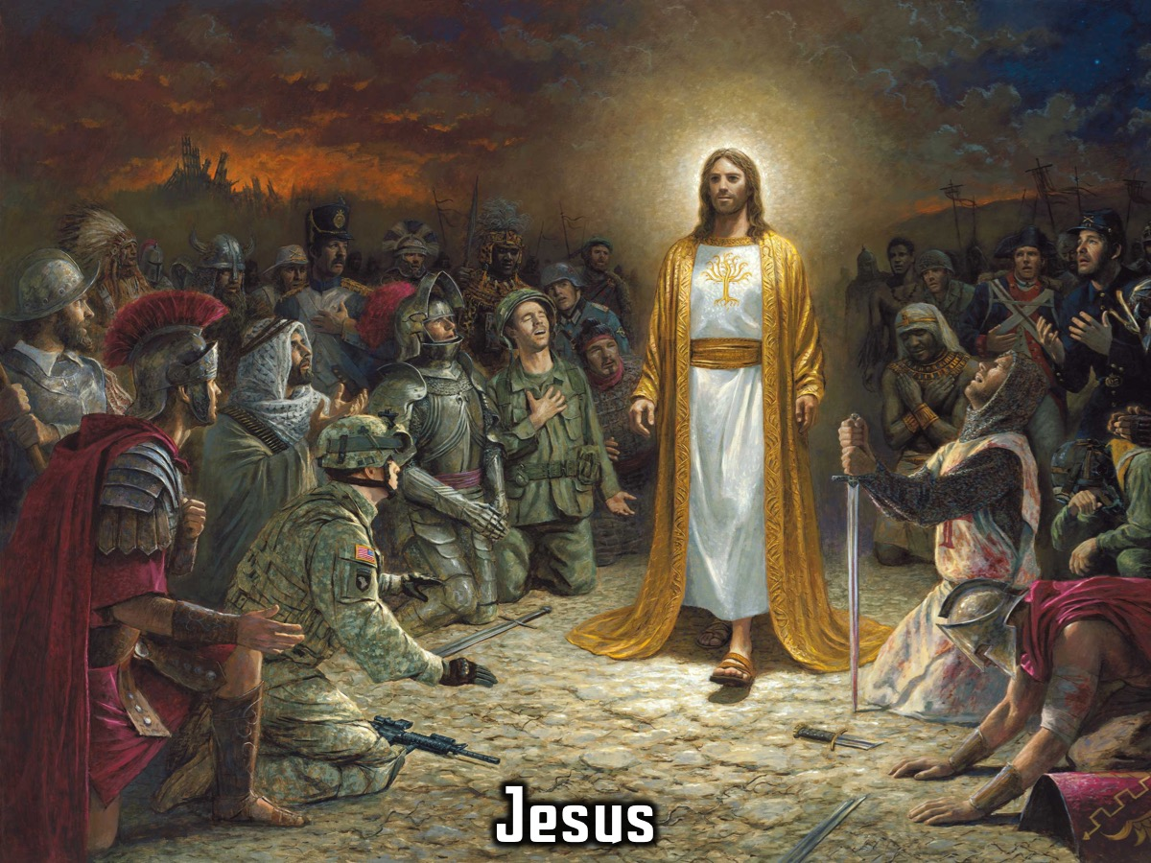
Notes:
3. Jesus.

Slide 19
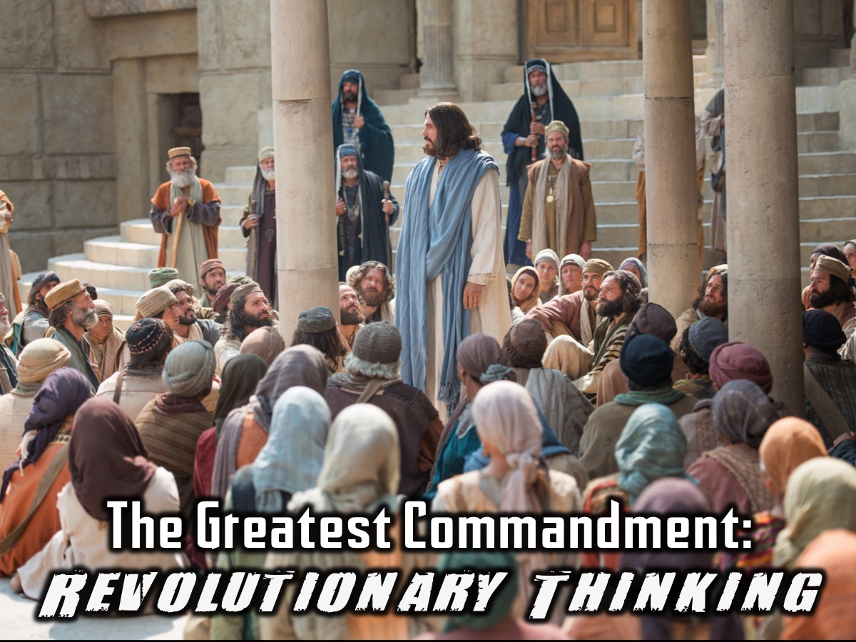
Notes:
The Greatest Commandment was an example of Revolutionary Thinking!

Slide 20
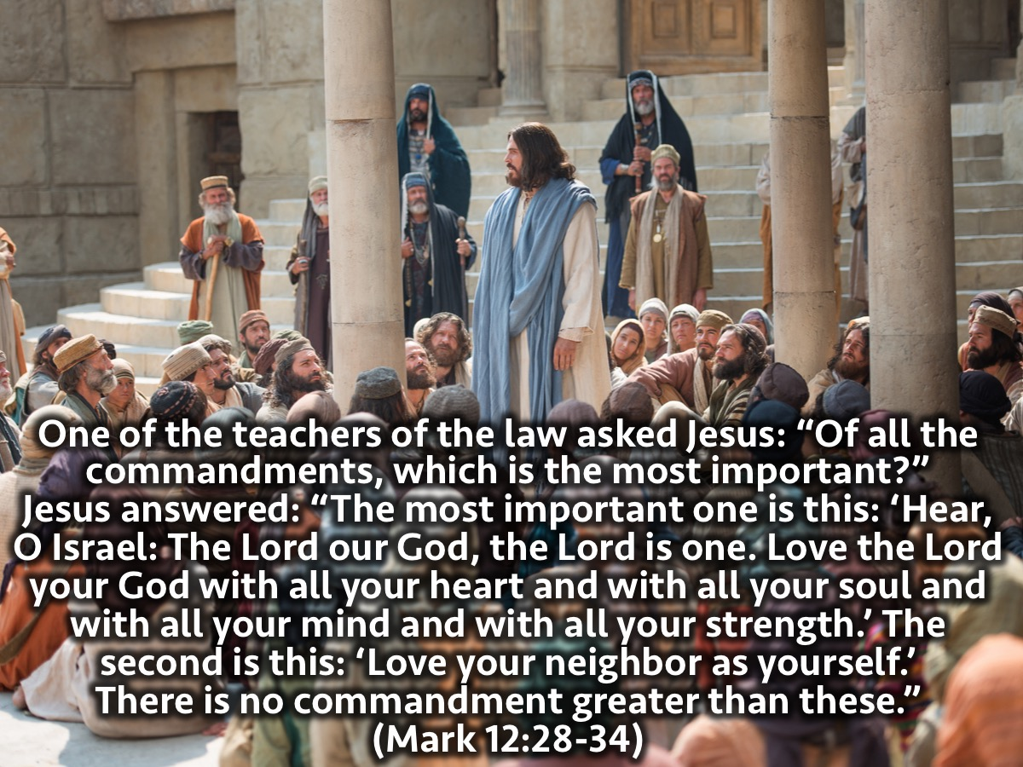
Notes:
Recommendation: Consider shortening this passage and only reading Mark 12:28-31.
The Greatest Commandment: One of the teachers of the law asked Jesus: “Of all the commandments, which is the most important?” Jesus answered: “The most important one is this: ‘Hear, O Israel: The Lord our God, the Lord is one. Love the Lord your God with all your heart and with all your soul and with all your mind and with all your strength.’ The second is this: ‘Love your neighbor as yourself.’ There is no commandment greater than these.”

Slide 21
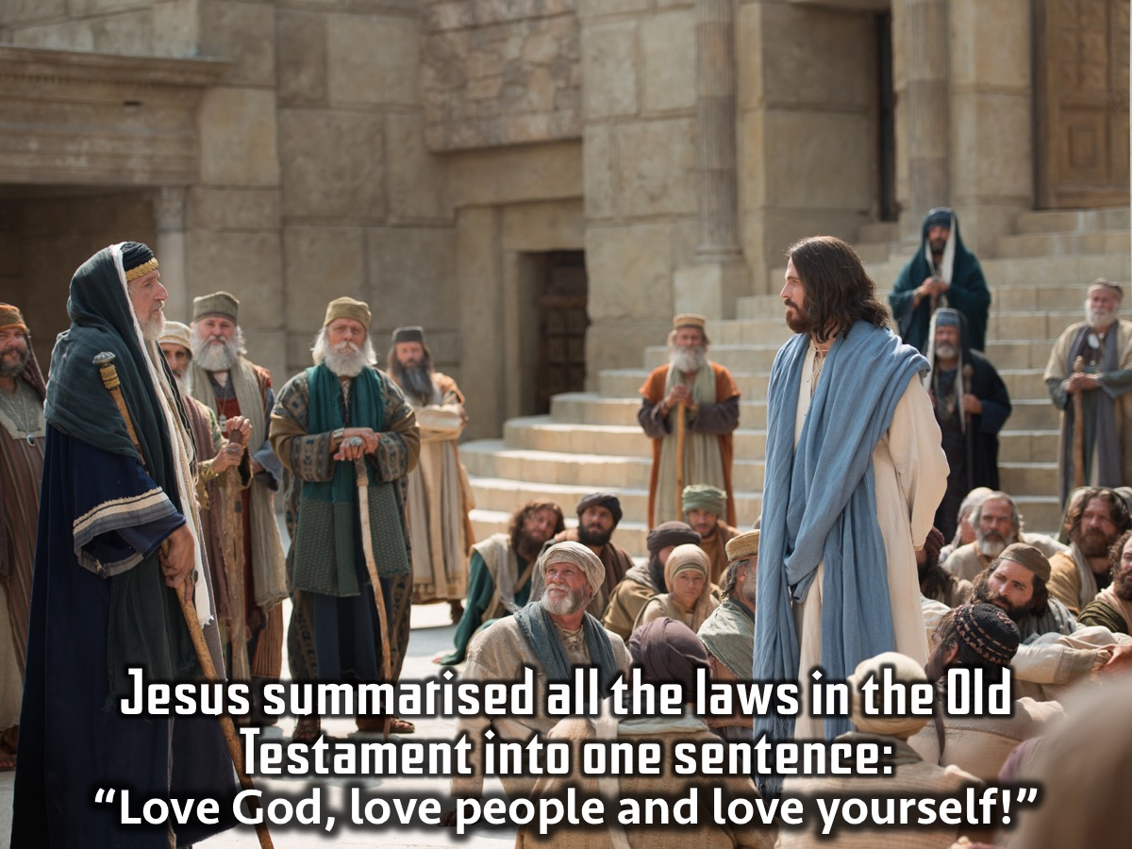
Notes:
Jesus summarised all the laws in the Old Testament into one sentence: “Love God, Love People and Love Yourself! Now that is revolutionary thinking!

Slide 22
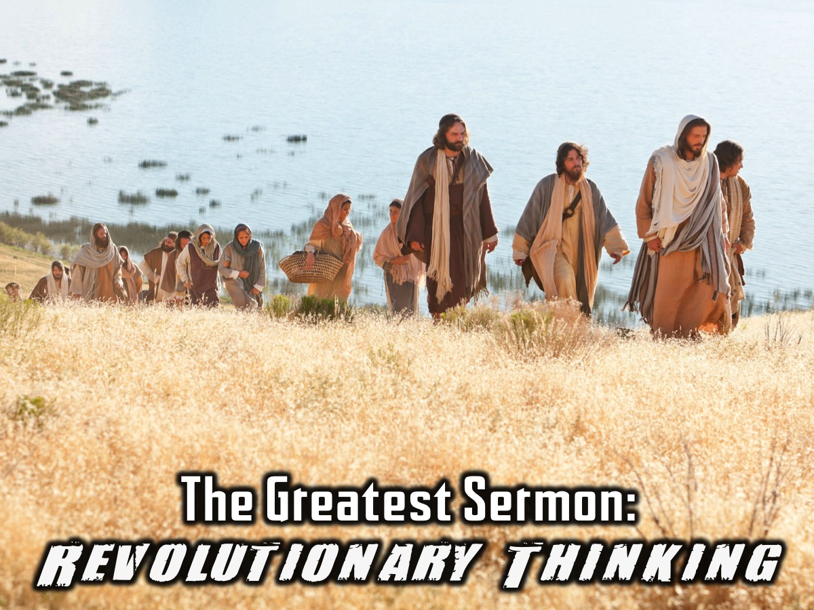
Notes:
The Greatest Sermon was an example of Revolutionary thinking. Jesus preached an amazing sermon to the crowds on a mountain that is known as the Sermon on the Mount. It is full of revolutionary thinking.

Slide 23
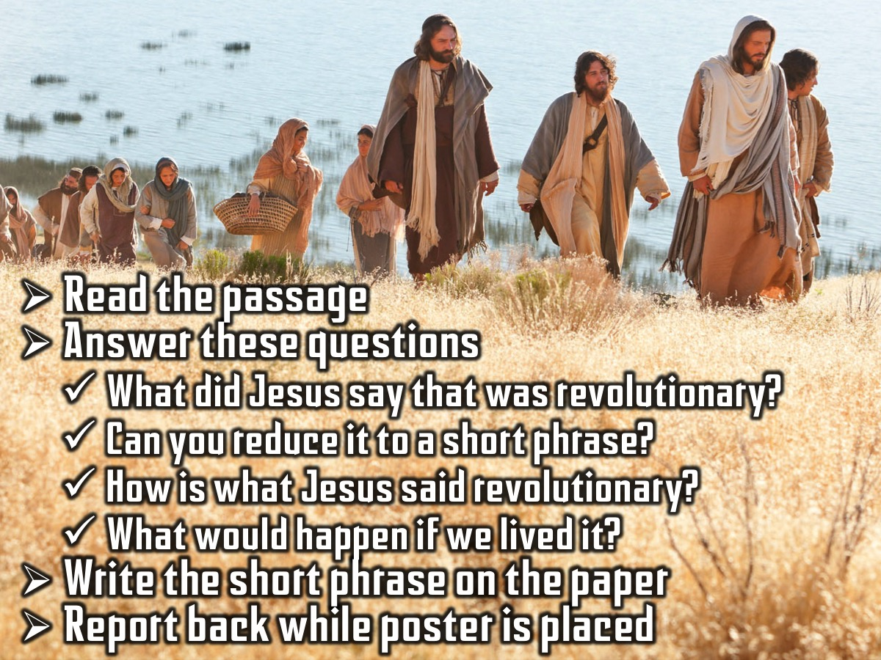
Notes:
You are going to divide into 6 groups and each group will get one small passage from the Sermon and you look for revolutionary thinking by answering these questions before reporting back to the large group: (1) What did Jesus say that was revolutionary? (2) Can you reduce it to a short phrase? (3) How is what Jesus said revolutionary? (4) What would happen if we lived it?
Each group will also be given a sheet of A3 paper and a red marker. They must write their phrase on the paper and place it on the wall marked “Red Letter Revolution” when their group’s speaker goes forward.

Slide 24
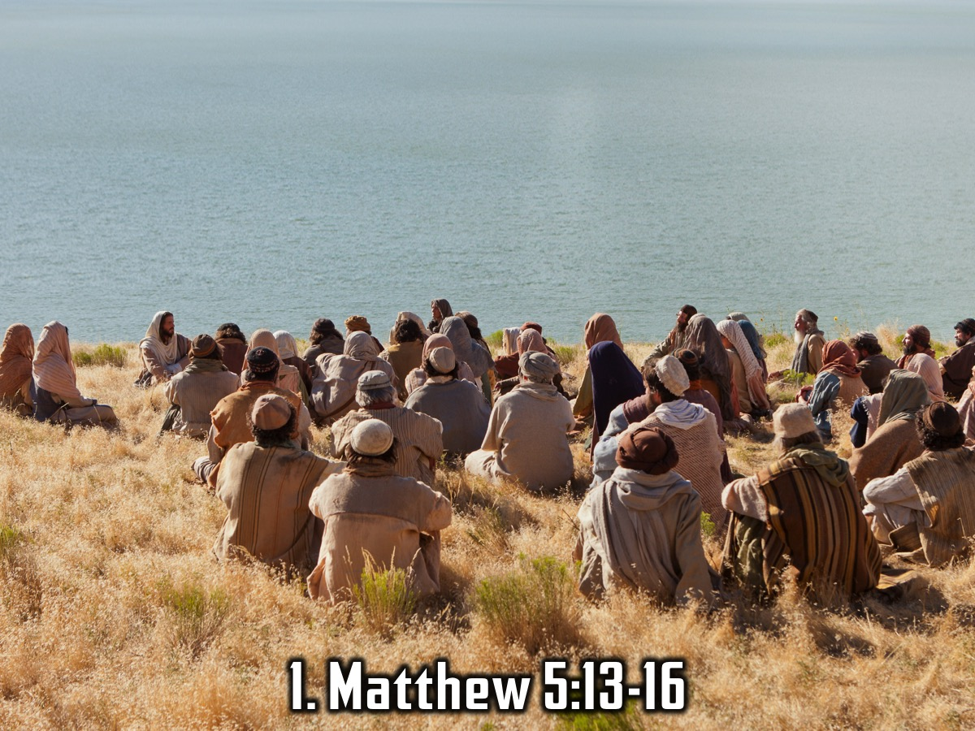
Notes:
Group 1: You are the salt of the earth. But if the salt loses its saltiness, how can it be made salty again? It is no longer good for anything, except to be thrown out and trampled underfoot. ‘You are the light of the world. A town built on a hill cannot be hidden. Neither do people light a lamp and put it under a bowl. Instead they put it on its stand, and it gives light to everyone in the house. In the same way, let your light shine before others, that they may see your good deeds and glorify your Father in heaven. (Matthew 5:13-16)

Slide 25
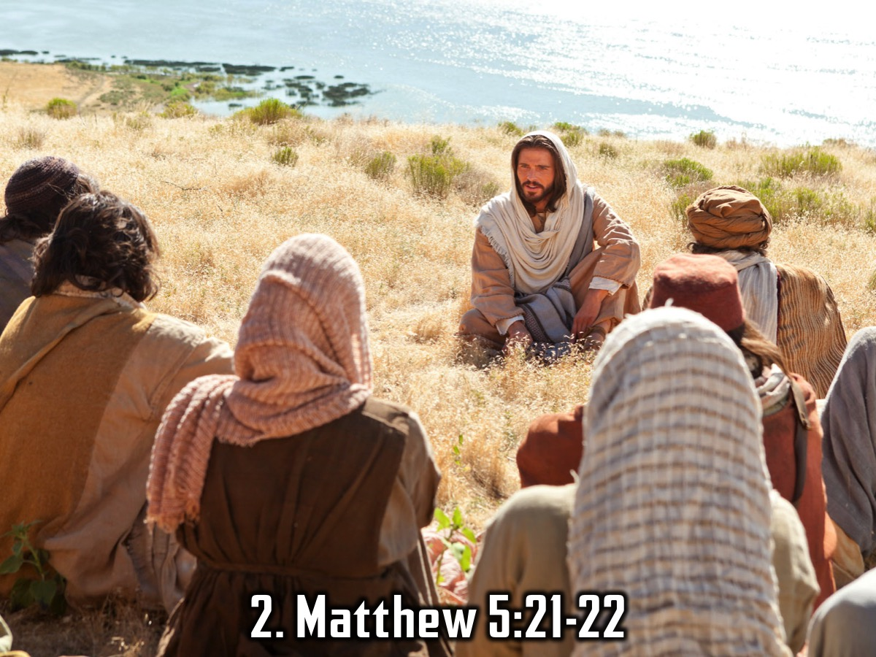
Notes:
Group 2: You have heard that it was said to the people long ago, “You shall not murder, and anyone who murders will be subject to judgment.” But I tell you that anyone who is angry with a brother or sister will be subject to judgment. Again, anyone who says to a brother or sister, “Raca,” is answerable to the court. And anyone who says, “You fool!” will be in danger of the fire of hell. (Matthew 5:21-22)

Slide 26
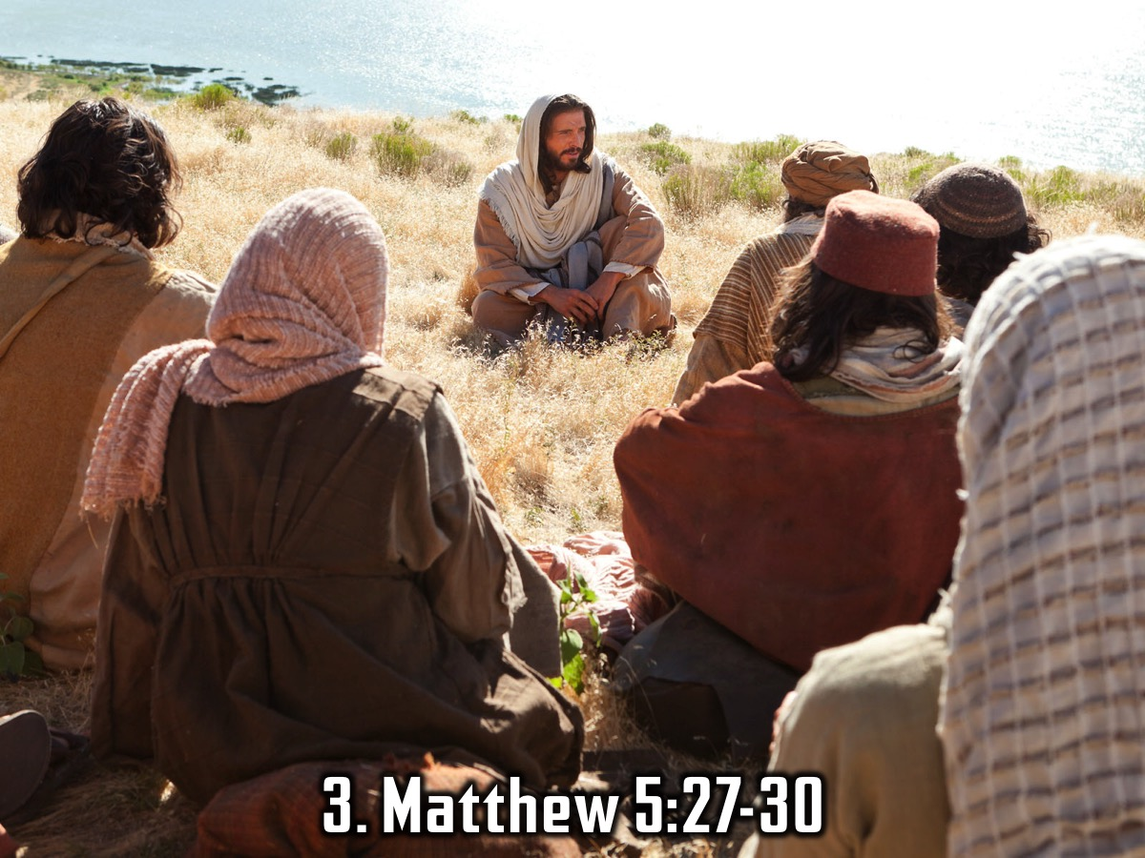
Notes:
Group 3: You have heard that it was said, “You shall not commit adultery.” But I tell you that anyone who looks at a woman lustfully has already committed adultery with her in his heart. If your right eye causes you to stumble, gouge it out and throw it away. It is better for you to lose one part of your body than for your whole body to be thrown into hell. And if your right hand causes you to stumble, cut it off and throw it away. It is better for you to lose one part of your body than for your whole body to go into hell. (Matthew 5:27-30)

Slide 27
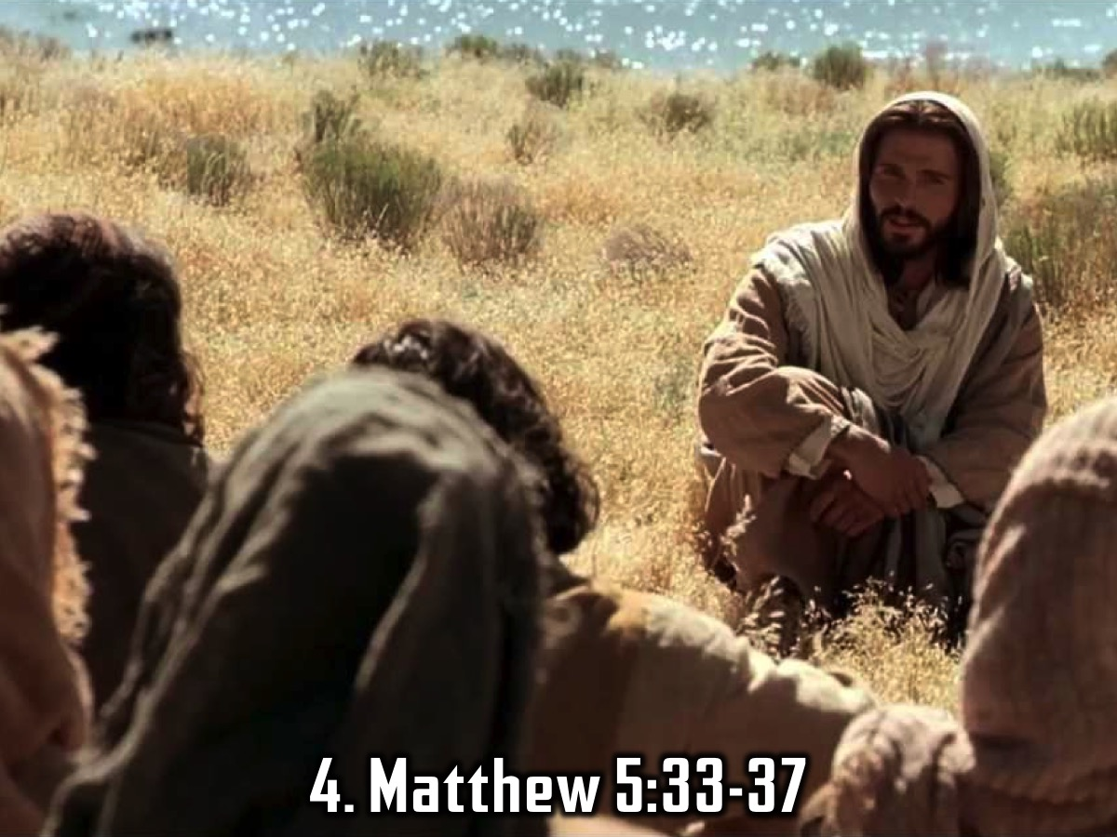
Notes:
Group 4: Again, you have heard that it was said to the people long ago, “Do not break your oath, but fulfil to the Lord the oaths you have made.” But I tell you, do not swear an oath at all: either by heaven, for it is God’s throne; or by the earth, for it is his footstool; or by Jerusalem, for it is the city of the Great King. And do not swear by your head, for you cannot make even one hair white or black. All you need to say is simply “Yes,” or “No”; anything beyond this comes from the evil one. (Matthew 5:33-37)

Slide 28
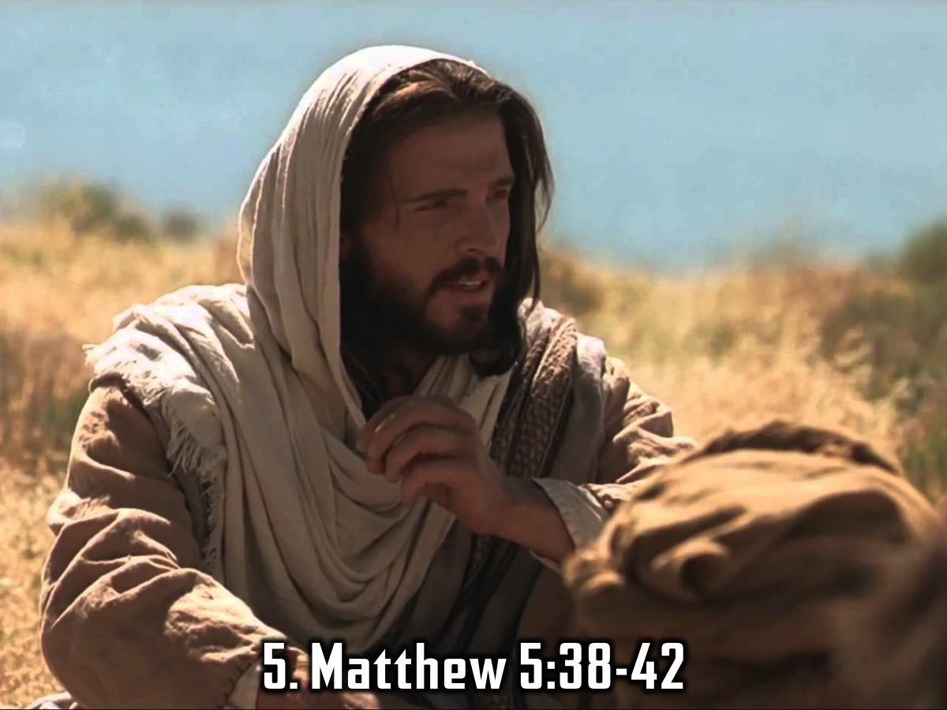
Notes:
Group 5: You have heard that it was said, “Eye for eye, and tooth for tooth.” But I tell you, do not resist an evil person. If anyone slaps you on the right cheek, turn to them the other cheek also. And if anyone wants to sue you and take your shirt, hand over your coat as well. If anyone forces you to go one mile, go with them two miles. Give to the one who asks you, and do not turn away from the one who wants to borrow from you. (Matthew 5:38-42)

Slide 29
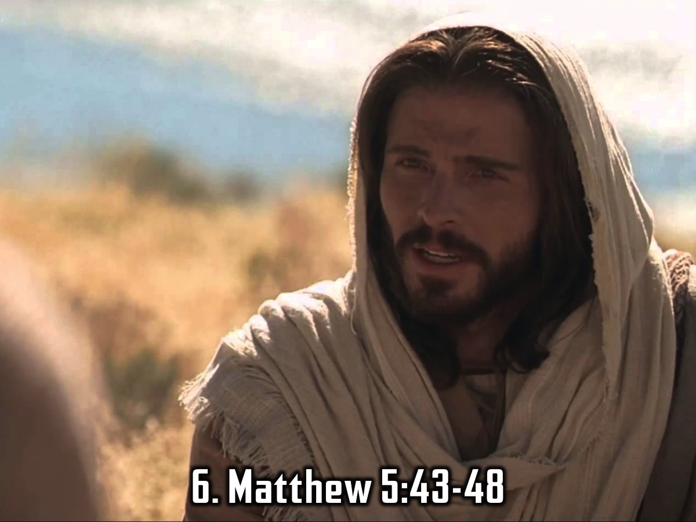
Notes:
Group 6: You have heard that it was said, “Love your neighbour and hate your enemy.” But I tell you, love your enemies and pray for those who persecute you, that you may be children of your Father in heaven. He causes his sun to rise on the evil and the good, and sends rain on the righteous and the unrighteous. If you love those who love you, what reward will you get? Are not even the tax collectors doing that? And if you greet only your own people, what are you doing more than others? Do not even pagans do that? Be perfect, therefore, as your heavenly Father is perfect. (Matthew 5:43-48)

Slide 30
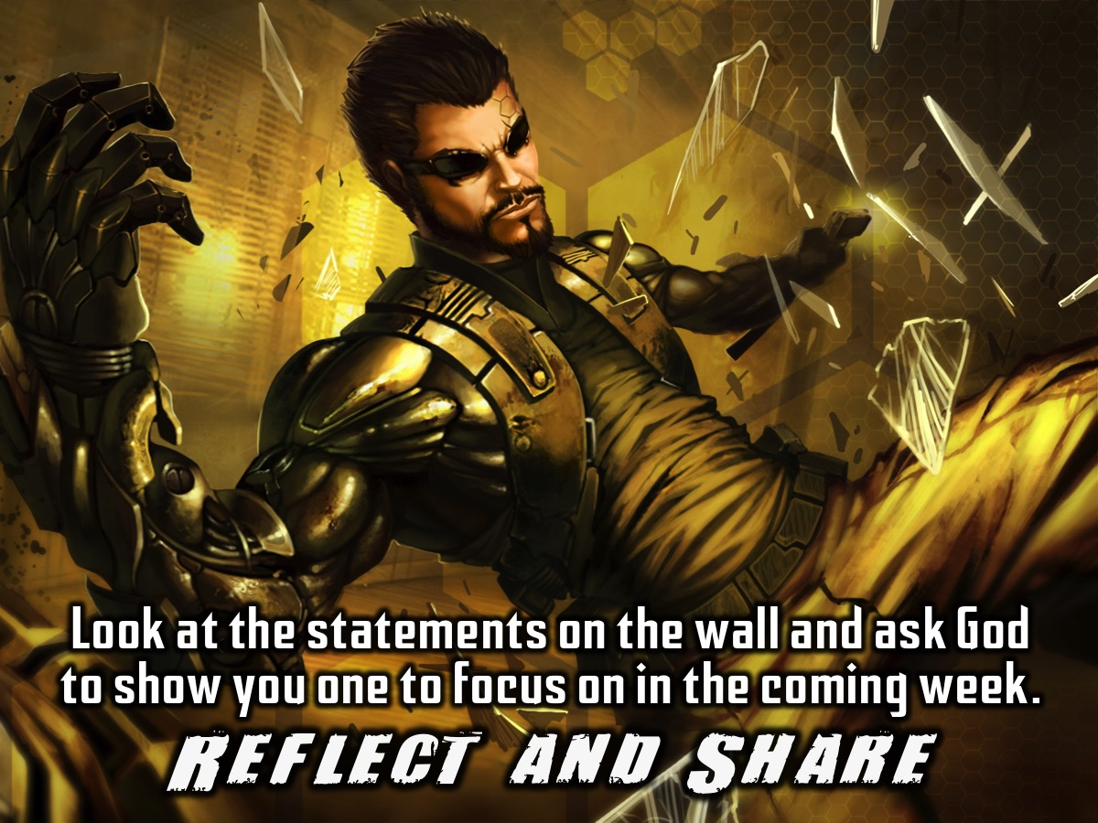
Notes:
Reflect and Share: Look at the statements on the wall and ask God to show you one to focus on in the coming week. Share it with the person sitting next to you!

Slide 31

Notes:
Two guys recently wrote a book called: Red Letter Revolution. It is all about actually living out the words written in red in your Bible – ie. The words of Jesus! Here is a video where the authors (Shane and Tony) tell us more about it…

Slide 32
Notes:
Video: Red Letter Revolution (A merge of two videos). Get it on YouTube at: https://www.youtube.com/watch?v=xnv5JZxP820 and https://www.youtube.com/watch?v=3Iof3xnYDtI.

Slide 33
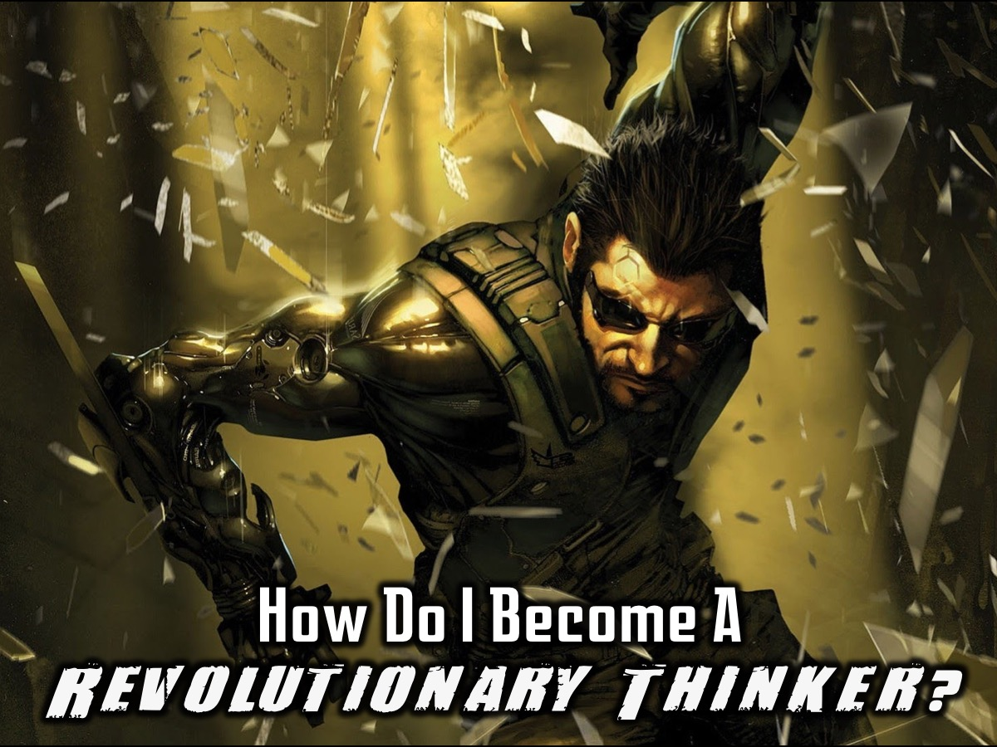
Notes:
So, how do I become a revolutionary thinker?

Slide 34

Notes:
1. Have Dreams: See a Better Future. Revolutionary thinkers have a vision of a future that is better than the present!

Slide 35

Notes:
2. Change Things: Be a Change Agent. Revolutionary thinker learn how to influence people around them.

Slide 36
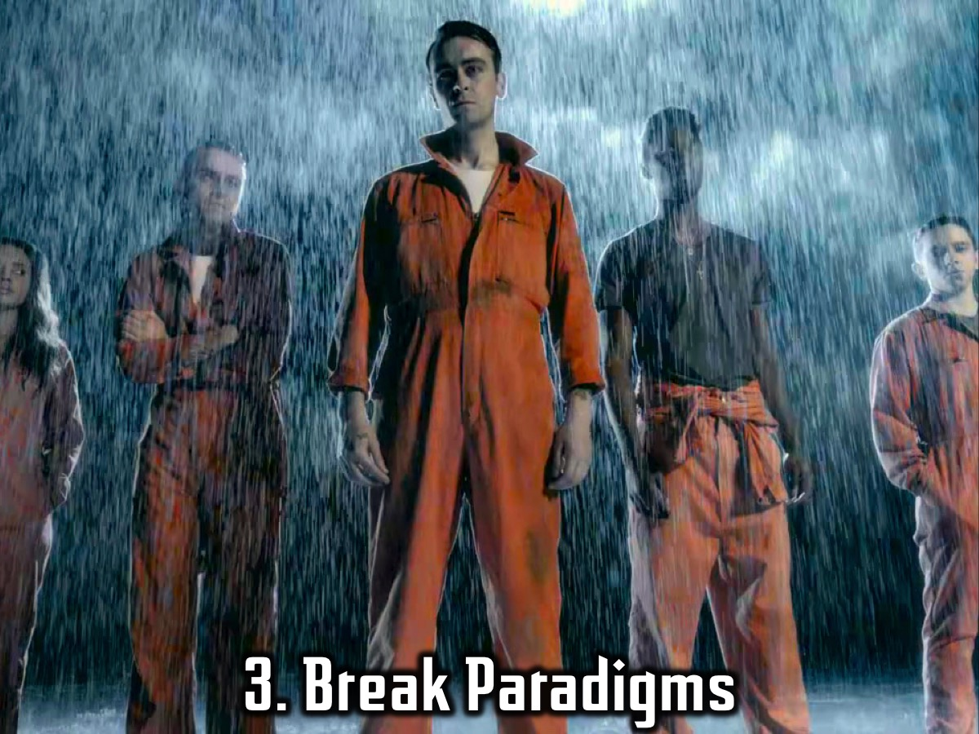
Notes:
3. Break Paradigms. Revolutionary thinkers are not happy with the status quo and set out to challenge and change existing thought patterns.

Slide 37
Notes:
Video: Apple Advert: Think Different. Get it on YouTube at: https://www.youtube.com/watch?v=WI8MjAoCos8

Slide 38
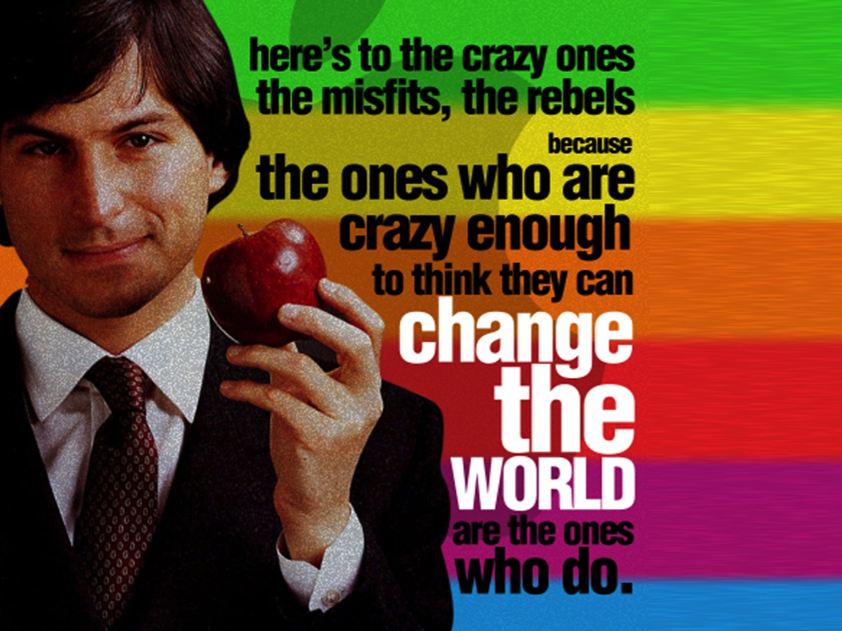
Notes:
Text from video: Here's to the crazy ones. The misfits. The rebels. The troublemakers. The round pegs in the square holes. The ones who see things differently. They're not fond of rules. And they have no respect for the status quo. You can quote them, disagree with them, glorify or vilify them. About the only thing you can't do is ignore them. Because they change things. They push the human race forward. And while some may see them as the crazy ones, we see genius. Because the people who are crazy enough to think they can change the world, are the ones who do.

Slide 39
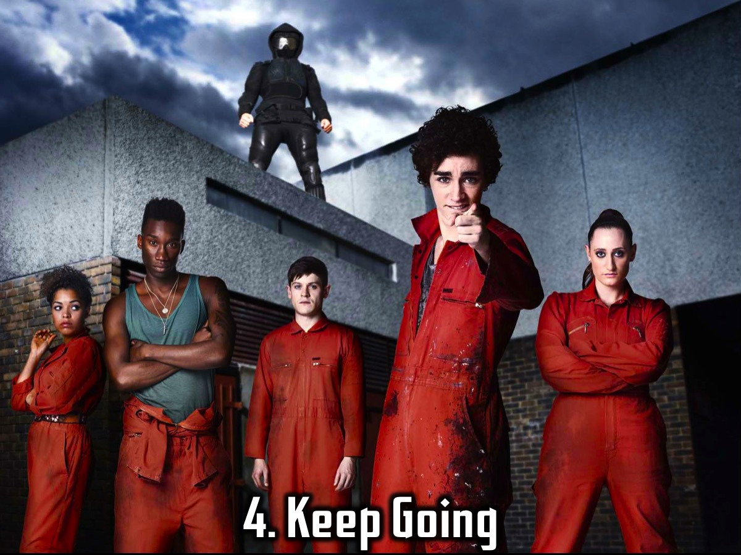
Notes:
4. Keep Going. Revolutionary thinkers keep going even when there are obstacles or when people disagree with them.

Slide 40

Notes:
5. Think Positively. Revolutionary thinkers always look for positive solutions to their situation!

Slide 41

Notes:
6. Hear God. Revolutionary thinkers are tuned to God’s voice and receptive to the Holy Spirit.

Slide 42
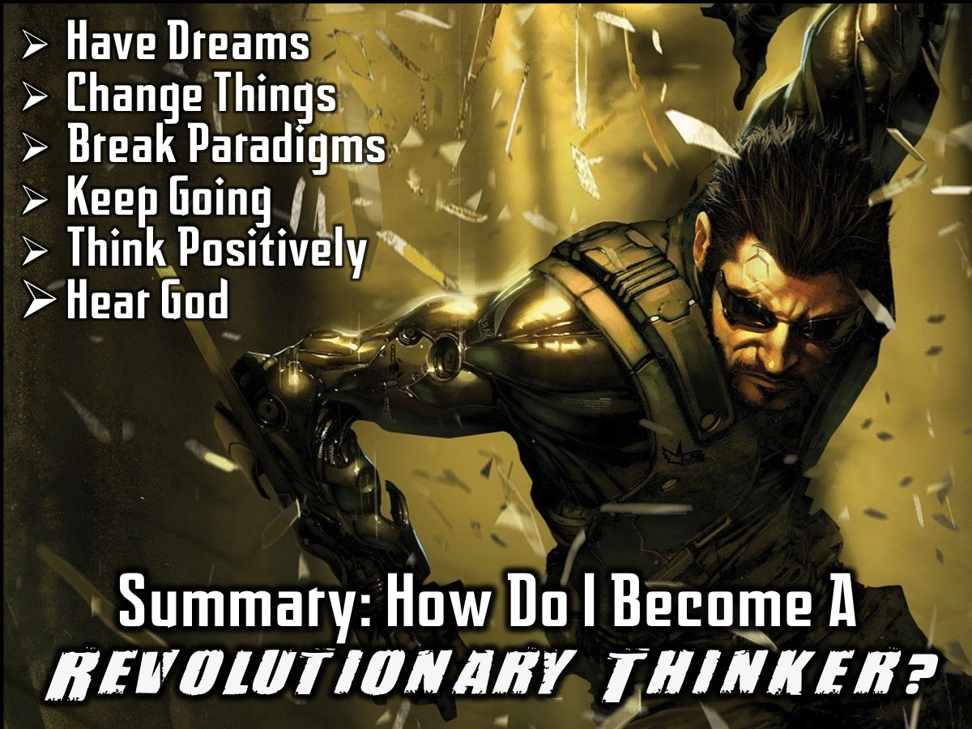
Notes:
Summary: So, how can I become a revolutionary thinker? (1) Have Dreams. (2) Change Things. (3) Break Paradigms. (4) Keep Going. (5) Think Positively. (6) Hear God.

Slide 43
Notes:
Video: Grey Boyd on Kingdom Revolution. Get it on YouTube at: https://www.youtube.com/watch?v=wHSm4KbdDfw

Slide 44
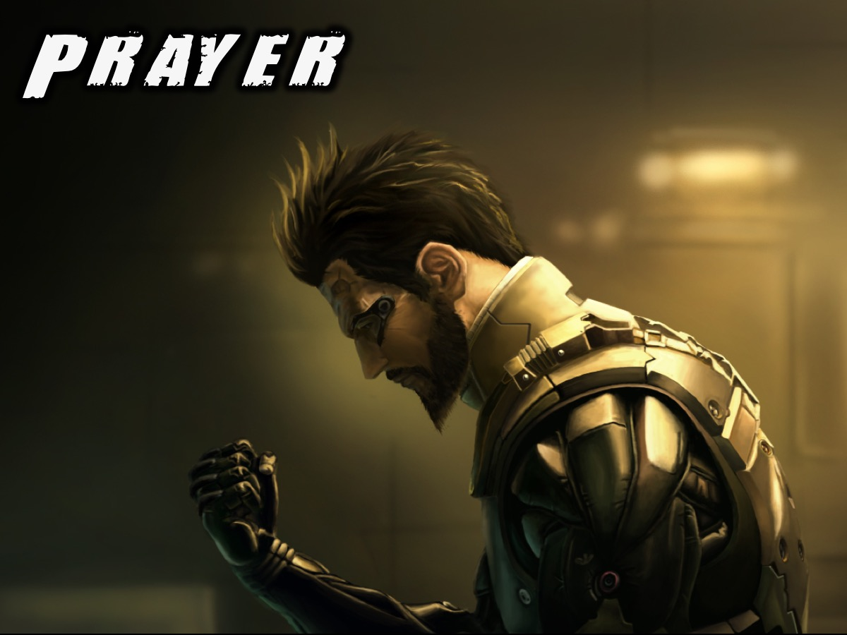
Notes:
Prayer

Slide 45

Notes:
Next week Shaun Pearce will help us learn how to act revolutionary.

Slide 46
Notes:
Video: Red Letter Revolution Words. A merging of 4 videos: Lose Your Life: https://vimeo.com/60264521, Love Your Enemy: https://vimeo.com/60265492, Throw A Mountain Into The Sea: https://vimeo.com/60266513 and Do Greater Things Than Jesus: https://vimeo.com/60267627.

Slide 47
Notes:
Next week Shaun Pearce will help us learn how to act revolutionary.

