Slide 1

Notes:
Today is week 7 in our Revolution series!

Slide 2
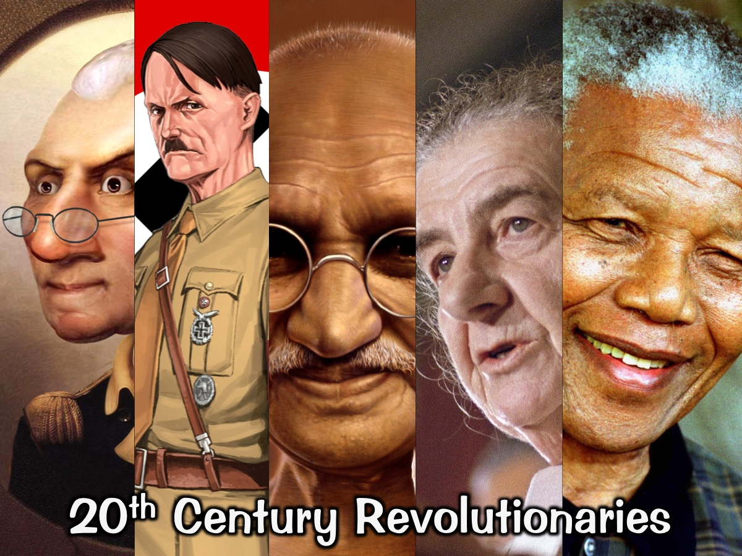
Notes:
Over the past few weeks we have been exposed to the lives of contemporary revolutionaries of the 20th century.

Slide 3
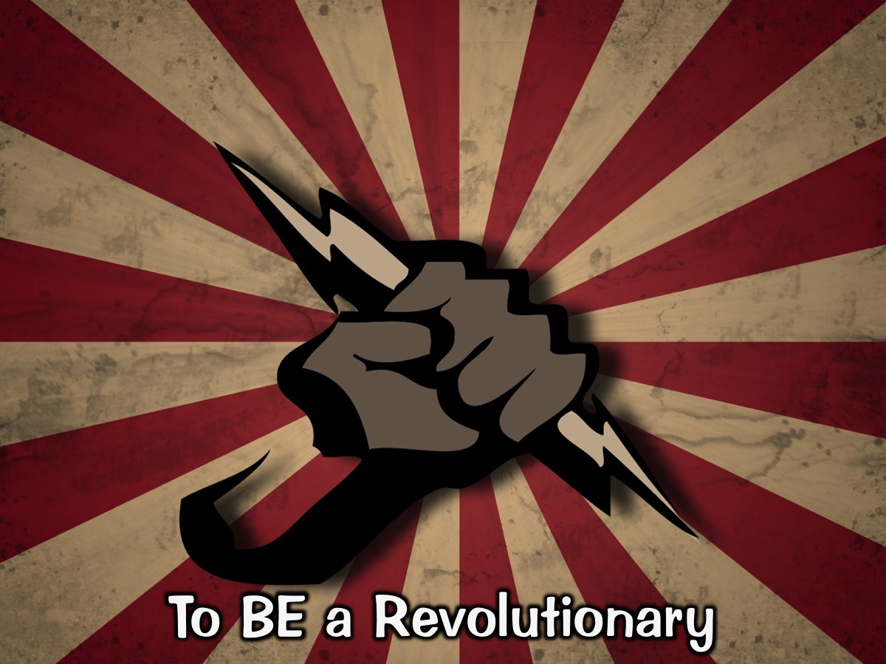
Notes:
We have learnt about what it is to be a revolutionary…

Slide 4
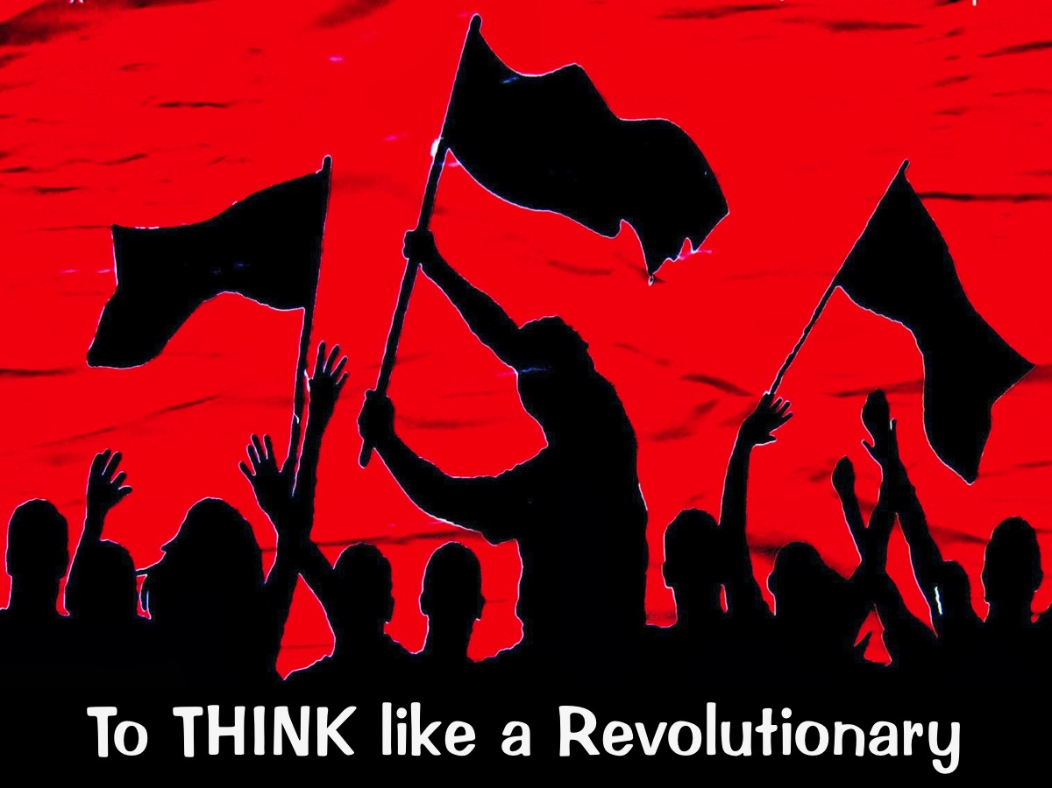
Notes:
And what it is to think like a revolutionary.

Slide 5
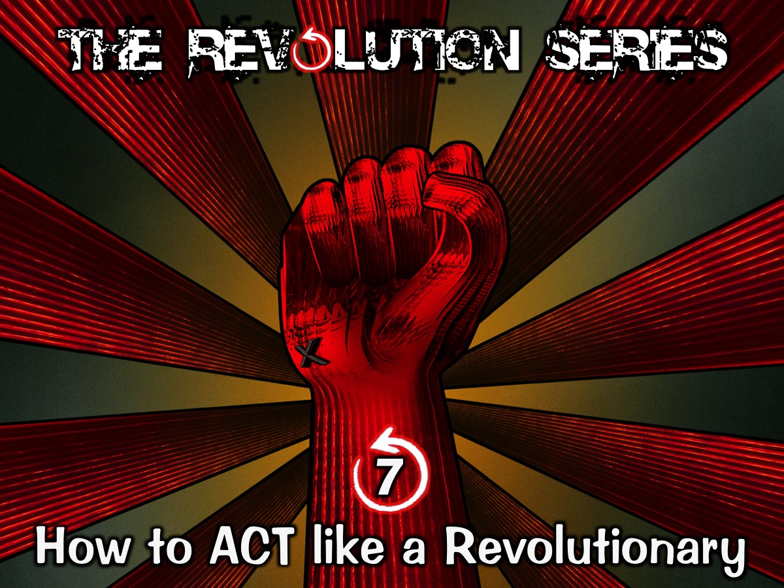
Notes:
Today we are going to learn how to act revolutionary.

Slide 6
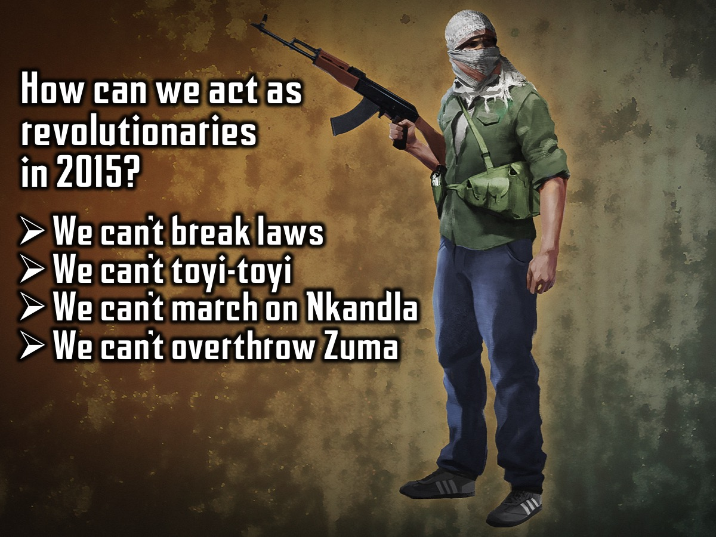
Notes:
How are we expected to act as a revolutionary in our day and age?
• We can’t break any laws.
• We can’t riot, protest and Toyi-toyi.
• We can’t skip school to march on Nkandla.
• We can’t overthrow the government because it is not anti-Christian.

Slide 7
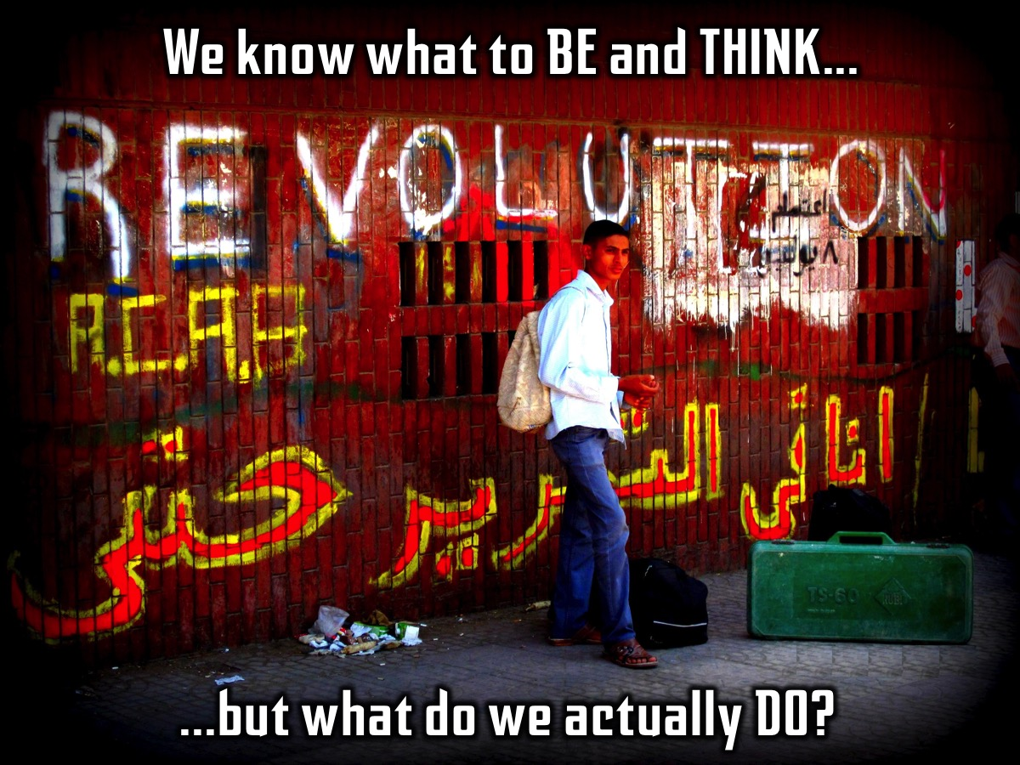
Notes:
I’ve been told what to be and what to think but what must I actually physically Do???

Slide 8
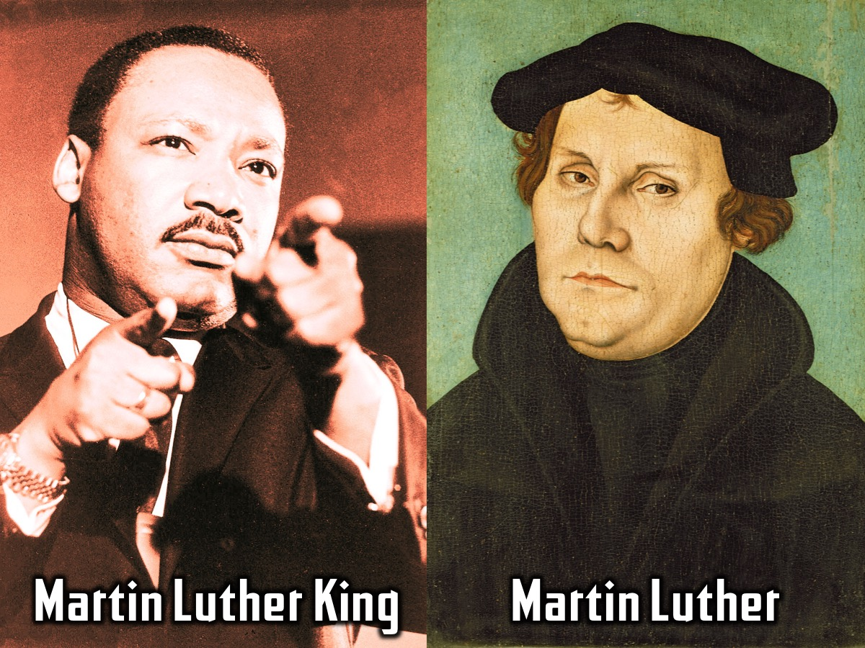
Notes:
We all know of Martin Luther King, the man who led the fight for equal rights in America in the 1950s. but how many of you know about the man Martin Luther who led a completely different revolution in 16th century Germany. And other great Christians reformers…

Slide 9

Notes:
We can learn so much from the lives of the Christian Reformers. They were theologians, churchmen and statesmen whose careers, works, and actions brought about the Protestant Reformation in the 16th century.

Slide 10
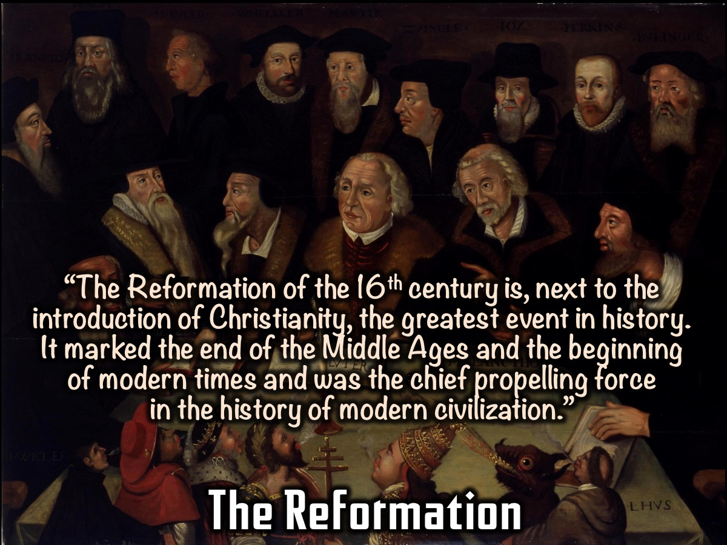
Notes:
The Reformation: A Church Historian wrote: “The Reformation of the sixteenth century is, next to the introduction of Christianity, the greatest event in history. It marks the end of the Middle Ages and the beginning of modern times and was the chief propelling force in the history of modern civilization.” (Philip Schaff, History of the Christian Church)

Slide 11
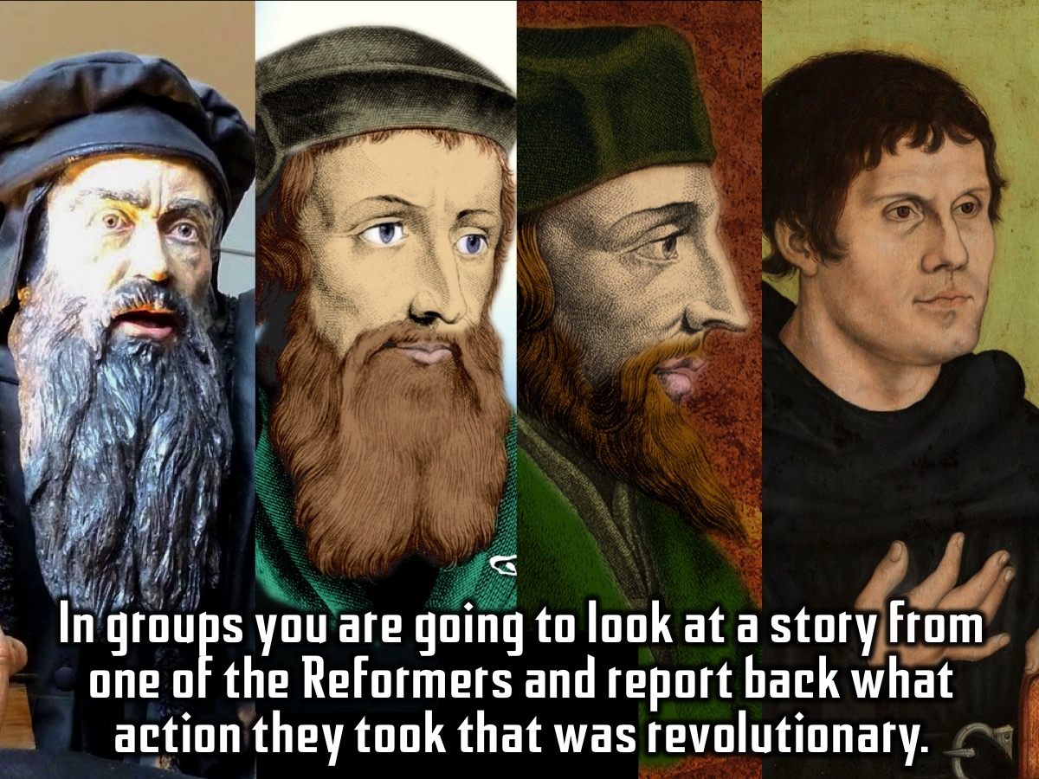
Notes:
Group Activity: In four groups you are going to look at a story from one of the reformers and report back what action they took that was revolutionary.
John Knox
Scotland in the 1500s was a land of great ignorance – the nation was largely uneducated, ignorant of the Scriptures, very superstitious. It was a church dominated by ignorance amongst the clergy, immorality amongst the clergy, superstition amongst the clergy; there was very little preaching and people were generally dissatisfied with the church. It was a church that needed radical reformation.
John Knox was a fiery preacher in Scotland who spoke out against the Roman Catholic Church and was forced to flee to Geneva. While he was there he published very controversial articles including one that told England to attack leaders who allowed Catholicism back into England; and one that told the Nobels in Scotland that ordinary people had the right or duty to rebel against unjust rulers.
When he returned to Scotland one of his sermons caused a riot where images were smashed and religious houses were destroyed.
The Parliament ordered Knox and his colleagues to write books that helped to reform the church in Scotland.
Knox was clearly a man of great courage: one man standing before Knox's open grave said, "Here lies a man who neither flattered nor feared any flesh."
His legacy is large: there are more than 750,000 Presbyterians in Scotland, 3 million in the United States, and many millions more worldwide.
John Wycliffe
When John Wycliffe was a scholar at Oxford University in 1360, there was only one legal translation of the Bible around and it was in Latin. Because common folks couldn't read Latin they had to accept what their priests told them. They could not study the Bible for themselves or disagree with the Church's interpretations. Just imagine living in a time when you were not able to pick up a Bible and read it for yourself!
John Wycliffe decided to do something about this terrible situation and in 1370 he and his colleagues at Oxford translated the Bible into English. You would have thought that everybody would be happy with the new ability people had to read and study the Bible but the authorities were furious. They probably felt that their dodgy practices would be exposed when people read the truth of God’s Word.
John Wycliffe was expelled from Oxford University because of his defiance and radical thinking and died of a stroke just two years later.
The church leaders also banned the Bible translation that John had written and also other books he wrote in English but thankfully they were smuggled out of the country to Prague where another reformer John Hus would make sure that they were copied and distributed.
John Hus
John Huss was a reformer who lived in Prague. He read the writings of another reformer, John Wycliffe, and also wrote that the corrupt church should not have that much authority over their daily lives. He convinced people that nothing in the Bible required them to buy Indulgences from the Church. An indulgence was like permission to sin that you could buy and know you would still get forgiveness from the Church when you committed the sin.
When people stopped buying Indulgences, the Pope was furious. He used money that was made from the sale of indulgences to finance a military campaign against the King of Naples. He kicked John Hus out of the church and put the entire city of Prague under an interdict, forbidding anyone from taking the sacraments – like communion or baptism.
Hus continued to speak his mind. He condemned the excessive lifestyles of the clergy, including the Pope. He told people not to listen to priests who didn't give Bible-based instruction. In response, the Church convened the Council of Constance to interrogate Hus. He was arrested and tried by the Council and condemned and handed over to the secular authorities to be burned at the stake.
On July 6, 1415, as John Hus (whose name means "goose") made his way to the place of execution, the authorities made him pass by a bonfire where his books were burning. Some of his last words were: You are going to burn a goose but in a century you will have a swan which you can neither roast nor boil. His words came true with a revolution that took place some years later.
But Hus' ideas lived on, and some of the people who adopted his thinking ultimately immigrated to America where they established the towns of Bethlehem and Nazareth, Pennsylvania. Other scholars continued his work in Europe.
Martin Luther
Martin Luther was a Catholic monk who was against the idea that you could buy an indulgence from the church (a kind of financial transaction to absolve sins). He was especially upset with a monk told crowds they could get their deceased friends and family out of purgatory if they put money into his indulgence box. He believed that it was wrong for people to think they could "buy" their way to salvation.
In fact Luther, had many concerns with the way in which the church of his day was operating so he wrote up a list of "95 Theses" – 95 points concerning two main areas: that the Bible is the central religious authority and that humans may reach salvation only by their faith and not by their deeds. He nailed the document to the door of the Castle Church in Wittenberg, Germany for everyone to see.
His ideas then became public and others agreed that the Catholic Church had no business raising money through the selling of Indulgences. Pope Leo X in Rome heard about what Luther had done and was furious and issued a document calling for the burning of Luther's writings and threatened to kick Luther out of the church if he didn't recant in 60 days. Luther's response was to burn the document that the Pope had sent out and other Church-issued materials that he disagreed with.
Luther was then summoned to a trial in Worms where a council was set up to judge Luther. At the trial, Luther refused to recant and uttered his famous words: "Here I stand; I can do no other." He was saved from the stake by a German ruler and went into hiding where he translated the entire Bible into German and it became the first book published for mass circulation on the Gutenberg press.

Slide 12
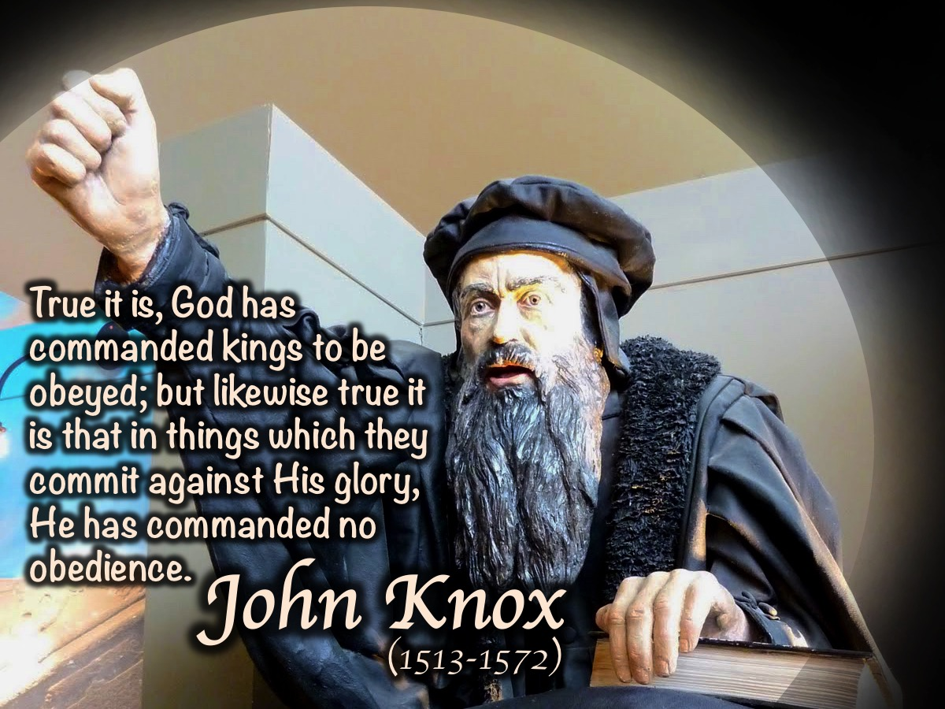
Notes:
1. John Knox. “True it is, God has commanded kings to be obeyed; but likewise true it is that in things which they commit against His glory. He has commanded no obedience”. (John Knox)

Slide 13
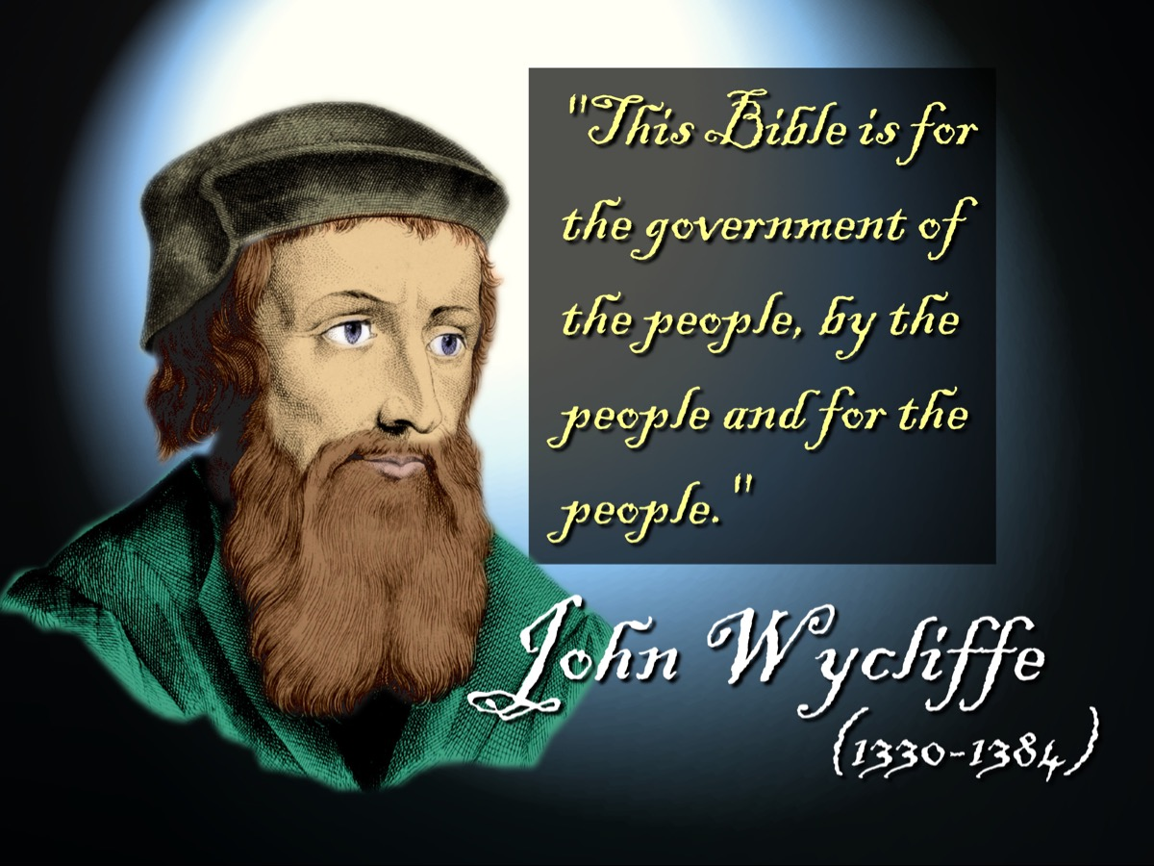
Notes:
2. John Wycliffe. “The Bible is for the government of the people, by the people and for the people.” (John Wycliffe)

Slide 14
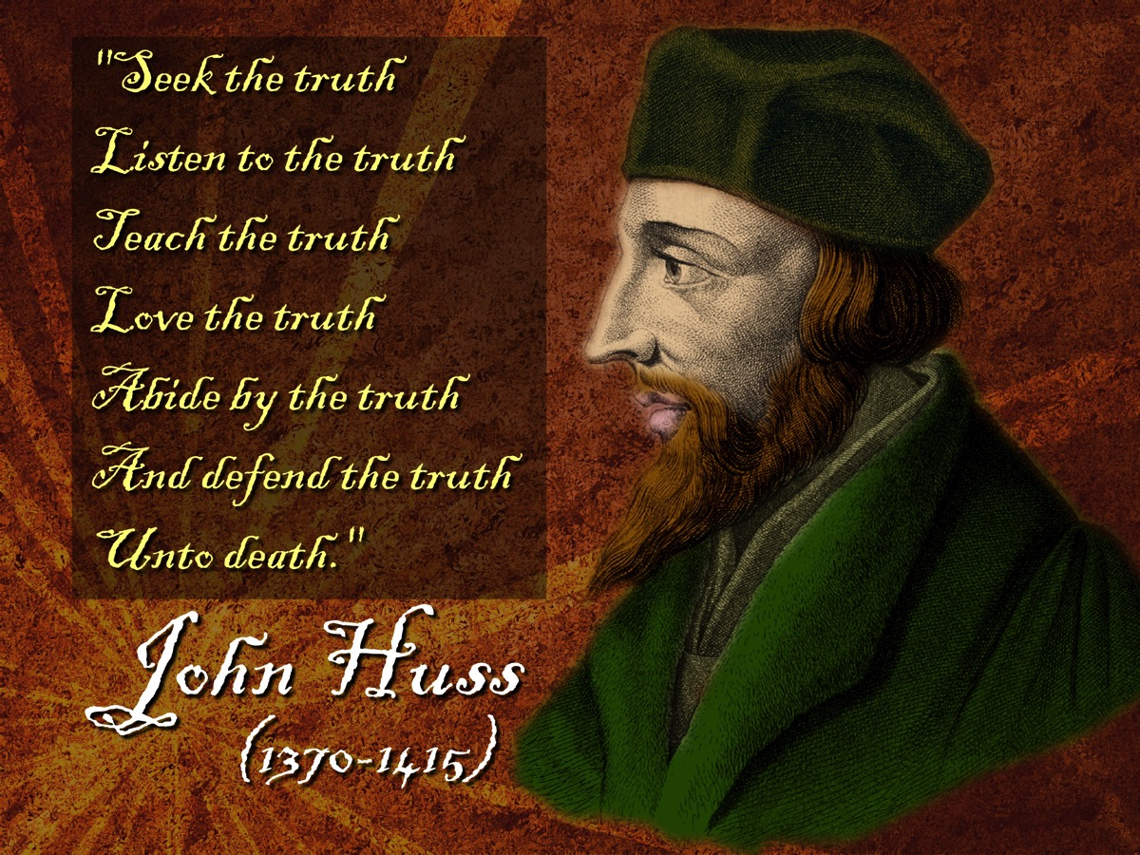
Notes:
3. John Hus. “Seek the truth. Listen to the truth. Teach the truth. Love the Truth. Abide by the truth. And defend the truth until death.” (John Huss)

Slide 15
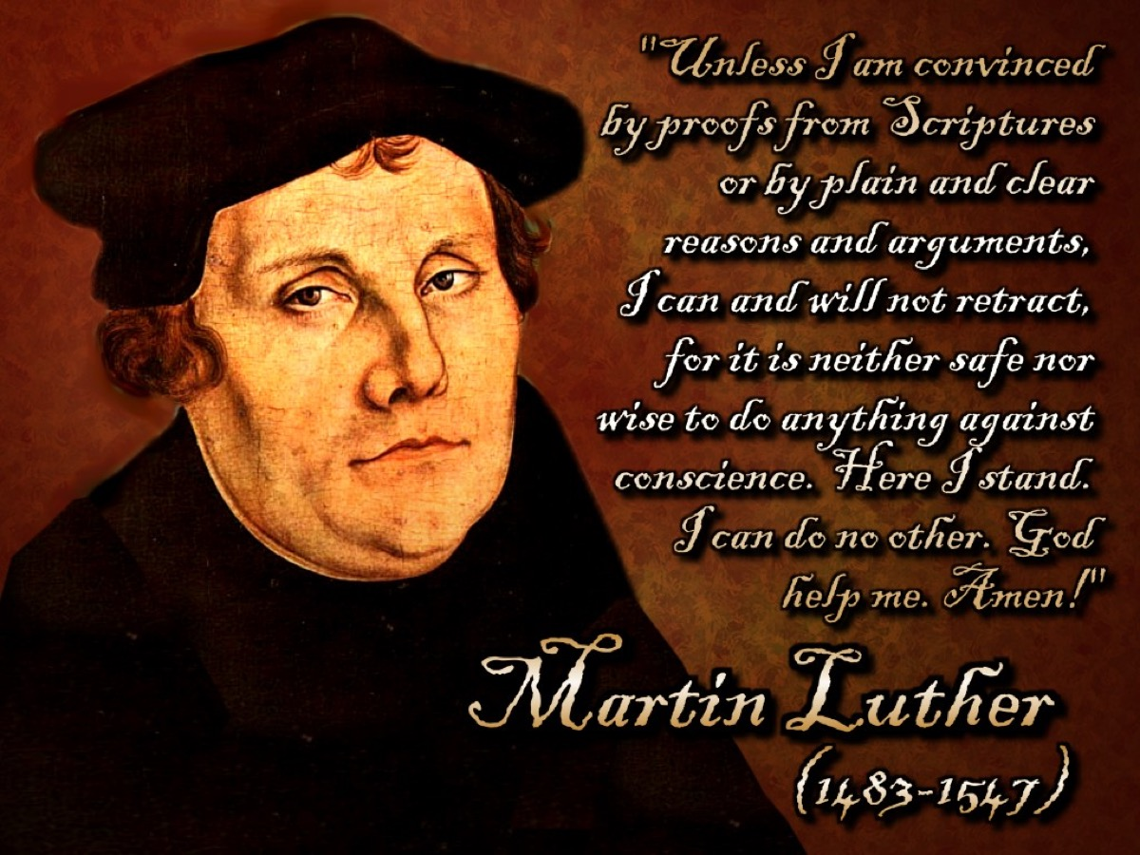
Notes:
4. Martin Luther. “Unless I am convinced by proofs from Scriptures or by plain and clear reasons and arguments, I can and will not retract, for it is neither safe not wise to do anything against conscience. Here I stand. I can do no other. God help me. Amen!” (Martin Luther)

Slide 16
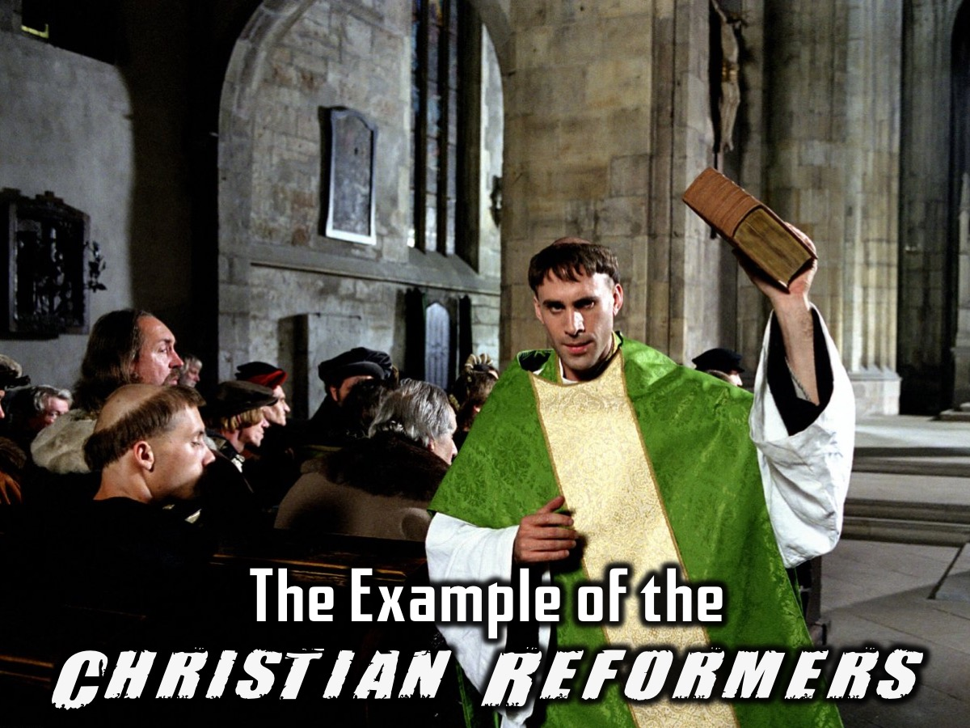
Notes:
The Example of the Christian Reformers. In previous weeks we saw that revolutions have common characteristics despite their differences for why they were started. The same common thread runs through the lives of the great reformers:

Slide 17
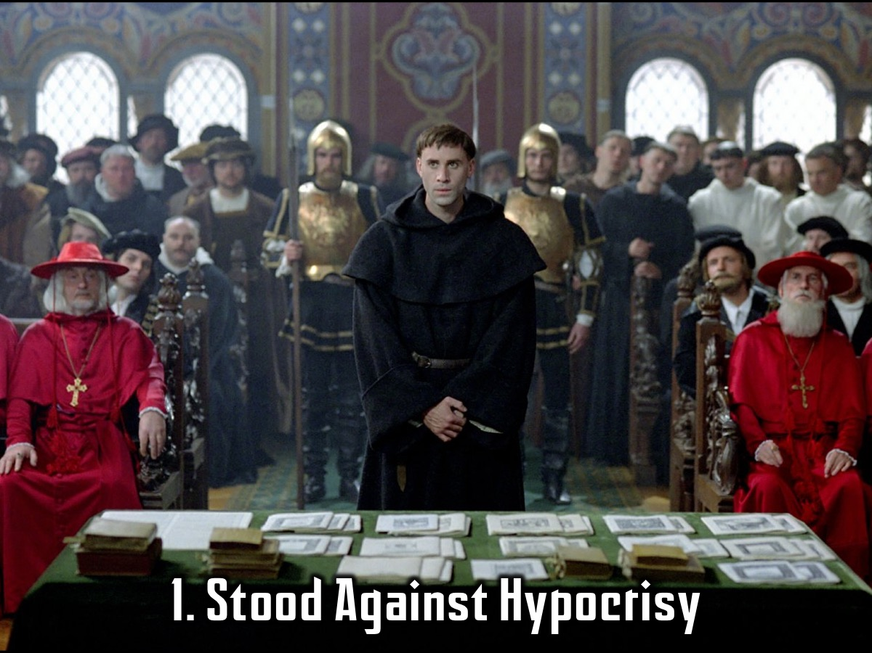
Notes:
1. Stood Against Hypocrisy (They took an unflinching stance against hypocrisy and the blasphemous lies of the existing churches and society of their day)

Slide 18
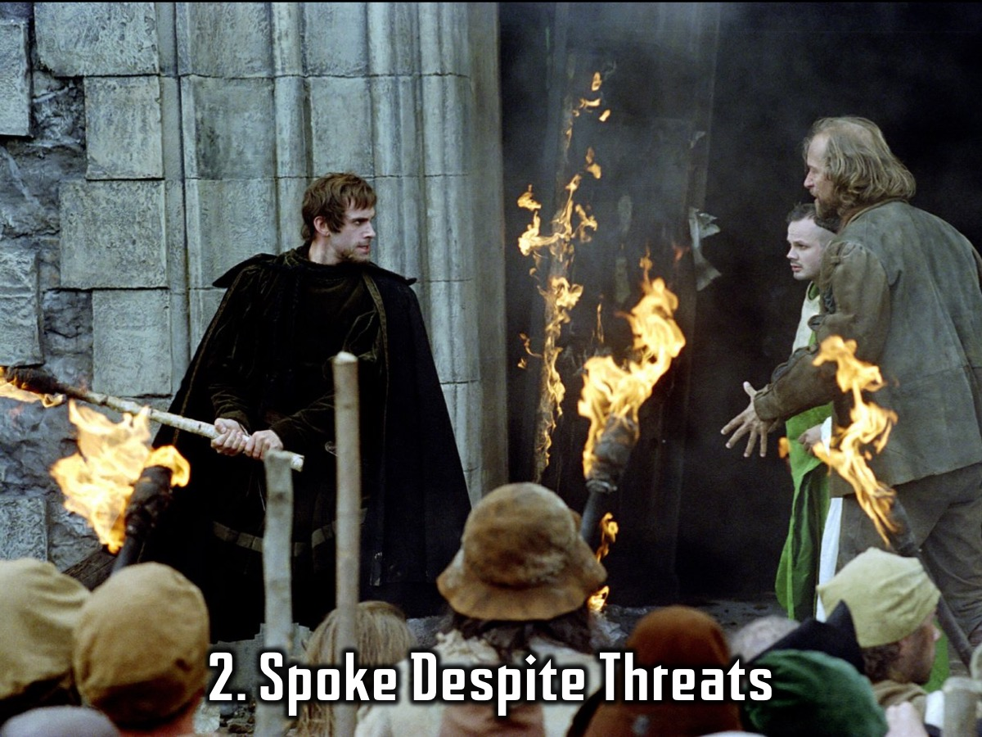
Notes:
2. Spoke Despite Threats (They could not and would not fall into line with everyone else and keep quiet even if it meant death or imprisonment.

Slide 19
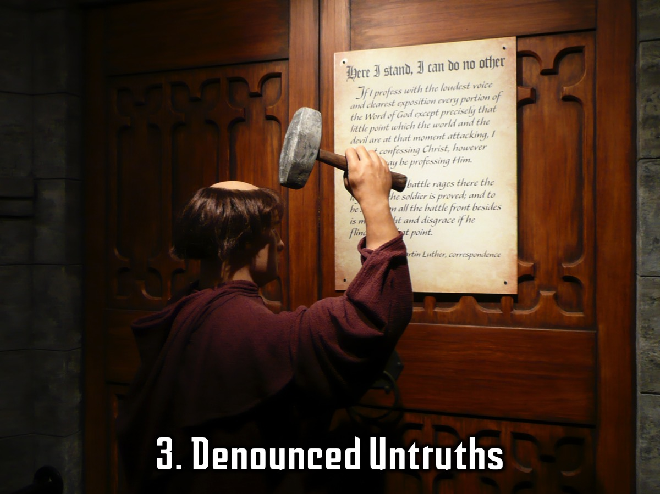
Notes:
3. Denounced Untruths (Soundly denounced untruths that were taught and widely accepted)

Slide 20
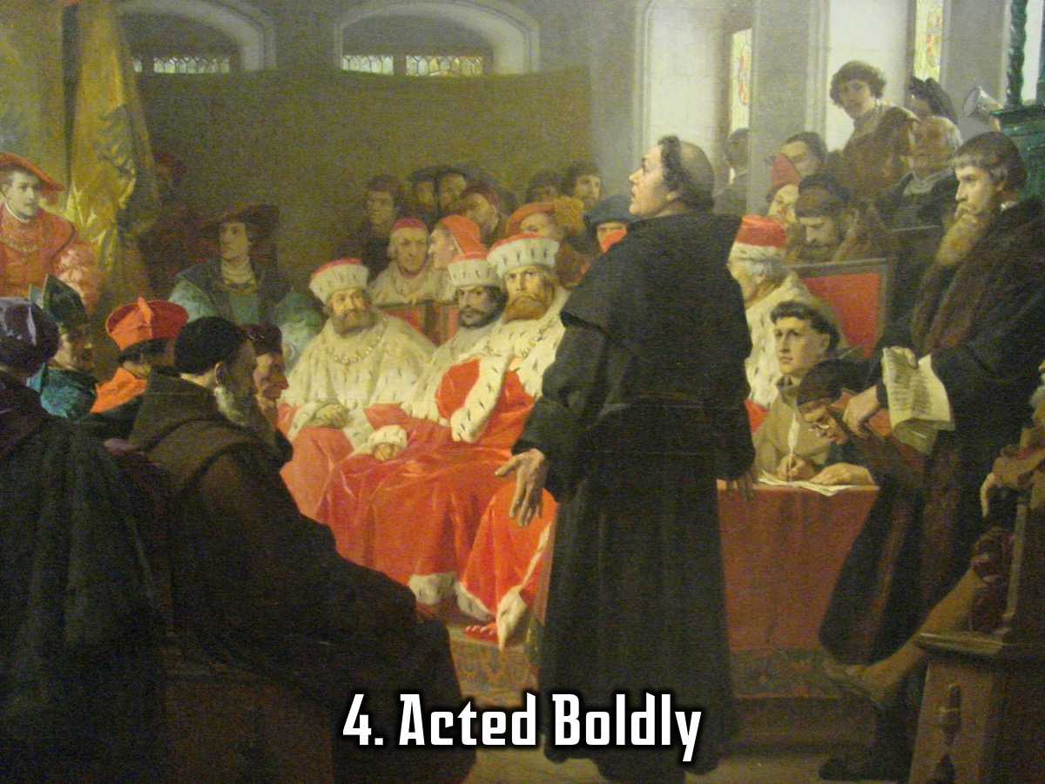
Notes:
4. Acted Boldly (They did not hesitate to act, even if they acted alone and were unsupported)

Slide 21
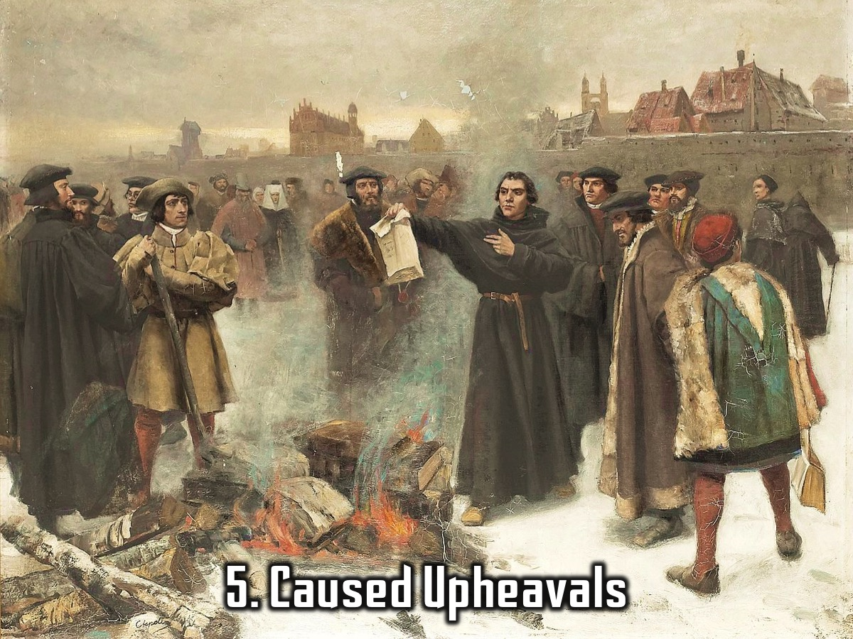
Notes:
5. Caused Upheavals (Started civil wars and political, social, and religious upheaval wherever they went)

Slide 22
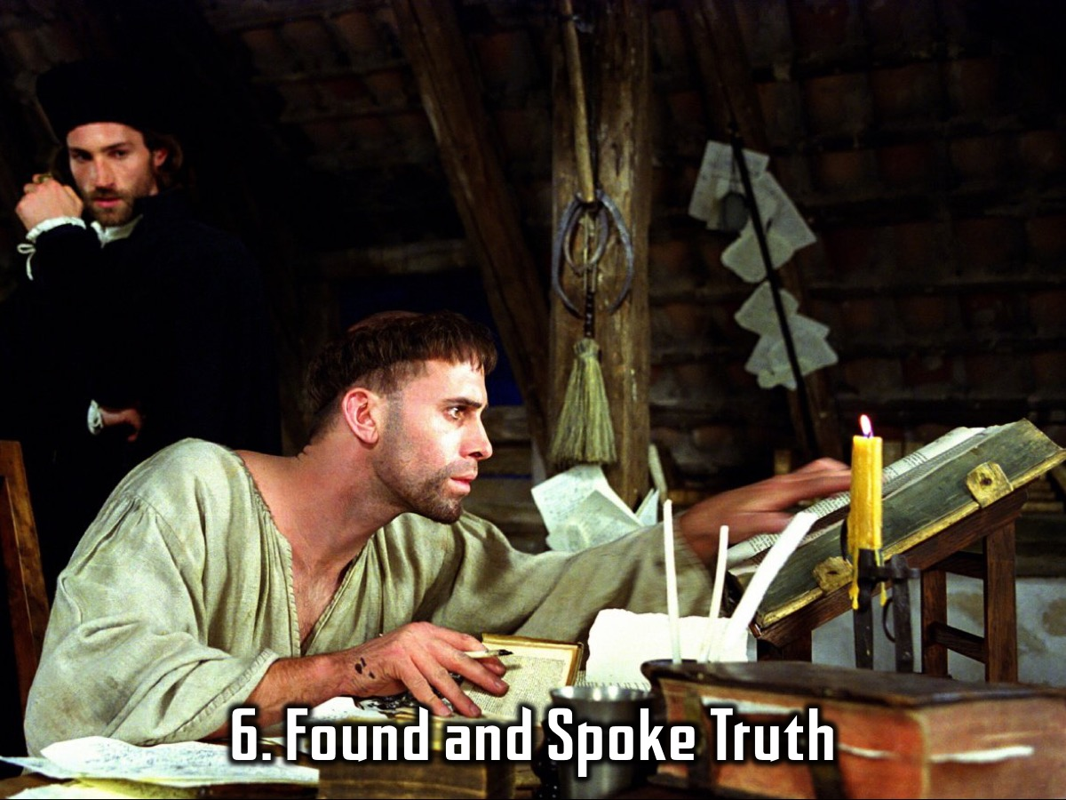
Notes:
6. Found and Spoke Truth (Searched for the truth, found the truth and spoke the truth to anyone and everyone)

Slide 23
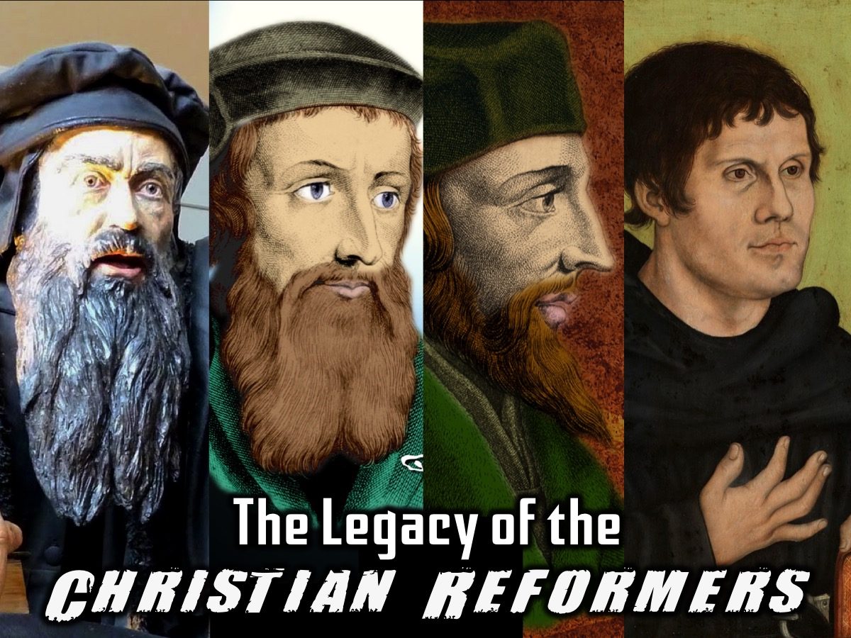
Notes:
The Legacy of the Christian Reformers. Although many of you might have no idea of who these men are they have left a legacy that we enjoy.

Slide 24
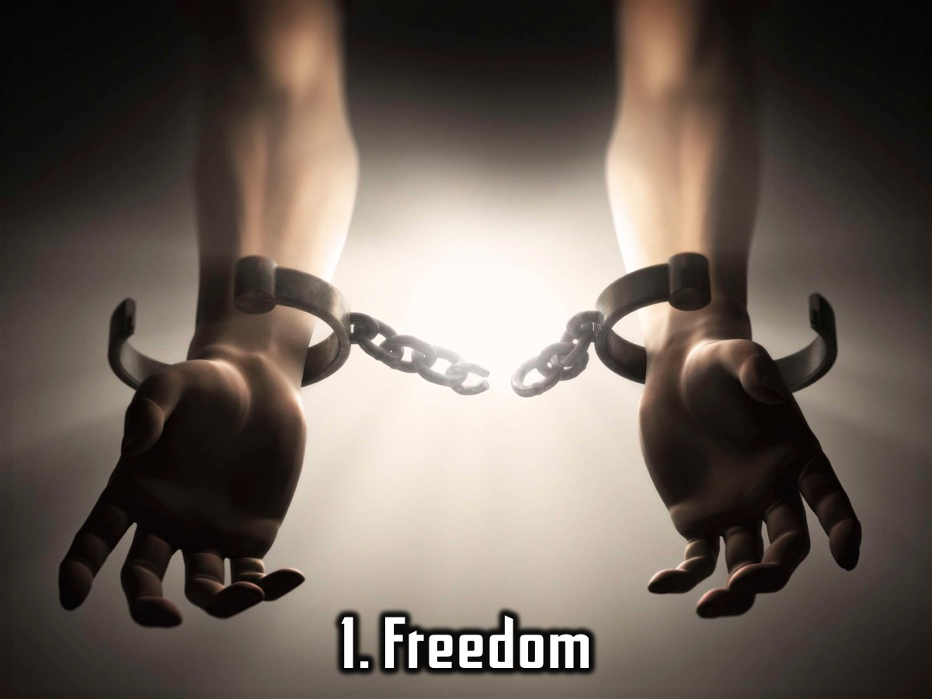
Notes:
1. Freedom. We have many freedoms and privileges because the reformers stood up against what was wrong in the church and in society.

Slide 25

Notes:
2. Scriptures. How many of you own a Bible? In Martin Luthers day you would all be arrested for owning one because you weren’t a Catholic priest. How many of you who own a Bible that has been translated into English? In Martin Luthers day you would be arrested and possibly executed because having a Bible in English was outlawed. Martin Luther was a monk who lived in a time where the world was blinded to God’s truth and where the church of the day told the common people lies to keep them in fear and submission. No ordinary person could read Latin and thus no ordinary person had ever read the Bible for themselves. Martin Luther was one such man who publically denounced the lies that the people were being told and spoke the truth.

Slide 26
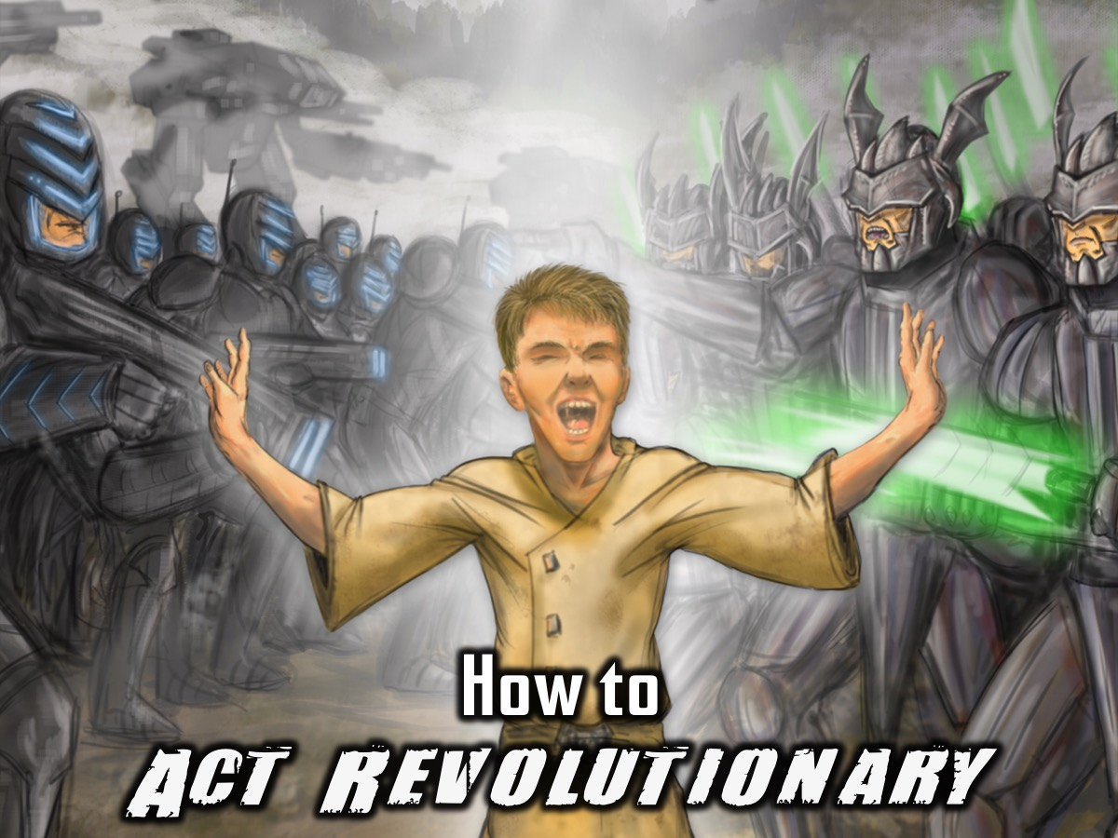
Notes:
How can we practically act revolutionary in the 21st century? We are not in the same situation as Ivan or some of the other great Christian revolutionaries were. Our faith is not illegal and thus it is all the more difficult to revolutionise our culture and society. To be a revolutionary in our time you need to do the following:

Slide 27
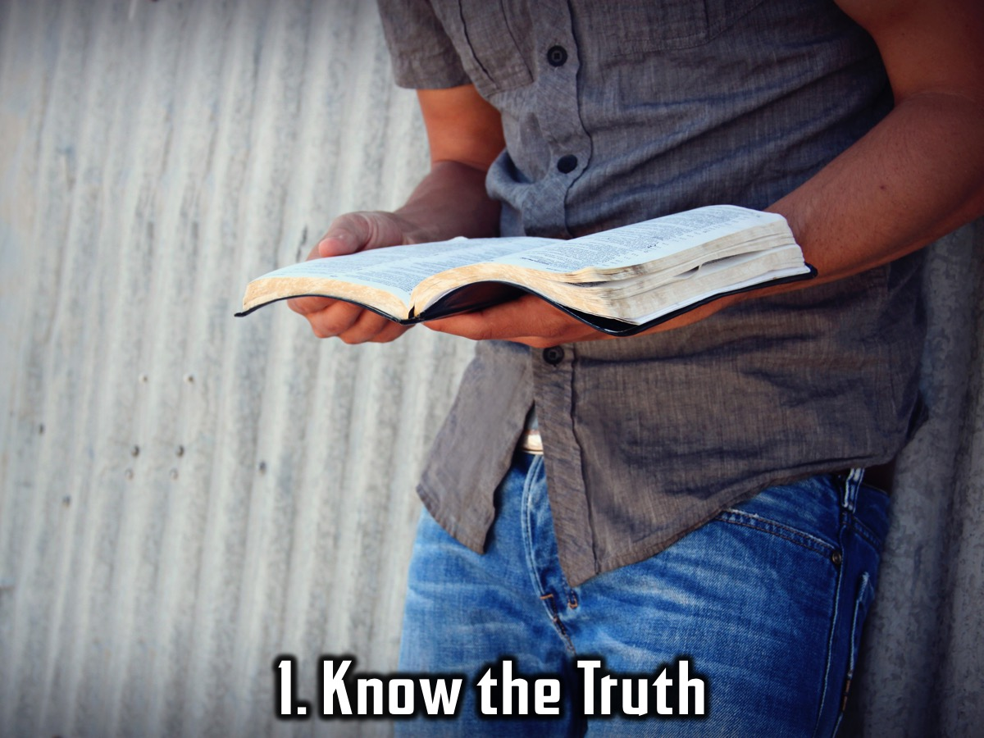
Notes:
1. Know the Truth. God’s word is the final authority on how we need to live our lives. Knowing this truth is vital in being able to live it out.

Slide 28

Notes:
2. Be a Rebel. Act against the common culture of lying, swearing, and manipulation, cheating and being morally lukewarm.

Slide 29

Notes:
3. Attack the Lies. Reject the lies that people say about the Bible and Jesus.

Slide 30
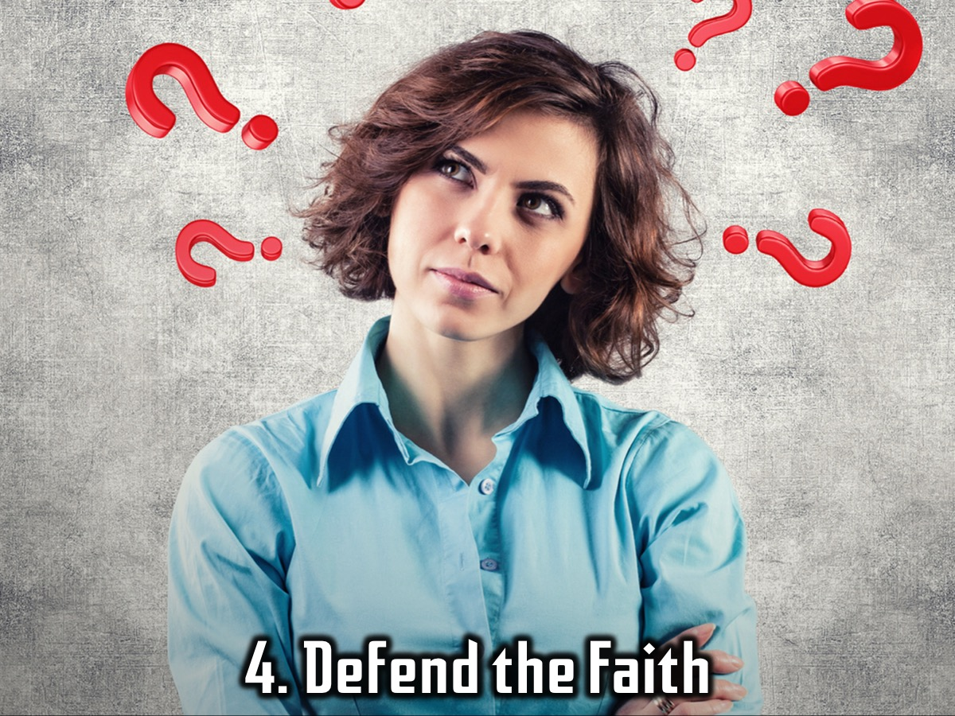
Notes:
4. Defend the Faith. Be ready and willing to stand up and defend your faith.

Slide 31
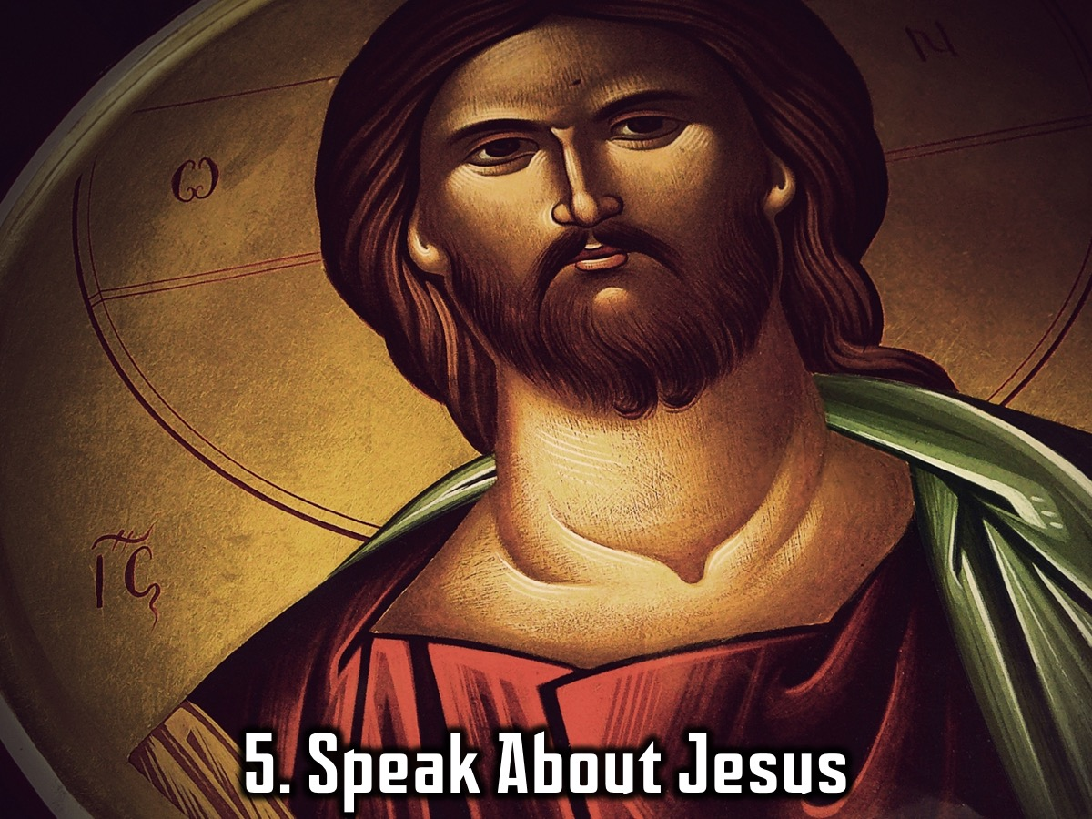
Notes:
5. Speak About Jesus. Do not be afraid to speak about your relationship with Jesus – you are not there to condemn them but to share your testimony.

Slide 32

Notes:
6. Start a Group. Start a connect group at your school where you can encourage other believers and engage with your friends.

Slide 33
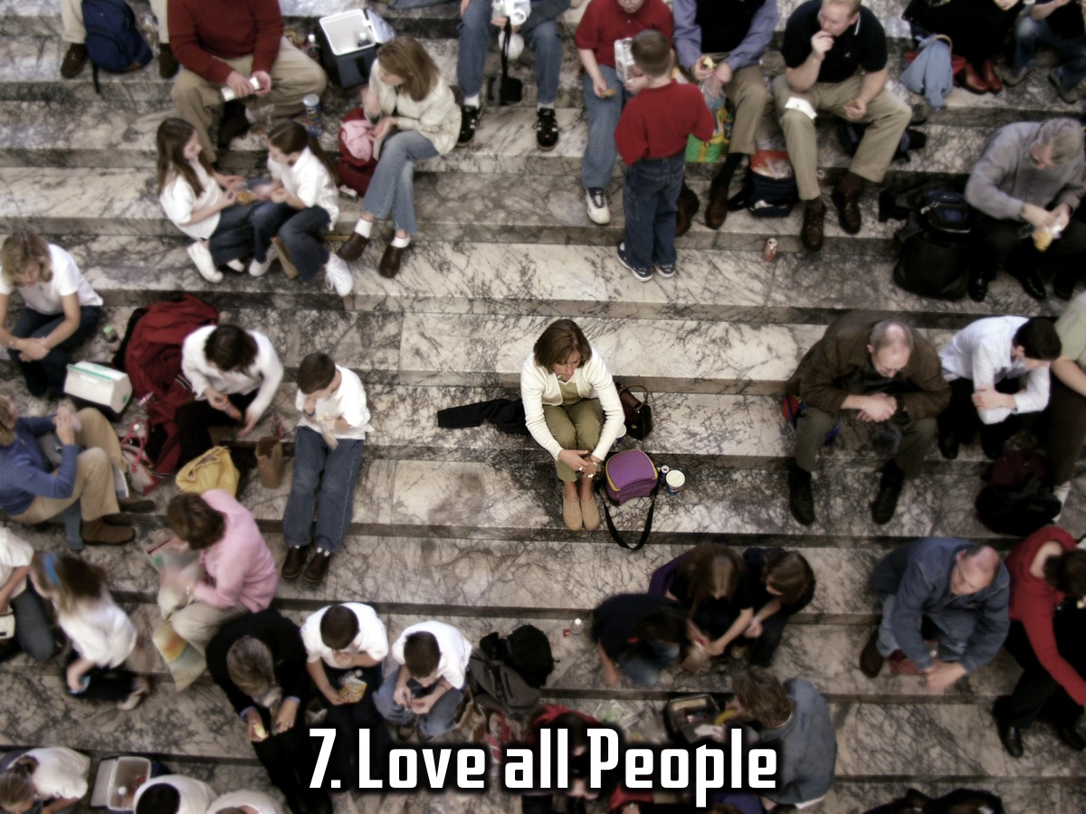
Notes:
7. Love all People. Love your enemies and those that others deem to be unworthy, uncool and unpopular.

Slide 34
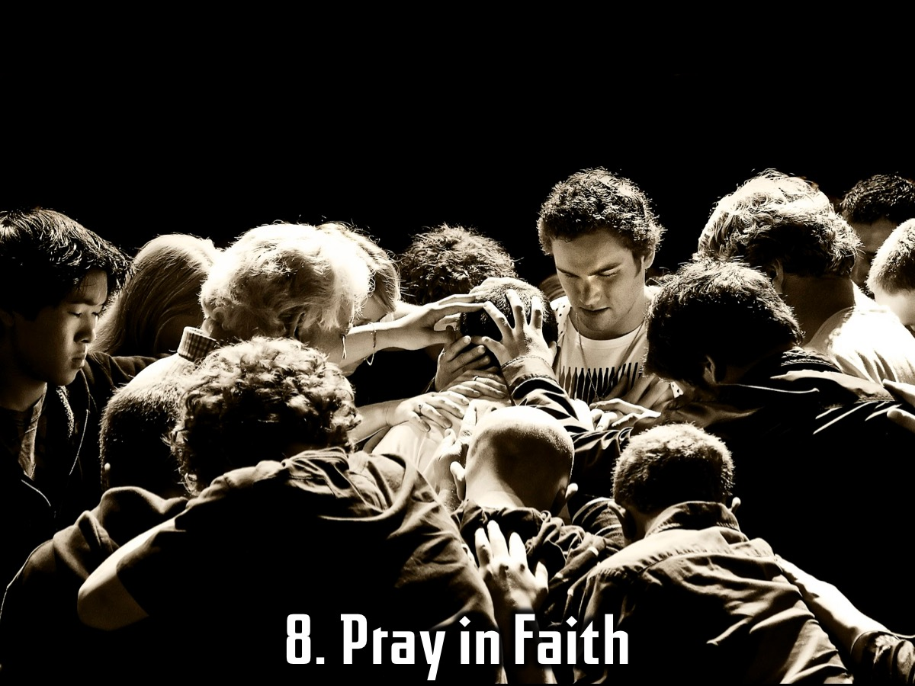
Notes:
8. Pray in Faith. Pray for those around you and expect results!

Slide 35
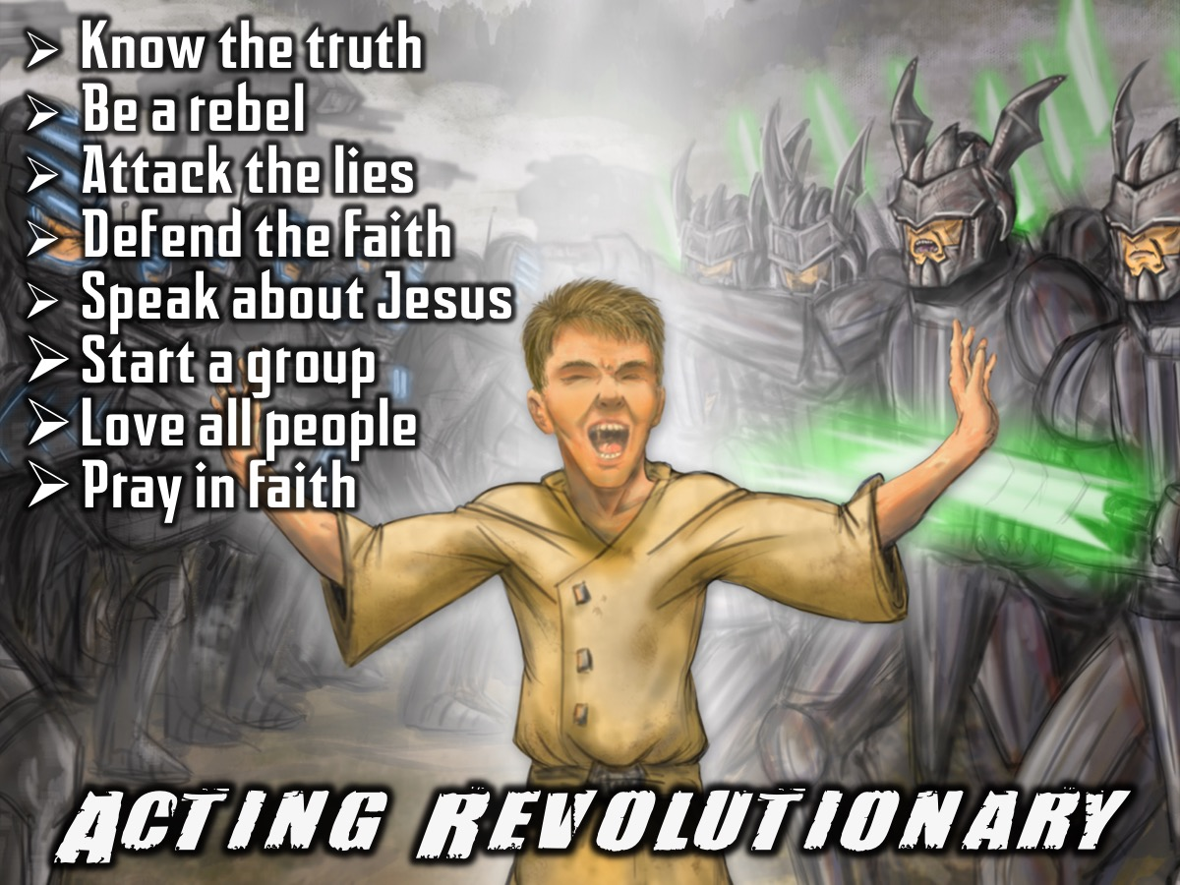
Notes:
So how can we act revolutionary in the 21st century? (1) Know the truth. (2) Be a rebel. (3) Attack the lies. (4) Defend the faith. (5) Speak about Jesus. (6) Start a group. (7) Love all people. (8) Pray in faith.

Slide 36
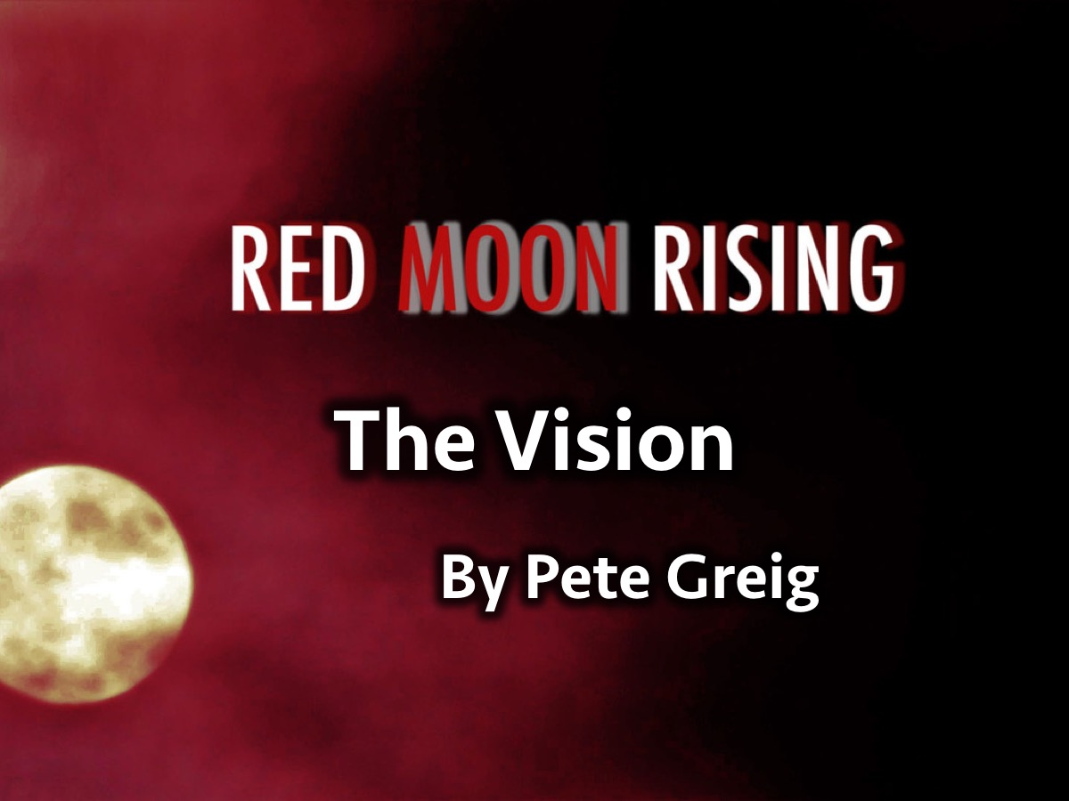
Notes:
In the book, Red Moon Rising, by Pete Greig there is an amazing piece that was written during a time of prayer – it is called The Vision.

Slide 37

Notes:
Video: The Vision by Pete Greig (Created using two videos on YouTube). Get it on YouTube at: https://www.youtube.com/watch?v=koUcySLfalo (Audio) and https://www.youtube.com/watch?v=11rbZWNGdNk (Video)
The Vision
So this guy comes up to me and says "what's the vision? What's the big idea?" I open my mouth and words come out like this… The vision?
The vision is JESUS – obsessively, dangerously, undeniably Jesus.
The vision is an army of young people.
You see bones? I see an army. And they are FREE from materialism.
They laugh at 9-5 little prisons. They could eat caviar on Monday and crusts on Tuesday. They wouldn't even notice. They know the meaning of the Matrix, the way the west was won. They are mobile like the wind, they belong to the nations. They need no passport.. People write their addresses in pencil and wonder at their strange existence. They are free yet they are slaves of the hurting and dirty and dying. What is the vision ? The vision is holiness that hurts the eyes. It makes children laugh and adults angry. It gave up the game of minimum integrity long ago to reach for the stars. It scorns the good and strains for the best. It is dangerously pure.
Light flickers from every secret motive, every private conversation. It loves people away from their suicide leaps, their Satan games. This is an army that will lay down its life for the cause. A million times a day its soldiers choose to lose that they might one day win the great 'Well done' of faithful sons and daughters.
Such heroes are as radical on Monday morning as Sunday night. They don't need fame from names. Instead they grin quietly upwards and hear the crowds chanting again and again: "COME ON!"
And this is the sound of the underground The whisper of history in the making Foundations shaking Revolutionaries dreaming once again Mystery is scheming in whispers Conspiracy is breathing… This is the sound of the underground
And the army is discipl(in)ed.
Young people who beat their bodies into submission.
Every soldier would take a bullet for his comrade at arms. The tattoo on their back boasts "for me to live is Christ and to die is gain".
Sacrifice fuels the fire of victory in their upward eyes. Winners. Martyrs. Who can stop them ? Can hormones hold them back? Can failure succeed? Can fear scare them or death kill them ?
And the generation prays like a dying man with groans beyond talking, with warrior cries, sulphuric tears and with great barrow loads of laughter! Waiting. Watching: 24 – 7 – 365.
Whatever it takes they will give: Breaking the rules. Shaking mediocrity from its cosy little hide. Laying down their rights and their precious little wrongs, laughing at labels, fasting essentials. The advertisers cannot mould them. Hollywood cannot hold them. Peer-pressure is powerless to shake their resolve at late night parties before the cockerel cries.
They are incredibly cool, dangerously attractive inside.
On the outside? They hardly care. They wear clothes like costumes to communicate and celebrate but never to hide. Would they surrender their image or their popularity? They would lay down their very lives - swap seats with the man on death row - guilty as hell. A throne for an electric chair.
With blood and sweat and many tears, with sleepless nights and fruitless days, they pray as if it all depends on God and live as if it all depends on them.
Their DNA chooses JESUS. (He breathes out, they breathe in.) Their subconscious sings. They had a blood transfusion with Jesus. Their words make demons scream in shopping centres. Don't you hear them coming? Herald the weirdo's! Summon the losers and the freaks. Here come the frightened and forgotten with fire in their eyes. They walk tall and trees applaud, skyscrapers bow, mountains are dwarfed by these children of another dimension. Their prayers summon the hounds of heaven and invoke the ancient dream of Eden.
And this vision will be. It will come to pass; it will come easily; it will come soon. How do I know? Because this is the longing of creation itself, the groaning of the Spirit, the very dream of God. My tomorrow is his today. My distant hope is his 3D. And my feeble, whispered, faithless prayer invokes a thunderous, resounding, bone-shaking great 'Amen!' from countless angels, from hero's of the faith, from Christ himself. And he is the original dreamer, the ultimate winner.
Guaranteed.

Slide 38
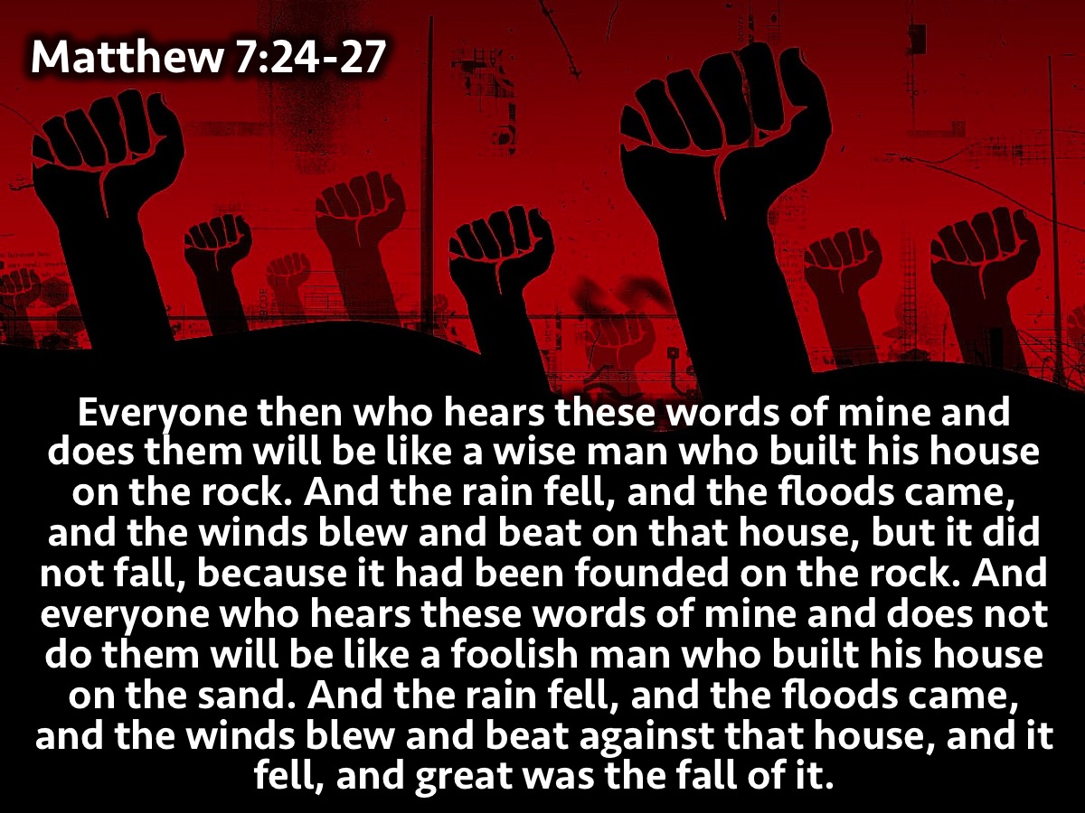
Notes:
Everyone then who hears these words of mine and does them will be like a wise man who built his house on the rock. And the rain fell, and the floods came, and the winds blew and beat on that house, but it did not fall, because it had been founded on the rock. And everyone who hears these words of mine and does not do them will be like a foolish man who built his house on the sand. And the rain fell, and the floods came, and the winds blew and beat against that house, and it fell, and great was the fall of it. (Matthew 7:24-27)
It is not enough to have listened every week to this reformation series without having put it into practice.

Slide 39
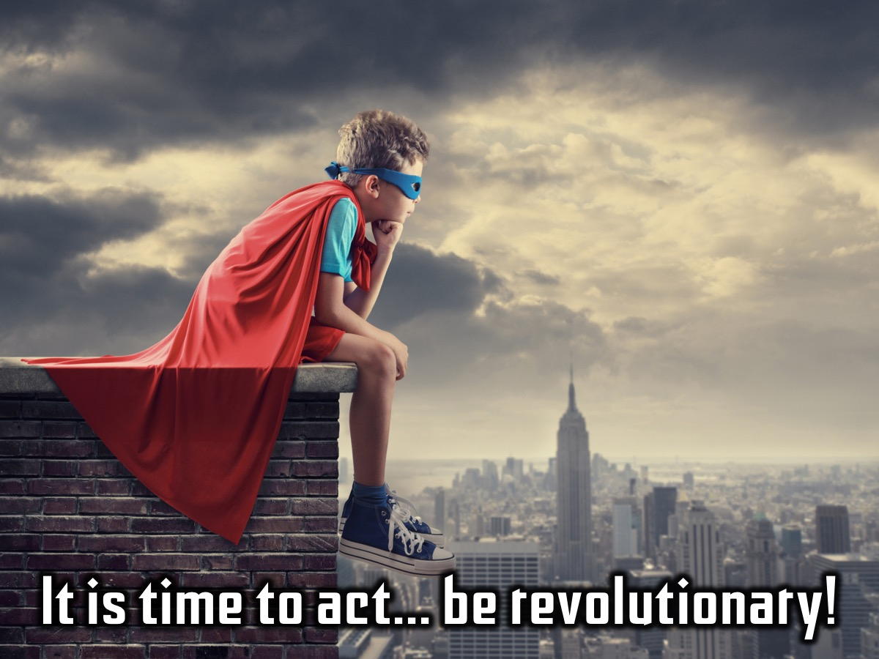
Notes:
It is time to act - time to be revolutionary!

Slide 40

Notes:
Prayer

Slide 41

Notes:
Next Sunday we will be wrapping up our Revolution series.

