Slide 1
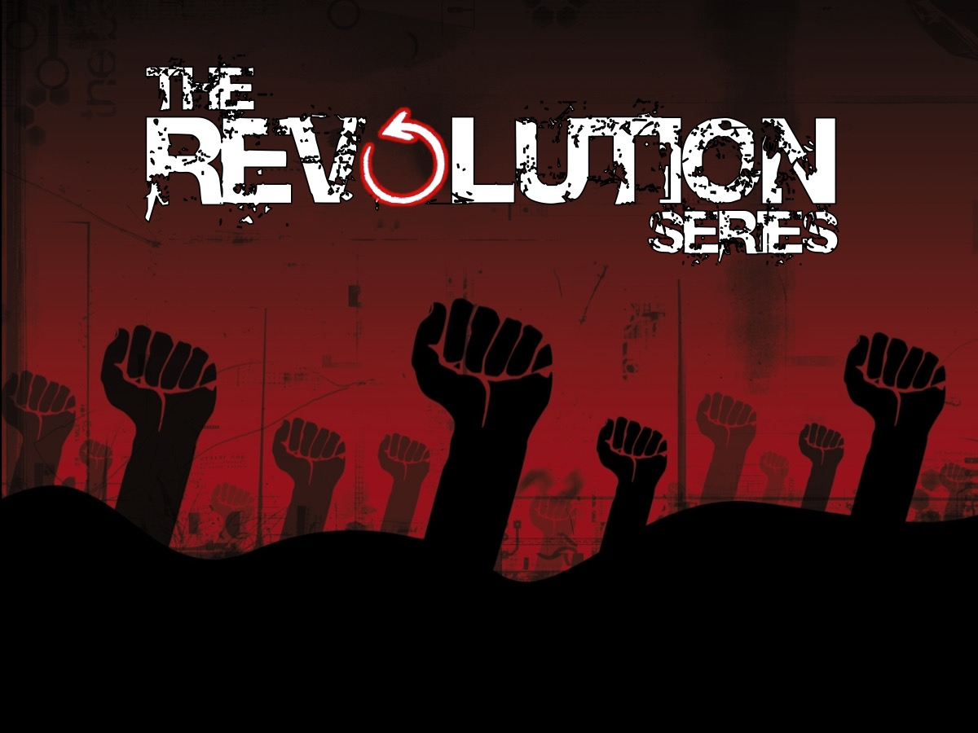
Notes:
Today is the final week in our Revolution series!

Slide 2
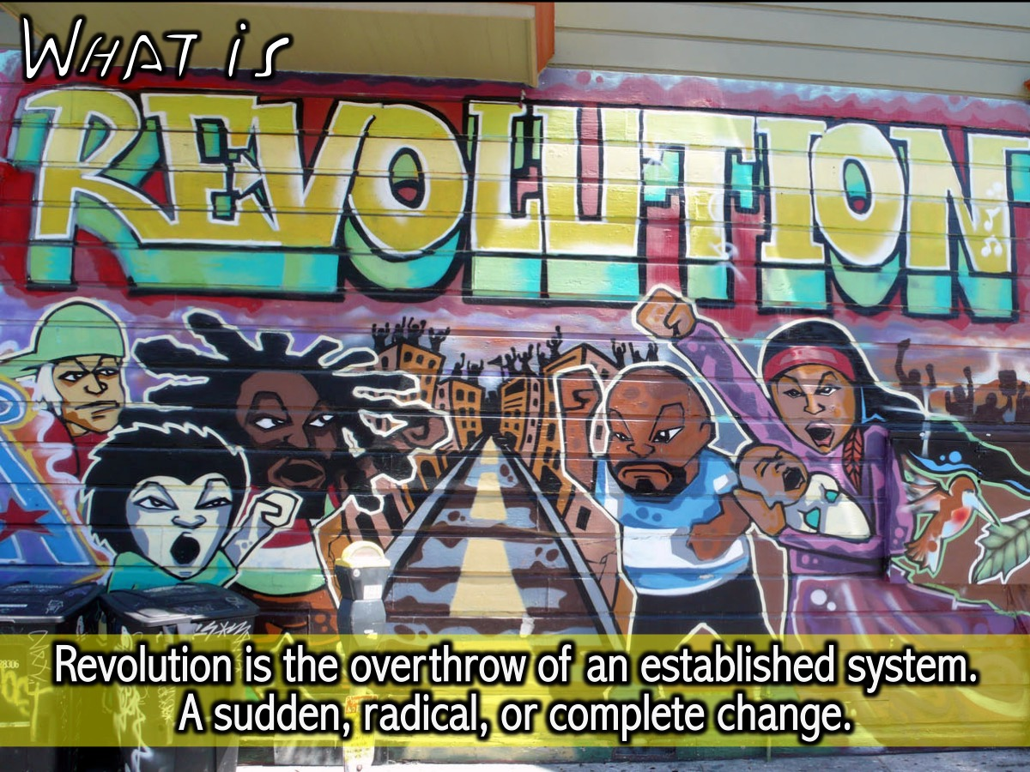
Notes:
In week 1 we defined revolution as an overthrow or replacement of an established system, a sudden, radical, or complete change.

Slide 3
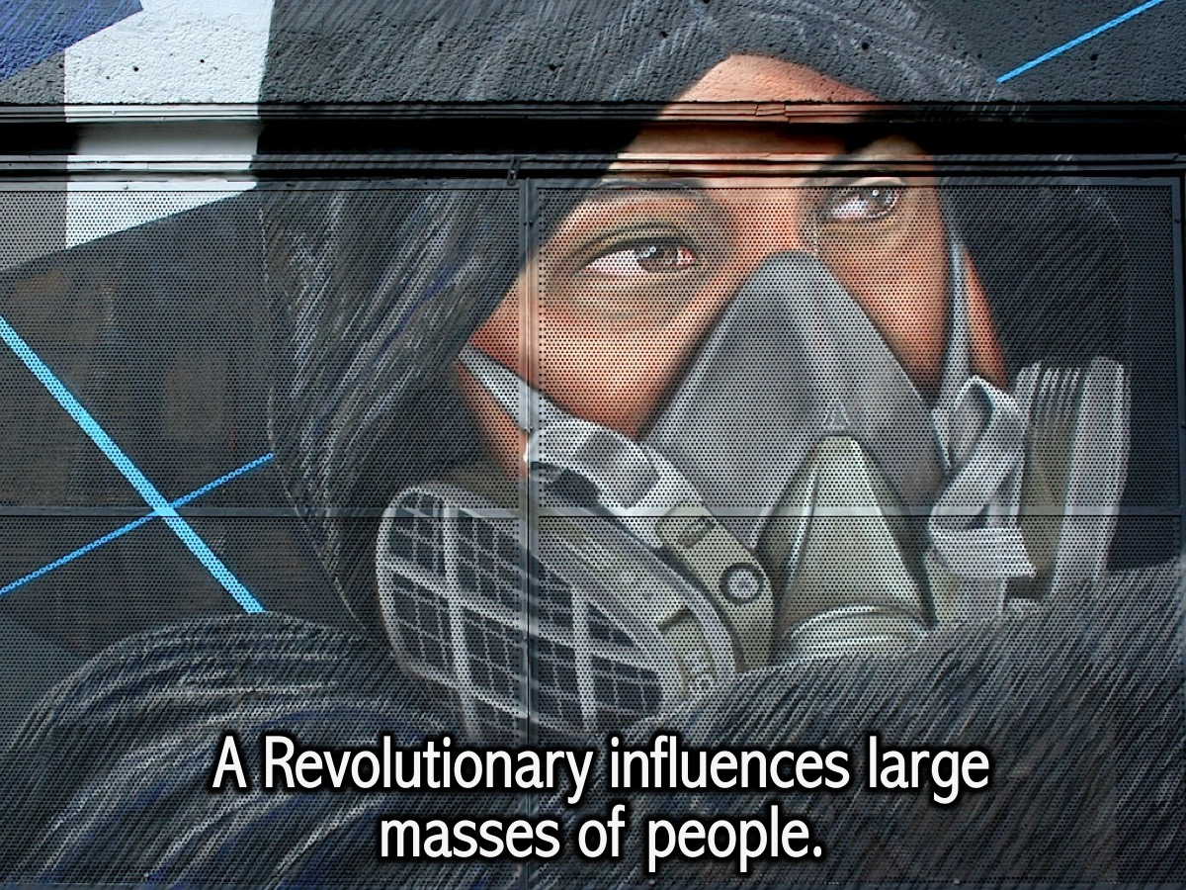
Notes:
A revolutionary influences large masses of people.

Slide 4
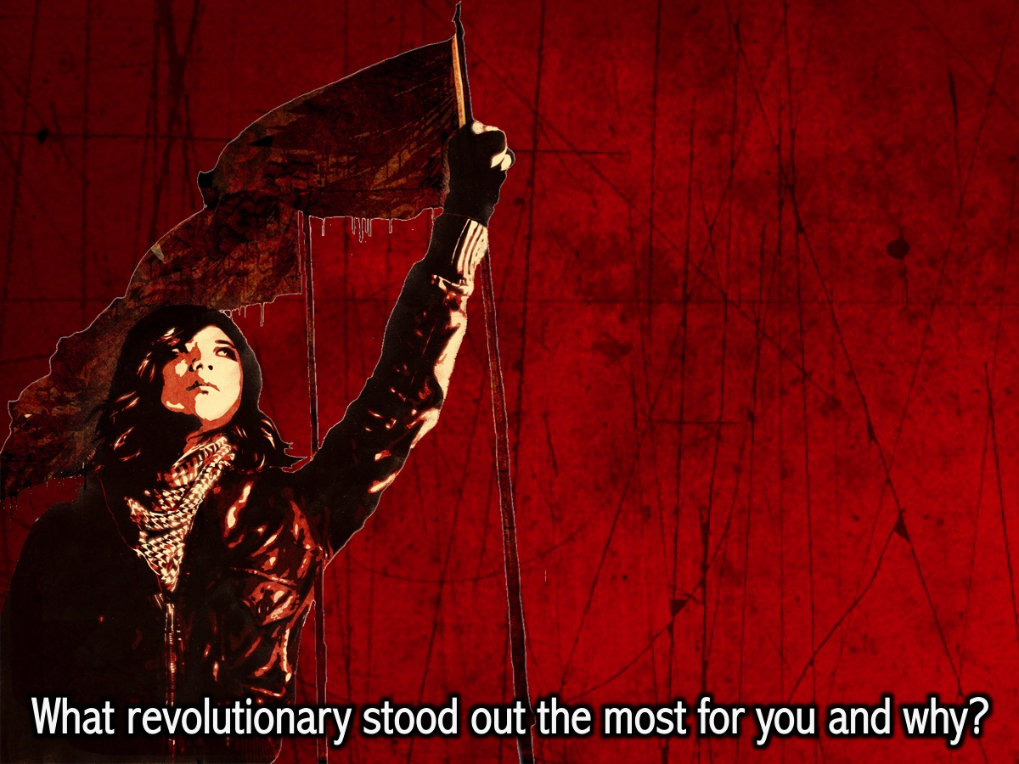
Notes:
In the past 7 weeks we’ve looked at various people in history who were able to achieve that. To influence society on a large scale.
Share: Take a moment and share with the person next to you who stood out for you the most and why?

Slide 5
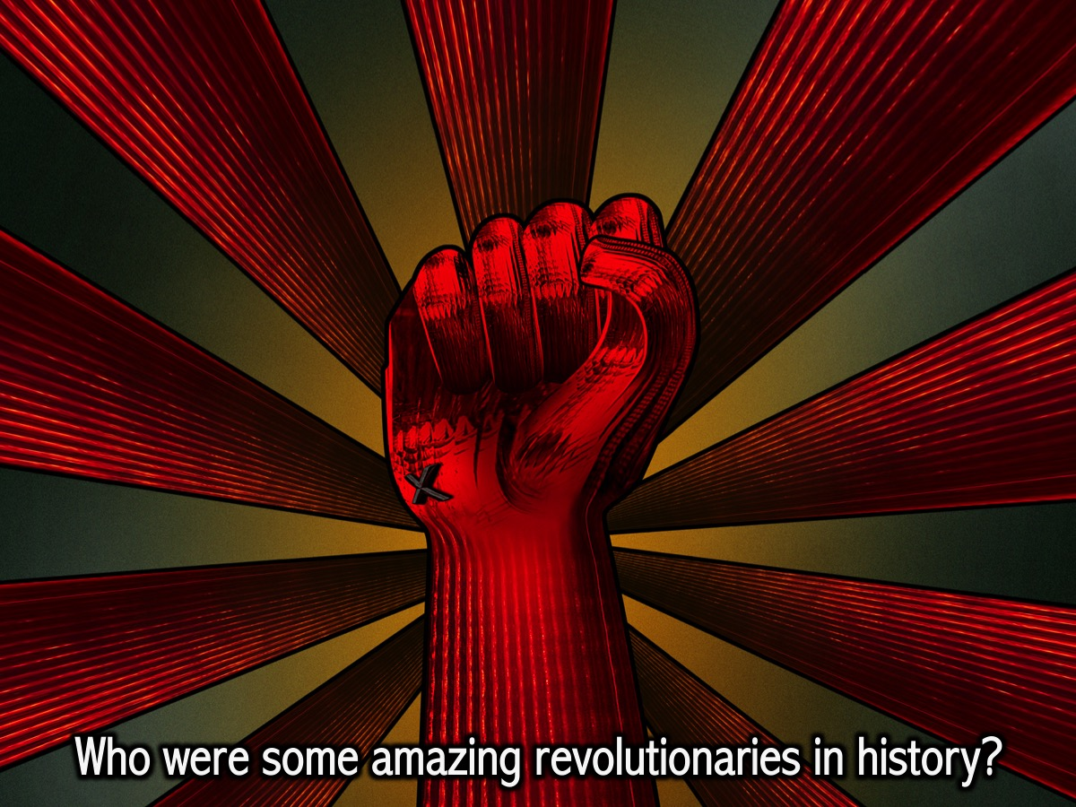
Notes:
Who were some amazing revolutionaries in history?
(Have some chocolates to handout to people who can mention significant figures in history)

Slide 6
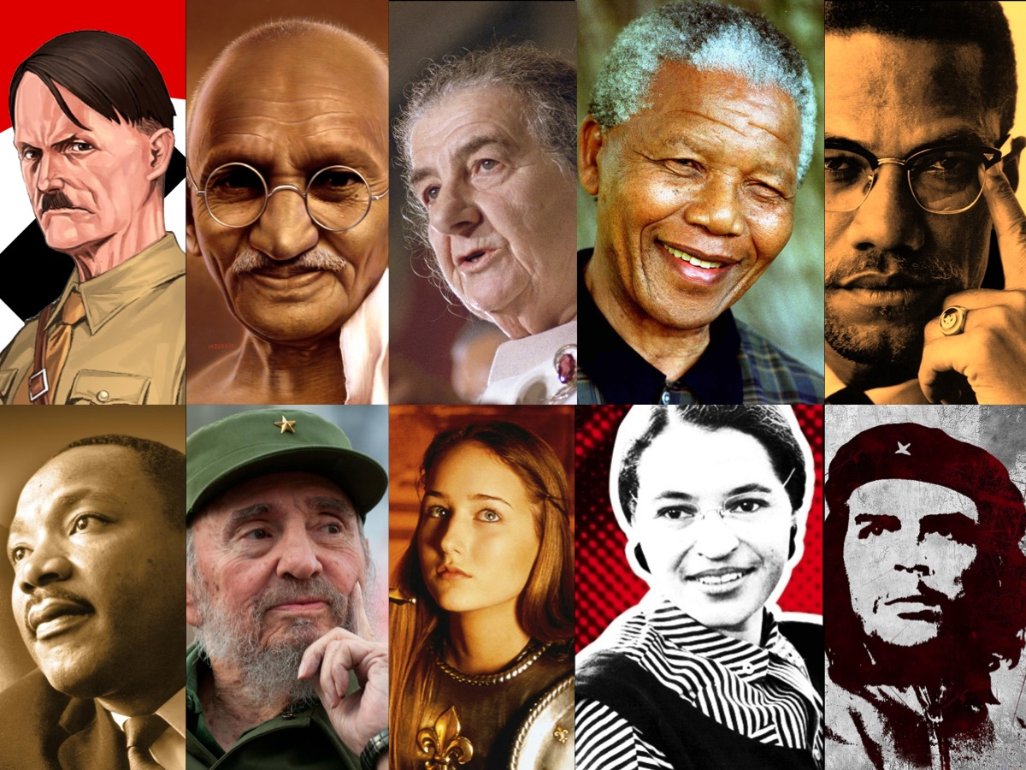
Notes:
We have looked at some amazing revolutionaries!

Slide 7
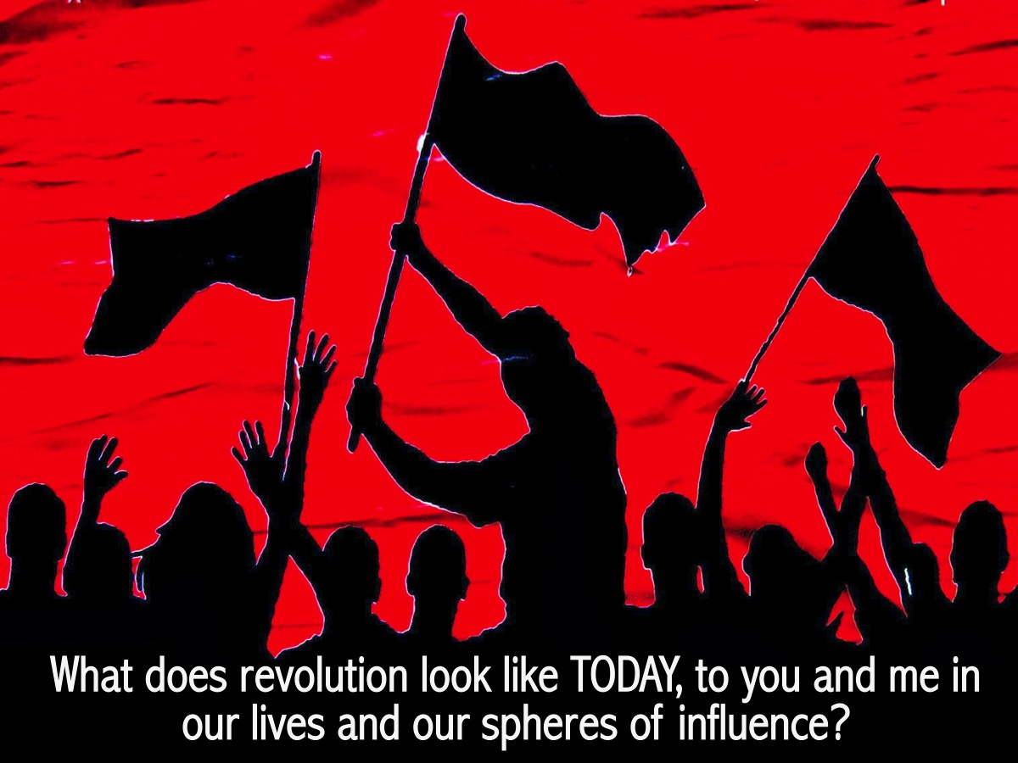
Notes:
What does revolution look like TODAY, to you and me in our lives and our spheres of influence?

Slide 8
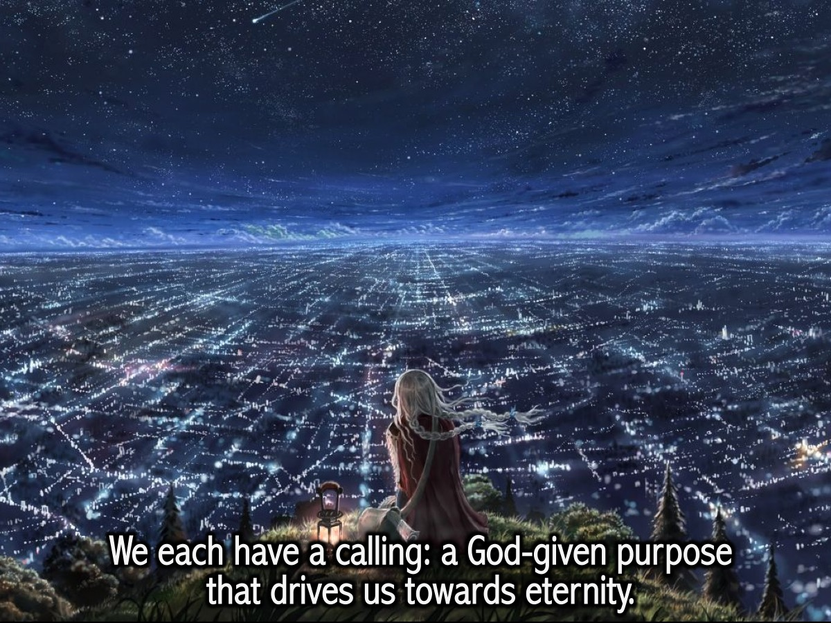
Notes:
We each have a calling: a God given purpose that drives us towards eternity.

Slide 9
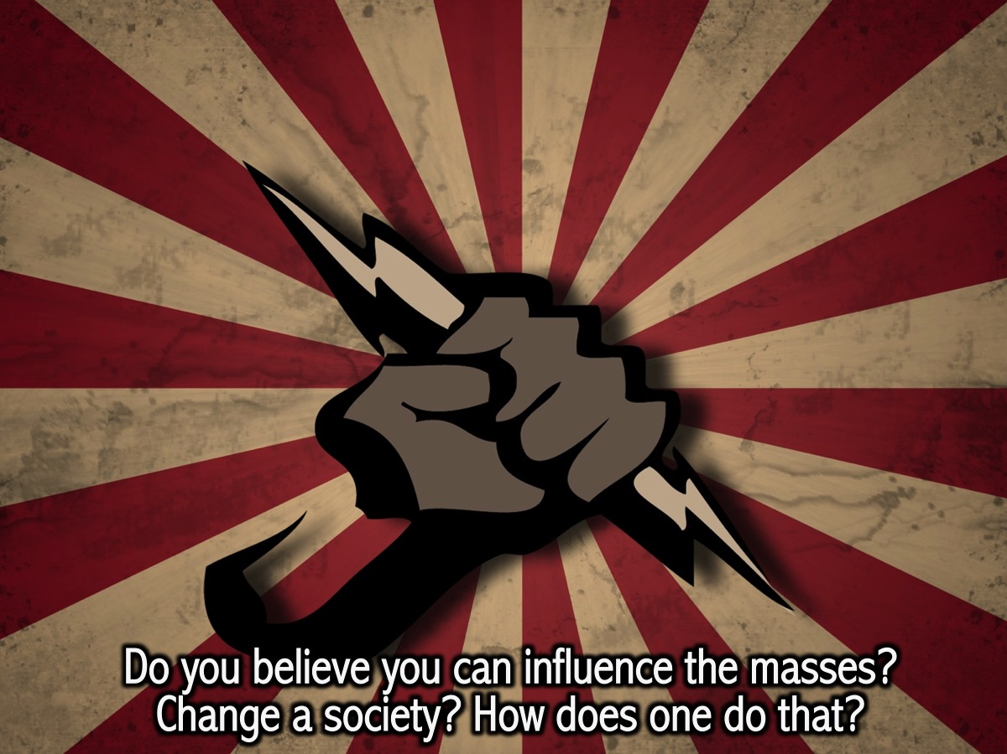
Notes:
Do you believe you can influence the masses? Change a society? How does one do that?

Slide 10

Notes:
In the Hunger Games, Katniss decides that she will lead the rebellion against the Capitol!
Video: The Hunger Games Mockingjay – Part 1 Official Teaser Trailer 1. Get it on YouTube at: https://www.youtube.com/watch?v=JfrJFtEwucc

Slide 11
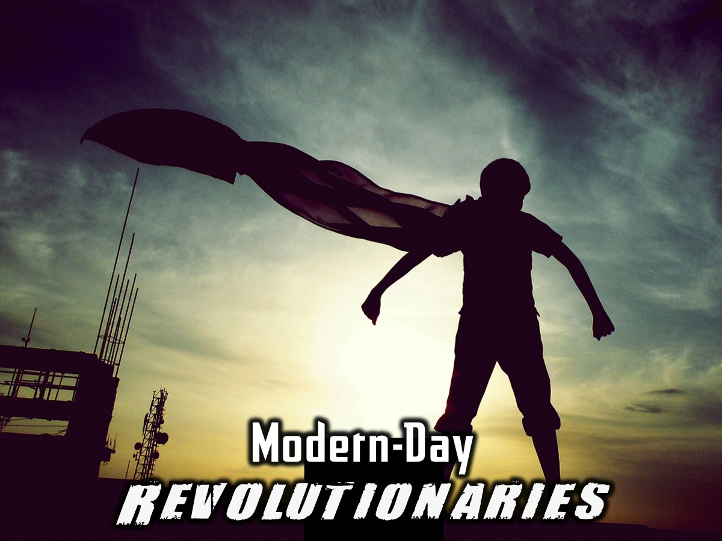
Notes:
Modern Day Revolutionaries: Let’s begin by looking at a couple people I think have brought about RADICAL change in their spheres of influence in our generation.

Slide 12

Notes:
I doubt any of you have owned a cassette player.

Slide 13
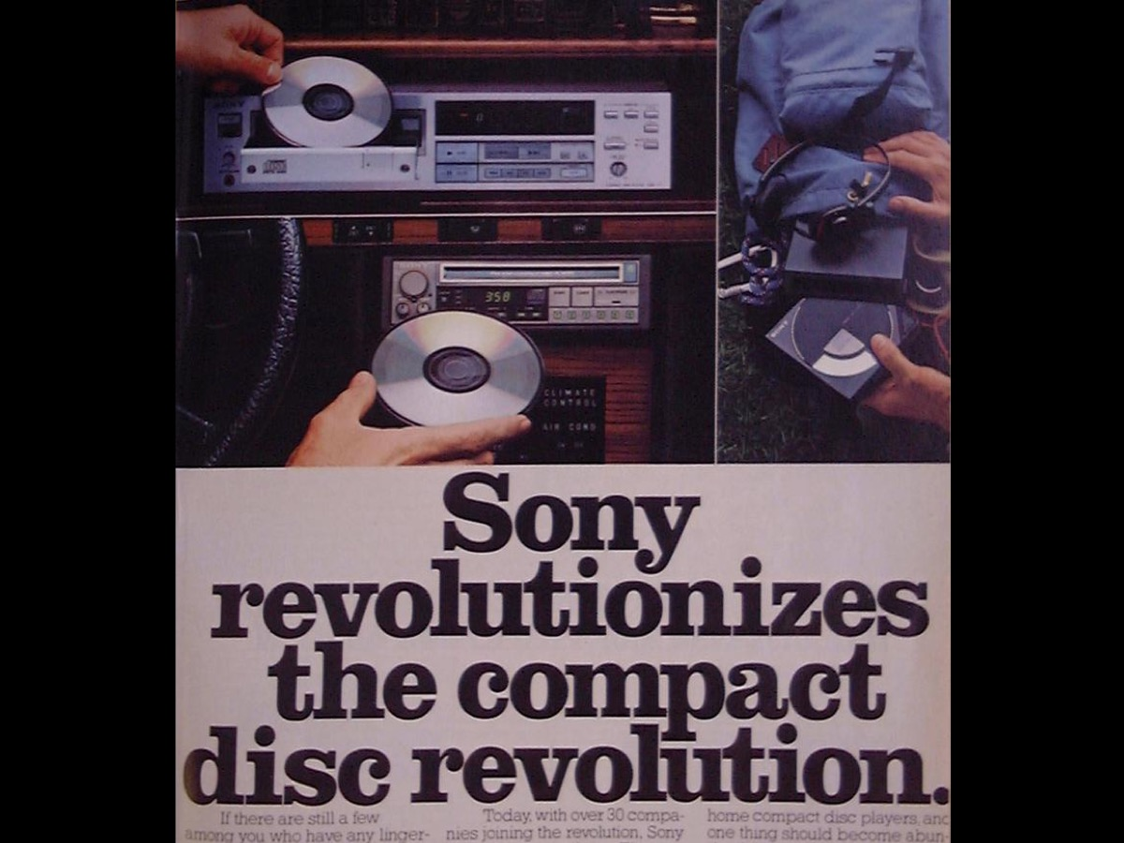
Notes:
Sony went on to revolutioniase the CD techonlogy by bringing out the first portable CD player.

Slide 14
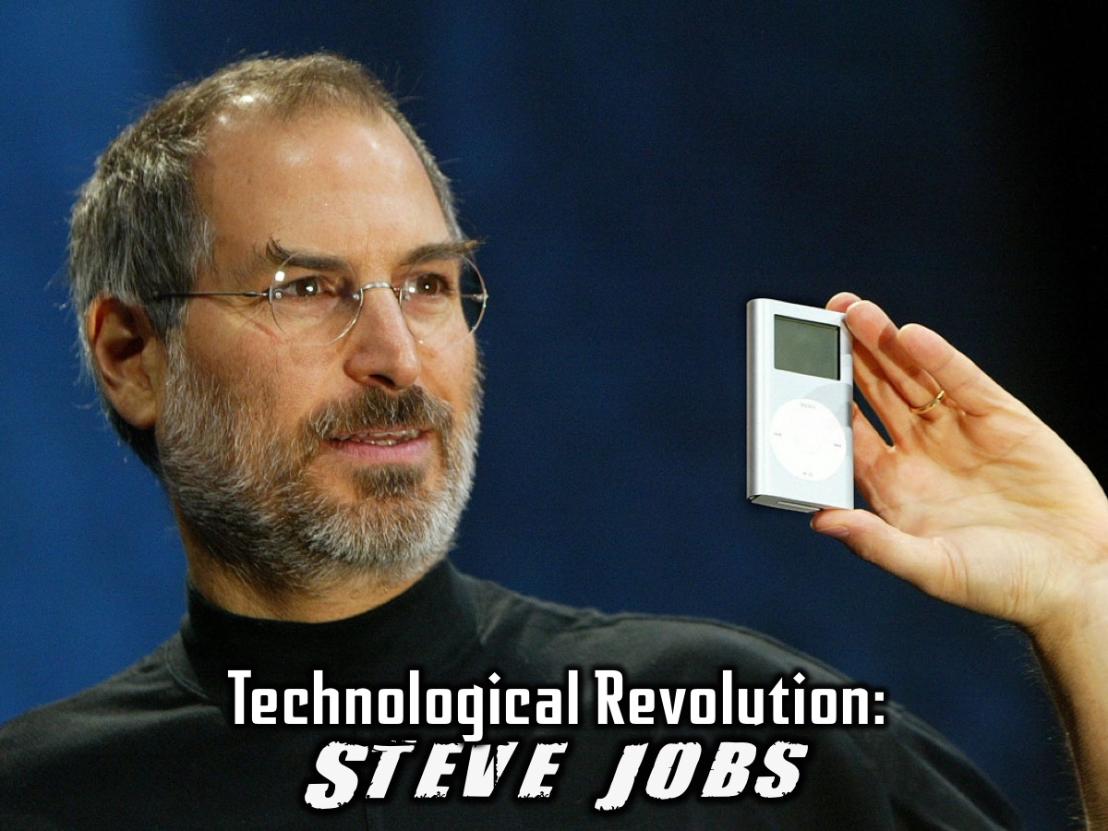
Notes:
Technological Revolution: Steve Jobs. Steve Jobs co-founded Apple Computers with Steve Wozniak. Under Jobs' guidance, the company pioneered a series of revolutionary technologies, including the iPhone and iPad. Apple introduced such revolutionary products as the Macbook Air, iPod and iPhone, all of which have dictated the evolution of modern technology. Almost immediately after Apple releases a new product, competitors scramble to produce comparable technologies.

Slide 15
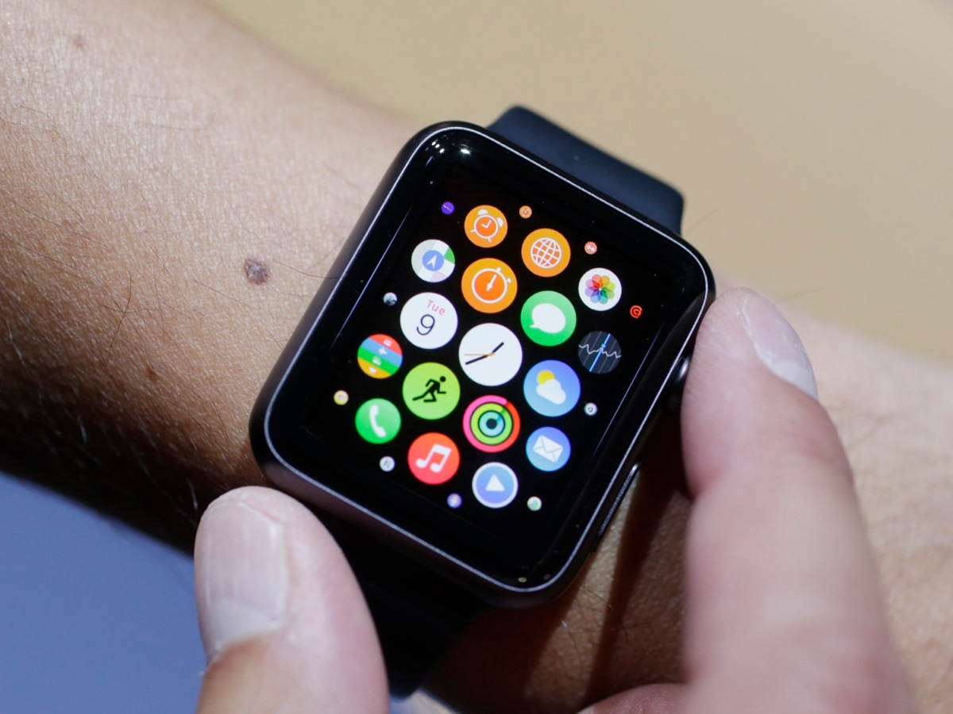
Notes:
Apple continues to influence trends as recently as earlier this past week – they launched the new Apple Watch.

Slide 16
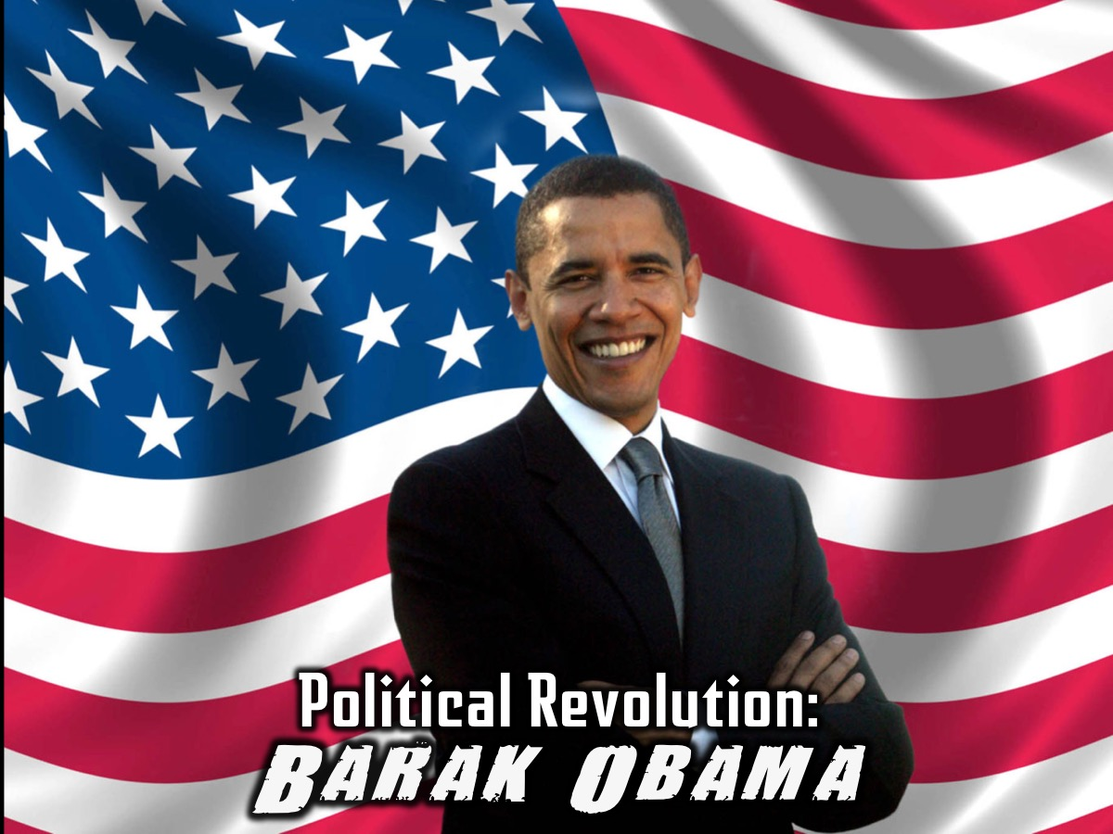
Notes:
Political Revolution: Barack Obama. Barack Obama is the 44th and current president of the United States, and the first African American to serve as U.S. president. First elected to the presidency in 2008, he won a second term in 2012.

Slide 17
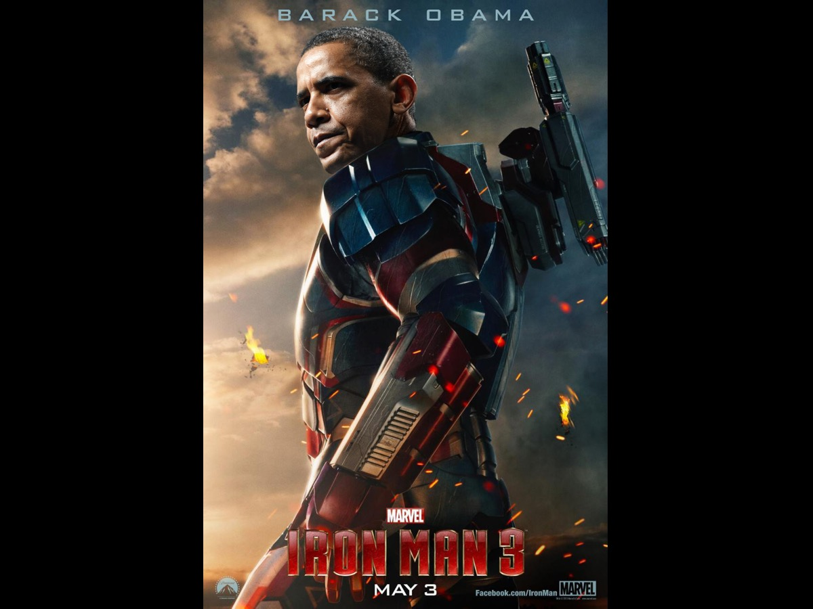
Notes:
Maybe President Obama is the ultimate Ironman!

Slide 18
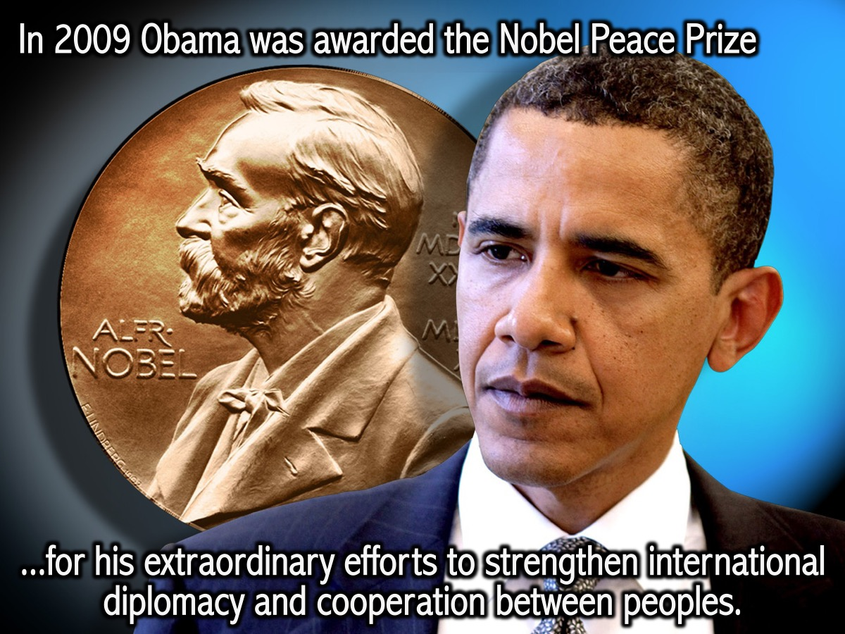
Notes:
In 2009 President Obama was awarded the Nobel Peace Prize "for his extraordinary efforts to strengthen international diplomacy and cooperation between peoples”.
Video: Part of President Obama’s victory speech in 2012 (from 0:54-2:00). Get it on YouTube at: https://www.youtube.com/watch?v=bumASg2LAmk

Slide 19
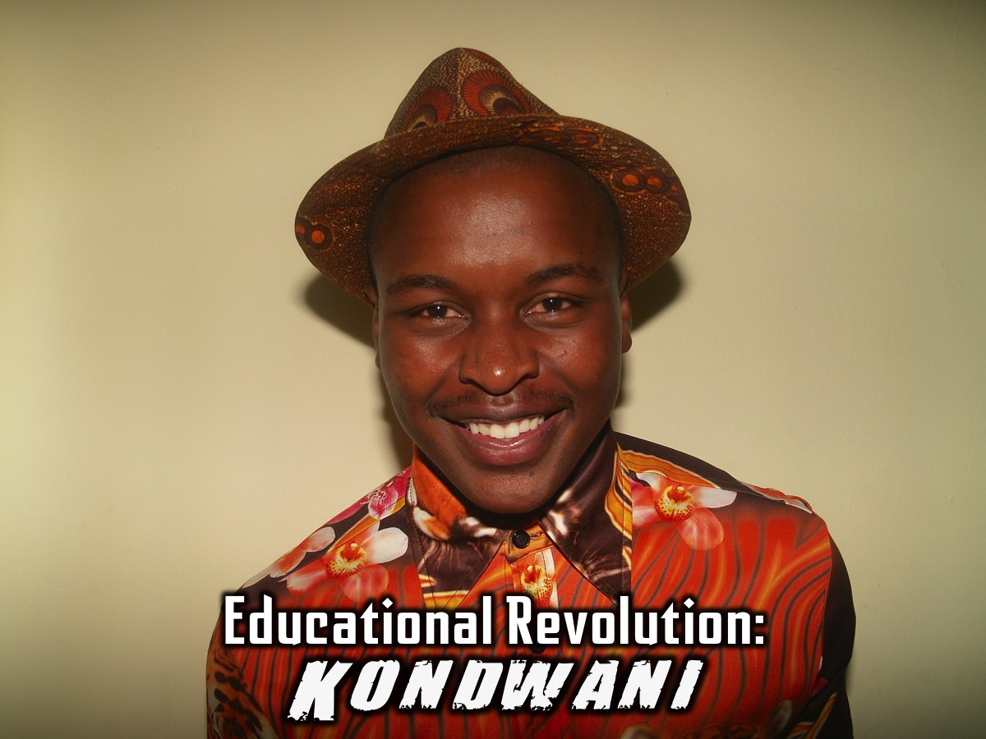
Notes:
Educational Revolution: Kondwani. Kondwani, who was part of His Youth and served as an intern with us recently, is a student at WITS University where he has helped to create a tech system that measures performance and predicts change in behavior to enable students to attain required grades. He is also working towards being elected to the student council to influence change on Campus.

Slide 20
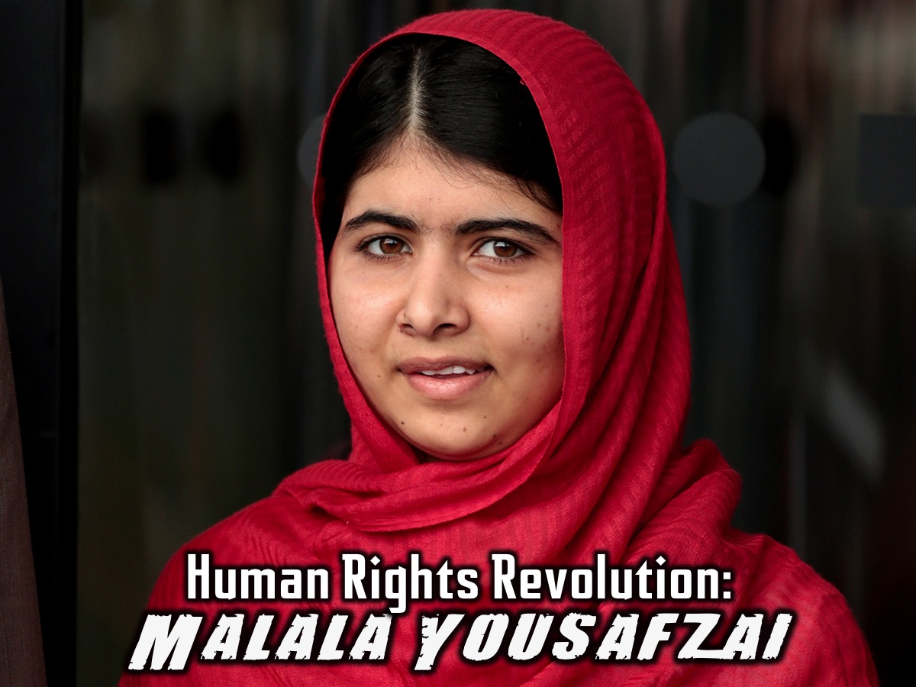
Notes:
Human Rights Revolution: Malala Yousafzai story. As a young girl, Malala Yousafzai defied the Taliban in Pakistan and demanded that girls be allowed to receive an education. When she was 14, Malala and her family learned that the Taliban had issued a death threat against her. One day on her way to school She was shot in the head by a Taliban gunman in 2012, but survived.
Video: Malala Yousafzai's UN Speech. Get it on YouTube at: https://www.youtube.com/watch?v=UrasFcGqM_s

Slide 21
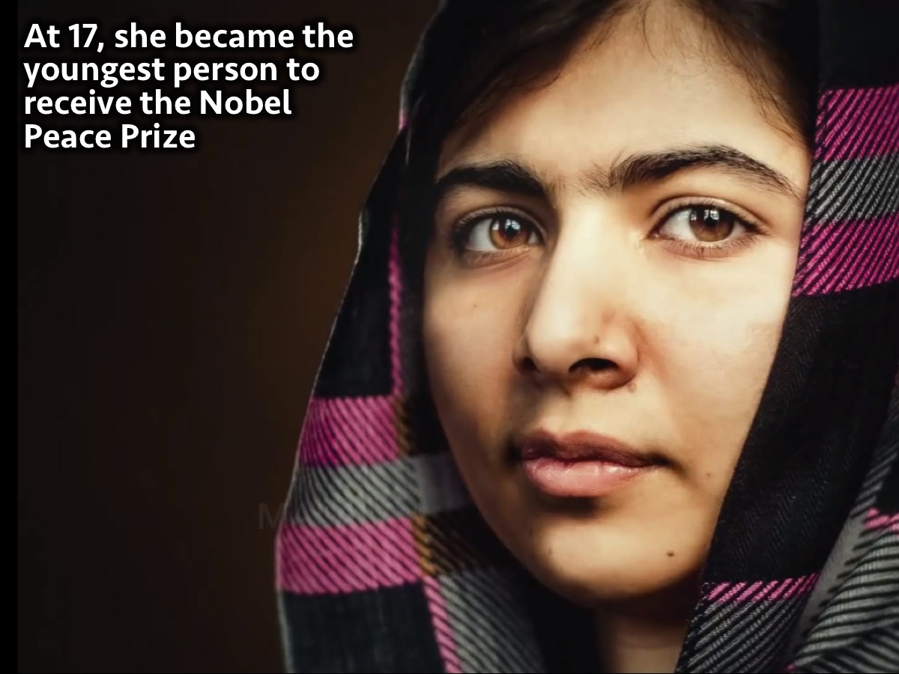
Notes:
At age 17, she became the youngest person to receive the Nobel Peace Prize.

Slide 22
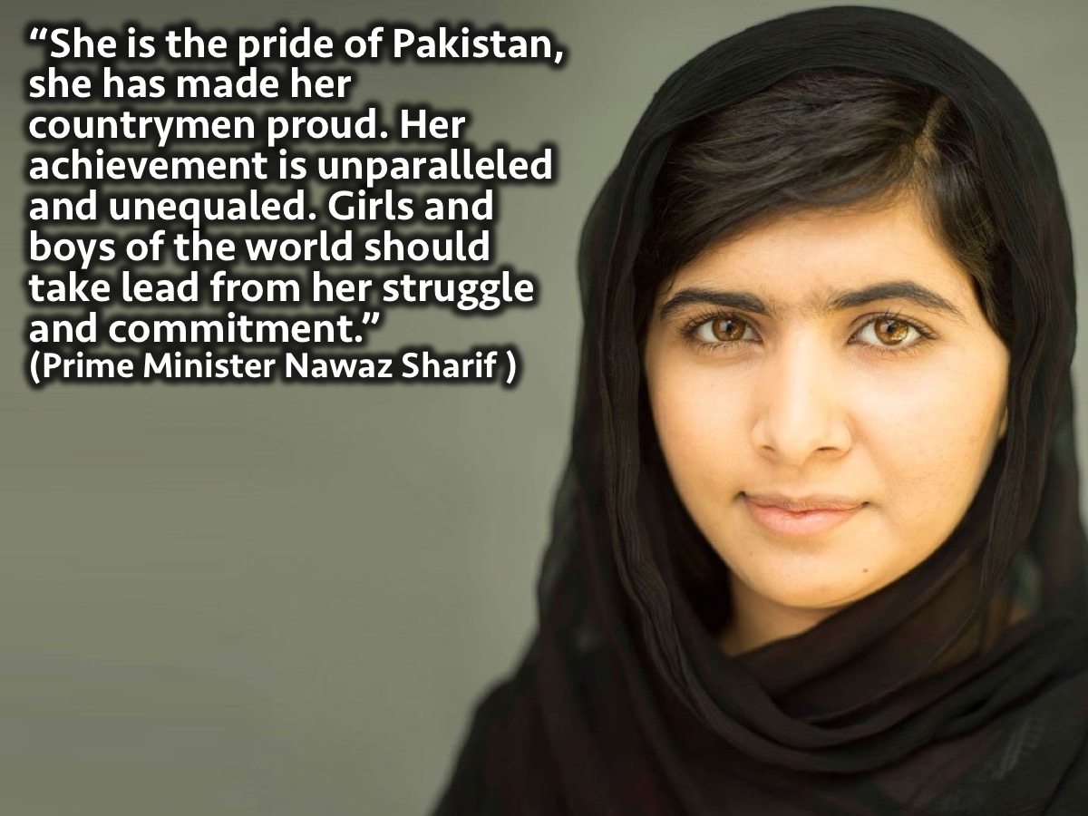
Notes:
In congratulating Yousafzai, Pakistani Prime Minister Nawaz Sharif said: “She is (the) pride of Pakistan, she has made her countrymen proud. Her achievement is unparalleled and unequaled. Girls and boys of the world should take lead from her struggle and commitment."
Video: The Bravest Girl in the World -- Malala Yousafzai. Get it on YouTube at: https://www.youtube.com/watch?v=HJRdeggPlZ0

Slide 23
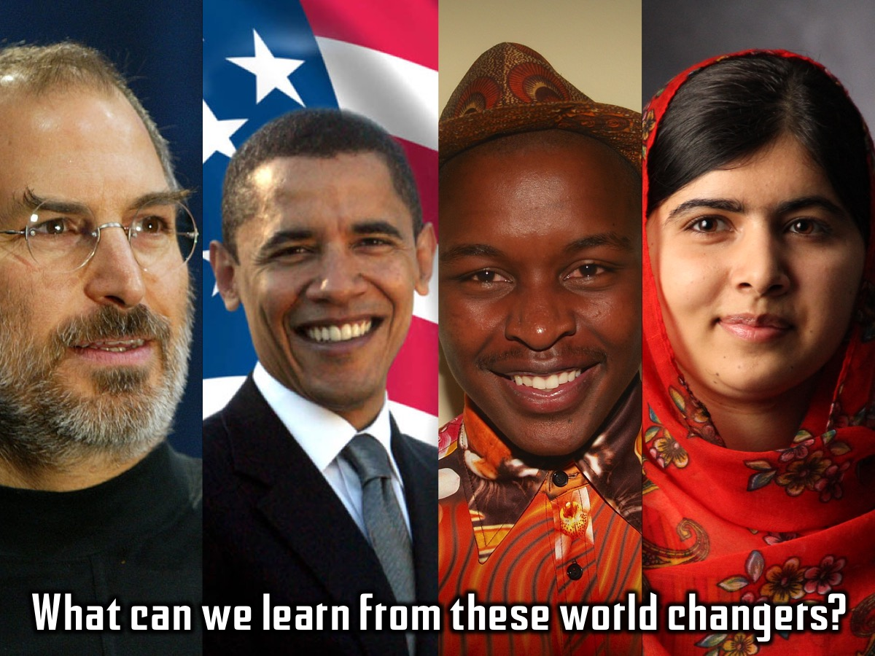
Notes:
What can we learn from these world changers?

Slide 24
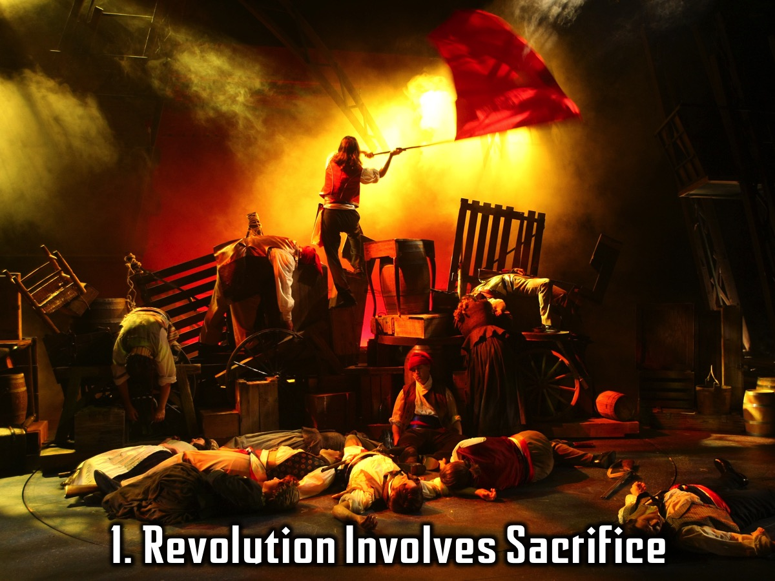
Notes:
1. Revolution Involves Sacrifice. The sacrifice you’re willing to give for a greater cause.

Slide 25
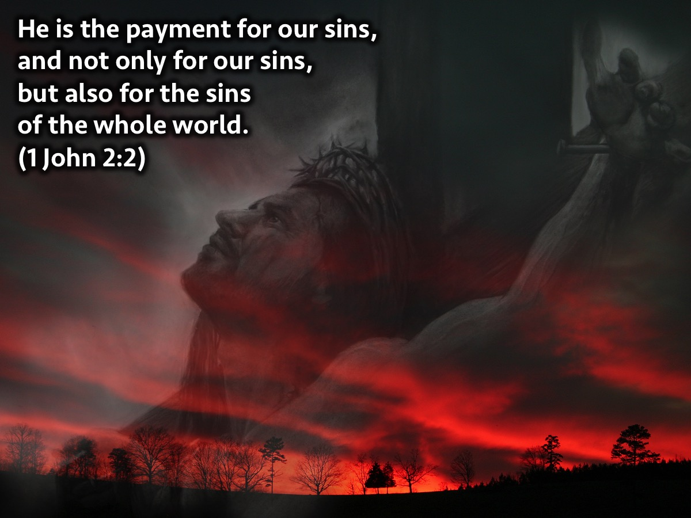
Notes:
And Jesus did that for you and I when he died on the cross. He sacrificed his own comfort and suffered for you and I. He Was persecuted and crucified so you and I can live free. He is the payment for our sins, and not only for our sins, but also for the sins of the whole world. (1 John 2:2)

Slide 26
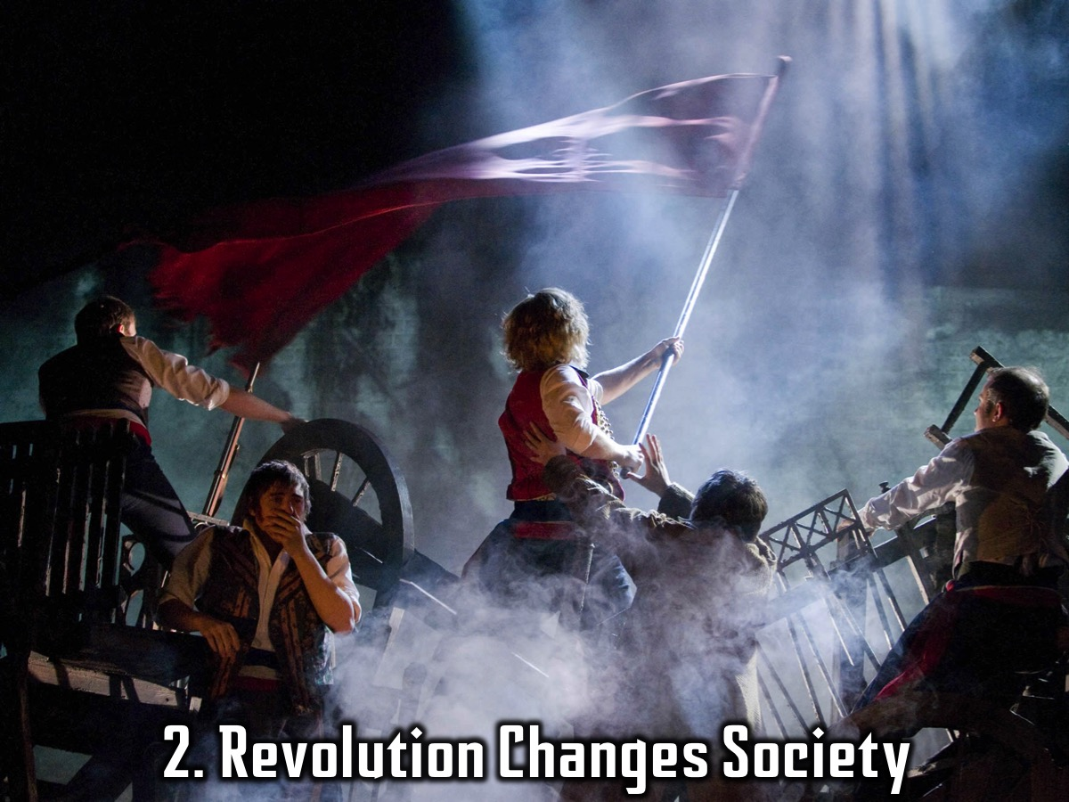
Notes:
2. Revolution Changes Society.

Slide 27
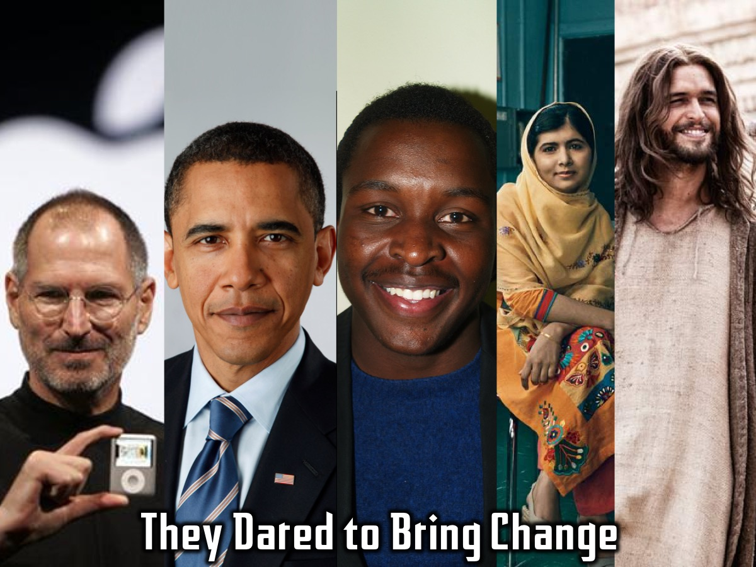
Notes:
All these people have one thing in common – they dared to bring change! Not just for themselves but for those around them. Jesus included.

Slide 28
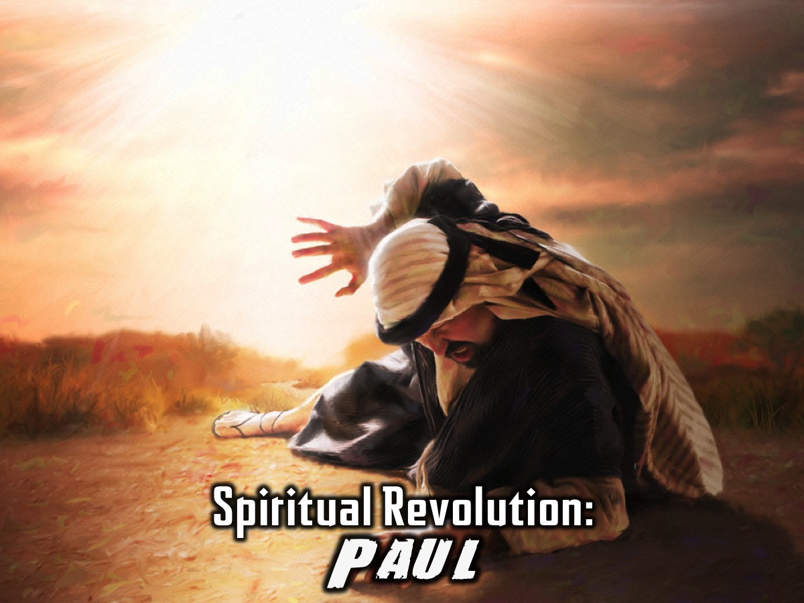
Notes:
Spiritual Revolution: Paul. We have looked at people who brought about technological, political, human rights, and educational revolution. But what about spiritual revolution? Following Jesus death we meet Paul who’s life was just as remarkable and there is little doubt that it changed the course of Christianity. He made an impact as apostle, as theologian, and as writer.

Slide 29
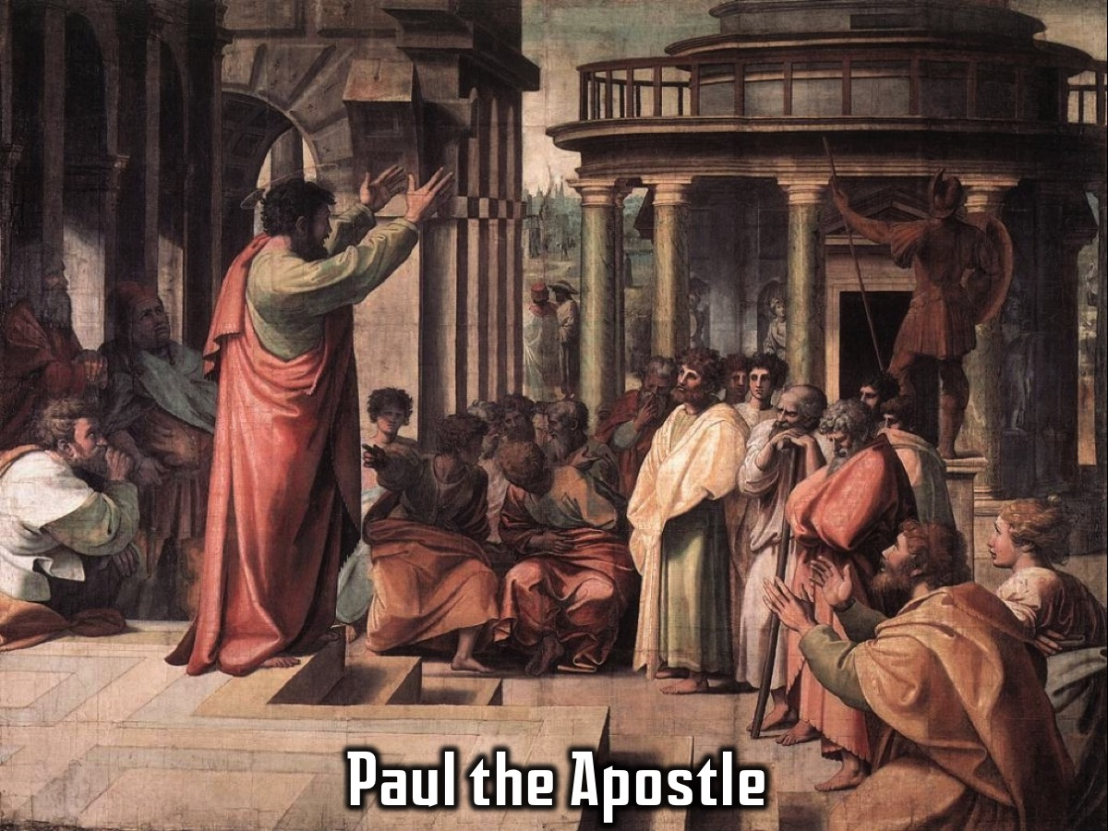
Notes:
1. Paul the Apostle. Paul the apostle had expanded the church far and wide, flinging open the doors to Gentiles, strenuously fighting for his conviction that the gospel was for all people and that no barriers should be put in the way of Gentiles.

Slide 30
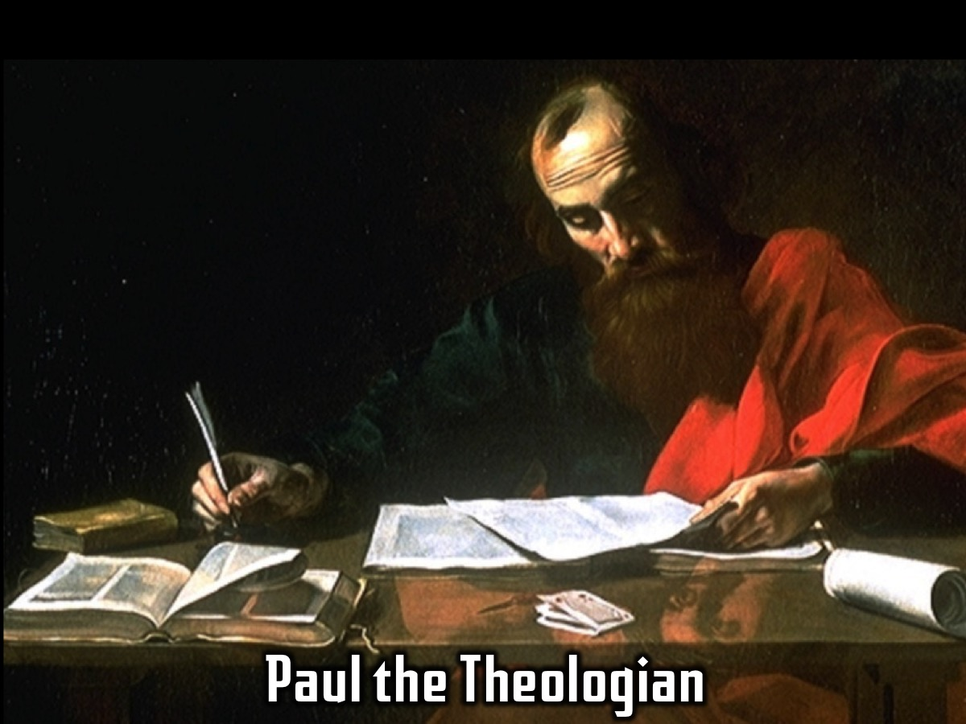
Notes:
2. Paul the Theologian. He was the first to work through many of the intriguing questions that Jesus' life, death and resurrection had thrown up.

Slide 31
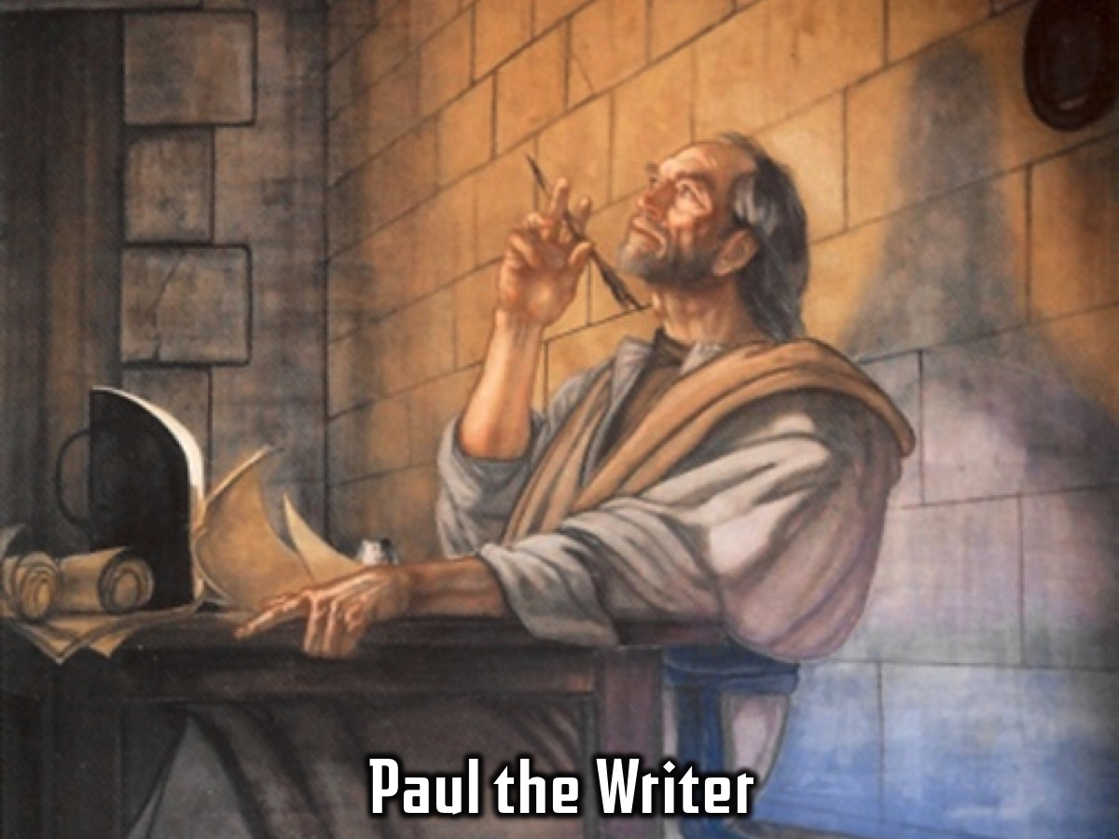
Notes:
3. Paul the Writer. He gave us not only some of the profoundest pieces of early Christian theological reflection, but also some of the finest, most poignant writing in history.

Slide 32
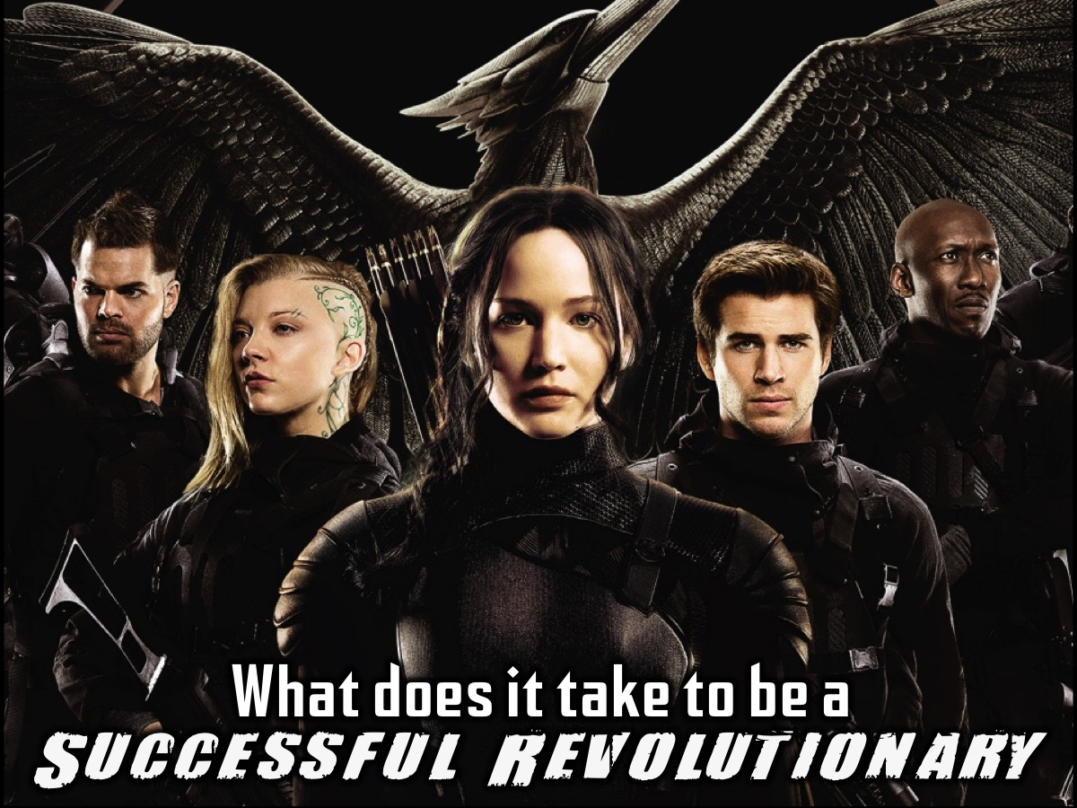
Notes:
So what does it take to be a Successful Revolutionary? Using Paul’s life as a guide, let’s take a look at what it takes to a successful revolutionary:

Slide 33
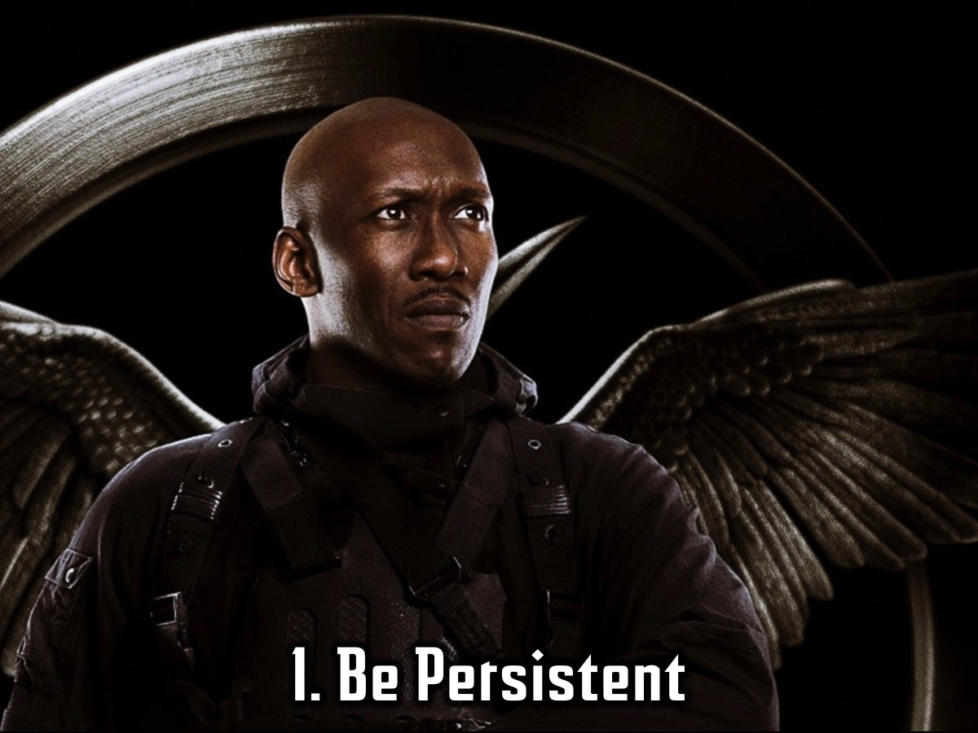
Notes:
1. Be Persistent – Remain committed to your God given purpose.

Slide 34
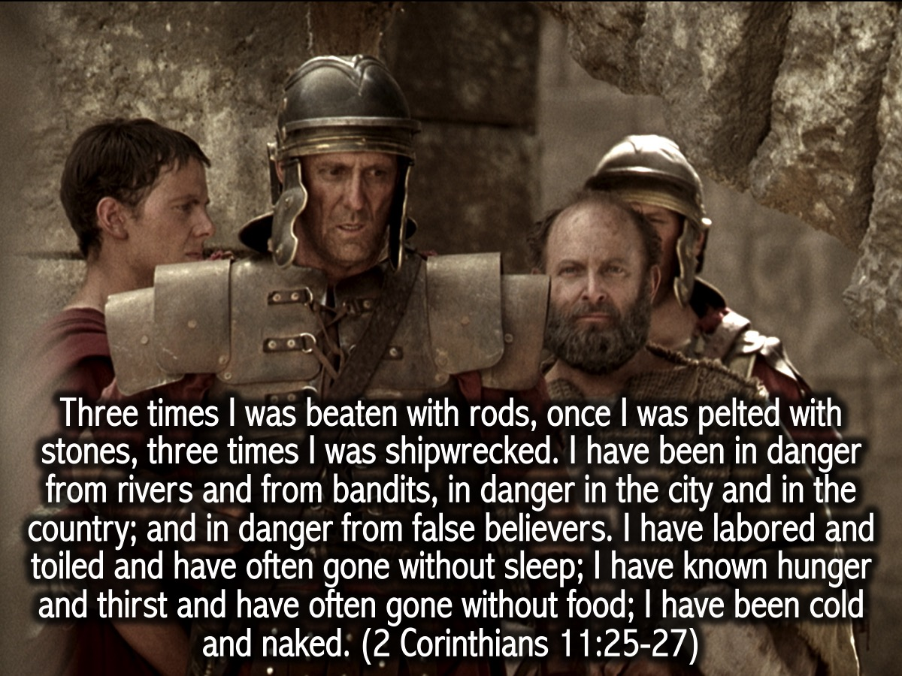
Notes:
Paul and Persistence: I don't think anyone experienced all the difficulties that Paul did in his life and yet he did not give up! “Three times I was beaten with rods, once I was pelted with stones, three times I was shipwrecked. I have been in danger from rivers and from bandits, in danger in the city and in the country; and in danger from false believers. I have labored and toiled and have often gone without sleep; I have known hunger and thirst and have often gone without food; I have been cold and naked”. (2 Corinthians 11:25-27)

Slide 35
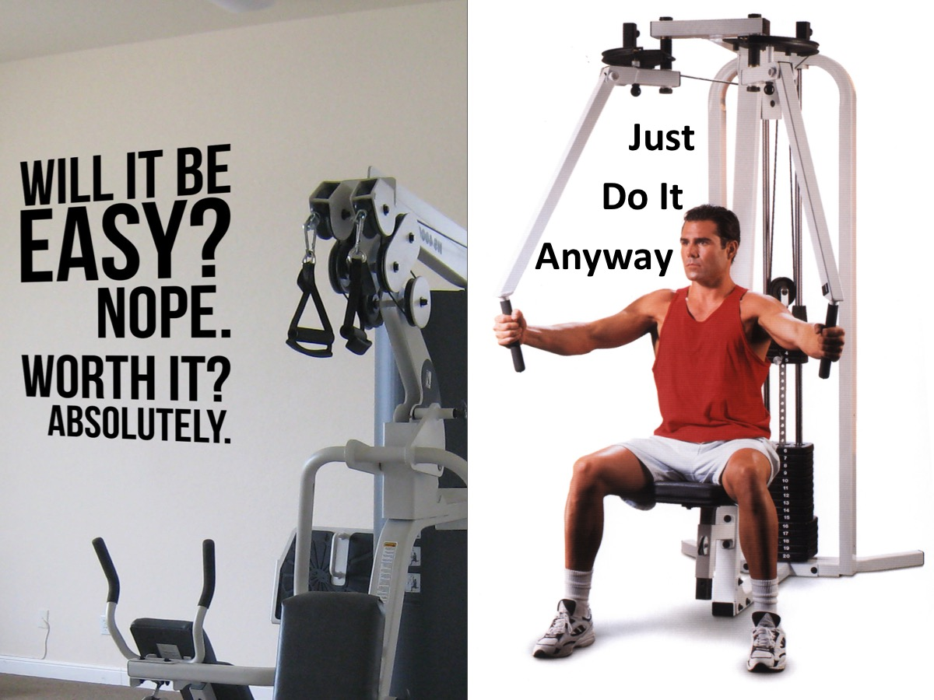
Notes:
I have these two reminders hanging on the wall in my house “Will it be easy? Nope! Worth it? Absolutely” and just below that I have one that says “Just Do It Anyway”. They serve as reminders that I must keep going. Keep on keeping on.

Slide 36
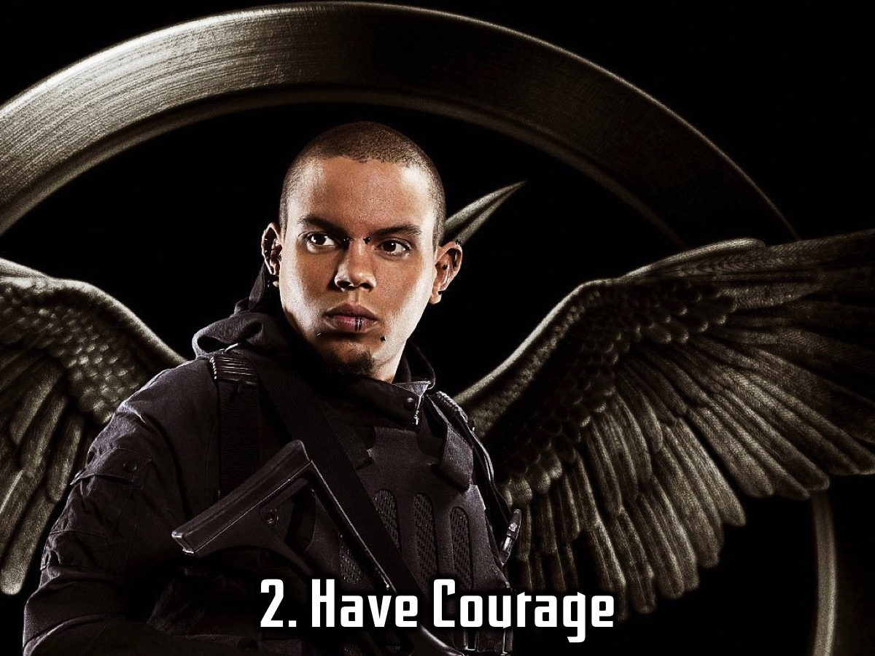
Notes:
2. Have Courage.

Slide 37
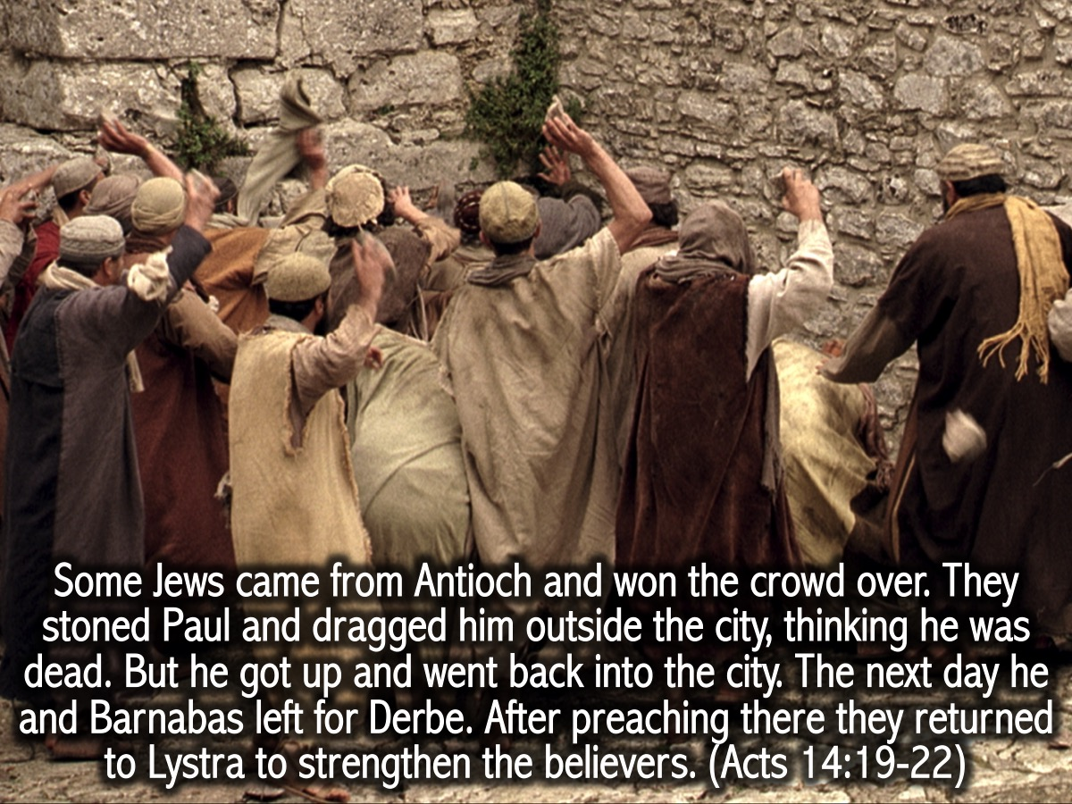
Notes:
Paul and Courage: In Lystra Paul is stoned by the angry crowds and left for dead but they return to the city to minister to the believers: “Some Jews came from Antioch and won the crowd over. They stoned Paul and dragged him outside the city, thinking he was dead. But he got up and went back into the city. The next day he and Barnabas left for Derbe. After preaching there they returned to Lystra to strengthen the believers.” (Acts 14:19-22)

Slide 38
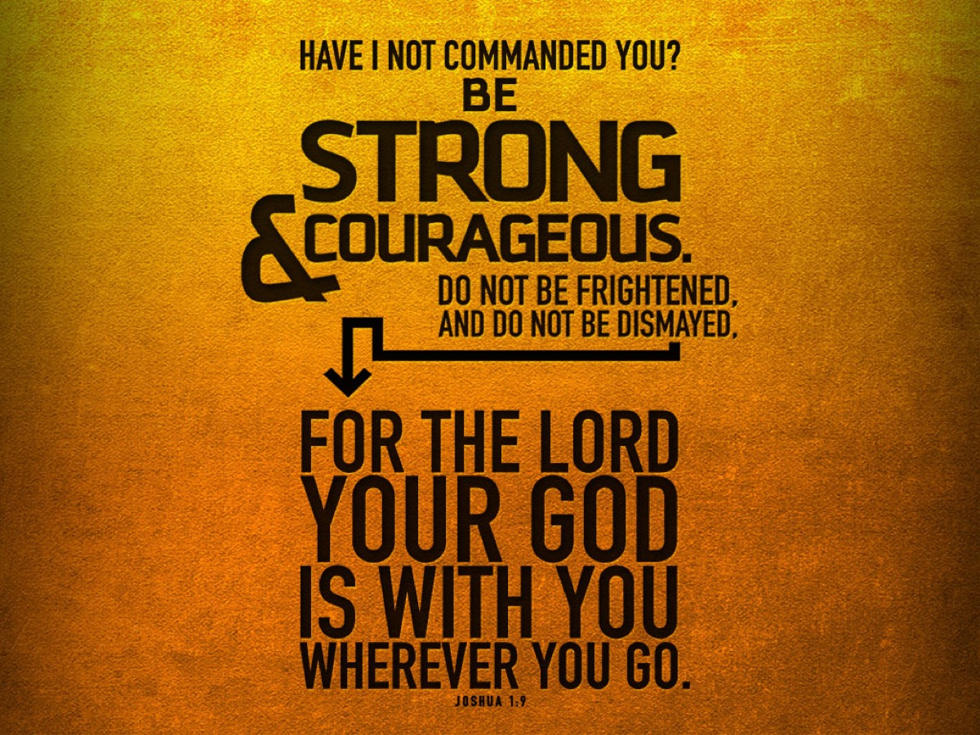
Notes:
God says, “Have I not commanded you? Be strong and courageous. Do not be frightened and do not be dismayed, for the Lord your God is with you wherever you go.” (Joshua 1: 9)

Slide 39
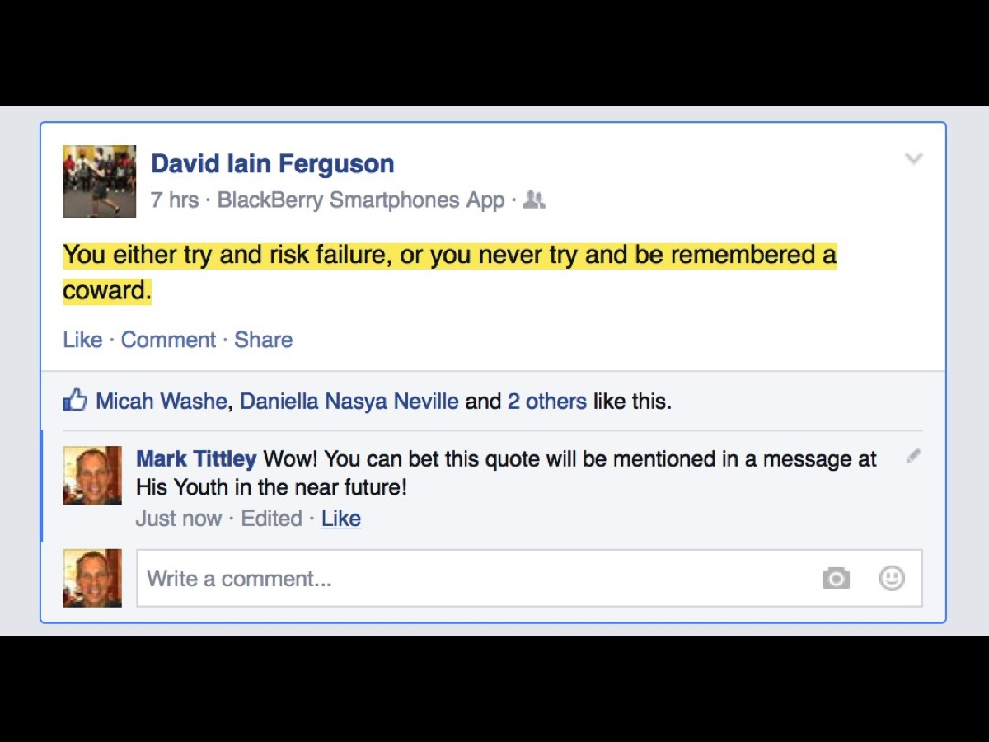
Notes:
One of our own teens recently posted this on Facebook: “You either try and risk failure, or you never try and be remembered a coward!”

Slide 40
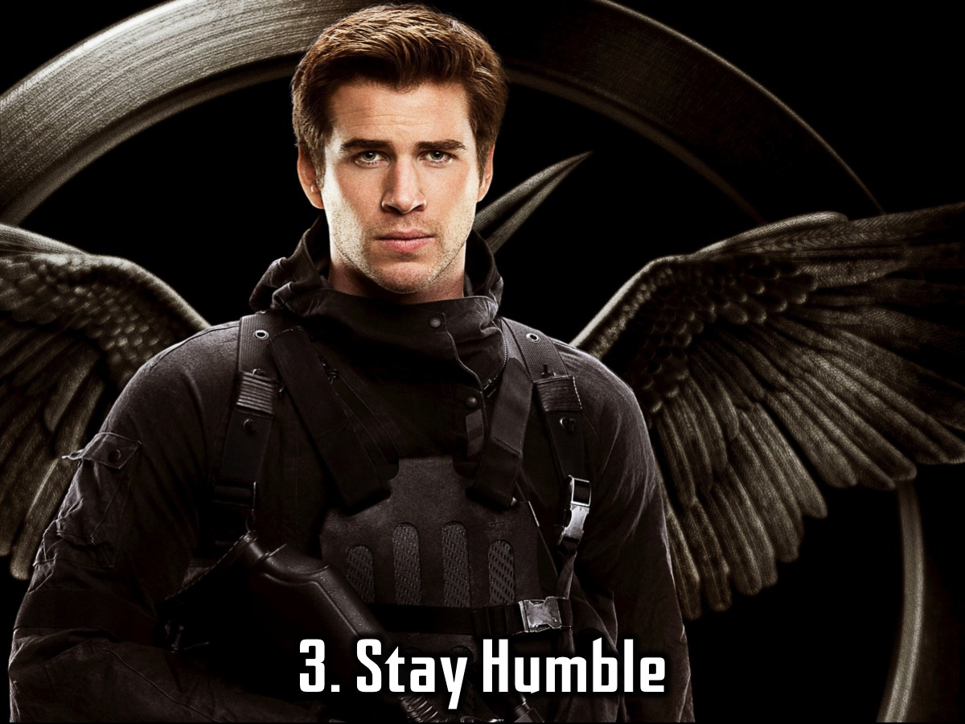
Notes:
3. Stay Humble.

Slide 41
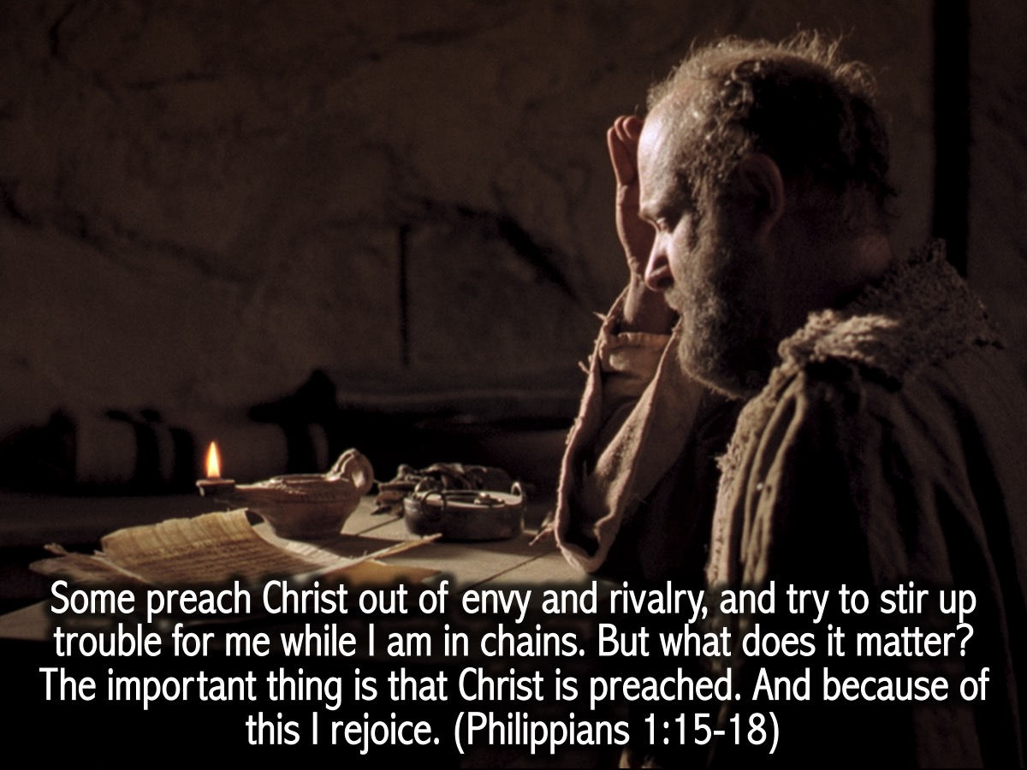
Notes:
Paul and Humility: You would have thought that Paul would have reacted harshly when people who were making life difficult for him but he was humble: ”Some preach Christ out of envy and rivalry, and try to stir up trouble for me while I am in chains. But what does it matter? The important thing is that Christ is preached. And because of this I rejoice.” (Philippians 1:15-18)

Slide 42
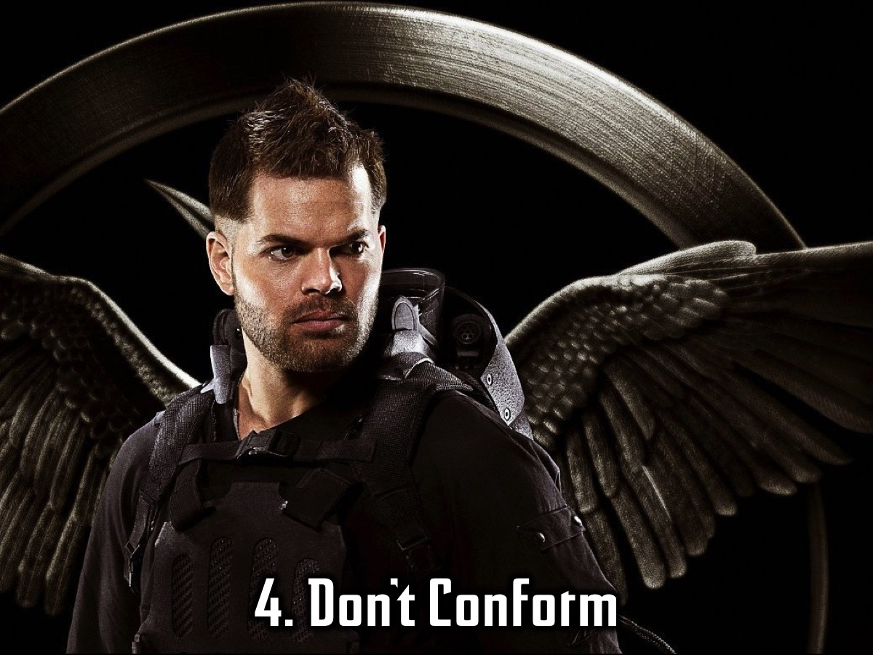
Notes:
4. Don’t Conform

Slide 43
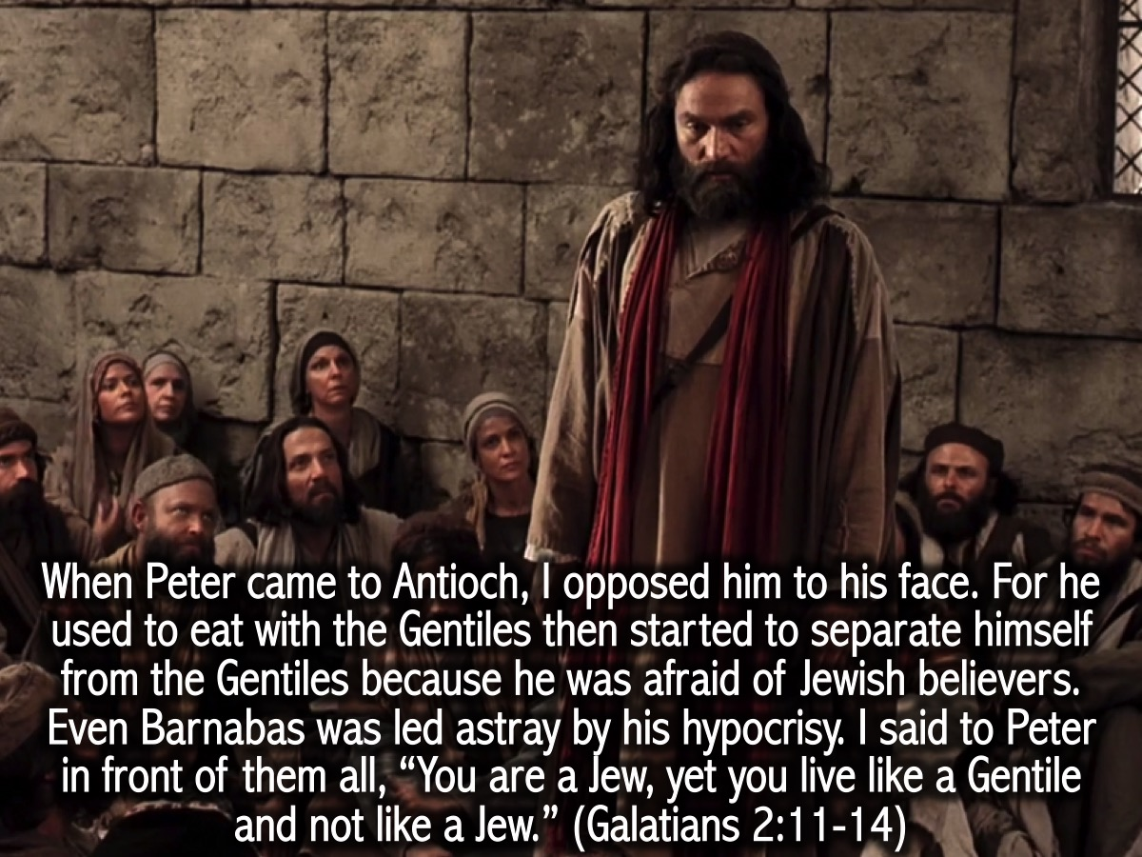
Notes:
Paul and Not Conforming: Even though Paul was humble he was not afraid to confront Peter because of his hypocrisy! “When Peter came to Antioch, I opposed him to his face. For he used to eat with the Gentiles then started to separate himself from the Gentiles because he was afraid of Jewish believers. Even Barnabas was led astray by his hypocrisy. I said to Peter in front of them all, “You are a Jew, yet you live like a Gentile and not like a Jew.” (Galatians 2:11-14)

Slide 44
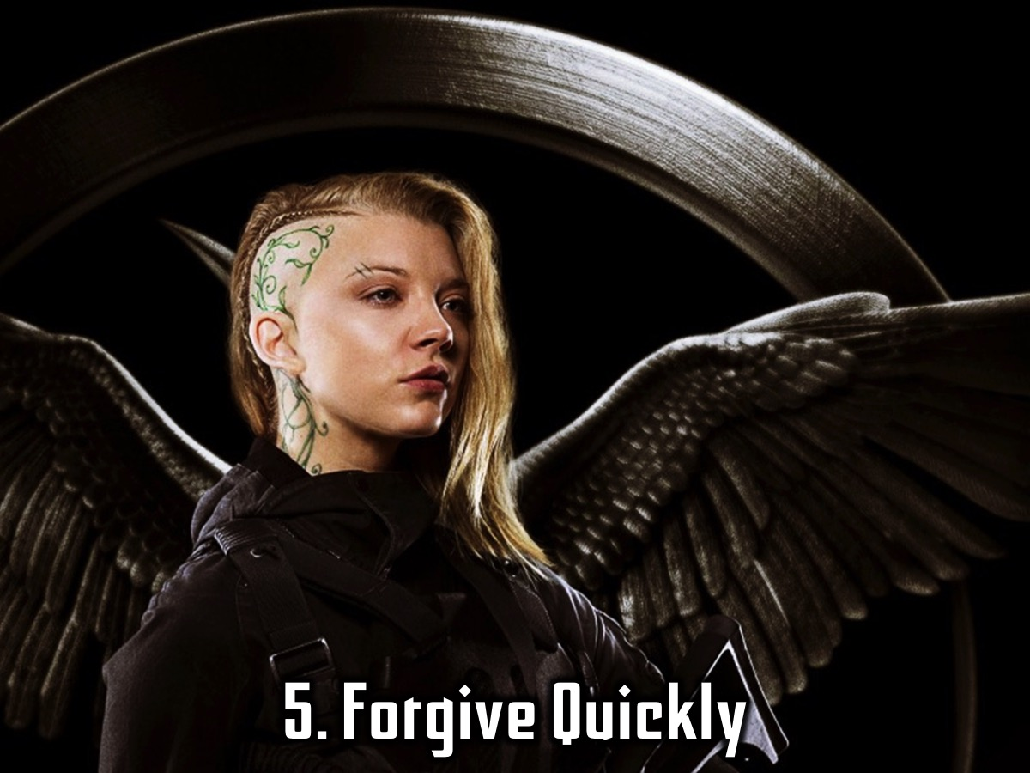
Notes:
5. Forgive Quickly

Slide 45
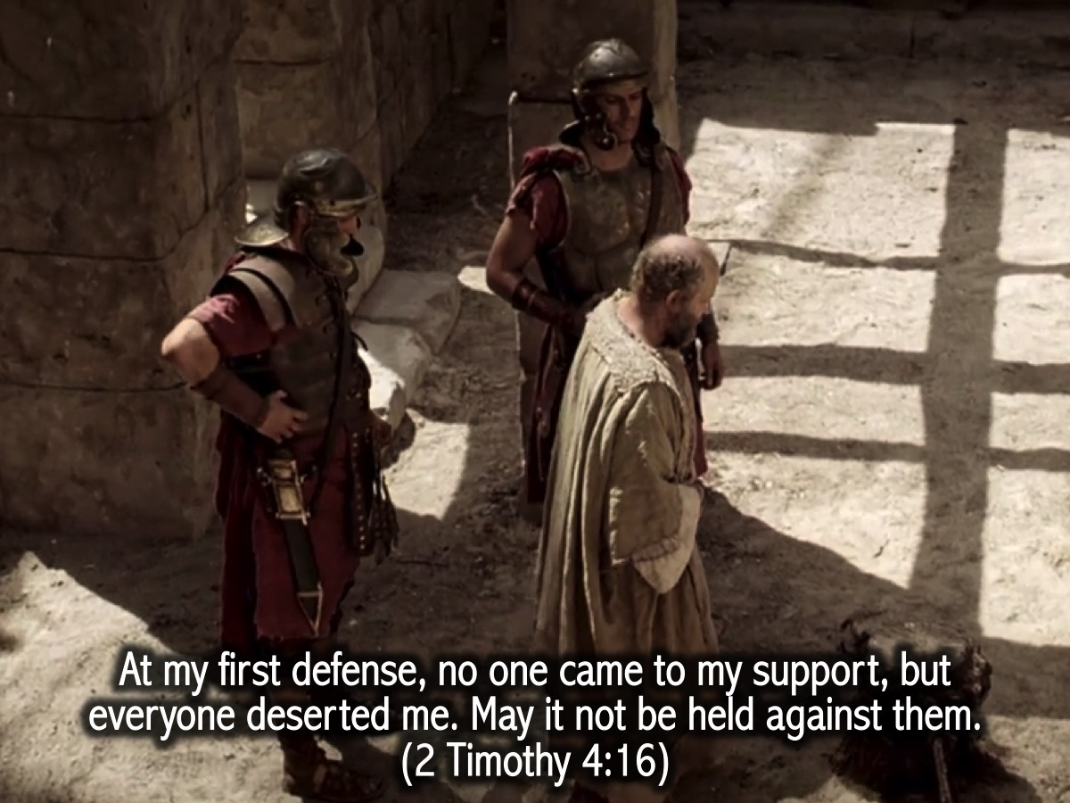
Notes:
Paul and Forgiveness: I am sure that Paul was very disappointed when his fellow believers did not come to support him at a trial he had to go through – but here we see that he forgives them and asks that it is something that appears on their record either before people or the Lord. “At my first defense, no one came to my support, but everyone deserted me. May it not be held against them”. (2 Timothy 4:16)

Slide 46
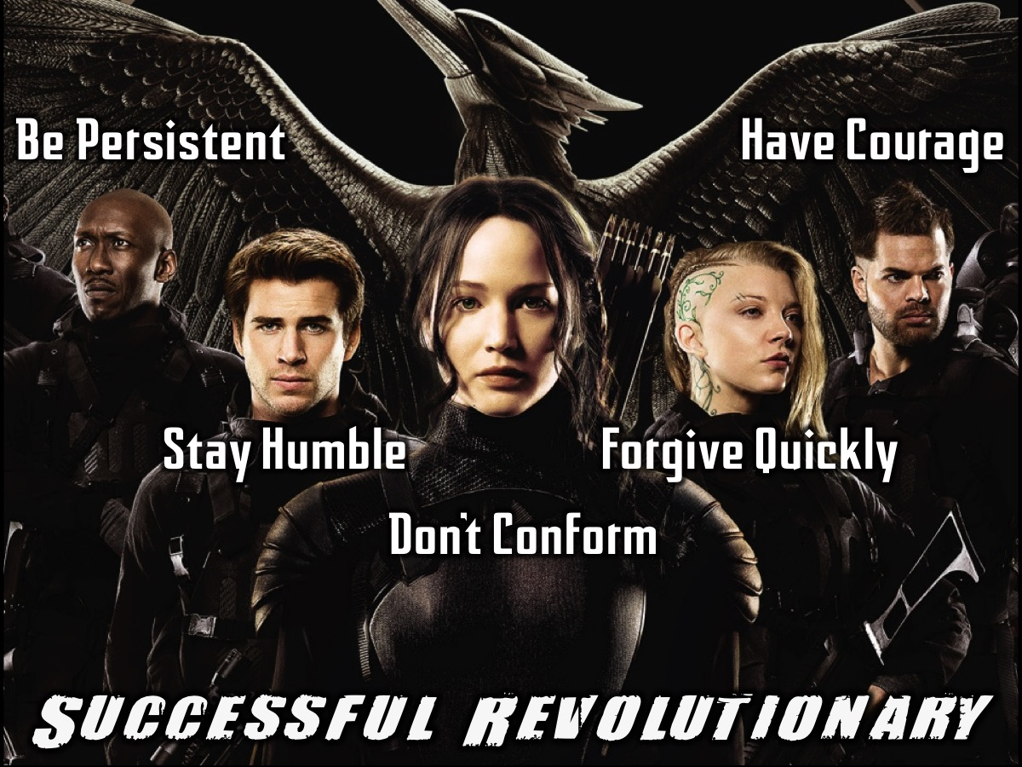
Notes:
Summary: So what does it take to be a successful revolutionary? (1) Be persistent; (2) Have Courage; (3) Stay Humble; (4) Don’t Compromise and (5) Forgive Quickly.

Slide 47
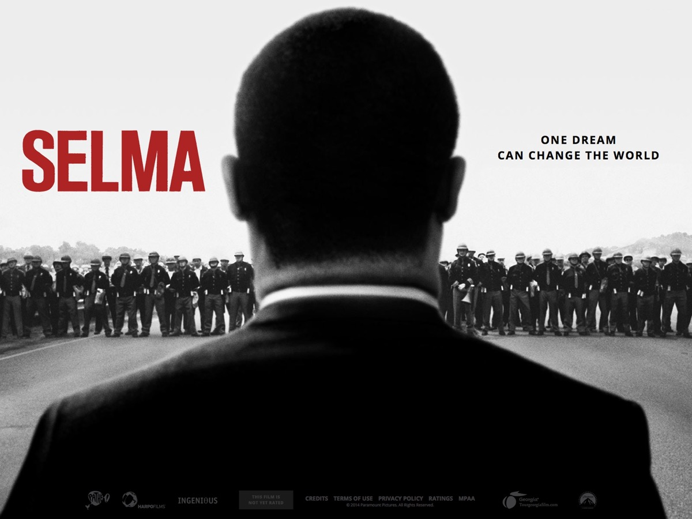
Notes:
How many of you have watched or heard of Selma? We’ve repeatedly talked about Dr. Martin Luther King during this series. Selma is a movie that chronicles Martin Luther King’s campaign to secure equal voting rights through an epic march from a town called Selma to Montgomery, Alabama in 1965.
Video: Selma Official Trailer #1. Get it on YouTube at: https://www.youtube.com/watch?v=x6t7vVTxaic

Slide 48
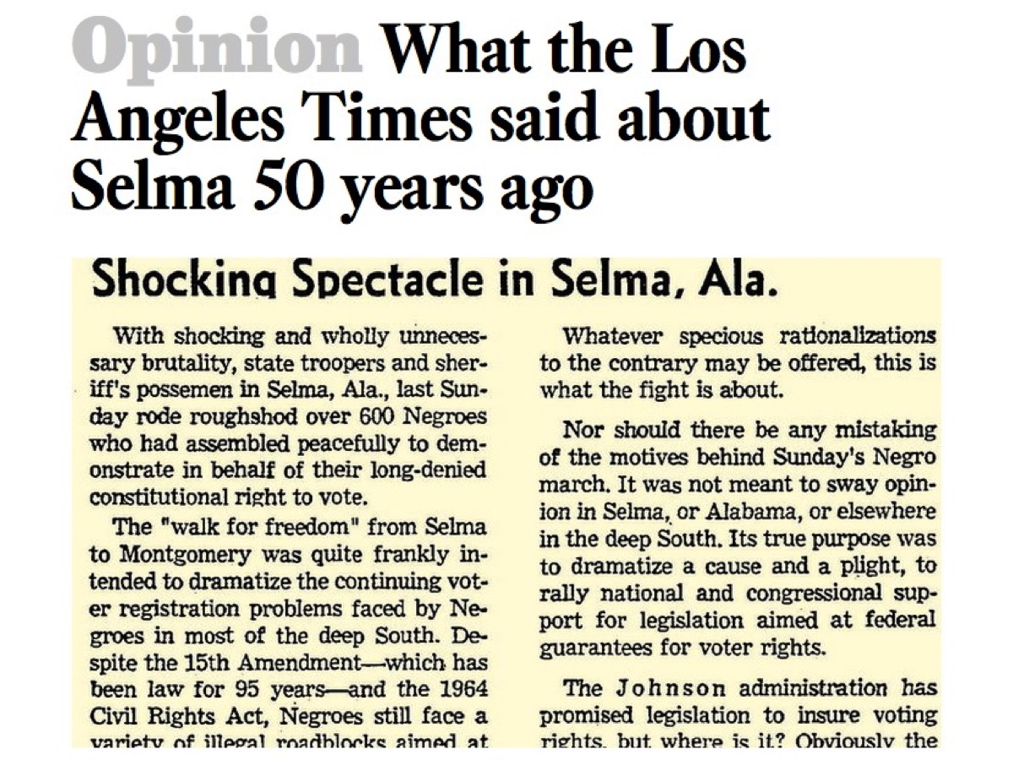
Notes:
Here’s what the LA times had to say about the march in Selma 50 years ago: “The ‘walk for freedom' from Selma to Montgomery was quite frankly intended to dramatize the continuing voter registration problems faced by Negroes in most of the deep South. Despite the 15th Amendment – which has been law for 95 years – and the 1964 Civil Rights Act, Negroes still face a variety of illegal roadblocks aimed at preventing their use of the ballot. Nor should there be any mistaking the motives behind Sunday’s Negro march. It was not meant to sway opinion in Selma, or Alabama, or elsewhere in the deep South. Its true purpose was to dramatize a cause and a plight, to rally national and congressional support for legislation aimed at federal guarantees for voter rights.”

Slide 49
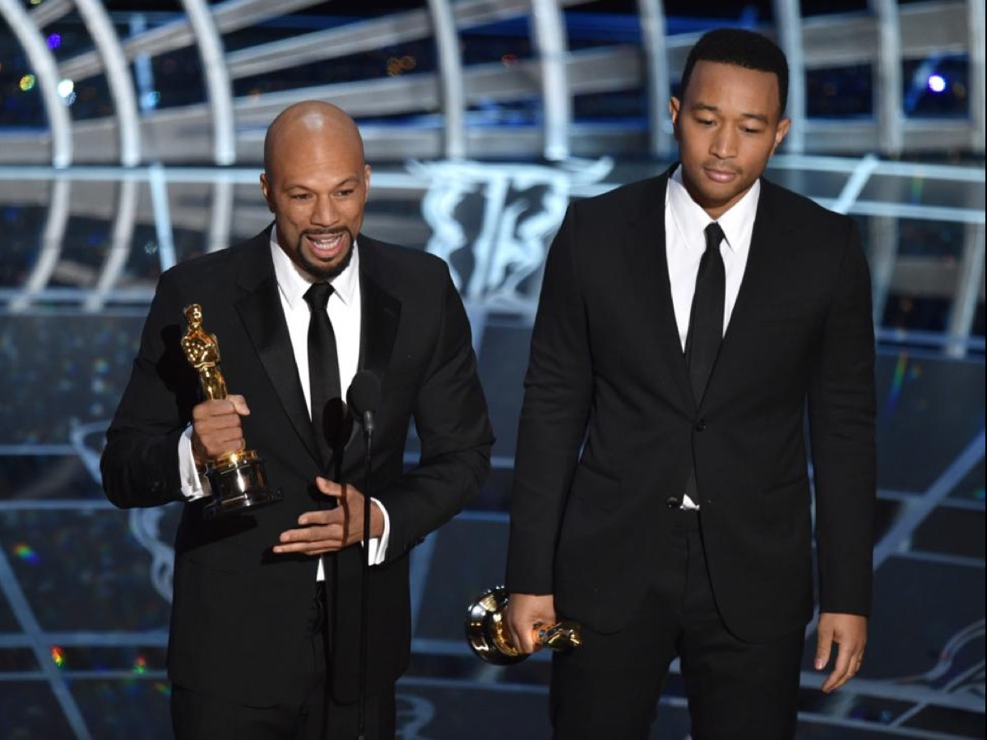
Notes:
Selma recently won the Academy Award for Best Song at the Oscars. During their acceptance speech Rapper Common and Singer John Legend said something extremely profound: Nina Simone said it’s an artist’s duty to reflect the times in which we live. We wrote this song for a film that was based on events that were 50 years ago, but we say Selma is now, because the struggle for justice is right now. We know that the voting rights, the act that they fought for 50 years ago is being compromised right now in this country today. We know that right now the struggle for freedom and justice is real. We live in the most incarcerated country in the world. There are more black men under correctional control today than were under slavery in 1850. When people are marching with our song, we want to tell you that we are with you, we see you, we love you, and march on.
Video: Oscars acceptance speech by Rapper Common and Singer John Legend. Get it on YouTube at: https://www.youtube.com/watch?v=gLFBOnI47W8

Slide 50
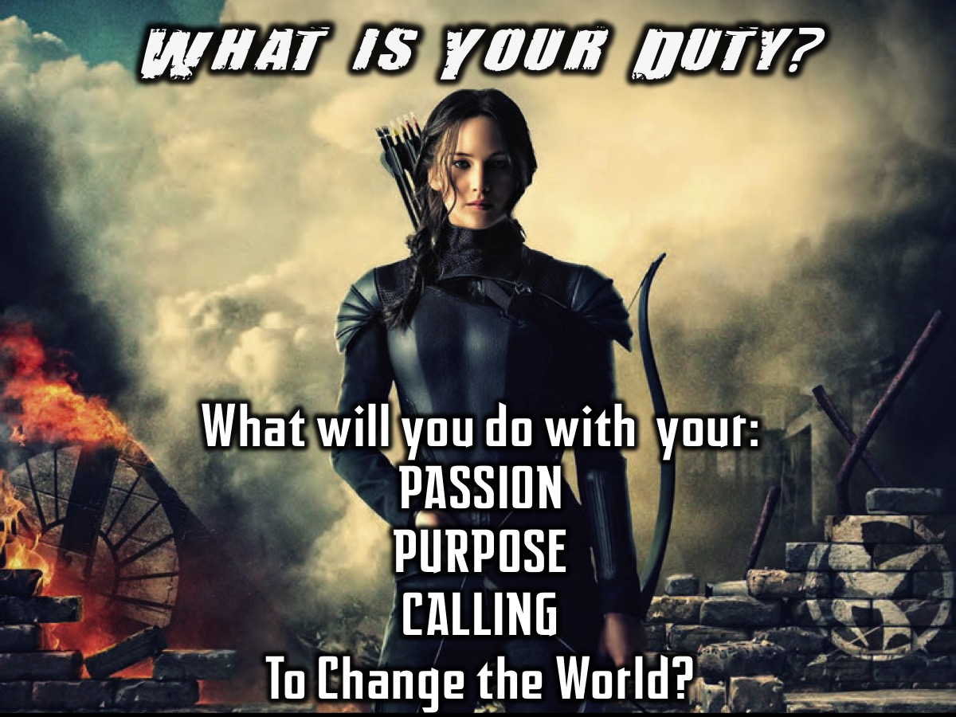
Notes:
What do you think is your duty? TODAY! What are you going to do with your passion? With your purpose? Your calling? Are you going to change the world?

Slide 51
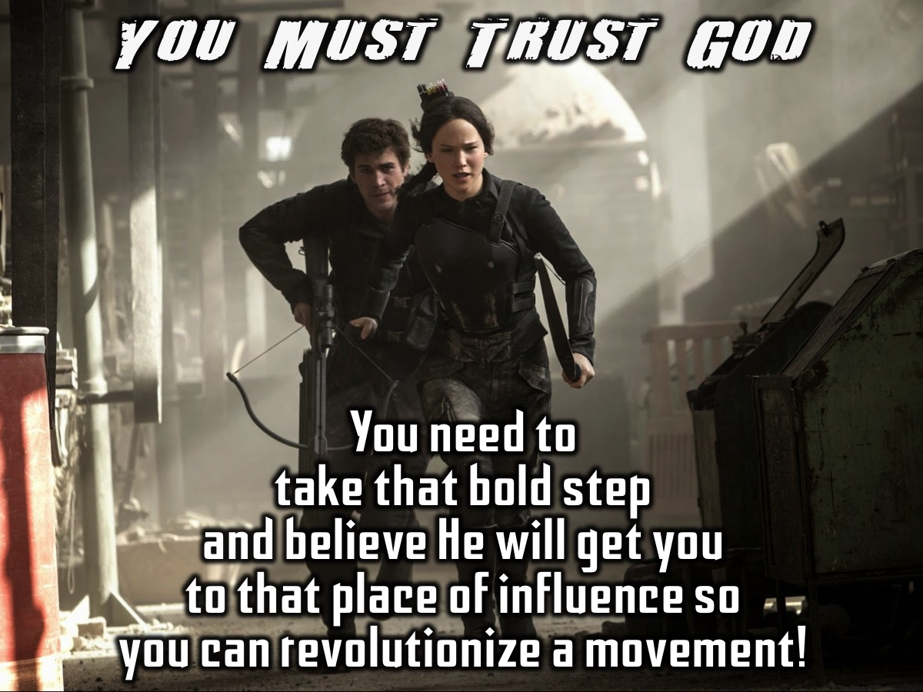
Notes:
It takes trusting in God to do that. You need to take that bold step and believe that he can get you to that place of influence where you can revolutionize a movement.

Slide 52
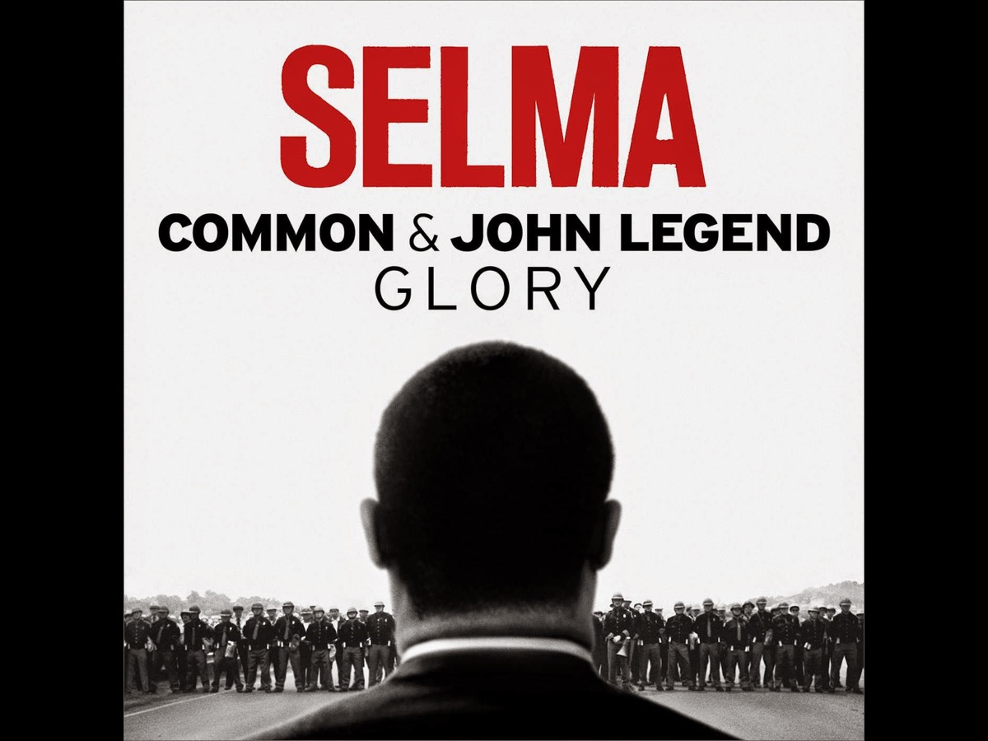
Notes:
Let’s listen to the song by Common and John Legend called Glory that has just won the Oscar.
Video: Common and John Legend, Glory. Get it on YouTube at: https://www.youtube.com/watch?v=HUZOKvYcx_o

Slide 53

Notes:
The 2nd verse lyrics:
Selma's now for every man, woman and child
Even Jesus got his crown in front of a crowd
They marched with the torch, we gon' run with it now
Never look back, we done gone hundreds of miles
From dark roads he rose, to become a hero
Facin' the league of justice, his power was the people

Slide 54

Notes:
The biggest weapon is to stay peaceful
We sing, our music is the cuts that we bleed through
Somewhere in the dream we had an epiphany
Now we right the wrongs in history
No one can win the war individually
It takes the wisdom of the elders and young people's energy
Welcome to the story we call victory
Comin' of the Lord, my eyes have seen the glory

Slide 55

Notes:
Prayer

Slide 56

Notes:
Next Sunday is Celebration Sunday – be sure to bring an appetite!

Slide 57
Notes:
Video: Selma - John Legend ft. Common Music Video - Glory. Get it on YouTube at: https://www.youtube.com/watch?v=ZzbKaDPMoDU

